Slide 1
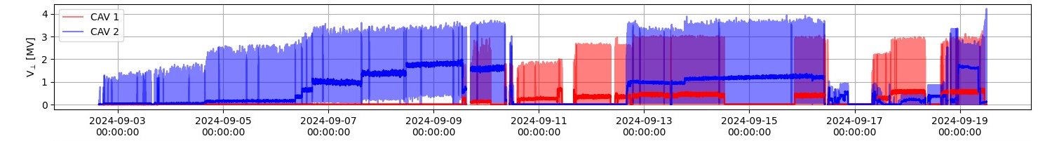
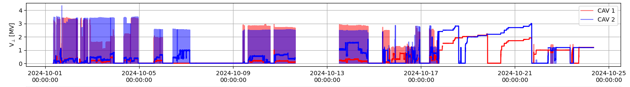
RFD-SPS, RF Commissioning
RF conditioning & commissioning since Sep 2024
Warm mid-Nov and moved to the SPS for installation as of today. Installation to be completed mid-Feb
Start RF conditioning (Sep 2024)
CW operation (Oct 2024)

Slide 2
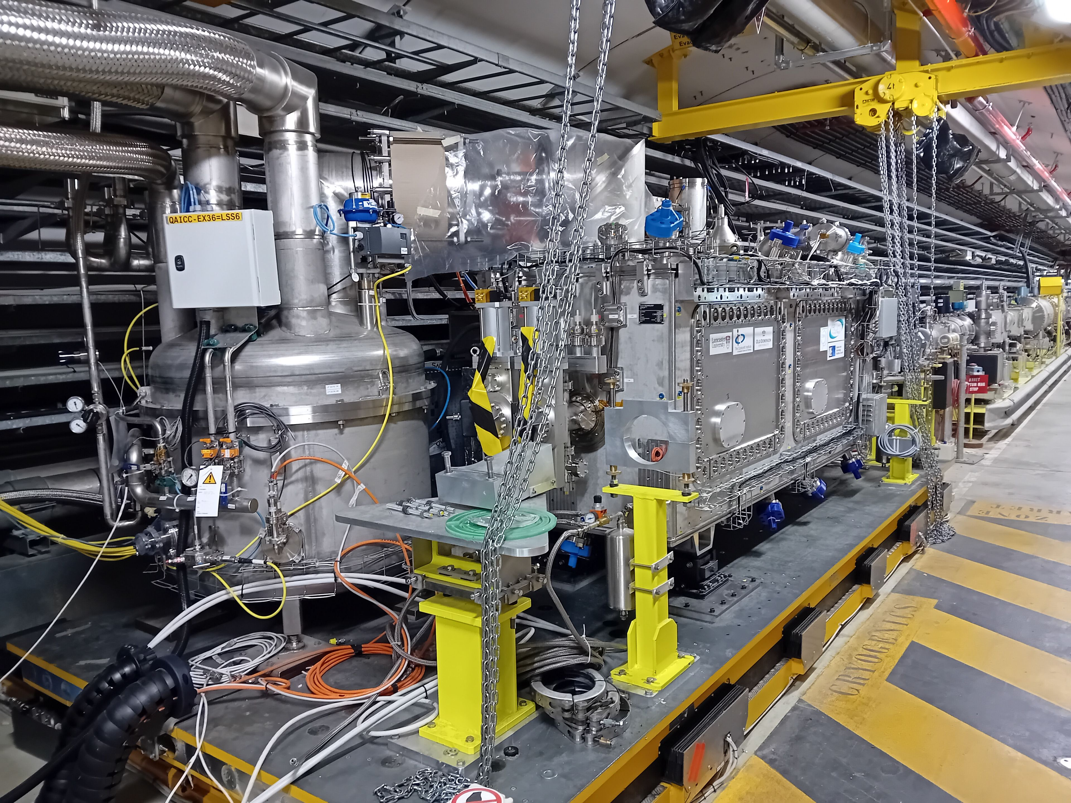
RFD-CM into SPS – Today!

Slide 3
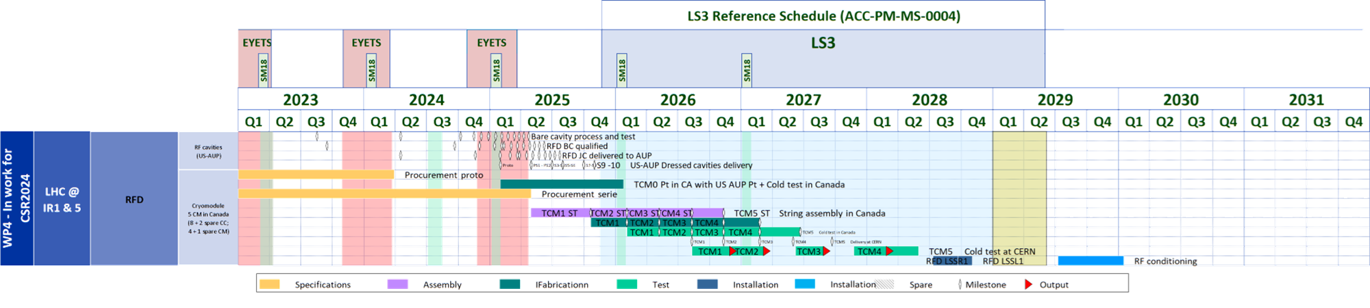
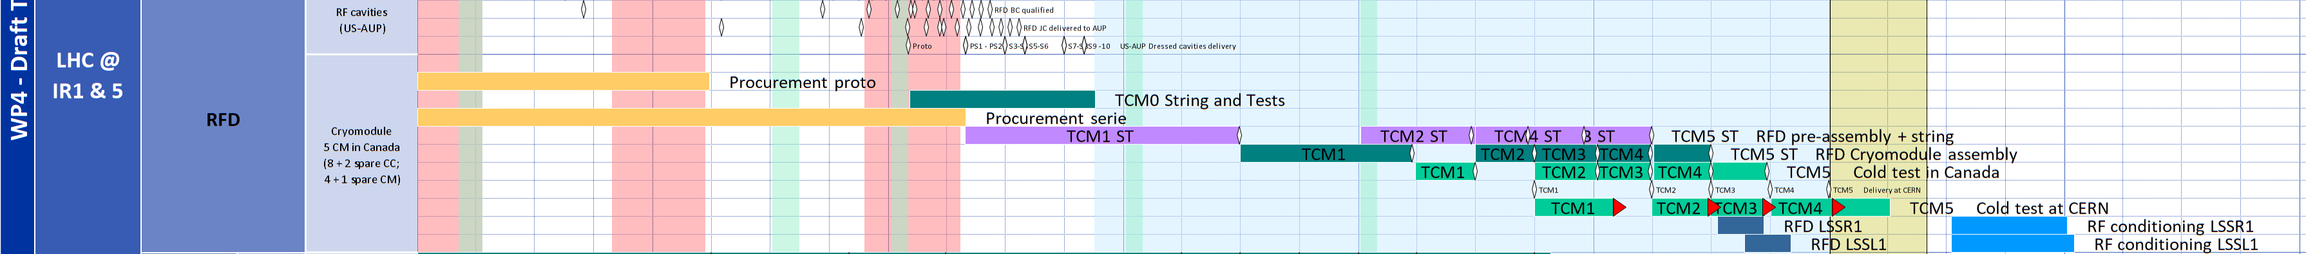
New dates for RFD-CMs
Baseline CSR24
TRIUMF new dates
TCM3-4 outside the present installation window
Options being studied for full installation in LS3

