Slide 1
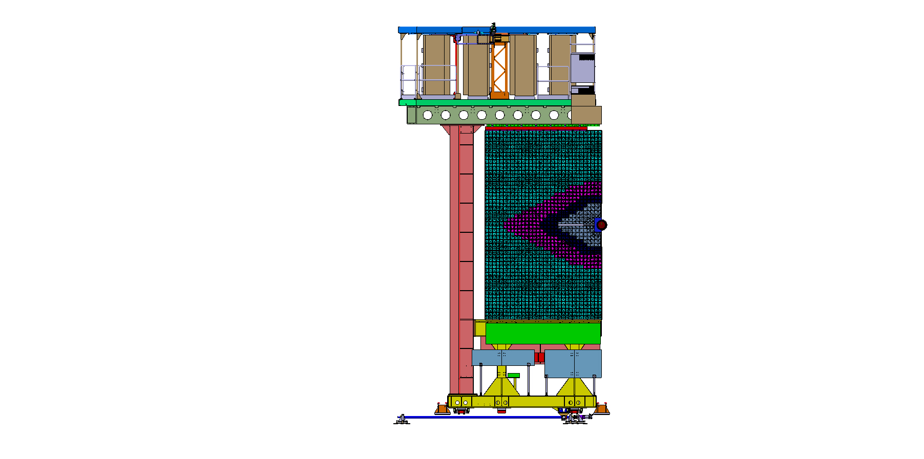
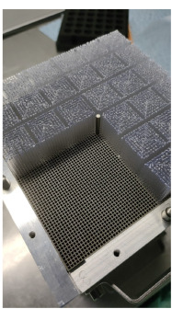
  LHCb ECal – UPGRADE II
Inner part to be changed in LS3/LS4
Tungsten Absorber with scintillating Fibers

Slide 2
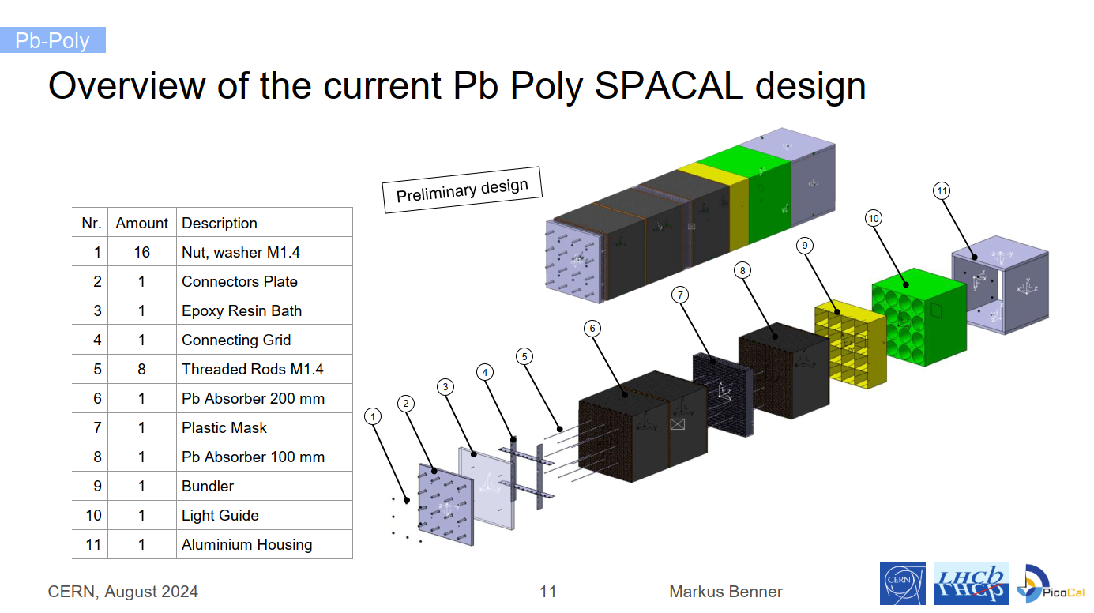

Slide 3
Material choice for Spacal Lightguide & Bundler

Slide 4
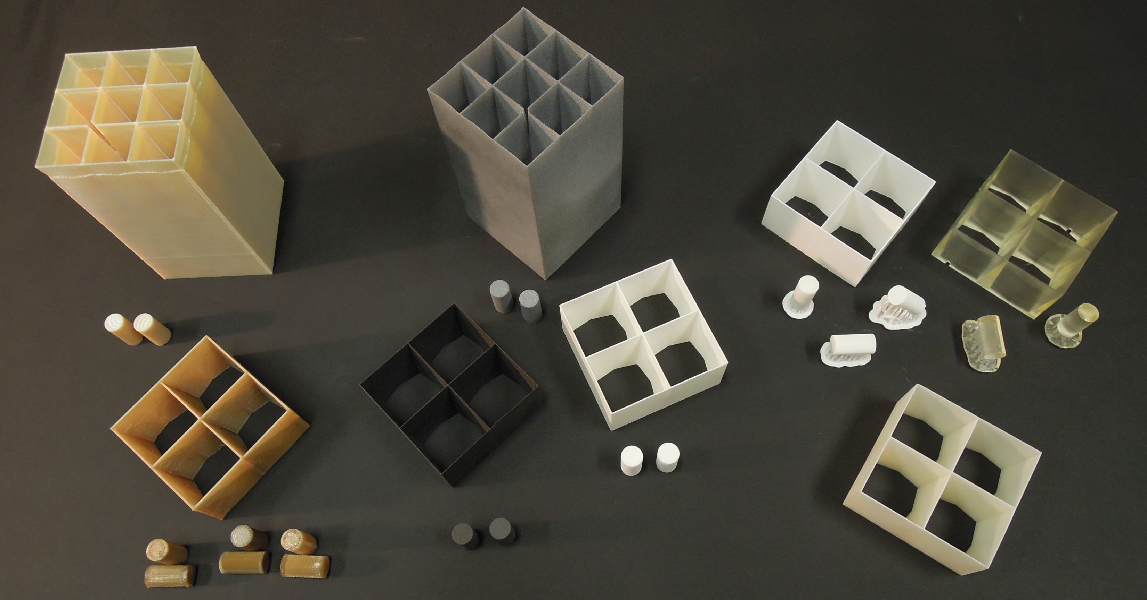
FDM SLS SLA

Slide 5
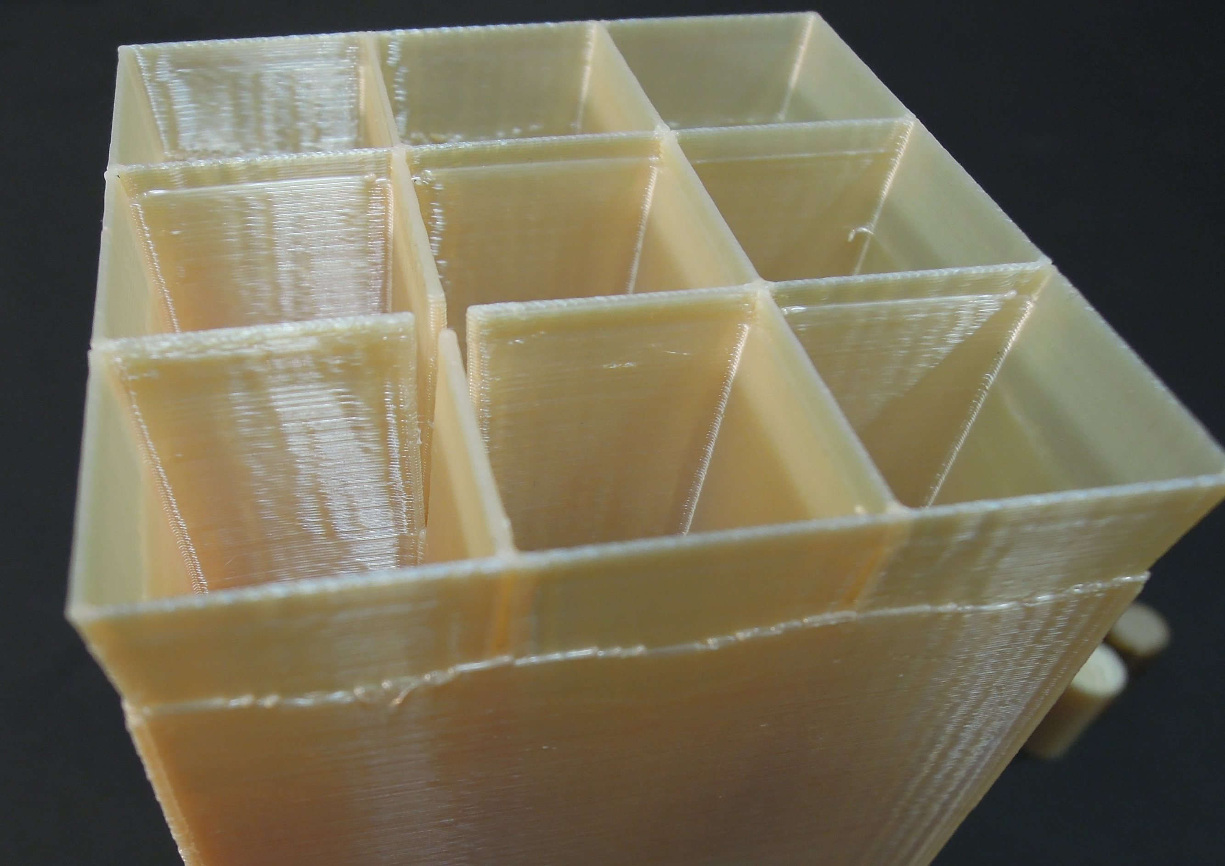
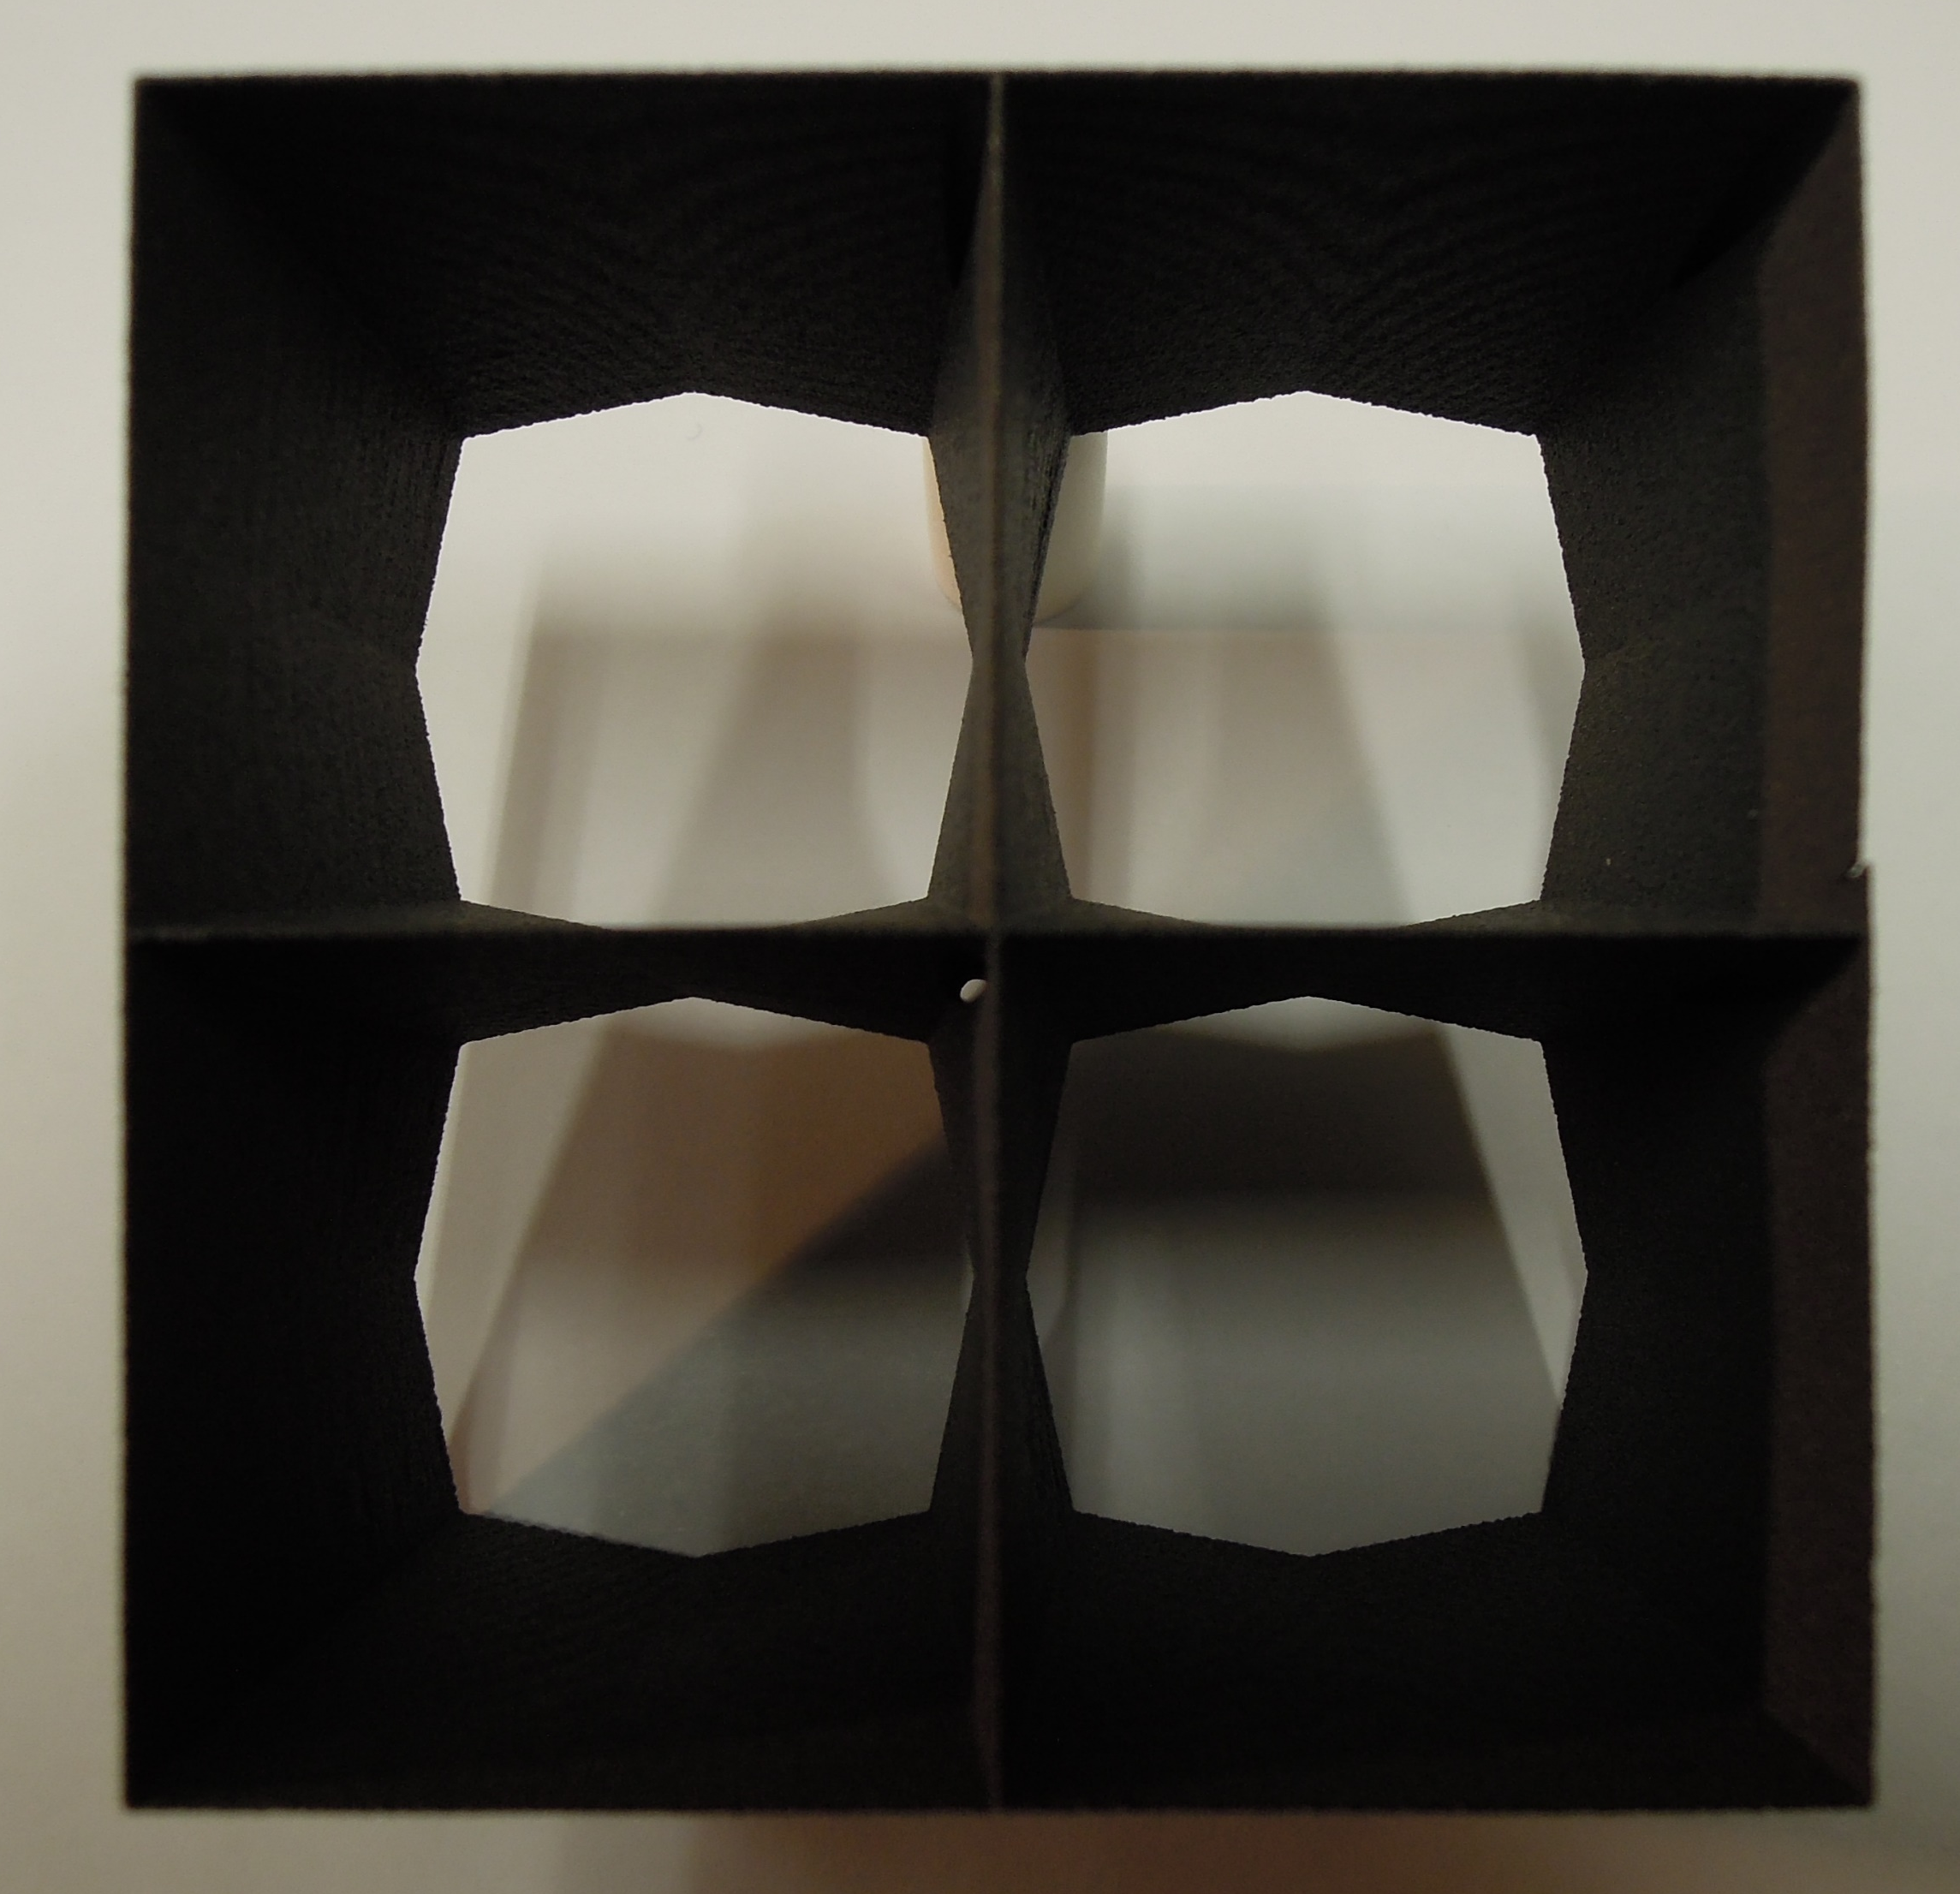
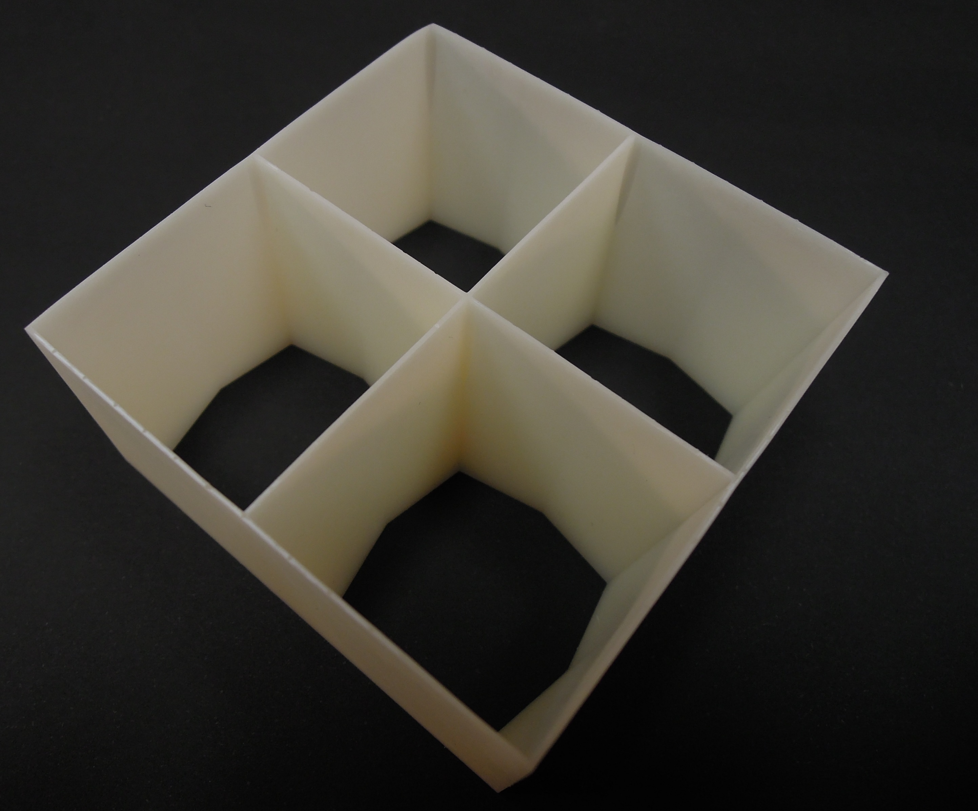
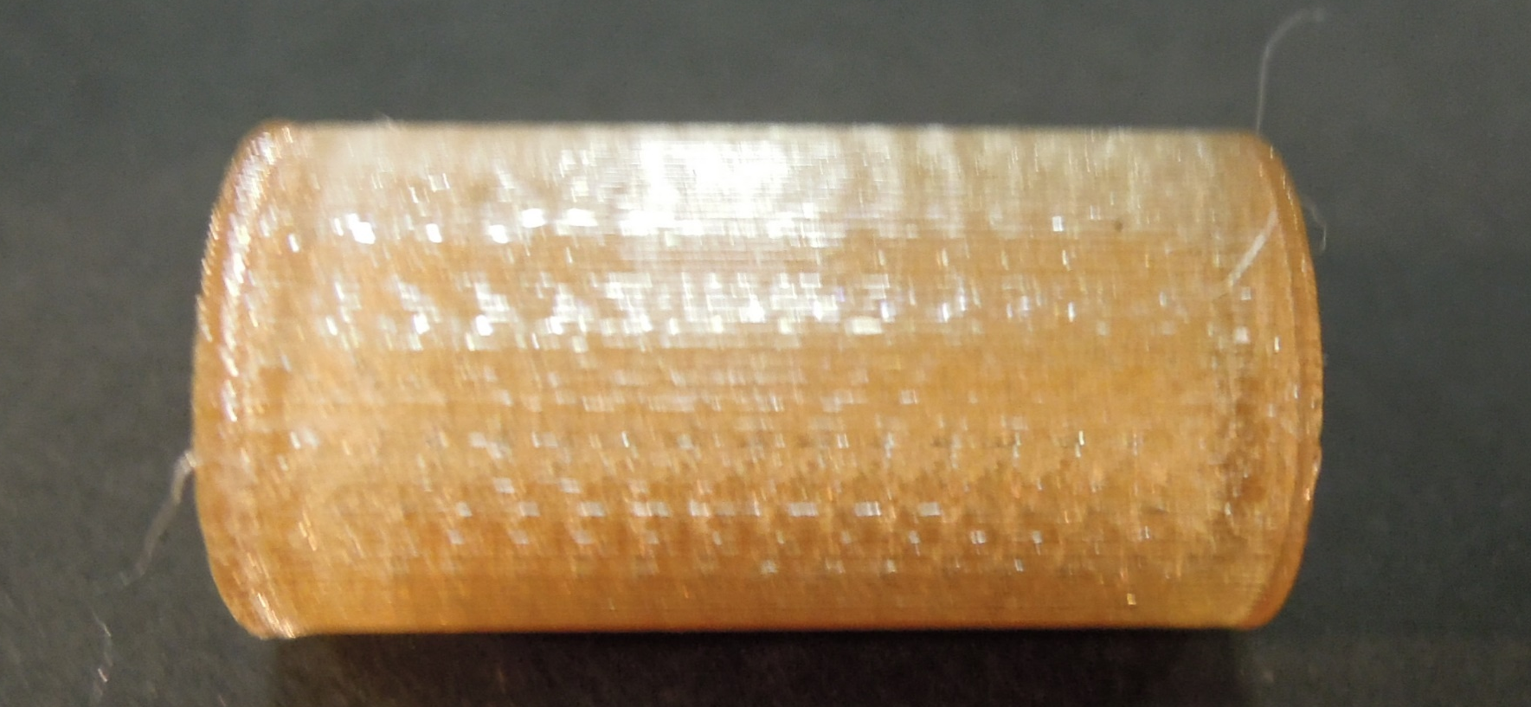
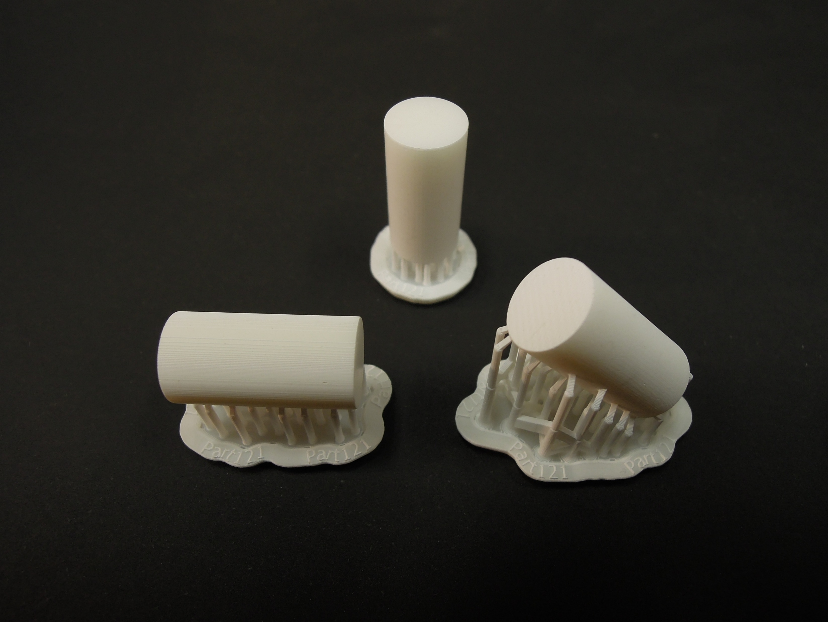
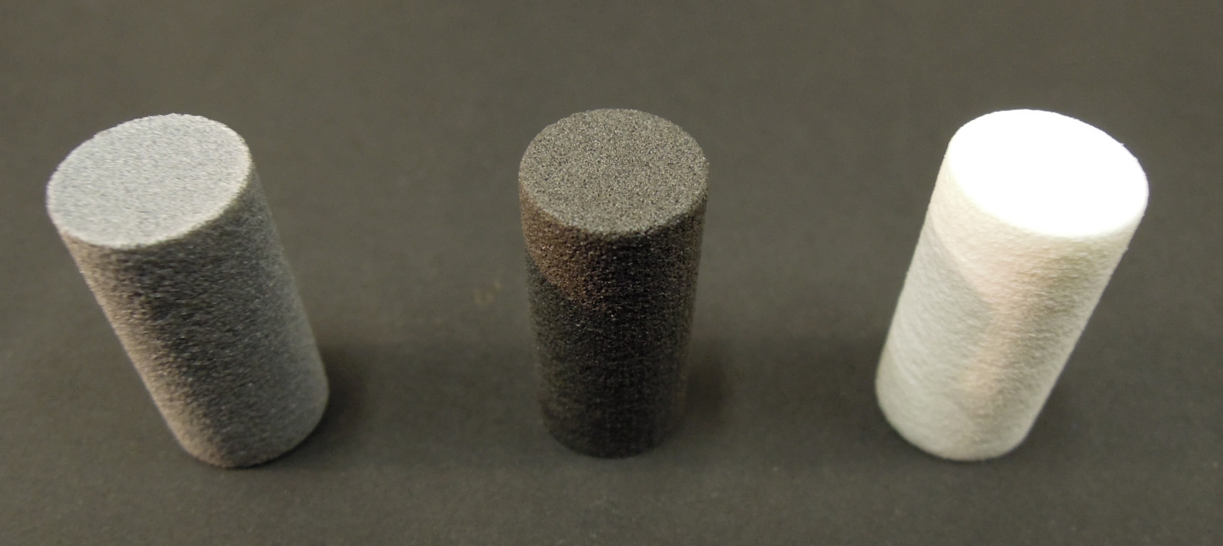
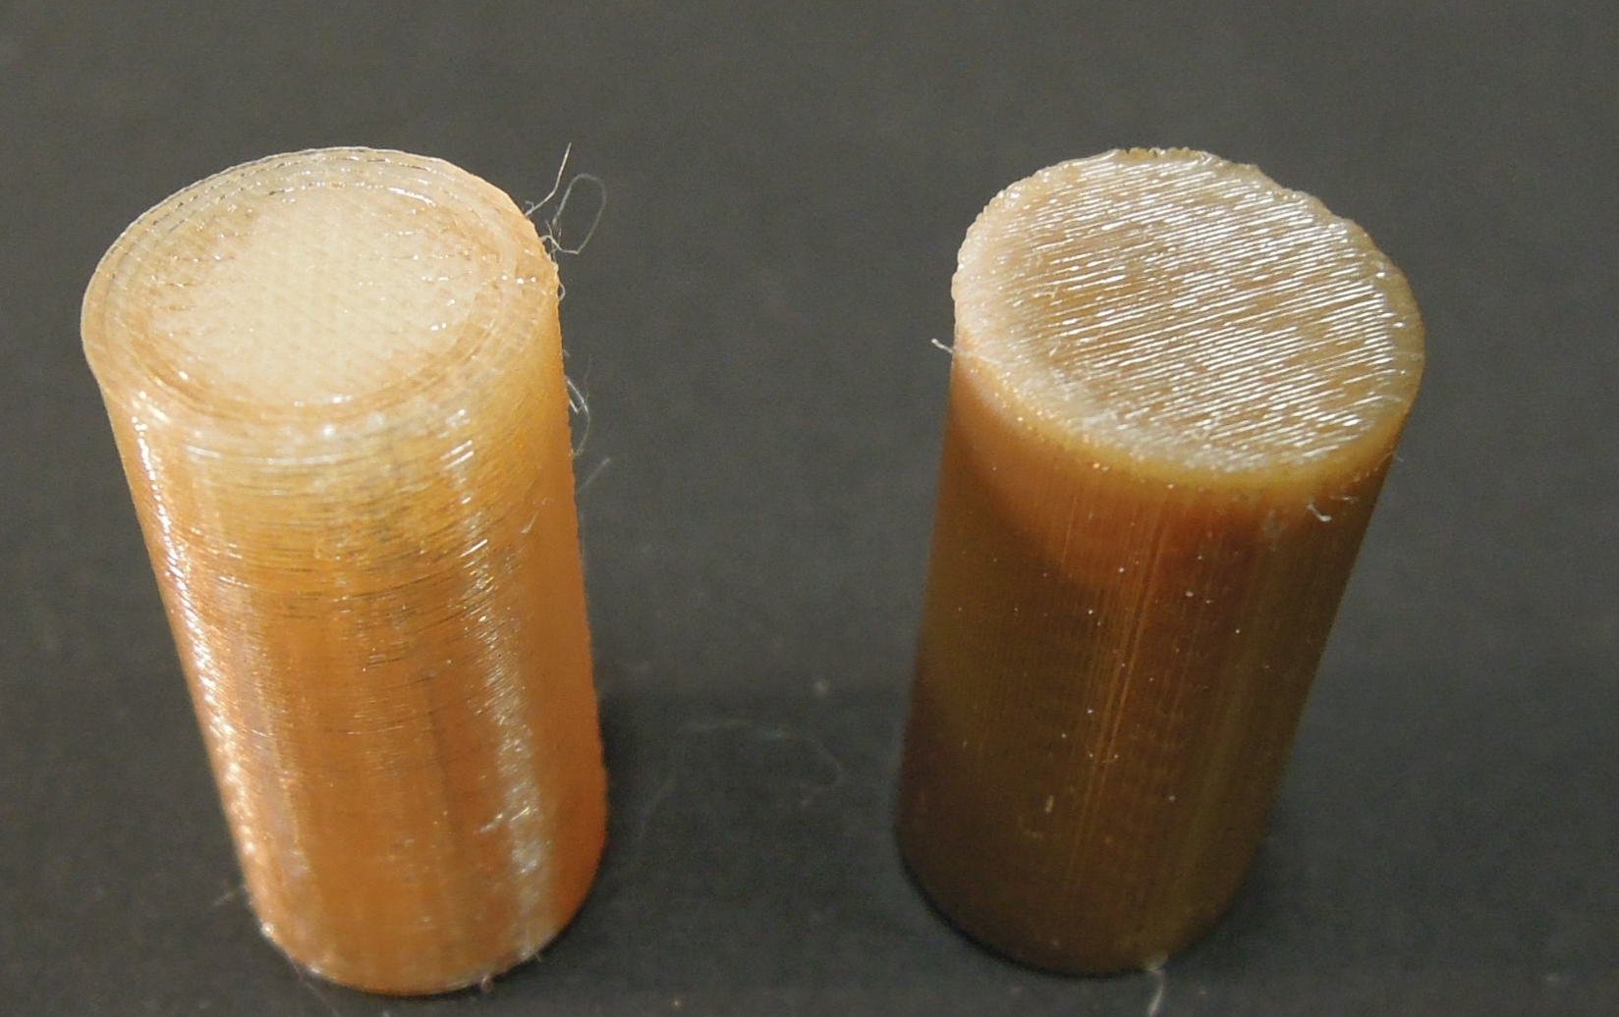
FDM SLS SLA

Slide 6
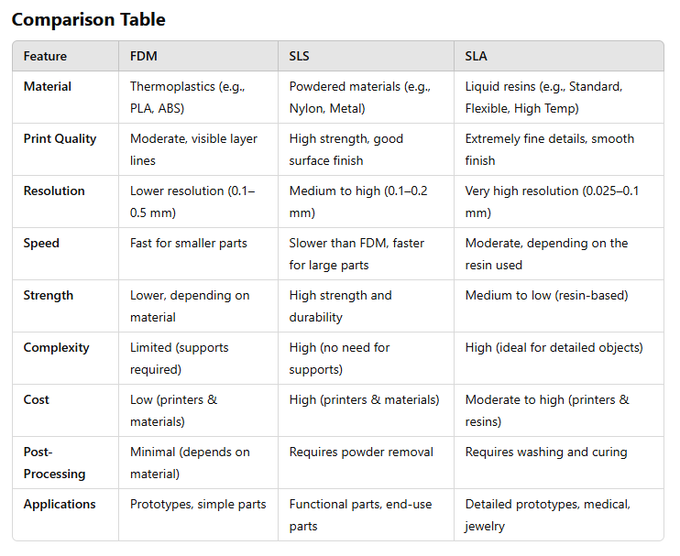
ChatGPT comparison of different 3D processes

Slide 7
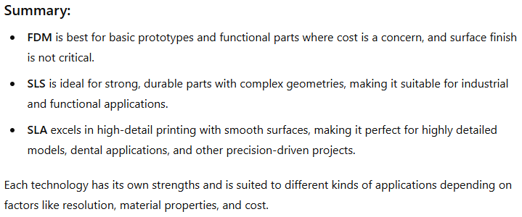
ChatGPT comparison of different 3D processes

Slide 8
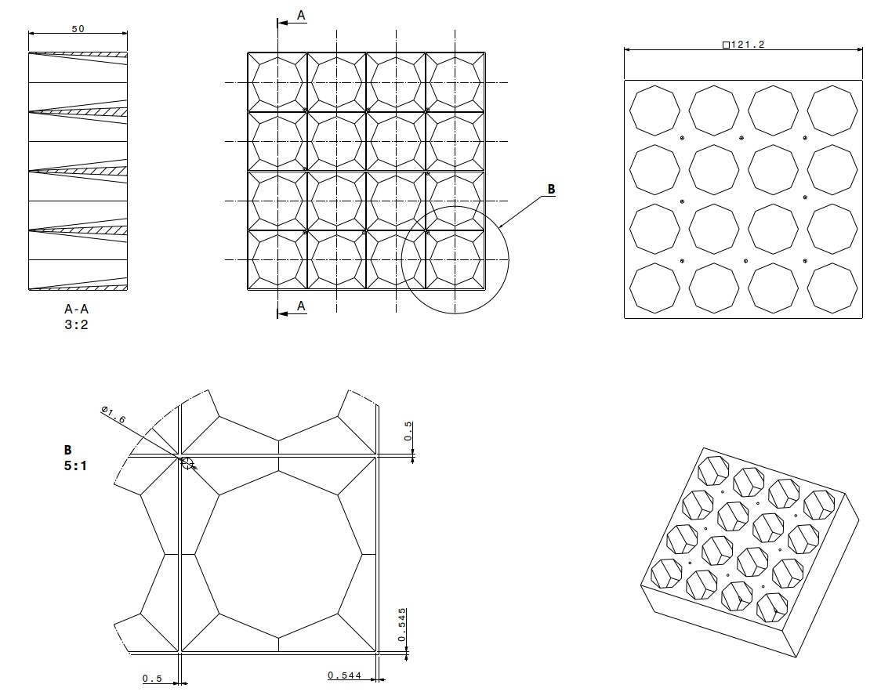
Design ideas to keep wall thickness above 0.5mm: Bundler PB module

Slide 9
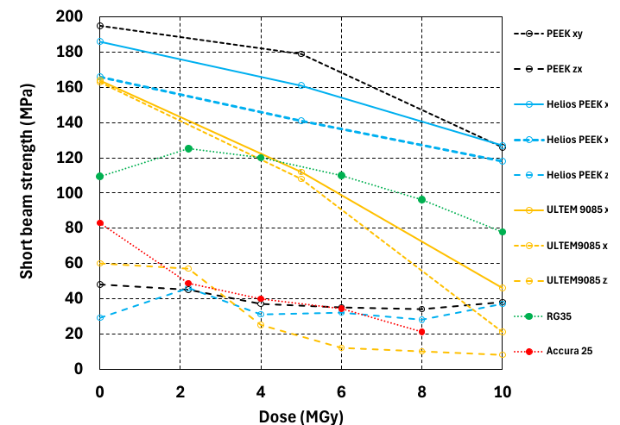
Radiation test performed by Polymer lab CERN

