Slide 1
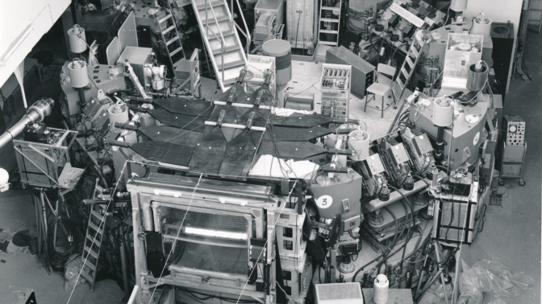



Analysis at the HL-LHC: Data Delivery, ServiceX, and Addressing Our Analysis Challenges
Ben Galewsky (UI), Ilija Vukotic (UChicago), Gordon Watts (UW/Seattle), Roger Janusiak (UW/Seattle), Peter Onyisi (UTexas), KyungEon Choi (UTexas), Artur Cordeiro Oudot Choi (UW/Seattle), Mason Proffitt(UW/Seattle)
And others that have contributed!
Supported by grants from the NSF: OAC-1836650 and PHY-2323298

Slide 2
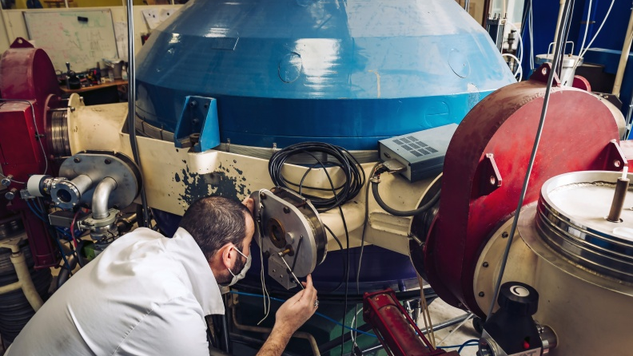
ServiceX – Introduction
Notes:
Isotope separator, first put in in 1969 (photo 2023)

Slide 3
ServiceX: Data Delivery for HL-LHC Analysis At Scale
On Demand
Experiment Agnostic Design
Accessible Anywhere
“Faster time to insight”

Slide 4
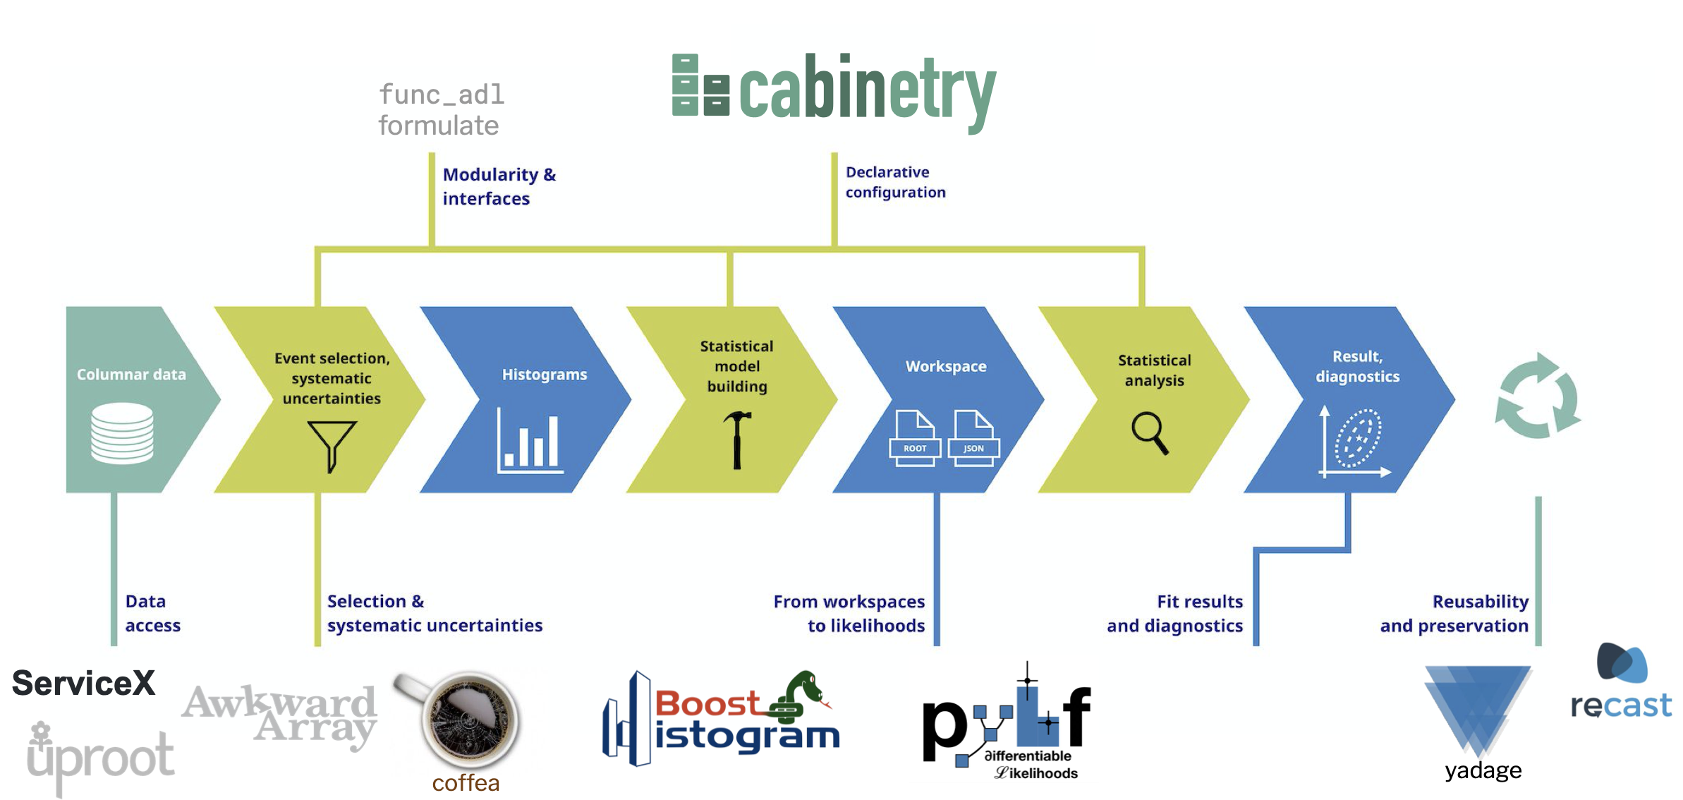
Where does it fit in Analysis?

Slide 5
ServiceX
Goals
Produce focused datasets for analysis
Produce training datasets for ML (high- and low-level features)
Quick small datasets/skims to answer specific systematic studies
Operate Quickly
Simplify user skimming and thinning
Non-Goals
Produce Histograms
Run statistical models
General Purpose Batch Facility
Produce datasets that require significant computing

Slide 6
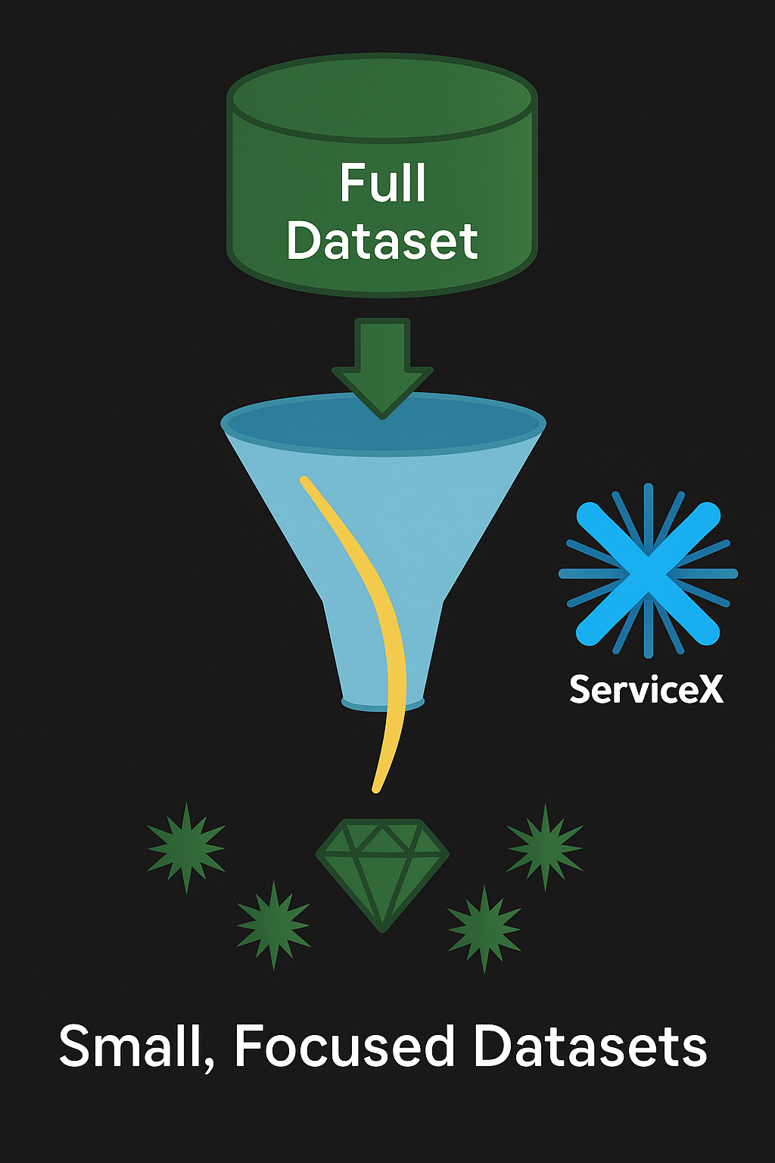
ServiceX: Data Delivery for HL-LHC Analysis At Scale
On Demand
Quick access to data
  Less need to develop giant derivations with everything you might need under any circumstance
  Small, ephemeral, focused datasets possible
Keep queries around, not giant datasets
  Try to eliminate these very large intermediate datasets we have in analysis
Depends on dataset generation being cheap: easy to do, and quick

Slide 7
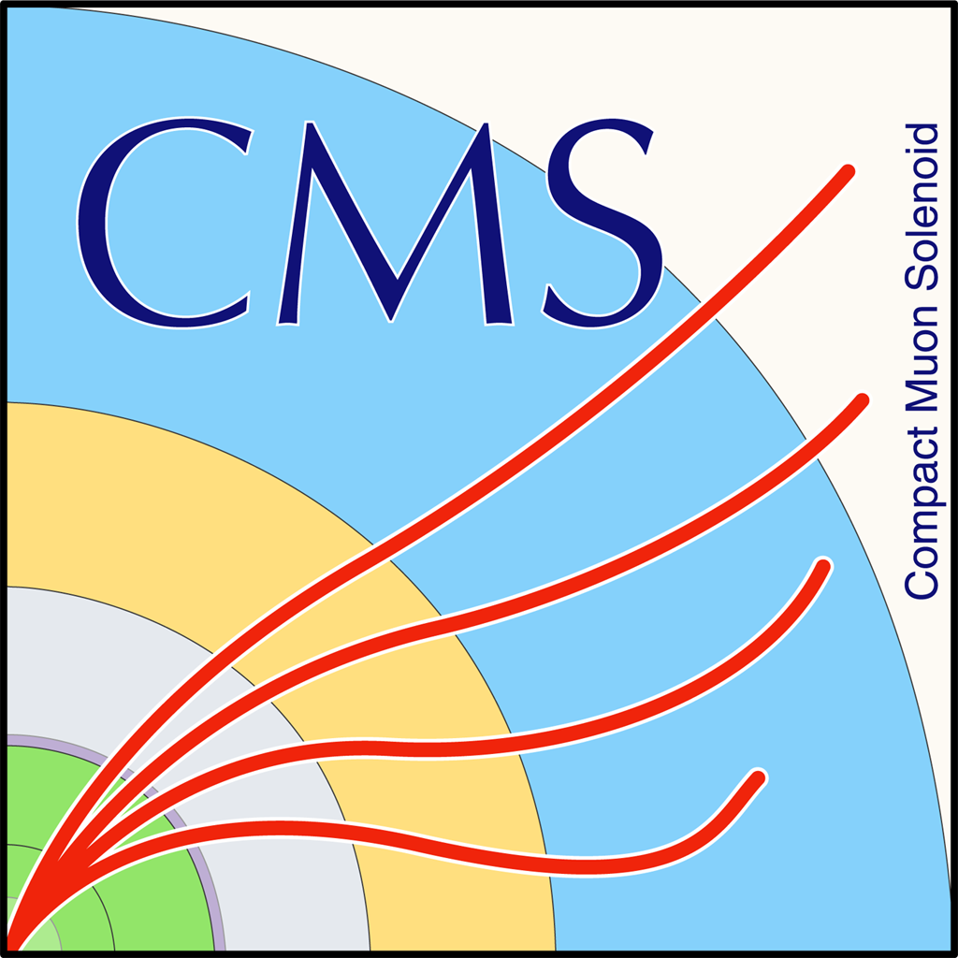

ServiceX: Data Delivery for HL-LHC Analysis At Scale
Experiment Agnostic Design
ServiceX manages
  file delivery
  processing (transformation),
  output dataset management and access.
Supports arbitrary input formats
  Support for ATLAS proprietary formats like xAOD, preliminary support for CMS miniAOD
  Support for ROOT TTree and some initial support for RNTuple, etc.
  Supported by exiting experiment frameworks (e.g. EventLoop and AnalysisBase release in ATLAS) in docker images
Output Formats include TTree, RNtuple, and parquet
Input data source: pluggable architecture current supports Rucio, http, and xrootd.

Slide 8
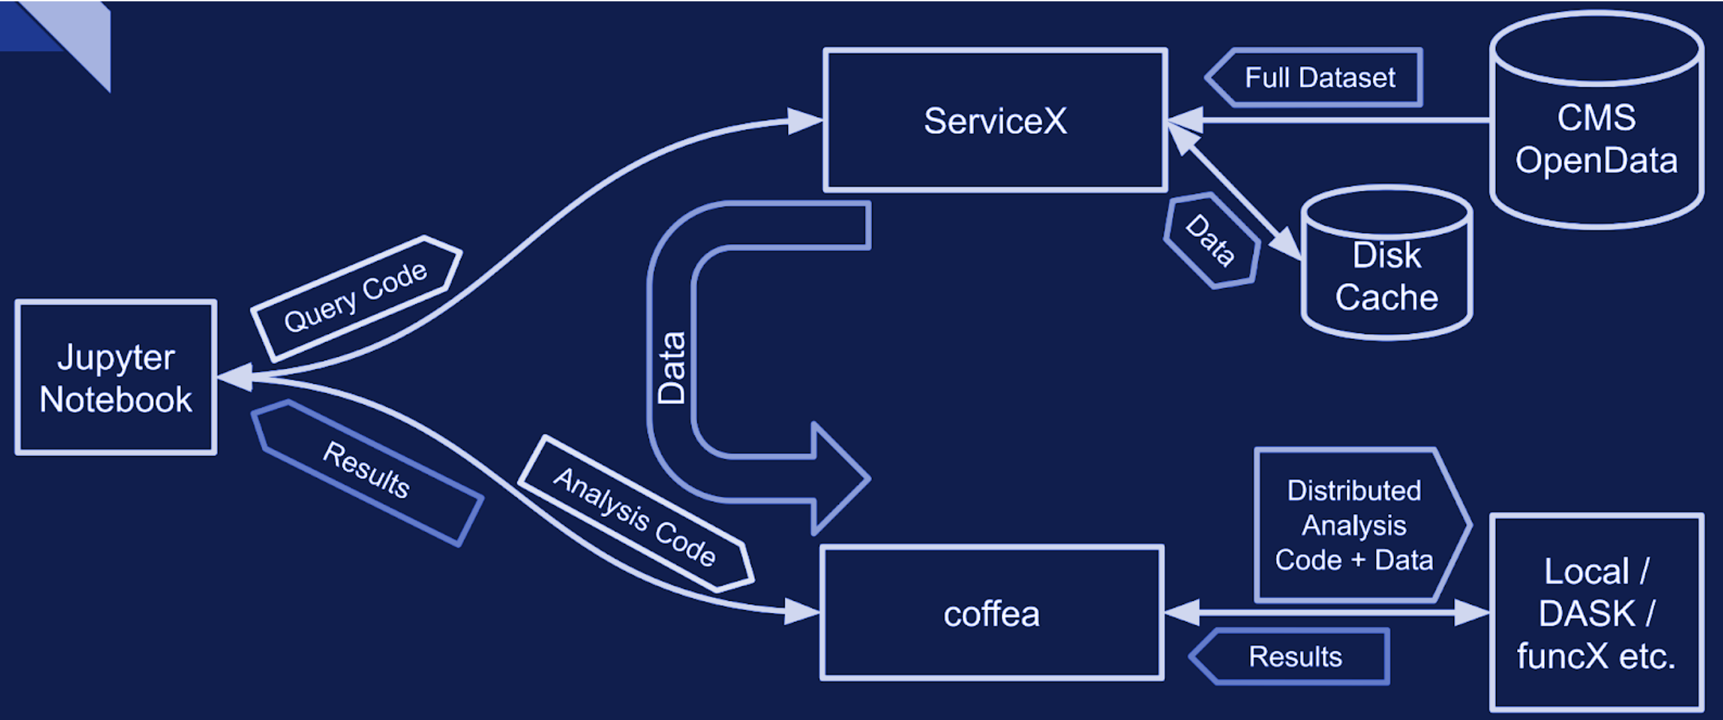
ServiceX: Data Delivery for HL-LHC Analysis At Scale
Accessible Anywhere
WebAPI Interface to start transforms
Amazon’s Object Store API for accessing resulting data (S3) in local object store
  compatible with python ecosystem and ROOT framework
Accessible from laptop to Analysis Facility
Support software for local downloads
Direct access to data in S3 for AF’s

Slide 9
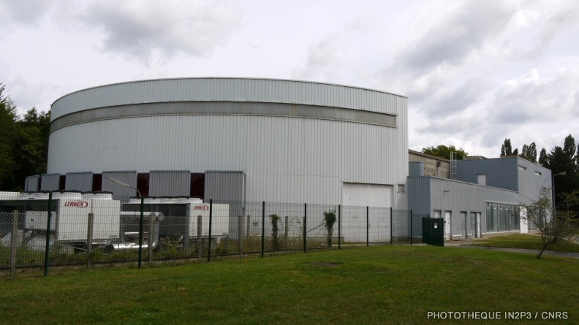
Quick Examples

Slide 10
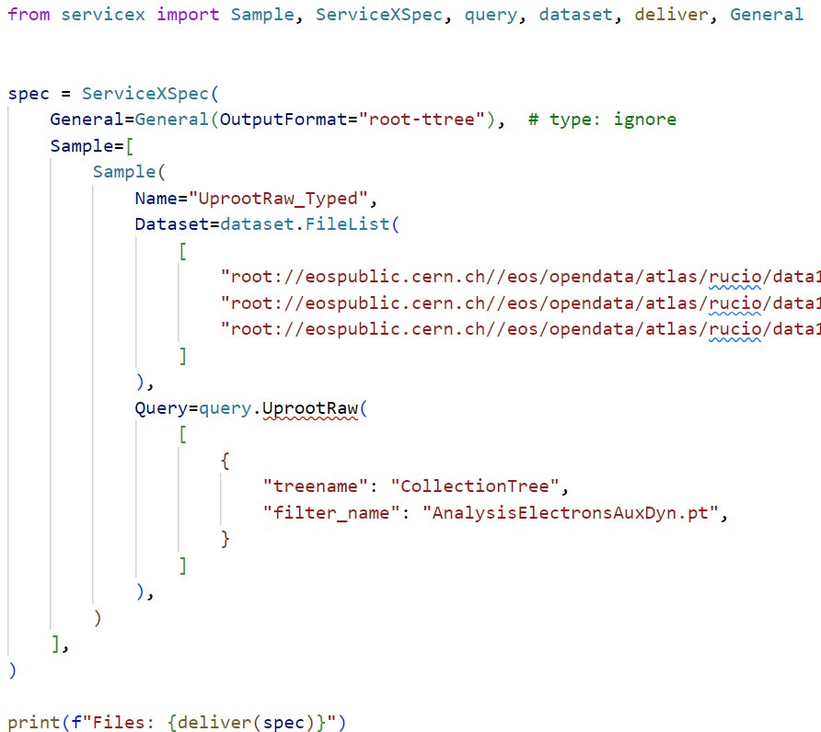
Components of a Transformation Request
4
3
1
The Input Data
The transformation to apply
The Output Format
How the transformation is specified
2

Slide 11
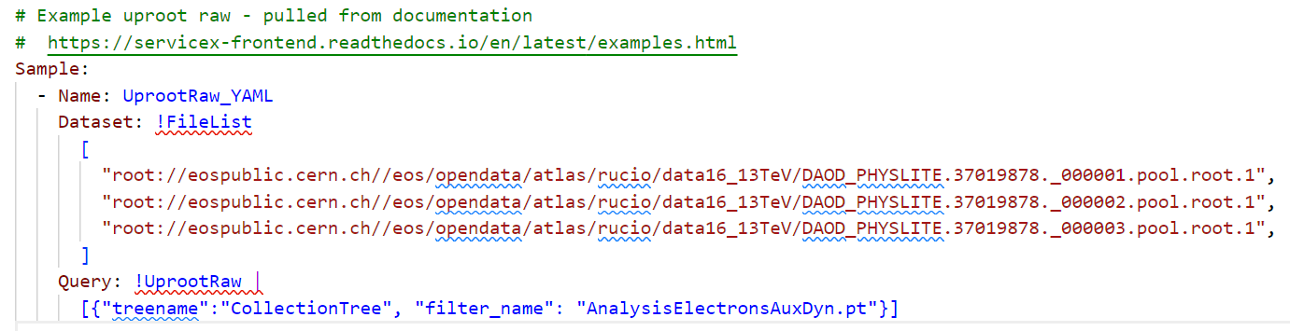
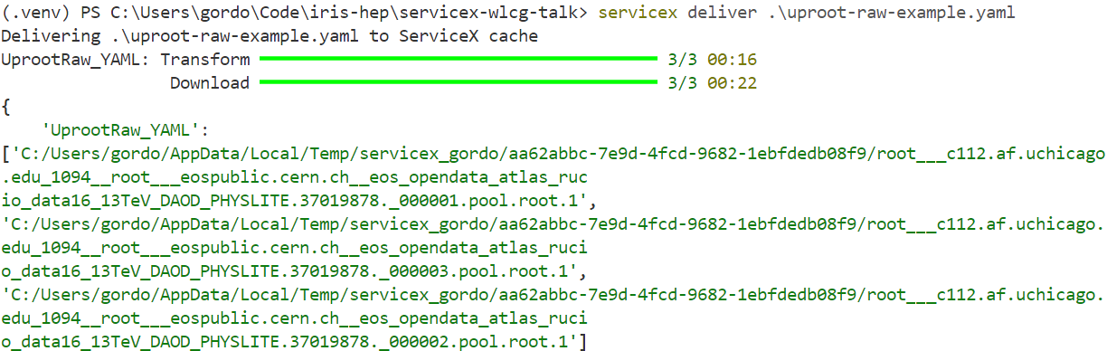
Transform specified as a YAML file
Command-line invocation
Easily checked into git
Tracking of “static” datasets
Avoid complex logic in dataset generation
Query isn’t always most readable…
3 Output Files

Slide 12
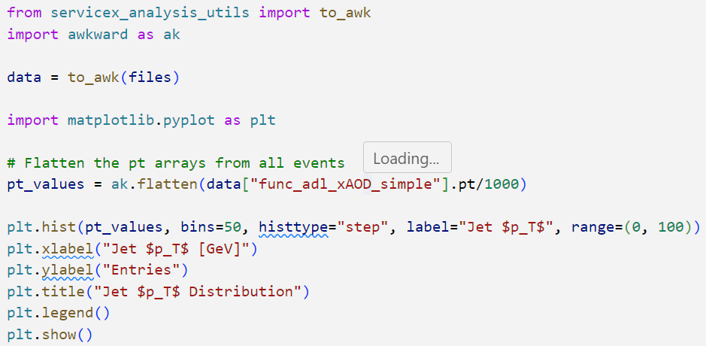
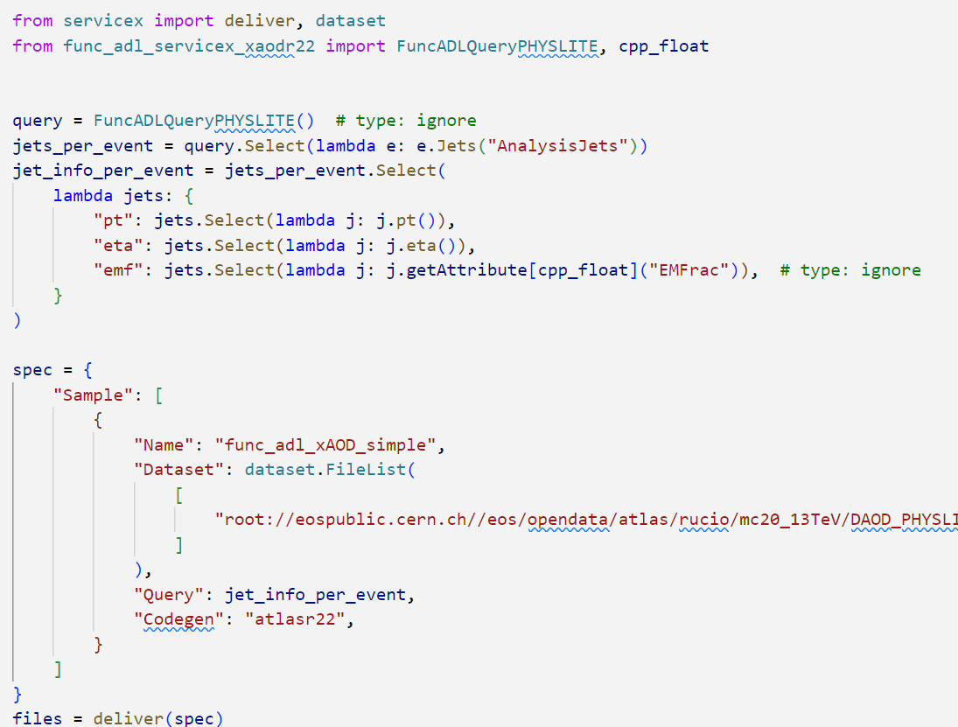
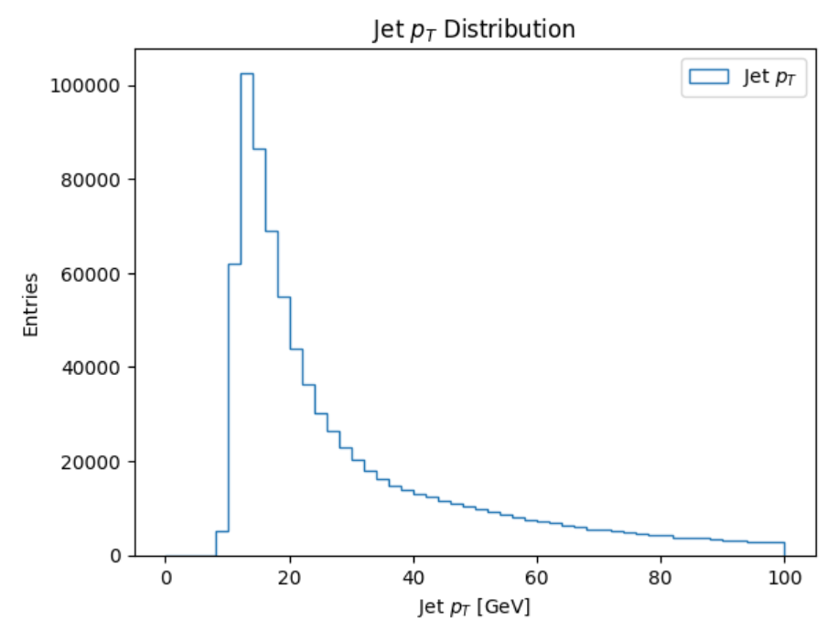
Cells of a Jupyter Notebook
Notebook
Used to perform quick studies of datasets exploring various “problems”.

Slide 13
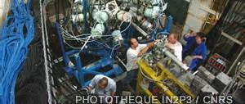
Recent Advances

Slide 14
TopCPToolkit Transformation
ATLAS has developed the TopCPToolkit to help with analyzing PHYS and PHYSLITE data
Started in top group, spread to large parts of experiment.
Configured by yaml!
Total control over what is written out
Uses experiment’s calibration framework
We have turned this into a science image
The “query” is the yaml configuration file.
Makes light-weight transformations easy…
CommonServices:
systematicsHistogram: 'listOfSystematics'
PileupReweighting: {}
EventCleaning:
cionEventCleaning: False
runGRL: False
Electrons:
- containerName: 'AnaElectrons'
crackVeto: True
IFFClassification: {}
WorkingPoint:
- selectionName: 'loose'
identificationWP: 'TightLH'
isolationWP: 'NonIso'
noEffSF: True
- selectionName: 'tight'
identificationWP: 'TightLH'
isolationWP: 'Tight_VarRad'
noEffSF: True
PtEtaSelection:
minPt: 25000.0
maxEta: 2.47
useClusterEta: True
# After configuring each container, many variables will be saved automatically.
Output:
treeName: 'reco'
vars: []
metVars: []
containers:
# Format should follow: '<suffix>:<output container>'
el_: 'AnaElectrons'
'': 'EventInfo'
commands:
# Turn output branches on and off with 'enable' and 'disable'
AddConfigBlocks: []
Electrons:
- containerName: 'AnaElectrons'
crackVeto: True
IFFClassification: {}
WorkingPoint:
- selectionName: 'loose'
identificationWP: 'TightLH'
isolationWP: 'NonIso'
noEffSF: True
- selectionName: 'tight'
identificationWP: 'TightLH'
isolationWP: 'Tight_VarRad'
noEffSF: True
PtEtaSelection:
minPt: 25000.0
maxEta: 2.47
useClusterEta: True

Slide 15
Developing a new Transform/Query Type
This is advanced coding
must be done in concert with ServiceX developers
site administrators.
But it isn’t technically difficult!
Codegen
Science Image
(docker)no
Simple python API
Translates the query string
configuration files
scripts to run the transform
Docker image that can execute the scripts
Can be based on whatever you want
Does need to have x509 support!

Slide 16
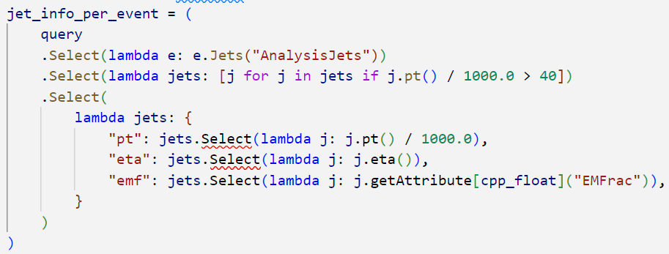
Func_adl – Supporting rich types
Loosely based on SQL
Allows fairly complex expressions
Translated into C++ (AnalysisBase/miniAOD) or uproot/awkward (root input)
Typed python – so you can take advantage of an IDE’s type checking…
1
2
3
Recent support added for C++ constants, enums…

Slide 17
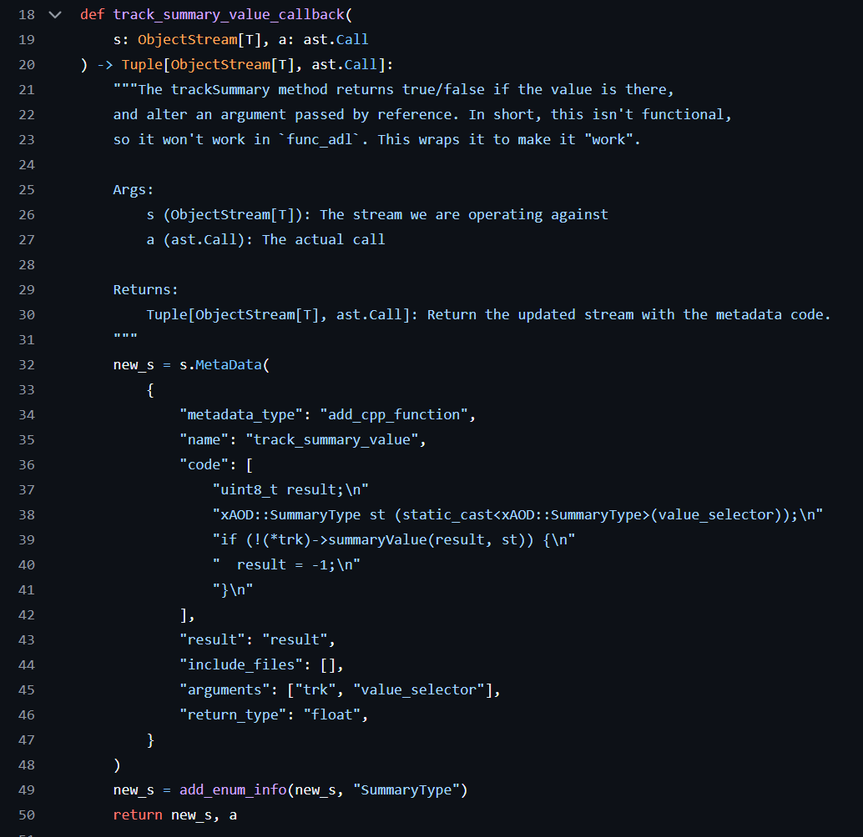
Allow leaky abstractions in C++…
There are parts of the ATLAS EDM API that are not function calls
Can inject C++ into the code stream in a composable way
Allows you to build a library to work around non-functional parts of an experiment’s EDM

Slide 18
Other Improvements
RNTuple Support
  Input for any uproot based transformer works now
  In some cases requires experiment support first
  Output works for uproot transformers, and converters for others coming.
User login now uses keycloak and CERN!
  No longer require an approval
  We’d love to get rid of the access token if we could…
    On Analysis Facilities?
Making ServiceX Less Of A Black Box
  It is a highly distributed system…
  Depends on file delivery over the GRID…
  Not easy, but far from impossible to write bad transform code…
  Lots of work on improving error messages and reporting…
Metadata
  Improved command line interface and API
  Access lots more information about transforms
  MCP Plug-in for Ilija’s talk!? (talk)

Slide 19
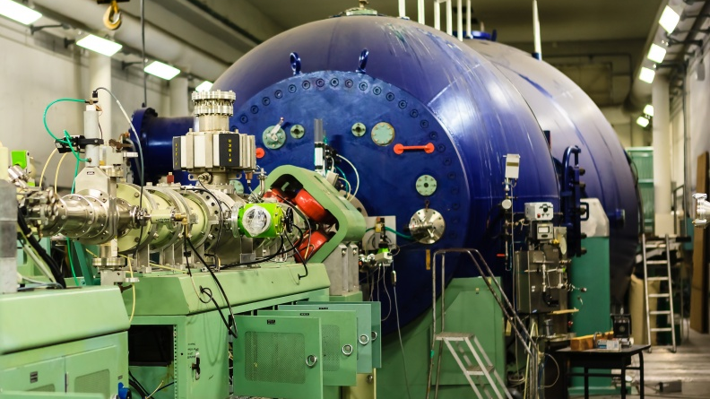
Use Cases and Scalability Testing

Slide 20
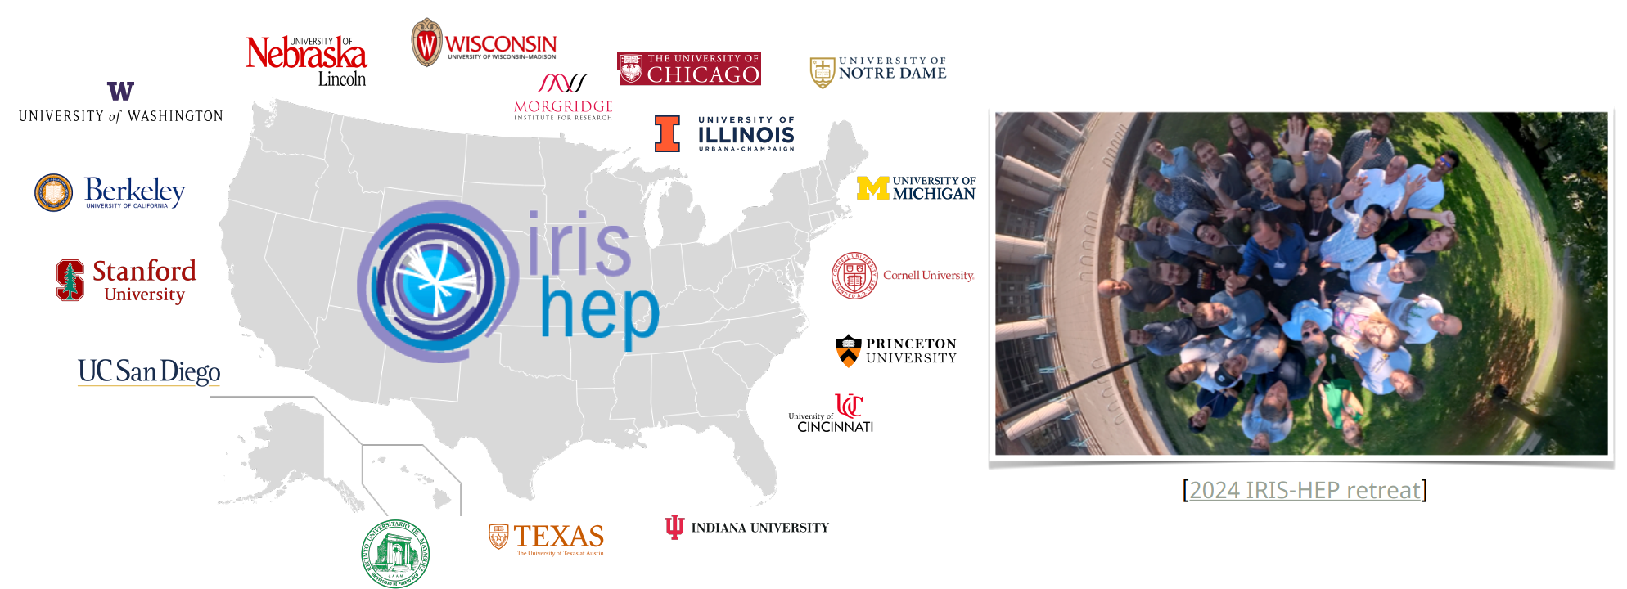
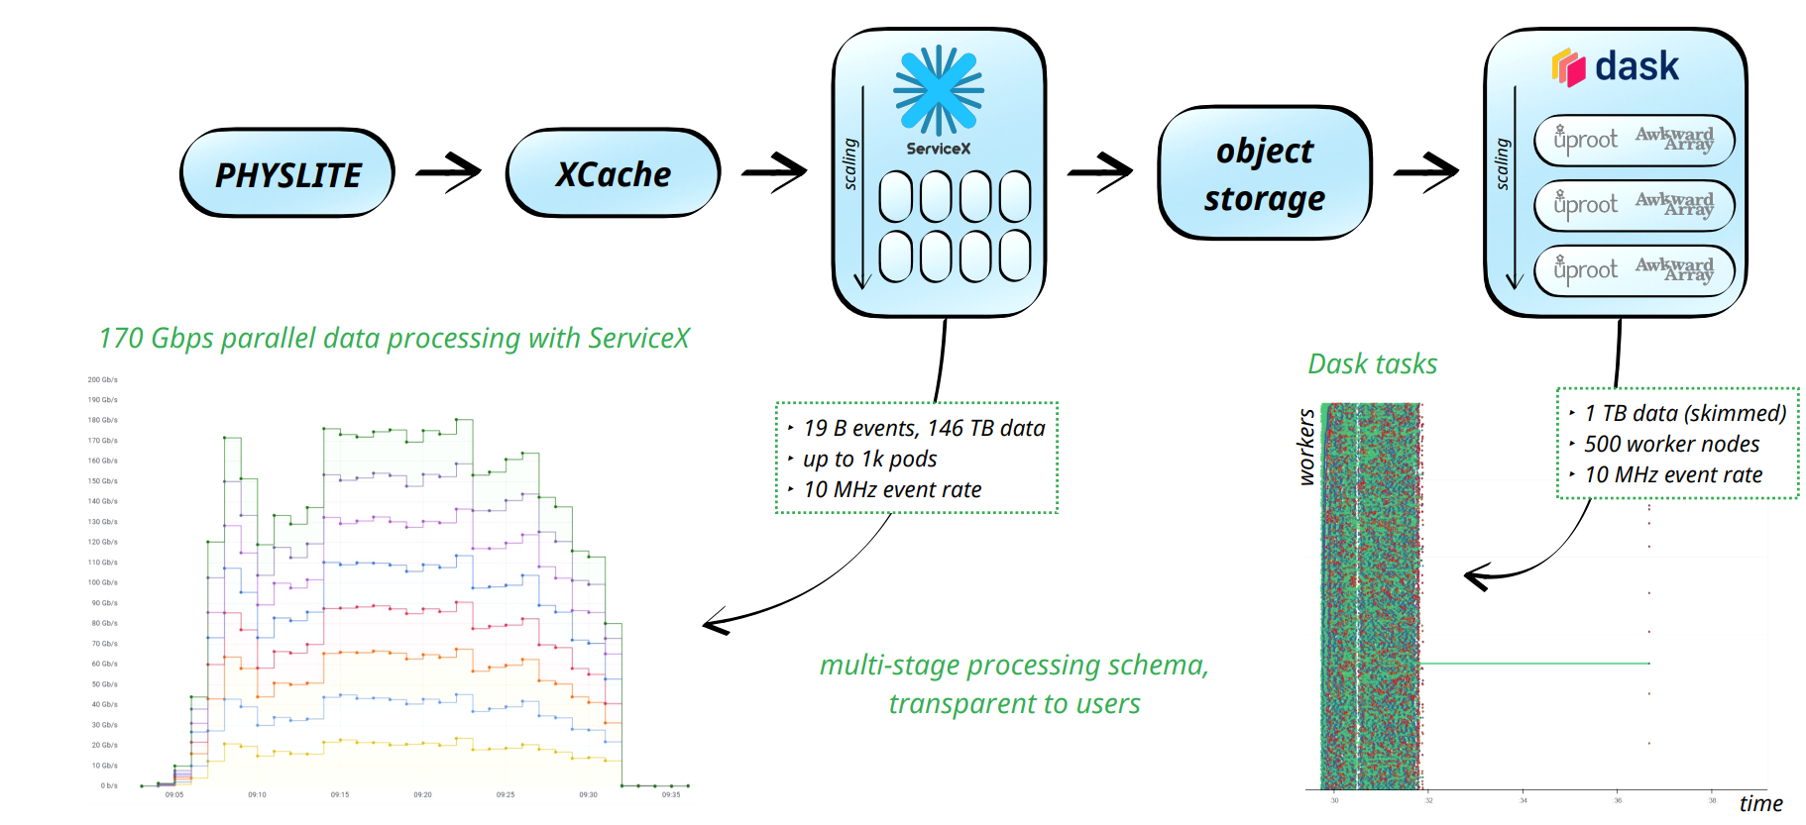
200 Gb/s Test
(click graphic for talk slide)
First time we consistently ran on large data sets
Learned from many small issues encountered
  Dropped internal messages
  Race conditions
  Configuration issues
  Facility provisioning issues
~30 minutes
Thanks to many people in IRIS-HEP and the facilities and US OPS programs for contributing to this test!

Slide 21
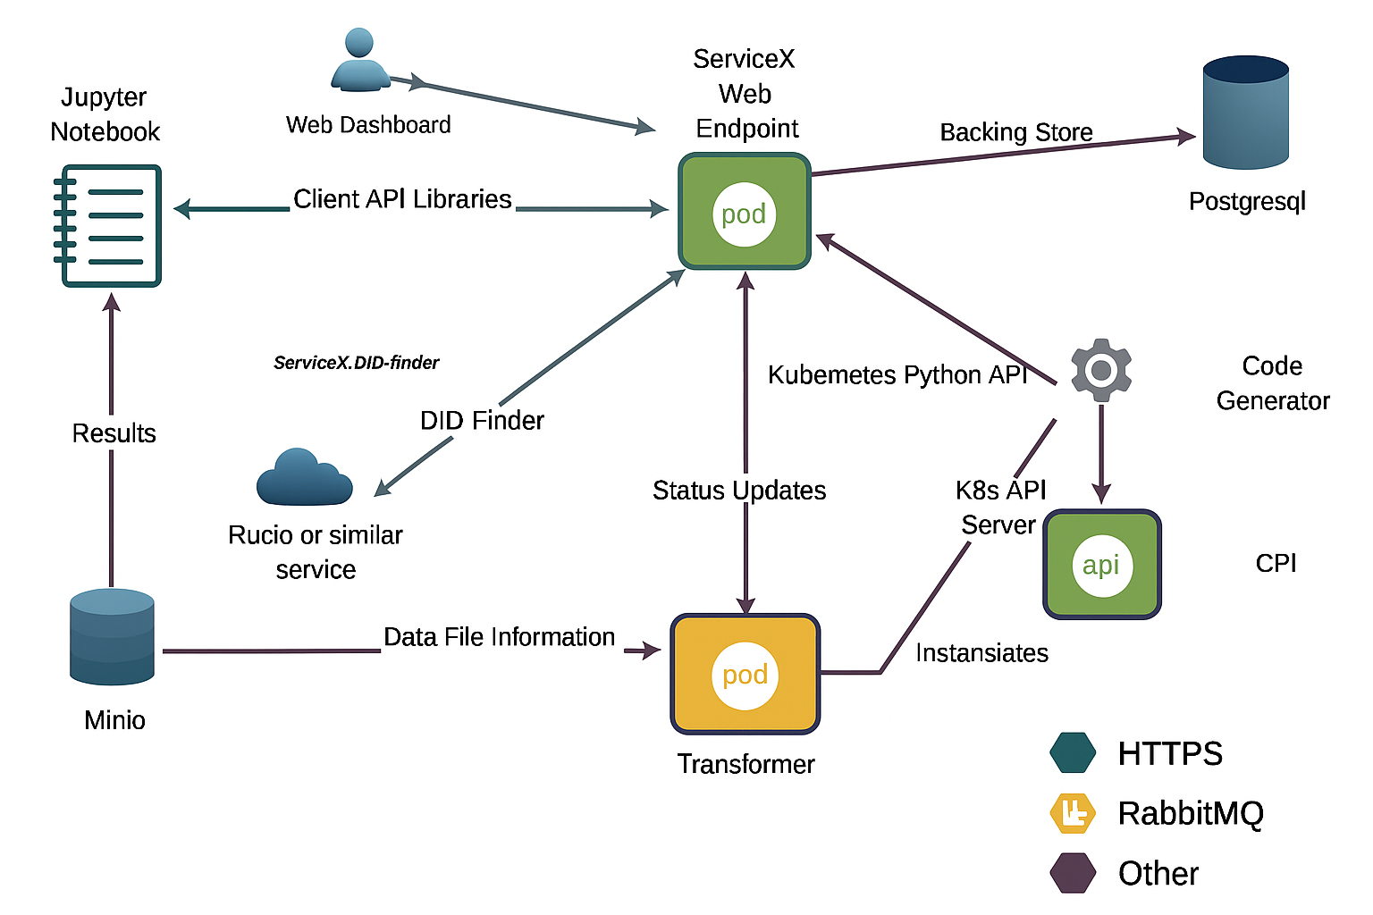
Stability Improvements
Designed for scalability
A lot of careful internal work
Converting the “easy” https connections to message queue for crucial messages
Protecting the database with transactions
Understanding bottlenecks in the database
Decoupling the frontend REST API from backend operations
Better resource sharing with rest of k8s cluster
Improed XCache integration
Now regularly test with a 50 TB dataset
We would not have seen any of these problems without the stress testing!

Slide 22
ML Training Data
Trained Model Parameters
ATLAS LLP1 Derivation
Training Data
(muon segments, calo clusters, tracks)
ML Training & Inference
ServiceX
TopCPToolkit
Inference Results
High Level Analysis Data
Statistical Model

Slide 23
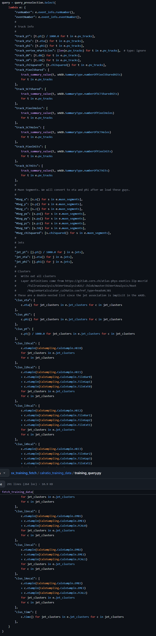
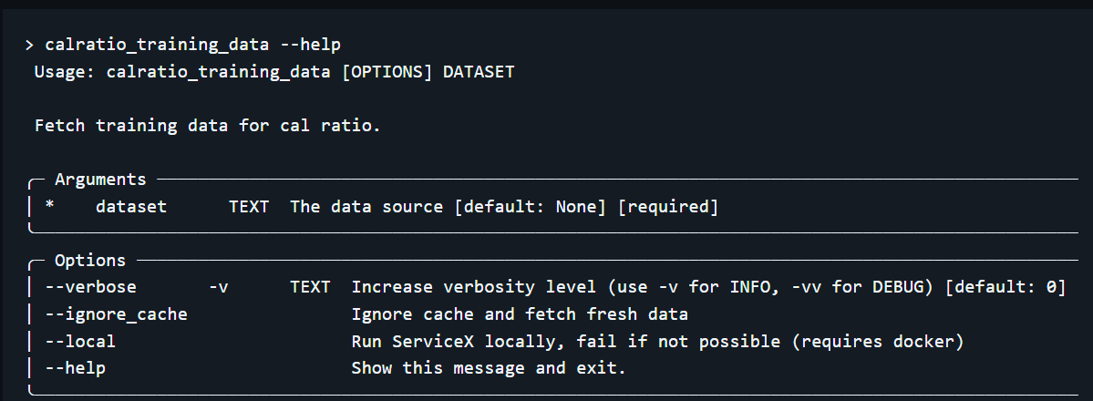
Training Extractor
Contains:
Jet
Tracks, including quality information (e.g. # of pixel hits)
Muon segments
Calorimeter Clusters
With ServiceX we have a hope of building a command-line slim/skim/delivery of the training data
Code is built as a library, enabling Jupyter notebook studies
Amazingly helpful for understanding missing data
And developing more complex algorithms and checking them (e.g. jet-segment association)

Slide 24
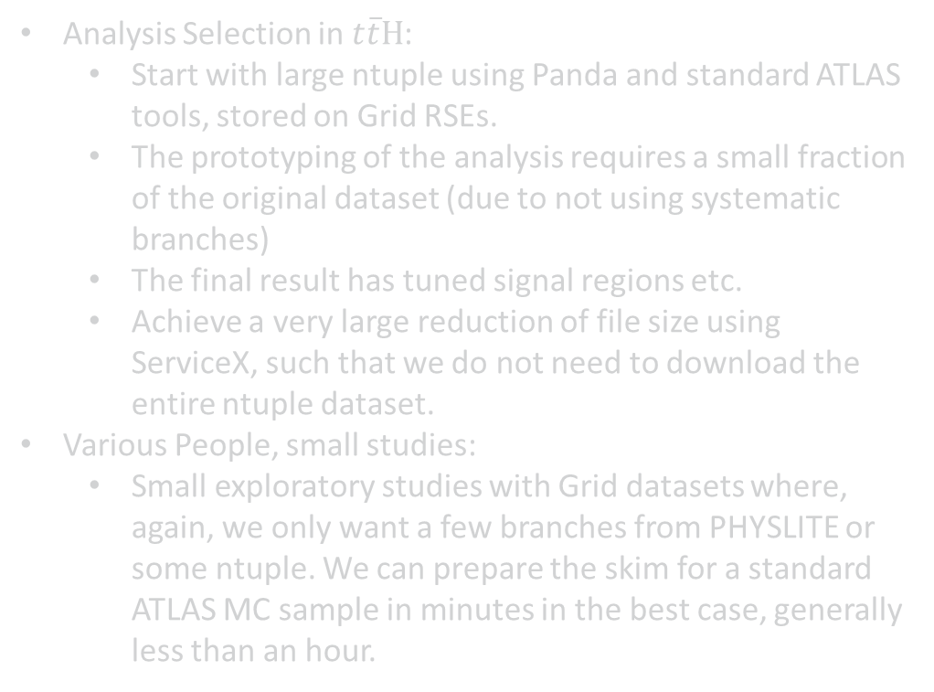
A Few Other Slim & Skim Use Cases
Analysis Selection in $t\overline{t}H$:
  Start with large ntuple using Panda and standard ATLAS tools, stored on Grid RSEs.
  The prototyping of the analysis requires a small fraction of the original dataset (due to not using systematic branches)
  The final result has tuned signal regions etc.
  Achieve a very large reduction of file size using ServiceX, such that we do not need to download the entire ntuple dataset.
Various People, small studies:
  Small exploratory studies with Grid datasets where, again, we only want a few branches from PHYSLITE or some ntuple. We can prepare the skim for a standard ATLAS MC sample in minutes in the best case, generally less than an hour.
Access to certain ATLAS datasets with unusual data structures not handled by standard ntupling tools but handled by the FuncADL xAOD backend.
Also aware of people setting up to use it to study compression settings for analysis!

Slide 25
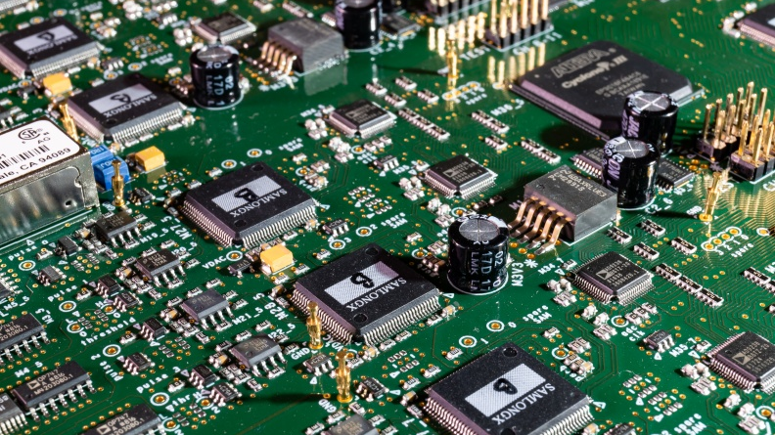
Wrap Up

Slide 26
Conclusions
Roadmap
  Publicly published on github
  But better idea by joining the #servicex channel in the iris-hep slack.
  And the ServiceX 2-week meeting
Huge amount of work on usability, scalability, and robustness after the 200 gpbs test
  Looking forward to the next edition!
  Current tests show system is quite robust
Usage Documentation
Scalability
  Uses k8s resources efficiently
Used by a small number of analyses and experiments
  Working hard with new users
  And improving our documentation
Use cases are now driving new features
The core of the system is stable
  Concentrating development on things like new transformers
  Supporting new use cases

Slide 27
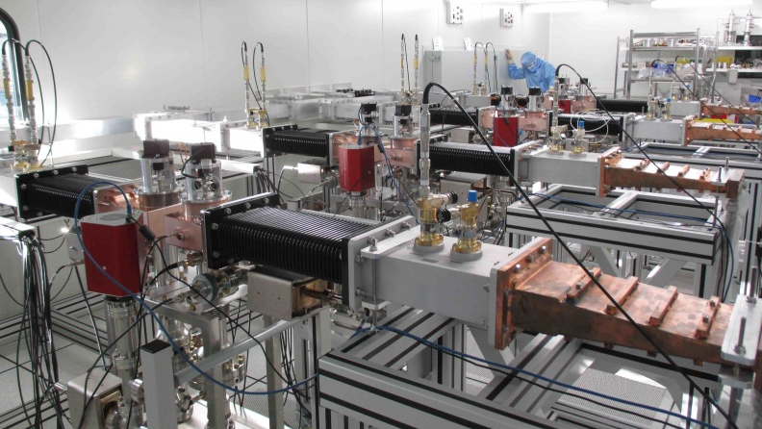
Backup

Slide 28
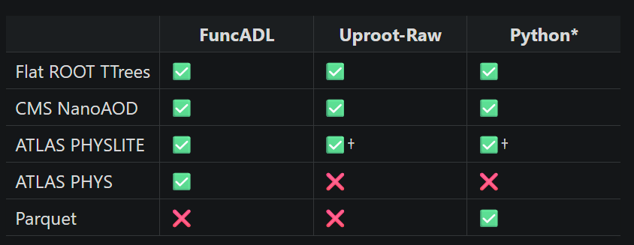
Input Matrix…
We’d love input to be agnostic of processing query
But inputs are tied to specific software frameworks…

Slide 29
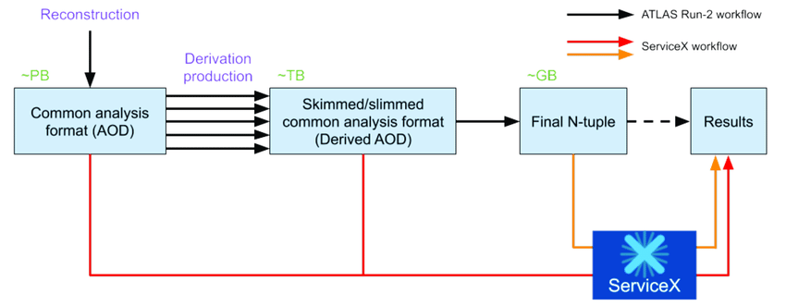
Its Place In Analysis

Slide 30
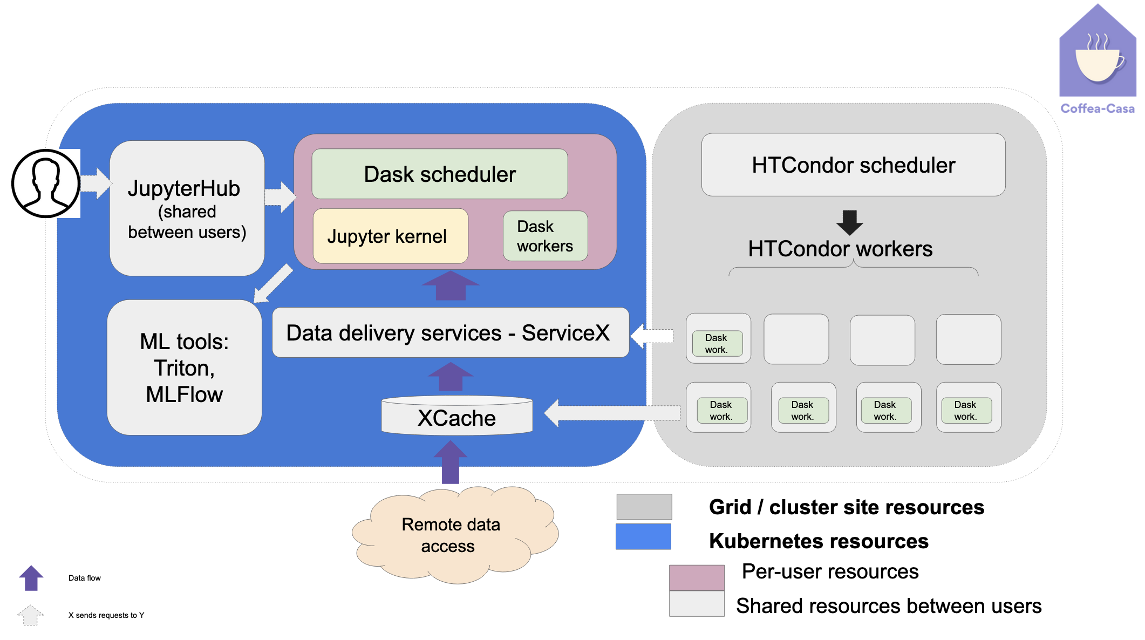
Analysis Facilities & Computing in HEP
Designed as a service that can be made available in a AF or standalone.
  Kubernetes based, helm chart published, site-personalization via values.yaml.
Enhances an AF with temporary high speed parallel storage for skimmed data sets
The “manages file delivery, processing (transformation), and output dataset” is a lot like the GRID’s mission!
  But this is built for small fast transformations
  Compute heavy workloads are not efficient use of ServiceX
  This is not a GRID replacement
  But it does depend on the GRID for data delivery!!

Slide 31
Components of a Transformation Request
4
3
1
The Input Data
The transformation to apply
The Output Format
How the transformation is specified
A Rucio dataset
A xrootd directory
A list of http or xrootd accessible files
2

Slide 32
Components of a Transformation Request
4
3
1
The Input Data
The transformation to apply
The Output Format
How the transformation is specified
2
An awkard array expression
A SQL-like selection expression (func-adl)
A raw Python expression

Slide 33
Components of a Transformation Request
4
TTree in a ROOT file
Parquet
3
1
The Input Data
The transformation to apply
The Output Format
How the transformation is specified
2

Slide 34
Components of a Transformation Request
4
3
1
The Input Data
The transformation to apply
The Output Format
How the transformation is specified
2
As a python dict
As typed python objects
As a YAML file

Slide 35
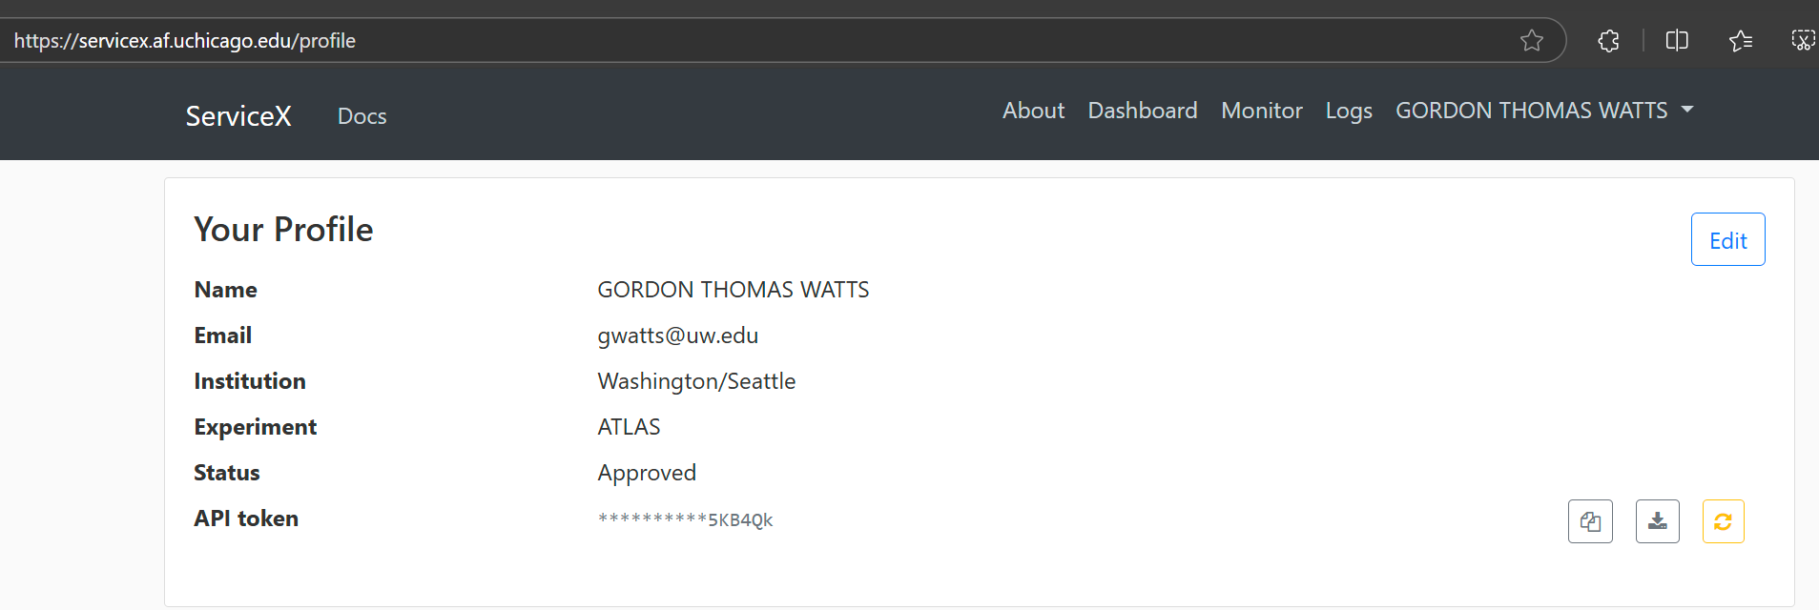
First… Don’t forget your access token!
Place the servicex.yaml (or .servicex) file in your home directory, or in the root directory of your analysis
Do not check into git!!!

Slide 36
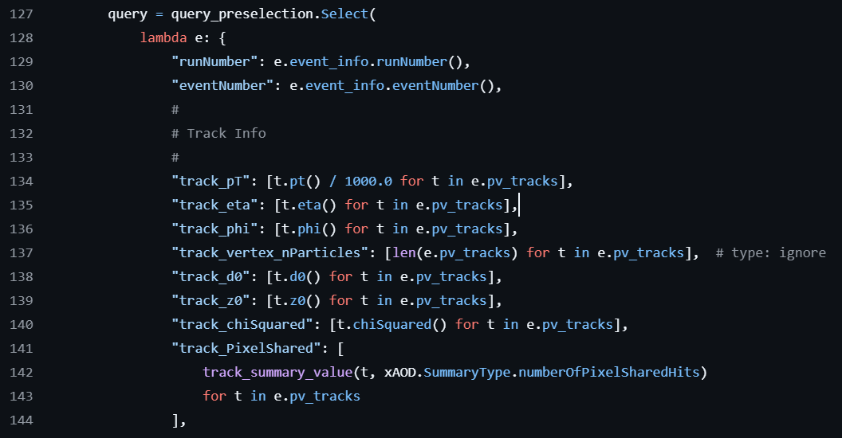
And use it in your expression…

Slide 37
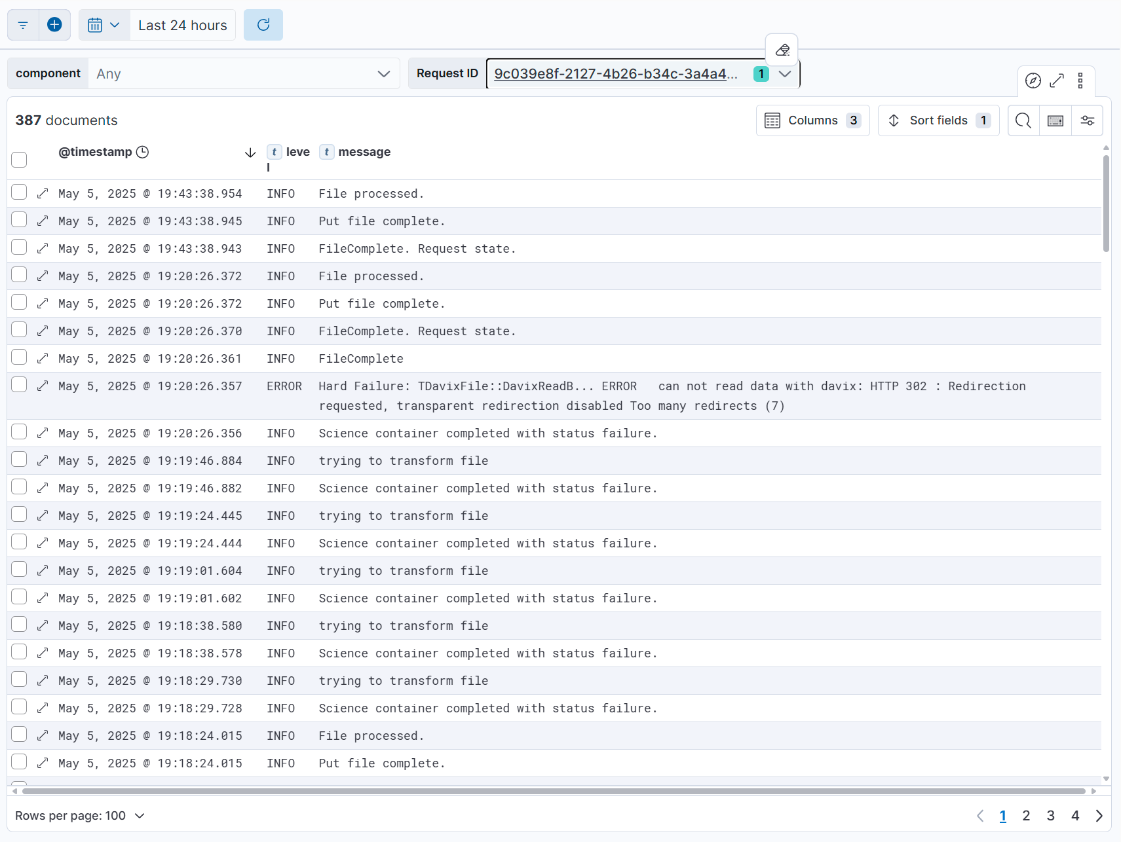
Errors are still hard…
Using elastic search
Captures everything
User gets links to errors
Transformer infrastructure can use regular expressions to find most likely cause (e.g. “ERROR”)
ToolSvc.TrigMatchingTool INFO initializing ToolSvc.TrigMatchingTool
ToolSvc.TrigMatchingTool INFO Remap broken links? 0
TDavixFile::DavixReadB... ERROR can not read data with davix: HTTP 302 : Redirection requested, transparent redirection disabled Too many redirects (7)
TFile::Cp ERROR cannot read from source file http://cern.ch/atlas-groupdata/ElectronEfficiencyCorrection/2015_2018/rel21.2/Precision_Summer2020_v1/trigger/efficiencySF.SINGLE_E_2015_e24_lhmedium_L1EM20VH_OR_e60_lhmedium_OR_e120_lhloose_2016_2018_e26_lhtight_nod0_ivarloose_OR_e60_lhmedium_nod0_OR_e140_lhloose_nod0.TightLLH_d0z0_v13_isolTight.root. readsize=81971 read=0 readop=1
(at the end of 18K lines of log file output…)

Slide 38
Running At Scale
At Scale means running on data
Run 2 dataset contains ~66K files
And many many MC datasets
Requires robust handling and communication inside ServiceX
RabbitMQ for message passing on crucial pathways
https, on a private backbone, for less important messages.
Database is carefully protected & transactional
Some of this was hard won insight – dropped messages & retries inside k8s network!
Scale Out

