Slide 1
WLCG/HSF workshop introduction: a WLCG view
IJCLab, May 2025
David Britton, Simone Campana, Tommaso Boccali

Slide 2
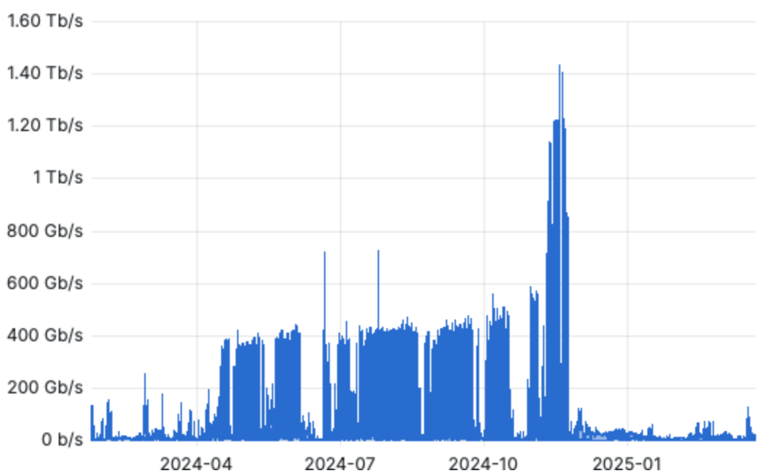
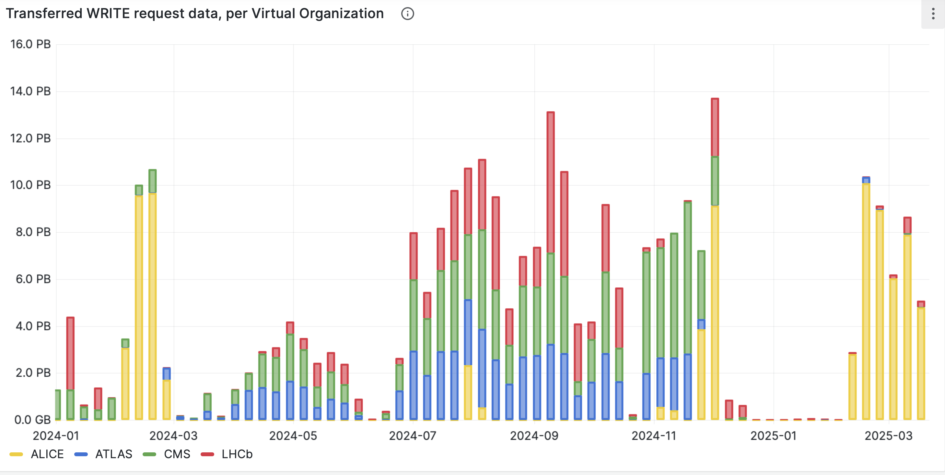
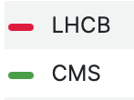
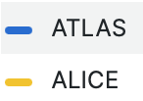
The 2024 (Heavy Ion) Run
Unprecedented data rates from the experiments to the Tier-0 and WLCG during the Heavy Ion Run
WLCG services supported the computing needs of the experiments with high performance and reliability
Hourly data rate from experiments to T0 (Tb/s)
Weekly LHC data archived at CERN (2024)
2024 pp
2024 HI
2024 HI
2023 ALICE
HI archival
2024 ALICE
HI archival
2024 pp
Run-2 peak

Slide 3
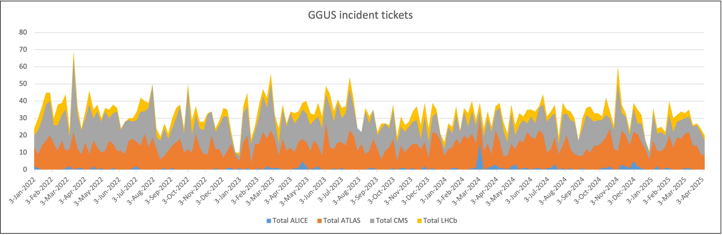
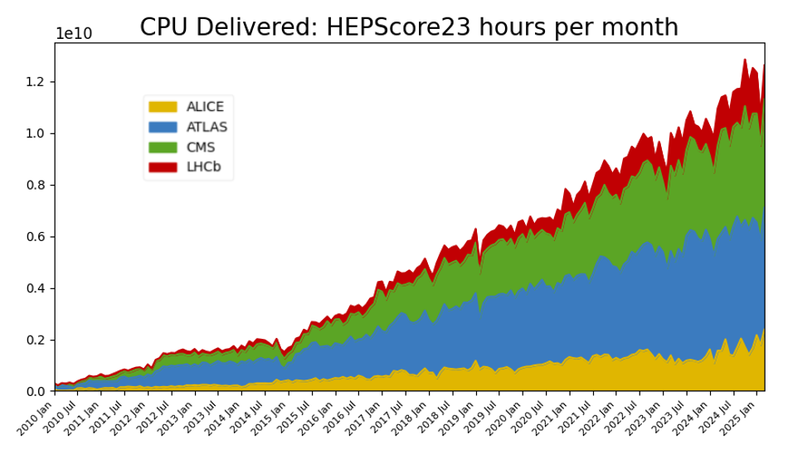
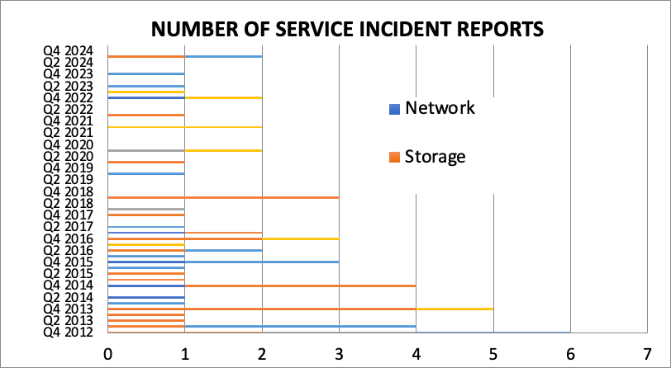
WLCG Operations
2024
2025
Stable operations, despite high data rates and many ongoing upgrades
e.g. upgrade of Linux OS from CentOS7 to RHEL9/Alma9/.. at all WLCG sites
Only two incident reports in 12 months

Slide 4
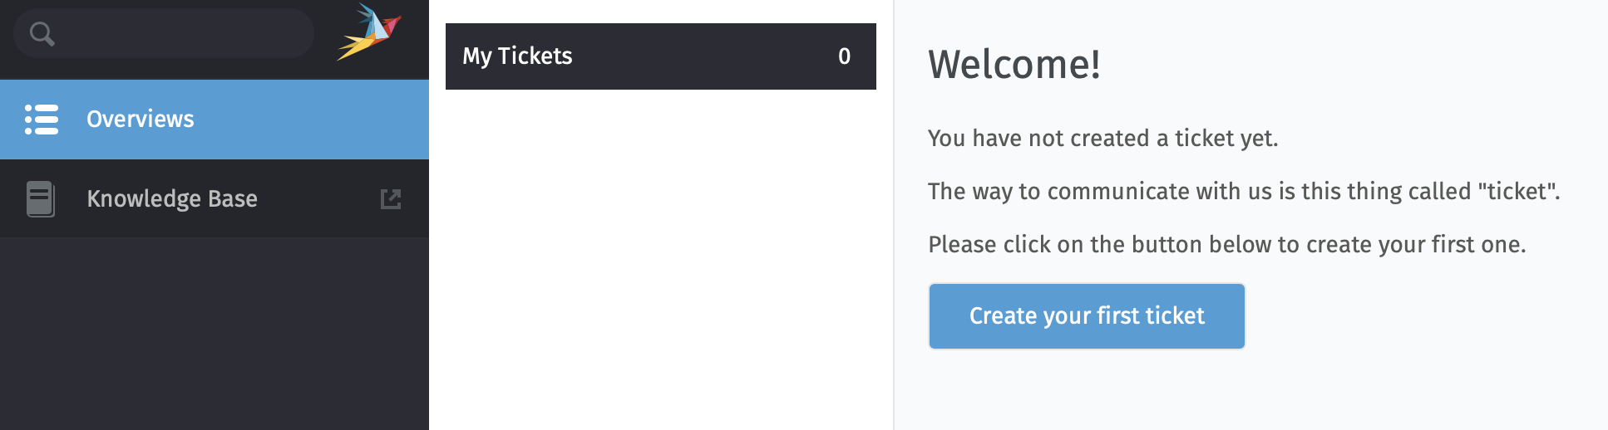
GGUS Helpdesk (new)
WLCG migrated to the new GGUS Helpdesk
Responsibility of KIT, a core member of WLCG
Transition happened in January 2025 and was smooth. Legacy system was decommissioned (backend unsupported)
Some improvements in the pipeline – mostly about integration with site ticketing
https://helpdesk.ggus.eu/

Slide 5
Summary about WLCG operations
The WLCG infrastructure and services are simply working
And that is thanks to the people in this room (and several others that could not join us today): sites, experiments, SW and MW developers
Our main objective for the next 2 years is to ensure data taking, processing, archiving of the experiments
In addition, we need to continue preparing for HL-LHC

Slide 6
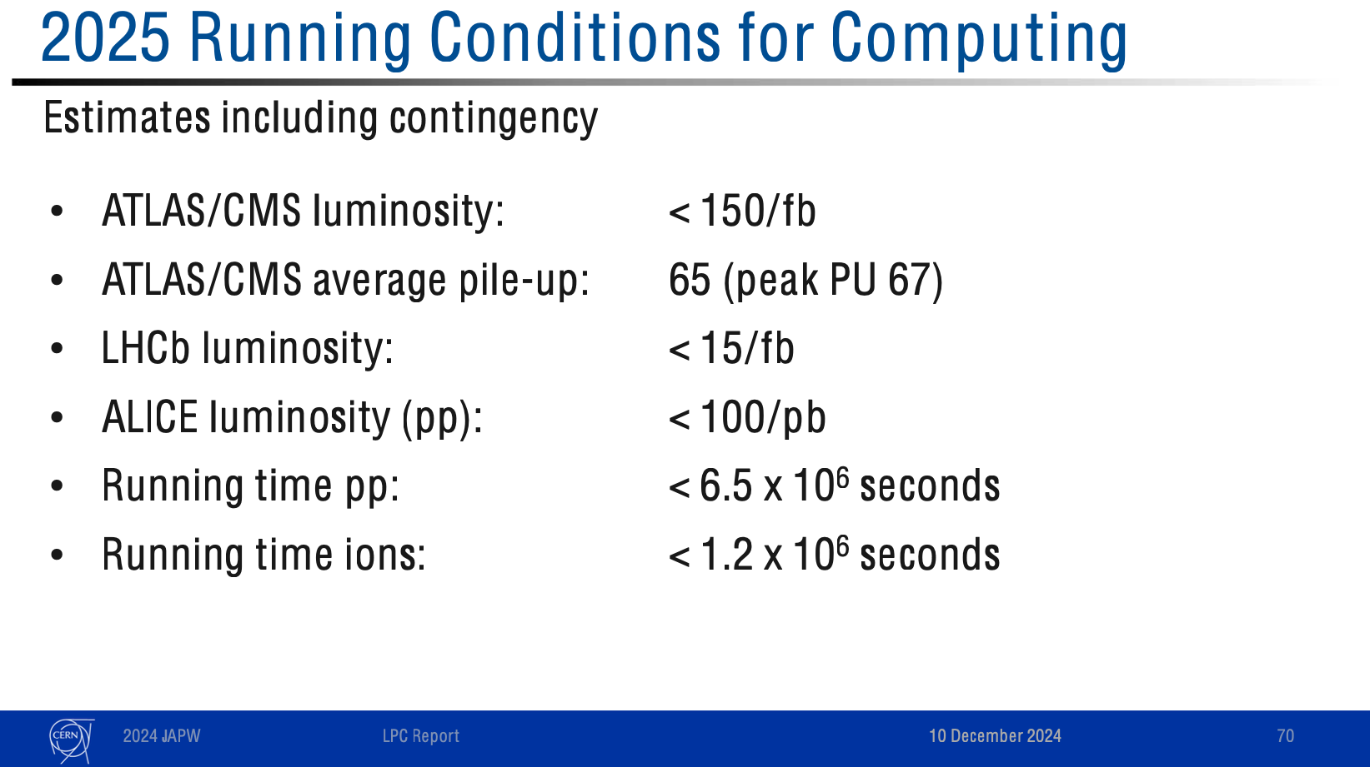
The 2025 Run in practice
The LHC Run in 2025 will not be trivial. We will have unprecedented data rate and pressure on resources. We asked the Funding Agencies to help.
In 2025 the experiments could collect up to ~50% more luminosity than planned - and resourced for
=> The LHC was expected to deliver in 2025 up to 100 fb-1 for ATLAS and CMS
=> This changed in December 2024

Slide 7
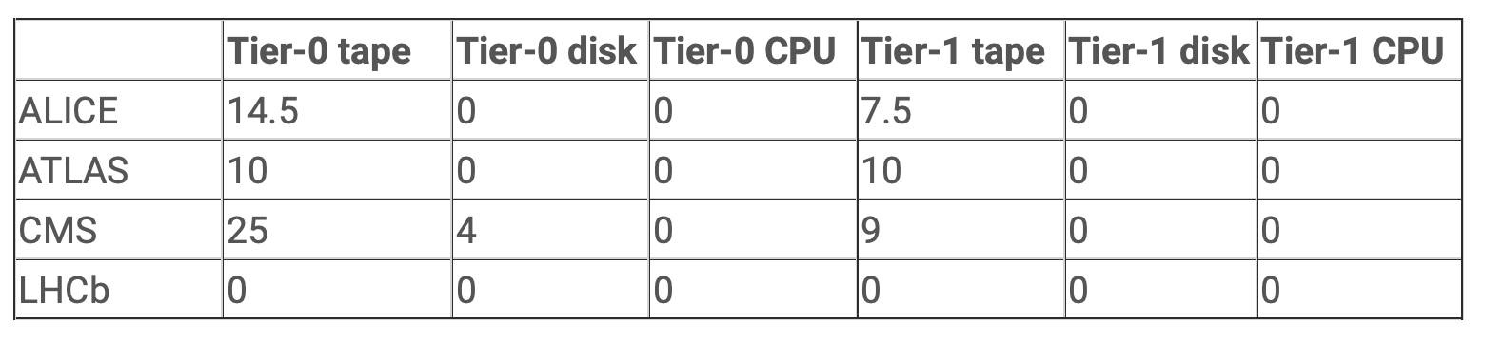
Resources for 2025
In 2025 the LHC experiments will likely need more resources than agreed at Apr 2024 RRB
Tape pledges:
2025 : 2358 PB
2024 : 1875 PB
Tape pledge increase
(2025 – 2024): 483 PB
Extra need 2025: 76 PB
(PB)
Resources needed in addition to Pledge for 2025
The WLCG priority is on ensuring that the experiments can collect and archive data (storage, particularly tape). This might come at the cost of something else (e.g. CPUs and possible disk)
We ask the Funding Agencies to support this extra request: ~50% more physics for 15% more tape
2025 CPU and disk pledges were installed by April 1st : ready to be used (minimal delays)

Slide 8
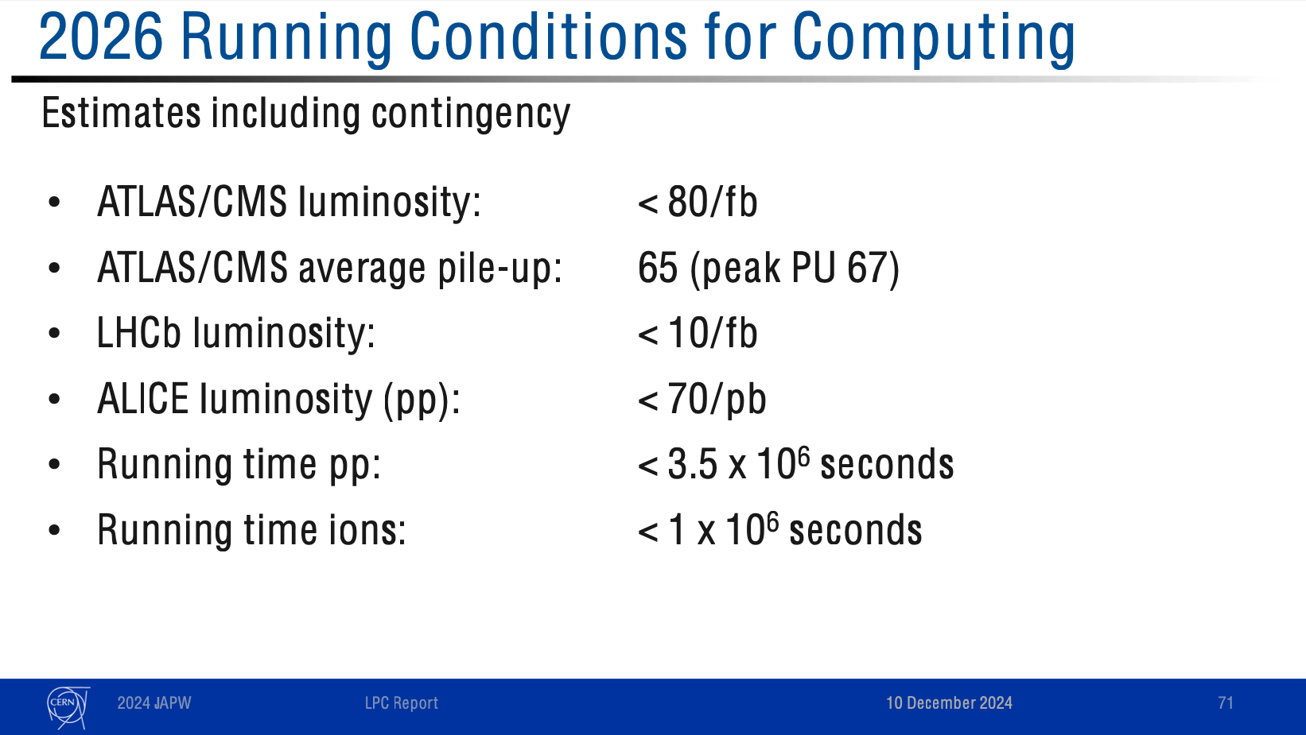
The 2026 Run in practice
We are asking the sites to prepare to deploy very early (~Feb 2026) as the run will start earlier than usual
150 /fb in 2025
15 /fb in 2025
100 /fb in 2025
6.5 M seconds in 2025

Slide 9
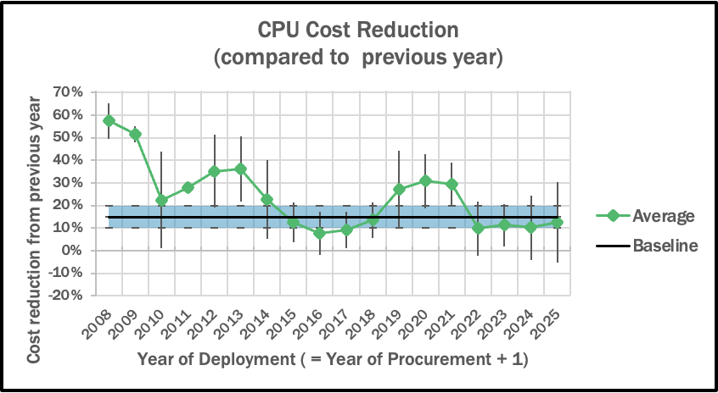
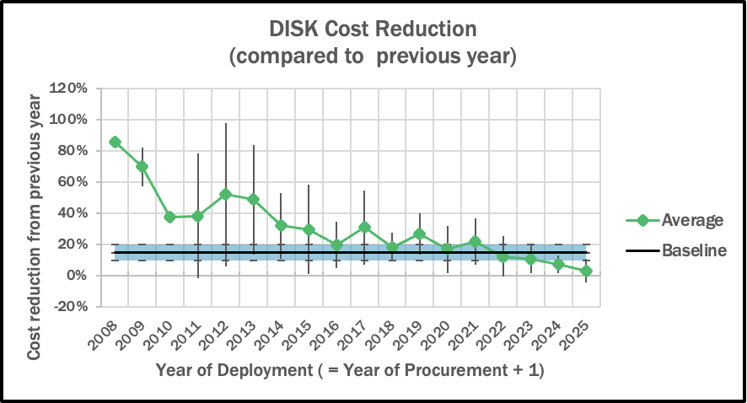
Hardware Cost Trends
The cost of hardware per unit of volume continues reducing for both CPU and disk, but much less than in the past and much less than the baseline expectation (15%/year)
Average cost reduction for CPUs:
last 5 years: 15% - last 3 years: 11% - last year: 13%
Average cost reduction for disk:
last 5 years: 11% - last 3 years: 7% - last year: 3%
Considerable consequences for resources HL-LHC capacity building!

Slide 10
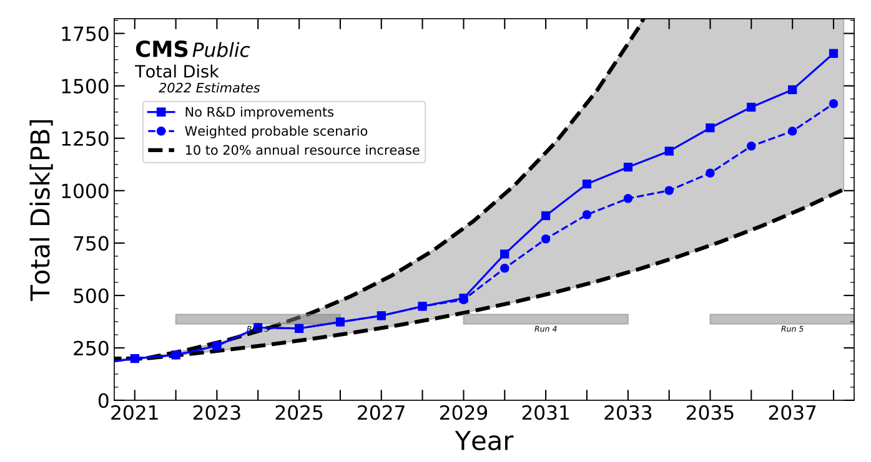
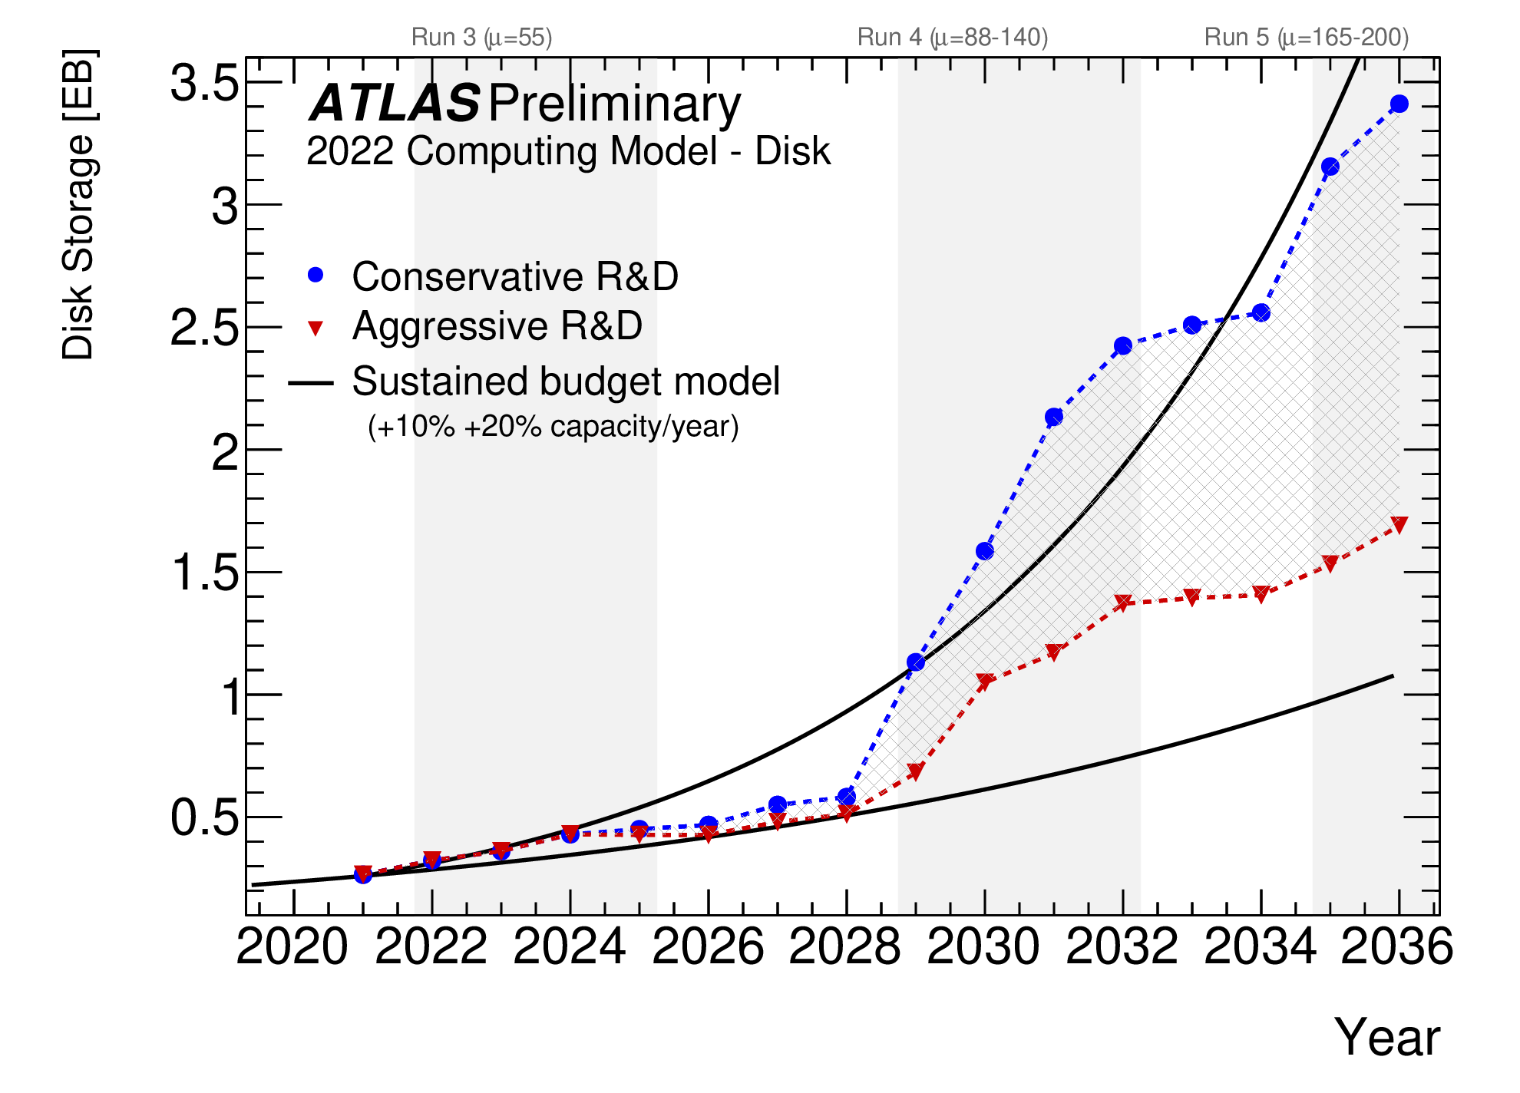
Preparation for HL-LHC
CMS Phase-2 computing model (2022)
ATLAS Phase-2 computing model (2022)
10% cost reduction
10% cost reduction
It is the right time to re-assess the readiness for HL-LHC
Experiments have made progress with various R&D activities
Technology and costing trends changed (less favorable than anticipated)
More experience to leverage from Run-3
ATLAS and CMS are preparing Computing updates (CDRs/TDRs) to be reviewed by the LHCC

Slide 11
WLCG Technical Roadmap
We will present an outline of the WLCG Technical Roadmap at the June 2025 LHCC
This workshop is the opportunity to make progress
This week we will focus on:
DOMA and the preparation for DC27
Infrastructures for HL-LHC physics analyses at scale
Transition from X509 to Tokens
Technical progress in WLCG is adiabatic. We deploy technical improvements gradually in the production environment as early as possible.
Understanding how to facilitate this process, bring early benefits to the sites and feedback to the middleware developers is vital. See Operations and Facilities sessions at this workshop

Slide 12
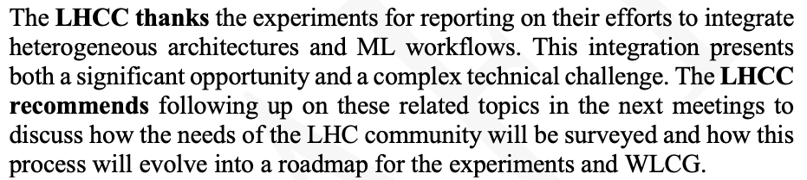
Heterogeneous architectures in WLCG
WLCG sites currently provide non-X86 CPUs (ARM) as part of the pledge (~10k cores for ATLAS)
WLCG has currently NO formal request for other architectures (e.g. GPUs) as part of the pledge
Some WLCG site provide GPU resources beyond their formal WLCG commitments
From the March 2025 LHCC
However, this can change quickly…
E.g. transition of more AI R&D activities into production-ready applications. See here
WLCG needs to prepare for this phase change
=> Discussion starts this week; workshop on Dec 3-5, 2025 (CERN)

Slide 13

Environmental Sustainability
Event Homepage
Some of the workshop outcomes:
1) Benchmarking: include storage and potentially networking, which are significant contributors to energy consumption. Collaboration with experiments will ensure realistic workflows and metrics are integrated
2) Physics per Unit of Energy Metric: define a metric for "physics per consumed unit of energy" and its implications for the evolution of computing models, ensuring alignment with sustainability goals.
3) Facilitating the Adoption of Heterogeneous Architectures: identify ways to support experiments in adopting new technologies, including GPUs and other heterogeneous architectures. This includes access to resources for development, profiling, and validation
This week we should start reviewing the progress in these and other areas

Slide 14

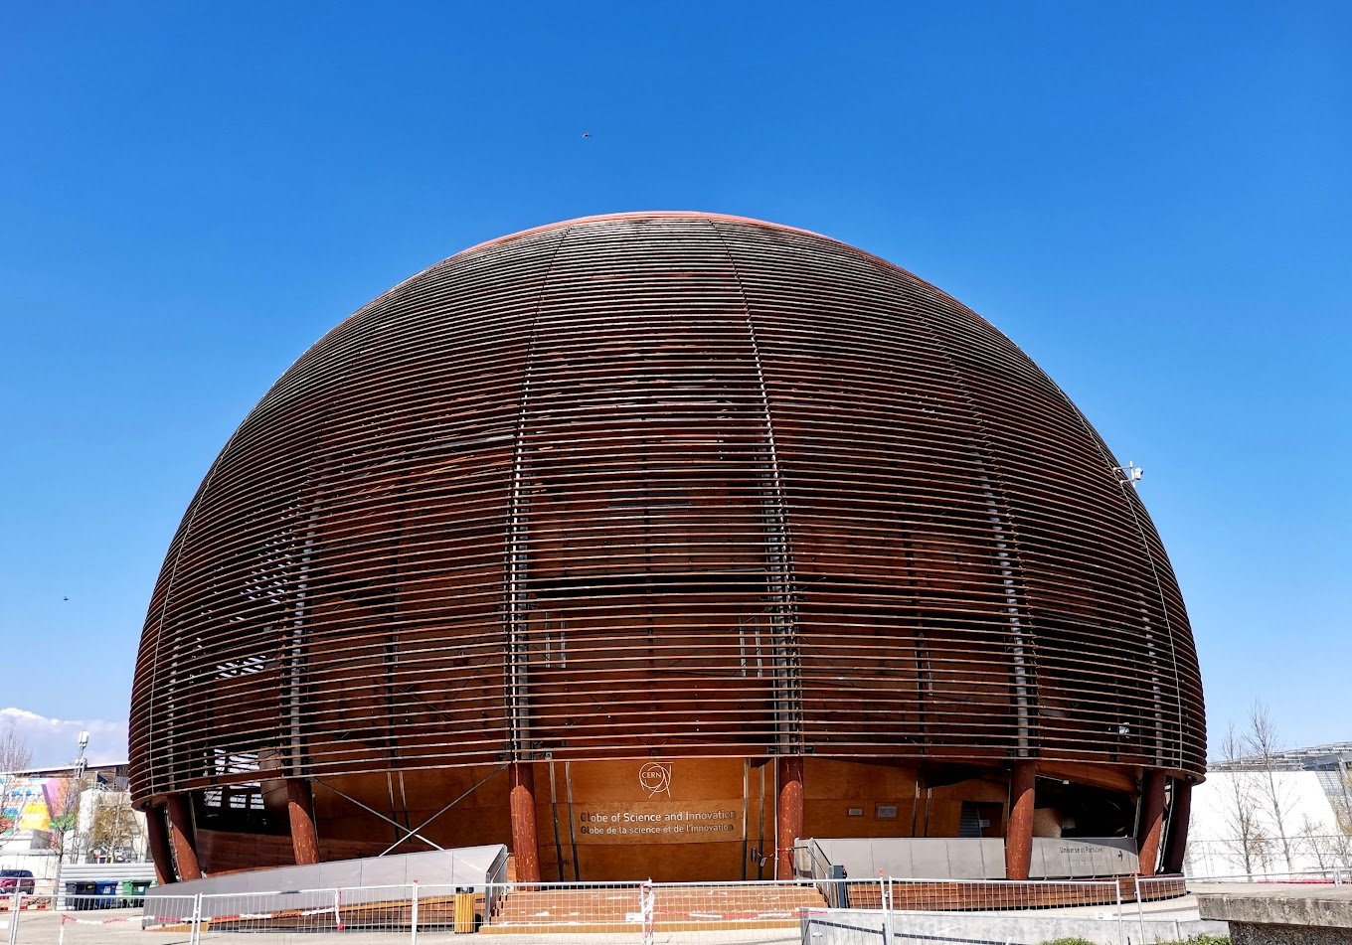
WLCG Events
IJCLab (Paris), 5-9 May 2029 (this week). Homepage
Workshop on “Heterogeneous Architectures in WLCG”, 3-5 Dec 2025 (CERN) Placeholder
The first WLCG MoU was signed on Friday the 9th of December 2005
Next December the WLCG Collaboration will be 20 years old
We will organise an event for the 20th anniversary at CERN on Monday the 8th of December 2025
Planning for a seminar-type event at the Globe

Slide 15
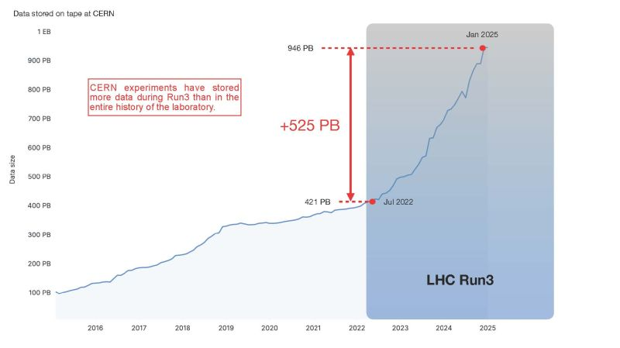
The summary I presented at the RRB
The CERN experiments collected more data during Run-3 than in the rest of the lab’s history
WLCG is supporting an exponential growth in science with flat funding. This is possible because of all the improvements in software, services, computing models
Data stored on tape at CERN
Thanks to the Funding Agencies for ensuring that flat funding (and flexibility), over an extended - and complicated – period
Run-3 will conclude in ~ 1 year
Run-4 preparation will then be the focus

