Slide 1


Accounting of Jobs Submitted with Tokens
Update from the WLCG AuthZ WG & APEL
Tom Dack
Federating Services Group Leader
Scientific Computing, STFC UKRI
Notes:
The abstract pattern can be removed or repositioned if required. Be careful to ‘Send to Back’ so that it does not obscure any important information.

Slide 2
Introduction & Landscape
For jobs submitted with VOMS, the communication of VO for accounting purposes was well understood – and consistent
In a token authenticated world, the process requires some reconsideration
  The WLCG Token profile v1 defines a token issuer per VO, asserting that the issuer token claim can be used to communicate VO
  However, this does not work for all issuers – especially those which serve several communities, such as EGI Check-in
Therefore, the method through which the association between VO and Job can be established needed to be revisited.

Slide 3
ARC CEs
Due to ARC having its own internal accounting, associating tokens and VOs is already implemented, and complete job records are sent directly to APEL.
Two methods to map tokens to jobs are supported in ARC v7:
  The usetokenforvoms option maps token claims directly as VOMS attributes, with use of the wlcg.groups* claim currently supported.
    This option is disabled by default
  The vomsless_vo option supports manual admin-defined maps of tokens to an appropriate VO.
    The token is first mapped to an authgroup through the standard ARC methods, and then the vomsless_vo config is used to assign this authgroup to a VO.
    Manual admin-defined maps in this way is the preferred method
Documentation available in the ARC v7 release notes
* The wlcg.groups token claim conveys group membership about an authenticated end-user, provides functionality similar to that of VOMS extensions in an X.509 proxy.
Notes:
Some security people were not happy to see wlcg.groups used for accounting, because it is less well defined for token issuer the structure of group names
for VOMS it was understood that e.g. all groups for ATLAS VO must start with /atlas, but nothing like this exists for tokens in WLCG profile

Slide 4
HT Condor CEs
HT Condor code currently relies on the presence of x509UserProxyFirstFQAN in the history record of each job
The proposed implementation for HT Condor is one resembling the configuration present in ARC config
Implementation of a flexible expression, which could also work when only a token is present, and establishing VO from token claims
  If present, wlcg.groups can be used
  The union of issuer and subject* claims are expected to be sufficient for most use-cases
* The subject claim indicates the individual or entity a token was originally issued to. The subject (sub) must be locally unique for a specific issuer.
Notes:
some OSG VOs are implemented as sub-VOs of an umbrella VO and for those, the issuer hostname is not sufficient: the subject needs to be taken into account as well.
ARC supports each VO having several auth groups, e.g. one for production, etc.
HTCondor quota groups could be used to imitate what is supported in ARC., or rely on the classed authentication attributes already recorded by HTCondor.

Slide 5

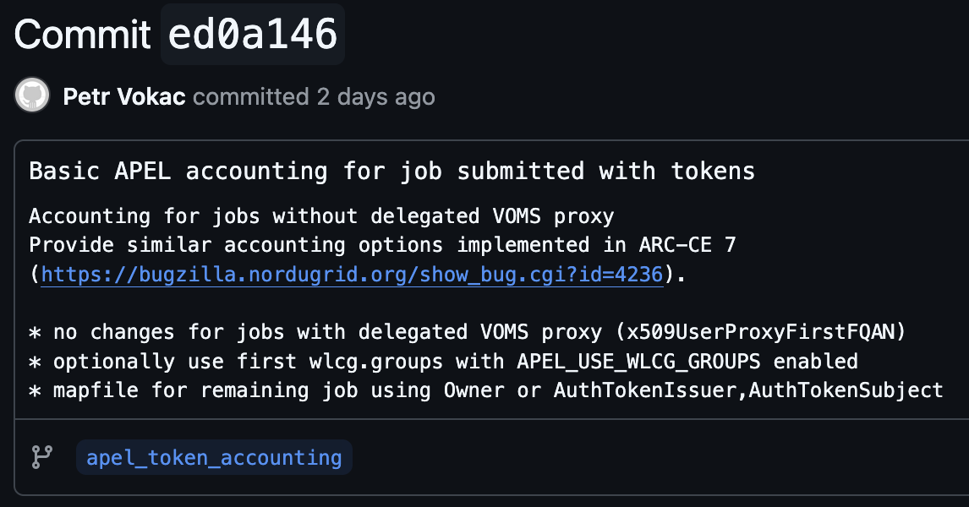
HT Condor CEs cont.
Following the WLCG AuthZ WG meeting on 24/04, and coordination with HT Condor team, a basic implementation of this expression has been prototyped and tested
This enables HTCondor CE to support the same accounting options as the ARC v7
  Currently works only with HTCondor as LRMS
  Similarly to ARC, a mapfile is preferred over wlcg.groups mapping
Petr Vokac, Maarten Litmaath, & Adrian Coveney are coordinating with the HT Condor development team
Notes:
some OSG VOs are implemented as sub-VOs of an umbrella VO and for those, the issuer hostname is not sufficient: the subject needs to be taken into account as well.
ARC supports each VO having several auth groups, e.g. one for production, etc.
HTCondor quota groups could be used to imitate what is supported in ARC., or rely on the classed authentication attributes already recorded by HTCondor.

Slide 6
Conclusions
Token Accounting is closer to being implemented than anticipated two weeks ago
If CEs can be configured to use tokens to map VOs, this avoids significant changes to accounting workflows
  Steps to be taken to verify that alternate clients – such as AUDITOR – can operate in the same manner
Solution for HTCondor CE with Slurm LRMS still to be investigated
It is important to ensure that sufficient information is communicated in tokens
  Of note are workflows where the subject & issuer union may not uniquely identify a VO
  An example is that it is currently impossible to distinguish Femilab jobs submitted for the "small experiment” VOs.
    NoVA, Mu2e, Minerva, ... rely on indistinguishable tokens:
    "sub": "fermilabpilot@fnal.gov",
    "iss": "https://cilogon.org/Fermilab",
Notes:
It seems to me that AUDITOR can't currently deal with HTCondor expressions when extract data from classads, so it'll be necessary to choose slightly different approach. Actually their example config file already assumes existence of VoName classad
https://alu-schumacher.github.io/AUDITOR/latest/#example-config
It is possible to set this variable e.g. in job routing configuration where you could use similar expression to populate VoName classadd, e.g. something like

Slide 7


Notes:
The abstract pattern can be removed or repositioned if required. Be careful to ‘Send to Back’ so that it does not obscure any important information.

Slide 8


sc.stfc.ac.uk
Notes:
The abstract pattern can be removed or repositioned if required. Be careful to ‘Send to Back’ so that it does not obscure any important information.

Slide 9
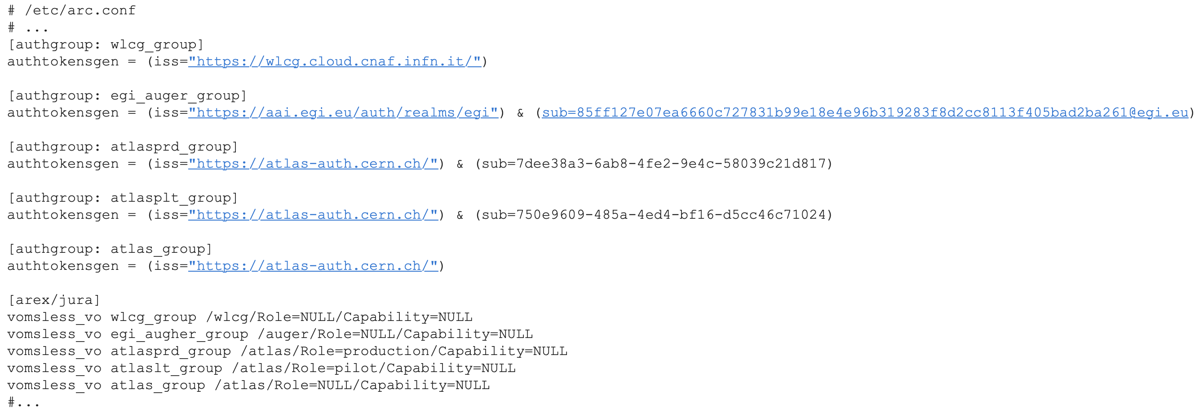
ARC Mapping example
Notes:
It seems to me that AUDITOR can't currently deal with HTCondor expressions when extract data from classads, so it'll be necessary to choose slightly different approach. Actually their example config file already assumes existence of VoName classad
https://alu-schumacher.github.io/AUDITOR/latest/#example-config
It is possible to set this variable e.g. in job routing configuration where you could use similar expression to populate VoName classadd, e.g. something like

Slide 10
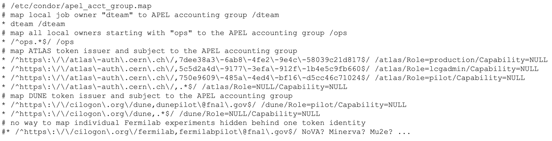
HTCondor-CE+HTCondor Mapping example
Notes:
It seems to me that AUDITOR can't currently deal with HTCondor expressions when extract data from classads, so it'll be necessary to choose slightly different approach. Actually their example config file already assumes existence of VoName classad
https://alu-schumacher.github.io/AUDITOR/latest/#example-config
It is possible to set this variable e.g. in job routing configuration where you could use similar expression to populate VoName classadd, e.g. something like

