Slide 1

A Large Ion Collider Experiment
ALICE Analysis Facilities
L. Betev, M. Litmaath
WLCG/HSF Workshop @ IJCLab Orsay, May 6, 2025

Slide 2
Scope of this presentation
A Large Ion Collider Experiment
Guided by the WLCG referees questions on analysis infrastructure
  Not discussing point 1 (Description of the current Run-3 analysis model) or point 2 (Future analysis model in Run-4 and Run-5) - these are extensively covered in the ALICE upgrade TDR and elsewhere
Focus on point 3 (Managing the evolution of the Analysis Infrastructure)
  ALICE approach to Analysis Facilities
  Operation and future plans
  In the hope this may help and inspire…

Slide 3
Quick recap of ALICE Analysis Facilities
A Large Ion Collider Experiment
Integral part of the ALICE computing model for Run3+
  Bulk of data analysis through organized analysis trains on Grid
  Final steps (histograms) on physicist laptop/workstation
Basic architectural considerations
  Dedicated location with comprehensive data samples from asynchronous and MC data processing at ~10% statistics
  Fast I/O, ~15MB/s/core, total of ~10kcores, ~10PB of storage capacity
    Emphasis on predictability of analysis turnover, especially in pre-conference times
  Leverage existing Grid sites and middleware
  Easy functional expansion for new elements, for example accelerators
Analysis Facility
Fast I/O
SE
CPU,
possibly
GPU
Data copied from Grid sites, requires good network connectivity
Common Grid/AF payload management

Slide 4
AF implementation
A Large Ion Collider Experiment
Identify AF suitable computing facilities
  Enthusiastic local support - highly visible part of the analysis system, downtimes are undesirable
  Adequate internal site structure - fast interconnect between SE and WNs
  Good WAN connectivity for data transfers
  Compatibility with Grid middleware - common workload and data management tools
3 T2s identified for full or partial conversion to AF
  GSI Darmstadt (GreenCube), KFKI Budapest (Wigner Scientific Computing Lab), LBNL Berkeley (HPC systems)
Choice of these T2s is not coincidental
  Full compatibility with architectural requirements for storage, compute size and connectivity
  Already existing centres with proven operational record
  Added bonus - lower energy footprint @ some of the AFs
Grid SEs
Fast WAN
AF
…
SE
CPU
GPU
Grid SEs
Analysis payload
JAliEn
Central Task Queue

Slide 5
AF use case sample
A Large Ion Collider Experiment
Develop and tune analysis algorithms rapidly using a data subset
  Scale the analysis to the full dataset on the Grid using the same software
Perform initial data exploration, detailed QA of processing/MC cycles and low-statistics analysis
Conduct detector calibration
  Leveraging the suitability for specific datasets and the need for fast turnaround
Ensure seamless transition between AF and Grid
  Both run the same O2 code, guaranteed consistent execution across all types of resources

Slide 6

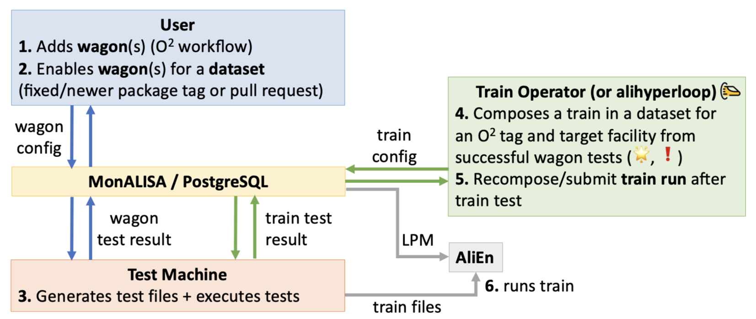
Hyperloop system
A Large Ion Collider Experiment
Facilitates the organisation and execution of all large-scale analysis in ALICE
Fully integrated with JAliEn workload management and MonALISA
Individual physics tasks are organized into wagons
  Wagons are assembled into trains to run over the same dataset (minimize I/O, maximise efficiency)
  Operates on 10% AOD samples using daily builds of O2Physics code, distributed through CVMFS
  Selected analyses run on full data sets across the grid after approval of physics board
Hyperloop offers
  Advanced web interface with user and operator views
  Immediate and automatic wagon test
  Automatic train submission under certain defined conditions
  Wagon and dataset bookkeeping

Slide 7
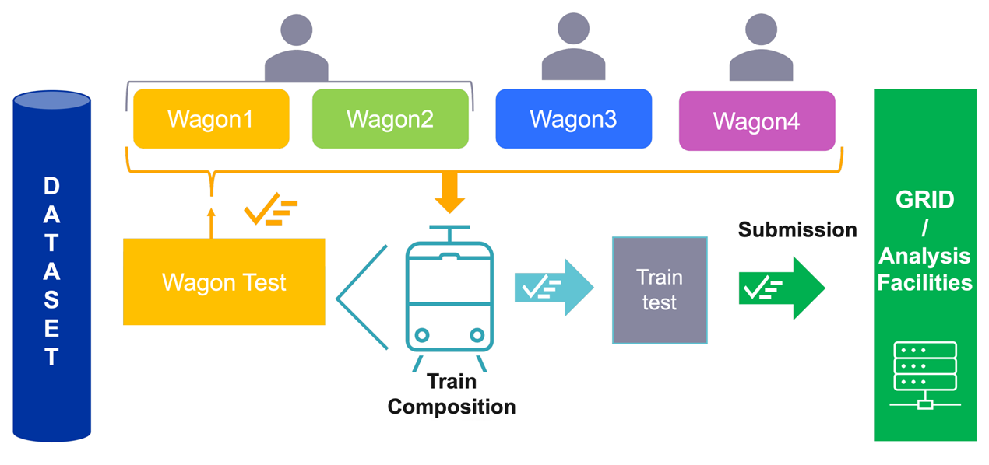
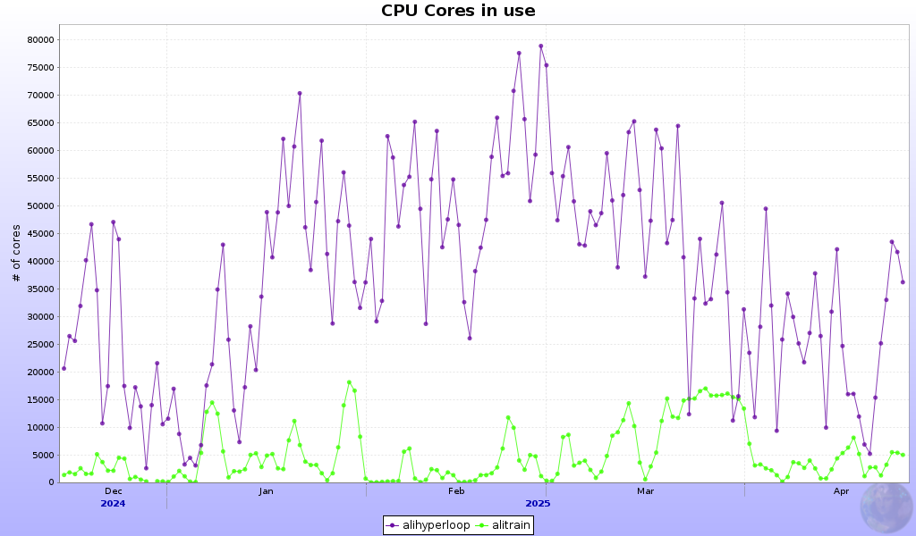
Role of AF
A Large Ion Collider Experiment
Organized analysis runs on Grid or AF, depending on the dataset
  Daily O2Physics builds, trains typically start late afternoon, results ready overnight
  Analysis trains can run at any time, for example those which differ only by applied cuts
Organized analysis core count
Part of the dataset resides on AF storage
Hyperloop runs targeted at AF or Grid

Slide 8
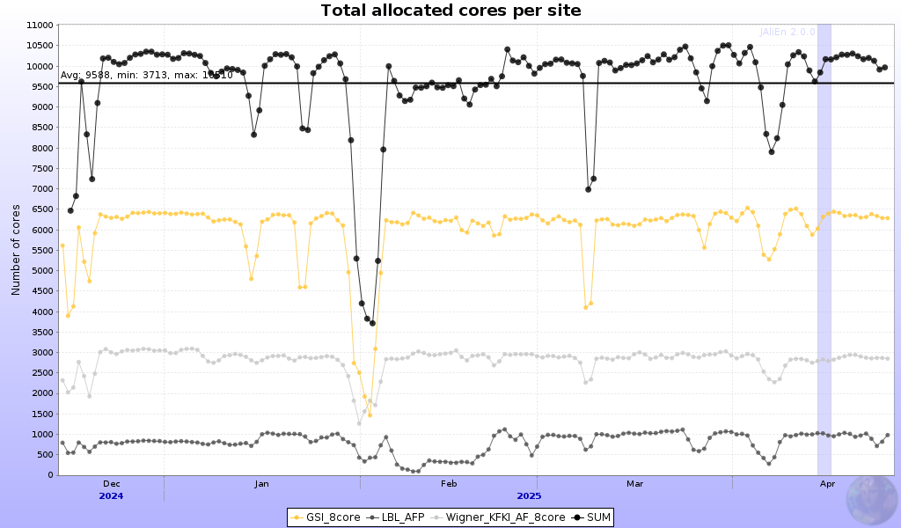
AF operation
A Large Ion Collider Experiment
10k core AF target for Run3
AFs are in operation since 3½ years ago
Execute analysis jobs with priority
  Priority maintained through JAliEn common task queue
  Free resources at AF are backfilled with normal Grid payload
Targeted datasets
  AFs receive specific datasets, depending on availability of space

Slide 9
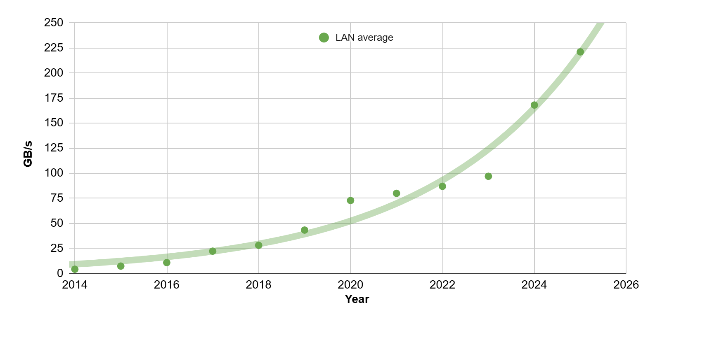
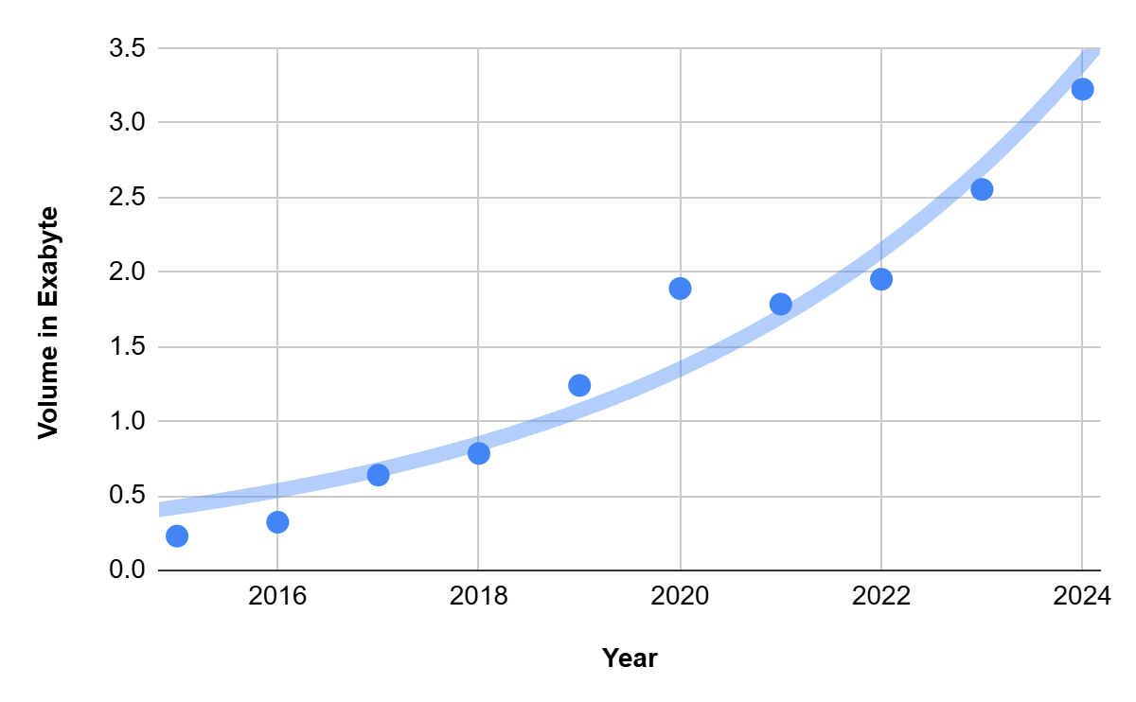
The exponential growth of data access
In 2024, data analysis (AF+GRID) utilizes 20% of the computing resources used by ALICE, corresponding to 480 kHS23.
The analysis input data for 2024 reached 3 EB
LAN traffic has increased ~15x in the past 10 years, exponential growth of volume and rate of read data

Slide 10
Data Model – Connected Tables
Structure-of-arrays instead of previously used array-of-structures
Arrays (columns) - organized in logical Tables, corresponding to physical concepts of Collisions, Tracks etc.
Tables may refer to other Tables through various indexing techniques
Significantly reduced size per collision compared to Run 1/2
Collision system | pp | Pb-Pb | p-Pb
CTF average size per event (kB) | 43.5 | 3203.0 | 128.0
AO2D average size per event (kB) | 5.77 | 290.0 | 17.0
CTF/AO2D reduction factor | 7.5 | 11.0 | 7.5
MC AO2D average size per event (KB) | 34 | 2260 | 88

Slide 11
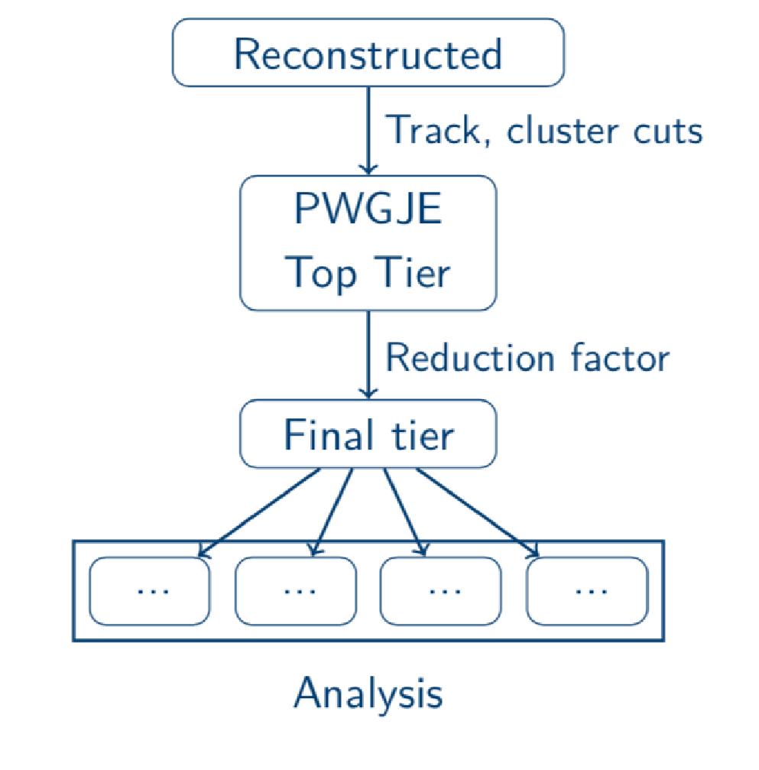
Derived data sets for AF and individual analysers
Some objectives of the derived data set strategy:
  Regulate load and optimize the frequency with which analyzers can access grid resources
  Allow for the possibility of meaningful local analyses
Tiered Skimming Approach
  Multi-tiered datasets, lowest tiers are reduced to the needs of individual analysers
Target and adoption:
  Requirement: reduction in data read load by a factor of 100x or more, similar for CPU wall time - applicable only for specific analyses
  The adoption of derived datasets is steadily increasing - over a third of the trains running on these

Slide 12
Challenges and future work
A Large Ion Collider Experiment
Data management per AF
  Current dataset placement relies solely on space availability
    This may result in unnecessary data movement over long distances
  Implement a data proximity/throughput based system to optimize AF storage transfers
  Develop a popularity service for automatic dataset removal
  Explore and experiment with new storage technologies (if available)
  Wider adoption of tiered datasets
Consider the use of alternative resources
  Install GPUs at one of the AF farms (Wigner) to gain user experience
  Leverage existing payload matching/container systems
Hyperloop development
  Organized analysis is tightly coupled with AF usage
  Maintain continuous development to incorporate new use cases, improve the control system

