Slide 1
Storage relocation
INFN-CNAF experience

Slide 2
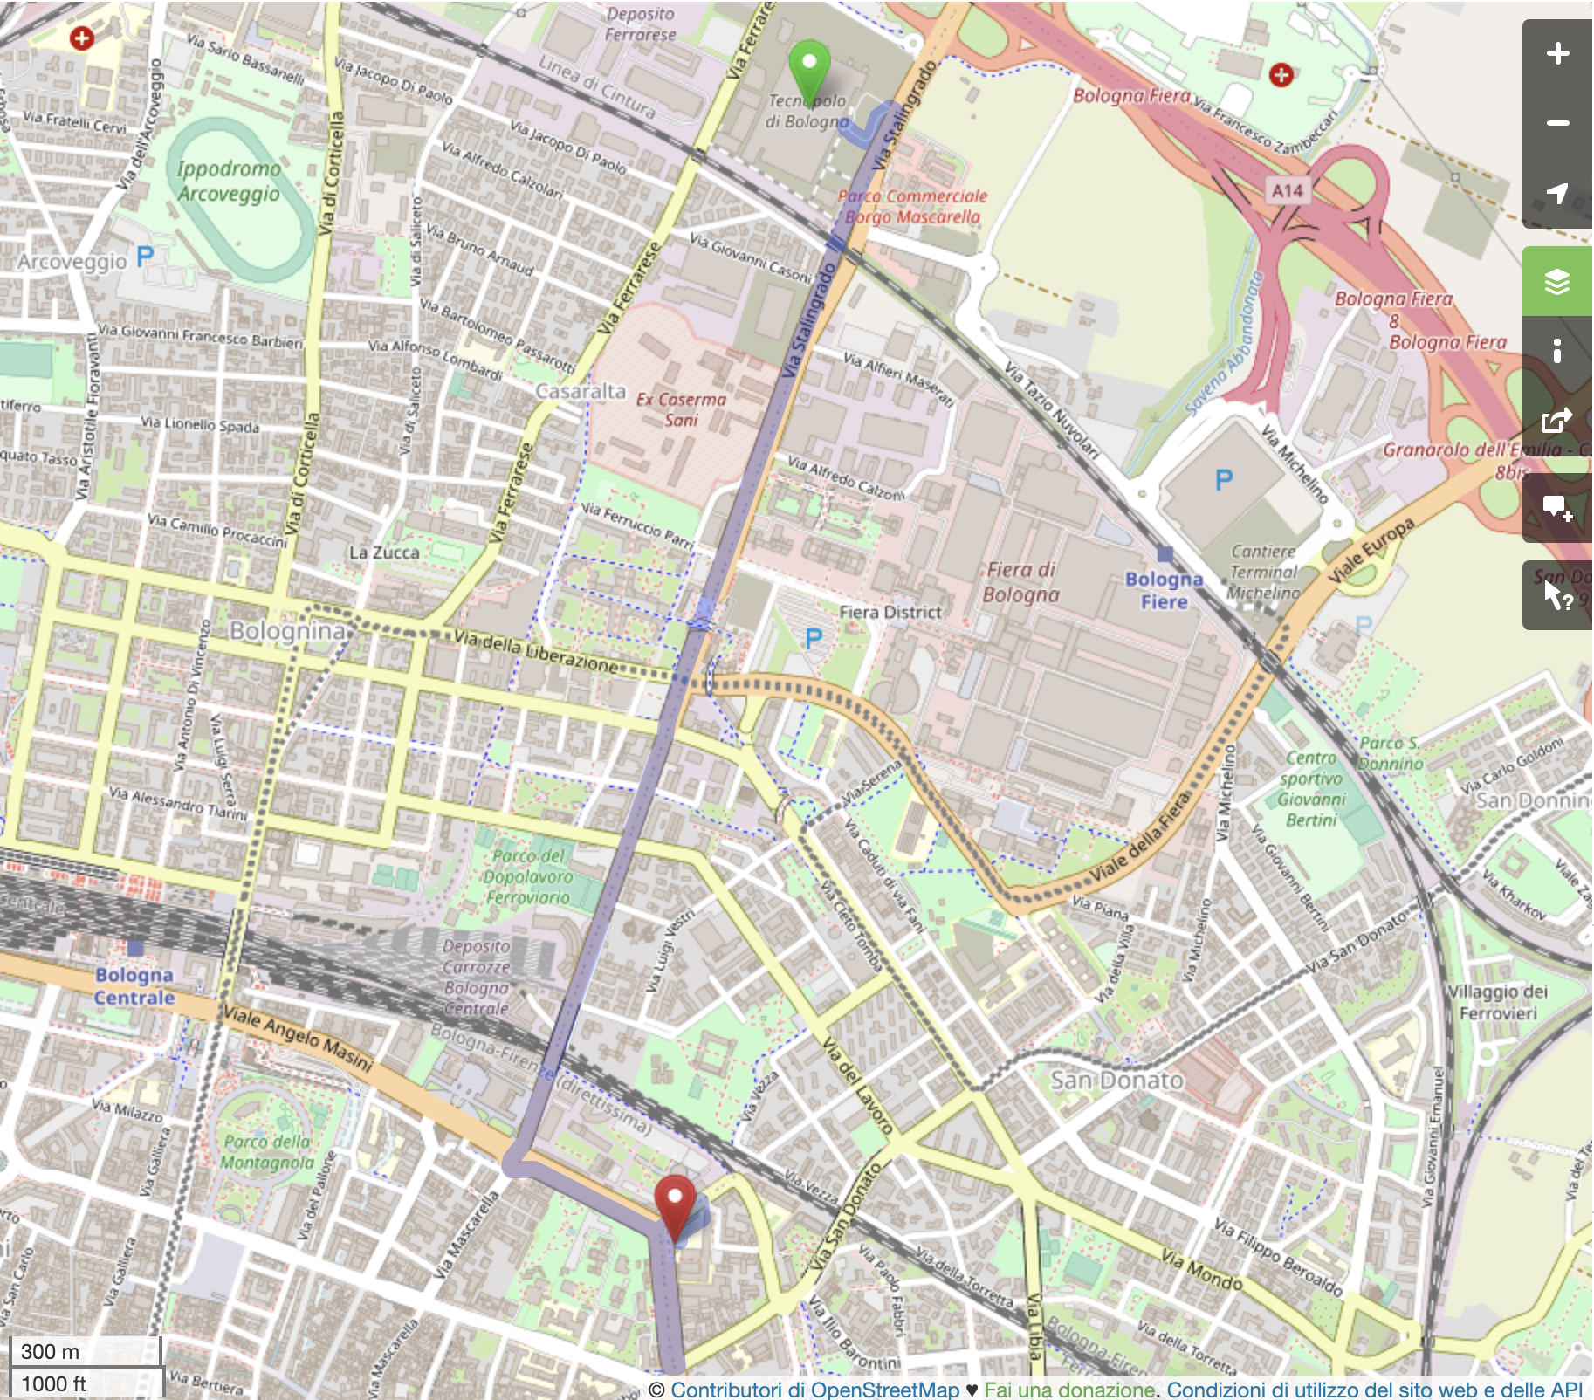

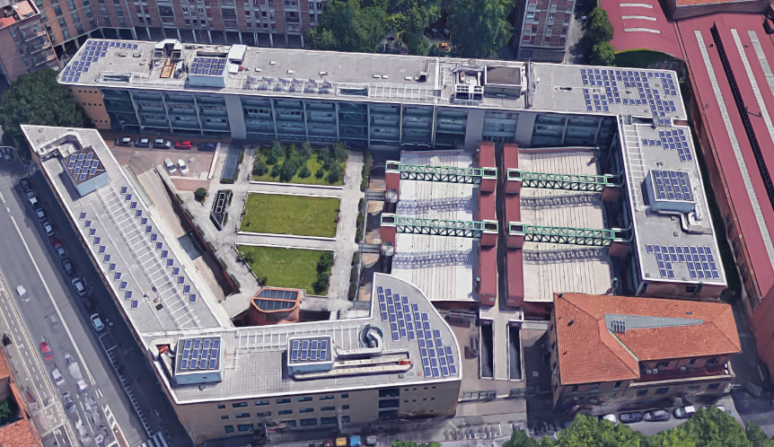


The new INFN-CNAF Data Center at Bologna Tecnopolo
To be able to operate on two different locations using the same servers we established Long Range FC link (7Km) using Dark Fibers
FC switch: Brocade G620
  32Gb/s FC LWL 10 km SFP+
~ 4km

Slide 3
Storage relocation: overview and goal
Make the storage relocation as transparent as possible for end users
Storage resources at source to relocate:
  Disks
  Tapes
    On two tape libraries:
    SL8500 - 80PB installed, 50PB USED
    TS4500 - 102PB
  Data Management and Gateway servers
    12 StoRM WebDAV, 24 XrootD and 5 HSM servers

Slide 4
Disk-based-storage relocation: the strategy
Disk storage resources before relocation
Delay in planned purchase until new site is ready (power and network fully functioning)
Install new equipment at the new site
Migrate data using GPFS functionality:
  add new disks to existing FS;
  migrate the data (without interruption in data access);
  remove old disks
Dismiss the end-of-life systems
Empty, disassemble and relocate the more recent system, then reassemble and re-initialize by the vendors
Model | Net capacity, TB | End of support
Huawei OS5800v5 | 8999 | 2027
DDN SFA 7990 | 5840 | 2025
DDN SFA 2000NV (NVMe) | 24 | 2025
Huawei OS6800v3 | 3400 | 07/2024
DDN SFA12k | 10120 | 12/2022
Dell MD3860f | 2308 | 12/2024
Dell MD3820f | 50 | 11/2023
Huawei OS18000v5 | 6520 | 7/2024

Slide 5
The strategy for disk-based-storage relocation: what happened in reality
Delays in infrastructure readiness: delivery, installation and testing of new storage systems (64PB) was done with great hurry from mid of June to mid of July 2024
For acceptance tests, we filled the storage with synthetic data up to the 50% of the available space. At that point the storage showed very good performance, even higher than requested (3.5MB/s/TB)
On July 17th, the first 6 (out of 8) storage systems were put into PROD for starting data migration of ATLAS, ALICE and LHCb
  Average rate of data migration was in 10-20 GB/s range for each exp

Slide 6
The strategy for disk-based-storage relocation: what happened in reality (2)
At the same time LHCb started (very) data-intensive analysis which saturated capabilities of storage systems
As result - in accordance with LHCb - we declared two weeks of downtime for LHCb to complete data migration
By the end of data migration - when almost 95% of available space on new storage was filled up - we observed a huge drop in performance (down to 20-30% of measured during acceptance tests)
The vendor was called in for troubleshooting and it turned out that the
storage system works only in “Thin Provisioning” mode

Slide 7
How thin provisioning works
All new writes go to not-yet-used blocks:
when a file is deleted, the corresponding file system block is marked as “freeable”, but for storage system it is still “in use”
To free up space from deleted data, an admin needs to run the "reclaim space" procedure, followed by invoking the "garbage collector"
This leads to the write amplification phenomenon

Slide 8
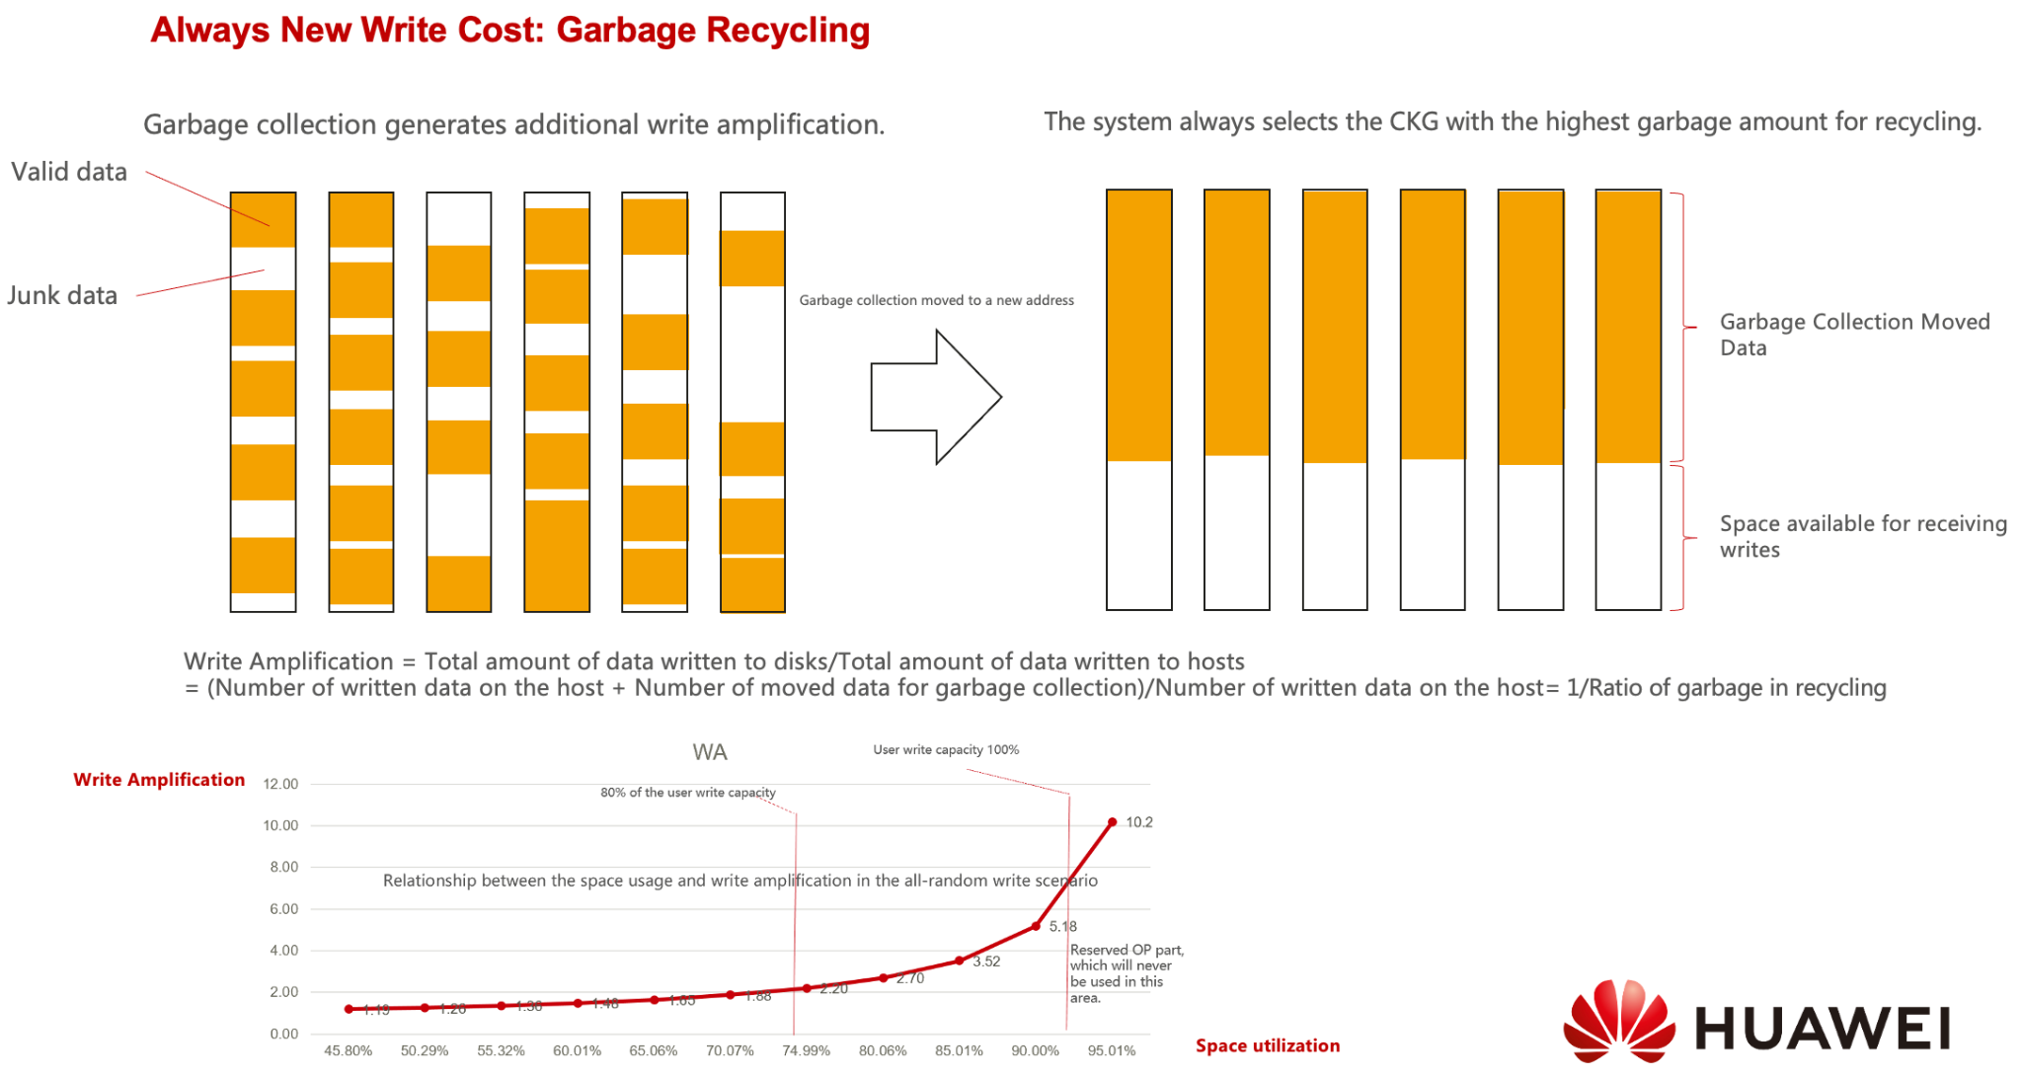
Write amplification in Thin Provisioned systems
Taken from a private communication with the vendor

Slide 9
Solutions proposed by the vendor
Enable support for “Thin Provisioning” at the file system level
Do not use more than 90% of the “usable space”

Slide 10
Enable support for “Thin Provisioning” at the file system level
Currently our file system does not support thin provisioning functionality
Drawback of enabling support for “Thin Provisioning”:
  Necessary to re-format all the disks → move all data
  It involves significant performance degradation, as the "space reclamation" procedure that writes zeros to the space to be freed (which creates traffic and takes a significant amount of time)
  It requires having approximately 5% reserved space (not accessible to users) [1]
  Supported only on certified hardware (IBM flash)

Slide 11
Reduce storage allocation to 90% of “usable space”
Storage
System 01
880 HDDs
16 disk pools
DiskPool_01
DiskPool_02
Disk pool
55 HDDs
(604TB)
100% allocated
LUN01
151TB
Disk pool
55 HDDs
(544TB)
90% allocated
LUN01
151TB
DiskPool_03
DiskPool_04
LUN02
151TB
LUN02
151TB
DiskPool_05
LUN03
151TB
LUN03
151TB
DiskPool_06
DiskPool_07
LUN04
151TB
LUN04
90TB
…
reserv 60 TB
Reserved space
DiskPool_16
Redefinition of all the storage pools to reserve 10% of disk space:
16x151TB=2.4PB for each of 8 storage systems
We moved ~15PB of data

Slide 12
Tape-based-storage relocation: the strategy
Install a new tape library (IBM TS4500) at the new location and connect it via Long Distance FC link to the servers at the old location
Switch production (writing) to the new library, disassemble and move one of the two old libraries (the other IBM TS4500) to the new location (one-week downtime for tape data access)
Do repack from SL8500 to TS4500 to complete data migration via LD FC link within 12 months
  Bandwidth 2x32Gbit/s (~ 7GB/s)
  Migration rate limited by number of tape drives in new library and max transfer rate of old tape drives (250MB/s), so that with 8 tape drives dedicated to data migration we could do 2GB/s, thus moving 50PB of data in ~12 months
  Of course, stop writing on SL8500

Slide 13
The strategy for tape-based-storage relocation: what happened in reality
Because of delay in procurement (no new tapes available on the new IBM TS4500) we had to stop repack and begin to write data again to SL8500, postponing the SL8500 decommissioning to the end of 2025 at least
Also, unexpectedly we were asked to free up space occupied by the tape libraries by the end of Jan 2025
Thus, we were forced to relocate SL8500 to Tecnopolo as well

Slide 14

Relocating tape library (twice)
Declared 1 week of downtime in tape data access, but the process of relocation took a little more than one week for a library
  Unload tapes from library - 1 day
  Disassemble library - 1 day
  Transportation - 1 day
  Re-assembly and cable tape drives - 1 day
  Realignment of library and reloade tapes - 1 day
  After-relocation troubleshoot - 2 days
    Some issues with FC cabling, tape drives, robotics
Relocation and reconfiguration of tape servers have been done in parallel with the tape libraries movement

Slide 15
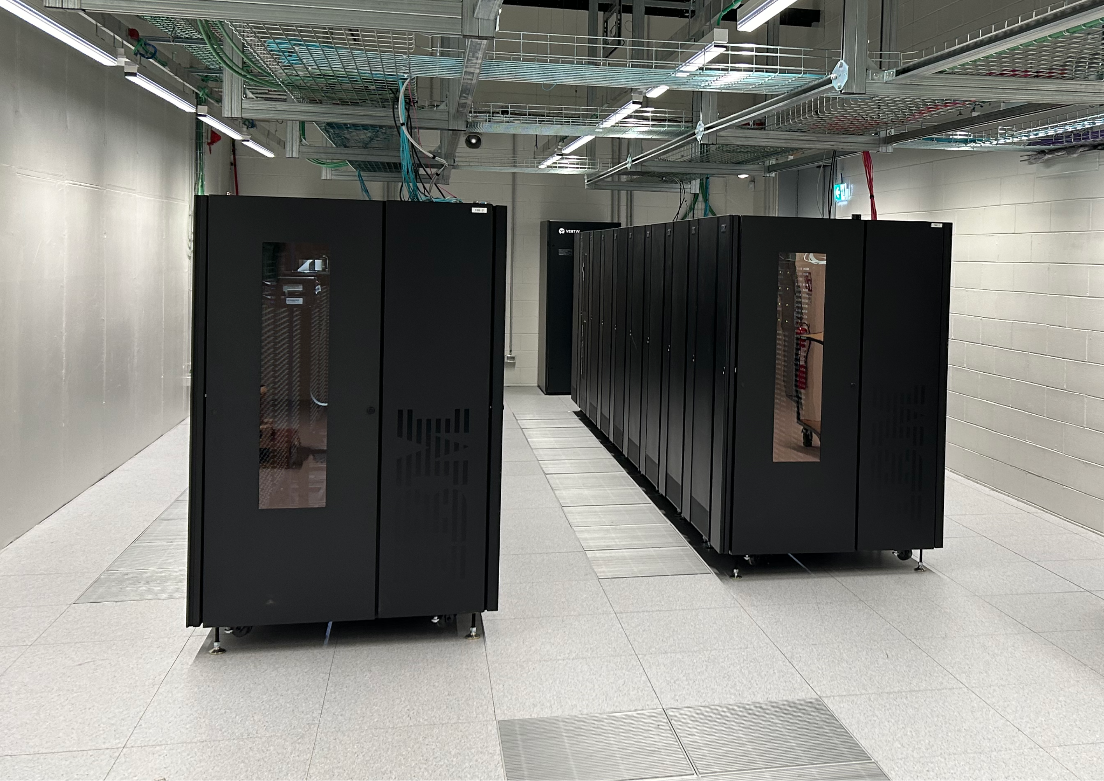
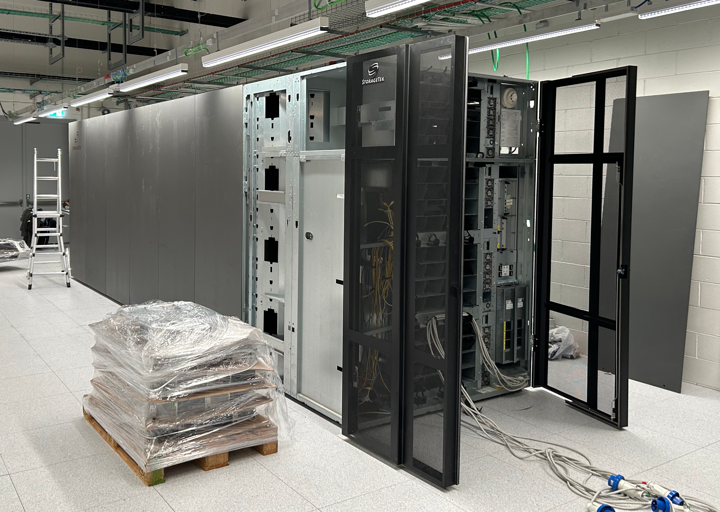
Relocating tape libraries

Slide 16
Setting up a metropolitan SAN
Site1
Site2
LAN
LAN
600 Gb
HSM
HSM
HSM
HSM
HSM
HSM
nsd
HSM
HSM
HSM
HSM
SAN
SAN
2x32 Gb
buffer
buffer
buffer
buffer
Notes:
Extending LAN between two sites
Installing new storage (disk+nsd servers) HW at site2
Installing SAN infrastructure (FC switches) at site2
Establishing Long Distance FC link (2x32Gb, <10Km, over dark fiber) between two sites
Installing new HSM servers at site2 and connecting them to tape drives at site1
Installing new tape library at site2
Switching off all HSM servers at site1
Moving IBM lib1 to site2

Slide 17
Relocation of data management servers
Thanks to the unified network infrastructure over the two sites, the new servers at the new facility can access the file systems at both the locations
We only needed to install the servers and put them in production by using the hostname alias used by the experiments

Slide 18
Lessons learned
Avoid “Thin Provisioned” storage systems for multi-PB and frequent rewriting use cases
  Need to better check storage system performance at the higher level of occupancy during acceptance test
  As an option: procure and keep as “reserved” at least 10% of disk space respect to the pledged space
Remote location for tape infrastructure (<10km) is not a problem at all
  Streaming data is not affected by a slightly higher latency
  It may be an advantage to keep tape infrastructure on a different location also considering different environment requirements for tapes and CPU/disks

Slide 19
Thanks

Slide 20
References
https://www.ibm.com/docs/en/storage-scale/5.1.8?topic=devices-storage-scale-thin-provisioned
https://www.dell.com/support/kbdoc/it-it/000123351/powerstore-alerts-capacity-utilization?lang=en
https://docs.netapp.com/us-en/active-iq-unified-manager-97/online-help/concept-what-performance-capacity-used-is.html
https://indico.cern.ch/event/1225131/contributions/5587454/attachments/2747666/4781495/StoRM%20Tape%20status%20-%20PreGDB%202023-11-07.pdf

