Slide 1

Computing Technology, Capacity Increase and Flat Budget Scenario
Andrea Sciabà
WLCG/HSF Workshop 2025 at IJCLab (Orsay, France), May 5-9, 2025

Slide 2
Outline
Introduction
Semiconductor industry
  Processing units: CPUs and GPUs
  Memory technology
Storage technologies
  Flash storage
  Disk storage
  Tape storage
Prospects for capacity increase
Conclusions

Slide 3
Introduction
WLCG computing is simple!
  Just as many CPU cores as possible, disk and tape to store the data, and fast enough WAN
  No need for fast interconnects or fast/lots of memory, very limited need for GPUs (so far)
Our needs are diverging from the state-of-the-art
  We just need lots of cheap resources!
  The downside is that our influence is diminishing compared to other realities
Our needs are known many years in advance (see Ben’s talk)
  Much easier to plan for purchases
The budget is “flat”
  This assumption worked so far
Still, it is very important to be aware of where technology is going
  Cost forecast more difficult than ever!
  GenAI and geopolitical instability may disrupt our plans

Slide 4
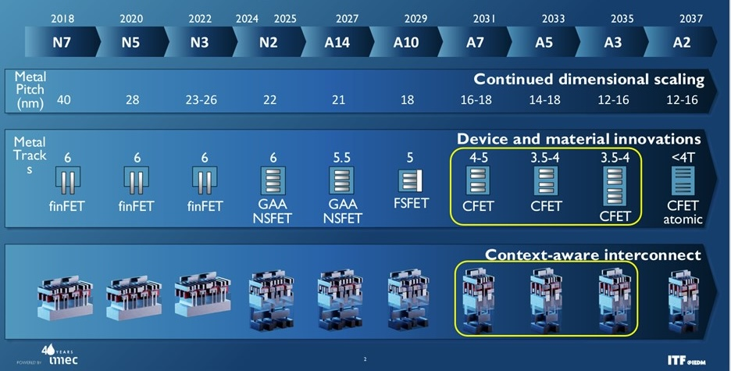
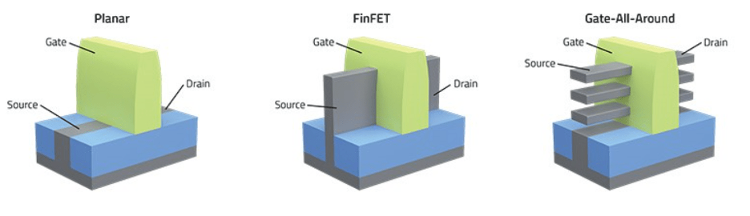
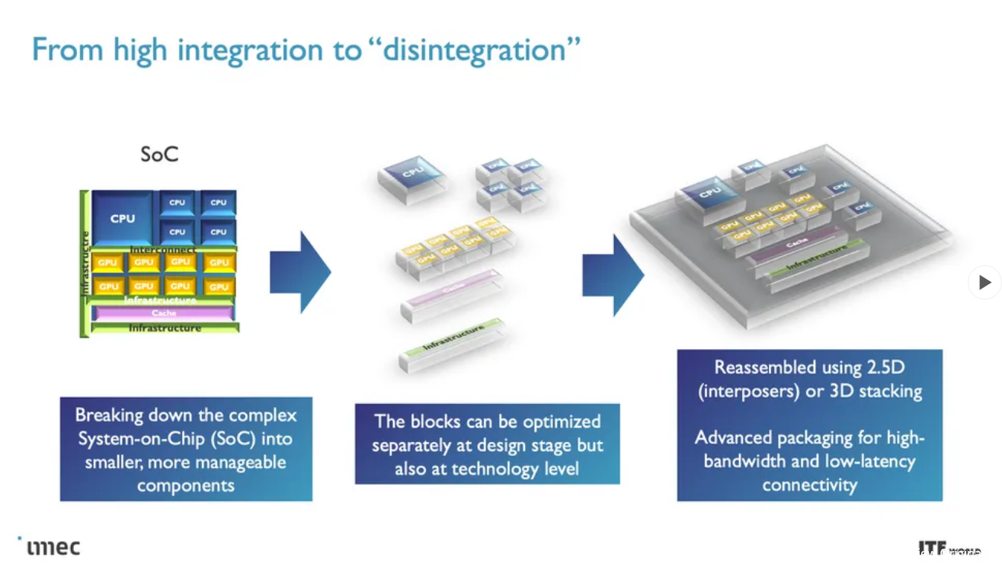
Fabrication processes
Roadmap until 2036 (“More Moore”)
  Transition from FinFET transistors to GAA nanosheet designs for N2 and beyond (“Angstrom era”) is ongoing
    Less leakage, faster transistor switching
    Near to volume production
    A16 will ramp up in the second half of 2026
  CFET transistors the next big thing, from 2031
Chiplet architectures (“More than Moore”)
  3D packaging used to compensate for the slower transistor shrinking
  Voltages are not decreasing any more
Semiconductor technical advances focus on materials, rather than lithography
  E.g. 2D materials to replace silicon transistor channels
Photonic Integrated Circuits (PIC)
  Would improve reliability and reduce power consumption and packaging costs
  Still not viable due to difficulties in material growth

Slide 5
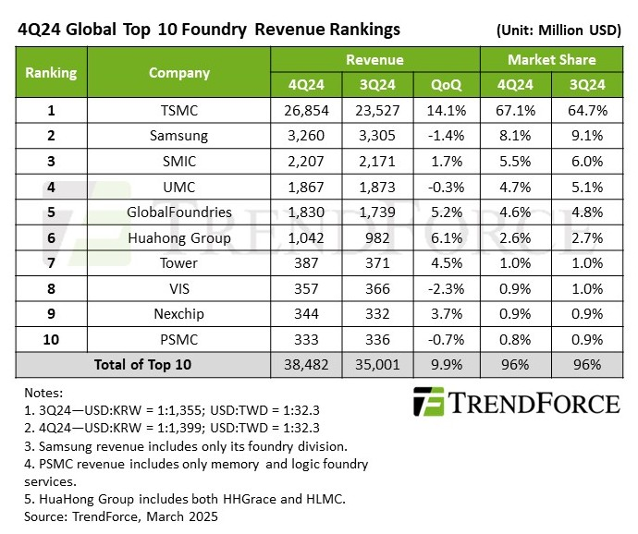
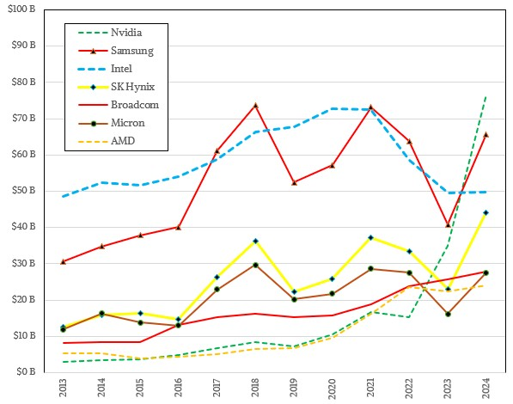
Semiconductor industry trends
TSMC dominates the market, 65% share
  Samsung comes second with 9%, Intel not even visible in the table (214 M$ in Q3 2024)
Nvidia dominates among the chip designing companies
  Increasing revenues for all of them apart Intel
Numbers should increase in the next years due to the GenAI boom, but many uncertainties
  Will AI keep using GPUs or shift to dedicated (and cheaper) hardware?
  What will be the effect of tariff wars?
    TSMC investing 165 G$ to build six fabs in Arizona!
    Nvidia trying to have everything they need made in the US
    Current USA-China tariffs estimated to shrink semiconductor market by 34% in 2026

Slide 6
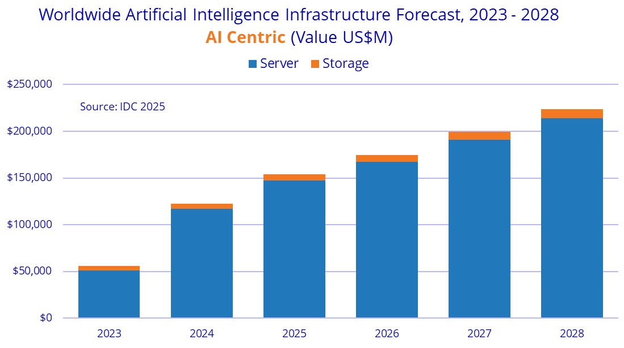
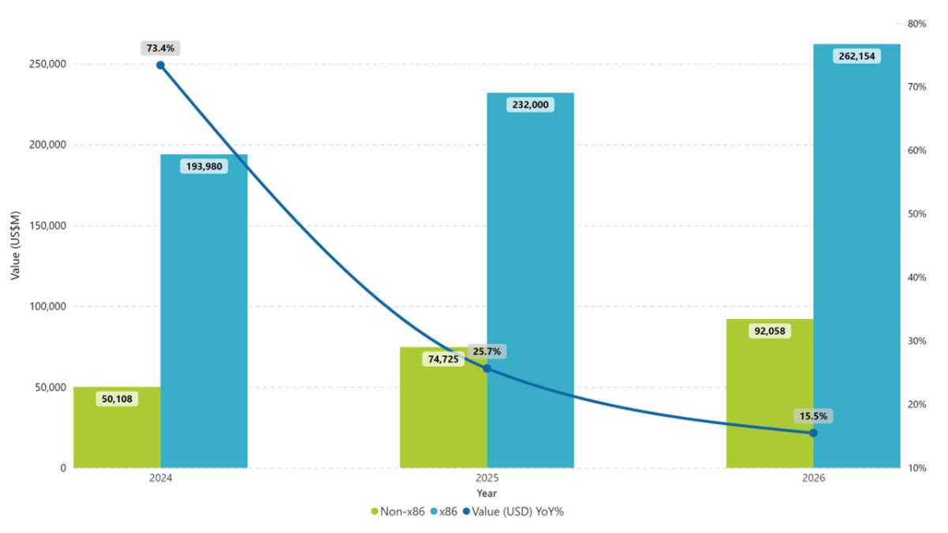
Server market
AI servers represent a rapidly increasing fraction of total servers delivered
  But only small margins for integrators, (~5%, typical for HPC hardware), while Nvidia, memory & flash makers make the highest profits
  Traditional servers (e.g. for databases) provide higher margins
Hyperscalers and cloud providers drive hardware market growth
  Efficiency gains will not harm growth (Jevons paradox)

Slide 7
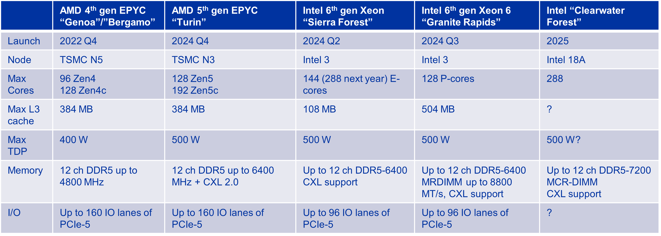
CPU processing
X86 market split between Intel and AMD
  AMD reached 25% share and increasing
Core count (and maximum power) keep increasing
  Air cooling becomes problematic
  Choice of SKUs heavily dependent on both price and power envelope
Performance increasing at a healthy rate
  ~ 15% IPC between generations
  More PCIe channels and memory bandwidth
  Better power efficiency
ARM should become fully viable for WLCG during 2025
  Very interesting price and power efficiency
  But only one vendor, Ampere, as Nvidia CPUs are still too expensive, and Ampere’s future priorities are unclear
  Fujitsu might also play a role

Slide 8
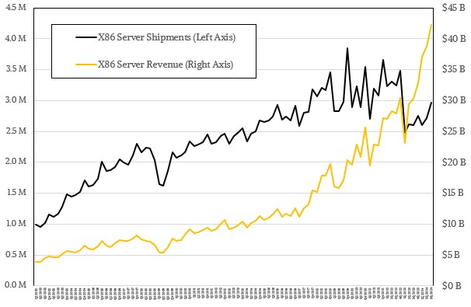
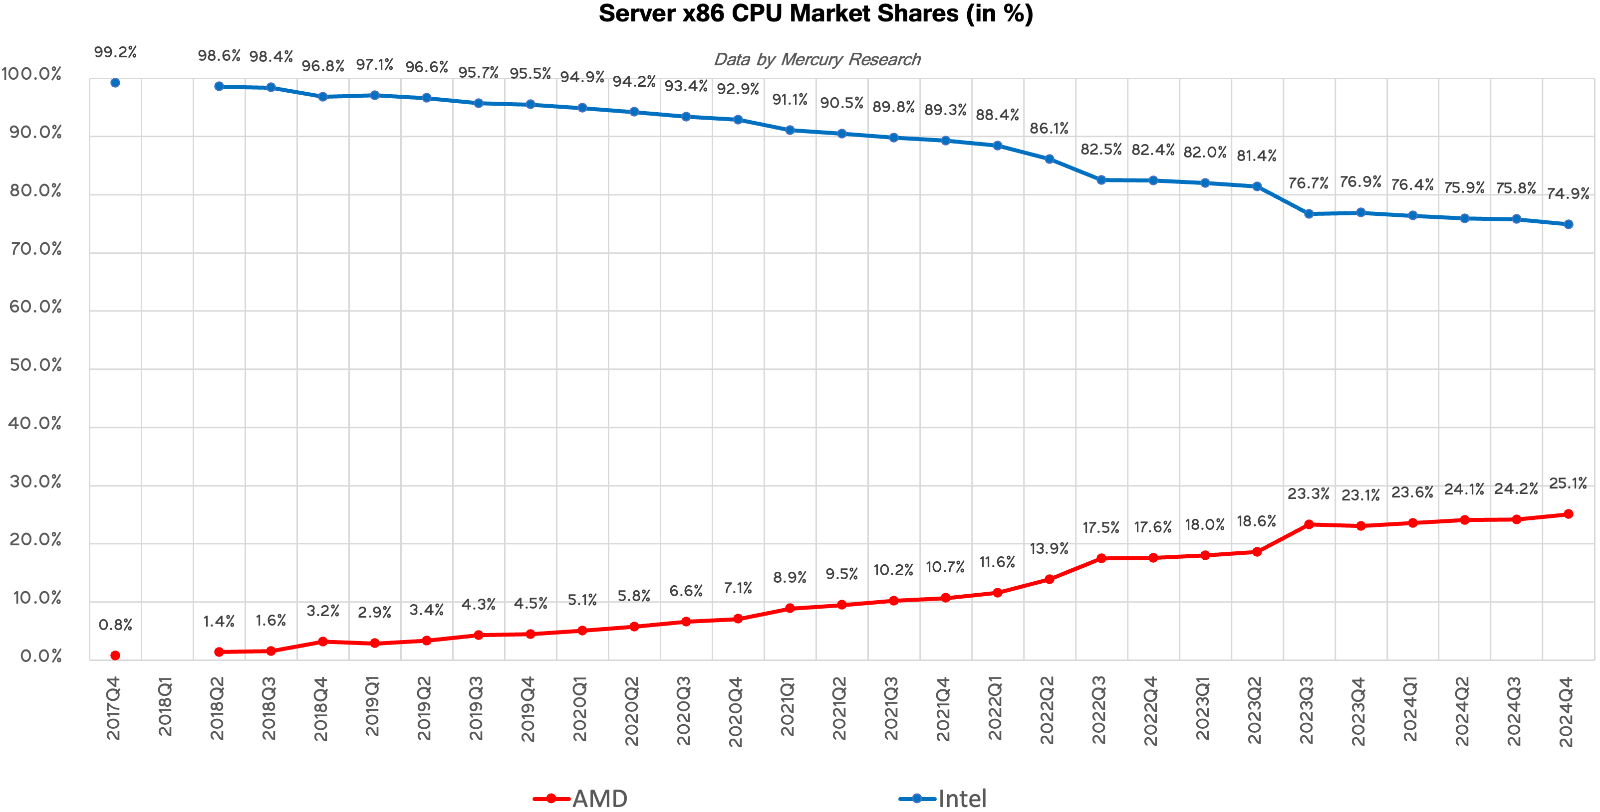
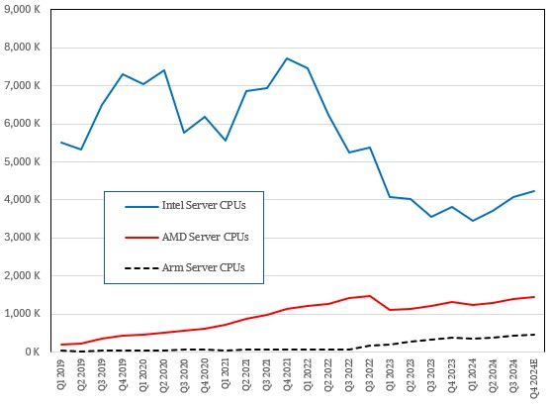
CPU server market
X86 server shipments and revenues increasing again
  Both for AMD and Intel
  Big drop in shipments was due to the GenAI boom, which made servers more expensive
Arm is increasing due to the much lower server operational costs
  Ampere bought by Softbank, future (for us) not clear
RISC-V also gaining some traction
  Much cheaper than ARM (no licensing costs)
  Popular in China and in Europe for HPC
  E.g. Meta designing a RISC-V AI chip for training to reduce reliance on Nvidia
25% AMD

Slide 9
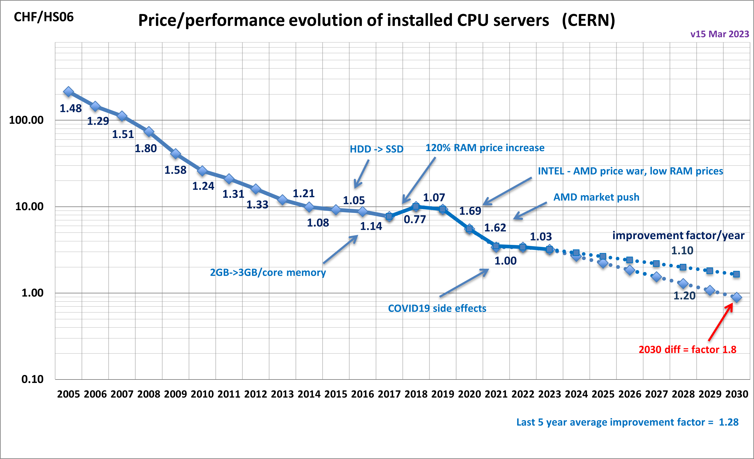
CPU cost
CPU price decrease rate relatively stable over time
AMD becoming again competitive gave a boost
Stagnant recently
  Waiting to see the 2025 purchase prices to update the plot ☺
Questions:
  Is Intel going to be competitive again?
  When (if) will Arm start having an impact? Or RISC-V?
  When (if) will GPUs will make CPUs less relevant?
Source: B. Panzer-Steindel

Slide 10
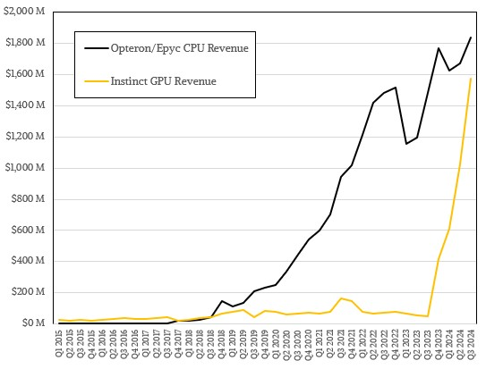
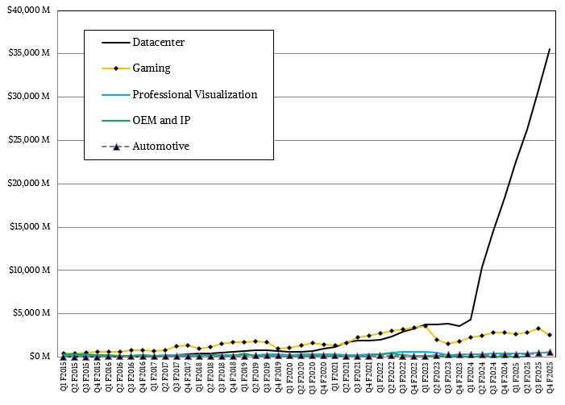
GPU processing
AMD revenues
The market most impacted by the GenAI frenzy
  Nvidia dominates and imposes huge margins
  AMD doing better and better, GPU revenues as high as CPU ones
Nvidia’s roadmap to 2028 very aggressive
  2024: Blackwell (B100/B200)
  2025: Blackwell Ultra (B300): 288 GB of HBM3e
  2026: Rubin (R100): 288 GB of HBM4, 50 PFLOPS of FP4
  2027: Rubin Ultra: 1 TB of HBM4, 100 PFLOPS of FP4
  2028: Feynman
AMD roadmap also plans a new product every year
  2024: MI325X, 288 GB of HBM3e, CDNA 3
  2025: MI350, adds FP4, CDNA 4
  2026: MI400, “CDNA next”
Unfortunately, no interest in improving FP32/64 performance
  We do not yet know how (much) we will be using GPUs in 5 years from now
Nvidia revenues

Slide 11
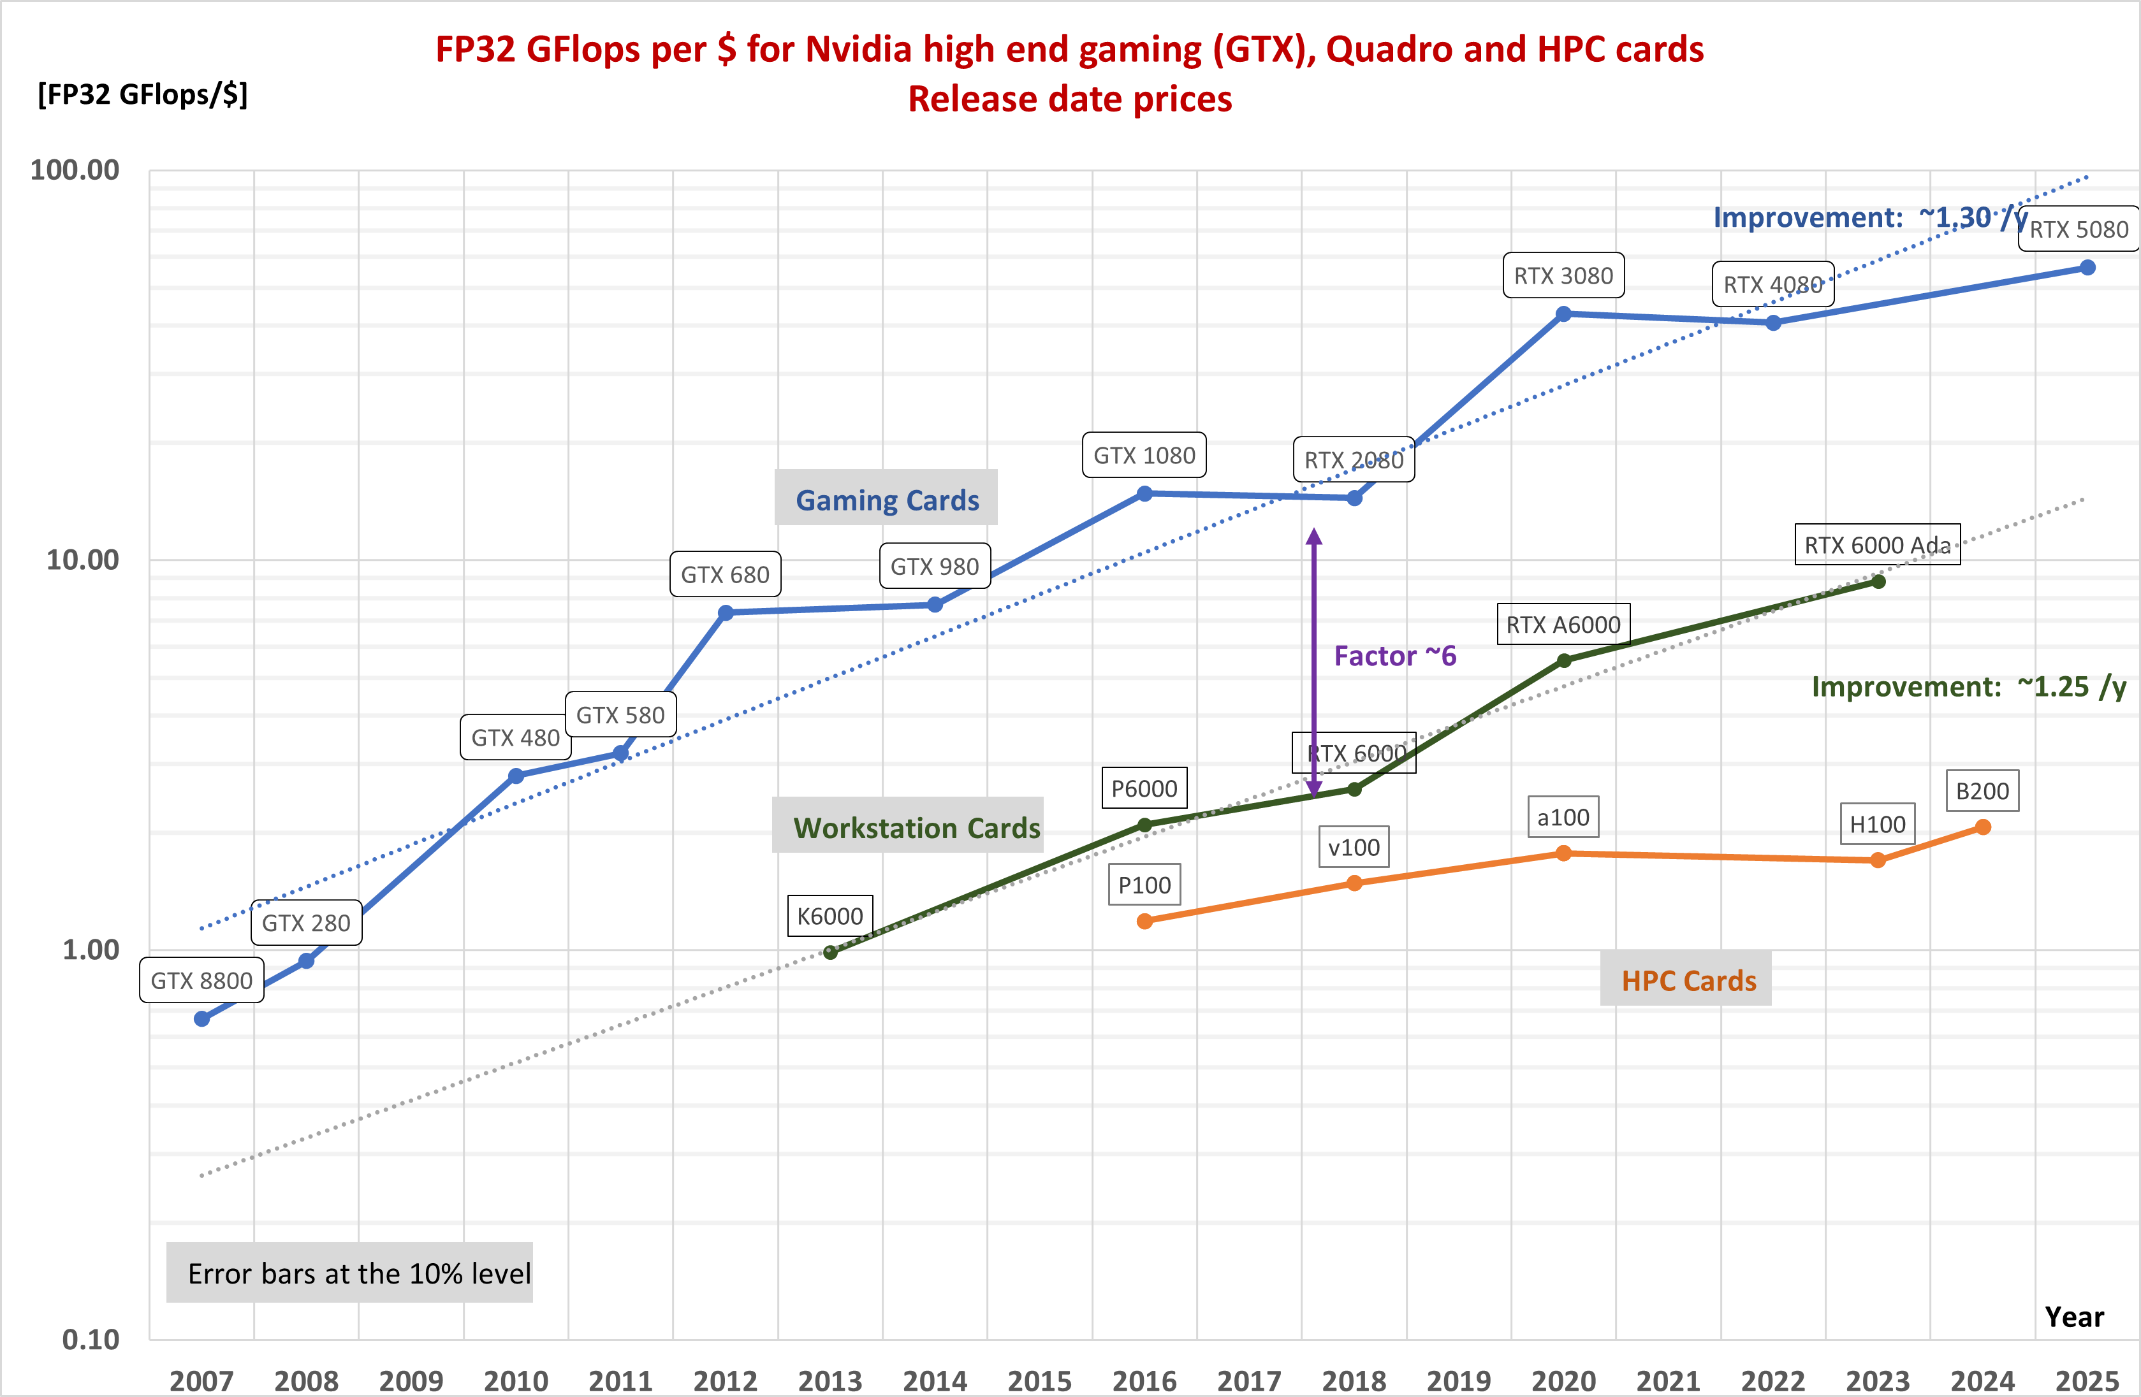
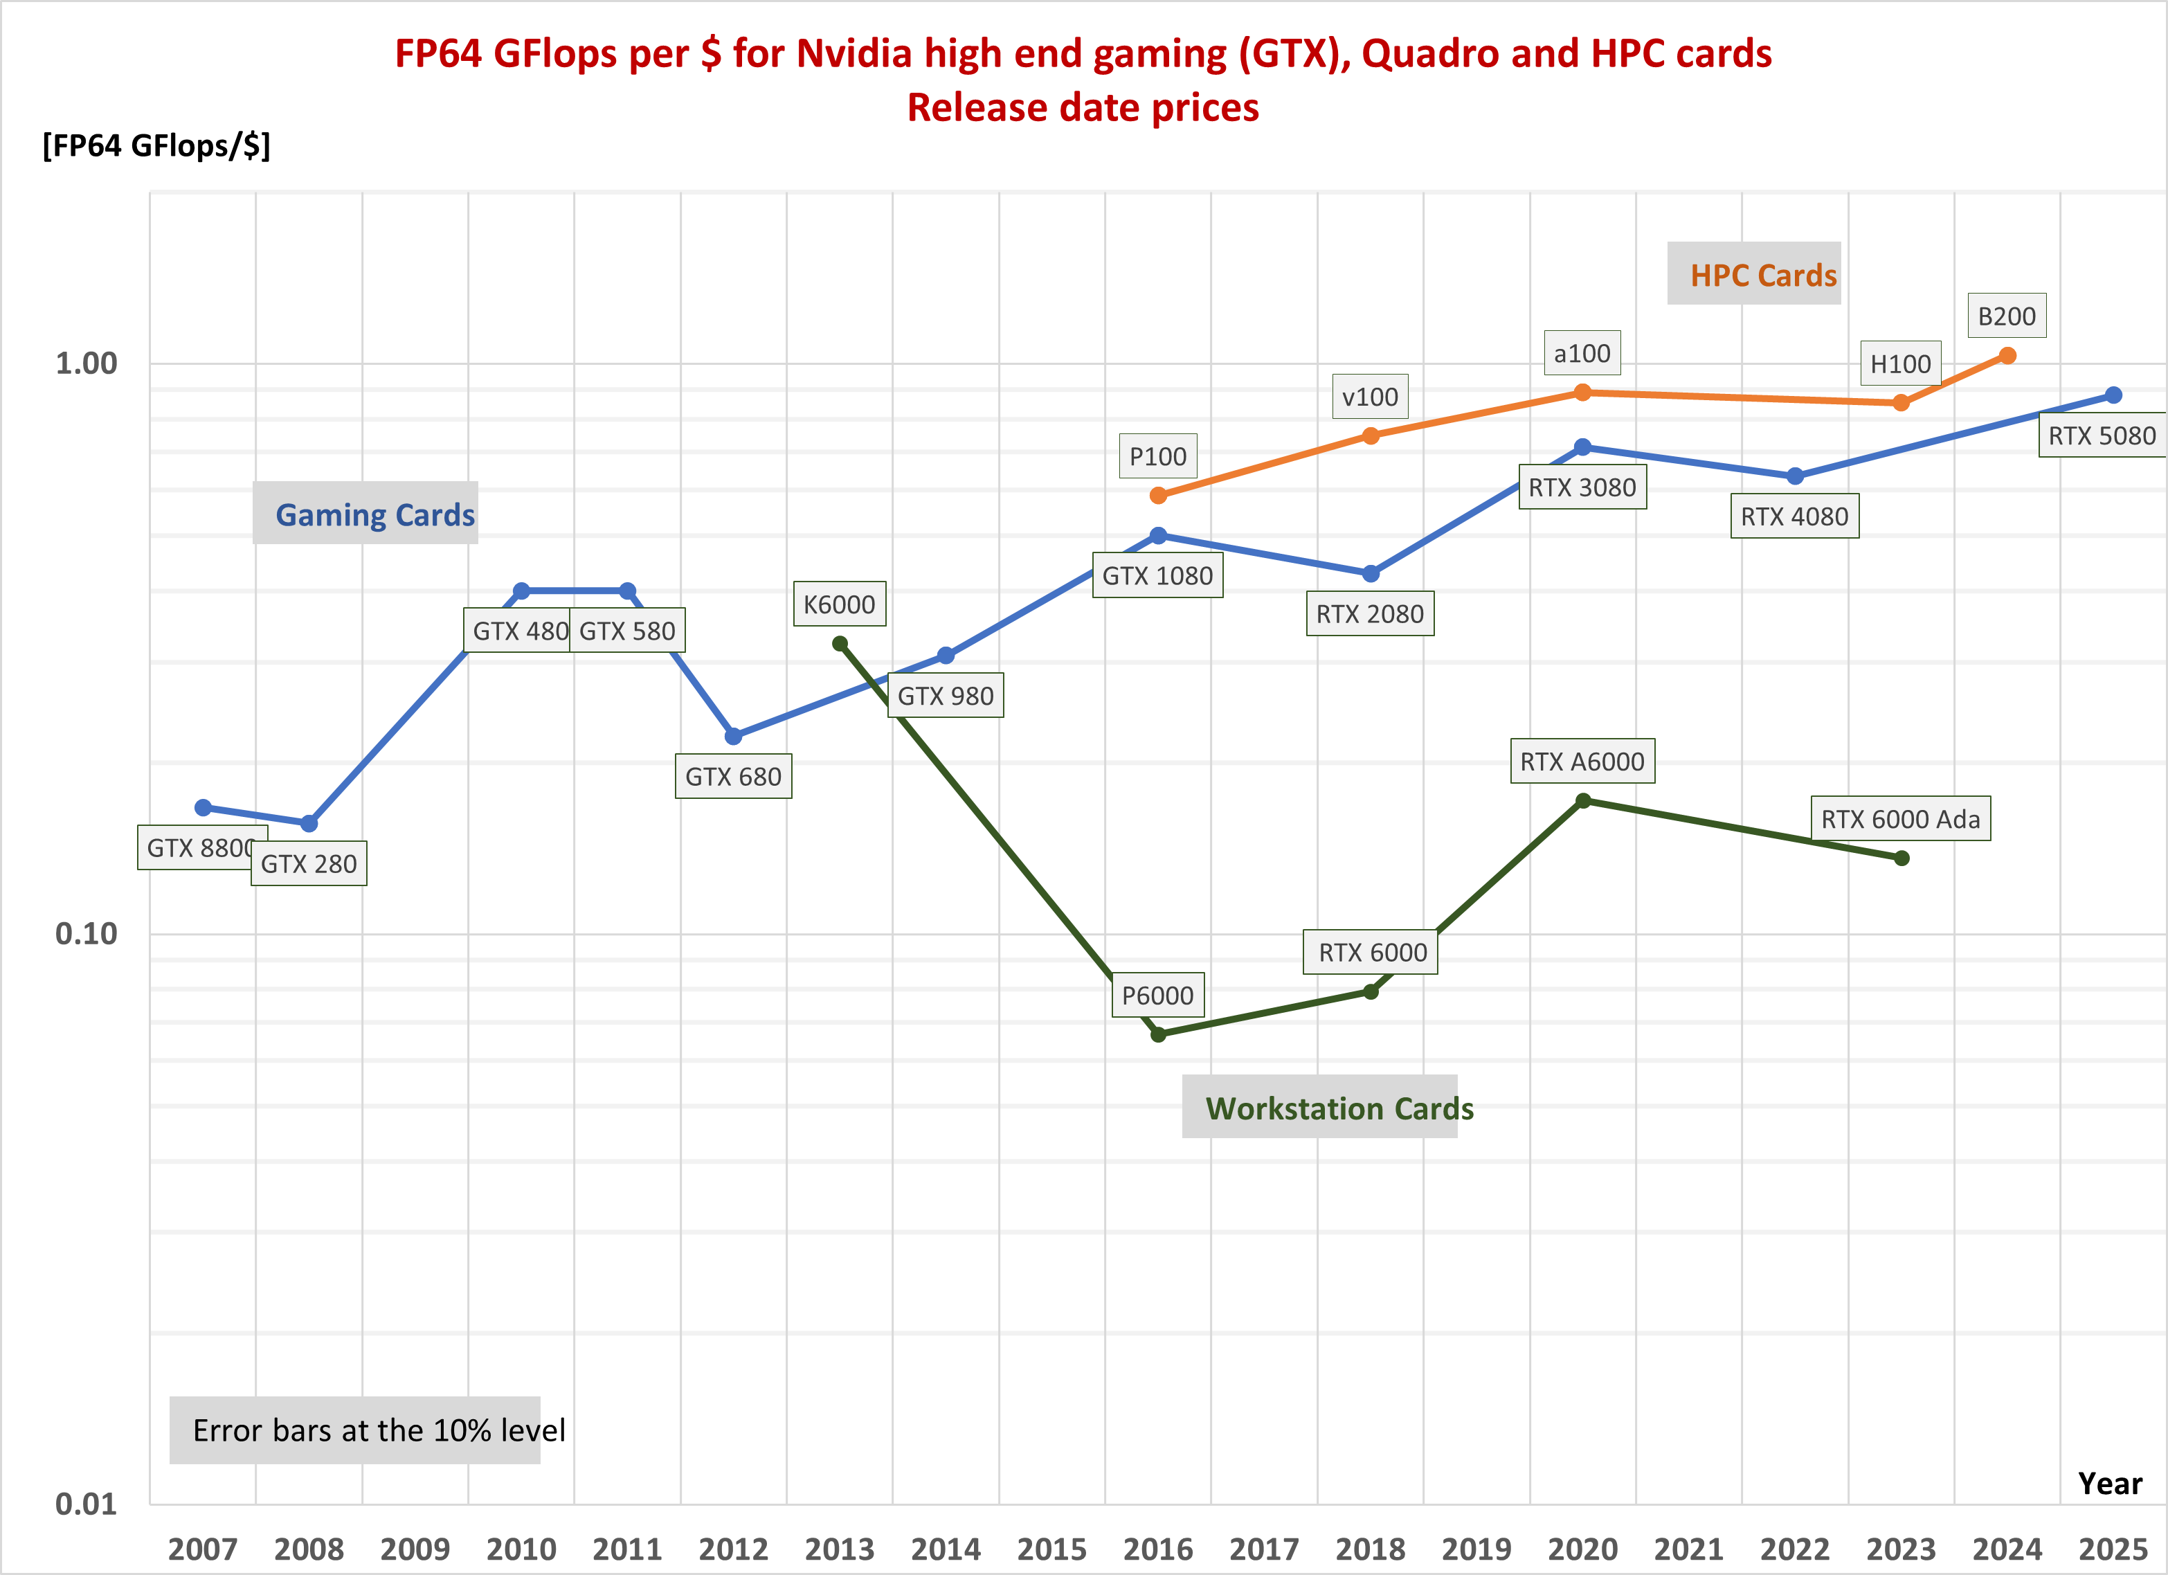
Evolution of GPU high precision performance
From Hopper to Blackwell the increase in FP64 and FP32 performance is marginal
Very hard to estimate performance/$, as the price of the single GPU is not well known
  Planning to start tracking GPU server prices at CERN
How much we will need GPUs is still rather undefined

Slide 12
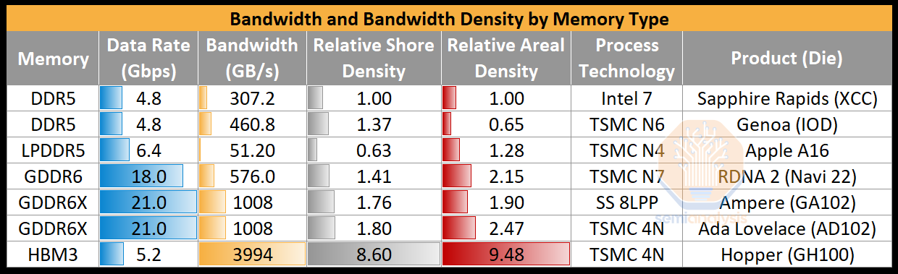
Memory technology
 | Max capacity | Bandwidth | Bus width | Used on
HBM3 | 24 GB per stack | ~820 GB/s per stack | 1024 bit | Hopper, MI300
HBM3E | 36 GB per stack | ~1.3 TB/s per stack | 1024 bit | Blackwell
GDDR7 | 64 Gbit per chip | 160 GB/s | 32 bit | RTX 50-series
MRDIMM | 256 GB per module | 8800 MT/s | 64 bit | System
Strong push towards high bandwidth, low latency for HPC and AI
  Wide range of types of DRAM for different applications
  Optimization via interconnecting different chiplets (logic, memory, IO)
System memory
  DDR5 current standard, up to 6400 MT/s
  LPDDR5X more power efficient, and cheaper than HBM, but has limitations
  MRDIMM (multi-ranked buffered DIMM) to achieve 8800 MT/s and more
  CXL (Compute Express Link) is a protocol on top of PCIe that allows to disaggregate memory and share it with many CPUs and GPUs, combining DRAM and non-volatile storage
Semianalysis

Slide 13
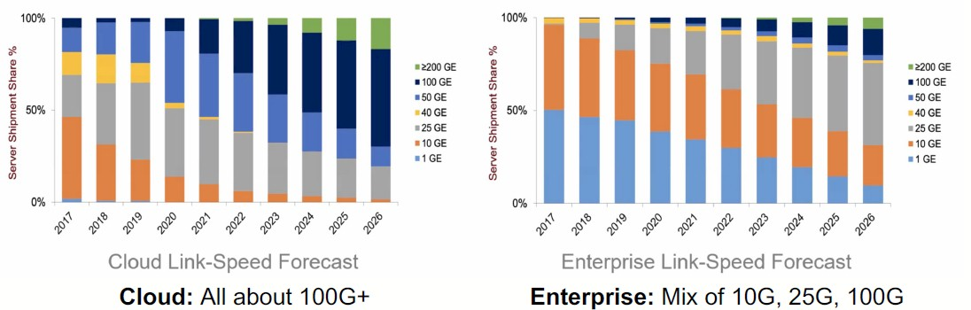
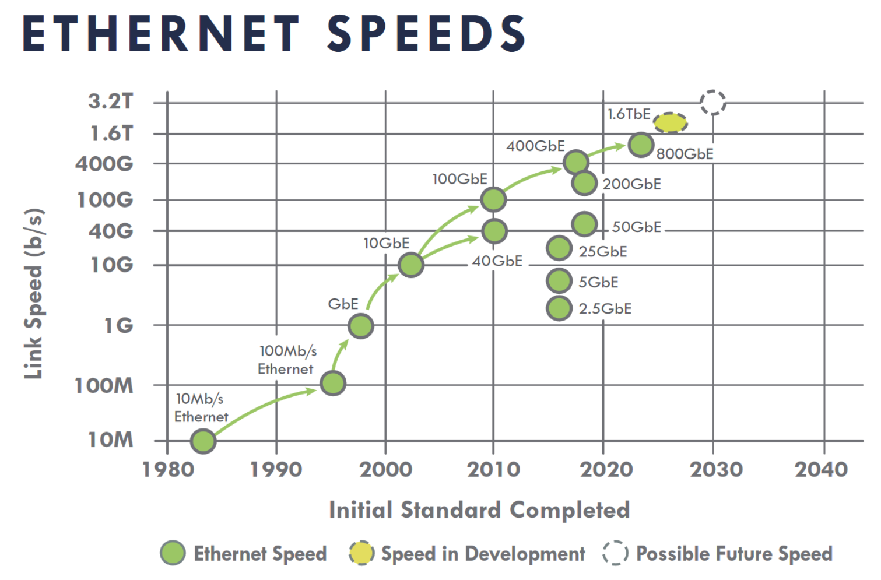
Local area network
Infiniband used for high bandwidth/low latency
  Only relevant for real HPC applications (and some HEP online systems)
  AI-focused and cloud providers do not need it
  Ethernet-based alternatives are RoCE (now) and Ultra Ethernet (future)
Network speeds in our computing centres are increasing
  10 Gbps the bare minimum, still OK for WNs and little else
  25-100 Gbps on server NICs are commonplace
Networking cost not a big concern
  Required switches contribute a small amount to the overall cost

Slide 14
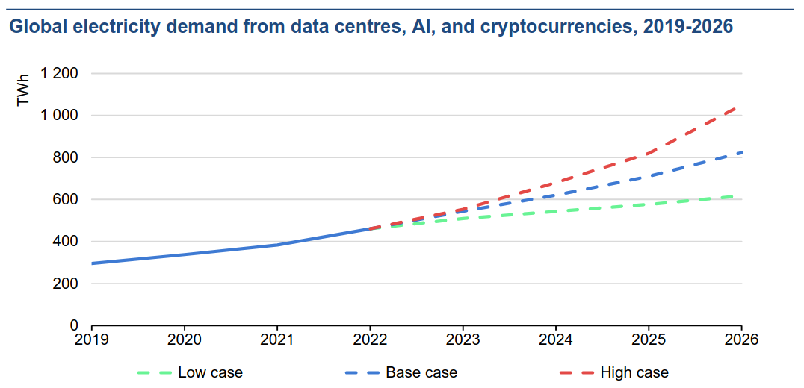
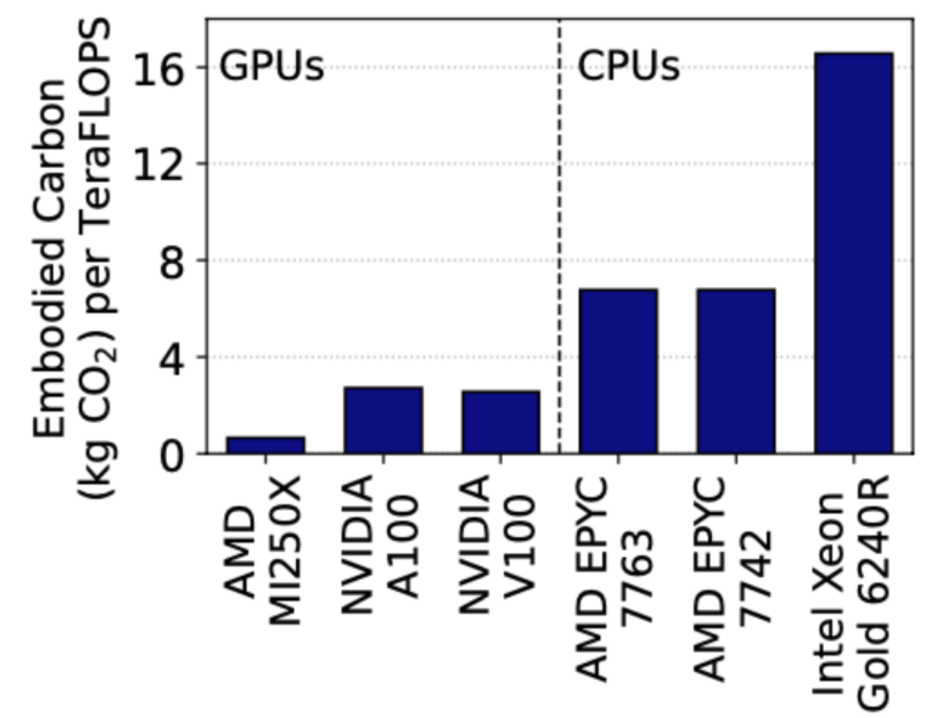
Power consumption and cooling
Electricity demand from data centers increasing very fast
  Power constraints are a strong incentive to energy efficiency
  Data centers used ~2% of global electricity in 2022, estimated twice as much in 2026
Power efficiency still improving, but power density of servers also increasing
  Liquid cooling increasingly required
CPU power efficiency now systematically measured in our community
  ARM is more efficient, but AMD is keeping up
GPUs are 5-10x more power efficient than CPUs
  Powerful incentive to move algorithms to GPUs
Embedded vs operational emissions must be considered
  Best strategy for hardware replacement in a data center heavily depends on how “clean” electricity production is
Source: IEA Report 2024

Slide 15
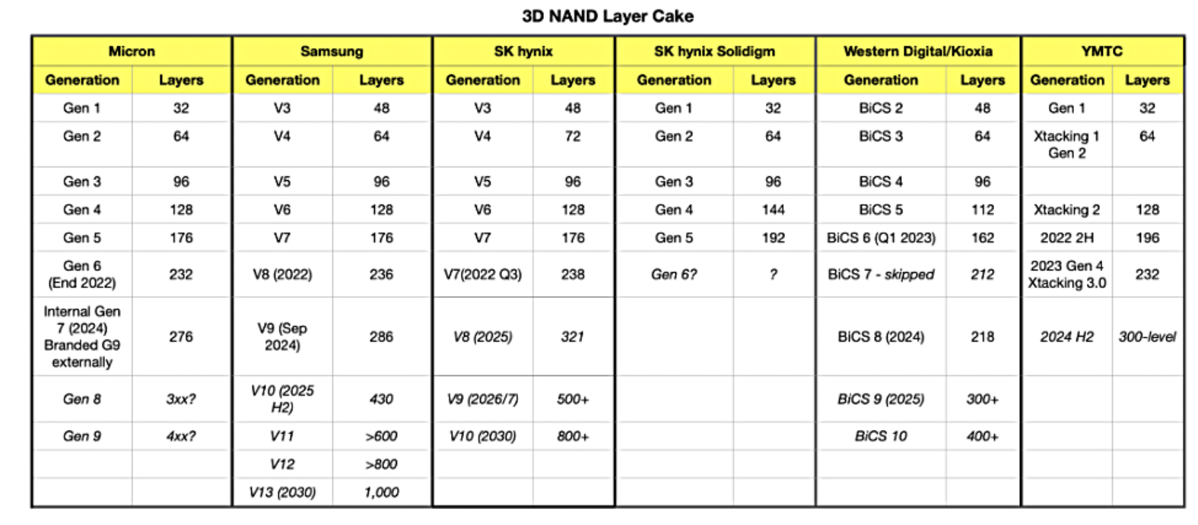
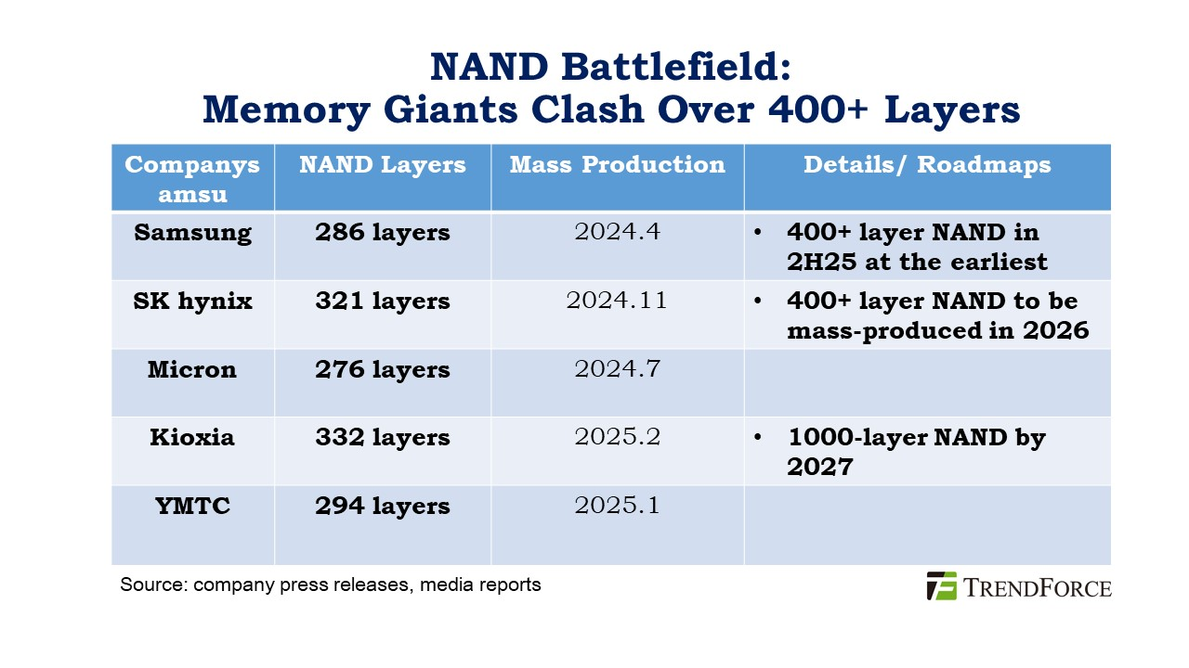
Flash storage
Capacity increasing in two dimensions
  Bits/cell: SLC → MLC → TLC → QLC → PLC?
    QLC for large SSD used for data serving
    TLC and lower for high R/W rates
  Number of layers: ~ 200-300 today, 400+ in 2025
  Drive capacity soon to exceed 120 TB!
Samsung confirms plans for 1000 layers by 2030
  Using a technique to bond multiple wafers, to break a manufacturing limit
  Mass producing NAND with ~400 layers this year
Performance will go up with PCIe 6
  Micron demoed an SSD reaching 27 GB/s!
Supplier 3D NAND layer count generations

Slide 16
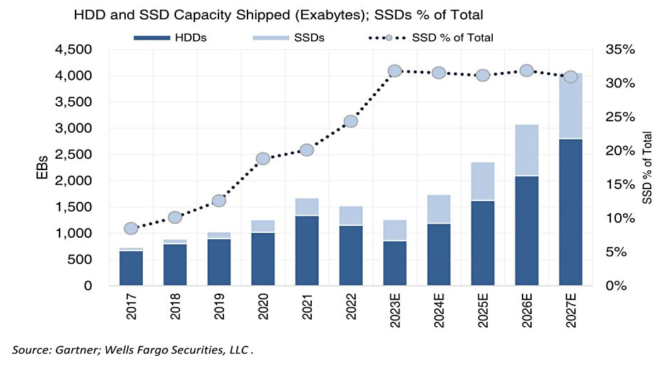
NAND Flash market
Globally, shipped NAND flash capacity amounts to 30% of the total (SSD+HDD)
  For HEP, it is much less: only as system drives and for certain high IOPS/bandwidth storage systems (data caches, tape buffers, analysis facilities…)
  Price gap with HDDs is still 3-4x, slowly decreasing
Growth rate for NAND flash less than predicted in the last few months (less orders from PC, mobile and key buyers)
  10-15% instead of 30%, Samsung and SK Hynix will scale down production by 10%
  Long term demand will go up again due to AI, no good for us!
Blocks and files

Slide 17
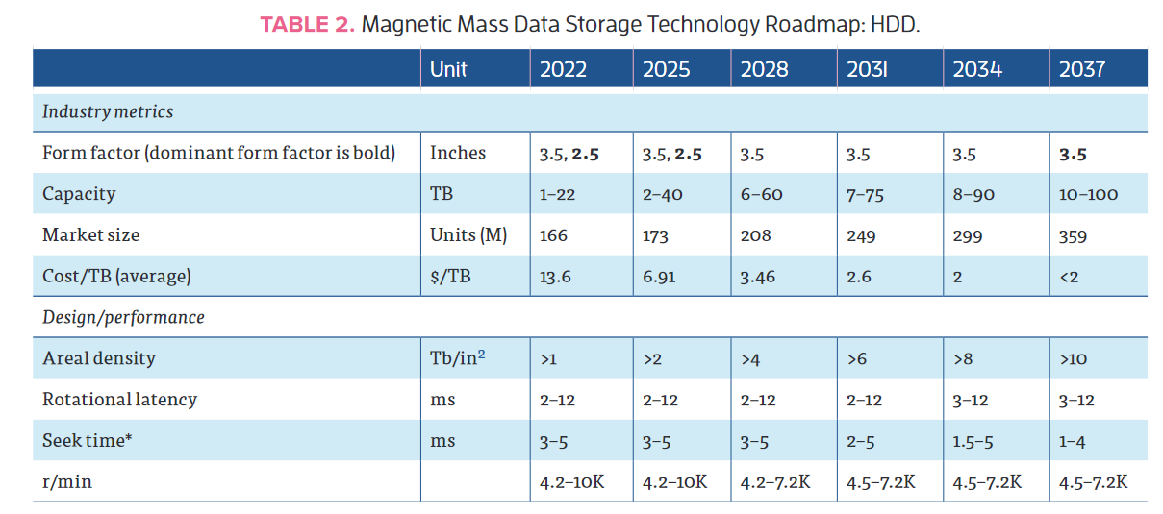
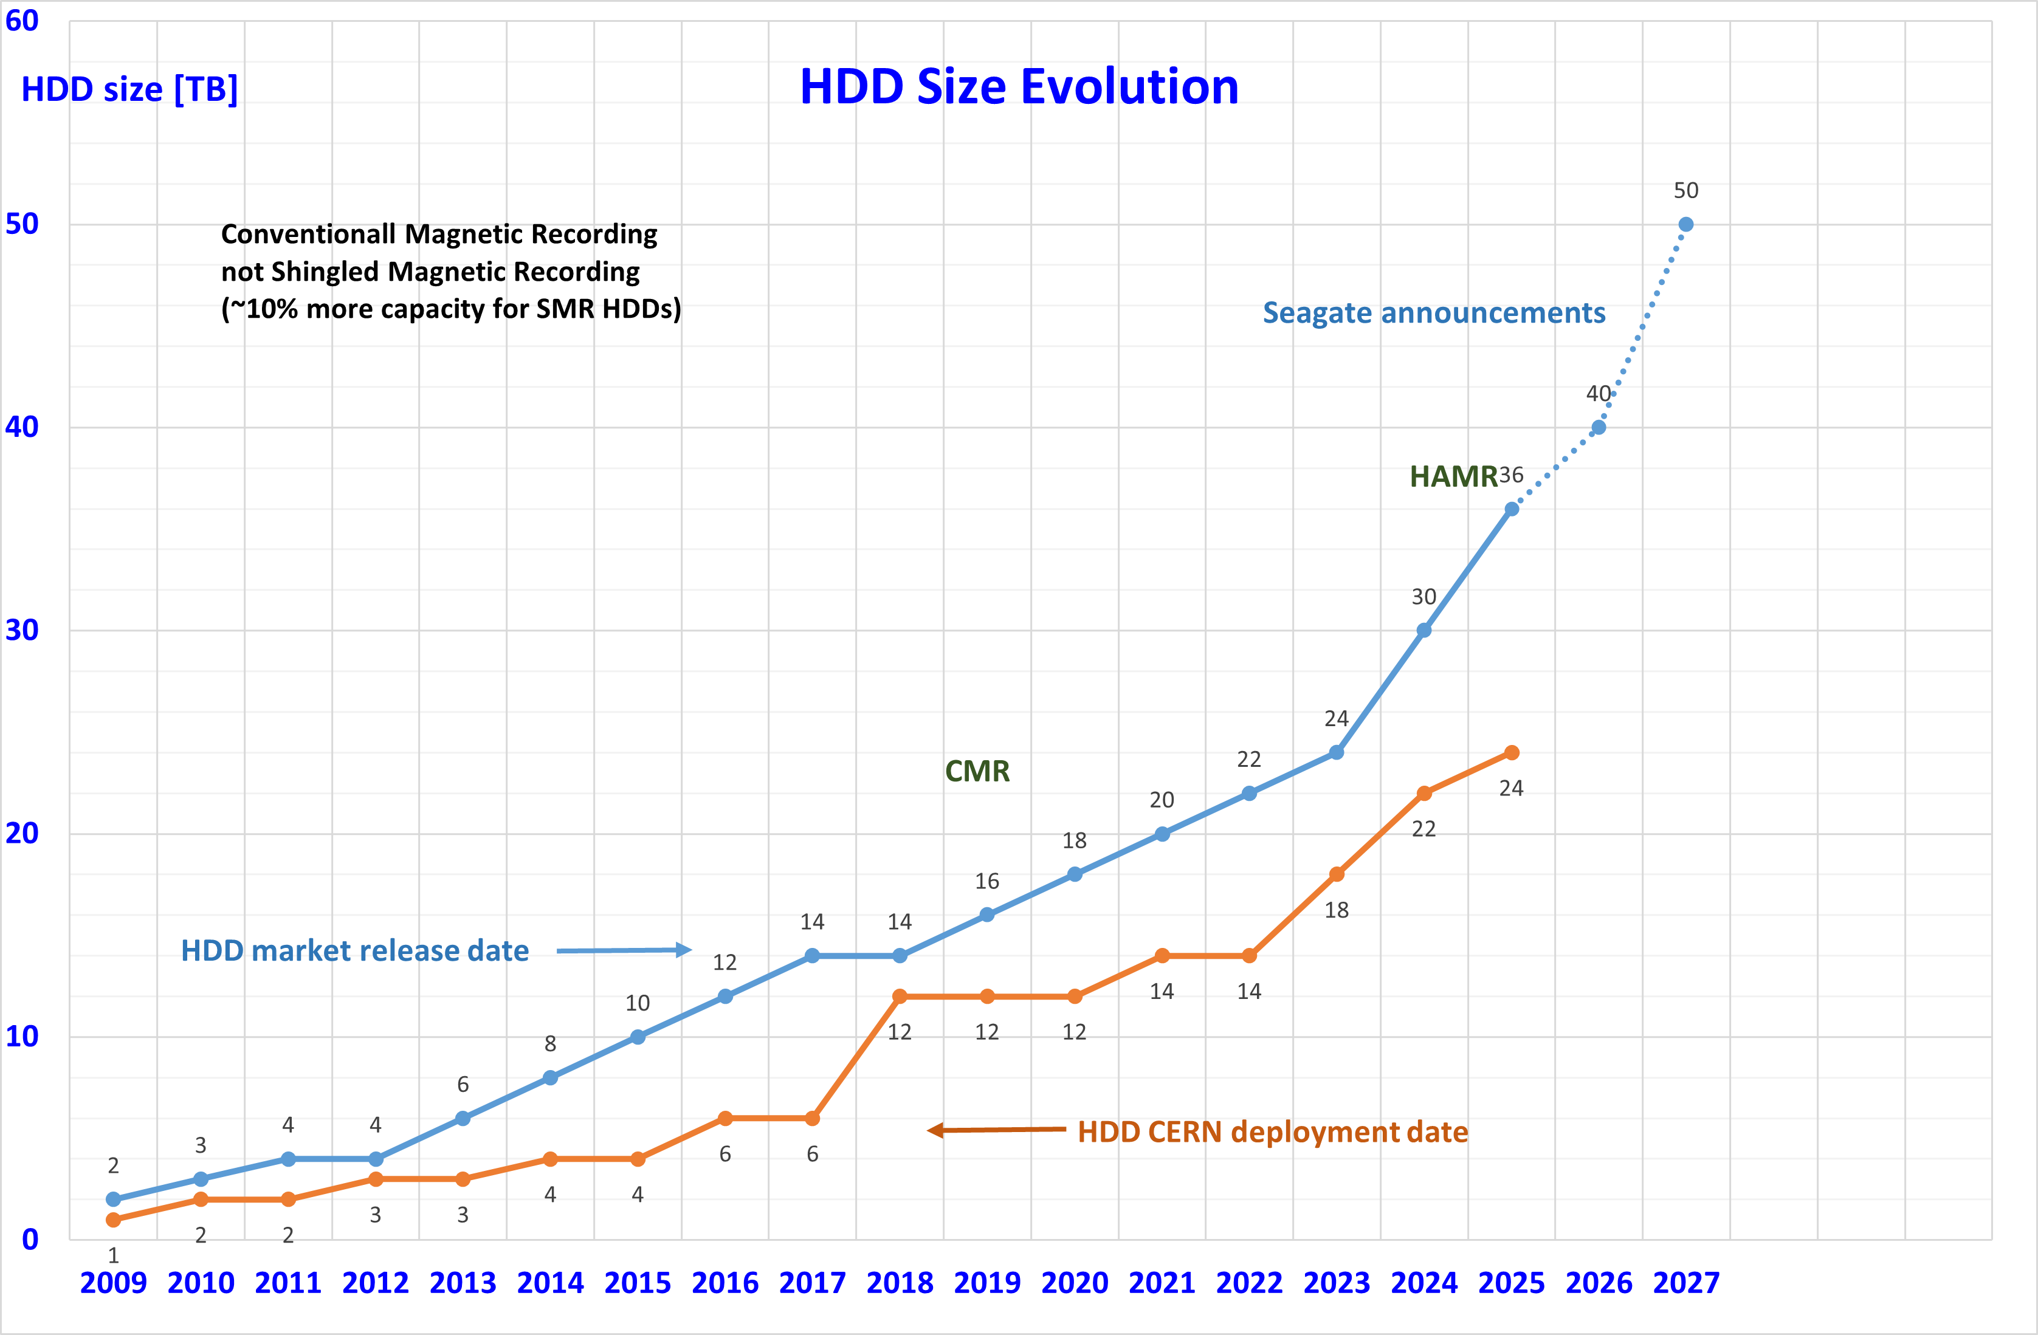
Disk storage
Market split among Seagate, WD and Toshiba
Capacities still increasing, thanks to SMR and HAMR
  HDD shipments will soon be almost only nearline
  HAMR drives can finally be bought, (e.g. Seagate @ 36TB) but not cost effective for now, other vendors will come later
  SMR drives mostly bought by hyperscalers
    Significant investments in software required
  Further increases in capacity more constrained by marketability than underlying technology
    60 TB disks by 2028 using HAMR?
  Power consumption should stay around 10 Watt/drive, so Watt/TB will decrease
Performance is not increasing (fast enough)
  Might create a bottleneck for data access in WLCG
IEEE roadmap for Mass Digital Storage Technology

Slide 18
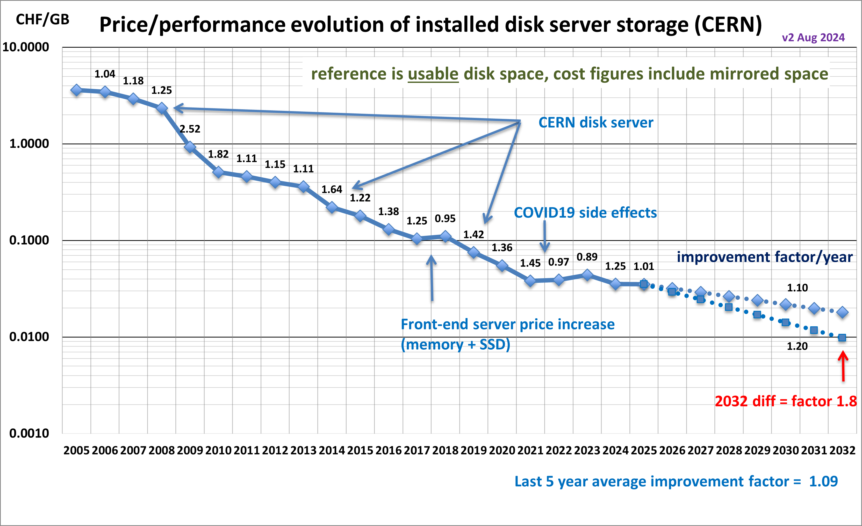
Disk cost extrapolation at CERN
Stable price decrease but also flattening out recently
  Observed by many Tier-1 sites
Questions:
  When will energy-assisted magnetic recording HDDs will become commonplace?
  AI demand driving up demand for all storage. Any hope to get better prices in the next 2-3 years?
What about SSDs?
  Won’t completely replace HDDs, but usage will increase and negatively impact the overall cost of storage
  Will soon track SSD storage price at CERN

Slide 19
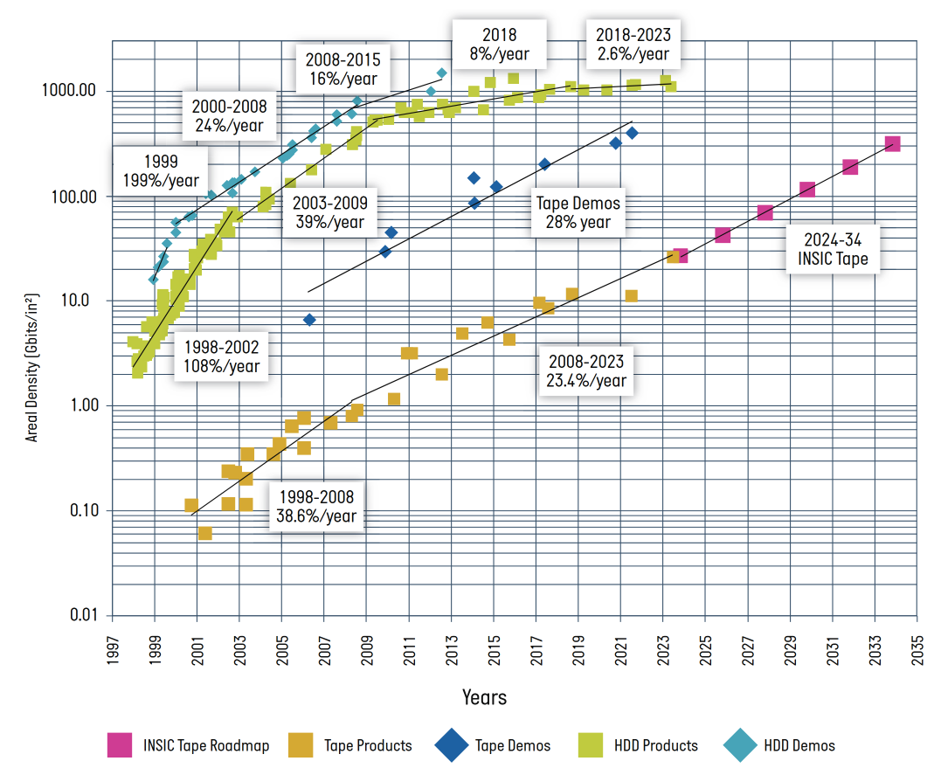
Tape storage
Still a lot of room for scaling
  30%-40% yearly increase in cartridge capacity
Lots of technology advancements in both media and drives
  LTO the leading standard, smaller share for the IBM TS11X0 format
Read rates also increasing, but by only 15%/year
Last but not least, tape is very environmentally friendly
Source: V. Bahyl

Slide 20
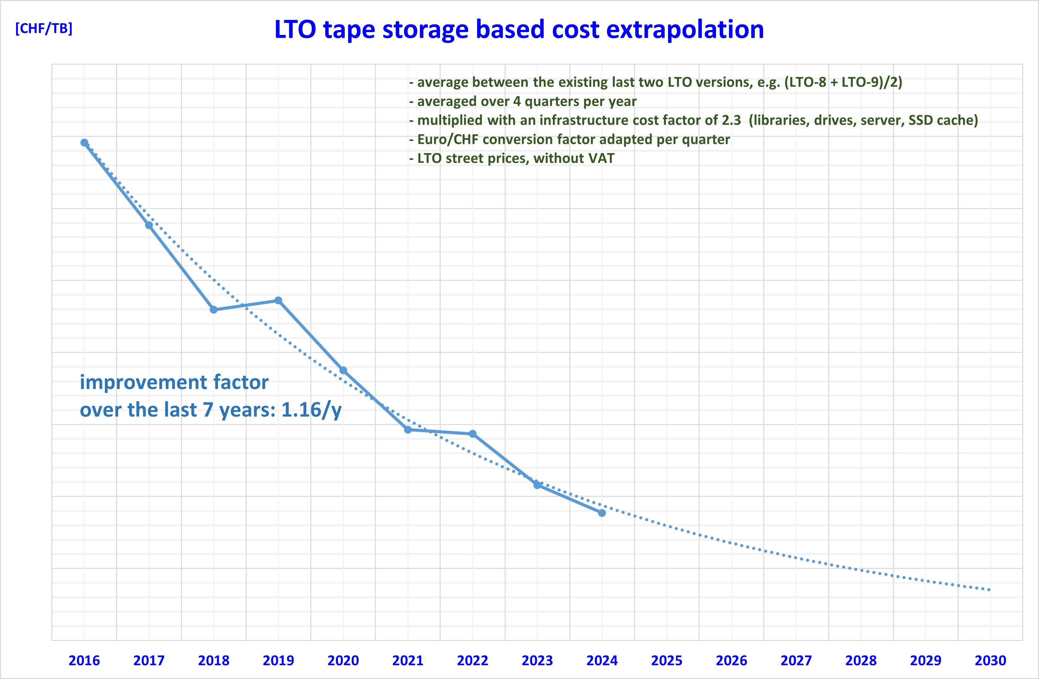
Tape media cost
Overall tape infrastructure cost at CERN dominated by media
  IBM TS11x0 / 3592 technology cartridges offer ~twice the storage density but it is ~twice as expensive as LTO
Vendors now focusing on the requirements of the hyperscalers
  We (HEP) have very little leverage
Significant market consolidation
  Drive manufacturer monopoly (IBM), tape media duopoly (Fujifilm, Sony)
  The decline in the overall cost tape technology data storage will slow down
Tape will still be the most cost-effective device to archive data
  But companies need to get back the money they invested
Number of tape cartridges sold is declining
  The prices per TB can not go down as fast as in the past

Slide 21
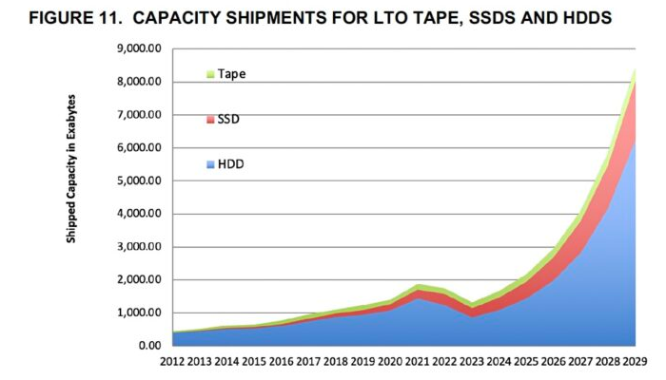
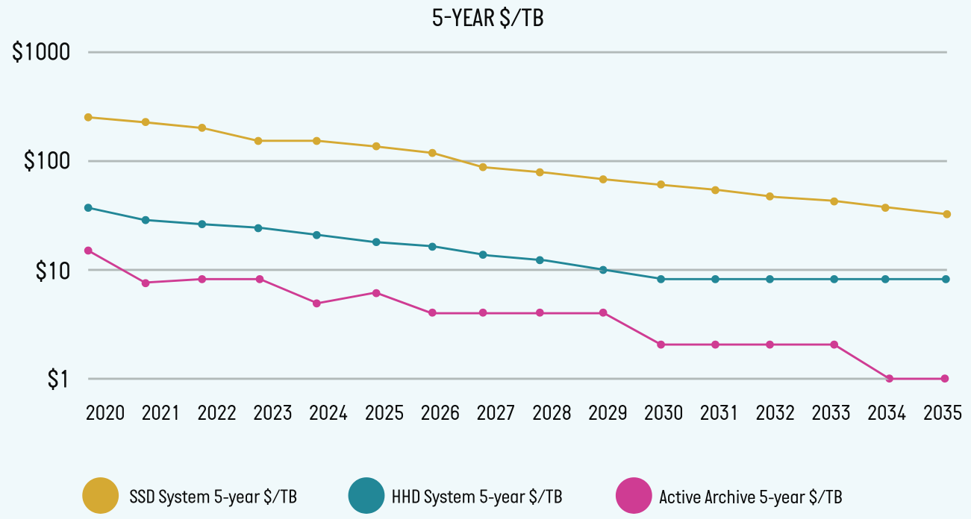
Storage evolution summary
To summarize:
  AI boom drives volume increase for all types of storage
  SSDs will not replace HDDs in data centers anytime soon
  Our usage of SSD will probably increase to cope with the performance bottlenecks of HDDs
  Tapes are not going anywhere either
  Prices would go down (in a normal world) at similar rates for all storage types
Source: Blocks and Files

Slide 22
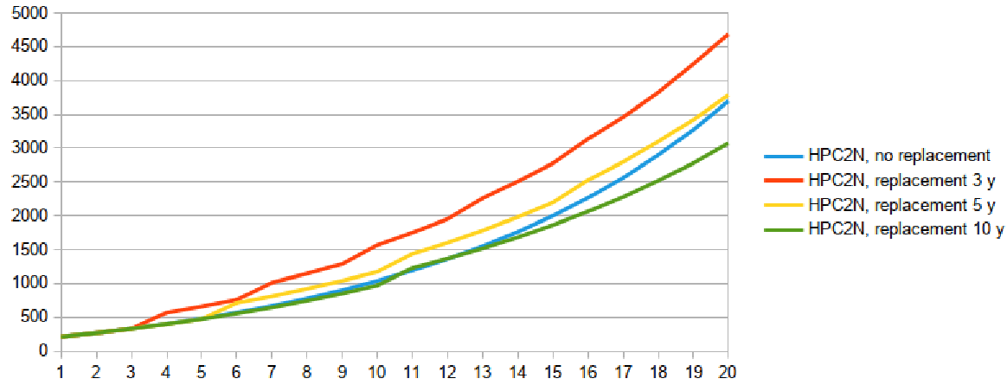
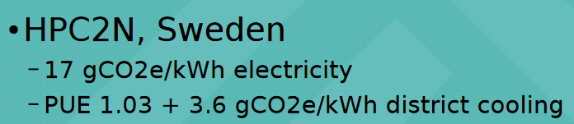
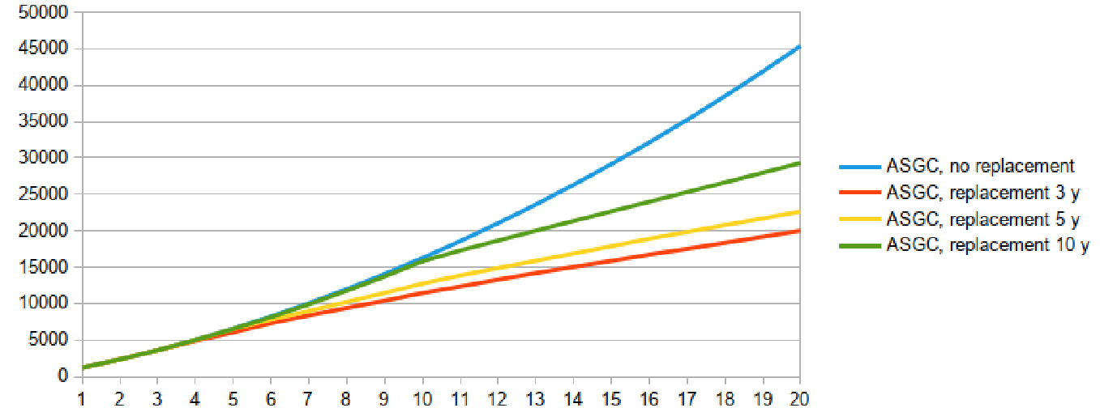
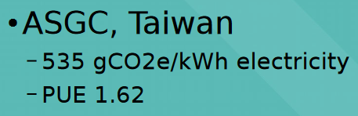
More on sustainability
Performance/Watt is now almost as important as performance/euro
  Electricity prices
  Limited cooling capacity of existing data centers
  Need to limit CO₂ emissions
HDD and tape much better than SSD in terms of emissions
  When embedded emissions are considered!
Arm CPUs are attracting a lot of interest
  Very power efficient, but not fully validated by LHC experiments
  Only two options: Ampere and Nvidia Grace
Many considerations enter into play
  “Embedded” emissions vs operational emissions: how often to replace hardware?
  Many new CPUs and GPUs will need liquid
Emissions (kg CO2) vs. time (y) per 1kHS23
M. Wadenstein, HEPiX Spring 2024

Slide 23
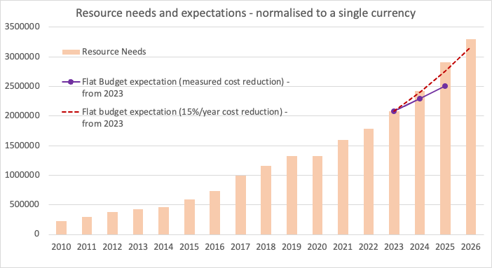
More on cost trends in WLCG
Source: S. Campana
Cost reduction/year experienced by Tier-0/1 sites is reducing
  CPU: 15% (5y), 11% (3y), 13% (1y)
  Disk: 11% (5y), 7% (3y), 3% (1y)
From 2023, we are falling short of the flat budget model
  It is not going to get better…

Slide 24
Implications for flat budget extrapolations
Prospects for CPUs
  Not critical for GenAI, so less pressure
  Generational improvements still good
  A 10-15% yearly improvement could still be realistic
Prospects for disk
  Lots of pressure from GenAI
  Technological improvements guaranteed
  A 0-10% yearly improvement might be expected
Prospects for flash
  Probably same trend as for HDD, we have no historical data in WLCG
Prospects for tape
  15% is the current trend, might assume 10% to be conservative
Prospects for GPUs
  Too early to quantify price trends, maximal pressure from GenAI

Slide 25
Conclusions
Technology tracking essential to make cost-efficient choices for HEP computing
  Done in different contexts in our community
Many server hardware components are rising in price due to the AI boom
  Memory, GPUs, flash, HDD are all affected
AMD, Arm and Intel show healthy competition
  A lot of attention to performance/Watt
Evolution of GPUs is not going in a direction very useful for us
  FP32/64 performance not increasing
Shipped storage capacity increasingly driven by the global trend
  SSDs, HDDs and tape all still relevant and making progress
Sustainability is more important than ever
  CO2 emissions, liquid cooling, electricity costs and distribution
Flat budget model under strain
  Will likely have to dampen our expectations (compared to the past)
  GenAI already a problem for us, geopolitical instability even worse
We should try to quantify the risk of our resources not meeting the needs of the experiments for HL-LHC
  And consider suitable alternative scenarios

Slide 26
Acknowledgements
This work was made possible by many contributions from and discussions with
  The members of the HEPiX Technology Working Group
  The members of the HEPiX Benchmarking Working Group
  Luca Atzori, Vladimir Bahyl, Eric Bonfillou, Simone Campana, Vincent Ducret, Bernd Panzer-Steindel, Hervé Rousseau, Markus Schulz

Slide 27
Questions?

