Slide 1
First studies of beam loss distributions from fast instabilities
WORK IN PROGRESS
16/12/2024 FCC-ee MDI meeting
Giulia Nigrelli
G. Nigrelli^{1,2,3}, M. Boscolo², G. Broggi^{1,2,3}, R. Bruce¹, X. Buffat ¹, S. Redaelli¹
¹ CERN, Geneva, Switzerland,
² INFN-LNF, Frascati, Italy,
³ Sapienza Università di Roma, Roma, Italy

Slide 2
Table of contents
16/12/2024 FCC-ee MDI meeting
Giulia Nigrelli
2
Introduction to Fast Instability
Horizontal Instability Characteristics
Vertical Instability Characteristics
Conclusions
Next steps

Slide 3
Fast instability Introduction
16/12/2024 FCC-ee MDI meeting
Giulia Nigrelli
3
The ring impedance can generate an instability that leads the beam to oscillate coherently with an exponentially growing amplitude, potentially losing the beam within few turns.
A feedback system is under development to damp the instability. However, feedback failures might happen and need to be investigated.
Effects on machine and detectors need to be understood to avoid damage.
Collimation system must protect the machine/detectors also in this scenario and shouldn’t be damaged by it.
If not, both collimation and feedback systems must be improved or the beam must be dumped before any damage occurs.

Slide 4
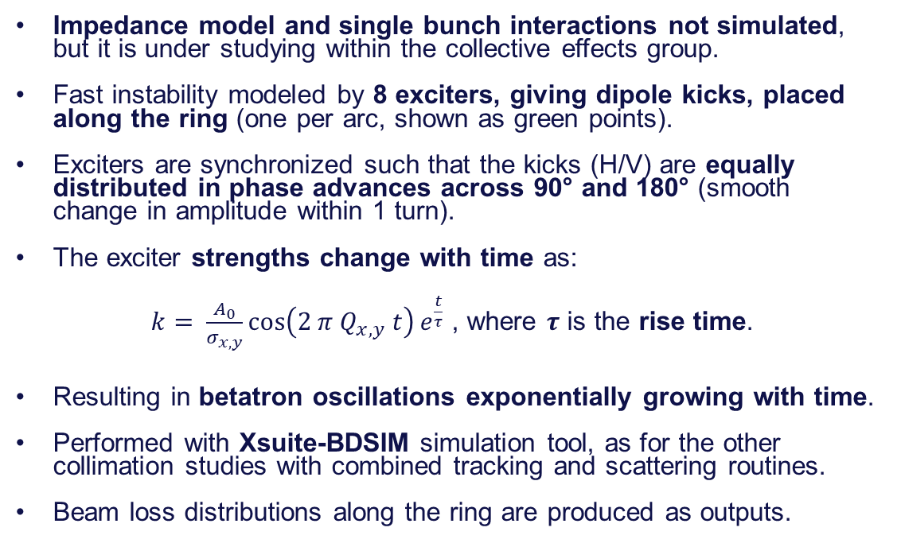
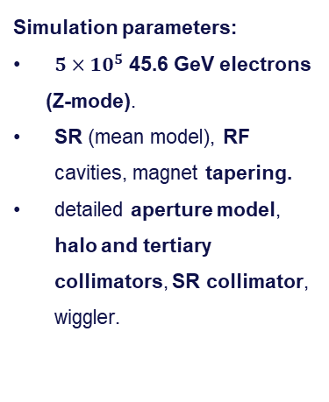
Simulation setup
16/12/2024 FCC-ee MDI meeting
Giulia Nigrelli
IPA
4
IPB
Impedance model and single bunch interactions not simulated, but it is under studying within the collective effects group.
Fast instability modeled by 8 exciters, giving dipole kicks, placed along the ring (one per arc, shown as green points).
Exciters are synchronized such that the kicks (H/V) are equally distributed in phase advances across 90° and 180° (smooth
change in amplitude within 1 turn).
The exciter strengths change with time as:
$k= \frac{A_{0}}{σ_{x, y}}\cos\left(2 π Q_{x,y} t\right)e^{\frac{t}{τ}}$ , where $τ$ is the rise time.
Resulting in betatron oscillations exponentially growing with time.
Performed with Xsuite-BDSIM simulation tool, as for the other collimation studies with combined tracking and scattering routines.
Beam loss distributions along the ring are produced as outputs.
IPJ
IPD
IPF
IPG
Simulation parameters:
$5×10^{5}$ 45.6 GeV electrons
(Z-mode).
SR (mean model), RF cavities, magnet tapering.
detailed aperture model, halo and tertiary collimators, SR collimator, wiggler.
Notes:
All the kickers are in phase?

Slide 5
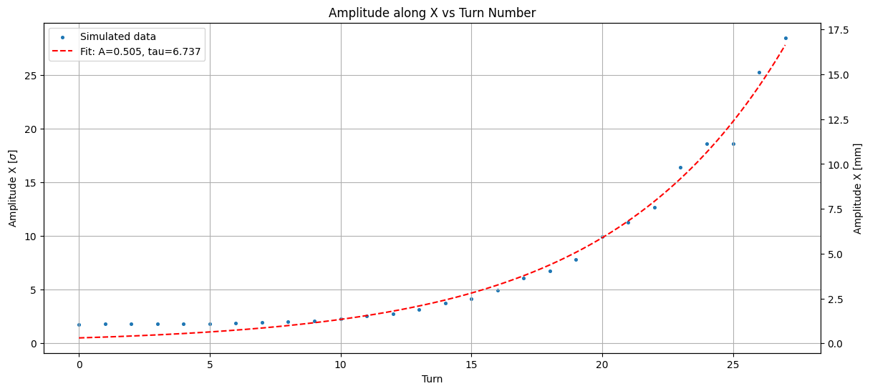
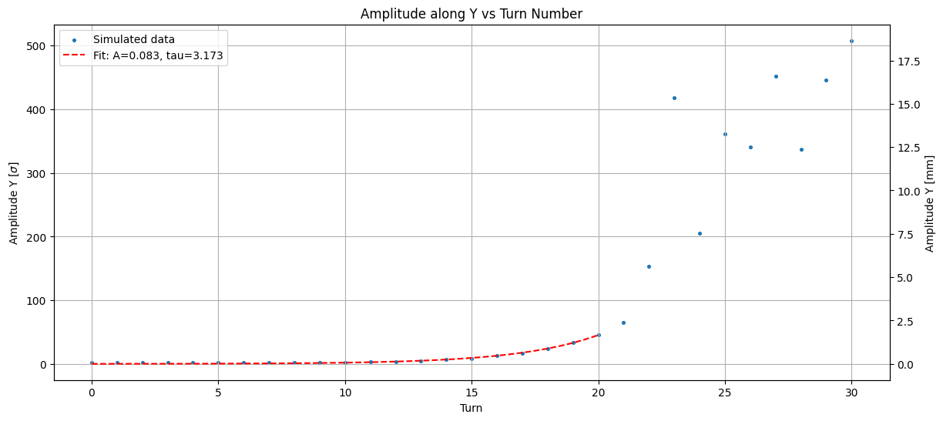

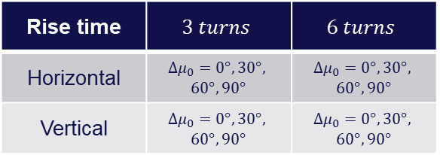
Case studies
16/12/2024 FCC-ee MDI meeting
Giulia Nigrelli
5
Horizontal: 6 turns
$$A_{x}[σ]=\frac{\sqrt{2 J_{x}β_{x}}}{σ_{x}}$$
Fit of the amplitude growth to the average centroid of the beam.
Since the instability can start at any point, it is relevant to explore the phase dependence.
Exciters shifted along the ring to have four different phase advances between the first exciter and the primary collimator.
16 different cases have been investigated:
Vertical: 3 turns
Rise time | $$3 turns$$ | $$6 turns$$
Horizontal | $${Δμ}_{0}=0°, 30°,$$ $$60°, 90°$$ | $${Δμ}_{0}=0°, 30°,$$ $$60°, 90°$$
Vertical | $$Δμ_{0}=0°, 30°,$$ $$60°, 90°$$ | $$Δμ_{0}=0°, 30°,$$ $$60°, 90°$$

Slide 6
Horizontal instability
CHARACTERISTICS
16/12/2024 FCC-ee MDI meeting
Giulia Nigrelli

Slide 7
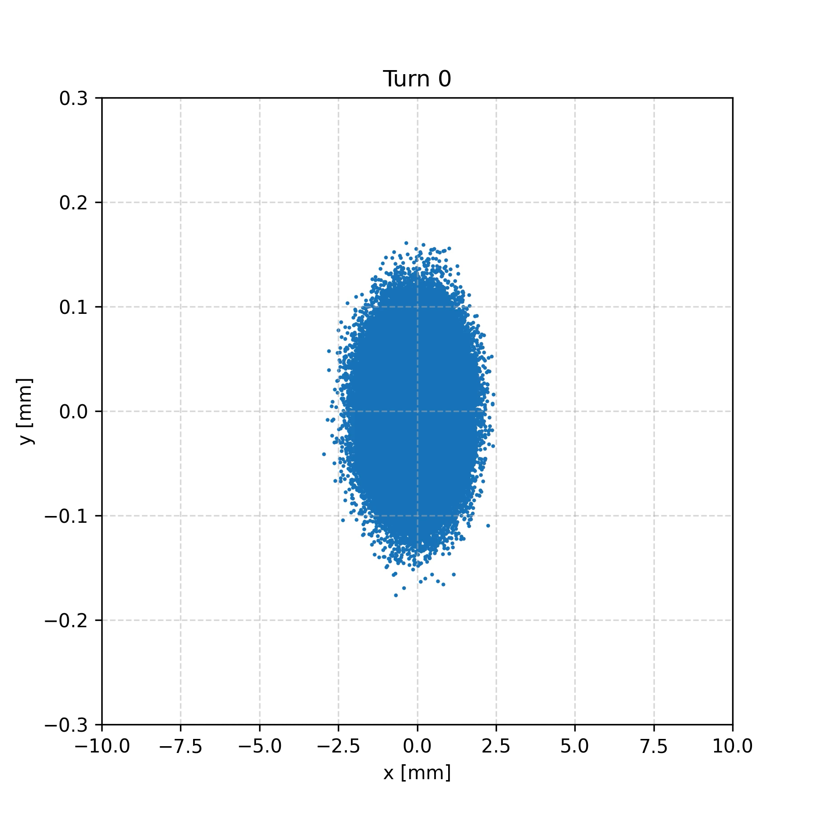

Transverse beam position at primary collimator
16/12/2024 FCC-ee MDI meeting
Giulia Nigrelli
7
$$\text{H} \text{0°} τ=3$$
The beam oscillates coherently in the horizontal plane until collimator apertures are reached.
This animation does not include scattering in the collimators, so the distribution would be even more spread.
Notes:
EXAMPLES PICTURES OF WORST TURN FOR BOTH VERTICAL/HORIZONATLA ND 3/6 TURNS
HIGLITH THAT 50% OF THE ENRìTIRE BEAM IS LOST IN 1 TURN
Highligth that the entire beam is lost within 20 turn but losses are observed only uring the last few turn
GIVE RANGE OF ENERGY LOST BEFORE THE BOOM, IS IT DETECTABLE?

Slide 8
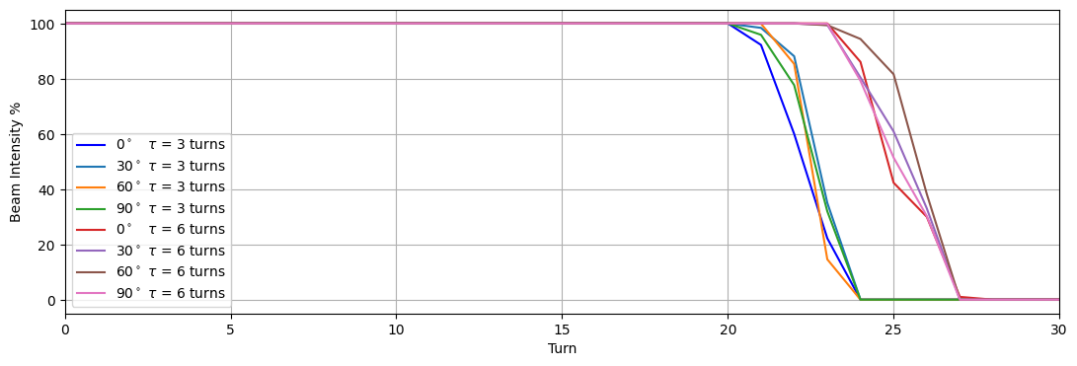
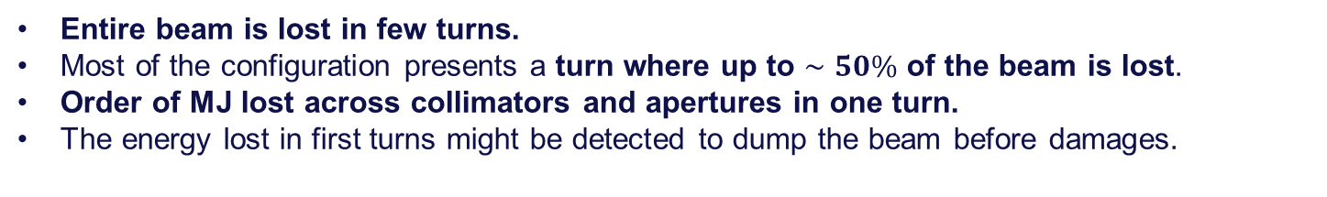
Beam intensity
16/12/2024 FCC-ee MDI meeting
Giulia Nigrelli
8
Entire beam is lost in few turns.
Most of the configuration presents a turn where up to $∼50\%$ of the beam is lost.
Order of MJ lost across collimators and apertures in one turn.
The energy lost in first turns might be detected to dump the beam before damages.

Slide 9
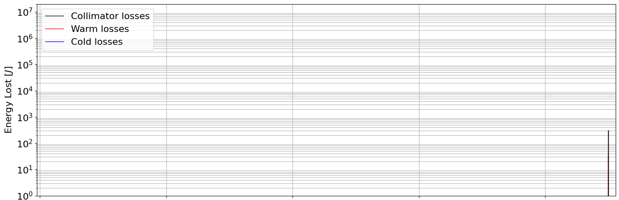
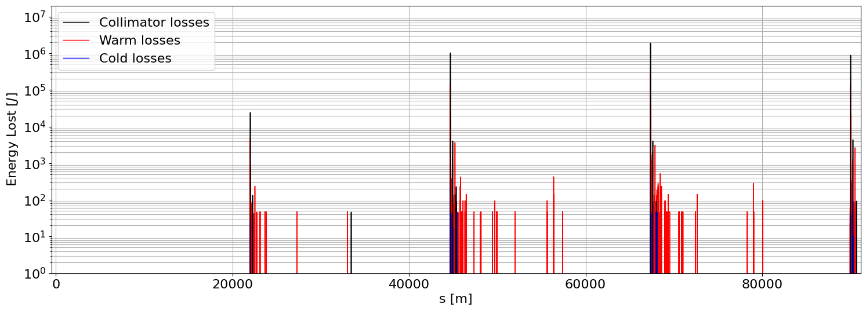


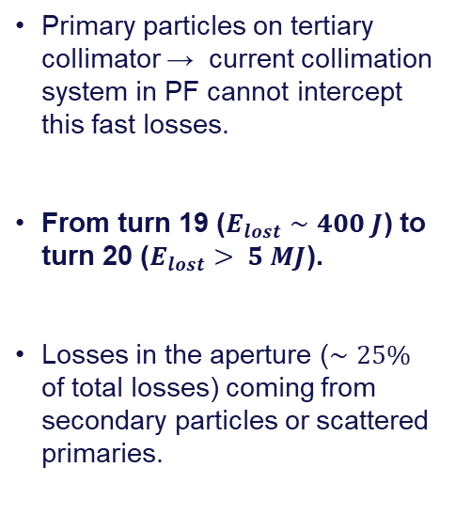
Lossmaps: worst case
16/12/2024 FCC-ee MDI meeting
Giulia Nigrelli
9
IPA
PB
IPD
PF
IPG
PH
IPJ
PL
IPA
$$\text{Turn} \text{19} \text{H}$$
$$\text{0°} τ=3$$
Primary particles on tertiary collimator → current collimation system in PF cannot intercept this fast losses.
From turn 19 ($E_{lost}∼400 J$) to turn 20 ($E_{lost}> 5 MJ$).
Losses in the aperture ($∼25\%$ of total losses) coming from secondary particles or scattered primaries.
$$\text{Turn} \text{20} \text{H}$$
$$\text{0°} τ=3$$

Slide 10
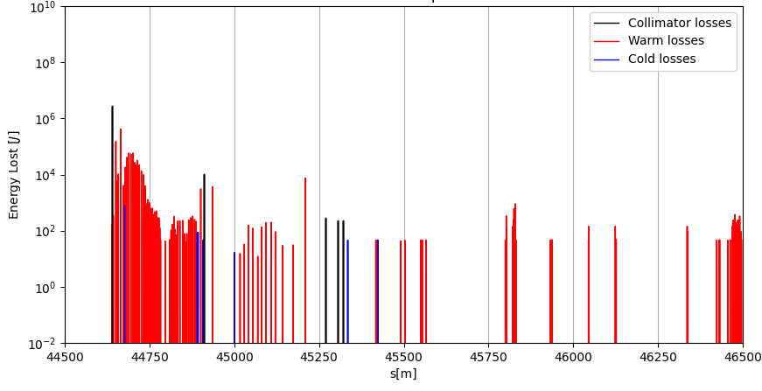

Lossmaps: Interaction regions (IPG)
16/12/2024 FCC-ee MDI meeting
Giulia Nigrelli
10
$$\text{H} \text{0°} τ=3$$
Significant losses close to the IPs, more than in the collimator insertion.
Possible solution:
  Shower absorber after tertiary collimator to protect detectors.
TCT
SR
IPG

Slide 11
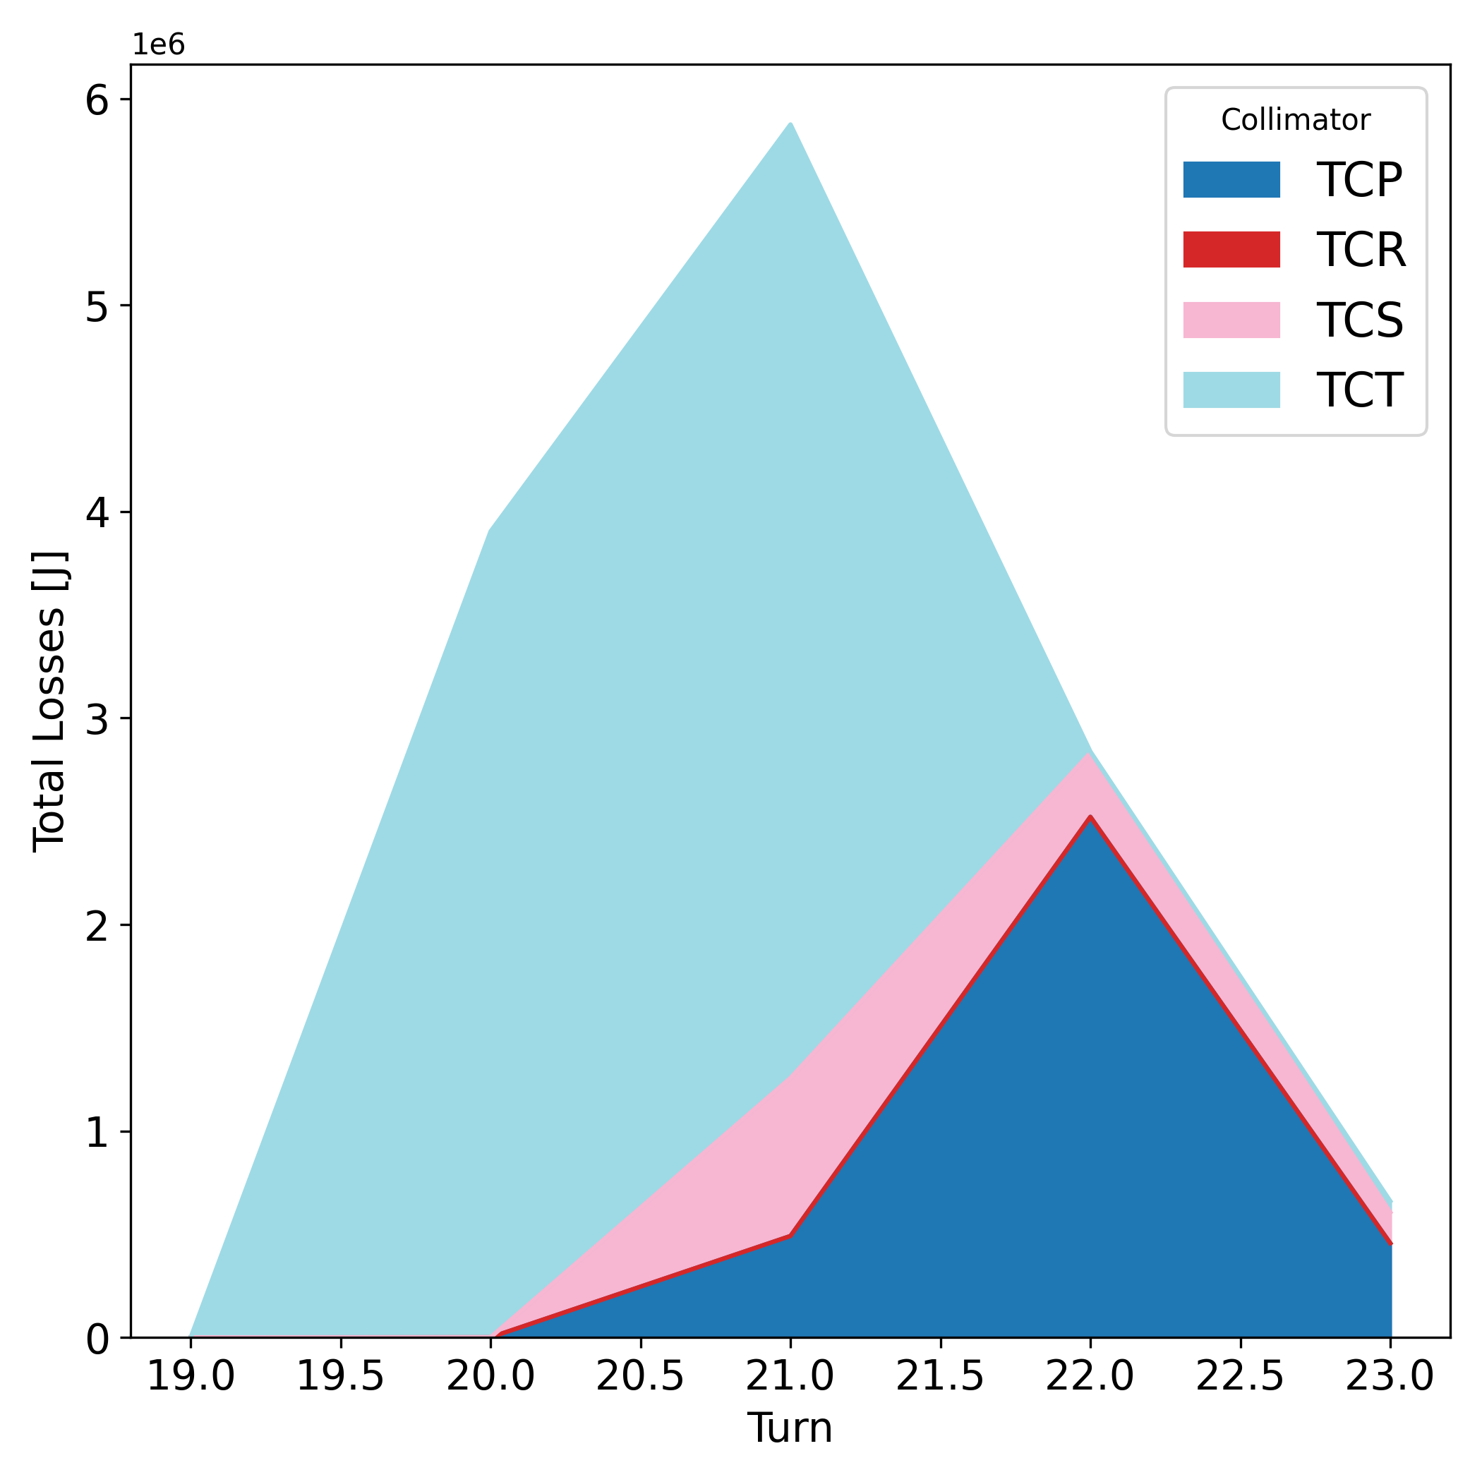
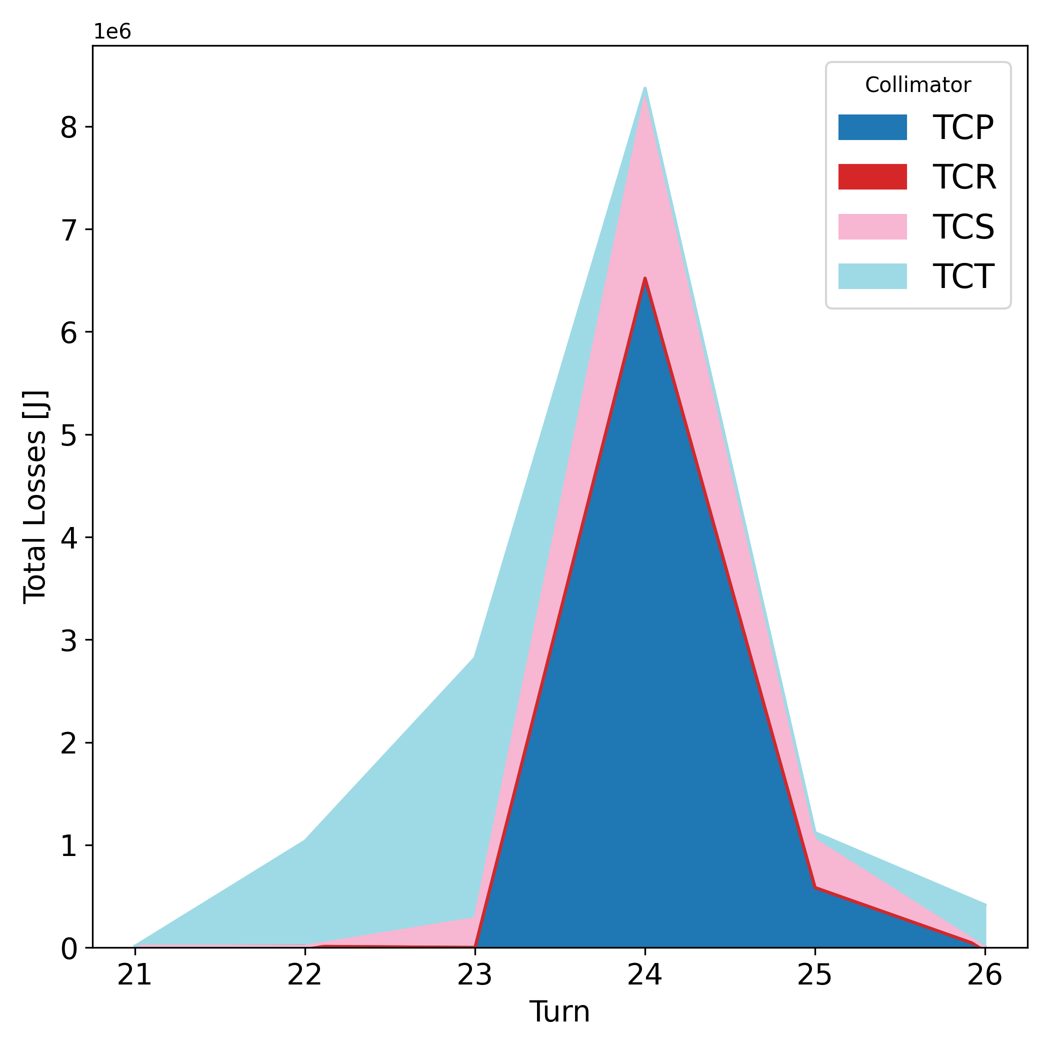


Losses across collimators
16/12/2024 FCC-ee MDI meeting
Giulia Nigrelli
11
Total loss on same type of collimator shows:
  Primary collimators not always absorb most of the energy lost → primaries on tertiary collimators.
  Significant losses in the tertiary collimators, efficiently protecting SR collimators.
$$\text{H} \text{0°} τ=3$$
$$\text{H}\text{ 6}\text{0°} τ=6$$
anchor

Slide 12
Vertical instability
CHARACTERISTICS
16/12/2024 FCC-ee MDI meeting
Giulia Nigrelli

Slide 13
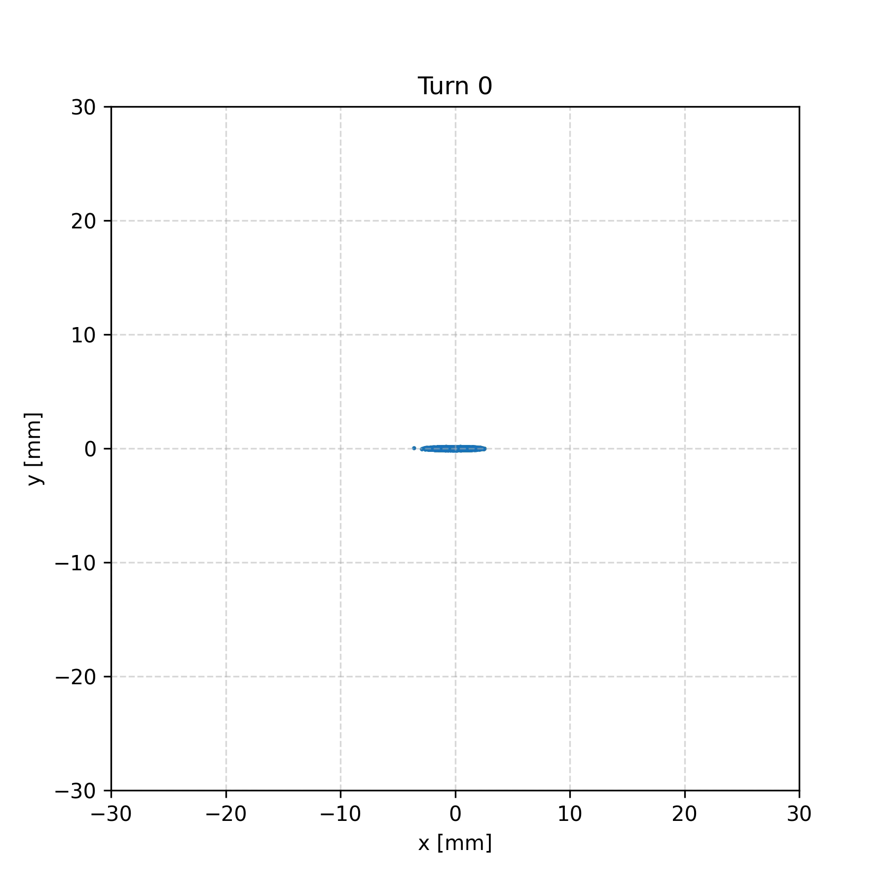

Transverse beam position at primary collimator
16/12/2024 FCC-ee MDI meeting
Giulia Nigrelli
13
$$\text{V} \text{0°} τ=3$$
The beam oscillate coherently along the vertical axis for many turns until the dynamic aperture is reached → beam distribution blows up.
Ongoing studies to tighten the vertical collimator’s apertures up to the DA.
This animation does not include scattering in the collimators.
Notes:
EXAMPLES PICTURES OF WORST TURN FOR BOTH VERTICAL/HORIZONATLA ND 3/6 TURNS
HIGLITH THAT 50% OF THE ENRìTIRE BEAM IS LOST IN 1 TURN
Highligth that the entire beam is lost within 20 turn but losses are observed only uring the last few turn
GIVE RANGE OF ENERGY LOST BEFORE THE BOOM, IS IT DETECTABLE?

Slide 14
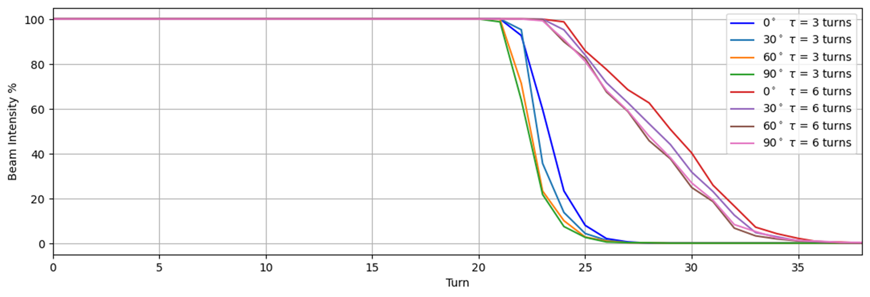
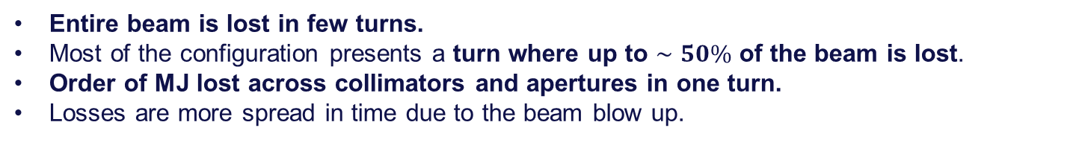
Beam intensity
16/12/2024 FCC-ee MDI meeting
Giulia Nigrelli
14
Entire beam is lost in few turns.
Most of the configuration presents a turn where up to $∼50\%$ of the beam is lost.
Order of MJ lost across collimators and apertures in one turn.
Losses are more spread in time due to the beam blow up.

Slide 15
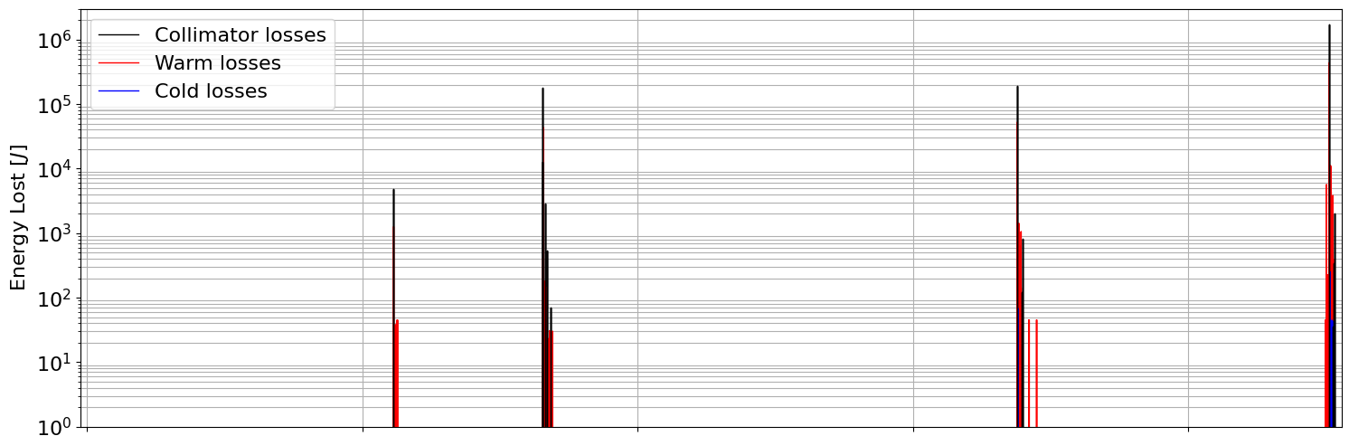
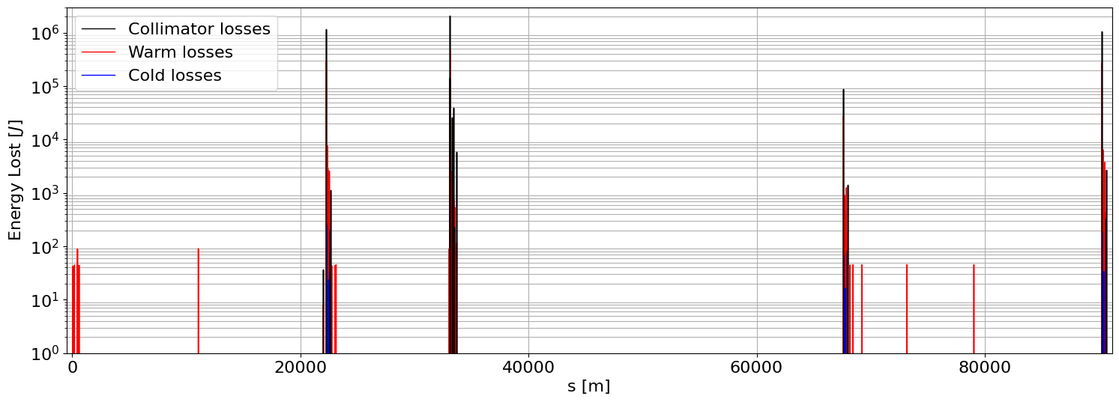


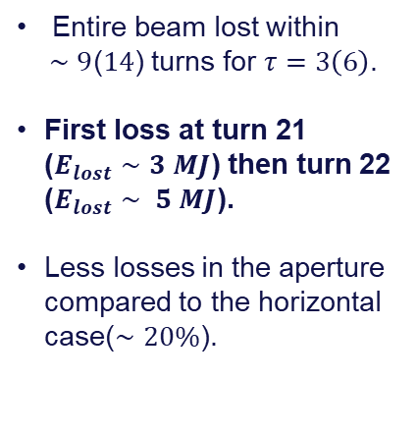
Lossmaps: worst case
16/12/2024 FCC-ee MDI meeting
Giulia Nigrelli
15
IPA
PB
IPD
PF
IPG
PH
IPJ
PL
IPA
$$\text{Turn} \text{21} \text{V} \text{0°} τ=3$$
Entire beam lost within
$∼9$($14$) turns for $τ=3\left(6\right)$.
First loss at turn 21 ($E_{lost}∼3 MJ$) then turn 22 ($E_{lost}∼ 5 MJ$).
Less losses in the aperture compared to the horizontal case($∼20\%$).
$$\text{Turn} \text{22} \text{V} \text{0°} τ=3$$

Slide 16
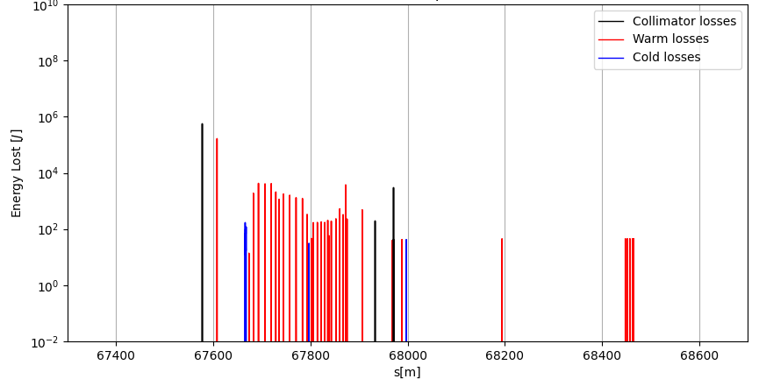
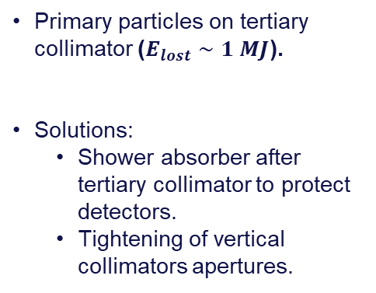

Lossmaps: Interaction regions (IPJ)
16/12/2024 FCC-ee MDI meeting
Giulia Nigrelli
16
$$\text{V} \text{0°} τ=3$$
TCT
Primary particles on tertiary collimator ($E_{lost}∼1 MJ$).
Solutions:
  Shower absorber after tertiary collimator to protect detectors.
  Tightening of vertical collimators apertures.
SR
IPJ

Slide 17
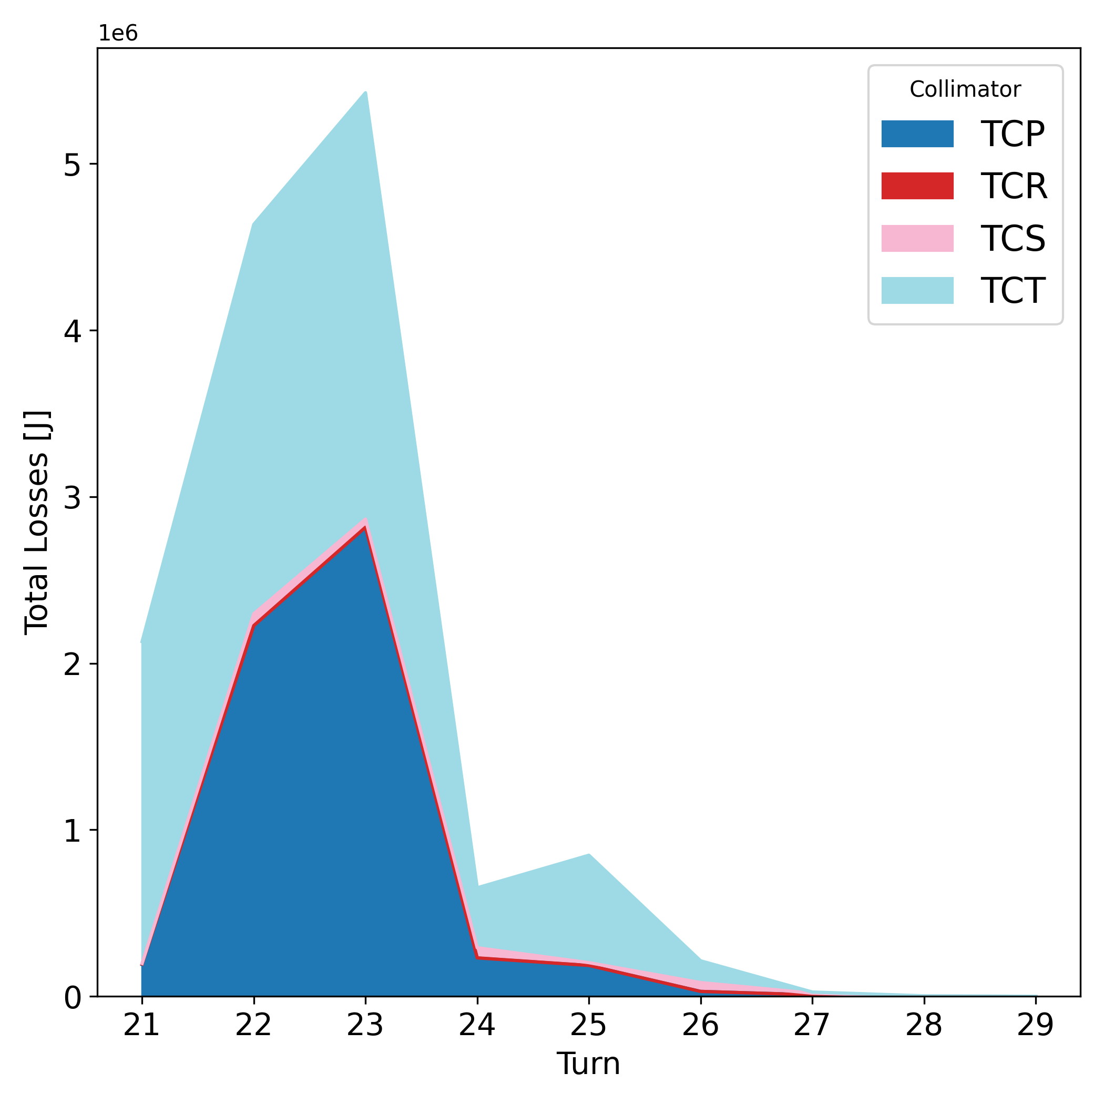
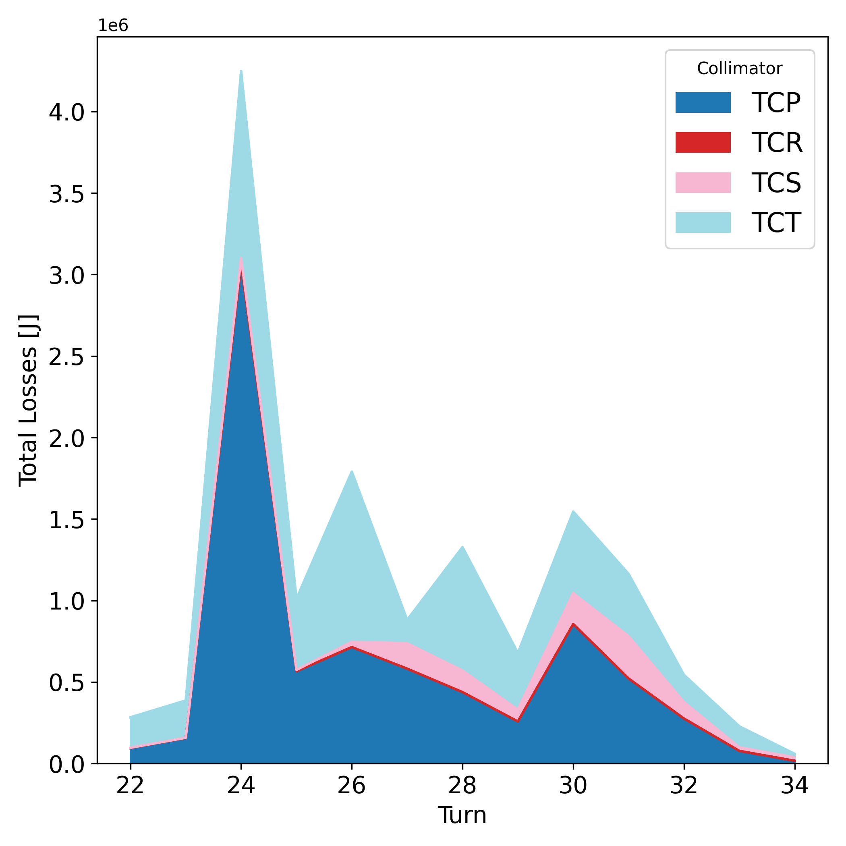


Losses across collimators
16/12/2024 FCC-ee MDI meeting
Giulia Nigrelli
17
Total loss on same type of collimator shows the same characteristic of the horizontal case:
  Primary collimators not always absorb most of the energy lost → primaries on tertiary collimators.
  Significant losses in the tertiary collimators, efficiently protecting SR collimators.
$$\text{V} \text{0°} τ=3$$
$$\text{V} \text{0°} τ=6$$
anchor

Slide 18
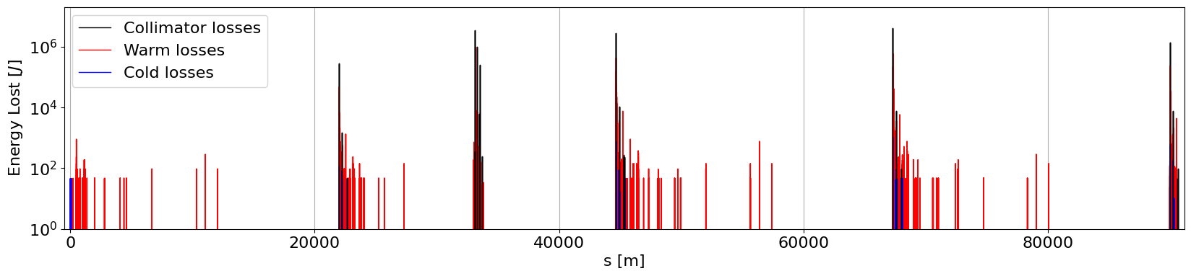
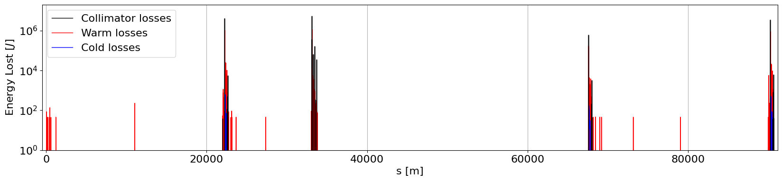
Integrated lossmaps over all turns H vs V
16/12/2024 FCC-ee MDI meeting
Giulia Nigrelli
18
IPA
PB
IPD
PF
IPG
PH
IPJ
PL
IPA
Horizontal 0° 3 turns
Vertical 0° 3 turns

Slide 19
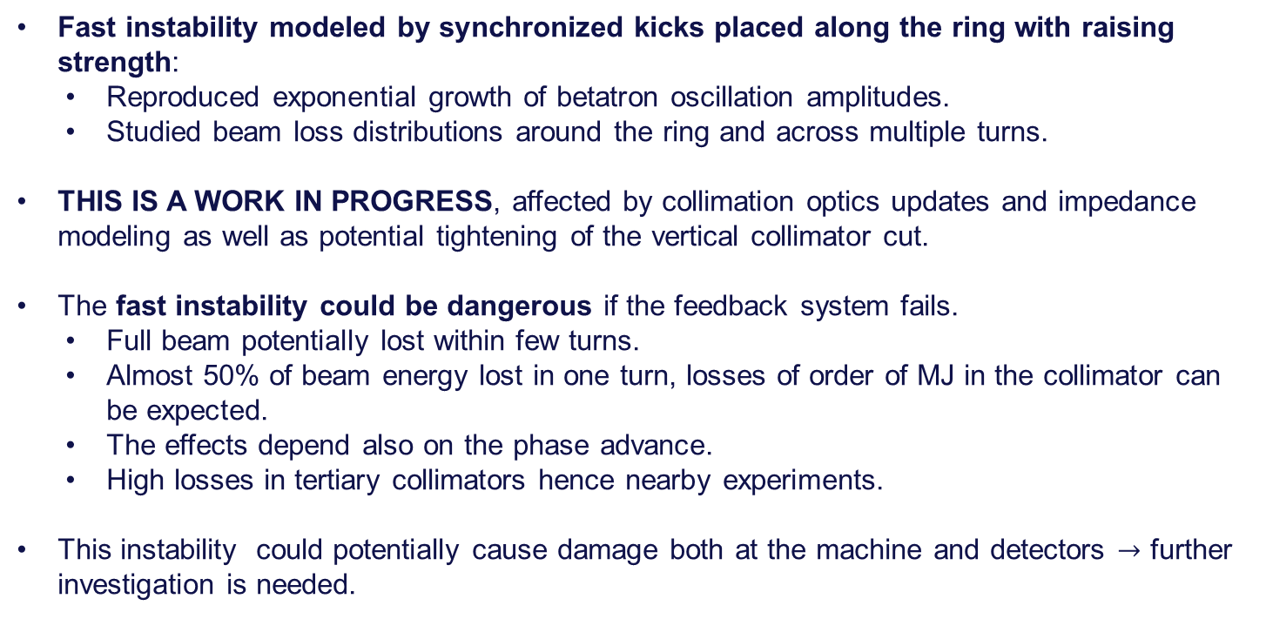
Conclusions
16/12/2024 FCC-ee MDI meeting
Giulia Nigrelli
19
Fast instability modeled by synchronized kicks placed along the ring with raising strength:
  Reproduced exponential growth of betatron oscillation amplitudes.
  Studied beam loss distributions around the ring and across multiple turns.
THIS IS A WORK IN PROGRESS, affected by collimation optics updates and impedance modeling as well as potential tightening of the vertical collimator cut.
The fast instability could be dangerous if the feedback system fails.
  Full beam potentially lost within few turns.
  Almost 50% of beam energy lost in one turn, losses of order of MJ in the collimator can be expected.
  The effects depend also on the phase advance.
  High losses in tertiary collimators hence nearby experiments.
This instability could potentially cause damage both at the machine and detectors $→$ further investigation is needed.

Slide 20
Next steps
16/12/2024 FCC-ee MDI meeting
Giulia Nigrelli
20
Energy deposition studies → impact distributions on collimators jaws provided to the FLUKA team.
High losses nearby experiments, shower calculation in the detector regions are needed.
Mitigating potential damage: the machine needs to be design such that this instability doesn’t occur:
  redundancy in damper system,
  Interlocks,
  reduced impedance,
  high chromaticity,
  …

Slide 21
Thank you for your attention!
16/12/2024 FCC-ee MDI meeting
Giulia Nigrelli

Slide 22
Backup

Slide 23
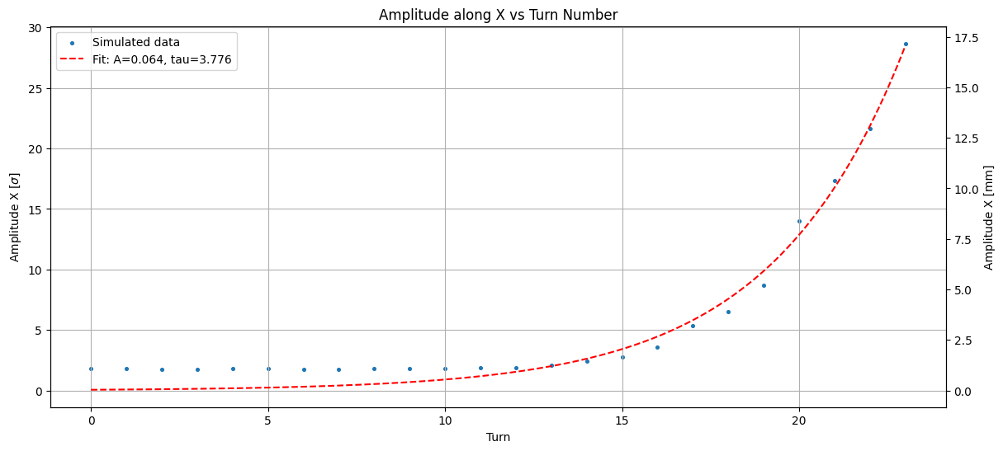
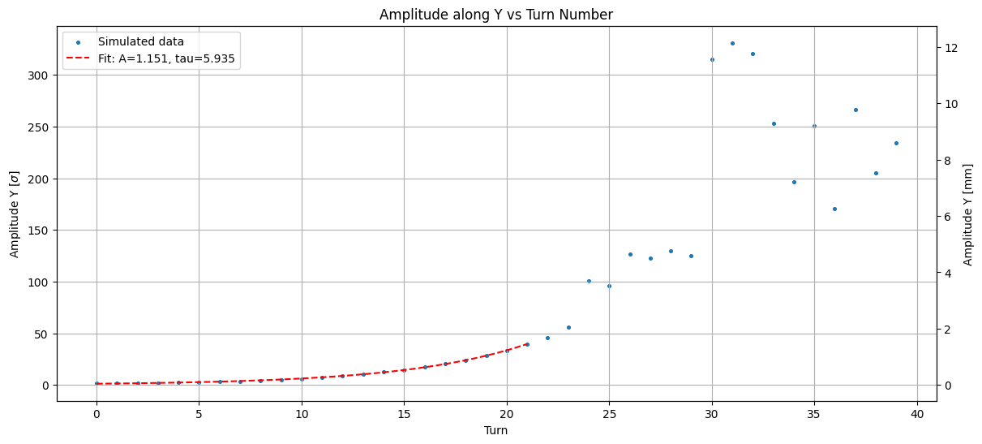
Horizontal: 3 turns
Giulia Nigrelli
23
At primary collimator.
Vertical: 6 turns

Slide 24
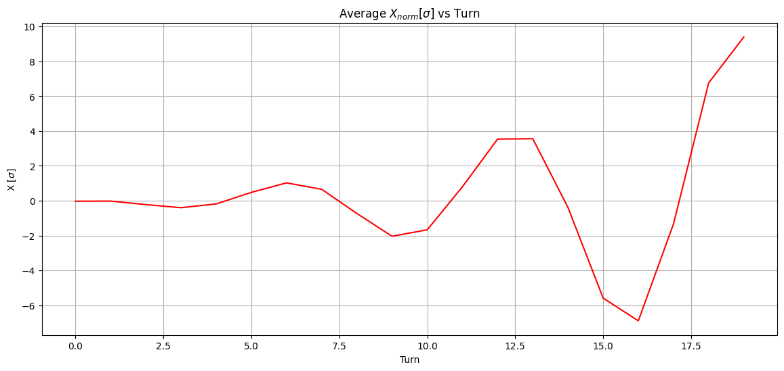
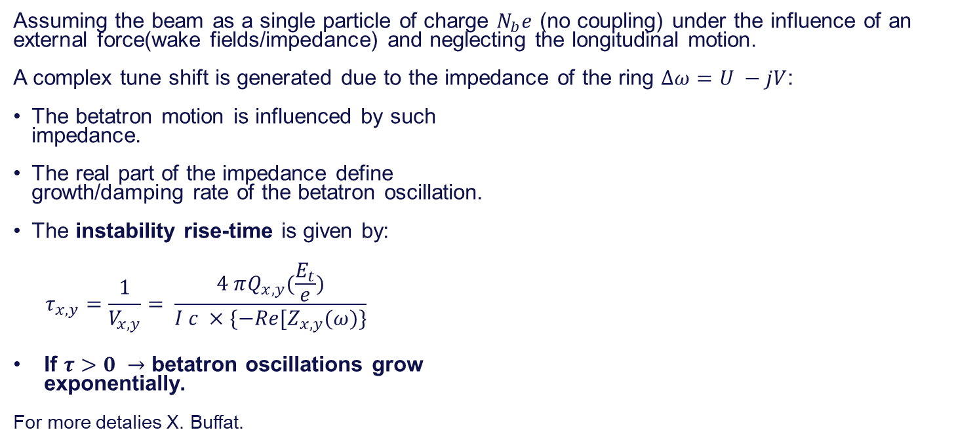
Fast instability: Introduction
04/11/2024 / 2nd FCC Italy & France Workshop
Giulia Nigrelli
24
Assuming the beam as a single particle of charge $N_{b}e$ (no coupling) under the influence of an external force(wake fields/impedance) and neglecting the longitudinal motion.
A complex tune shift is generated due to the impedance of the ring $Δω=U −jV$:
The betatron motion is influenced by such
impedance.
The real part of the impedance define
growth/damping rate of the betatron oscillation.
The instability rise-time is given by:
$$τ_{x,y}=\frac{1}{V_{x,y}}= \frac{4 πQ_{x,y}(\frac{E_{t}}{e})}{I c ×\{−Re[Z_{x,y}(ω)\}}$$
If $τ>0 →$ betatron oscillations grow
exponentially.
For more detalies X. Buffat.

Slide 25
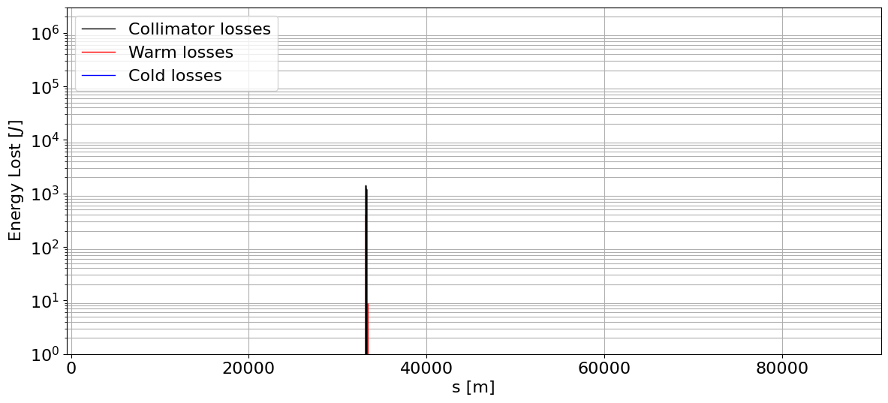
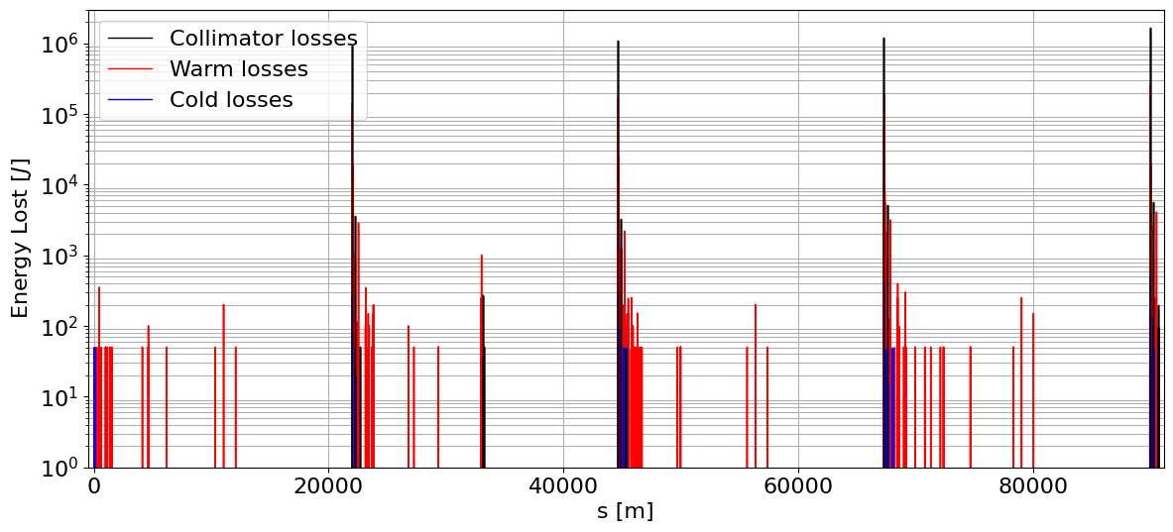
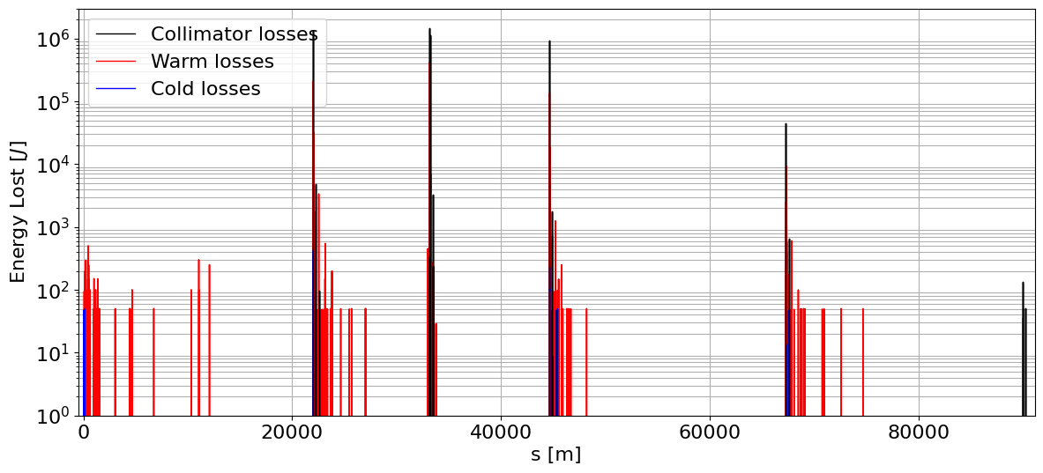




Lossmaps: Time distribution
28/11/2024 10th FCC-ee Machine Protection Task Force meeting
Giulia Nigrelli
25
IPA
PB
IPD
PF
IPG
PH
IPJ
PL
IPA
PB
IPD
PF
IPG
PH
IPJ
PL
IPA
$$\text{Turn} \text{21} \text{H}$$
$$\text{3}\text{0°} τ=6$$
$$\text{Turn} \text{22} \text{H}$$
$$\text{3}\text{0°} τ=6$$
$$\text{Turn} \text{23} \text{H}$$
$$\text{3}\text{0°} τ=6$$
$$\text{Turn} \text{24} \text{H}$$
$$\text{3}\text{0°} τ=6$$

Slide 26
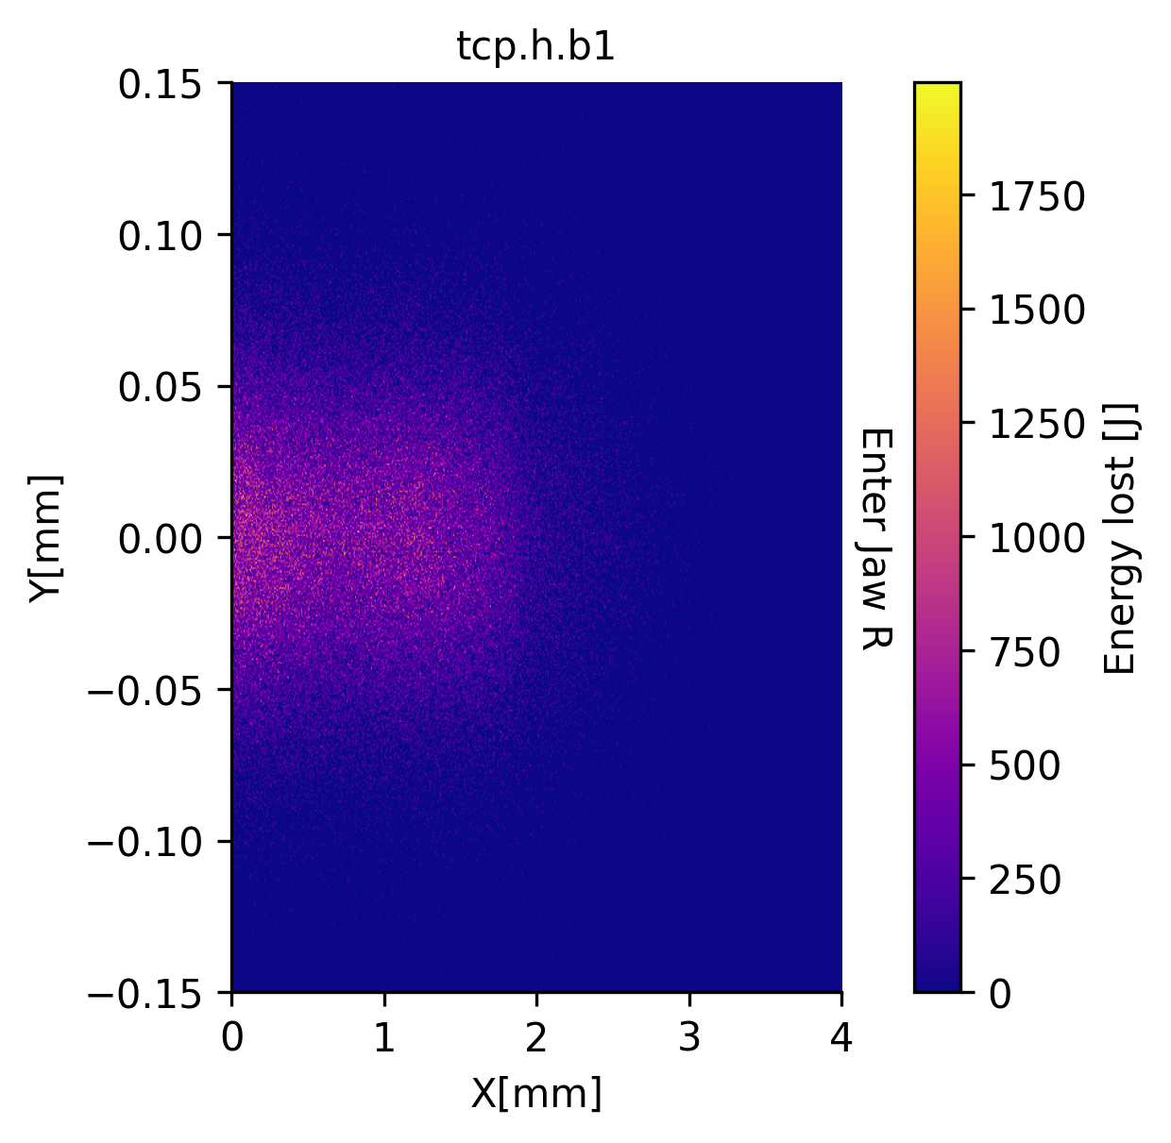
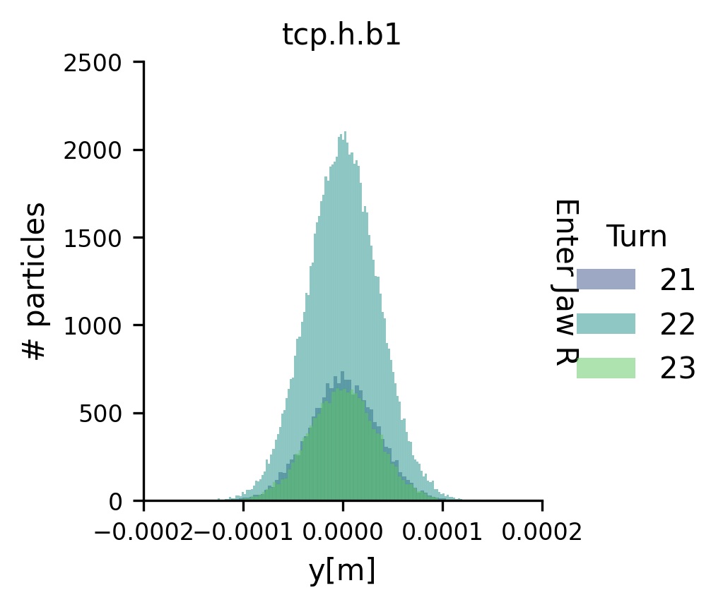
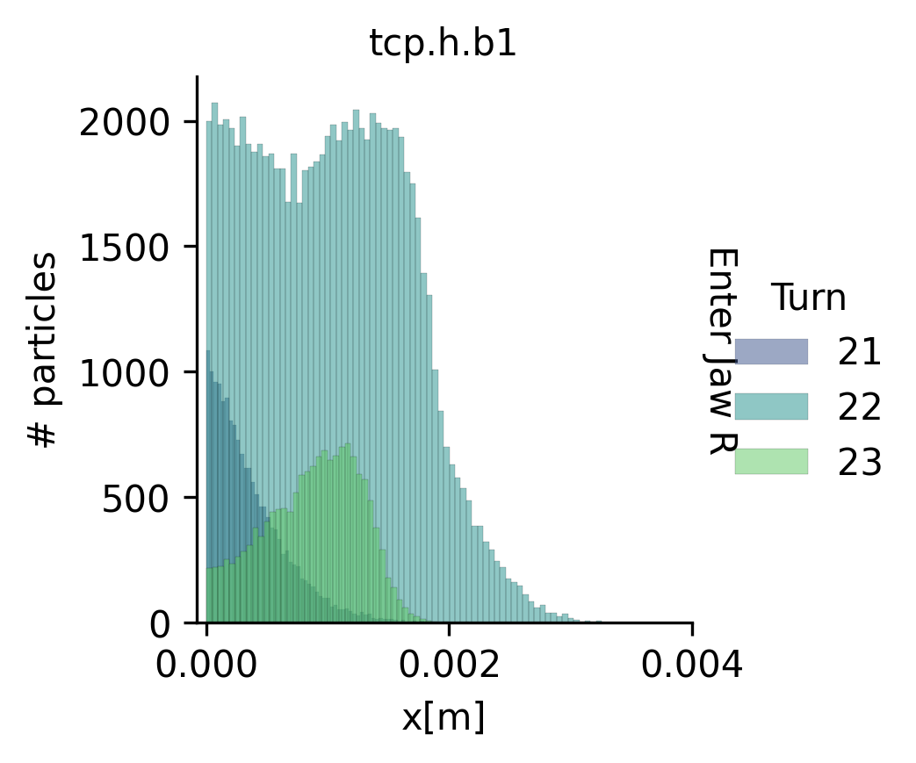

Collimator impact distributions
28/11/2024 10th FCC-ee Machine Protection Task Force meeting
Giulia Nigrelli
26
Considering the configuration $μ= \text{0°} τ=3$:
anchor
Impact distributions have been provided to the FLUKA team for energy deposition studies.
Note: Axes are with respect to the collimator system.

Slide 27
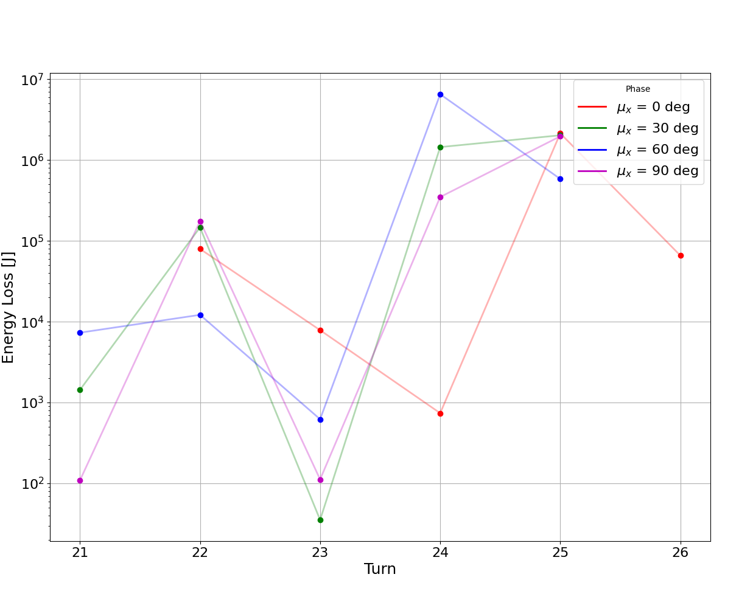
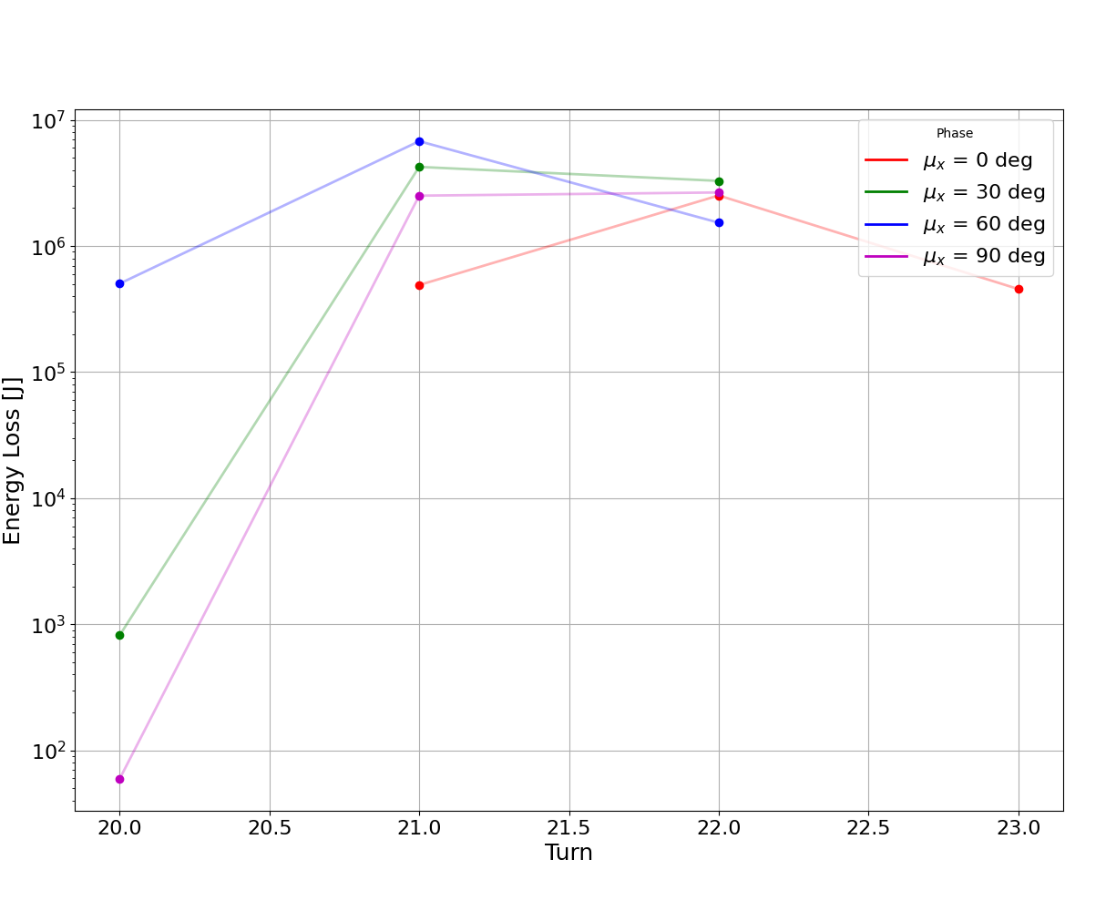


Losses at the primary collimator (tcp.h.b1)
28/11/2024 10th FCC-ee Machine Protection Task Force meeting
Giulia Nigrelli
27
To compare the various cases is useful to look at the losses in the primary with respect to time:
$$τ=6$$
$$τ=3$$

Slide 28
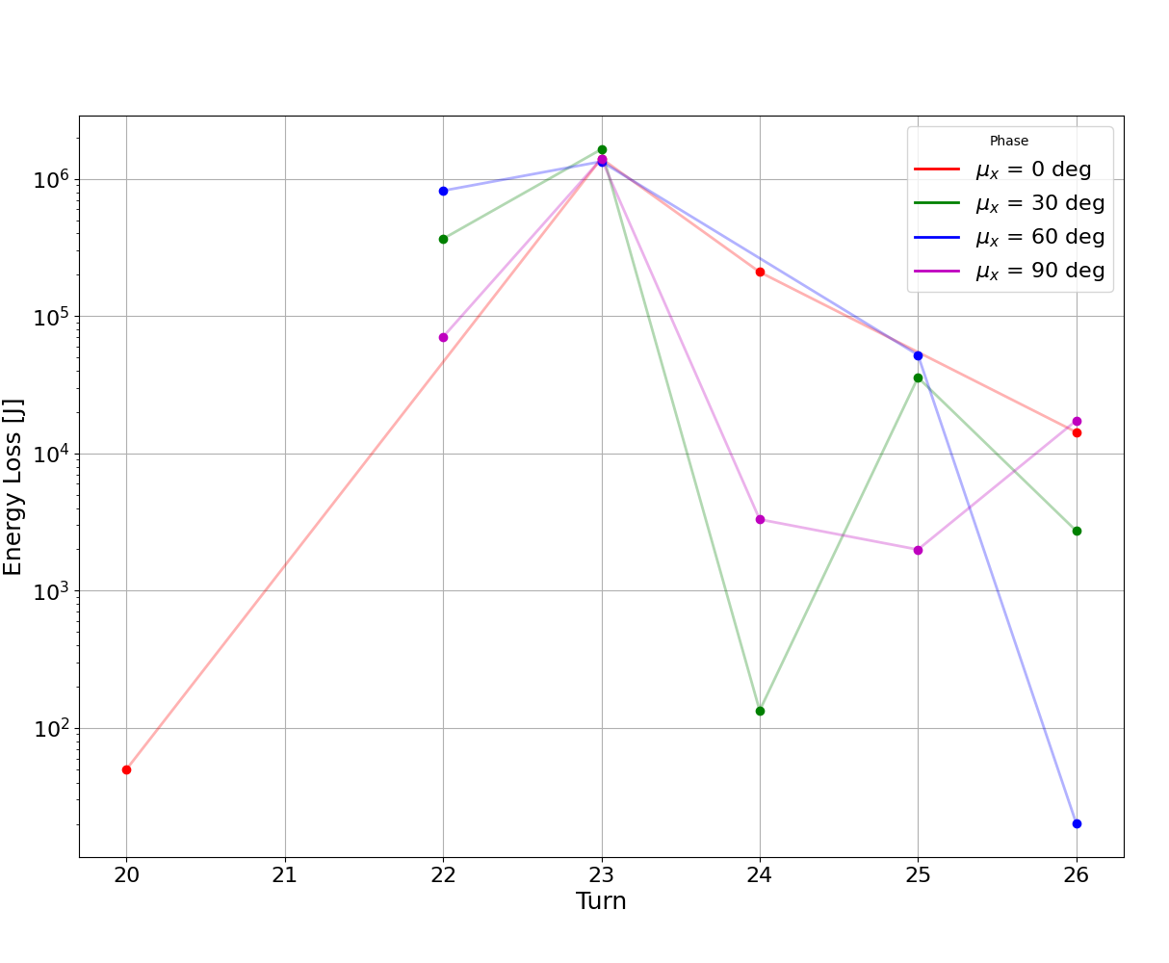
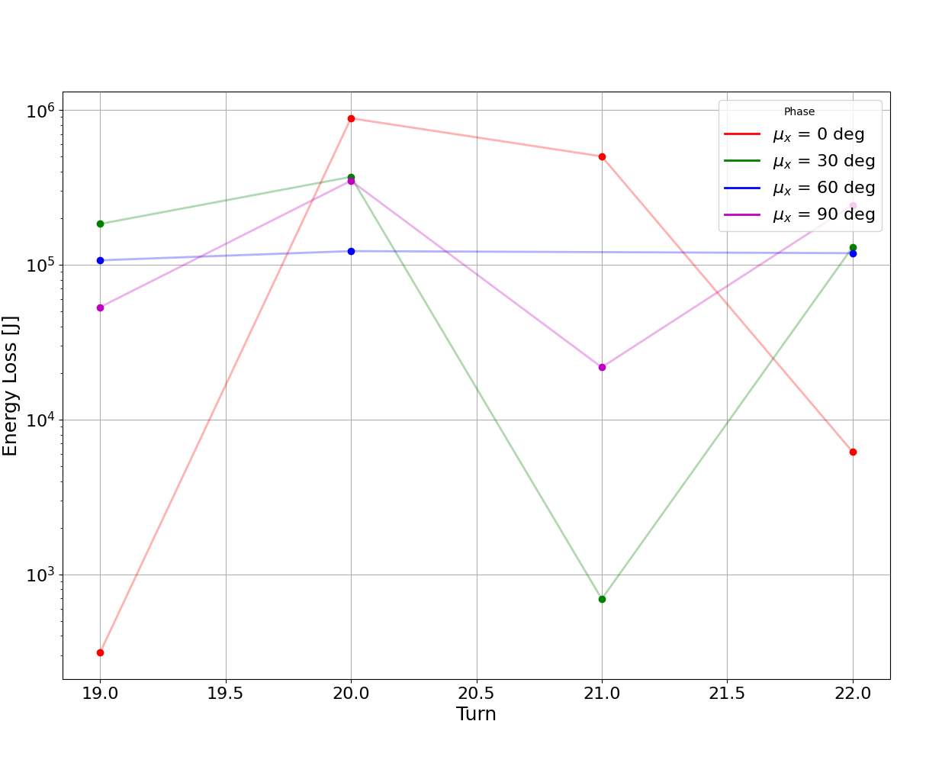
Losses at the tertiary collimator (tct.h.1.b1)
28/11/2024 10th FCC-ee Machine Protection Task Force meeting
Giulia Nigrelli
28
To compare the various cases is useful to look at the losses in the primary with respect to time:
$$τ=6$$
$$τ=3$$

Slide 29
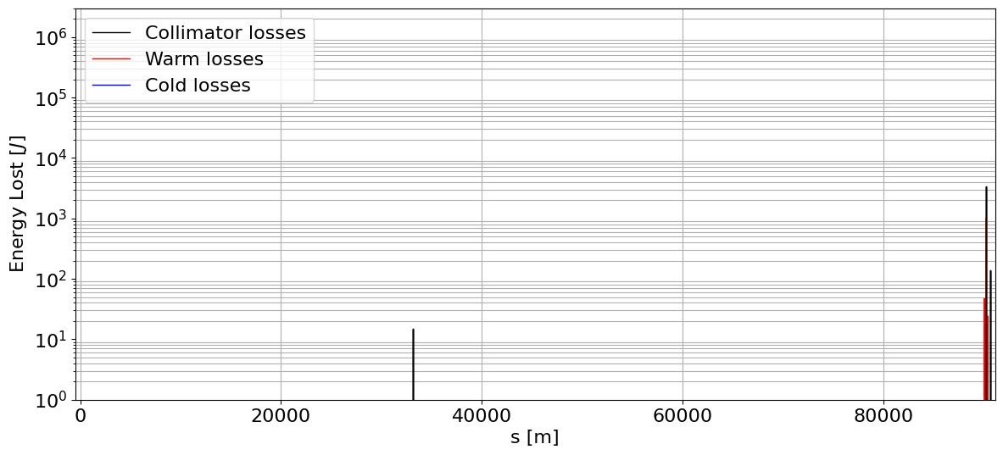
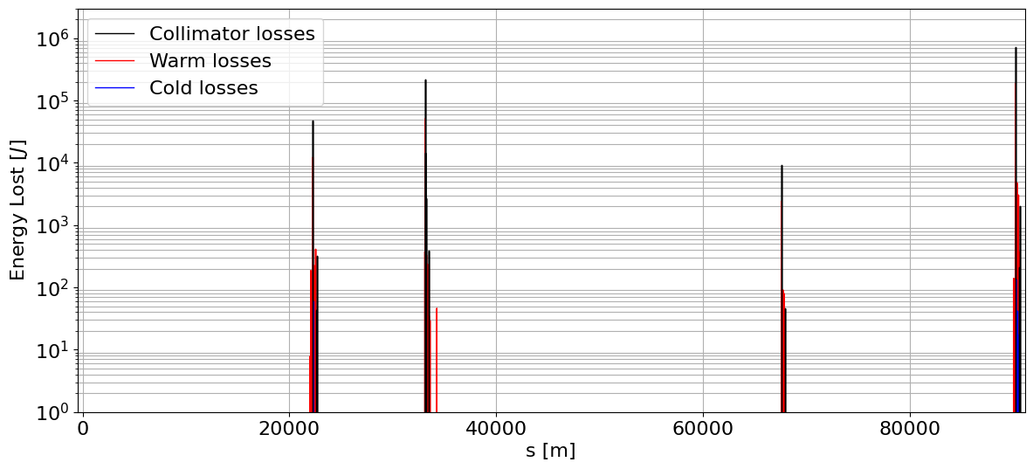
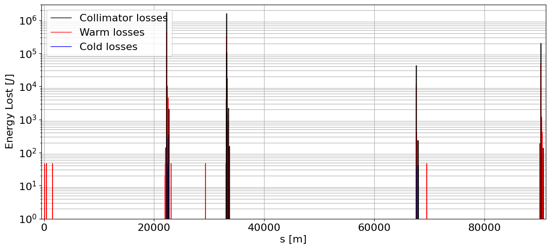




Lossmaps: Time distribution
28/11/2024 10th FCC-ee Machine Protection Task Force meeting
Giulia Nigrelli
29
IPA
PB
IPD
PF
IPG
PH
IPJ
PL
IPA
PB
IPD
PF
IPG
PH
IPJ
PL
IPA
$$\text{Turn} \text{21} \text{V}$$
$$\text{3}\text{0°} τ=6$$
$$\text{Turn} \text{22} \text{V}$$
$$\text{3}\text{0°} τ=6$$
$$\text{Turn} \text{23} \text{V}$$
$$\text{3}\text{0°} τ=6$$
$$\text{Turn} \text{24} \text{V}$$
$$\text{3}\text{0°} τ=6$$
Notes:
Lossmaps at each turn have been generated to study the time distribution of the losses:

Slide 30
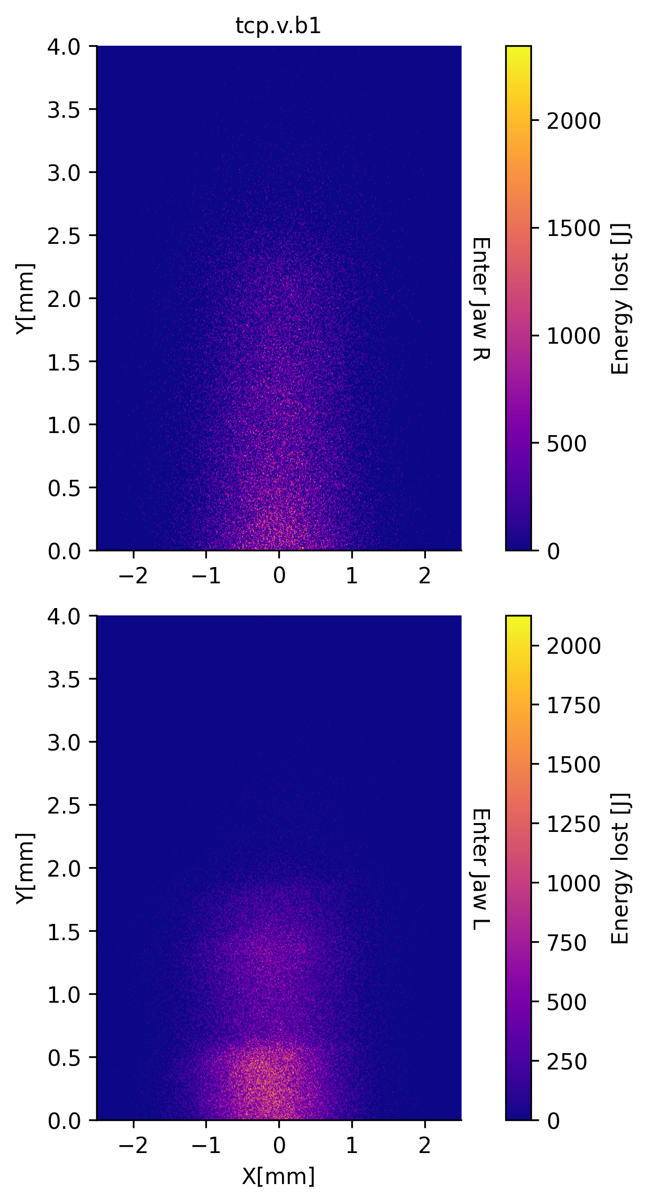
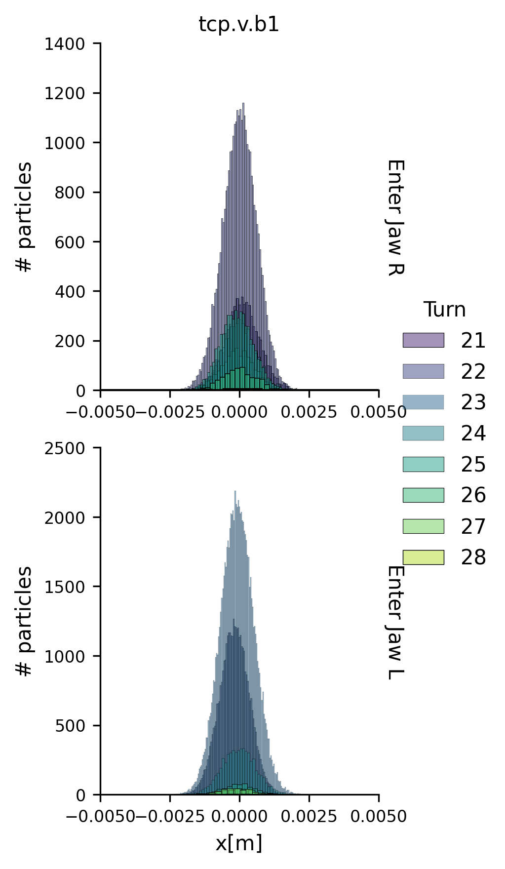
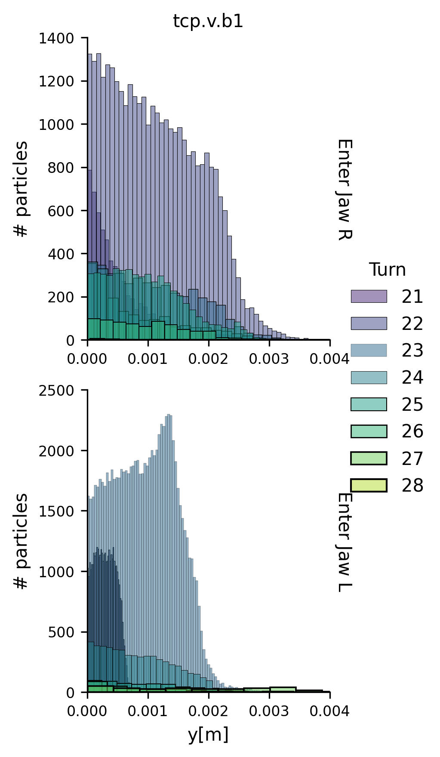

Collimator impact distributions
28/11/2024 10th FCC-ee Machine Protection Task Force meeting
Giulia Nigrelli
30
For the configuration $μ= \text{0°} τ=3$:
Impact distributions have been provided to the FLUKA team for energy deposition studies.

Slide 31
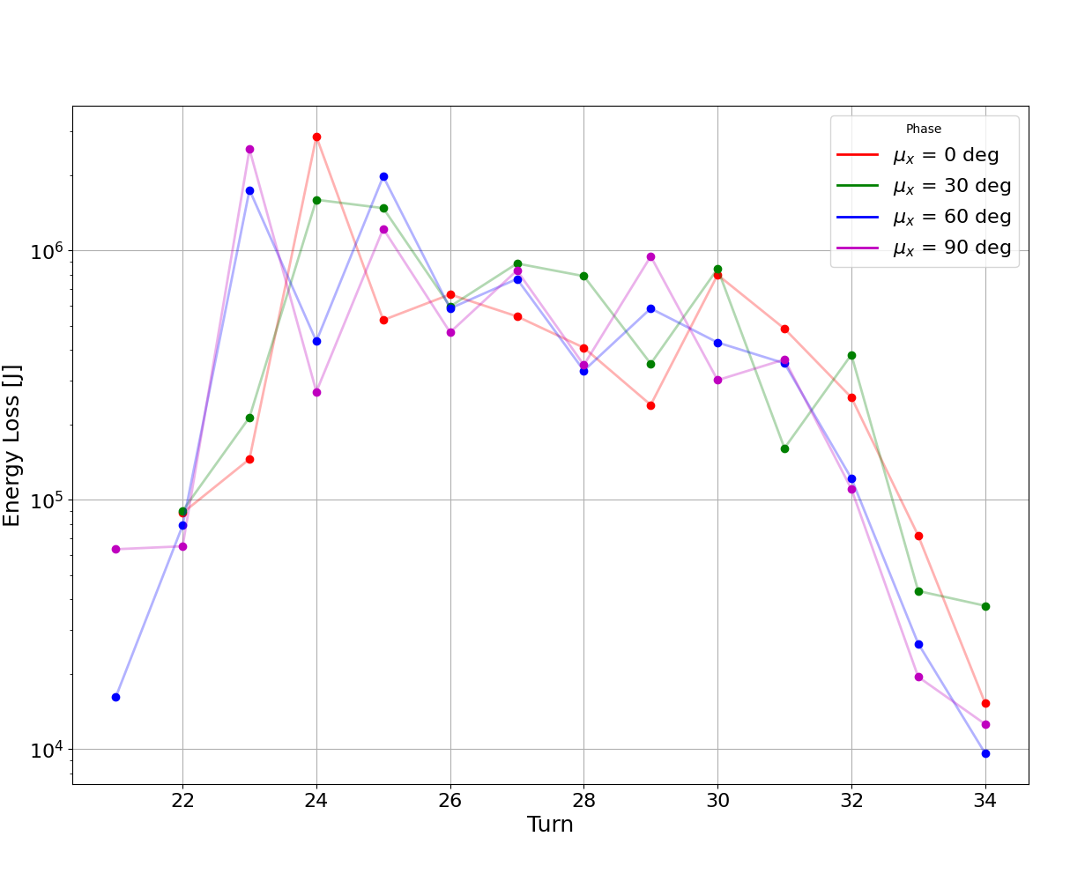
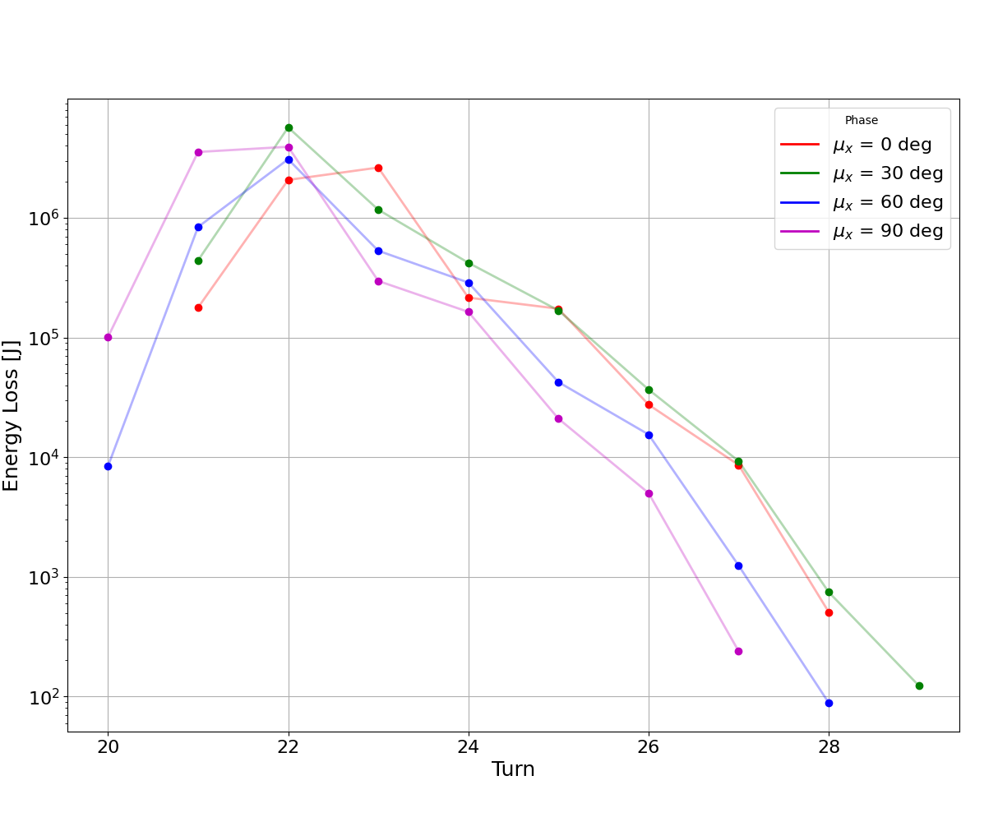
Losses at the primary collimator (tcp.v.b1)
28/11/2024 10th FCC-ee Machine Protection Task Force meeting
Giulia Nigrelli
31
To compare the various cases is useful to look at the losses in the primary with respect to time:
$$τ=6$$
$$τ=3$$

Slide 32
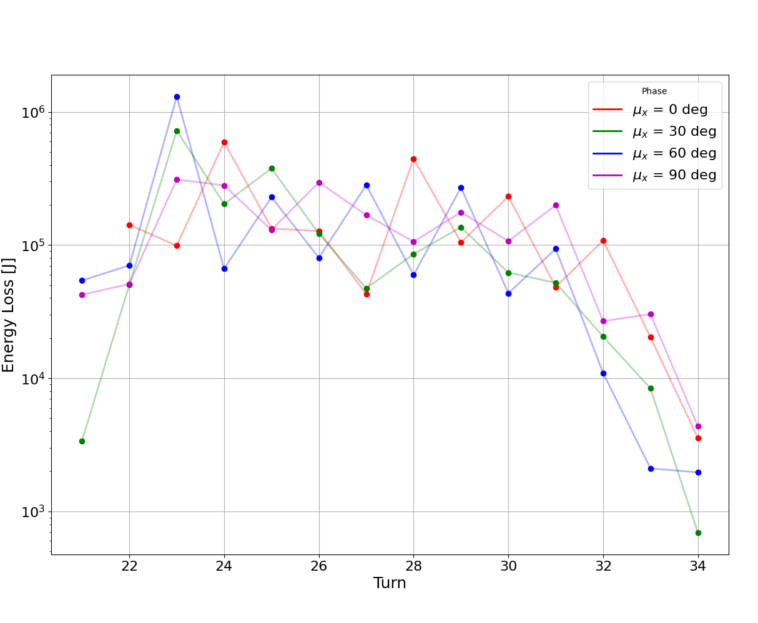

Losses at the tertiary collimator (tct.v.1.b1)
28/11/2024 10th FCC-ee Machine Protection Task Force meeting
Giulia Nigrelli
32
To compare the various cases is useful to look at the losses in the primary with respect to time:
$$τ=6$$
$$τ=3$$

Slide 33
Colors
Backgrounds
Background Blue
Background Purple
Background Yellow
Background Grey
Use for Layout
Radiant Blue
Flash
Energy
Green
Red
Deep
Blue

Slide 34

Graphical Elements
Badges
This information is a badge because it is important!
This information is a badge because it is important!
Separation lines 1.5 pt
Arrows
Use blue badges on light backgrounds
Infographics
This information is a badge because it is important!
This information is a badge because it is important!
Use light badges on dark backgrounds

