Slide 1
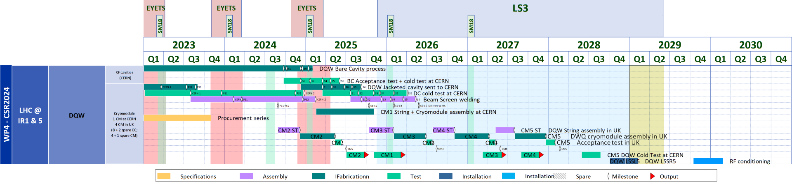
Schedule for DQW Modules
Two cavities fully qualified to 4.7 MV → at UK for cryostating. Two additional cavities at CERN qualified up to 3.7 MV. Retesting to understand limits. CM expected to finish Q1 2026
All cavities welded at Research instruments; two of cavities may have welding NCRs under investigation. If critical, back-up is being prepared to recuperate two cavities from SPS-DQW (check impedance) or build two additional cavities at CERN
sufficient float

Slide 2
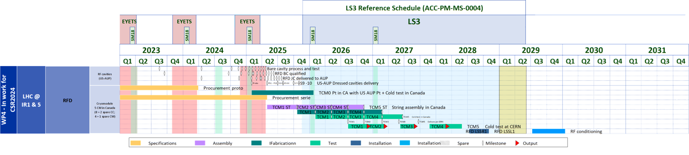
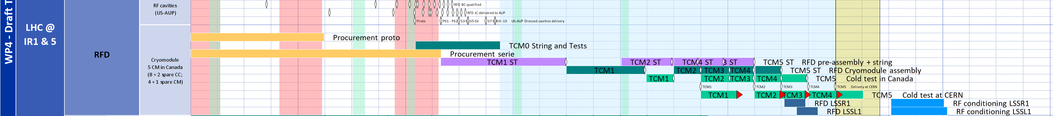
New dates for RFD-CMs
Baseline CSR24
TRIUMF new dates
TCM3-4 outside the installation window, options under investigation
Adding LS3 shift → +2 (TCM3)

Slide 3
Main options under discussion
Not for distribution
Evaluate the minor adaptations for SPS-RFD to be installed in the HL-LHC
  May have voltage limitations on C1 due to coupler NCR
Check if swap of DQW #5 & TCM #5 between UK and Canada is feasible
  Requires a full tooling exchange and collaboration constraints
Construction of 1-3 RFD cavities is being estimated for budget/schedule. Jacket them along with qualified RFD #3 to have enough for 2-CMs
  UK-STFC cryostats one more RFD module or DQW module while CERN builds the RFD module
Evaluate installation feasibility for RFD #4 post LS3
  Study ongoing under the HL-project (Markus/Paolo)

Slide 4
Where do we stand today
Baseline strategy is to install all modules at IP1 & IP5 in LS3
  Due to delays at US-AUP & new TRIUMF schedule, we may have to use RFD-proto with known present limit at 2.1 MV during SM18 tests
If delayed installation of 1 RFD-CM, nominal crabbing from 2nd year. During 1st year crabbing on at least one beam will be available for commissioning & MDs
  This will likely require warm-up of IR to connect cryomodules and some additional time for commissioning of the new module

