Slide 1

DAMSA Experiment Overview
1st DAMSA Collaboration Meeting
January 16 – 18, 2025
University of Texas at Arlington
Jaehoon Yu, Juan Estrada and Un-Ki Yang
For the DAMSA Collaboration

Slide 2
What is DAMSA?
A very short baseline dark sector particle (DSP) search and discovery experiment at high intensity p beams
Stands for DAark Messenger Searches at an Accelerator (DAMSA, pronounced da-am-sa)
  담사 (潭思) = 깊은생각 – Rumination or Reflection
    J. Yu et al., PRD 107, L031901 (2023)
Aims to discover DSP’s in the low mass regime at an accelerator ➔ E_{beam} below the pion threshold beneficial
  Originally developed for 600MeV proton beams at a nuclear rare isotope facility
  The 800MeV PIP-II and the ACE beams at Fermilab fit the bill
DAMSA can be at any accl. facility, including CERN

Slide 3
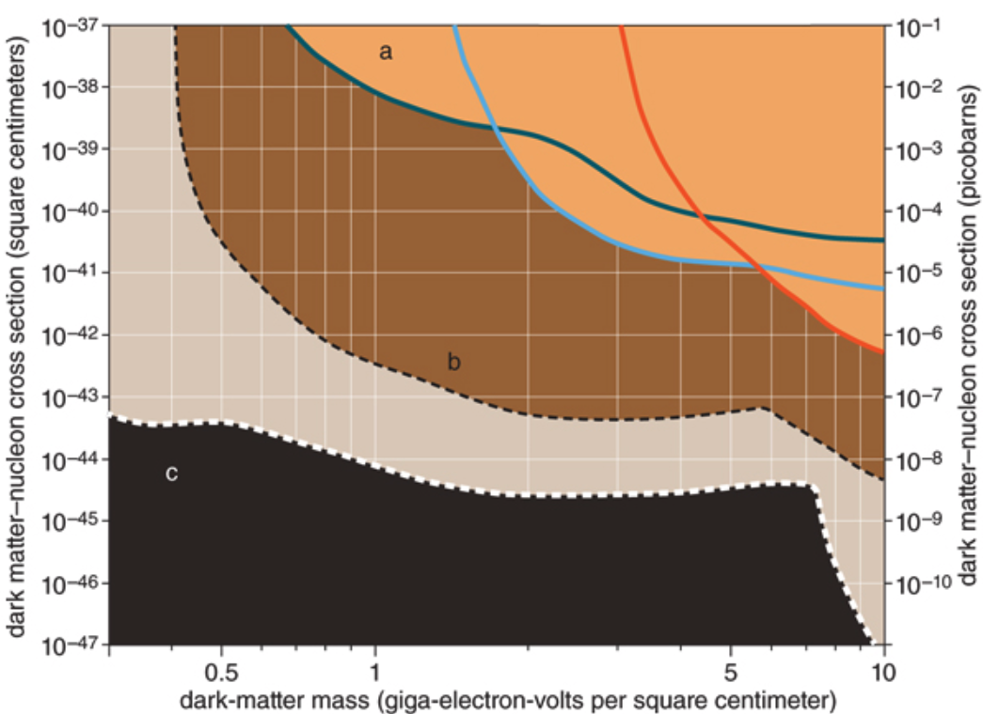
Physics Motivation For DSP
Direct searches have challenges in kinematic reach, leaving low mass range un-explored
Strategy:
  Search for dark sector particles in unexplored kinematic regime
  Make and discover DSPs in an accelerator
  Establish human infra on DM production & US leadership
No DM
Focus
here
Future: SuperCDMS SNOLAB
Solar Neutrino Background

Slide 4
Unique Opportunity on Dark Sector
Many DM search experiments in beams BUT
None of them at a super-short baseline (<1m)!
  Yes, it presents a significant challenge
This makes DAMSA unique!
DAMSA is a small-size experiment with good physics cases and provides an excellent opportunity to enhance international collaboration

Slide 5
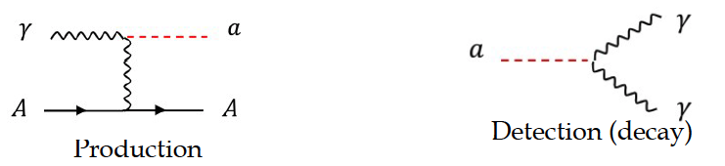
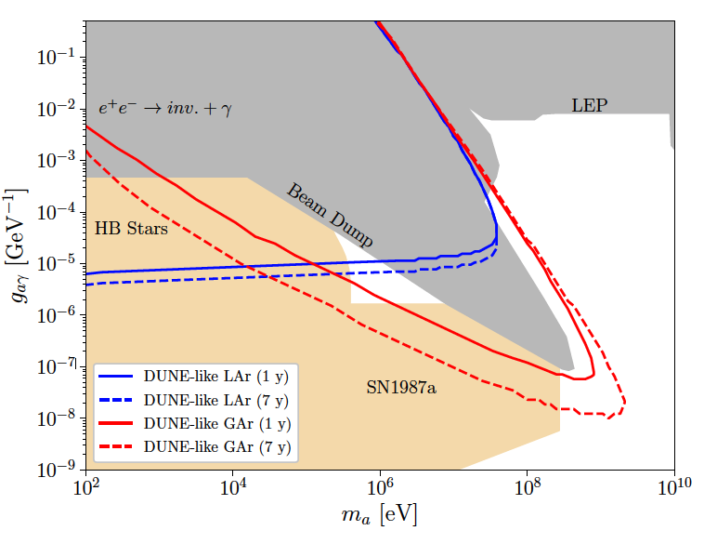
DAMSA Physics Strategy
Photons are the sources for dark sector particle production
  Use case: Axion-like particles (ALP) in two-photon final state via the Primakoff process
  Brdar, Yu et al., PRL126, 201801 (2021)
What is the most peculiar feature of the DUNE sensitivity reach?
This edge limited (ceiling) by the distance from the source to the detector
  Kim, Yu et al., 2401.09529 (2024)

Slide 6
DAMSA Physics Strategy
Photons are the sources for dark sector particle production
  Use case: Axion-like particles (ALP) in two-photon final state via the Primakoff process
Produce as many photons as possible from the beam
Capture as many ALPs in as wide a mass range as possible
Mitigate the backgrounds from neutral particles, using two EM particle final states
Place the detector very close to the beam
  Brdar, et al., PRL126, 201801 (2021)
Note : ND-GAr only in DUNE Phase-II
Focus here

Slide 7
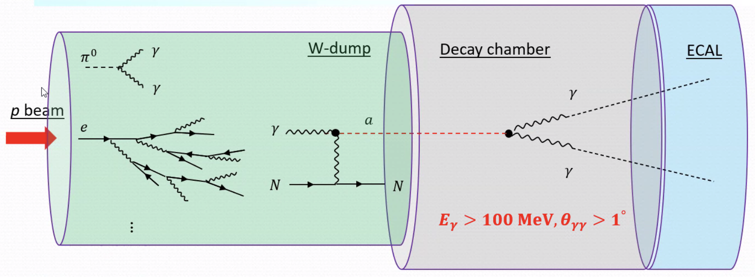
DAMSA Exp. Concept
Inject and absorb as many protons and produce as large number of γ in the dump as possible
Allow higher coupling ALP’s to decay in the vacuum w/ as small number of neutrons escaping the dump as possible
Place the detector as close to the dump as possible on axis to expand the mass reach to higher mass region
NOT TO SCALE
D=10m, L = full containment
D=1m, L=1m
D=10m, L=10m

Slide 8
Physics Driven DAMSA Detector
Discover dark sector particles beyond 2γ ALP, such as
  Dark photon / ALP to e+e-
  HNL, Low mass dark matter, etc
Based on the signal and neutron background mitigation studies, using GEANT4 ➔ Detector assumptions
  Fine granularity for a superb shower position and angular resolutions for 2 EM particle vertex pointing & DCA precision better than 1cm in the vacuum decay volume
  Fast timing capability at sub-ns level (~100ps) for two EM particle arrival time differences
  Capability of measuring up to 500 MeV photons with as fine a mass resolution as accomplishable

Slide 9
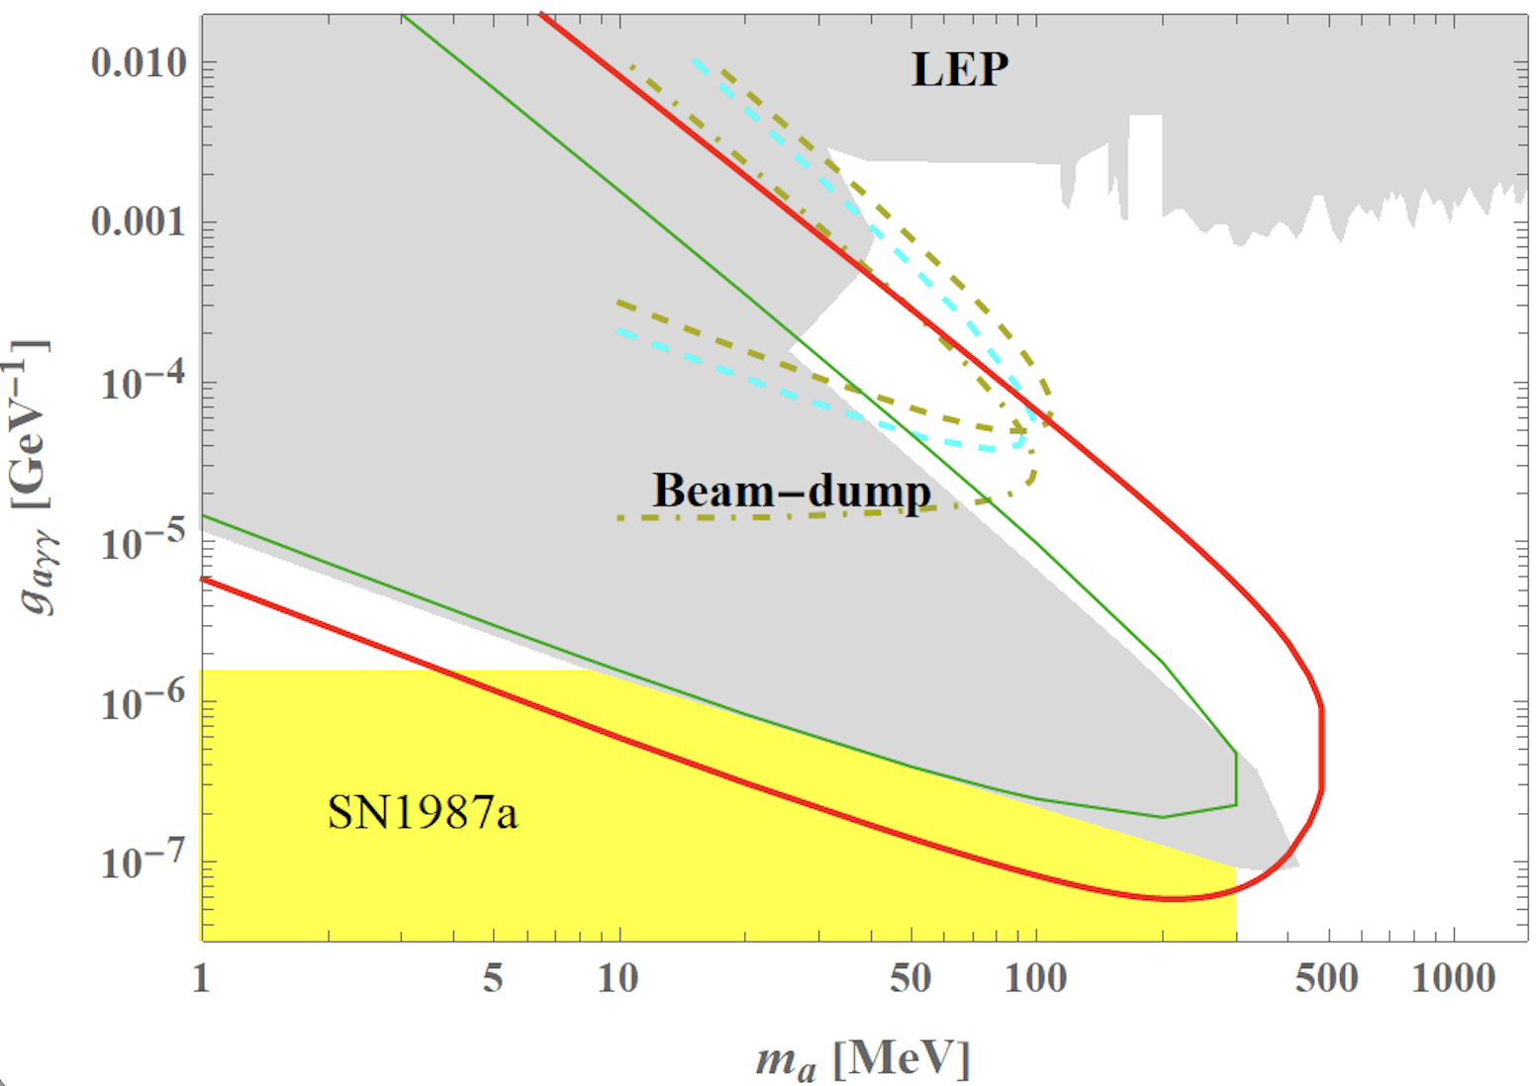
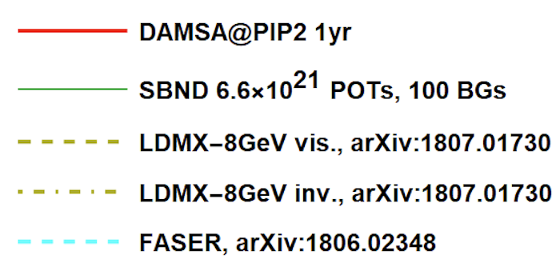
DAMSA Sensitivity – Running Experiments
Year 2031

Slide 10
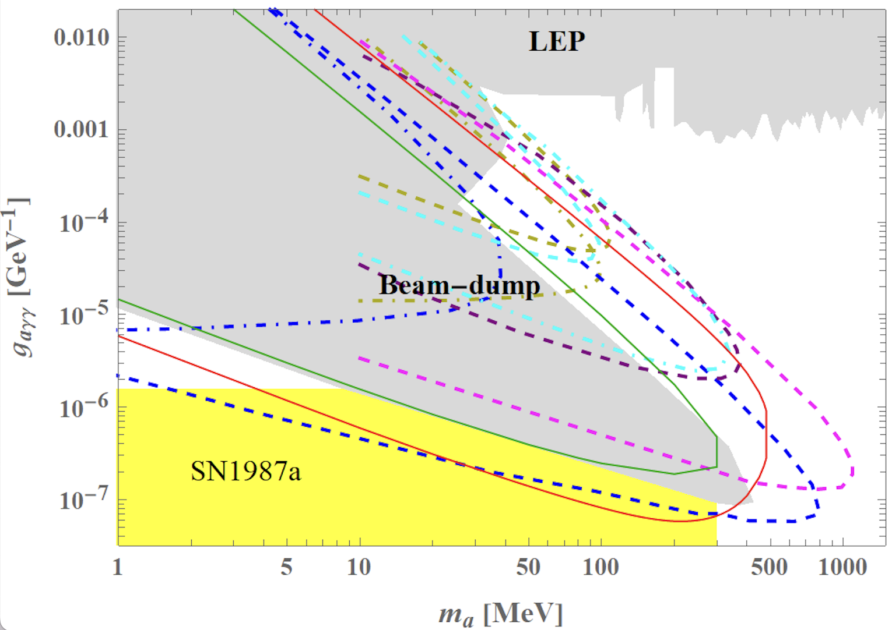
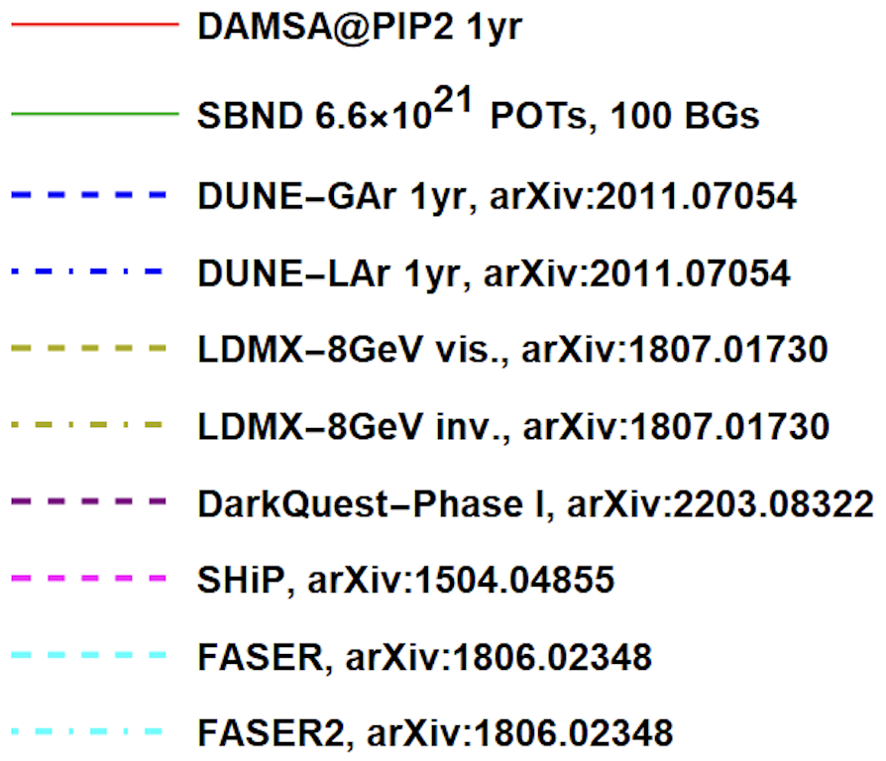
DAMSA Sensitivity – All Experiments
Apologize for missing ones

Slide 11
Detector Design Concept
2DST W-Scint
ECAL (~13 X₀)
Tail catcher
ECAL (~5 X₀)
Vacuum Decay Chamber
HD HG-ECAL - γ converter
(4 low X₀ layers ~3X₀)
6 layers of Si trk
Magnet

Slide 12
The Little DAMSA
The question: Can we access the targeted parameter space with a dramatically smaller scale experiment (2401.09529)?
  Concept Study: L_{dump}=1m, D_{vac}=10m, L_{vac}=10m, θ_{det}=0.5rad, N_{yr}=1yr
  Smaller scale: L_{dump}=1m, D_{vac}=1m, L_{vac}=1m, θ_{det}=0.05rad, N_{yr}=3mo

Slide 13
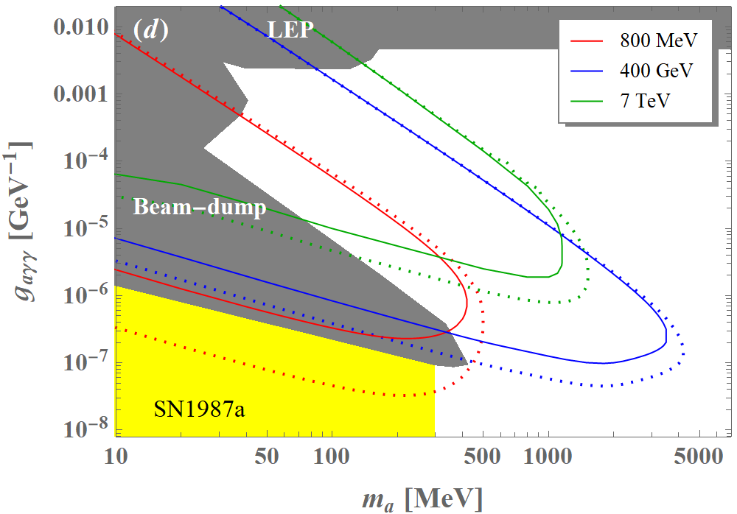
Small Scale DAMSA Sensitivity
The access to the ceiling unaffected!
Solid lines w/
Smaller dimensions
& 3mo data taking
  Kim, Yu et al., 2401.09529 (2024)

Slide 14
The Little DAMSA That Could!
The question: Can we access the targeted parameter space with a dramatically smaller scale experiment (2401.09529)?
Further studied the combinations of the following cases
  Reduce the detector radius to 0.1m from 1.1m, same depth (10⁻²)
  Reduce the vacuum chamber radius and length to 0.1m from 1m (10⁻³)
  Reduce the W dump length to 0.5m (case 1) & 0.25m (case 2)
W Dump
L=0.5/0.25m
R=0.5m
Vacuum
L=0.1m,
R=0.1m
Proton
Detector
R=0.1m

Slide 15
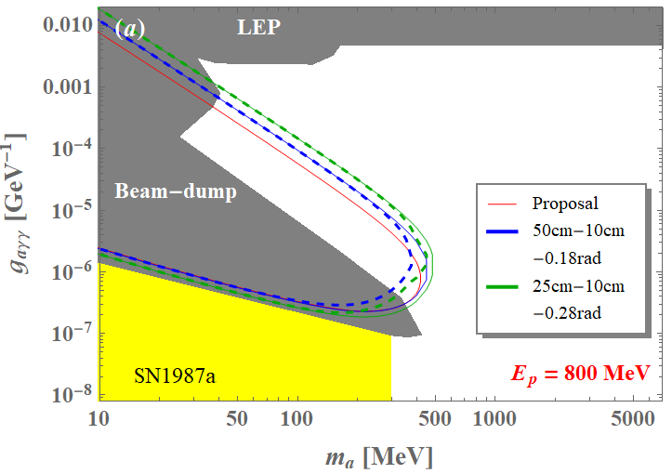
The Little DAMSA Sensitivity
3mo data taking
Shorter distance helps expanding
1m-1m-0.05rad

Slide 16
Why DAMSA Pilot?
Given the results of the Little DAMSA sensitivity study, it is possible for us to imagine a very small detector ➔ The Experiment is much more realistic
Primary issues to demonstrate
  Physics case feasibility ➔ can we access the target parameter space?
  Background validation and handling
  Physics before the beam dump facility is ready
    Produce physics, as the collaboration builds up the experiment
Strategy for a pilot
  Find a pathway to focus on physics case feasibility test
    Need a facility that has as little neutron background from the dump as possible
  Focus on the fast-decaying particles with high coupling

Slide 17
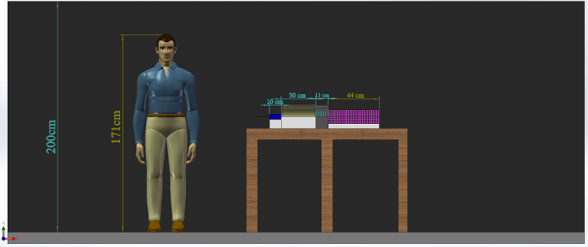
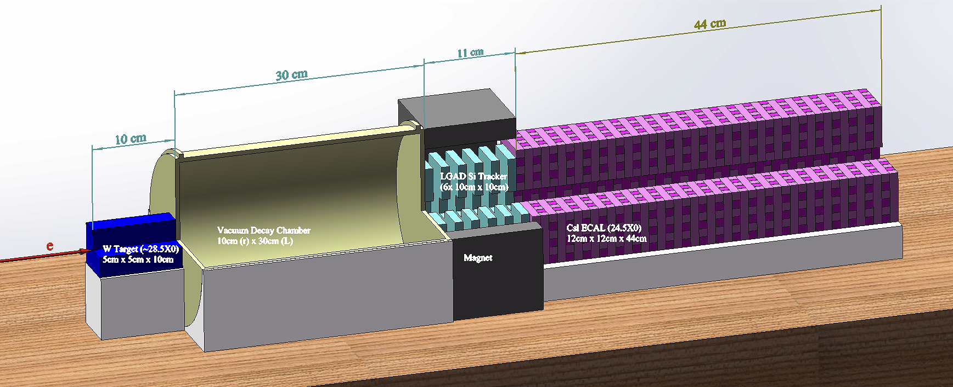
The Little DAMSA Experiment
Goal: Mount and complete a physics demonstrator in the next 3 yrs
Beam: 300MeV e-beams at Fermilab’s FAST ➔ greatly reduced neutron backgrounds, compared to proton beams, provides flexibility
Target: 5cm x 5cm x 10cm W target (~28.5X₀)
Vacuum decay chamber : 10cm (r) x 30cm (L)
  Enable the two EM particles from the vertex in vacuum to be separated
Detector: 6 layers of 10cmx10cm Si tracker under B=1T permanent magnet + 44 layers of 12x12x1cm³ 4D CsI total absorption Ecal (24.5X₀)

Slide 18
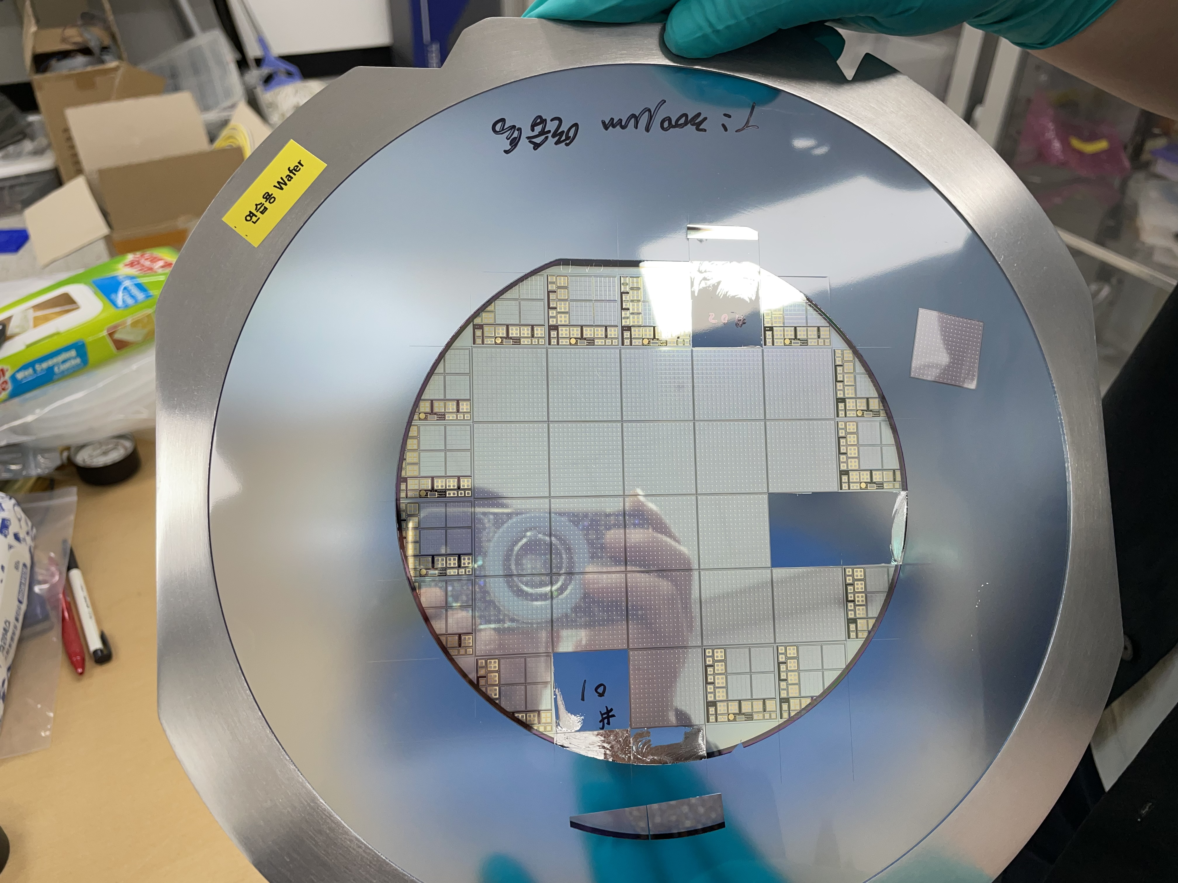
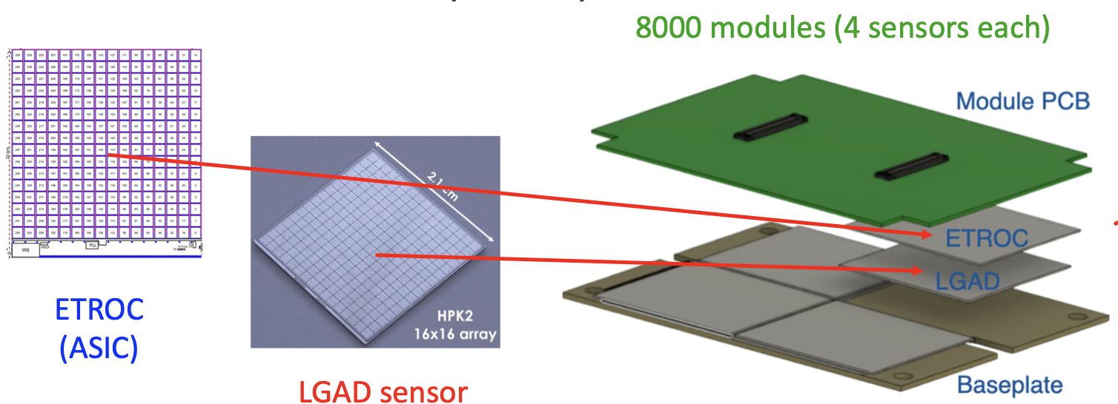
DAMSA – The Tracker
KNU in SK responsible for CMS forward LGAD detector
The Low Gain Avalanche Diode (LGAD) consists of 16x16 pixels of 1.3x1.3mm²
  Position resolution of 35 – 50 μm
  Timing resolution per track <35ps (single hit resolution <50ps)
High radiation tolerance ➔ DAMSA can be a testing ground

Slide 19
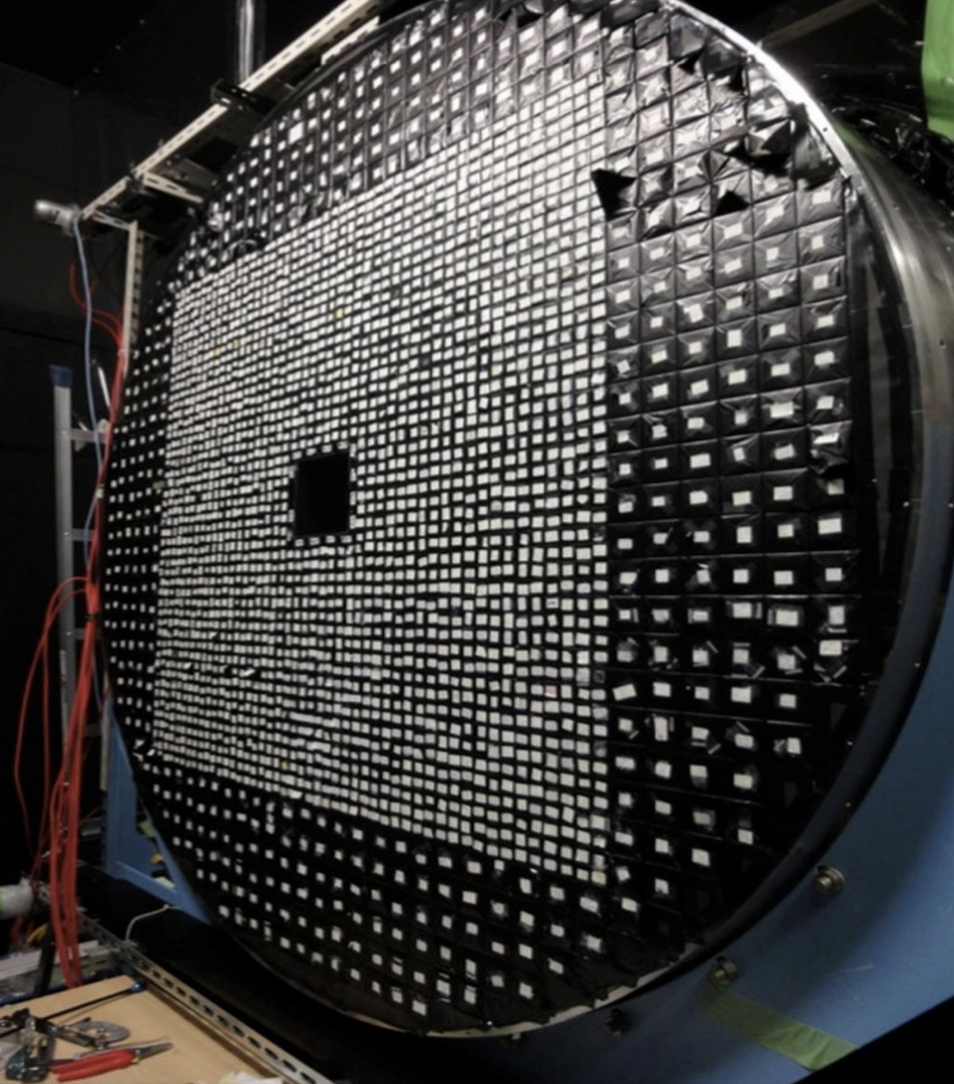
DAMSA – The ECAL
U. of Chicago built CsI ECAL for K-TeV experiment at Fermilab and the KOTO experiment at KEK
  Timing resolution of 200ps accomplished
  Has 16 of 5x5x50cm³ undoped CsI crystal bars in hand
  Each of these bars can be cut into 80 or so 1x1x12cm³ bars, read out by 2 SiPM’s mounted on either end ➔ could provide ~mm level shower position resolution
  These bars need to be cut, polished, wrapped and SiPM mounted ➔ Working with the Ukrainian company, ISMa (Institute for Scintillation Materials) for initial evaluation of UC Crystals and the performance of the cut pieces

Slide 20
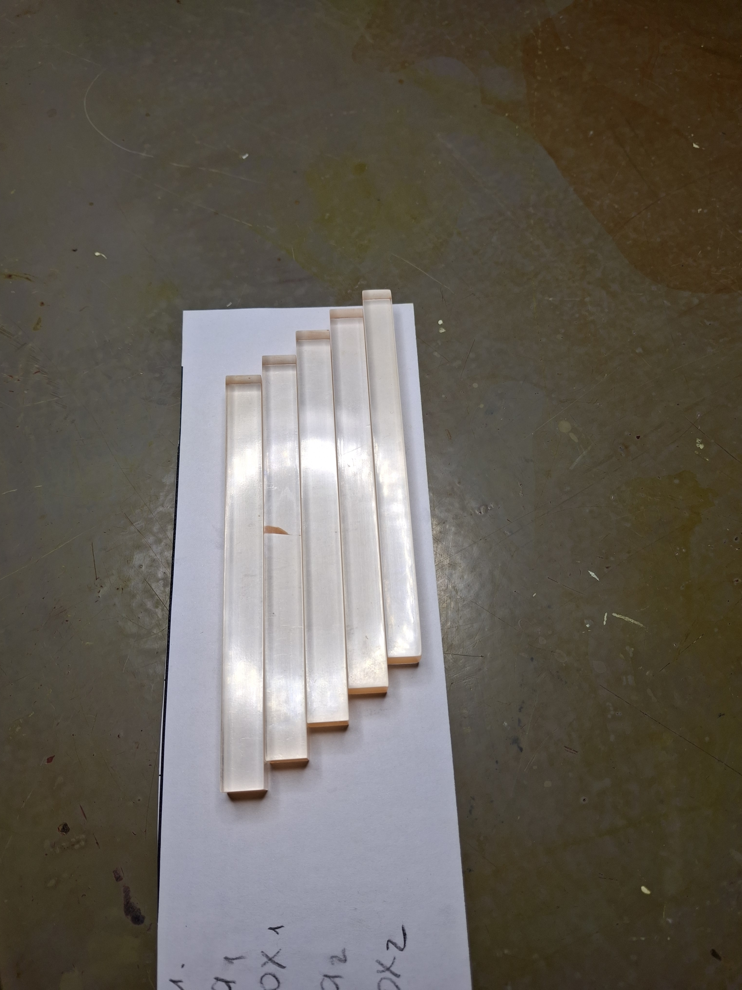
Progress On Crystal Bars
ISMa has been very helpful with DAMSA at no costs
Produced 50 crystal bars of 1x1x12cm³ bars using one 5x5x50cm³ Chicago CsI crystal block
  Bars are cut, polished, FTPE reflector wrapped & QCed
  All 50 bars are back in Paul Rubinov’s lab at Fermilab
    20 will be taken by the SNU group for further testing
ISMa engineers claim that they can produce as small as 0.5x0.5x6cm³ fully processed bars and as small as 0.1x0.1x6cm³ unprocessed bars
ISMa provided cost estimates for producing fully processed crystal bars with SiPM mounted
  $75/bar for 1x1x12cm³
  $70/bar for 0.5x0.5x6cm³
Marsinski at DOE suggested two other companies as backup solution
  Contacted both RMD in the US & Crytur in Czech but no reply yet

Slide 21
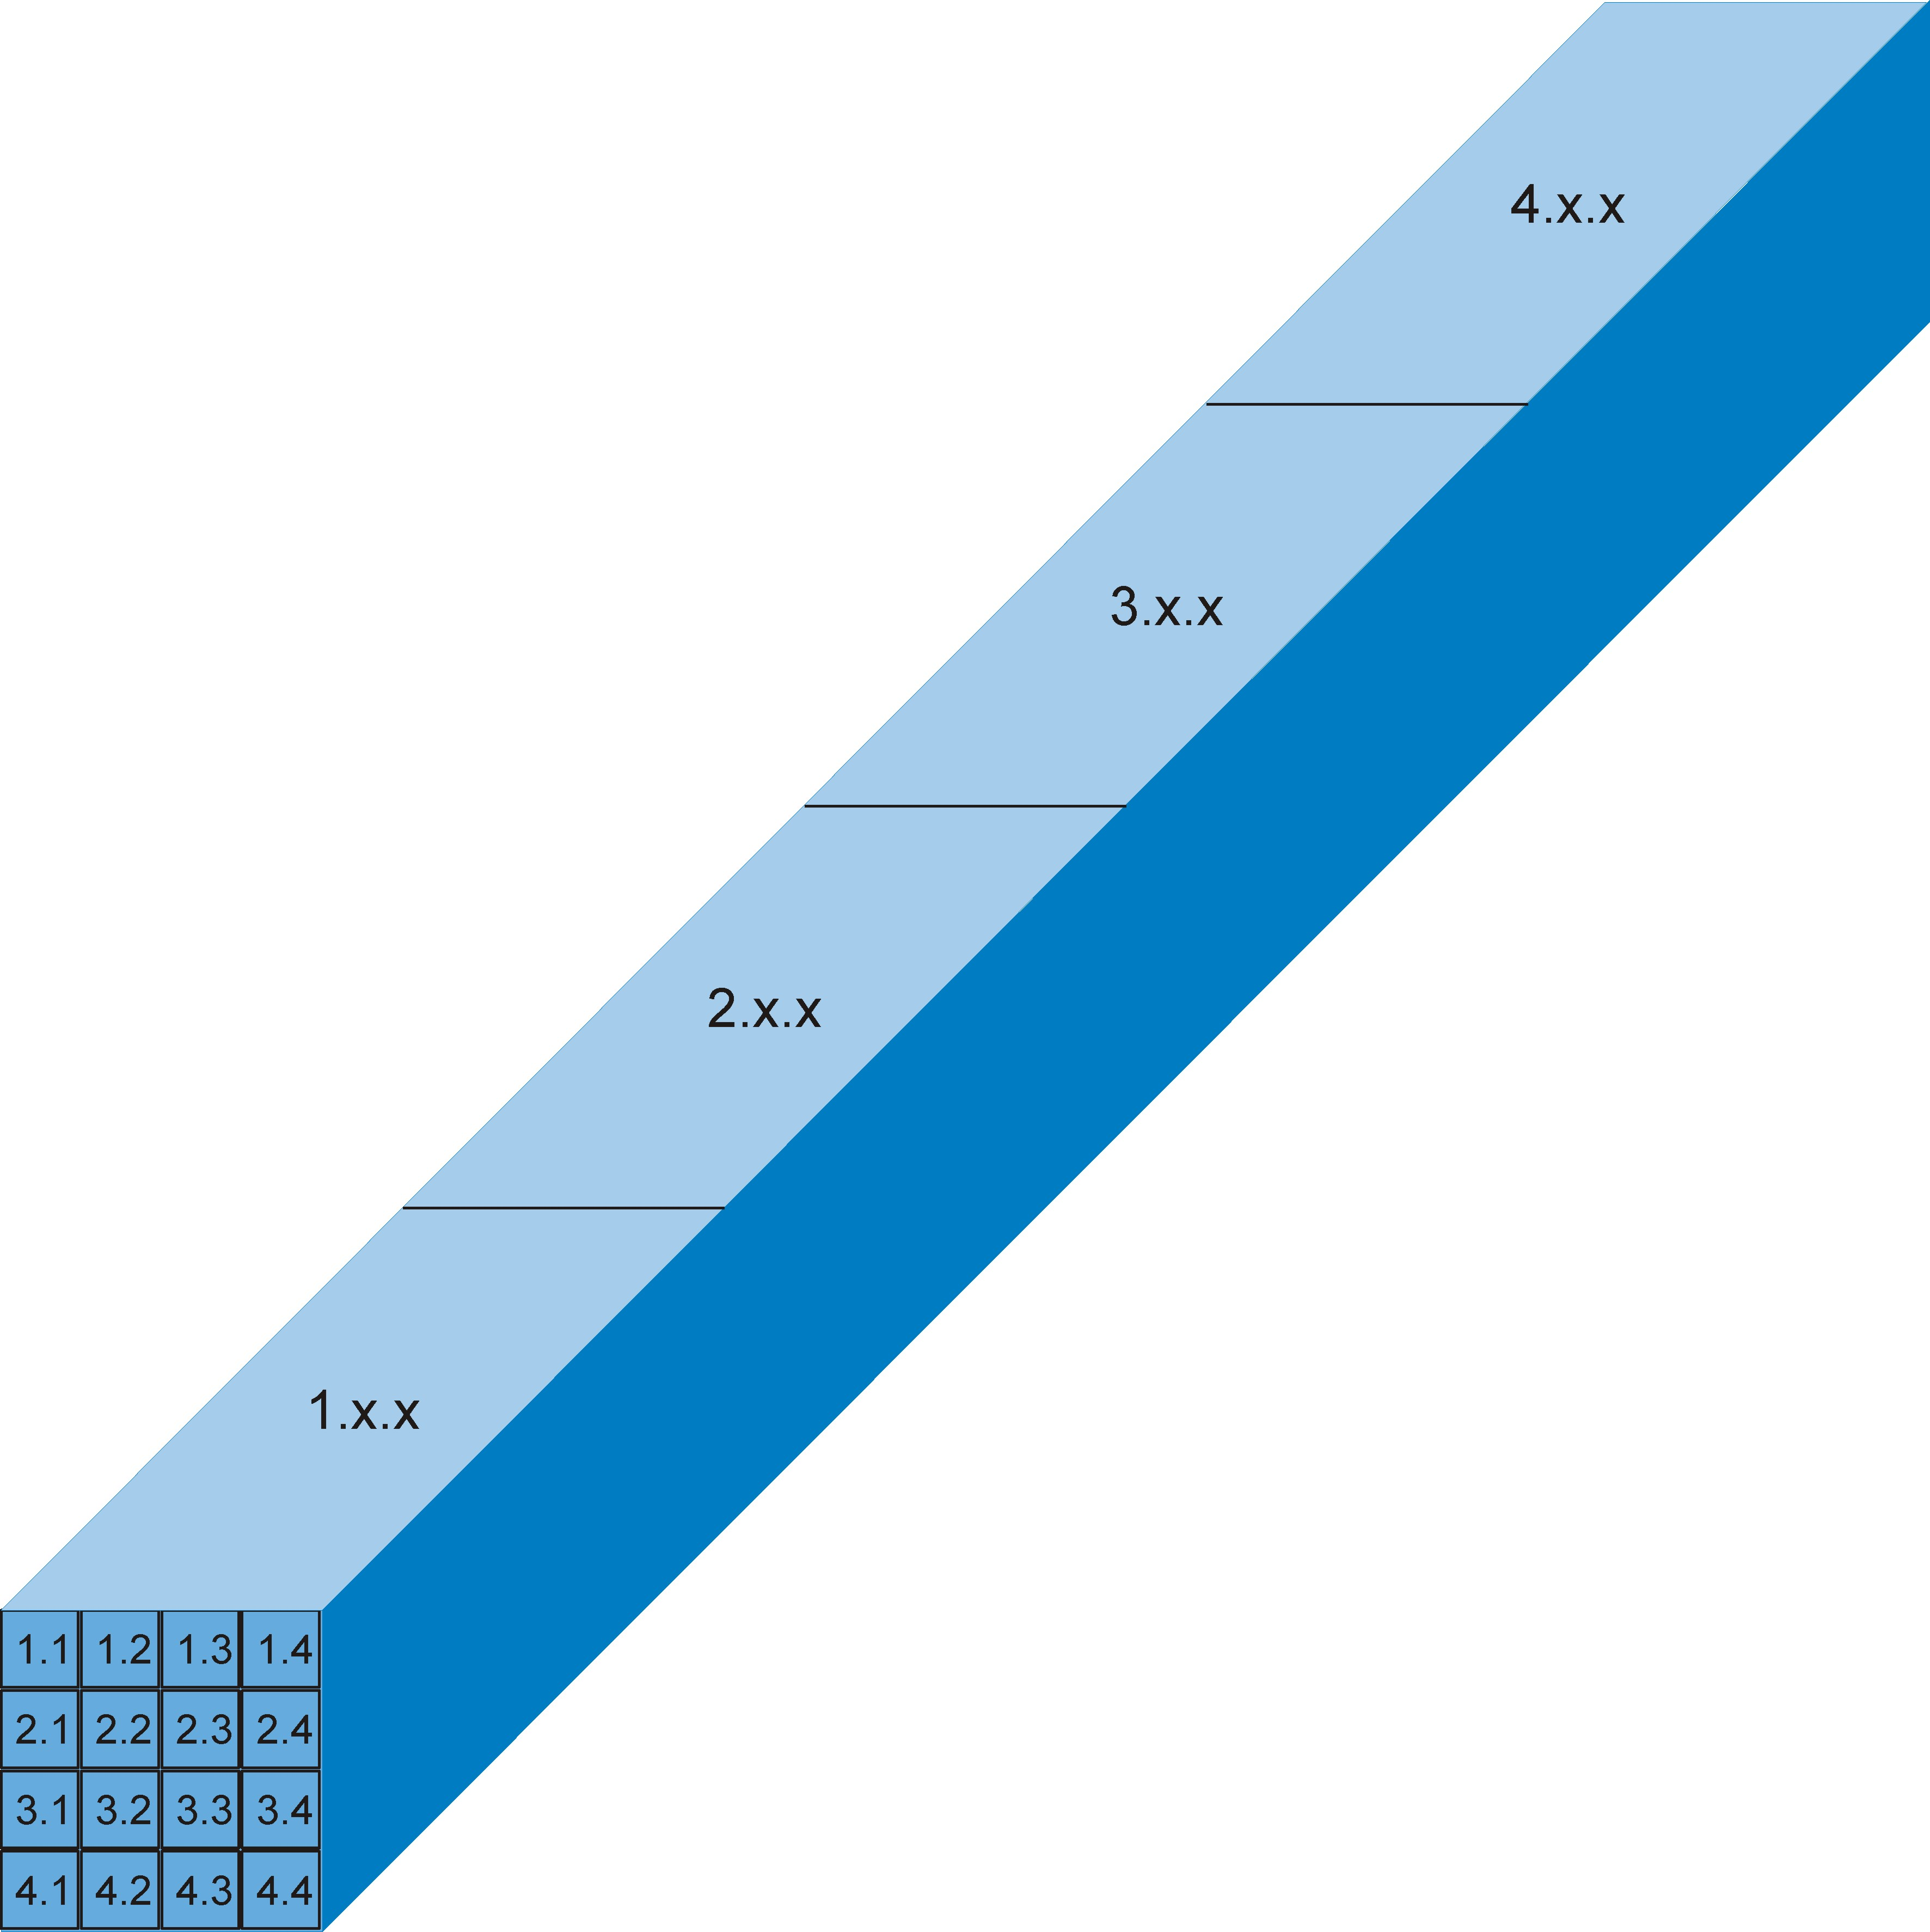
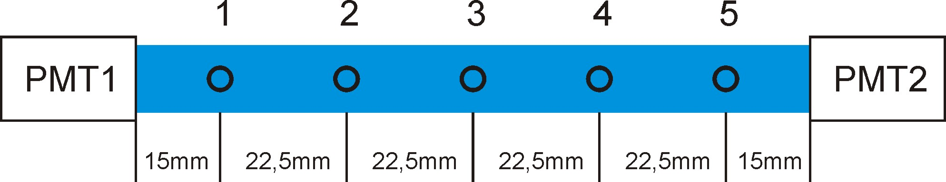
ISMa Crystal Quality Testing Report
10±0.1x10±0.1x120±0.2 mm
Reflector: PTFE film
PMT:R2059 HV=1500V
Collimator d=4mm.
Source: Cs137(γ 662keV)

Slide 22
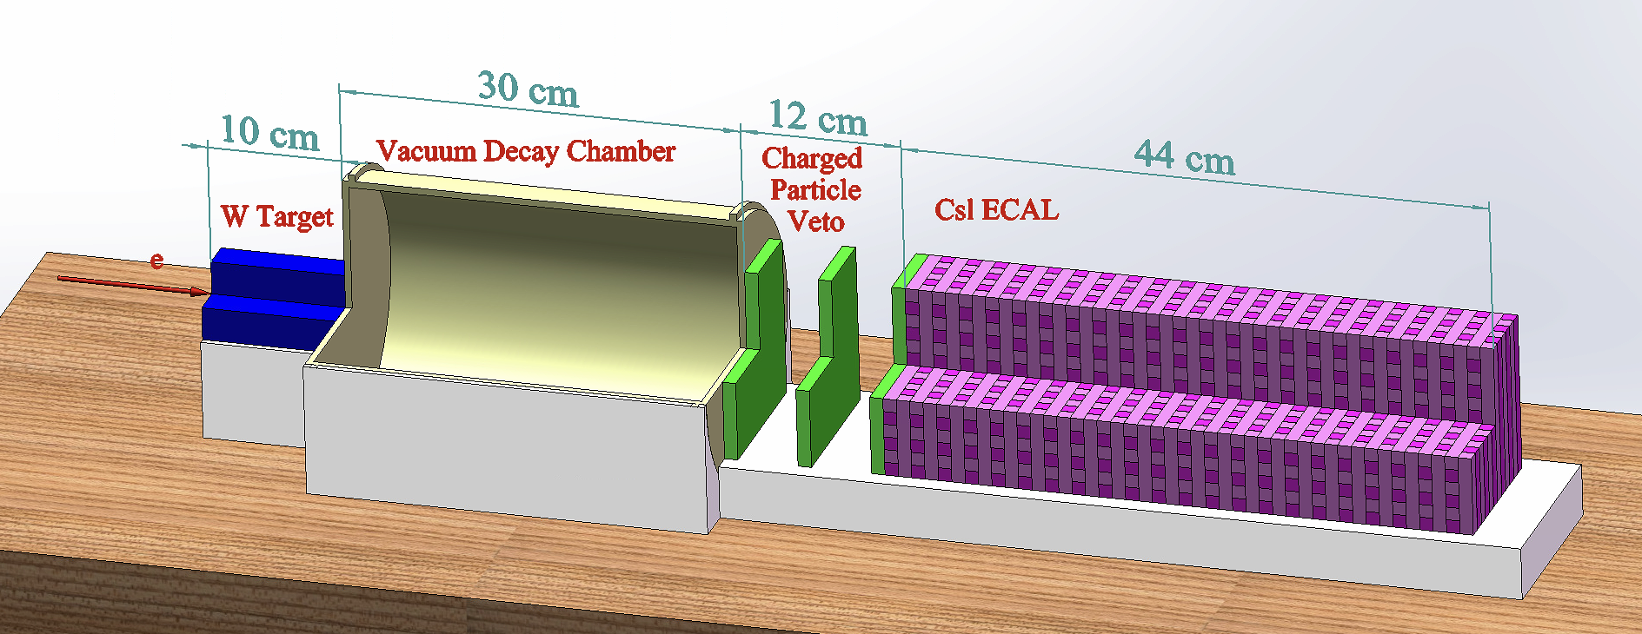
Little DAMSA – Stages 0 & 1
Stage 0 (yr 1 – 3) ➔ e-beam background validator
  Measure and validate the MC neutron and photon bck counts ➔ 1st data taking run at Fermilab Beam Test Facility (see WYJ talk)
Stage 1 (yr 1 – 3) ➔ The a2γ demonstrator @ e-beam
  Build a demonstrator with only W target, vacuum decay chamber and an ECAL + charged particle veto counters which occupy the same location and space as the tracker
Little DAMSA Path-Finder (LDPF, Stages 0 and 1)
Joe Pastika Submitted an LDRD Preproposal

Slide 23
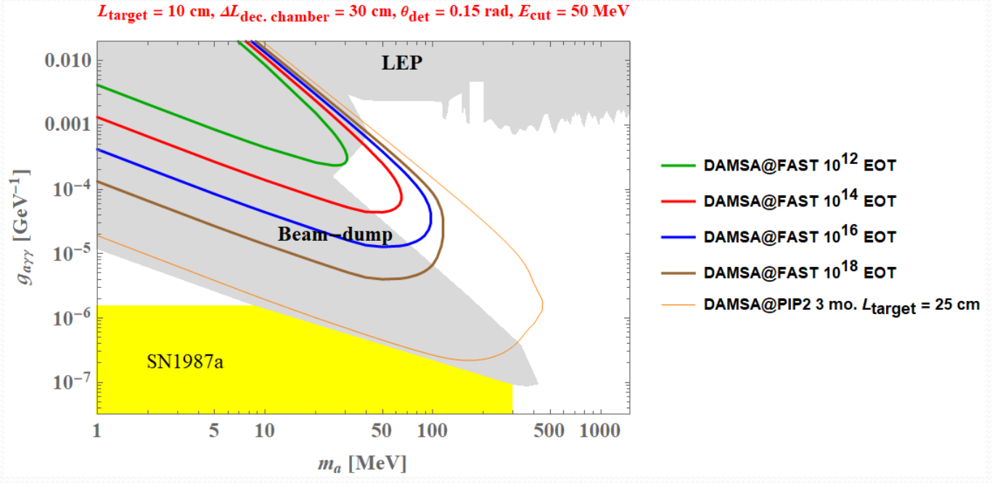
Little DAMSA Path-Finder Expectation
Even w/ 10¹⁴ EOT could already help accessing the target parameter space!

Slide 24
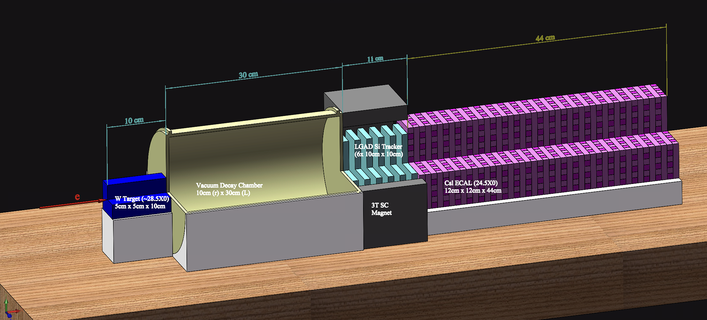
Little DAMSA – Stage 2
Stage 2 (yr 3 – 4) ➔ The a2e demonstrator @ e-beam
  Build on the stage 1 demonstrator, add 6 Si tracker layers and 1T permanent magnet
  Demonstrate the expanded signal capture
Little DAMSA Physics Expander (Stage 2)

Slide 25
Little DAMSA – Stages 3 & 4
Stage 3 (yr 4 – 5) ➔ The neutron bck demonstrator @ p-beams
  Move the demonstrator to a low E, low power proton beams
  Demonstrate neutron background handling
Stage 4 (yr 4 – 5)➔ The full scale DAMSA @ F2D2
  Move the complete detector to available proton beam facilities
  Perform search and discovery
Little DAMSA @ PIP-II F2D2
2cmx2cm square through hole
Little DAMSA @ Proton Beams (Stages 3 & 4)
2cmx2cm square through-hole

Slide 26
Where is the DAMSA experiment?
DAMSA has been introduced to the community throughout the past >2.5 years, more intensely since 2023
  Concept included in a few Snowmass2021 white papers
  Physics case study published on PRD107, L031901 (2023)
  Multiple presentations made at conferences, workshops and seminars in the U.S., SK and CERN in 2023 and 2024
    Presented at a couple of P5 townhall meetings early 2023
  Updated the DOE IF managers 3 times
Initial stage of DAMSA collaboration building complete
  Lead Investigators: J. Yu (UTA), J. Estrada (FNAL), UK Yang (SNU)
    13 US + 11 SK institutions on DAMSA
    A healthy mixture of theorists and experimentalists
  Funding applications being submitted (some successes in SK!)

Slide 27
Collaboration Organization
Leads: Jae Yu (UTA), Juan Estrada (FNAL) & Un-Ki Yang (SNU-SK)
Physics : Doojin Kim & Bhaskar Dutta (TAMU)
  J. Berger (CSU), A. Tompson (NWU), B. Dev (WashU), Jong-Chul Park (CNU-SK), Seodong Shin (CBU-SK) + several SK theorists
Detector Development: Alan Bross & Paul Rubinov (FNAL), Chang-Sung Moon (KNU- SK)
  US: J. Pastika (FNAL), P. Gutierrez & M. Marjanovic (OU), Y. Wah (UC), UCI, UTA
  SK: SNU, KNU, KU, UoS, and others
Permanent magnet : S.H.Kim (KNU – SK)
Neutron and other backgrounds: Juergen Reichenbacher (SDSM) & Shawn Westerdale (UCR), SNU team
Dump, Target and other facilities: Jeff Eldred & Bill Pellico (FNAL), Un-Ki Yang (SNU)
  FNAL (Jonathan Jarvis from FAST included), UMD & SNU, KU-SeJong (SK)
Sim, reco and analysis software: UTA, TAMU, CSU, SNU, KU, KNU, CNU
Costs : 3 leads + Bross, Rubinov, Reichenbacher, Wah, Moon, Kim

Slide 28
Conclusions
DAMSA is a table-top DSP search and discovery exp.
DAMSA has been making steady and serious progress
  Aim to be ready for a beam data before the end of this decade
  First neutron background validation measurement performed!
DAMSA proto collaboration building complete
A proof-of-concept Path-Finder experiment is being developed
  Crystal processing has been exercised ➔ Costs better known
DAMSA presents an excellent opportunity for to lead in DSP production & discovery in beams, through the strong partnership with South Korean HEP community

Slide 29
Primary Goals of the Meeting
What are the additional physics topics that can be explored by DAMSA at different facilities?
What are the detector functionalities to meet the physics need?
What is the baseline design for the detector to effectively mitigate and access the targeted phase space?
What is the strategic direction to realize DAMSA’s first physics results before the end of this decade?
Complete the first draft of the conceptual design white paper
  Goal to release to the archive no later than April 1.

Slide 30
CDR WP Sections
Introduction
Physics Background & Reach
  ALP → 2g, 2e, 2m
  LED
  Other Physics
Facilities
Detector :
  Target/Dump
  Tracker + Magnet
  Calorimeter
  Neutron Monitoring
Conclusions

