Slide 1
The Fermilab Facility for Dark Matter Discovery (F2D2): Targetry Overview and Conceptual Design Updates
Jonathan Williams (on behalf of the F2D2 Task Force)
DAMSA Collaboration Meeting
17 January 2025 FERMILAB-SLIDES-25-0002-AD

Slide 2
Overview
Dark Sector Searches
PIP-II
F2D2 Requirements
Design Challenges
Targetry Theory
High Power Targetry Facilities
F2D2 Design Iterations
Look to the Future…

Slide 3

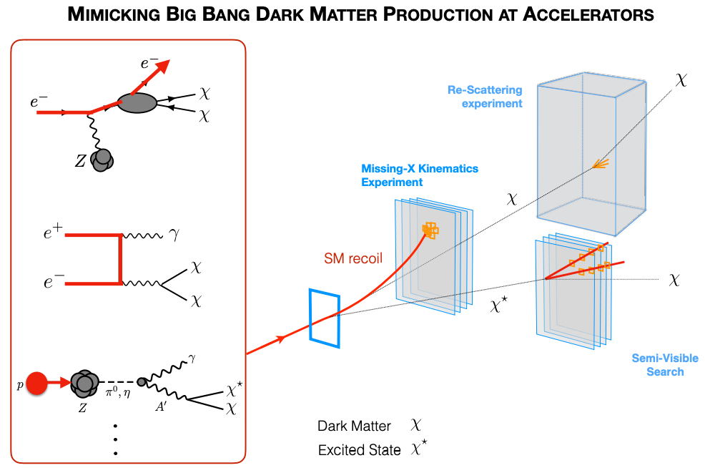
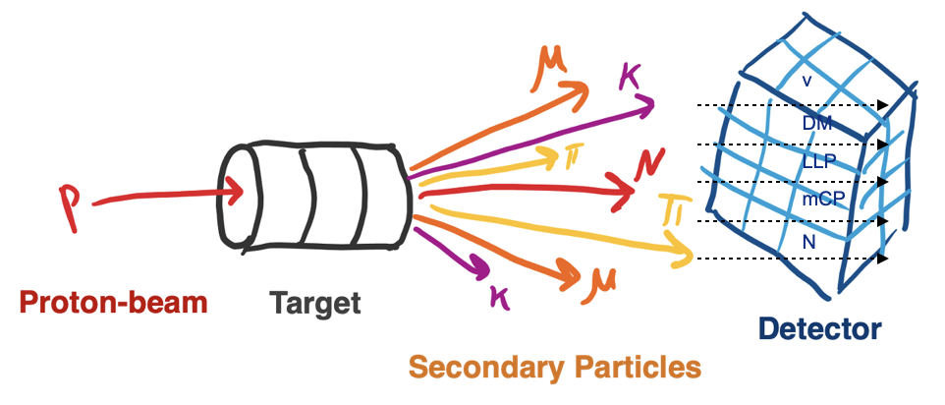
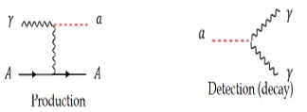
Dark Sector Searches with Beam Dumps
Can you create dark matter in a target? Theory says maybe.
  If so, amount of DM proportional to the number of protons on target
  High current beam onto a target – more POT, more DM
  Capture all known SM particles with thick shielding
  Place detectors in quiet zone, look for signal
  https://arxiv.org/abs/2311.09915
Figures from J. Eldred, M. Toups, J. Yu

Slide 4
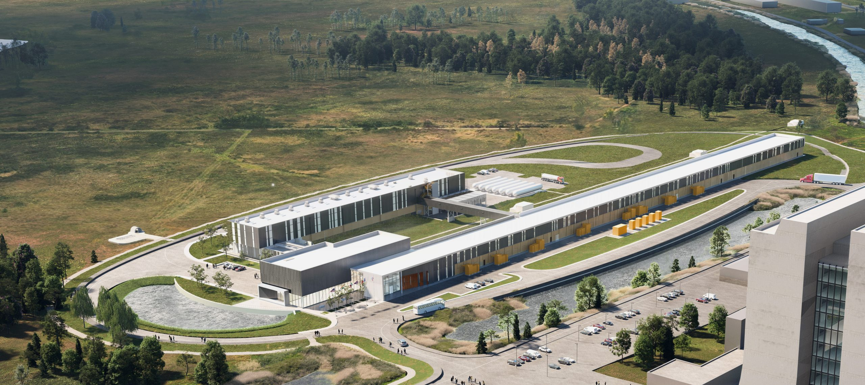
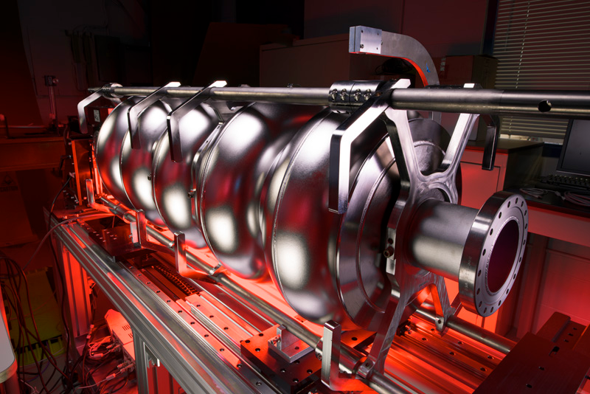
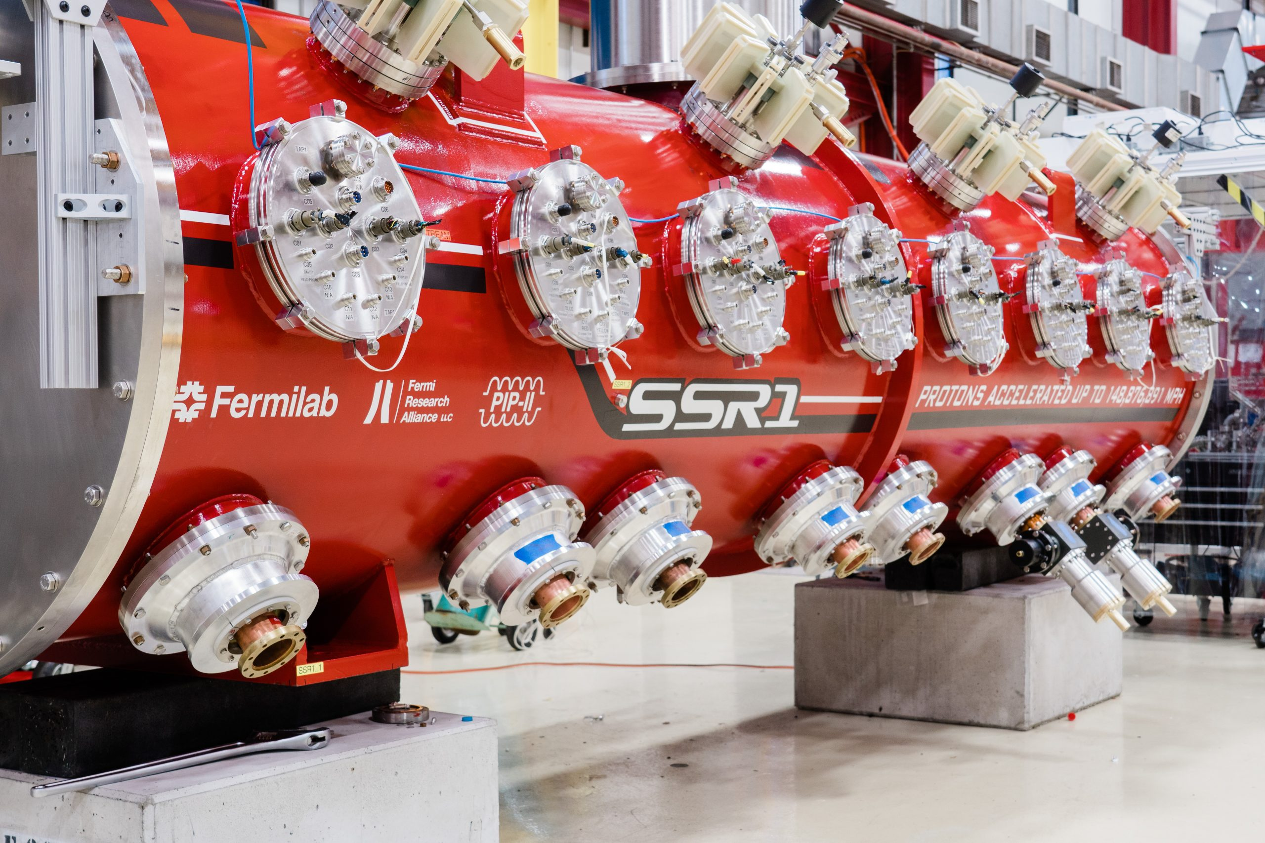
The PIP-II Superconducting Linac
CW acceleration – high power, high duty cycle (rated for 2 mA at 800 MeV, 1.6 MW)
  With upgrades/extensions, 1 GeV at 2.5 mA (2.5 MW) possible near-term
  Use as a driver for smaller experiments
  LBNF/DUNE needs only 2% of nameplate capacity

Slide 5
F2D2: Top-Level Requirements
Use a high-power, low-energy target/beam dump to create many, many opportunities for dark sector interactions
  Use a low-Z target material, if possible
  Stopped/captured charged pions with possible DS decays – relevant for targetry design
Experiments located downstream in a separate hall
  Allow for additional experimental space ahead of main target/dump
Absorb 2.5 MW of 1-GeV PIP-II-representative beam
  Absorb and reject thermal energy
  Contain radiation and activated materials
  Be serviceable for the life of the facility (assume 5+ years)
Easy, right? Not so much…
  PIP-II (800 MeV+) is a different targetry design space than NuMI/LBNF (120 GeV)

Slide 6
F2D2: Why Be Worried?
Beam power is a useful metric for scaling beamline designs, but misses some
subtlety for targetry – specifics of energy and beam current matter!
Parameter | LBNF | F2D2 | Comment
Power | 2.4 MW | 2.5 MW | Roughly equal
Thermal shock | High (pulsed beam) | Low (CW beam) | Big difference in thermal stress
Thermal rejection | ~25 kW/MW on target | 2.5 MW | 100x (comparable to LBNF Absorber @ 2.4MW)
EDEP density | High | Higher | dE/dx larger at lower energies, EM shower at high energy
# of Protons on Target | 1.5E14 p/pulse (every ~1.2 sec) | 1.565e16 p/s Continuous wave! | For same power, 120x more protons at 1 GeV than 120 GeV
Radioactivation | Manageable (*with work!) | Severe (in static target) | ~Proportional to POT
Radiation damage (dpa) | Manageable* | Manageable*, but worse | ~Proportional to POT, also energy dependent

Slide 7
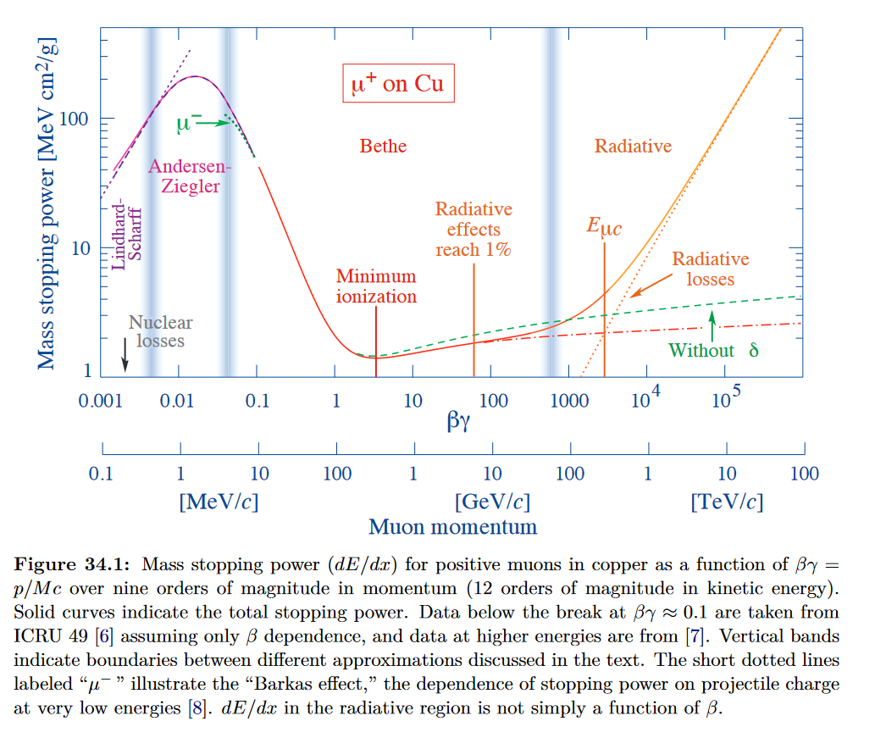
Stopping Power – dE/dx
Energy deposited in material = thermal energy density, and potential for damage and activation
High energy particles see modest increases in dE/dx with higher energy
  EM cascade generates additional secondaries that can interact and heat/damage elsewhere
  High-energy targets are very short compared to the stopping length
Low energies see huge increases in dE/dx as a particle slows down
  Lower energy, but deposited very quickly
  EM cascade deposition also concentrates
S. Navas et al. (Particle Data Group), Phys. Rev. D 110, 030001 (2024)

Slide 8
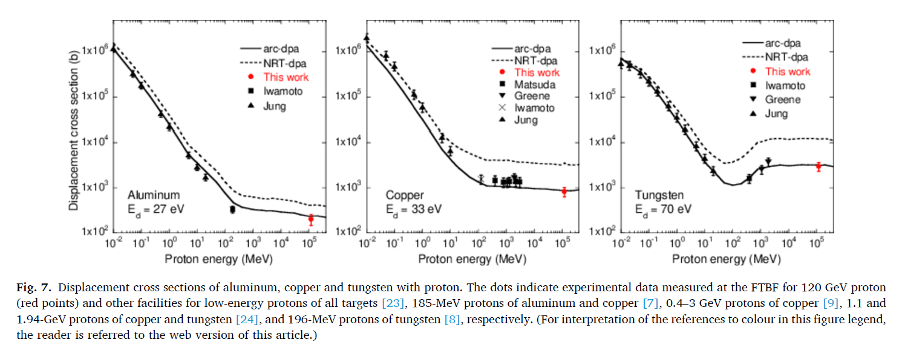
DPA Cross-section
https://doi.org/10.1016/j.nimb.2024.165543
A beam dump experiences 10x-100x+ more dpa per primary proton than a high energy target
A high energy target can see additional damage from EM cascade and shower

Slide 9
DPA Cross-section
Radiation damage scales directly with protons on target!!!
https://doi.org/10.1016/j.nimb.2024.165543
A beam dump experiences 10x-100x+ more dpa per primary proton than a high energy target
A high energy target can see additional damage from EM cascade and shower

Slide 10
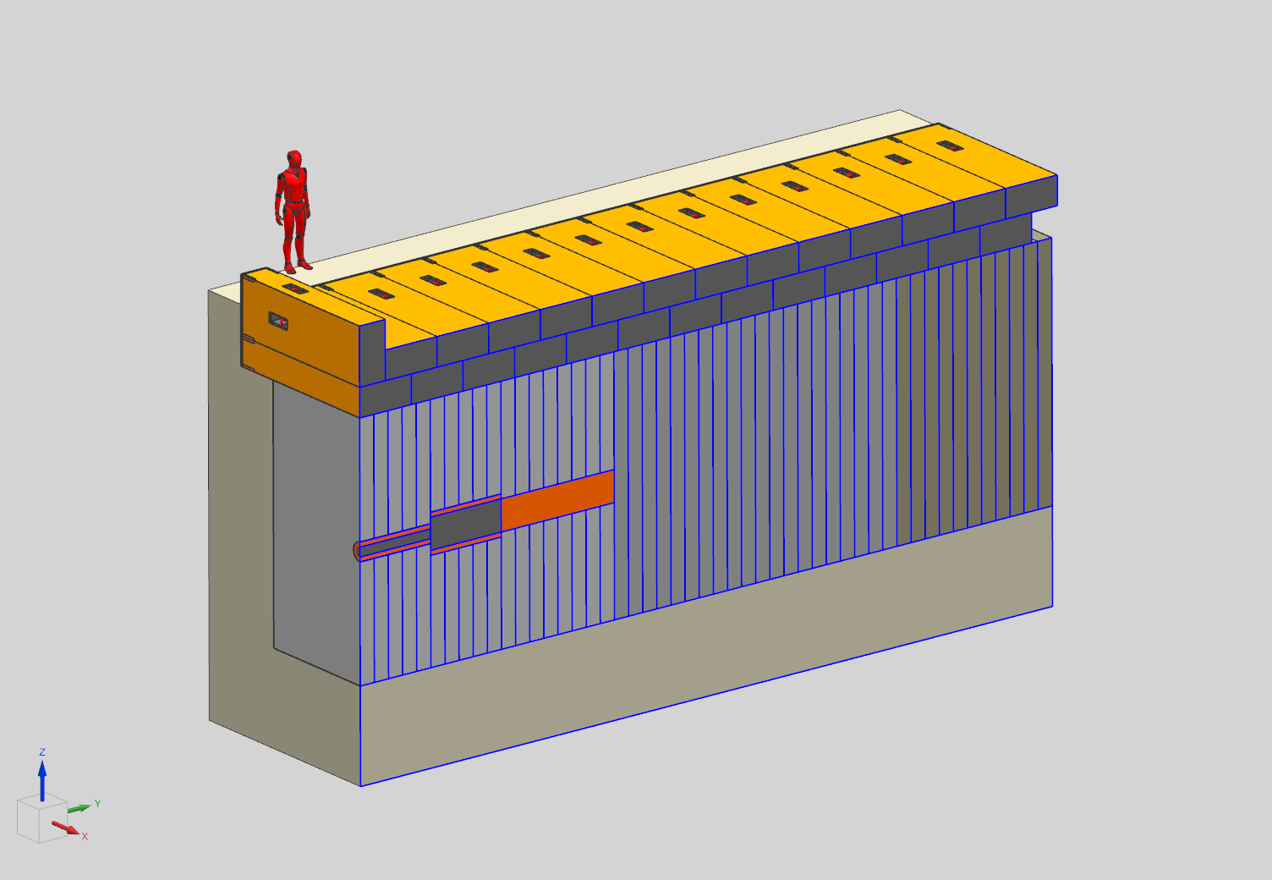
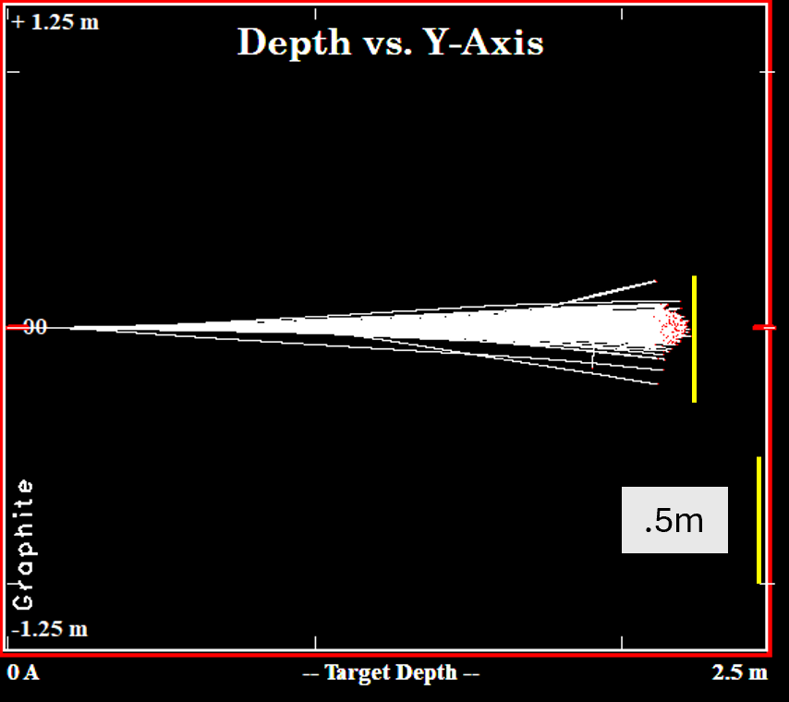
F2D2 - Version 1
Extrapolate from existing beam dumps
  LBNF Absorber (2.4 MW), PIP-II Absorber (30 kW)
Graphite cores
Copper cooling jackets
  Water cooled
Steel bulk shielding
  Forced-gas cooled
Concrete outer enclosure
  Removable shield blocks on top for maintenance access

Slide 11
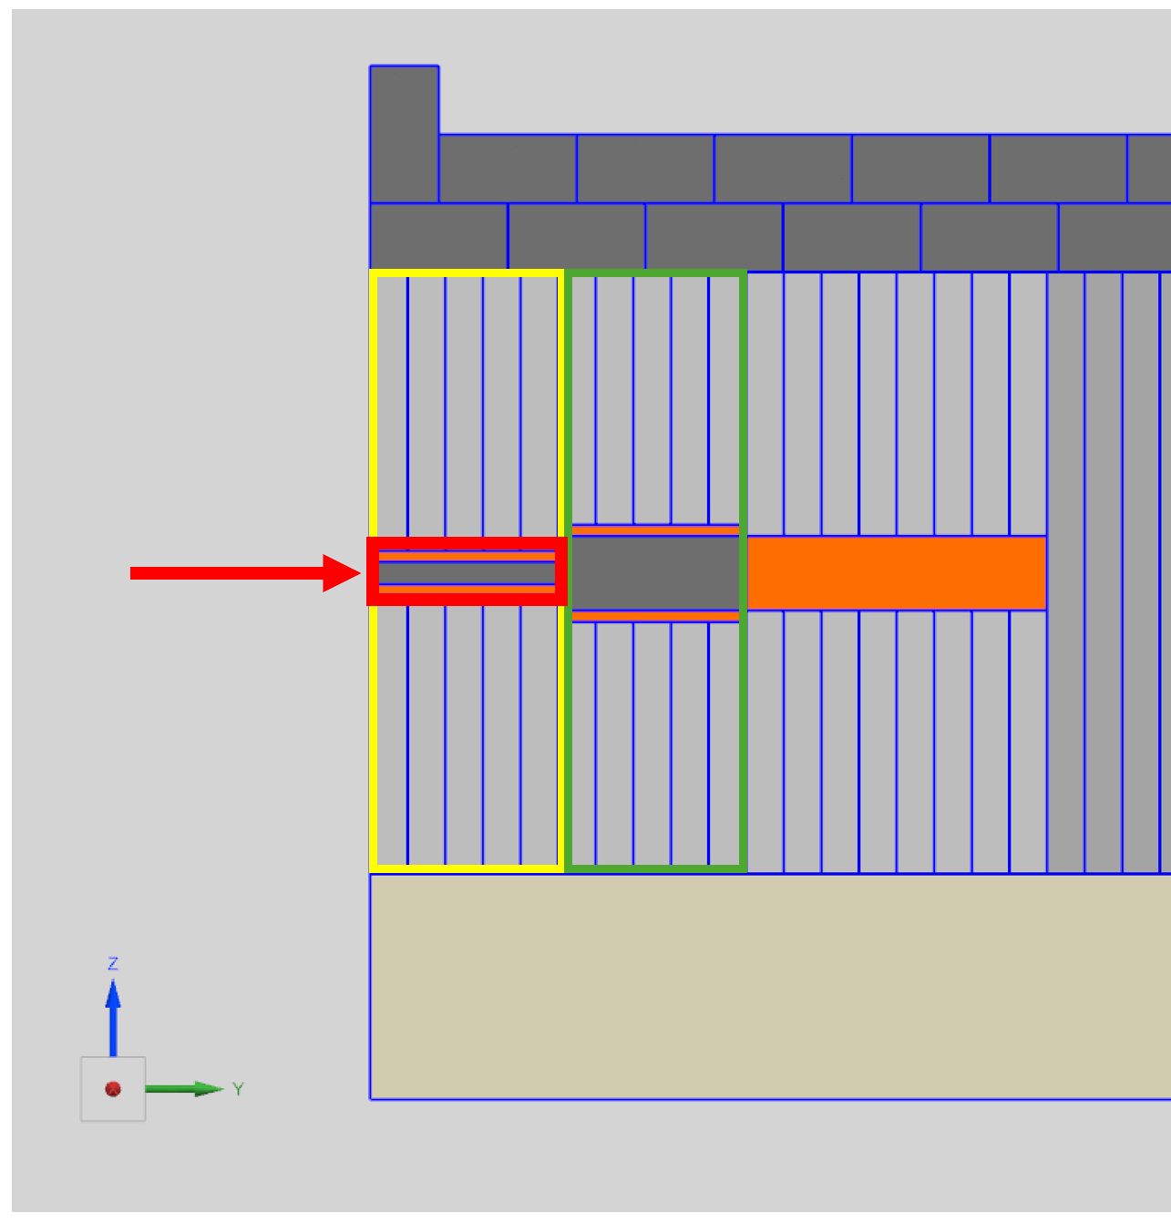
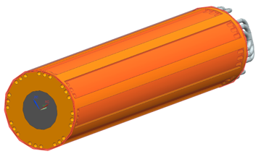
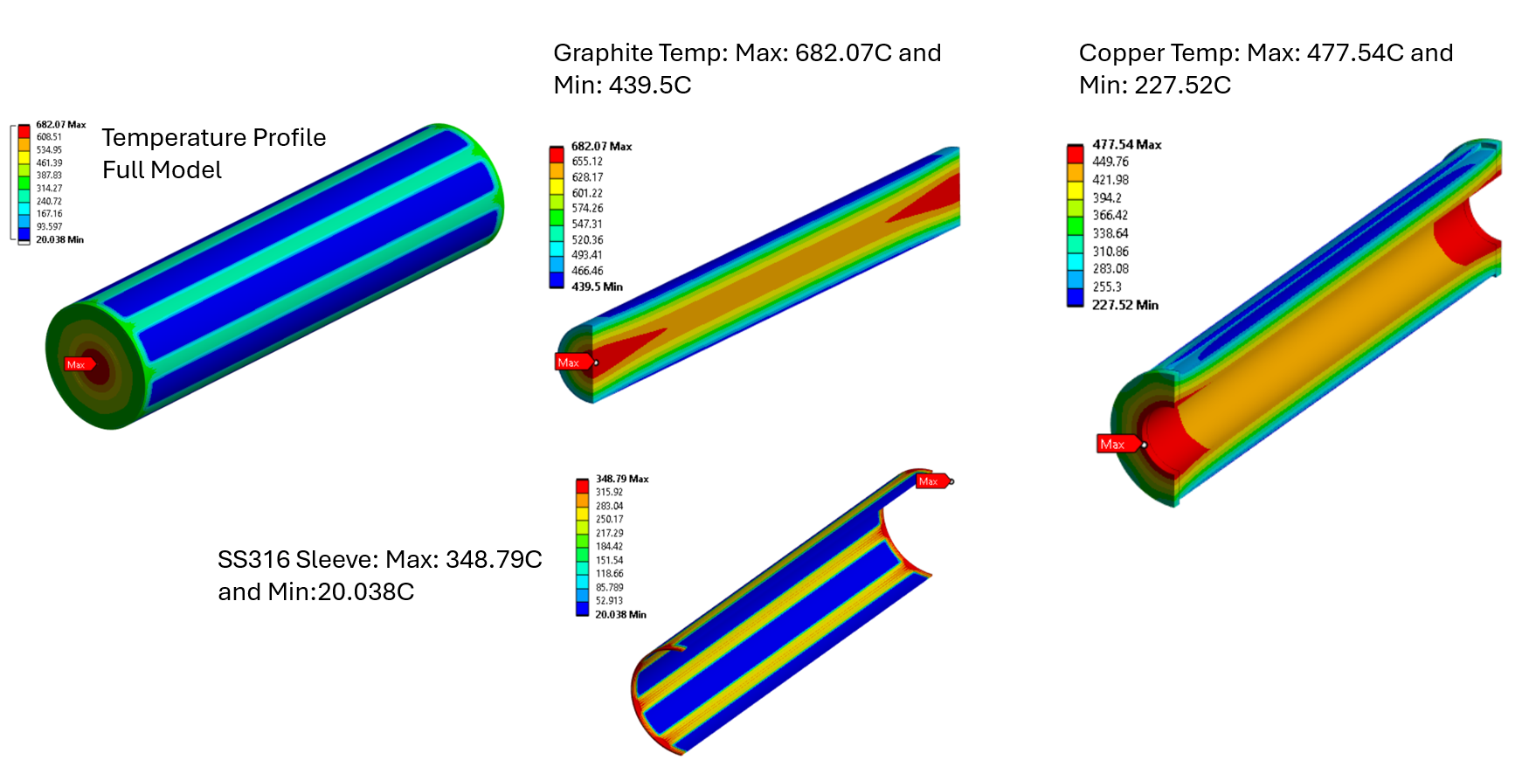
F2D2 – Version 1
EDEP Totals By Component | Power (kW)
Graphite Core 1 | 604
Copper Jacket 1 | 1100
Steel Shield 1 | 376
Graphite Core 2 | 81
Copper Jacket 2 | 9
Steel Shield 2 | 12.3
Copper Slug | 3.3
Steel Shield 3 | 1.6
Grand Total: | 2187

Slide 12
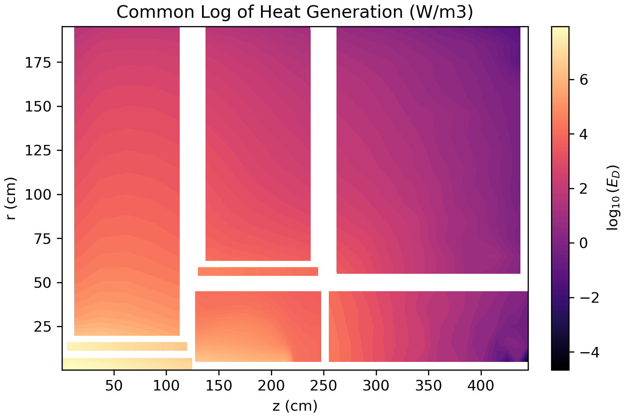
EDEP from MARS
Majority of energy deposition at front of target
Peak density of ~90 MW/m^3 in graphite core 1
*Problem with this sim:
  5-cm beam sigma
  Protons hitting copper directly
Steel
Steel
Steel
Copper Jackets
Copper
Graphite Cores

Slide 13
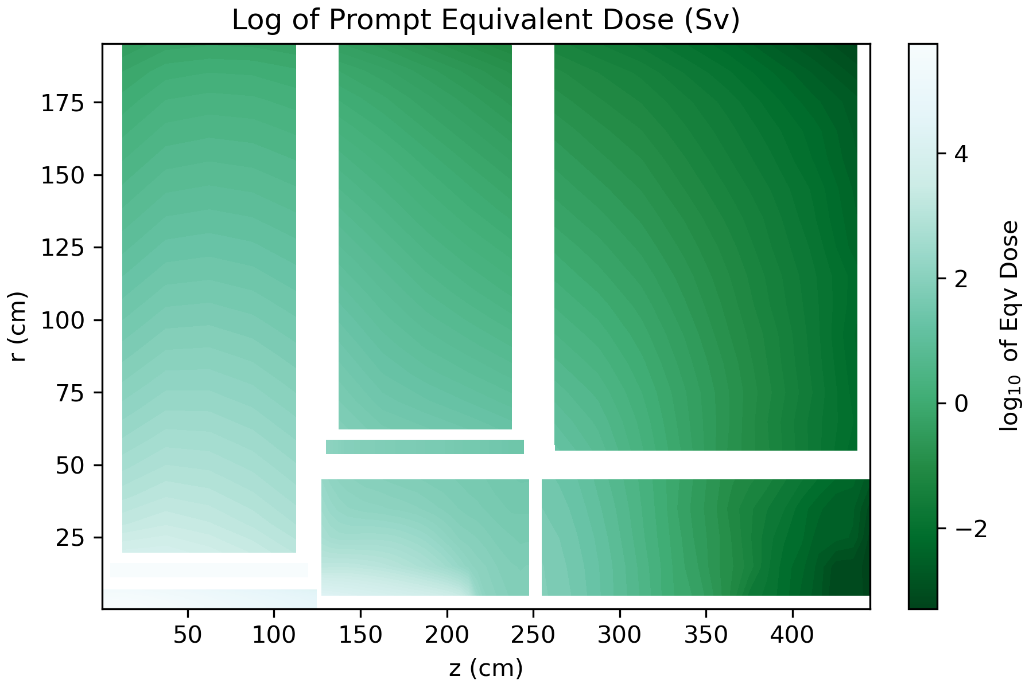
Just One 10^4 Problems Per Hour…
After 100 d irradiation, 4 hr cooling
For context:
  “Normal” dose rate limit for prelim design: 0.2 mSv/hr
  A marked high radiation area at Fermilab is >=1 mSv/hr
  The copper jacket reaches ~10,000 Sv/hr!
  Sv/hr = very, very bad
Activity does decay, but…
  Not fast enough for maintenance
  Need to rethink how this beam dump is put together

Slide 14
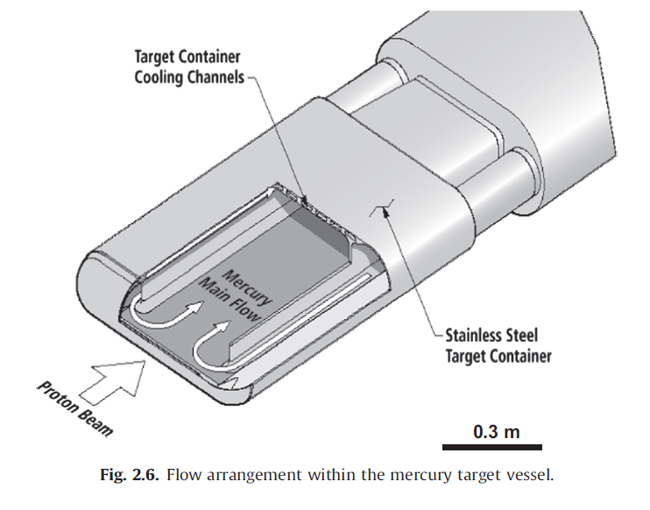
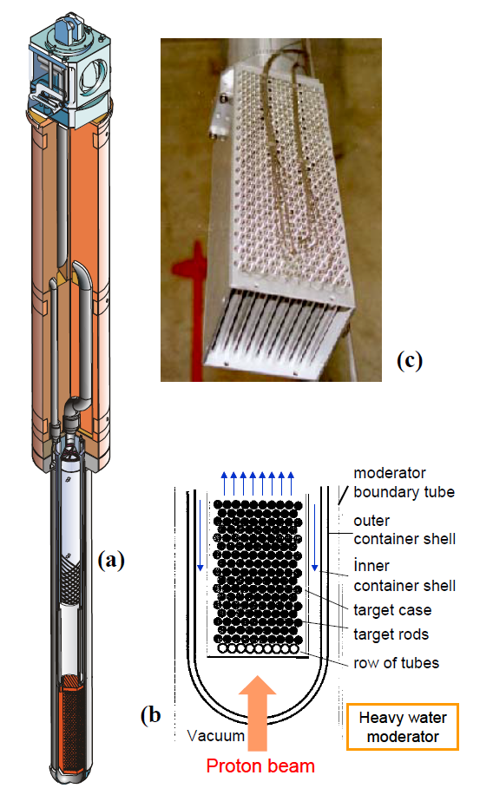
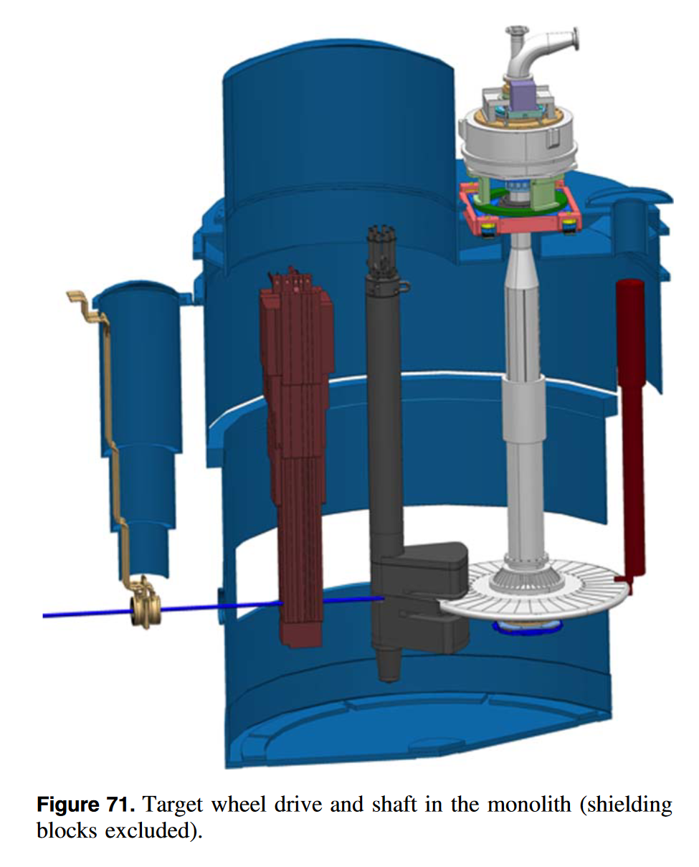
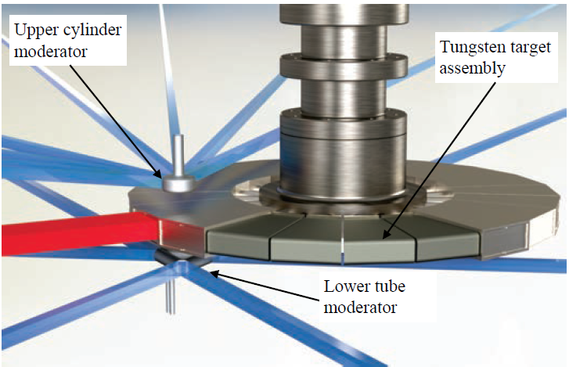
Low Energy, High Power Targetry – World Tour
Water-cooled, small, solid target – only 1 MW
ORNL SNS FTS
Large Hg target, massive facility
PSI SINQ
ESS
Large rotating target, massive facility
ORNL STS
Large rotating target, massive facility
***Low-Z requirement means F2D2 target gets even bigger, and 2.5 MW direct water cooling is difficult while limiting activation***

Slide 15
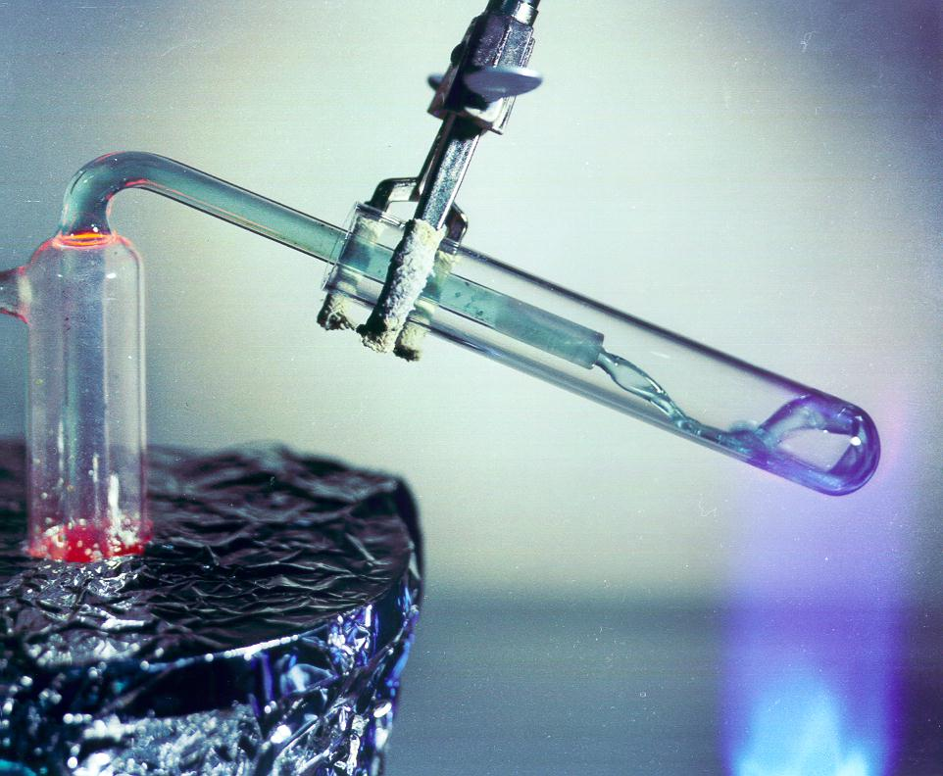
Molten Salt as a Target Material?
Benefits:
  Convenient melting point, good thermophysical properties
  Dilution of activation products in total salt inventory
  Heat removed with the flowing salt
  It isn’t liquid mercury!
Drawbacks:
  Tight control of salt chemistry required
    Chemical compatibility with container materials
  Beam windows still limit life
  Difficult, expensive remote handling and disposal for highly-activated materials
    Activation on par with existing targets
FLiBe salt, ORNL
Commercial parallels with Molten Salt Reactor
Spallation sources solve this with replaceable primary beam windows
Spallation sources (ESS and SNS STS) have similar facilities to what we would need

Slide 16
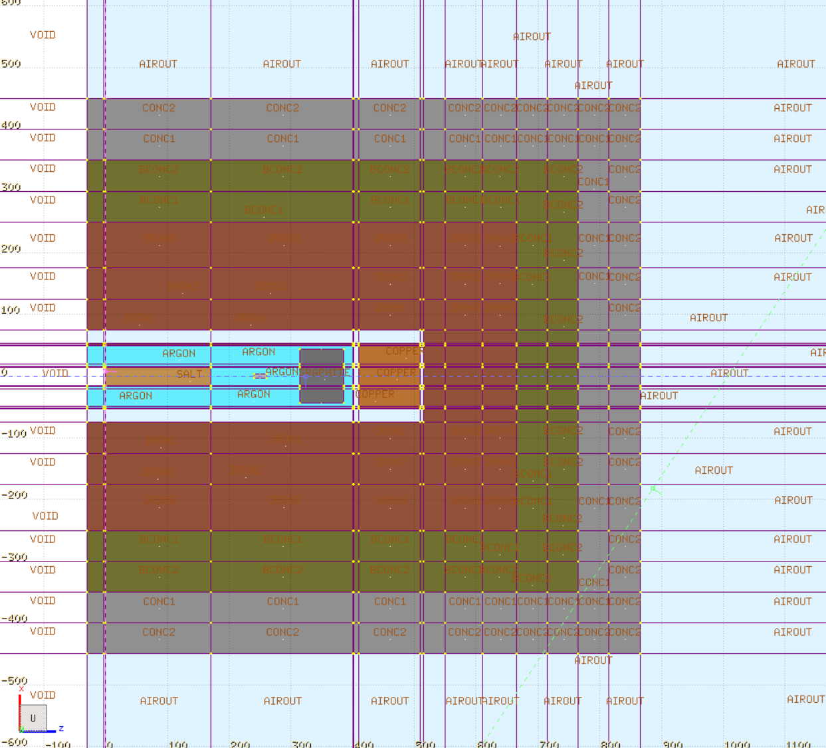
F2D2 Molten Salt - FLUKA Geometry

Slide 17
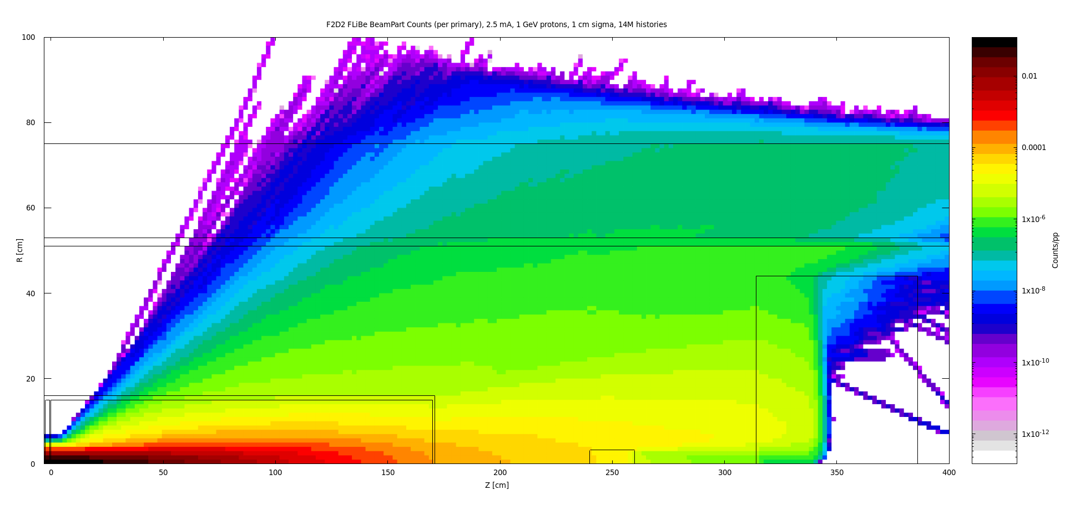
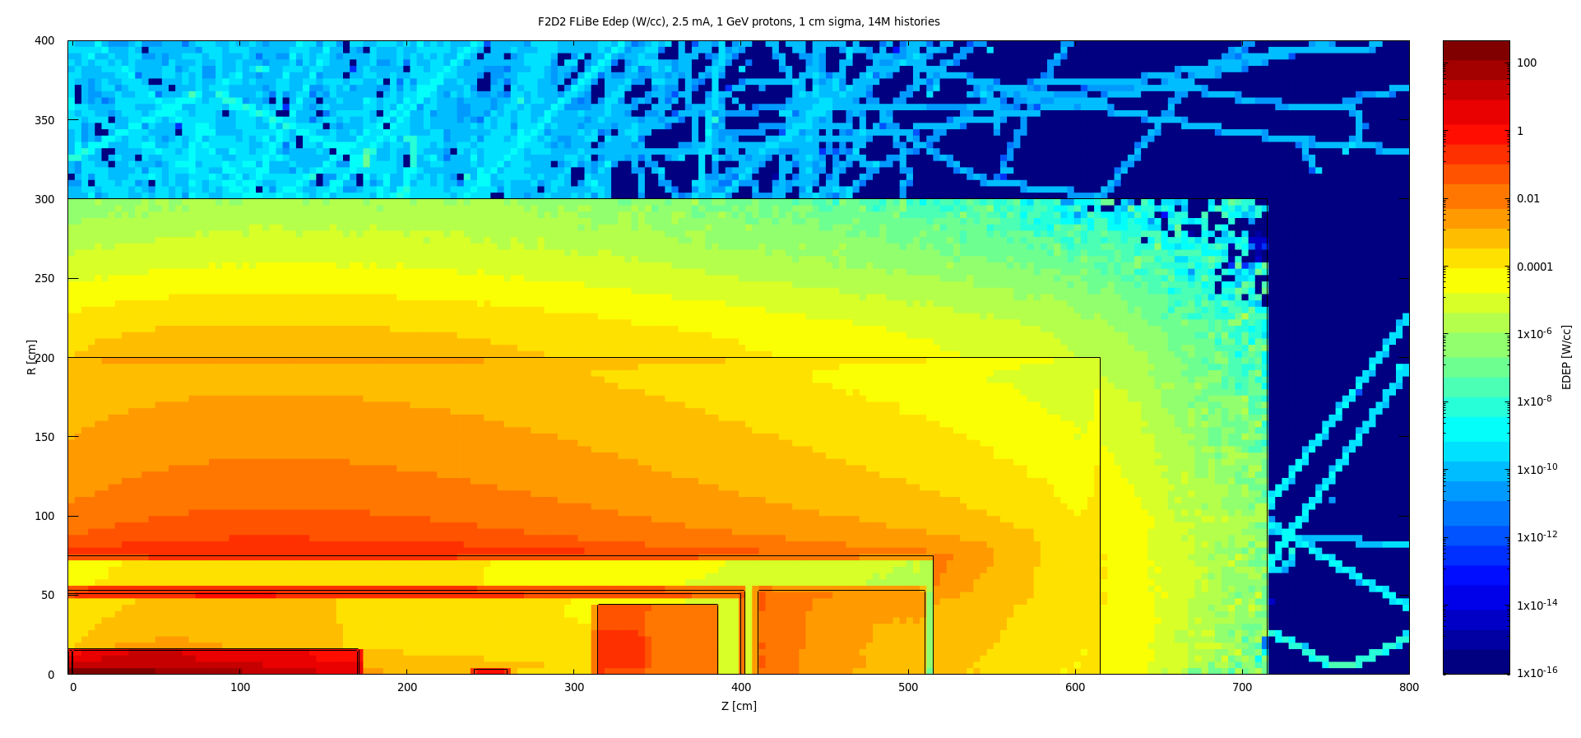
FLUKA Iterations
Fast design iterations with FLUKA
  Establish shielding thicknesses
  Compare energy deposition
Examples at right from an early iteration:
  Top: Beam particle counts per primary (averaged across annular bins)
  Bottom: EDEP (W/cc) in shield pile, area of plot 1 outlined
Preliminary runs with molten salt indicate target residual dose below 10 Sv/hr
  On par with LBNF facilities

Slide 18
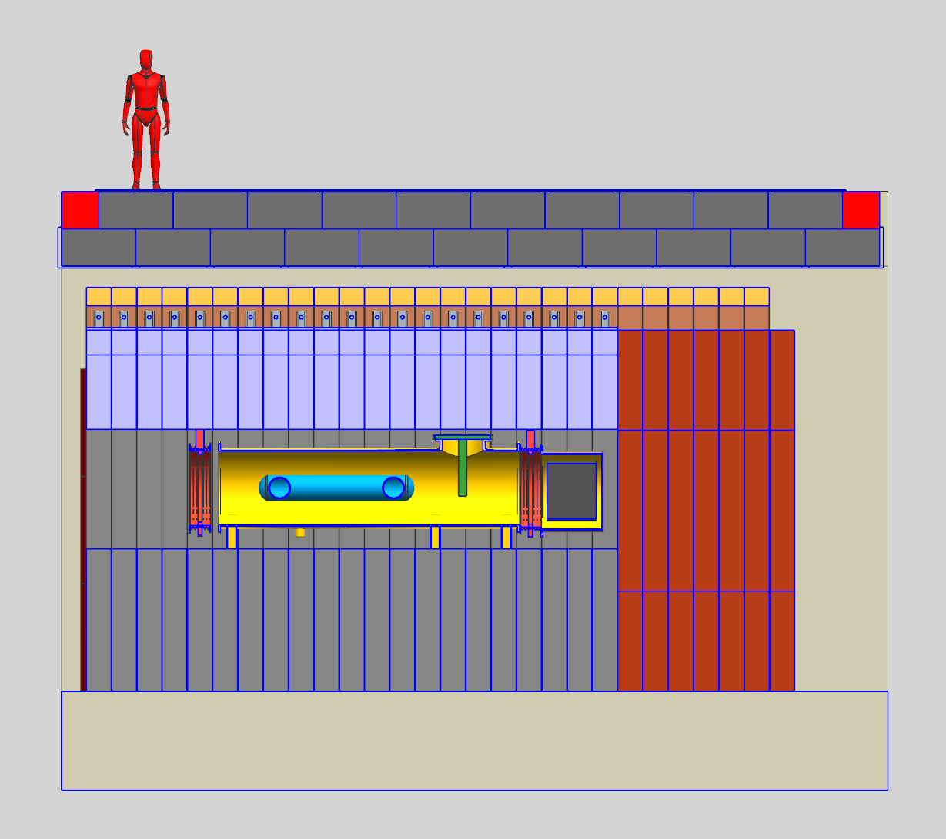
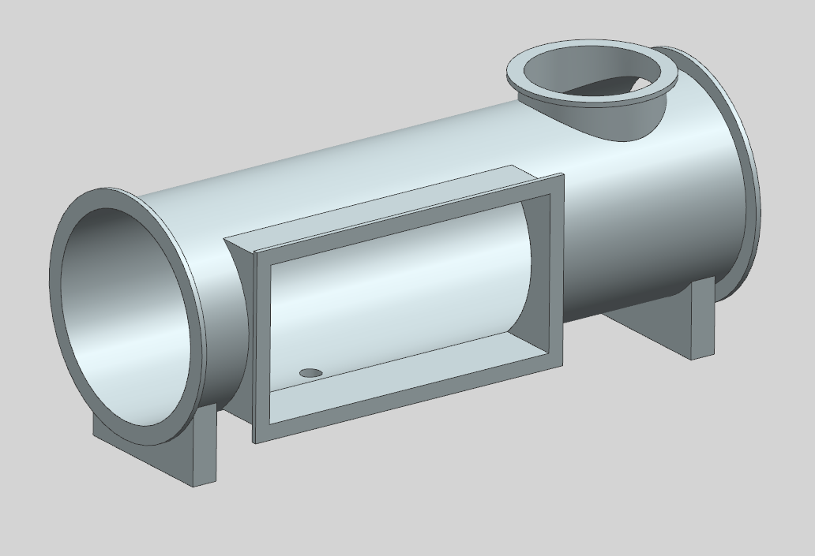
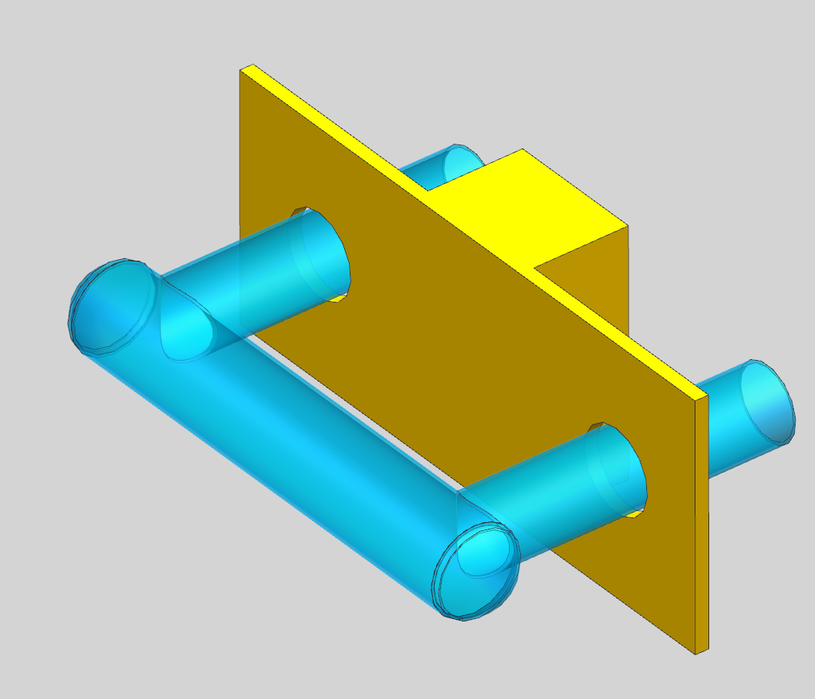
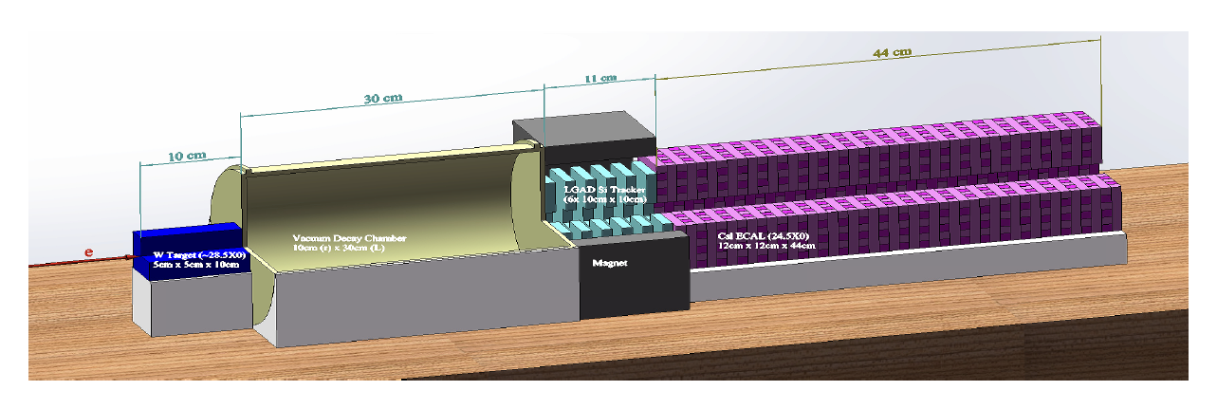
F2D2 – Molten Salt Target
Containment Can – Inert Atmosphere
Port for
Irradiation station
Port for
salt tube
DAMSA could go here,
with reduced beam power
Salt Tube
Primary beam
Pre-target experimental area
Note: Conceptual shielding stack, has not undergone formal Radiological Safety review!

Slide 19
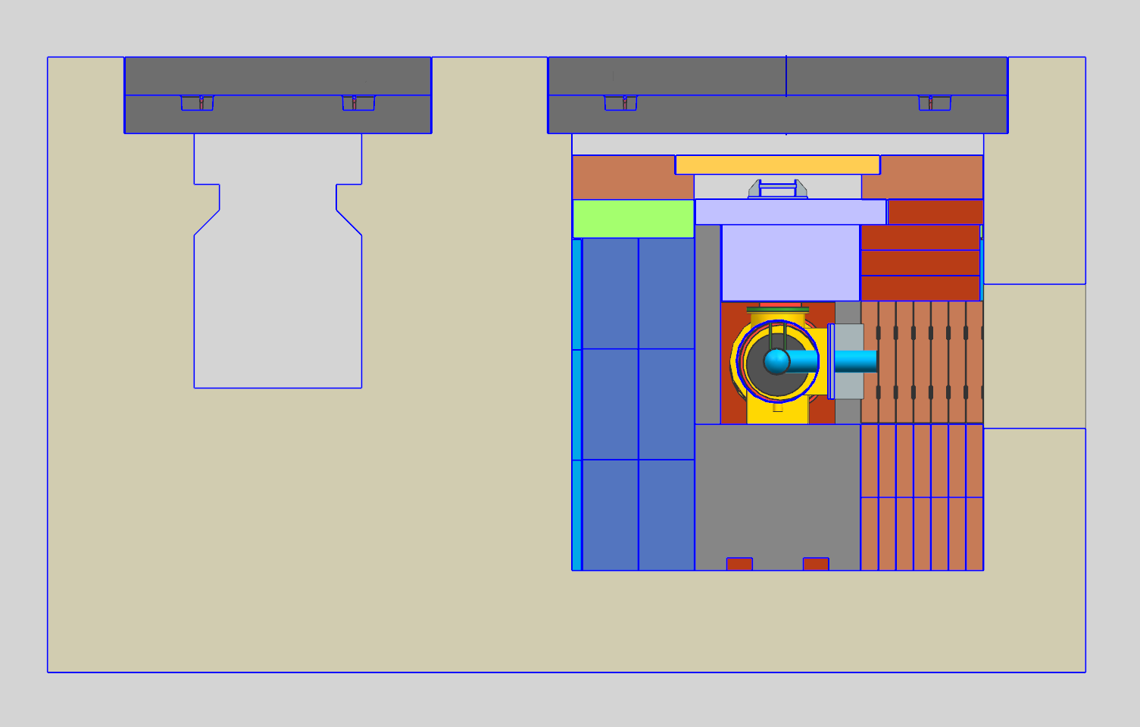
F2D2 Molten Salt Target – Bunker and Shield Pile Cross Section
Morgue
Tunnel to remote handling area
Target Chase

Slide 20
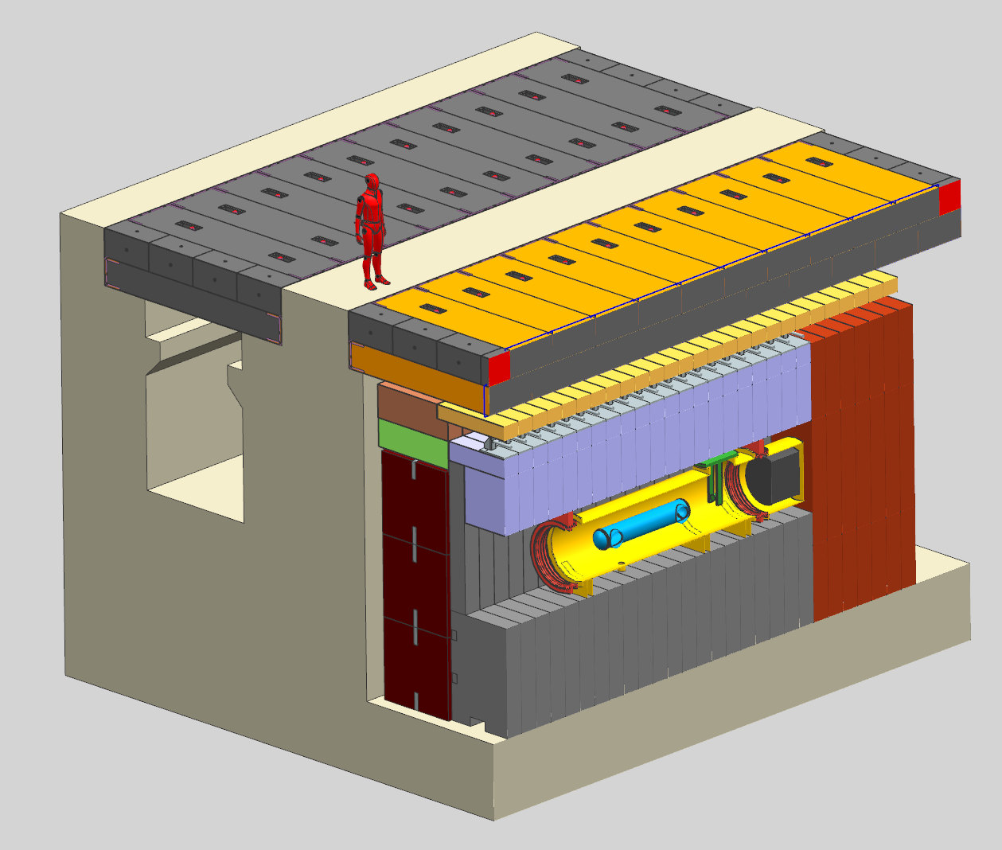
F2D2 Molten Salt Target – Bunker and Shield Pile
Beam

Slide 21
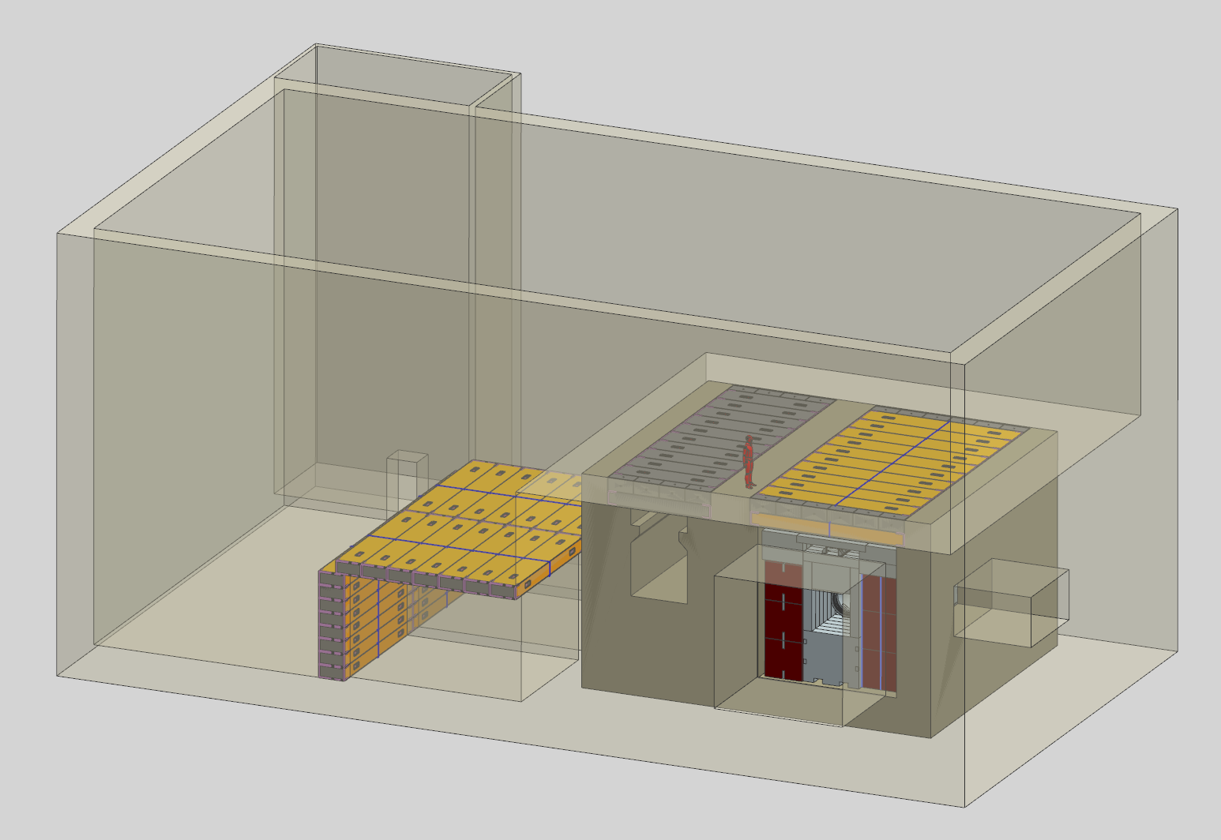
F2D2 Target Hall Concept
Beam

Slide 22
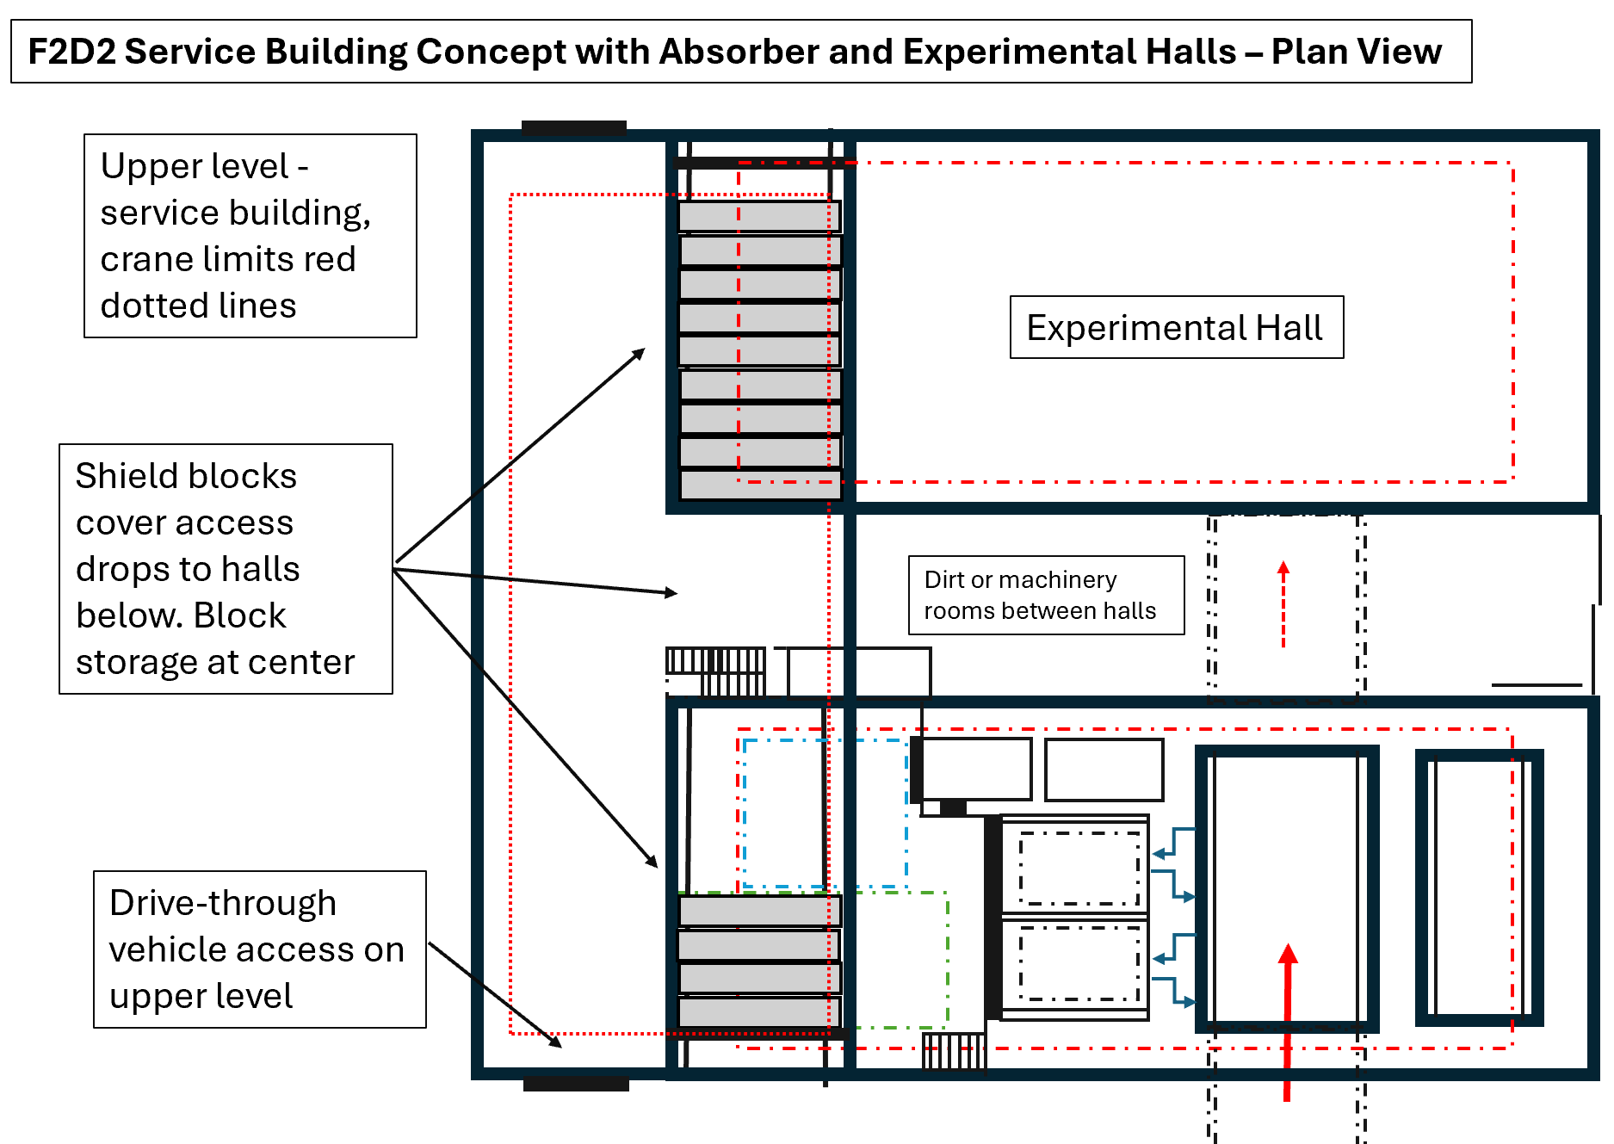
F2D2 Facility Layout
Service Bay - not included in this drawing
  Molten salt equipment
  Manipulators for servicing operations
  Comparable to SNS or ESS
Service Bay is pre-conceptual design
  Expensive remote manipulators
  Hot lab, machine shop
  Waste storage and monitoring
To
Service
Bay
Swap target chase and morgue to accommodate tunnel to service bay,
see previous slide

Slide 23

Looking forward to 2045…
?
F2D2 is a compelling engineering project, beyond P5 science goals
  Especially with multipurpose facilities:
    World-class remote handling and PIE facility - we need hot cells and hot labs
    Irradiation station for materials research
    Pre-target area for experiments and equipment tests
All of these problems will need to be solved for the Muon Collider:
  Thermals & Radiation
  Remote handling & waste stream management
  Conventional facilities
The μ-Collider target station will be harder than F2D2, probably even more radioactive
  Need to think about remote handling and final disposition for kSv/hr waste now

Slide 24
Acknowledgements
F2D2 Task Force Members
M. Toups, N. Dhanaraj, S. Dixon, S. Ganguly, M. Hedges, J. Eldred, J. Estrada,
G. Krnjaic, K. Lynch, V. Pandey, M. Strait, N. Tran, J. Williams, and J. Zettlemoyer
Fermi National Accelerator Laboratory, Batavia, IL 60510, USA
W. Asztalos
Illinois Institute of Technology, Chicago, IL 60616, USA
B. Batell
University of Pittsburgh, Pittsburgh, PA 15260, USA
S. Gori
University of California, Santa Cruz, Santa Cruz, CA 95064, USA
K. J. Kelly
Texas A&M University, College Station, TX 77840, USA
J. Yu
Department of Physics, University of Texas, Arlington, TX 76019, USA

Slide 25



Collaborations / Partnerships / Members
This work was produced by Fermi Forward Discovery Group, LLC under Contract No. 89243024CSC000002 with the U.S. Department of Energy, Office of Science, Office of High Energy Physics. Publisher acknowledges the U.S. Government license to provide public access under the DOE Public Access Plan DOE Public Access Plan

Slide 26
Questions?

Slide 27
Backup

Slide 28
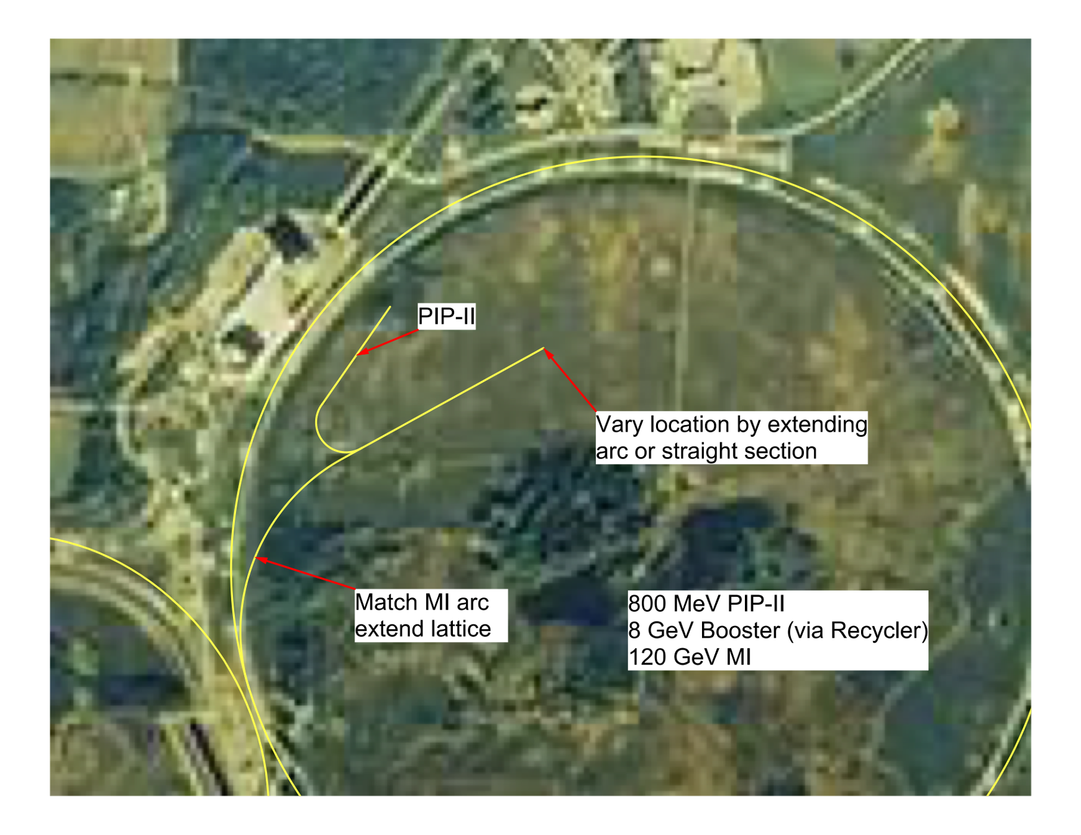
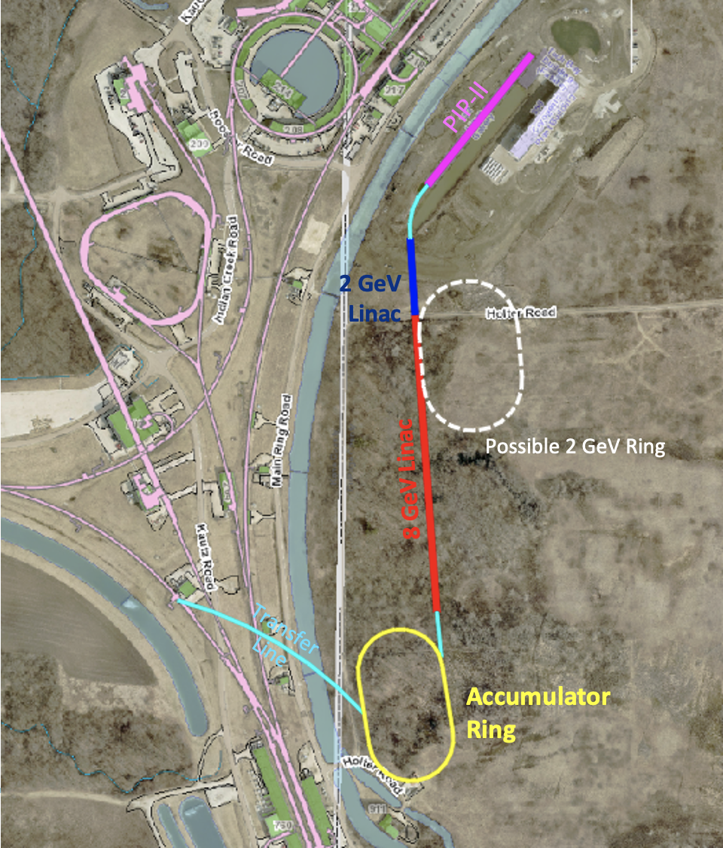
F2D2 Site Layout – Integrated with Future Fixed Target Campus
Experiment hall
target
28

Slide 29
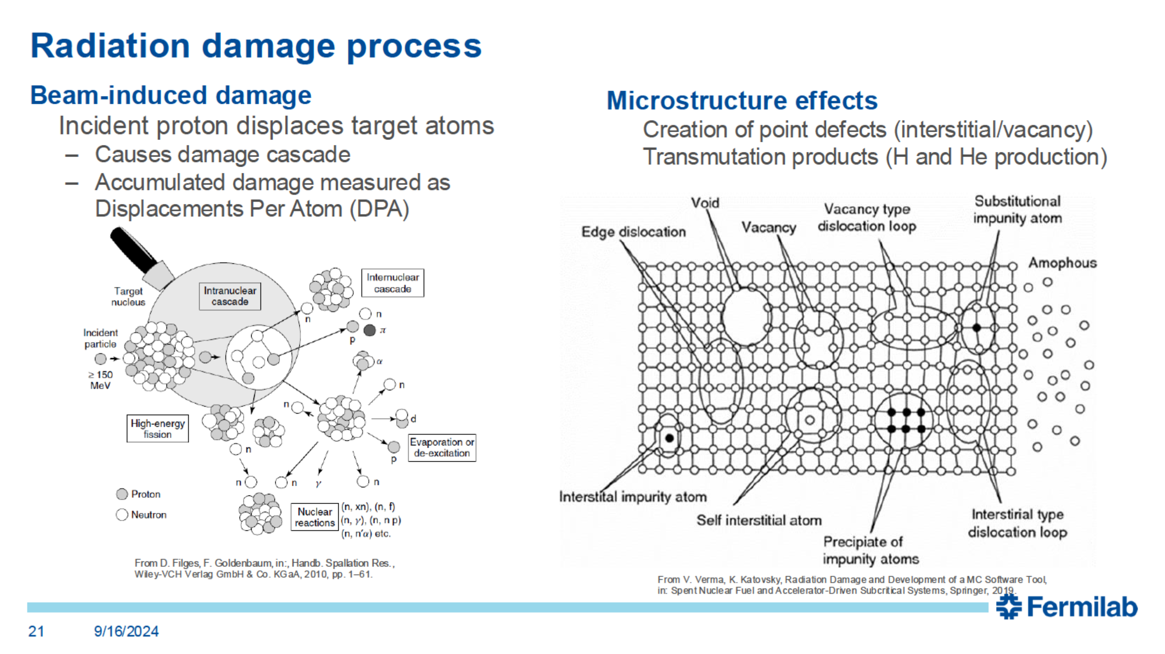
Atomic Displacements and DPA
Slide courtesy of Abe Burleigh, TSD, FNAL

Slide 30
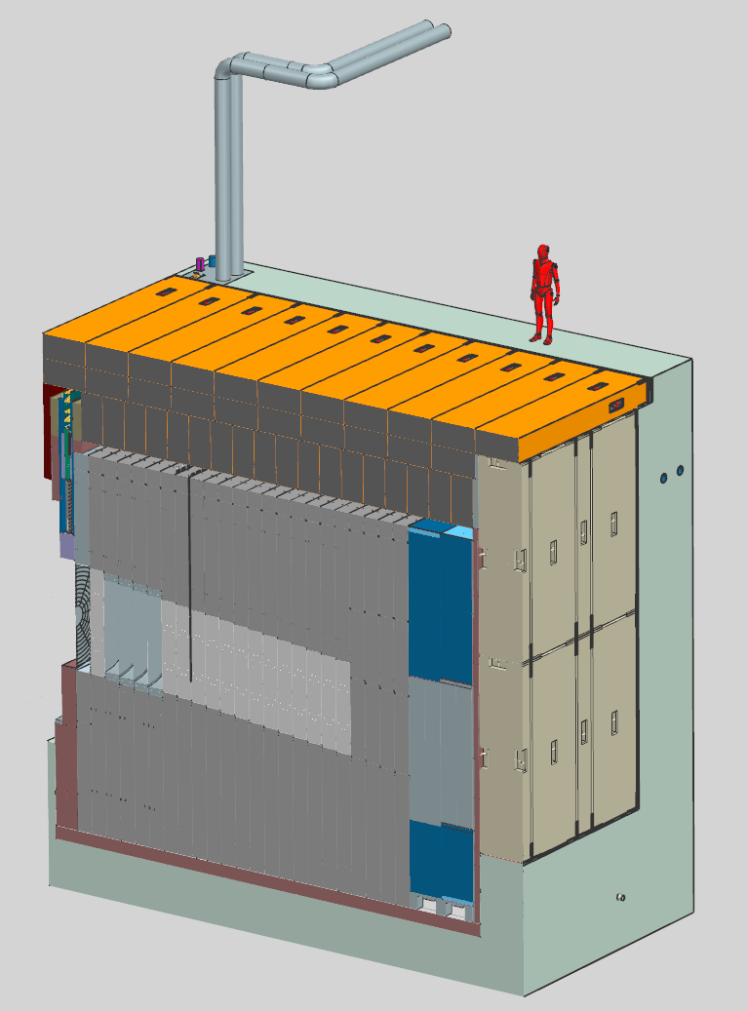
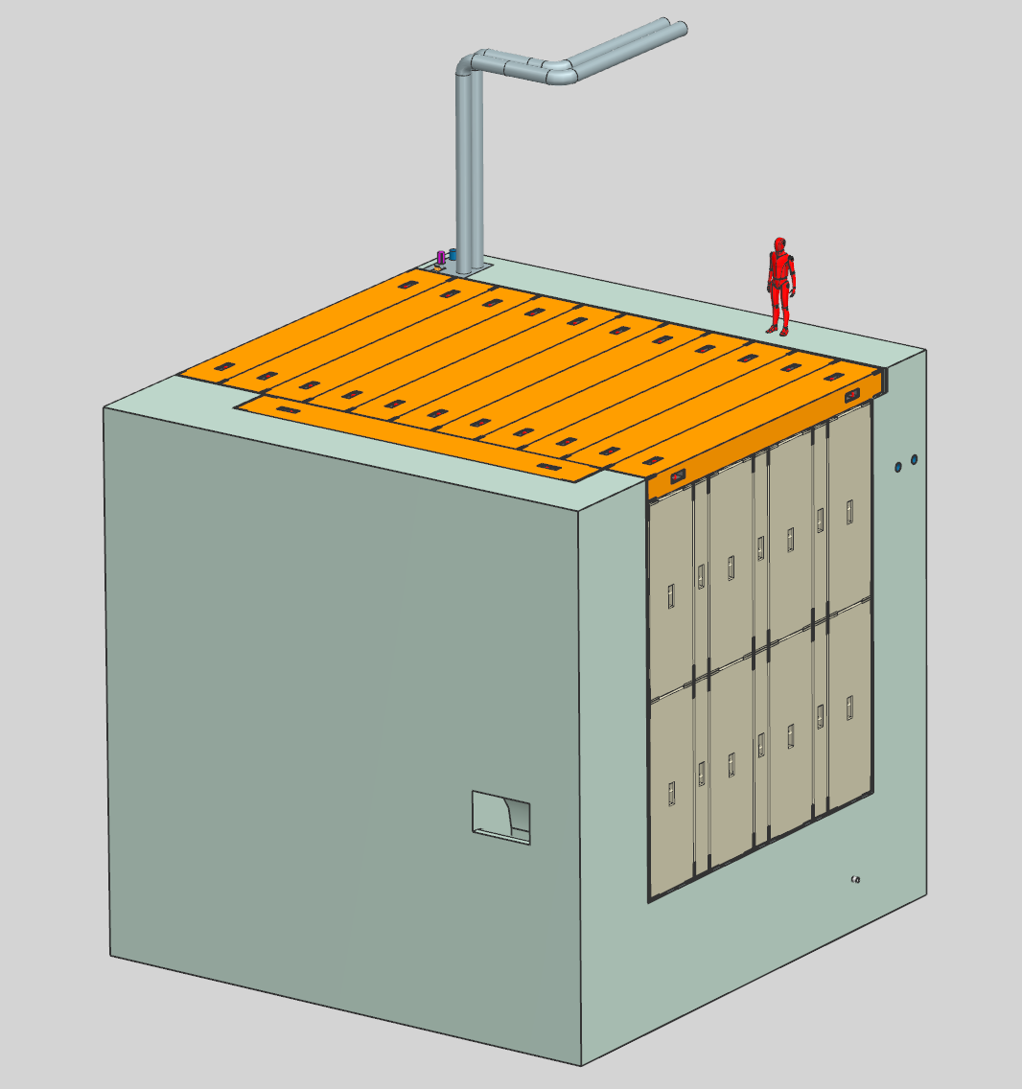
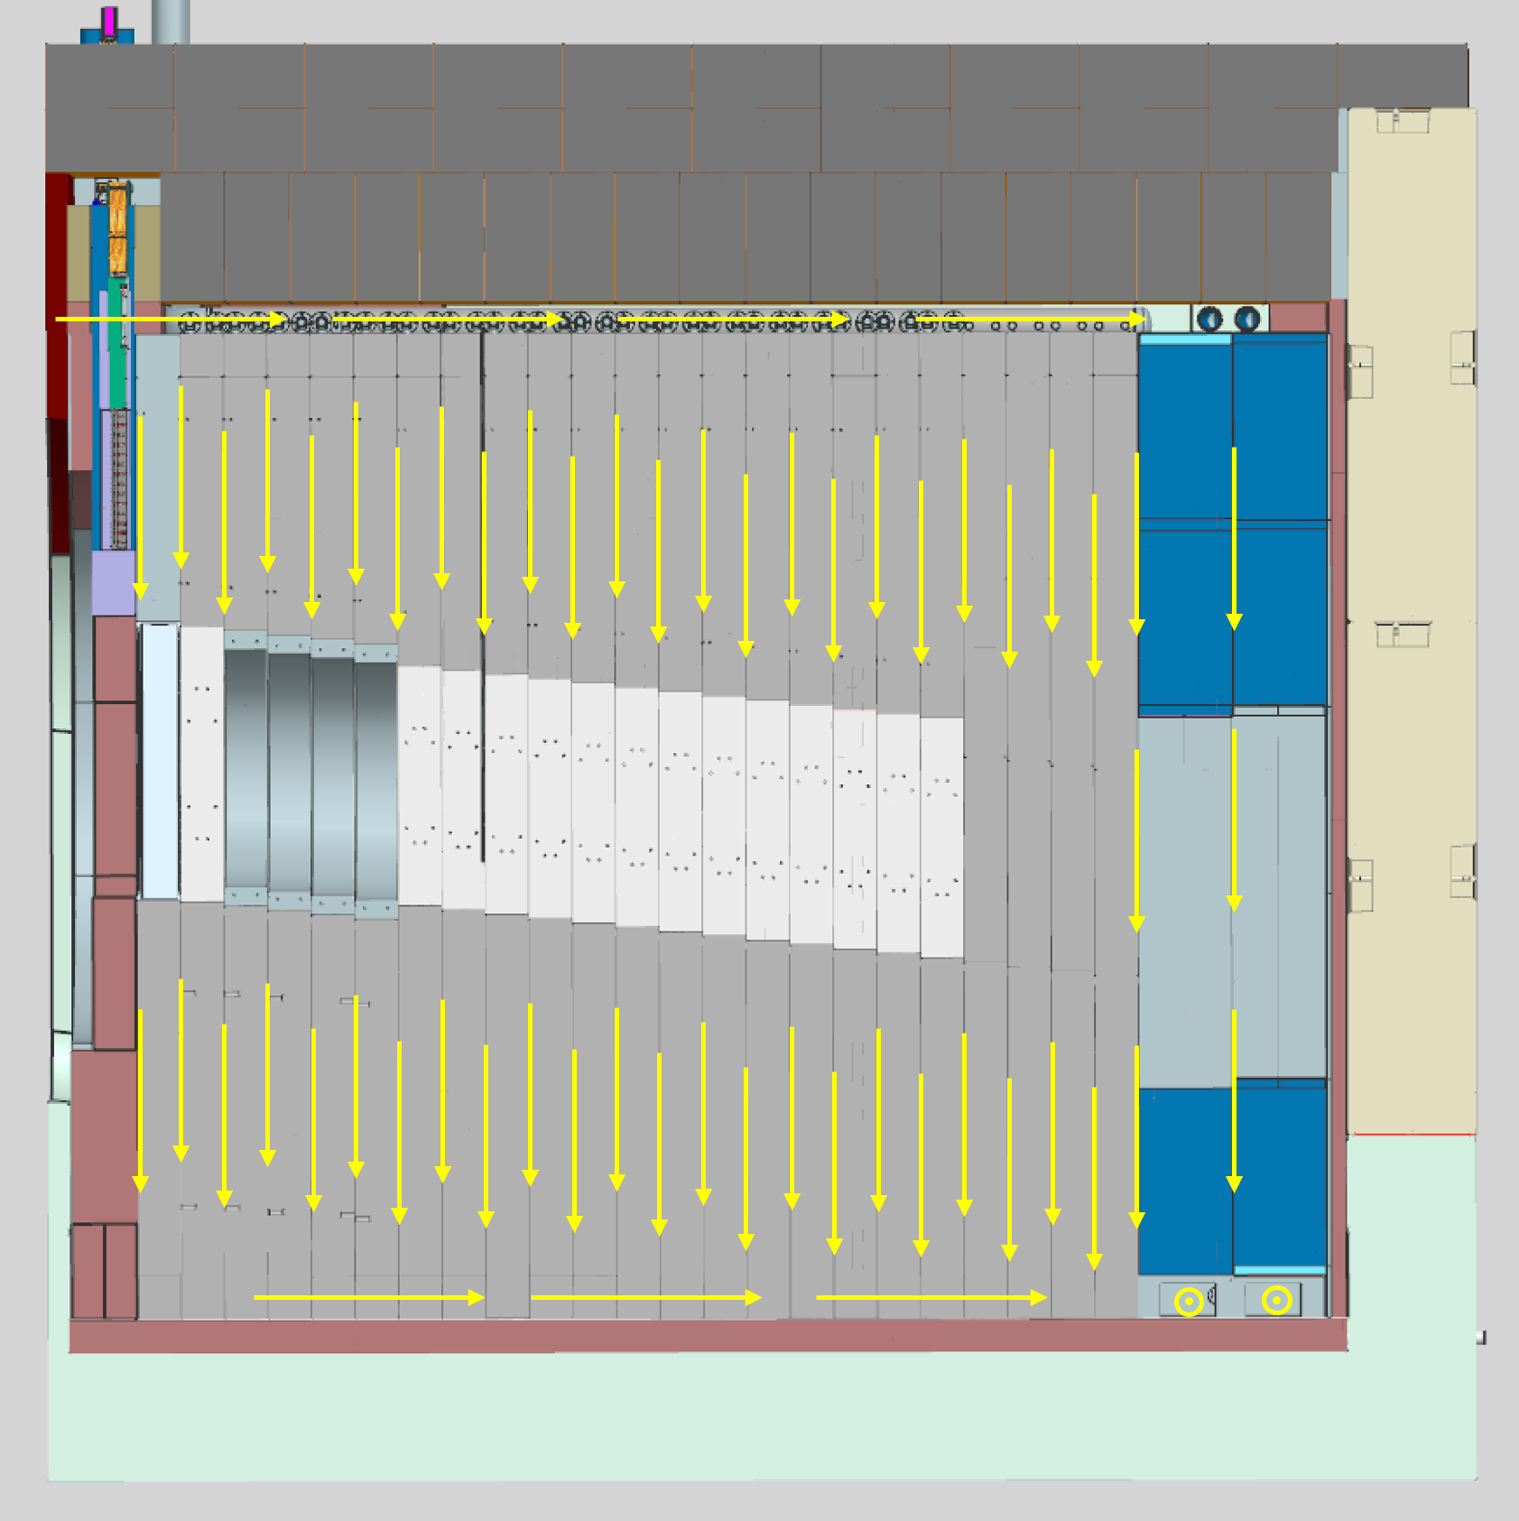
LBNF Hadron Absorber – 2.4 MW Beam Absorber

Slide 31
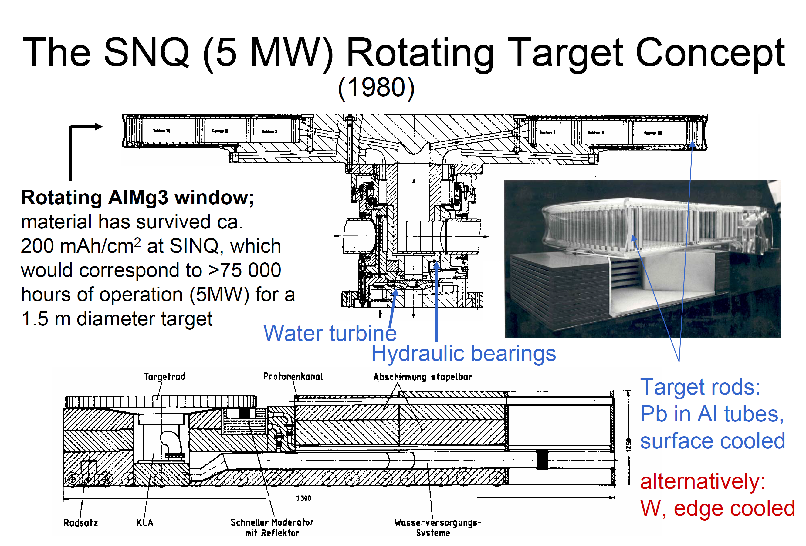
Low Energy, High Power Targetry Honorable Mention – SNQ
German spallation neutron source project
  Cancelled mid-80’s
  Rotating wheel
  Water-driven rotation (no electronics in radiation area)
Mounted on a rolling sled (like SNS)
Water-cooled target canisters (like SINQ)
From 9th European Particle Accelerator Conference, 5 to 9 July 2004, Lucerne, “High Power Targets for Accelerator Applications”, G.S. Bauer Forschungszentrum Jülich, Germany

Slide 32
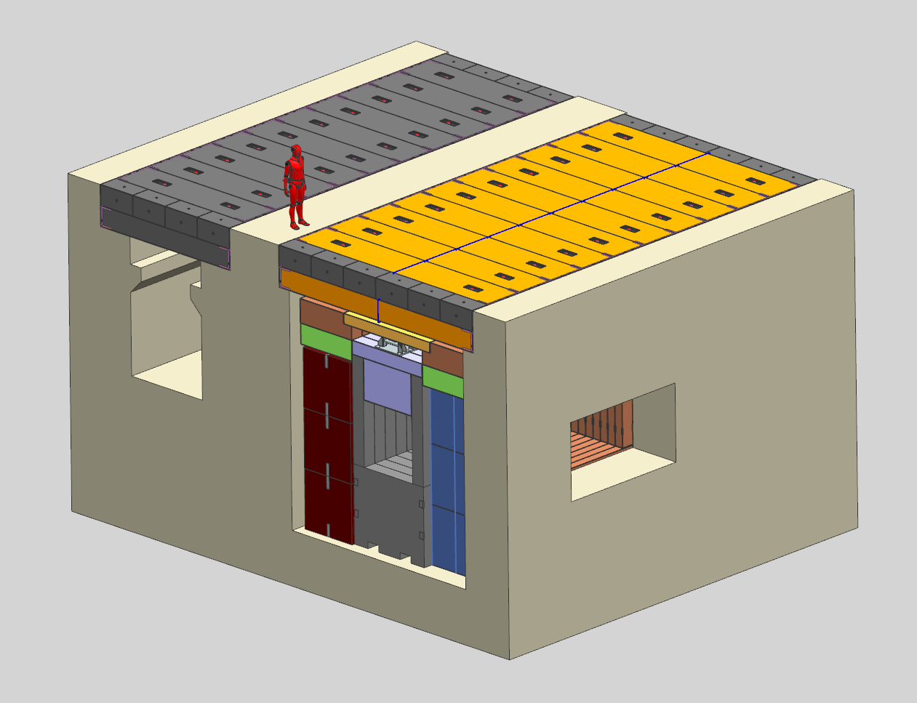
F2D2 Molten Salt – Shield Pile and Morgue

Slide 33
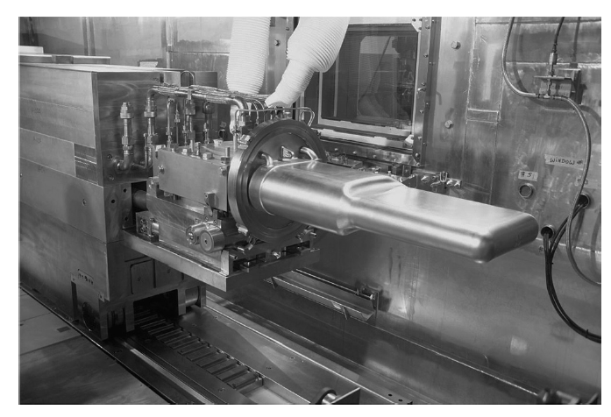
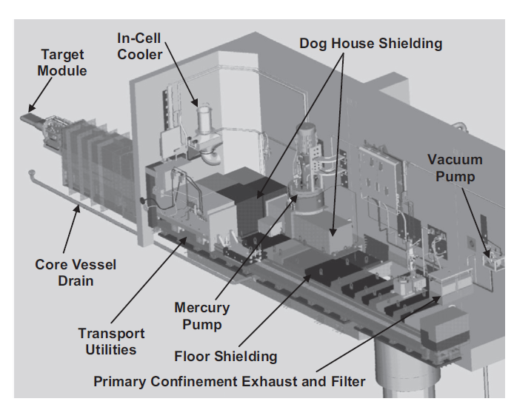
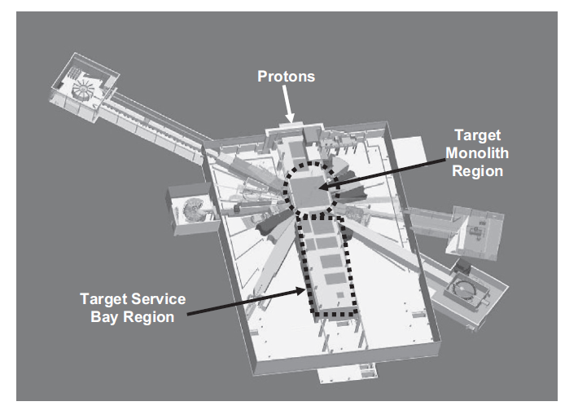
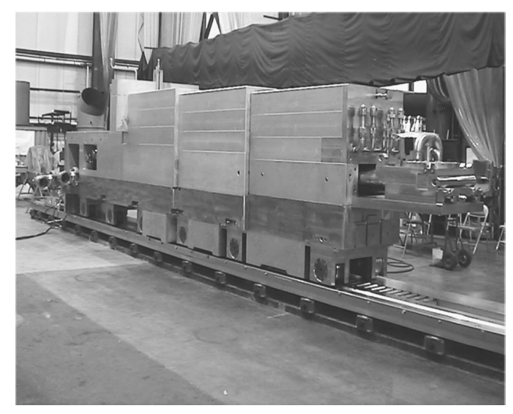
ORNL SNS FTS

Slide 34
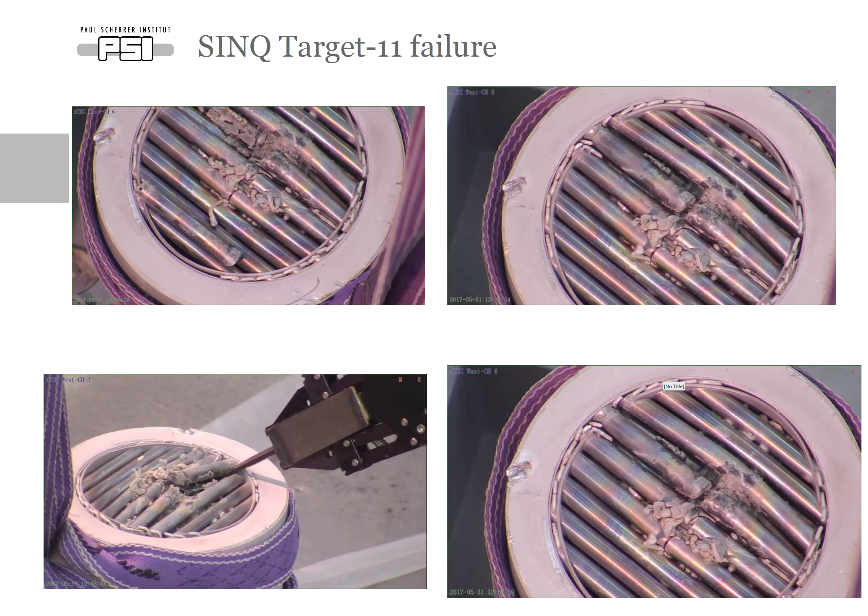
PSI SINQ Target Failure and PIE
https://indico.psi.ch/event/7274/contributions/18866/attachments/14876/20209/Wohlmuther_SINQ_target_development.pdf

Slide 35
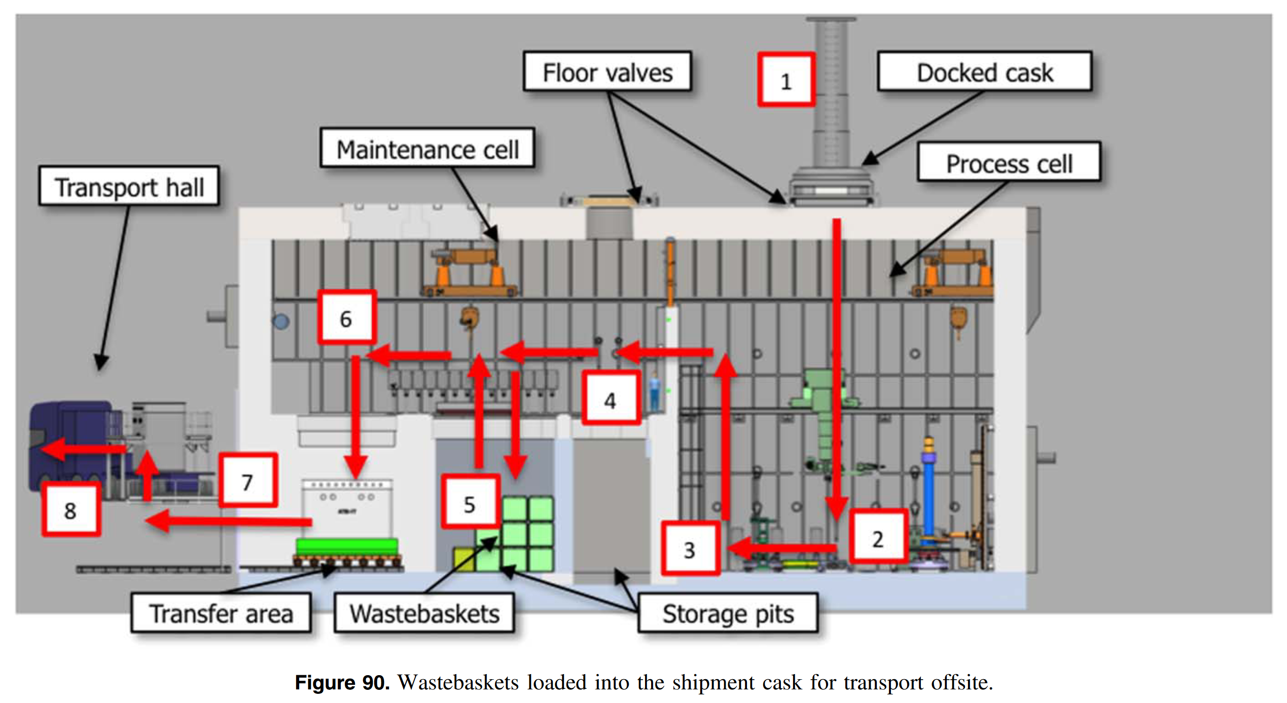
ESS Remote Handling
https://doi.org/10.1088/1402-4896/aaecea

Slide 36
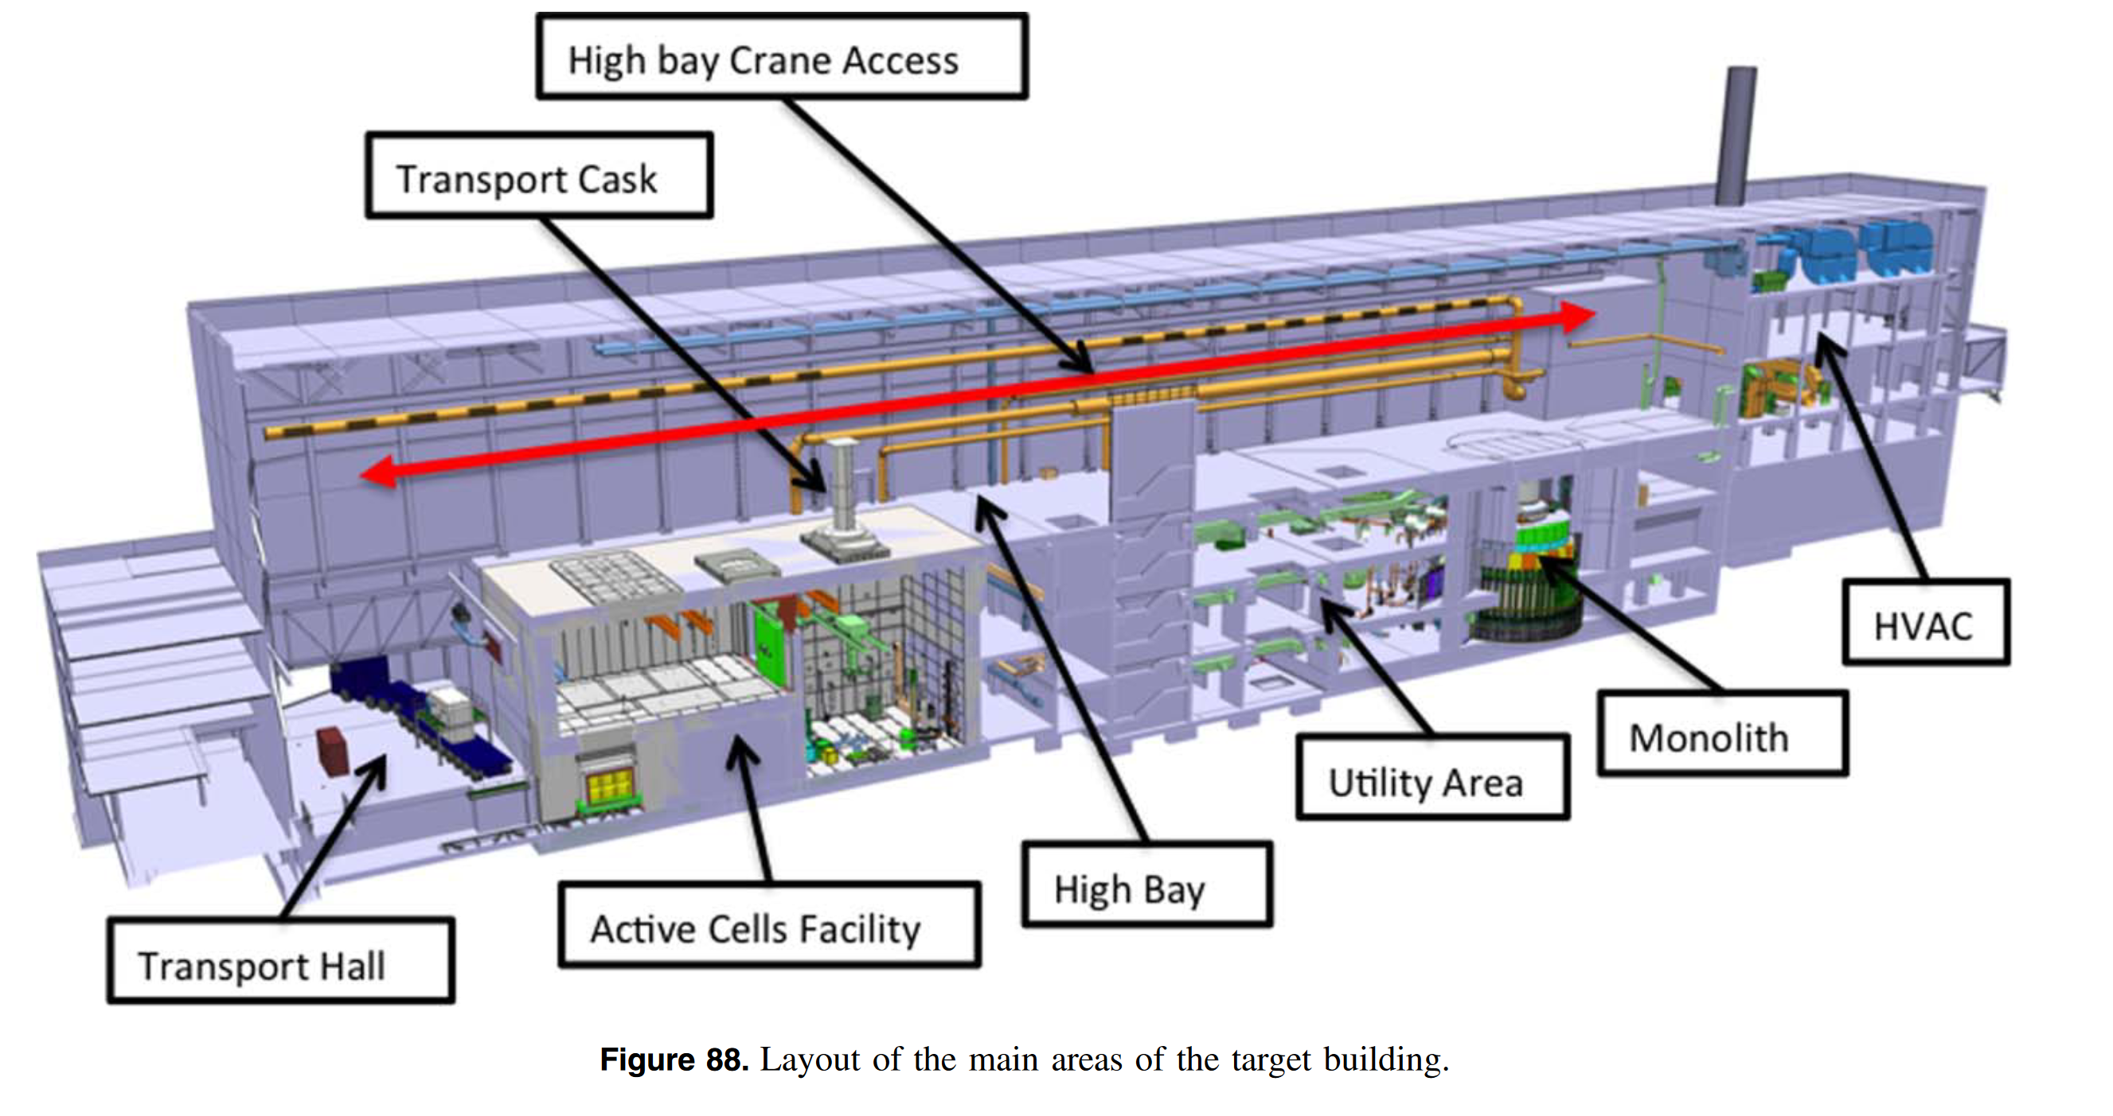
ESS Remote Handling
https://doi.org/10.1088/1402-4896/aaecea

