Slide 1

ALP to Diphoton/Dilepton
Benchmark Scenarios at
Different Facilities
Doojin Kim
(doojin.kim@usd.edu)
DAMSA Collaboration Meeting
University of Texas at Arlington, Arlington, TX
January 17th, 2025

Slide 2
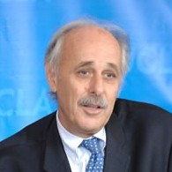
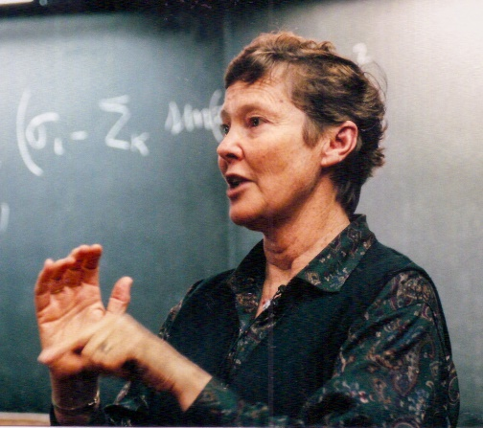
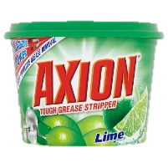
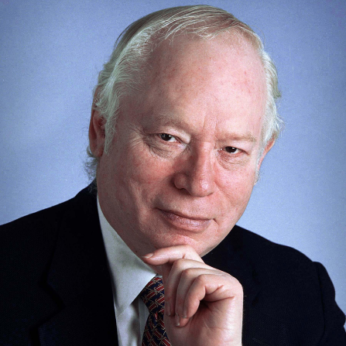
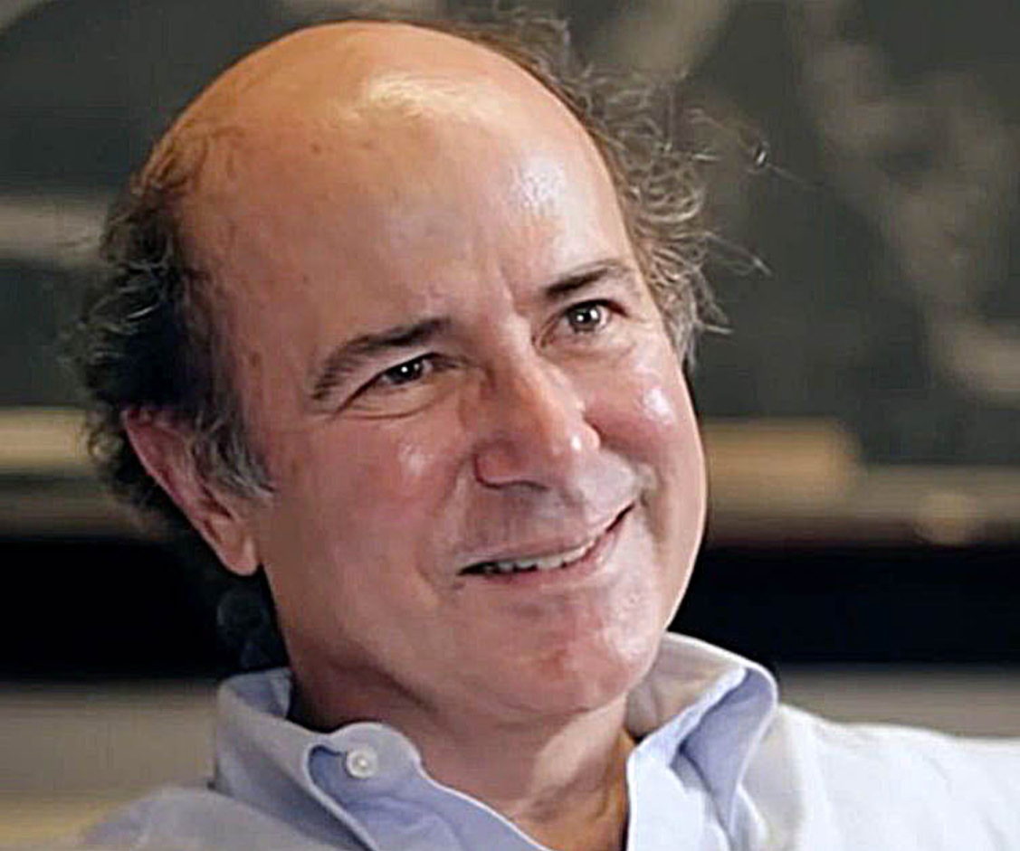
Axions and Axion-like Particles
QCD axion for solving dynamically the strong CP problem
[Peccei, Quinn, PRL (1977); Weinberg, PRL (1978); Wilczek, PRL (1978)]
Extended to more general pseudo-scalar axion-like particles (ALPs) which share similar properties/pheno. wiith QCD axion [Arvanitaki, Dimopoulos, Dubovsky, Kaloper, March-Russell, PRD (2010); Cicoli, Goodsell, Ringwald, JHEP (2012)]

Slide 3
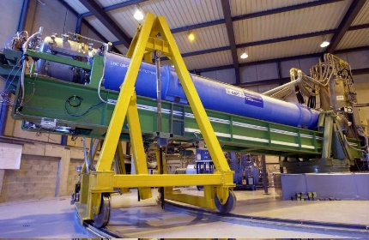
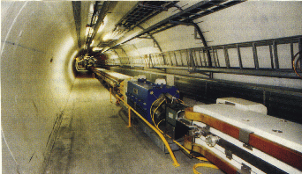
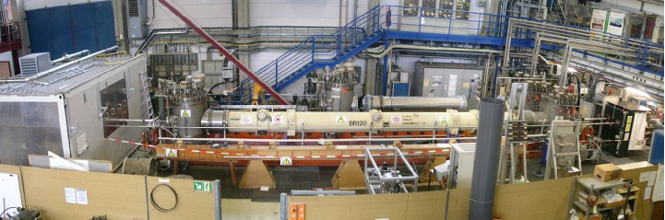
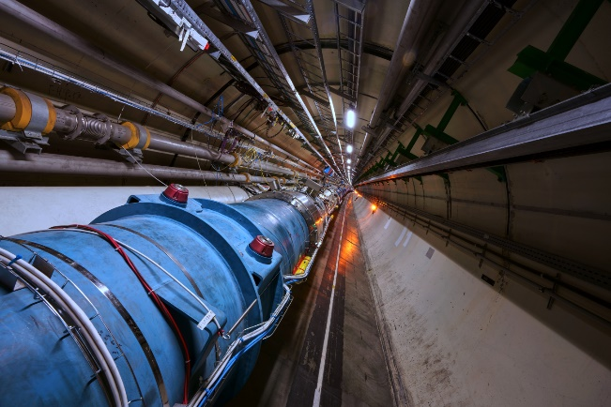
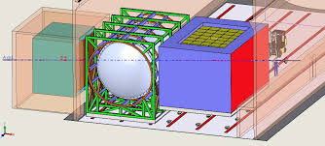
Axion/Axion-like Particle Searches
Low-energy & intensity frontier
High-energy frontier
Axion/ALP searches (this talk)
E.g. Heavy resonance searches

Slide 4
ALPs Interacting with
SM Photons

Slide 5





Axion-like Particles Interacting with SM Photons
$$γ$$
$$a$$
$$g_{aγγ }$$
$$γ$$
Axion-like particles interacting with the SM photon

Slide 6






Production of ALP: Sources of Photons
Meson decays
Cascade photons
Target/Dump
Target/Dump
$$γ$$
Proton beam
$$π^{0}, η, …$$
Proton beam
…
$$γ$$
$$γ$$
Promptly decaying $π^{0}, η$
secondary $e^{±}$
Dedicated simulation using e.g., GEANT is needed to describe the production of cascade photons inside the target. cf.) See also [Verbinski, Weber, and Sund, PRC (1973)] for photons at reactors.

Slide 7



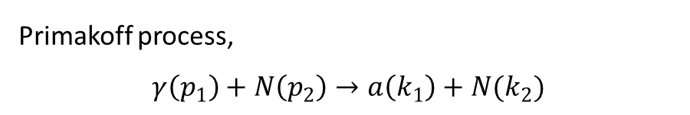


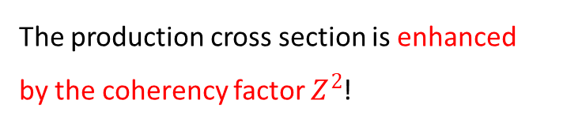
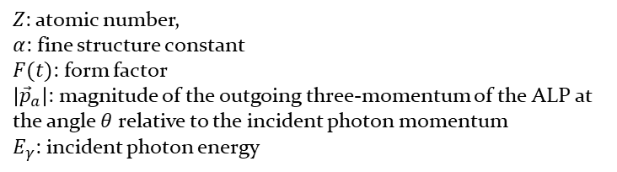


ALP Production: Primakoff Process
Primakoff process,
$$γ\left(p_{1}\right)+N\left(p_{2}\right)→a\left(k_{1}\right)+N(k_{2})$$
$$γ$$
$$g_{aγγ }$$
$$a$$
$$N$$
$$N$$
The production cross section is enhanced by the coherency factor $Z^{2}$!
$Z$: atomic number,
$α$: fine structure constant
$F(t)$: form factor
$\left|{\vec{p}}_{a}\right|$: magnitude of the outgoing three-momentum of the ALP at the angle $θ$ relative to the incident photon momentum
$E_{γ}$: incident photon energy

Slide 8





ALP Detection: ALP Decay
ALP decays in flight to a couple of photons which are detected by the DAMSA detector.
$$γ$$
$$a$$
$$g_{aγγ }$$
$$γ$$
E.g., with $E_{a}=0.3$ GeV, $m_{a}=0.1$ GeV and $g_{aγγ}={10}^{−5} {GeV}^{−1}$, the mean decay length is 1.1 meters.

Slide 9




DAMSA: “Portable” Very Short Baseline Experiment
Portable ≈ small size
Decay chamber
(vacuum vessel)
$θ_{det}=0.05$ rad
Pulsed
$p$ beam
W dump
$0.1$m
: Smaller than the radius of the FASER detector!
ECAL
W-dump is assumed thick enough (i.e., radius) not to affect the fiducial photon flux.
${∆L}_{det}≤$ 1 m
A few tens of
cm to m
Distance between the dominant signal production point and the dump end; varies depending on the beam energy
[DK, Yu, Park, Kim, arXiv:2401.09529]

Slide 10
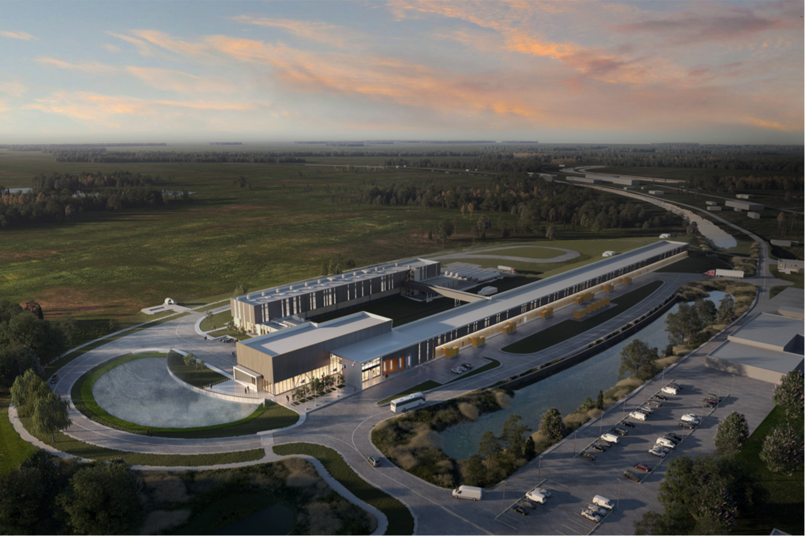
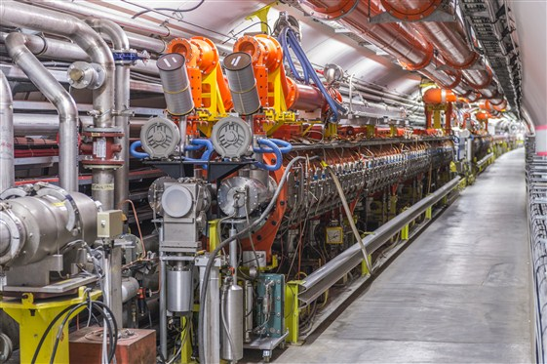
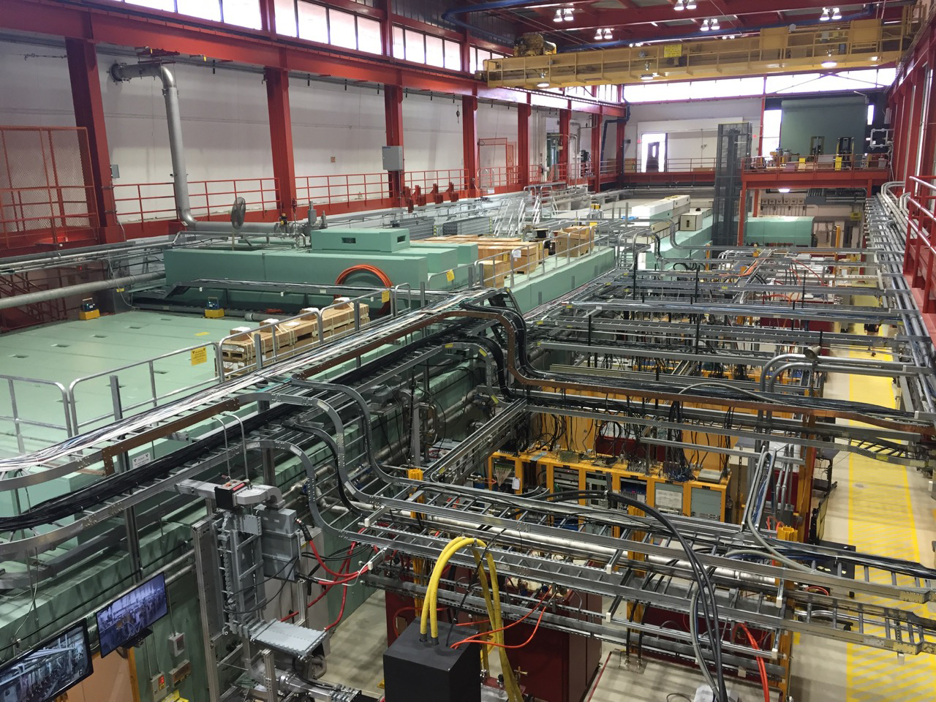
Benchmark Beam Facilities
PIP-II@FermiLab
SPS@CERN
FAST@FermiLab
Proton beam
800 MeV
Proton beam
400 GeV
Electron beam
300 MeV

Slide 11
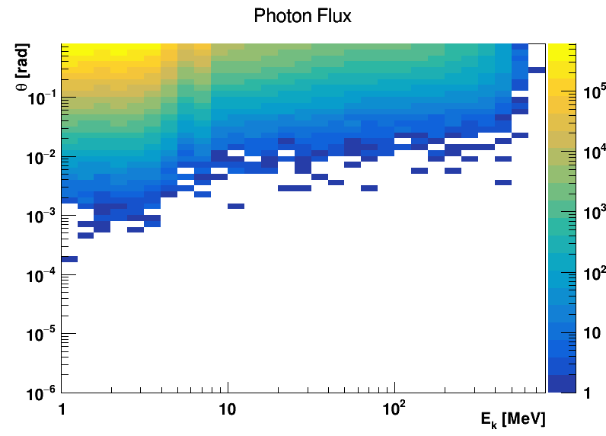
Photon Spectrum at PIP2@FermiLab

Slide 12

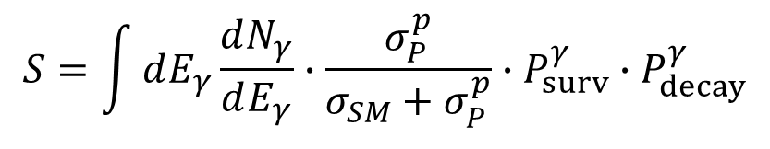



Calculating Signal Detection Rate
$$S=\int{dE_{γ}\frac{dN_{γ}}{dE_{γ}}∙\frac{σ_{P}^{p}}{σ_{SM}+σ_{P}^{p}}∙P_{surv}^{γ}∙P_{decay}^{γ}}$$
ALP flux at the detector location
Probability of decay inside the detector volume
$$P_{decay}^{γ}=1−\exp\left(−\frac{Δℓ m_{a}}{p_{a}τ_{a}^{γ}}\right)$$
Number of photons moving
toward the detector
ALP survival probability
$$P_{surv}^{γ}=exp\left(−\frac{ℓ_{d}m_{a}}{p_{a}τ_{a}^{γ}}\right)$$
Competition between Primakoff production and other SM processes
($Δℓ$: decay chamber length)
$(ℓ_{d}=$ dump-detector distance)

Slide 13


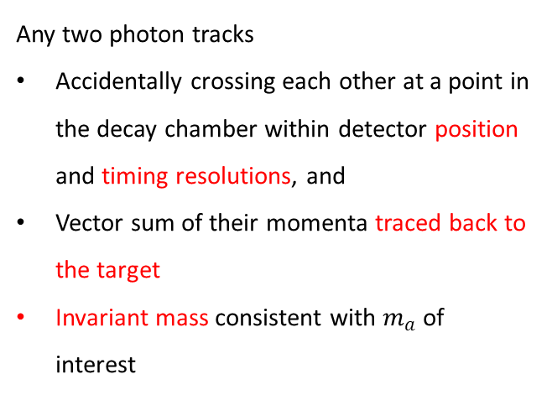


Background Considerations
Photons mostly neutron-originating
Any two photon tracks
Accidentally crossing each other at a point in the decay chamber within detector position and timing resolutions, and
Vector sum of their momenta traced back to the target
Invariant mass consistent with $m_{a}$ of interest
$$n$$
$$γ$$
$$n$$
$$γ$$
Decay chamber wall
1) Distance-to-closest-approach cut, 2) Arrival-time-difference cut, 3) Fiducial-volume cut, 4) Trace-back analysis cut, and 5) Invariant-mass-window cut
⇒ Reducible by more than 10-11 orders of magnitude
[Jang, DK, Kong, Kwon, Park, Ryu, Shin, Van De Water, Yang, Yu, PRD (2023)]

Slide 14
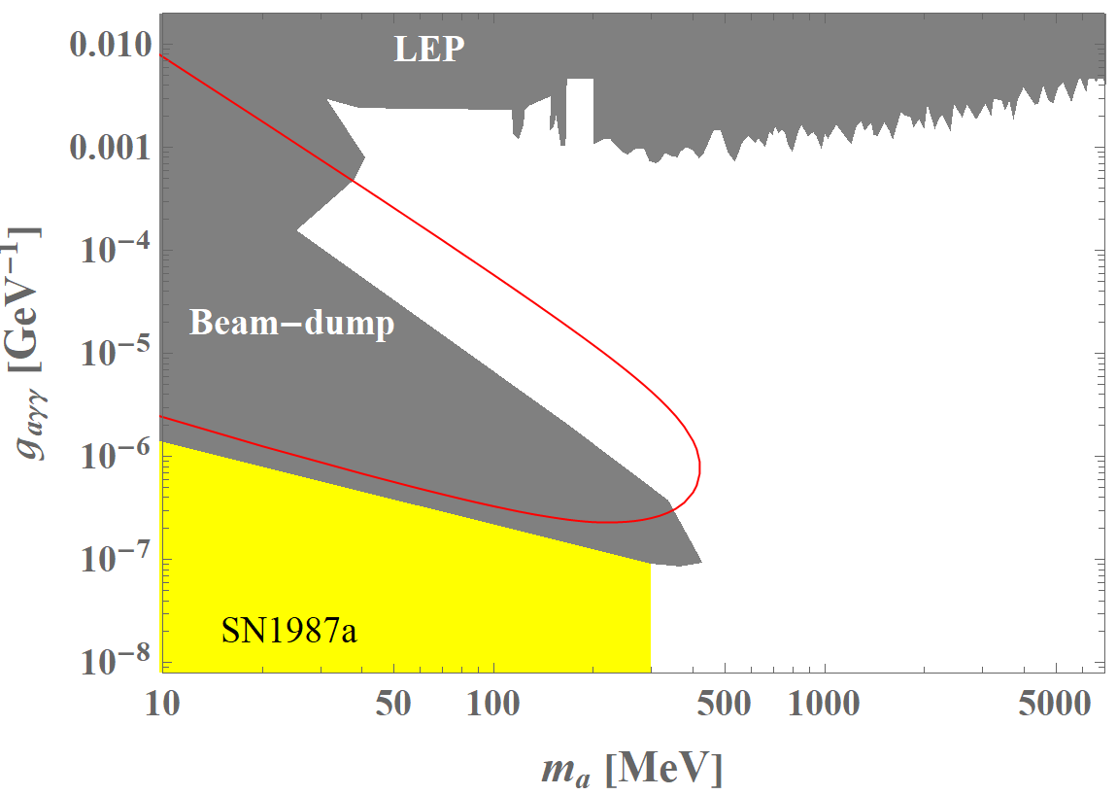

DAMSA with PIP2@FermiLab
$E_{p}=800 MeV$
$POT/yr=4×{10}^{23}$
$POT/bunch=7.7×{10}^{7}$
$E_{γ,cut}=100 MeV$
${∆L}_{det}=1 m$
$θ_{det}=0.05 rad$
$N_{yr}=3 months$
$L_{target}=1 m$
[DK, Yu, Park, Kim, arXiv:2401.09529]

Slide 15
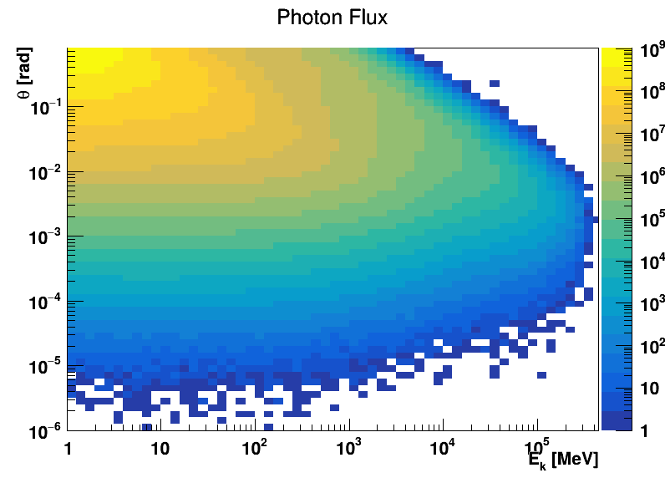
Photon Spectrum at SPS@CERN

Slide 16
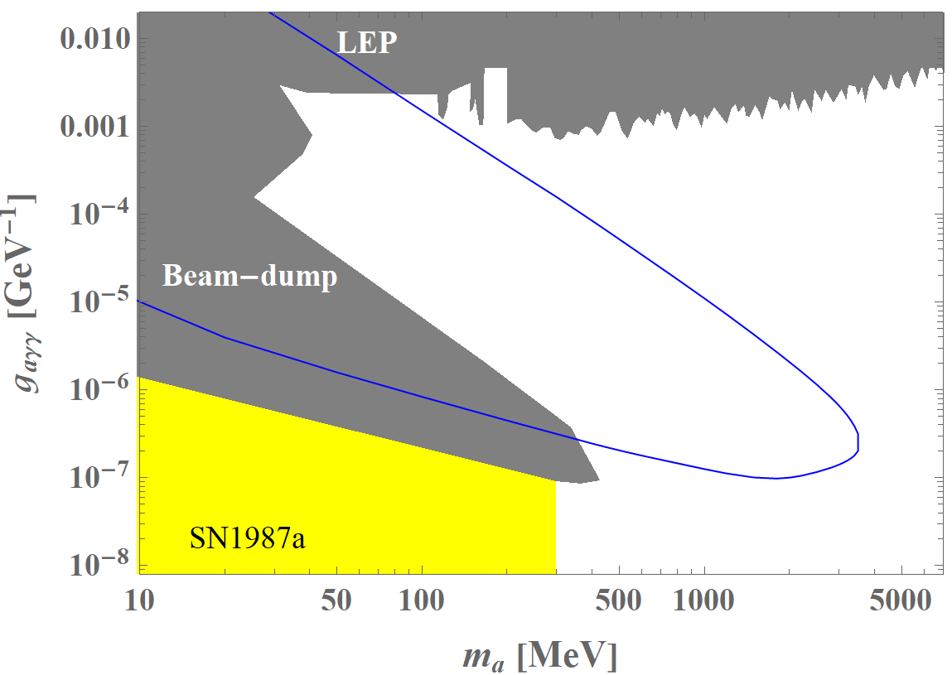

DAMSA with SPS@CERN
$E_{p}=400 GeV$
$POT/yr=4×{10}^{19}$
$POT/bunch=5.1×{10}^{4}$
$E_{γ,cut}=5 GeV$
${∆L}_{det}=1 m$
$θ_{det}=0.05 rad$
$N_{yr}=3 months$
$L_{target}=1 m$
[DK, Yu, Park, Kim, arXiv:2401.09529]

Slide 17
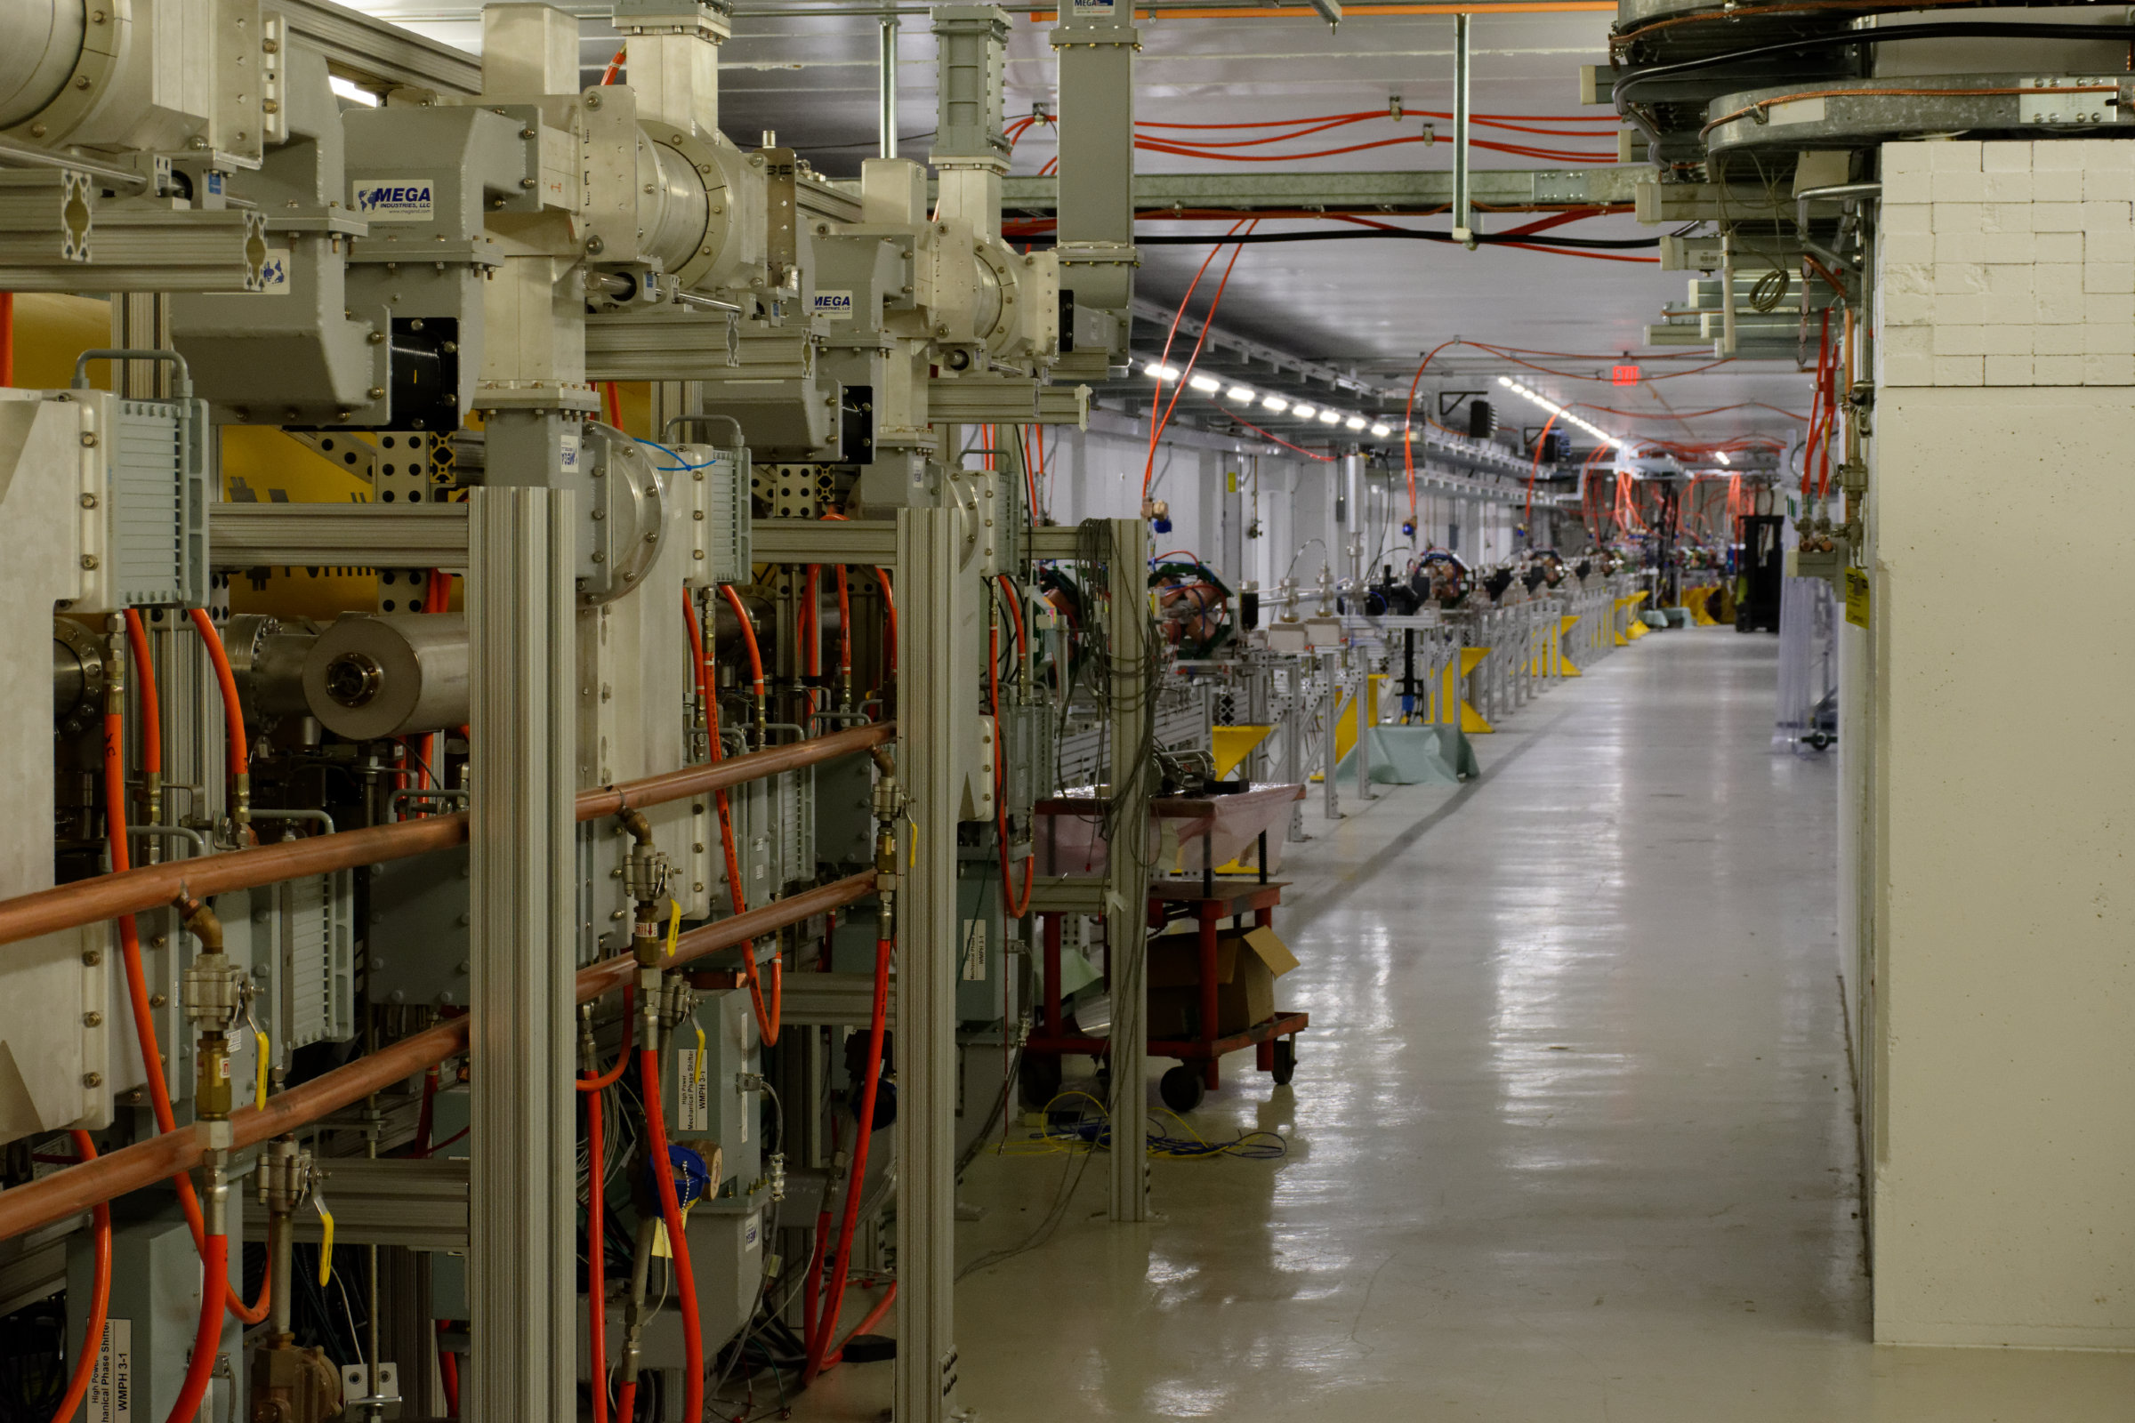
DAMSA Study with Electron Beams: ProtoDAMSA
Electron beams (e.g., FAST@FermiLab)
Less busy neutron-induced activities (vs. proton beam)
Cleaner environment to understand
  Neutron-induced backgrounds
  Pile-up at detectors

Slide 18
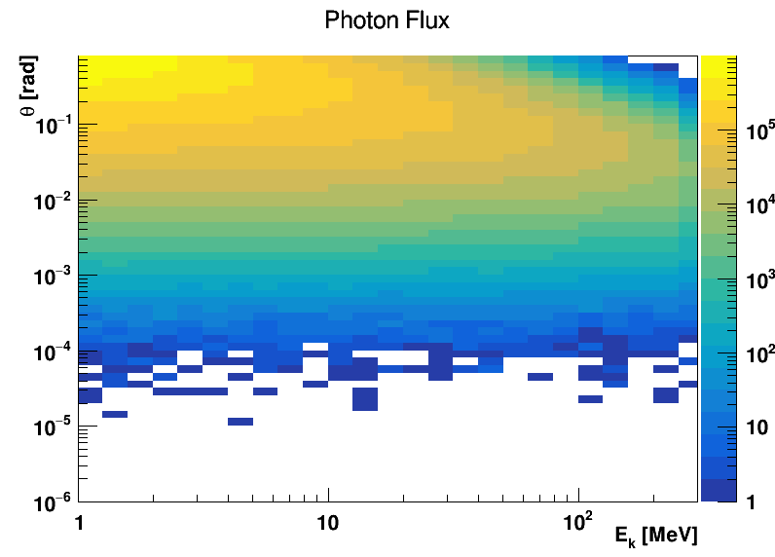
Photon Spectrum at FAST@FermiLab

Slide 19
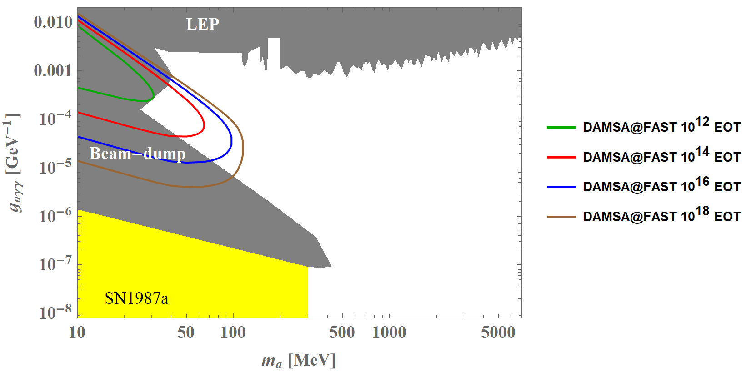

ProtoDAMSA with FAST@FermiLab
$E_{e}=300 MeV$
$EOT/bunch=1×{10}^{5}$
$E_{γ,cut}=50 MeV$
${∆L}_{det}=30 cm$
$θ_{det}=0.15 rad$
$L_{target}=10 cm$
[Kim, DK, Park, Yu, in preparation]

Slide 20
ALPs Interacting with
SM Photons

Slide 21
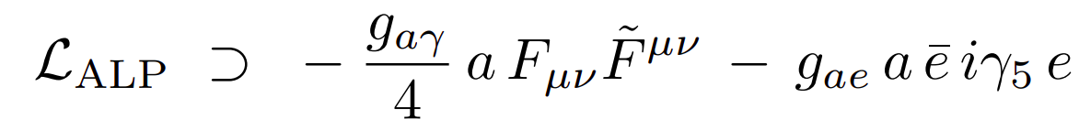
ALP-Electron Coupling
We can search for axion-like particles (ALPs) coupled primarily to electrons (assuming the photon coupling and other couplings to SM are relatively suppressed, e.g. in DFSZ-type scenarios)
We make use of the electromagnetic particle shower in the DAMSA target to be sensitive to this operator

Slide 22
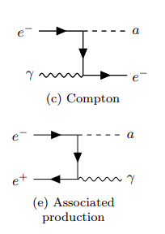
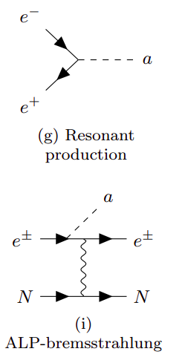
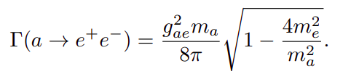
Simulation Scheme
Propagate to detector
4 scattering channels from 𝜸,e± radiative transport in W target
Look for decays to electron-positron pairs using the ALP lifetime
See 2112.09979 for matrix elements, cross sections, event rates, and other details

Slide 23
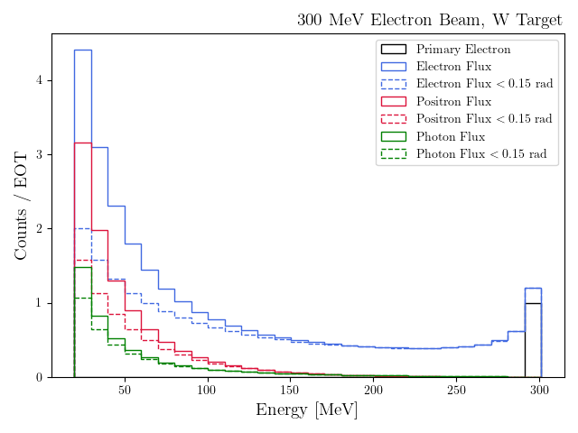
Fluxes in the W Target from GEANT4 Simulation
electron, positron, and photon fluxes in the W target
Normalized to EOT (electrons on target)
No fluxes shown below 25 MeV → detector threshold

Slide 24
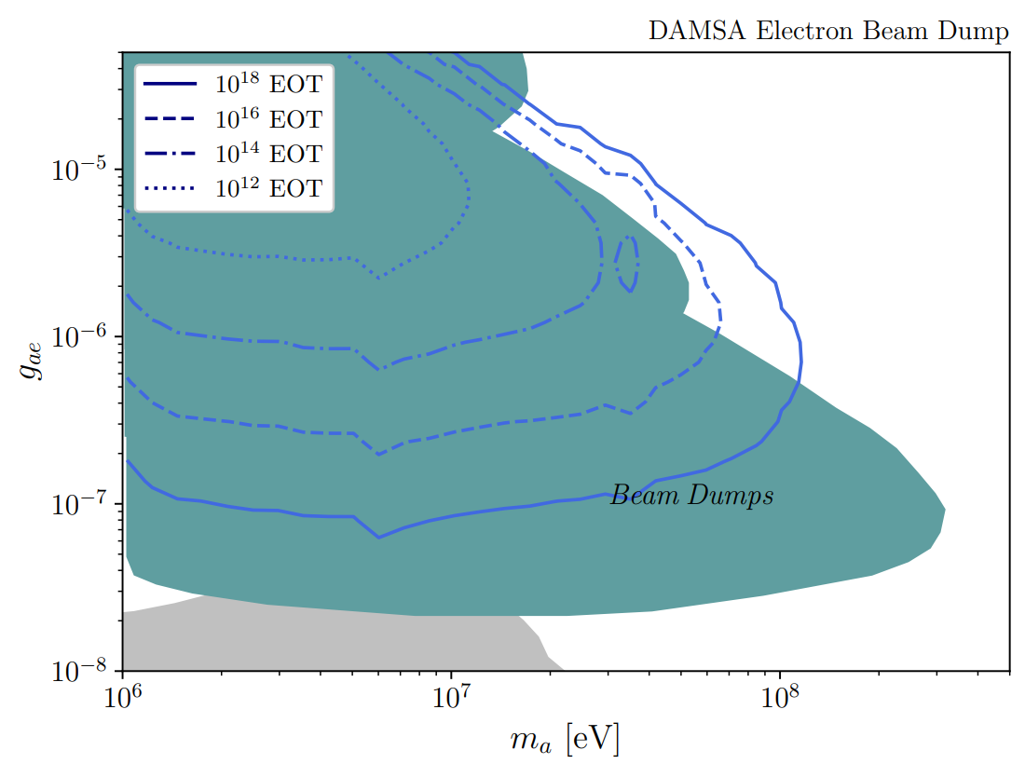
Parameter Space Scan: 300 MeV Electron Beam

Slide 25
Conclusions
Both proton and electron beams will copiously produce photons/ electrons in the dump.
The searches for axion-like particles interacting with SM photons/ electrons were illustrated as an example physics case of DAMSA.
DAMSA can be sensitive to large-mass and large-coupling regions of ALP parameter space due to its close proximity to the dump.
DAMSA at various beam facilities can provide complementary information in the search for ALPs.
Thank you!

Slide 26
Bonus Slides

Slide 27
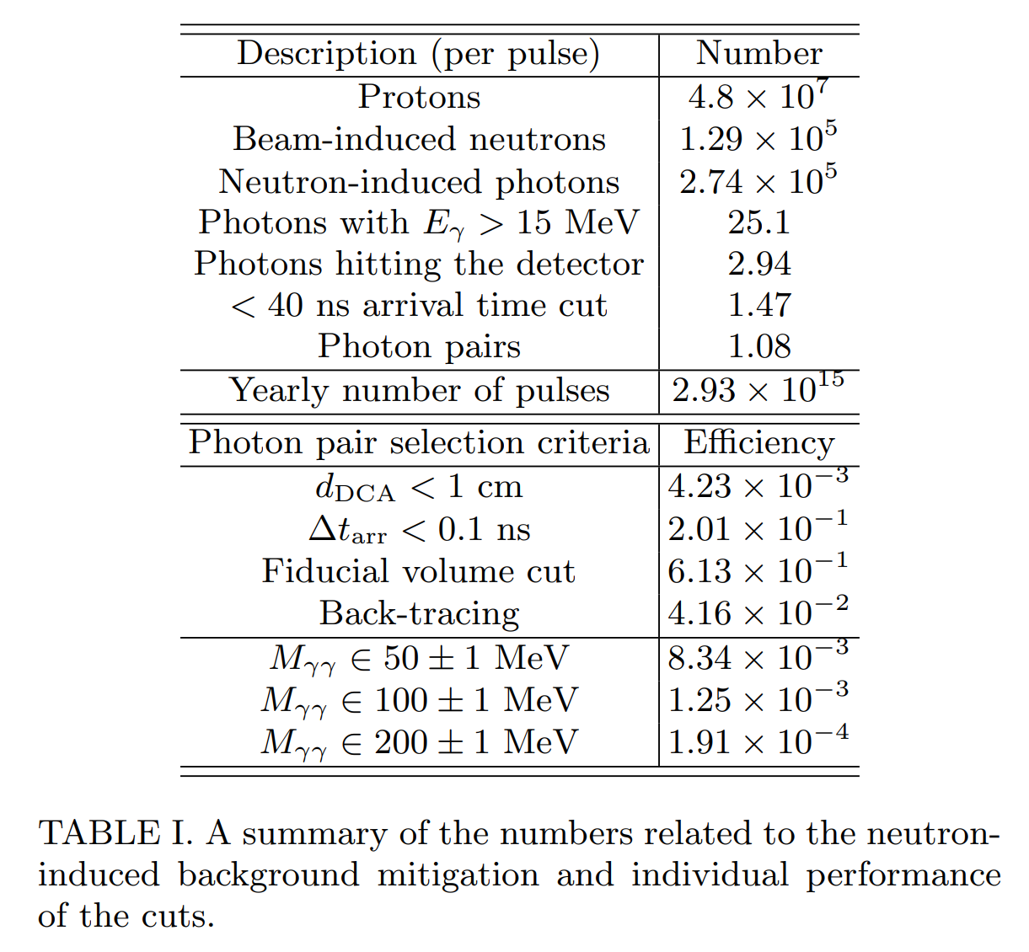
Cut Flow

Slide 28



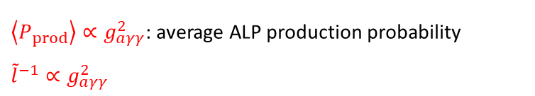
No Sturdy “Floor”
In the “delayed-decay” regime, $L, ∆L≪\tilde{l}$ ⇒ $P_{det}≈\frac{∆L}{\tilde{l}}$
$$N_{sig}=N_{γ}\left\langle P_{prod}\right\rangle \frac{∆L}{\tilde{l}}$$
$\left\langle P_{prod}\right\rangle ∝g_{aγγ}^{2}$: average ALP production probability
${\tilde{l}}^{−1}∝g_{aγγ}^{2}$
If new reach $g_{aγγ}^{′}$ is achieved with $x$ times more statistics,
$$g_{aγγ}^{′}=\frac{g_{aγγ}}{x^{1/4}}$$
[Dutta, DK, Kim, PLB (2025)]
For large background scenarios,$x^{1/4}→x^{1/8}$

