Slide 1

DAMSA Physics Opportunities
Doojin Kim
(doojin.kim@usd.edu)
DAMSA Collaboration Meeting
University of Texas at Arlington, Arlington, TX
January 18th, 2025

Slide 2
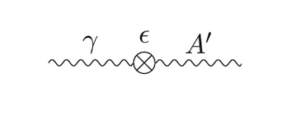
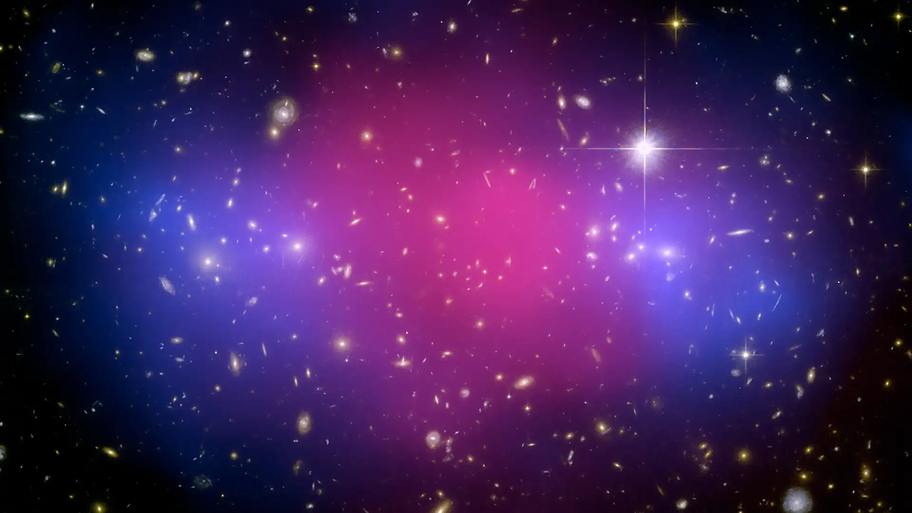
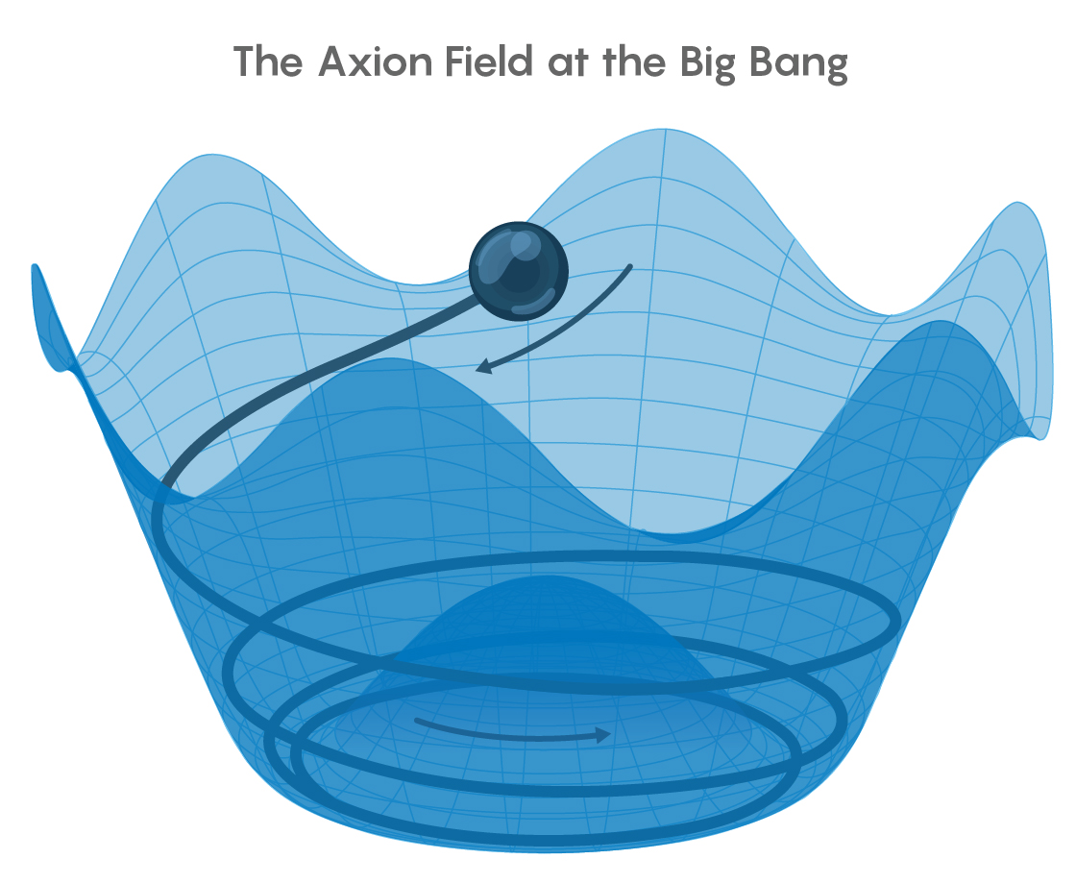


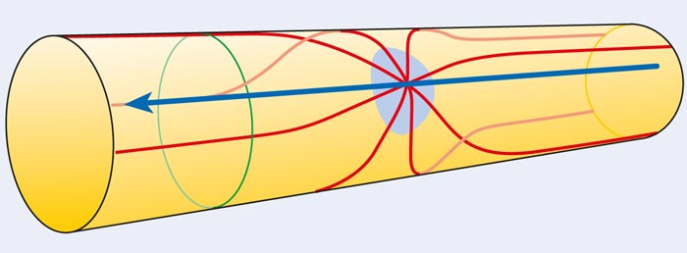
DAMSA: Unique Opportunities on Dark Sector Physics
Mediators (ALPs, Dark Photon, etc)
Light Dark Matter
Large Extra Dimensions
Neutrinos
…

Slide 3
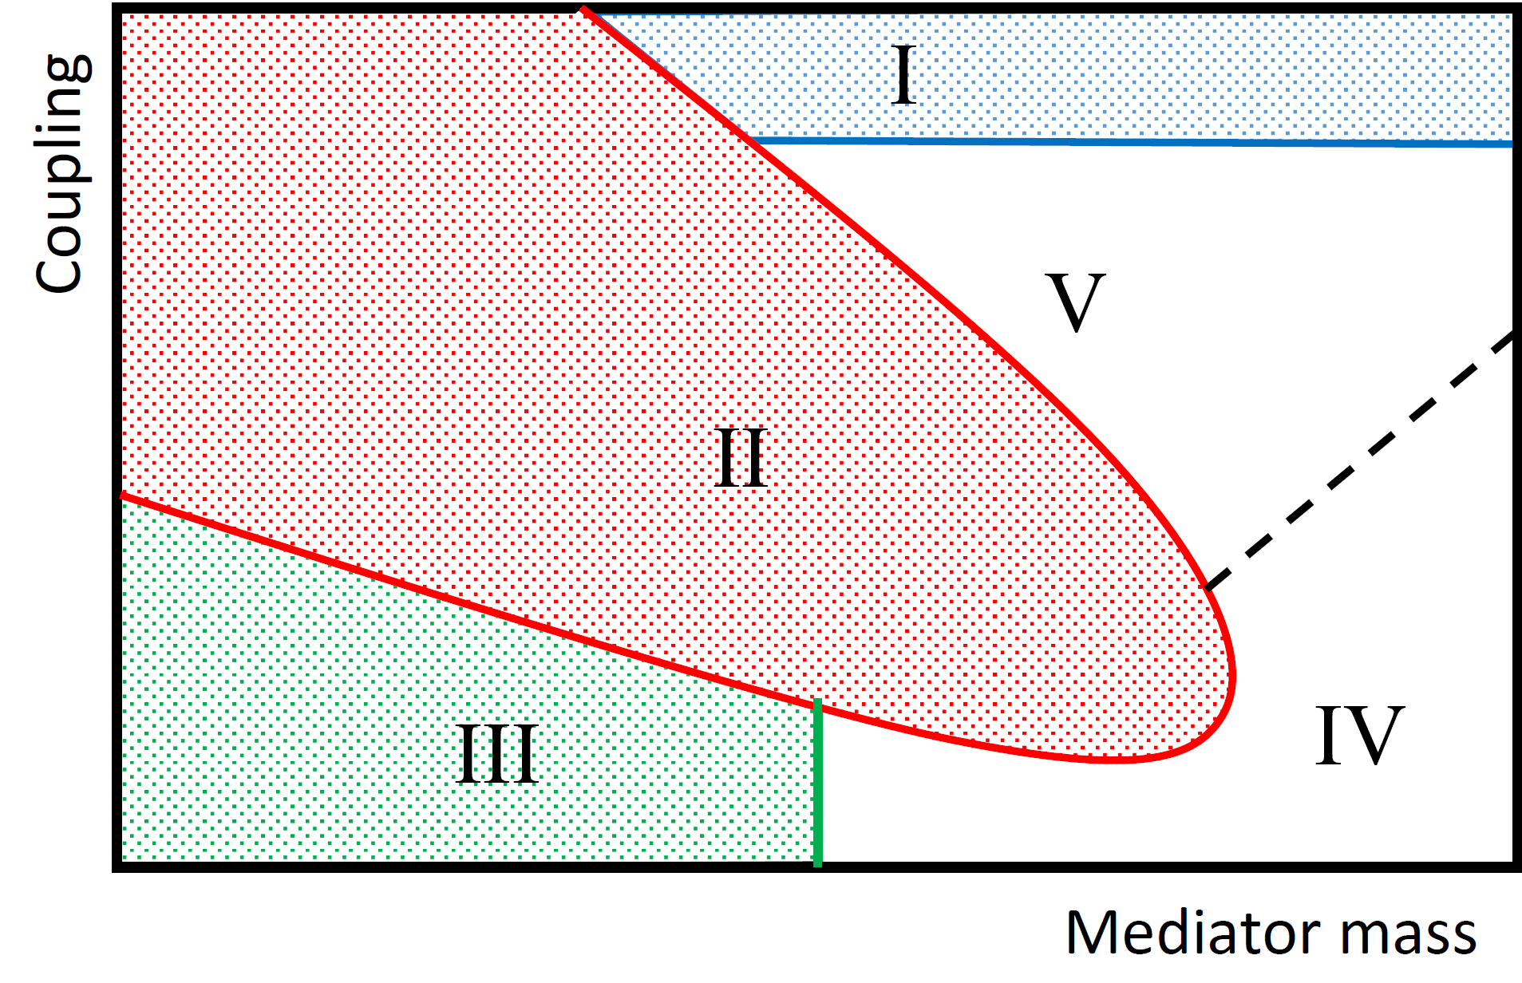
Primary Target of DAMSA

Slide 4
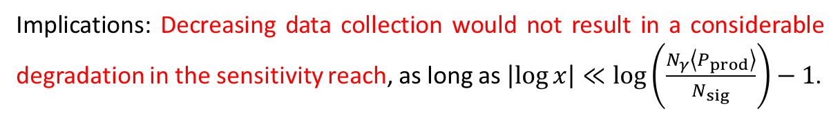
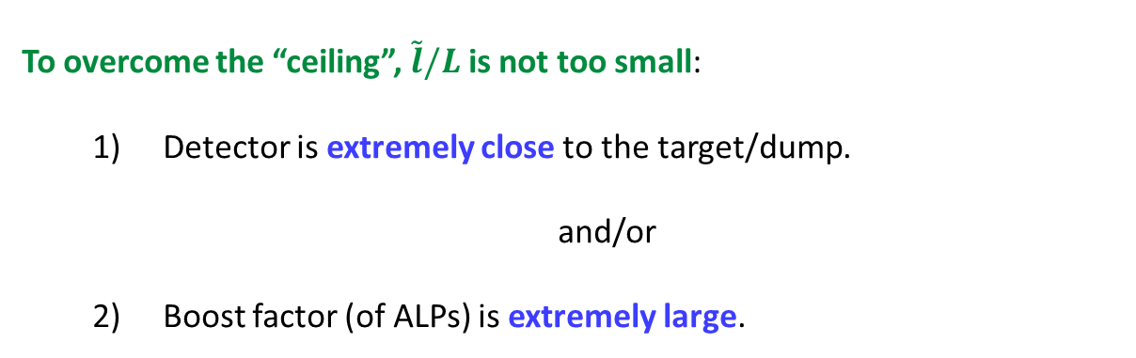
Beam-Dump “Ceiling”
Implications: Decreasing data collection would not result in a considerable degradation in the sensitivity reach, as long as $\left|\log{x}\right|≪\log\left(\frac{N_{γ}\left\langle P_{prod}\right\rangle }{N_{sig}}\right)−1$.
To overcome the “ceiling”, $\tilde{l}/L$ is not too small:
  Detector is extremely close to the target/dump.
  and/or
  Boost factor (of ALPs) is extremely large.

Slide 5
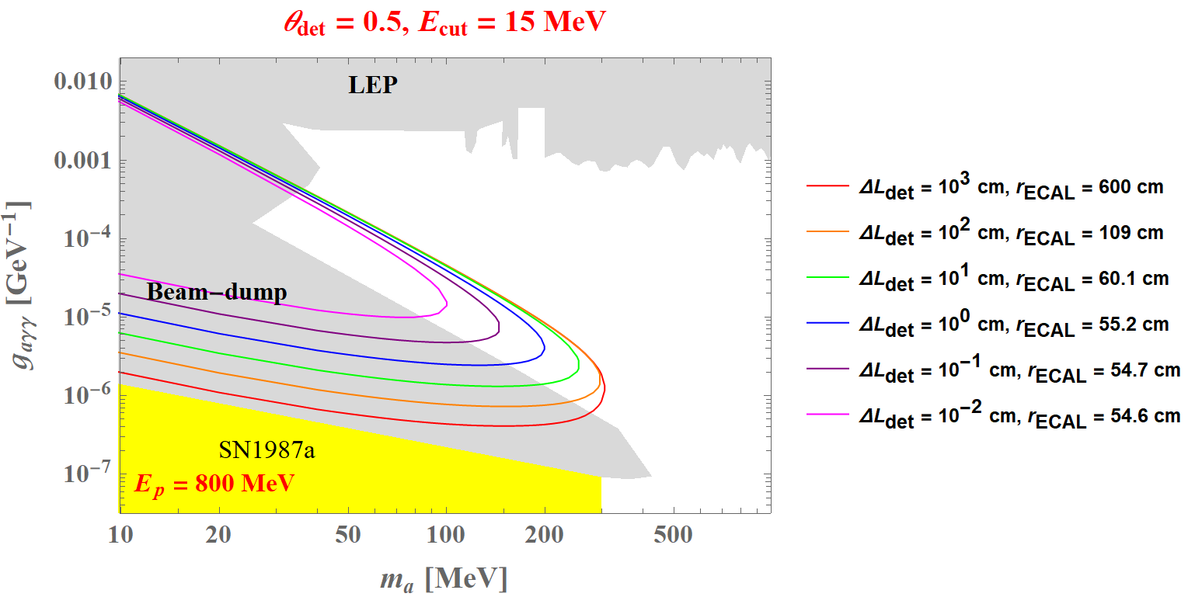
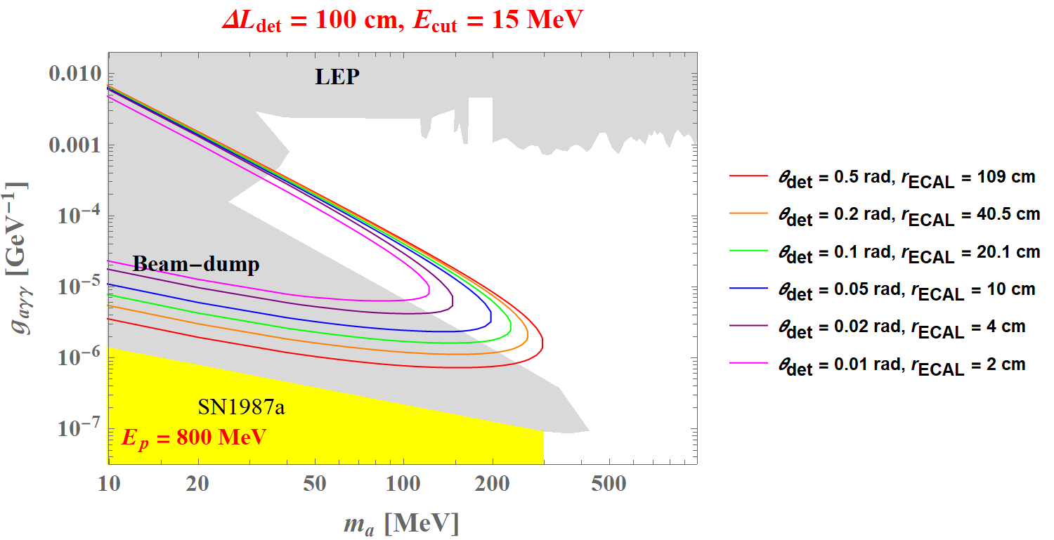
Detector Geometry Optimization
Varying detector distance
Varying angular coverage
(See Doojin Kim’s talk on Thursday)

Slide 6
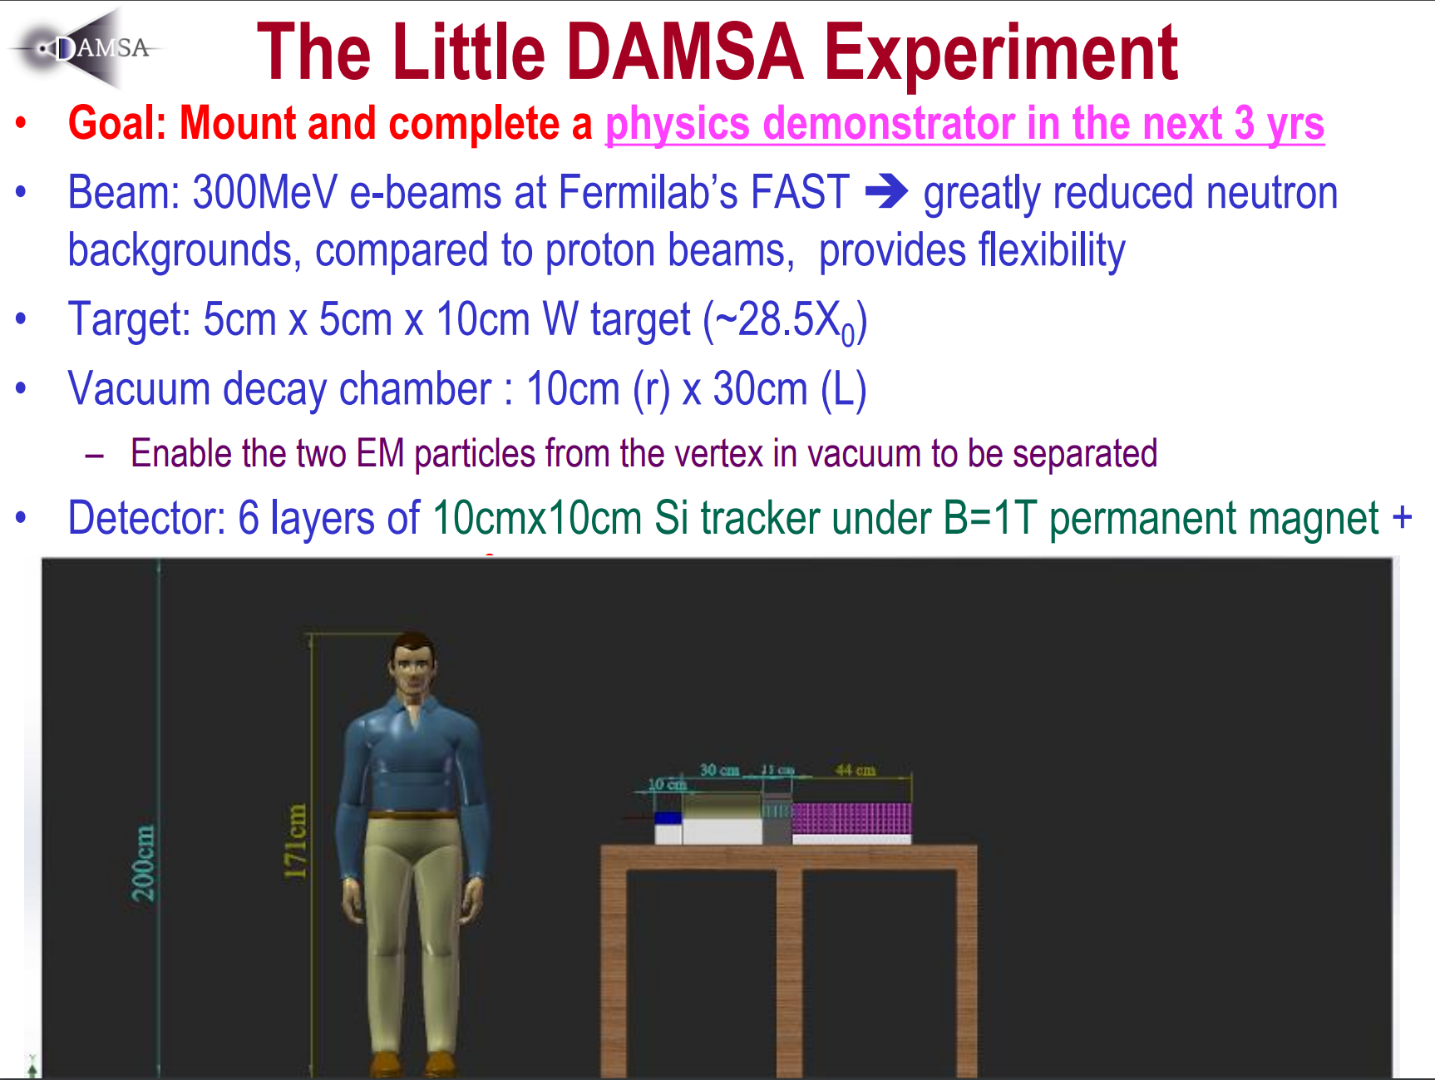
(See Jae Yu’s talk on Thursday)

Slide 7










Axion-like Particles Interacting with SM Photons
$$γ$$
$$g_{aγγ }$$
$$a$$
$$γ$$
$$a$$
$$g_{aγγ }$$
$$γ$$
$$N$$
$$N$$
Production
Detection

Slide 8
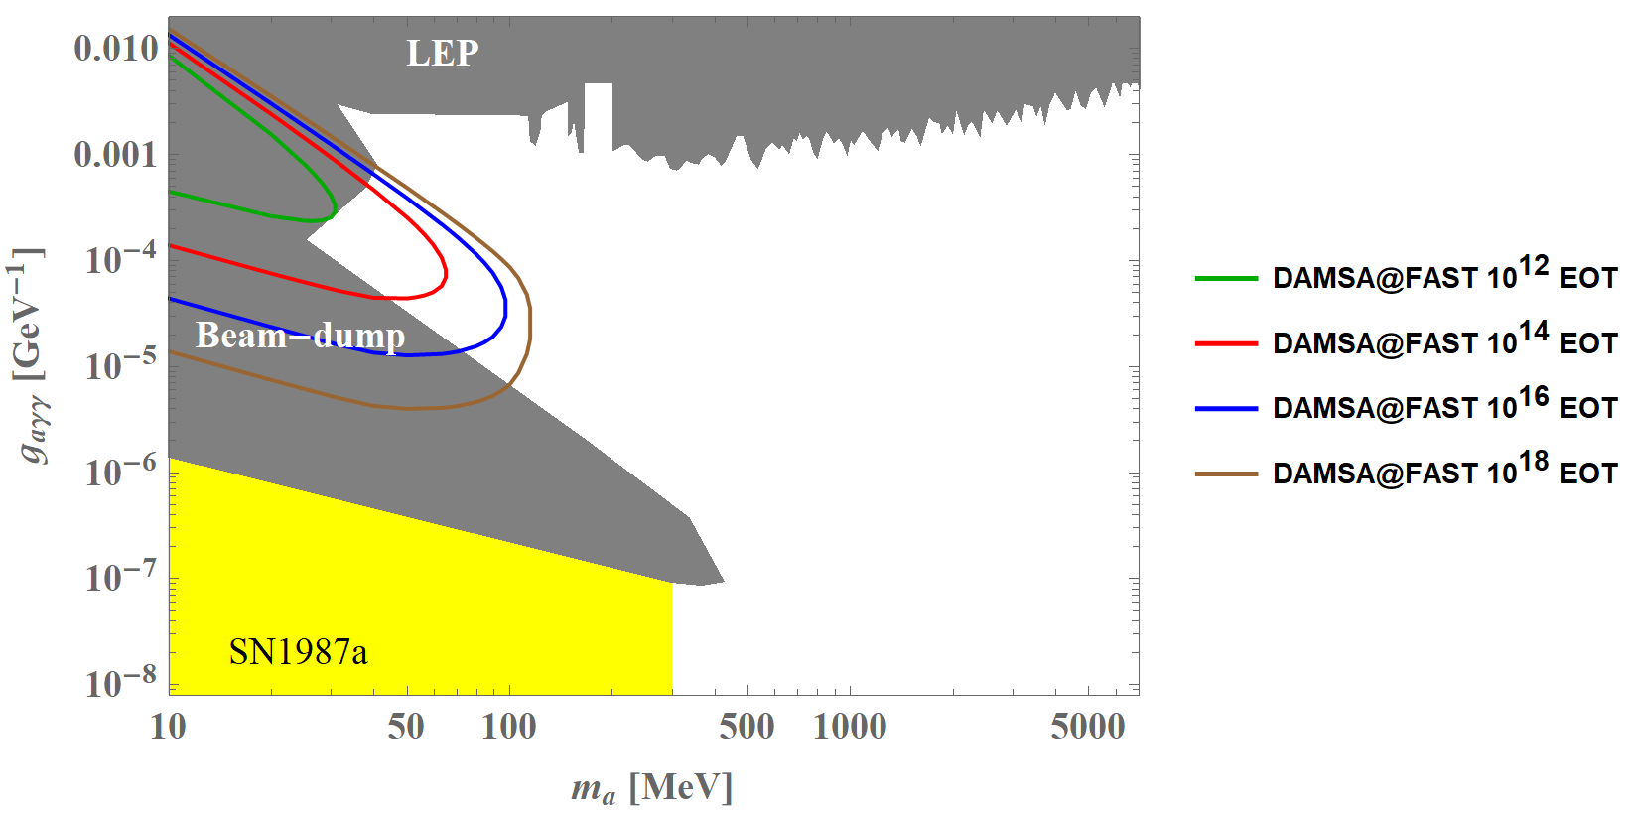
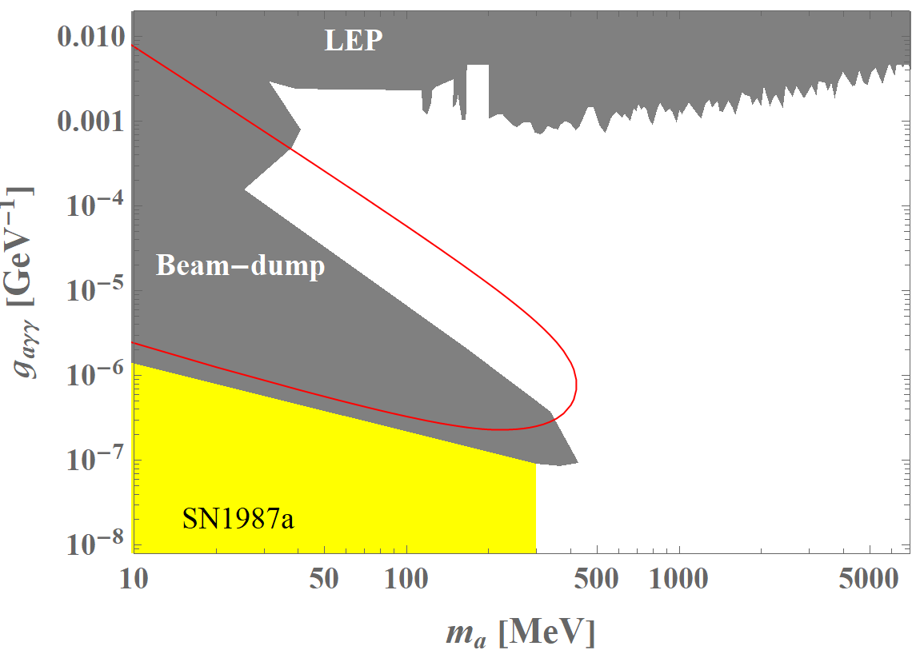
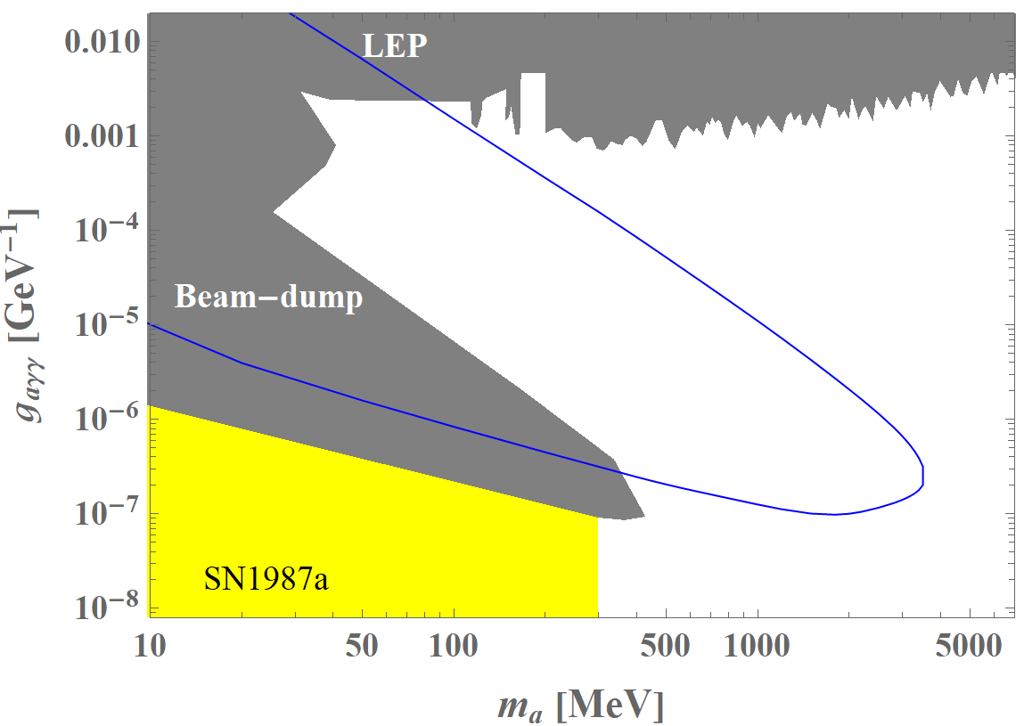
Sensitivity Estimates at Various Beam Facilities
DAMSA@FAST
DAMSA@PIP-II
DAMSA@SPS
(See Doojin Kim’s talk on Friday)

Slide 9
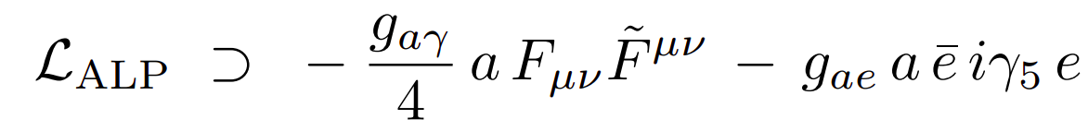
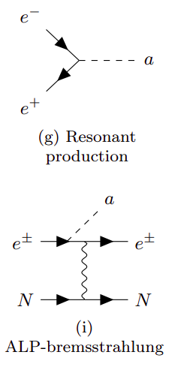
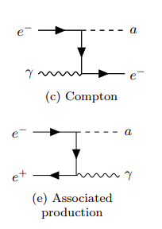



ALP Interacting with SM Electrons
$$e$$
$$a$$
$$e$$
Production
Detection

Slide 10
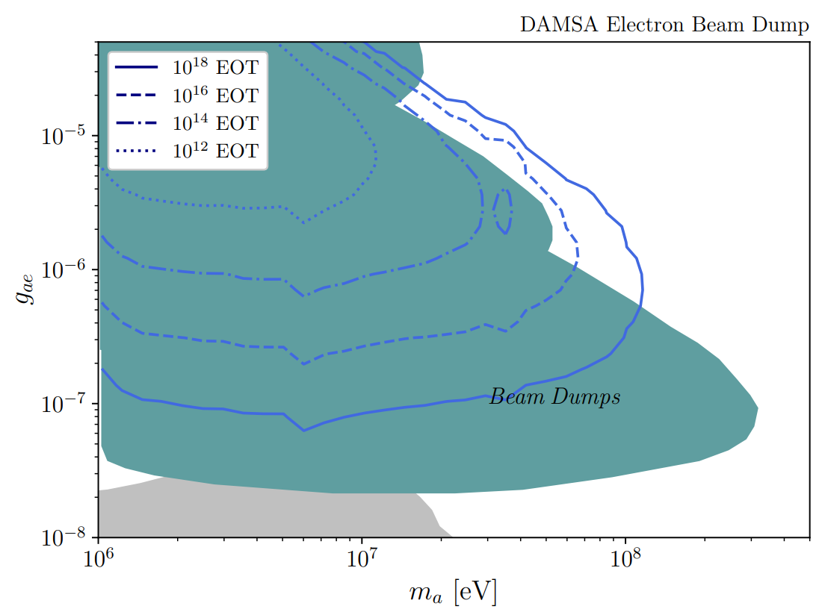
Parameter Space Scan: 300 MeV Electron Beam
(Plots produced by Adrian Thompson and see Doojin Kim’s talk on Friday)

Slide 11
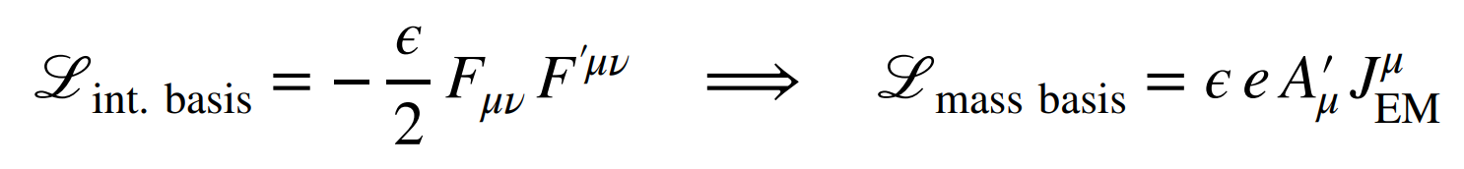
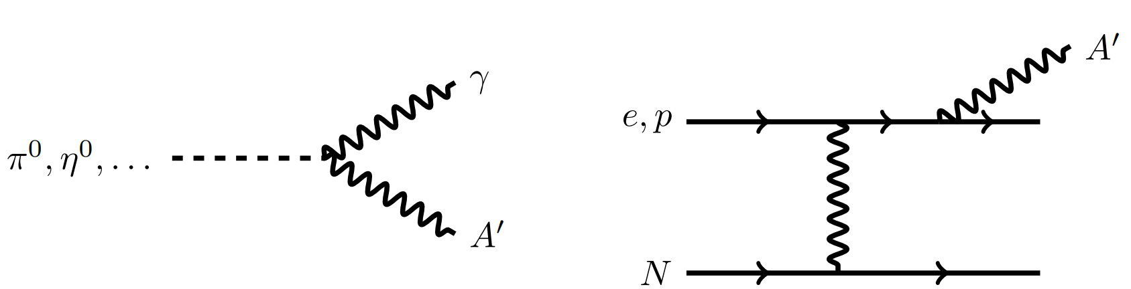
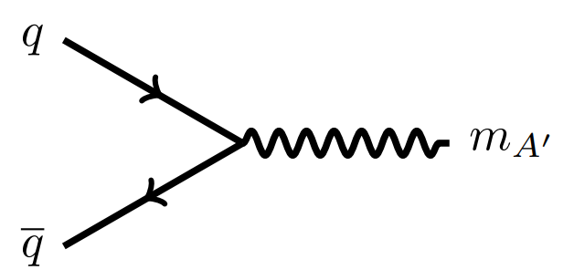



Dark Photon
$$f$$
$$A′$$
$$\overline{f}$$
Production
Detection

Slide 12
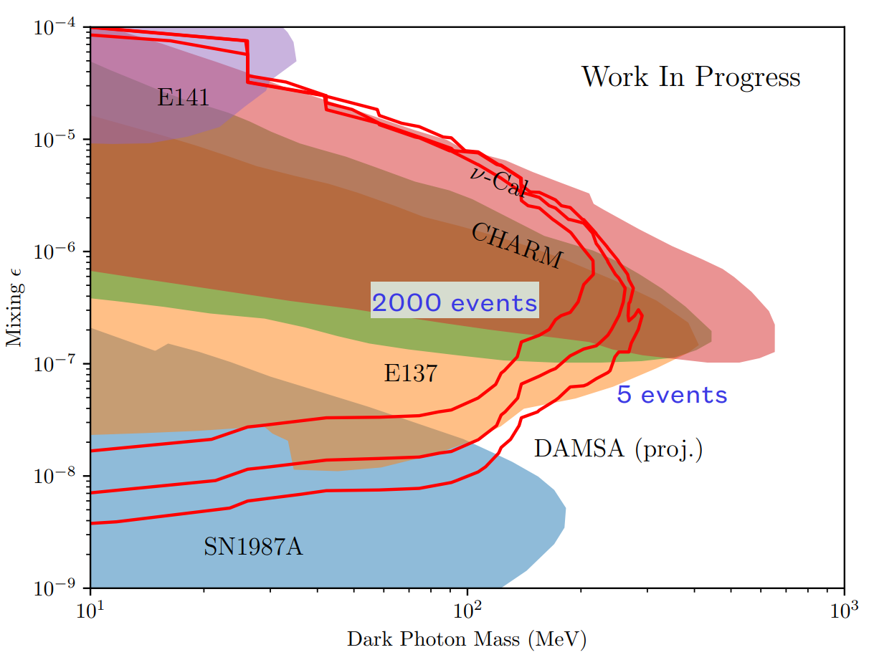
Current Best Estimates
Potentially more promising with other vector portal scenarios (e.g., hadrophilic vector portal)
(See Joshua Berger’s talk on Friday)

Slide 13
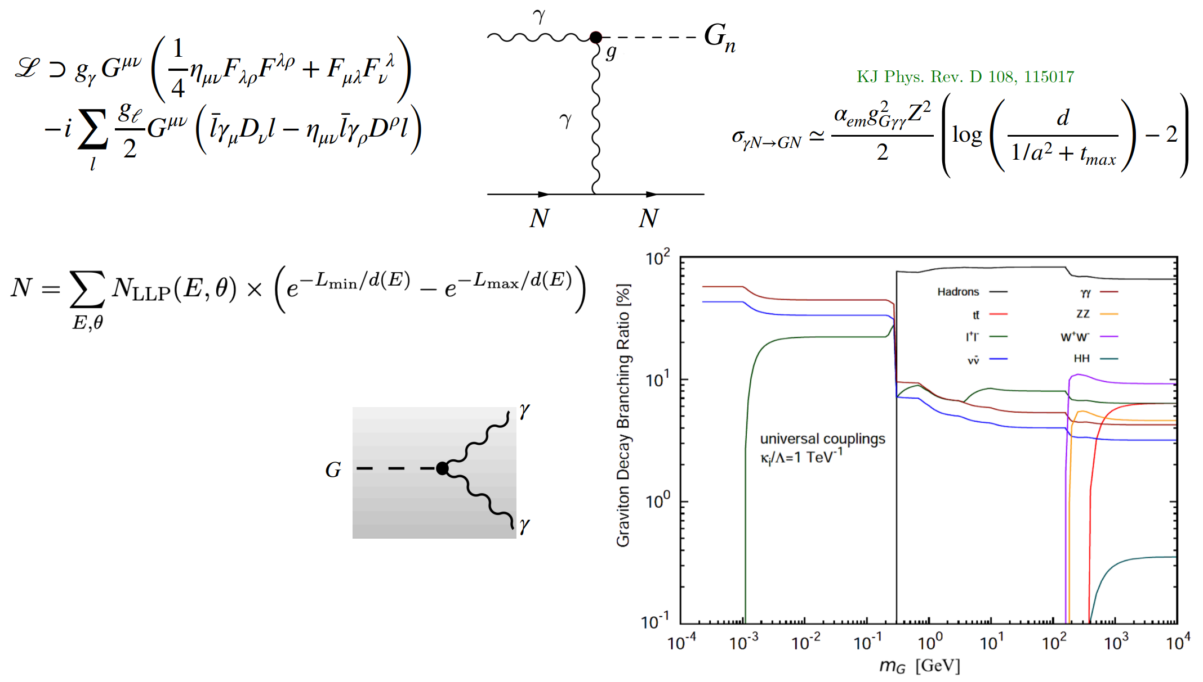
Extra Dimensions: KK Gravitons

Slide 14
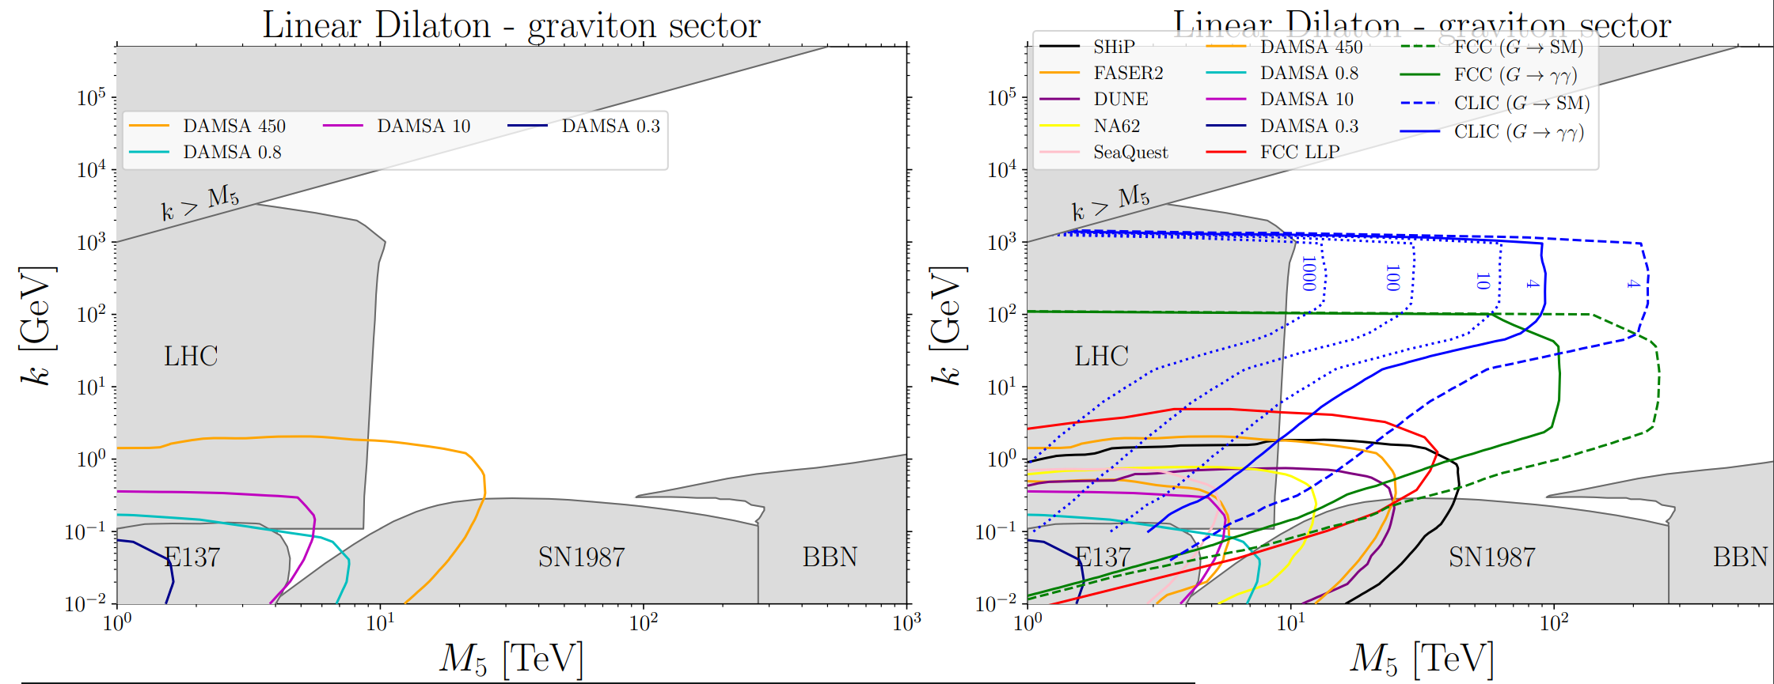
Sensitivity of DAMSA to KK Graviton Signals
(See Krzysztof Jodlowski’s talk on Friday)

Slide 15
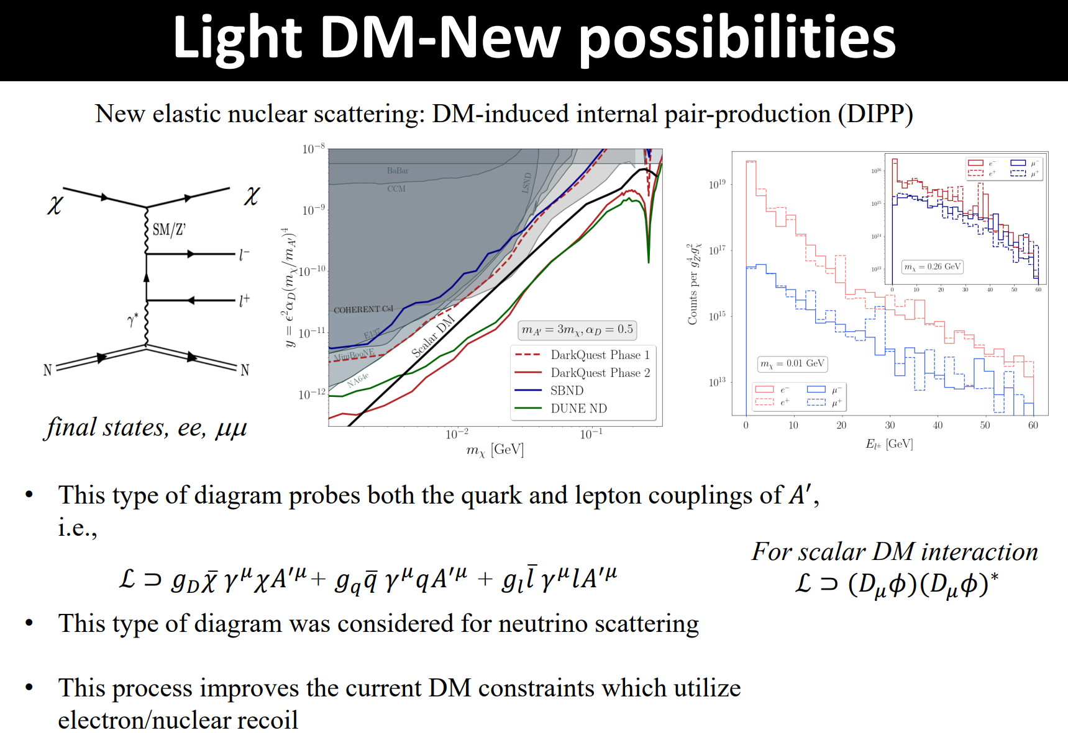
Light Dark Matter
(See Bhaskar Dutta’s talk on Friday)

Slide 16
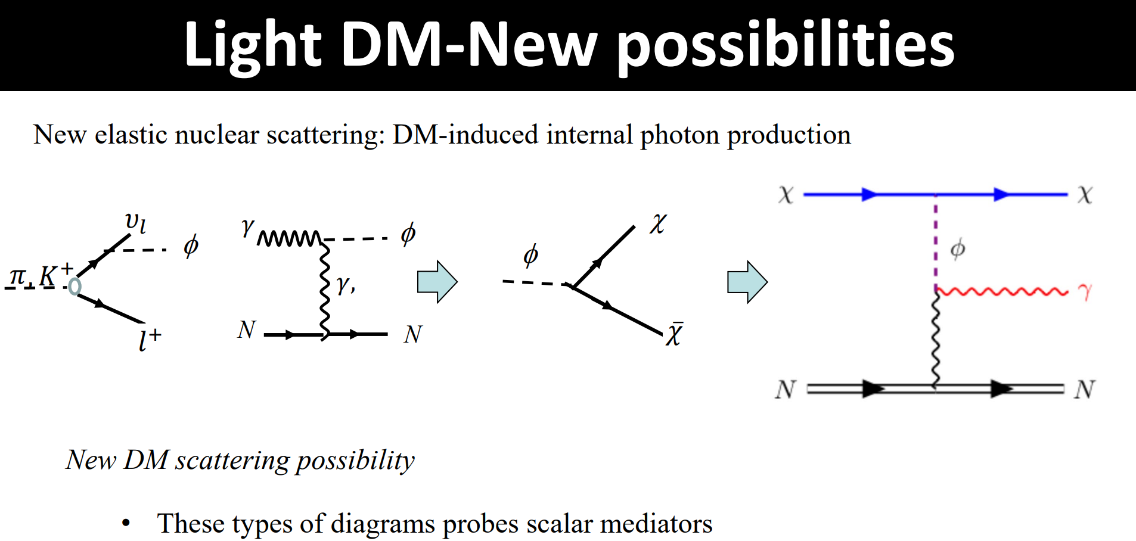
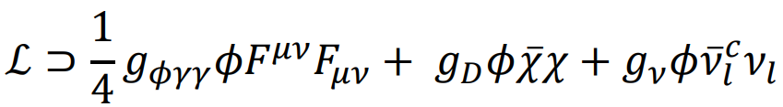
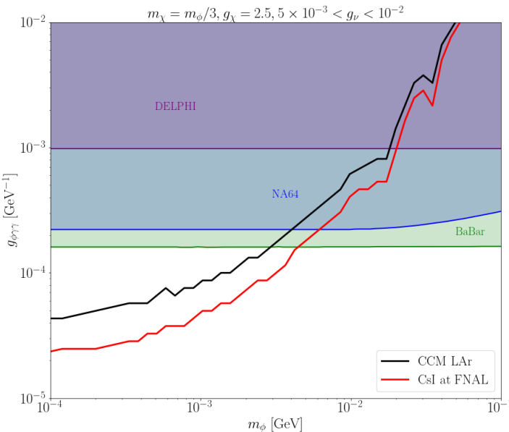
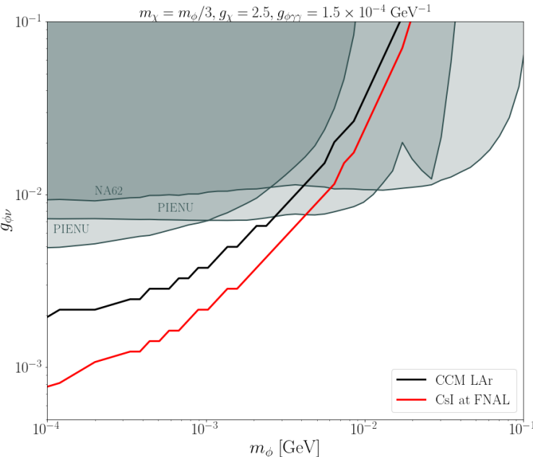
(See Bhaskar Dutta’s talk on Friday)

Slide 17
Conclusions
DAMSA can serve as a tabletop discovery experiment for the search for dark sector particles including:
  Axion-like particles interacting with SM photons
  Axion-like particles interacting with SM electrons
  Dark photons and similar variations of vector portal mediators
  Kaluza-Klein gravitons in extra-dimensional models
  Light dark matter via new detection channels
More than welcome to propose new BSM and SM opportunities testable at DAMSA.
Thank you!

