Slide 1
CDR-WP Writing Organization
Overleaf: https://www.overleaf.com/3827187499vkkgchtcctcn#8575a3
Zoom links and breakout rooms:
  Physics (CPB347): https://usd.zoom.us/j/92612712379
  Tracker & Magnet (CPB126): https://cern.zoom.us/j/2024782583?pwd=amNZUGdVR1lBYnQ5eDB4ZFRKSjJtQT09
  Calorimetry & Neutron Background Mitigation (CPB303) : https://fnal.zoom.us/j/9091743077?pwd=ZmJUMzYzWnFVTWxGaVZYWVhkVlBkdz09

Slide 2
CDR-WP Writing Organization
Overleaf: https://www.overleaf.com/3827187499vkkgchtcctcn#8575a3
Executive Summary – JY, UKY, JE
Introduction – JY, UKY, JE
Physics (CPB347) – DJK, BD, JB, AT, KJ, SC, AP,etc
Facilities – JY, AH, JW, JCP
Experiment and Detector
  Trackers and Magnet (CPB126) – SHK, ISY, UKY,AB
  Calorimeter (CPB303) – JP,SW,WYJ,HYK,BHT,MSO,BB,RR,EG,
Cost Estimate – JY, UKY, JE, JP
Strategic Direction – JY, UKY, JE
Conclusions - JY, UKY, JE

Slide 3
Closing: Meeting Goals
We’ve got to meet and had a chance to be acquainted with each other!
Discussed various physics topics and facilities that could help us expand our physics reach
  Settled on our benchmark facility to be 300MeV and 10GeV e
  Decided on background flux studies to be done
Had discussions on what we need to do to make the detector to meet the physics goals and how
  Target configuration becomes an essential element in further suppressing the background photons from the secondary interactions ➔ need detailed study for the geometry
  Detector granularity for 300MeV electron beam signal must be increased by >2 orders of magnitude for signal γ identification
CDR White Paper overleaf is set but need more studies to fill them in a credible manner ➔ Let’s target for completion 7/1/25

Slide 4
CDR-WP Writing Responsibles
Overleaf: https://www.overleaf.com/3827187499vkkgchtcctcn#8575a3
Executive Summary – JY, UKY, JE
Introduction – JY, UKY, JE
Physics (CPB347) – DJK, BD, JB, AT, KJ, SC, AP, etc
Facilities – JY, AH, JW, JCP
Experiment and Detector
  Trackers and Magnet (CPB126) – SHK, ISY, UKY,AB
  Calorimeter (CPB303) – JP,SW,WYJ,HYK,BHT,MSO,BB,RR,EG,
Cost Estimate – JY, UKY, JE, JP
Strategic Direction – JY, UKY, JE
Conclusions - JY, UKY, JE

Slide 5
Thanks
The meeting was a smashing success!
  Thank you all for coming all the way to Arlington!
Thank UTA for making it possible for us to discuss the exciting opportunities with DAMSA
  Thank you, SNU for supporting the meeting dinner!
UTA UG research associates have done a wonderful job, feeding us, making us effective and comfortable

Slide 6
Have a nice trip back home!!

Slide 7
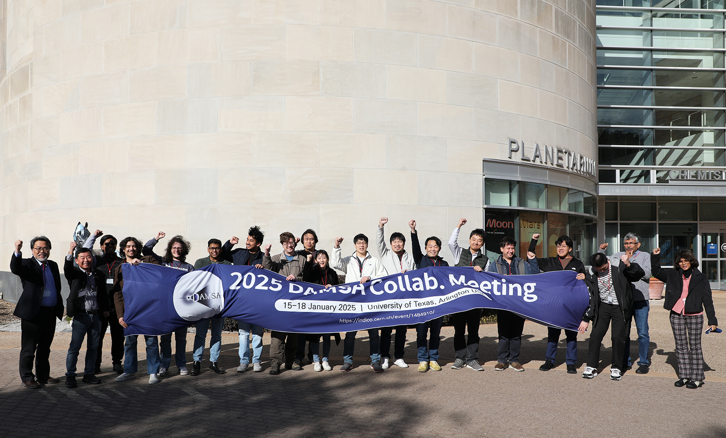
Go DAMSA!!!

