Slide 1


Comprehensive redesign of CLIC MB Injector
Y. Zhao, S. Doebert, A. Grudiev, A. Kurtulus, A. Latina, CERN
CLIC MB Injector Meeting
02/12/2024

Slide 2
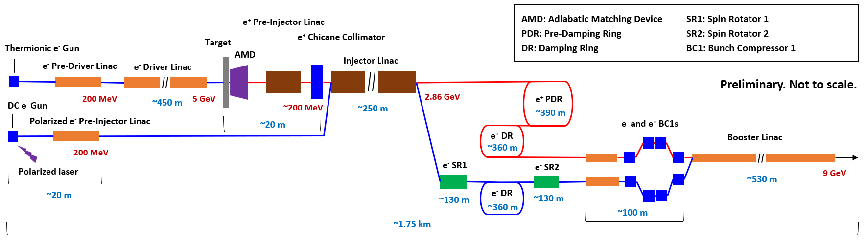
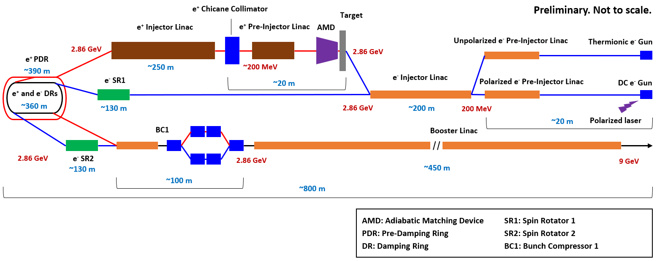
Layout
Old (baseline)
New (alternative)

Slide 3
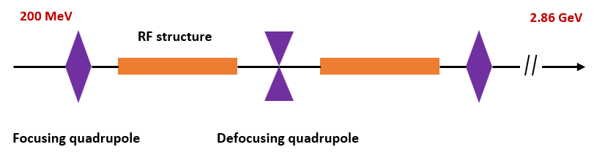
New e- Injector Linac
Layout
RF structure
  f = 2 GHz, L = 3 m, Δφ = 2π/3 per cell, N_{cell} = 30, G = 16.48 MV/m (≤ 16.74 MV/m), φ = 0°
  a₀ = (19.5+14.5)/2 = 17 mm, d₀ = (2.86+4.26)/2 = 3.56 mm
Beam parameters (DBA @ 380 GeV)
  δ_{E} = 1%, σ_{z} = 1 mm, Q_{b} ~ 1 nC
  Polarized e-: ε_{n,x,y} = 10 um, Unpolarized e-: ε_{n,x,y} = 50 um
FODO lattice
  FODO phase advance: 76.345°, k1 ~ 0.8584 m⁻¹, 54 structures (2 structures per module, not including spare module)
3 m

Slide 4
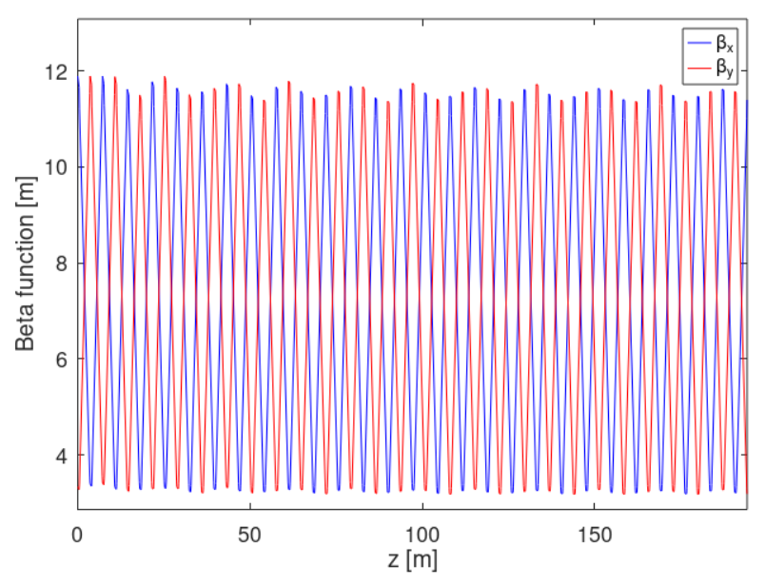
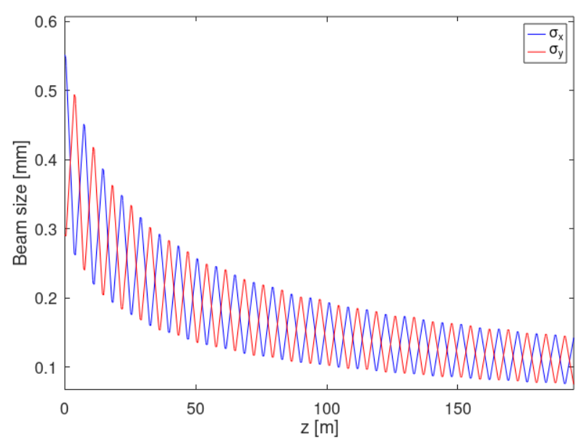
New e- Injector Linac
Results from RF-Track
Parameter | Unit | Value
Final E | GeV | 2.860
Final E spread | % | 0.15
Emittance growth | um | 0

Slide 5
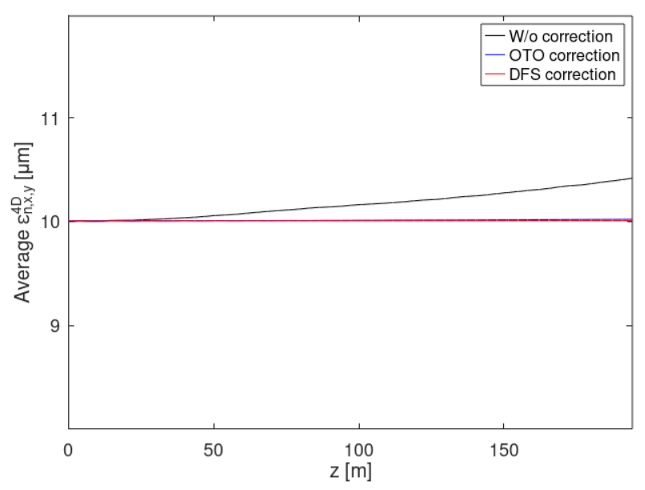
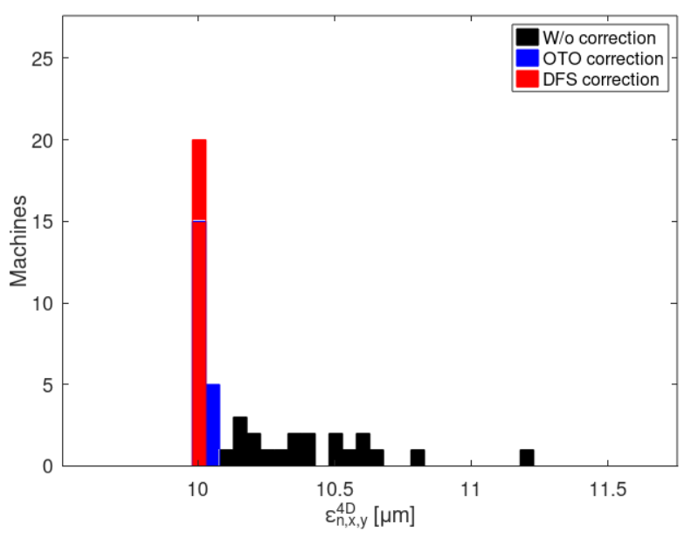
New e- Injector Linac
Imperfections
  Position error (x, y): σ = 100 um (Quads, RFs, BPMs)
  Angular error (roll, pitch, yaw): σ = 100 urad (Quads, RFs, BPMs)
  BPM resolution: σ = 1 um
  Magnatic strength error: σ = 0.1%
  RF gradient error: σ = 1%
  RF phase error: σ = 0.1°
  Beam position jitter (x, y): σ = 100 um
  Beam angular jitter (x’, y’): σ = 100 urad
BBA

Slide 6
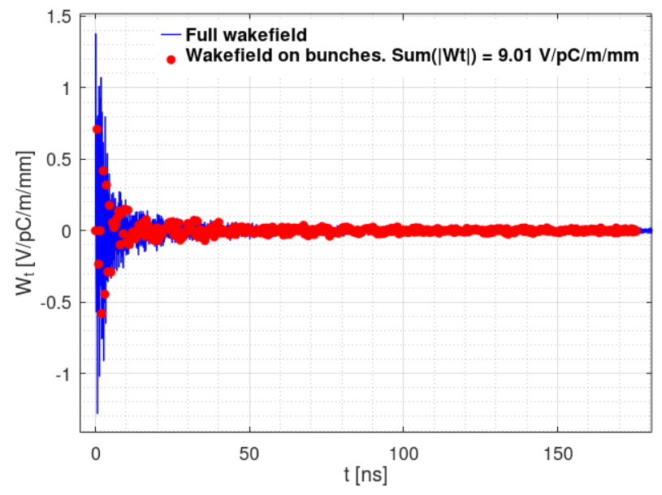
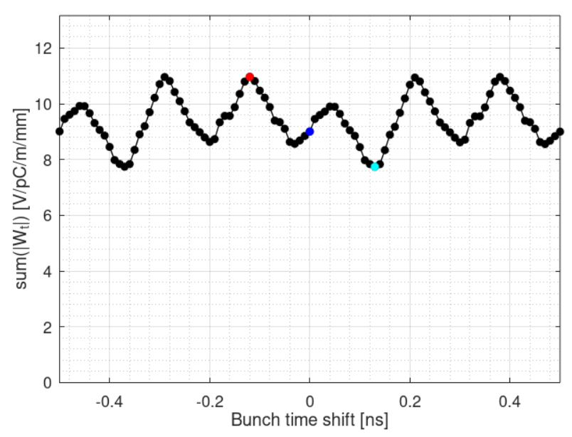
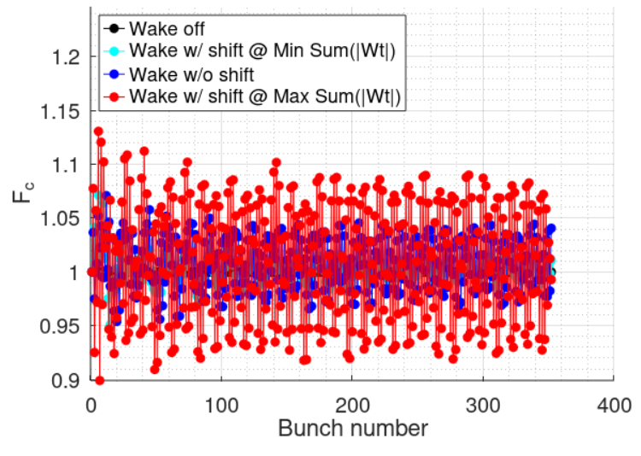
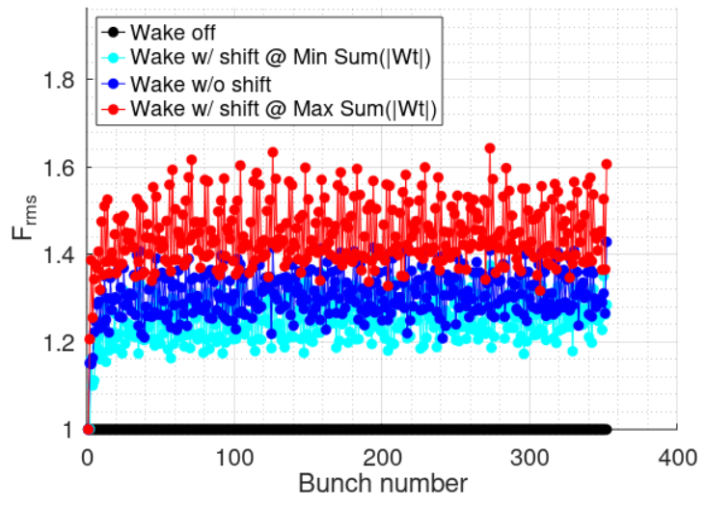
New e- Injector Linac
Jitter amplifications
a0 = 17 mm

Slide 7
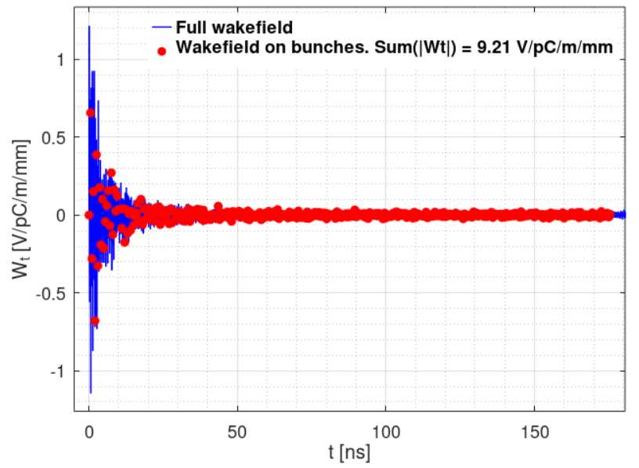
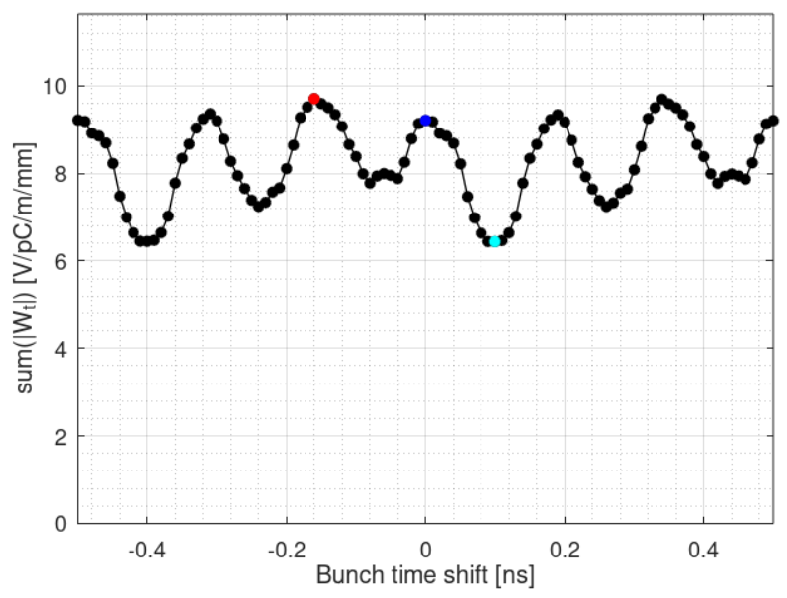
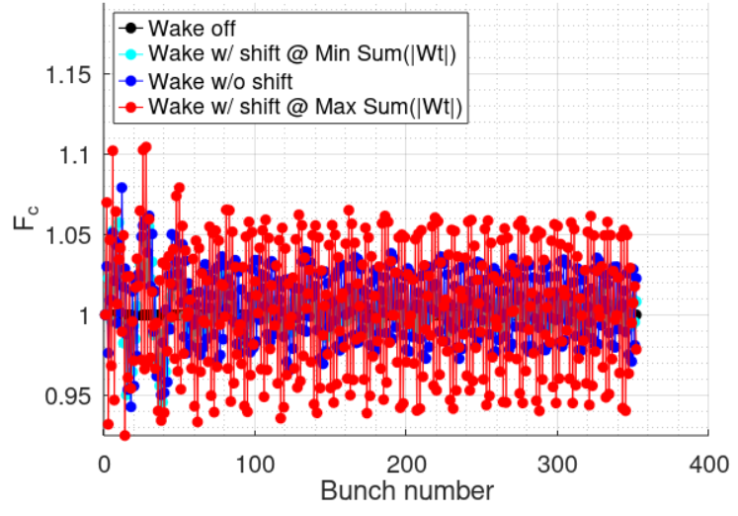
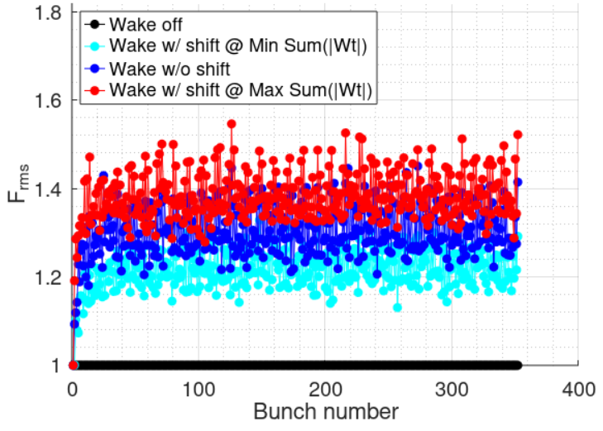
New e- Injector Linac
Jitter amplifications
Average, Max, Min are smaller than a0 = 17 mm
a0 = 18 mm

Slide 8
New e- Injector Linac
Jitter amplifications
a0 = 17 mm
a0 = 18 mm

Slide 9
Conclusions
For long-range wake, a0 = 18 mm seems better than a0 = 17 mm.
e- Injector Linac well designed. No emittance growth. Final energy spread is 0.15% @ 2.86 GeV. BBA works very well. Jitter amplification seems OK (Fc ~ 1.0, Frms ~ 1.4).
e+ Injector Linac design, simulation and jitter amplification study in progress

Slide 10
BACKUP

