Slide 1
CERN Open Access Policy and Implementation
February 2025

Slide 2
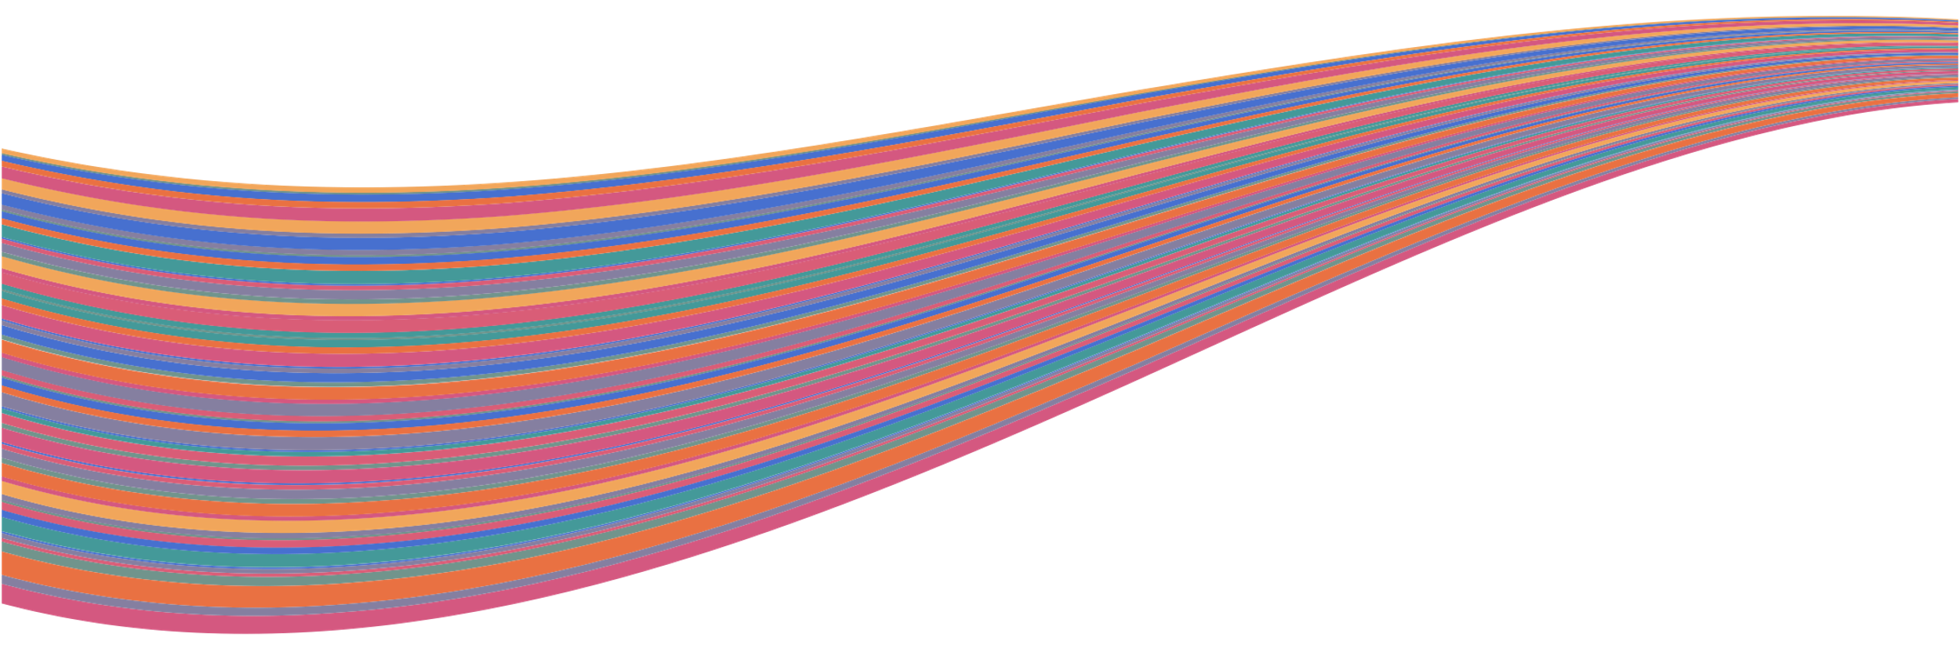
“… and the results of its experimental and theoretical work shall be published or otherwise made generally available.”
CERN CONVENTION, 1954

Slide 3
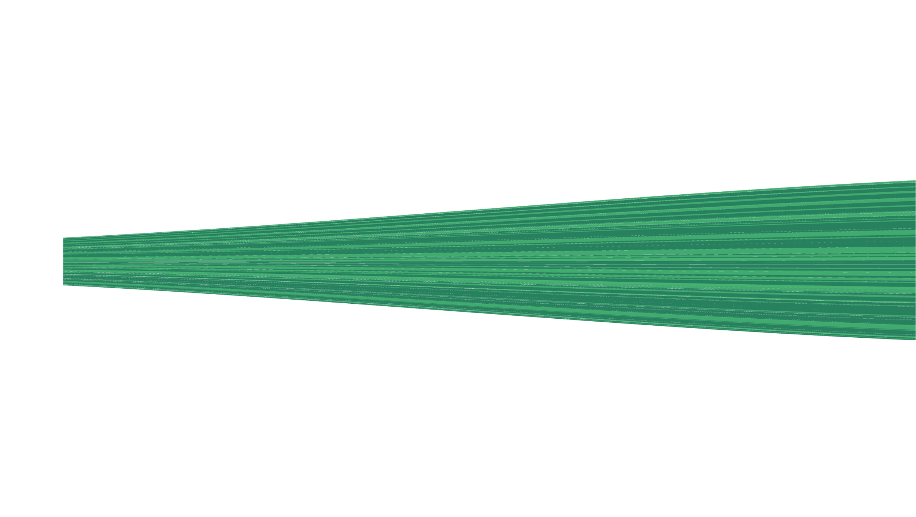
Open Access
1991-2024
2024
SCOAP³ Introduces Open Science Elements
2014
CERN Open Access Policy
1991
arXiv.org
2014
Launch of SCOAP³
2018
APS joins SCOAP³, 90% of OA in HEP

Slide 4
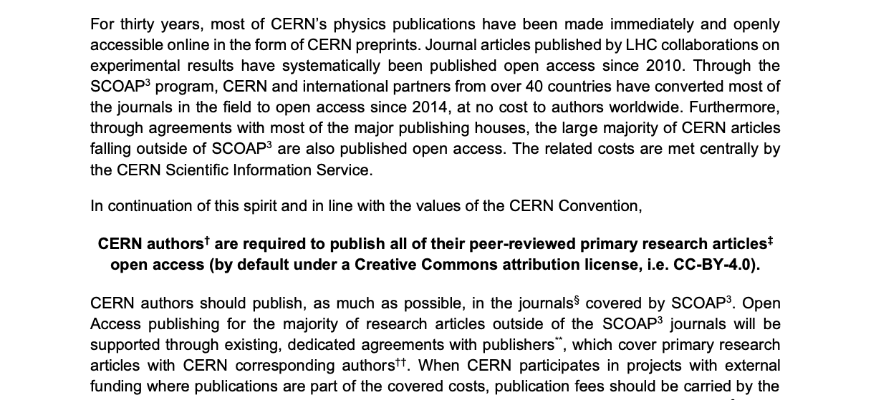
CERN Open Access Policy

Slide 5

The CC-BY 4.0 License
Least restrictive license
Protects the rights of authors

Slide 6

Open Access
Mechanisms
SCOAP³
COLLECTIVE MODELS
Sponsoring consortium for Open Access publishing in Particle Physics.
CERN supports other OA Model transparent for the author (S2O, sponsorship).
OA AGREEMENTS
INDIVIDUAL APC
CERN has negotiated Open Access agreements with 10+ publishers for 4000+ journals.
For other articles fees can
be centrally covered under certain conditions.

Slide 7

What is SCOAP³ ?
International collaboration launched in 2014
Partnership consisting of 3000+ libraries, research institutions and international research organizations from 45 countries (and growing !)
Covers 11 of the leading journals in the discipline of High Energy Physics (HEP)
Mission:
SCOAP3 enables open access publishing in the field of high-energy physics, helping to remove financial and administrative barriers to science.

Slide 8
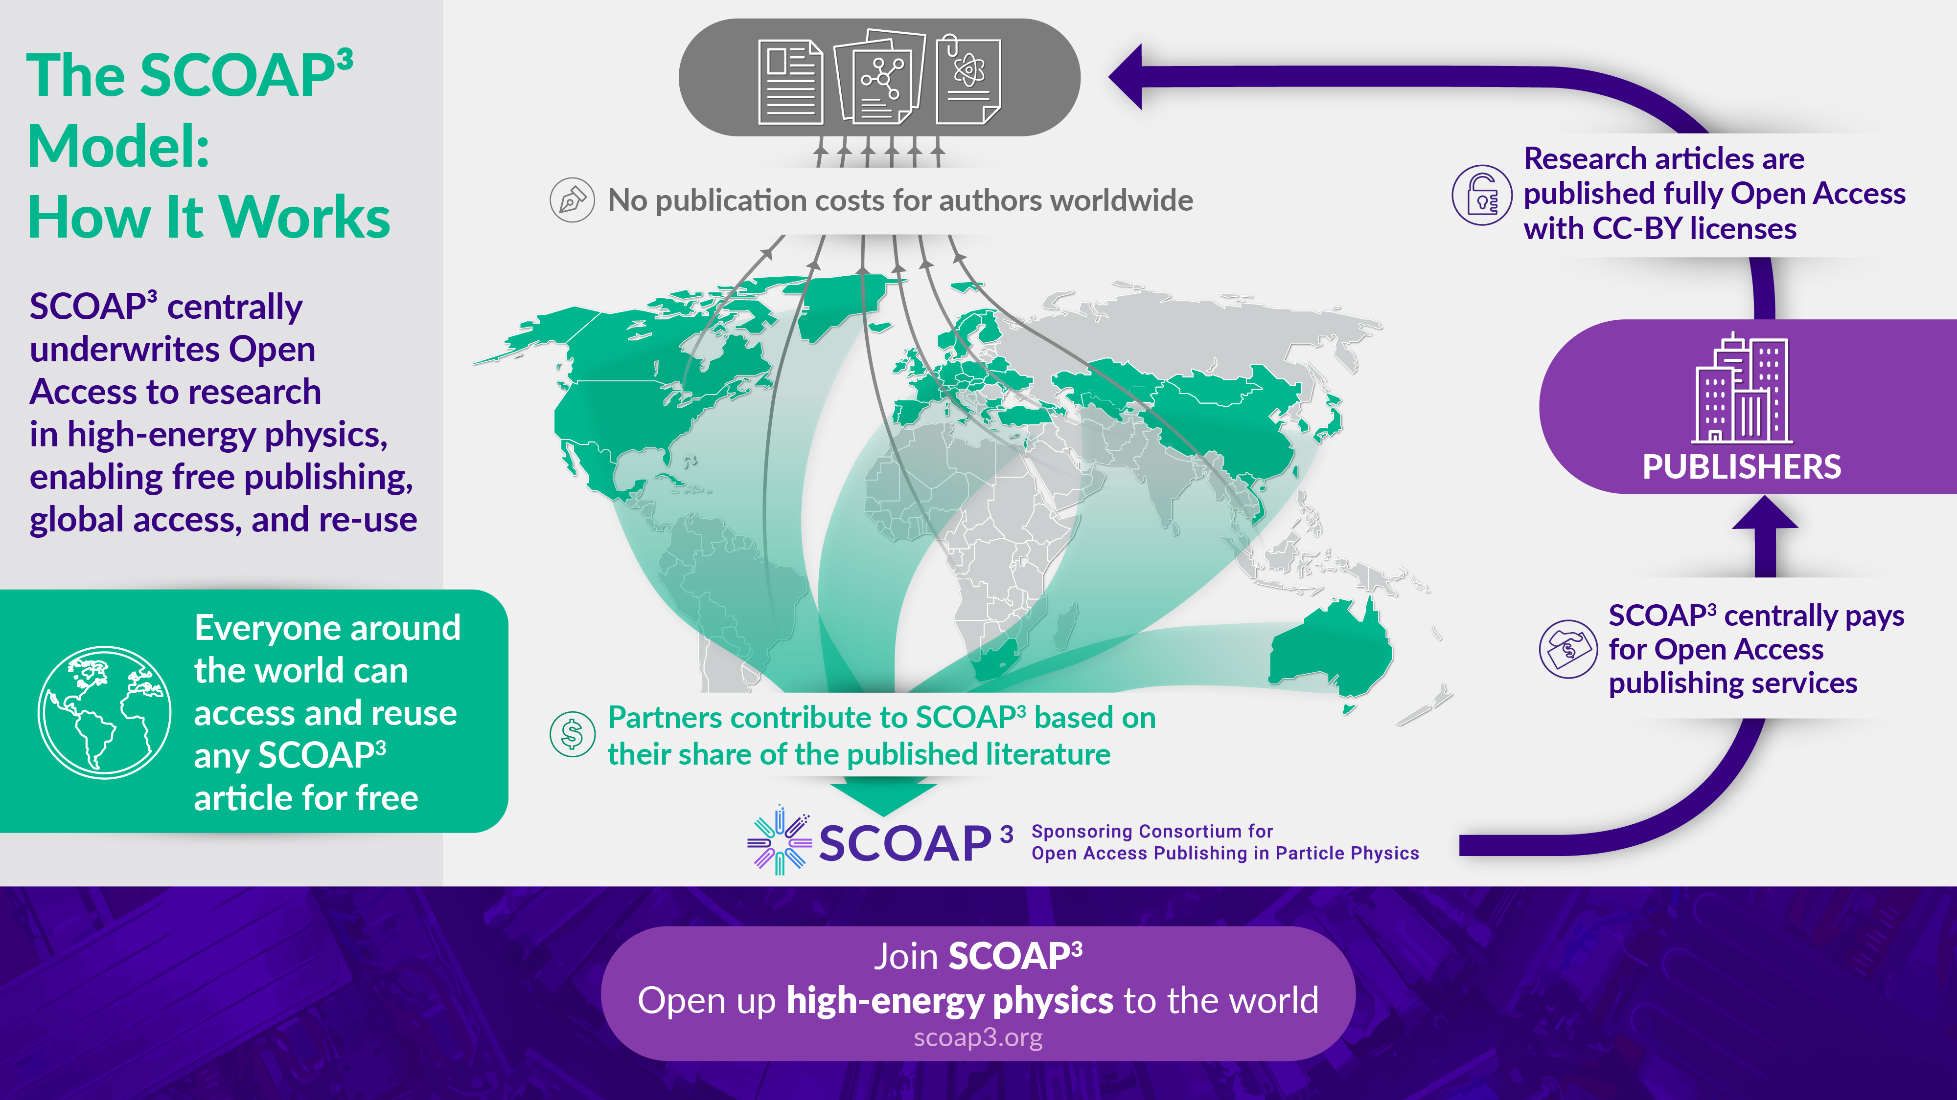

Slide 9
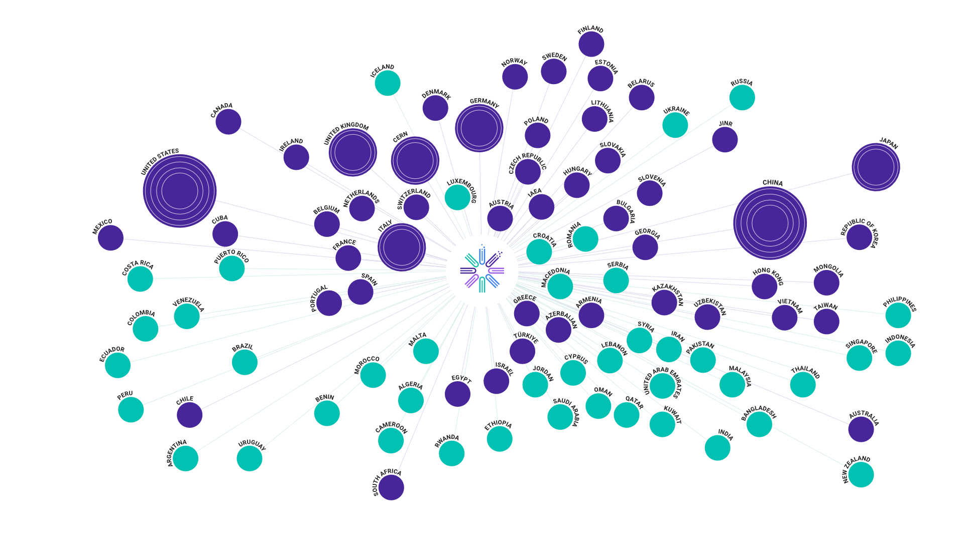

Partners in the SCOAP3 Collaboration
Countries & Territories with at least one SCOAP3 Author
Global Partners

Slide 10

And 10 Years On…
Continued best-in-class value for money!
List price APCs of comparable journals
Effective cost per article for SCOAP³

Slide 11
Phase 4 of SCOAP3:
From Open Access to Open Science
Disciplinary OA has been achieved and sustained for a decade
No new journals are to be considered for inclusion
Mechanism to financially incentivize publishers on delivery of Open Science Elements that situate publications in HEP more readily for OS future
  Adjustment of financial compensation to publishers
  Based on comparative scoring performance with other SCOAP3 publishers
  Pioneering OS elements leading to better service quality and innovative compensation mechanism

Slide 12
Open Science Elements
Element | Definition
Accessibility | Removing barriers to accessing content for people with disabilities by following WCAG guidelines.
Dataset Linking | Enabling linking between articles and related datasets; improve/incentivize publishing of data as supplementary material associated with publications
Transparent Peer Review | Offer open or public peer-review services which provide both authors and reviewers options to publish peer-review reports
ORCID adoption | Integrate ORCiD submission for all (co)authors into the publishing process and ensure systematic distribution of ORCiDs in subsequent metadata feeds
ROR adoption | Integrate ROR submission for institutional identification into the publishing process and ensure systematic distribution of RORs in subsequent metadata feeds
SCOAP³ Community Values Disclosures | Provide transparent statements on core business practices related to defined community values (see next slide)
Software Linking | Enabling linking between articles and related research software; improve/ incentivize publishing of software as supplementary material associated with publications
Standardized metadata provision | Provide enriched article metadata in a consistent, standardized, community-determined format; include abstracts and references

Slide 13



Other Collective Funding Models
CERN supports collective agreements with publishers to cover OA for all articles.
Transparent for the author
All the articles are automatically published Open Access
PRAB
S2O

Slide 14
Open Access Transformative Agreements with Publishers
Article submitted by author or collaboration
Publisher captures article within scope of the agreement
CERN Open Access Team confirms eligibility
Article is Published Open Access
But, "Transformative agreements” have limitations:
  Difficult to negotiate with some publishers, reluctant to offer options in line with our policy
  Costs, "closed” to not-participants and hence not equitable
  Re-creates barrier on the publishing side

Slide 15
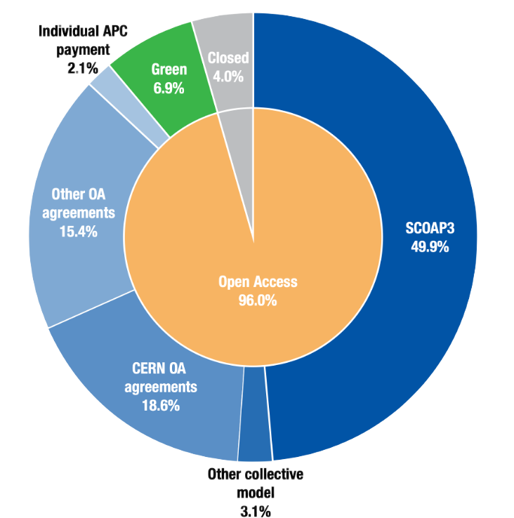
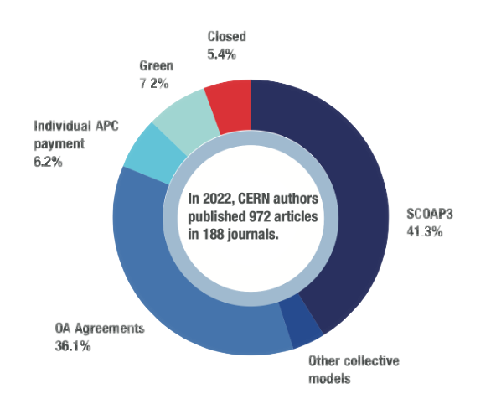
Open Access Statistics
Groundbreaking Results: 96% Open Access in 2023

Slide 16
16
Research
Asesstment
Recognize the diversity of contributions to, and careers in, research in accordance with the needs and nature of the research.
Base research assessment primarily on qualitative evaluation for which peer review is central, supported
by responsible use of quantitative indicators.
Abandon inappropriate uses in research assessment of journal and publication-based metrics, in particular inappropriate uses of Journal Impact Factor (JIF)
and h-index.
Avoid the use of rankings of research organizations
in research assessment.”
CoARA

Slide 17





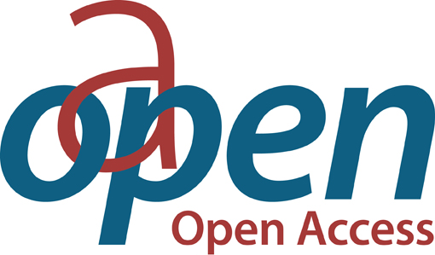

Supporting Global Open Access & Open Science Infrastructures
Open Access and Open science need a globalized infrastructure…
  With standardized metadata and persistent identifiers (ORCID, ROR, CrossRef, OA Switchboard…)
  And Open Infrastructure created and used by the community (DOAJ, OAPEN, OJS…)

Slide 18


What’s next?
World-wide discussions on Diamond Open Access
  Cape Town global summit in Cape Town in 2024
  European Diamond Capacity Hub launch in 2025
In 2025, we will review our OA strategy for the next years
  Continue to support global OA infrastructure
  Promote further / contribute to collective models
  Review negotiation goals with publishers
  And move further towards equitable OA

Slide 19
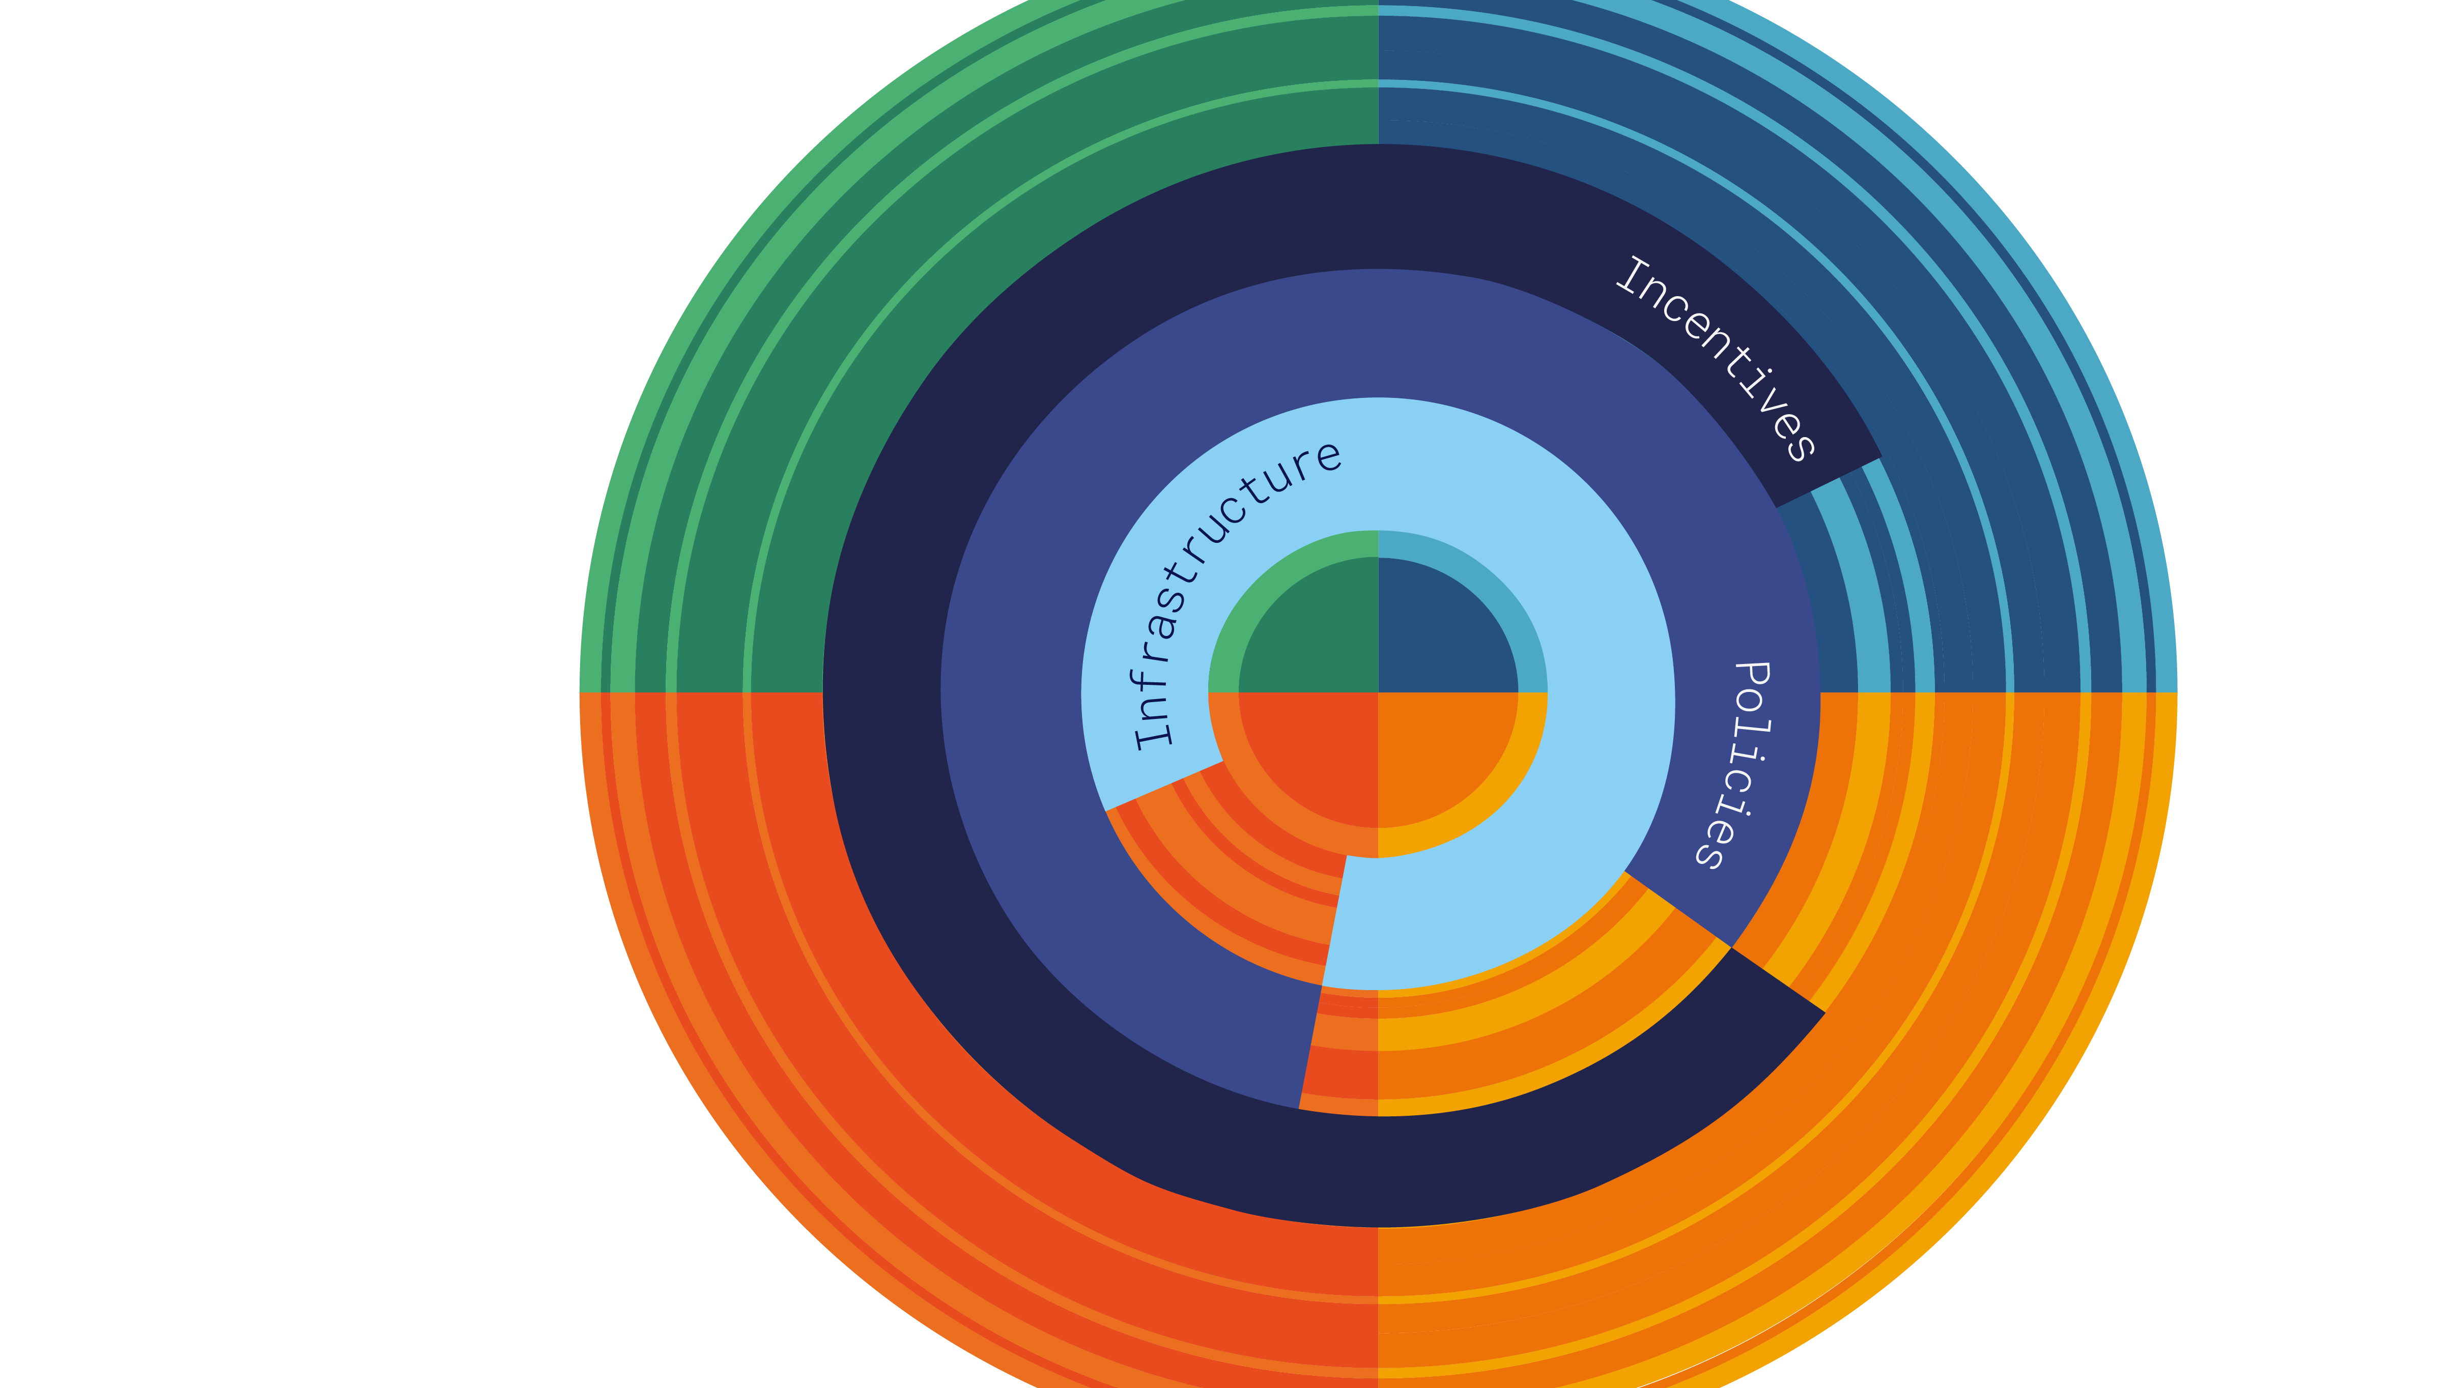
Open Science
Structures & Process
DATA
PUBLICATIONS
SOFTWARE
HARDWARE

Slide 20
List of links
SCOAP3 website: https://scoap3.org
SCOAP3 Journals: https://scoap3.org/scoap3-journals-2025-2027/
CERN OA policy: http://dx.doi.org/10.17181/CERN.XDL3.FX3J
CERN Open Access implementation: https://sis.web.cern.ch/submit-and-publish/publish-open-access
CERN Open Science Website: https://openscience.cern

Slide 21
Anne Gentil-Beccot
Anne.gentil-beccot@cern.ch

