Slide 1




Spotting the
Wolves: Protecting
Your Research
(from Predatory
Publishers)
Susan Veldsman
Director: Scholarly Publishing
CERN-UNESCO-NRF Open School Programme
20 February 2025

Slide 2
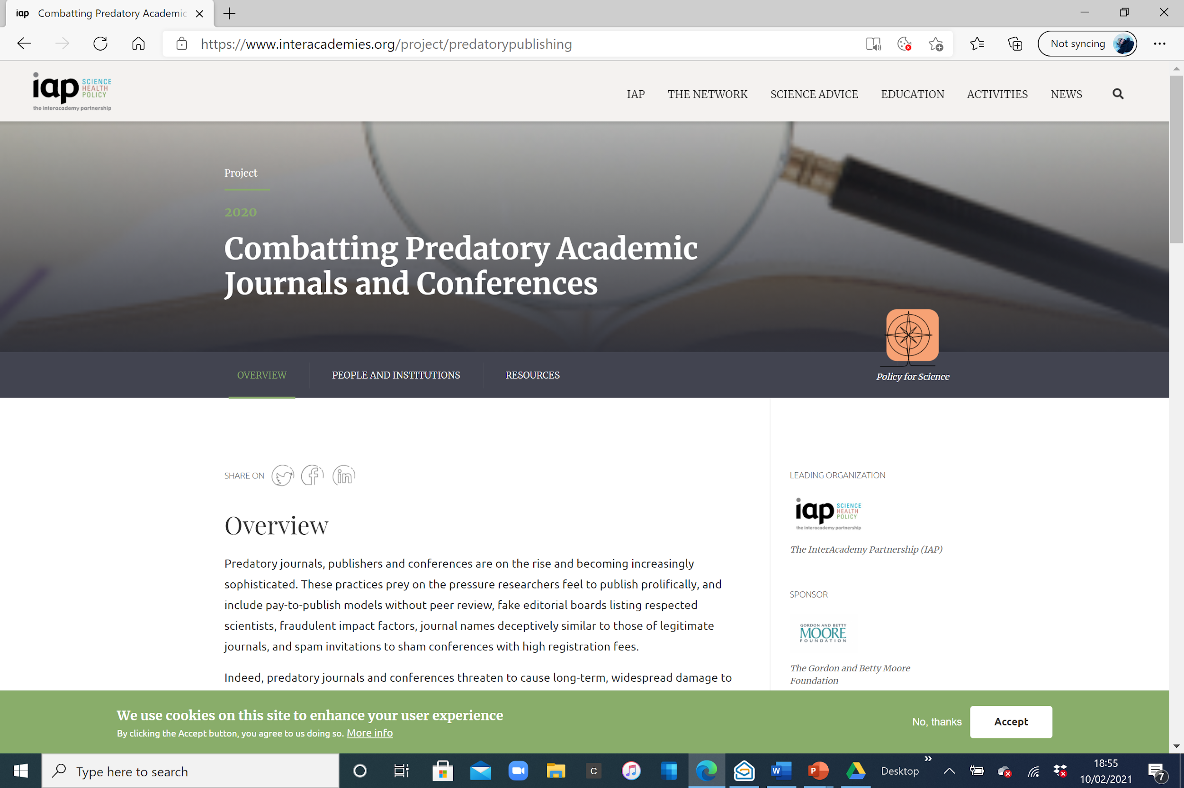

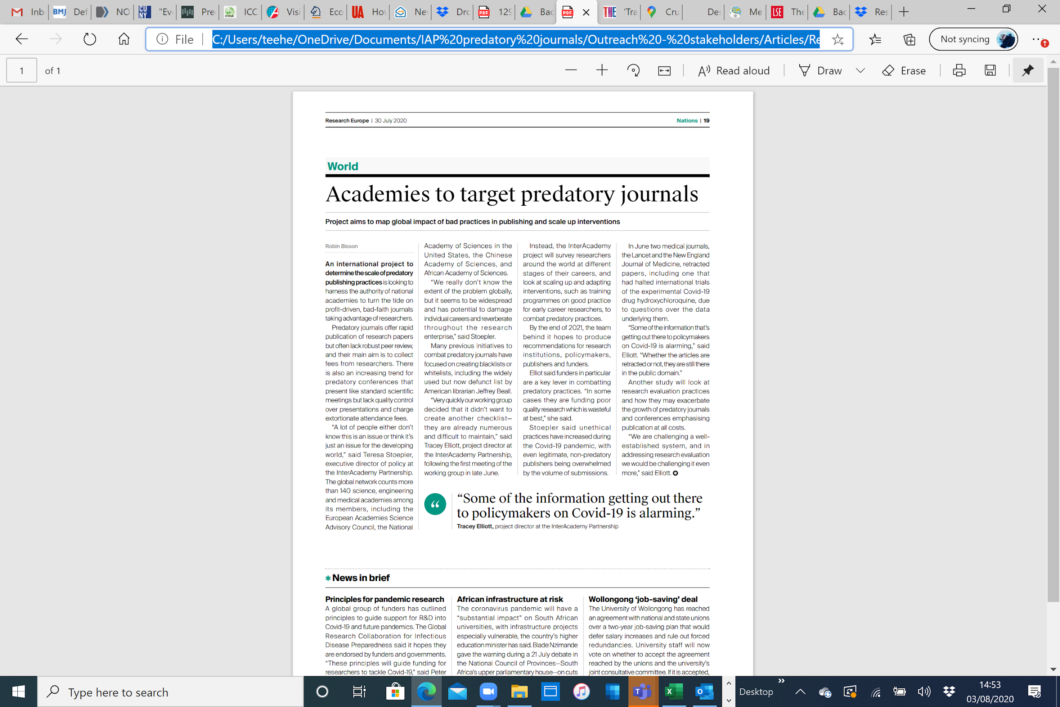
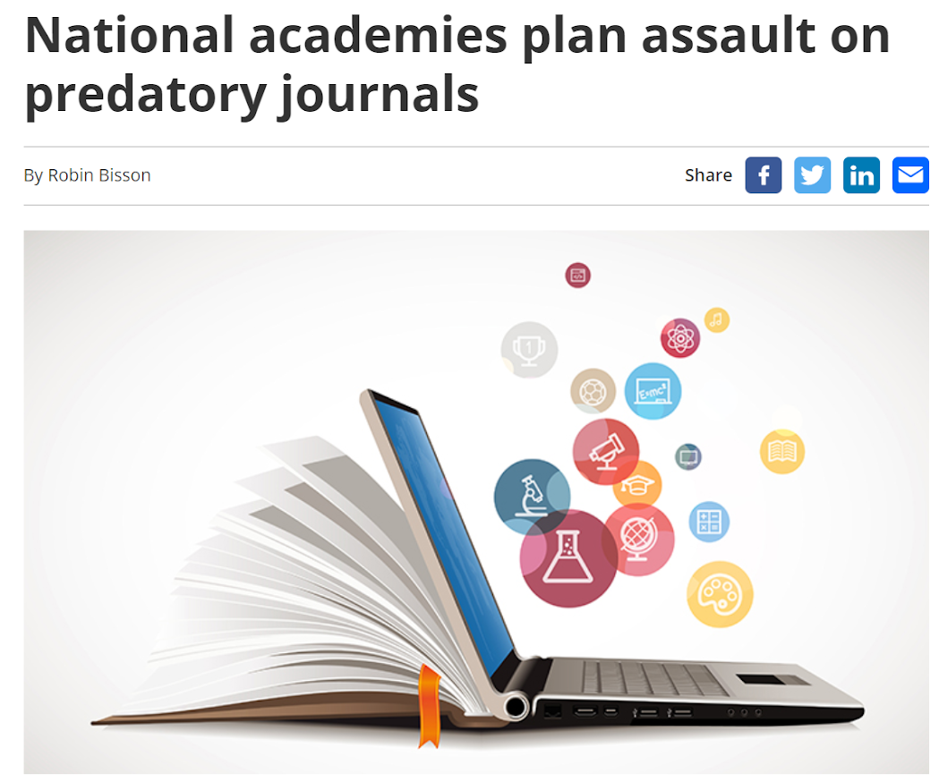
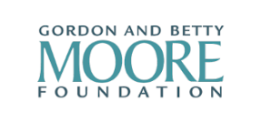


“Combatting predatory academic journals and conferences"
Notes:
Funded by the GBMF, the IAP project – “Combatting predatory journals and conferences” - was launched in May 2020 and reports shortly.

Slide 3
Study objectives
Define predatory and unethical practices in academic journals and conferences
Gauge their prevalence and impact
Understand the primary drivers or root causes
Examine efforts to-date to combat predatory journals and conferences around the world
Provide concrete recommendations for a GLOBAL STRATEGY to address the problem, that engages all key stakeholders
research community and academies
policymakers
universities and research administrators
libraries and indexing services
public and private sector funders of research
publishers
“Comatting predatory academic journals and conferences"
Notes:
[Read from slide]
The study speaks to the system as a whole i.e. to key stakeholders whose action can effect systemic change. Each needs to play their part, and this includes all of you.

Slide 4
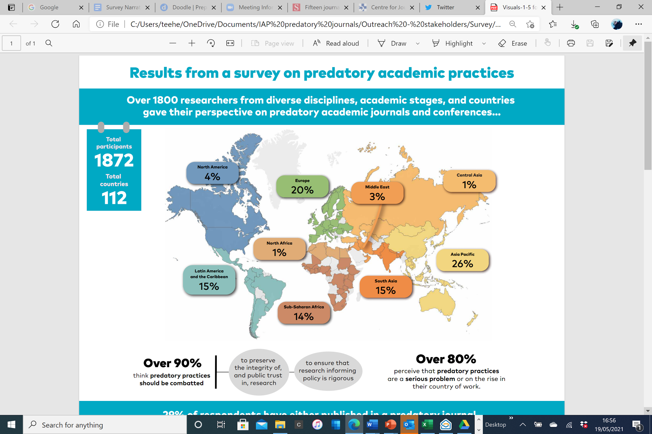
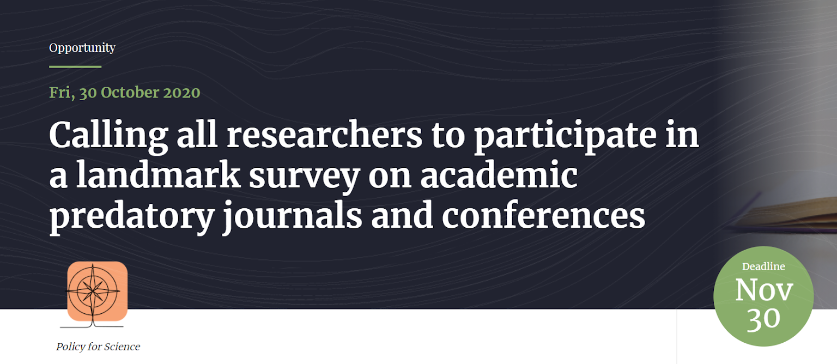
Landmark survey of researchers
“Combatting predatory academic journals and conferences"
Notes:
We have conducted a survey of researchers – the largest and mosy comprehensive of this topic.
Over 1,800 researchers from 112 countries responded to the survey, providing a rich data set for analysis. All major geographic regions of the world were represented, as were disciplines and career stages. Just over half of the respondents were members or alumni of national or global academies. If you participated, thank you! We have learned a great deal.
In fact, the data are stark: over 80% of respondents perceive that predatory journals and conferences are already a serious problem or on the rise in their country of work.

Slide 5
Survey headlines
Researchers at ALL career stages need to be on their guard
Researchers in low and middle income countries are more vulnerable
Some disciplines are more vulnerable than others
- researchers in arts and humanities with predatory journals
- researchers in transdisciplinary & engineering sciences with predatory conferences
At least 14% of respondents admit they have used a predatory journal or conference
This equates to over 1.2 million researchers of the 8.8m around the world who could have used predatory outlets, with billions of dollars of research costs (people, materials, time) wasted as a result. This requires urgent attention.
“Combatting predatory academic journals and conferences"
Notes:
The survey tells us that
predatory journals and conferences may have infiltrated a wider demographic of researchers than previously thought, with researchers at all career stages needing to be on their guard, especially in lower and middle income countries, and in some disciplines more than others.
a significant proportion of respondents have admitted they have published in a predatory journal or participated in a predatory conference (14%), the large majority of them unknowingly.
Using this 14% figure as a conservative estimate, and the survey sample as a rough proxy for the global research community, if extrapolated, this could equate to around 1.2 million researchers and billions of dollars in wasted research costs based on figures in the UNESCO Science Report (2021).
This is not a trivial or marginal issue. It requires urgent attention.

Slide 6

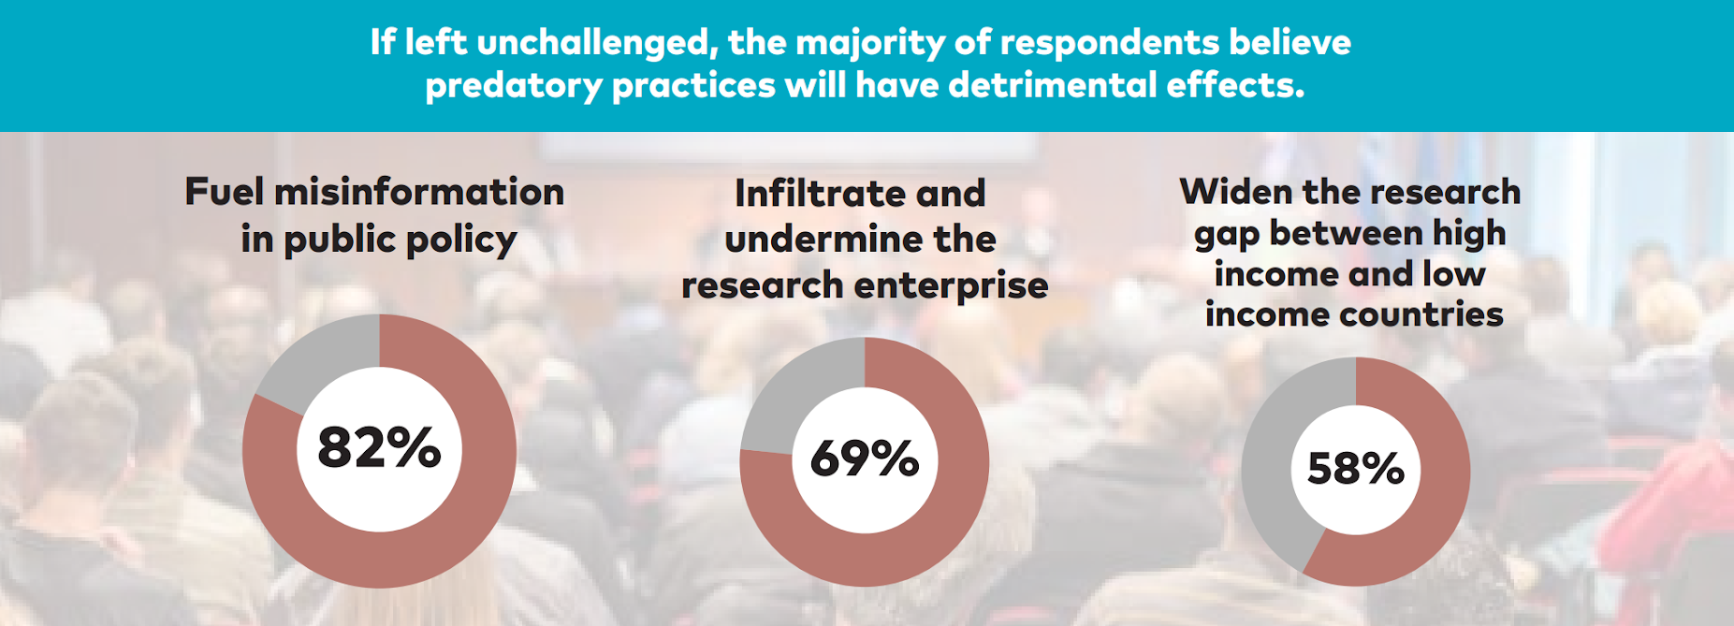
Why it is important to address these practices
“Combatting predatory academic journals and conferences"
Notes:
Over 90% of the survey respondents think predatory practices should be combatted, to preserve the integrity of, and public trust in, research and to ensure that eseach informing policy is rigorous.
If left unchallenged, the majority are concerned about poor or inaccurate research fuelling misinformation in public policy – no doubt an issue that has been brought into stark relief by CV-19.
The next highest concerns are undermining the research enterprise as a whole, not least public trust in it, and widening the gap still further between high and low income countries.

Slide 7
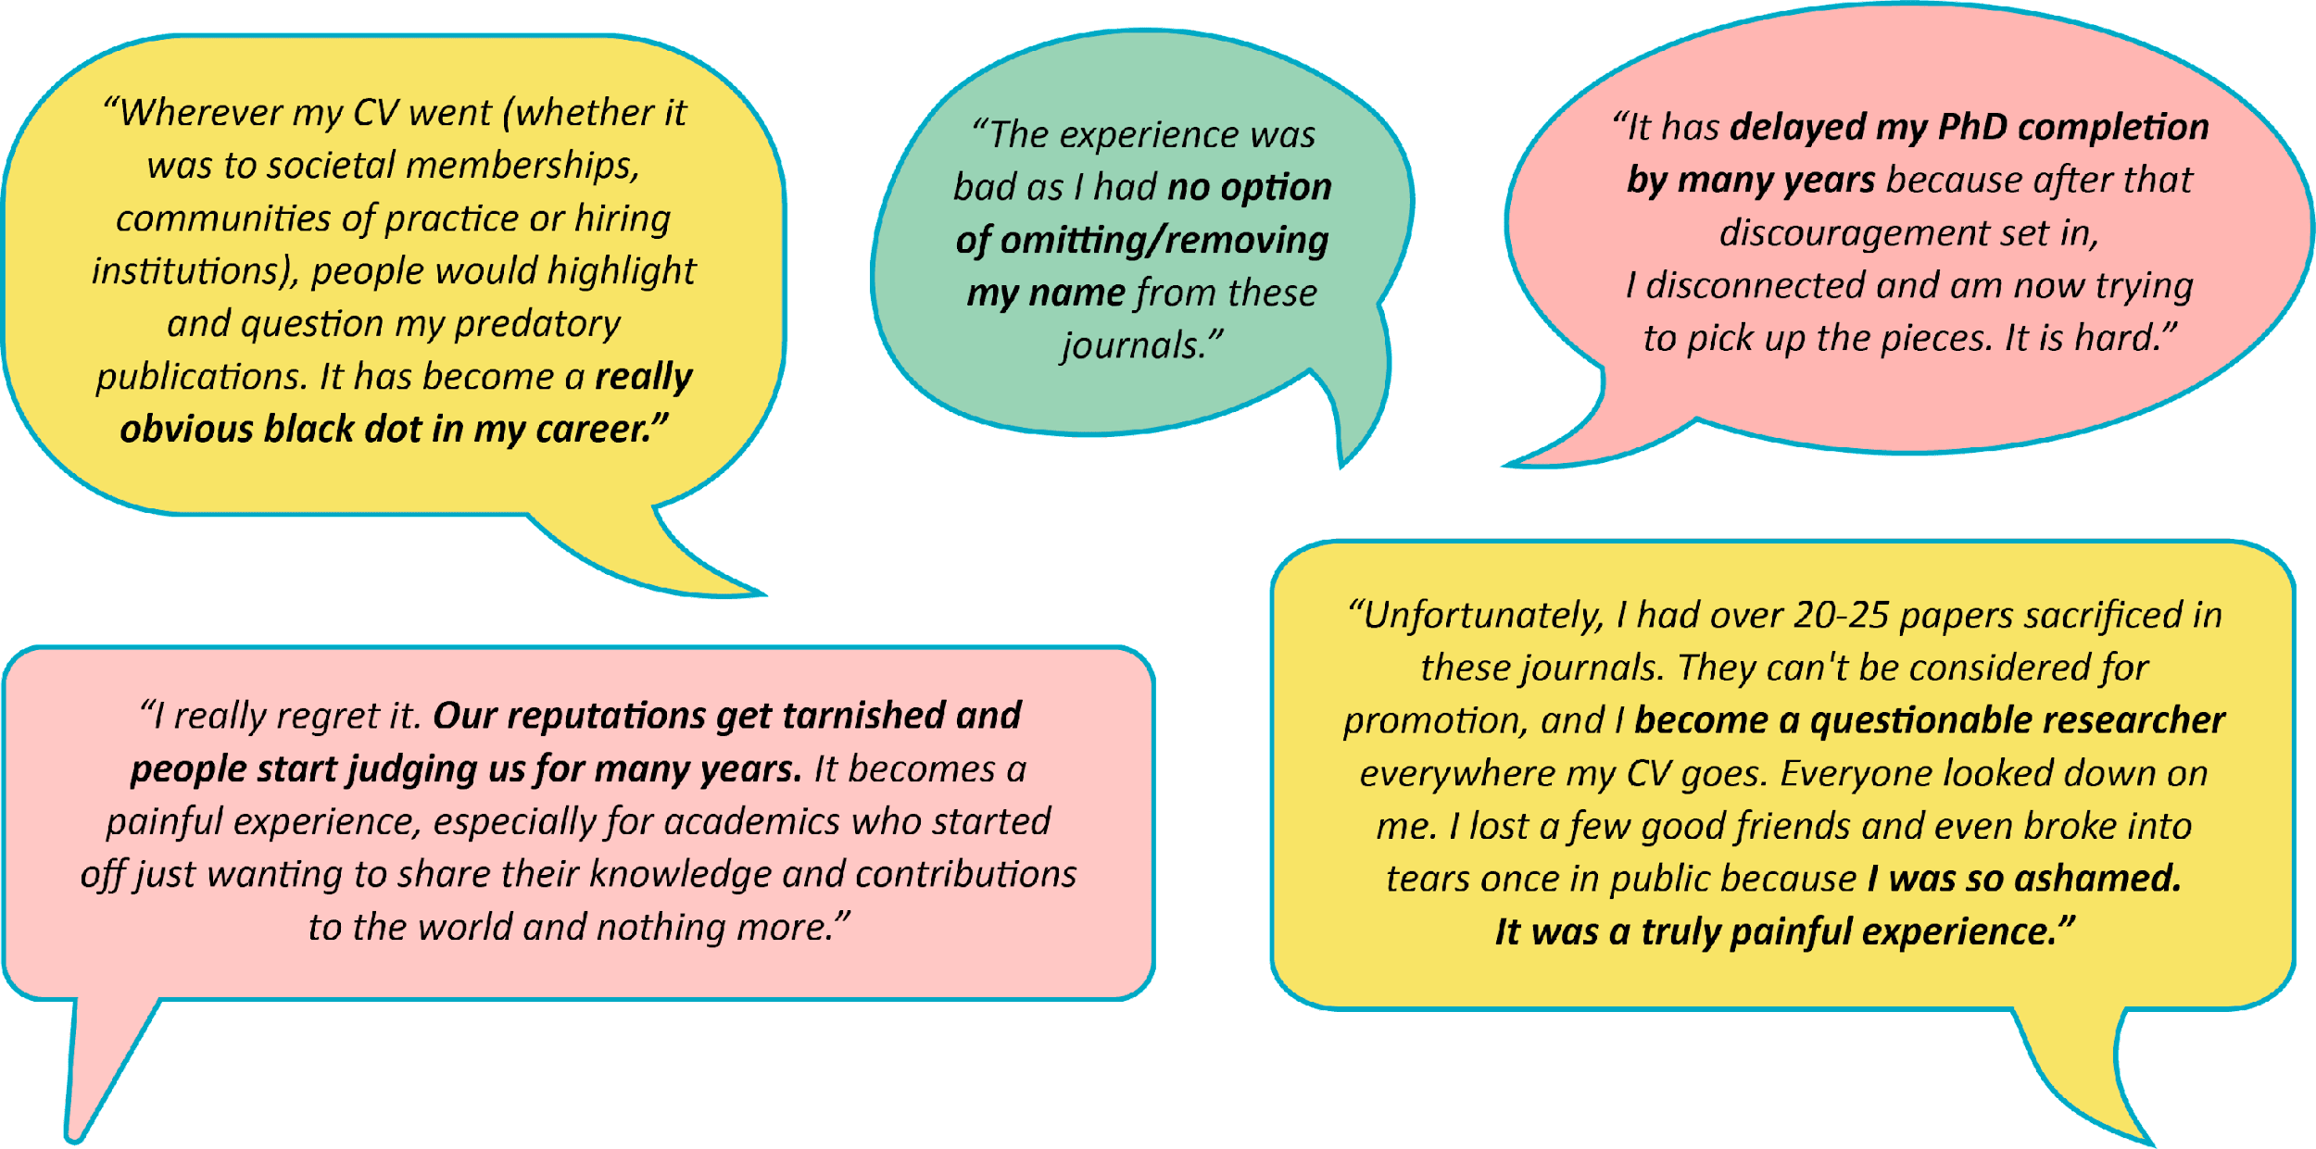
Some personal accounts
“Combatting predatory academic journals and conferences"
Notes:
Some interesting personal insights from those who have used PPs, largely but not exclusively inadvertently i.e. scammed

Slide 8
Seeking profit over contribution to scholarship
Predatory journals are characterised by:
• The deliberate deception of authors by either hiding or not disclosing fees (APC, handling fees, fast-track fees, etc.)
• The omission of any revenue-related information
• The simultaneous launch of a large number of journals, for example, in 2009 OMICS launched 200 journal titles

Slide 9
Example: Profit Making
Dear Dr. ABC,
Thank you for the prompt response.
If you want to withdraw the manuscript, as per our journal policy you need to pay 50% of actual processing charges as withdrawal fee i.e., 1150 Euros.
Kindly provide your acceptance to this email. So that we will send you the withdrawal invoice.
If we did not receive any response with in 24 hours the your article will be published with RETRACTION NOTE.
+++++++++++++++++++++++++++++++++++++++++++++++++++
Dear L,
See below and kindly advise. The student submitted without checking that the journal is in the DHET list.
Best Regards

Slide 10
However, I am concerned that Dr D’s application for promotion seems to me to be undermined by her choice of publishing platforms.
African researchers are perhaps particularly at risk from the global network of predatory publishing which takes advantage of the increasing pressure on career academics to ‘publish or perish’ to make money for themselves as commercial (and not properly academic) enterprizes. The consequent undermining of academic standards and the damage to the structures of the scholarly profession are by now well attested.
It is unfortunate that the articles and chapters submitted for review purposes all appeared in what are generally viewed by the international academic community as predatory journals/publishing houses.
My own reading of the articles and book chapters presented suggests that it is likely that these would have been improved if a more thorough process of peer-review had been involved, as would have occurred through submission to non-predatory publishing outlets that engage in robust peer-review processes.

Slide 11
Misrepresentation of abstracting, indexing and metrics
• False claims of indexing in Web of Science and/or Scopus and others
• Claims of inclusion in databases of companies that provide fake and misleading services
• Claims and listing of fake indexing and other organisations

Slide 12
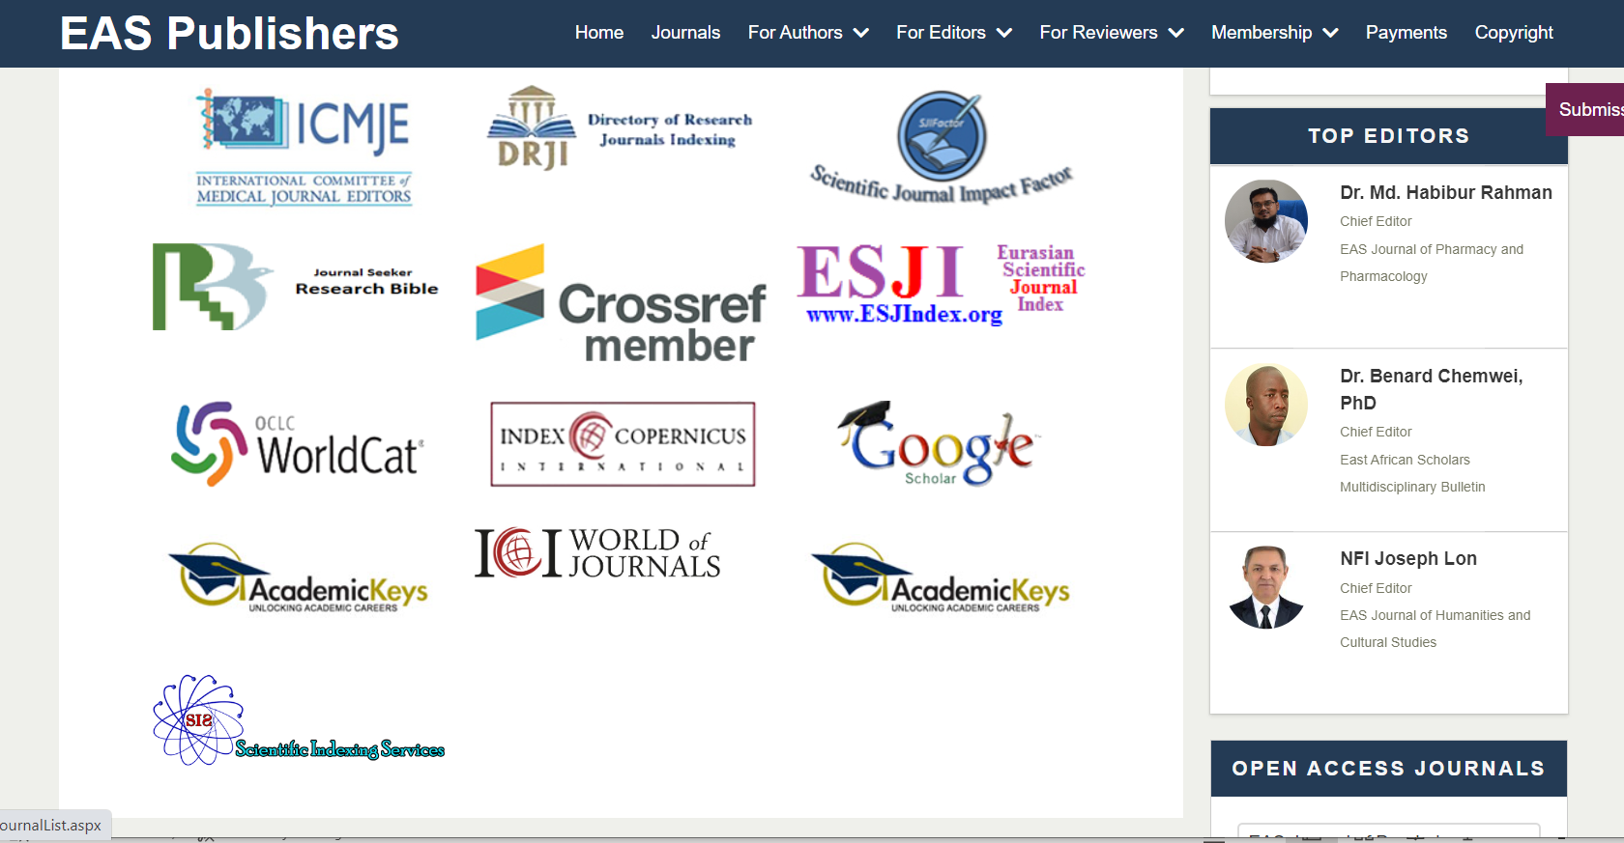
Examples of fake indexing listed on a predatory journal website

Slide 13
Aggressive advertising and solicitation of articles
• Daily indiscriminate e-mails to prospective authors
• Increasingly familiar and flattering language
• The use of business marketing language, for example submit two articles and pay for one

Slide 14
Inappropriate journal title and scope
• A broader disciplinary scope
• A combination of scientific disciplines with very little in common
• Copying the titles of acclaimed journals, for example Science and Nature

Slide 15

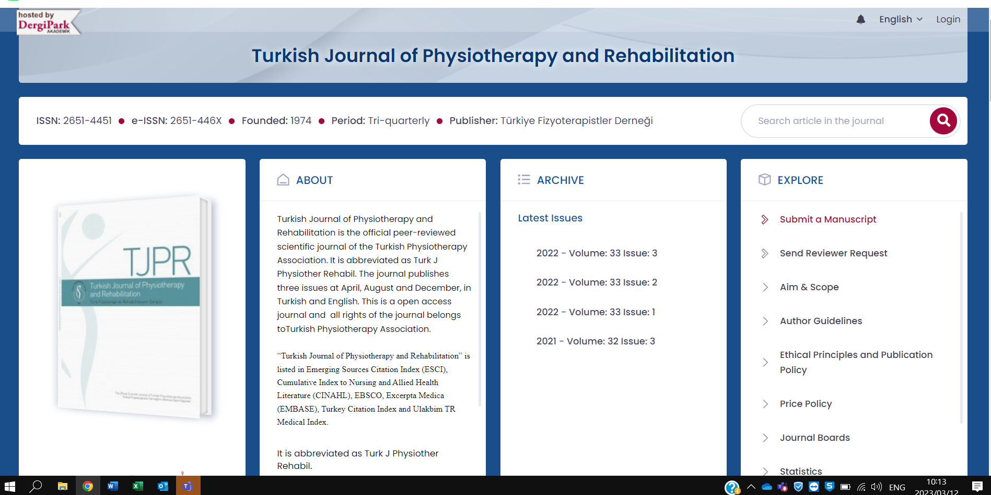
Example: Physiotherapy
.

Slide 16
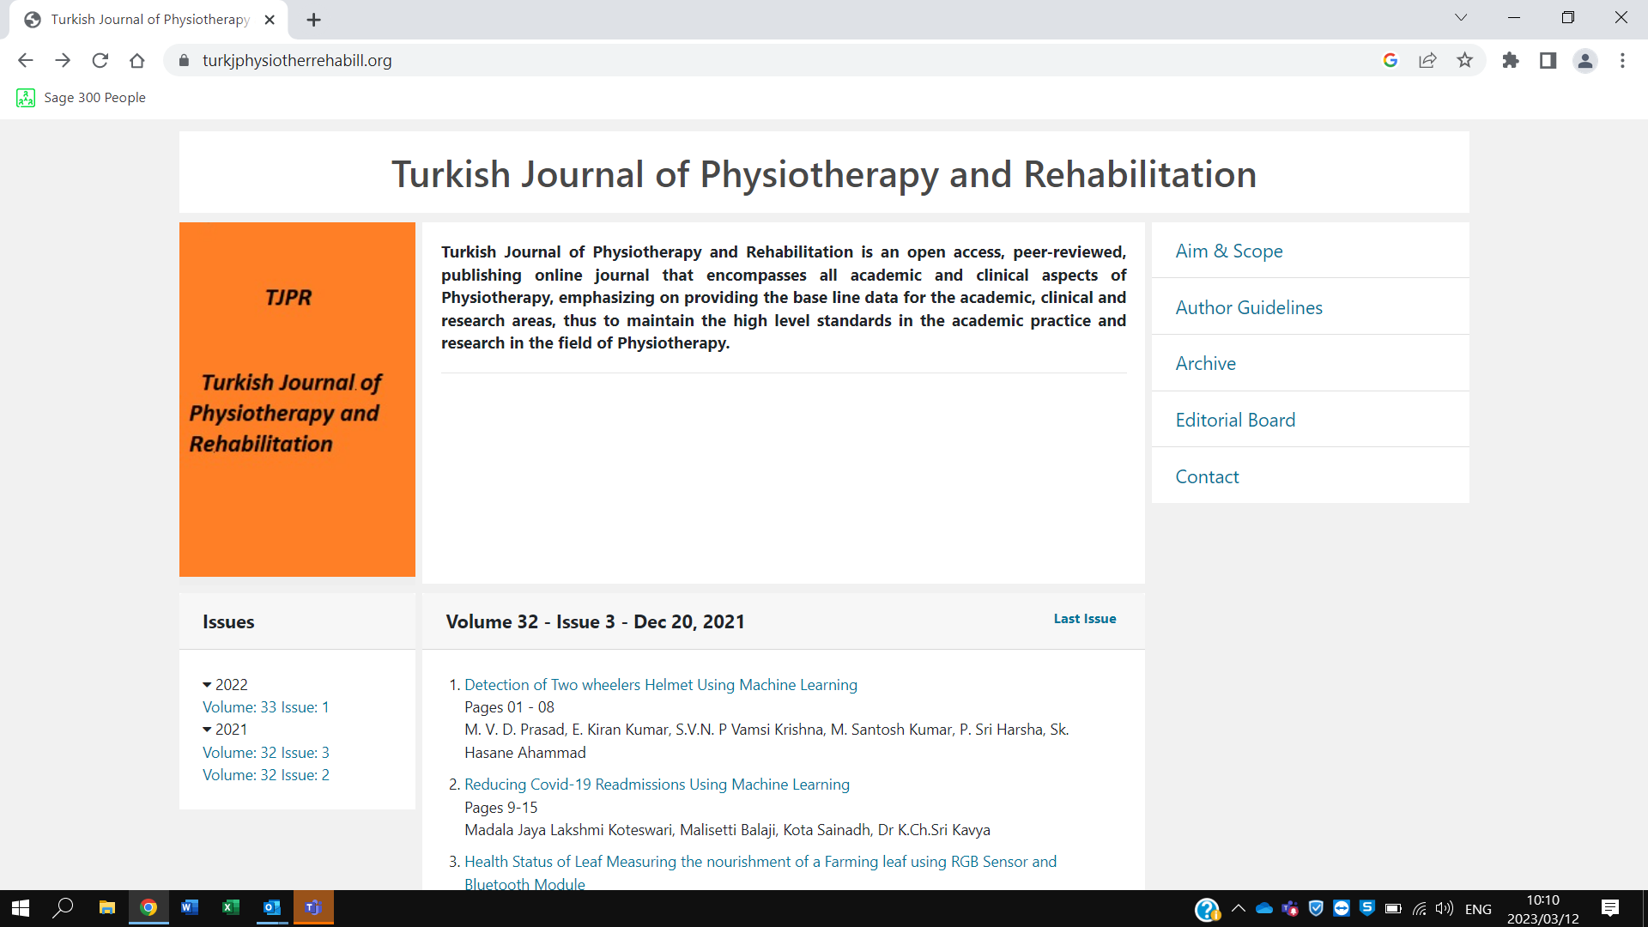
Example: Physiotherapy

Slide 17
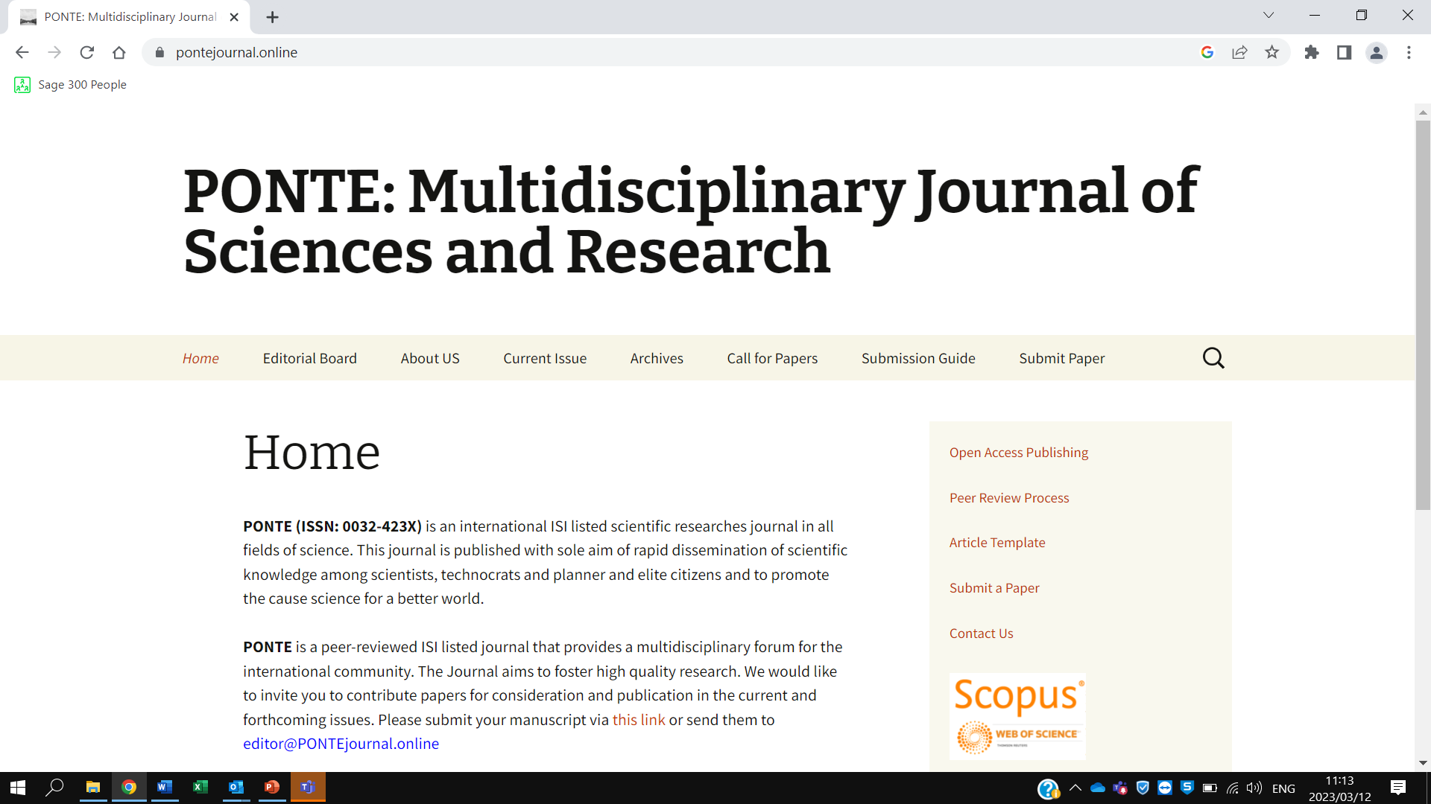
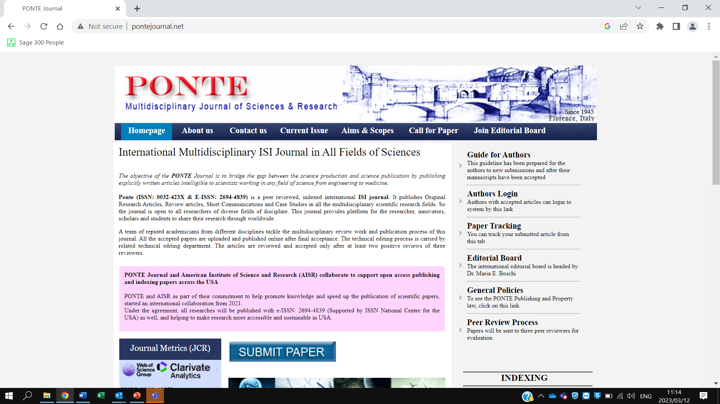
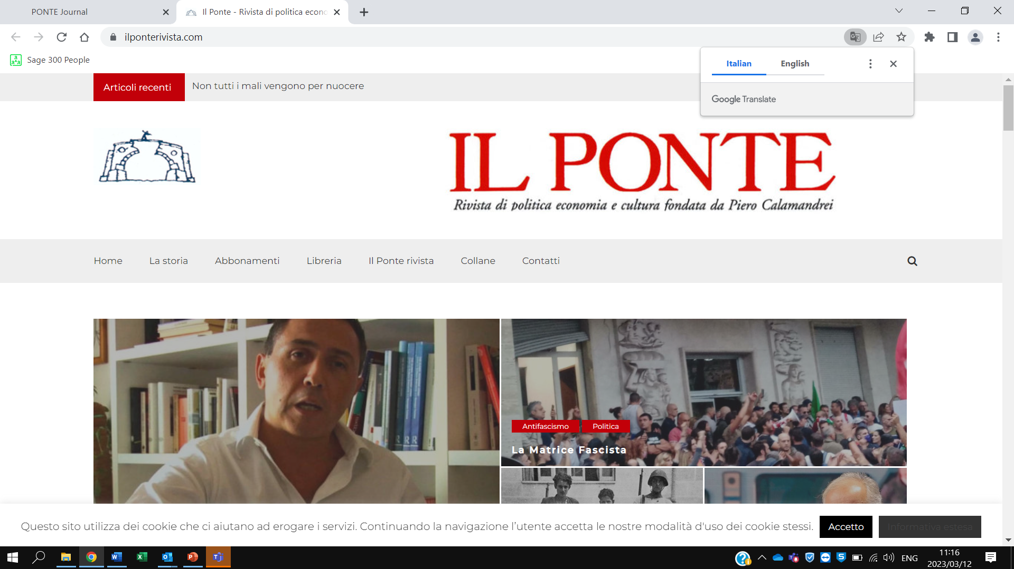
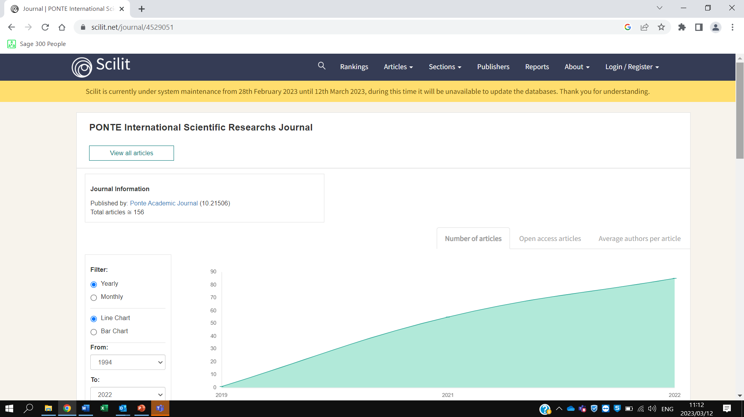
Example: Multidisciplinary

Slide 18
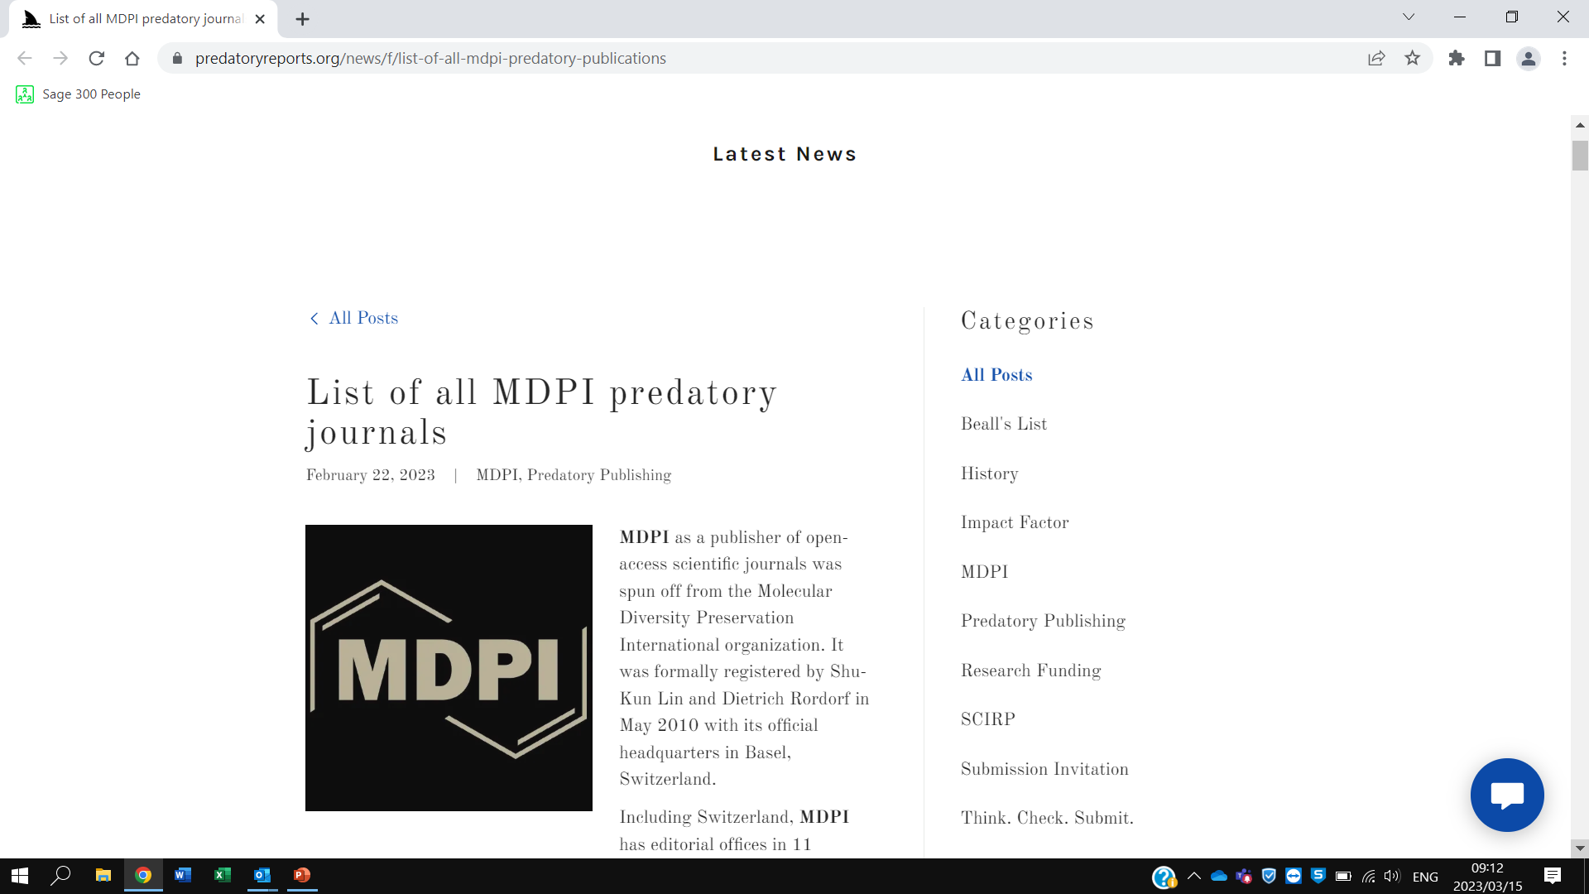
The case of MDPI

Slide 19
MDPI?
Is it predatory?
Has elements of both: they have aggressive ways of rent-seeking (money-making) rather than predatory. Current publishing practices and growth rates may shift them to predatory
They are publishing good articles, but their strategies are questionable and on the verge of predatory
  huge growth rate in article publishing
  APCs are charged, APCs have increased. Dan Brockington: 14 mill in 2015-191 mill in 2020
  https://paolocrosetto.wordpress.com/blog/

Slide 20
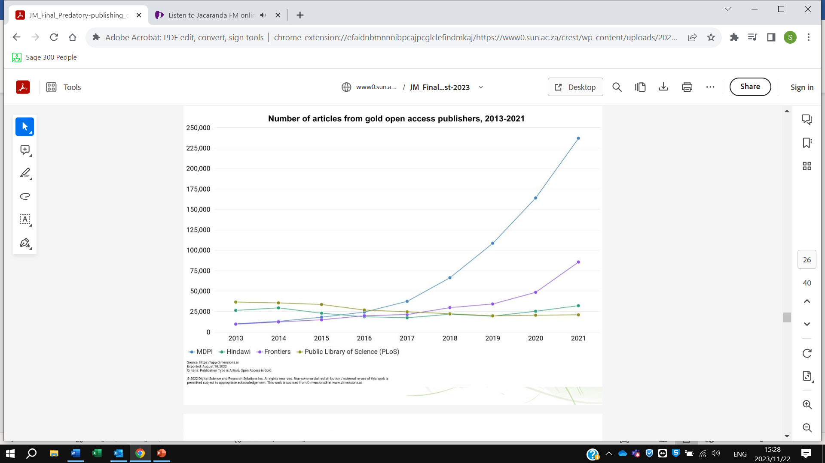
Source: Mouton, J & Van Niekerk, M. 2023. What is and how to identify predatory publishing. CREST (ppt)

Slide 21
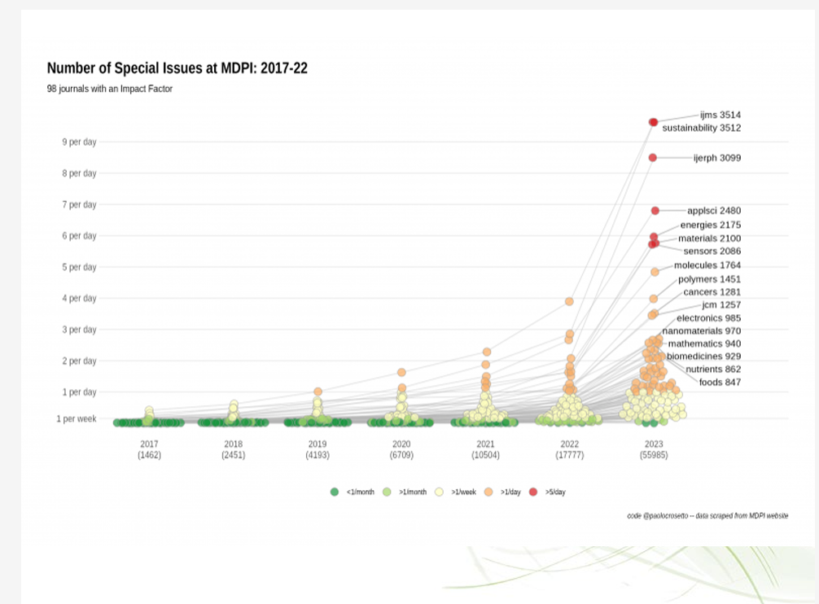
Source: Mouton, J & Van Niekerk, M. 2023. What is and how to identify predatory publishing. CREST (ppt)

Slide 22


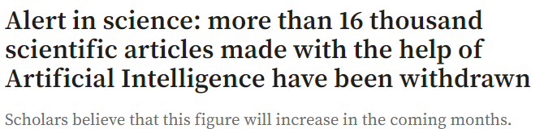
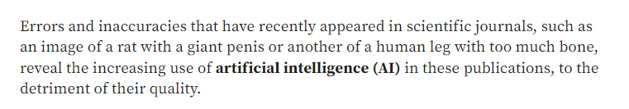
https://www.elcolombiano.com/tecnologia/retiran-miles-de-articulos-cientificos-hechos-con-inteligencia-artificial-HP25195741

Slide 23
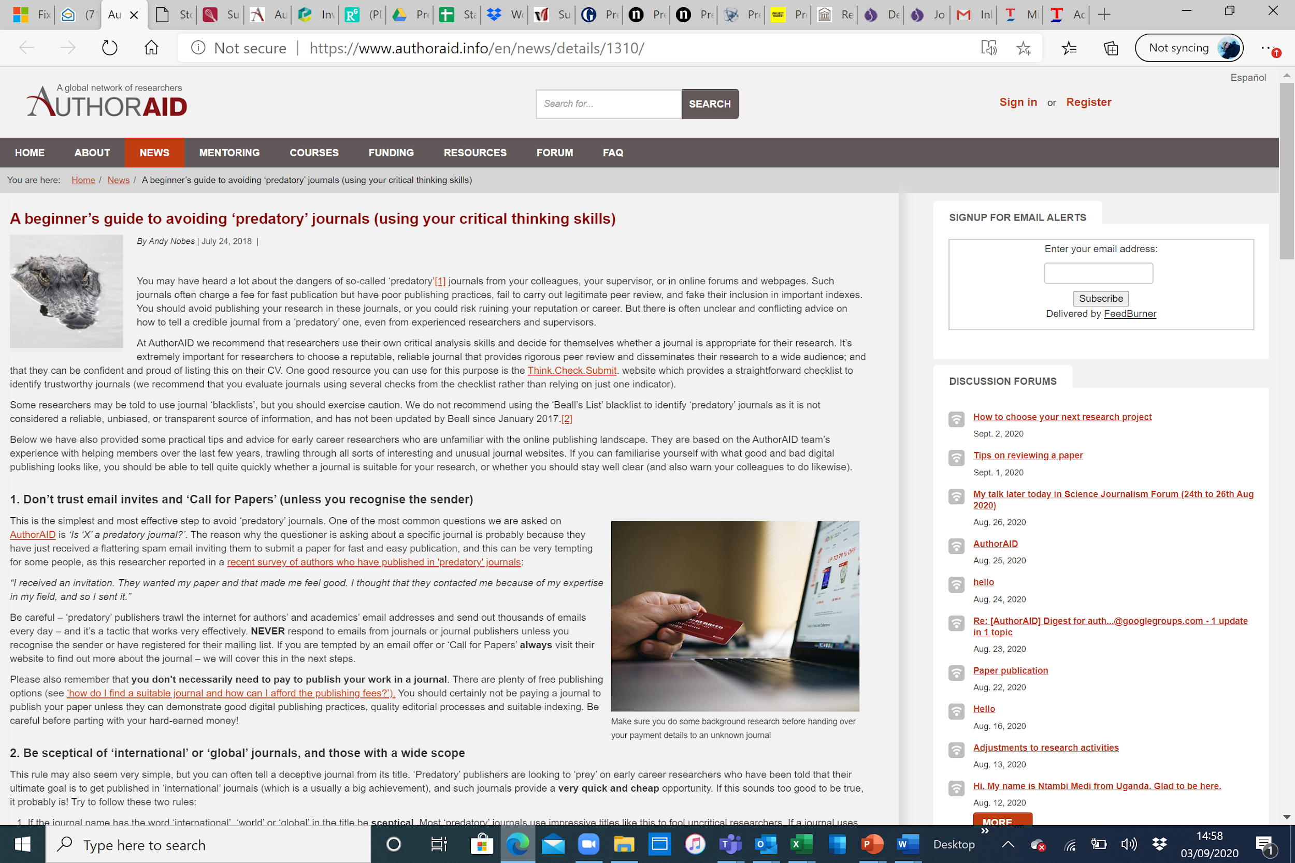
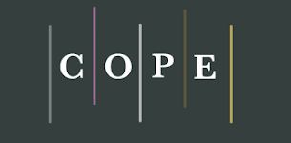
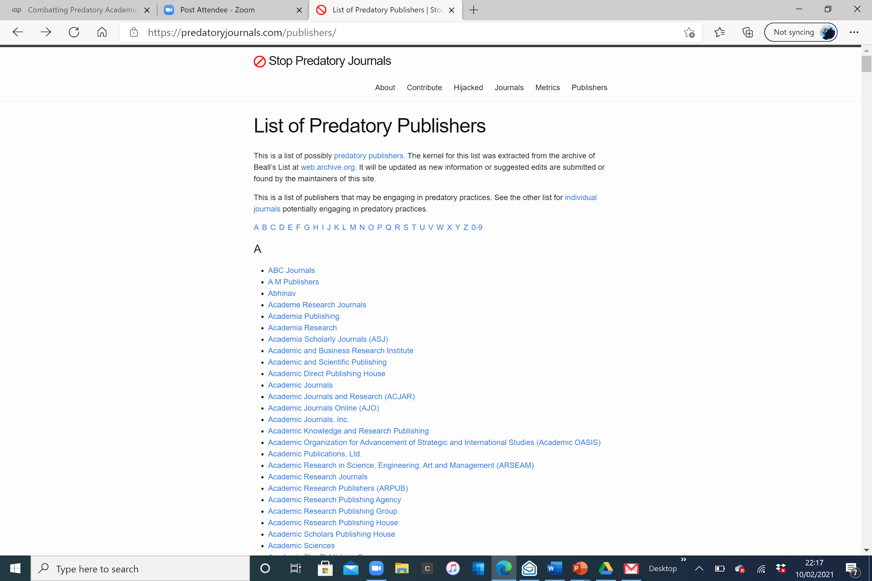
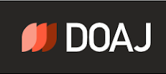
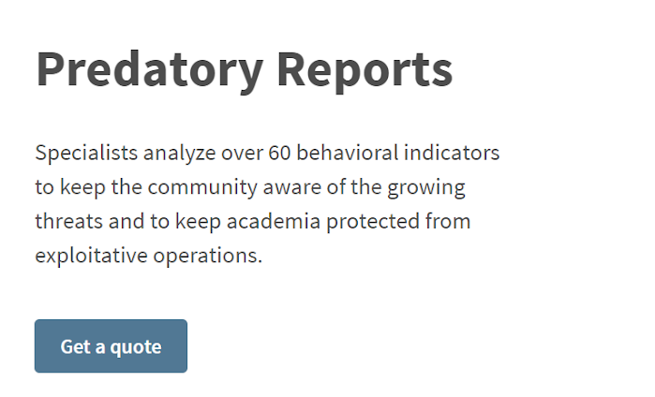

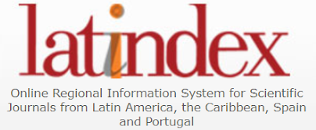
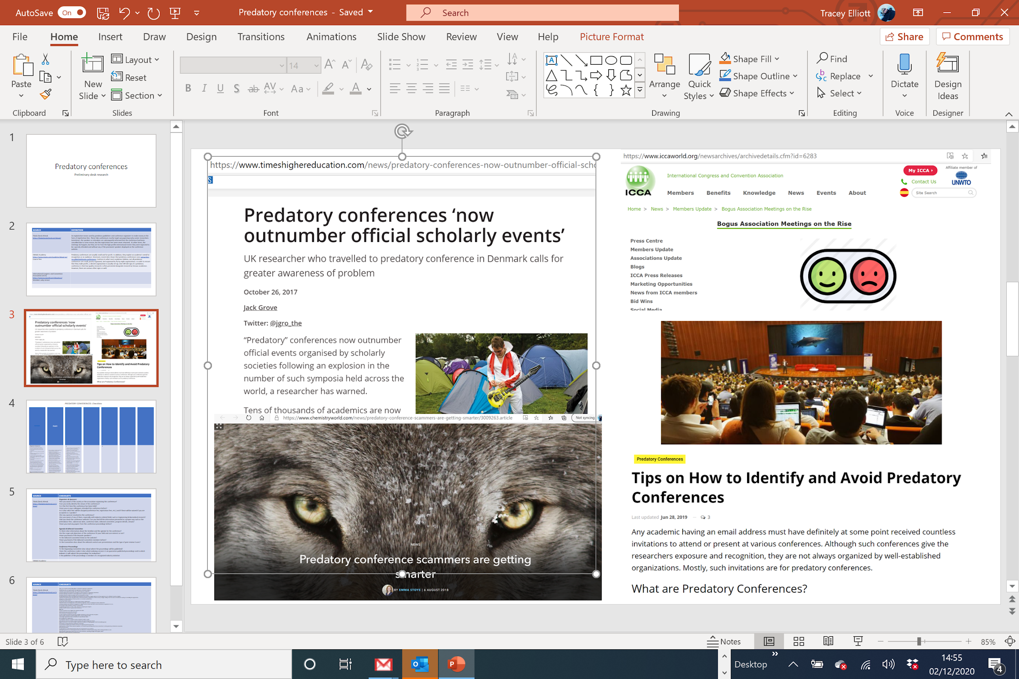
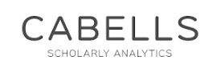
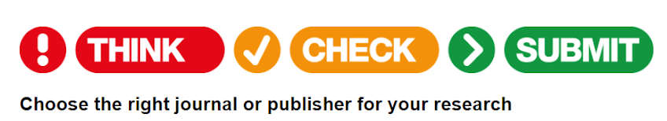

Examples of resources already available
“Combatting predatory academic journals and conferences"
Notes:
Awareness raising is vital and we identify a range of self-help resources already available online to guide researchers, especially with respect to journals. Here are a few examples. Some of these are publicly available – like AuthorAid, while others- like Cabells - are pay for subscription services. Some universities have their own guides and tips.

Slide 24
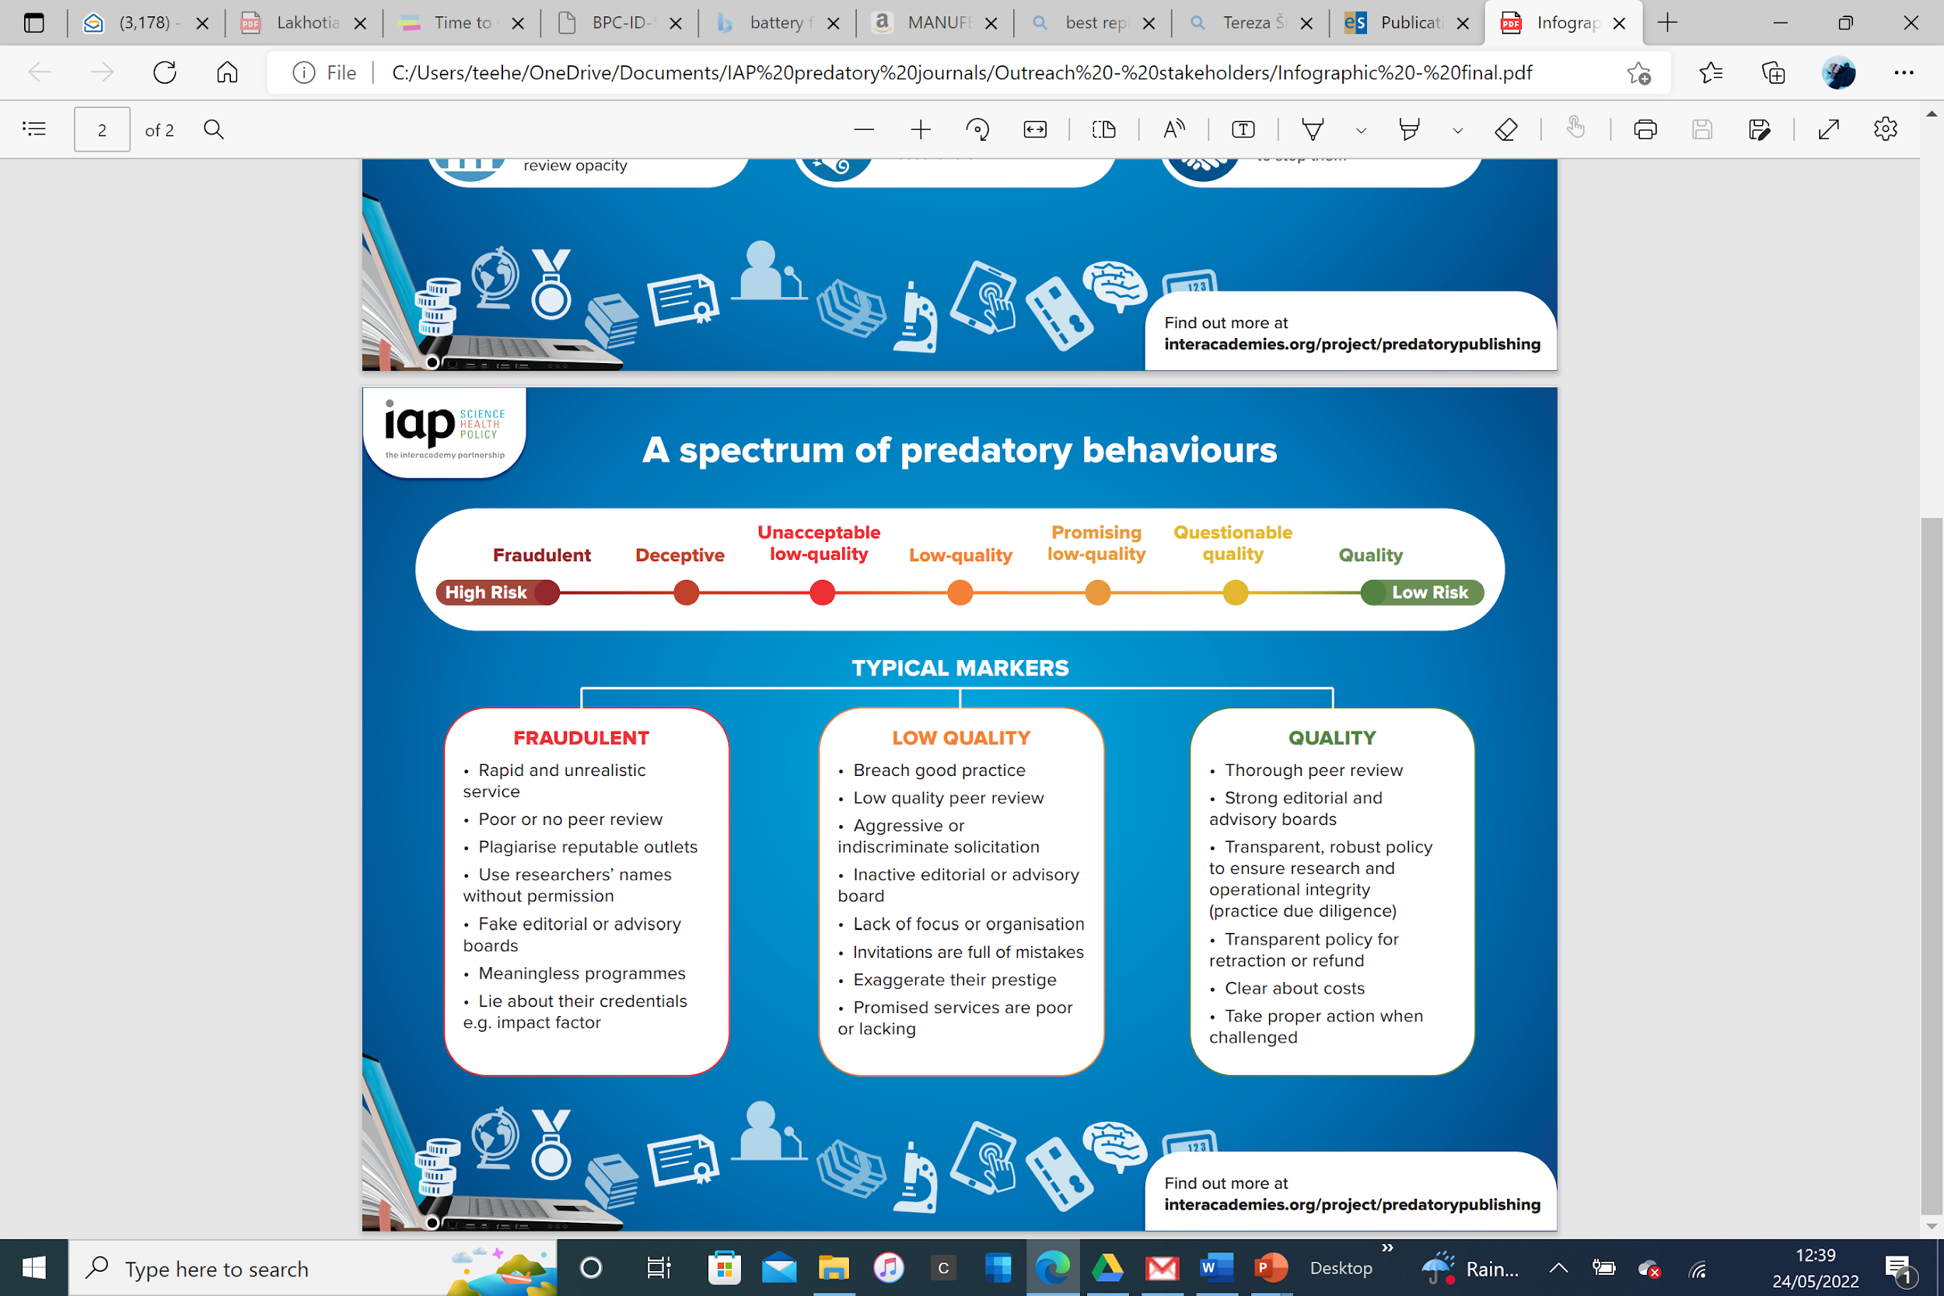
Notes:
We redefine predatory practices as a spectrum or broad set of dynamic behaviours that range from genuinely fraudulent and deceitful practices on the left - as most often recognised in the literature - to low-quality, questionable, unethical and quality ones, moving to the right. This more nuanced approach endeavours to account for well-intentioned, promising low-quality or poorly-resourced practices in the middle of the spectrum, which can be caught in the crossfire of the more usual binary – good v. bad - approach. These practices can be committed by new and established, fraudulent and reputable, traditional and Open Access publishers, anywhere in the world. Typical markers are provided for each part of the spectrum to help users navigate their way around this complexity.
We anticipate this tool will help researchers practice due diligence – more so than published lists (which can be misleading, outdated and even libellous), and will supplement other tools already in the public domain.

Slide 25
Recommendations to authors, supervisors and mentors
Practice due diligence to minimise risk
Use the spectrums as meta-level navigation tools.
Get to know the common and most reliable characteristics/traits of predatory journals
If a journal purports to be indexed in a reputable index e.g. Scopus, Web of Science, check personally and if found untrue, avoid such journals.

Slide 26
Recommendations to authors, supervisors and mentors
Check if a journal is listed in DOAJ (Directory of Open Access Journals); if it is, the journal is less likely to be problematic because it has been vetted. Similarly, check if a journal is a member of COPE (Committee on Publication Ethics), where it must follow COPE’s publication ethics (COPE Core Practices).
If a researcher’s institution has its own list(s) of acceptable and unacceptable journals, or subscribes to Cabells Predatory Reports, use them with caution and cross-check with other resources in this report.
Seek advice from mentor/supervisor/librarians: if they are uninformed themselves, encourage them to train up.

Slide 27
Recommendations to authors, supervisors and mentors
Ignore SPAM e-mails; they will likely be SCAM emails
Researchers should familiarise themselves with peer-review good practice and offer their services as a peer reviewer to help build capacity
Actively participate in committees/other platforms to advocate for quality-not-quantity evaluation. Use journals and indexing services, universities and academies fora as platforms for change. Be activists – help effect change.

Slide 28
Thank you!!
susan@assaf.org.za

