Slide 1

Identifying and avoiding predatory practices
2021 UNESCO Recommendation on Open Science
Dr Tiffany Straza
20 February 2025
openscience@unesco.org

Slide 2







What are the costs of publishing? (after an article is written)
Hosting the article: archiving, access
Enacting the peer review process: editorial oversight, coordination of reviews
Improving the quality and reach: text editing, visual design, factchecking
Connecting with audiences: distribution
…
Prestige is not a service.
Notes:
Prestige should be earned by the quality of services.

Slide 3

Conventional
Model
Subscription fee to journal (readers pay)
Authors publish for free
APC
Model
Reading is free
Article processing charges (APC) paid by authors / authoring institutions
$

Slide 4
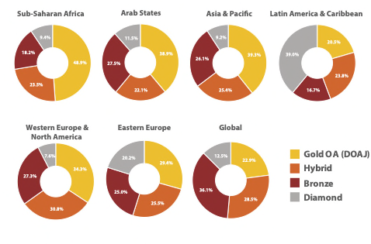
What are the costs of publishing?
Nearly half of OA articles from African authors were *published in a journal using a gold APC model (waivers may have been used)
African researchers are more likely to publish OA research using a gold APC model, compared to any other region
Figure 2.7. Share of open access articles, published between 2012 and 2021, by category of open access
Notes:
And there is another problem with this new model:

Slide 5

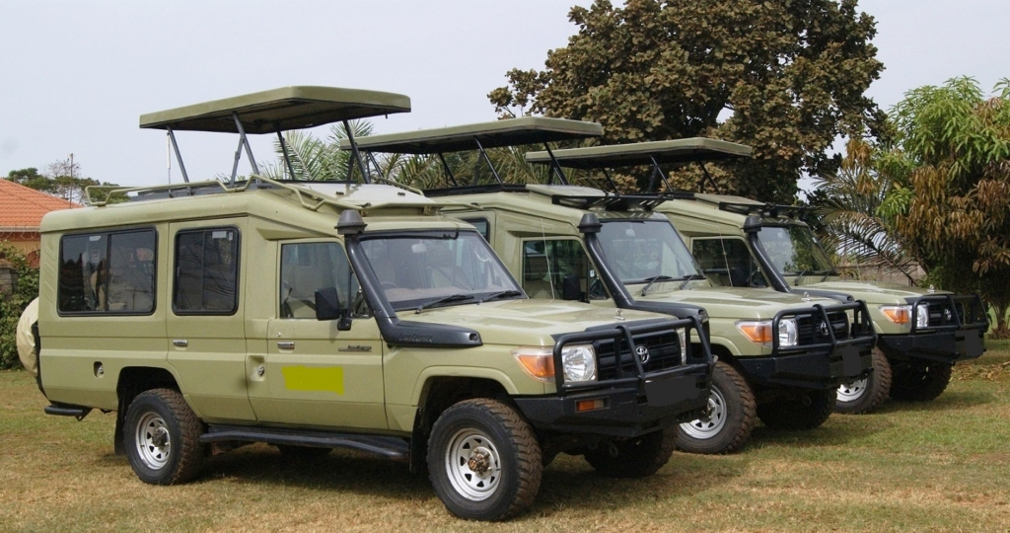
Conventional model: Publishers make deals with an institution
(Apologies to Green Lion Press! )

Slide 6
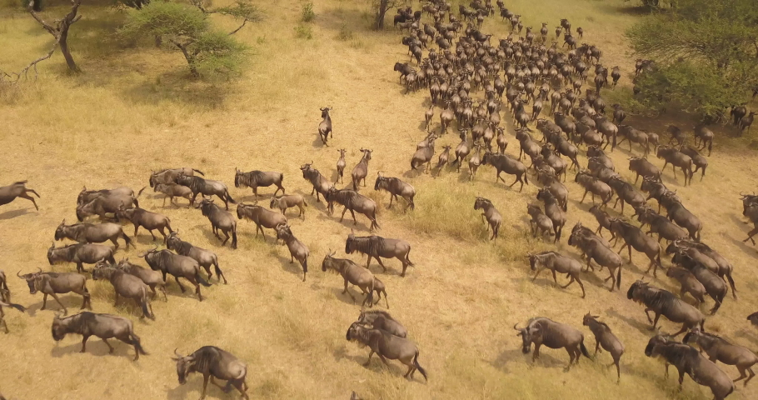
APC model: publishers make deals with many individual researchers

Slide 7
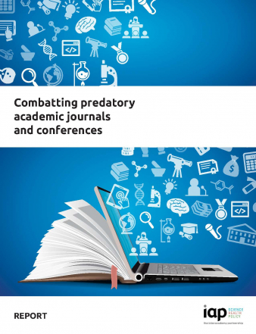
Guidance from Open Science Toolkit
Notes:
2022 report by the InterAcademies Partnership

Slide 8
A byproduct of commercialization of science
Predatory behaviours:
deploy deceitful or misleading practices to make money: charge a fee without providing the service
motivated mainly by profit rather than scholarship
Examples:
predatory journals and conferences;
falsification of experimental evidence;
fake or embellished qualifications, such as “predatory PhD”, certificates, awards and medals; and
predatory preprint servers.
Characteristics: rapid pay-to-publish models with little or no peer review, fake editorial boards falsely listing respected scientists, fraudulent impact factors, hijacked titles and aggressive spam invitations.

Slide 9
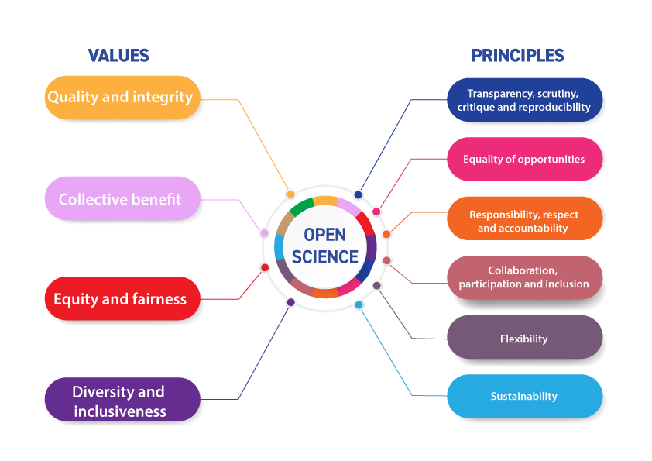
Open science values and principles

Slide 10
What is the link with open science?
Shifting from a model where publishing services are covered by subscriptions
…to a model where open access is promised, but the AUTHORS PAY per article
… plus tech permitting ‘instant journals’
A growing problem:
Over 16,000 predatory journals in May 2022
Hundreds more added every month
Reputational challenges even for ‘good’ journals!

Slide 11
Notes:
There is a real risk of avoiding/hurting smaller, non-central (non-N/W) journals by blacklists or assumed predation

Slide 12
What makes people vulnerable?
‘Publish or perish’ assessment
Monetization and commercialization of research output
Weaknesses in peer review systems

Slide 13
Why have people used predatory journals or conferences?

Slide 14
What makes people vulnerable?
‘Publish or perish’ assessment
Monetization and commercialization of research output
Weaknesses in peer review systems
Solutions from open science
More sustainable, less profit-motivated academic models
Responsible research assessment
Raise awareness: what does ‘good’ look like?
Robust training, including access to strong publishing practices
Disincentivizing rushed, low-quality publishing
Promoting more effective and sustainable peer review

Slide 16
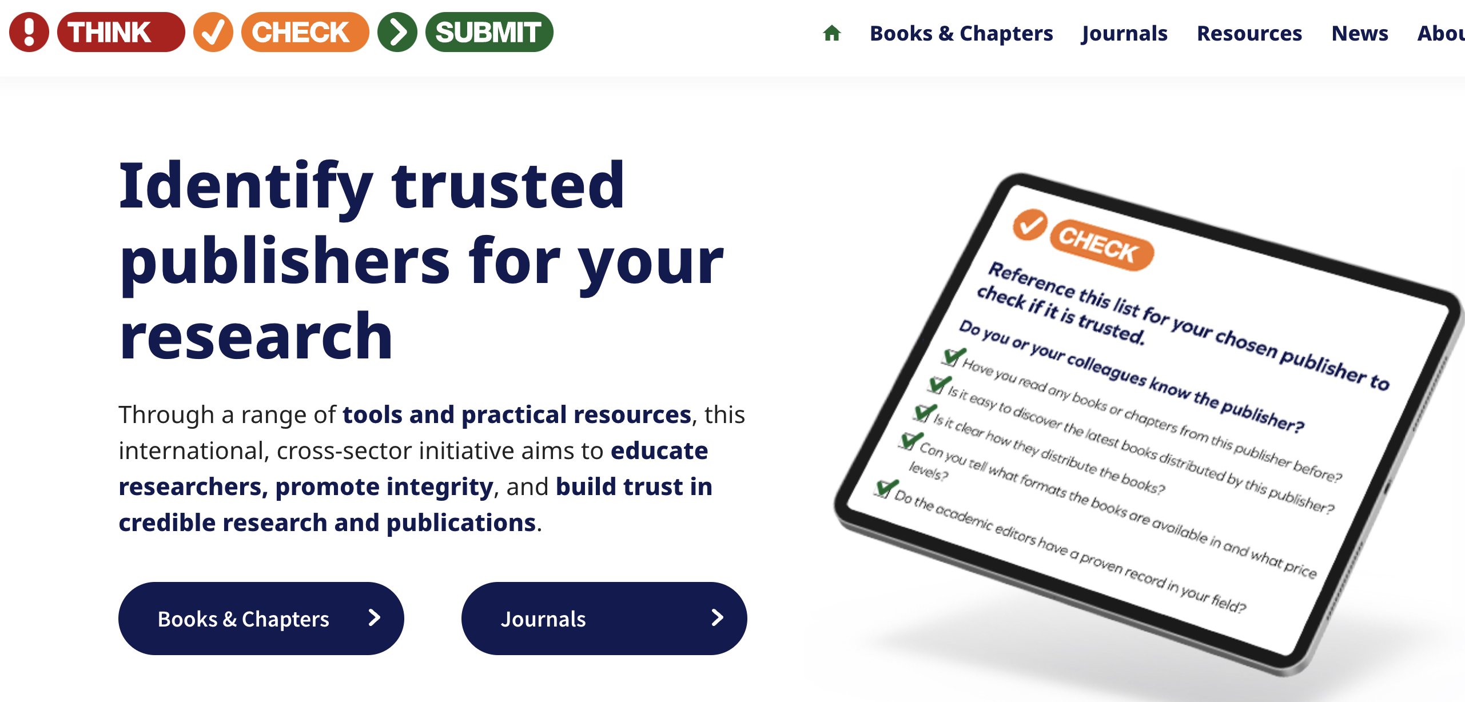

Help is available!
https://thinkchecksubmit.org/ https://thinkcheckattend.org/

Slide 17
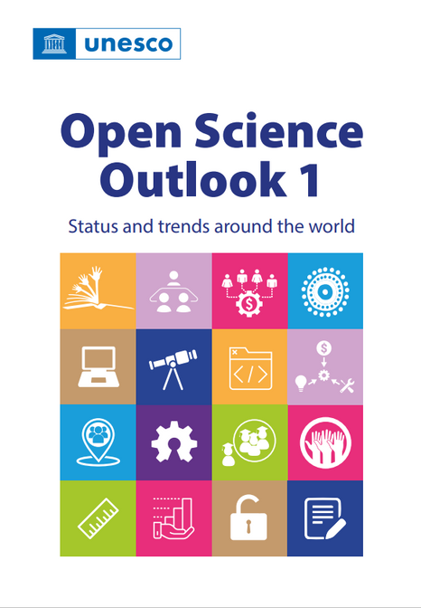



Join the Global Open Science Movement
Join the UNESCO Open Science Partnership
Contribute to global open science calls
Engage in the global discussions
Be in touch!
UNESCO Open science website: https://www.unesco.org/open-science
Read the Open Science Outlook:
Contact: openscience@unesco.org

