Slide 1

National Open Science Policy
Summary and progress
Igle Gledhill
Wits University, South Africa
Member of the DSI OS Expert Task Team 2020-present
Acknowledgement: Dr Daniel Adams, Dr Sagren Moodley, DSTI
Adrian Tiplady, Nicola Mulder, Wim Hugo

Slide 2
INTRODUCTION
Open Science … seeks to improve the practice and return on investment in science, and deepen the positive socio-economic benefits across all sectors of society
  Rapidly evolving international policy framework, including UNESCO Recommendation on Open Science,
  the European Open Science Policy, and the African Open Science Platform
Benefits of Open Science demonstrated at global level
Open Science will facilitate equality of opportunity within our National System of Innovation, and be a vehicle of the ‘democratisation of knowledge’
  Strengthen the RSA research enterprise…including
  Historically Disadvantaged Institutions
  Gender equality
  Indigenous Knowledge Systems
Notes:
Participation on our own terms

Slide 3
PROBLEM STATEMENT (1/2)
2020: Reviews by the National Advisory Council on Innovation (NACI) show declining global competitiveness of innovation in South Africa
  Disparity across higher education and research performing organisations aggravated by hurdles to accessing research publications and outputs
  Research cyberinfrastructure for Open Science growing, … but requires clear policy framework and investment to realise its full potential and equality of opportunity

Slide 4
PROBLEM STATEMENT (2/2)
Open Science is transforming the global practice of publicly funded research and development
  Competitiveness: requires understanding and implementing new research paradigms
  Transition towards an open research culture requires an enabling environment and appropriate support mechanisms in place
  Clear policy framework is needed.
Notes:
Time of fiscal constraint for South Africa

Slide 5
OBJECTIVES
Adoption of an Open Science policy will
  Facilitate equality of opportunity within South Africa’s National System of Innovation
  Enhance opportunities for environmentally sustainable and inclusive socio-economic development through the scientific research endeavour
Six inter-related outcomes
  Open Access
  Open Data
  Open Source
  Open Resources
  Open Methods
  Open Review
Image credit African Open Science Platform

Slide 6

STAKEHOLDER CONSULTATION & ENGAGEMENT (1/2)
SA-EU Open Science Dialogue Report
  Delivered by SA-EU stakeholders to Steering Committee of stakeholders
    DSI, DHET, ASSAf, UCT, University of Botswana, NRF, USAf, European Commission, EU Delegation to SA, DIRISA, SKA, NIPMO
  Two consultative workshops with a broad set of stakeholders
    Government departments, research funding organisations, universities and research performing organisations, scientific societies and academies, citizen science and public engagement organisations, professional researchers, citizen scientists, research and cyber/e-Infrastructures, research libraries, museums and publishers
  Final report was input into Draft Open Science Policy

Slide 7
STAKEHOLDER CONSULTATION & ENGAGEMENT (2/2)
Draft Open Science Policy
  2020: Open Science Advisory Board founded
  2020: Expert Task Team appointed
  2021/2022: Delivered by Expert Task Team to the DSI, with guidance from Open Science Advisory Board
  One consultative workshop with broad set of stakeholders (similar to SA-EU Dialogue Consultative Workshops)
  Considerations by the Expert Task Team
    SA-EU Open Science Dialogue Report
    International declarations and policies, such as the UNESCO Recommendation on Open Science
    International best practice; Stakeholder inputs
    Policy linkages, such as the AU Agenda 2063, National Development Plan 2030, Science Technology and Innovation Strategy for Africa 2024, and the African Open Science Platform;
    ASSAf report “Twelve Years Later”, 2019
Notes:
Chaired by Ahmed Bawa and involving a number of relevant government departments

Slide 8

Values informing the principles
Quality and integrity
Equity, fairness and collective benefit
Diversity and inclusiveness
Image attribution: Davies et al. The State of Open Data, African Minds, 2014
http://www.africanminds.co.za/state-of-open-data/ cropped
Notes:
Of this resource

Slide 9
GUIDING PRINCIPLES
Key Principle
  ‘As open as possible, as closed as necessary’ – research outputs shall be open unless untenable risks arise
  Roots in Human Rights and SA Constitution
  Refer to Intro to UNESCO Recommendation on Open Science
  Ethical: Including but not restricted to protection of human rights; right to privacy and respect for human subjects of study; protection of sacred or secret indigenous knowledge; protection of vulnerable populations

Slide 10
GUIDING PRINCIPLES
Key Principle
  ‘As open as possible, as closed as necessary’ – research outputs shall be open unless untenable risks arise
  Legislative: legislation or policy, legal process and public order; protection of personal information; national security
  Intellectual Property: protection of Intellectual Property Rights and copyright
  Contractual or commercial: confidentiality, contractual agreements, and research agreements
  Environmental: protection of rare, threatened or endangered species and preservation of the natural environment

Slide 11
GUIDING PRINCIPLES
Key Principle
  ‘As open as possible, as closed as necessary’ – research outputs shall be open unless untenable risks arise
  Research credibility:
  Compromise of the scientific credibility of the researcher or research output due to publication context
  Examples
  journals in the correct research scope are not open
  relevant open journals have been identified as predatory
  transitional impediments (examples: inadequate funding sources for Article Processing Charges, relevant journal does not offer Open Access)

Slide 12
GUIDING PRINCIPLES
Key Principle
  ‘As open as possible, as closed as necessary’ – research outputs shall be open unless untenable risks arise
Open Science Principles
  FAIR –Findable, Accessible,Inter-operable and Re-usable
  CARE – Collective Benefit, Authority to Control, Responsibility, and Ethics
  TRUST – Transparency, Responsibility, User Community, and Sustainability, and Technology

Slide 13
IMPLEMENTATION:
GUIDING PRINCIPLES
Flexibility – flexible approach, context driven
Sustainability – sustainable long term practices, services, infrastructures and funding models

Slide 14
SEVEN POLICY INTENTS (1/7)
Regulatory Changes
  Provisions to ensure alignment with Copyright and Intellectual Property needs
  Open Science licensing/copyright should be used when appropriate use of research is without cost to the user
  IP licensing when income should be generated …NIPMO
  Strong need to reconsider Copyright, IP law and regulation in terms of an Open Science-friendly environment
Image credit African Open Science Platform
Notes:
NIPMO Nat Intellectual Property Management Office

Slide 15

SEVEN POLICY INTENTS (2/7)
Open Access
  1. ‘As open as possible, as closed as necessary’
  2. Establish a National Open Science Forum … dialog with users
  3. Approve Open Access Code of Conduct for reference by universities, editors ...
  4. Adopt Incentive schemes
  5. Paywalls, including APCs:
  The OSAB will consider and advise on a national scheme that provides publication funding and resources that are sustainable and robust, and fast, effective and equitable to enable both authorship and readership. Such a scheme should not compromise research funds or research time.
  A severe problem: publish a paper, or support a student?
  Be excluded from publication?
  Funding
Image credit: https://www.openaccess.nl/
Notes:
UNESCO trade secrets, first-to-market, IP,
Protection of personal information act,
Petroleum products act,
Indigenous Secret knowledge, protection of assets
Human security

Slide 16
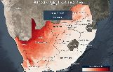
SEVEN POLICY INTENTS (3/7)
Open Data
  Provisions to ensure publicly funded research data is accessible, in line with technical standards
  1. Data Management Plans integrated into a FAIR framework
  2. Identify and resource an agency to
  Identify curators and stewards of valuable publicly funded research data …
  Serve as long term curators and stewards of all valuable publicly funded research data …
  Provide oversight
  Provide necessary archiving or mirroring.
  Advise on standards
  Develop tools.
  3. Consult through Open Science Forum
Image: https://greenbook.co.za/

Slide 17
SEVEN POLICY INTENTS (4/7)
Education & Skills
  Provisions to ensure development of necessary Open Science skills, and development of an Open Science culture within the research community
  1. Establish Human Resource Development Strategy
  2. with objectives:
  Establish OS culture
  Ensure equitable human resource development
  Establish e-learning platforms
  Identify, codify best practice
  Foster qualifications
  Adopt in Basic Science Education curriculum
  Promote innovative approaches
  3. Open Science Communication Strategy … across business and industry
Image credit African Open Science Platform

Slide 18
SEVEN POLICY INTENTS (5/7)
Rewards & Incentives
  Provisions to ensure appropriate incentives and evaluation systems are in place to promote adoption of Open Science amongst researchers
  1. Online tools
  2. Monitoring and evaluation
  3. Enhance reward and recognition frameworks
  4. Resource data curation
  5. Encourage private sector funding
Image credit African Open Science Platform
Notes:
Researcher Evaluation
Hybrid model of evaluation, accounting for traditional measures of academic output and those relevant for Open Science participation, needs to exist on timescales required for broader research community to adopt Open Science practice
Should not unreasonably disadvantage individual researchers within their community of practice
Examples where this has the case: at present multiple author papers are not taken into account, but a very sensititve system: DHET is the largest funder of research in the country and operates the incentive scheme, not to be tinkered with using the latest bright idea

Slide 19

SEVEN POLICY INTENTS (6/7)
Open Science Infrastructure
  Provisions to establish open science infrastructure with relevant technical support, tools and software to enable data intensive research across broader research community
  1. Develop a plan with National Integrated Cyber Infrastructure System (NICIS)
  2. OSAB advise on infrastructure
  3. DSI provide financial support
  4. Data Management Plans
  and focus on:
  Reliable and freely accessible broadband internet connectivity …
  Safety of researchers, especially women, utilizing research facilities and resources …
  ‘last kilometer connectivity’, within District Development Model.
Image attribution: Davies et al. The State of Open Data, African Minds, 2014
http://www.africanminds.co.za/state-of-open-data/ cropped
Notes:
4 to be managed

Slide 20
SEVEN POLICY INTENTS (6/7)
Open Science Infrastructure
  Provisions to establish open science infrastructure with relevant technical support, tools and software to enable data intensive research across broader research community
  1. Develop a plan with National Integrated Cyber Infrastructure System (NICIS)
  2. OSAB advise on infrastructure
  3. DSI provide financial support
  4. Data Management Plans
  and focus on:
  Reliable and freely accessible broadband internet connectivity …
  Safety of researchers, especially women, utilizing research facilities and resources …
  ‘last kilometer connectivity’, within District Development Model.
Image attribution: Davies et al. The State of Open Data, African Minds, 2014
http://www.africanminds.co.za/state-of-open-data/ cropped
Notes:
4 to be managed

Slide 21
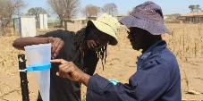
SEVEN POLICY INTENTS (7/7)
Citizen Science
  Provisions to establish a Centre for Citizen Science to fund and promote research collaboration between professional scientists and the public
  1. Establish an independent Centre for Citizen Science
  2. Provide for scientific and ethical oversight and, where necessary, supervision of a Professional Scientist
  3. Include in Basic Education curriculum
  4. …Measure the contribution and impact of Citizen Science on South Africa’s scientific output
Image source: https://council.science/current/blog/citizen-science/
Notes:
In publicly funded projects,

Slide 22

IMPLEMENTATION: CRITICAL SUCCESS FACTORS
Universal access
Trusted security of repositories
Cognisance of publishing realities, which are discipline specific
Legislation to establish appropriate balance
Sustainability
Stakeholder Engagement
Change Management: test and design cycle!
Global Compatibility
Consistent Inter-departmental policy
Notes:
Universal Access - District and local internet coverage must be improved, whilst online training for citizens is critical.
Trusted Security – Security eco-system, consisting of policy, process, skilled people, as well as hardware and software. Absence of security makes a gift of South African research to malicious actors.
Cogniscance of Publishing Realities – In many disciplines, publication practice is globally determined. The National Open Science policy must not, in its enthusiasm, ‘kill the goose that lays the golden eggs’ by penalising disciplines that are nevertheless making impact. In some cases (and discipline specific), timescales for implementation must be informed by the global community.
Legislation: need the Copyright Law to be updated from 1978!!! Fair use and fair dealing: ask an expert
Sustainability - Open Science must be sustainable, in the sense of able to be maintained for an extended time as well as being defensible and legitimate for all stakeholders.
Stakeholder Engagement – A research community that sees the Open Science project as legitimate with a value proposition that benefits the research enterprise.
Change Management - a Change Management Plan for transition is required, involving the most experienced people. Iterative testing and designing of the Implementation Plan should be undertaken before it is considered for acceptance. Unforeseen consequences will be investigated before implementation to ensure that the implementation does not drive circumventions or stop good work, that the transaction costs for researchers are low, and the components of the policy and plan are internally compatible with each other.
Global Compatibility – African OS Platform
Consistent Inter-departmental policy - A success factor for this policy is the ability to implement consistent policy across departments.

Slide 23

MONITORING
AND EVALUATION
South African Open Science Observatory
make available to stakeholders appropriate online tools for the monitoring and evaluation of the implementation
establishment of the Open Science Observatory shall take into consideration the existence of other entities that have similar functional scope
Image: www.sarao.ac.za

Slide 24
GOVERNANCE
RESOURCES, STAKEHOLDERS,
RESPONSIBILITIES
Governance
  Open Science Advisory Board (OSAB)
  National Stakeholder Forum(s) to provide input into the OSAB
OSAB shall approve an Open Science Implementation Plan
Image credit African Open Science Platform

Slide 25
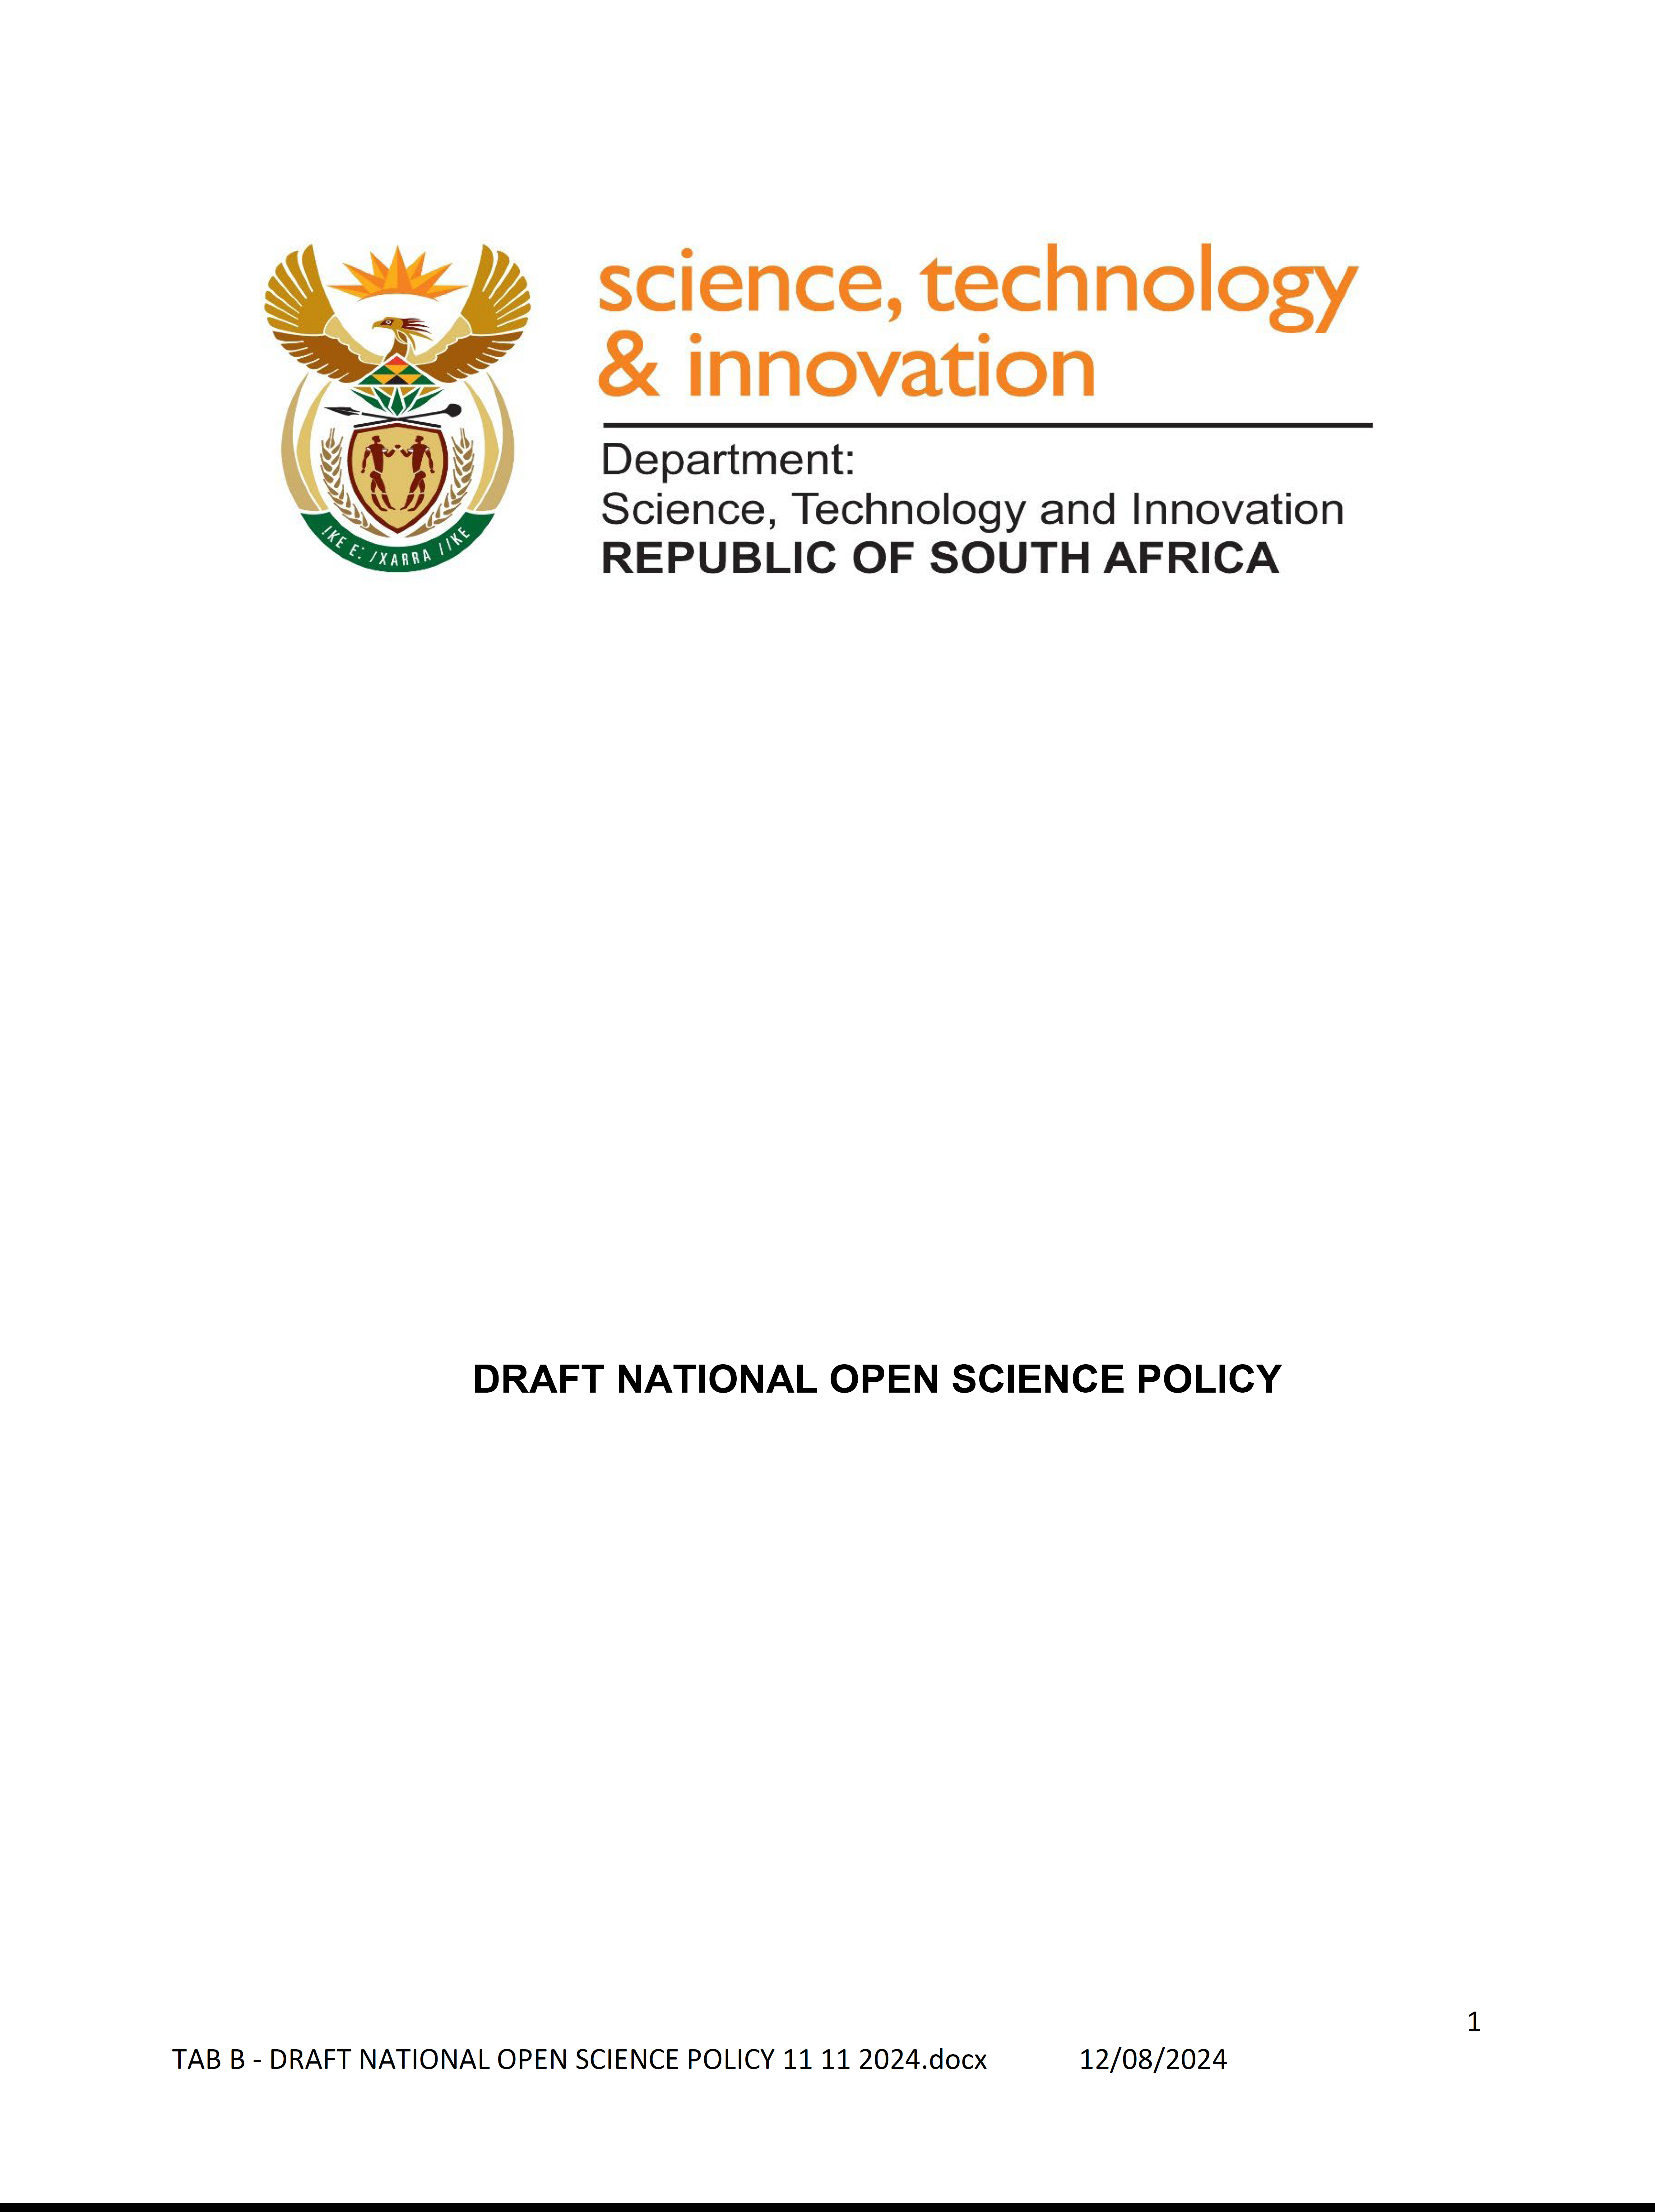
DECISIONS
✓DSI Exco submission of Draft 1, accepted 2022
✓ Economic Sectors, Investment, Employment and Infrastructure Development (ESIEID) cluster, accepted 2022

Slide 26
DECISIONS
✓DSI Exco submission of Draft 1, accepted 2022
✓ Economic Sectors, Investment, Employment and Infrastructure Development (ESIEID) cluster, accepted 2022
Submission to Cabinet started 2022
Restarted 2024…

