Slide 1
Framework for Publisher Contracts… (and much more).
Courtney Crummett
Massachusetts Institute of Technology Libraries
Thursday Feb 20 2025
CERN-UNESCO-NRF Open Science School

Slide 2
Today’s plan:
~Presentation~
MIT and MIT Libraries
MIT Libraries Negotiation Team
Principled Negotiations
MIT Framework for Publisher Contracts
~Break~
2 Case studies
~Activity~
Negotiations Planning Document
Sharing outcomes

Slide 3
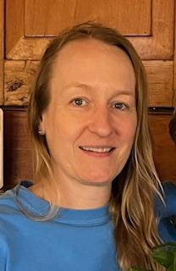
Courtney Crummett
Collection Strategist for Science and Engineering in the Scholarly Communications and Collection Strategy department
MIT Libraries Negotiation team lead negotiator
17 years at MIT, current role for 4 years
Previously Biosciences Liaison
On negotiation team for 7 years

Slide 4
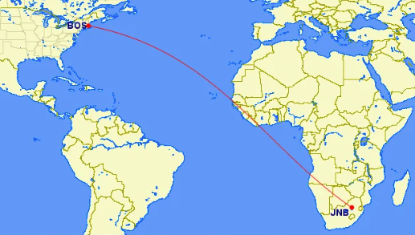

Slide 5
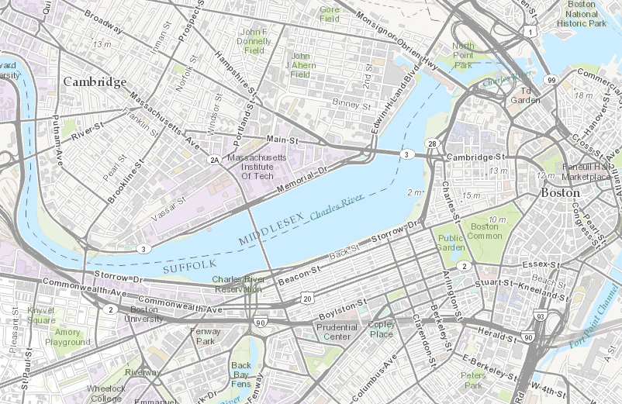

Slide 6
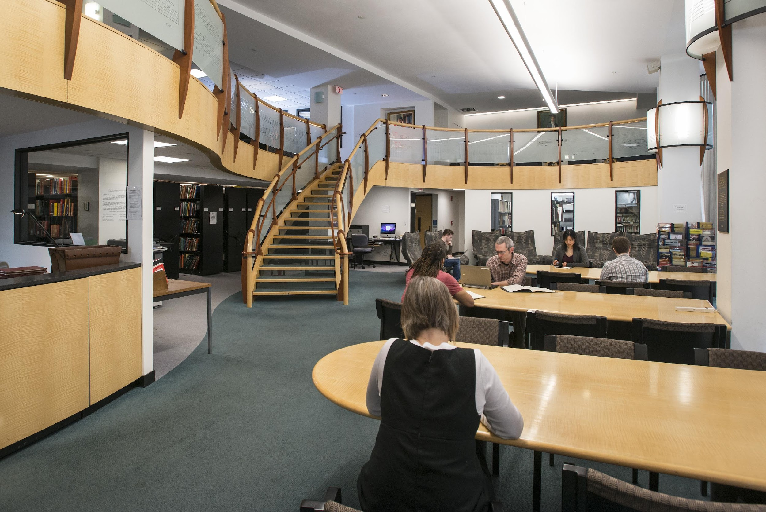
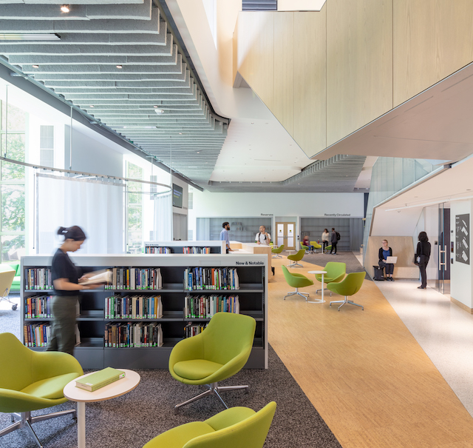
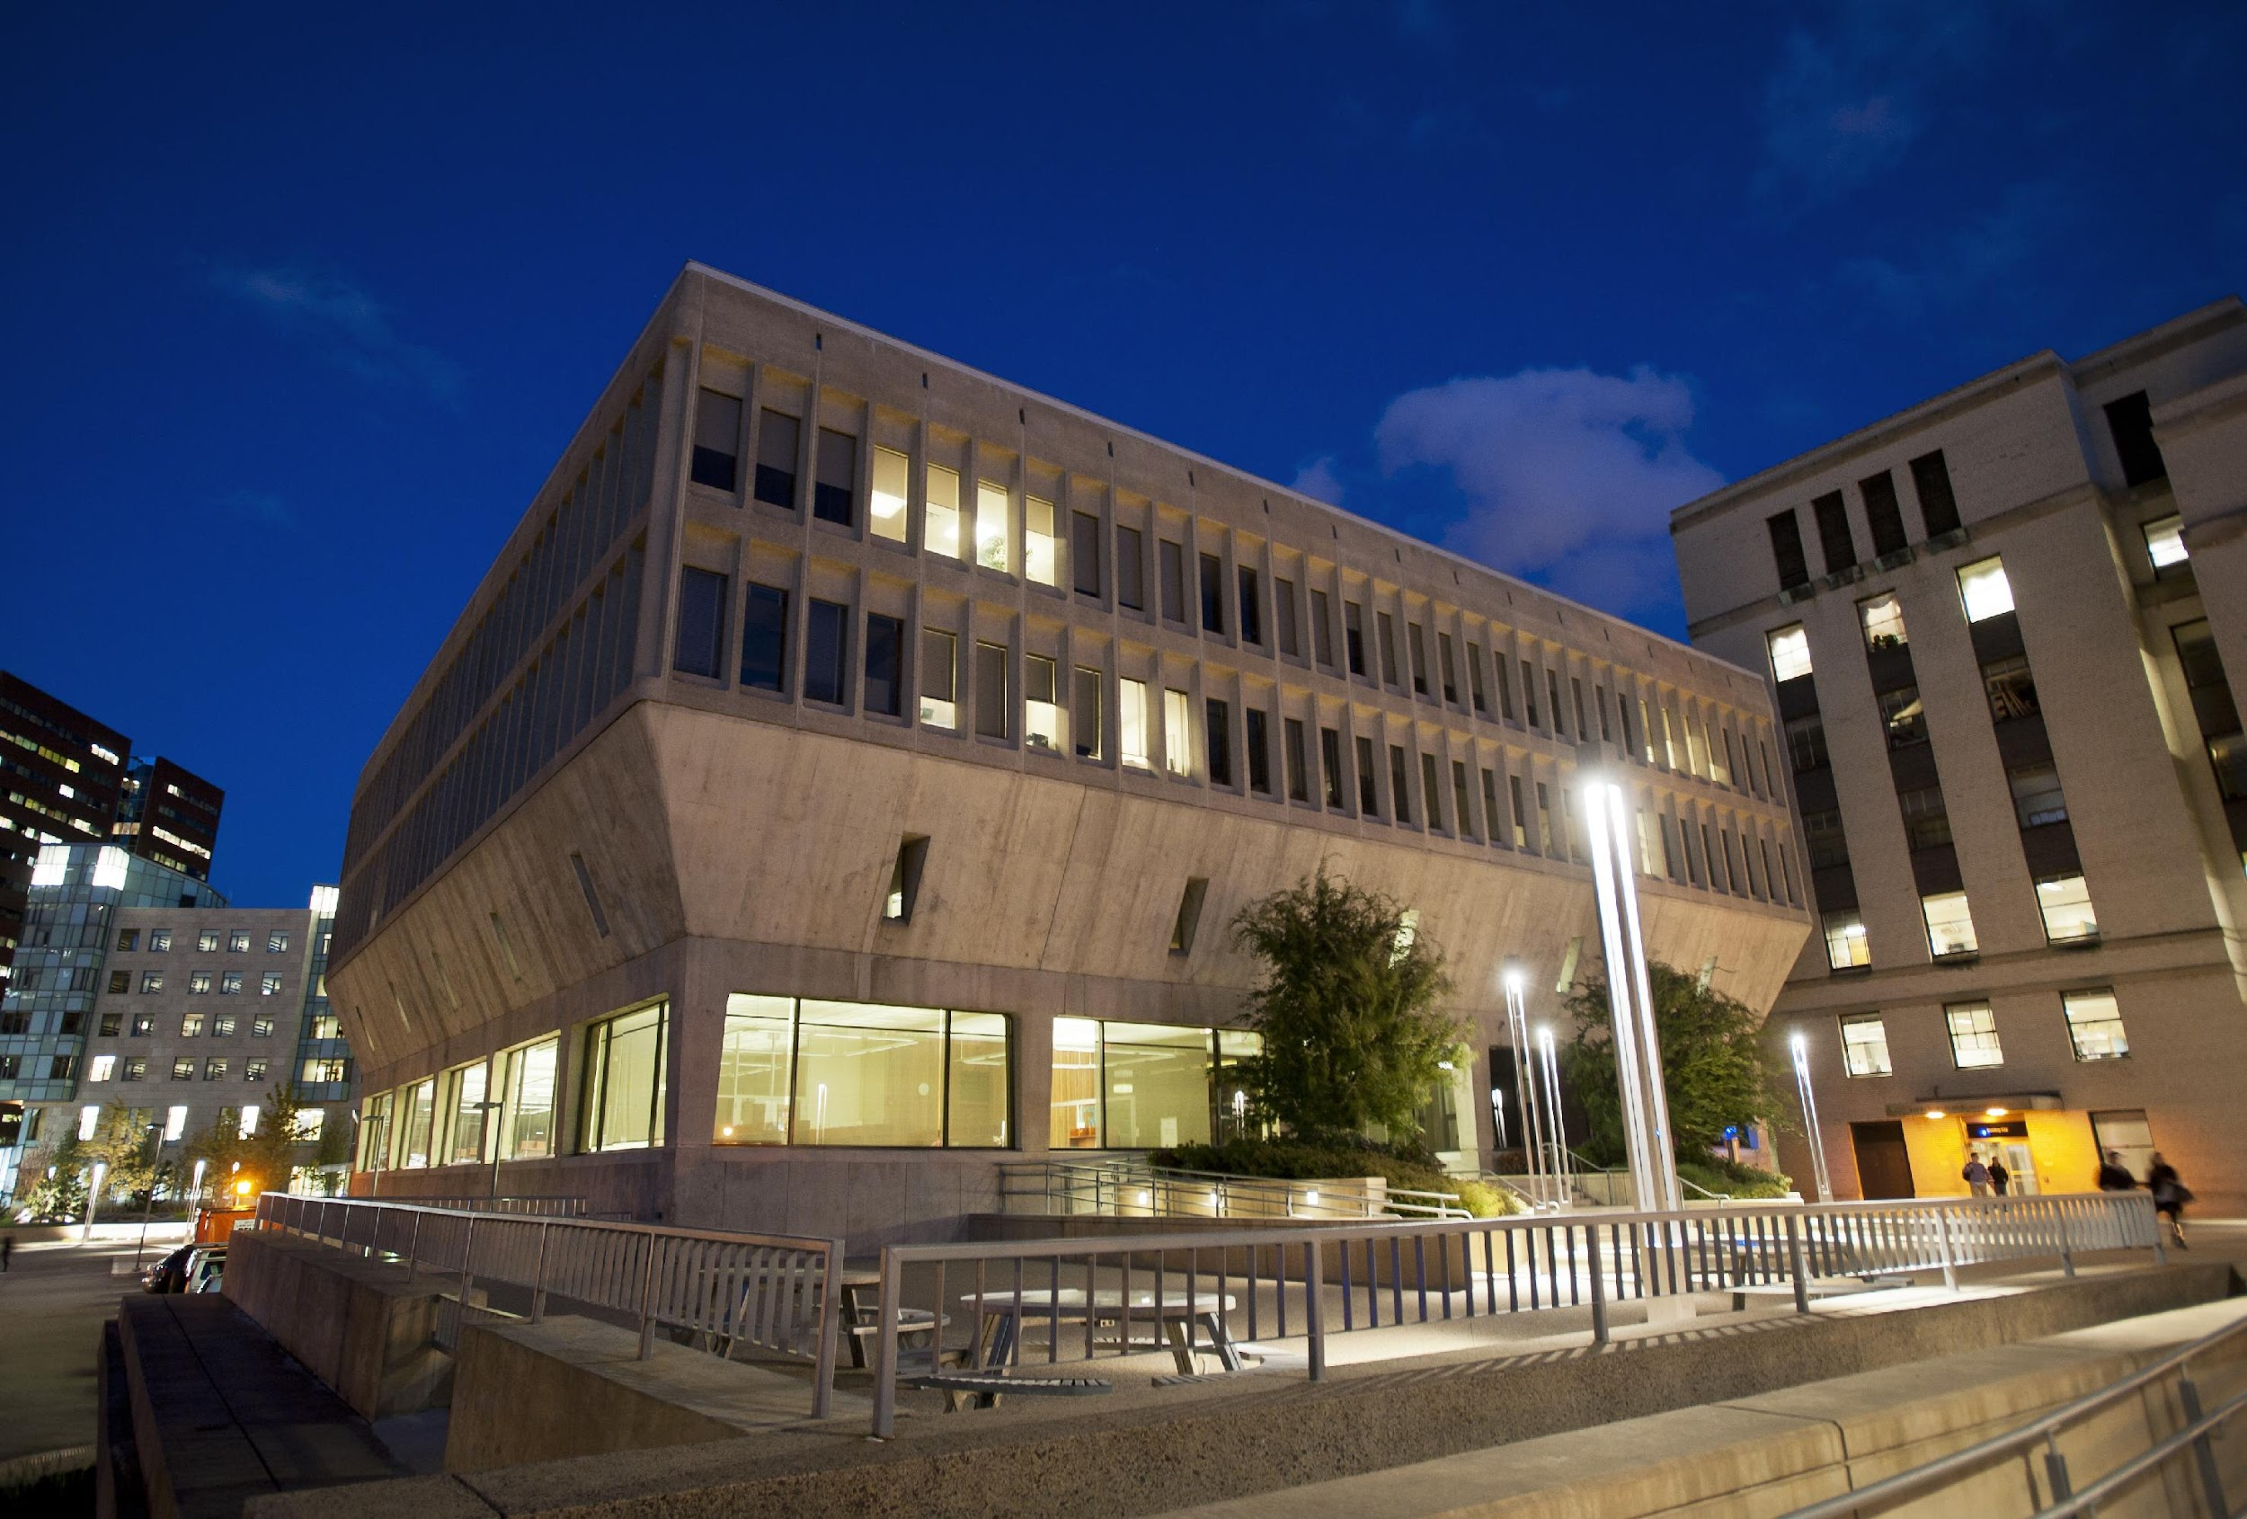
MIT Libraries

Slide 7
Openness at MIT has a long history
MIT OpenCourseWare 2001
First Open Access Policy in US 2009
60% of MIT authored papers open
MIT theses and dissertation open by default
Relentless pursuit of more open and equitable scholarly landscape

Slide 8
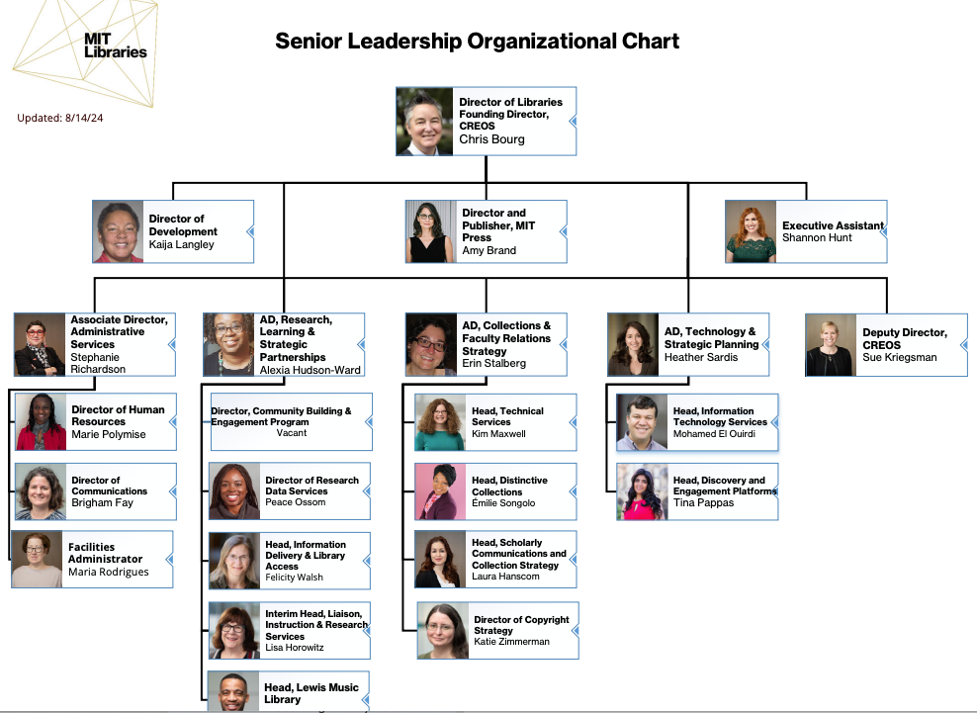

Slide 9

FROM TO
Scholarly Communications Program and the Collections Budget working independently
Collection Budgets placed underneath the Scholarly Communications Program
New Name: Scholarly Communications & Collections Strategy Department

Slide 10

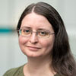

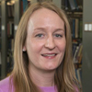
Negotiations Team Members
Laura Hanscom
Department Head of Scholarly Communications and Collection Strategy
Katie Zimmerman
Director of Copyright Strategy
Kim Maxwell
Department Head of Technical Services
Courtney Crummett
Collection Strategist for Science & Engineering

Slide 11


Principled Negotiation Methods
It is a technique designed to meet the needs of both sides as much as possible, quickly, while maintaining or improving relationships.
Principled negotiations focuses on basic interests, mutually satisfying options, and fair standards.

Slide 12
Principled Negotiation Methods
4 points to a Principled Negotiation:
People: Separate the people from the problem
Interests: Focus on the interests, not positions
Options: Invent multiple options looking for mutual gains
Criteria: Use objective standards

Slide 13
How do we do principled negotiations?
People: Separate the people from the problem
We make and manifest the commitment to do this
Interests: Focus on the interests, not positions
We express our interest, values, and aims
(via the Framework for Publisher Contracts)

Slide 14
Options: Invent multiple options looking for mutual gains before deciding what to do. (Via the negotiations planning document)
We explain that we are open to options and experimentation
Criteria: Refer to standards and guidelines
COUNTER statistics
IASTM Publisher guidelines for reuse of figures and text

Slide 15
Questions?

Slide 16
What are our principles?
MIT Framework for Publisher Contracts
Established in 2019
Written by faculty, students, post docs
Direct result of MIT-wide task force on open access to MIT’s research.
Publisher contracts are a main tool that Libraries can use to advance openness
Endorsed by over 200 libraries, organizations, and consortia
6 elements aimed to transform scholarly communications

Slide 17
No author will be required to waive any institutional or funder open access policy to publish in any of the publisher’s journals.
The MIT Open Access Policy that was established by the Faculty in 2009 means that MIT authors can post their author manuscripts in our Open Access Repository, DSpace@MIT. If a publisher requires MIT authors to waive this policy (or any other similar policy) they are not in alignment with this principle.
As you are thinking about what your own principles are, this might not be relevant if you don’t have an open access policy. This IS relevant if your authors are funded by agencies with open access requirements.
Framework

Slide 18
No author will be required to relinquish copyright, but instead will be provided with options that enable publication while also providing authors with generous reuse rights.
MIT Authors should retain their rights over their scholarly work. We want our authors to be presented with non exclusive publisher agreements as opposed to agreements that transfer copyright from the author to the publisher.
Framework

Slide 19
Publishers will directly deposit scholarly articles in institutional repositories immediately upon publication or will provide tools/mechanisms that facilitate immediate deposit.
When the faculty established the open access policy, the Libraries were charged with implementation. We do that through populating and maintaining our Open Access Repository, DSpace@MIT. To remove the burden of deposit for authors, we want publishers to deposit the manuscripts into DSpace@MIT automatically. We refer to this as “autodeposit.”
Again, if your institution doesn’t have an open access policy, this may be less relevant and not a principle that would be useful.
Framework

Slide 20
Publishers will provide computational access to subscribed content as a standard part of all contracts, with no restrictions on non-consumptive, computational analysis of the corpus of subscribed content.
Computational access to our collections is part of our Libraries’ mission and we aim to enable ways for researchers to analyze the scholarly literature we are paying for which is an amount that is beyond what the human eye can read.
Framework

Slide 21
Publishers will ensure the long-term digital preservation and accessibility of their content through participation in trusted digital archives.
This is usually the easiest element for publishers to align with as digital preservation is a standard practice through CLOCKSS, Portico, and other platforms.
Framework

Slide 22
Institutions will pay a fair and sustainable price to publishers for value-added services, based on transparent and cost-based pricing models.
We are asking publishers to share details of what we are paying for and how the cost of those services and infrastructure are determined. As we work to transform scholarly communication, we want to ensure that instead of paying a price that the publisher thinks the market will bear, we instead pay a price that reflects the costs of doing business, with specific pricing for services that add value to the publishing process. Publishers provide valuable services (e.g. editorial oversight, curation, and coordination of the submission and peer review processes), for which we want to pay a fair and sustainable price.
Framework

Slide 23
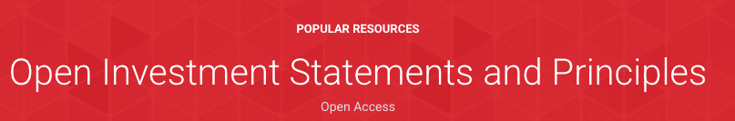

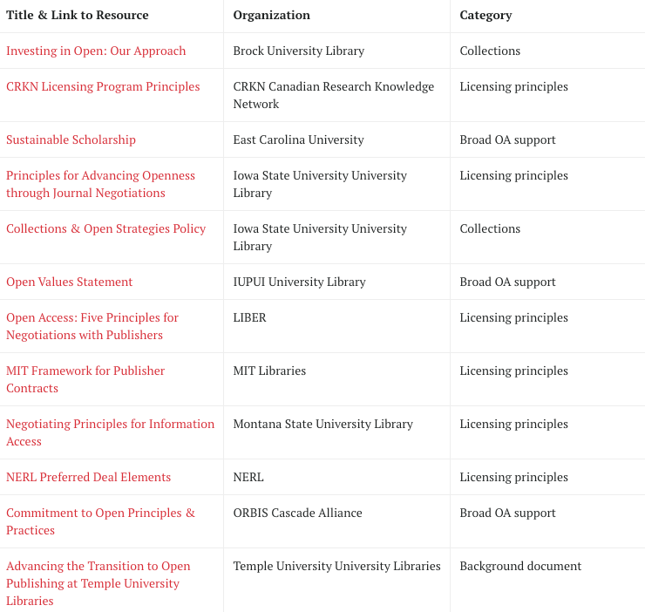
What are examples of other principles?

Slide 24

What about consortiums?
NERL has “NERL demands a better deal” principles.
Staff from member libraries work on teams to negotiate consortium level deals.

Slide 25
Questions?

Slide 26
Let’s break for 10 minutes

Slide 27
The MIT Libraries Negotiation Team uses principled based negotiation techniques using the Framework for Publisher Contracts to push the landscape of scholarly communication towards more openness….
But how do we actually do that work? What does it look like day to day?

Slide 28
Weekly meetings
Internal wikis logging all communication and summary of current agreement
Negotiation planning template
Establish meeting schedules for publisher check-ins and negotiations
15 minute meetings before after each publisher meeting for prep and debrief

Slide 29
Internal Wiki
Summary: Length of agreement Cost with increases Details of the agreement such as gold/hybrid, number of articles included, etc Major accomplishments Framework alignment with new agreement List of future work to tackle over the course of agreement or during next renewal Link to license
Date | Communication
Communications are posted in reverse chronological order so we know what happened most recently | We post every email communication
Wiki can be searched by date and text | The wiki allows us to post attachments such as proposals, publication data and more.

Slide 30
Negotiation planning template
Generates the options in principled based negotiations. Brainstorming, strategizing, and organization tool that we use to plan our negotiations.
The template helps to identify interests, priorities and alternatives of you and the other party. Among those, it helps to identify which are in conflict, shared or tradable.
SPOILER ALERT: we will use the template later today in a group activity

Slide 31
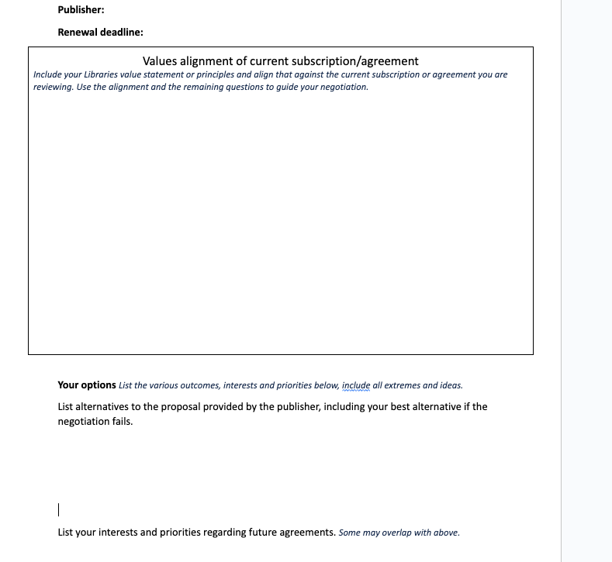
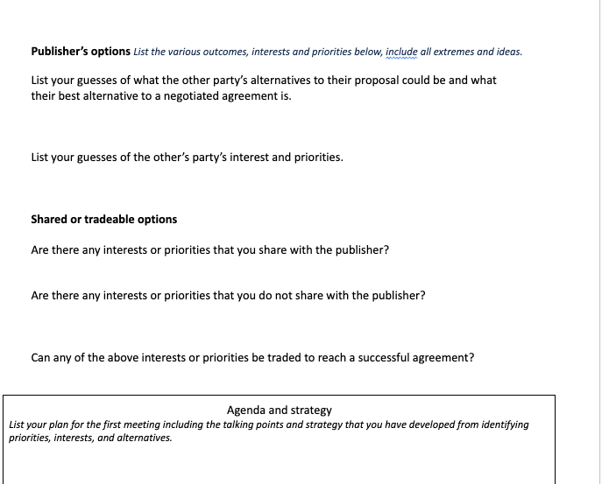

Slide 32
Closing thoughts...
We are a very tight team and that is really rewarding to be a part of.
The work has a tangible impact
It’s hard to herd cats (publisher/vendor)
Principled negotiation methods deliver results
Having established principles (The Framework) is an advantage
We are building strong relationships with publishers

Slide 33
Questions?

Slide 34


Case studies

Slide 35
Sage Publications Case Study
MIT Libraries subscribed Title by Title (TbT), no packages, no OA.
Our title subscriptions were interdisciplinary, but less in science and engineering.
MIT authors published less in Sage when compared to similar publishers
We were attracted because Sage is a charitable Trust and cannot be sold (to a commercial)
Sage also publishes a S2O journal and we thought there might be room to experiment in that area with them.

Slide 36
Sage Negotiations Planning Template

Slide 37
Sage Negotiation Outcome
3 year Read & Publish agreement (2024-2026)
Increased read access from TbT to all Sage journals
MIT authors can publish hybrid OA at no cost to them
No article cap on hybrid OA articles
Commitment to autodeposit articles under agreement
Price increase to get into R&P was under 5%
Added computational access language to contract
Agreement included an investment in Sage S2O journal focused on climate change.

Slide 38
Sage progress toward alignment with Framework for Publisher Contracts
No author will be required to waive any institutional or funder open access policy to publish in any of the publisher’s journals.
  Yes, no waiver
No author will be required to relinquish copyright, but instead will be provided with options that enable publication while also providing authors with generous reuse rights.
  Yes, with some exceptions (information here)
Publishers will directly deposit scholarly articles in institutional repositories immediately upon publication or will provide tools/mechanisms that facilitate immediate deposit.
  Yes, autodeposit is included in this agreement. Currently, due to technical constraints, it is limited to articles made OA under this agreement, and we hope to expand that in the future
Publishers will provide computational access to subscribed content as a standard part of all contracts, with no restrictions on non-consumptive, computational analysis of the corpus of subscribed content.
  Yes, we added a text mining clause to our license for the first time for Sage content
Publishers will ensure the long-term digital preservation and accessibility of their content through participation in trusted digital archives.
  Yes, via Portico
Institutions will pay a fair and sustainable price to publishers for value-added services, based on transparent and cost-based pricing models.
  Partially; R&P pricing was based on historical spend and Carnegie tier. There was high transparency in the R&P, and it is not APC-based, but it’s also not strongly cost-based.The S2O experiment is highly cost-based and transparent.

Slide 39
Questions?

Slide 40
Elsevier Case Study
MIT Libraries subscribed Title by Title (TbT), no packages, no OA
Our Elsevier subscription was a large portion of our subscription costs
Subscription titles were interdisciplinary, heavy on science and engineering.
MIT authors publish a lot in Elsevier
Elsevier does require authors to sign waivers for institutional policies

Slide 41
Elsevier Negotiations Planning Document

Slide 42
Elsevier Negotiation Outcome
We have been out of contract since 2020
We have perpetual access to our previous subscriptions
We are paying for per article service using Reprints Desk to fulfill requests for content we previously subscribed to from 2020 forward
  92% of articles are arriving in less than a minute
This pay per articles service is costing 10% of the original subscription contract from 2020

Slide 43
Questions?

Slide 44
Small group activity:
Break out into small groups
Review the scenario on the next slide
Use the blank negotiation planning template to strategize your negotiations for the following scenario
Use principles that make the most sense to you–you can use the Framework, your Library’s mission statement, or pick from the Sparc List.
We will regather in 25 minutes to share out.
No wrong answers!

Slide 45
Small group activity: Use the blank negotiation planning template to strategize your negotiations for the following scenario:
You have a title by title subscription with a mid to large sized commercial publisher, your subscription includes some titles but not all, and the subjects are interdisciplinary.
The Publisher has provided a proposal with an OA publication component that enables your authors to publish OA articles in hybrid journals at no cost to them.The OA proposal provided is a 10% increase from your subscription cost.
See you in ~25 minutes.

Slide 46
Web links and image credits
Campus Map: https://whereis.mit.edu/
MIT Facts: https://facts.mit.edu/
MIT OpenCourseWare: https://ocw.mit.edu/about/
Image credit: MIT Libraries Staff Directory
Image credit: Umbrella Dollar Sign
Harvard Program on Negotiation: https://www.pon.harvard.edu/
MIT Libraries Framework for Publisher Contracts: https://libraries.mit.edu/scholarly/publishing/framework/
Institute-wide task force on open access to MIT’s research:https://open-access.mit.edu/
MIT OA Policy https://libraries.mit.edu/scholarly/mit-open-access/open-access-policy/
MIT Repository https://dspace.mit.edu/handle/1721.1/49433
CLOCKSS https://clockss.org/
Portico: https://www.portico.org/
Sparc’s list of Open Investments Statements and Principles https://sparcopen.org/our-work/negotiation-resources/strategic-priorities-working-group/open-investment-statements-and-principles/
NERL https://nerl.org/working-with-nerl/
Blank negotiations planning template https://docs.google.com/document/d/1kfg_bZgjgFvJZc06cc0Q5C3mSNLELkSpy6jOEgdGaXo/edit?usp=sharing

