Slide 1


DRD2 - WP4: Scaling-up challenges
Task 4.2: Detector & target procurement/production & purification
Summary talk
2025-02-13 – CM @ CERN (11-13 Feb)
Minfang Yeh (BNL) - Mauro Caravati (GSSI)

Slide 2
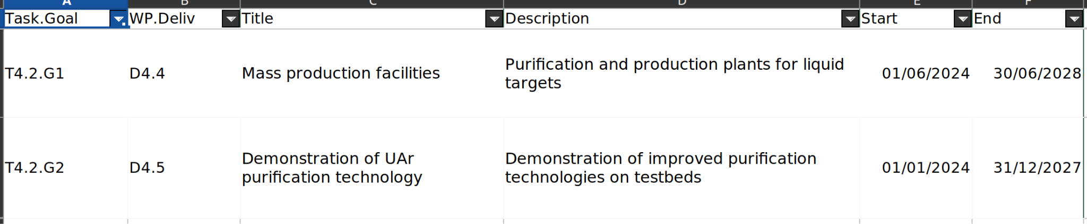
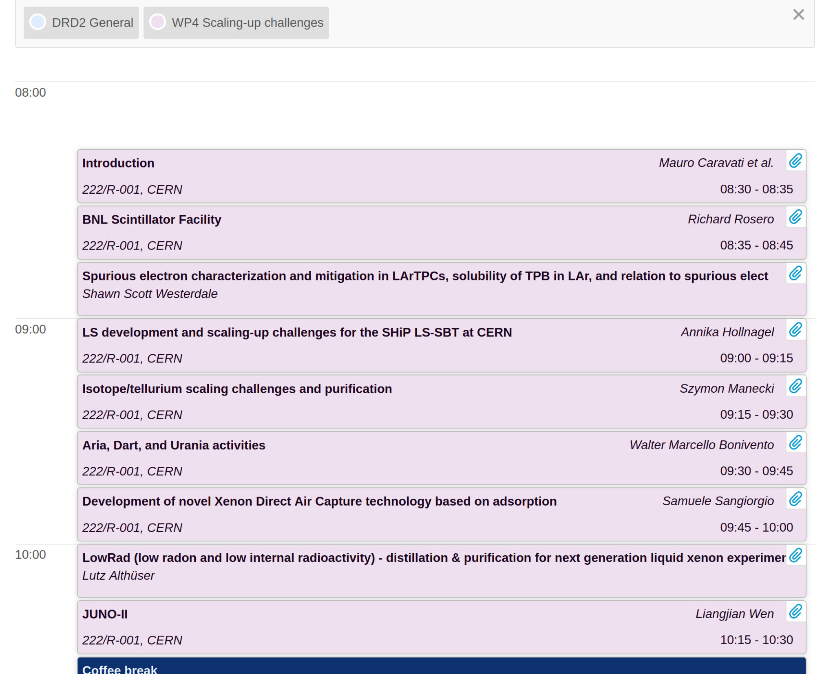
WP4 - T4.2 - Timetable (13th Feb - 2 hours)

Slide 3
-) The Task has some coherence: summary to show how the activities are happening and how they may relate together
-) There are common grounds in requirement of scale-up purification and production for multiple physics frontiers.
-) Available expertise, test-stand, and facility among participating institutes presented in the meeting.
-) Facilitate connections between institutes and collaborative projects
-) Identify overlap with other DRDs, WPs, and RDCs (US-CPAD).

Slide 4
-) Plans
-) Bi-monthly meeting
-) Community workshop in 2025 (TBD)
-) Joint meeting with T3.1, DRD6, and RDC 1, 2 and 9 (TBD)
-) formulate a collaborative proposal (or joint with other WPs) toward the deliverables

Slide 5
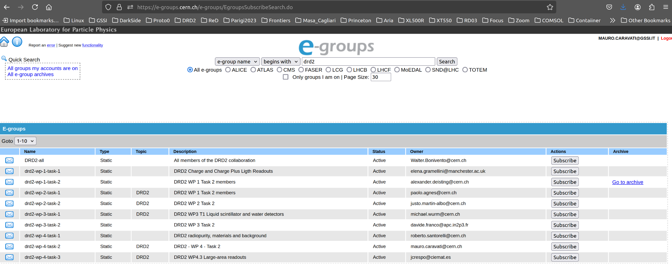
Mailing list → we now have our T4.2 mailing list
Please subscribe
https://e-groups.cern.ch/e-groups/EgroupsSubscribeSearch.do
(search for drd2 in the form, you’ll get all the drd2 related mailing lists)

