Slide 1
Welcome to WP1 T2
(Charge-to-light, electroluminescence and amplification)
DRD2 collaboration meeting at CERN (11-13 Feb. ‘25)
Alexander Deisting (JGU Mainz)
Kostas Mavrokoridis (University of Liverpool)
alexander.deisting@cern.ch, k.mavrokoridis@liverpool.ac.uk

Slide 2
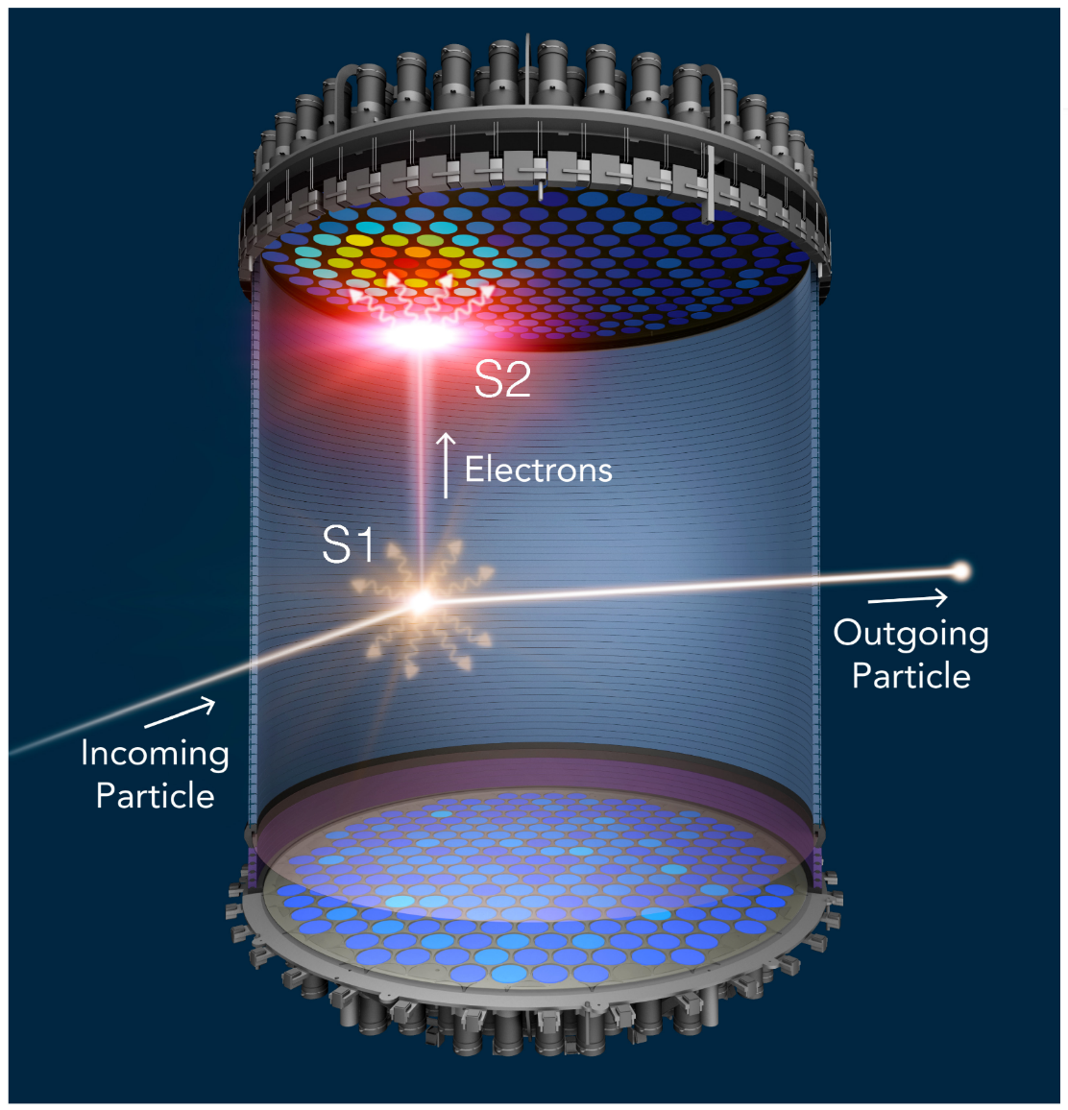
Introduction to work package 1, task 2:
R&D on technologies to amplify the charge signal in
liquid noble time projection chambers (TPCs)
  S2 light signal in dual-phase Ar and Xe TPC
  Charge amplification in LAr TPCs
  Novel microstructures for light production
Development of highly granular light readout using
SiPMs and TimePix (3 and 4)
Model charge transport in liquid nobles, and simulate the response of SiPMs and PMTs to neutron interactions in the liquid
Show how these technologies are scalable

Slide 3
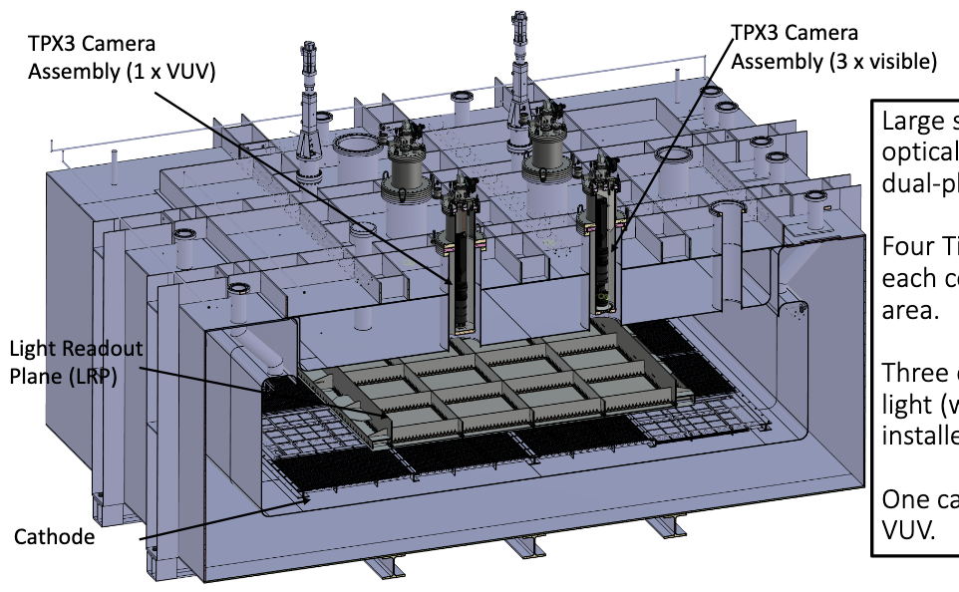
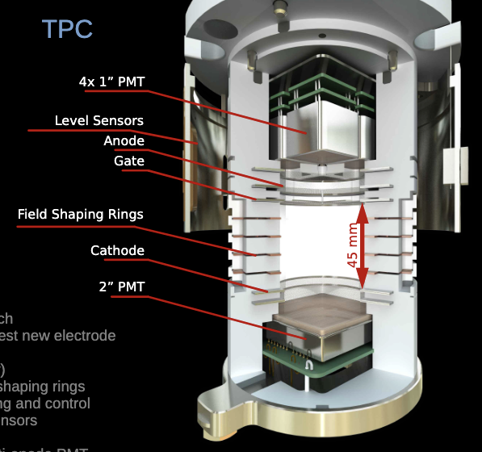
Technologically diverse task
Dark matter, neutrino physics, liquid noble phenomenology
Readout plane size of prototypes: From cm² to m²
LAr & LXe
For example:
ARIADNE⁺, Liverpool group
XeLab, LPNHE group

Slide 4
News since the last collaboration meeting
In 2024: Focus mainly on agreeing the content of the MoU for T1.2:
Meeting in September to discuss with PIs
Virtual MoU meeting of the whole collaboration in October: Final definition of the goals of our task (→ next slides, also: https://indico.cern.ch/event/1466284/)
After: The actual fun part has started: R&D and science
First online meeting to discuss progress in the various groups
(→ https://indico.cern.ch/event/1499469/)
Regular slot to be defined by the end of this meeting

Slide 5
Organizational matters
Task coordinators: Kostas Mavrokoridis (K.Mavrokoridis@liverpool.ac.uk) and Alexander Deisting (alexander.deisting@cern.ch)
Task email list: drd2-wp-1-task-2@cern.ch Please self-subscribe or ask the coordinators to add you and your students
Please fill this poll: https://www.when2meet.com/?28946622-BfzZR (Ignoring the dates, this is just about finding a time across many time zones)
After the CM: Poll on inner cryostats and their capabilities (Size, LAr and/or LXe, etc…)

Slide 6
Last but not least: Institutions joining the task since last CM
Griffith University (Australia); Nathan Garland
James Cook University (Australia); Greg Boyle
Tel Aviv University (Israel); Adi Ashkenazi
Welcome!

Slide 7
Short updates from groups

Slide 8
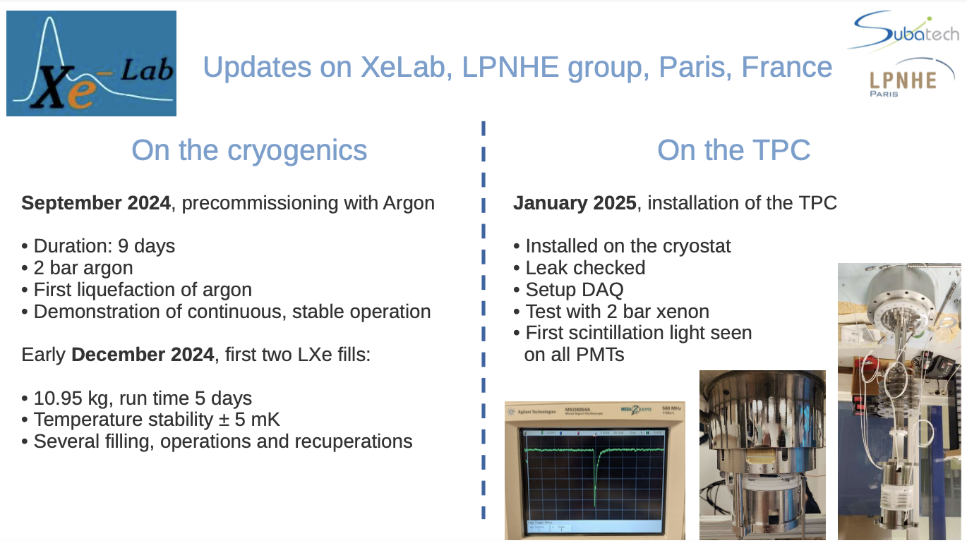

Slide 9
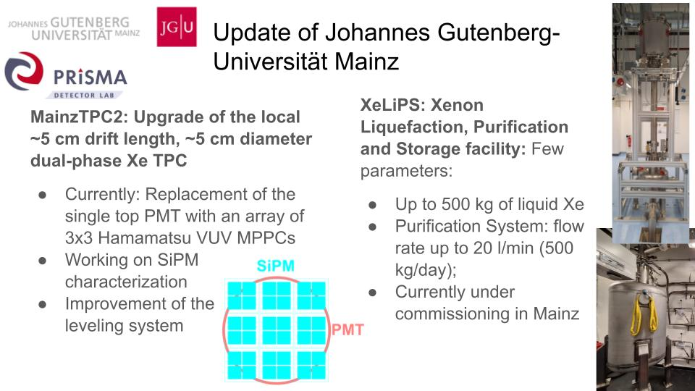

Slide 10
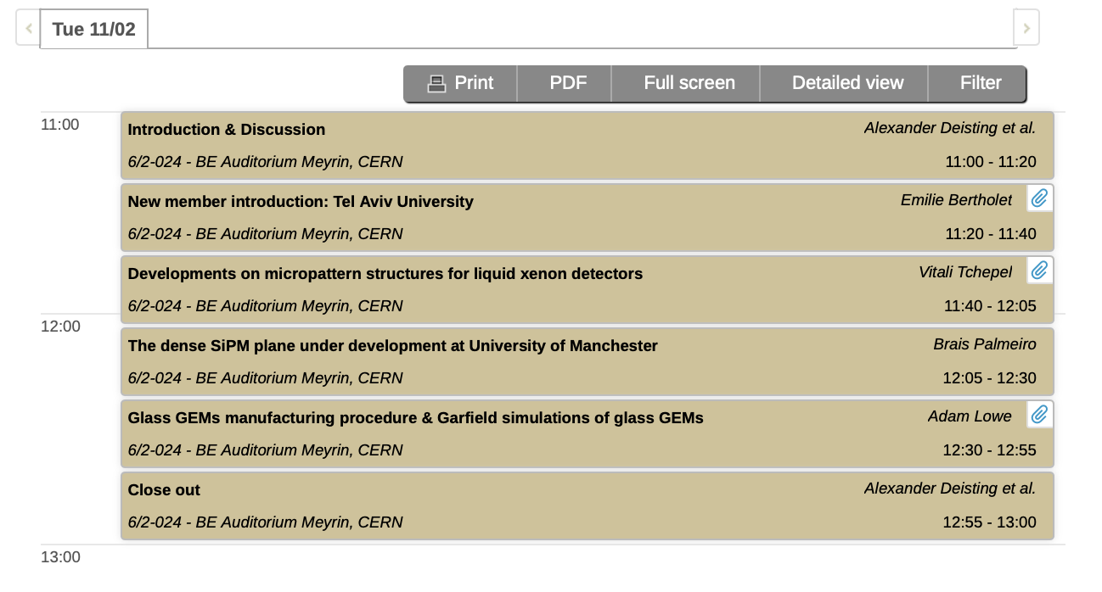
Session Outlook

Slide 11
Backup

Slide 12
G1: Demonstrate camera- and SiPM-based particle tracking
Particle tracking in LAr with SiPMs, and fast TimePix3 / TimePix4 cameras, as well as testing these technologies at scale
Deliverable: A technology demonstrator designed to be scalable

Slide 13
G2: Development of novel devices for charge amplification in single- and dual-phase detectors
Technologically versatile task: R&D on single-phase charge-to-light converting structures (thin wires, micro pattern structures) charge amplification in LAr electrodes for future Ar/Xe dual-phase experiments which are scalable to large-sizes
Deliverable: A two part report: I) on the development of novel electrodes and II) on the scaling-up of electrodes

Slide 14
G3: Theoretical models of electron transport in LAr/LXe, and simulation models of PMT, SIPM pulse shapes
Developments in theory, model, simulation of electron transport in Xe/Ar liquid & dual-phase over broader energy ranges (→ connection to T3.2) and measurement, simulation of PMT/SiPM pulse shape of neutrons in LAr
Deliverable: A report on the development of models as stated above (which could be compared to existing measurements or measurements done within the task)

