Slide 1





Developments on micropattern structures for liquid xenon detectors
Vitaly Chepel
LIP and University of Coimbra
A. Breskin, G. Martinez Lema, A. Roy, V. Solovov, F. Neves
2024.00269.CERN

Slide 2
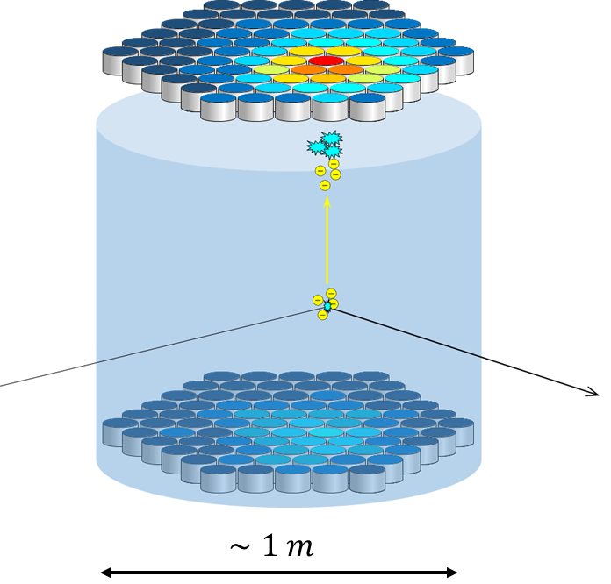
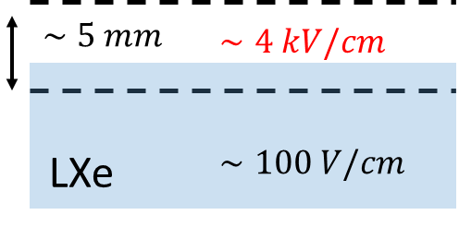
Double-phase liquid noble gas detector
Two-phase liquid detectors are probably the most versatile detectors for low energies and rare events
Typical configuration of a two-phase WIMP detector
WIMP signature
Neutrons (nuclear recoils)
S2
S1
S2
Gammas/electrons
S1
S1
S2
Measurement of the two signals is the basis for e/nuclear recoils discrimination
> 1 m
The threshold is determined by S1 (usually 2 or 3 phe are required in coincidence)
S2 provides energy and position in (x,y) – typically $∼$300 ph/e

Slide 3
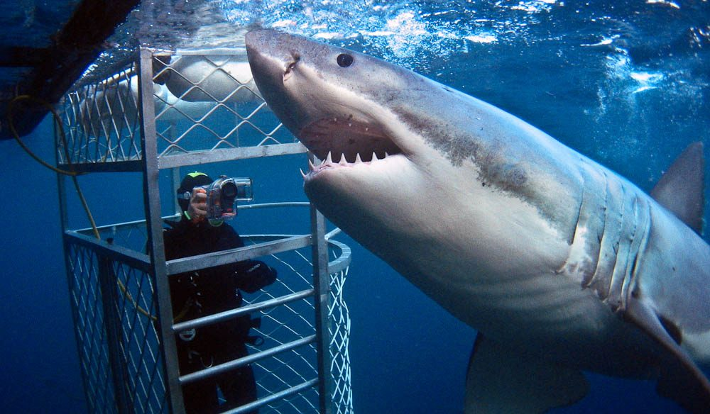

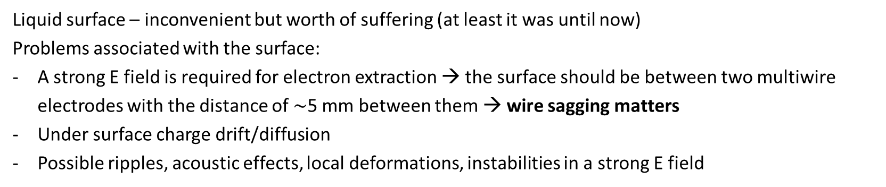
Motivation
Liquid surface – inconvenient but worth of suffering (at least it was until now)
Problems associated with the surface:
A strong E field is required for electron extraction → the surface should be between two multiwire electrodes with the distance of $∼$5 mm between them → wire sagging matters
Under surface charge drift/diffusion
Possible ripples, acoustic effects, local deformations, instabilities in a strong E field
The bigger the detector the bigger the problem
Two options: dive or float
“No surface, no problem” – back to single (liquid) phase
OR
Take the best of it and enjoy
“We are one” – electrodes & surface – floating electrodes

Slide 4
Outline
Double-phase: development of floating electrodes for LXe
Single phase: electroluminescence of LXe (LAr) on narrow strips:
Results with a microstrip plate
Results with a VCC – Virtual Cathode Chamber

Slide 5
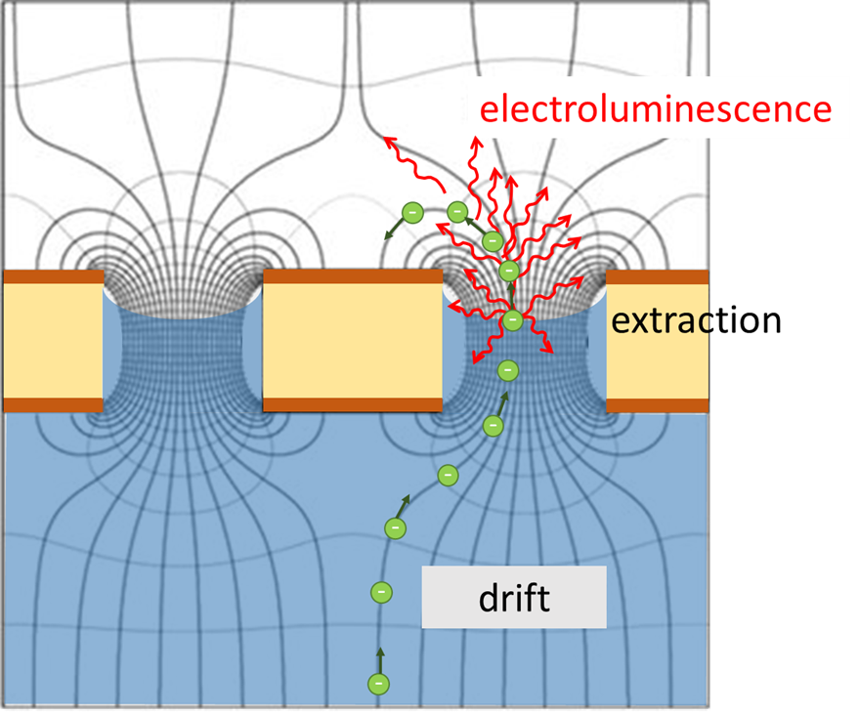
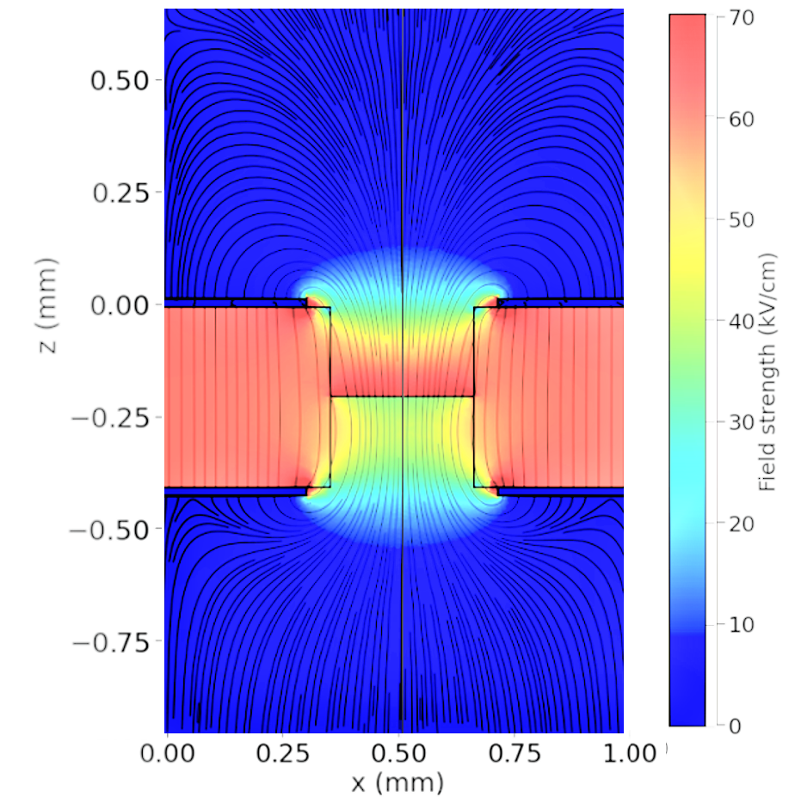
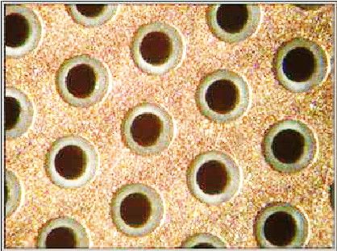


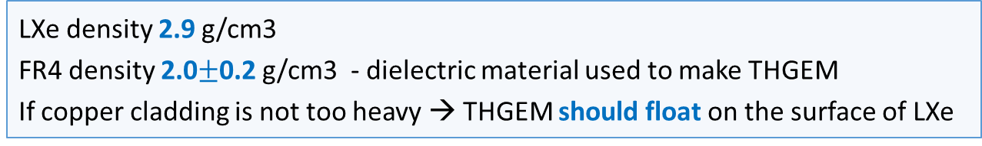

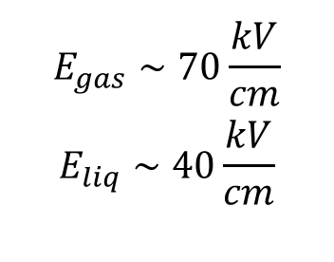
1. Floating electrodes – THGEM
LXe density 2.9 g/cm3
FR4 density 2.0$±$0.2 g/cm3 - dielectric material used to make THGEM
If copper cladding is not too heavy → THGEM should float on the surface of LXe
Field near the LXe surface:
$$E_{gas}∼70\frac{kV}{cm}$$
$$E_{liq}∼40\frac{kV}{cm}$$
THGEM
$$ΔV_{extr}=0$$
$$ΔV_{THGEM}=2500 V$$
$$ΔV_{drift}=400 V$$
FR4
copper
0.4 mm holes
Chepel e.a. JINST 18(2023)P05013

Slide 6
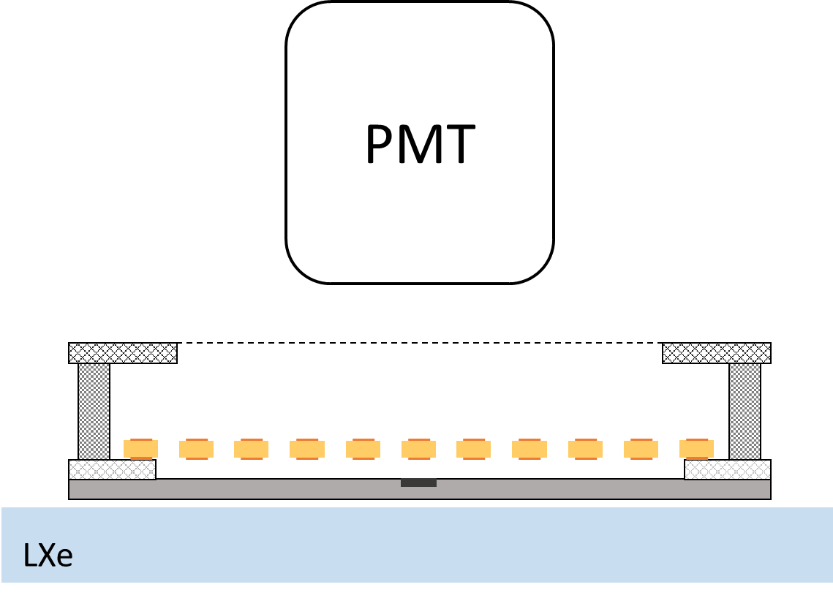
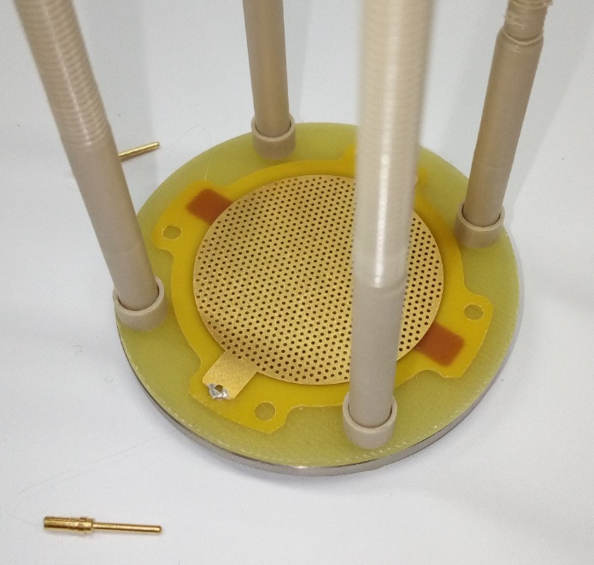
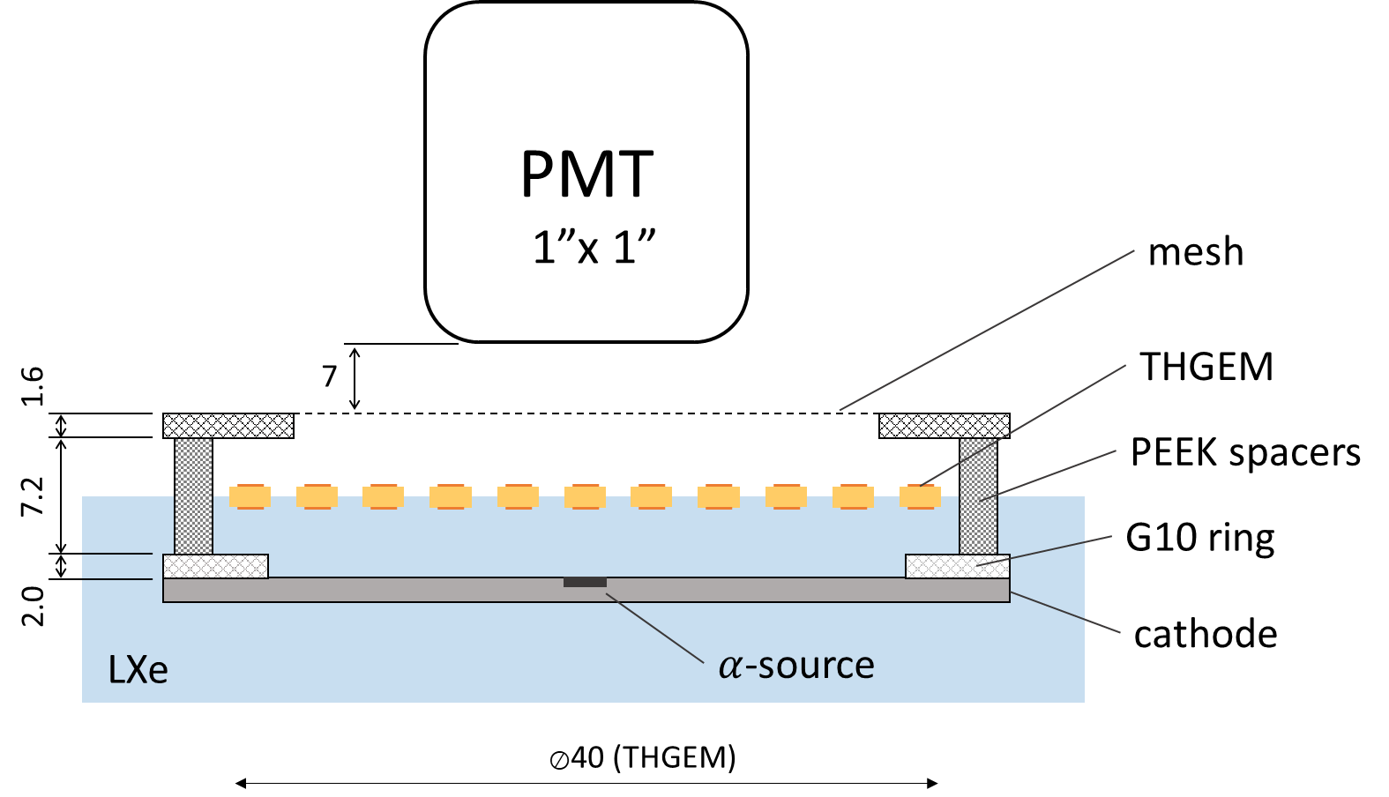
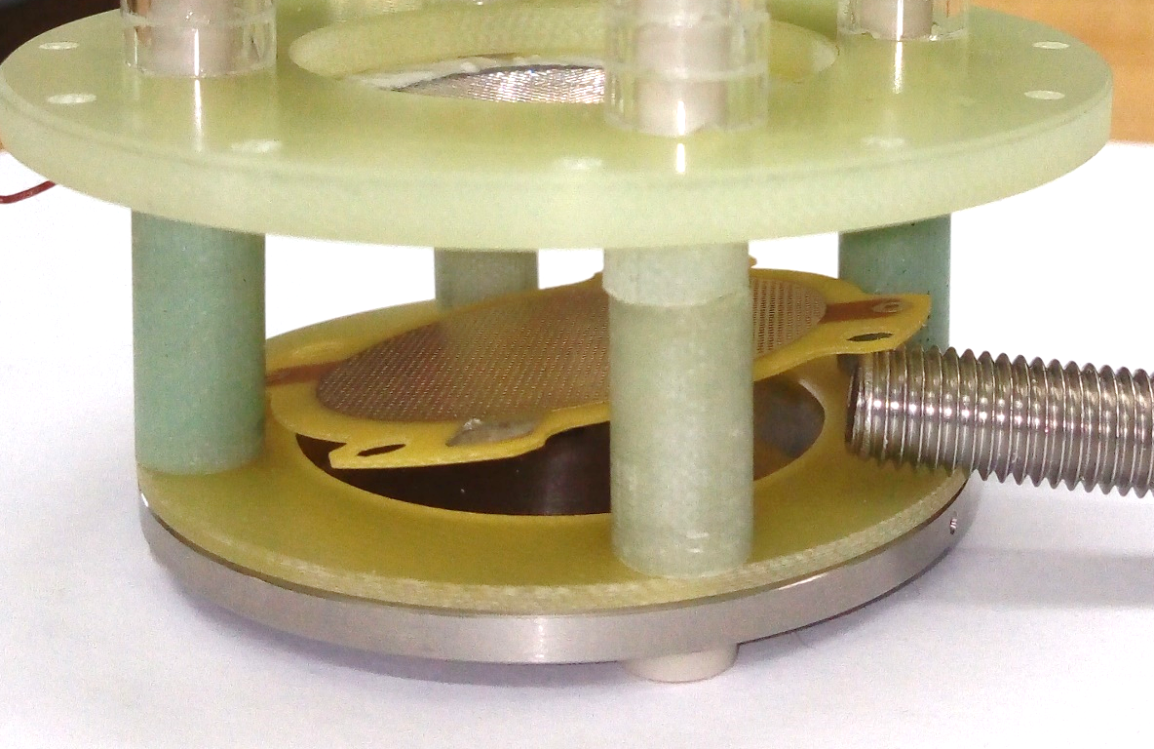
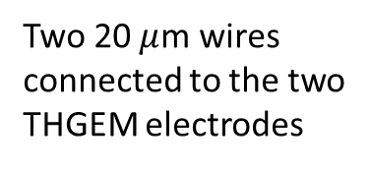


1. Floating THGEM – setup
Experimental setup - schematics
THGEM position with LXe below the cathode
Two 20 $μ$m wires
connected to the two THGEM electrodes
$⊘$34 mm
THGEM:
0.4 mm thick
0.3 mm holes, 0.1 mm rim
1.0 mm pitch
Floating THGEM
$α−$source

Slide 7
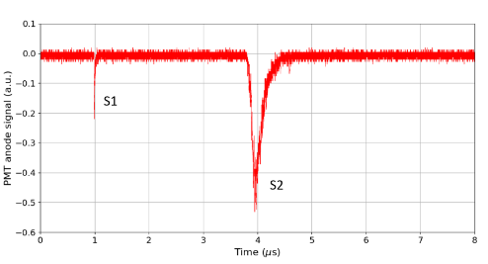
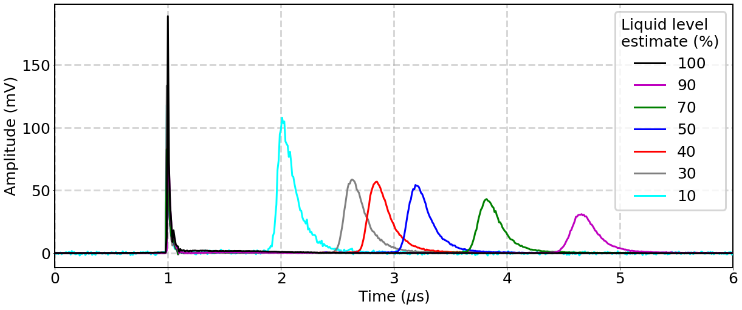
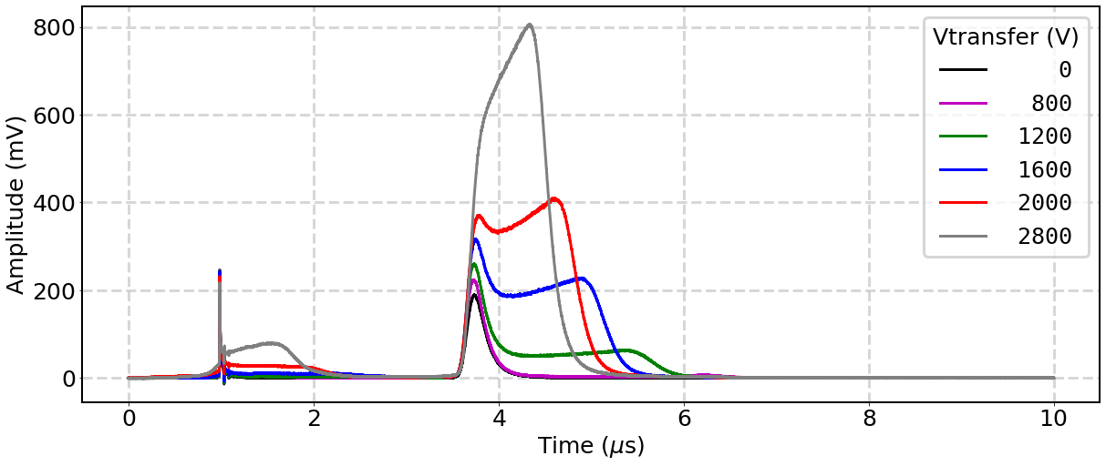
1. Floating THGEM – results
Increase LXe thickness → S2 moves right
S1
S2
No S2 for fully covered THGEM
Increasing extraction field (above THGEM) → electroluminescence in the uniform field shows up
Chepel e.a. JINST 18(2023)P05013

Slide 8
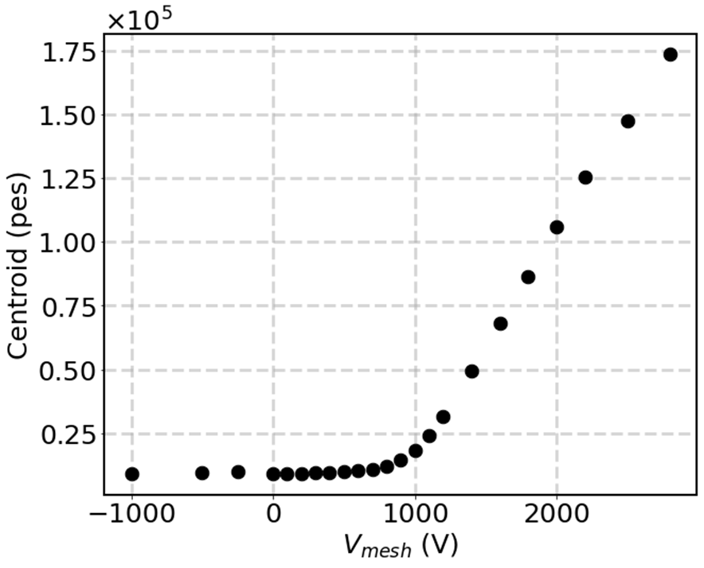
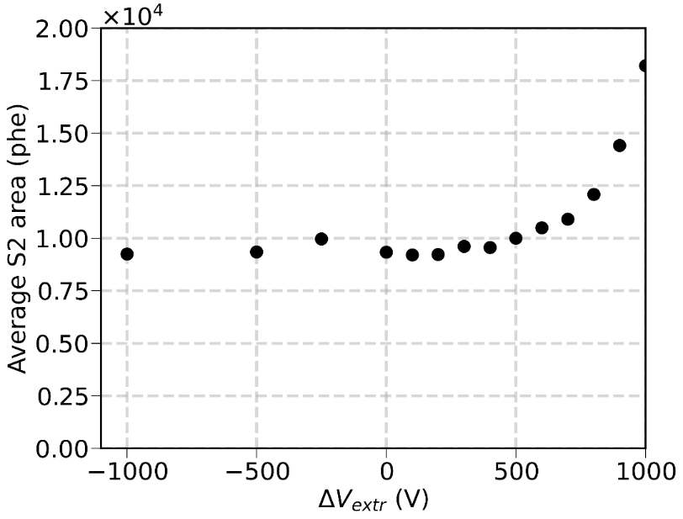
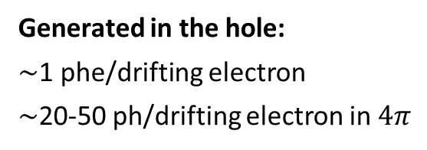
1. Floating THGEM – results
Light in the uniform field
Computation model
Assumed LXe level
Light in THGEM holes
zoom
Generated in the hole:
$\sim$1 phe/drifting electron
$\sim$20-50 ph/drifting electron in $4π$
LXe in the hole: does it really look like this?
(see my talk in WP3.2)
Not very impressive…
V_{mesh}(V)
Chepel e.a. JINST 18(2023)P05013

Slide 9
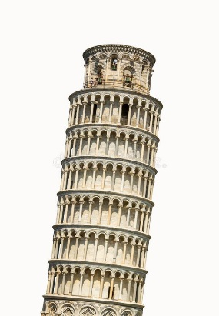

1. Floating multihole electrodes – benefits
Significantly smaller free liquid surface – reduced probability of any kind of surface instabilities (ripples, waves, microexplosions, local deformations, etc.)
Electron drift/diffusion under the surface – eliminated or made local (within the hole pitch)
High electron extraction probability thanks to high field at the interface (unreachable in uniform field)
Positive ion feedback (if any) – likely to end up at the floating electrode
Result – reduced single electron noise
Parallelism between the gate and extraction electrodes – guaranteed for any dimensions
No sagging
No need for fine detector levelling and liquid level control

Slide 10
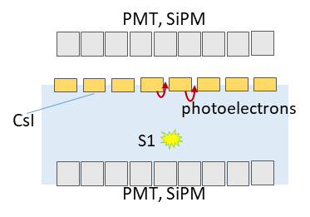
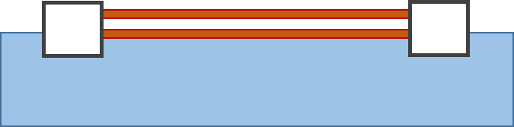
1. Floating electrodes – remaining questions/further work
Prove of principle – successful. Open questions:
Opacity for VUV (S1 problem) – CsI photocathode? Quartz substrate?
Physics – meniscus profile, wettability, field effects, electron transmission efficiency
Structure optimization – thicker THGEM? Bigger holes?
Works in LAr (1.4 g/cm³)?
Some plastics do float in LAr, e.g. polycarbonate (1.2 g/cm³).
The question is whether one can make a THGEM-like electrode from them and put into a cryogenic liquid.
Other possible configurations:
LAr or LXe
(a collaboration with AstroCeNT, Warsaw, is established)
floaters
LAr or LXe

Slide 11
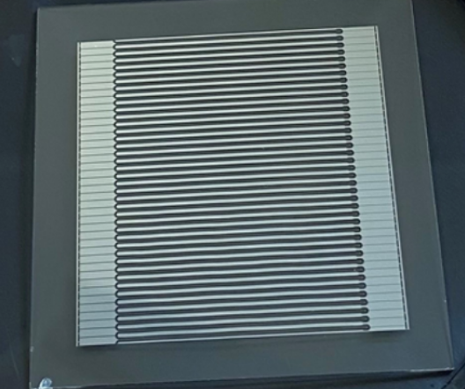
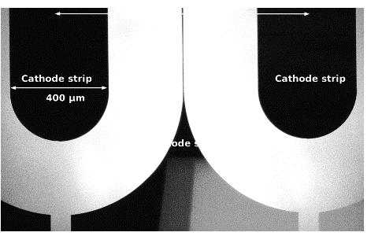
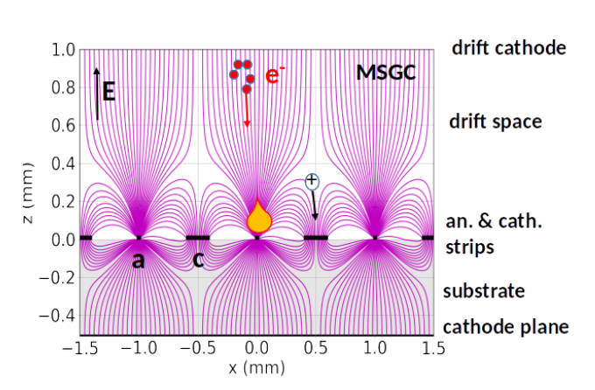
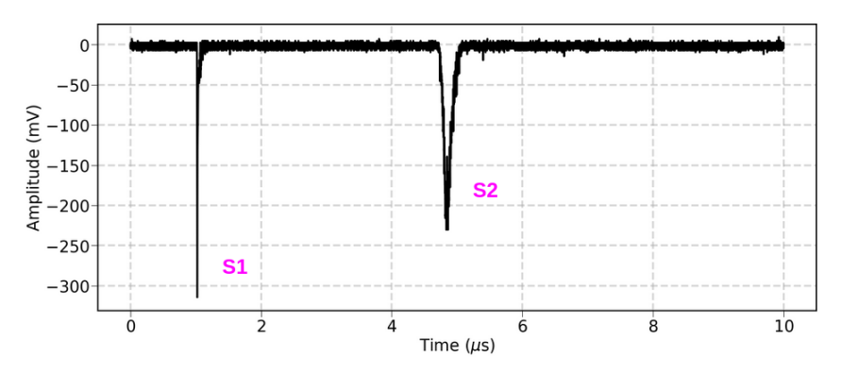




2a. Microstrip plate in LXe (WIS)
1 mm
Cathode 400 $μm$
5x5 cm² D263 Schott glass 0.5 mm thick
(same as we used to observe electron multiplication in LXe back in 1995)
Anode 8 $μm$
$α−$source
$V_{a}$=2000 V
Policarpo e. a. NIMA365(1995)568
microstrips
Martinez-Lema e.a. JINST 19(2024)P02037

Slide 12
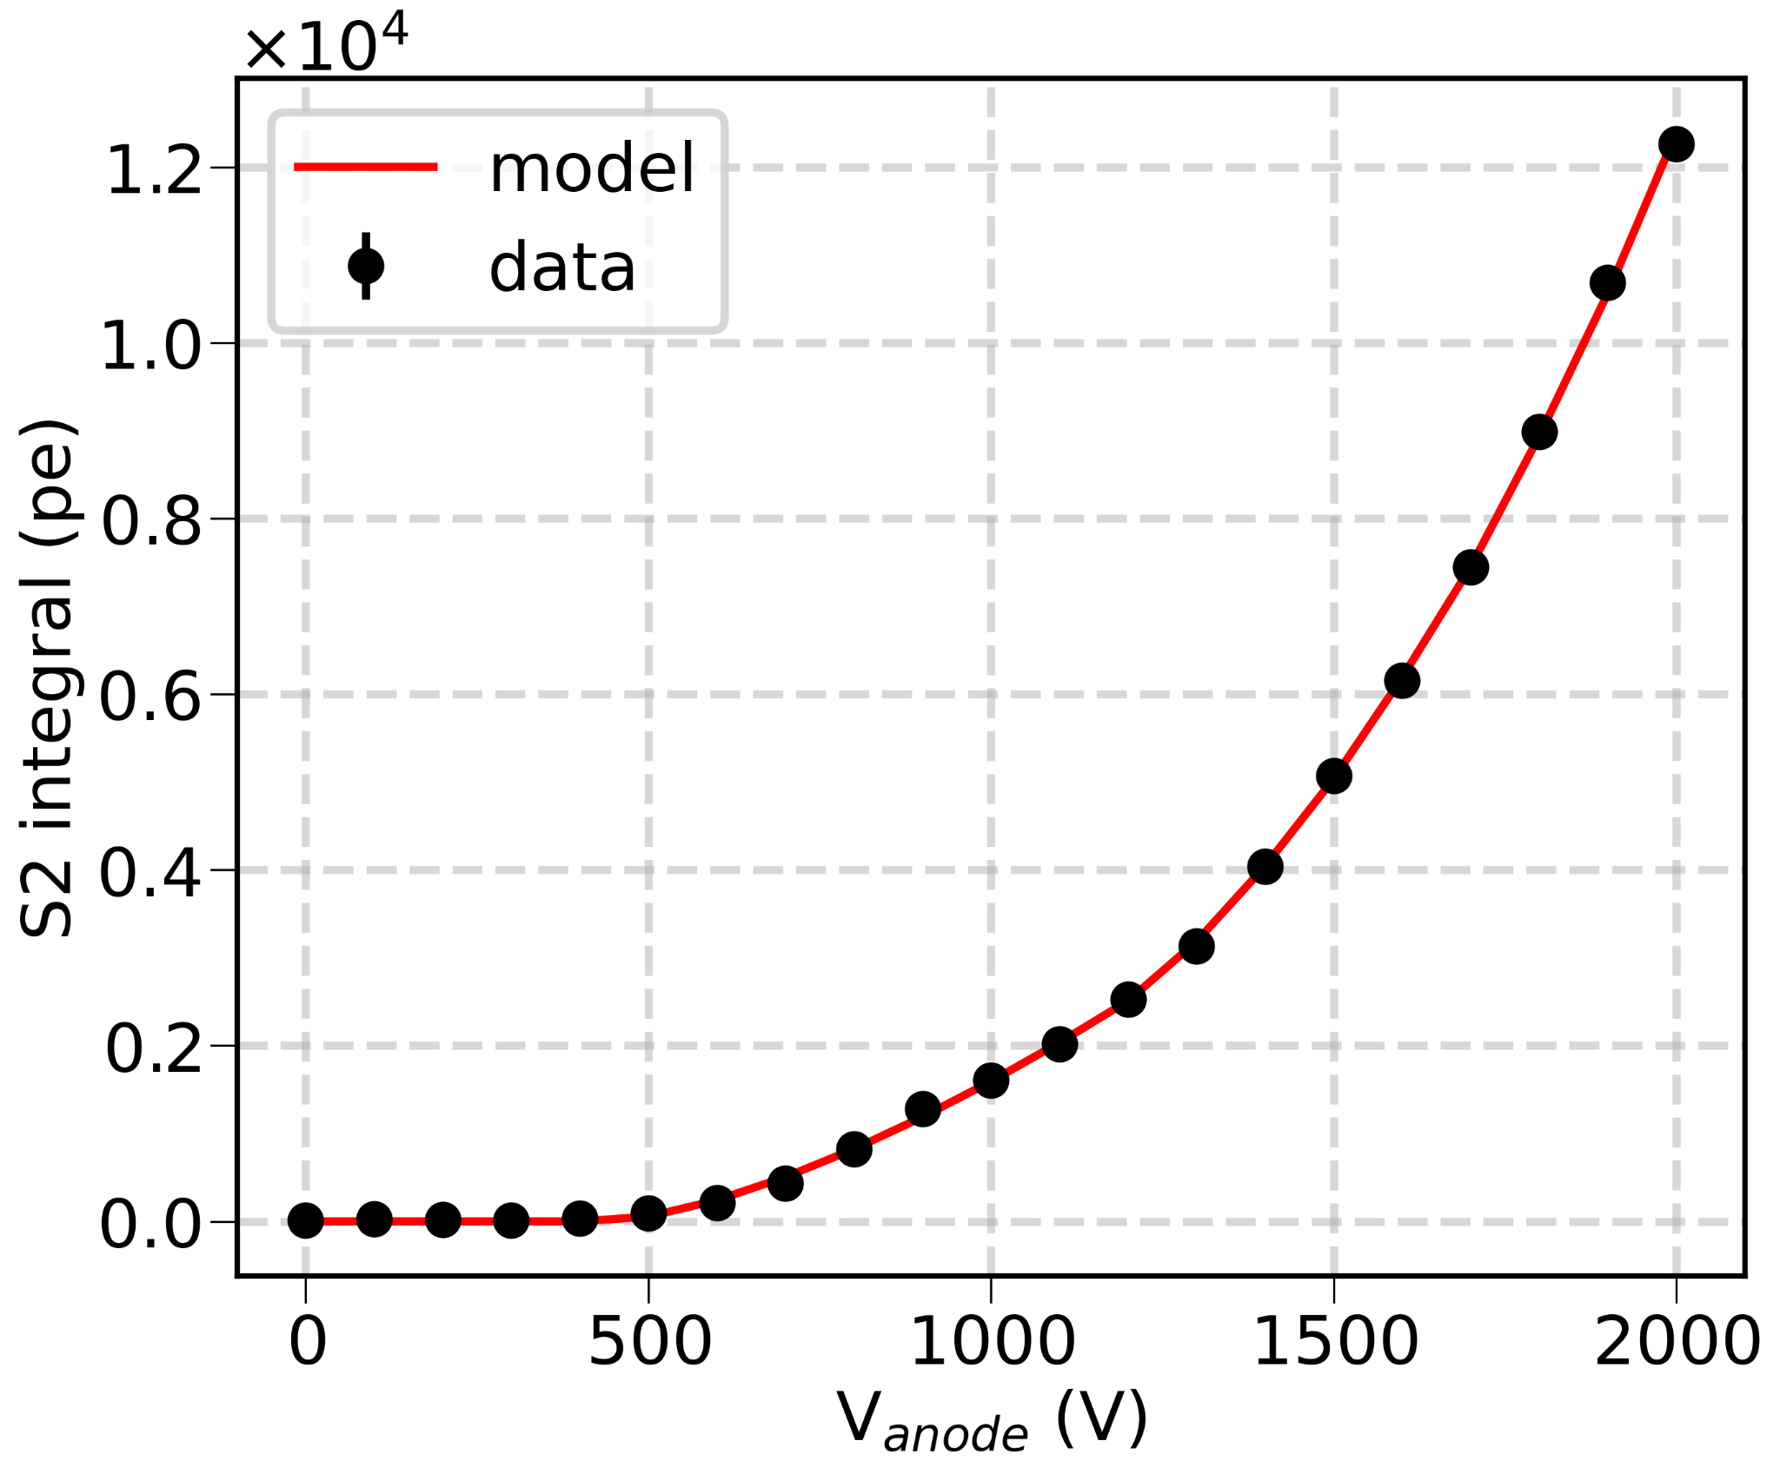
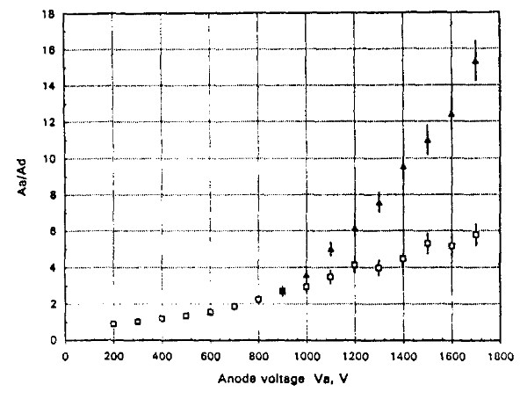
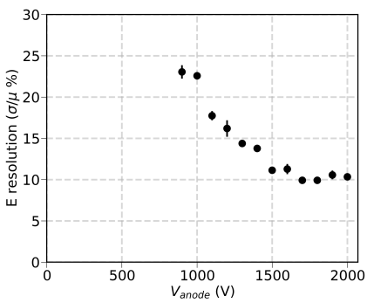
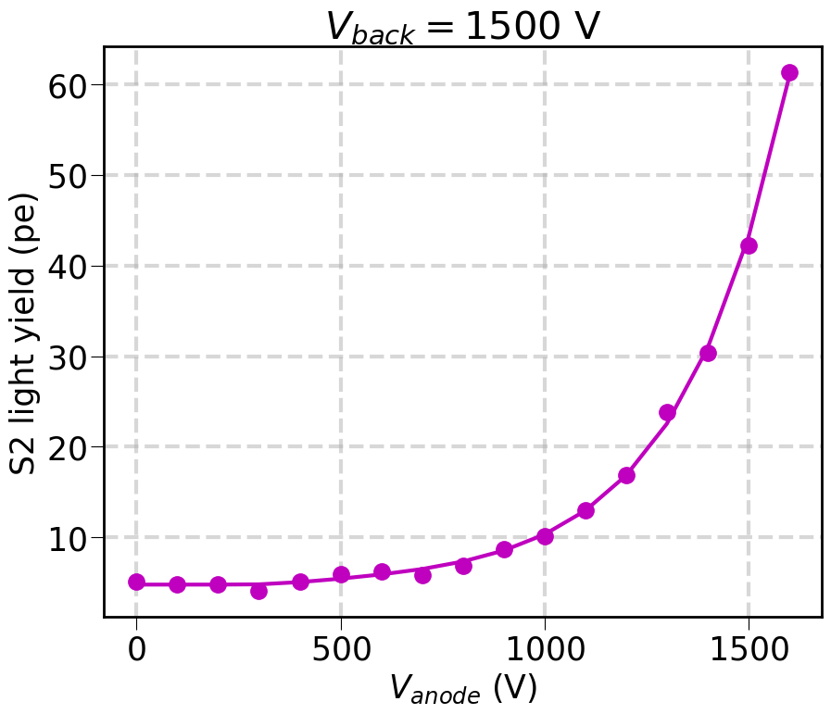


2a. Microstrip plate in LXe (LAr preliminary)
LXe
Light
Energy resolution (light)
Charge
Anode voltage
Anode voltage
Martinez-Lema e.a. JINST 19(2024)P02037
Martinez-Lema e.a. JINST 19(2024)P02037
Policarpo e. a. NIMA365(1995)568
35.5$±$2.6 VUV phot/drifting e⁻ in $4π$
LAr
Light
Same geometry as for LXe (PMT quartz window covered with TPB)
preliminary
S2 signall by a factor of $∼$100 smaller
Martinez-Lema e.a. LIDINE2024

Slide 13
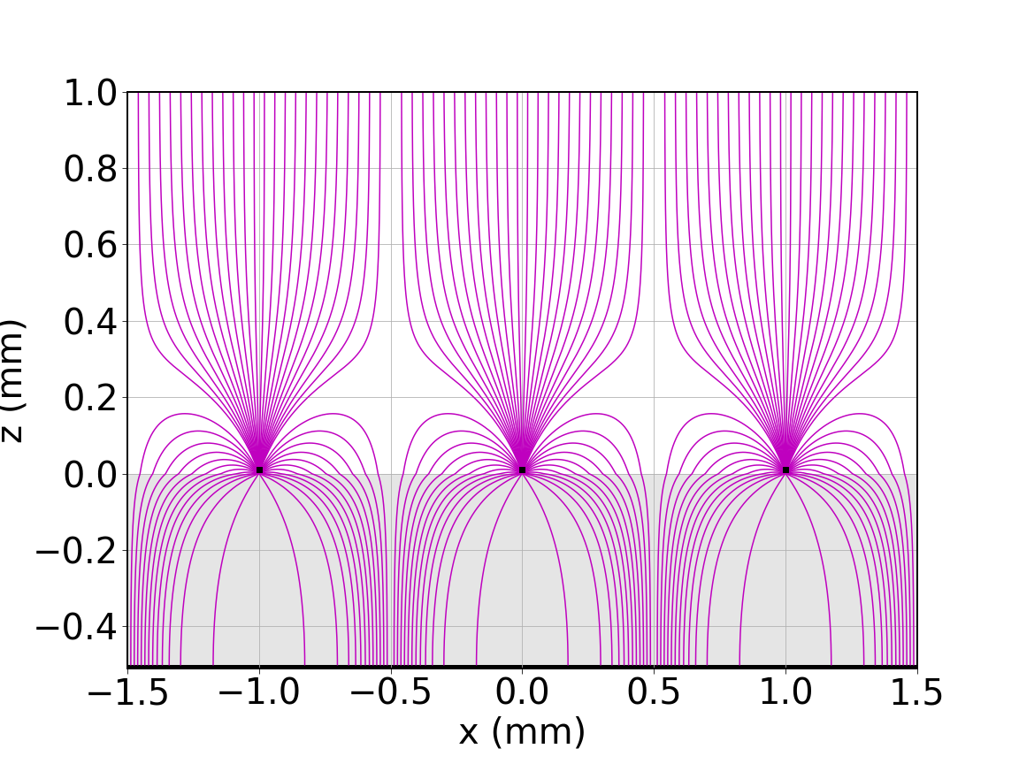
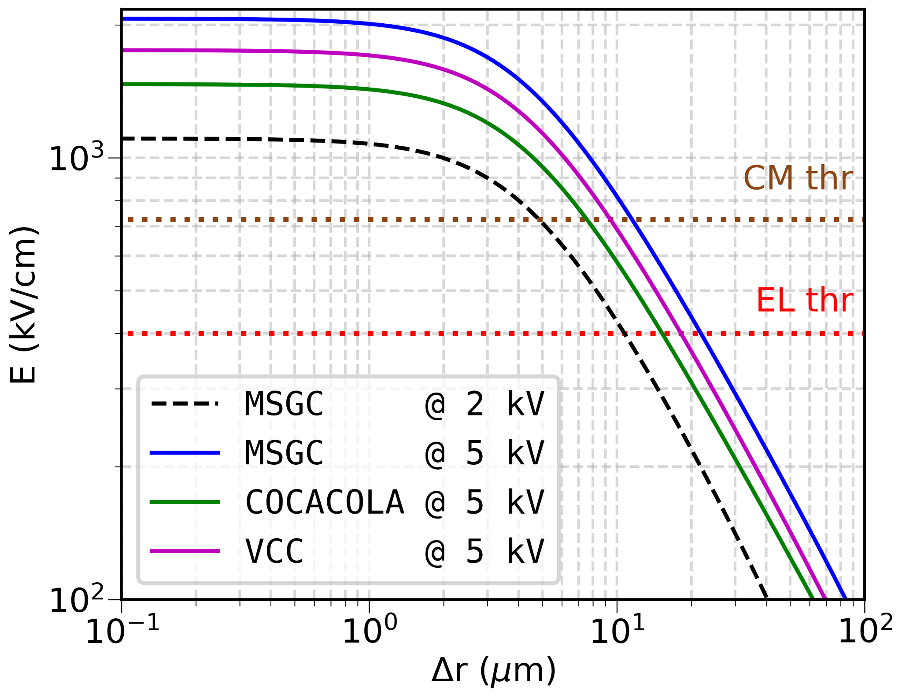
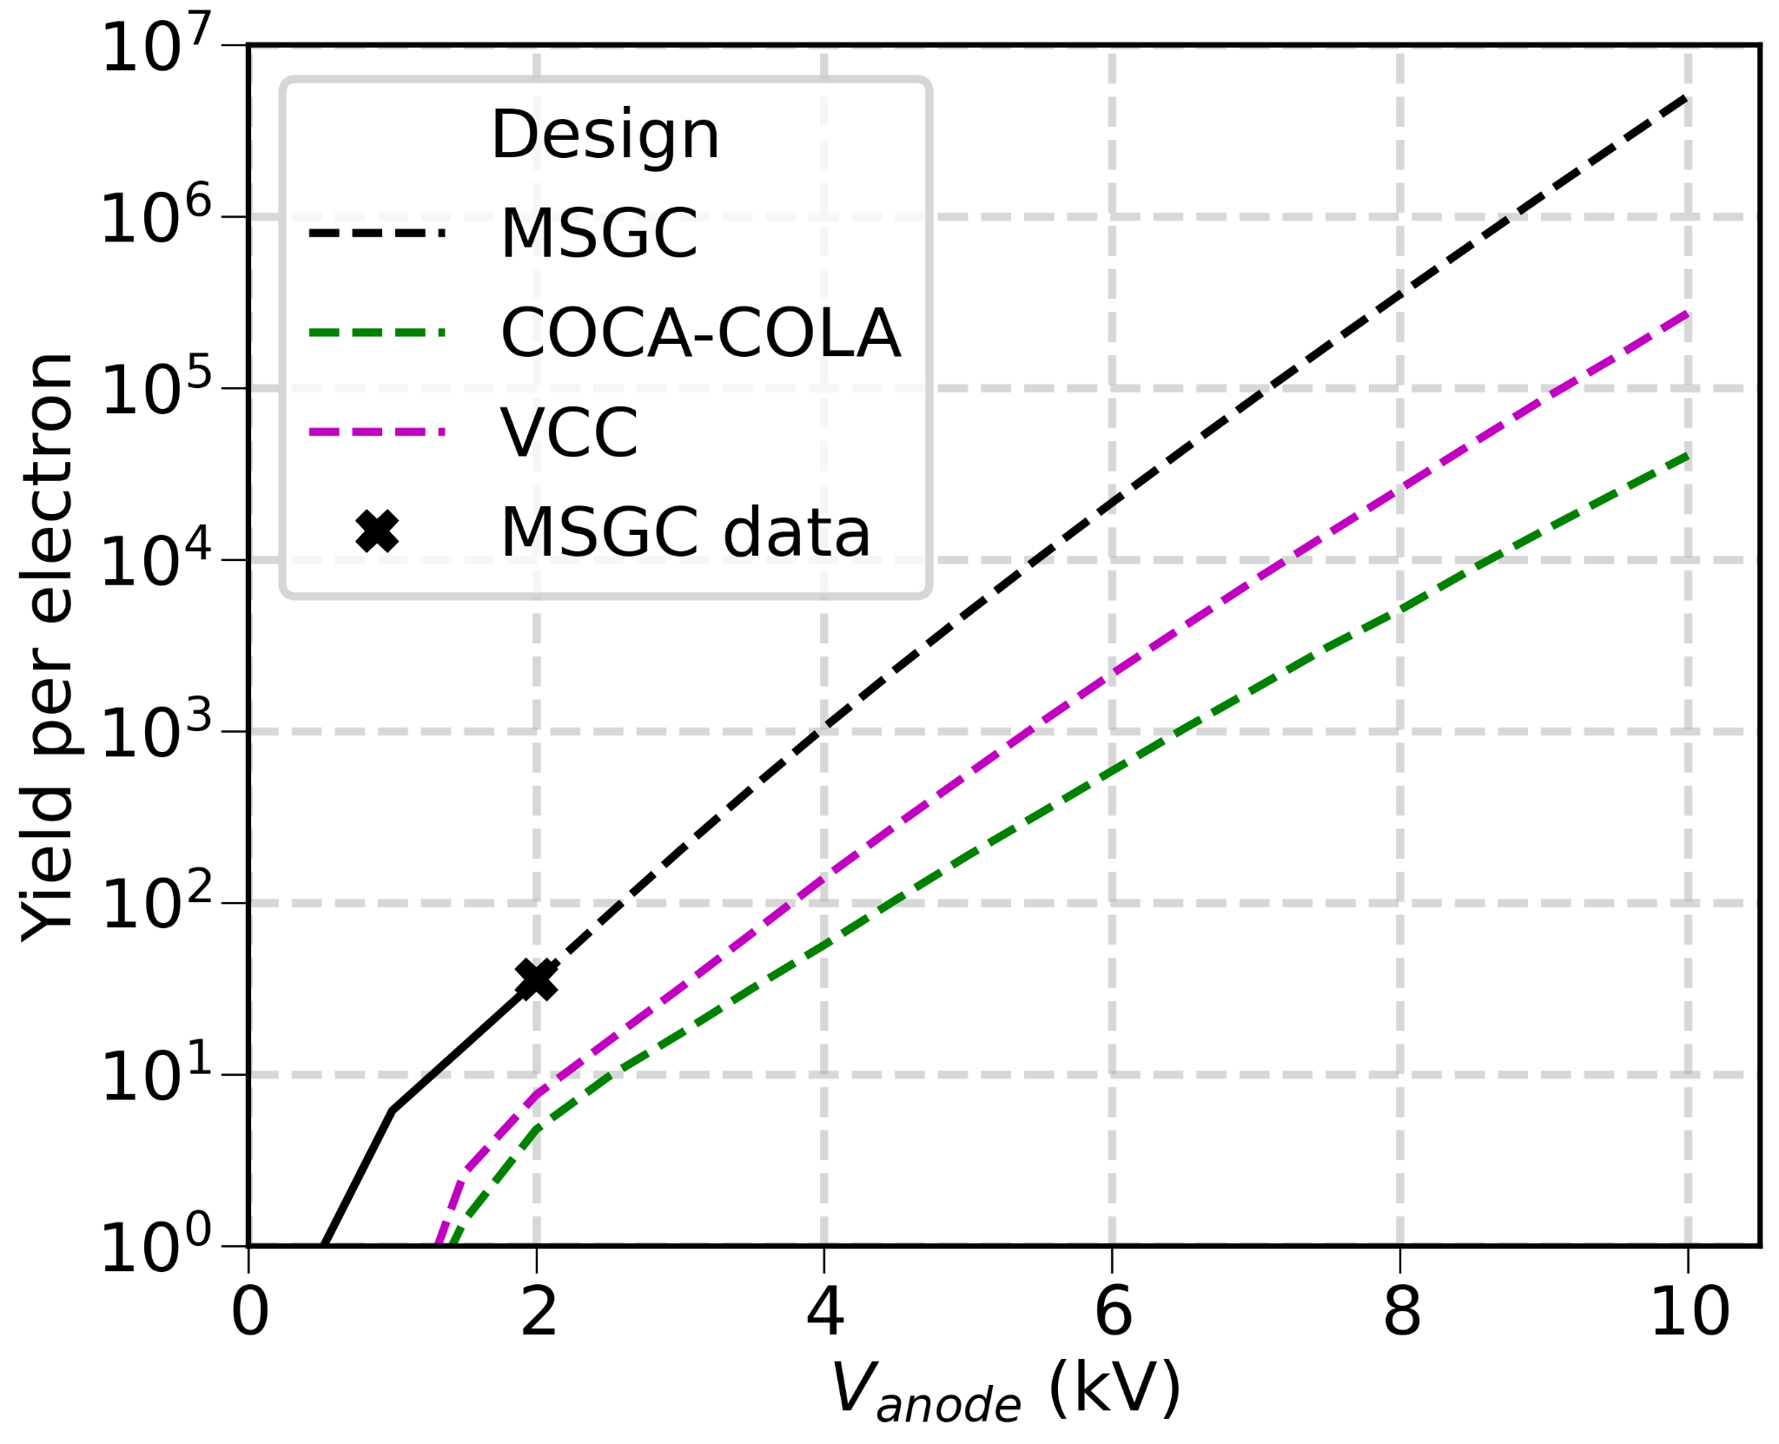



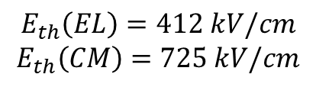

2b. Virtual Cathode Chamber (VCC) vs Microstrip plate
No cathode strips; the cathode is on the other side of the plate (Capeans e. a. NIMA400(1997)17)
Computations using
$$E_{th}\left(EL\right)=412 kV/cm$$
$$E_{th}\left(CM\right)=725 kV/cm$$
VCC
$E$ (kV/cm)
Photon yield (per electron)
$∼$10 $μ$m
$∼$20 $μ$m
Good chance to get
Our best
Distance from strip$(μm)$
Anode voltage (kV)
Martinez-Lema e.a. JINST 19(2024)P02037
For same voltage, microstrip is better than other configurations
However, higher voltages can be applied to VCC than to a microstrip plate

Slide 14
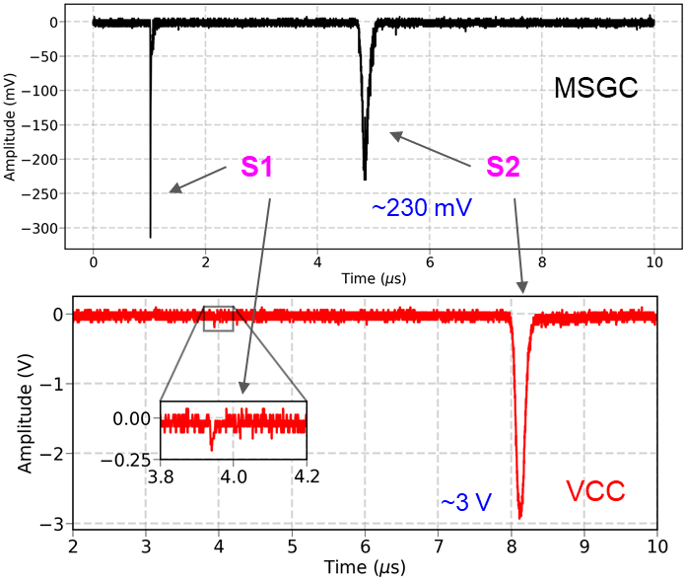
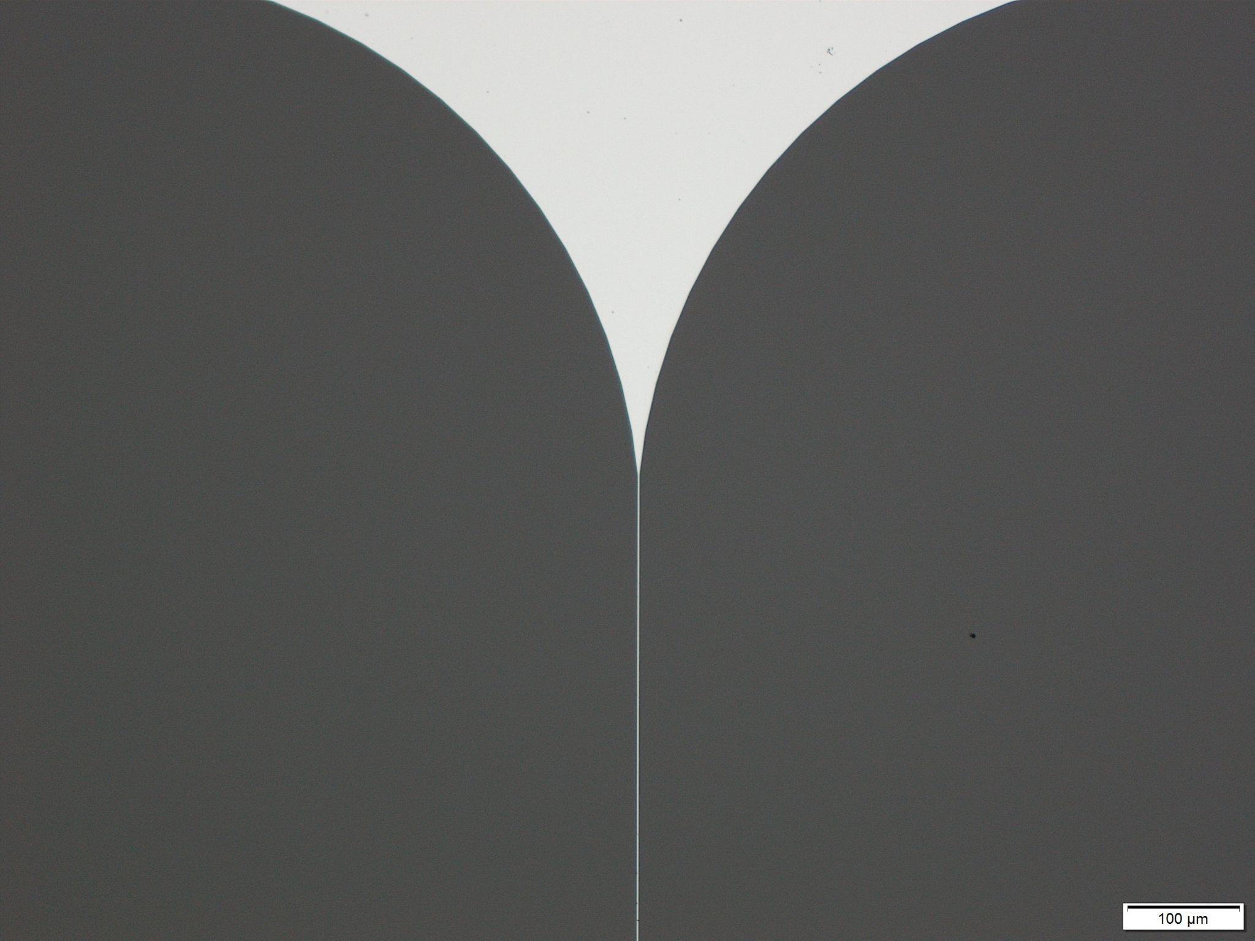
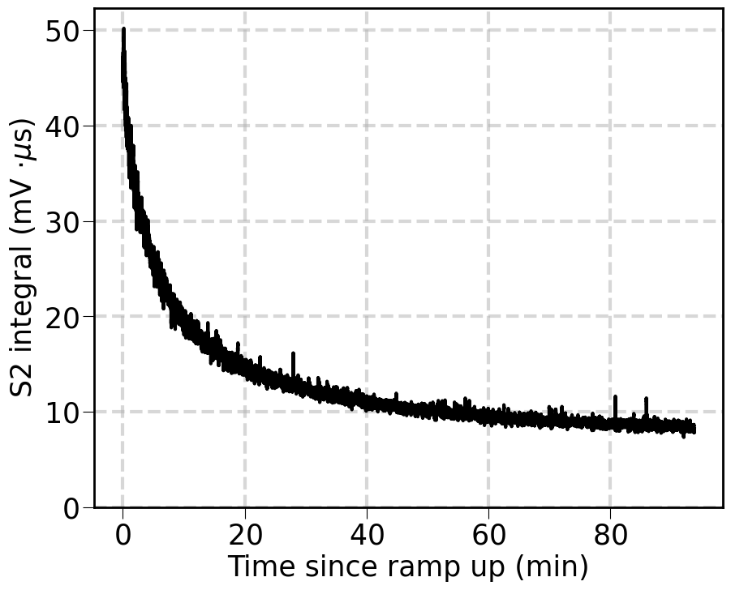
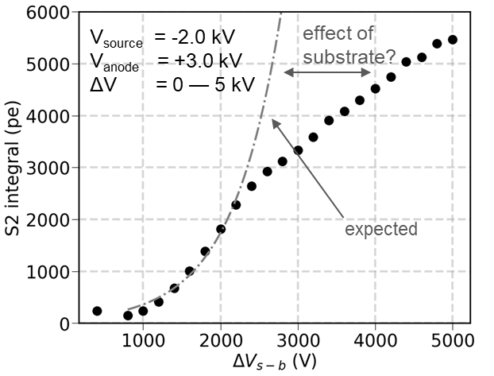





2b. VCC – results in LXe
Our VCC plate
V_{source} = -2.0 kV
V_{cathode} = ground
V_{back} = -2.0 kV
V_{anode} = +1.6 kV
ΔV = 1.6 kV
V_{source} = - 2.0 kV
V_{back} = - 1.75 kV
V_{anode} = +3.25 kV
anode strip (Cr) 2 $μ$m wide
ΔV = 5.0 kV
S2 drops x5 in 1h
$∼30$ photons/drifting e–
Preliminary
At more or less stable conditions (in small steps, after waiting a few min)
S2 integral (mV$⋅μs$)
S2 integral (phe)
expected
Max $∼500$ photons/electron observed
Time since ramp up, min
$ΔV$ (V)
Martinez-Lema e.a. LIDINE2024

Slide 15
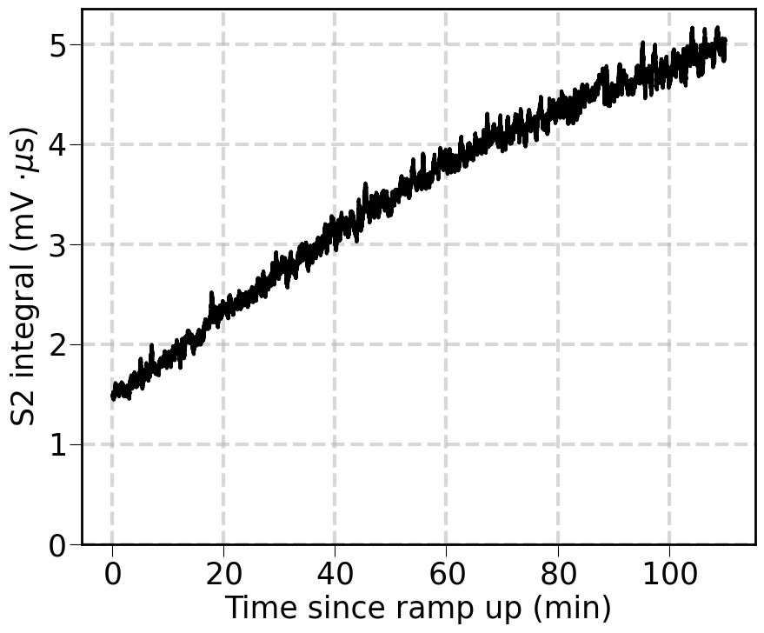


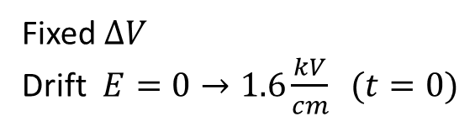
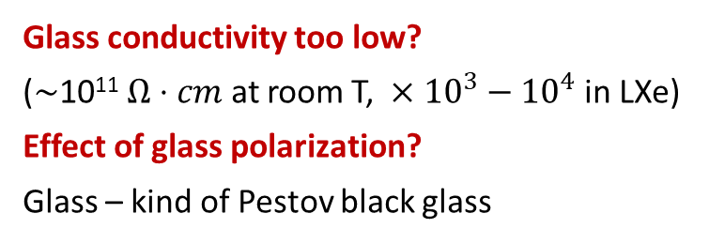
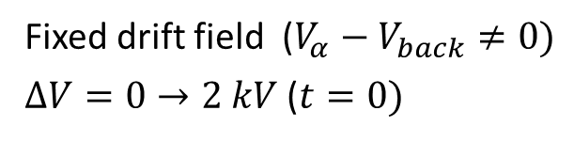


2b. VCC – possible explanations for signal degradation
$$V_{α}$$
VCC
?
$$ΔV$$
$$V_{back}$$
Charging up? – 40 Bq source, $G≲10$ …
Fixed drift field ($V_{α}−V_{back}≠0)$
$ΔV=0→2 kV$ ($t=0)$
Fixed $ΔV$
Drift $E=0→1.6\frac{kV}{cm} (t=0)$
Glass conductivity too low?
($∼$10¹¹ $Ω⋅cm$ at room T, $×{10}^{3}−{10}^{4}$ in LXe)
Effect of glass polarization?
Glass – kind of Pestov black glass
S2
S2
?
?
One thing is clear – the substrate matters
Martinez-Lema e.a. LIDINE2024

Slide 16
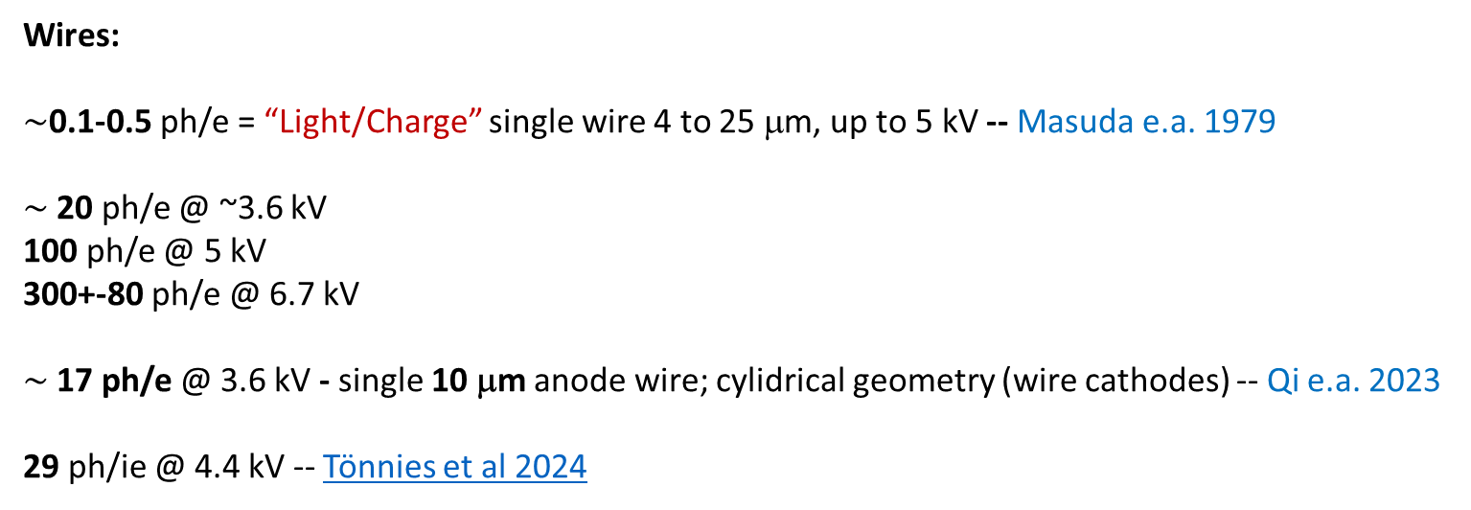
2. Microstrips and VCC vs wires
Us: $∼30$ photons/drifting e– ( >500 possible with VCC?)
Wires:
$∼$0.1-0.5 ph/e = “Light/Charge” single wire 4 to 25 μm, up to 5 kV -- Masuda e.a. 1979
$∼$20 ph/e @ ~3.6 kV
100 ph/e @ 5 kV
300+-80 ph/e @ 6.7 kV
$∼$17 ph/e @ 3.6 kV - single 10 μm anode wire; cylidrical geometry (wire cathodes) -- Qi e.a. 2023
29 ph/ie @ 4.4 kV -- Tönnies et al 2024
10 μm anode wire between two plane multiwire cathodes, 8 mm between them -- Aprile 2014
As a footnote: first report on electroluminescence of LXe (in uniform field) – Dolgoshein e.a. 1967

Slide 17
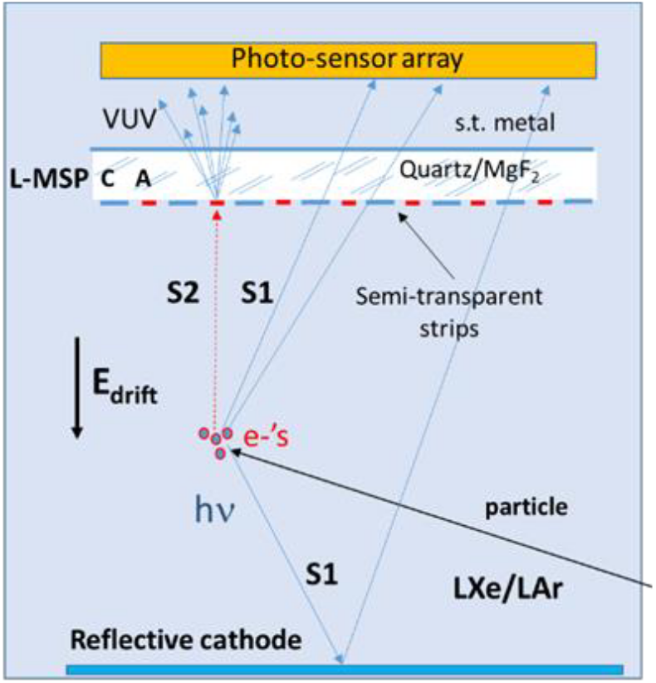
2. Microstrips: what next
Prove of principle – successful.
Advantage - No liquid-gas interface
    Reduced instabilities (interface ripples)
    No delayed e⁻ emission or e⁻ transfer inefficiency through interface
    No gate-interface-anode alignment problems
    Potential improvement for S2-only events (e.g. lower background)
Drawbacks
  Electric fields ~few 100 kV/cm required for electroluminescence (EL)
  So far, lower light yield than dual-phase detectors (except VCC right after applying the voltage)
Open questions:
Substrate polarization/charging up/…? – clarify
Would higher conductivity of the substrate help?
Is it possible to do on a VUV transparent substrate?
Works in LAr ?
How do we maximize electroluminescence and avoid charge multiplication?
Breskin JINST 17 (2022) P08002

Slide 18
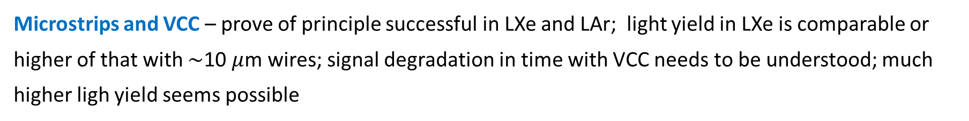
Conclusions
FHM – prove of principle in LXe successful, structure optimization and material studies are needed; floating in LAr is interesting but challenging – will try soon
Microstrips and VCC – prove of principle successful in LXe and LAr; light yield in LXe is comparable or higher of that with $∼$10 $μ$m wires; signal degradation in time with VCC needs to be understood; much higher ligh yield seems possible
Thank you

