Slide 1

Characterization of the ArGON ionization yield for sub-keV nuclear recoils
L. Pandola
(INFN, Laboratori Nazionali del Sud)
CERN, February 12th, 2025

Slide 2
Why and what: microphysics of NL response
Better understanding of the physics processes underlying the response in scintillation and ionization, especially in the sub-keV range
Poorly known (especially in Ar) and critical ingredient for light DM searches («low mass WIMPS») and astrophysical neutrinos via CEvNS
Evaluate effect of single-electron background, which limits the sensitivity to low-mass WIMPs
  Vs. purity
General strategy: use small-scale dedicated setups, exposed to neutron sources/beams

Slide 3
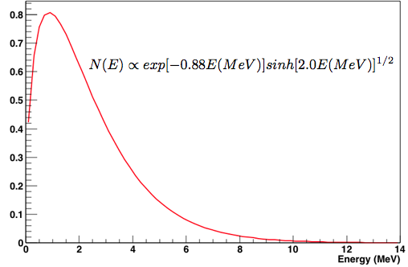
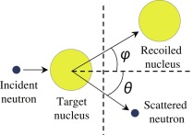

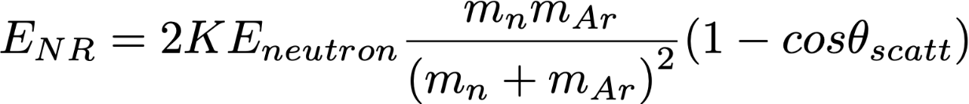
The working principle
Strategy: Produce Ar recoils of known energy in the TPC by (n,n')
Neutrons from a ²⁵²Cf fission source
  Neutrons O(2 MeV) and up to 10 MeV
  Appropriate to produce recoils of a few keV
Close detectors (BaF₂) to tag fission events
Neutron spectrometer to detect neutrons scattered off-Ar
²⁵²Cf
Time of flight
Fixed by geometry
tagger
Two-body kinematics!
Detector
Notes:
Put old dear two-body kinematics at work

Slide 4
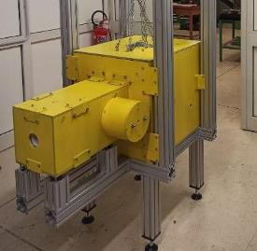
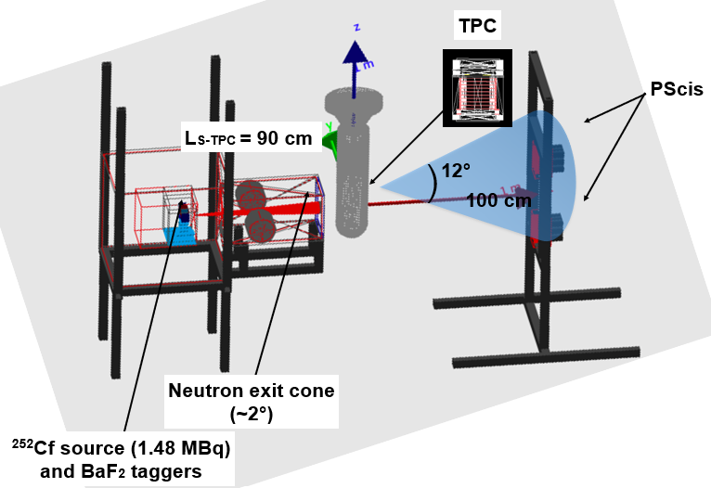

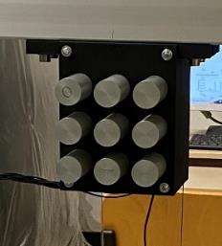


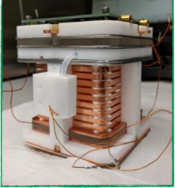
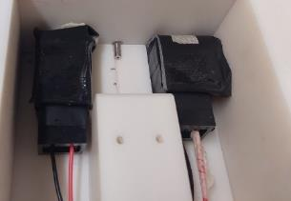
The ReD conceptual layout
Design sensitivity in the range 2-5 keV_{nr}

Slide 5
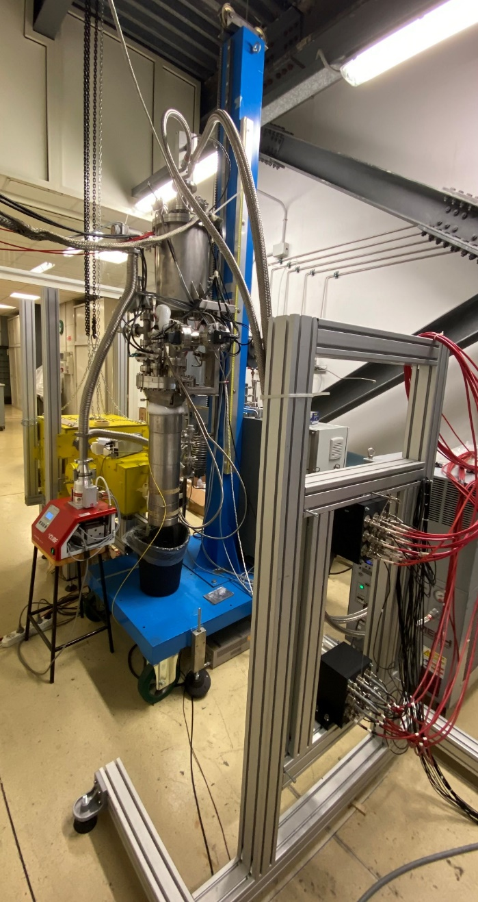
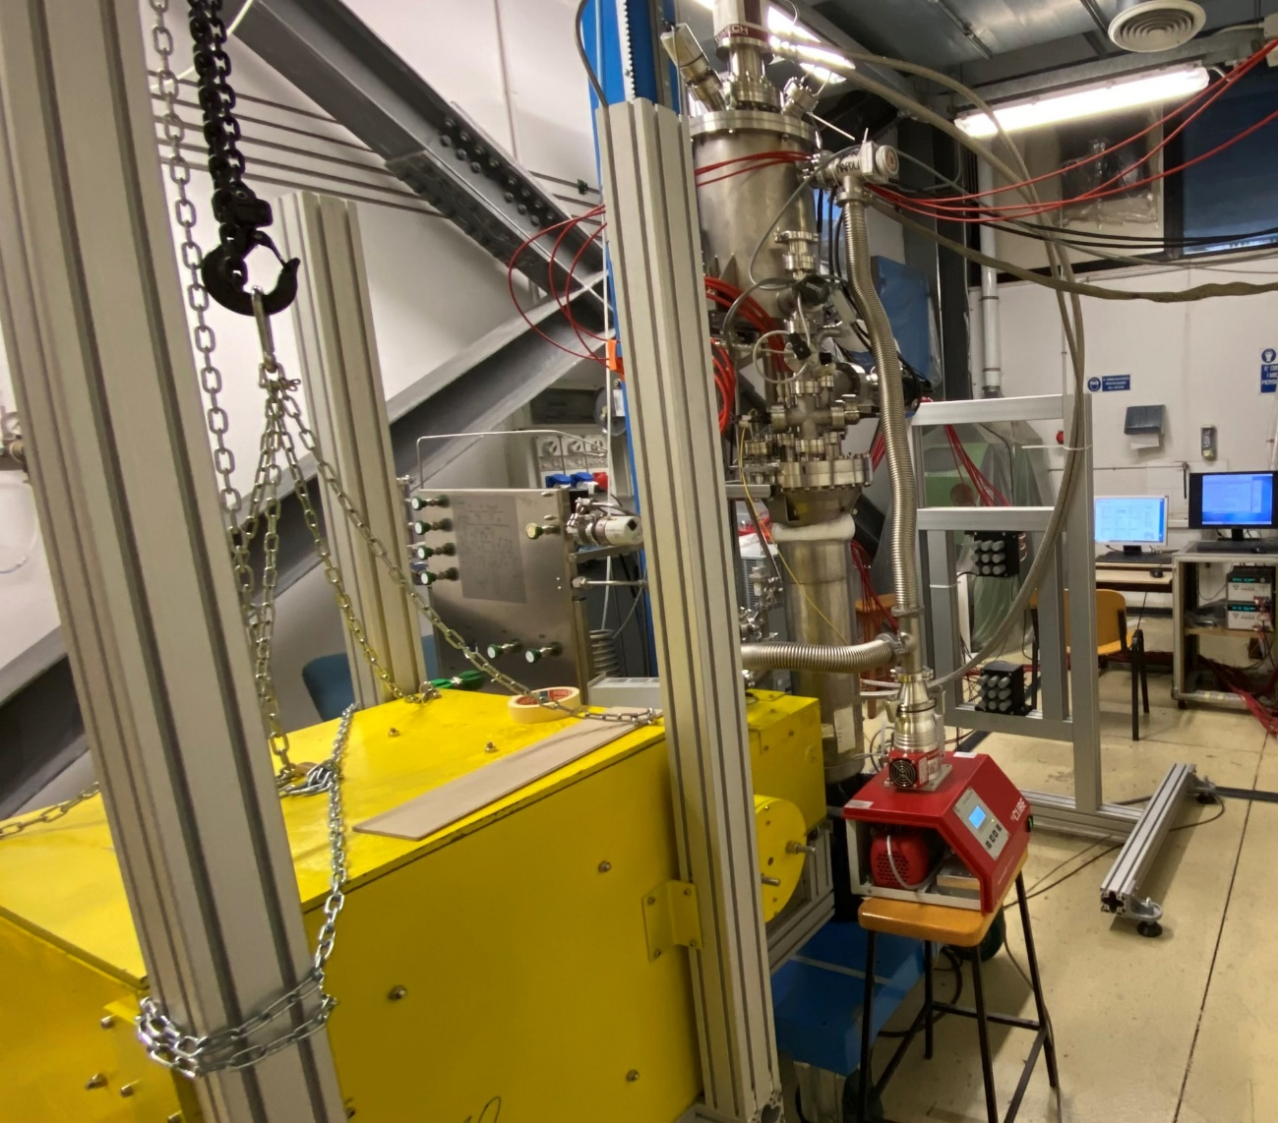
The real thing at

Slide 6

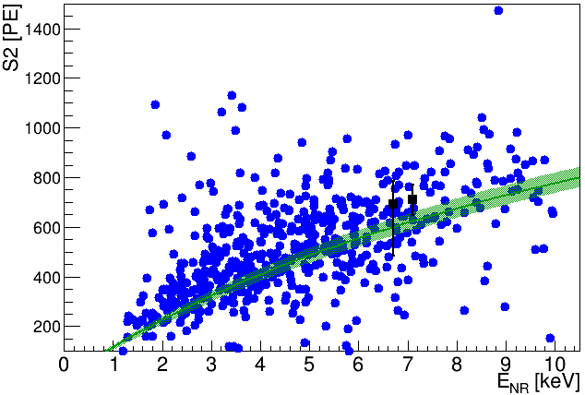
The lesson learnt for the new round
ReD took data in Winter 2023 → analysis in progress
Sensitivity confirmed down to 2 keV_{nr}
Concept validated!
Sensitivity to screening models
☑
Sensitivity limited by:
  Intensity of the ²⁵²Cf source: signal rate O(cph)
  Unfavourable signal/accidental ratio
  Multiple neutron scattering in passive material and neutrons leaking from the shielding
    Spoils kinematics correlation
I. Amhad et al. PoS(TAUP2023) 052
Preliminary
DS-50 model

Slide 7

The (staged) path to the sub-keV range
Concept OK → improved version to reach 0.2-0.5 keV_{nr} range
  Improve on: source, TPC, neutron spectrometer, shielding
Intermediate step: ReD+, funded as a 2-year grant of the Italian Ministry of Research (PRIN project)
  Approved after DRD submission
  Goal: improve and extend coverage of ReD down to 0.5 keV_{nr}
    same approach (stronger ²⁵²Cf source) but optimized spectrometer and new TPC
  Timeline: 2023 - 2025, at INFN-LNS (Catania)
Within DRD2 WP3.2: aiming at 0.2 keV_{nr} by using a DD neutron generator (2026-2027)
  Use the TPC and the infrastructure for a single-e background campaign (2028-9), controlled doping with N₂ and O₂

Slide 8


Improvements: new TPC
New optimized TPC, readout by SiPM
  Improve signal/background and maximize the signal rate
  Re-use as much as possible the existing cryogenic infrastructure
  SiPM from DarkSide-20k
Preliminary MC simulations, now technical design in progress
Desiderata:
  Cylindrical shape for symmetry reasons
  Size → compromise between single-scattering topology and signal rate
  Passive volumes upstream and downstream to be minimized
    Spoil kinematic correlation
  Higher g₂ to target weaker S2 signals (~ 2-3 e-)
Conceptual design: TPC with the largest active volume fitting in the existing cryostat (Ø 132 mm)
  Current design TPC active volume Ø ~85 mm → minimal passive LAr
    Old TPC: 50x50x50 mm (cubic)
Notes:
as they spoil kinematic correlation and worsen signal/background

Slide 9
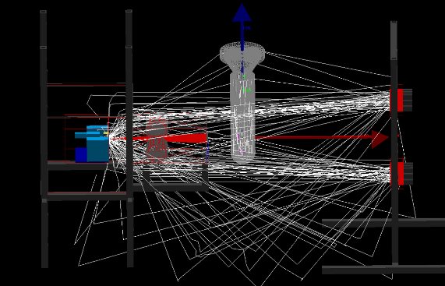
Improvements: source and shielding
First phase (ReD+): stronger ²⁵²Cf neutron source
  About a factor of 2, funded under the PRIN grant → being ordered
  BaF₂ detectors to be replaced with faster ones to reduce pile-up and accidental coincidences
Possibly using a D-D generator: mono-energetic 2.4 MeV neutrons (taggable via associated ³He), up to 10⁷ n/s
☑
Improve shielding
  Significant of background in ReD (> 70%) due to neutrons leaking the shielding from the front side → no single-scattering!
  Add 10-15 cm of extra B-loaded PE to the existing shielding

Slide 10
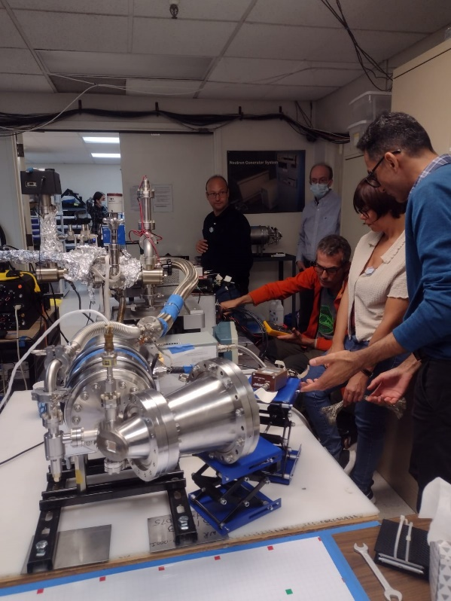
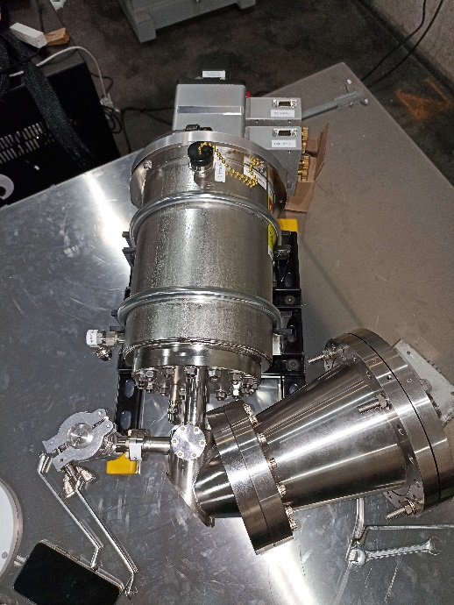

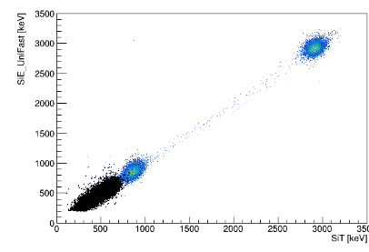
DD-Gun
Commercial DD gun (Adelphi)
Mono-energetic 2.4 MeV
Neutron tagging via associated ³He
  Demonstrated → experimental tests at Adelphi on October 2023
Very small x-ray background
Assuming a conservative flux of 10⁶ n/s (achieved @Adelphi), signal rate comparable to ²⁵²Cf
  Different systematics
Funded by FAPESP (Brasil)
  Delivered to USP on June 2024
  Could be shipped at LNS in fall 2025
p
☑
³He
t

Slide 11
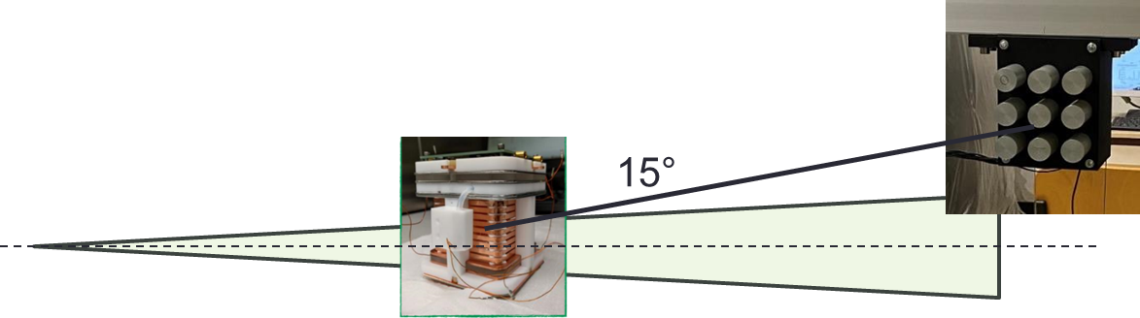
Improvements: spectrometer
Targeting smaller recoil energies → detectors deployed at smaller angle (9° instead of 15°)

Slide 12
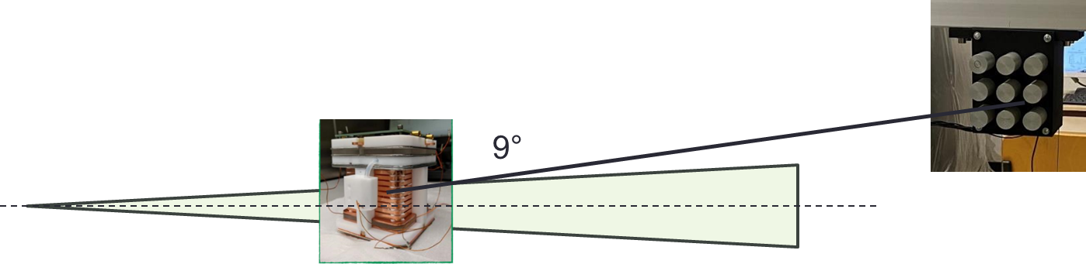
Improvements: spectrometer
Targeting smaller recoil energies → detectors deployed at smaller angle (9° instead of 15°)
  Still have to be outside of the collimator cone → to be placed farther

Slide 13

Improvements: spectrometer
Targeting smaller recoil energies → detectors deployed at smaller angle (9° instead of 15°)
  Still have to be outside of the collimator cone → to be placed farther
More detectors to compensate for the loss in solid angle
  4 arrays (36 detectors) instead of 18 (top/bottom, left/right) → already purchased
  Additional control on alignment systematics
Lighter support structure
  Plastic → contributes to parasitic neutron scattering
☑

Slide 14
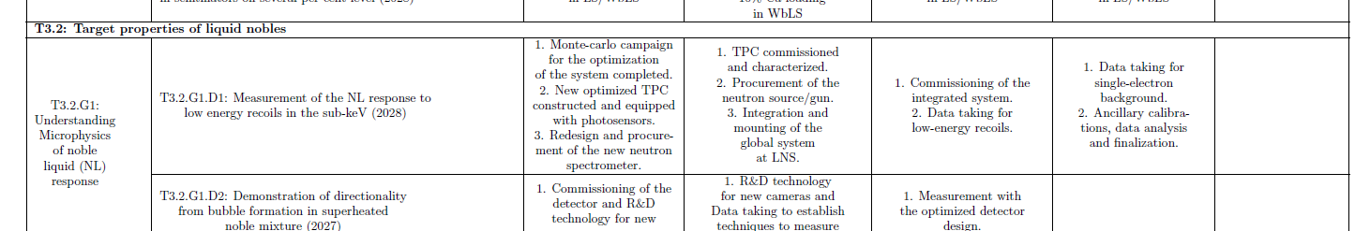
The T3.2.G1 work and timeplan
Costs 250 k€:
  Equip TPC with photosensors (SiPM) and readout electronics
  Purchase of a D-D neutron generator (long-term infrastructure)
    D-D generator by FAPESP is a temporary lent
  Consumables (purification cartridge, Ar 6.0, …)
Cost-effective re-usage of existing hardware from ReD&ReD+
  Integration and commissioning (2025-6)
Measure ionization yield in Ar down to 0.2-0.4 keV_{nr} (2026-7)
Campaign for the single-e background (2027-9)
  Controlled doping with N₂ and O₂

Slide 15
Conclusions
Characterization of the ionization response in the sub-keV range is critical for next-generation experiments looking for low-mass WIMPs
  Especially true for Argon: less measurements available
ReD within DarkSide-20k measured the response of a miniaturized LAr dual-phase TPC down to 1-2 keV_{nr} @INFN Catania (2023)
  Neutrons produced by a ²⁵²Cf fission source
  Two-body kinematics
Future: nice relay of ReD+ (PRIN grant), aiming to 0.5 keV_{nr} and DRD2 (T3.2.G1) to 0.2 keV_{n}
  Same conceptual layout with optimized new TPC and components
  Long-term neutron infrastructure established within DRD2: use for single-e studies and possibly for other detectors/targets

Slide 16
THANKS FOR YOUR ATTENTION

Slide 17
BACkup

Slide 18
SWOT
Strengths:
  Proven technology
  Covers a significant gap in the literature, which is crucial for the analysis of next-generator Ar-based WIMP dark matter experiments
  Cost-effective (re-usage of a significant part of ReD and ReD+)
Weaknesses:
  Location compliant with Radiation Safety regulations, due to the high neutron flux → Laboratori Nazionali del Sud of INFN proposed host
Opportunities:
  Infrastructure (e.g. DD generator) can be re-used to characterize other target materials and/or for neutron irradiations
  Interdisciplinary fields, e.g. cultural heritage.
Risks: low risk
  Entirely based on existing technologies, validated in ReD

Slide 19
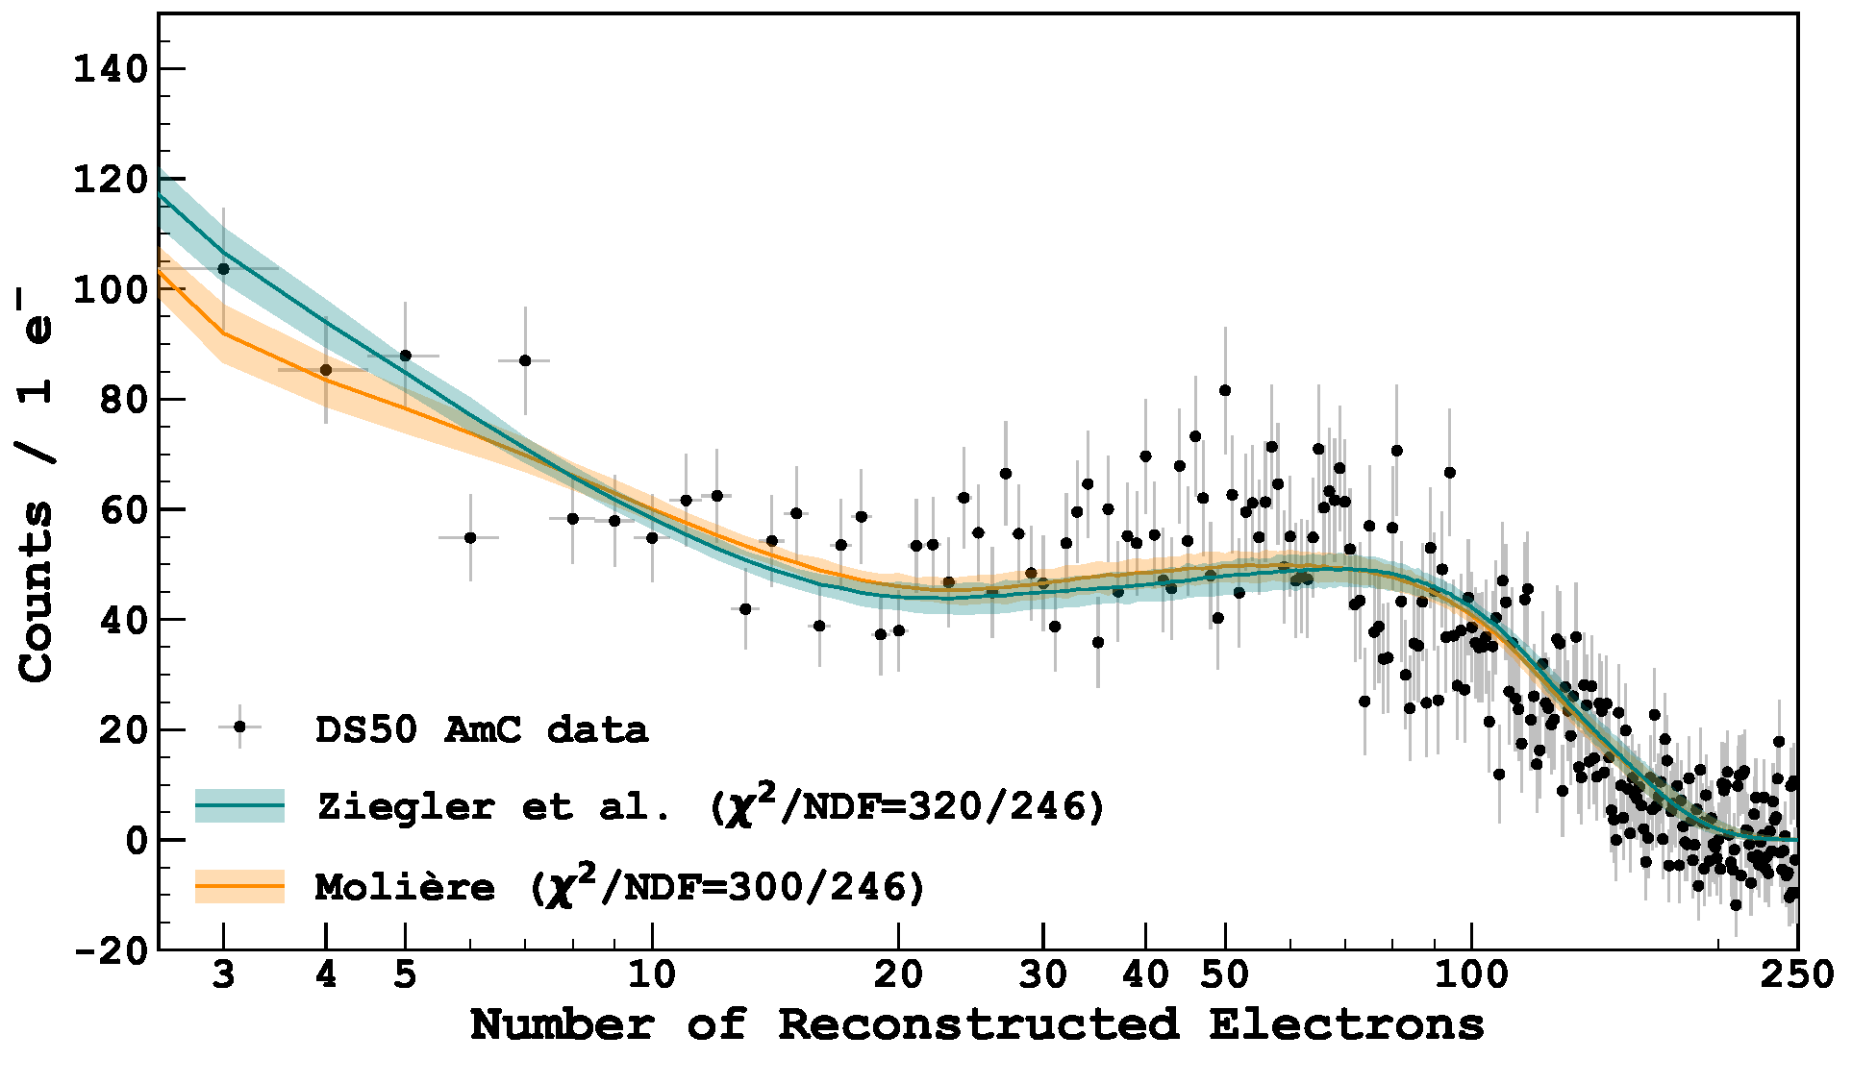
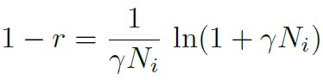
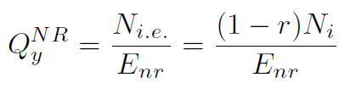
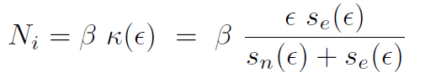
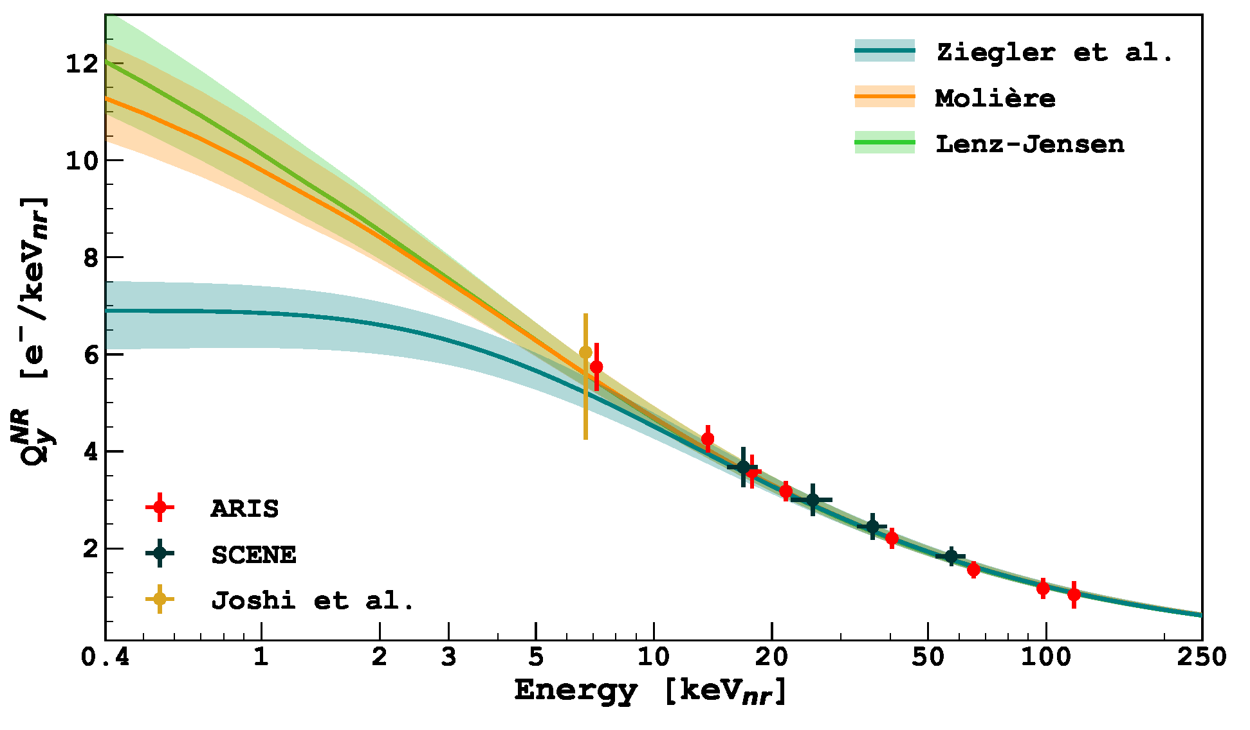
Ar NRs ionisation yield at low energy
Measurement within DS-50, with AmC and AmBe neutron sources
Dedicated 2-parameter model
Thomas-Imel
Agnes et al. PRD 104 (2021) 082005
Different screening models for s_{n}, possible low-E suppression for s_{e}
Constrains only by small low-energy sample from the AmC calibration of DS-50
  No closed 2-body kinematics
Strong case for a LAr direct measurement at 1-5 keV_{nr}

Slide 20

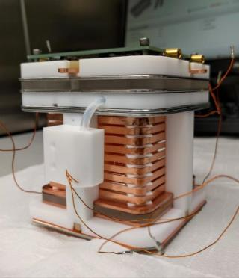
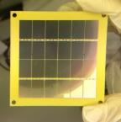
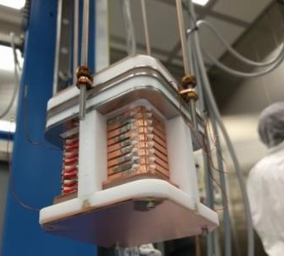
The TPC …
Design by UCLA
Miniaturized version of the DS-20k TPC
  Active volume: 5(L) x 5 (W) x 6 (H) cm
  Gas pocket: 7 mm thick
  TPB coating for wavelength shifting
DS-20k light readout: 5x5 cm² SiPM, 24x1cm² SiPM
  24 ch readout (top), for increased (x,y) resolution
  24x1cm² SiPM, 4 ch readout (bottom)
Front End from the DS-20k R&D
3D event reconstruction:
  (x,y) from S2 pattern on the top SiPMs
  z from drift time (up to ∼55 μs)
In this campaign:
  g₂ = ~17 PE/e- (E_{drift} = 200 V/cm, E_{el}=5.79 kV/cm)
  Electron lifetime > 1 ms
Agnes et al. EPJ C 81 (2021) 1014
Notes:
[Quick] TPC: dimensions, readout, event reconstruction in XY-Z, PSD

Slide 21
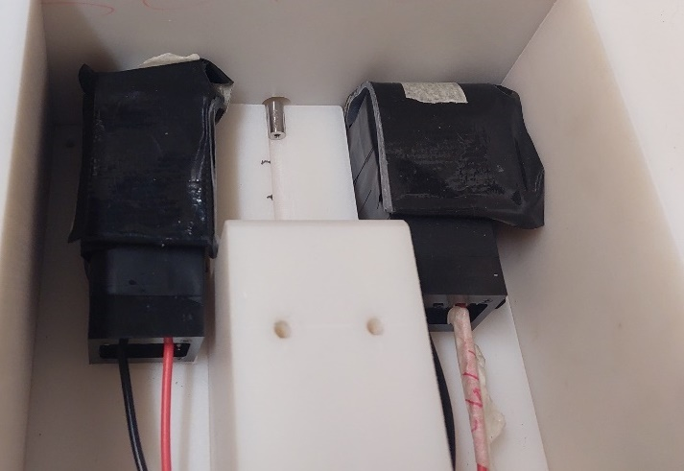
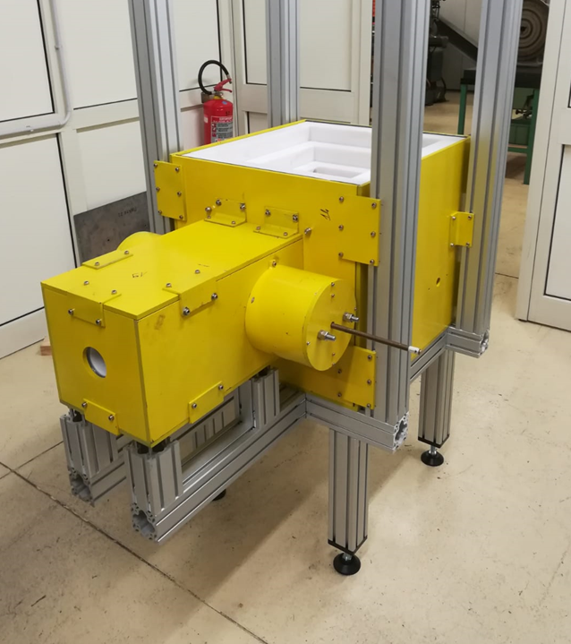
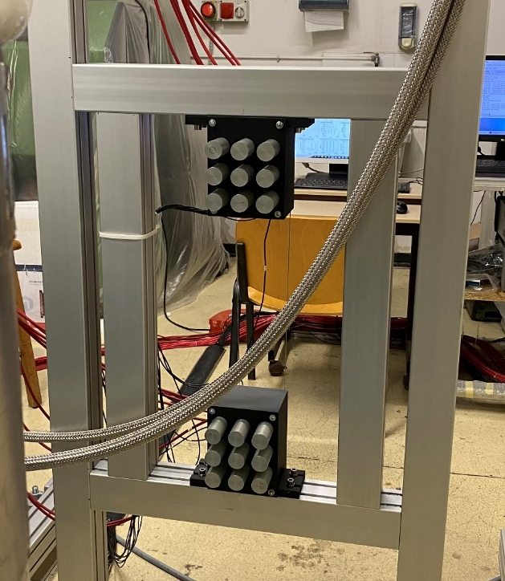
… and all the rest
Ø 5 mm
²⁵²Cf source (26 kBq fission)
  Collimator of opening angle ~2°
  Shines the entire TPC at 1 m distance
Two BaF₂ detectors to tag fission products
  Fast (high source rate, pile-up)
  START for time of flight
Neutron spectrometer: two 3x3 arrays of EJ276 plastic scintillators
  STOP for time of flight
  Features n/γ discrimination
  1 m downstream the TPC
  Symmetric deployment to control systematics due to alignment
  θ ~ 12°-17° in order to avoid direct neutrons from the source
Tag Ar recoils down to ~1-2 keV_{nr}

Slide 22
PUTTING EVERYTHING AT WORK

Slide 23
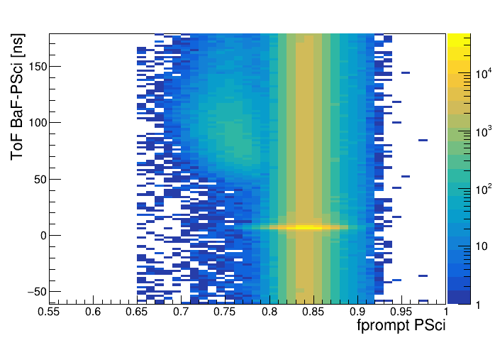
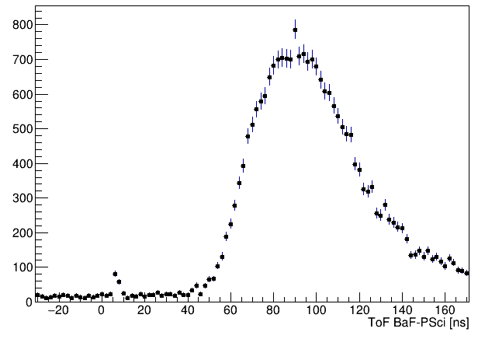
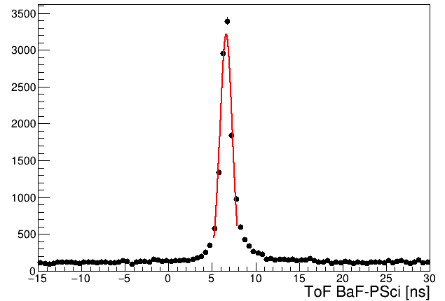
Finding neutrons…
Δt(PSci-BaF) vs. PSD in PSci
Event rate dominated by γ-rays and accidentals
Selection of candidate neutrons by time of flight and PSD
  About 28 events/hour (0.3%)
ToF resolution ~ 0.7 ns
Event-by-event E_{n} at <5%
gamma accidentals
neutrons
gamma flash
Δt(PSci-BaF)
n-PSD
Δt(PSci-BaF)
γ-PSD

Slide 24
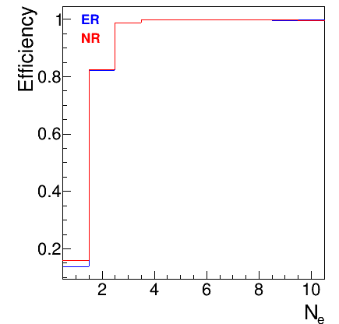
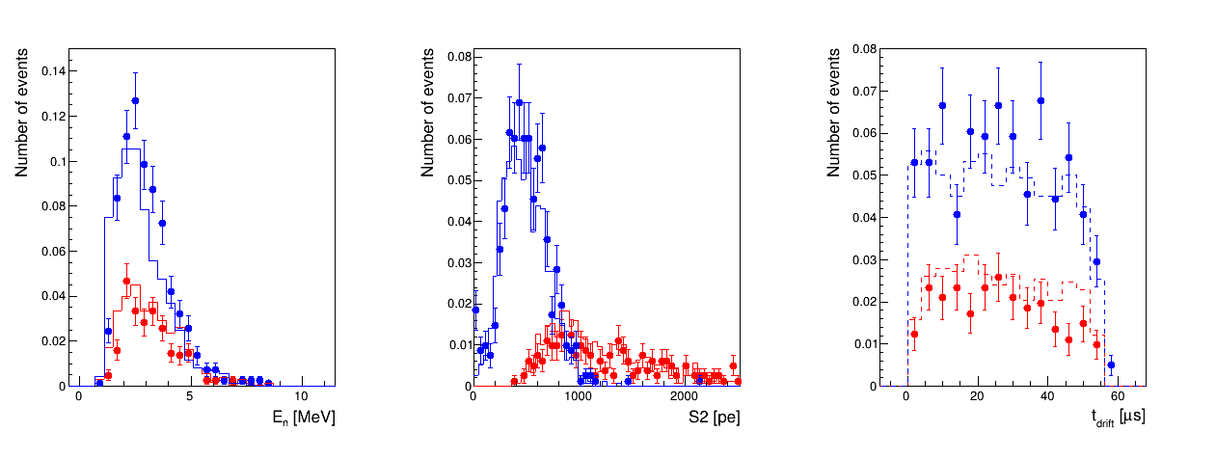
… interacting in the TPC
Look for TPC events offline
  Analysis flow: de-convolution of SiPM response function, TPC pulse finder
From MC: pulse finder fully efficient for S1 > 25 PE, S2 > 4 e-
Selection cuts:
  One S2 within 65 μs from BaF₂ and optionally, an S1 (< 100 PE)
  If S1 available, consistent BaF-TPC tof
  No tails of previous S2 pulses
  (x,y) in the central 4x4 cm region (fiducialization)
S2 only
S1+S2
S2 only
S1+S2
Data & MC
Final sample: ~820 passing all cuts, out of 2300 candidate neutron events w/ TPC signal
  75% are S2-only (~ as in MC)
  Expected: S1~8 PE for 5 keV_{nr}

Slide 25
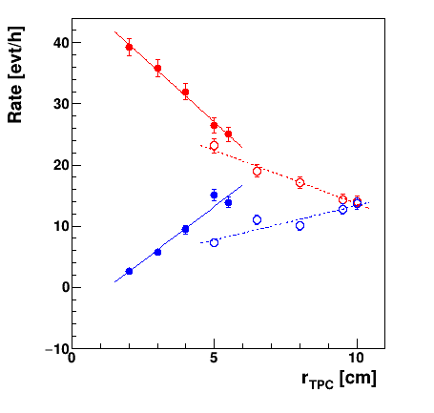
Rates
Psci tagged neutron: red markers
Signal : blue markers
Solid Markers : small cryostat
Empty Markers: big cryostat
Blue curve: signal rate
Includes the effect of total rate and of «good topology» efficiency
Slope in the big cryostat different for three reasons:
YZ beam containment in the TPC (TPC section > beam spot)
Interaction in the passive Ar upstream
Increased probability of multi-hit (= bad topology) for a big TPC
Same signal rate for r = 5 cm in the old cryostat and r = 10 cm in the large cryostat
BaF AND Psci NAND TPC
BaF AND Psci AND TPC
Notes:
25

Slide 26
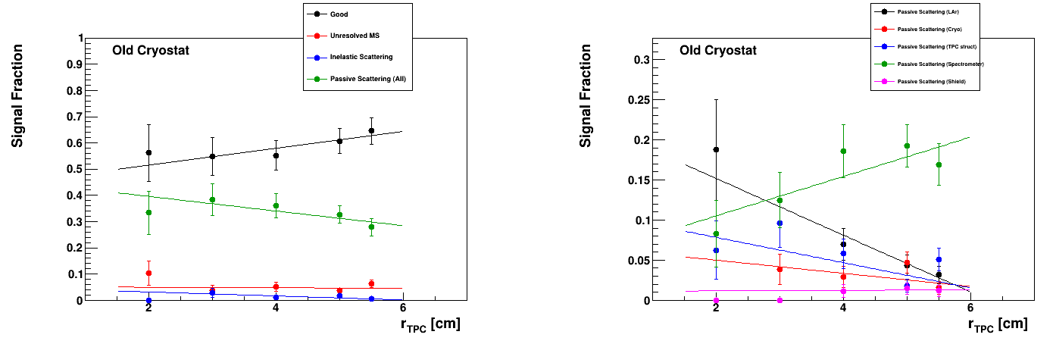
Topologies (Only cone=0)
Old Cryostat
breakdown
Irreducible bad topologies:
10% : Inelastic Scattering / Unresolved MS / Passive Scattering in Shield and Cryostat
Topology that can be improved
10-20% : Passive scattering in the Psci Spectrometer
Topologies that get better with TPC radius:
Passive Scattering in LAr 20% → 3%
Passive Scattering in TPC struct 8% → 2%
Notes:
26

Slide 27
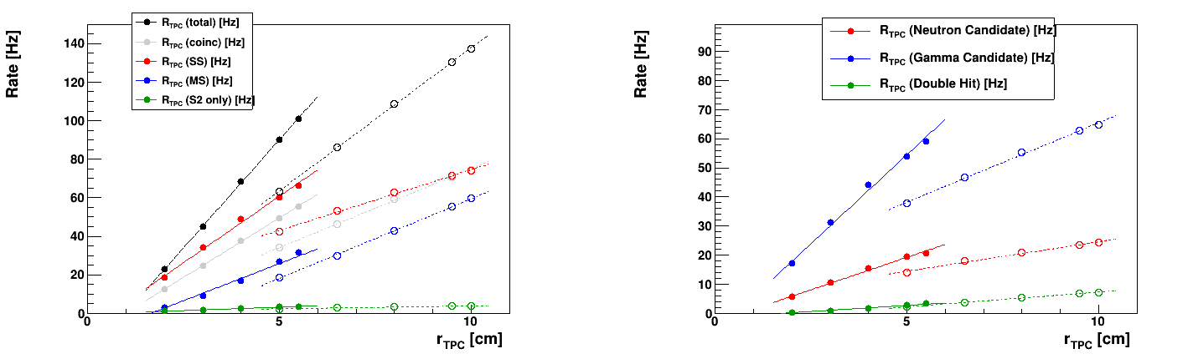
TPC (single) rates
Solid Markers : small cryostat
Empty Markers: big cryostat
The same three effects mentioned for the signal sample drive the behaviour observed.
Gamma/Neutron candidate:
→ Single Scatters , S1>100 && f100 compatible
→ S2 only and S1<100 (this population is counted in both types)
Double Hit:
S1>100 && f100>0.5 && Multiple S2
The double hit rate is the base population for scattering angle calculation on the basis of LAr only.
The rate is 3 [Hz] (Old cryo r=5 [cm]) and 10 [Hz] (New cryo r=10 [cm])
If BaF is required in coincidence ~1.5 / 5 [Hz]
Notes:
27

