Slide 1


Updates of the SOURCES4 code for (α,n) reactions
Mihaela Parvu¹, Vitaly Kudryavtsev²
    ¹ University of Bucharest, Romania
    ² University of Sheffield, United Kingdom
DRD2 Collaboration Meeting, CERN, 11-13 February 2025

Slide 2
Outline
Neutron production in (α,n) reactions in SOURCES4
Modifications of the SOURCES4 code
  Cross sections comparison
  Branching ratios calculations
Neutron yields and neutron spectra
Conclusions
2

Slide 3
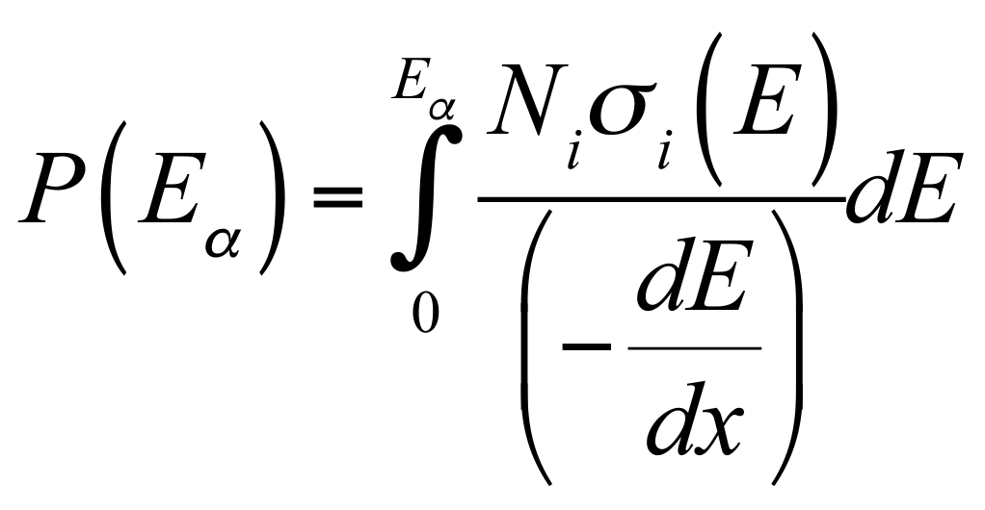
The SOURCES4 code to calculate neutron production (α,n) reactions
The probability for an alpha particle to produce a neutron by interacting with a nuclide i (N_{i} is the number density of atoms of nuclide i):
Stopping power cross-sections from the tables compiled by Ziegler.
Ziegler, James F. "Helium: stopping powers and ranges in all elemental matter." (1977).
W.B. Wilson, et al., SOURCES4A: a code for calculating (α,n), spontaneous fission, and delayed neutron sourcesand spectra, Technical Report LA-13639-MS, Los Alamos, 1999;
J. Carson, et al., Neutron background in large-scale xenon detectors for dark matter searches, Astropart. Phys. 21 (2004) 667–687.
V. Tomasello, V. A. Kudryavtsev, M. Robinson, Calculation of neutron background for underground experiments, Nucl. Instrum. & Meth. in Phys. Res. A 595 (2) (2008), arXiv:0807.0851
3

Slide 4
The SOURCES4 code to calculate neutron production (α,n) reactions
Advantages
Flexible libraries of cross-sections and branching ratios
Fast calculation
Total neutron spectra; spectra from interactions on individual isotopes and from the variety of radioisotopes in a single calculation
        Spectra from the ground state
        Spectra from excited states.
Ziegler, James F. "Helium: stopping powers and ranges in all elemental matter." (1977).
W.B. Wilson, et al., SOURCES4A: a code for calculating (α,n), spontaneous fission, and delayed neutron sourcesand spectra, Technical Report LA-13639-MS, Los Alamos, 1999;
J. Carson, et al., Neutron background in large-scale xenon detectors for dark matter searches, Astropart. Phys. 21 (2004) 667–687.
V. Tomasello, V. A. Kudryavtsev, M. Robinson, Calculation of neutron background for underground experiments, Nucl. Instrum. & Meth. in Phys. Res. A 595 (2) (2008), arXiv:0807.0851
4

Slide 5
The SOURCES4 code to calculate neutron production (α,n) reactions
The original code SOURCES4A was modified to allow calculations of neutron production from alphas with energies up to 10 MeV.
The maximum number of discrete nuclear levels for the product nuclides was increased from 100 to 500.
The maximum number of target elements was increased from 20 to 110.
The cross-sections and the branching ratios for (α, n) reactions in SOURCES4 have been taken from reliable experimental data (including some recent ones) where possible and complemented by the calculations with EMPIRE2.19/3.2.3, TALYS1.96 and JENDL-5 where the data were scarce or unavailable.
Various sets of cross-sections are available in the library → we just recommend the most reliable.
W.B. Wilson, et al., Technical Report LA-13639-MS, Los Alamos, 1999;
J. Carson, et al., Astropart. Phys. 21 (2004) 667–687.
V. Tomasello, et al.,NIM A 595 (2) (2008)
V.A. Kudryavtsev et al., NIMA 972 (2020): 164095.
V.A. Kudryavtsevet al., SciPost Physics Proceedings 12 (2023): 018.
V.A. Kudryavtsev et al., AIP Conference Proceedings. Vol. 2908. No. 1 (2023)
M. Parvu, P. Krawczun, V.A. Kudryavtsev, arXiv:2408.10910
5
Notes:
6.5 MeV energy cut

Slide 6
TALYS 1.96
Currently, in the default version of the TALYS 1.96 nuclear reaction code, the maximum number of discrete levels that are considered in the Hauser-Feshbach model for the residual nuclei is set to 30.
We have modified the code in order to increase the number of levels, therefore all the possible excited states for the final state nucleus that are available in RIPL-3 can be considered for the calculation of the branching ratios. In this way, we ensure that 100% of neutrons from the neutron energy spectrum are accounted for in the total neutron yield.
* Codes based on statistical models do not predict the resonance structure or the cross sections for light elements.
6

Slide 7
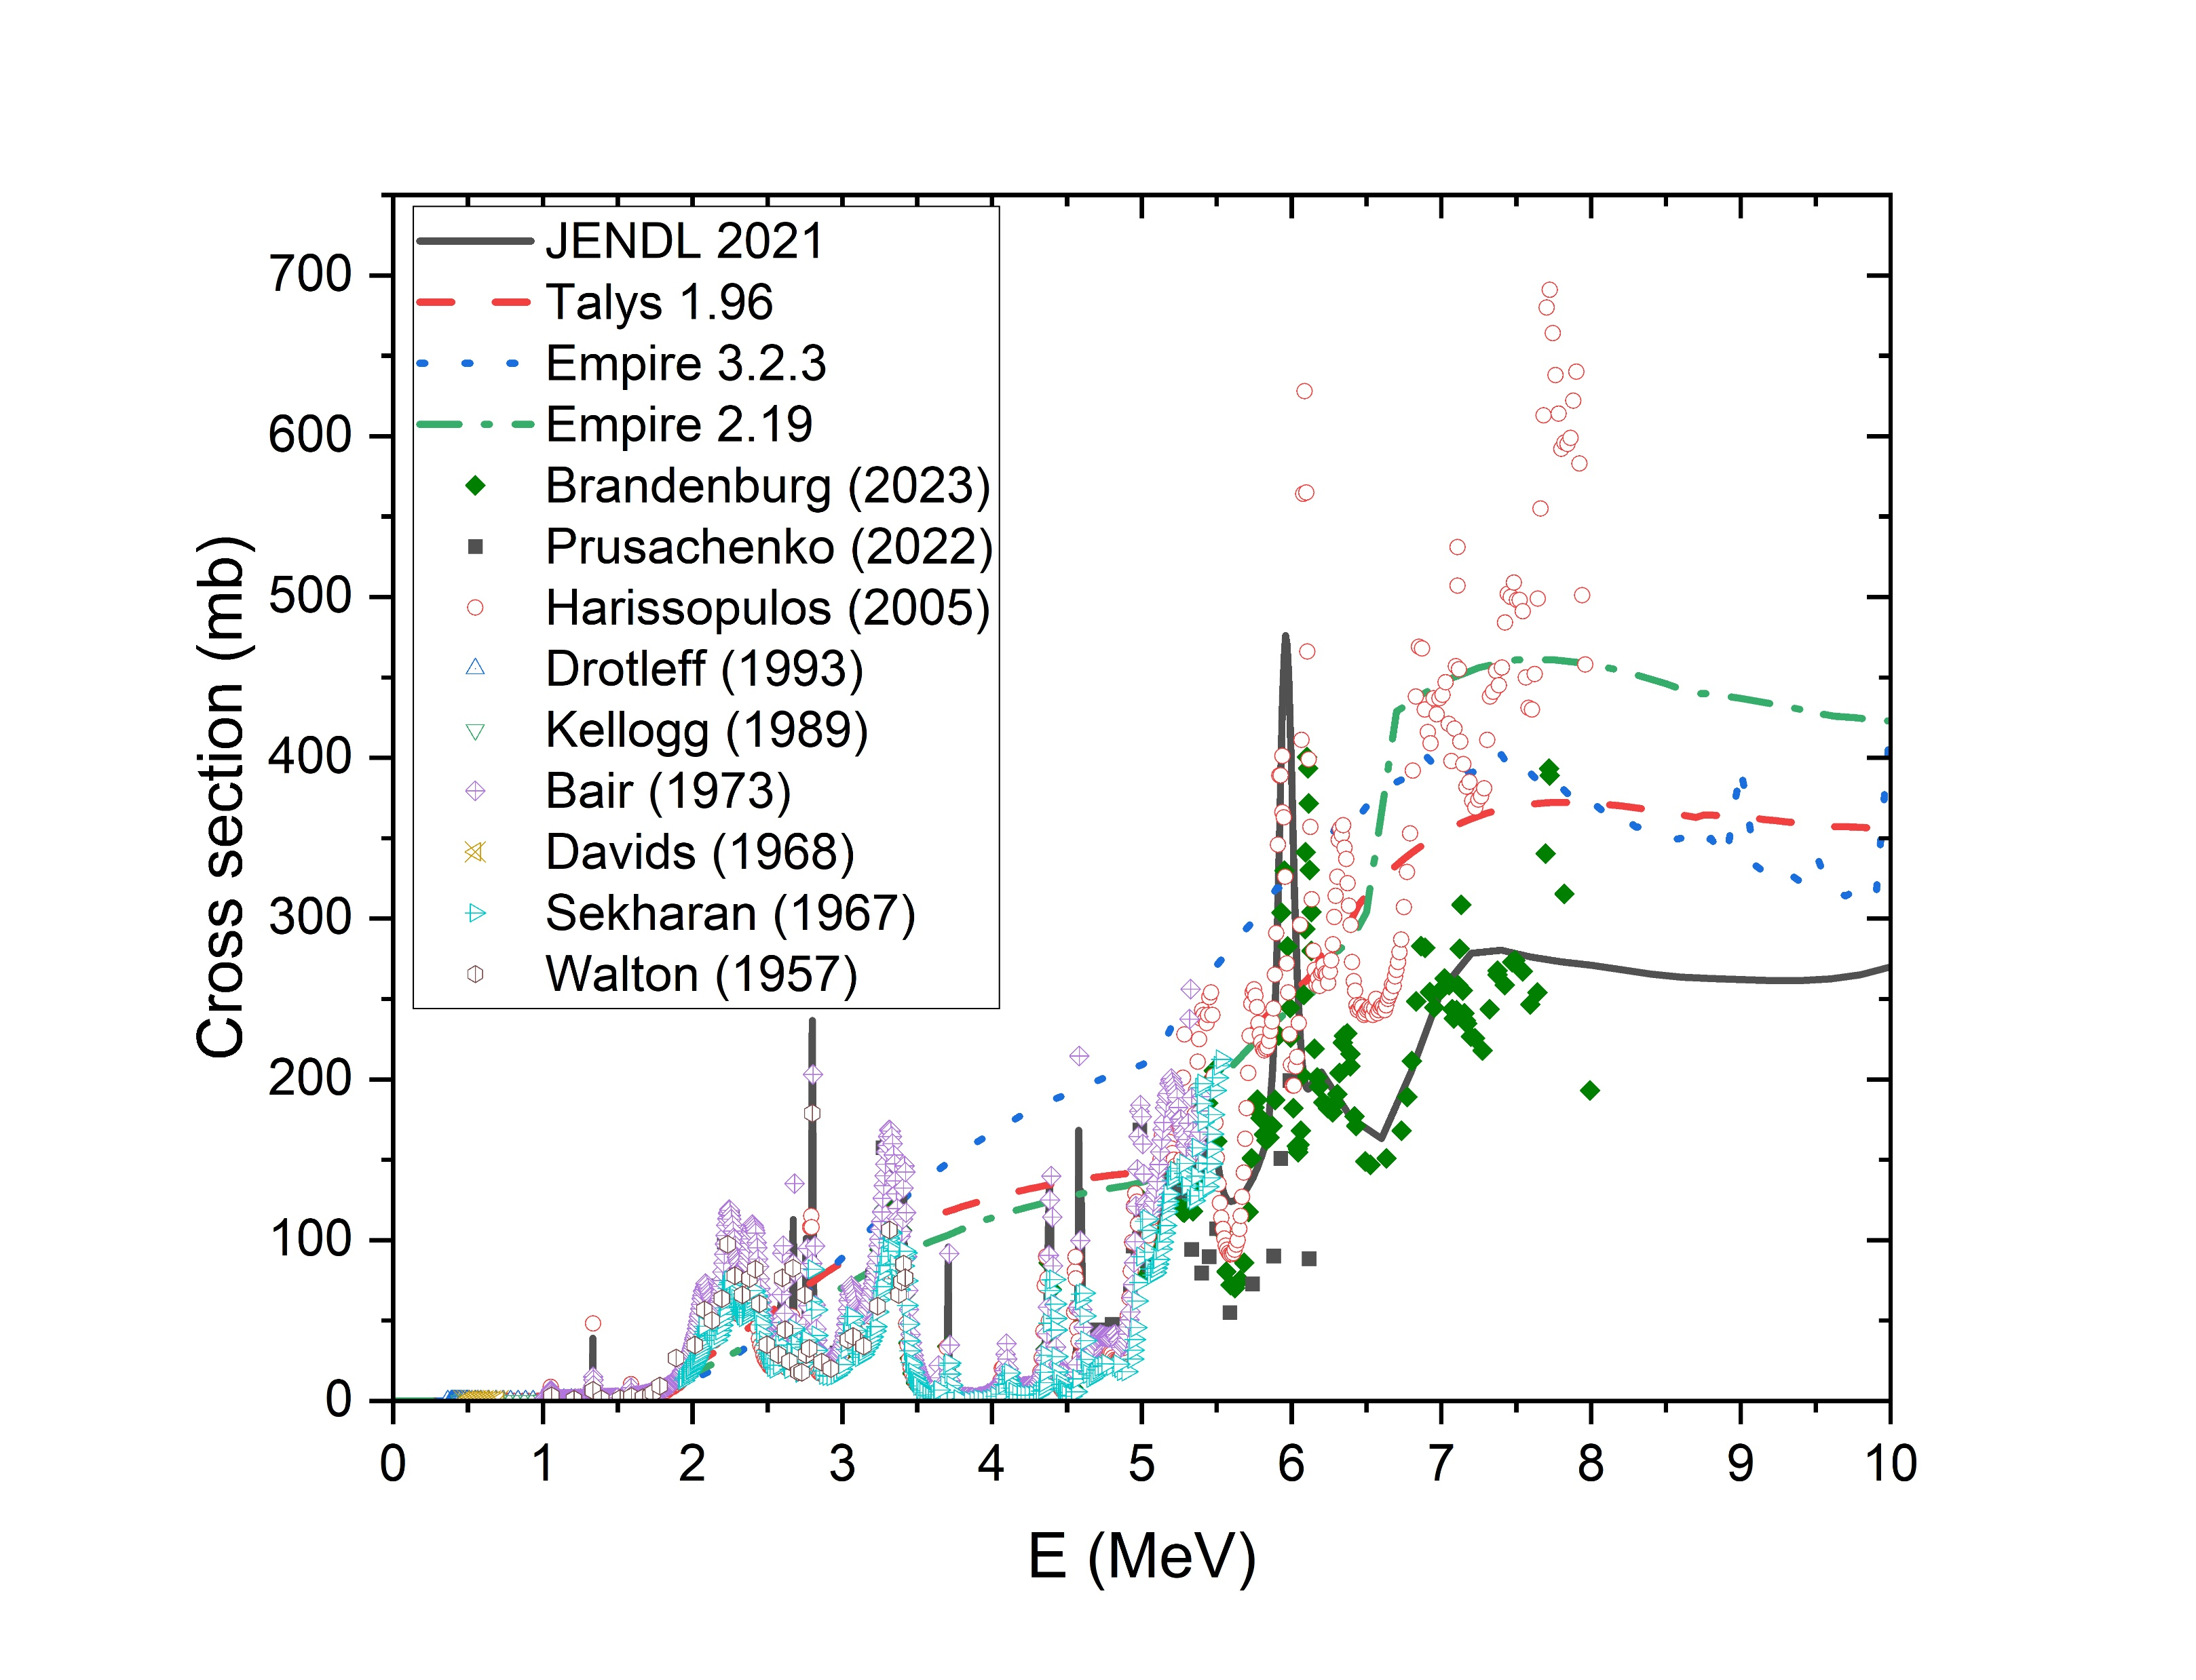
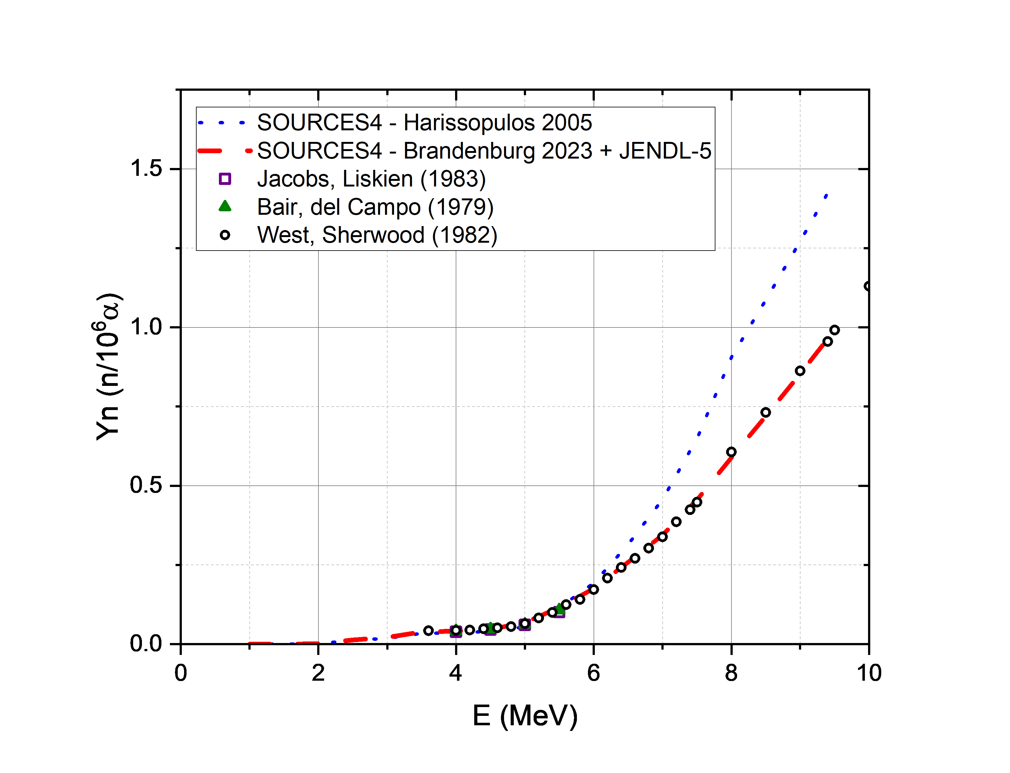
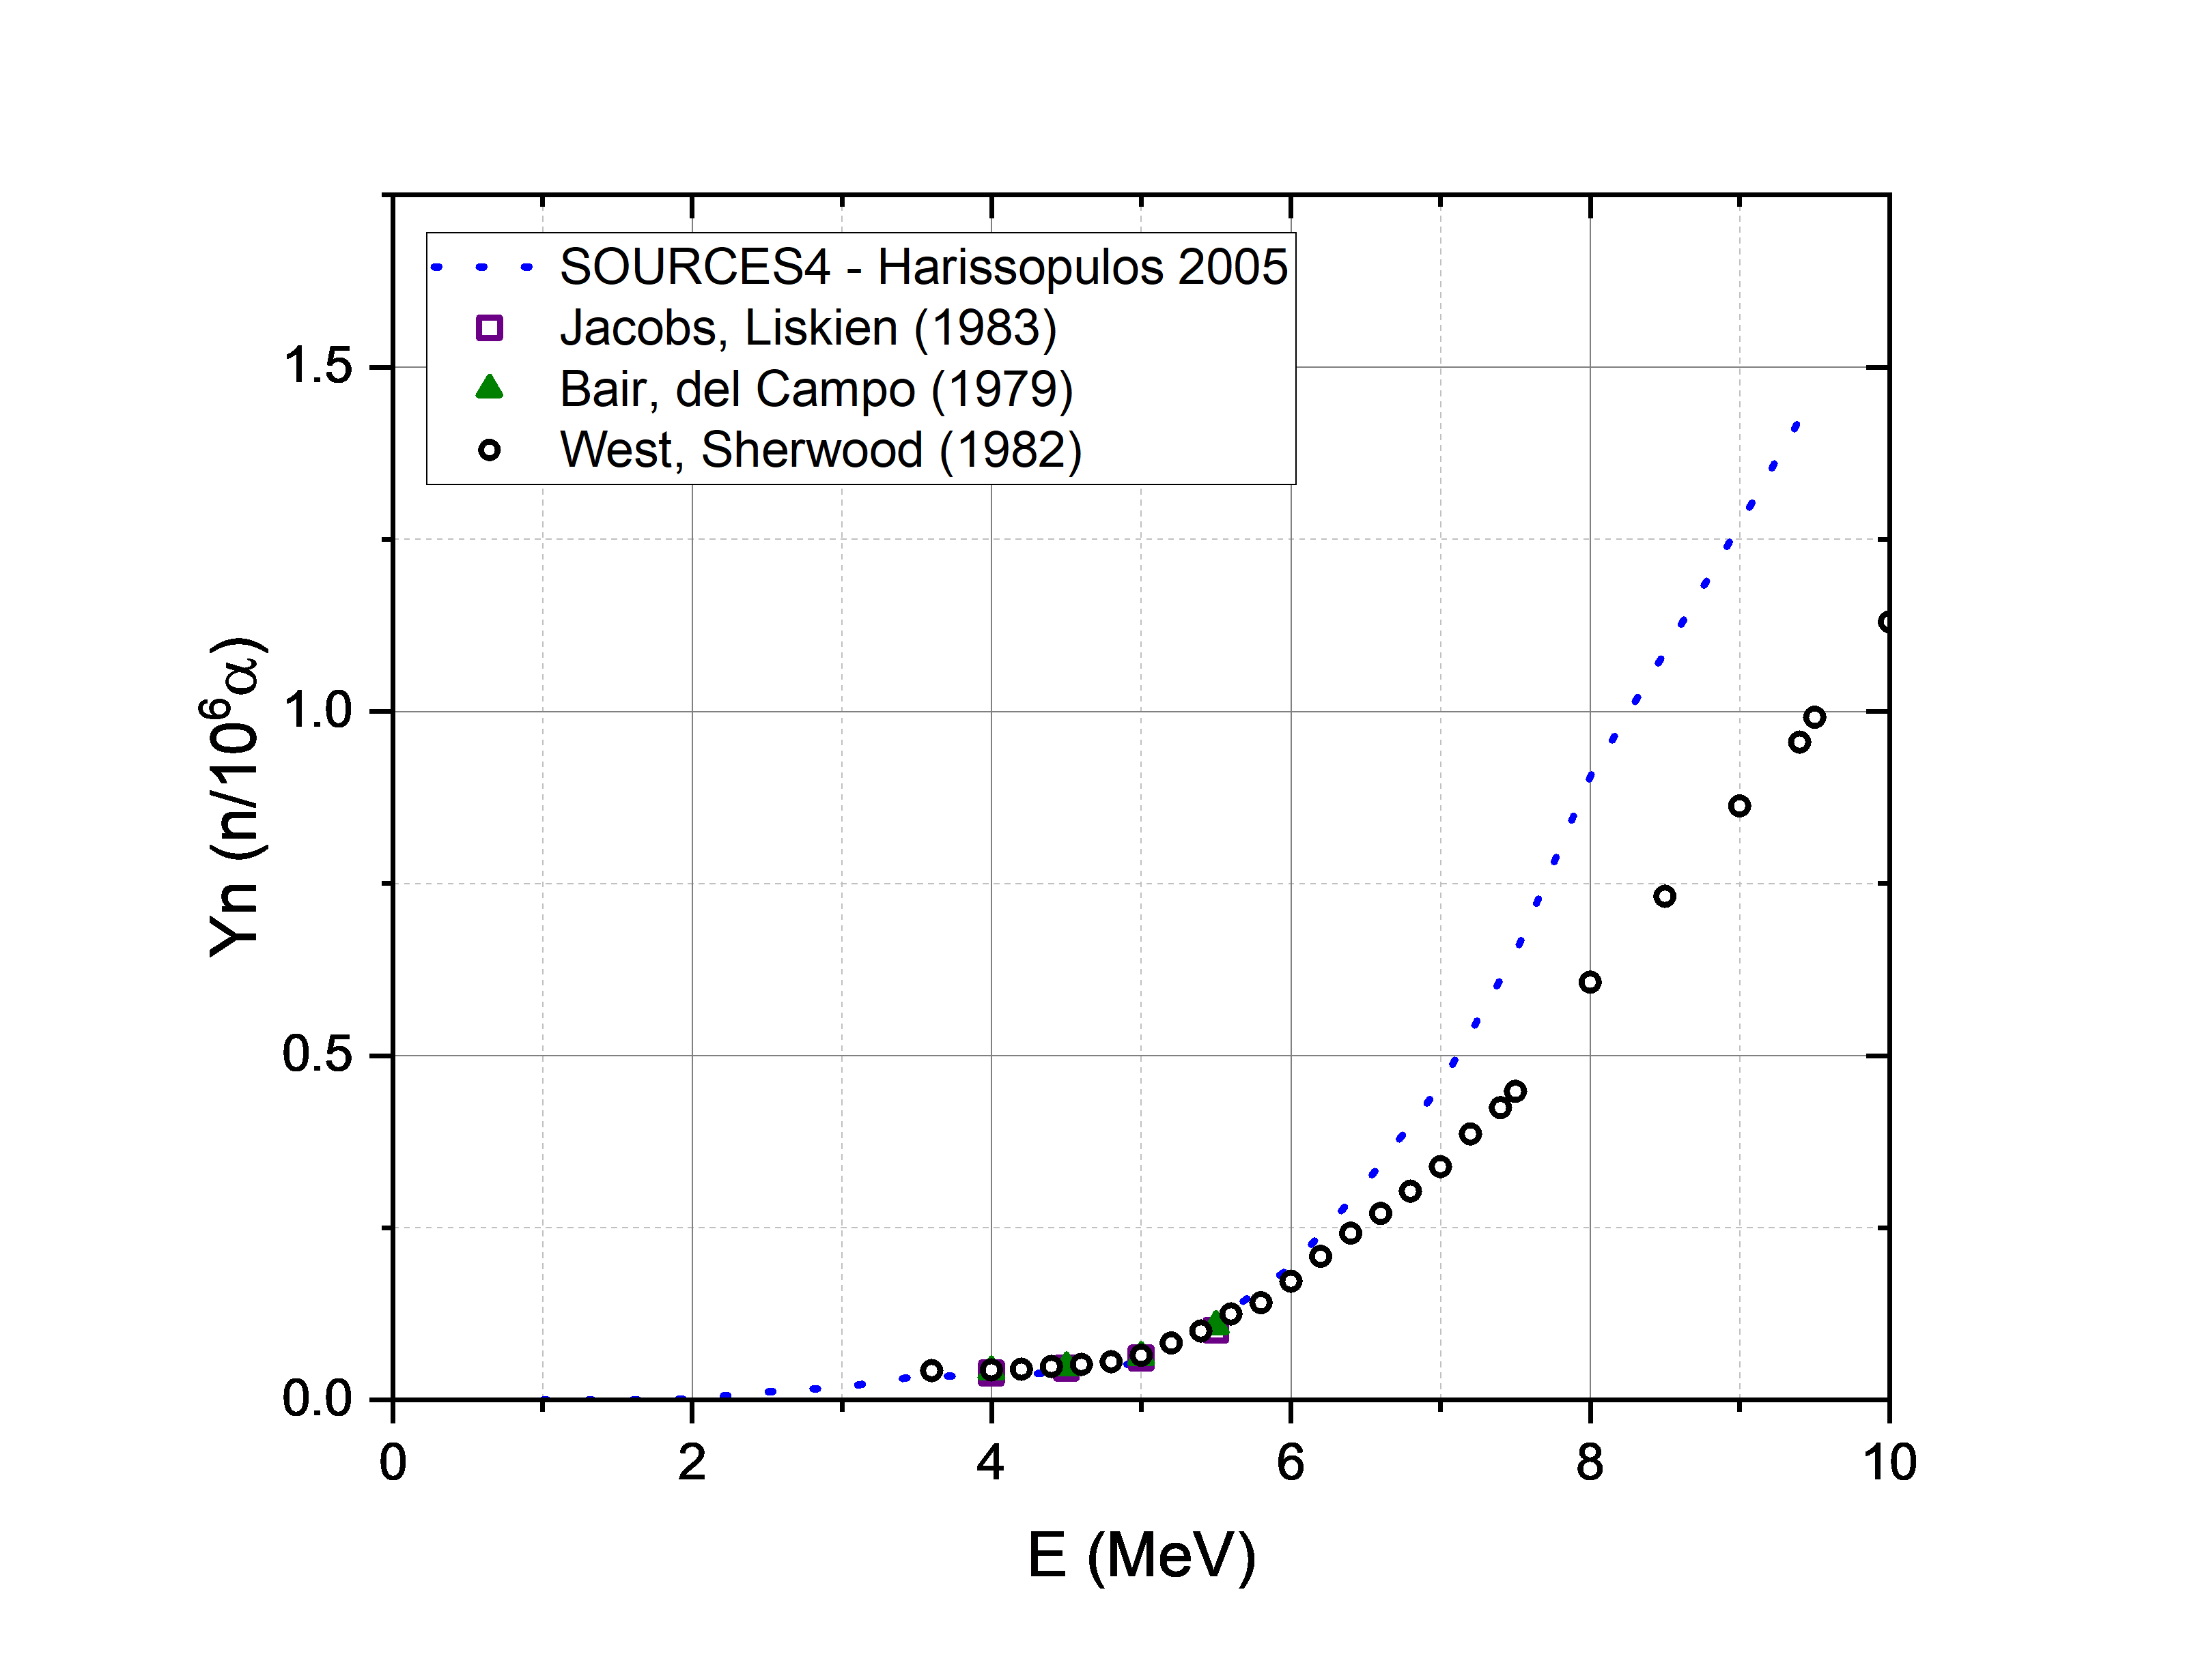
¹³C(α,n)¹⁶O
previous cross-sections resulted in a higher neutron yield.
most recent experimental data lead to a very good agreement for the neutron yield.
Brandenburg (2023) + TALYS 1.96 calc. - new default in SOURCES4
*Prusachenko data are for the ground state transition
Kellogg, S. E., R. B. Vogelaar, and R. W. Kavanagh. "13C (α, n) and 14C (p, n): Astrophysical neutron sources and sinks." Bulletin of the American Physical Society 34 (1989)
J. K. Bair and F. X. Haas, Phys. Rev. C 7, 1356 (1973)
Davids, Cary N. "A study of (α, n) reactions on 9Be and 13C at low energies." Nuclear Physics A 110.3 (1968)
K. K. Sekharan, A. S. Divatia, M. K. Mehta, S. S. Kerekatte, and K. B. Nambiar, Phys. Rev. 156, 1187 (1967)
R. B. Walton, J. D. Clement, and F. Boreli, Phys. Rev. 107, 1065 (1957)
K. Brandenburg, et al., Measurements of the 13C(α, n)16O cross section up to Eα = 8MeV, Phys. Rev. C, 108 (2023) L061601.
P. S. Prusachenko, T. L. Bobrovsky, I. P. Bondarenko, M. V. Bokhovko, A. F. Gurbich, and V. V. Ketlerov, Phys. Rev. C 105, 024612 (2022)
S. Harissopulos, H. W. Becker, J. W. Hammer, A. Lagoyannis, C. Rolfs, and F. Strieder, Phys. Rev. C 72, 062801(R) (2005)
H.W. Drotleff et al., Astrophysical Journal v.414, p.735 (1993)
7

Slide 8
¹⁷O(α,n)²⁰Ne
¹⁸O(α,n)²¹Ne
The cross-sections measured by Kunz and Bair are used, and replaced with the ones from JENDL-5 above ⁓5.2 MeV.
J.K.Bair,J.Gomez del Campo:Nucl.Sci.Eng.71,18(1979)
Kunz, Rino E., et al., International Conference on Neutrons and Their Applications. Vol. 2339. SPIE, 1995.
Hansen et al., Nuclear Physics A 98.1 (1967): 25-32.
8

Slide 9
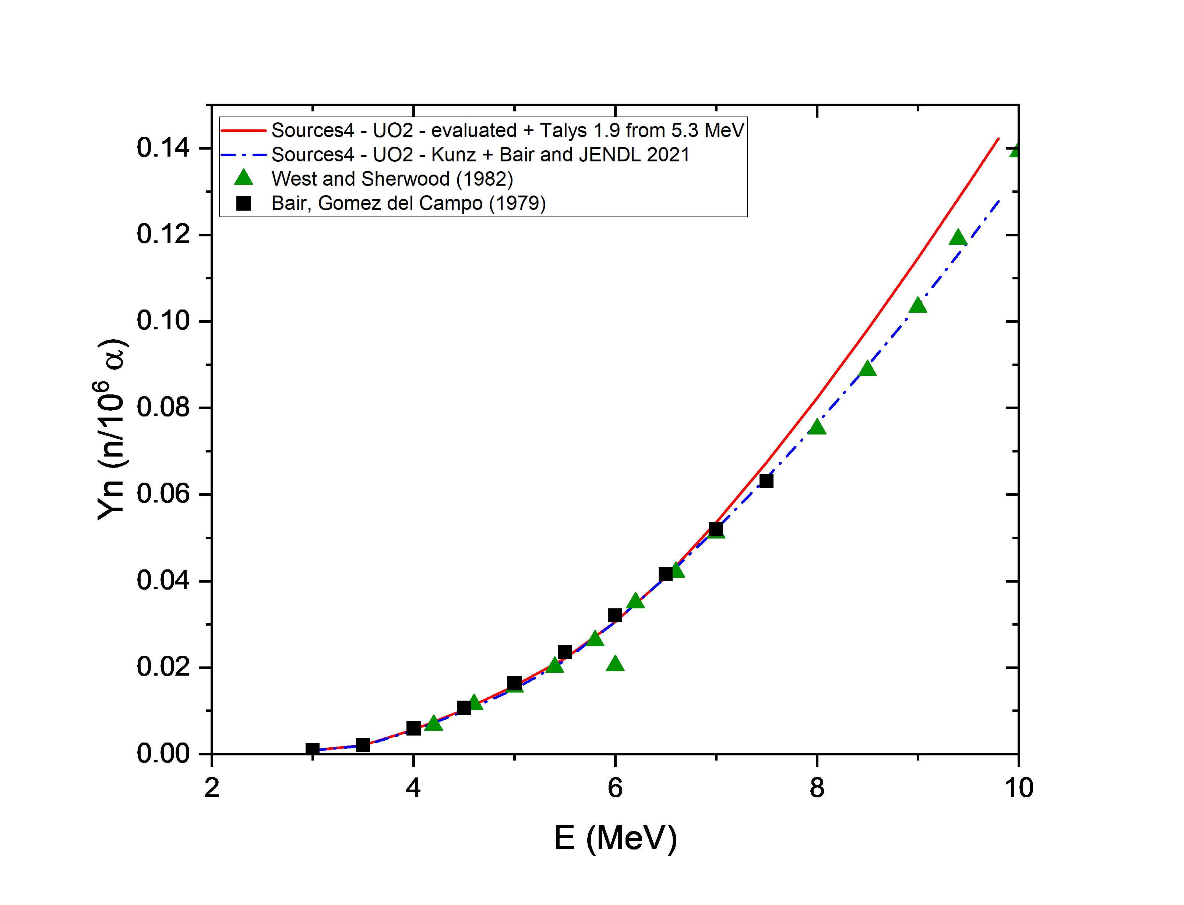
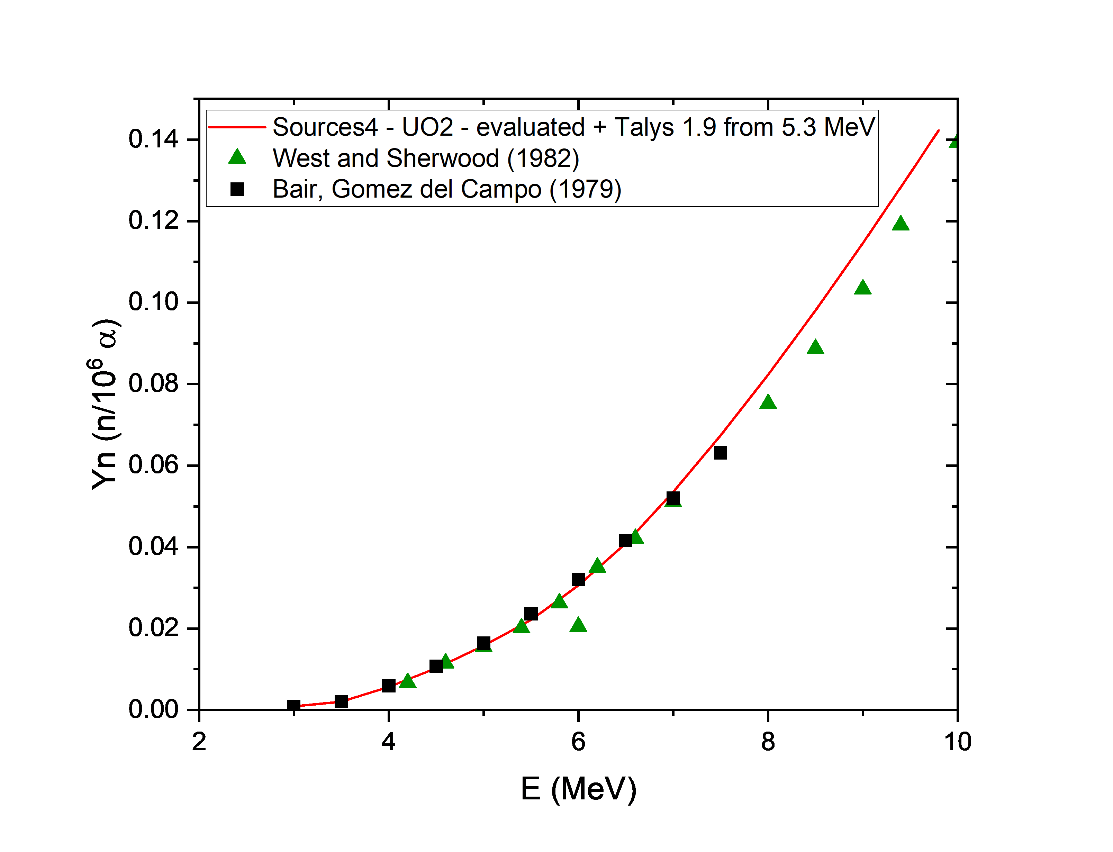
UO2 neutron yield
Previous cross sections were taken from evaluated data of Perry and Wilson, Los Alamos report la-8869-ms and complemented with Talys (red curve)
→ Yn does not reproduce the data above 7 MeV.
The cross-sections measured by Kunz and Bair are used and complemented with the ones from JENDL-5 above ⁓5.2 MeV.
→ very good agreement with the experimental data.
West, D., and A. C. Sherwood, Annals of Nuclear Energy 9.11-12 (1982): 551-577.
J.K.Bair,J.Gomez del Campo:Nucl.Sci.Eng.71,18(1979)
9

Slide 10
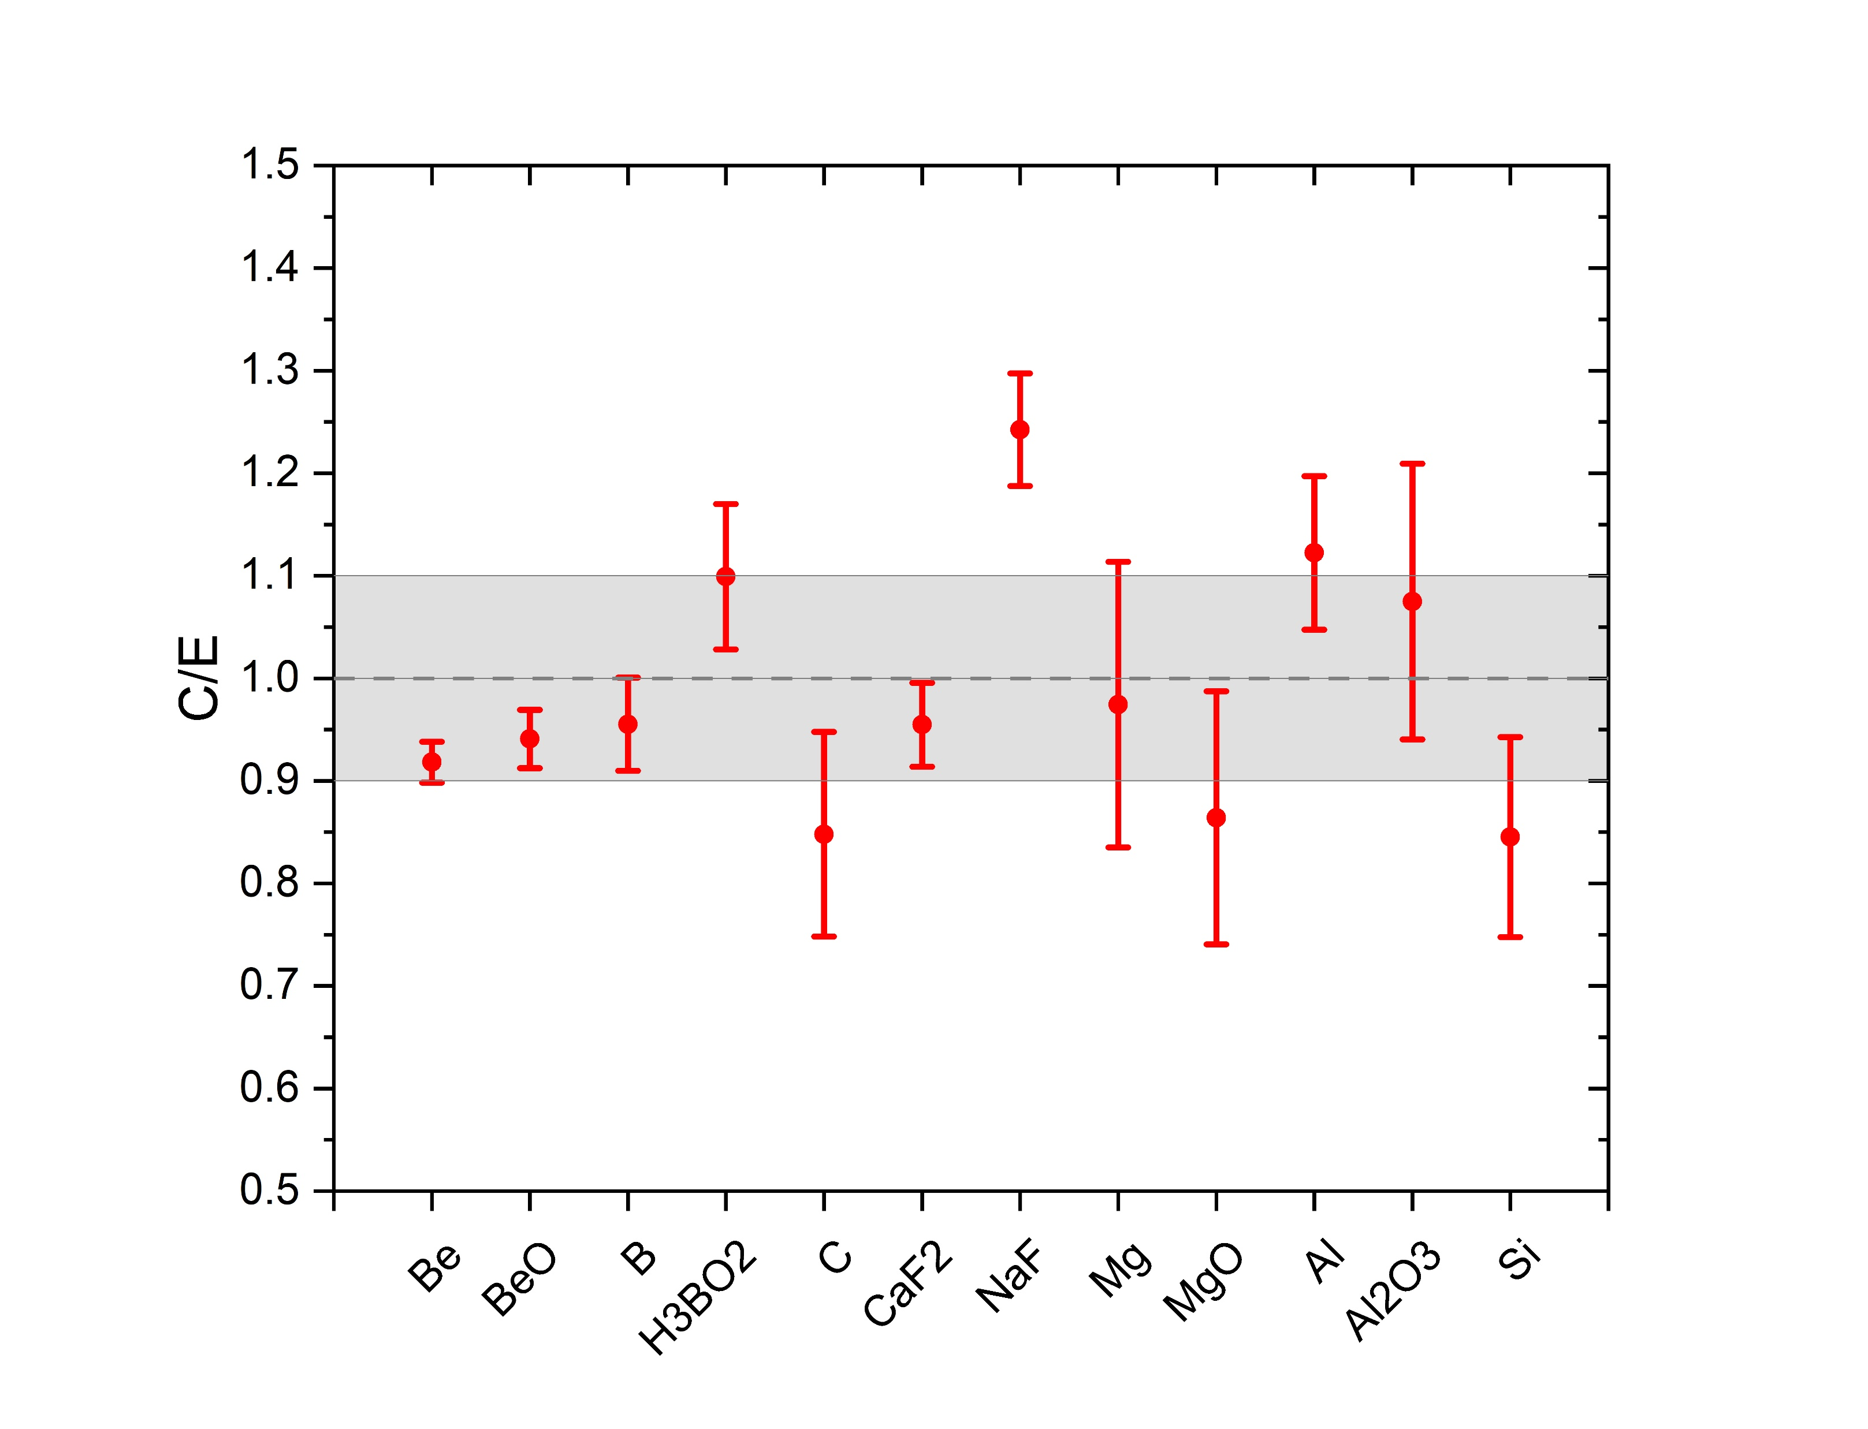
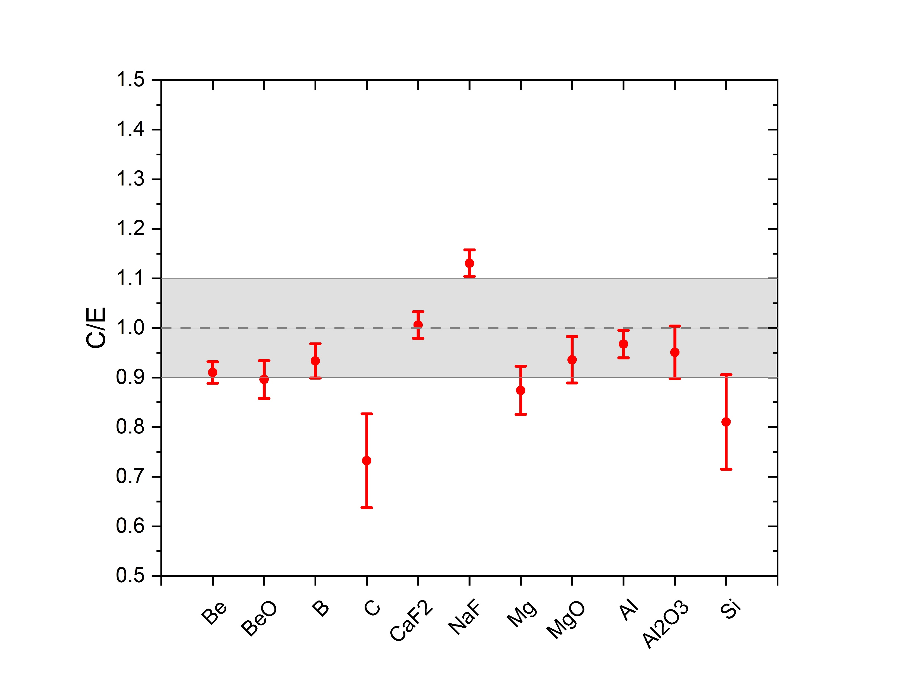
Neutron Yield from (α,n) reactions with optimised SOURCES4 code
In the case of Al, the Yn for U decay chain is higher, but in the case of Th-232 decay chain the results are closer to the evaluated ones.
→ Is this due to different α energies or uncertainties?
NaF neutron yield is higher than measurement.
Ratio of the calculations with optimised SOURCES4 to the neutron yield measured by Gorshkov et al. for: (a) ^{nat}U and (b) ²³²Th decay chains in several materials. The shaded area represents the ±10% difference. Only the experimental errors are included.
Agreement within 10% for most isotopes and within 20% for almost all of them.
Gorshkov, G. V., and O. S. Tsvetkov. "Be, B, C, O, F, Na, Mg, Al and Si neutron yields from an (α, n) reaction under the effect of thorium and uranium α-particles and their decay products." Soviet Atomic Energy 14.6 (1964): 573-577.

Slide 11
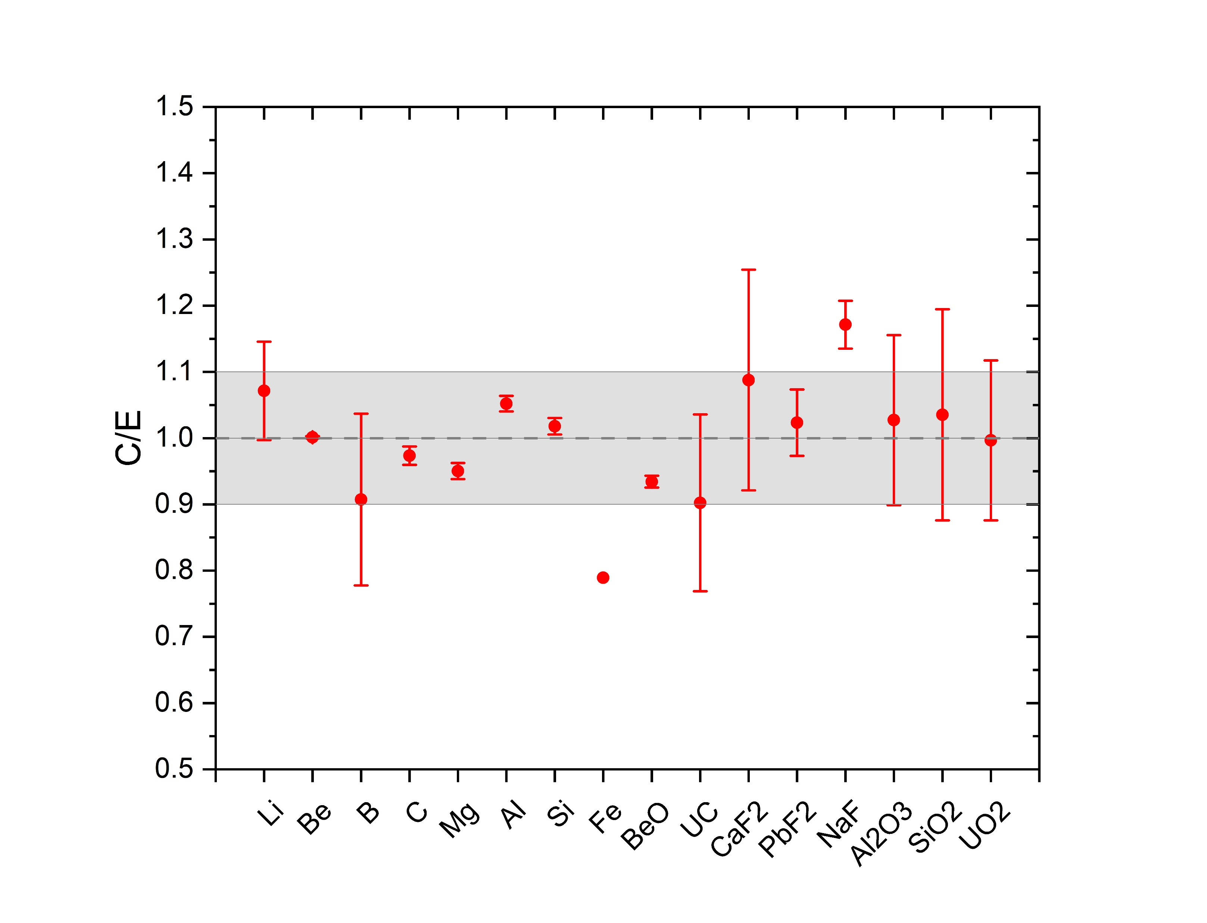
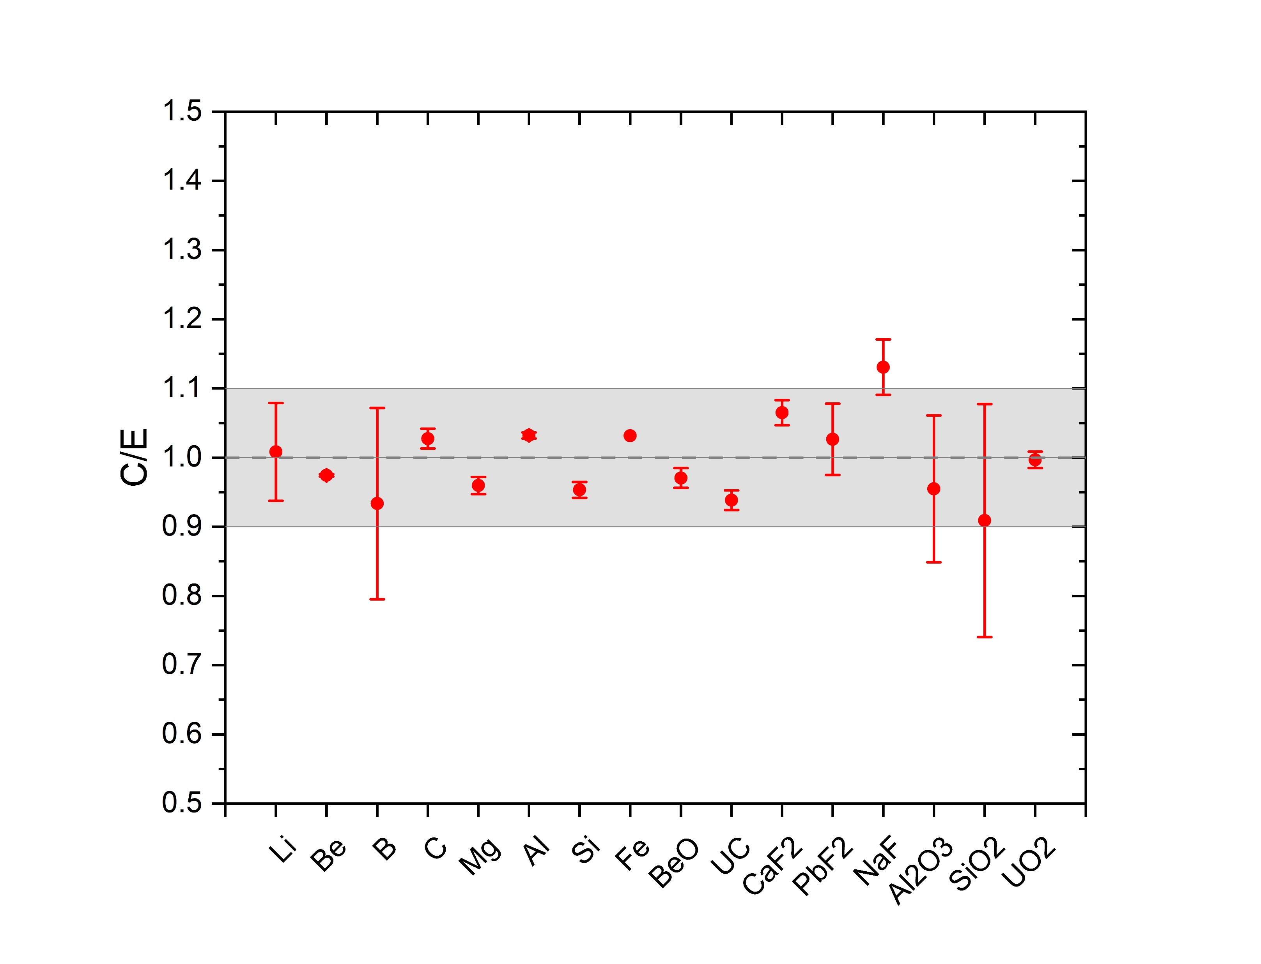
Neutron Yield from (α,n) reactions with optimised SOURCES4 code
NaF neutron yield is higher than measurements but for CaF₂ and PbF₂ are not so high. In all cases F dominates. Is this a problem with data?
In the case of Fe, the Yn for U-238 decay chain is much smaller, but in the case of Th-232 decay chain the results are closer to the evaluated ones. Is this due to different α energies or uncertainties?
Ratio of the calculated values from the optimised SOURCES4 code to the evaluated neutron yield data from Fernandes et al. for (a) ²³⁸U and (b) ²³²Th decay chains in several materials. The shaded area represents the ±10% difference. No error was given for Fe. Only the experimental errors were taken into account for other materials.
Fernandes, Ana C., Andreas Kling, and Gennadiy N. Vlaskin. "Comparison of thick-target (alpha, n) yield calculation codes." EPJ Web of Conferences. Vol. 153. EDP Sciences, 2017.
11

Slide 12
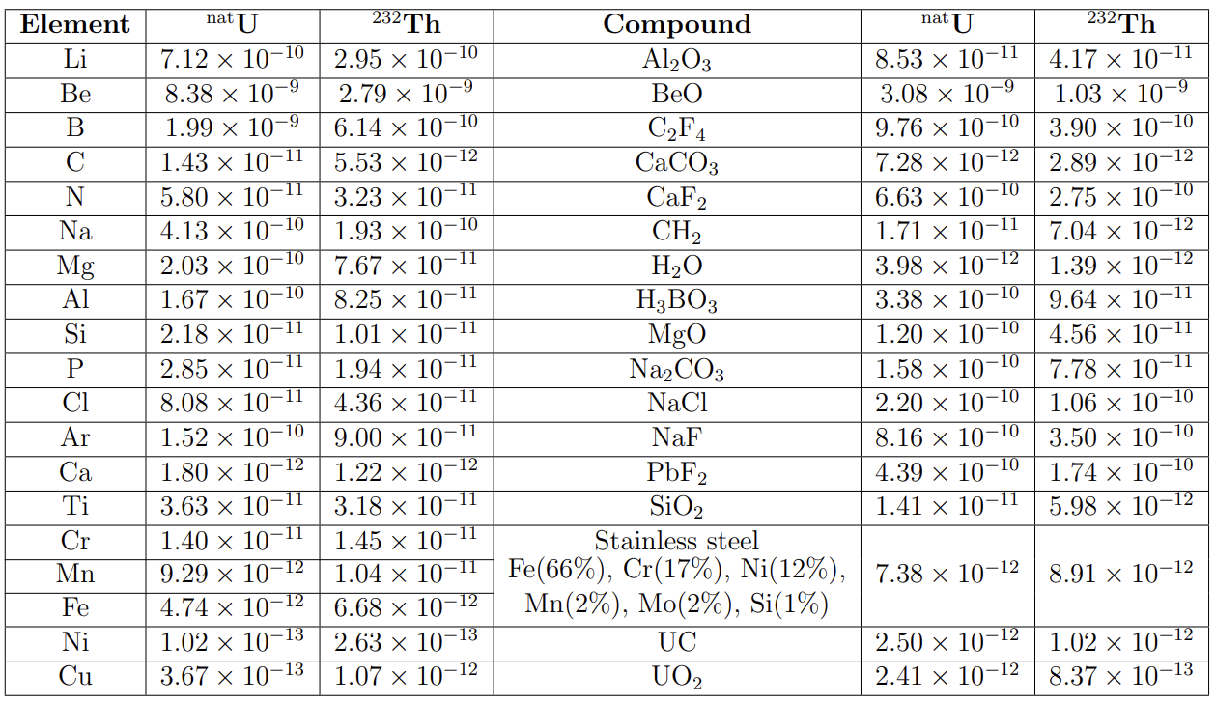
Neutron yield from (α, n) reactions originated in ^{nat}U and ²³²Th decay chains in several materials as calculated by the SOURCES4 code. Neutron yield is given as the number of neutrons per gram of material per second per ppb of U or Th concentration. Spontaneous fission of ²³⁸U gives a neutron yield of 1.35×10⁻¹¹ n/g/s/ppb in all materials.
12

Slide 13
Neutron yields from (α,n) reactions for Stainless Steel
Stainless Steel | SOURCES4 [n/s/g/ppb]
 | U_{tot} | U_{early} | U_{late} | Th-232
SS304L Fe(66.76%), C(0.16%), Cr(19.99%), Ni(9.31%), Mn(1.97%), Si(1.48%), P(0.05), S(0.05%), Al(0.22) | 6.58 × 10⁻¹² | 2.57 × 10⁻¹³ | 6.32 × 10⁻¹² | 7.76 × 10⁻¹²
S460ML Fe(95.35%), Mn(1.7%), Ni(0.8%), Si(0.6%), Cu(0.55%), C(0.18%), P(0.03%), S(0.025%), Al(2e-8%), N(0.025%), Nb(0.05%), V(0.12%), Ti(0.05%), Cr(0.3%), Mo(0.2%) | 4.92 × 10⁻¹² | 1.652 × 10⁻¹³ | 4.75 × 10⁻¹² | 6.71 × 10⁻¹²
Rel. diff. (%) | 25.22% | 35.71% | 24.84% | 13.53%
13

Slide 14
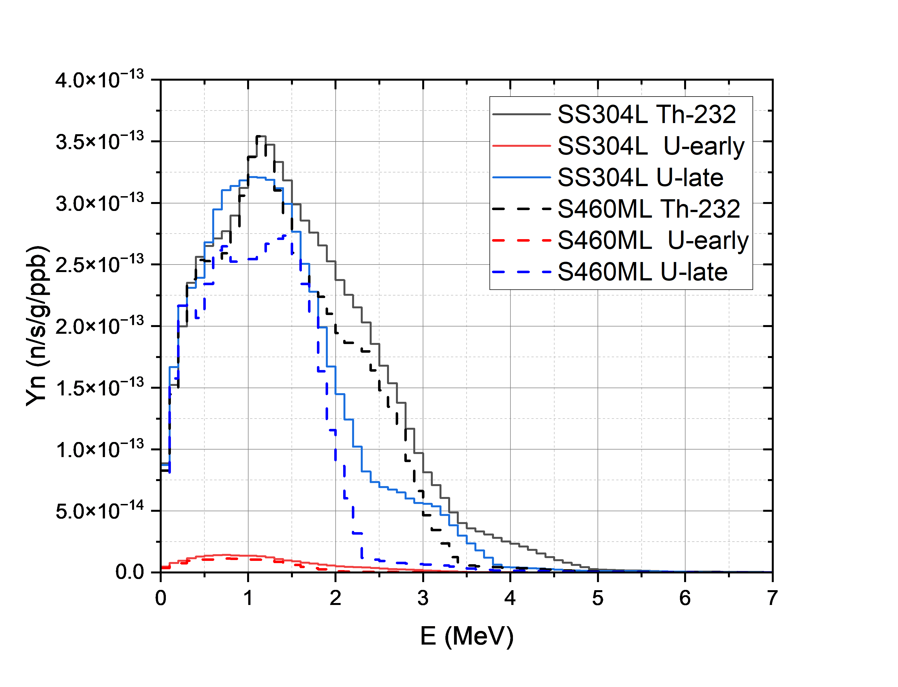
Neutron spectra from Stainless Steel
SS304L vs. S460ML
 | Average neutron energy [MeV]
 | SS304L | S460ML
Th-232 | 1.583 | 1.420
U_{early} | 1.248 | 1.005
U_{late} | 1.346 | 1.116
* this does not include the s.f. of ²³⁸U which will add a supplementary neutron yield of 1.353 × 10⁻¹¹ n/s/g/ppb with a mean energy of 1.688 MeV
14

Slide 15
Conclusions
Data on cross-sections are not always sufficient to choose the best code/model or data set.
New experimental and calculated cross-sections were added to SOURCES4 libraries.
The code was modified to include extended range of excited states and isotopes.
‘Optimised' approach
  Use reliable cross-section data where possible
  If no data exist for an isotope, use a model (TALYS or EMPIRE) or JENDL database
  Choose the model based on comparison with alpha beam data (when available)
Neutron yields with the 'optimised' approach show a good agreement with data within 10% for most materials where comparison is possible.

Slide 16
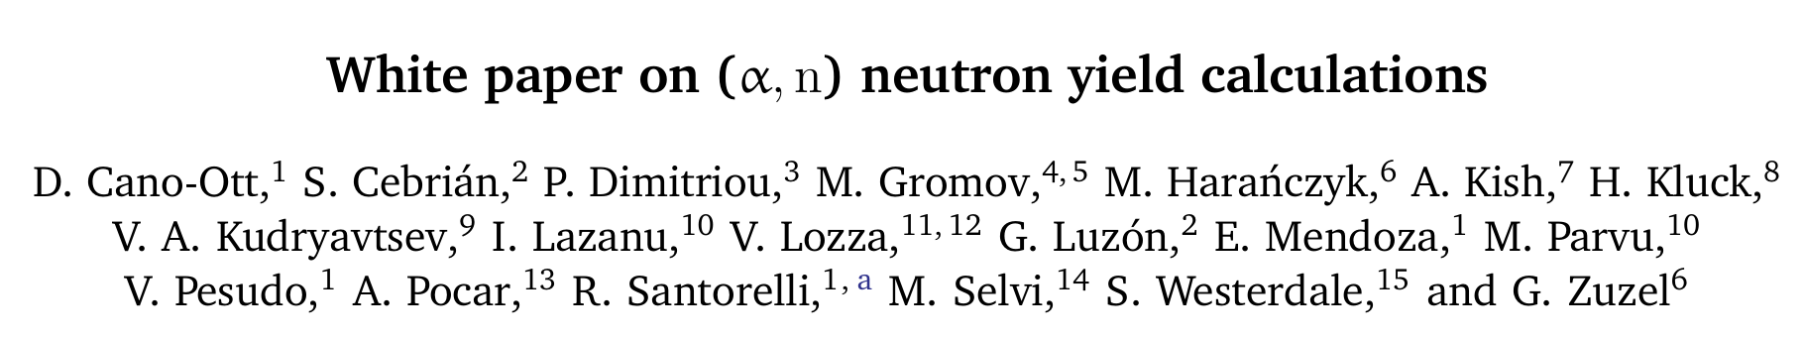



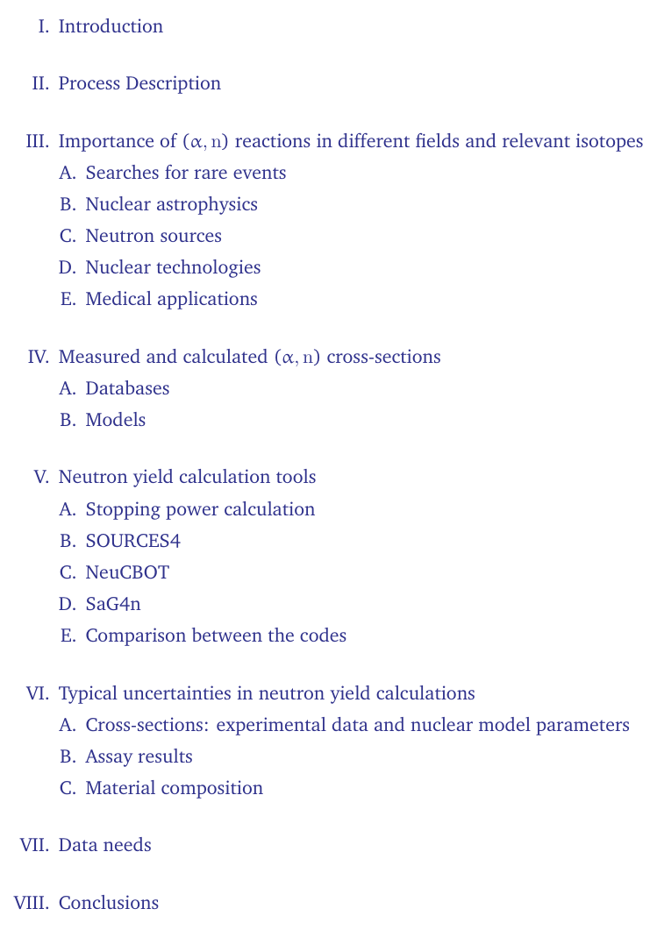
16

Slide 17
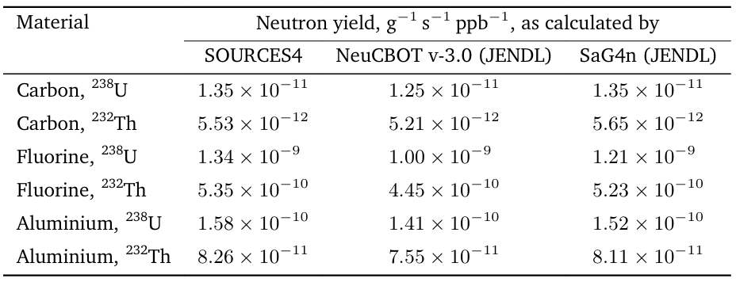
17

Slide 18
Thank you for your attention!

Slide 19
Additional slides

Slide 20
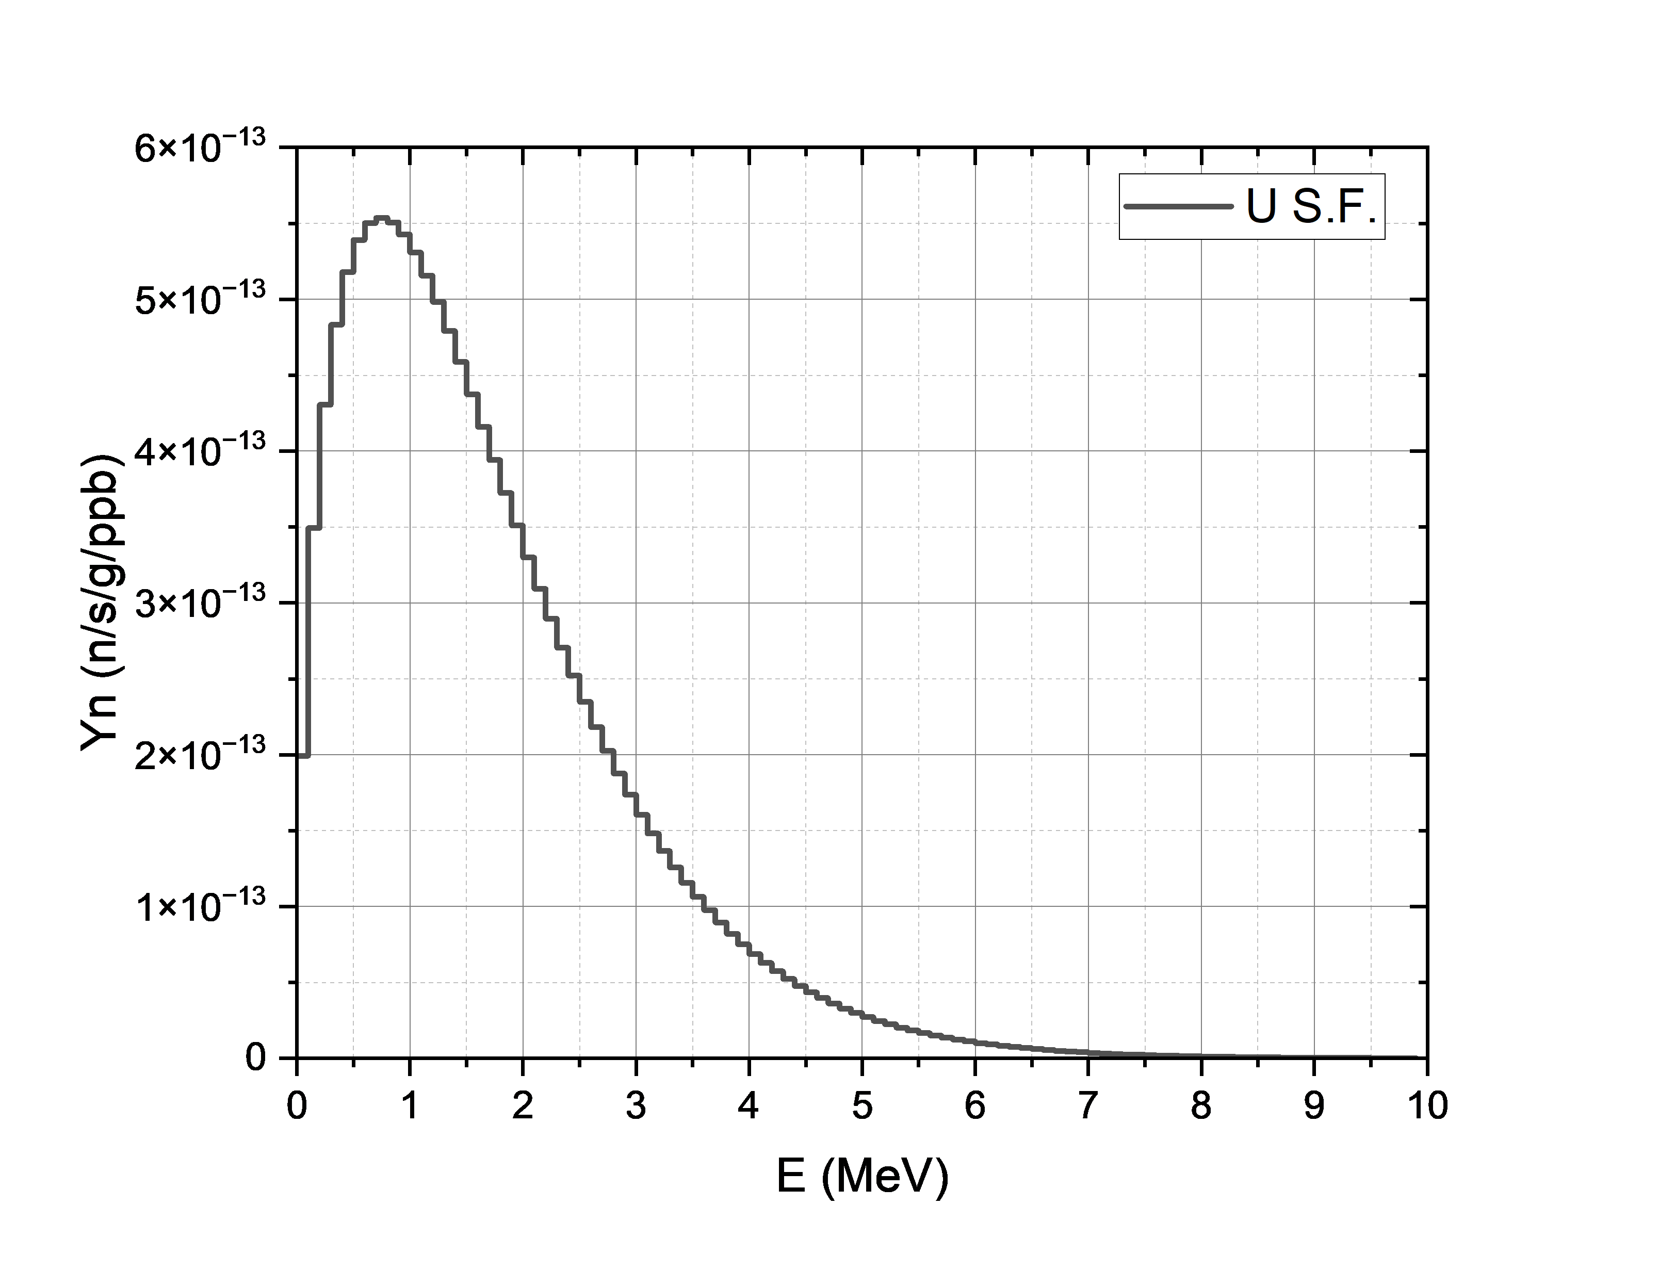
Important!
For all the elements the spontaneous fission of ²³⁸U decay chain will add a supplementary neutron yield of 1.353 × 10⁻¹¹ n/s/g/ppb with a mean energy of 1.688 MeV.

Slide 21
Neutron yields from (α,n) reactions for Stainless Steel
Stainless Steel | SOURCES4 [n/s/g/ppb]
 | U_{tot} | U_{early} | U_{late} | Th-232
SS304L Fe(66.76%), C(0.16%), Cr(19.99%), Ni(9.31%), Mn(1.97%), Si(1.48%), P(0.05), S(0.05%), Al(0.22) | 6.58 × 10⁻¹² | 2.57 × 10⁻¹³ | 6.32 × 10⁻¹² | 7.76 × 10⁻¹²
S460ML Fe(95.35%), Mn(1.7%), Ni(0.8%), Si(0.6%), Cu(0.55%), C(0.18%), P(0.03%), S(0.025%), Al(2e-8%), N(0.025%), Nb(0.05%), V(0.12%), Ti(0.05%), Cr(0.3%), Mo(0.2%) | 4.92 × 10⁻¹² | 1.652 × 10⁻¹³ | 4.75 × 10⁻¹² | 6.71 × 10⁻¹²
Rel. diff. (%) | 25.22% | 35.71% | 24.84% | 13.53%
 | U_{early} |  | U_{late} |  | Th-232 |  | fraction
 | SS304L | S460ML | SS304L | S460ML | SS304L | S460ML | SS304L | S460ML
Cr | 8.5692E-14 | 1.2693E-15 | 2.2070E-12 | 3.2702E-14 | 2.3842E-12 | 3.5343E-14 | 32.61% | 0.60%
Al | 2.0753E-14 | 1.8587E-15 | 2.1070E-13 | 1.8889E-14 | 1.1376E-13 | 1.0202E-14 | 2.41% | 0.27%
Fe | 8.7742E-14 | 1.3533E-13 | 2.7075E-12 | 4.1770E-12 | 3.9452E-12 | 6.0893E-12 | 47.00% | 89.44%
Tot | 1.94E-13 | 1.38E-13 | 5.13E-12 | 4.23E-12 | 6.44E-12 | 6.13E-12 | 82.03% | 90.30%
21

Slide 22
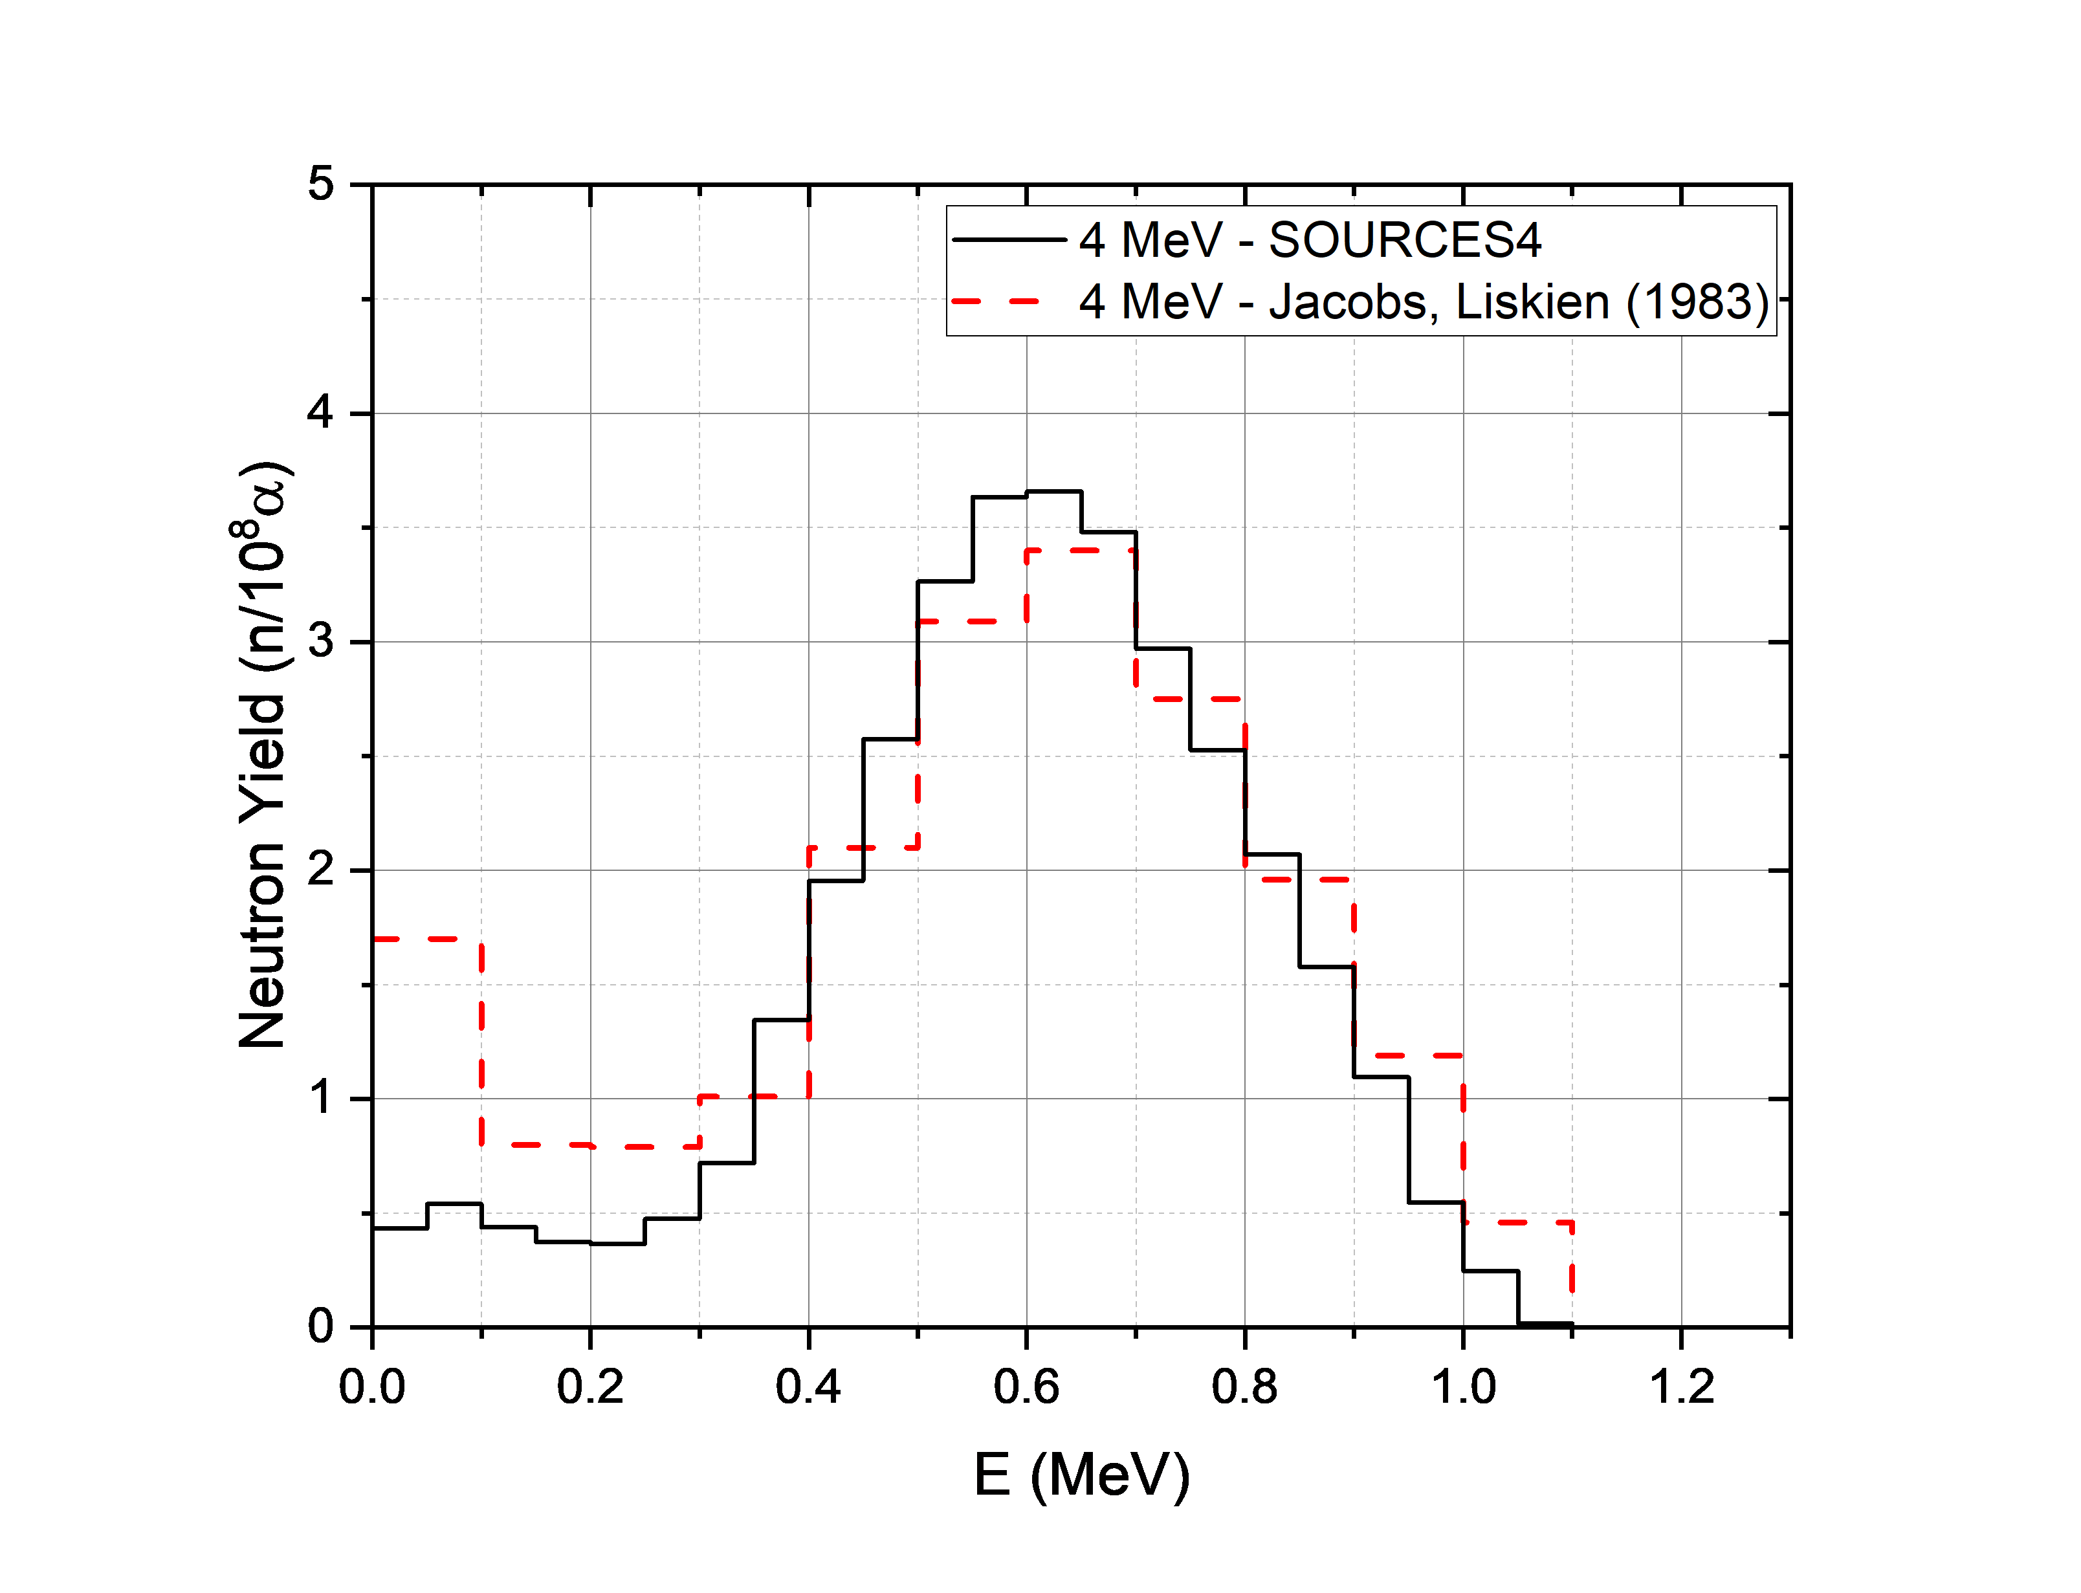
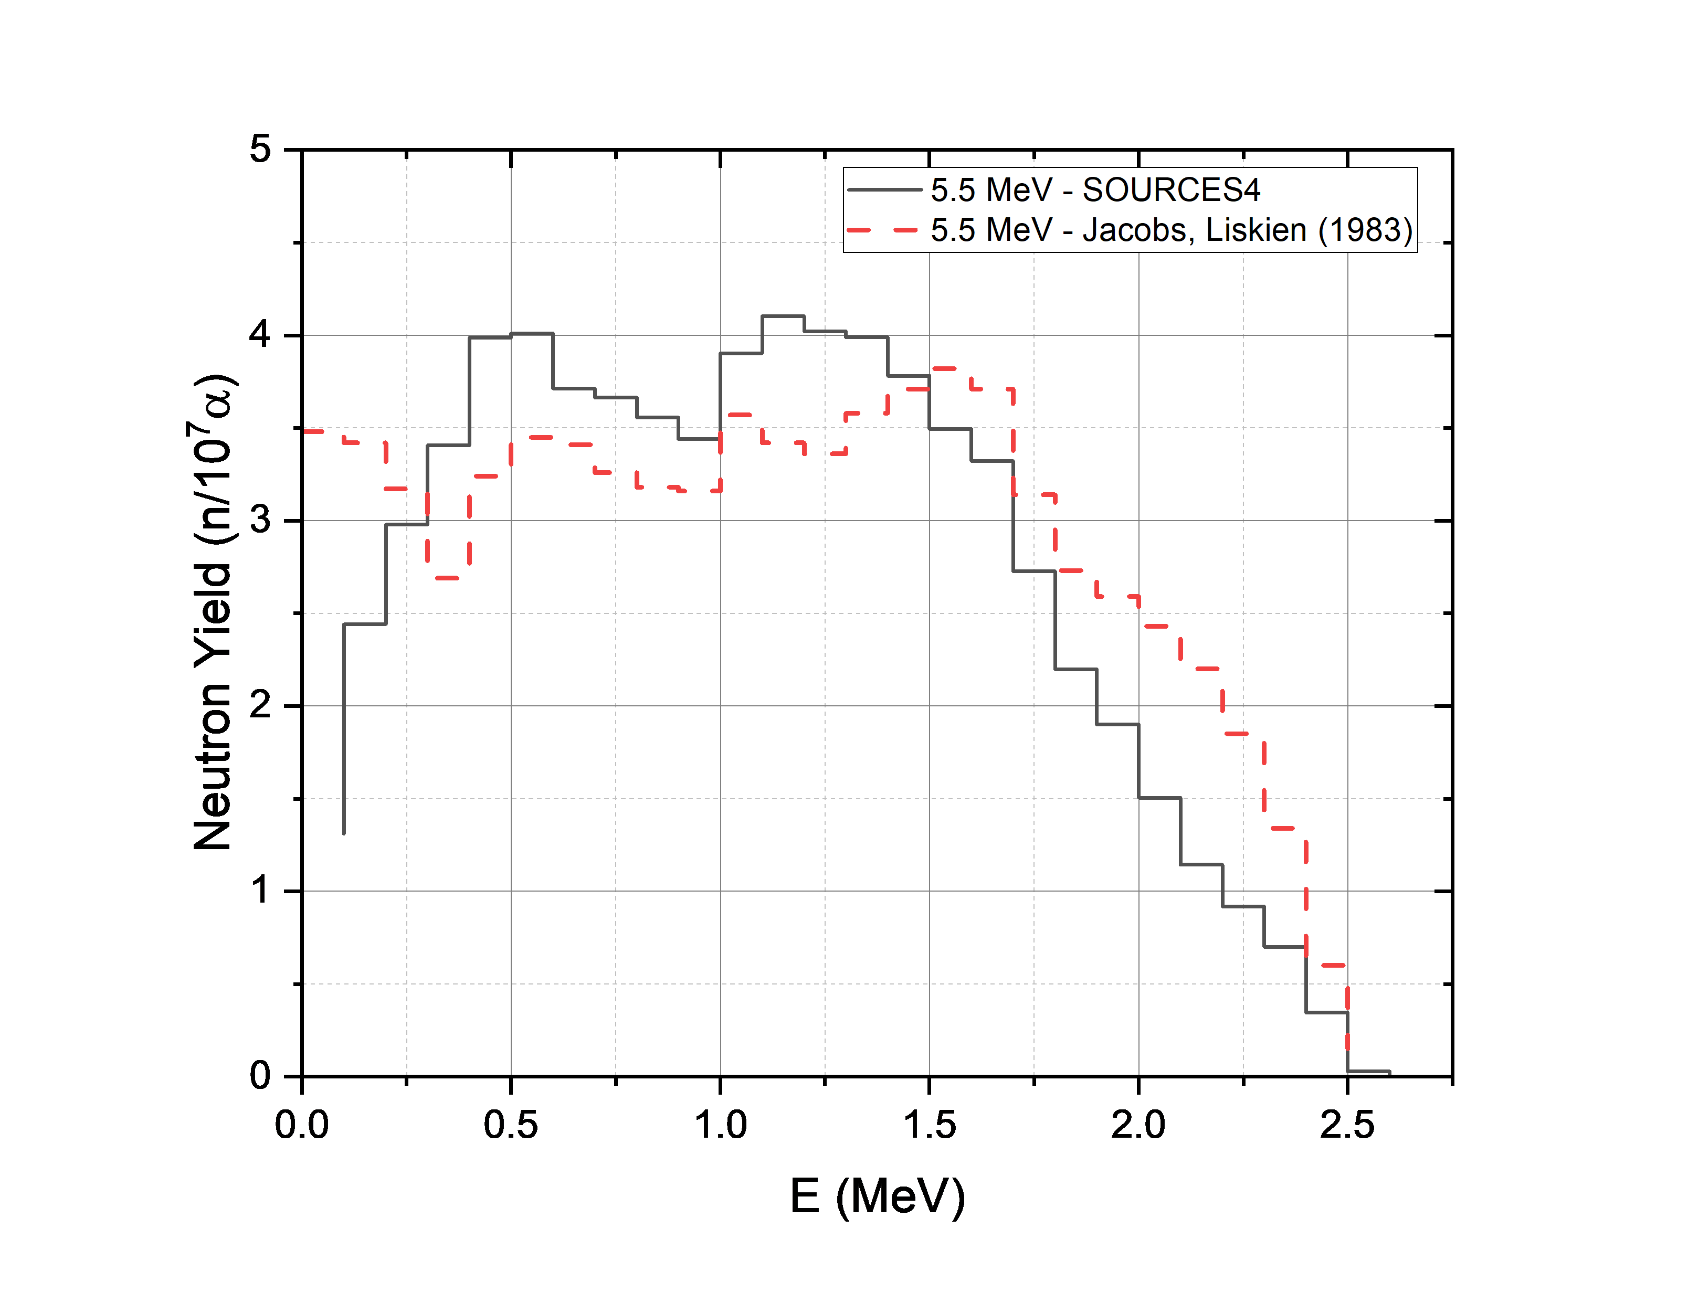
²⁷Al(α,n)³⁰P Neutron Spectra
Jacobs, G. J. H., and Horst Liskien. "Energy spectra of neutrons produced by α-particles in thick targets of light elements." Annals of Nuclear Energy 10.10 (1983): 541-552.
22

