Slide 1
AWAKE, Advanced Wakefield Experiment att CERN

Slide 2
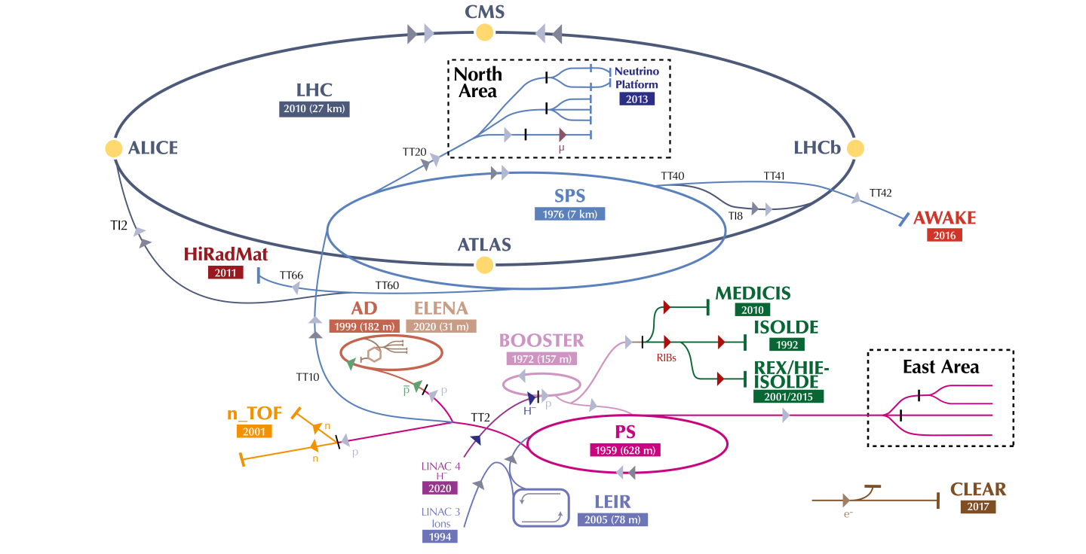
AWAKE at CERN
Advanced WAKEfield Experiment
Accelerator R&D experiment at CERN.
Unique facility driving wakefields in plasma with a 400 GeV proton bunch from the SPS.
  At CERN highly relativistic protons with high energy (> kJ) available
Accelerating externally injected electrons to GeV scale.
The only proton driven plasma wakefield acceleration experiment worldwide!
E. Gschwendtner, CERN

Slide 3
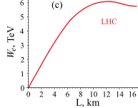
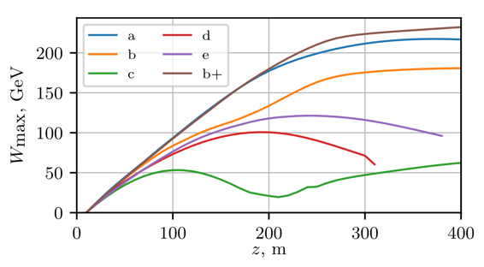
AWAKE: Why a Proton Plasma Wakefield Accelerator?
PW laser ≈ 40J/Pulse
FACET (electron PWFA) ≈ 30J/Pulse
SPS 19 kJ/bunch
LHC 112kJ/bunch
High energy gain in a single plasma
Energy gain LHC bunch
2D numerical simulation results
TeV in km ≈ GeV/m
SPS
19 kJ
100 μm long p⁺ bunch driver
K. V. Lotov & P. V. Tuev, Plasma wakefield acceleration beyond the dephasing limit with 400 GeV proton driver, Plasma Phys. and Control. Fusion, 63, 125027 (2021)
A. Caldwell & K. V. Lotov. Plasma wakefield acceleration with a modulated proton bunch, Physics of Plasmas, 18(10), 103101, (2011)
Notes:
Simulation showed

Slide 4






















AWAKE is an International Collaboration
21 Institutes

Slide 5
AWAKE has a Well-Defined Program
Proof of concept
Towards an accelerator
First particle physics experiments

Slide 6
AWAKE is Part of the European Strategy Roadmap
➔ AWAKE is part of the roadmap of the European Strategy for Particle Physics
e-p collider
R. Pattathil, presented at EAAC 2023
➔ AWAKE allows to bridge the gap between the PWFA development in general and a e+/e- collider.

Slide 7

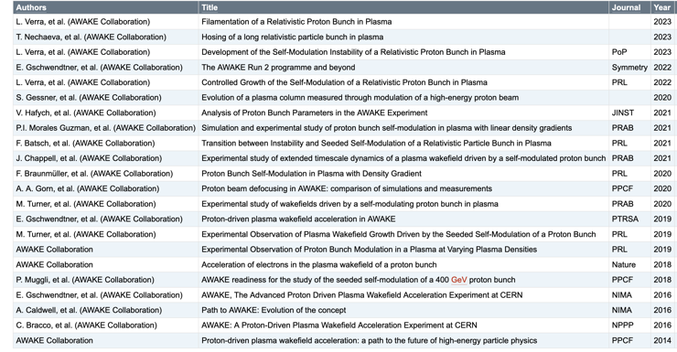



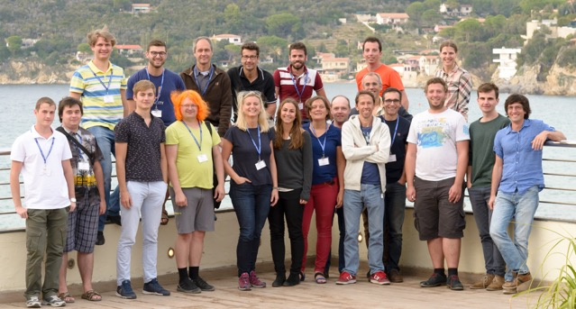
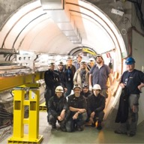


AWAKE’s Strong Scientific and Educational Output
22 AWAKE Collaboration papers in high-level journals
AWAKE courses and seminars
> 70 papers related to AWAKE
> 90 Conference proceedings and papers
CERN Teacher Program
USPAS, JUAS, CAS
➔ 4 doctoral thesis prizes, 2 early career awards!
Outreach: Newspapers, TEDX, …
> 28 PhD students
> 11 Master students
> 20 Post-docs

Slide 8
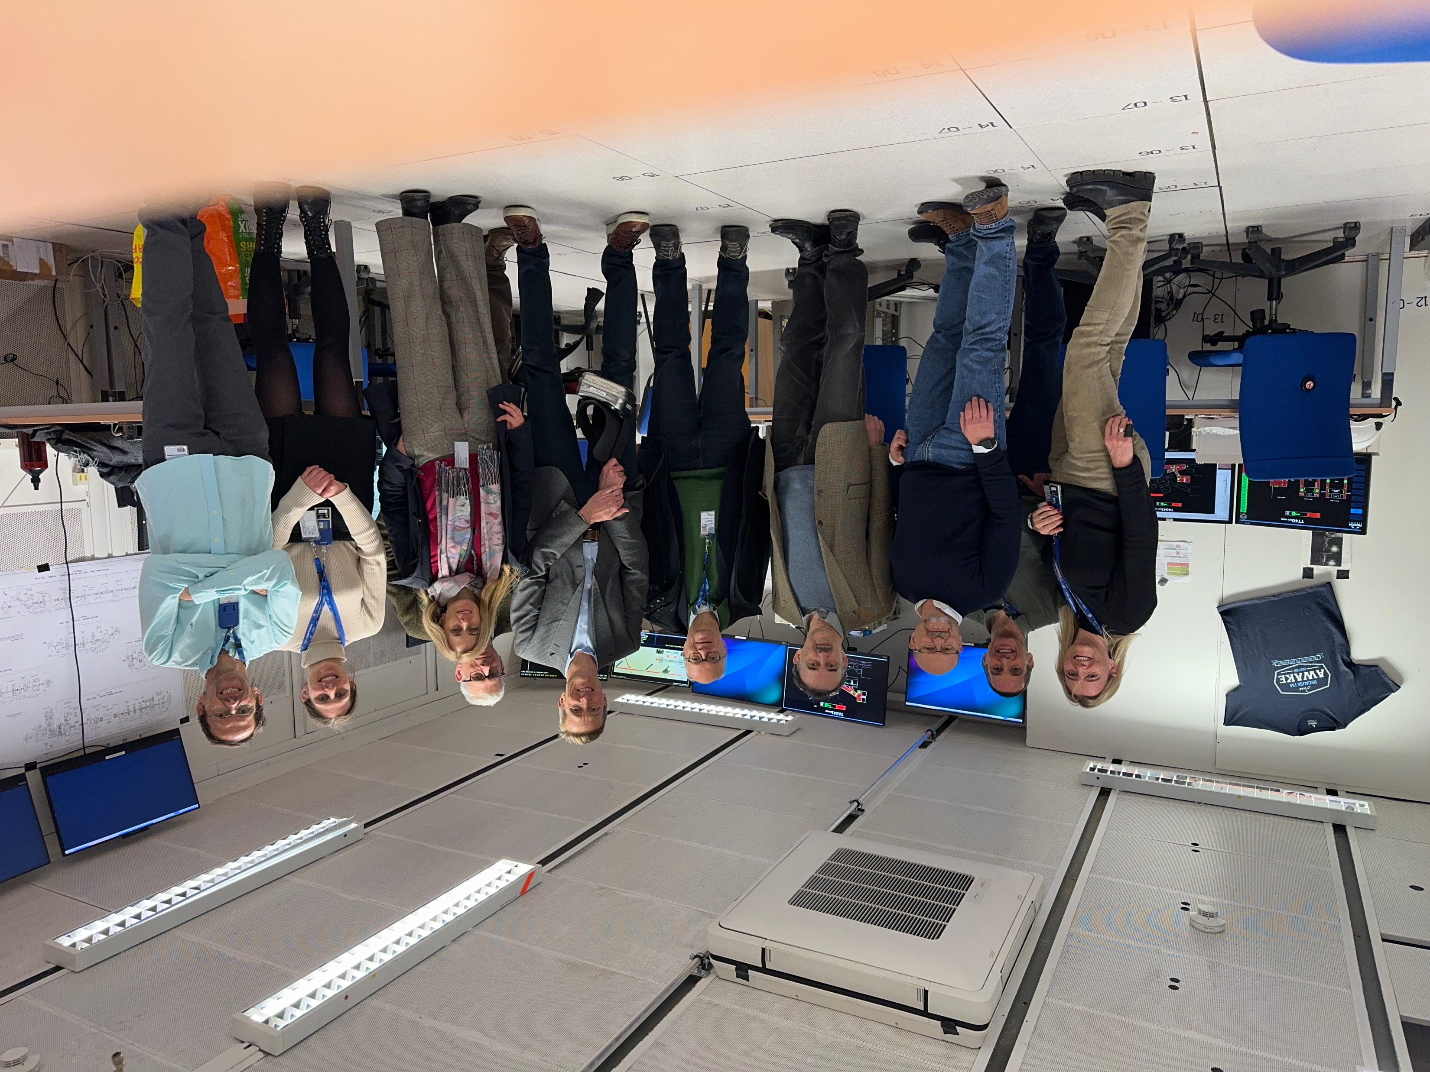
External Review, 5 February 2024
External Review on the Scientific and Technological Objectives of the AWAKE Project
Reviewers:
Chair: Andrei Seryi (JLAB), Members: Ralph Assmann (GSI), Enrica Chiadroni (INFN), Roberto Corsini (CERN), Mark Hogan (SLAC), Simon Hooker (Oxford).
… The Committee commends for spectacular achievements… fulfilling all so far planned milestones… an excellent impact on training of the next generations… unique experiment … profound impact on any future… well-integrated into European strategy planning and roadmaps… address technological challenges… synergistic with CERN’s plans to ramp-up efforts on FCCee, as experts on electron acceleration trained on AWAKE...
➔ The committee strongly endorses AWAKE’s plan for future run.

Slide 9
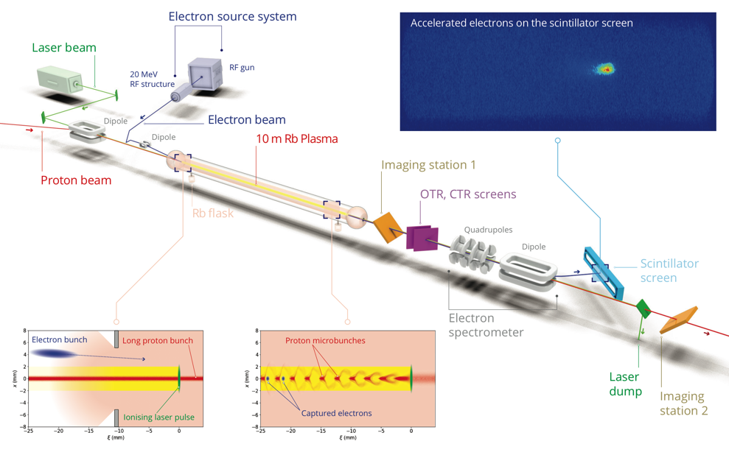
AWAKE Experiment

Slide 10

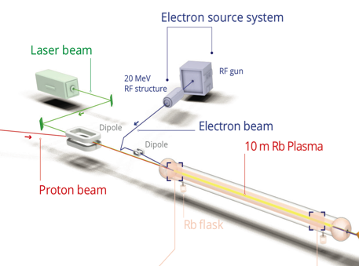
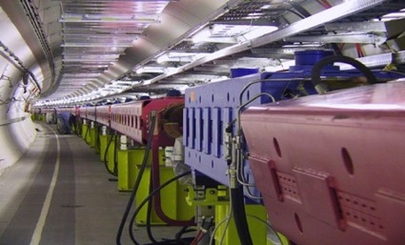
AWAKE Proton Beam Line
400 GeV protons
750m proton beam line
The AWAKE beamline is designed to deliver a high-quality beam to the experiment. The proton beam must be steered around a mirror which couples a terawatt class laser into the beamline.
Further downstream, the witness electron beam will be injected into the same beamline.

Slide 11
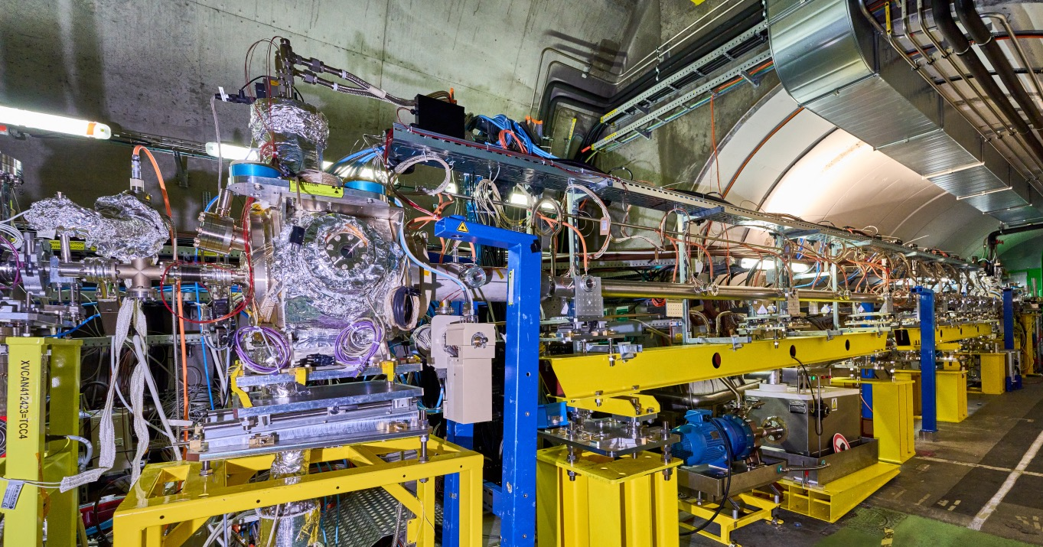
AWAKE Plasma Cell
10 m long, 4 cm diameter Rubidium vapour source
Laser ionizes Rb vapour to become Rb plasma.
Density adjustable from 10¹⁴ – 10¹⁵ cm⁻³ ➔ desired: 7x 10¹⁴ cm⁻³
Notes:
.

Slide 12
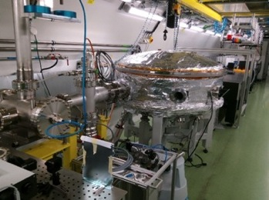
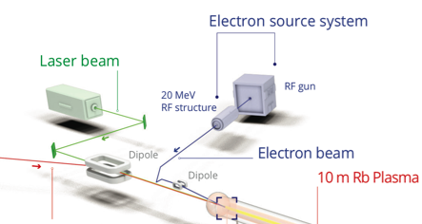
Laser and Laser Line
AWAKE uses a short-pulse Titanium:Sapphire laser to ionize the rubidium source.
→ Seeding of the self-modulation with the ionization front.
The laser can deliver up to 500 mJ in a 120 fs pulse envelope.
Laser beam
e-source laser
Diagnostic laser
Laser, compressor in laser room

Slide 13
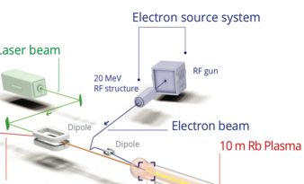
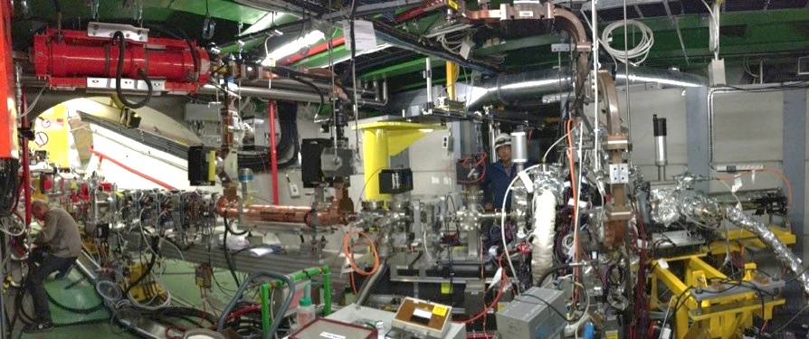
Electron Beam System
Laser beam
e-source laser
Laser line
Transfer line
Diagnostics and booster structure
Electron source
A Photo-injector originally built for a CLIC test facility is now used as electron source for AWAKE producing short electron bunches at an energy of ~20 MeV/c.
A new 12 m long electron beam line was designed and built to connect the electrons from the e-source with the plasma cell.
Notes:
19 MeV
14mm mrad
650 pC at source
FWHM = 5.2 ps.

Slide 14
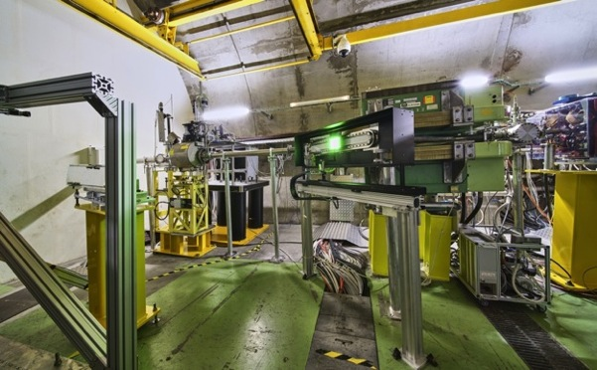
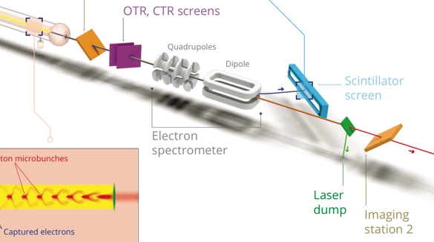
Electron Acceleration Diagnostics
camera
scintillator screen Lanex, 1m x 6cm
Electrons will be accelerated in the plasma. To measure the energy the electrons pass through a dipole spectrometer and the dispersed electron impact on the scintillator screen.
The resulting light is collected with an intensified CCD camera.
Notes:
Spectrometer:
Dipole: B = 0.1 - 1.5 T, Magnetic length = 1m
→ detect electrons with energies ranging from 30MeV - 8.5 GeV

Slide 15


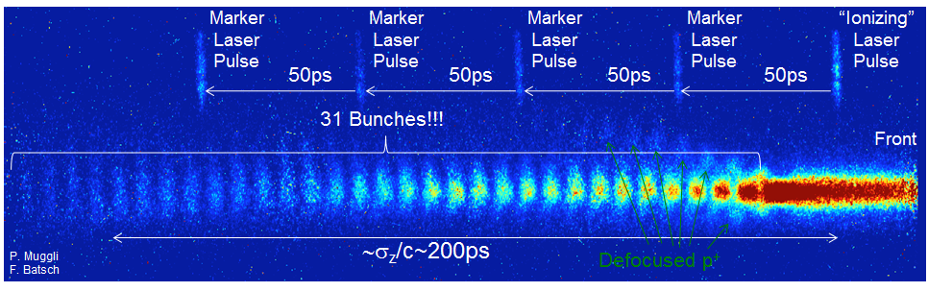
Milestone Result: Seeded Self-Modulation of the Proton Bunch
Reach high-amplitude wakefields
Phase-stable
reproducible
Laser
Plasma
Vapor
p⁺
AWAKE
collaboration
AWAKE Collaboration, Phys. Rev. Lett. 122, 054802 (2019).
M. Turner et al. (AWAKE Collaboration), ‘Phys. Rev. Lett. 122, 054801 (2019).
M. Turner, P. Muggli et al. (AWAKE Collaboration), Phys. Rev. Accel. Beams 23, 081302 (2020)
F. Braunmueller, T. Nechaeva et al. (AWAKE Collaboration), Phys. Rev. Lett. July 30 (2020).
A.A. Gorn, M. Turner et al. (AWAKE Collaboration), Plasma Phys. Control Fusion, Vol. 62, Nr 12 (2020).
F. Batsch, P. Muggli et al. (AWAKE Collaboration), Phys. Rev. Lett. 126, 164802 (2021).

Slide 16
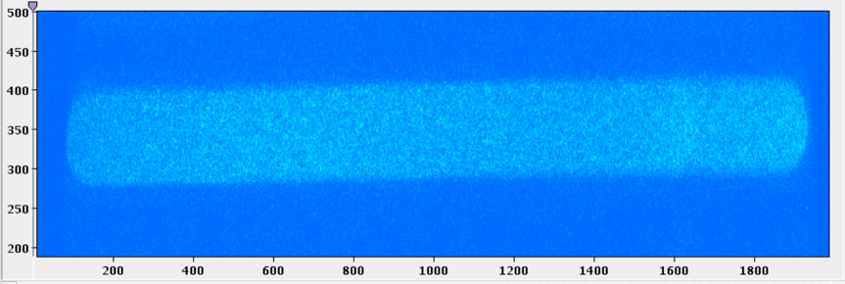
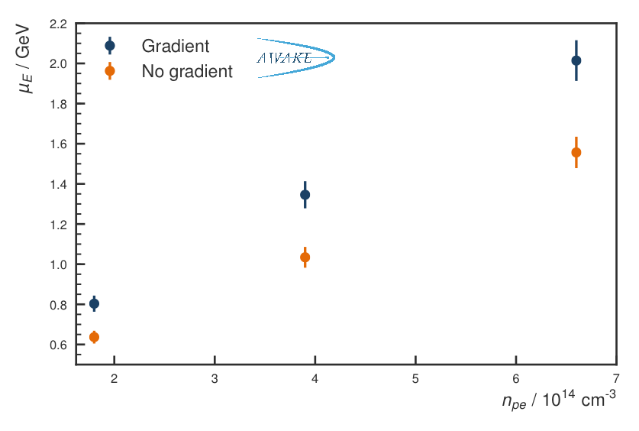
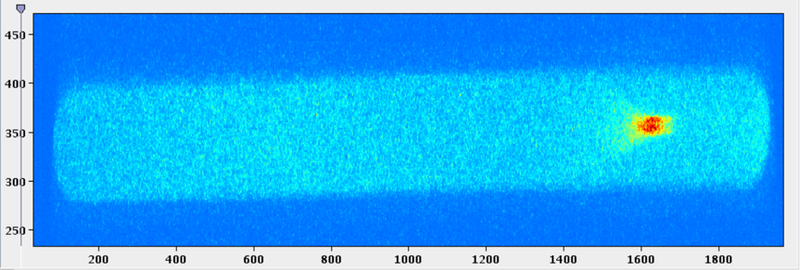
Milestone Result: Electron Acceleration to 2 GeV
Run 1, 2018
Acceleration up to 2 GeV has been achieved.
Charge capture up to 20%.
No accelerated electrons
Accelerated electrons
Convert pixel-size and dipole setting to energy
E. Adli et al. (AWAKE Collaboration), Nature 561, 363–367 (2018)
E. Gschwendtner, CERN

Slide 17
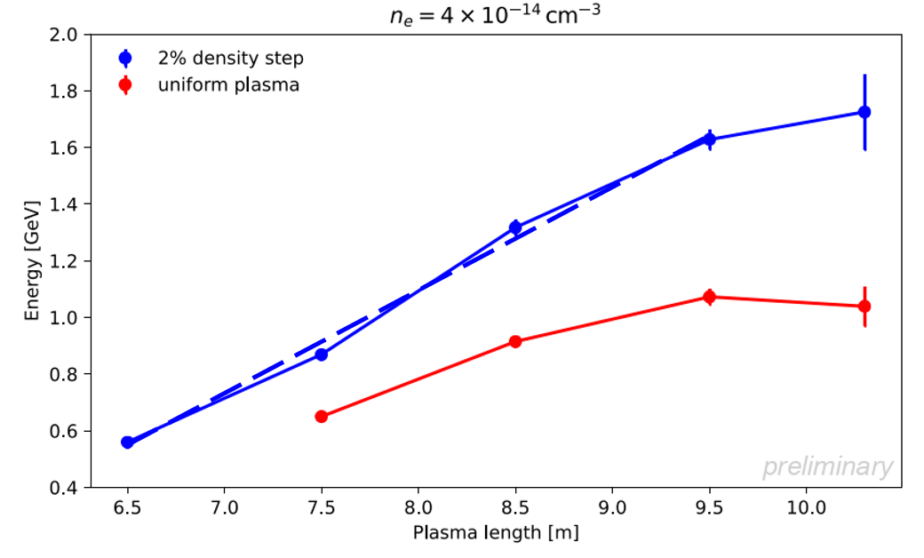
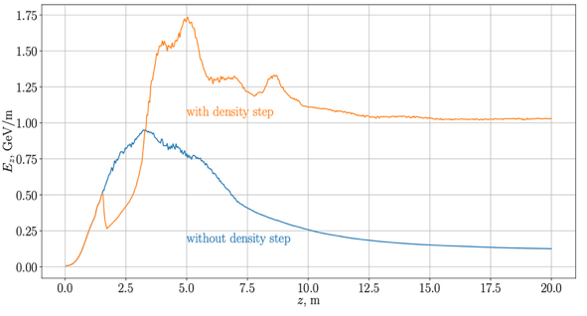
Recent Milestone: Increase in Accelerated Electron Energy and Accelerating Gradient
Plasma density step in 10m plasma source:
increases energy gain
constant acceleration gradient
1.73 GeV
n_{e0}=2x10¹⁴cm⁻³
365 MeV/m
1.04 GeV
211 MeV/m
preliminary
Wakefield amplitude along plasma length
Simulations
Energy of e- emerging from plasma at various lengths
Without/with density step: → Clear increase in final energy and in accelerating gradient

Slide 18
Milestone:
First Operation of a 10 m Discharge Plasma Source in AWAKE
➔ Possible candidate for plasma source in Run 2 (2029-2034) and particle physics applications
Unique opportunity to test the discharge plasma source in May 2023 with protons in the AWAKE facility

Slide 19
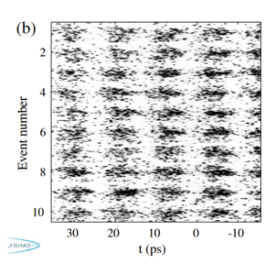
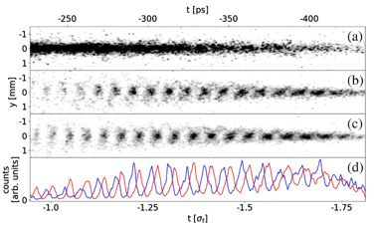
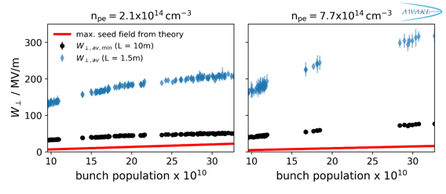
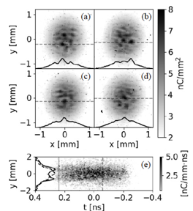
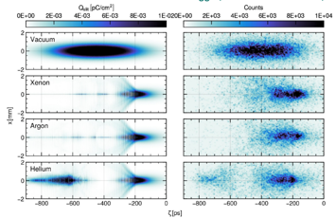
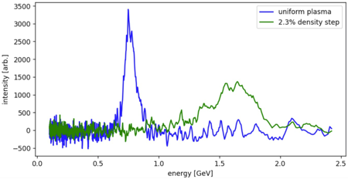
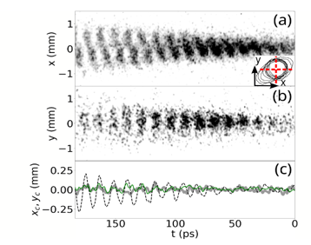
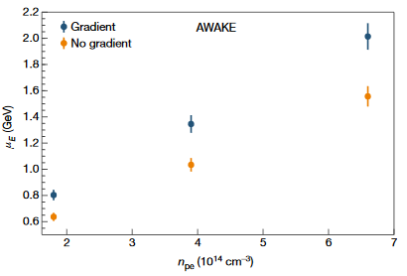
AWAKE Scientific Merit
Seeding with relativ. ionization front
Seeding with electron bunch
Wakefield growth due to SM
Proton bunch self-modulation
AWAKE Collaboration, Phys. Rev. Lett. 122, 054802 (2019).
L. Verra et al. (AWAKE Collaboration), Phys. Rev. Lett. 129, 024802 (2022)
M. Turner et al. (AWAKE Collaboration), ‘Phys. Rev. Lett. 122, 054801 (2019).
Filamentation instability
F. Batsch, P. Muggli et al. (AWAKE Collaboration), Phys. Rev. Lett. 126, 164802 (2021).
Ion motion, Sim/Meas
preliminary
All milestones achieved – plus additional ones.
  Relevant studies for general plasma wakefield acceleration concepts.
Investing in young researchers.
AWAKE
collaboration
M. Turner, CERN, AWAKE Collaboration
Increase e-energy with density gradients
L. Verra, et al. (AWAKE Collaboration), Phys. Rev. E 109, 055203 (2024).
Accelerated electrons
Effect of density step on accelerated electrons
Beam-hose instability
preliminary
AWAKE Collaboration, Nature 561, 363–367 (2018)
F. Pannell, UCL, AWAKE Collaboration
T. Nechaeva, et al. (AWAKE Collaboration), Phys. Rev. Lett. 132, 075001 (2024).

Slide 20
AWAKE has a Well-Defined Program
Run 2a (2021-2022): CONTROL: demonstrate the seeding of the self-modulation of the entire proton bunch with an electron bunch
Run 2b (2023-2024): STABILIZATION: maintain large wakefield amplitudes over long plasma distances by introducing a step in the plasma density
(2025-2027): CNGS dismantling, CERN Long Shutdown LS3, installation of Run 2c
Run 2c (2029-2032): QUALITY: demonstrate electron acceleration and emittance control of externally injected electrons.
Run 2d (2033- LS4): SCALABILITY: development of scalable plasma sources to 100s meters length with sub-% level plasma density uniformity.
Once AWAKE Run 2 is demonstrated: First particle physics application of the AWAKE-like technology.
👍
AWAKE Run 2 approved in June 2024!

Slide 21
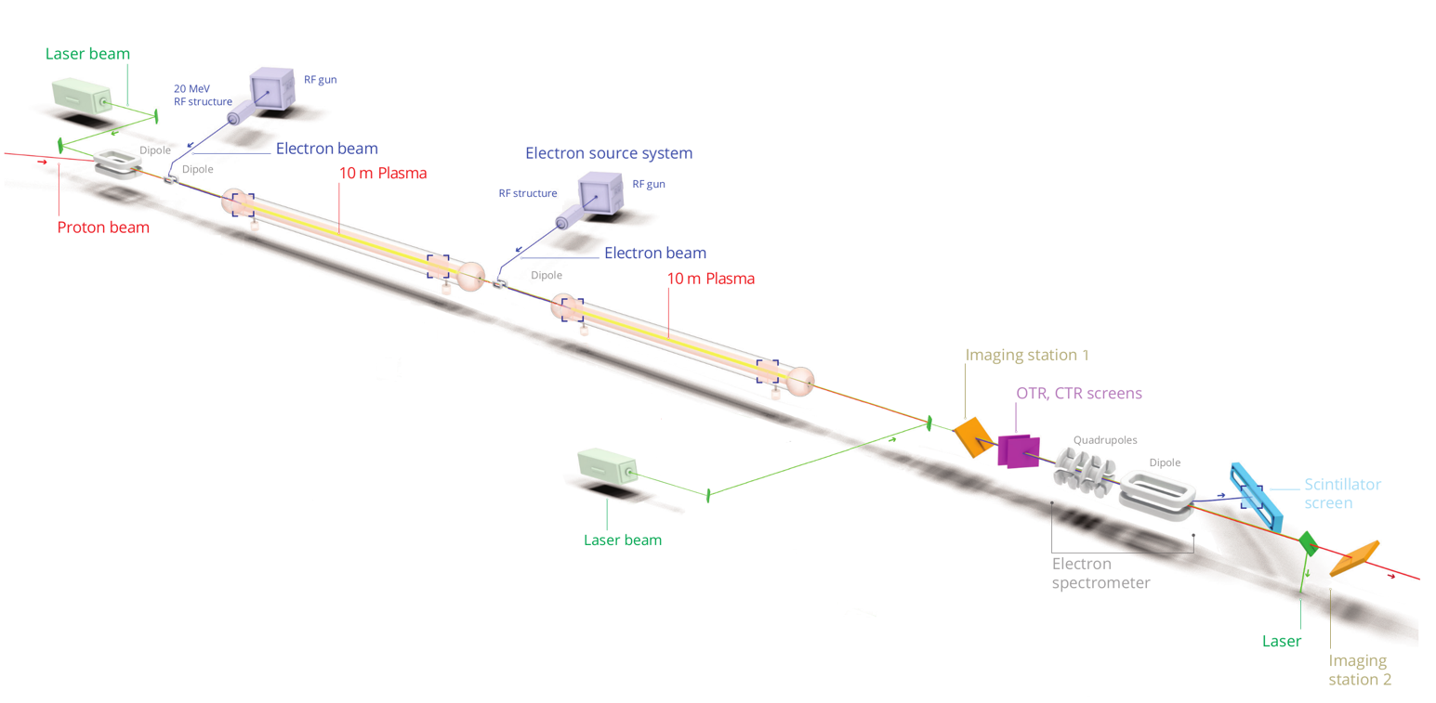
AWAKE Run 2
Accelerate an electron beam to high energies, while controlling the electron beam quality and demonstrate scalable plasma source technology.
2nd plasma source: Optimize acceleration of electrons in p-driven plasma wakefield
1st plasma source: Optimize self-modulation of the proton bunch
Expected parameters:
Normalized emittance: (2-30) mm mrad
Q_{e} = 100 pC
dE/E: 5-8 %
Energy gain: E ~ 4-10 GeV in 10 m
E. Gschwendtner, CERN

Slide 22
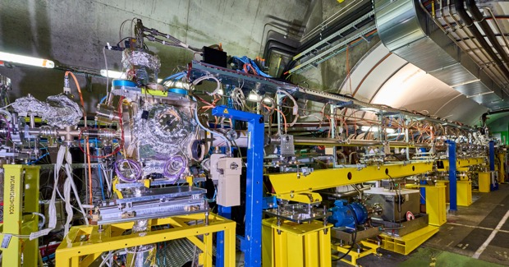
AWAKE Run 2 Technological Advancements
Benefit of accelerator technology expertise at CERN
Benefit from plasma wakefield expertise at Institutes
  Synergy with future electron/positron colliders at CERN
Address key challenges of plasma wakefield community
  External injection, scalable plasma source development
Rb vapour source with density step
10m long discharge plasma source

Slide 23
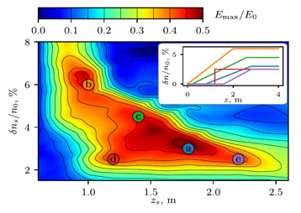
AWAKE Run 2 Expected Parameters and Relevance
Ex: Broad tolerances for SMI control with a density step
Expected parameters:
Norm. emittance: (2-30) mm mrad
Q_{e} = 100 pC
dE/E: 5-8 %
Energy gain:
  Run 2c: E: 4-10 GeV, 10m
  Run 2d: E > 10 GeV, 10+ m
AWAKE simulation results provide confidence that the Run 2 goals are achievable.
Expected parameters after Run 2 are in line with beam parameters for first particle physics applications.
Relevance: Developments shared with other plasma-based accelerators:
Externally inject an e⁻ bunch ⬄ injection, staging
Acceleration to multi-GeV level ⬄ large energy gain
Control e-bunch quality: E, ∆E/E, Q, ε_{N} ⬄ quality!!
Plasma source: length, density uniformity, reproducibility, tunability ⬄ staging, >1 plasma
Development of diagnostics: plasma density, bunch parameters (ε_{N}) ⬄ quality

Slide 24
Thank You!

Slide 25


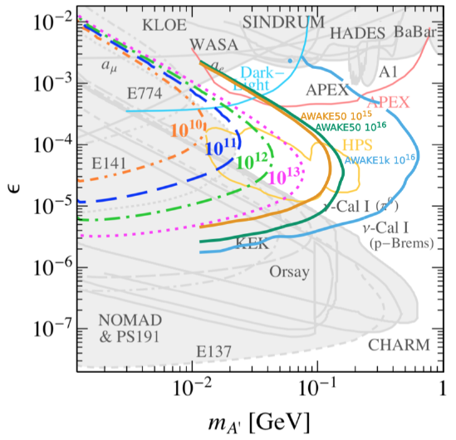
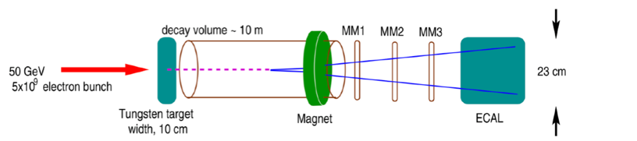
Applications with AWAKE-Like Scheme
➔ Requirements on emittance are moderate for fixed target experiments and e/p collider experiments, so first experiments in not-too far future!
First Application: Fixed target test facility:
Deep inelastic scattering, non-linear QED, search for dark photons
→ Decay of dark photon into visible particles (e.g. e+/e-)
Energy and flux is important
Relaxed parameters for emittance
Experimental conditions modeled on NA64 experiment.
10¹⁶ electrons on target with AWAKE-like beam (Factor 1000 more than NA64)
50 GeV e-beam: Extend sensitivity further to ε~ 10⁻³ − 10⁻⁵ and to high masses~0.1 GeV.
1 TeV e-beam: : Similar ε values, approaching 1 GeV, beyond any other planned experiments.
Extension of kinematic coverage for 50 GeV electrons and even more for 1 TeV electrons

Slide 26
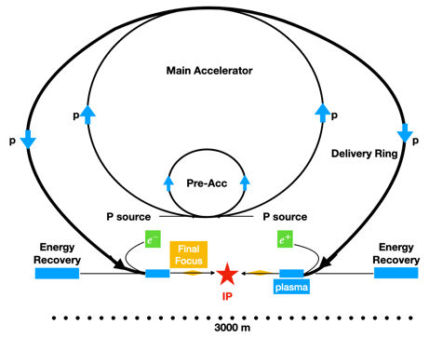
Applications with AWAKE-Like Scheme
Investigate non-linear QED in electron- photon collisions.
Produce TeV-range electrons with an LHC p+ bunch: use for lower luminosity measurements in electron-proton or electron-ion collisions.
ℒ Limited by proton accelerator repetition rate – look for high-cross-section processes to compensate.
  PEPIC: Low-luminosity version of LHeC (50 GeV electrons)
    Use the SPS to drive electron bunches to 50 GeV and collide with protons from the LHC
    Modest luminosity → only interesting should the LHeC not go ahead
  EIC:
    use the RHIC-EIC proton beam to accelerate electron
  3 TeV VHEeP
    use the LHC protons to accelerate electrons to 3 TeV and collide with protons from LHC with 7 TeV
    Yields centre-of-mass energy of 9 TeV, Luminosity is relatively modest ~1028 – 10²⁹ cm⁻² s⁻¹, i.e. 1bp⁻¹/yr.
    New energy regime means new physics sensitivity even at low luminosities.
  Fixed target variants with these electron beams
  Higgs factory: electron-positron collider 250 GeV c.o.m, proton driven
    J. Farmer, A. Caldwell, A. Pukhov, NJP, DOI 10.1088/1367-2630/ad8fc5 (2024)

