Slide 1
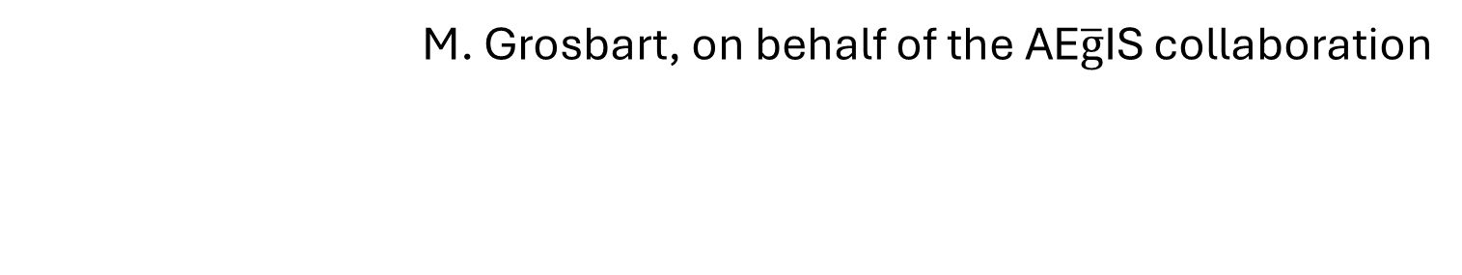
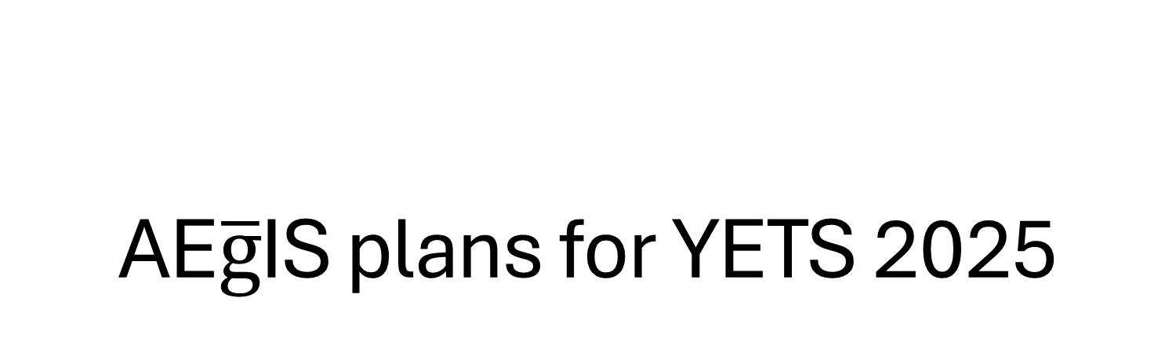
AE$\overline{g}$IS plans for YETS 2025
M. Grosbart, on behalf of the AE$\overline{g}$IS collaboration

Slide 2

Opening of the AE$\overline{g}$IS apparatus
Planned for beginning of January 2025
We will be localizing and fixing the heat leak
Smaller repairs inside of the apparatus/beamline
Planned closure- as soon as possible… (we hope to resume physics before the beamtime)

Slide 3
Redistribution of electronics inside the zone
Installation of new electronic racks
In coordination with ESO

Slide 4
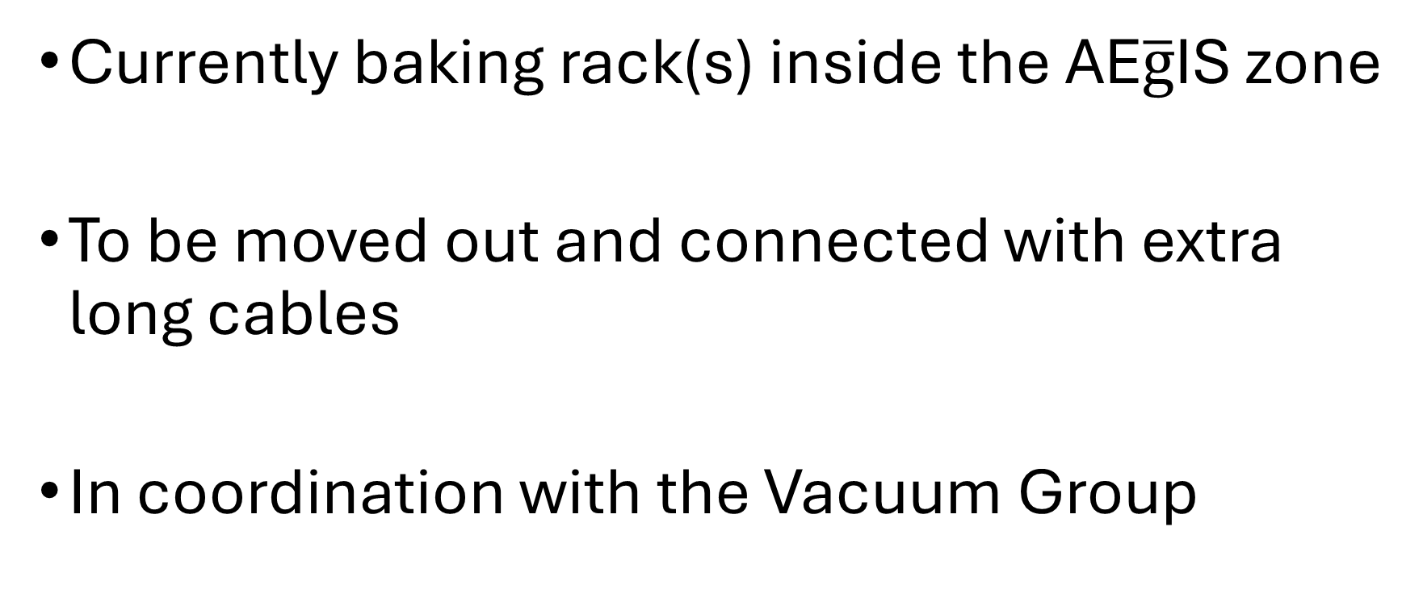
Improvement of bake-out
Currently baking rack(s) inside the AE$\overline{g}$IS zone
To be moved out and connected with extra long cables
In coordination with the Vacuum Group

