Slide 1
Türkiye Industrial Return
C. Hartley
Head of Industry, Procurement and Knowledge Transfer Department

Slide 2
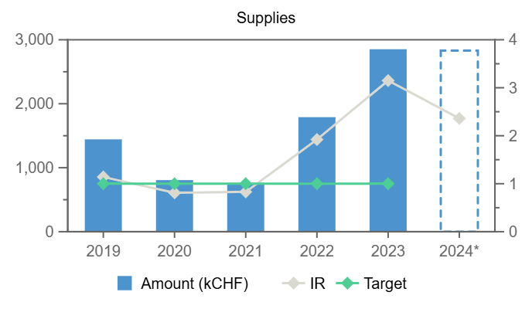
Strong Supplier
4 year coefficient 2020-2023 of 1.65
So far annual coefficient for 2024 >3.6

Slide 3
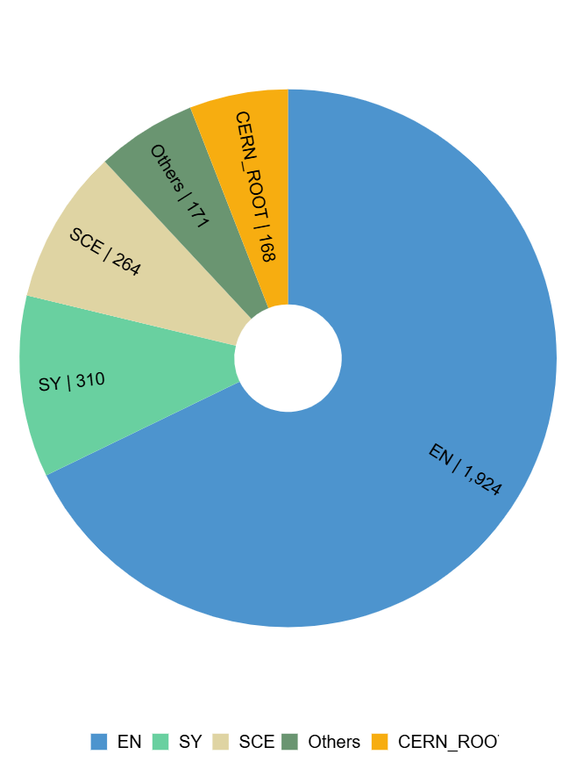
By Department

Slide 4
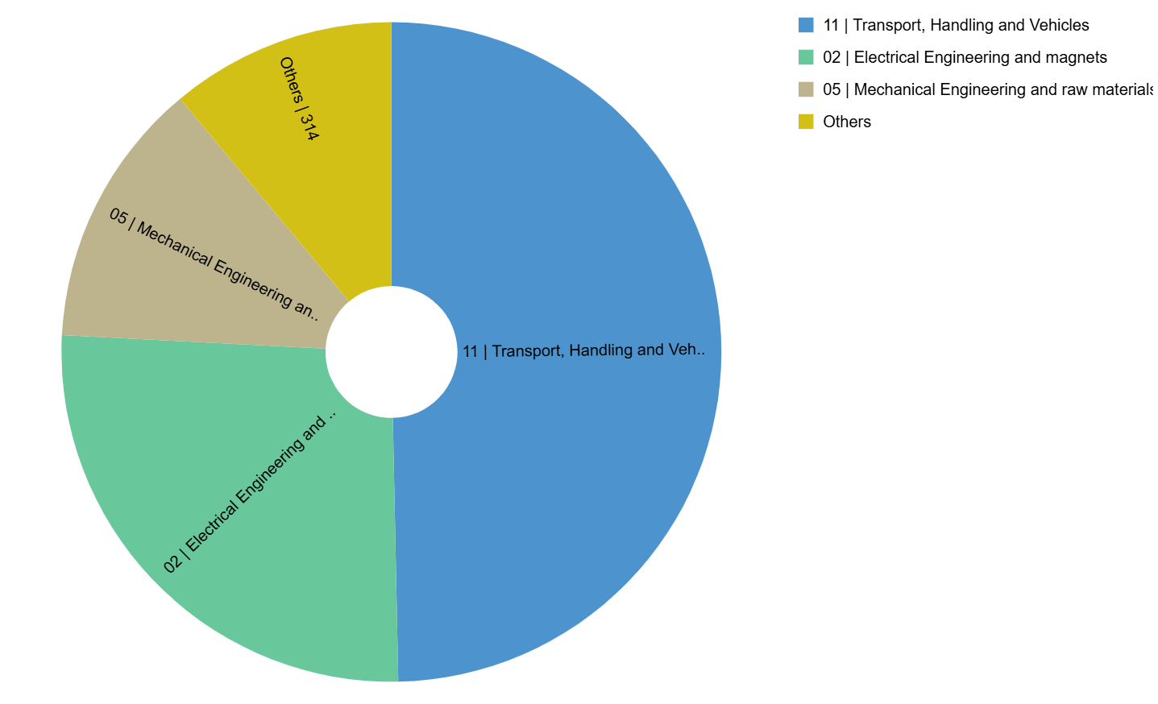
Product Families

Slide 5
Top orders in 2024
B1753 | CRANES SUPPLY AND RENOVATION | VISAN VINC VE HAREKET SISTEMLERI SANAYI VE TICARET | 1 189 260
CD1095855 | DO-33913/EN HIGH VOLTAGE CABLES NA-CONS | BASOGLU KABLO VE PROFIL SAN VE TIC AS | 297 696
CD1095854 | FORGED CUCR1ZR BLANKS FOR COLLIMATORS | ALBAKSAN ALASIMLI BAKIR SANAYI VE TICARET ANONIM SIRKETI | 207 506
DT2100234 | 30 DAYS | 2M KABLO SANAYI VE TICARET AS | 176 789
B1526 | SUPPLY OF UTILITARY VEHICLES | BYMYCAR ACACIAS SA | 172 492
B1659 | SUPPLY OF PRE-FITTED OF CABLES | SAMM TEKNOLOJI ILETISIM SAN VE TIC A S | 134 645

Slide 6
Victim of success
ISO Contribution Remaining *Procurement **Personnel
TR 4,771 -526 2,836 2,460
Going forward important to under your priorities

Slide 7
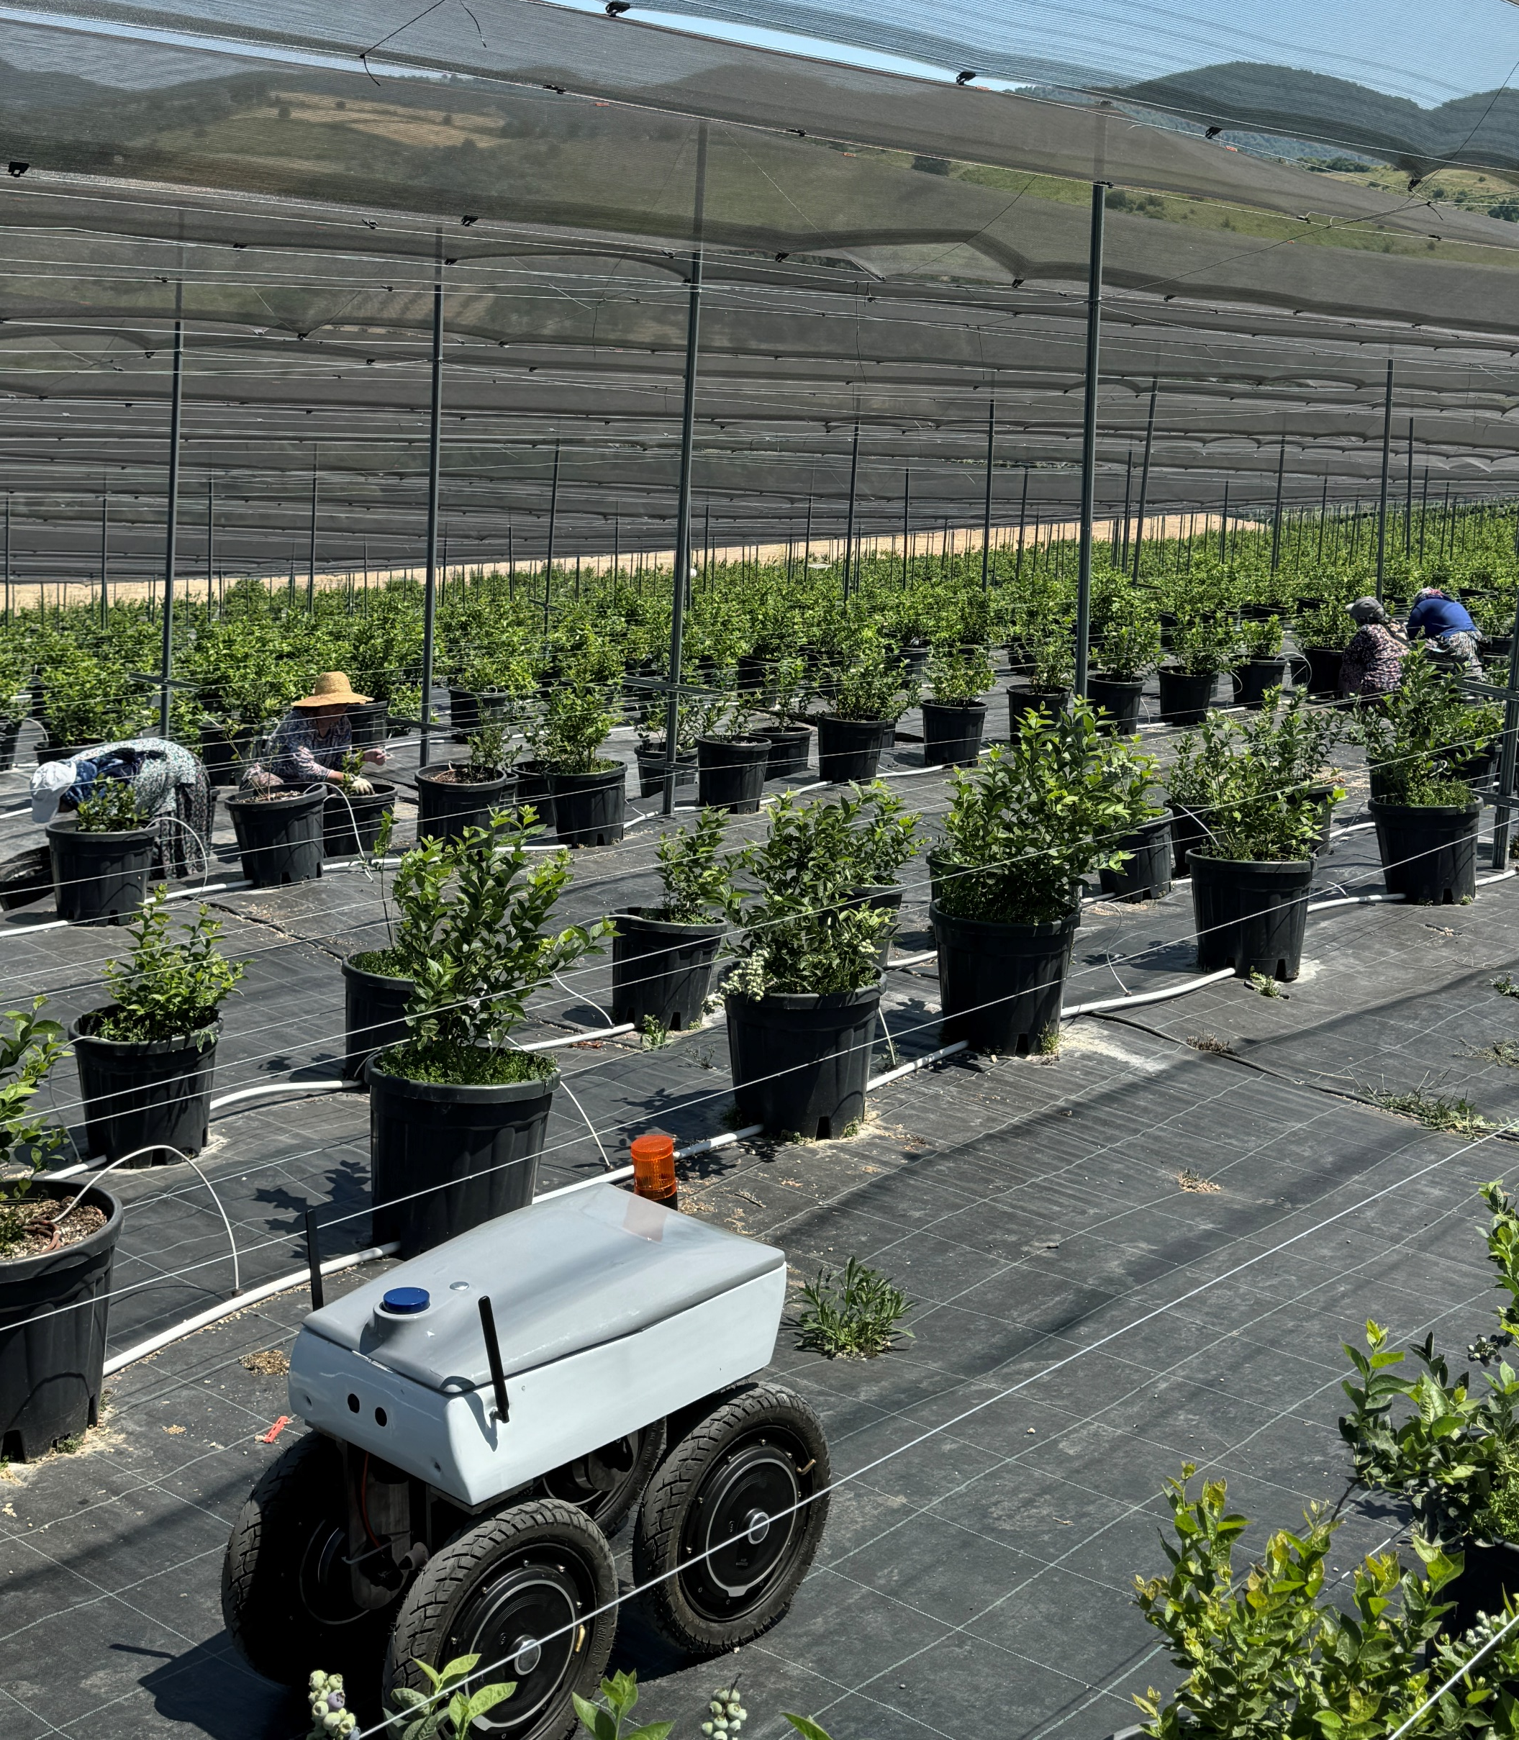
Knowledge transfer activities in Turkey
Orbiba Robotics autonomous farming robot
Turkish Startup Orbiba Robotics officially enrolled in the CERN Venture Connect programme per Dec 2024, to apply the CERN Structured Laser Beam in agriculture autonomous robotics applications.
CERN Venture Connect Partner Yildiz Technopark will be the very first partner receiving a CVC tech prototype beginning of next year.
R&D License to Middle East Technical University (“METU”) on CERN’s NINO semiconductor chip, for use in space radiation monitoring.
Discussions with Turk Telekom related to nano-second time synchronisation and participation in the White Rabbit Collaboration

