Slide 1

CERN 5 yearly evolution
Türkiye

Slide 2
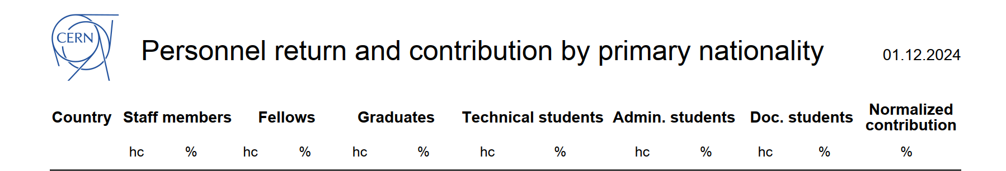
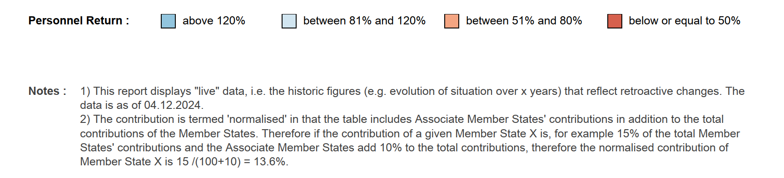
Personnel Return and Contribution
(data source: Personnel Return Report, 04.12.2024)

Slide 3
Turk at CERN, by CERN contract status
(data source: HRT on 10.12.2024, by primary nationality)
 | TR
ADMI | 2
DOCT | 3
FELL | 6
GRAE | 12
GRAP | 3
SASS | 1
STAF | 4
TECH | 6
USER | 190
VISC | 3
Grand Total: | 261

Slide 4
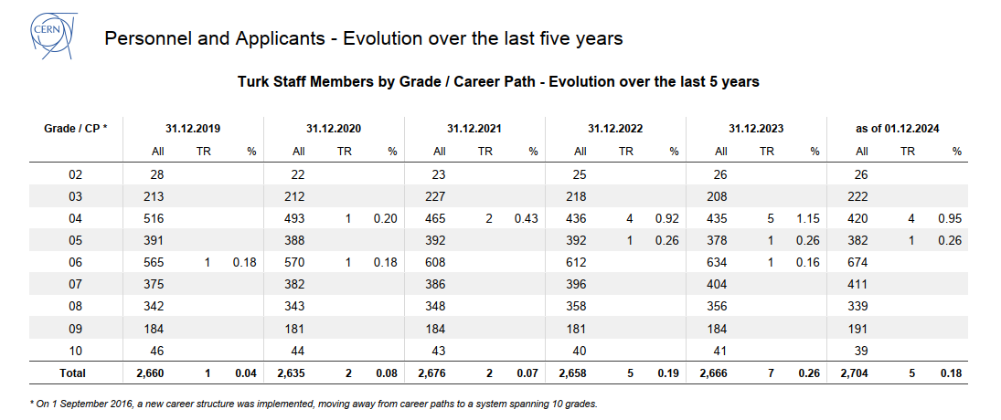

Slide 5
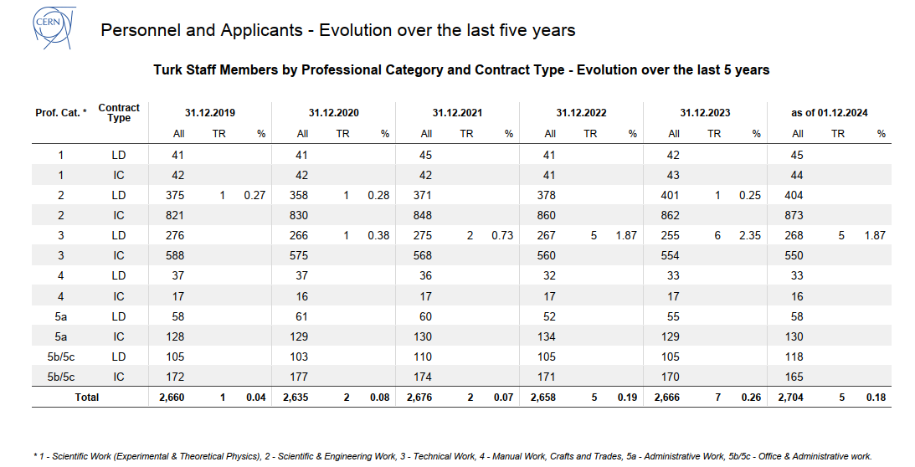

Slide 6
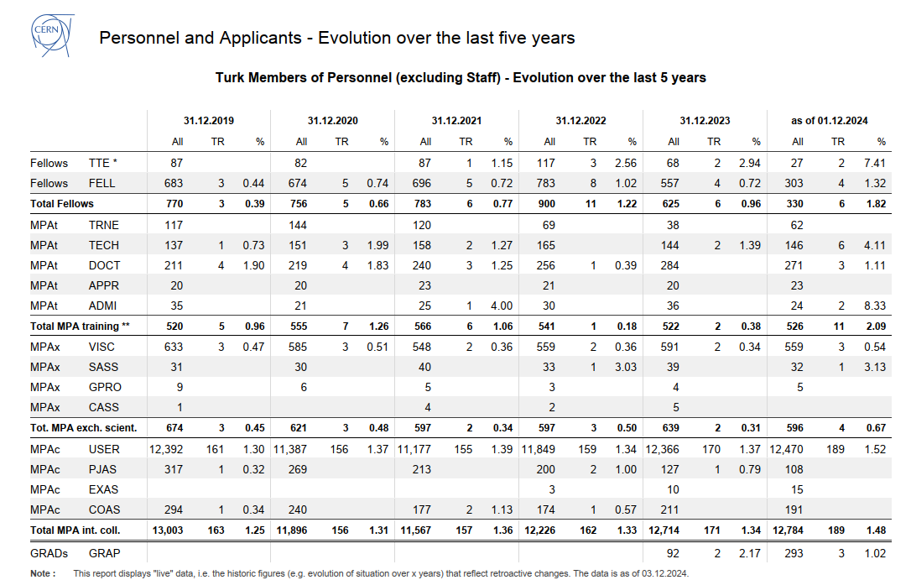
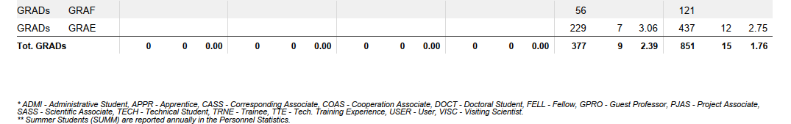

Slide 7
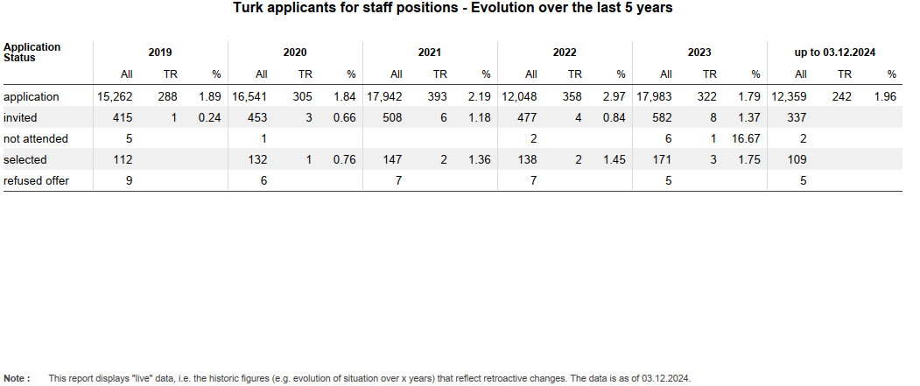

Slide 8
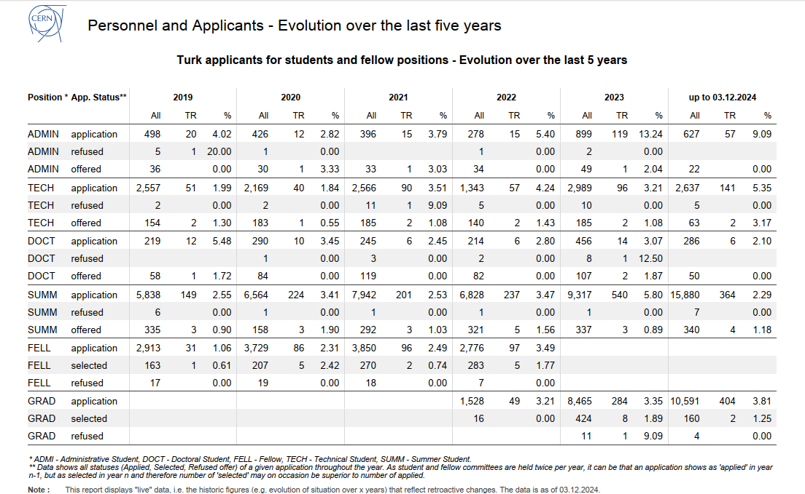

Slide 9


CERN’s Talent Acquisition branding initiatives
"Shared effort, shared success."
…and many others…

