Slide 1
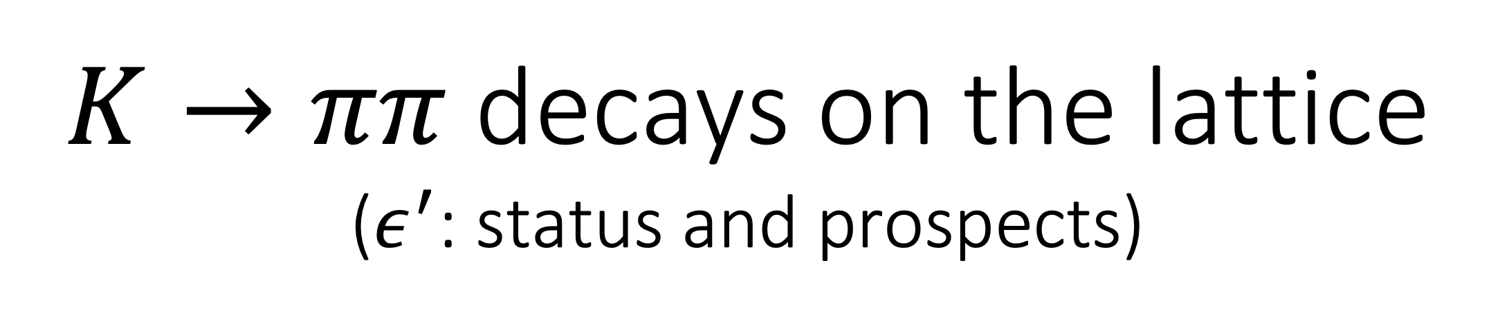
$K→ππ$ decays on the lattice ($ε^{′}$: status and prospects)
Tom Blum (UConn/RBRC)
RBC/UKQCD Collaborations
KAON 2025
Johannes Gutenberg Universität, Mainz
September 8, 2025

Slide 2

Outline
Introduction
Lattice QCD calculation of the relevant matrix elements
Summary/status for $ΔS=1$ matrix elements and $\frac{ε^{′}}{ε}$
Plans and Prospects

Slide 3
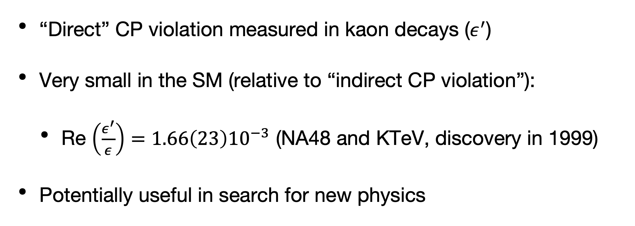
Introduction
“Direct” CP violation measured in kaon decays ($ε^{′}$)
Very small in the SM (relative to “indirect CP violation”):
Re $\left(\frac{ε^{′}}{ε}\right)=1.66\left(23\right){10}^{−3}$ (NA48 and KTeV, discovery in 1999)
Potentially useful in search for new physics
[RBC/UKQCD 2020]

Slide 4
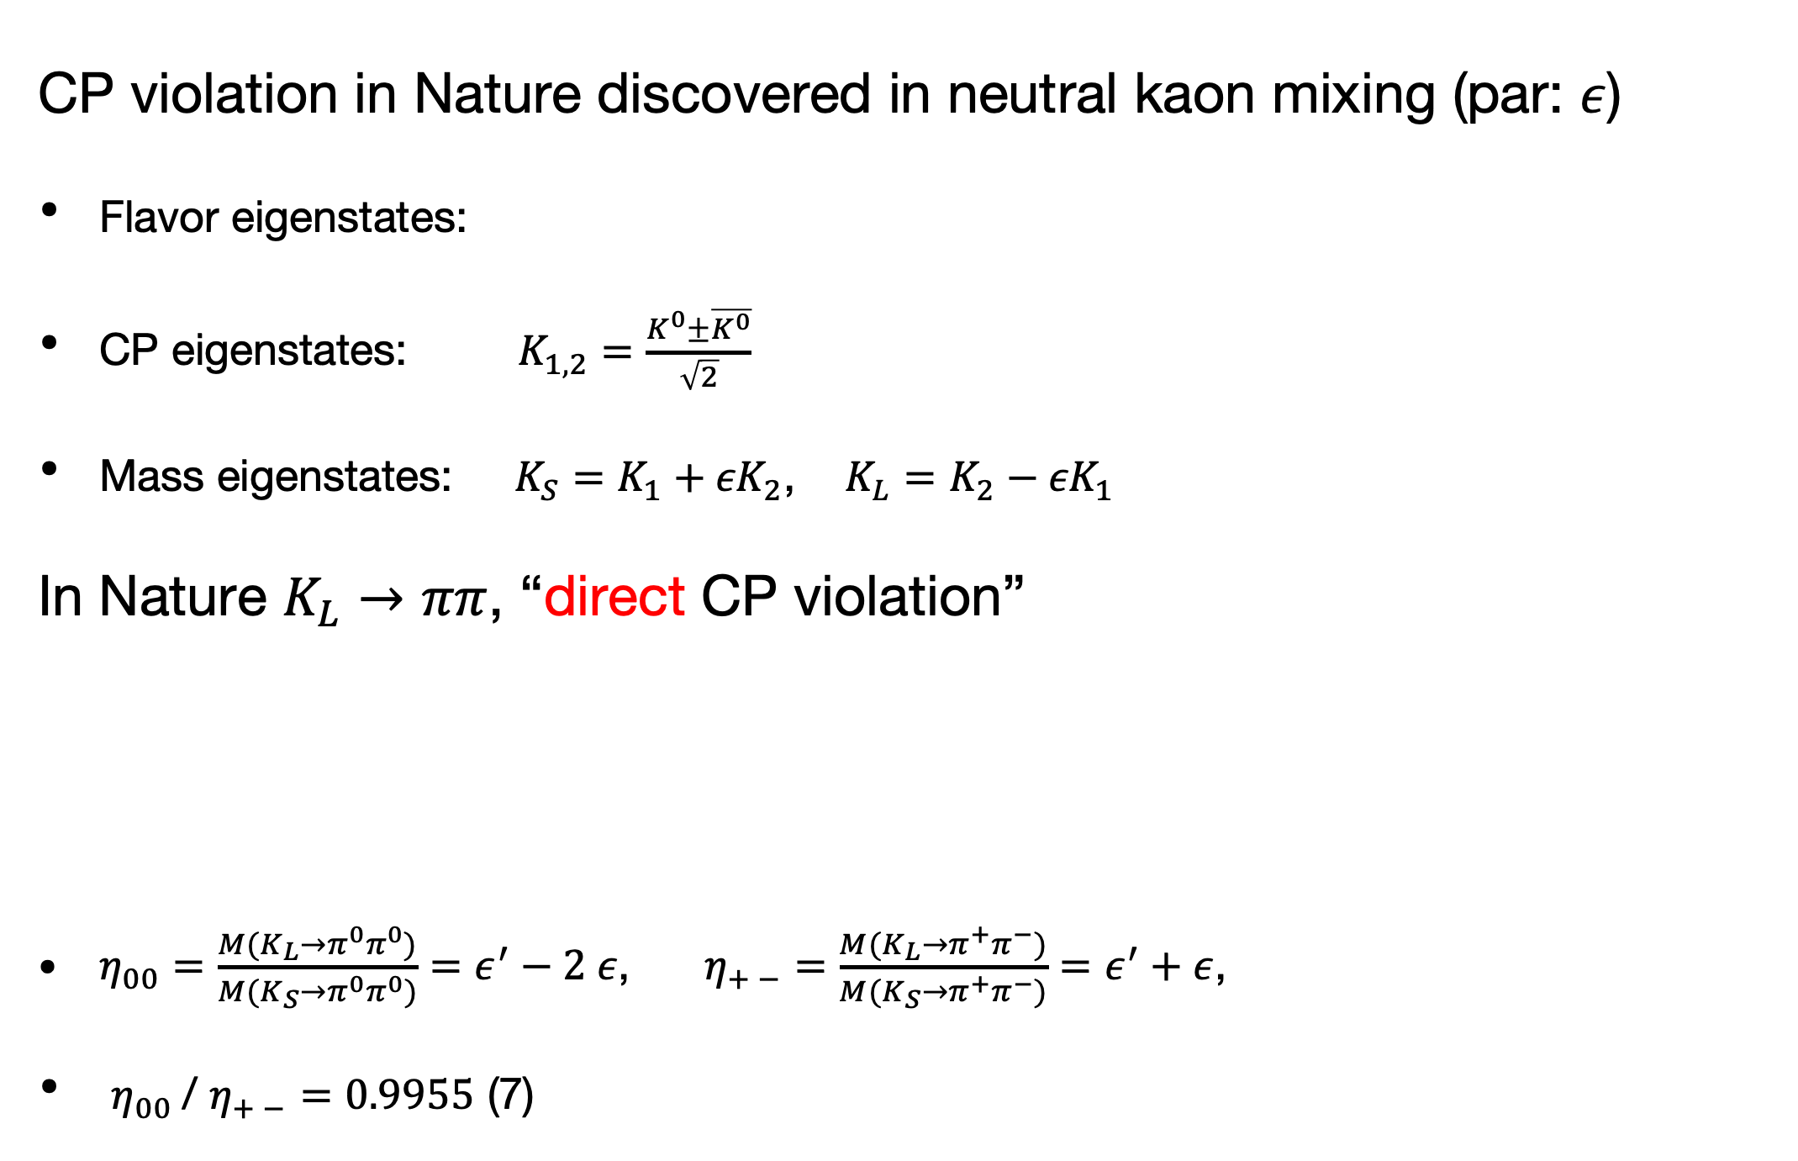
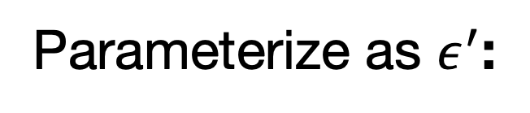


Introduction
CP violation in Nature discovered in neutral kaon mixing (par: $ε$)
Flavor eigenstates:
CP eigenstates: $K_{1,2}=\frac{K^{0}±\overline{K^{0}}}{\sqrt{2}}$
Mass eigenstates: $K_{S}=K_{1}{+ εK}_{2}$, $K_{L}=K_{2}{− εK}_{1}$
In Nature $K_{L}→ππ$, “direct CP violation”
$η_{00}=\frac{M(K_{L}→π^{0}π^{0})}{M(K_{S}→π^{0}π^{0})}=ε^{′}−2 ε$, $η_{+ −}=\frac{M(K_{L}→π^{+}π^{−})}{M(K_{S}→π^{+}π^{−})}=ε^{′}+ε$,
$η_{00}$/ $η_{+ −}=0.9955$ (7)
$$\overline{K^{0}}=\overline{d}s$$
$$K^{0}=\overline{s}d$$
Parameterize as $ε^{′}$:

Slide 5
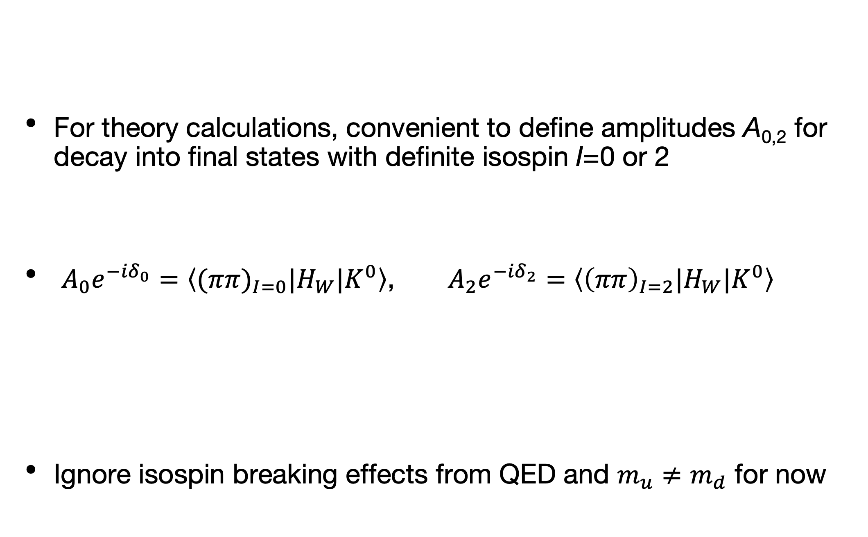
Introduction
For theory calculations, convenient to define amplitudes A_{0,2} for decay into final states with definite isospin I=0 or 2
$A_{0}e^{−{iδ}_{0}}=\left\langle {(ππ)}_{I=0}|H_{W}|K^{0}\right\rangle$, $A_{2}e^{−{iδ}_{2}}=\left\langle {\left(ππ\right)}_{I=2}|H_{W}|K^{0}\right\rangle$
Ignore isospin breaking effects from QED and $m_{u}≠m_{d}$ for now

Slide 6
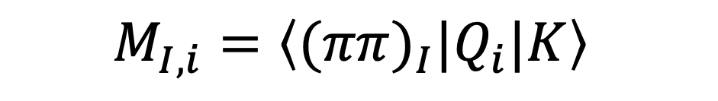
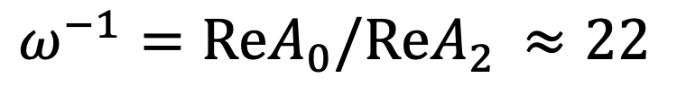
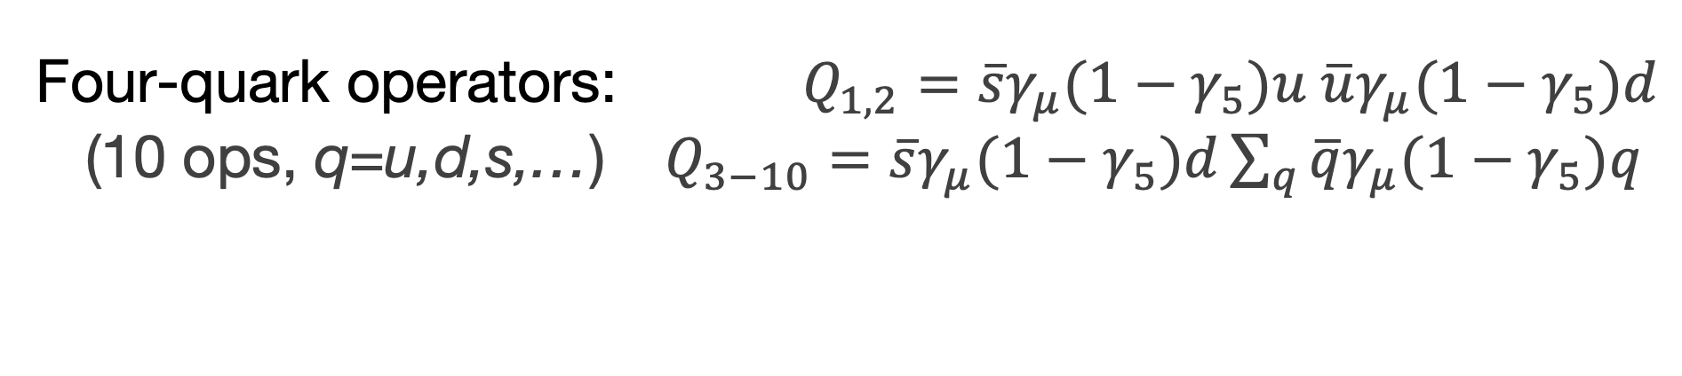
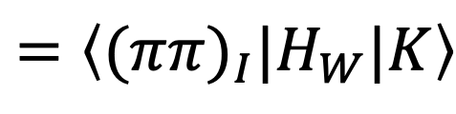
Introduction
Goal:
$$ω^{−1}=ReA_{0}/ReA_{2 }≈22$$
(Effective) Weak Hamiltonian (OPE, RG) evaluated at low scale $μ≪M_{W}$:
Four-quark operators: $Q_{1,2}=\overline{s}γ_{μ}{(1−γ}_{5})u \overline{u}γ_{μ}{(1−γ}_{5})d$
(10 ops, q=u,d,s,…) $Q_{3−10}=\overline{s}γ_{μ}{(1−γ}_{5})d\sum_{q}{\overline{q}γ_{μ}{(1−γ}_{5})q}$
Isospin amplitudes:
$$=\left\langle {(ππ)}_{I}|H_{W}|K\right\rangle$$
Wilson coefficients:
Matrix elements:
$$M_{I,i}=\left\langle {(ππ)}_{I}|Q_{i}|K\right\rangle$$
Calculate on lattice…

Slide 7

Outline
Introduction
Lattice QCD calculation of the relevant matrix elements
Summary/status for $ΔS=1$ matrix elements and $\frac{ε^{′}}{ε}$
Plans and Prospects

Slide 8
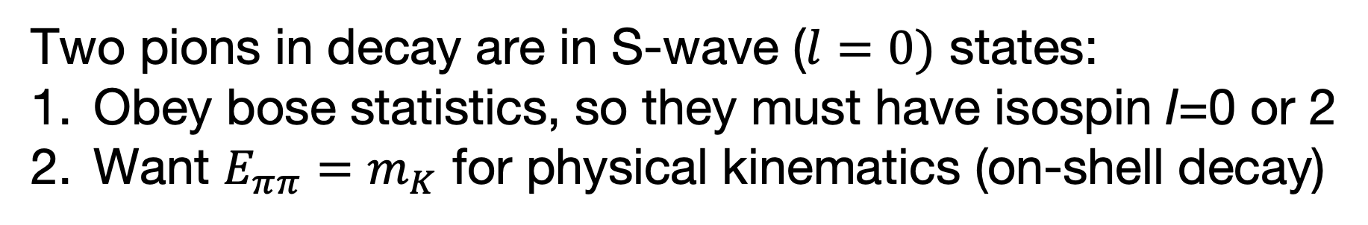
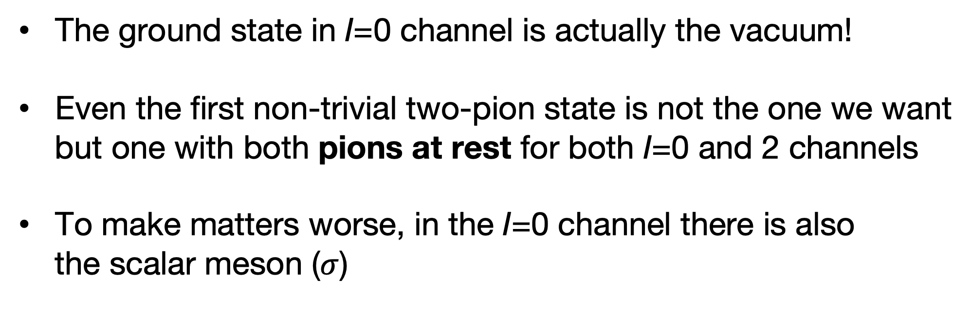
Lattice calculation of the relevant matrix elements
Two pions in decay are in S-wave ($l=0)$ states:
Obey bose statistics, so they must have isospin I=0 or 2
Want $E_{ππ}=m_{K}$ for physical kinematics (on-shell decay)
The problem(s) with two pion states on the lattice:
Work in Euclidean space, so
The ground state in I=0 channel is actually the vacuum!
Even the first non-trivial two-pion state is not the one we want
but one with both pions at rest for both I=0 and 2 channels
To make matters worse, in the I=0 channel there is also
the scalar meson ($σ$)

Slide 9

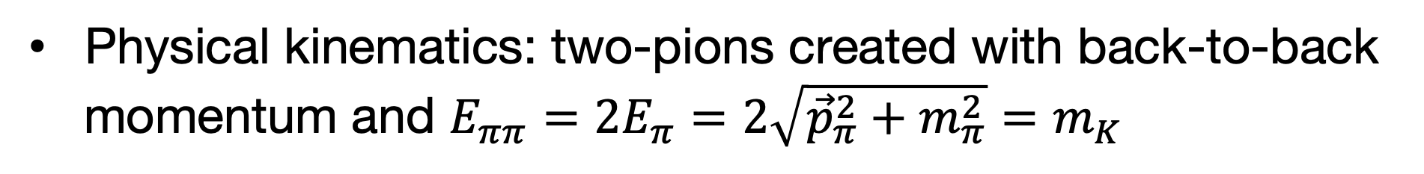
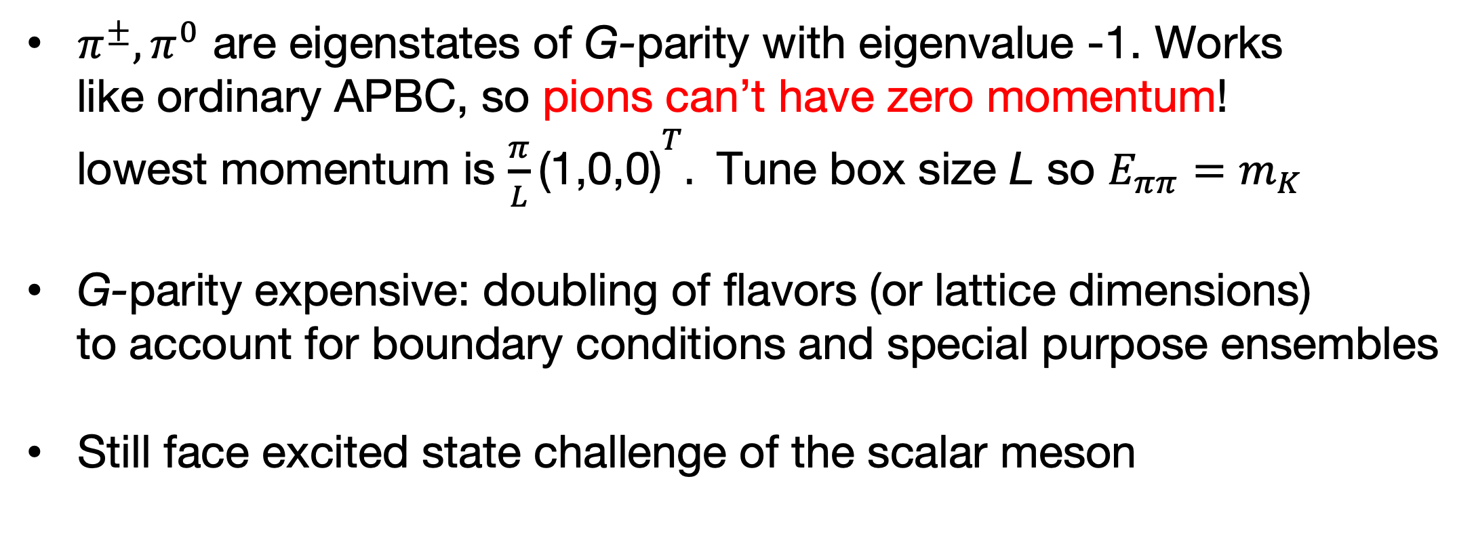
Lattice calculation of the relevant matrix elements
Physical kinematics: two-pions created with back-to-back
momentum and $E_{ππ}=2E_{π}=2\sqrt{{\vec{p}}_{π}^{2}+m_{π}^{2}}=m_{K}$
First solution for physical kinematics: G-parity boundary conditions
on the quark fields: charge conjugation and 180 degree rotation
about “y-axis” in isospin space:
$$G=Ce^{iπI_{y}}$$
$π^{±},π^{0}$ are eigenstates of G-parity with eigenvalue -1. Works
like ordinary APBC, so pions can’t have zero momentum!
lowest momentum is $\frac{π}{L}{\text{(1,0,0) }}^{T}.$ Tune box size L so $E_{ππ}=m_{K}$
G-parity expensive: doubling of flavors (or lattice dimensions)
to account for boundary conditions and special purpose ensembles
Still face excited state challenge of the scalar meson

Slide 10
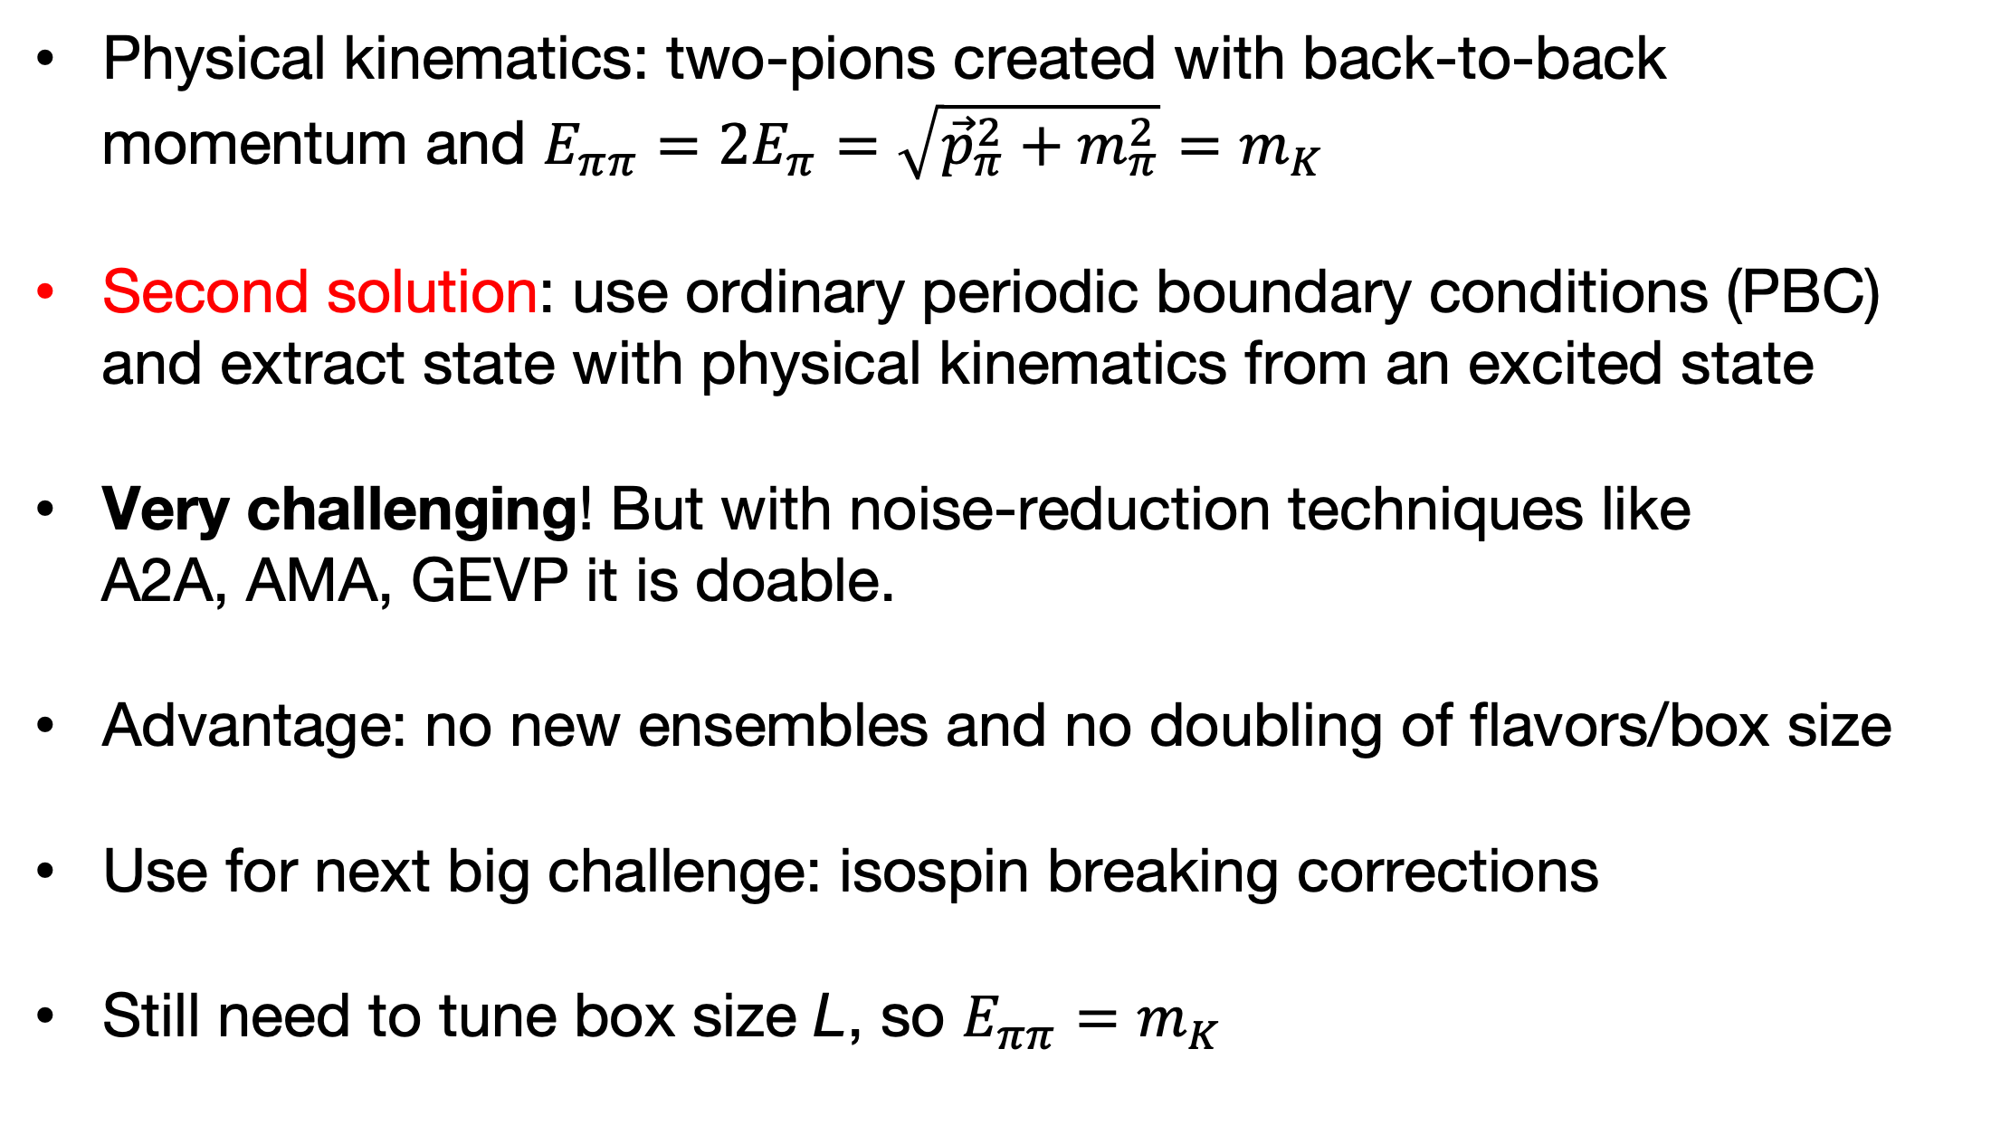
Lattice calculation of the relevant matrix elements
Physical kinematics: two-pions created with back-to-back
momentum and $E_{ππ}=2E_{π}=\sqrt{{\vec{p}}_{π}^{2}+m_{π}^{2}}=m_{K}$
Second solution: use ordinary periodic boundary conditions (PBC)
and extract state with physical kinematics from an excited state
Very challenging! But with noise-reduction techniques like
A2A, AMA, GEVP it is doable.
Advantage: no new ensembles and no doubling of flavors/box size
Use for next big challenge: isospin breaking corrections
Still need to tune box size L, so $E_{ππ}=m_{K}$

Slide 11
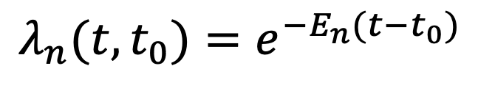
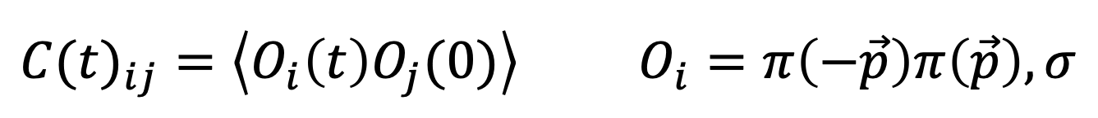

Lattice calculation of the relevant matrix elements
First, GEVP (generalized eigenvalue problem) for two pions
Get N states from N$×$N matrix of correlators
$${C(t)}_{ij}=\left\langle O_{i}\left(t\right)O_{j}(0)\right\rangle O_{i}=π\left(−\vec{p}\right)π\left(\vec{p}\right), σ$$
$$λ_{n}(t,t_{0})=e^{−E_{n}(t−t_{0})}$$
N QCD eigenstates, including excited state with physical kinematics
Fine print: up to excited state contamination of N+1st state left out of GEVP

Slide 12



Lattice calculation of the relevant matrix elements
$$K→ππ$$
matrix elements
$$ππ$$
$$K$$
Form linear combination for state n using GEVP eigenvectors for two pions:
Matrix element from ratios with 2pt-point functions

Slide 13
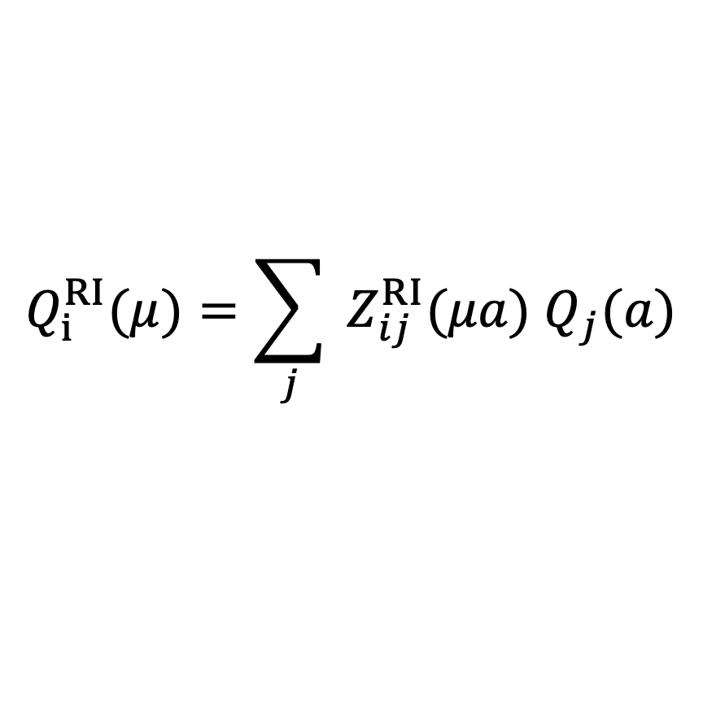
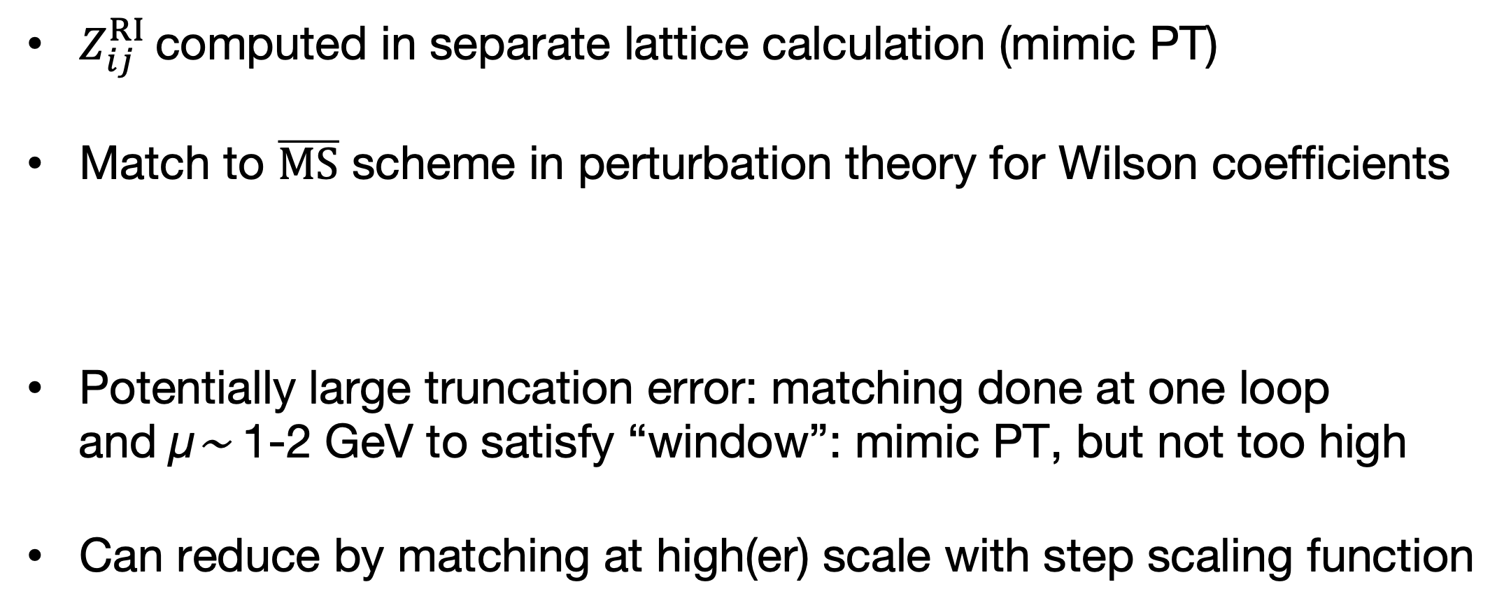
Lattice calculation of the relevant matrix elements
$$Q_{i}^{RI}(μ)=\sum_{j}{ Z_{ij}^{RI}(μa) Q_{j}(a)}$$
Operator renormalization:
$Z_{ij}^{RI}$ computed in separate lattice calculation (mimic PT)
Match to $\overline{MS}$ scheme in perturbation theory for Wilson coefficients
Potentially large truncation error: matching done at one loop
and µ∼ 1-2 GeV to satisfy “window”: mimic PT, but not too high
Can reduce by matching at high(er) scale with step scaling function

Slide 14
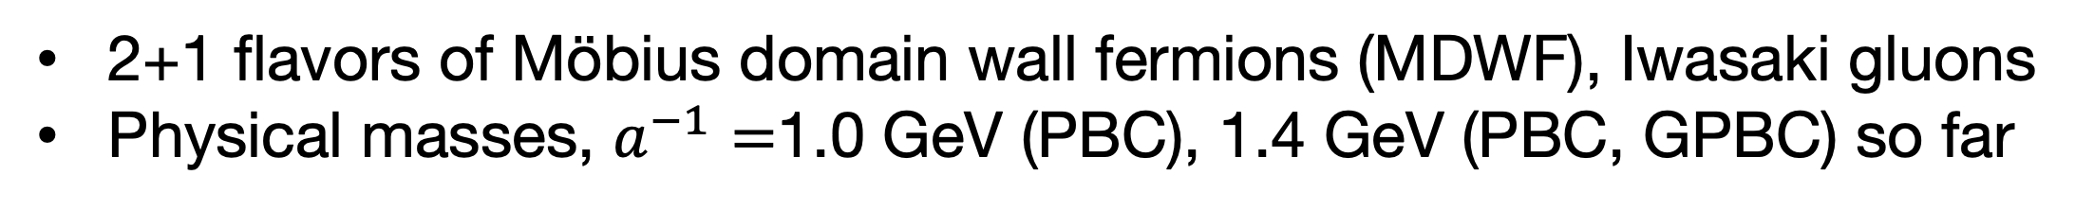
Lattice calculation of the relevant matrix elements
2+1 flavors of Möbius domain wall fermions (MDWF), Iwasaki gluons
Physical masses, $a^{−1}=$1.0 GeV (PBC), 1.4 GeV (PBC, GPBC) so far
1.0 GeV, L=4.8 fm
1.4 GeV, L=4.6 fm
1.73 GeV, L=5.5 fm
2.36 GeV, L=5.4 fm
2.69 GeV, L=7.0 fm
1.73 GeV, L=7.3 fm
(RBC/UKQCD
ensembles)

Slide 15

Outline
Introduction
Lattice QCD calculation of the relevant matrix elements
Summary/status for $ΔS=1$ matrix elements and $\frac{ε^{′}}{ε}$
Plans and Prospects

Slide 16
GPBC
a⁻¹=1.4 GeV (0.11 fm)

Slide 17
PBC
a⁻¹=1.0 GeV (0.2 fm)

Slide 18
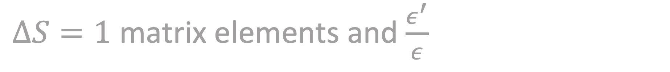
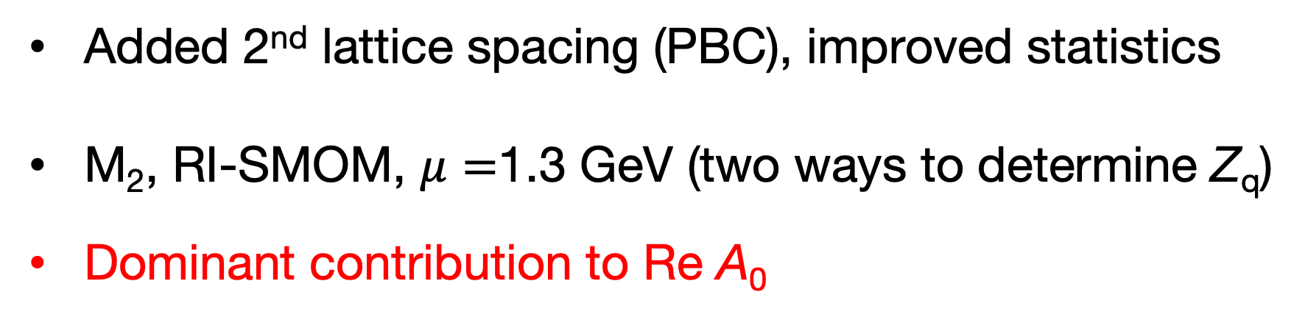
$ΔS=1$ matrix elements and $\frac{ε^{′}}{ε}$
Take continuum limit, small shifts to correct $E_{ππ}≠m_{K}$, FV
Added 2nd lattice spacing (PBC), improved statistics
M₂, RI-SMOM, $μ=$1.3 GeV (two ways to determine Z_{q})
Dominant contribution to Re A₀
(constrained CL)
a⁻¹ = 1.0 and 1.4 GeV
Combined PBC+GPBC
continuum limit extrapolation
First calculation with two lattice spacings

Slide 19
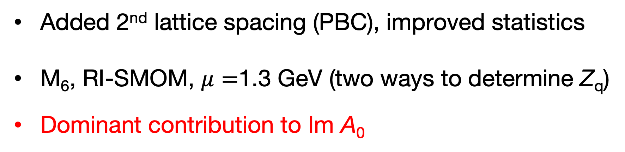
$ΔS=1$ matrix elements and $\frac{ε^{′}}{ε}$
Take continuum limit, small shifts to correct $E_{ππ}≠m_{K}$, FV
Added 2nd lattice spacing (PBC), improved statistics
M₆, RI-SMOM, $μ=$1.3 GeV (two ways to determine Z_{q})
Dominant contribution to Im A₀
(constrained CL)
a⁻¹ = 1.0 and 1.4 GeV
Combined PBC+GPBC
continuum limit extrapolation
First calculation with two lattice spacings

Slide 20
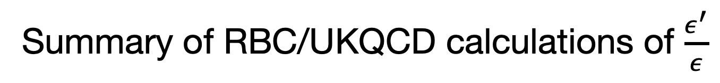
$ΔS=1$ matrix elements and $\frac{ε^{′}}{ε}$
Summary of RBC/UKQCD calculations of $\frac{ε^{′}}{ε}$
[plot credit: Masaaki Tomii]

Slide 21
$ΔS=1$ matrix elements and $\frac{ε^{′}}{ε}$
Preliminary PBC+GPBC continuum limit values and uncertainties
Dominant source of error is continuum limit (coarse lattices)
A paper describing this work is in preparation and will be out soon

Slide 22

Outline
Introduction
Lattice QCD calculation of the relevant matrix elements
Summary/status for $ΔS=1$ matrix elements and $\frac{ε^{′}}{ε}$
Plans and Prospects

Slide 23
Plans and prospects [M. Tomii, J. Hildebrand]
Continuum limit with 2+1 flavors of MDWF fermions, Iwasaki gluons. PBC. Current systematic error 22% (coarse lattices)
Current method (A2A, LMA, AMA), new calculations
Supplement with large set of existing point-source propagators
Physical mass ensembles:
1.73 GeV (0.114 fm)
Ongoing
2.36 GeV (0.084 fm)
Planned start 2026
2.69 GeV (0.073 fm)
Planned start 2027

Slide 24
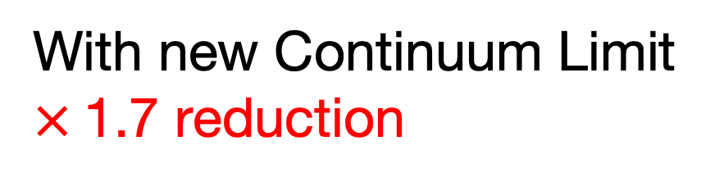
Plans and prospects [M. Tomii, J. Hildebrand]
Physical mass ensembles:
Finite Volume error 10%
based on previous 3/2 results
L = 4.8 fm (1.0 GeV)
Complete
L = 5.5 fm (1.73 GeV)
Ongoing
With new Continuum Limit
$×$1.7 reduction
Even larger 1.73 GeV lattices
available
L = 4.6 fm (1.4 GeV)
Complete
L = 5.4 fm ( 2.36 GeV)
Planned start 2026

Slide 25
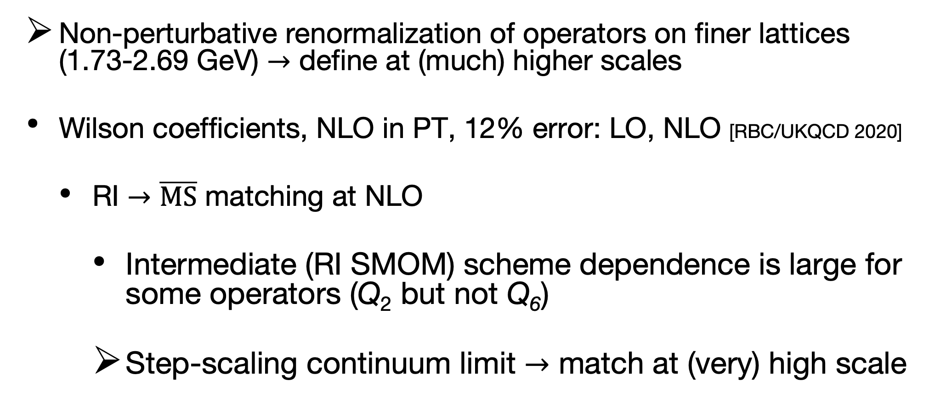
Plans and prospects [M. Tomii]
Renormalization, matching, and Wilson coefficients
Non-perturbative renormalization of operators on finer lattices (1.73-2.69 GeV) $→$ define at (much) higher scales
Wilson coefficients, NLO in PT, 12% error: LO, NLO [RBC/UKQCD 2020]
RI $→\overline{MS}$ matching at NLO
Intermediate (RI SMOM) scheme dependence is large for some operators (Q₂ but not Q₆)
Step-scaling continuum limit $→$ match at (very) high scale

Slide 26
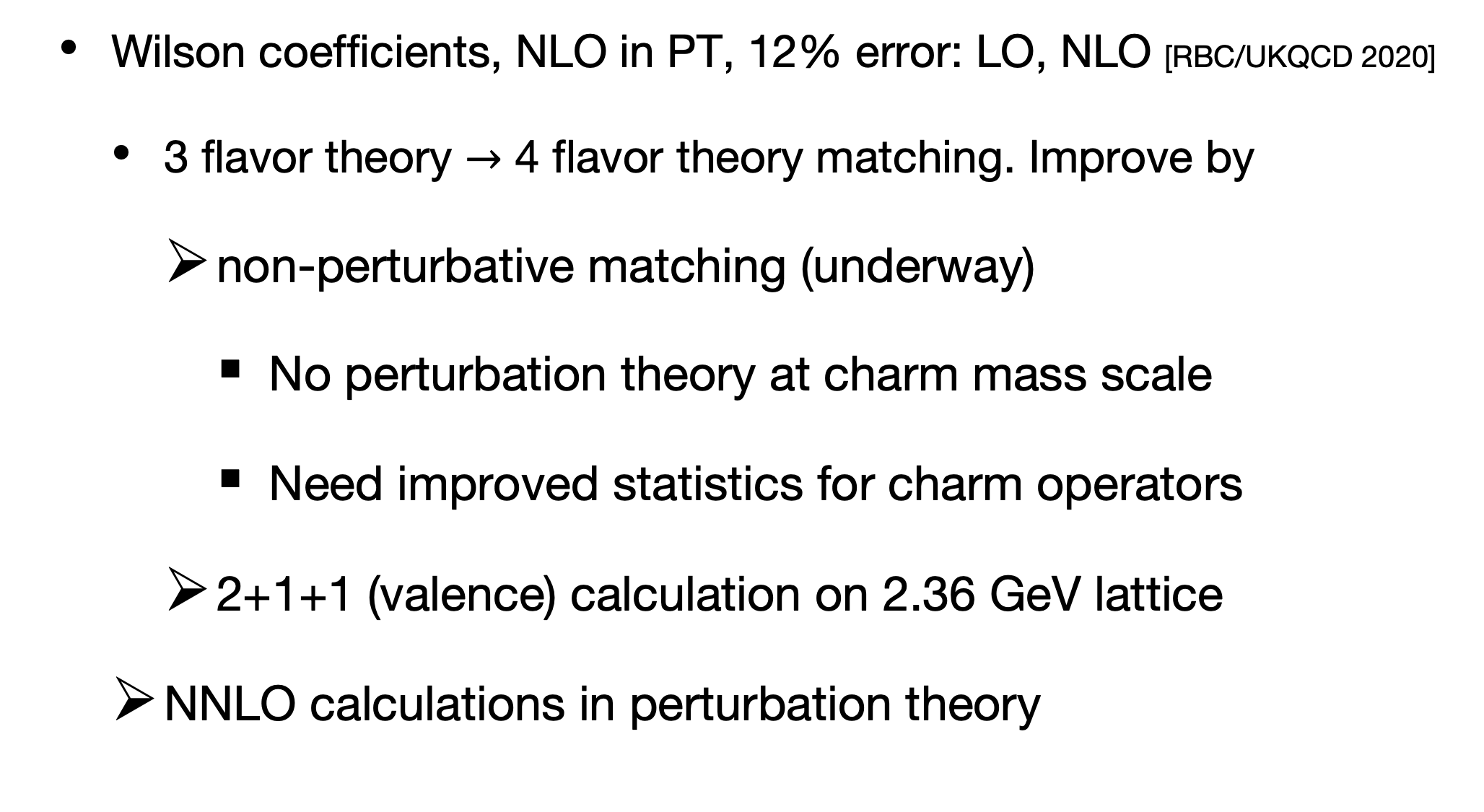
Plans and prospects [M. Tomii]
Renormalization, matching, and Wilson coefficients
Wilson coefficients, NLO in PT, 12% error: LO, NLO [RBC/UKQCD 2020]
3 flavor theory $→$ 4 flavor theory matching. Improve by
non-perturbative matching (underway)
No perturbation theory at charm mass scale
Need improved statistics for charm operators
2+1+1 (valence) calculation on 2.36 GeV lattice
NNLO calculations in perturbation theory
(See talk by M. Gorbahn on Friday)

Slide 27
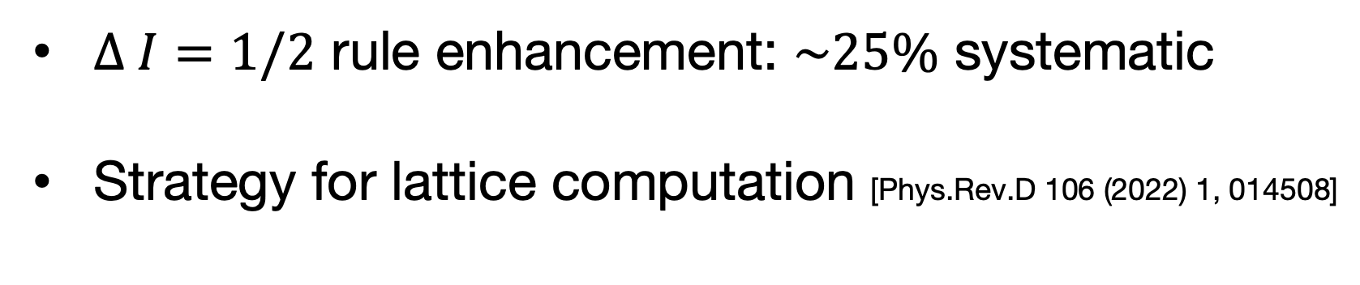
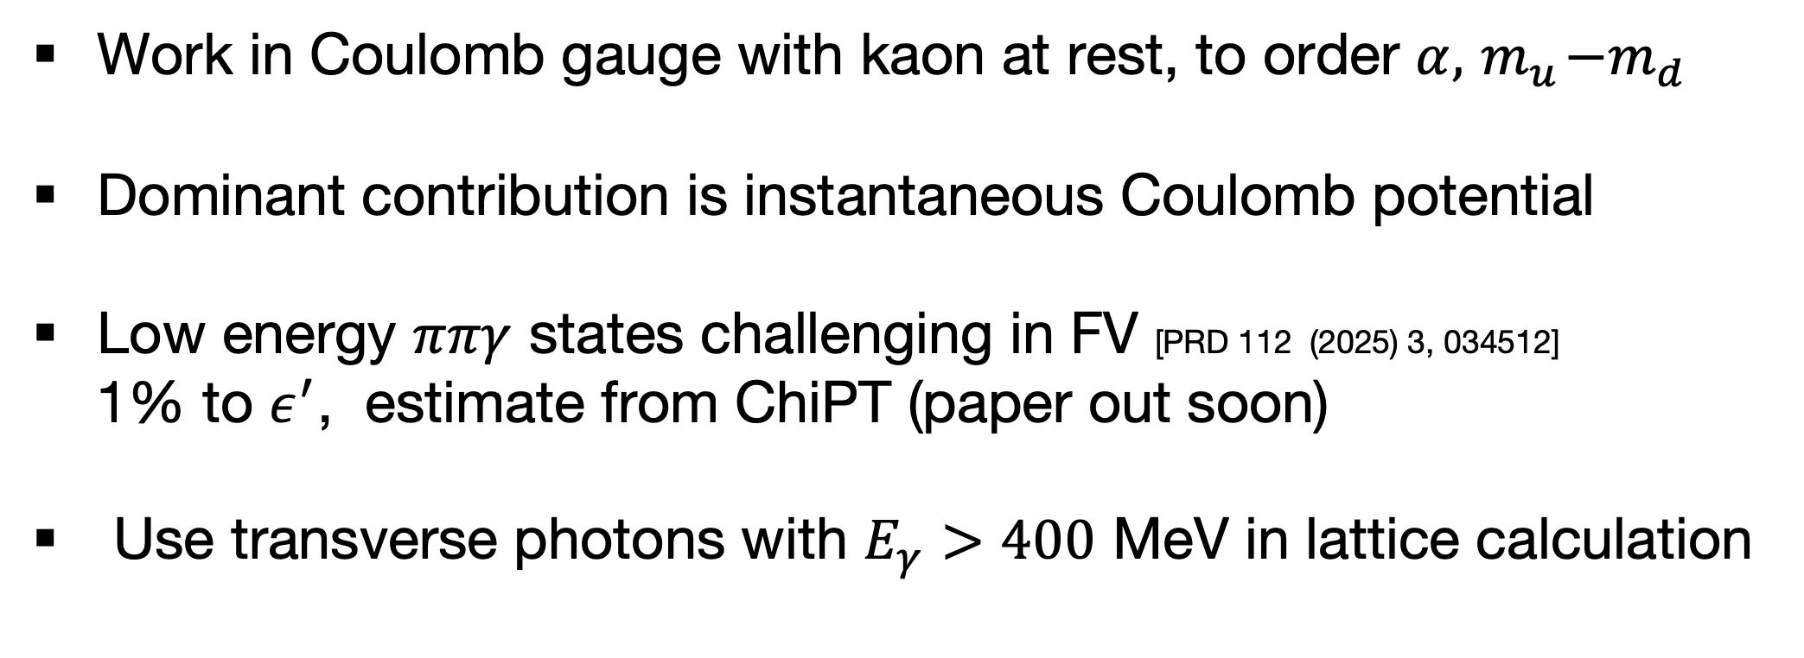
Plans and prospects [E. Lundstrum, N. Christ]
Isospin breaking effects: amplified by $ΔI=1/2$ rule
$∆ I=1/2$ rule enhancement: $\sim 25\%$ systematic
Strategy for lattice computation [Phys.Rev.D 106 (2022) 1, 014508]
Work in Coulomb gauge with kaon at rest, to order $α, { m}_{u}−m_{d}$
Dominant contribution is instantaneous Coulomb potential
Low energy $ππγ$ states challenging in FV [PRD 112 (2025) 3, 034512]
1% to $ε^{′}$, estimate from ChiPT (paper out soon)
Use transverse photons with $E_{γ}>400$ MeV in lattice calculation

Slide 28
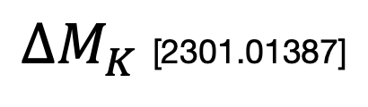
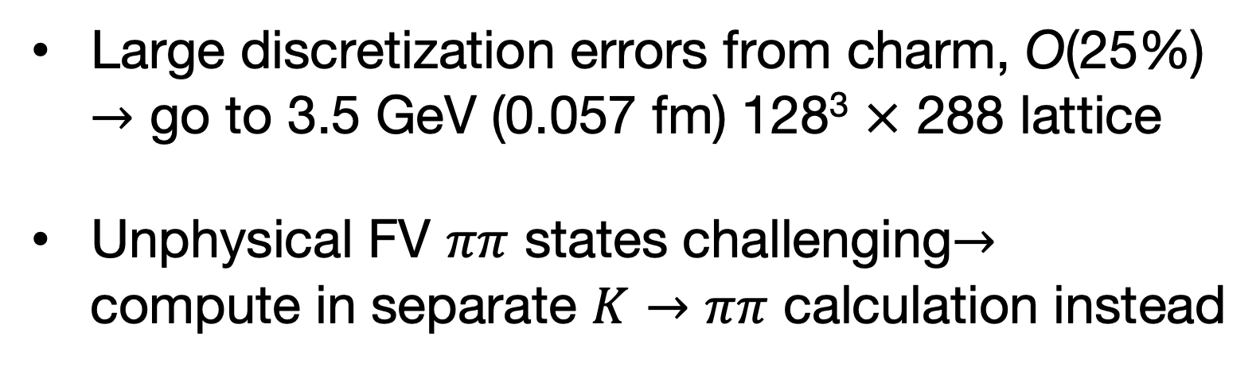
Plans and prospects [Y. Huo]
${∆M}_{K}$[2301.01387]
and Long-distance correction to $ε_{K}$ [PRD 109 (2024) 5, 054501]
Large discretization errors from charm, O(25%)
$→$ go to 3.5 GeV (0.057 fm) 128³ $×$ 288 lattice
Unphysical FV $ππ$ states challenging$→$
compute in separate $K→ππ$ calculation instead
2.36 GeV (0.084 fm)
Ongoing
Physical mass ensembles
3.5 GeV (0.057 fm)
Planned

Slide 29
Plans and prospects [J. Hildebrand]
(See talk by J. Aebischer on Friday)
If we can get total SM uncertainty at or below experiment, (10%) new physics searches become interesting
Compute SMEFT operator matrix elements
new four-quark operators
but very similar to SM
(chromo) magnetic dipole
operator

Slide 30
Acknowledgements
Special thanks to Masaaki Tomii
TB partially supported by US Department of Energy (DOE)
Computations done on Cori (US DOE, NERSC) and USQCD clusters (BNL, FNAL, JLab)

Slide 31
Backup Slides

Slide 32
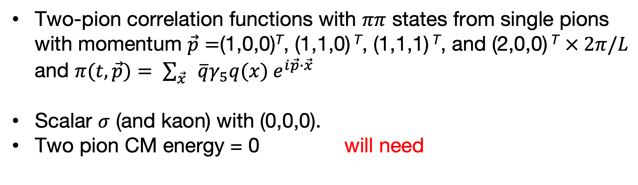
Lattice calculation of the relevant matrix elements
Two-pion correlation functions with $ππ$ states from single pions
with momentum $\vec{p}=$(1,0,0)^{T}, (1,1,0) ^{T}, (1,1,1) ^{T}, and (2,0,0) ^{T} $× 2π/L$
and $π(t,\vec{p})= \sum_{\vec{x}}{ }\overline{q}γ_{5}q(x){ e}^{i\vec{p}∙\vec{x}}$
Scalar $σ$ (and kaon) with (0,0,0).
Two pion CM energy = 0 will need
D
C
R
V

Slide 33
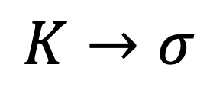
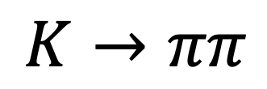
Lattice calculation of the relevant matrix elements
Contractions for three-point correlation functions
(can have different spin and color contractions)
O_{a} are same two-pion operators as before
$$K→ππ$$
$$K→σ$$

Slide 34
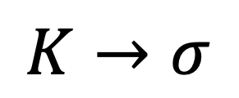
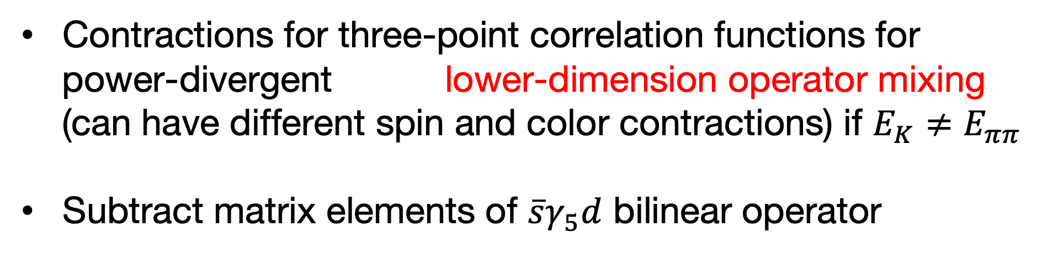
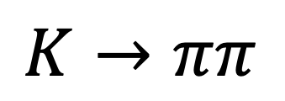

Lattice calculation of the relevant matrix elements
Contractions for three-point correlation functions for
power-divergent lower-dimension operator mixing
(can have different spin and color contractions) if $E_{K}≠E_{ππ}$
Subtract matrix elements of $\overline{s}γ_{5}d$ bilinear operator
${(a}^{−2}$)
$$K→ππ$$
$$K→σ$$

Slide 35
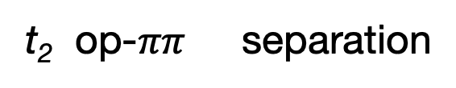
Lattice calculation of the relevant matrix elements
Ground state ME’s
Effective matrix element
t₁ kaon-op separation
t₂ op-$ππ$ separation
matrix element from fit
M₀₂ and M₀₆, dominant contributions to Re, Im A₀

Slide 36
Lattice calculation of the relevant matrix elements
1st excited state ME’s
Effective matrix element
t₁ kaon-op separation
t₂ op-$ππ$ separation
matrix element from fit
M_{1,2} and M_{1,6} dominant contributions to Re, Im A₀

Slide 37
Lattice calculation of the relevant matrix elements
Effect of the sigma meson on matrix elements (from fit)
Ground state
1st excited state

