Slide 1

Overview of the existing Head-Tail monitors in LHC
T. Levens, SY-BI
HL-LHC High Bandwidth Beam Position Monitor Review – 15th January 2025

Slide 2
Introduction
Head-Tail Monitors are wideband beam position monitors capable of measuring intra-bunch beam position.
A 180º hybrid calculates analogue sum and difference of long strip-line BPM electrodes.
Signals are acquired after short cables by high-speed digitizer located in a service gallery.
Originally installed in SPS/LHC for chromaticity measurements, now used primarily for instability diagnostics.

Slide 3
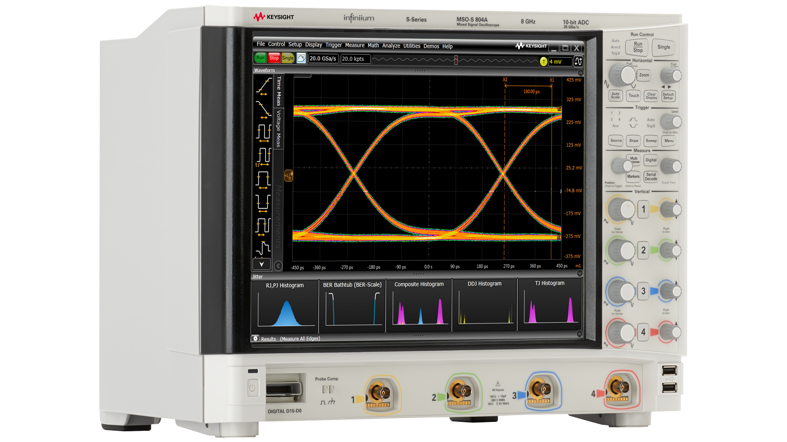
LHC Head-Tail Monitors
Four 40 cm long BPLH/V type (single plane) BPMs installed close to Q5R4 and Q6R4 in LSS4.
  Installed at positions with maximum beta functions.
H-9 hybrid in tunnel calculates sum/difference.
~25m 7/8” coax cables to UA47 service gallery.
Acquisition with high-speed oscilloscopes:
  10GSPS (100ps) with 4GHz bandwidth.
  Maximum record size:
    460 turns (41ms) for 3564 bunches.
    64k turns (5.8s) for <24 bunches.
  Readout speed (10-20 seconds) limits
  retrigger rate.
Keysight DSOS404A

Slide 4
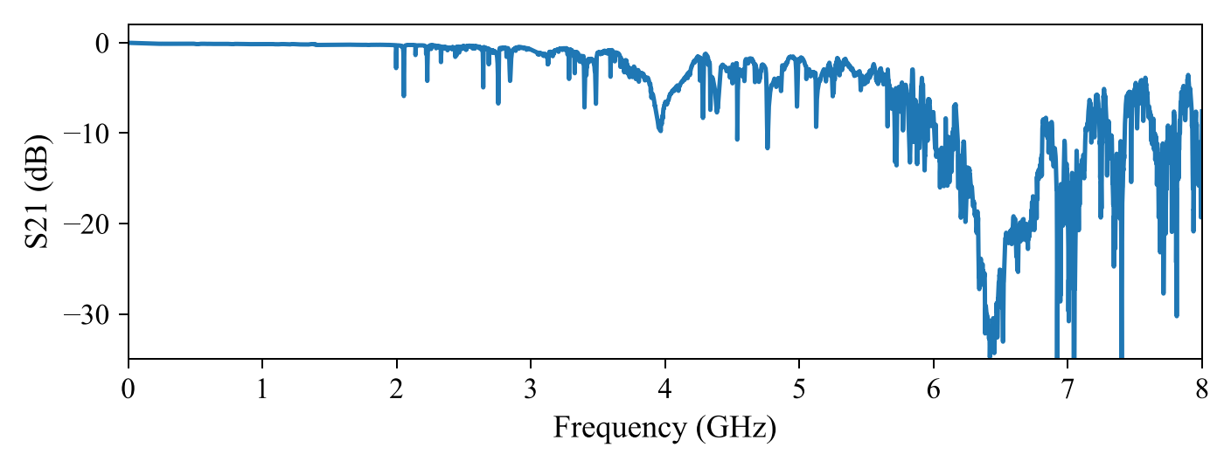
Limitations I
Frequency response of BPLH/V strip-lines starts to show imperfections above 2GHz:
VNA measurement through BPLV strip-line

Slide 5
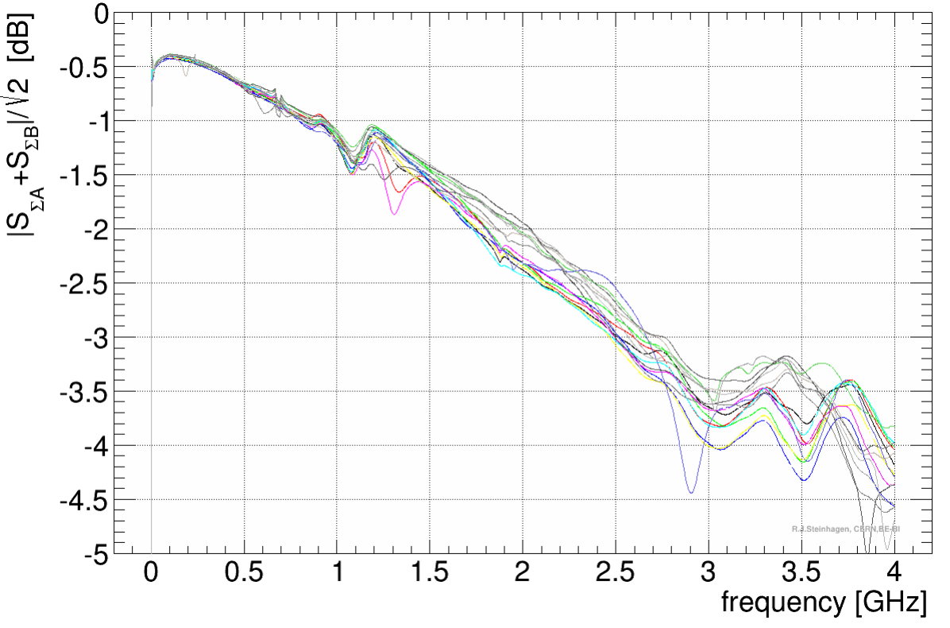
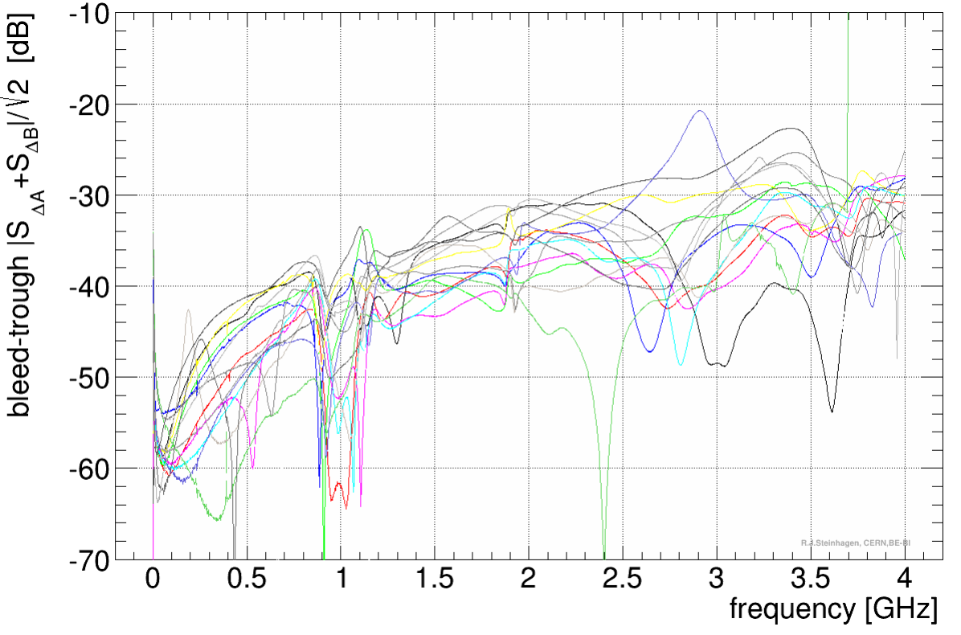
Limitations II
H-9 hybrids used are specified from 2MHz to 2GHz.
  -30dB CMMR up to 2GHz, large spread, good ones “usable” to higher freq.
Unfortunately, no better option has been identified up to now…
G. Kotzian et al at IBIC 2013: WEPC12

Slide 6
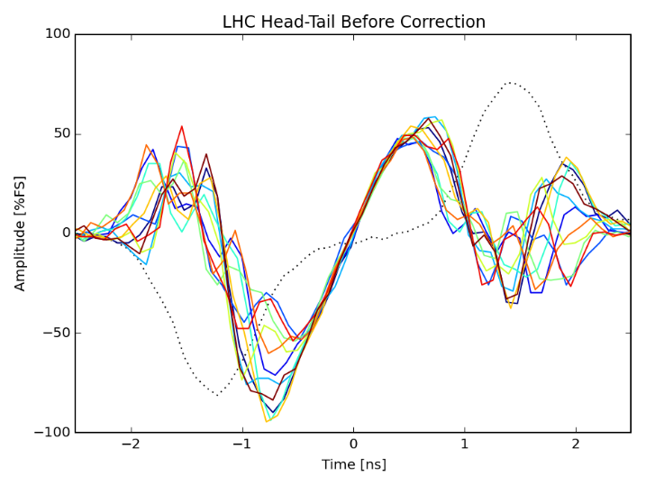
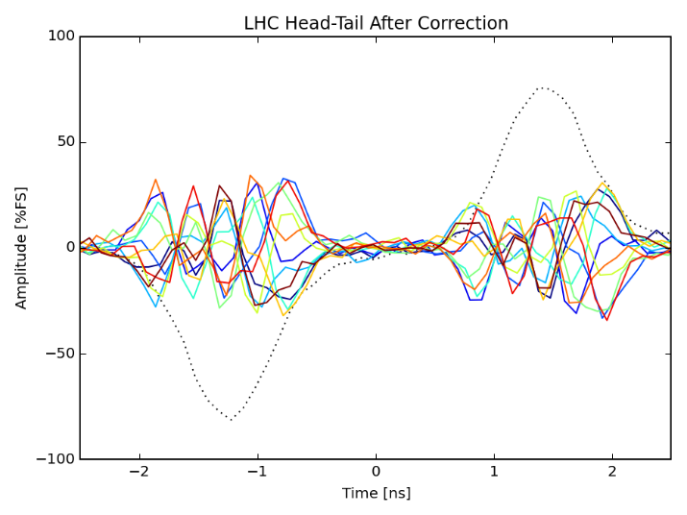
Limitations III
Significant “residual” difference signal measured on HT monitor.
  Pattern is different for each system and exact source is unclear.
Corrected in post-processing for instability measurements but limits dynamic range → correction will be more difficult for static effects of CC.

Slide 7
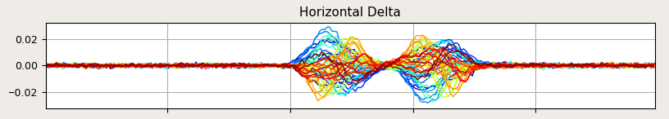
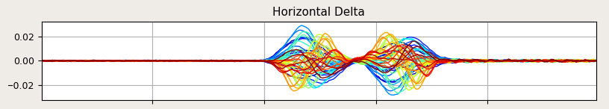
Limitations IV
Limited dynamic range due to high-speed 10GSPS digitizers.
Upgrade from 8 to 10-bit digitizers (2018) improved dynamic range.
State of the art today is “12-bit” digitizers at 10GSPS.
  But, in reality, ENOB is only increased from 7.8 to 8.1-bits!
8-bit
(< 2018)
~9dB lower noise floor
10-bit
(> 2018)

Slide 8
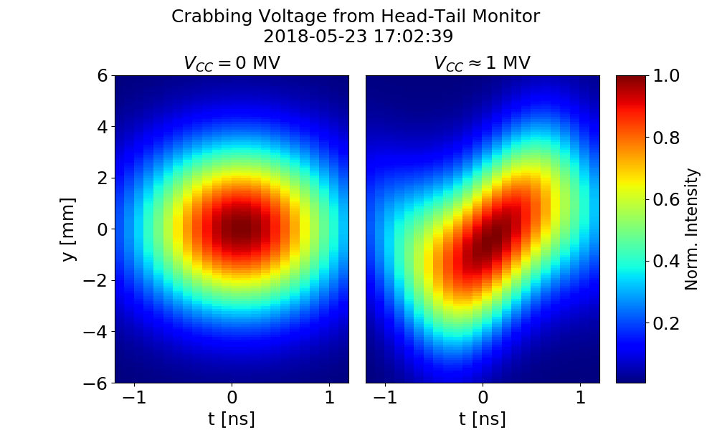
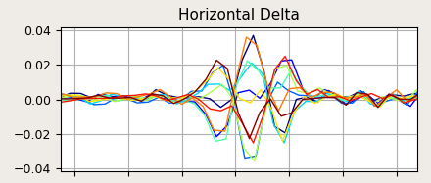
Results
Despite these limitations the Head-Tail monitors are simple, robust and operationally reliable → key qualities to maintain in the future!
Good results have been achieved for instability measurements in SPS & LHC and crab-cavity tests in SPS…
  Resolution ~20-50um achieved
  turn-by-turn.

Slide 9
Can we do better?
Limited potential for improvements using electromagnetic techniques.
  No better alternative to H-9 hybrids identified.
  Dynamic range of digitizers close to physical limits.
Electro-optical techniques identified > 10 years ago as having potential to improve performance.
  Collaboration agreement with Royal Holloway University, as part of HL-UK(2), to develop EO-BPMs for HL-LHC.
  Long development history → talk of Stephen
Note: WP13 is only considering wide-band time-domain acquisition options for the BPW.
  Serving as a complement to narrow-band measurements being developed by WP4 as part of the CC noise feedback system → talk of Daniel

Slide 10
HL-LHC BPW specifications
BPW performance criteria given in LHC-BPW-ES-0001 (v1.2) are based on an extrapolation from existing HT specifications.
  Aim to improve resolution, bandwidth and sampling rate…
But, these were not specifically written with Crab Cavity diagnostics in mind!
Criterion | Key | Target | Units
Single bunch, single pass resolution at bunch centre for pilot bunch intensity | 100 | 50 | um
Single bunch, single pass resolution at bunch centre for nominal bunch intensity | 10 | 5 | um
Precision¹ of the measurement for nominal bunch intensity | 10 | 5 | um
Long term stability² of the offset for nominal bunch intensity | 50 | 20 | um
High frequency cut-off (-3dB) | 5 | 10 | GHz
Low frequency cut-off (-3dB) | ≤ 1 | ≤ 0.5 | MHz
In-band (between -1dB low and high cut-off roll-off) response variation | ≤ 1 | ≤ 1 | dB
Time resolution for single bunch, single pass measurement | 50 | 25 | ps
Acquisition length for a single bunch measurement on successive turns | > 1000 | 10000 | turn
Minimum time between two successive measurements | 25 | 25 | ns

Slide 11
Location of HL-LHC BPW
Baseline for HL-LHC was to install BPW in LSS4.
  Space reservation: LHC-BPW-EC-0001 (v0.1)
Subsequent study by WP2 indicated that LSS4 is not optimal for CC diagnostics.
  Would require pairs of BPMs with π/2 phase advance to achieve <10um residual crabbing, optics dependent.
The best location is close to the CC in IP1/5…
  Significant additional constraints → talk of Michal

Slide 12
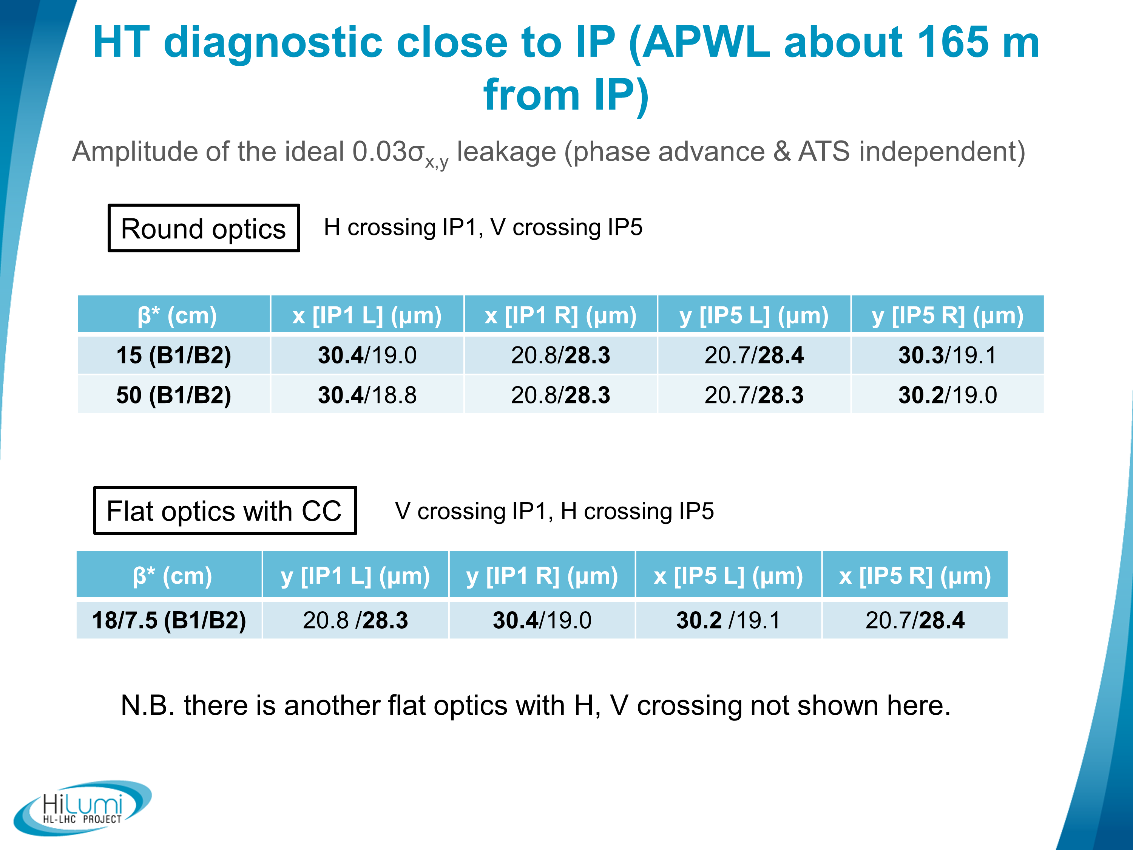
i.e. beside the CC
Approx. 30um residual signal in all cases!
R. De Maria, S. Kostoglou, Special Joint HiLumi WP2/WP4/WP13 Meeting, 15/06/2021 (https://indico.cern.ch/event/1044711/)

Slide 13
Limits of traditional Head-Tail
With optimal BPM locations (IP1/5) need to measure ~30um signal.
Given existing HT, 30um corresponds to a ~3mV signal.
Baseline signals of ~20mV need to be digitized.
  Current HT scopes have ~175uVrms noise for these signal levels.
  ~10% of signal level.
No FRAS foreseen for these BPMs, can expect ~mm offset between beam and BPM electrical center.
  Resulting in an additional ~200mV baseline from the beam offset.
  Current HT scopes have ~750uVrms noise for these signal levels.
  ~25% of signal level.
Since residual crabbing is a static effect, we can take advantage of averaging to reduce noise…

Slide 14
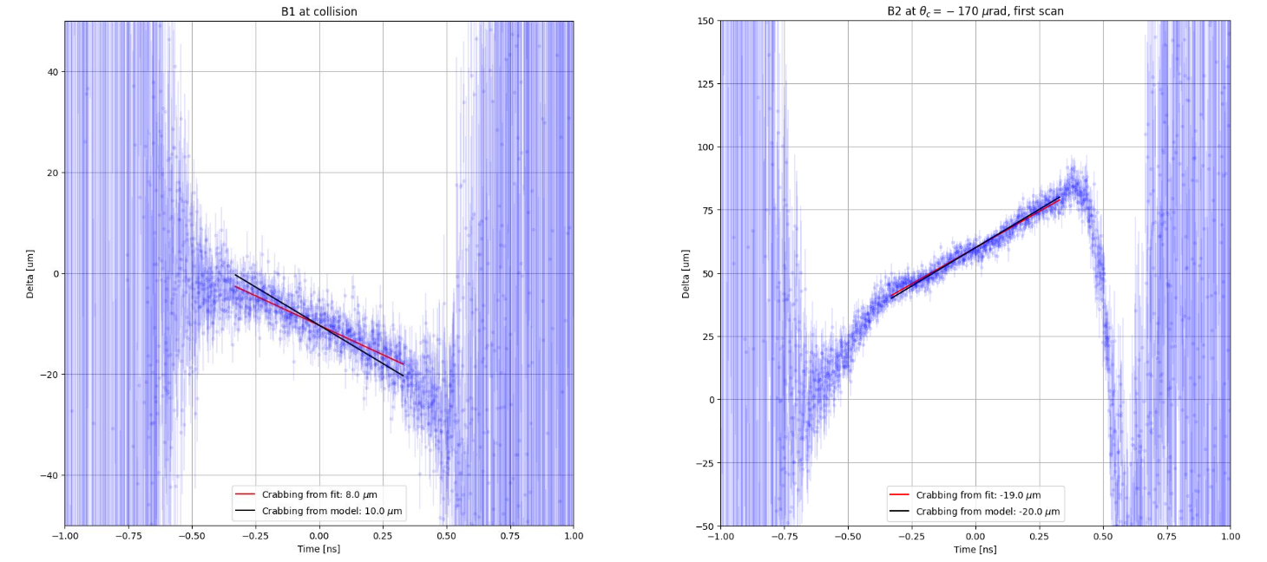
Limits of traditional Head-Tail
Recent measurements by A. Fornara have demonstrated the possibility to measure ~10um crabbing due to beam-beam effects with the HT monitor in the LHC with averaging of 1k turns:

Slide 15
Conclusion
Existing wide-band “Head-Tail” monitors are installed in LHC LSS4 and used primarily for instability monitoring.
A number of limitations with the existing instruments identified and found difficult to solve with EM techniques.
  Launched the development of EO-BPMs in collaboration with RHUL as part of HL-UK(2).
WP13 mandated to install new wide-band BPMs (BPW) for crab-cavity diagnostics in HL-LHC.
  The optimal location is close to the crab cavities in IP1/5.
Despite their limitations, existing HT monitors are simple, operationally reliable and have given good results!
  First crabbing measurements demonstrated in LHC in 2024!

Slide 16
Thank you…

