Slide 1
Beam motion measurement subsystem for the Crab-Cavity noise feedback
X. Buffat, R. Calaga, G. Hagmann, M. Krupa, T. Levens, R. De Maria, D. Valuch
15.1.2025

Slide 2
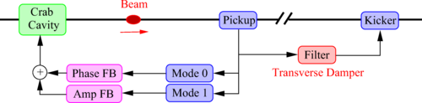
Crab Cavity noise feedback system
Feedback system proposed to mitigate the emittance growth due to the residual amplitude and phase noise of the Crab Cavities
Baudrenghien, P. and Mastoridis, T.: Transverse emittance growth due to rf noise in crab cavities: Theory, measurements, cure, and high luminosity LHC estimates
10.1103/PhysRevAccelBeams.27.051001

Slide 3
Crab Cavity noise feedback system
Performance requirements for the feedback system beam position measurement units:
The measurement noise thresholds are thus σ₀ < 320 nm and σ₁ < 8.3 μrad. These are bunch-by-bunch measurement levels
The above measurement noise thresholds require extremely high precision measurements. Fortunately, the closed loop bandwidth of the crab cavity with LLRF field regulation will only extend to 136 kHz. As a result, the noise bandwidth will also be limited to 136 kHz. In addition, the bunches are spaced every 25 ns and the measurement noise is uncorrelated from bunch to bunch.
Filtering the data with a low-pass filter matching the signal spectrum will scale the measurement noise power by a factor of about 12 (linear) improvement in signal-to-noise ratio.
This increases the actual single bunch resolution threshold to σ₀ < 3.9 μm rms and σ₁ < 100 μrad rms. This is a tight, but achievable specification.
Baudrenghien, P. and Mastoridis, T.: Transverse emittance growth due to rf noise in crab cavities: Theory, measurements, cure, and high luminosity LHC estimates
DOI 10.1103/PhysRevAccelBeams.27.051001

Slide 4
Crab Cavity noise feedback system
Evaluation of viable options for the feedback system hardware started In a broad collaboration
ABP:
  Optics scenarios, expected position range etc.
  Possible contraindications
  Discussion about options to measure at Ips 1/5, and/or at point 4…
BI:
  Pickup design
  Detailed numeric simulations providing sensitivity to mode 0 and 1 motion
RF:
  Analytic model providing sensitivity to mode 0 and 1 motions
  Mathematical analysis and detailed modelling of the beam position measurement signal processing chain to identify critical points and calculate the noise budget
  Evaluation of digitizer performance.

Slide 5
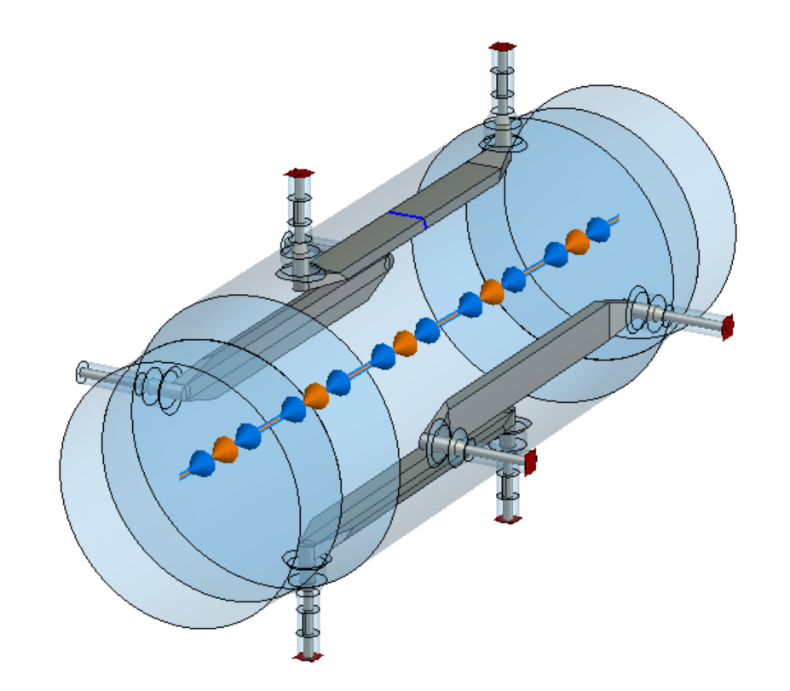
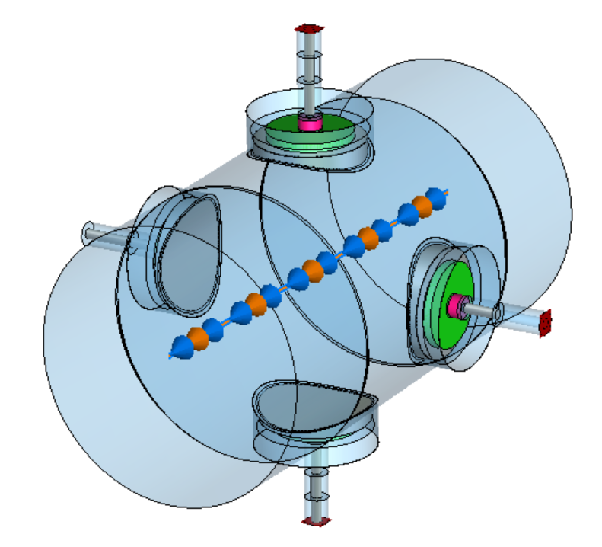
Crab Cavity noise feedback system
A set of pickups installed next to the CC
Pickup functional specifications Hofle, Calaga: Conceptual Specification - BPTQR Crab Cavity RF Pick-up System. EDMS 3069868 v.0.1 LHC-BPM-ES-0015 v.0.1
A combined button + stripline pick-up proposed
Simulations and models: M. Krupa

Slide 6
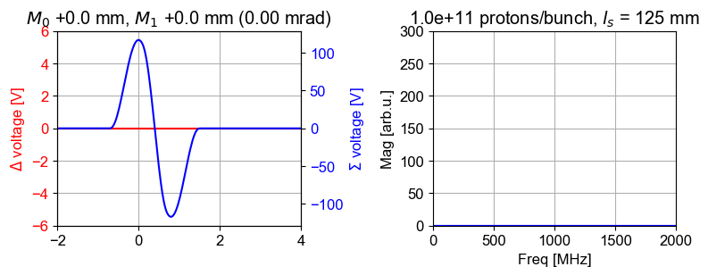
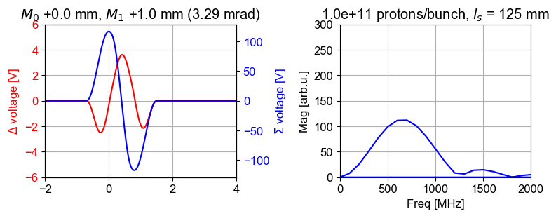
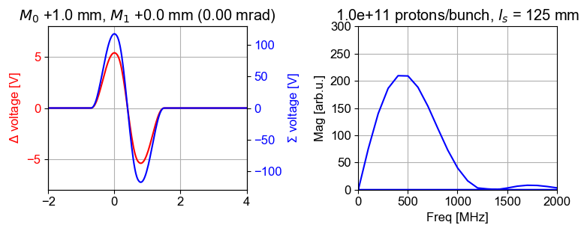
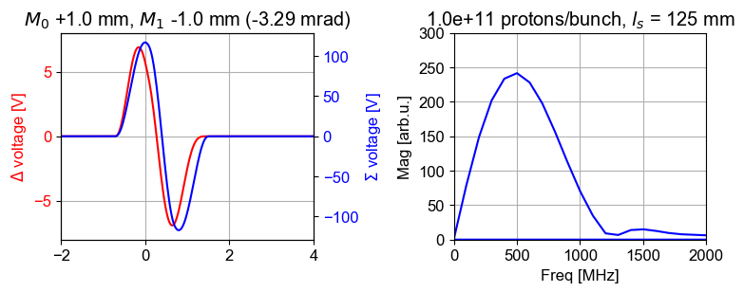
Pickup type selection
After extensive comparison of the two technologies, we have converged to use the strip-line pickup for the feedback
Length 125 mm (peak response at 600 MHz), diameter 86.5 mm
Expected beam displacement in operation up to ±2 mm (slow and fast)

Slide 7
m₀ and m₁ motion detection
Both m₀ and m₁ motion can be extracted from a measurement at the same frequency
1. Raw Σ, Δ signals
2. Phase aligned Σ, Δ signals
3. Effect of m₀ and m₁ motion
Kotzian et al.: Sensitivity of the LHC Transverse Feedback System to Intra-Bunch Motion
DOI 10.18429/JACoW-IPAC2017-TUPIK093

Slide 8
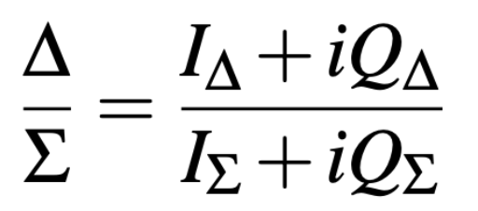
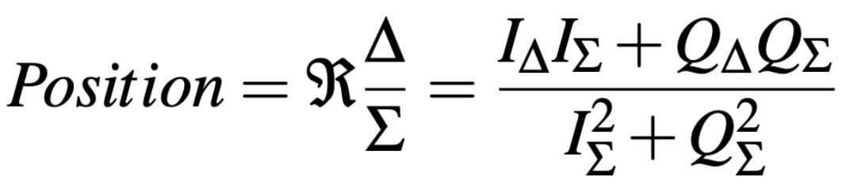
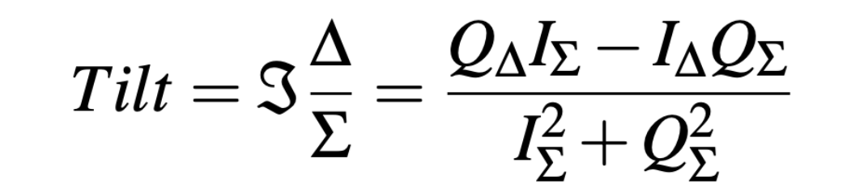
m₀ and m₁ motion detection
Both m₀ and m₁ motion can be extracted from a measurement at the same frequency
Kotzian et al.: Sensitivity of the LHC Transverse Feedback System to Intra-Bunch Motion
DOI 10.18429/JACoW-IPAC2017-TUPIK093

Slide 9
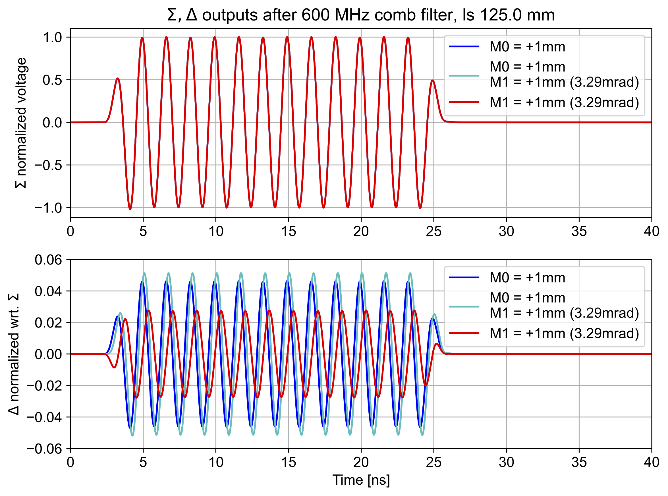
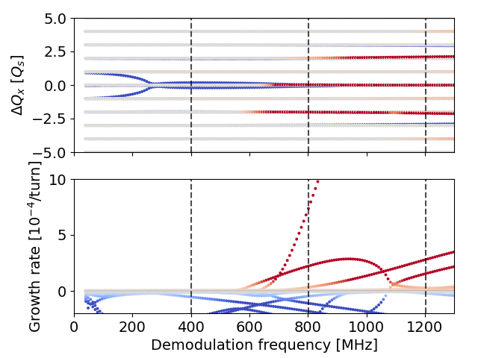
Measurement frequency selection
Technically, we can process the RF at any frequency. Proposed stripline pickup has a peak sensitivity at 600 MHz…
However, beam dynamics studies show a presence of two-node head-tail mode in a vicinity of 600 MHz, with a risk to be driven by the noise feedback if the position and tilt measurement will be done above 500 MHz.
Buffat X: Update on stability from the amplitude feedback - Impact of RF curvature and quality factor. HL-LHC WP2 meeting 05.04.2022 https://indico.cern.ch/event/1144197/

Slide 10
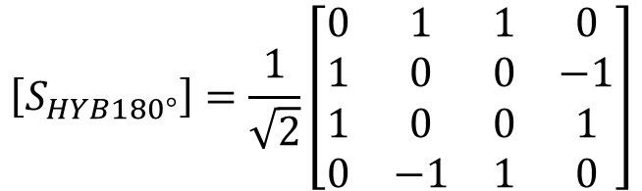
Critical component – the 180° hybrid
Major complications:
With such a large pick-up, the expected Δ signals will have about the same magnitude than the 180° hybrid crosstalk (isolation)
Standard phase unbalance between Σ and Δ ports of H-9 hybrid ~5°
Implications:
Loss of dynamic range, the output will be always close to the full scale
Mixing of m₀ and m₁ signals, or cross-generation of false motion signals
1
$$\left[S_{HYB180°}\right]=\frac{1}{\sqrt{2}}\left[\begin{matrix}0 & 1 & 1 & 0 \\ 1 & 0 & 0 & −1 \\ 1 & 0 & 0 & 1 \\ 0 & −1 & 1 & 0\end{matrix}\right]$$
1
2
-1
1
4
3
1

Slide 11
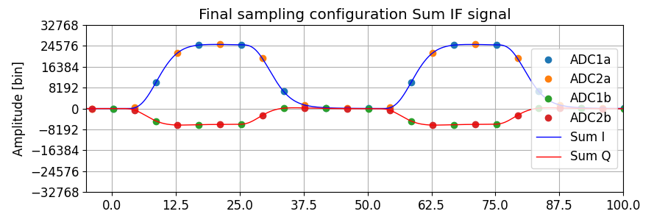
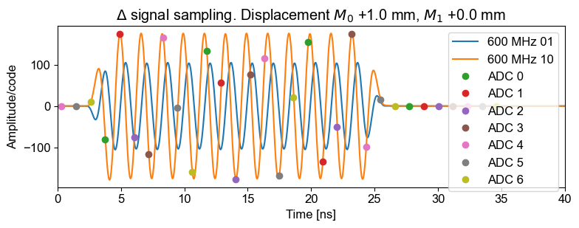
Receiver and digitizer performance requirements
Typical receiver architectures
Super heterodyne receiver with analogue quadrature demodulation
Direct RF sampling with digital quadrature demodulation

Slide 12
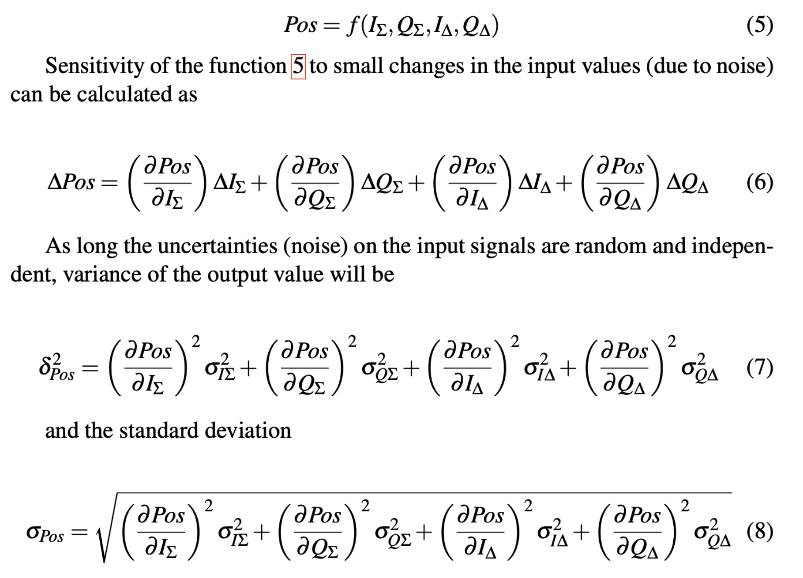
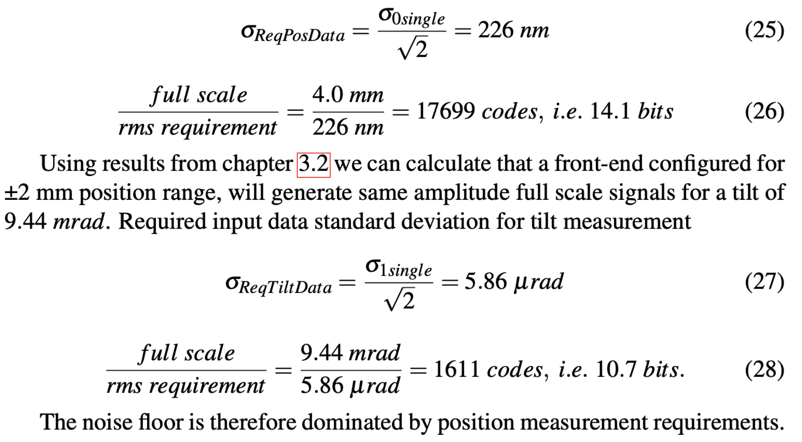

Receiver and digitizer performance requirements
“The measurement noise thresholds are thus σ₀ < 320 nm and σ₁ < 8.3 μrad. These are bunch-by-bunch measurement levels”
How good our signal processing needs to be?
20 steps later…

Slide 13
Receiver and digitizer performance requirements
Is the required ENOB of 14.1 bits needed for σ₀ < 320 nm and σ₁ < 8.3 μrad for a bunch by bunch mode easy or difficult to achieve?
It depends…

Slide 14
Receiver and digitizer performance requirements
Is the required ENOB of 14.1 bits needed for σ₀ < 320 nm and σ₁ < 8.3 μrad for a bunch by bunch mode easy or difficult to achieve?
It depends…
For bunch by bunch measurement we need ~80 MHz analogue bandwidth
With a single, off the shelve uTCA SIS8300KU digitizer module with 10 ADCs, which is preferred for compatibility and synergy reasons it is out of reach.
For operation with reduced bandwidth (with relaxed constraints) it is usable.
Work is very advanced to select the best architecture (analogue receivers/direct sampling)

Slide 15
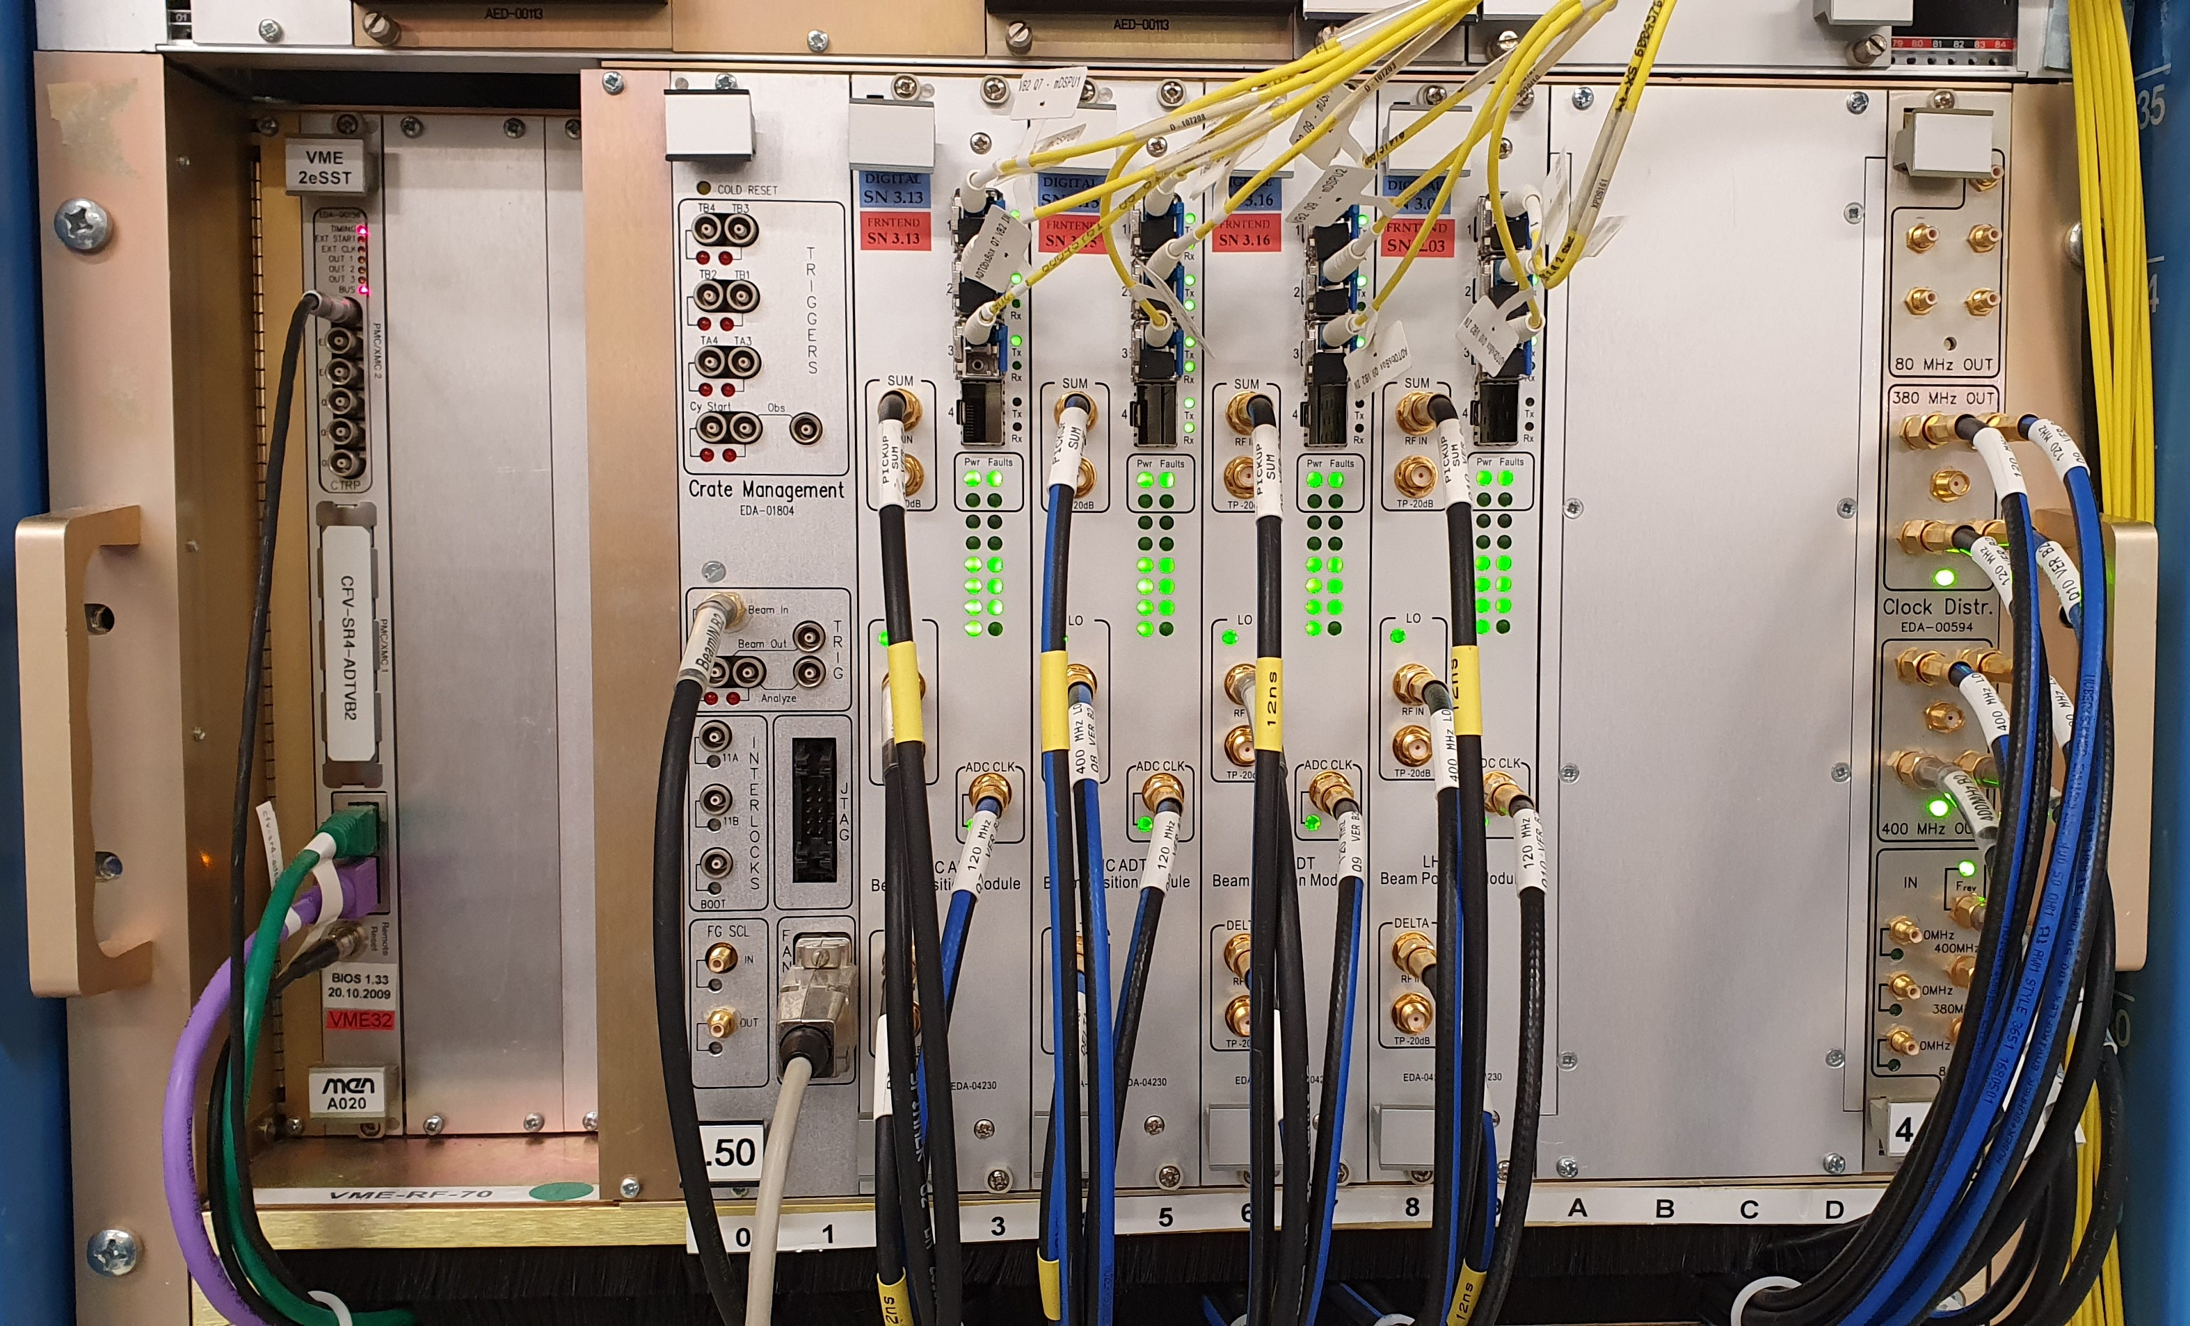
Receiver and digitizer performance requirements
Is the required ENOB of 14.1 bits needed for σ₀ < 320 nm and σ₁ < 8.3 μrad for a bunch by bunch mode easy or difficult to achieve?
LHC ADT was upgraded for low noise pickups during LS2. Estimation of achieved b-b-b performance σ₀ < 219 nm. Needs 4 Pickups, novel receiver architecture, 12 ADCs each…
Valuch D. Stopjakova V.: New Generation of Very Low Noise Beam Position Measurement System for the LHC Transverse Feedback
DOI 10.18429/JACoW-IPAC2022-TUPOST007

Slide 16


By the way, LHC ADT…
An excerpt from the ADT beam position measurement module VHDL code
process(clk)
begin
if rising_edge(clk) then
ThreshSquared <= signed(Threshold) * signed(Threshold);
SumISquared <= signed(SumI) * signed(SumI);
SumQSquared <= signed(SumQ) * signed(SumQ);
SumDeltaI <= signed(SumI) * signed(DeltaI);
SumDeltaQ <= signed(SumQ) * signed(DeltaQ);
Divident <= SumDeltaI + SumDeltaQ;
Divisor <= SumISquared + SumQSquared;
end if;
end process;
PositionOut <= FractionRemainder(15 downto 0);

Slide 17




By the way, LHC ADT…
An excerpt from the ADT beam position measurement module VHDL code
What if we would add 3 lines of code to the already existing, very low noise LHC ADT BPM?
process(clk)
begin
if rising_edge(clk) then
ThreshSquared <= signed(Threshold) * signed(Threshold);
SumISquared <= signed(SumI) * signed(SumI);
SumQSquared <= signed(SumQ) * signed(SumQ);
SumDeltaI <= signed(SumI) * signed(DeltaI);
SumDeltaQ <= signed(SumQ) * signed(DeltaQ);
Divident <= SumDeltaI + SumDeltaQ;
Divisor <= SumISquared + SumQSquared;
end if;
end process;
PositionOut <= FractionRemainder(15 downto 0);
process(clk)
begin
if rising_edge(clk) then
ThreshSquared <= signed(Threshold) * signed(Threshold);
SumISquared <= signed(SumI) * signed(SumI);
SumQSquared <= signed(SumQ) * signed(SumQ);
SumDeltaI <= signed(SumI) * signed(DeltaI);
SumDeltaQ <= signed(SumQ) * signed(DeltaQ);
DeltaQSumI <= signed(DeltaQ) * signed(SumI);
DeltaISumQ <= signed(DeltaI) * signed(SumQ);
DividentPosition <= SumDeltaI + SumDeltaQ;
DividentTilt <= DeltaQSumI - DeltaISumQ;
Divisor <= SumISquared + SumQSquared;
end if;
end process;
PositionOut <= FractionRemainder(15 downto 0);

Slide 18
Current status and ongoing work
Pickup specifications completed
Selection which of the two pickups will be used completed
Analytic model of pickup and calculation of expected signals for all modes completed
Numerical modelling of pickup response to verify analytic model completed
Analysis of required digitizer performance to obtain requested noise floor completed
Evaluation of proposed uTCA digitizer module compatibility with performance requirements completed
Evaluation of possibility to use the LHC ADT at point 4 to do the measurement ongoing
Finding potential method to overcome the 180° hybrid imperfections ongoing
Finding clever RF signal processing to allow for pickup electrical centering and crosstalk compensation ongoing

Slide 19
Current status and ongoing work
Detailed design of RF hardware prototype for tests in SPS/LHC not started yet
Production of a prototype hardware for tests in SPS/LHC not started yet
Preparation of MD(s) in LHC, using the prototype measurement hardware not started yet
Definition of detailed digital signal processing using the CC fixed frequency LLRF architecture not started yet
Clarification on interaction between the regular LHC transverse feedback and CC mode 0 feedback (section VI, paragraph F of the Baudrenghien/Mastoridis paper) ? or ?

Slide 20
Thank you for your attention

