Slide 1
Constraints for installation in IP1 and 5
Michal Krupa SY-BI-BP / WP13
HF BPM review, 15/01/2025

Slide 2
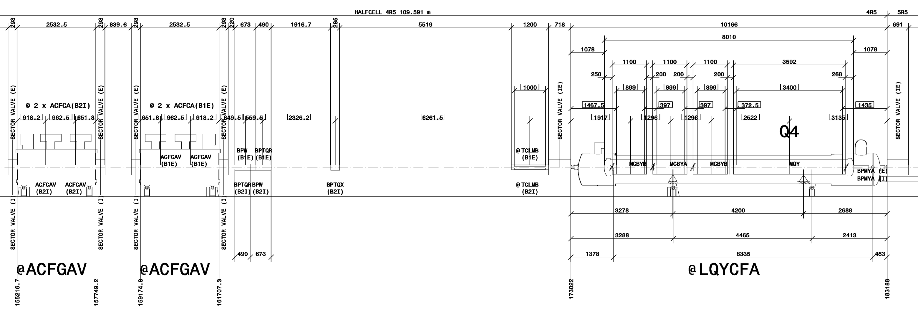
Location of BPMs for CC diagnostics
Requirements for best BPM performance: high beta functions and favourable phase advance from the crab cavities
  IP4 ruled out
  Best locations found in IP1/5 close to the CCs (on the Q4 side)

Slide 3
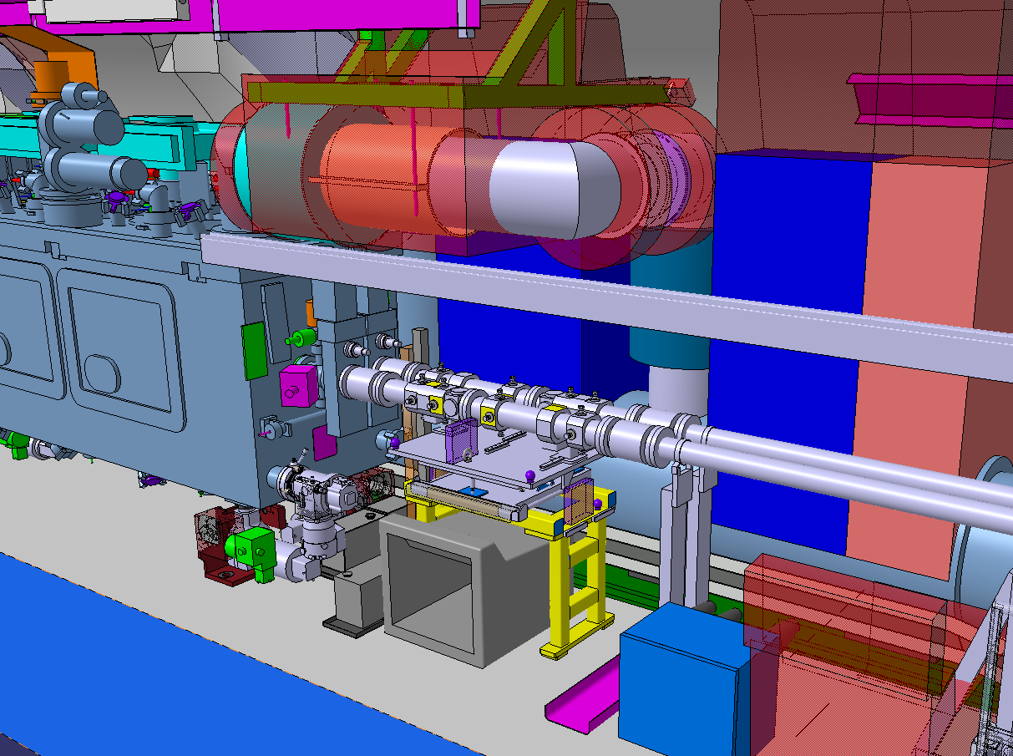
Integration in the CC region
Quite busy area
Limited tunnel floor space available
Strict space constraints / reservations around the pick-ups
Very little space between the beam lines
Interfaces with VSC considered frozen
BPMs
Alignment
system
Support

Slide 4
BPTQR + BPW
Two different BPMs at the same location, installed on a common support / alignment platform:
BPTQR (out of review scope): BPM for CC diagnostics and feedback
  Owned by SY-BI
  Used by SY-RF
BPW (BPM under review): BPM for CC and instability diagnostics
  Owned and used by SY-BI
BPW
(one of the possible implementations)
BPTQR

Slide 5
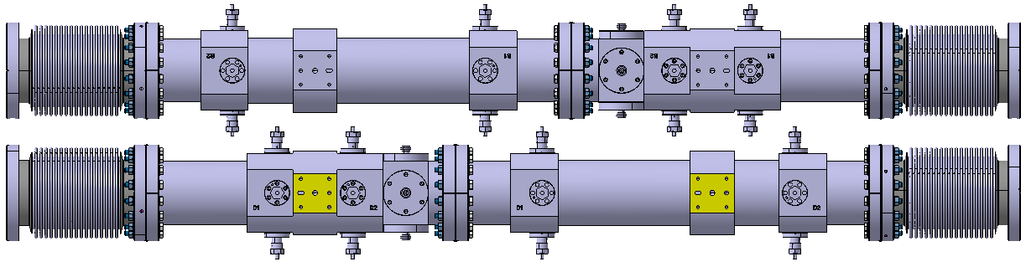
Vacuum layout
BPW
(one of the possible implementations)
BPTQR
(latest design)
194 mm
BPTQR
(latest design)
BPW
(one of the possible implementations)
BPTQR design was optimized to gain maximum space for the connectors between the two beam lines. It might change for different BPW implementations.

Slide 6
Vacuum layout
Reserved [BPTQR + BPW] length: 1163 mm
Min. BPTQR length: 400 mm
(current design: 490 mm)
ID:
Ø 80 mm (min)
DN100CF
Intermediate flange for compatibility with any BPW implementation. Flangeless design might be considered when BPW technology is chosen (beneficial for alignment).
DN100CF

Slide 7
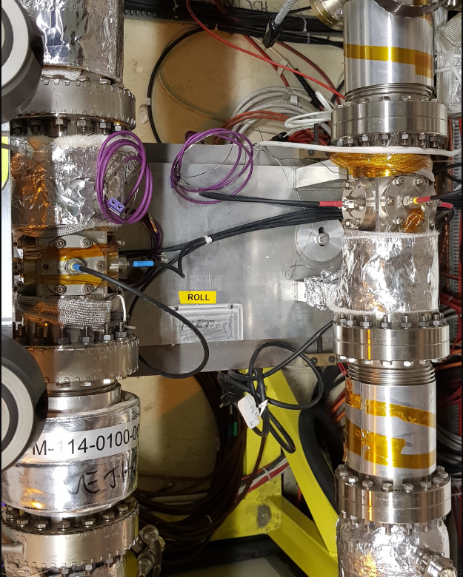
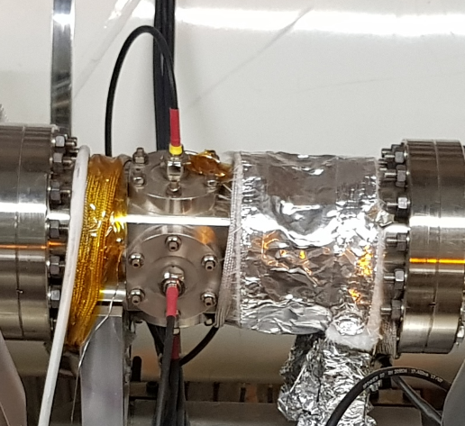
Other vacuum considerations
Coatings:
  Flash of gold + 100 μm copper (as all other LHC BPMs)
  NEG coating might be required due to the significant length of the BPTQR + BPW assembly – TBD with WP12
Bakeout:
  Warm beam lines will be baked out – BPMs must sustain ~250 deg C over tens of hours (ideally without any preparatory intervention)
  TE-VSC might install permanent bakeout jackets in this region to minimise the required interventions:
    Typically not represented in integration models
    Reduced space between the beam lines
    Reduced accessibility to the BPM connectors

Slide 8
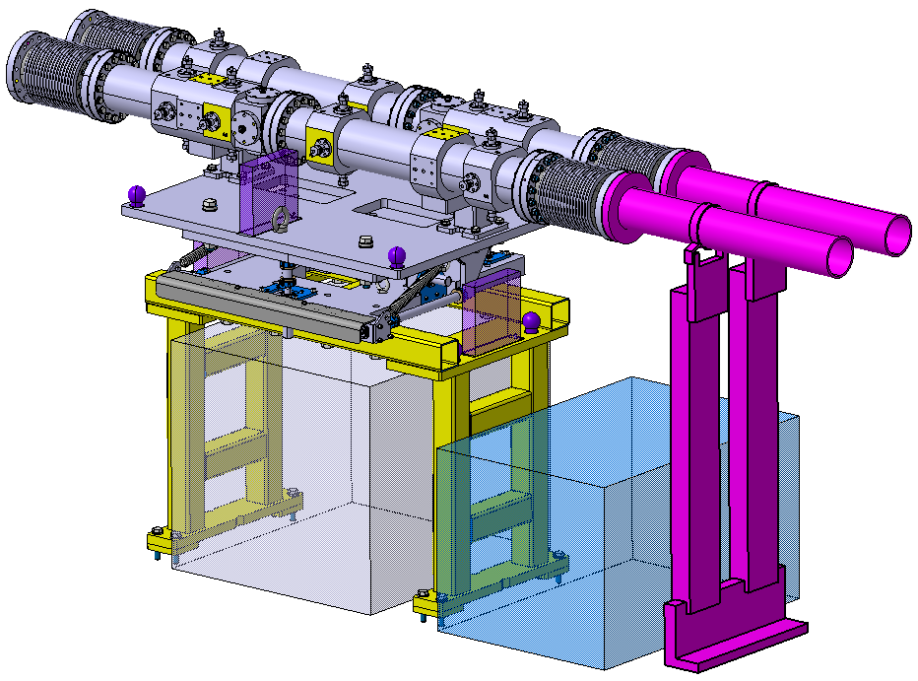
Alignment
BPTQR and BPW are compatible with FRAS but not equipped with FRAS – remote alignment not possible, manual alignment during YETS/LS only
Baseline: all BPMs (i.e. B1 & B2, BPTQR & BPW) on a single common Universal Alignment Platform (UAP)
  UAP design by SY-BI based on a TE-VSC design, following BE-GM guidelines

Slide 9
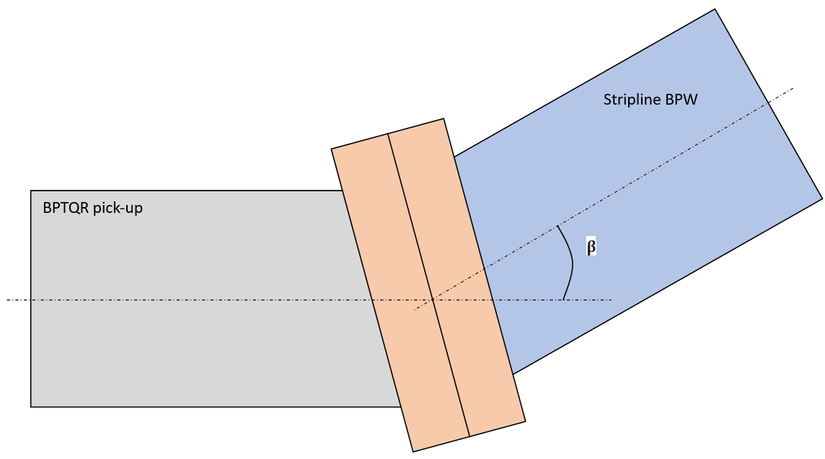
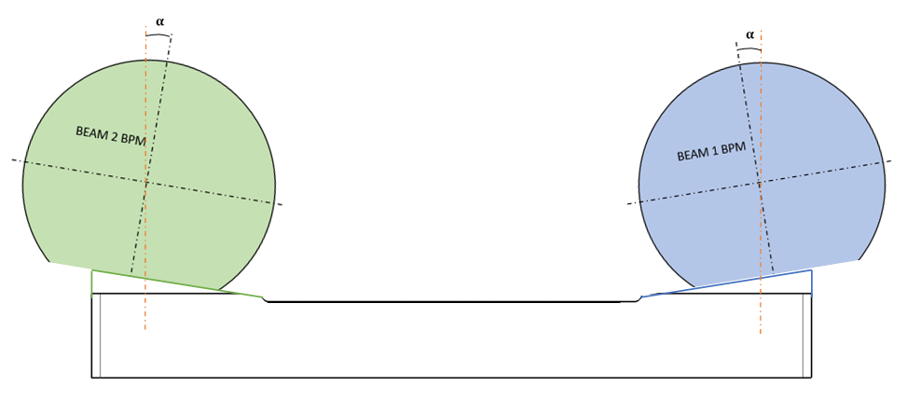
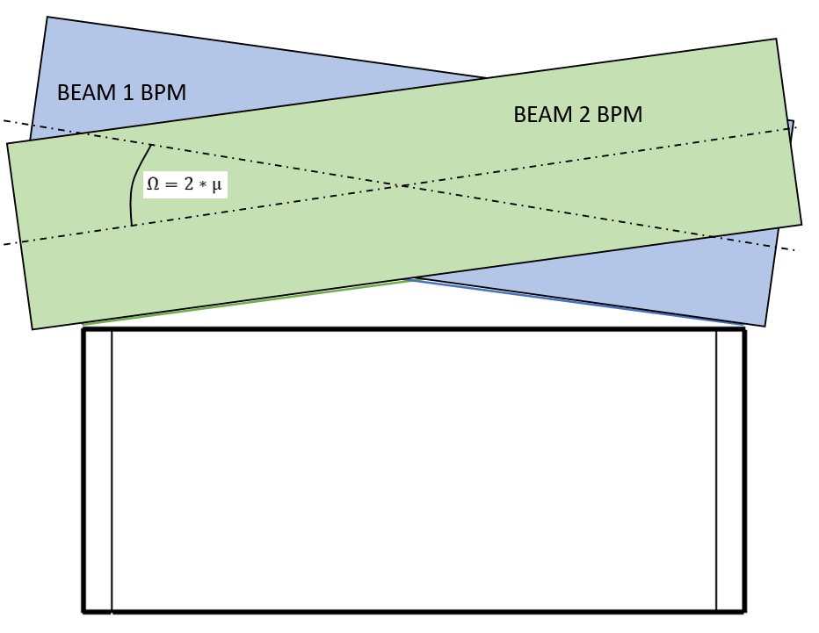
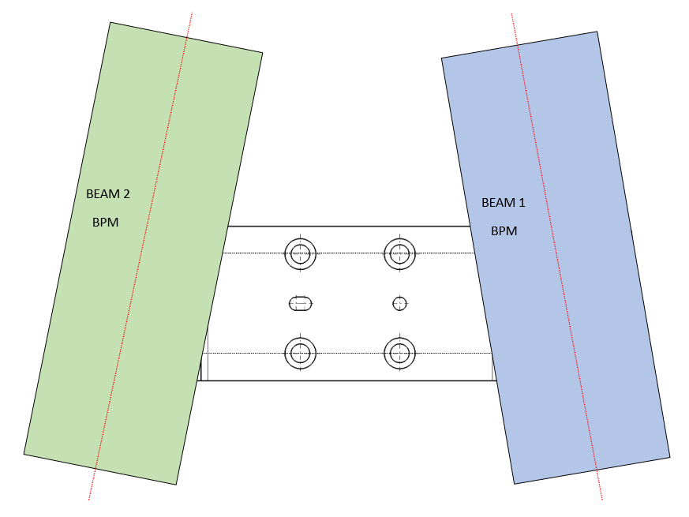
Alignment
Alignment requirements for BPTQR formally defined and discussed among WP4, WP13 and WP19: EDMS 3069868
No formal alignment requirements for BPW as of today
  Design driven by the (challenging!) BPTQR specification
  BPW alignment error calculated with tolerance stack analysis (for one possible BPW implementation only): EDMS 3151026
Transverse offset B1-B2 BPM: 70 um
1.4 mrad
0.7 mrad
0.7 mrad
2 mrad

Slide 10
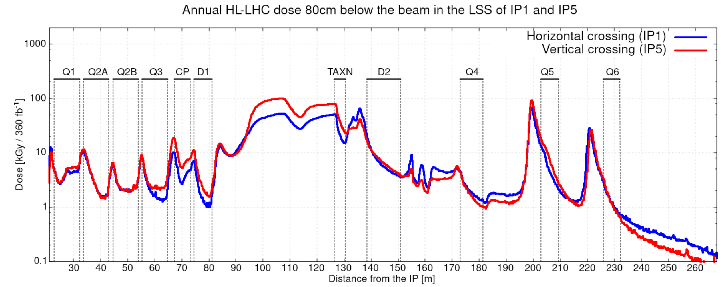
Radiation levels
Only damage to material (TID) considered
HL-LHC Radiation level specification document: EDMS 2302154
  TID to a specific pick-up design not yet estimated
BPTQR + BPW
5

Slide 11
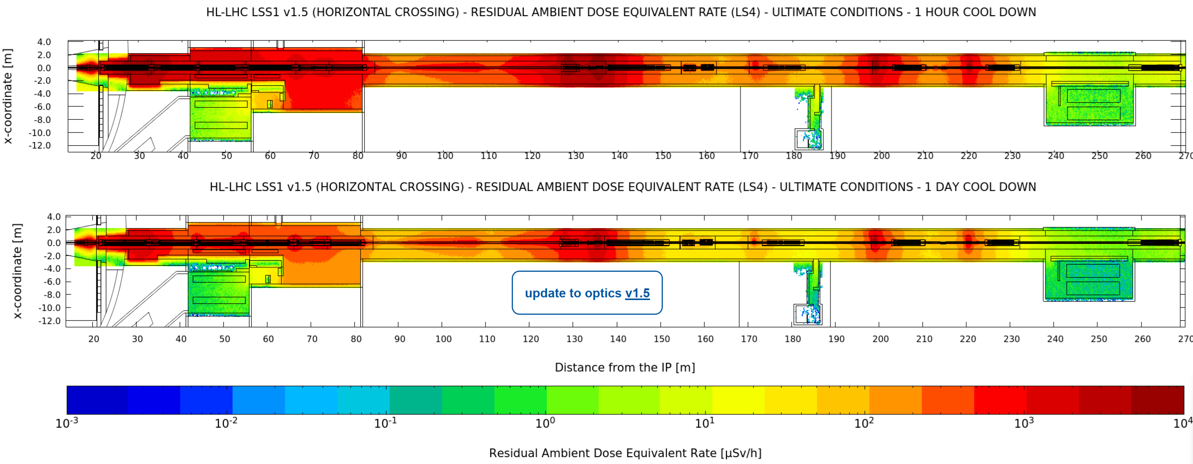
Radiation levels
BPTQR + BPW
Simple controlled radiation area
1 day
1 h

Slide 12
Accessibility
Limited space available around the BPMs
Interventions (such as dis- / re-connections) will be tricky, especially on the tunnel wall side and between the beam lines
Other teams (e.g. EN-CV, TE-CRG, TE-VSC) will perform maintenance of their equipment close to the BPMs – all fragile components, cables and optical fibres must be protected against accidental damage

Slide 13
Thank you for your attention

