Slide 1
EM stripline developments status and plans
Michal Krupa SY-BI-BP / WP13
HF BPM review, 15/01/2025

Slide 2
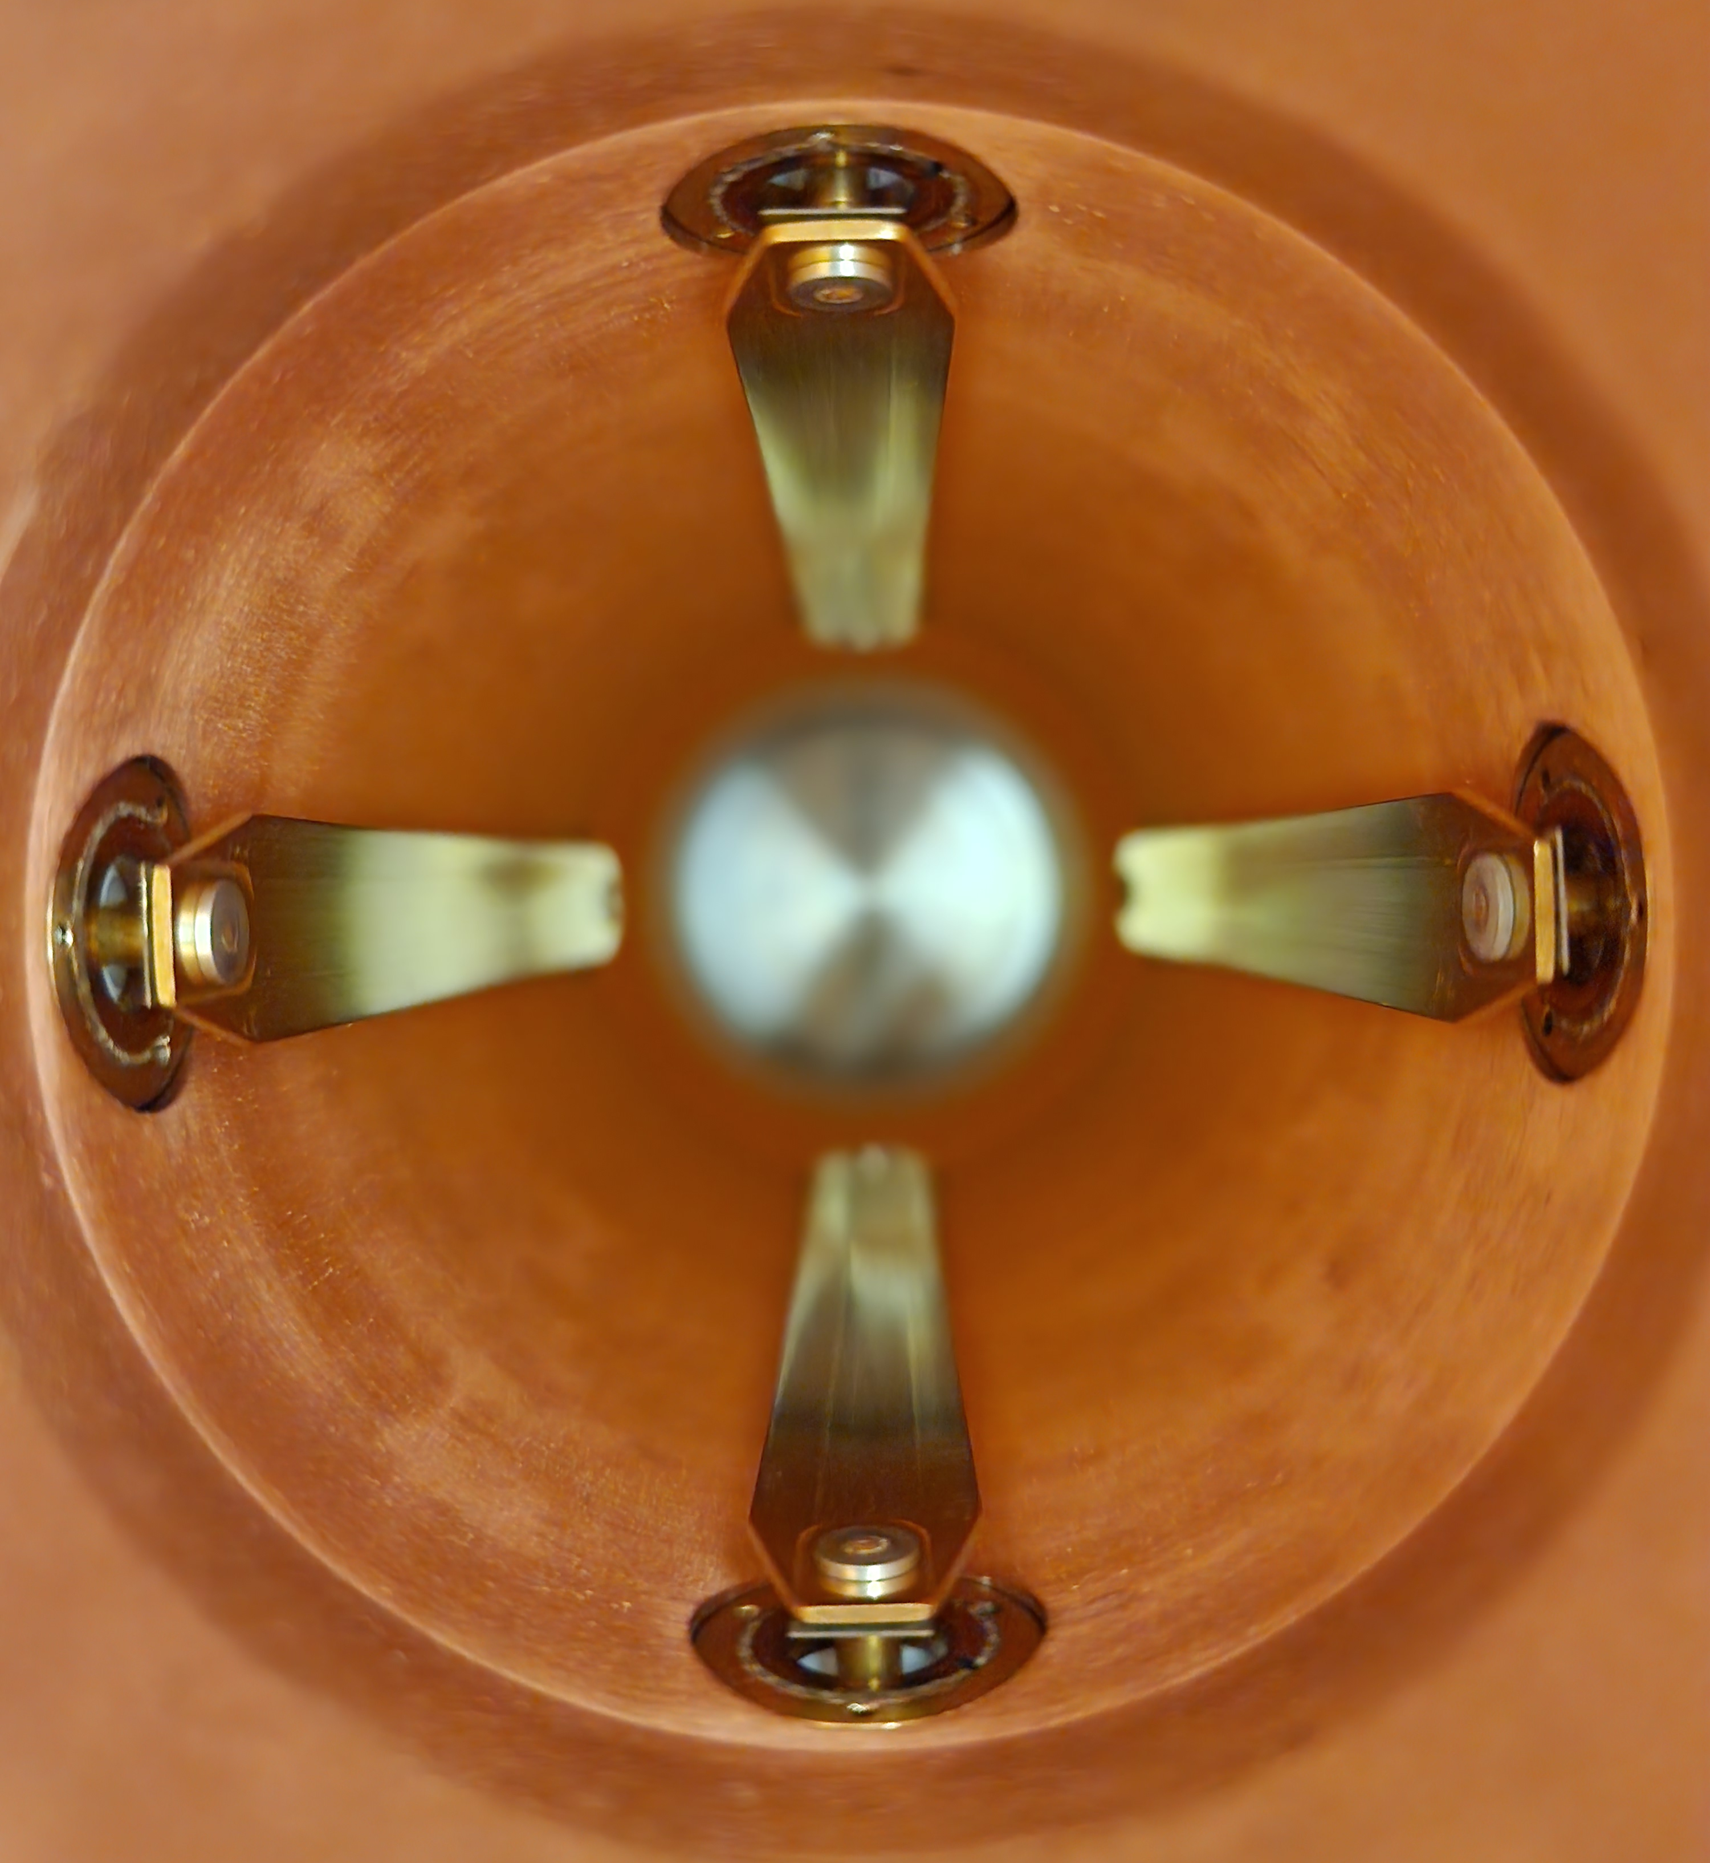
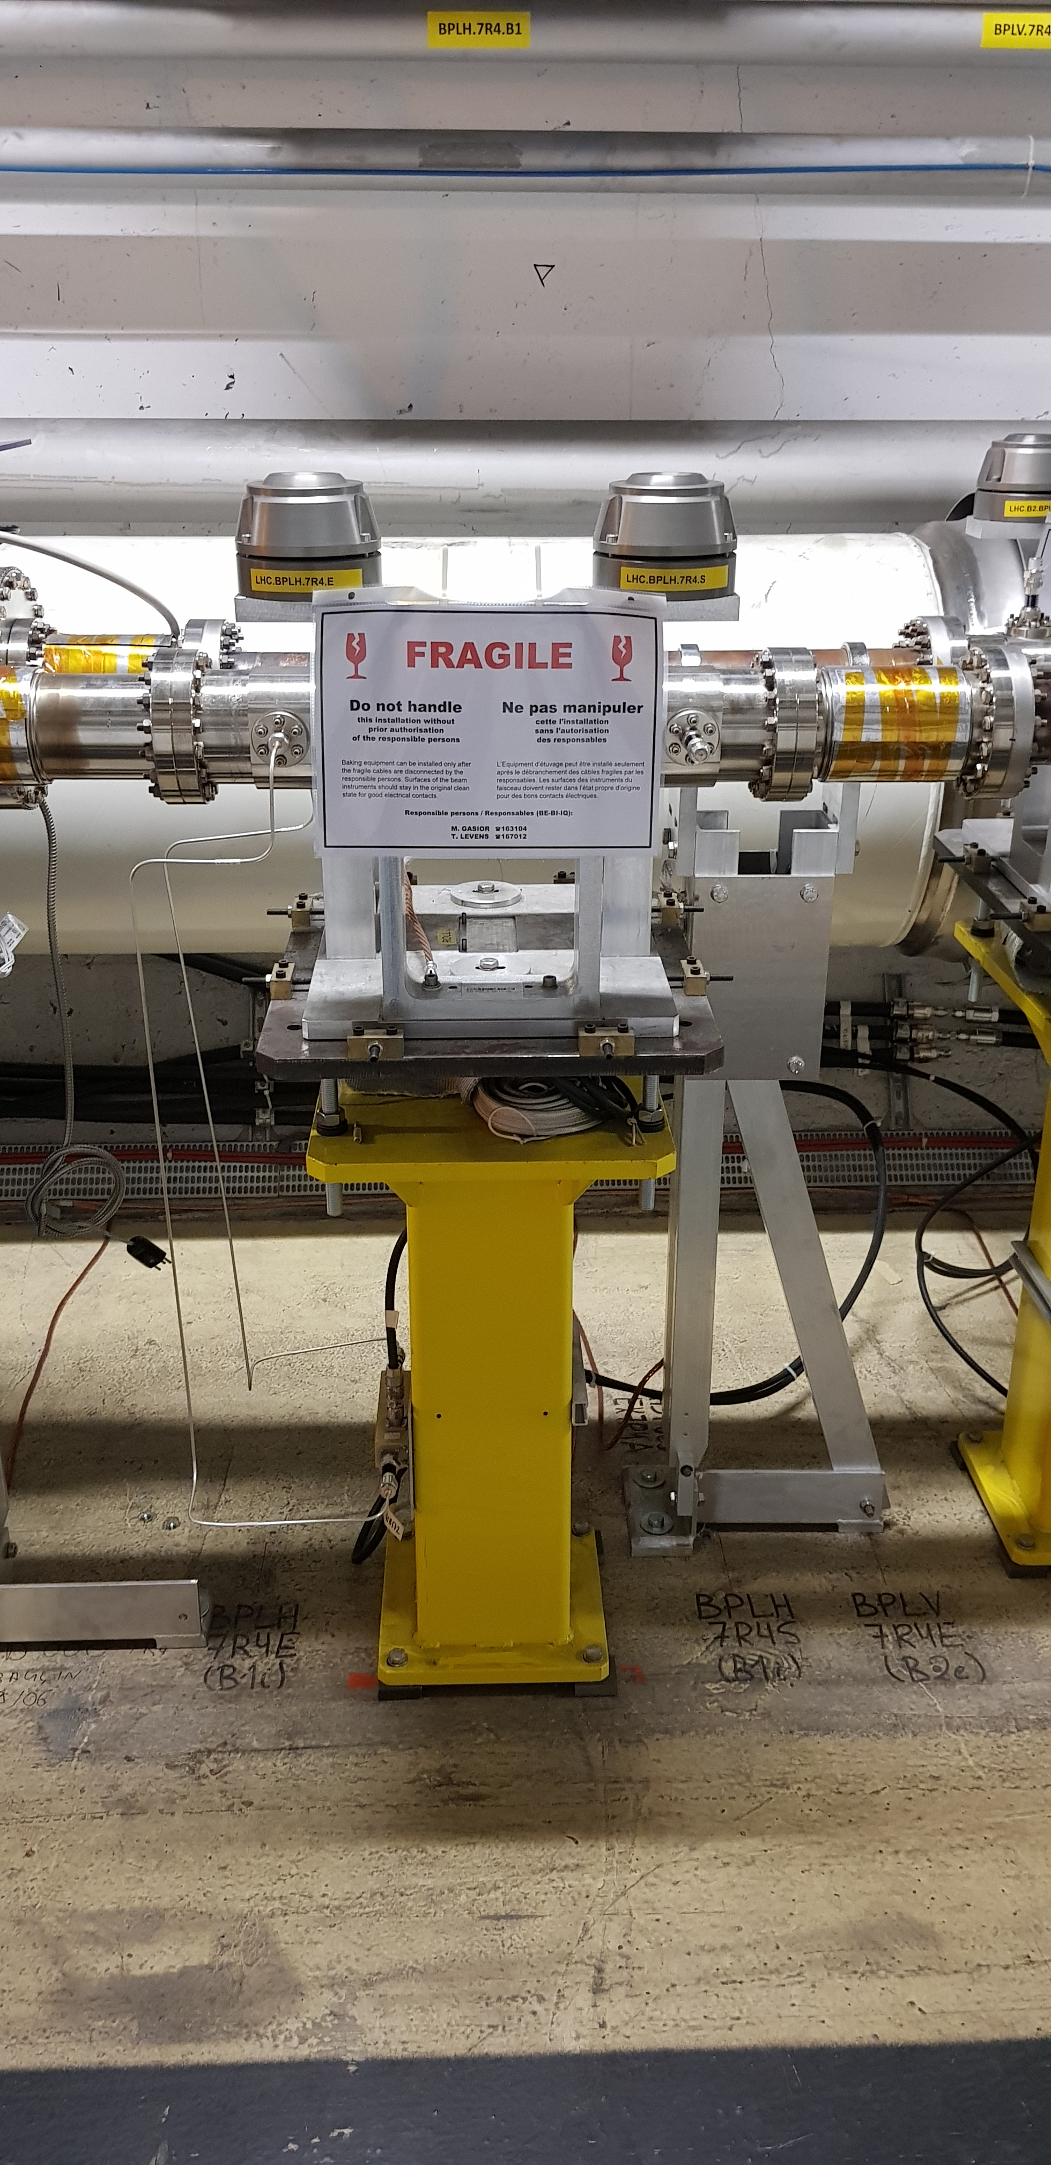
Stripline BPMs
Signal output
50 Ω
load
SiO2 cables
Long coax to a scope
Long electrodes with a connector on each end
  For head-tail (HT): one end for signal generation, the other end loaded with 50 Ω
Current HT – elongated version of the standard LHC stripline BPM
RF hybrid

Slide 3
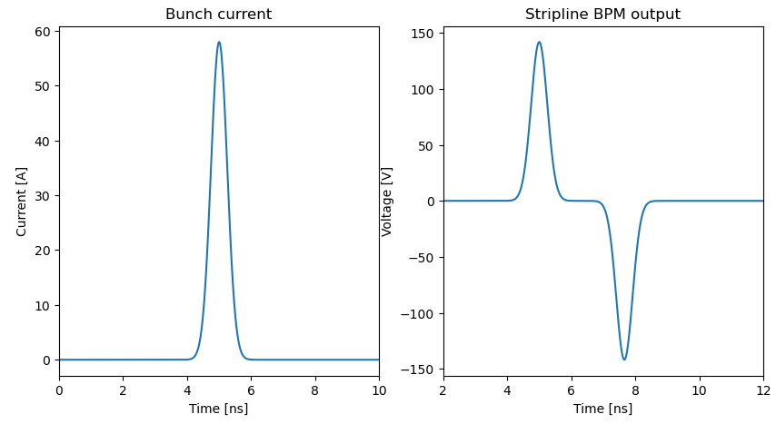
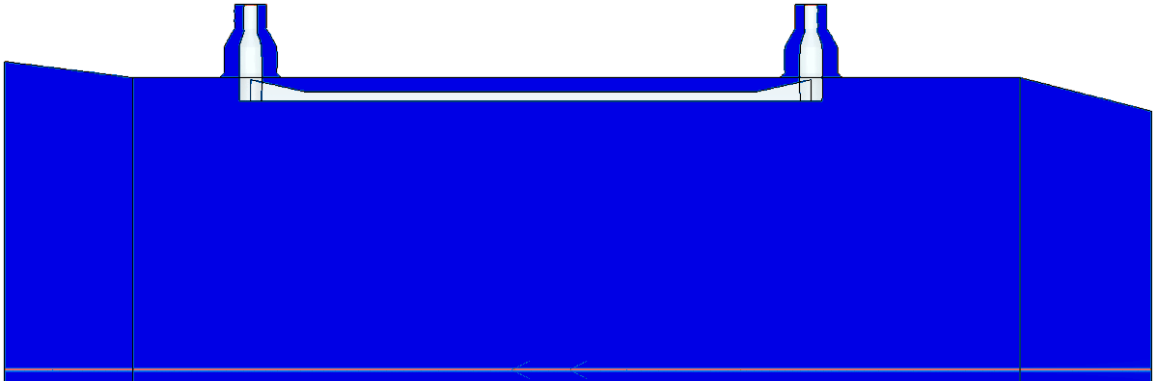
Stripline BPM for intra-bunch measurements
The same longitudinal profile
as the bunch (for an on-axis bunch)
Perfect stripline generates an electric signal which is a replica of the bunch current (+ reflection) which is modulated by the intra-bunch position
  Commonly used at CERN and other facilities as an HT monitor
  Gating on the positive signal only for HT measurements
  “Standard” electrode length to resolve LHC bunches – 400 mm
In real (imperfect) world the signal is distorted due to the electrode impedance variations, and other reflections and BW limitations in cables and electronics
Mirrored
reflection
Time delay
2 x electrode length / speed of light

Slide 4
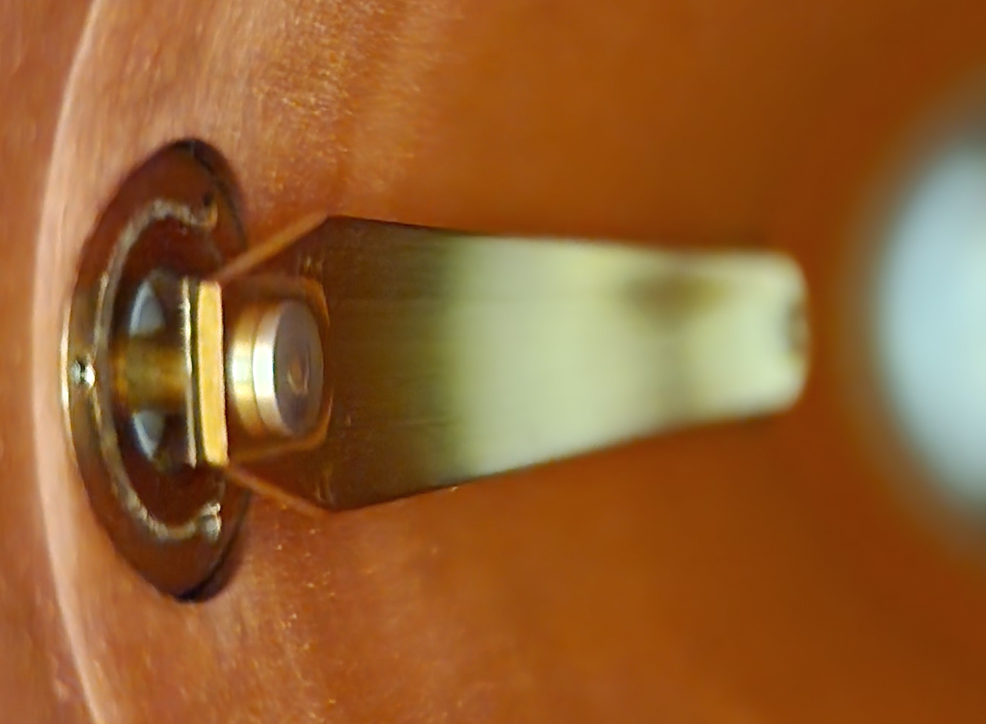
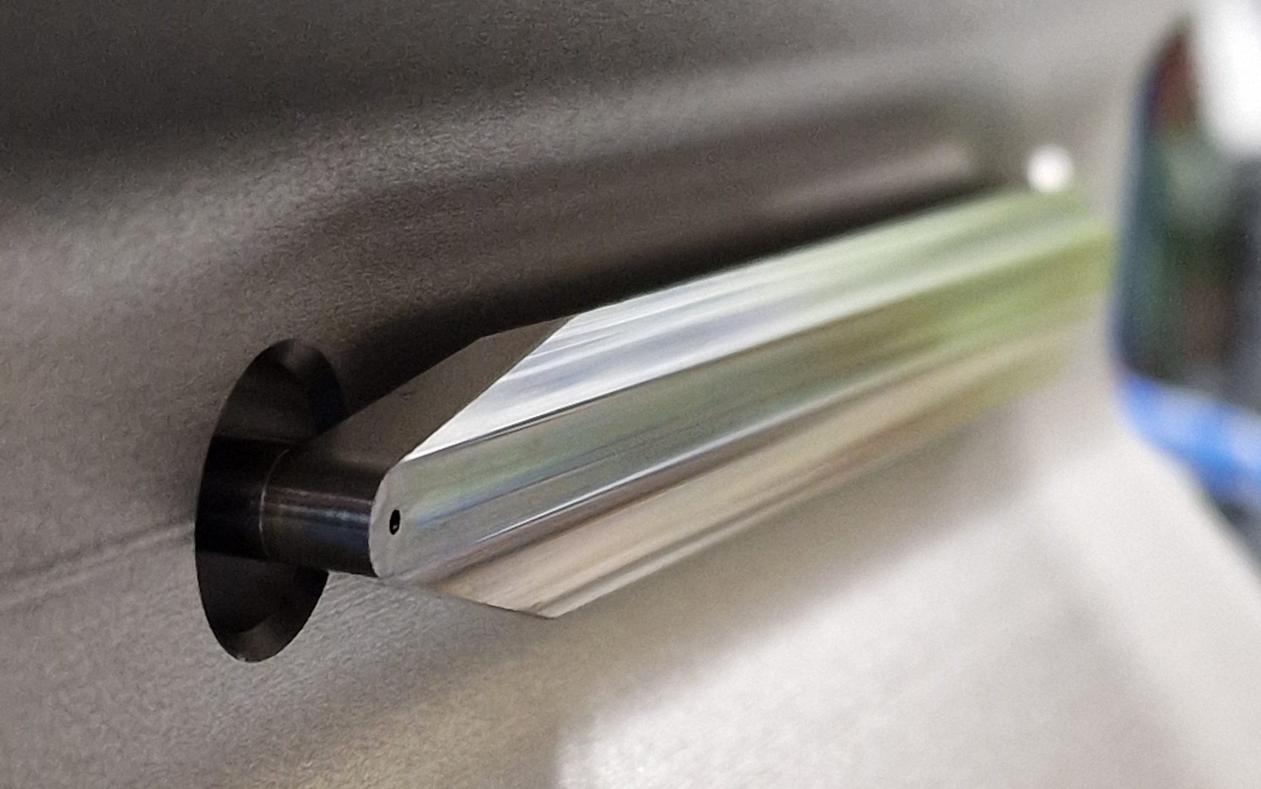
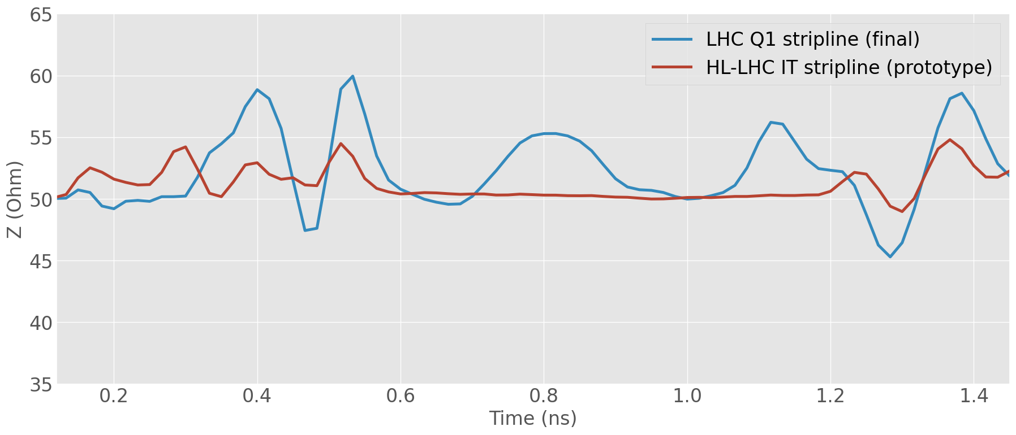
Can we reuse the existing LHC HT BPM design?
End flanges, aperture, body length, electrode length are appropriate for the HL-LHC BPW
Three issues:
  Currently used LHC HT BPMs are single plane only – design update would be needed to accommodate the request for a double-plane BPW
  Non-optimal electrode design: very complex mechanical connection to the BPM body and poor impedance control
  Limited availability of spare FTs
LHC stripline
HL-LHC stripline
Further improved
FT
Electrode
TDR up to 20 GHz
Change of N connector grade and pin dimensions to compensate for decrease of ε during thermal treatment

Slide 5
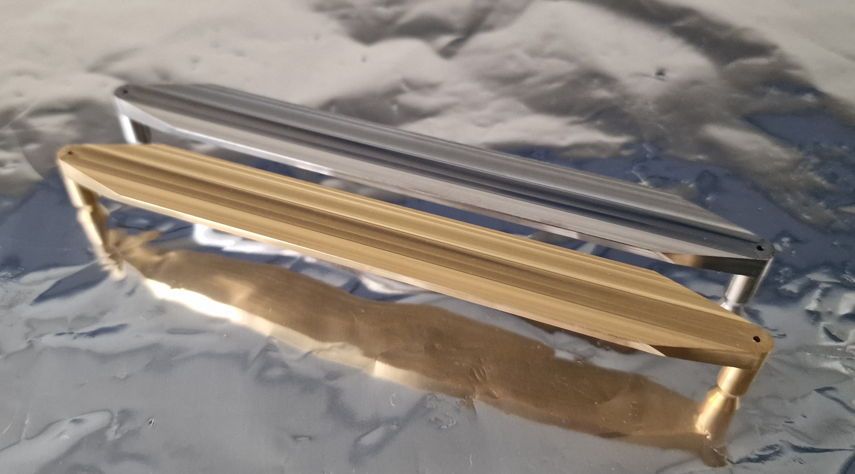
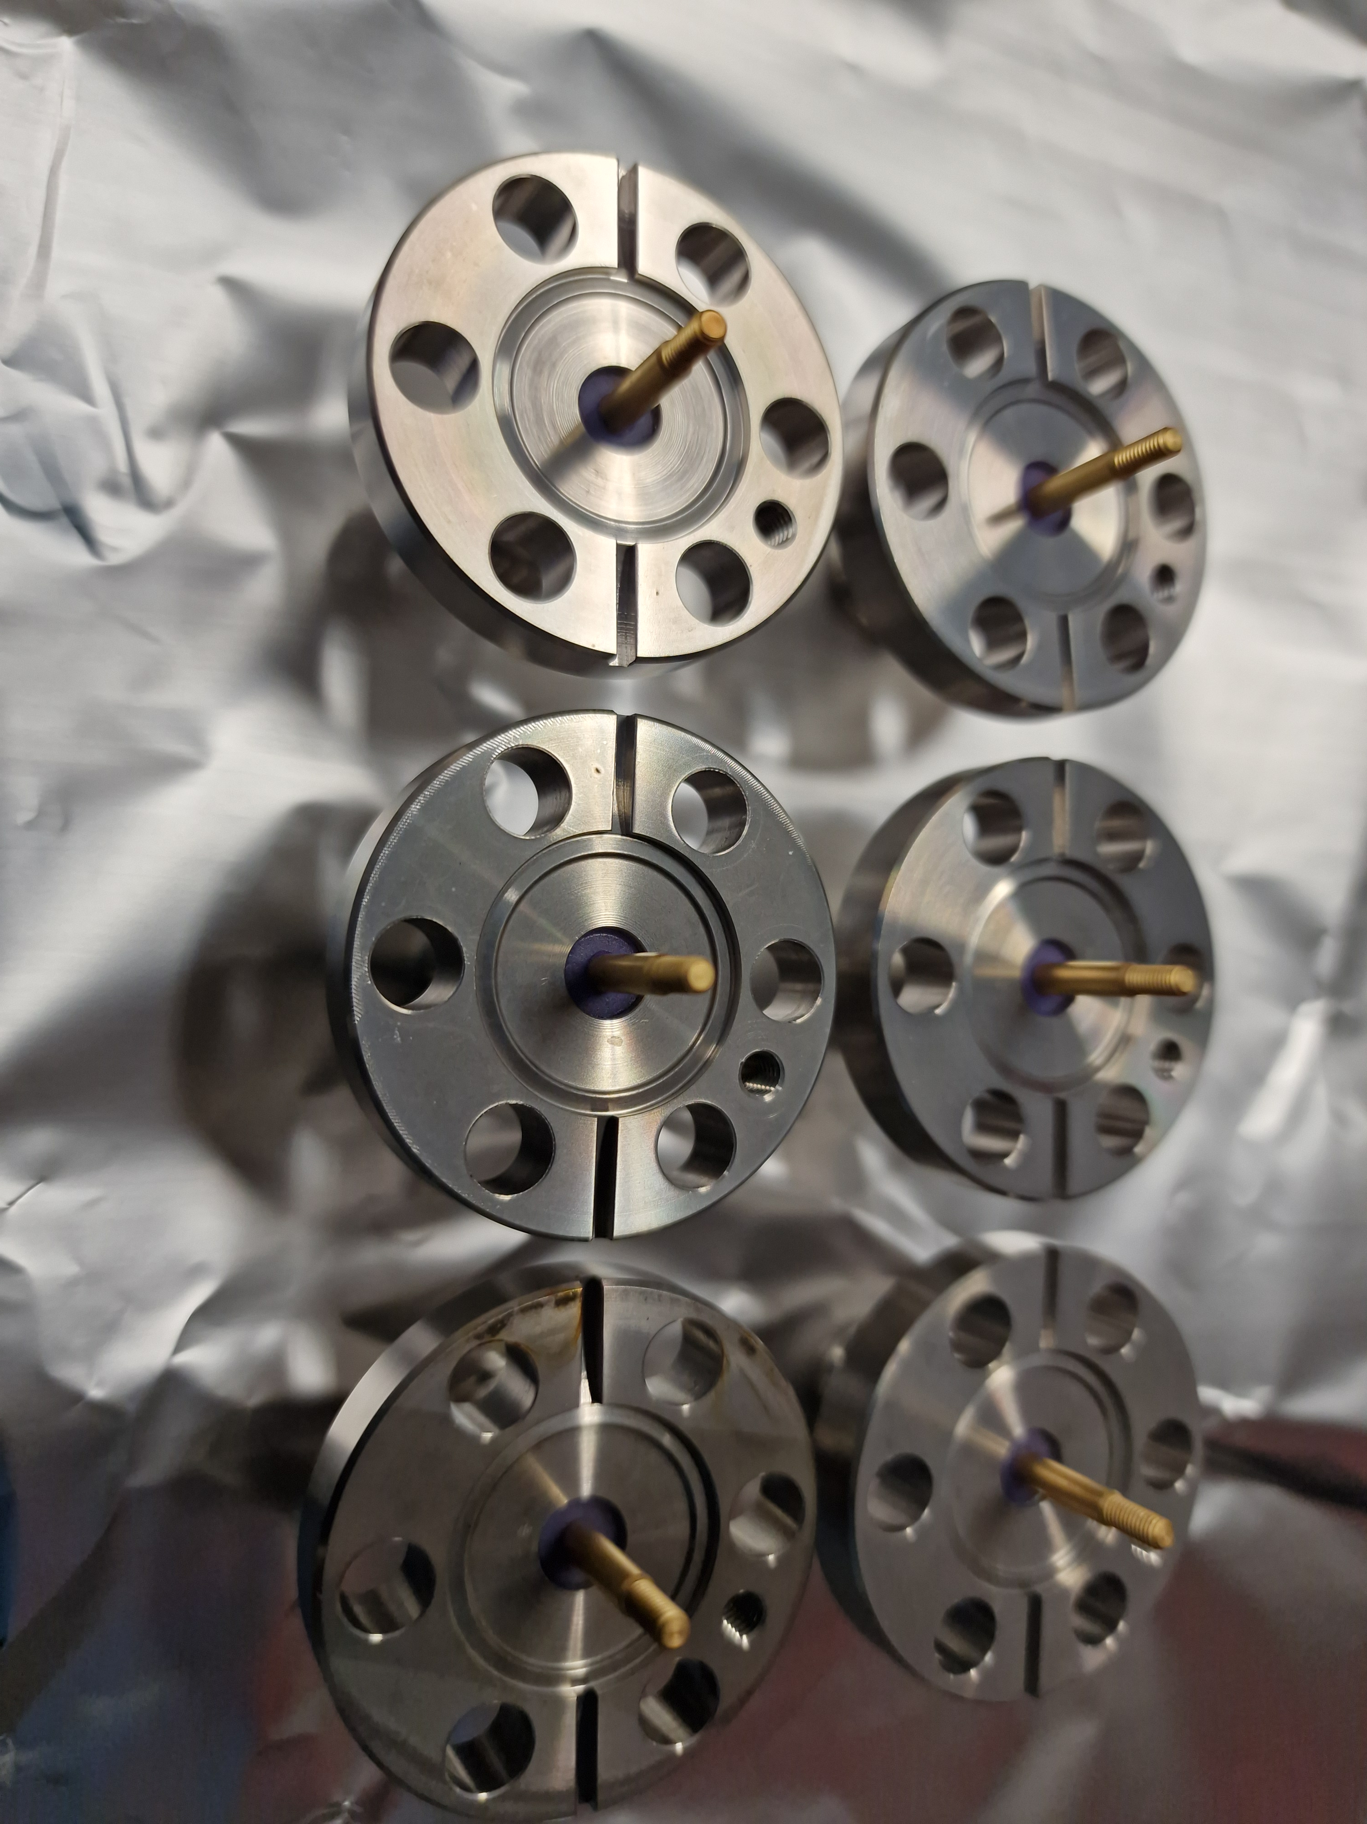
Elongated HL-like stripline
Same approach as the LHC HT pick-ups: use the latest stripline BPM design but make the electrode longer (400 mm)
  Electrode and feedthroughs already optimized for 6 GHz BW, measured up to 20 - 26.5 GHz
  Machining techniques already developed and demonstrated
  Good reproducibility achieved after a few design iterations
  The same approach is used for the BPTQR

Slide 6
Signal levels
Stripline BPMs generate high-amplitude signals exceeding 100 Vpp in the LHC
~ 15 W per BPM output with full beam
  Can get much worse for off-centred beams
This power must be taken by the front-end electronics (e.g. hybrid, attenuators)
2.3e11 ppb

Slide 7
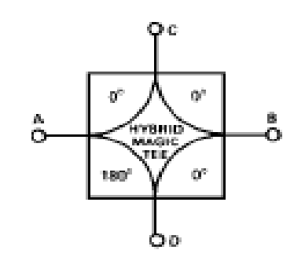
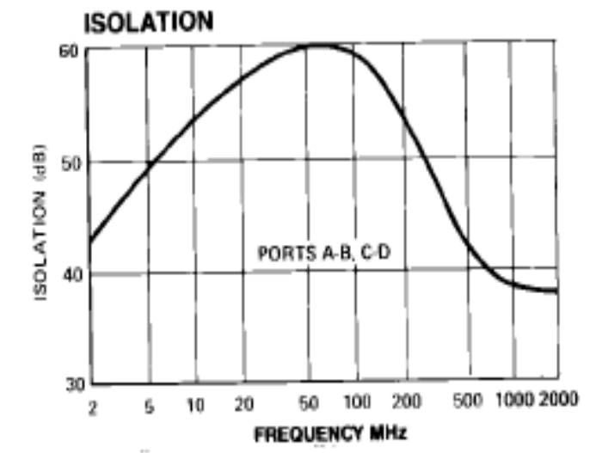
Expected performance
BPM thermal noise (10 GHz BW) with a pilot bunch: ~ 1 μm
  Resolution will be (most likely) limited by the front-end (e.g. hybrid) and acquisition electronics (e.g. scope)
H-9 hybrid, used in the existing LHC HT, is the best available on the market
  BW: 2 GHz; Power: 25 W; Isolation: min. 30 dB
  Collaboration with Oxford University to develop a better hybrid – many prototypes not exceeding the H-9 performance
  Most likely candidate for “classical” stripline BPW – no performance improvement
    Alternative solution in the next talk
Better digitizers might be available in 5 years to improve on the existing HT resolution / sampling
20 μm
65 μm
200 μm

Slide 8
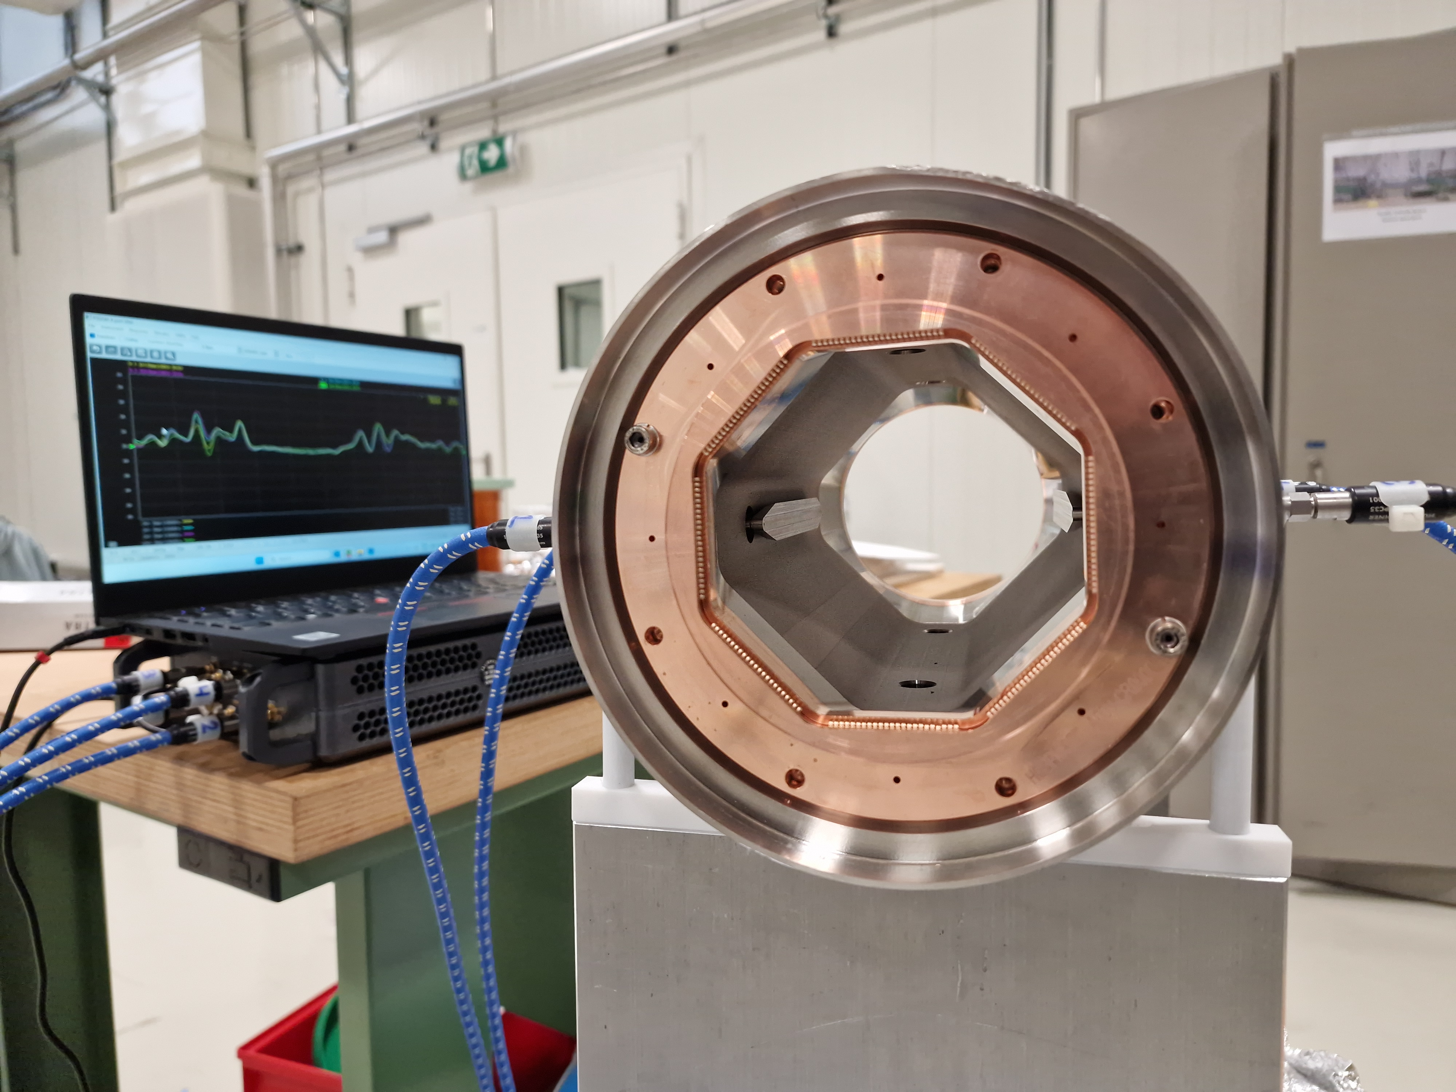
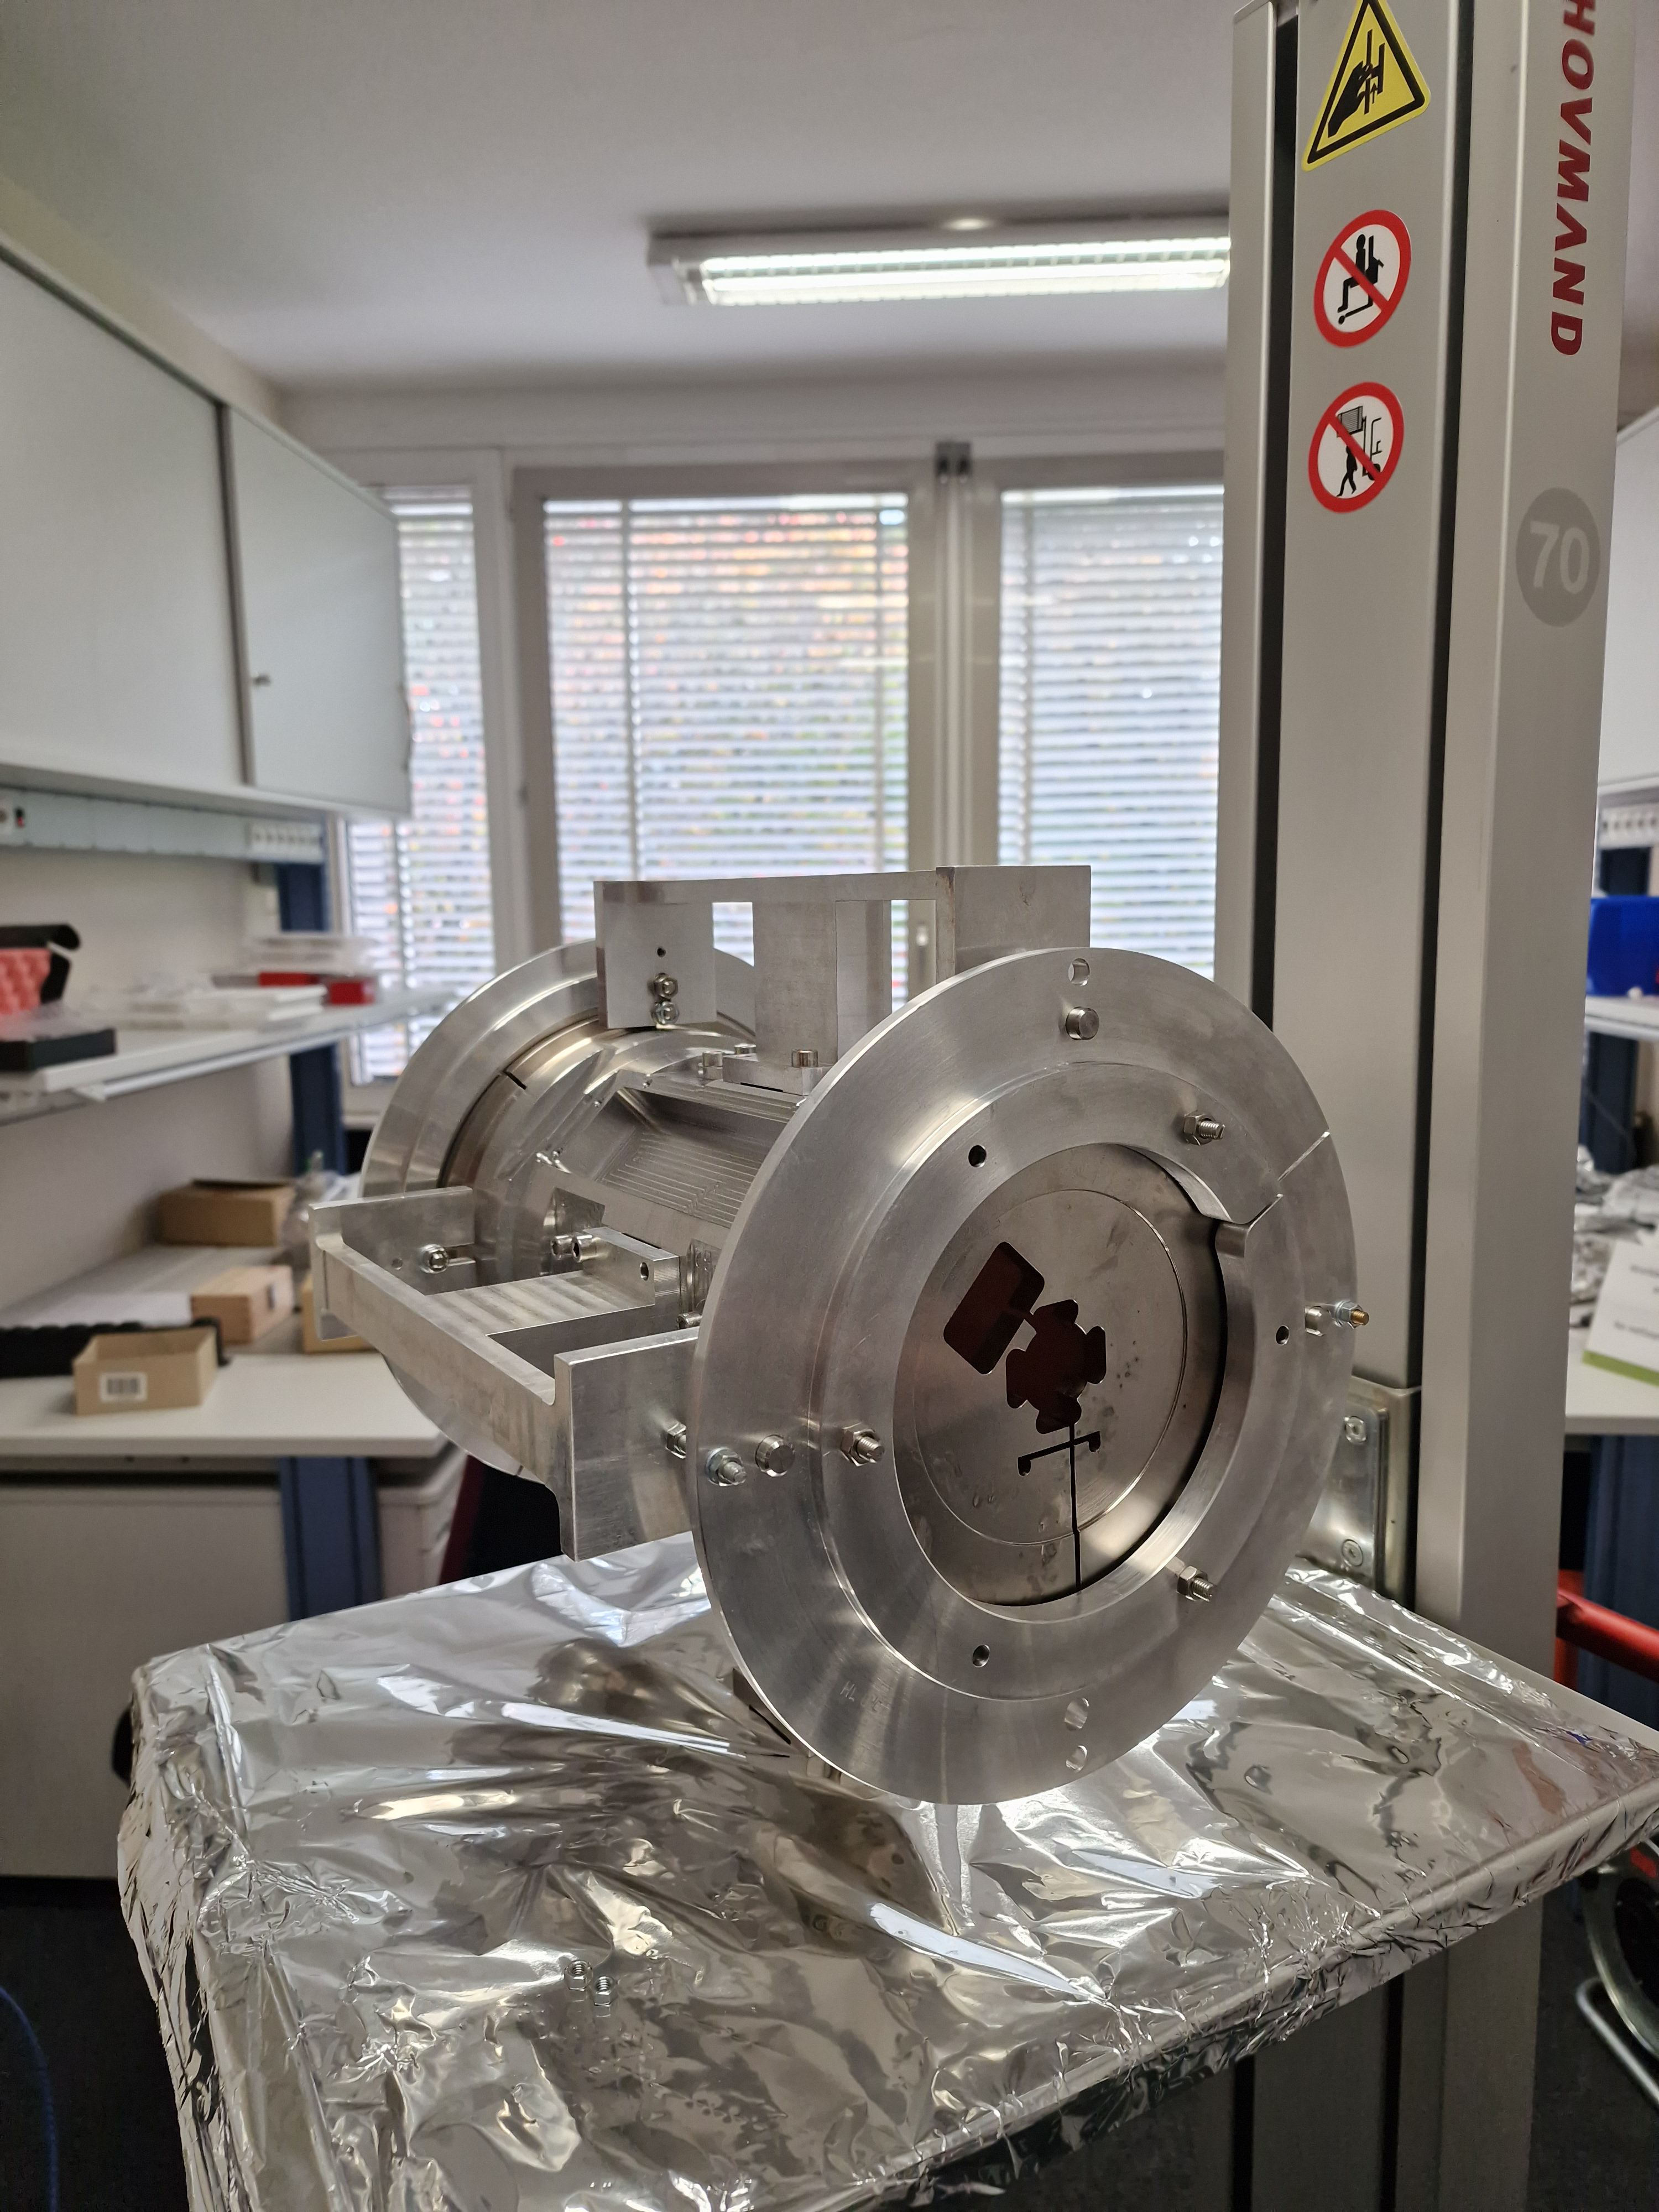
Lab RF measurements
RF measurements performed for the cryogenic HL-LHC striplines:
  Electrode impedance
  Electrode symmetry
  Electrode cross-coupling
  Electrical center w.r.t. the mechanical fiducials
  Beam position sensitivity
  Beam position nonlinearity
The same measurements are possible for a stripline BPW – all measurement equipment and tooling already exists or can be easily adapted

Slide 9
Compatibility with environmental constraints
Mechanics:
  Preliminary design compatible with the available space done
  No known alignment constraints
Bakeout:
  BPM, feedthroughs and SiO2 cables compatible with the LHC bakeout requirements
  50 Ω loads will need to be removed before and reinstalled after each bakeout (5 min per BPM)
Radiation:
  BPM, feedthroughs and SiO2 cables are rad-hard up to 10’s MGy (needed for the IP1/IP5 IT)
  50 Ω loads and hybrids might eventually suffer from radiation damage – replacement parts must be available
Accessibility:
  Preliminary design giving access to all BPM connectors done

Slide 10
Proposed strategy and milestones
Study:
  RF measurements of the existing LHC HT BPMs, hybrids and cables [Q1’25]
  Estimation of performance limitation due to each component [Q2’25]
Design:
  Decision on the necessity of the intermediate flange [Q2’25]
  Final BPTQR design + stripline BPW design [Q2-Q4’25]
  Final alignment and support system design [Q3-Q4’25]
  Production of manufacturing drawings [Q1’26]
Production:
  Procurement of RF FTs and SiO2 cables [done]
  Procurement of raw material for BPTQR and stripline BPW [Q1’25]
  Production of two prototype elongated HL-like electrodes [Q2-Q3’25]
  Production of a pre-series alignment platform [Q2’26]
  Production of two pre-series BPTQR + BPW assemblies [Q2’26-Q4’26]
  Series production of alignment platforms, BPTQR’s and BPW’s [Q2’27-Q4’27]
Testing:
  Metrology and lab RF measurements of prototype electrodes [Q3-Q4’25]
  Alignment tests with the pre-series alignment platform and pick-ups [Q4’26-Q1’27]
  Lab RF measurements (and at CLEAR?) of pre-series BPTQR’s and BPW’s [Q1’27]
Giusy Passarelli [DOCT]
Loann Havart [TECH]
EN-MME job already opened
EN-MME or external, TBC
SY-BI

Slide 11
Thank you for your attention

