Slide 1

Electro-optical Modulator Time Stretch Acquisition System
- status and plans -
A. Schlögelhofer, T. Lefèvre, T.E. Levens
HL-LHC High Bandwidth Beam Position Monitor Review, 15th January 2025

Slide 2
Building a high bandwidth acquisition system
Difficulties to overcome:
  short propagation distance for high frequency signals leads to short transmission lines
    high-speed digitizer needs to be
    as close as possible to signal source
    radiation hardness of high-frequency components
  maintain high resolution at high bandwidth
  e.g. 8 GHz
  20 GSa/s CHF ~100k
  10 bit
Combine two approaches to solve them:
1
radio-over-fibre
    encoding and transporting RF signal
    using an optical carrier
2
  high resolution at lower bandwidth through time stretch
  e.g. 2.5 GHz
  5 GSa/s CHF ~15k
  14 bit

Slide 3
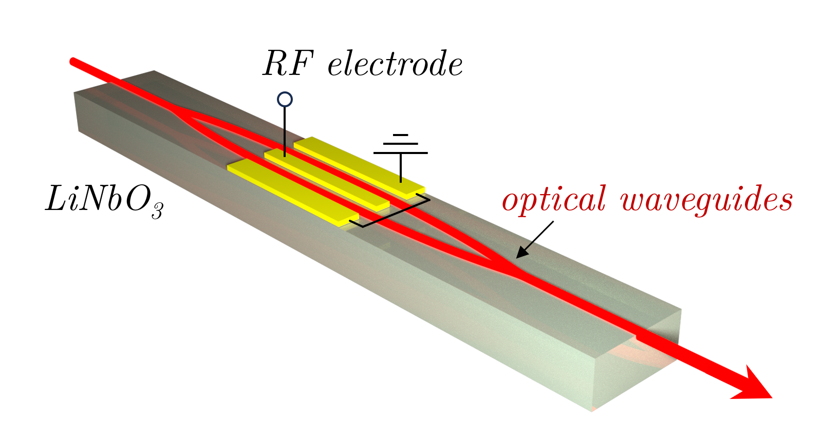
Radio-over-fibre with electro-optical modulators
Modulation due to Pockels effect
    linear variation of refractive index in response
    to an applied electric field
Electro-optic material
    Lithium niobate (LiNbO₃)
    Gallium arsenide (GaAs)
    …
Interference-based modulation of light
    laser light split into two arms, modulated, and recombined
    designed for continuous wave lasers
    → large variety of off-the-shelf products for telecommunication
Mach-Zehnder electro-optical modulator

Slide 4
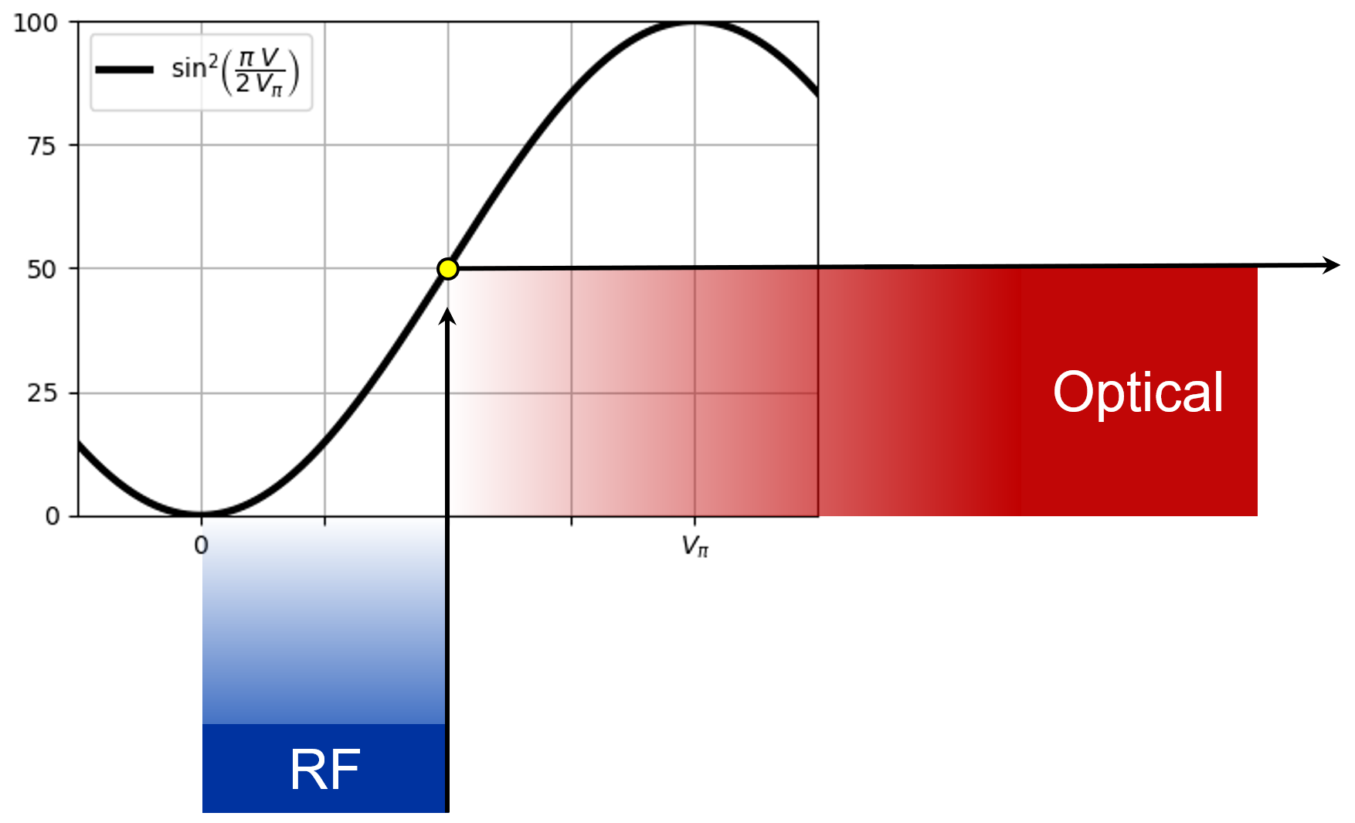
Radio-over-fibre with electro-optical modulators
Transfer Function

Slide 5
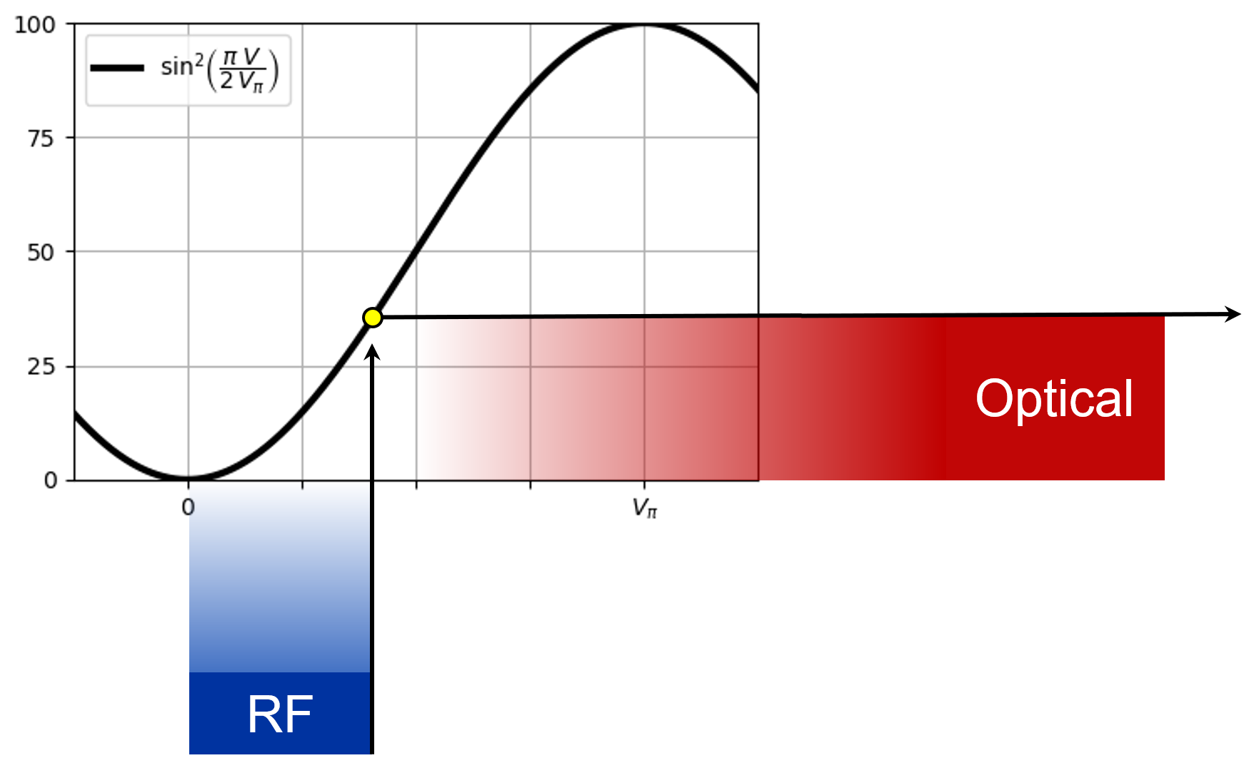
Radio-over-fibre with electro-optical modulators
Transfer Function

Slide 6
Radio-over-fibre with electro-optical modulators
Transfer Function
bias point

Slide 7
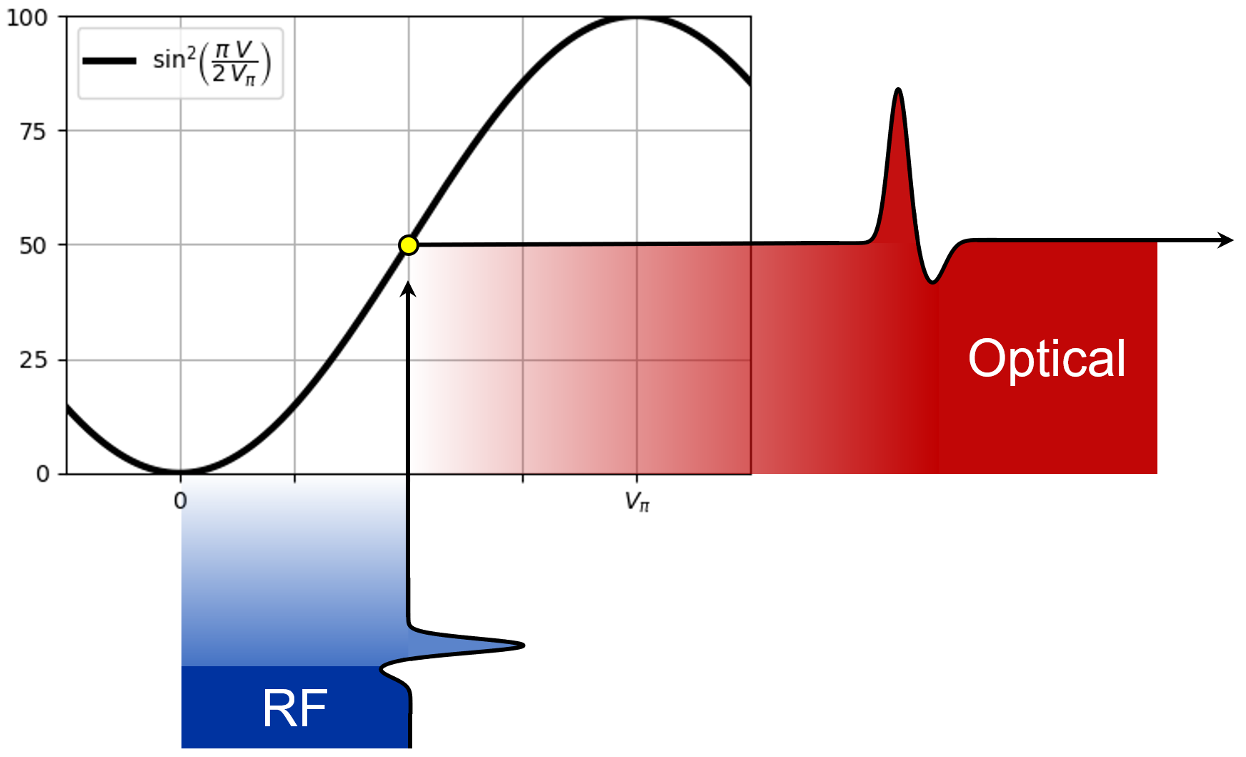
Radio-over-fibre with electro-optical modulators
Transfer Function
1
✓
radio-over-fibre

Slide 8
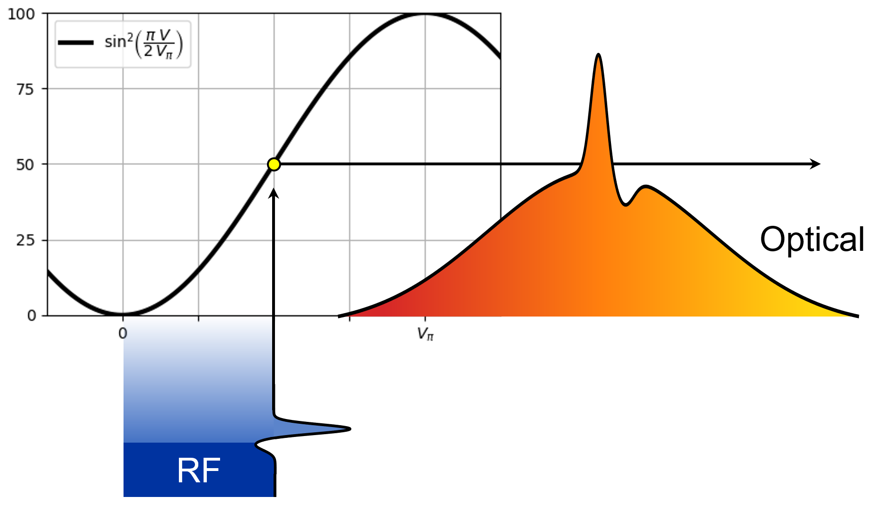
Time Stretch through Spectral Encoding
Continuous wave laser
Use a chirped laser pulse instead of a continuous wave laser
    increase power density of the laser
Narrow optical spectrum
    keep reasonable performance of Mach-Zehnder interferometer
Encode the signals on the laser spectrum
    possibility to use laser spectrum also for decoding
    → time stretch: moving away from real-time sampling
Chirped laser pulse

Slide 9

Time Stretch through Spectral Encoding
linear dispersion in optical fibre
~ km
real time
stretched time
1
✓
2
✓
radio-over-fibre
time stretch

Slide 10
Test-Setup for LHC Point 4

Slide 11







Test-Setup
Surface (SX4 R-002)
Gallery (UA47/U0-001)
Tunnel (2438/U0-2438)
DCM 5 km
DUT 1
PM fibre
EO modulator
DUT 2
DC bias voltage
RF signal
Femtosecond
laser
Chirped volume
bragg grating
Attenuation (> 30 dB)
BQK
DCM 20 km
Read-out electronics
$$p^{+}$$
Photodetector
stretched time
+12.5 ns
BQK

Slide 12
Main part of the setup is accessible 24/7
Surface (SX4 R-002)
Gallery (UA47/U0-001)
Tunnel (2438/U0-2438)
DCM 5 km
DUT 1
PM fibre
EO modulator
DUT 2
DC bias voltage
RF signal
Femtosecond
laser
Chirped volume
bragg grating
Attenuation (> 30 dB)
BQK
DCM 20 km
Read-out electronics
$$p^{+}$$
Photodetector
stretched time
+12.5 ns
BQK

Slide 13
Main part of the setup is accessible 24/7
Remote controllable RF attenuators are the only active electronic components in the radiation area
Surface (SX4 R-002)
Gallery (UA47/U0-001)
Tunnel (2438/U0-2438)
DCM 5 km
DUT 1
PM fibre
EO modulator
DUT 2
DC bias voltage
RF signal
Femtosecond
laser
Chirped volume
bragg grating
Attenuation (> 30 dB)
BQK
DCM 20 km
Read-out electronics
$$p^{+}$$
Photodetector
stretched time
+12.5 ns
BQK

Slide 14
Lab-Tests

Slide 15





Time Conversion
t
λ
time
spectrum
Δt
Δt
Δλ
Δλ
t
-λ
Establish relationship between
wavelength and time
$$p^{+}$$

Slide 16
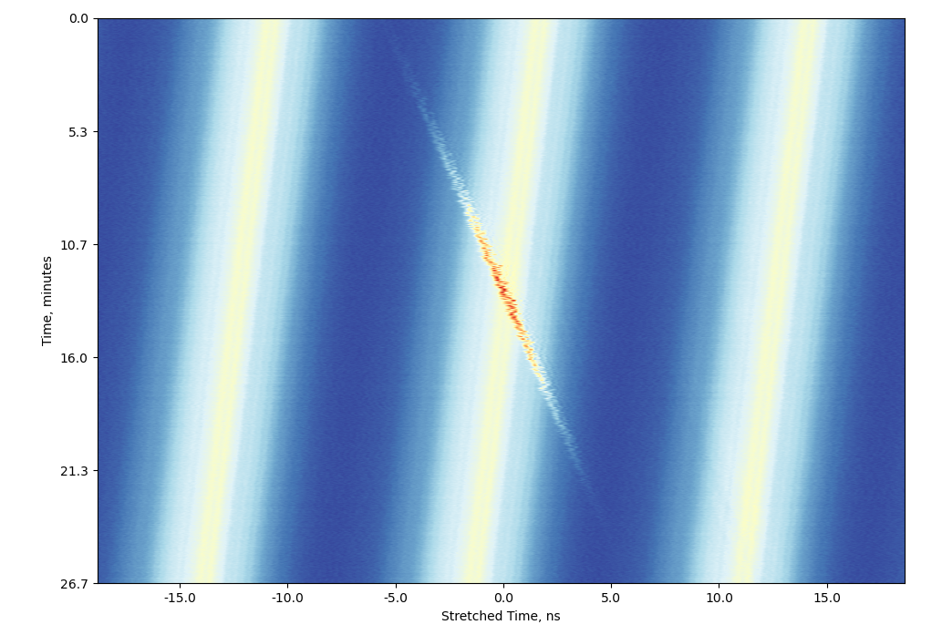
Time Conversion at Lab
12.5 ns
12.5 ns

Slide 17
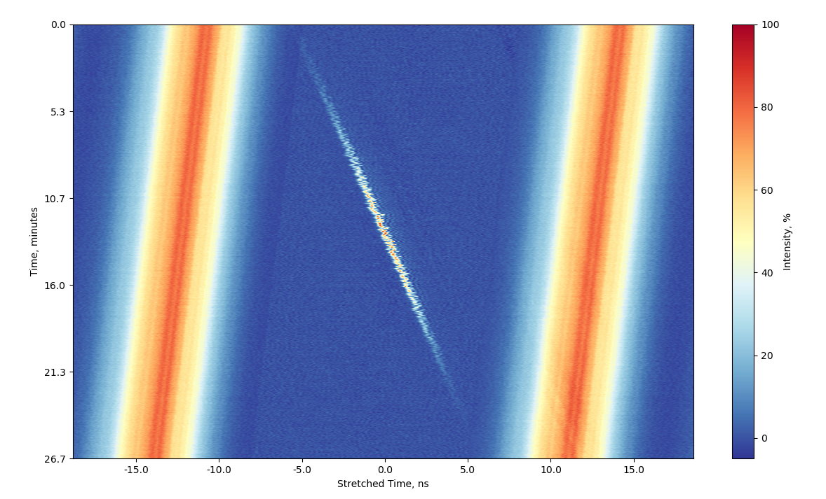
Time Conversion at Lab
12.5 ns
12.5 ns
background subtraction
→ stretching factor 4.68 ± 0.01
e.g. 2.5 GHz ≙ 11.7 GHz

Slide 18
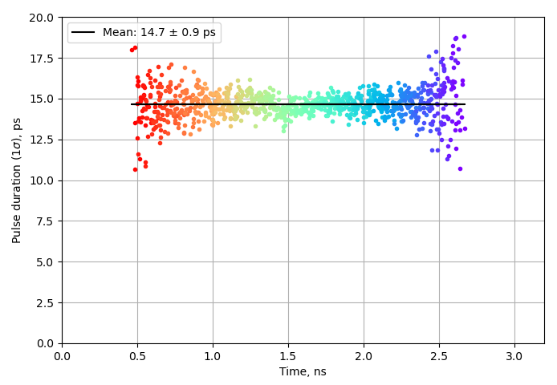

Bandwidth at Lab
25 km stretching
real-time equivalent
1.0 ns
14.7 ps (1 σ) ≈ 14.4 GHz
What limits this?
14.4 GHz / 4.68 ≈ 3.1 GHz
→ Oscilloscope

Slide 19
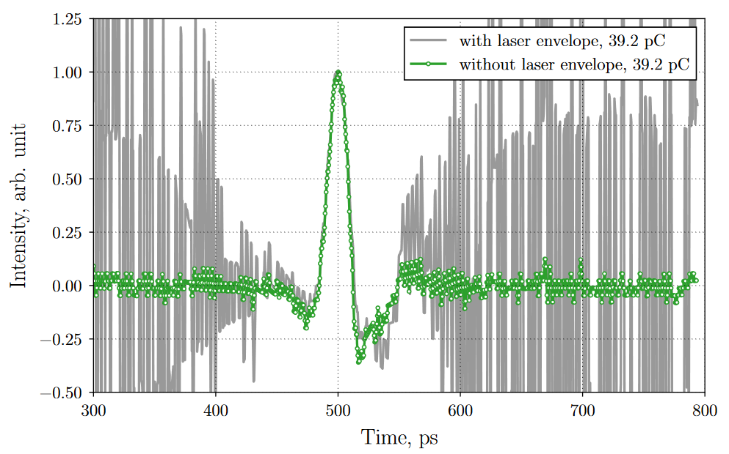
Measurements with Electron Bunches
Acquisition window
𝜏_{c} ≈ 72 ps
Photodetector + Oscilloscope
Analog bandwidth | 33 GHz
Sampling rate | 256 GSa/s
stretching
x 9
300 GHz
2315 GSa/s
Modulator + Antenna
Measured bandwidth
45 GHz
modulator bandwidth: ~ 10s GHz
> bandwidth of stripline pickup
→

Slide 20
Setup Limitations
Vertical Resolution not tested yet
    various detection schemes possible, in case the current setup will not be able to meet specs
    1) optical background subtraction using a balanced photodetector
    2) IQ modulator to encode difference and sum optically
Laser pulses need to be synchronized to particle beams
    e.g. for protons: 40.078 885 MHz to 40.078 970 MHz (0.45 Hz/s during ramp)
    current laser system only allows for 0.065 Hz/s
    → custom-made laser unit necessary if measurement during ramp is needed
Radiation hardness of various parts still to be assessed
    GaAs vs. LiNbO₃ modulators
    Polarization maintaining fibers

Slide 21
Summary
High-bandwidth, high-resolution acquisition is challenging
    bandwidth of 14.4 GHz demonstrated, which can be easily adapted with different stretching stages
    good linearity of time stretching
    → promising start to tackle high-resolution problematic with beam
Versatile setup
    most critical components accessible 24/7
    modifications for various detection schemes possible (balanced detection, IQ modulation, …)
First proton beam data in the coming months
  installation in Point 4 in the coming weeks

Slide 22
Thank you!

Slide 23
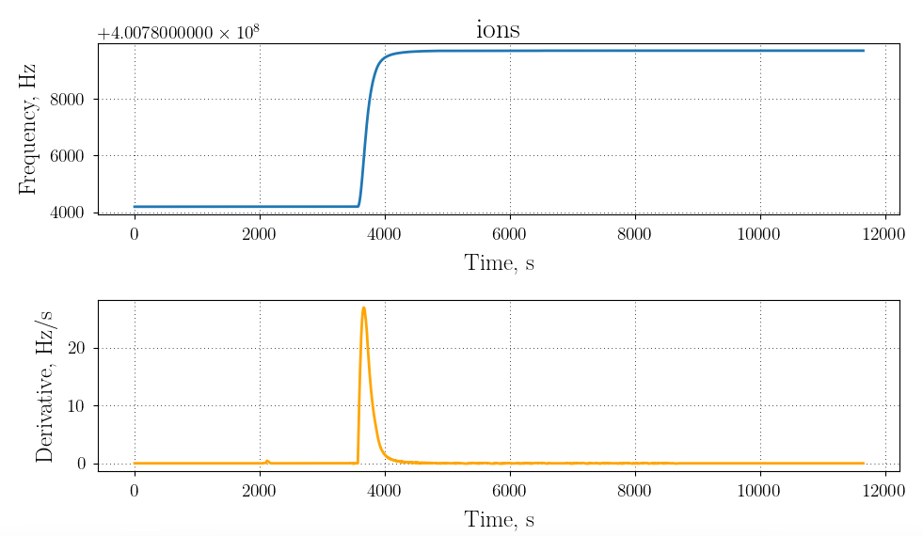
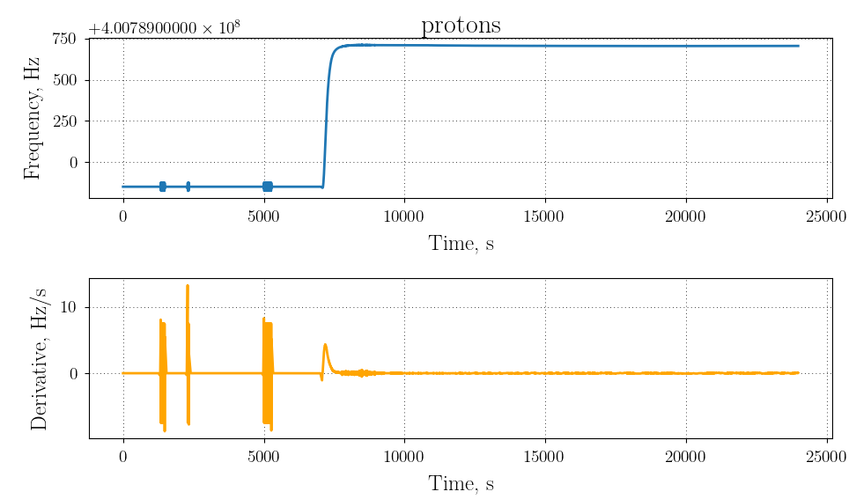
LHC Rep. Rate
400 MHz
 | 40 MHz | 80 MHz
Min, MHz | 40.078 420 | 80.156 839
Max, MHz | 40.078 970 | 80.157 939
Range, Hz | 550 | 1100
Tuning speed, Hz/s | 2.7 | 5.4
ions
 | 40 MHz | 80 MHz
Min, MHz | 40.078 885 | 80.157 770
Max, MHz | 40.078 970 | 80.157 941
Range, Hz | 85 | 171
Tuning speed, Hz/s | 0.45 | 0.9
protons
 | 80 MHz
Min, MHz | 80.156 800
Max, MHz | 80.158 000
Range, Hz | 1200
Tuning speed, Hz/s | 0.13 (synchronized)
laser

Slide 24
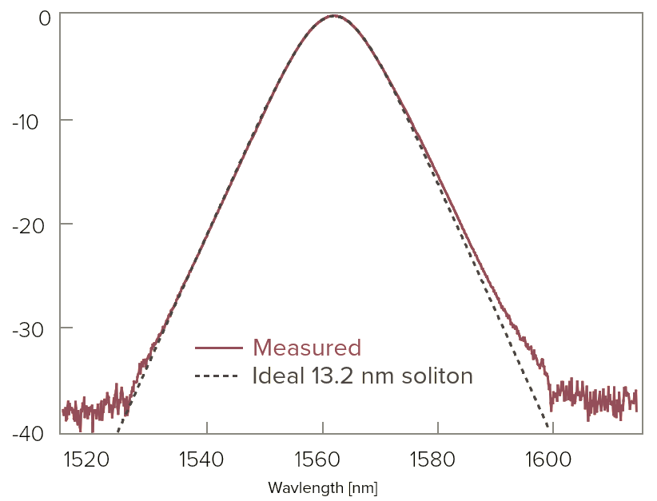
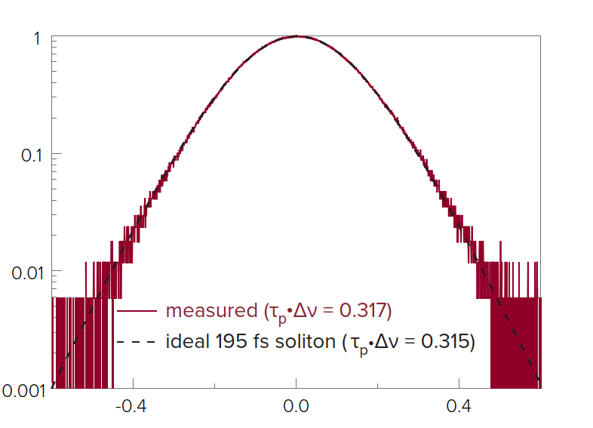
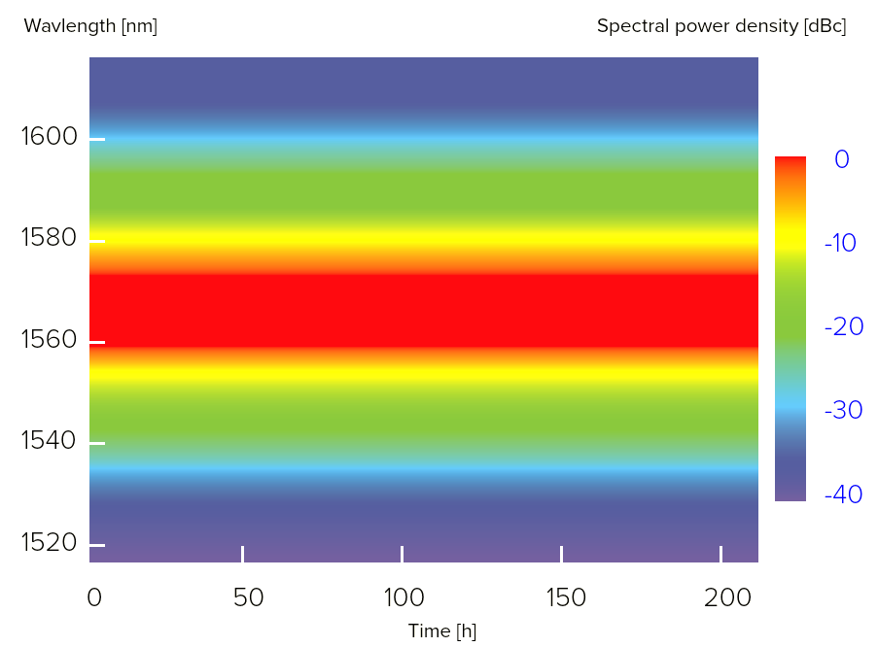
LHC Setup Laser
Center wavelength | 1560 nm
Pulse duration | 195 fs
Spectral width (FWHM) | 13.2 nm
Power | > 120 mW
Pulse energy | > 1.5 nJ
Peak power | > 6 kW
Laser

Slide 25
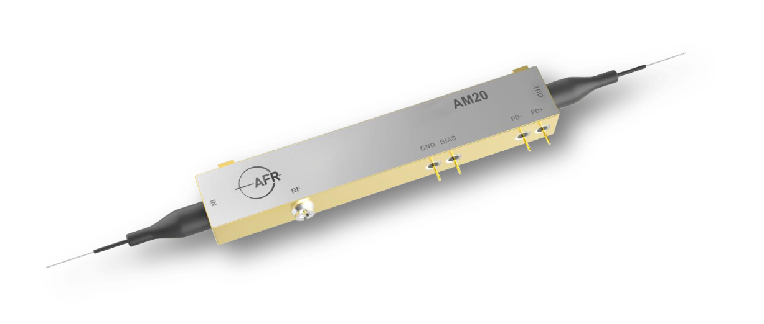
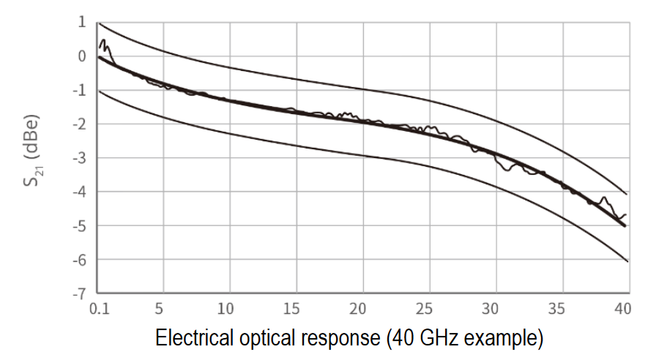
LHC Setup Modulator
Operating wavelength | 1525 – 1615 nm
Max. optical input power | 100 mW
Max. RF input power | 25 dBm
Extinction ratio | > 20 dB (23 dB typ)
Connector type | 1.85 mm
Electro optical bandwidth | > 30 GHz
V_{π} RF @ 50 kHz | 4.7 V (< 5.2 V)
Insertion loss | < 5.5 dB (4.5 dB typ)
Modulator

Slide 26
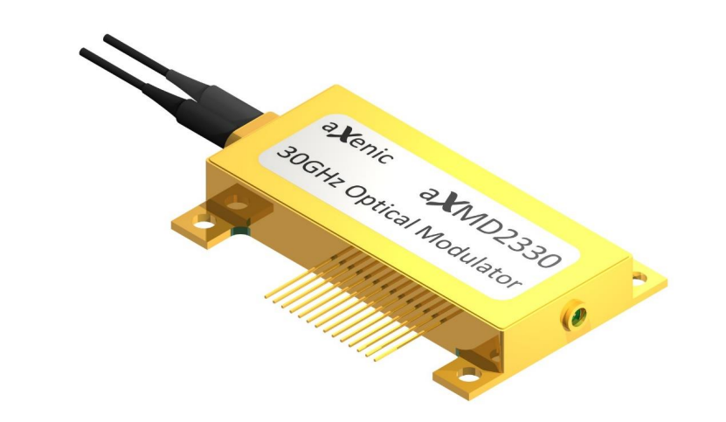
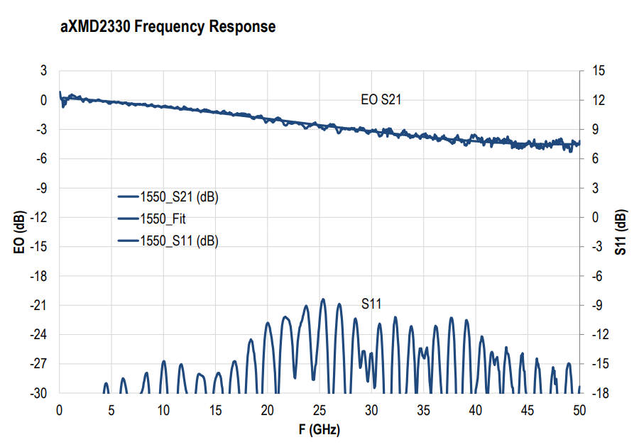
LHC Setup Modulator
Operating wavelength | 1520 – 1580 nm
Max. optical input power | 100 mW
Max. RF input power | 21 dBm
Extinction ratio | 23 dB
Connector type | SMPM
Electro optical bandwidth | > 30 GHz
V_{π} RF | 3.5 V (< 5 V)
Insertion loss | 5.0 dB (< 7.0 dB)
Modulator

Slide 27
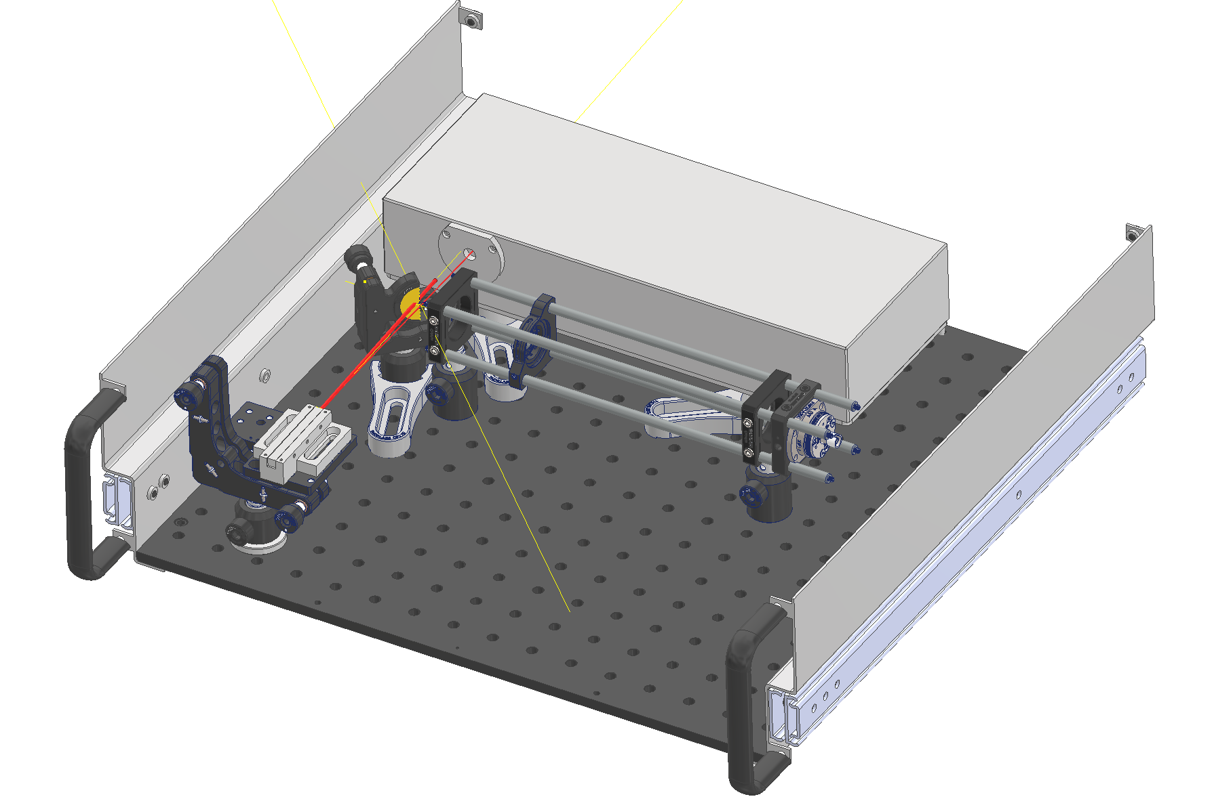

Surface (SX4 R-002)
Femtosecond laser
Mirror
SM
DCM 5 km
Chirped volume
bragg grating

Slide 28

Stretching
2nd stretching
 | RFSoC
Sample Rate | 5 GSa/s
Analog BW | 6 GHz
Analog BW avoiding aliasing | < 2.5 GHz
RFSoC to digitize
 | Pickup |  | 2nd stretching needed for RFSoC
BW ideally | 10 GHz | < 50 ps | factor 4
Stripline pickup
 | Modulator |  | 2nd stretching needed for RFSoC
BW | > 40 GHz | < 12.5 ps | factor 16
EO-modulator encoding
→ factor 4 to 16
1st stretching
 | 1st stretching (FWHM) | Optical spectrum | min. 2nd stretching
BW | 750 ps | > 40 GHz | 3 ns
 | 1500 ps | > 28 GHz | 6 ns
 | 3125 ps | > 20 GHz | 12.5 ns
$$1/( 2 \sqrt{τ0 τc} )$$
→ limited by 2nd stretching

Slide 29
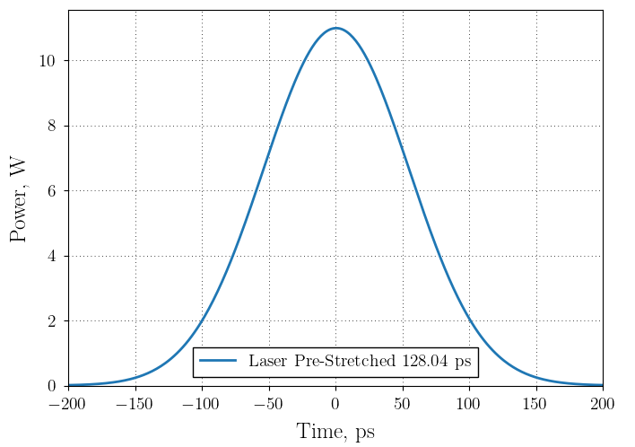
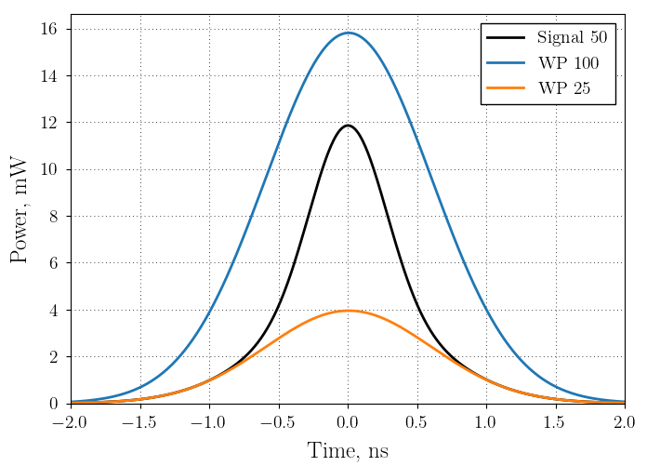
LHC Setup Beam
Laser after CVBG
Laser @ Modulator
50 ps/nm
stretching to 2 x bunch (300 ps sigma)
including optical attenuation

Slide 30
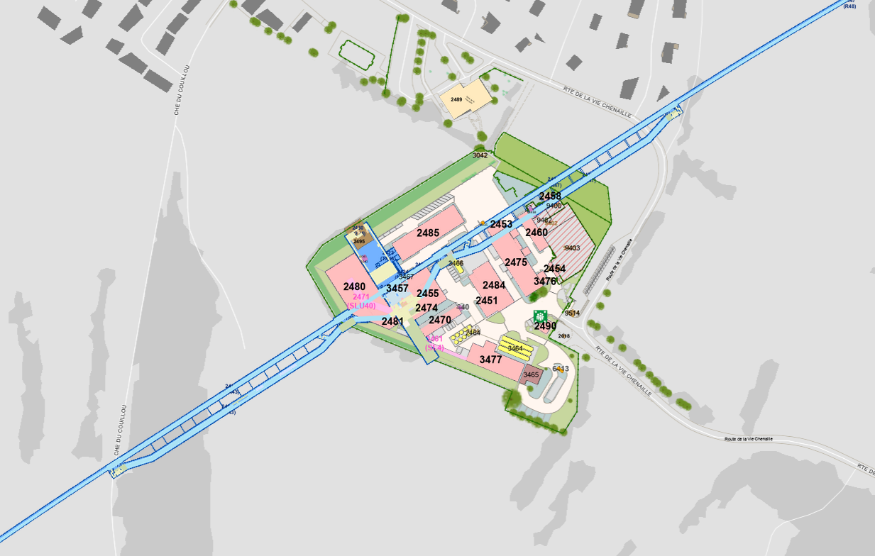
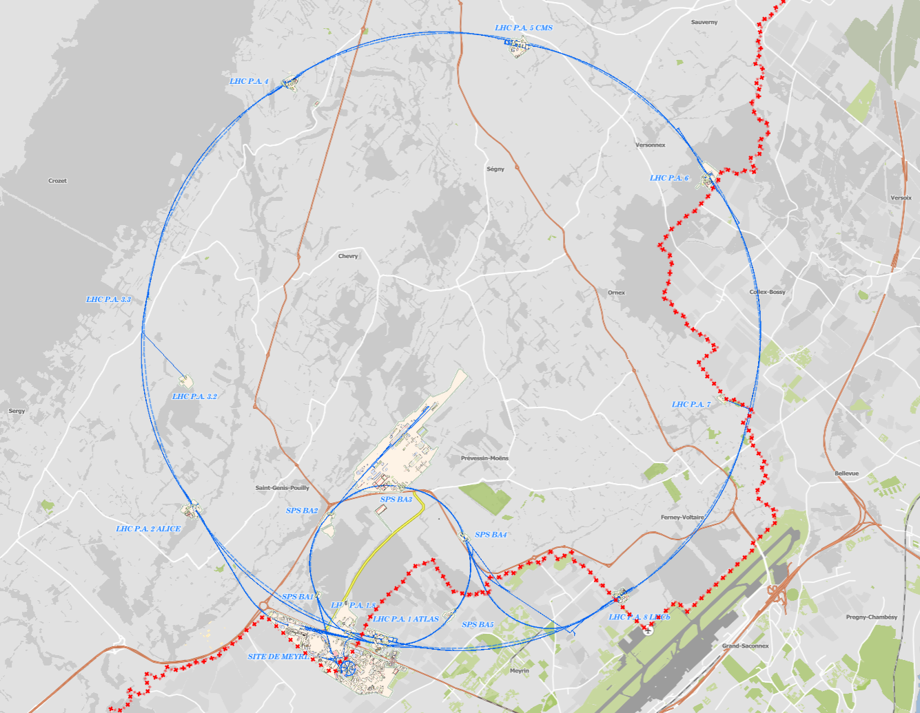
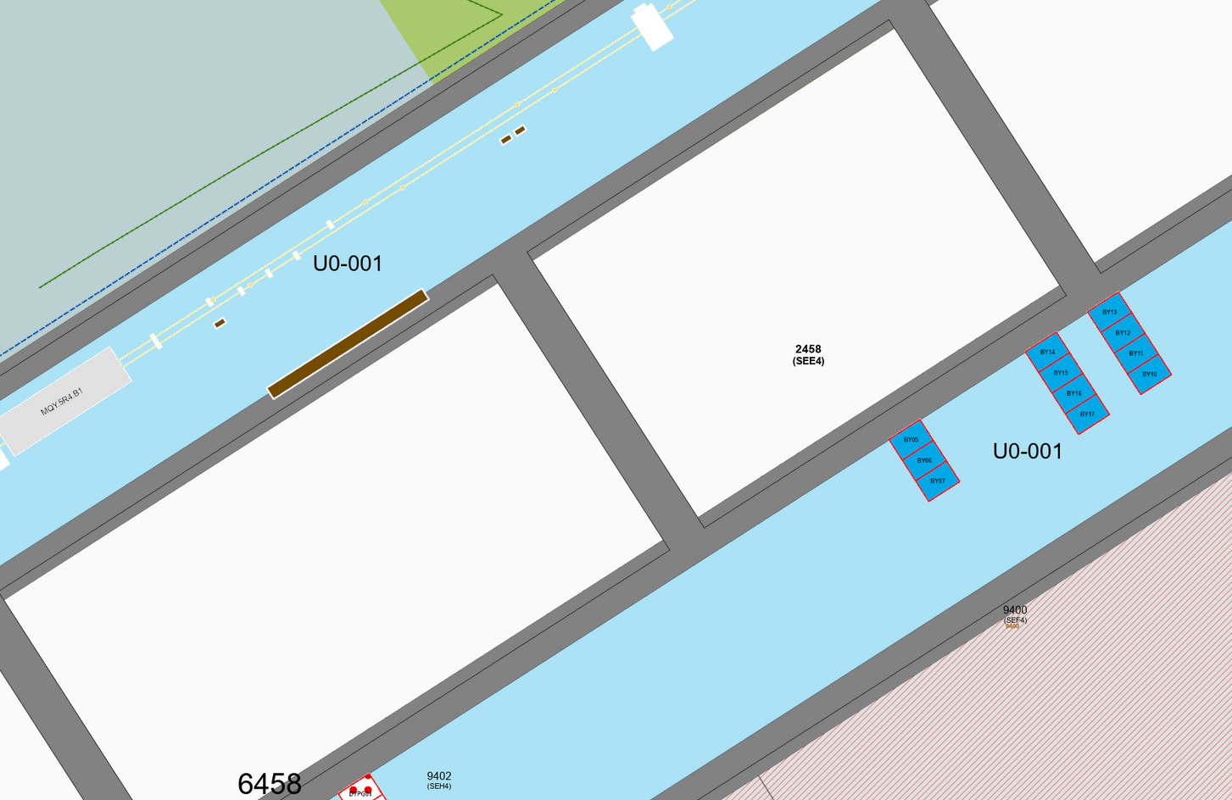
LHC Setup Signal Source
LHC Point 4
LHC Point 4
BQK
140 m to IP4

Slide 31
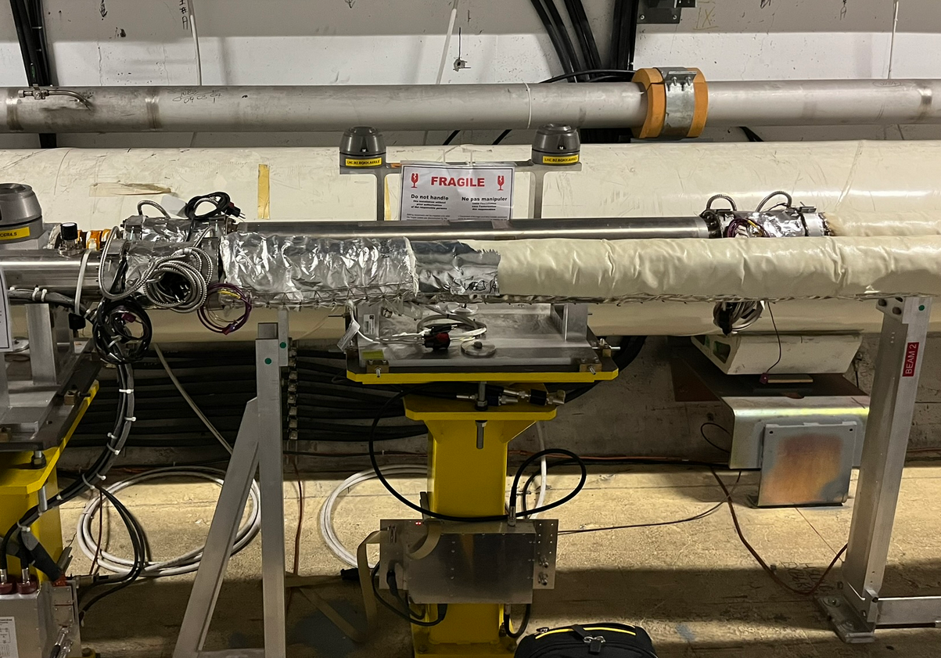
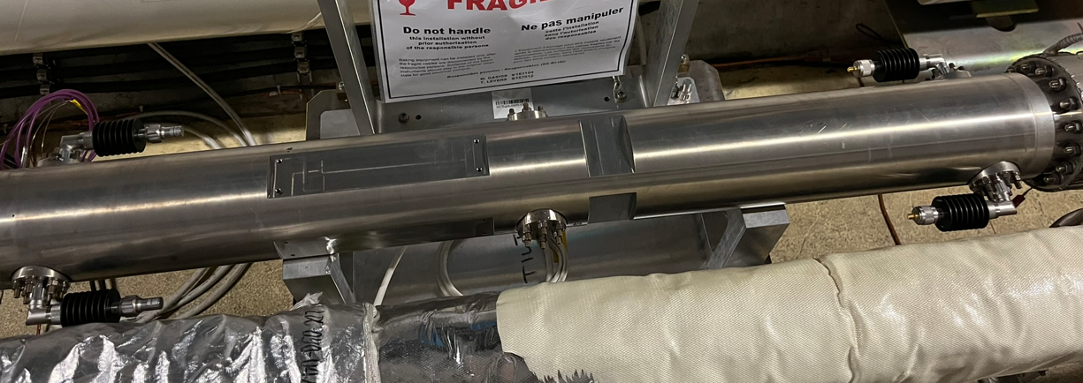
BQK
Element | BQKH.A6R4.B2 Strip-line kicker “Tune shaker”
Beamline | B2
Type | BQKH
1 m
Beam 2
Beam 1

Slide 32
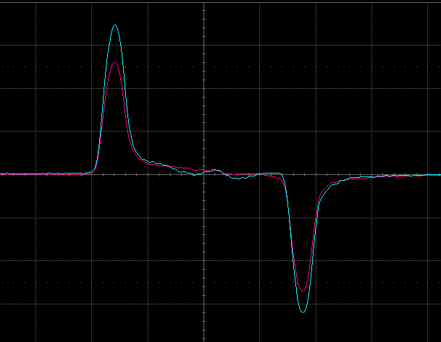
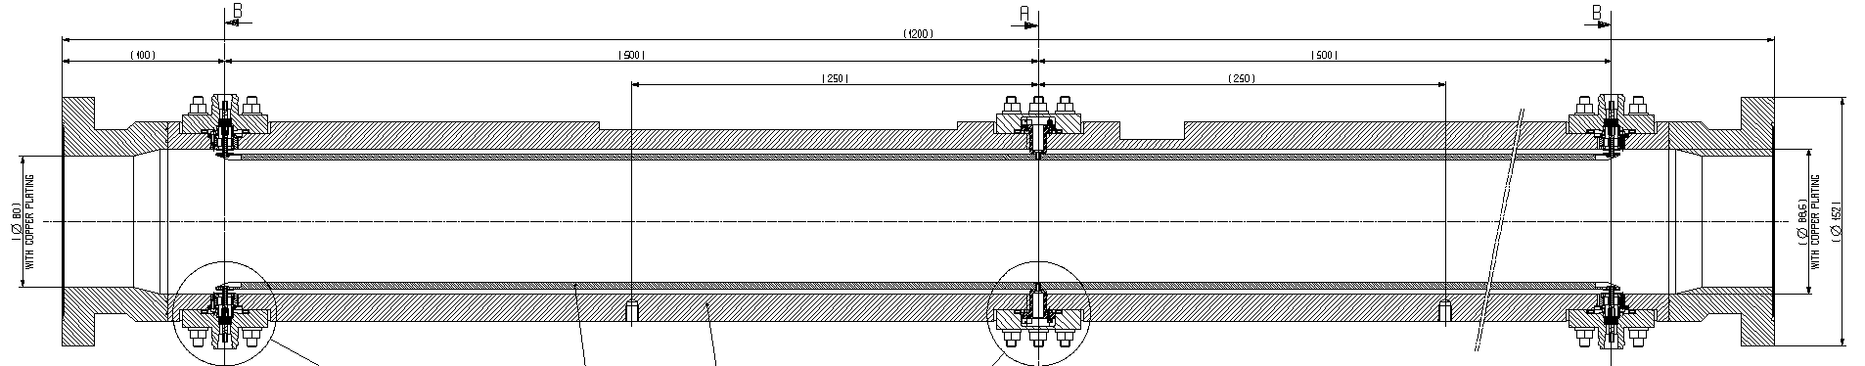
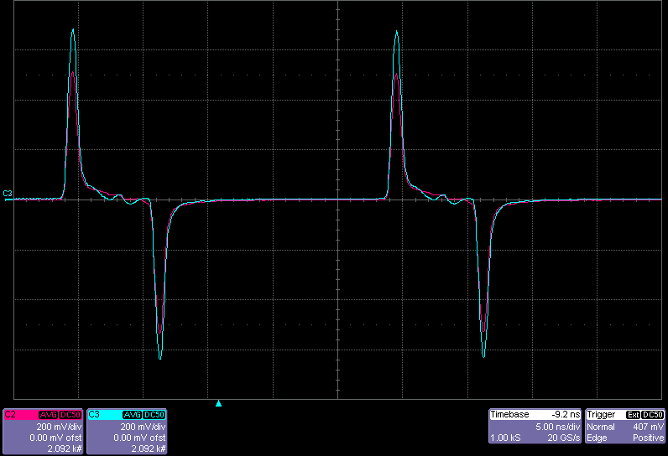
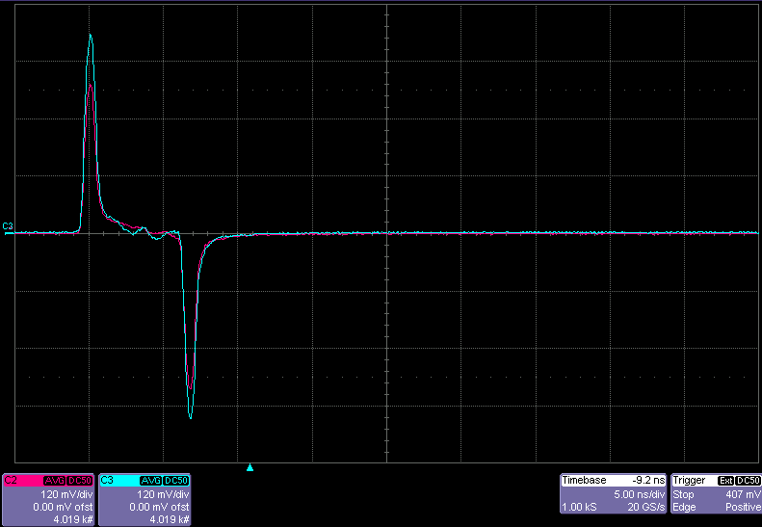
BQK
~ 6.6 ns
-40 dB
Beam 2
-40 dB
1.40 × 10¹¹ p⁺
8.65 × 10¹⁰ p⁺
25 ns
~ 675 mV
~ 420 mV

