Slide 1

WP13.5 update – budget and schedule considerations
T. Levens, SY-BI
with input from S. Gibson, D. Harryman, M. Krupa, T. Lefevre, A. Schloegelhofer
HL-LHC High Bandwidth Beam Position Monitor Review – 15th January 2025

Slide 2
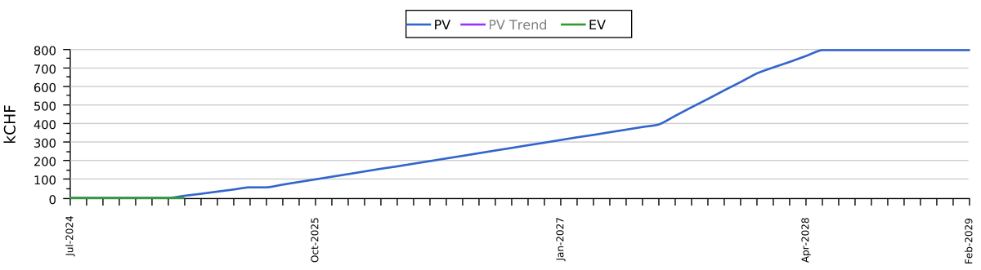
CERN Budget
CERN budget lines in APT (WU 192433)
  594 kCHF for BPW instruments and acquisition
  200 kCHF for BPW spares
Current spending profile is starting now until mid-2028:
Some reprofiling will be needed due to delay of LS3
  Desire to purchase acquisition system as late as possible (i.e. now in 2029) to avoid technological obsolescence of digitizers and PCs during run

Slide 3
Royal Holloway Budget
Royal Holloway has grant of £760k from STFC for the delivery of four EO-BPMs to CERN as part of HL-UK.
  Split into R&D costs and prototype (~£230k) and delivery of the final instruments (~£530k).
  Note, the original budget assumed that the prototype would be reused as one of the final four instruments.
  As part of the agreement, CERN should provide an additional £150k for the final instruments.
From this initial grant ~£600k is remaining.
  Some of the R&D funded by I.FAST project.
Note that currently the grant ends in March 2026!
  Extension beyond this would need to be requested to STFC.

Slide 4
Scenarios for CC diagnostic in IP1/5
Baseline for WP13 was to install one per beam per plane.
→ 4 total single-plane instruments (4x planes)
  IP1L: Hor. B1
  IP1R: Hor. B2
Recent request from WP2 to install dual-plane BPMs for both beams in all locations to cover all possible optics scenarios.
→ 8 total dual-plane instruments (16x planes)
Agreement between WP13 and WP2 on the strategy:
  Install dual-plane pick-ups and cables in all locations.
  Initially equip only baseline 4x planes with acquisition systems.
  Full deployment of acquisition on all 16x planes would require additional budget (~600kCHF) for digitizers.
  IP5L: Ver. B2
  IP5R: Ver. B1

Slide 5
Budget estimates
Budget estimates for the following configurations for the agreed CC diagnostics (16 planes, 4 acquired) in IP1/5:
  Strip-line BPMs with traditional acquisition
  Strip-line BPMs with EOMTS acquisition
  EO-BPMs
Note the estimates are based on the best information that we have today and there is some uncertainty…

Slide 6
1. Strip-line BPMs
Pick-ups & cabling: 464kCHF
  Strip-line BPMs – 400kCHF
    Estimate for 8+2 dual-plane BPMs including development and prototyping
  Coaxial cables – 64kCHF
    Estimate of 2kCHF/100m, 32 cables, each cable ~100m
Acquisition: 300kCHF
  High-speed digitizers (4x 2ch) – 200kCHF
  Spares (50%) – 100kCHF
Total cost: 764 kCHF

Slide 7
2. Strip-line BPMs + EOMTS
Pick-ups & cabling: 494kCHF
  Strip-line BPMs – 400kCHF (as option 1)
  Coaxial cables – 64kCHF (as option 1)
  Fibers – 30kCHF
    2 fibers per plane → 8 per IP side
    Estimate of 3kCHF/100m per cable, 4x cables, each cable ~250m
Acquisition: 375kCHF
  Digitizers (2x RFSoC) – 50kCHF
  Pulsed lasers (4x) – 130kCHF
  Optical components (4x) – 70kCHF
  Spares (50%) – 125kCHF
Total cost: 919kCHF

Slide 8
3. EO-BPMs
Pick-ups and cabling: 480kCHF
  EO-BPMs – 400kCHF
    Estimate for 8+2 dual-plane EO-BPMs
  Fibers – 80kCHF
    1 PM + 3 SM fibers per plane → 4 PM + 12 SM fibers per IP side
    Estimate of 8kCHF/100m per cable, 4x cables, each cable ~250m
Acquisition: 720kCHF
  High speed digitizers (4x 3ch) – 300kCHF
  CW lasers + amplifiers (2x) – 100kCHF
  Optical components (4x) – 80kCHF
  Spares (50%) – 240kCHF
Total cost: 1’200kCHF

Slide 9
Schedule
Pick-ups:
  Instruments are required for installation in LSS1/5 in mid-2028.
    Planned to be installed after the CC, so this date is depending on the CC schedule.
  They must be available for vacuum acceptance tests by the end of 2027.
  The designs must be finalised by end of 2025 to give sufficient time for procurement and production.
  The technological decision (strip-line vs. EO-BPM) must be made as soon as possible to allow design and integration work to start.
Acquisition (including EOMTS):
  Final decision on acquisition system by early-2029 to give time for procurement and installation at end of LS3 (mid-2030).
  Beneficial to purchase it as late as possible to avoid technological obsolescence of digitizers and PCs during run.

Slide 10
Summary
WP13 requested to install 8x dual-plane high-bandwidth BPMs in IP1/5 for HL-LHC crab-cavity diagnostics.
  Note only 4x planes will be equipped with acquisition as baseline.
Total project budget:
  794kCHF at CERN
  ~£600k at Royal Holloway
Current best cost estimates are in line with the available budgets:
  Strip-line: 764kCHF
  Strip-line + EOMTS: 919kCHF
  EO-BPM: 1’200kCHF
Technical decision on pick-up type (i.e. EO-BPMs vs. strip-line) needed urgently to finalise the design and ensure we can meet the deadlines for installation in mid-2028.
Decision on final acquisition system needed by early-2029.

Slide 11
Thank you…

Slide 12
3a. EO-BPMs in LSS4
Additional option to install 4x single-plane EO-BPMs in LSS4 dedicated to instability diagnostics…
Pick-ups and cabling: 190kCHF
  EO-BPMs – 150kCHF
    Estimate for 4+1 single-plane EO-BPMs
  Fibers – 40kCHF
    1 PM + 3 SM fibers per plane → 4 PM and 12 SM fibers total
    Estimate of 8kCHF/100m per cable, 1x cable of ~500m
Acquisition: 645kCHF
  High speed digitizers (4x 3ch) – 300kCHF
  CW laser + amplifier (1x) – 50kCHF
  Optical components (4x) – 80kCHF
  Spares (50%) – 215kCHF
Total cost: 835kCHF

Slide 13
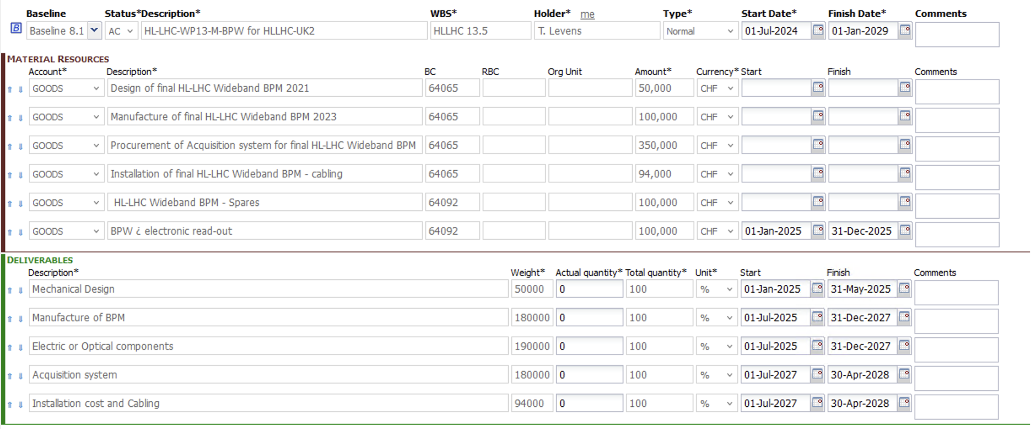
APT

