Slide 1
Launch event debrief
Results, ideas, actions

Slide 2
Audience
208 registrations (incl. EVERSE members)
Peak attendance: 140 people
Average attendance: 120 people
Slido top participation: 119 answers/people
Slido lowest participation: 17 answers/people
(Very rough) average: 80 people/answers

Slide 3
Audience demographics
Top countries:
UK
Germany
France
Non-European attendance:
India
South Africa
(114 answers)

Slide 4
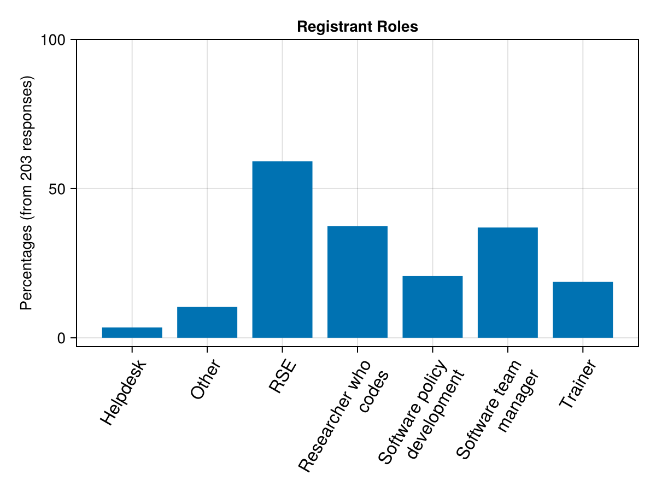
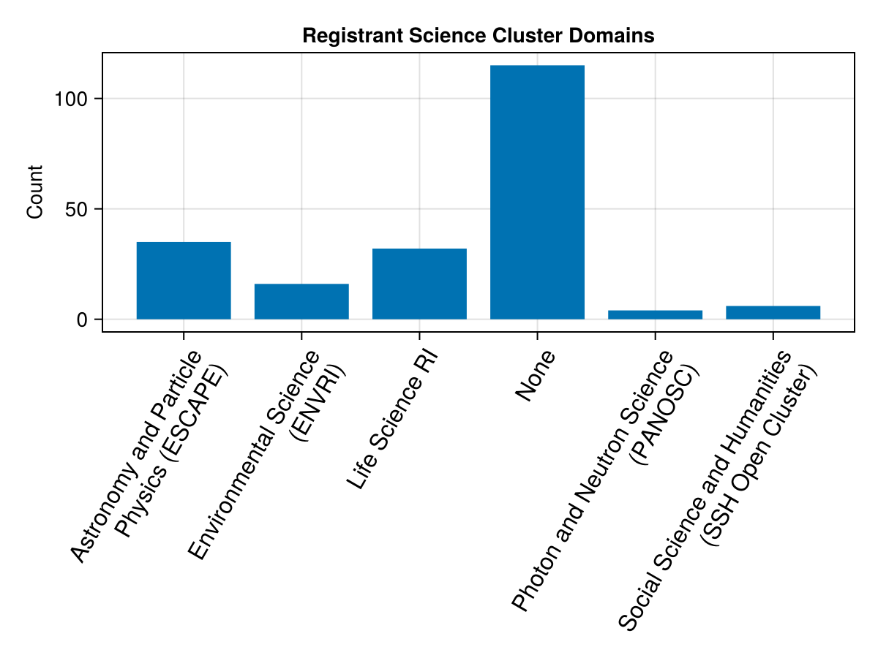
Professions & Connections

Slide 5
Professions & Connections
50% of the participants (106) work at institution where RSE is a recognised career path
>52% are not yet involved in RSE communities
  41% in national ones
List of other RSE initiatives on OwnCloud
56 submitted answers to software quality guidelines
  some without any or unsure
  institutional guidelines
  Turing Way
  OSSR
  ELIXIR
  FAIR4RS and many more

Slide 6
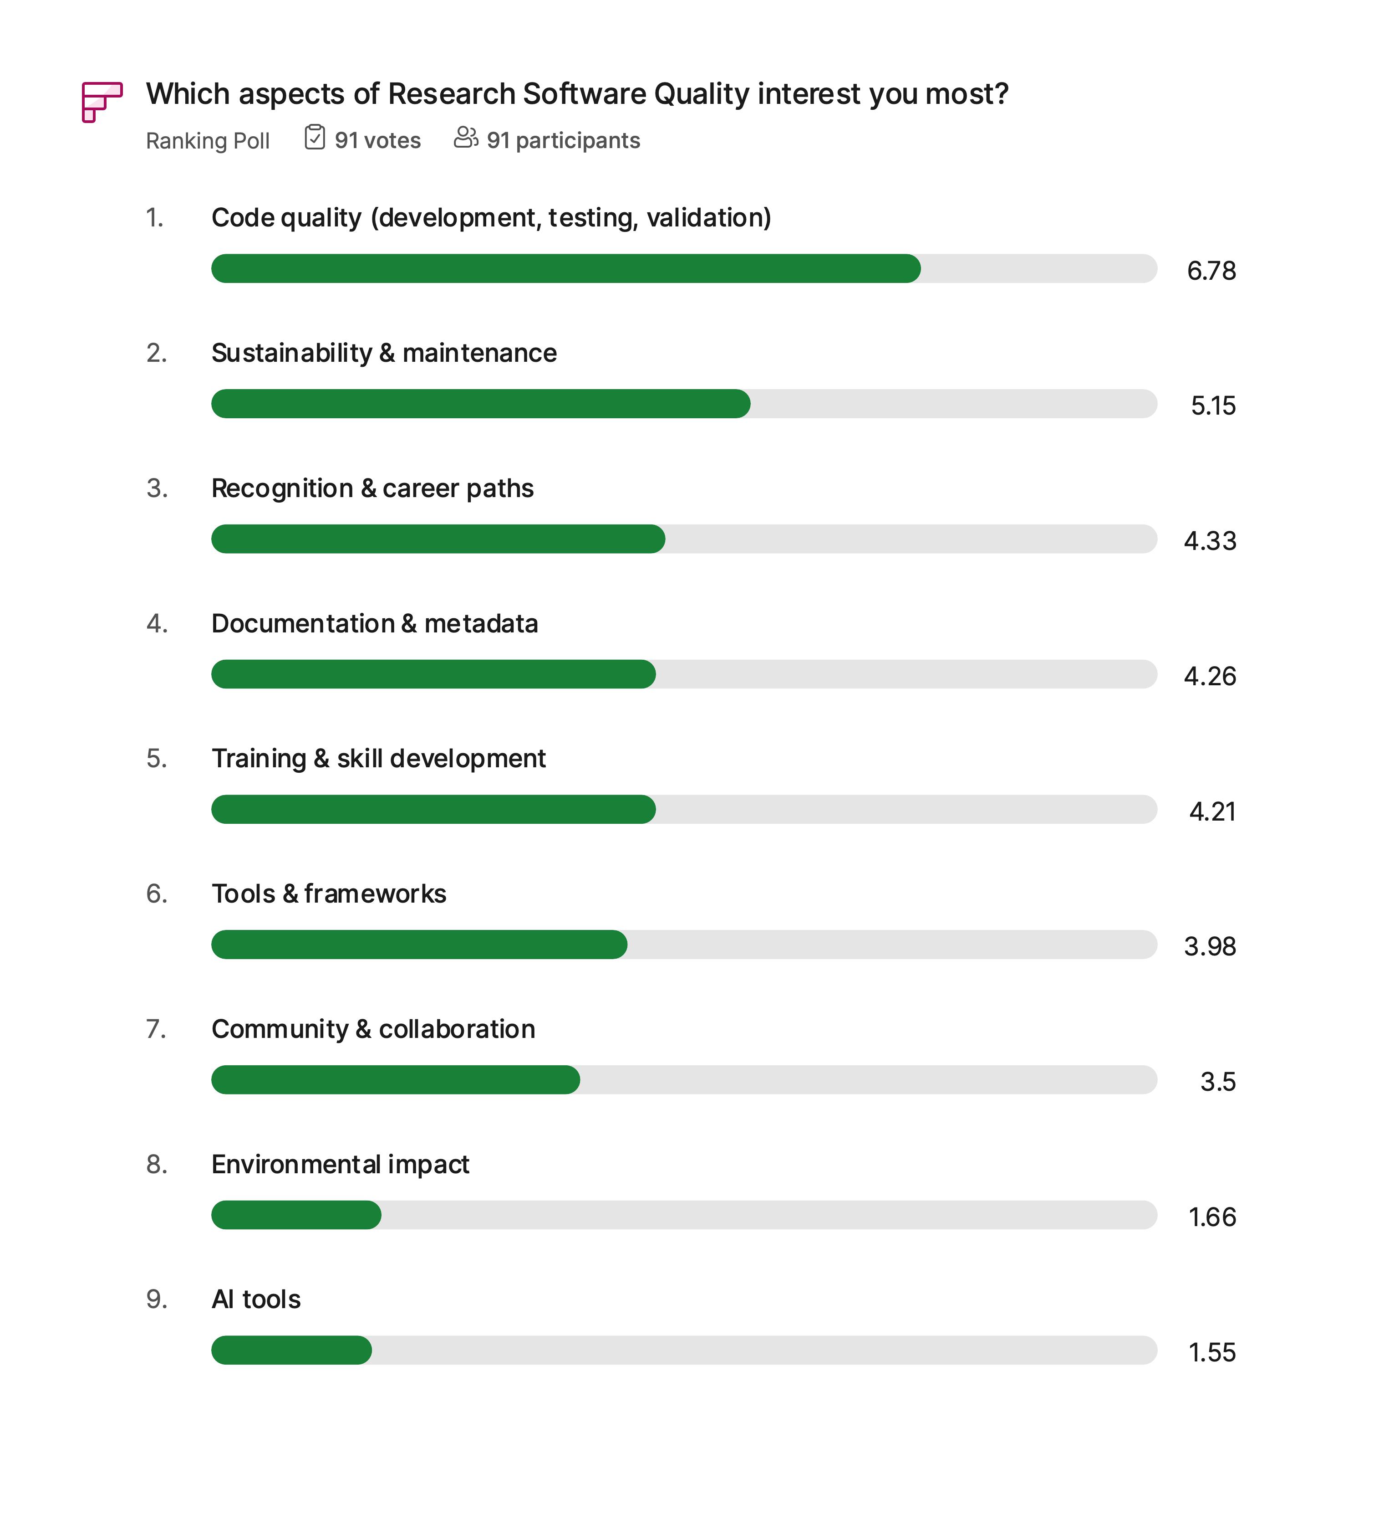
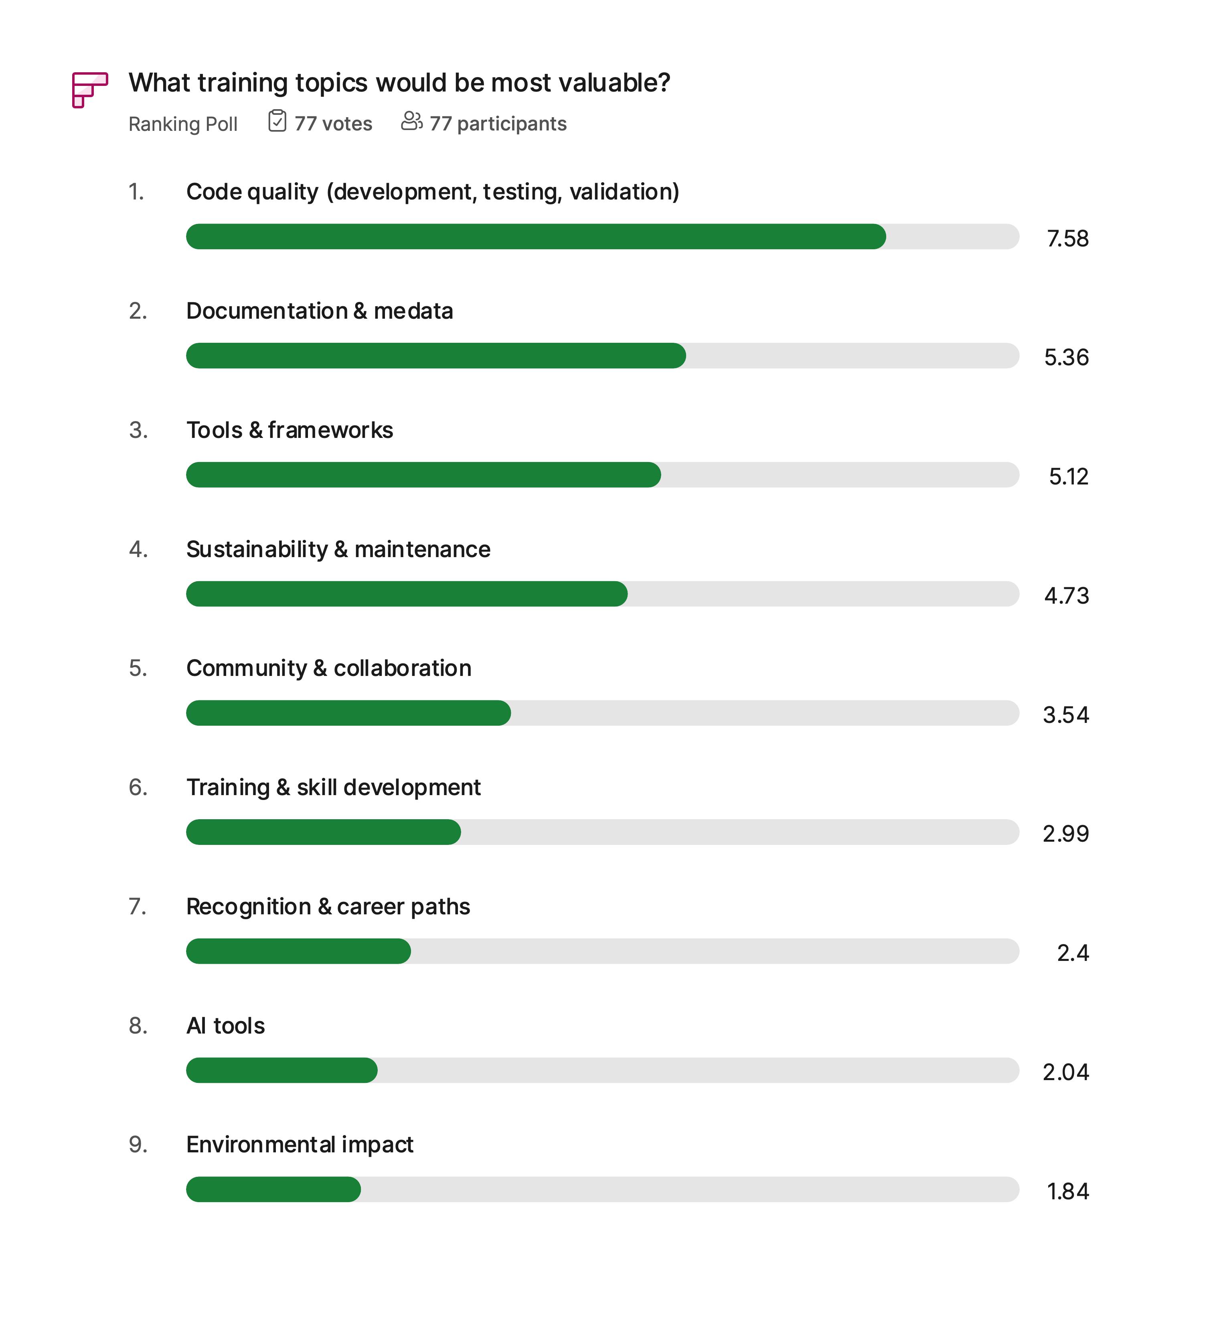
Personal interest vs training importance

Slide 7
Biggest Challenge
“Community and Collaboration ranked very low on the poll, yet Maintenance was very high, both there and in the keywords. And yet sustainable maintenance of research software is impossible without community and collaboration. Any comments on this disparity?“

Slide 8
Engagement
Audience contribution
Interestingly 73% (85 participants) voted to join working groups
  Action on us? What kind? How to organise? Topics?
  If even?
72% want to share best practices
  Promote RSQKit
  Spread the word online, repost, in institutions
  Share resources
  Bring cake & buy beers
Followed by testing quality frameworks (46%) and help with community building (45%)
Expressed interests during registration show wish to be in a Network and connect

Slide 9
Engagement
Our side
Newsletter is preferred way of staying in touch
More than half interested in webinars
  mid morning 10-12 CET
  mid afternoon 14-16 CET
Request for podcasts….
  look… if anyone in EVERSE has enough time and nerves to do this, post-process audio quality, find topics etc be my guest, I can’t put this additionally on my To-Do-List
  or be invited/go as guest to existing podcasts
Create some sort of chat platform (Mattermost, Slack, Discord)
Connect to RSS feed
Invitation to meetings (e.g. Nordic RSE)
From registration: high interest in networking and being part of the Network

Slide 10
What has happened so far
YouTube channel is alive
  52 views on recording
New subscribers added to Newsletter mailing list
New mailing list for “broadcast” Network specific news/announcements to member
Interest for organisational membership

Slide 11
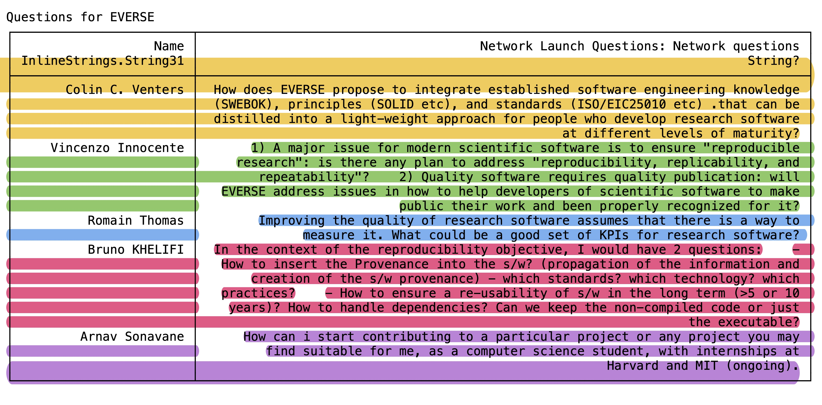
What’s pending
or has been proposed
Define organisational membership
Establish a communication/networking channel
Consider working groups
Proposed potential collaboration with CodeRefinery
Check if possible to go to NordicRSE
Start webinar/training series
Check pre-event questions
Check non-answered questions (34 remaining)
Dedicate more time to results at GAM, define next steps

Slide 12

Conclusion
Launch event went really well, thanks to all
Good engagement, especially on open question
Lot of actions on us to then disseminate to the Network
People are interested in being connected via a RSE/RSQ Network

