Slide 1

Coupling Correction Through Beam Position Data
J. Chavanne, P. Elleaume, F. Ewald,
L. Farvacque, A. Franchi,
T. Perron, K. Scheidt
Low-emittance Rings workshop 2011
Heraklion, Crete, greece, 3rd to 5th October 2011

Slide 2
Outlines
Vertical emittances in the presence of coupling
Coupling correction via Resonance Driving Terms
2010: Application in the ESRF storage ring
2010: Preserving small vertical emittance during beam delivery
2011: Towards ultra-small vertical emittance
PS: Indirect measurements of vertical emittance

Slide 3
Outlines
Vertical emittances in the presence of coupling
Coupling correction via Resonance Driving Terms
2010: Application in the ESRF storage ring
2010: Preserving small vertical emittance during beam delivery
2011: Towards ultra-small vertical emittance
PS: Indirect measurements of vertical emittance

Slide 4
Vertical emittance in the absence of coupling
Eigen-emittance E: constant along the ring, dependent on the linear lattice only. Ideally Ev≅0

Slide 5
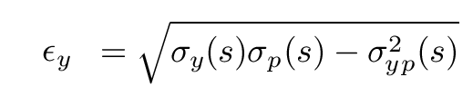
Vertical emittance in the absence of coupling
Eigen-emittance E: constant along the ring, dependent on the linear lattice only. Ideally Ev≅0
Non measurable RMS emittance:

Slide 6
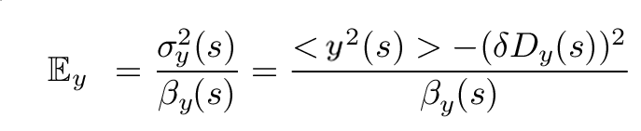
Vertical emittance in the absence of coupling
Eigen-emittance E: constant along the ring, dependent on the linear lattice only. Ideally Ev≅0
Non measurable RMS emittance:
Measurable emittance from RMS beam size:

Slide 7
Vertical emittance in the absence of coupling
Eigen-emittance E: constant along the ring, dependent on the linear lattice only. Ideally Ev≅0
Non measurable RMS emittance:
Measurable emittance from RMS beam size:
Ev=εy=Ey=const.
With zero vertical dispersion, Ev=εy=Ey≅0

Slide 8
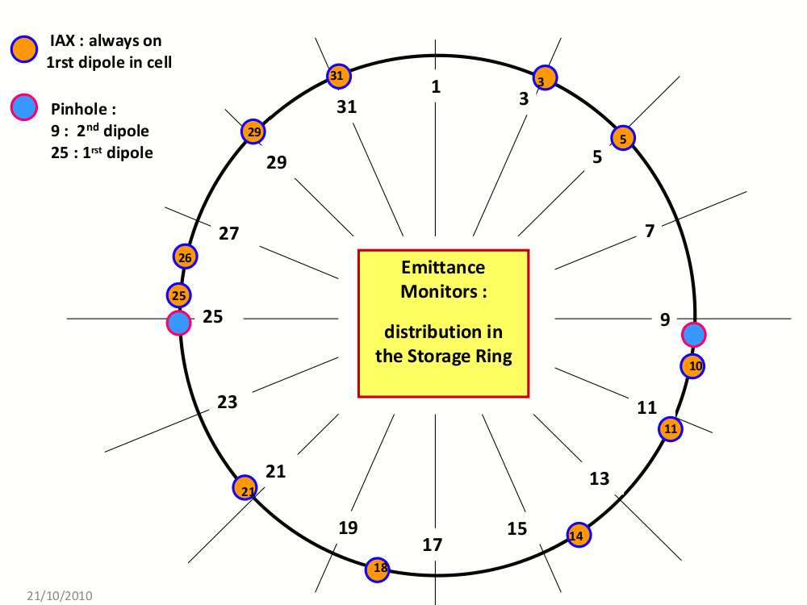
Meas. vertical emittance Ey from RMS beam size
ESRF SR equipment:
11 dipole radiation projection monitors (IAX)
2 pinhole cameras

Slide 9
Meas. vertical emittance Ey from RMS beam size
Ex=4.2 nm
Well corrected coupling
Low beam current (20 mA)
3.3 pm
1.8 pm
4.2 pm
5.5 pm
3.7 pm
2.3 pm
2.8 pm
3.6 pm
1.0 pm
2.8 pm
1.4 pm

Slide 10
Meas. vertical emittance Ey from RMS beam size
Ex=4.2 nm
Well corrected coupling
Low beam current (20 mA)
Εy=3.0 pm
±1.3 (STD)
±0.15 (fluctuation)
3.3 pm
1.8 pm
4.2 pm
5.5 pm
3.7 pm
2.3 pm
2.8 pm
3.6 pm
1.0 pm
2.8 pm
1.4 pm

Slide 11
Meas. vertical emittance Ey from RMS beam size
Ex=4.2 nm
Well corrected coupling
Low beam current (20 mA)
Εy=3.0 pm
±1.3 (STD)
±0.15 (fluctuation)
3.3 pm
Are vertical emittance and E_{y}/E_{x} always good indicators of coupling?
1.8 pm
4.2 pm
5.5 pm
3.7 pm
2.3 pm
2.8 pm
3.6 pm
1.0 pm
2.8 pm
1.4 pm

Slide 12
Meas. vertical emittance Ey from RMS beam size
Fixed low coupling
Stored beam current [mA] | Measured Vertical emittance [pm] INCREASING ION TRAPPING
20 | 3.0 ± 1.5 (STD) ±0.15 (F)
100 | 5.7 ± 1.7 (STD) ±0.07 (F)
160 | 10.1 ± 2.0 (STD) ±0.12 (F)
200 | 17.2 ± 1.8 (STD) ±0.35 (F)
STD =standard deviation from 11 IAX monitors
F=Fluctuation over 30 s from 1-Hz sampling

Slide 13
Meas. vertical emittance Ey from RMS beam size
Fixed low coupling
Stored beam current [mA] | Measured Vertical emittance [pm] INCREASING ION TRAPPING
20 | 3.0 ± 1.5 (STD) ±0.15 (F)
100 | 5.7 ± 1.7 (STD) ±0.07 (F)
160 | 10.1 ± 2.0 (STD) ±0.12 (F)
200 | 17.2 ± 1.8 (STD) ±0.35 (F)
200* | 4.2 ± 1.4 (STD) ±0.05 (F) | ⬅ with bunch-by-bunch feedback
STD =standard deviation from 11 IAX monitors
F=Fluctuation over 30 s from 1-Hz sampling

Slide 14
Meas. vertical emittance Ey from RMS beam size
Fixed low coupling Fixed low beam current
Stored beam current [mA] | Measured Vertical emittance [pm] INCREASING ION TRAPPING | Corrector skew quad (S13C1) current [A] | Measured Vertical emittance [pm] INCREASING COUPLING
20 | 3.0 ± 1.5 (STD) ±0.15 (F) | 0 | 3.1 ± 1.5 (STD) ±0.20 (F)
100 | 5.7 ± 1.7 (STD) ±0.07 (F) | 0.08 | 5.7 ± 1.8 (STD) ±0.20 (F)
160 | 10.1 ± 2.0 (STD) ±0.12 (F) | 0.15 | 10.0 ± 2.7 (STD) ±0.20 (F)
200 | 17.2 ± 1.8 (STD) ±0.35 (F) | 0.18 | 17.2 ± 3.2 (STD) ±0.20 (F)
STD =standard deviation from 11 IAX monitors
F=Fluctuation over 30 s from 1-Hz sampling

Slide 15
Meas. vertical emittance Ey from RMS beam size
Fixed low coupling Fixed low beam current
Stored beam current [mA] | Measured Vertical emittance [pm] INCREASING ION TRAPPING | Corrector skew quad (S13C1) current [A] | Measured Vertical emittance [pm] INCREASING COUPLING
20 | 3.0 ± 1.5 (STD) ±0.15 (F) | 0 | 3.1 ± 1.5 (STD) ±0.20 (F)
100 | 5.7 ± 1.7 (STD) ±0.07 (F) | 0.08 | 5.7 ± 1.8 (STD) ±0.20 (F)
160 | 10.1 ± 2.0 (STD) ±0.12 (F) | 0.15 | 10.0 ± 2.7 (STD) ±0.20 (F)
200 | 17.2 ± 1.8 (STD) ±0.35 (F) | 0.18 | 17.2 ± 3.2 (STD) ±0.20 (F)
2 different physical phenomena,
same average vertical emittance
STD =standard deviation from 11 IAX monitors
F=Fluctuation over 30 s from 1-Hz sampling

Slide 16
Meas. vertical emittance Ey from RMS beam size
Fixed low coupling Fixed low beam current
Are vertical emittance and E_{y}/E_{x} always good indicators of coupling?
Maybe not
Stored beam current [mA] | Measured Vertical emittance [pm] INCREASING ION TRAPPING | Corrector skew quad (S13C1) current [A] | Measured Vertical emittance [pm] INCREASING COUPLING
20 | 3.0 ± 1.5 (STD) ±0.15 (F) | 0 | 3.1 ± 1.5 (STD) ±0.20 (F)
100 | 5.7 ± 1.7 (STD) ±0.07 (F) | 0.08 | 5.7 ± 1.8 (STD) ±0.20 (F)
160 | 10.1 ± 2.0 (STD) ±0.12 (F) | 0.15 | 10.0 ± 2.7 (STD) ±0.20 (F)
200 | 17.2 ± 1.8 (STD) ±0.35 (F) | 0.18 | 17.2 ± 3.2 (STD) ±0.20 (F)
2 different physical phenomena,
same average vertical emittance
STD =standard deviation from 11 IAX monitors
F=Fluctuation over 30 s from 1-Hz sampling

Slide 17
Meas. vertical emittance Ey from RMS beam size
Fixed low coupling Fixed low beam current
Stored beam current [mA] | Measured Vertical emittance [pm] INCREASING ION TRAPPING | Corrector skew quad (S13C1) current [A] | Measured Vertical emittance [pm] INCREASING COUPLING
20 | 3.0 ± 1.5 (STD) ±0.15 (F) | 0 | 3.1 ± 1.5 (STD) ±0.20 (F)
100 | 5.7 ± 1.7 (STD) ±0.07 (F) | 0.08 | 5.7 ± 1.8 (STD) ±0.20 (F)
160 | 10.1 ± 2.0 (STD) ±0.12 (F) | 0.15 | 10.0 ± 2.7 (STD) ±0.20 (F)
200 | 17.2 ± 1.8 (STD) ±0.35 (F) | 0.18 | 17.2 ± 3.2 (STD) ±0.20 (F)
20% larger STD
110% larger STD
STD =standard deviation from 11 IAX monitors
F=Fluctuation over 30 s from 1-Hz sampling

Slide 18
Meas. vertical emittance Ey from RMS beam size
Fixed low coupling Fixed low beam current
The spread among vertical emittance measurements along the ring increases with coupling. Why?
Stored beam current [mA] | Measured Vertical emittance [pm] | Corrector skew quad (S13C1) current [A] | Measured Vertical emittance [pm] INCREASING COUPLING
20 | 3.0 ± 1.5 (STD) ±0.15 (F) | 0 | 3.1 ± 1.5 (STD) ±0.20 (F)
100 | 5.7 ± 1.7 (STD) ±0.07 (F) | 0.08 | 5.7 ± 1.8 (STD) ±0.20 (F)
160 | 10.1 ± 2.0 (STD) ±0.12 (F) | 0.15 | 10.0 ± 2.7 (STD) ±0.20 (F)
200 | 17.2 ± 1.8 (STD) ±0.35 (F) | 0.18 | 17.2 ± 3.2 (STD) ±0.20 (F)
20% larger STD
110% larger STD
STD =standard deviation from 11 IAX monitors
F=Fluctuation over 30 s from 1-Hz sampling

Slide 19
Vertical emittance in the absence of coupling
Eigen-emittance E: constant along the ring, dependent on the linear lattice only. Ideally Ev≅0
Non measurable RMS emittance:
Measurable emittance from RMS beam size:
Ev=εy=Ey=const.
With zero vertical dispersion, Ev=εy=Ey≅0

Slide 20
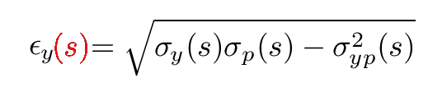
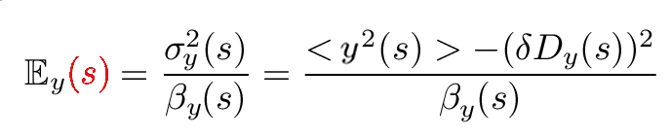
Vertical emittances in the presence of coupling
Eigen-emittance E: still constant along the ring, but Ev≠0
Non measurable projected s-dependent RMS emittance:
Measurable apparent s-dependent emittance from RMS beam size:

Slide 21
Vertical emittances in the presence of coupling
Eigen-emittance E: still constant along the ring, but Ev≠0
Non measurable projected s-dependent RMS emittance:
Measurable apparent s-dependent emittance from RMS beam size:
Ev=const ≠ εy(s) ≠ Ey(s)

Slide 22
Vertical emittances in the presence of coupling
Coupling sources (tilted quads, misaligned sextupoles, ID error fields, etc.) generate skew quad fields J₁(s)

Slide 23
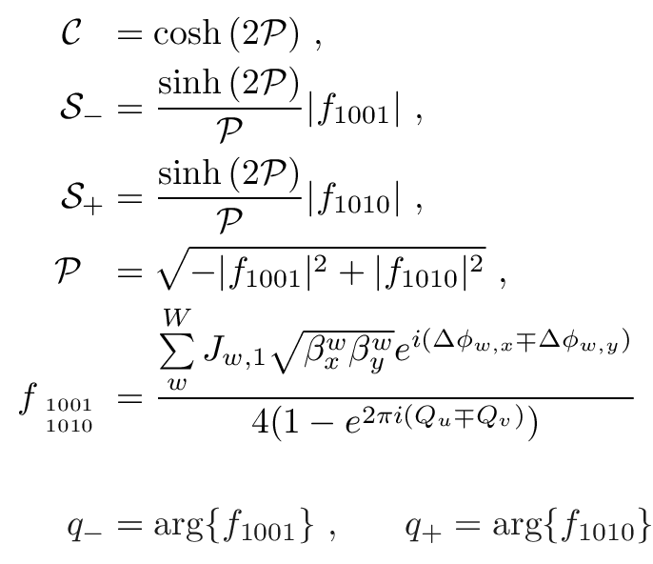
Vertical emittances in the presence of coupling
Coupling sources (tilted quads, misaligned sextupoles, ID error fields, etc.) generate skew quad fields J₁(s)

Slide 24
Vertical emittances in the presence of coupling
Coupling sources (tilted quads, misaligned sextupoles, ID error fields, etc.) generate skew quad fields J₁(s)
J₁(s) generate two Resonance Driving Terms (RDTs) f(s)
f_{a}=M_{ab}(β,φ) J_{b,1}
Linear dependence!

Slide 25
Vertical emittances in the presence of coupling
Coupling sources (tilted quads, misaligned sextupoles, ID error fields, etc.) generate skew quad fields J₁(s)
J₁(s) generate two Resonance Driving Terms (RDTs) f(s)
f_{a}=M_{ab}(β,φ) J_{b,1}
Linear dependence!

Slide 26
Vertical emittances in the presence of coupling
Coupling sources (tilted quads, misaligned sextupoles, ID error fields, etc.) generate skew quad fields J₁(s)
J₁(s) generate two Resonance Driving Terms (RDTs) f(s)
f_{a}=M_{ab}(β,φ) J_{b,1}
Linear dependence!

Slide 27
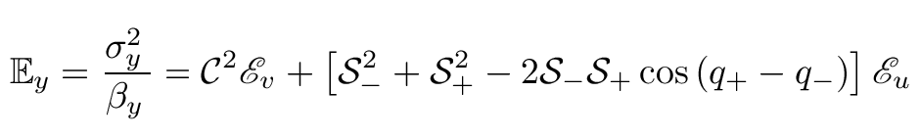
Vertical emittances in the presence of coupling
Non measurable projected s-dependent emittance
Measurable apparent s-dependent emittance

Slide 28
Vertical emittances in the presence of coupling
Non measurable projected s-dependent emittance
Measurable apparent s-dependent emittance
Nonlinear dependence on the RDTs and J₁

Slide 29
Vertical emittances in the presence of coupling
Non measurable projected s-dependent emittance
Measurable apparent s-dependent emittance
Vert. Eigen-emittance Hor. Eigen-emittance

Slide 30
Vertical emittances in the presence of coupling
Non measurable projected s-dependent emittance
Measurable apparent s-dependent emittance
If |f₁₀₁₀| ~ |f₁₀₀₁| ( i.e. S₊ ~ S₋) [low-emitt. rings] εy(s) ≠ Ey(s)

Slide 31
Vertical emittances in the presence of coupling
Non measurable projected s-dependent emittance
Measurable apparent s-dependent emittance
If |f₁₀₁₀|<<|f₁₀₀₁| ( i.e. S₊<< S₋) [hadron rings] εy(s) = Ey(s)

Slide 32
Vertical emittances in the presence of coupling
Non measurable projected s-dependent emittance
Measurable apparent s-dependent emittance
In absence of coupling C=1, S₋=S₊=0 and Ey=Ev=εy=const

Slide 33
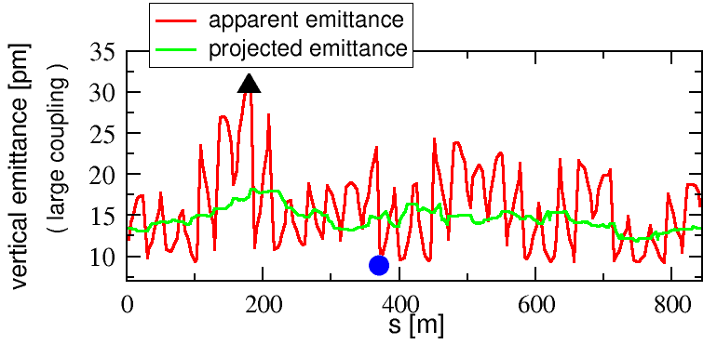
Vertical emittances in the presence of coupling
Measurable apparent emittance:
Non measurable projected emittance:
Ev= 9 pm
Lattice errors from Orbit Response Matrix measurement + Accel. Toolbox

Slide 34
Vertical emittances in the presence of coupling
Measurable apparent emittance:
Non measurable projected emittance:
Ev= 9 pm
100% overestimation
40% underestimation

Slide 35
Vertical emittances in the presence of coupling
Measurable apparent emittance:
Non measurable projected emittance:
Ev= 9 pm
100% overestimation
40% underestimation
300% overestimation Ey(apparent) Vs Ev (equilibrium)

Slide 36
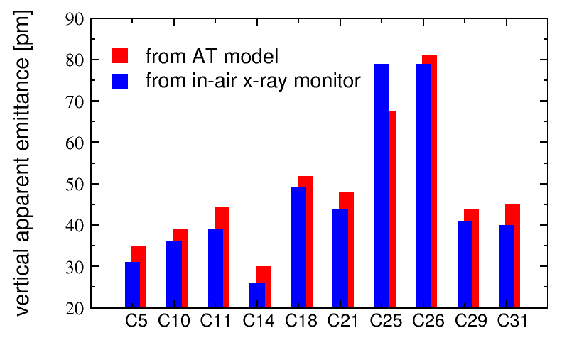
Vertical emittances in the presence of coupling
Measurable apparent emittance:
Non measurable projected emittance:
Ev= 9 pm
100% overestimation
40% underestimation
300% overestimation Ey(apparent) Vs Ev (equilibrium)

Slide 37
Vertical emittances in the presence of coupling
Measurable apparent emittance:
Non measurable projected emittance:
Which “vertical emittance” shall we choose, then?
Ev= 9 pm
100% overestimation
40% underestimation
300% overestimation Ey(apparent) Vs Ev (equilibrium)

Slide 38
Vertical emittances in the presence of coupling
Measurable apparent emittance:
Non measurable projected emittance:
< >
Average over the ring
< >
Ev= 9 pm

Slide 39
Vertical emittances in the presence of coupling
Measurable apparent emittance:
Non measurable projected emittance:
< >
Average over the ring
< >
Ev= 9 pm

Slide 40
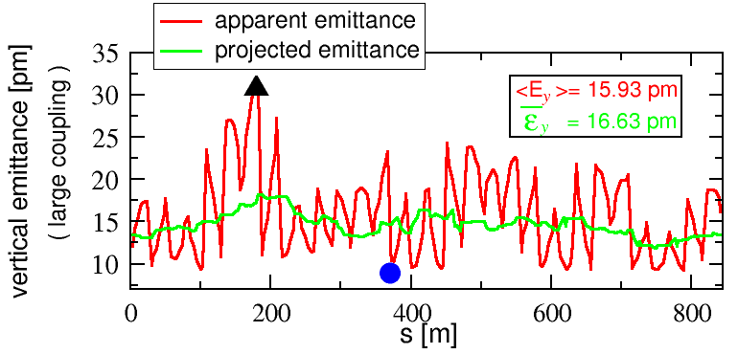
Vertical emittances in the presence of coupling
Measurable apparent emittance:
Non measurable projected emittance:
< >
Average over the ring
< >
Ev= 9 pm

Slide 41
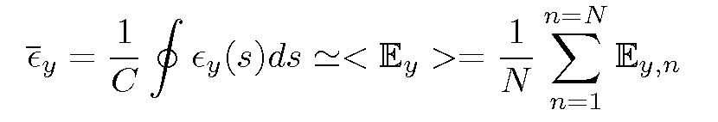
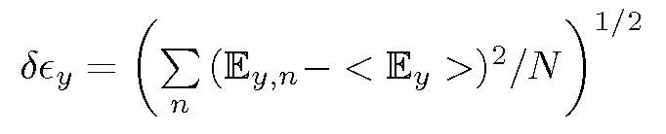
Vertical emittances in the presence of coupling
Measurable apparent emittance:
Non measurable projected emittance:
< >
Average over the ring
< >
Ev= 9 pm
Definition of vertical emittance @ ESRF:
More details in PRSTAB-14-012804 (2011)

Slide 42
Outlines
Vertical emittances in the presence of coupling
Coupling correction via Resonance Driving Terms
2010: Application in the ESRF storage ring
2010: Preserving small vertical emittance during beam delivery
2011: Towards ultra-small vertical emittance
PS: Indirect measurements of vertical emittance

Slide 43
Vertical emittance reduction in the storage ring
Coupling (x-y & y-δ) correction @ ESRF SR is carried out with independent skew quadrupoles (V=J₁xy) distributed along the machine.

Slide 44
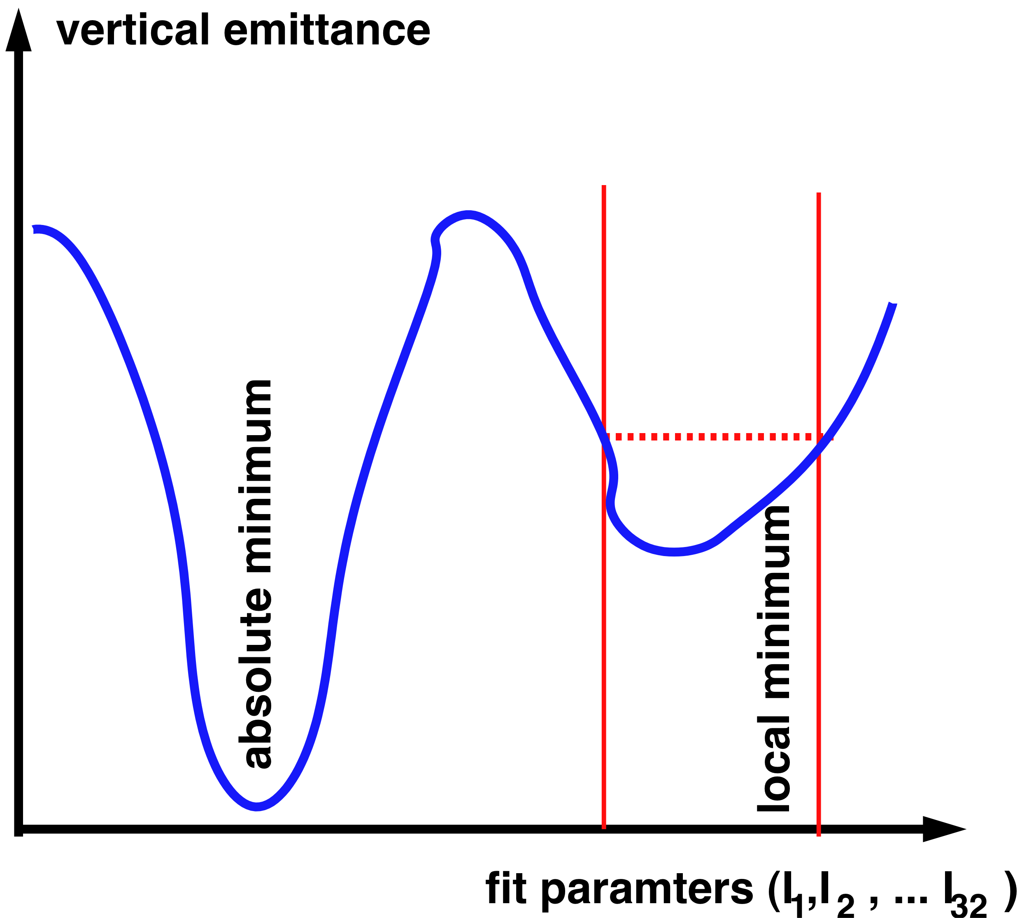
Vertical emittance reduction in the storage ring
Coupling (x-y & y-δ) correction @ ESRF SR is carried out with independent skew quadrupoles (V=J₁xy) distributed along the machine.
Until 2009 their currents were computed by trying to minimize the apparent vertical emittance along the machine ➔ non-linear fitting
- time consuming
- may get stuck into a
local minimum value
Details and formulas in PRSTAB-14-012804 (2011)

Slide 45
Vertical emittance reduction in the storage ring
Coupling (x-y & y-δ) correction @ ESRF SR is carried out with independent skew quadrupoles (V=J₁xy) distributed along the machine.
As of 2010 their currents are computed by trying to minimize other quantities: Resonance Driving Terms, obtained from orbit measurements (for x-y) and vert. disp. (for y-δ). This automatically minimizes vertical emittance ➔ linear fitting
- faster
- gets directly to absolute minimum value
Details and formulas in PRSTAB-14-012804 (2011)

Slide 46
Coupling correction via Resonance Driving Terms
The lower the vertical dispersion and the coupling RDTs, the smaller the vertical emittances
Procedure [already independently developed by R. Tomas (for ALBA)]:
Build an error lattice model (quad tilts, etc. from Orbit Response Matrix or turn-by-turn BPM data) => RDTs and Dy
F = (a₁*f₁₀₀₁, a₁*f₁₀₁₀, a₂*Dy) , a₁+a₂=1
Evaluate response matrix of the available skew correctors M
Find via SVD a corrector setting J that minimizes both RDTs and Dy
J =-M F to be pseudo-inverted
➔
➔
➔
➔

Slide 47
Coupling correction via Resonance Driving Terms
Procedure [already independently developed by R. Tomas (for ALBA)]:
Build an error lattice model (quad tilts, etc. from Orbit Response Matrix or turn-by-turn BPM data) => RDTs and Dy
F = (a₁*f₁₀₀₁, a₁*f₁₀₁₀, a₂*Dy) , a₁+a₂=1
Evaluate response matrix of the available skew correctors M
Find via SVD a corrector setting J that minimizes both RDTs and Dy
J =-M F to be pseudo-inverted
➔
➔
➔
➔

Slide 48
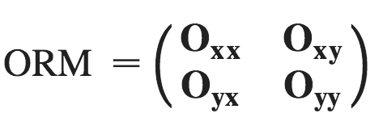
Coupling correction via Resonance Driving Terms
Orbit Response Matrix at 224 BPMs after exciting 16x2 steerers (H,V)
Build an error lattice model (quad tilts, etc. from Orbit Response Matrix or turn-by-turn BPM data) => RDTs and Dy
F = (a₁*f₁₀₀₁, a₁*f₁₀₁₀, a₂*Dy) , a₁+a₂=1
Evaluate response matrix of the available skew correctors M
Find via SVD a corrector setting J that minimizes both RDTs and Dy
J =-M F to be pseudo-inverted
➔
➔
➔
➔

Slide 49
Coupling correction via Resonance Driving Terms
Fitting measured diagonal blocks from ideal ORM => focusing errors ΔK₁ .
Build an error lattice model (quad tilts, etc. from Orbit Response Matrix or turn-by-turn BPM data) => RDTs and Dy
F = (a₁*f₁₀₀₁, a₁*f₁₀₁₀, a₂*Dy) , a₁+a₂=1
Evaluate response matrix of the available skew correctors M
Find via SVD a corrector setting J that minimizes both RDTs and Dy
J =-M F to be pseudo-inverted
➔
➔
➔
➔

Slide 50
Coupling correction via Resonance Driving Terms
Fitting measured off-diagonal blocks from ideal ORM => effective quadrupole tilts θ (accounting for sextupole ver. misalignments )
Build an error lattice model (quad tilts, etc. from Orbit Response Matrix or turn-by-turn BPM data) => RDTs and Dy
F = (a₁*f₁₀₀₁, a₁*f₁₀₁₀, a₂*Dy) , a₁+a₂=1
Evaluate response matrix of the available skew correctors M
Find via SVD a corrector setting J that minimizes both RDTs and Dy
J =-M F to be pseudo-inverted
➔
➔
➔
➔

Slide 51

Coupling correction via Resonance Driving Terms
Fitting measured off-diagonal blocks from ideal ORM => effective quadrupole tilts θ (accounting for sextupole ver. misalignments )
Build an error lattice model (quad tilts, etc. from Orbit Response Matrix or turn-by-turn BPM data) => RDTs and Dy
F = (a₁*f₁₀₀₁, a₁*f₁₀₁₀, a₂*Dy) , a₁+a₂=1
Evaluate response matrix of the available skew correctors M
Find via SVD a corrector setting J that minimizes both RDTs and Dy
J =-M F to be pseudo-inverted
➔
➔
➔
➔

Slide 52
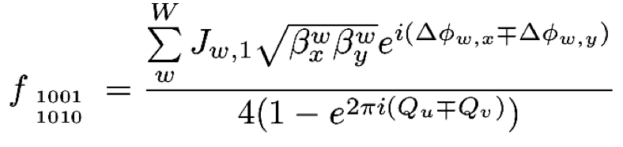
Coupling correction via Resonance Driving Terms
Fitting measured off-diagonal blocks from ideal ORM => effective quadrupole tilts θ (accounting for sextupole ver. misalignments )
Build an error lattice model (quad tilts, etc. from Orbit Response Matrix or turn-by-turn BPM data) => RDTs and Dy
F = (a₁*f₁₀₀₁, a₁*f₁₀₁₀, a₂*Dy) , a₁+a₂=1
Evaluate response matrix of the available skew correctors M
Find via SVD a corrector setting J that minimizes both RDTs and Dy
J =-M F to be pseudo-inverted
➔
➔
➔
➔

Slide 53
Coupling correction via Resonance Driving Terms
Fitting measured off-diagonal blocks from ideal ORM => effective quadrupole tilts θ (accounting for sextupole ver. misalignments )
Build an error lattice model (quad tilts, etc. from Orbit Response Matrix or turn-by-turn BPM data) => RDTs and Dy
F = (a₁*f₁₀₀₁, a₁*f₁₀₁₀, a₂*Dy) , a₁+a₂=1
Evaluate response matrix of the available skew correctors M
Find via SVD a corrector setting J that minimizes both RDTs and Dy
J =-M F to be pseudo-inverted
➔
➔
➔
➔

Slide 54
Coupling correction via Resonance Driving Terms
Vertical dispersion Dy is measured at all 224 BPMs
Build an error lattice model (quad tilts, etc. from Orbit Response Matrix or turn-by-turn BPM data) => RDTs and Dy
F = (a₁*f₁₀₀₁, a₁*f₁₀₁₀, a₂*Dy) , a₁+a₂=1
Evaluate response matrix of the available skew correctors M
Find via SVD a corrector setting J that minimizes both RDTs and Dy
J =-M F to be pseudo-inverted
➔
➔
➔
➔

Slide 55
Coupling correction via Resonance Driving Terms
Build an error lattice model (quad tilts, etc. from Orbit Response Matrix or turn-by-turn BPM data) => RDTs and Dy
F = (a₁*f₁₀₀₁, a₁*f₁₀₁₀, a₂*Dy) , a₁+a₂=1
Evaluate response matrix of the available skew correctors M
Find via SVD a corrector setting J that minimizes both RDTs and Dy
J =-M F to be pseudo-inverted
➔
➔
➔
➔

Slide 56
Coupling correction via Resonance Driving Terms
Build an error lattice model (quad tilts, etc. from Orbit Response Matrix or turn-by-turn BPM data) => RDTs and Dy
F = (a₁*f₁₀₀₁, a₁*f₁₀₁₀, a₂*Dy) , a₁+a₂=1
Evaluate response matrix of the available skew correctors M
Find via SVD a corrector setting J that minimizes both RDTs and Dy
J =-M F to be pseudo-inverted
➔
➔
➔
➔

Slide 57
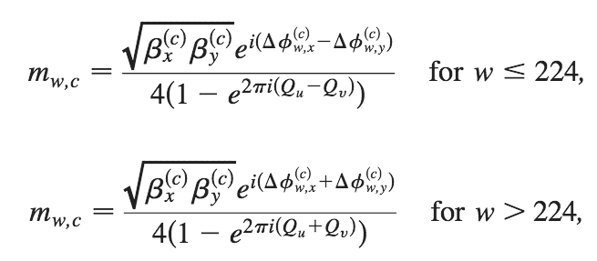
Coupling correction via Resonance Driving Terms
Build an error lattice model (quad tilts, etc. from Orbit Response Matrix or turn-by-turn BPM data) => RDTs and Dy
F = (a₁*f₁₀₀₁, a₁*f₁₀₁₀, a₂*Dy) , a₁+a₂=1
Evaluate response matrix of the available skew correctors M
Find via SVD a corrector setting J that minimizes both RDTs and Dy
J =-M F to be pseudo-inverted
➔
➔
➔
➔

Slide 58
Coupling correction via Resonance Driving Terms
From MADX or AT
Build an error lattice model (quad tilts, etc. from Orbit Response Matrix or turn-by-turn BPM data) => RDTs and Dy
F = (a₁*f₁₀₀₁, a₁*f₁₀₁₀, a₂*Dy) , a₁+a₂=1
Evaluate response matrix of the available skew correctors M
Find via SVD a corrector setting J that minimizes both RDTs and Dy
J =-M F to be pseudo-inverted
➔
➔
➔
➔

Slide 59
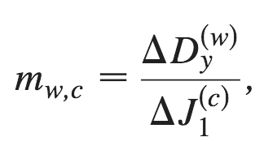
Coupling correction via Resonance Driving Terms
From MADX or AT
From MADX or AT
Build an error lattice model (quad tilts, etc. from Orbit Response Matrix or turn-by-turn BPM data) => RDTs and Dy
F = (a₁*f₁₀₀₁, a₁*f₁₀₁₀, a₂*Dy) , a₁+a₂=1
Evaluate response matrix of the available skew correctors M
Find via SVD a corrector setting J that minimizes both RDTs and Dy
J =-M F to be pseudo-inverted
➔
➔
➔
➔

Slide 60
Coupling correction via Resonance Driving Terms
Build an error lattice model (quad tilts, etc. from Orbit Response Matrix or turn-by-turn BPM data) => RDTs and Dy
F = (a₁*f₁₀₀₁, a₁*f₁₀₁₀, a₂*Dy) , a₁+a₂=1
Evaluate response matrix of the available skew correctors M
Find via SVD a corrector setting J that minimizes both RDTs and Dy
J =-M F to be pseudo-inverted
➔
➔
➔
➔

Slide 61
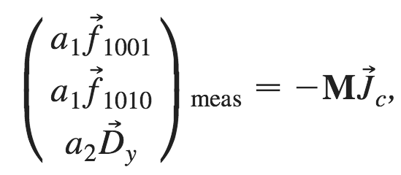
Coupling correction via Resonance Driving Terms
a₂=0.7 (2010) , 0.4 (2011)
a₁+a₂=1
Different weights on f₁₀₀₁ and f₁₀₁₀ tried, best if equal.
Build an error lattice model (quad tilts, etc. from Orbit Response Matrix or turn-by-turn BPM data) => RDTs and Dy
F = (a₁*f₁₀₀₁, a₁*f₁₀₁₀, a₂*Dy) , a₁+a₂=1
Evaluate response matrix of the available skew correctors M
Find via SVD a corrector setting J that minimizes both RDTs and Dy
J =-M F to be pseudo-inverted
➔
➔
➔
➔

Slide 62
Outlines
Vertical emittances in the presence of coupling
Coupling correction via Resonance Driving Terms
2010: Application in the ESRF storage ring
2010: Preserving small vertical emittance during beam delivery
2011: Towards ultra-small vertical emittance
PS: Indirect measurements of vertical emittance

Slide 63
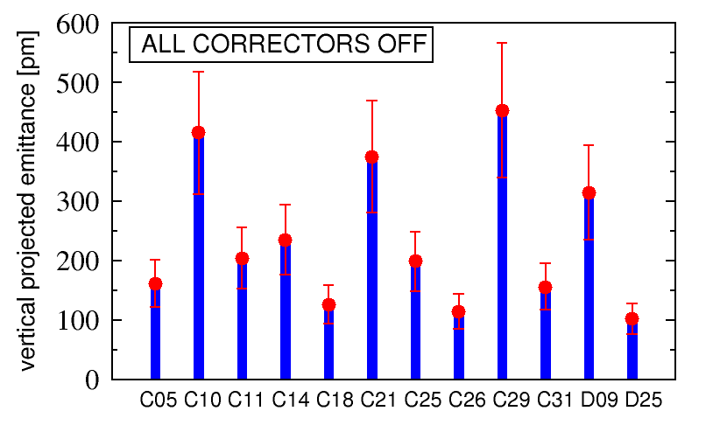
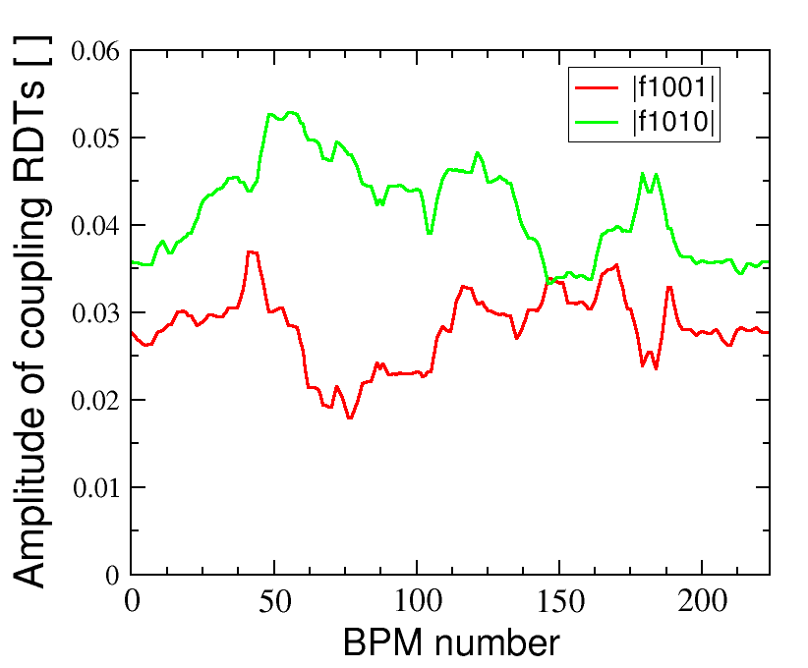
2010: Application in the ESRF storage ring
First RDT correction: January 16th 2010
All skew correctors OFF: ε_{y} ±δε_{y} = 237 ± 122 pm

Slide 64
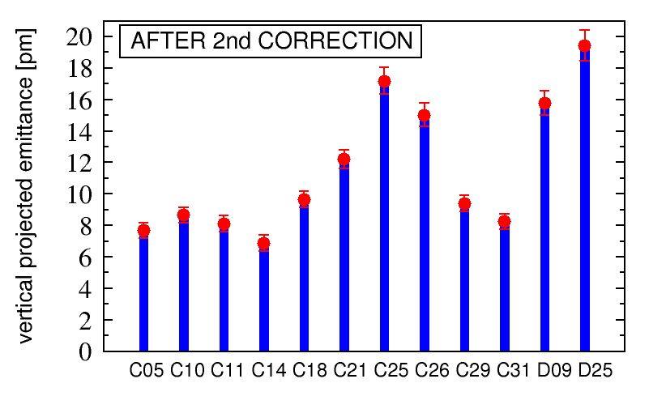
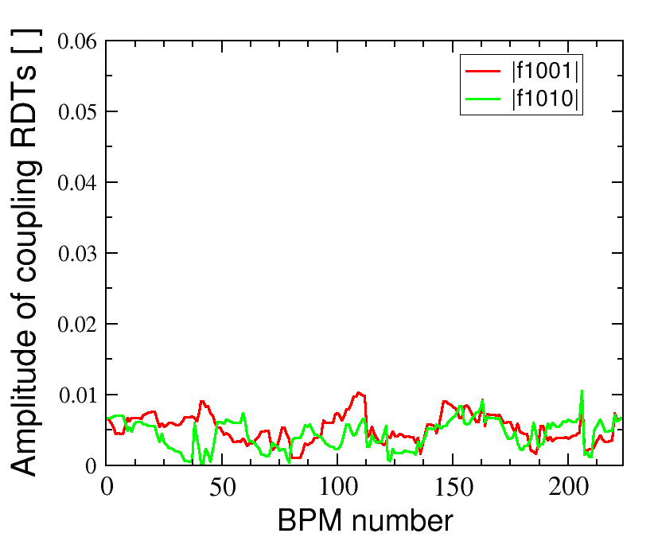
2010: Application in the ESRF storage ring
First RDT correction: January 16th 2010
After ORM measur. and RDT correction: ε_{y} ±δε_{y} = 11.5 ± 4.3 pm
~20 min. for ORM
a few seconds for RDT correction

Slide 65
2010: Application in the ESRF storage ring
First RDT correction: January 16th 2010
After ORM measur. and RDT correction: ε_{y} ±δε_{y} = 11.5 ± 4.3 pm
|f₁₀₁₀| ~ |f₁₀₀₁| ( i.e. S₊ ~ S₋) =>
sum resonance may not be neglected
~20 min. for ORM
a few seconds for RDT correction

Slide 66
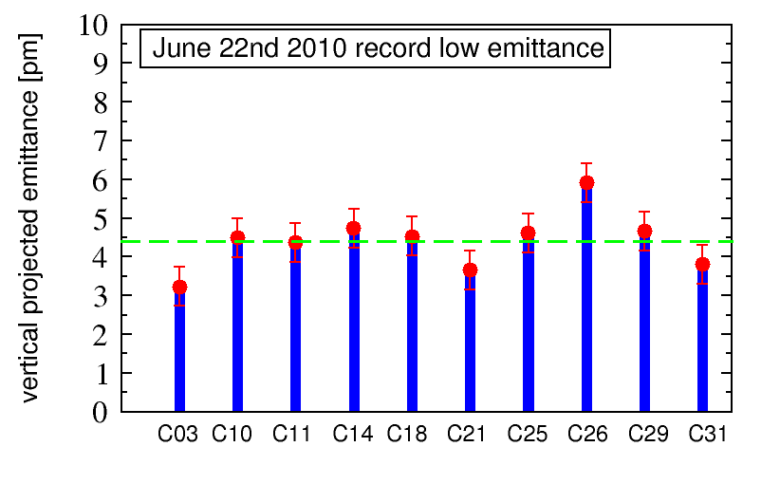
2010: Application in the ESRF storage ring
ESRF 2010 temporary record-low vertical emittance: June 22nd
At ID gaps open: ε_{y} ±δε_{y} = 4.4 ± 0.7 pm

Slide 67
Outlines
Vertical emittances in the presence of coupling
Coupling correction via Resonance Driving Terms
2010: Application in the ESRF storage ring
2010: Preserving small vertical emittance during beam delivery
2011: Towards ultra-small vertical emittance
PS: Indirect measurements of vertical emittance

Slide 68
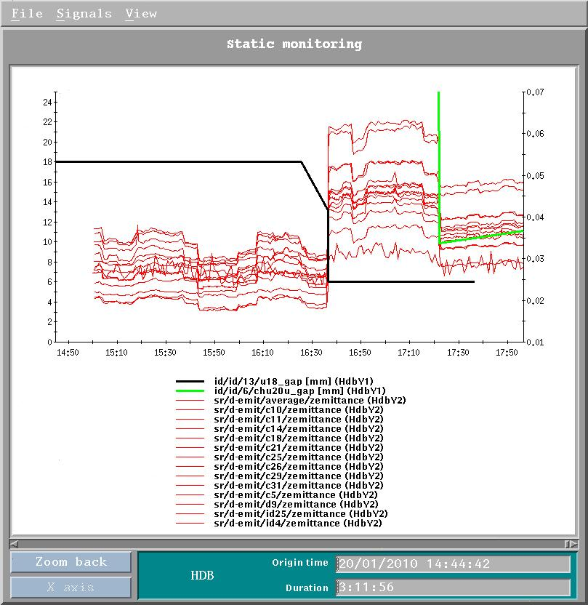
2010: Preserving vertical emittance during beam delivery
Low coupling may not be preserved during beam delivery because of continuous changes of ID gaps that vary coupling along the ring
Apparent emittance measured at 13 monitors (red) on Jan. 20th 2010, during beam delivery and movements of two ID gaps (black & green)

Slide 69
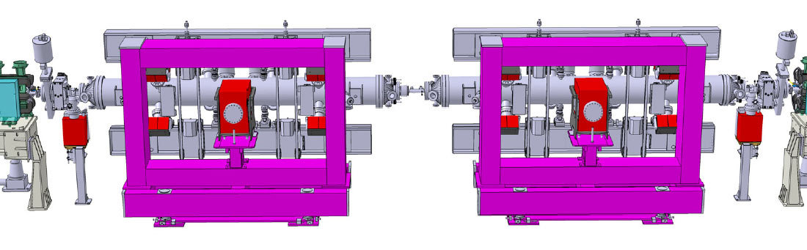
2010: Preserving vertical emittance during beam delivery
H-V steerers at the ends of an ID straight section were cabled so as to provide skew quad fields.
Look-up tables (corrector currents Vs ID gap aperture) were defined so as to preserve the vertical emittance at any gap value.

Slide 70
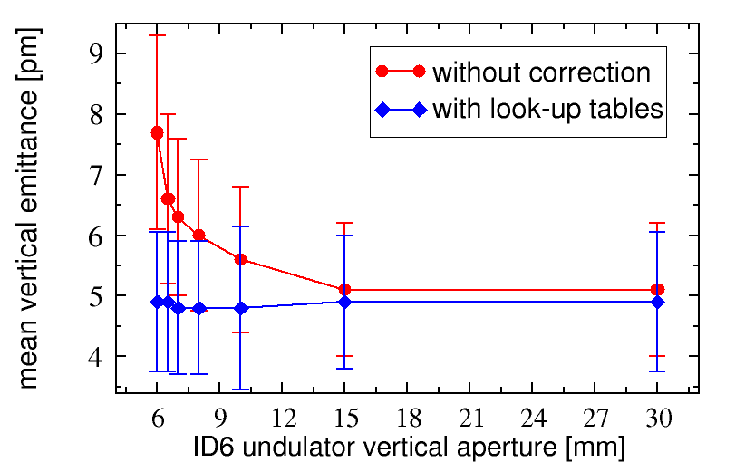
2010: Preserving vertical emittance during beam delivery
H-V steerers at the ends of an ID straight section were cabled so as to provide skew quad fields.
Look-up tables (corrector currents Vs ID gap aperture) were defined so as to preserve the vertical emittance at any gap value.

Slide 71
2010: Preserving vertical emittance during beam delivery
This scheme is being implemented on other IDs
H-V steerers at the ends of an ID straight section were cabled so as to provide skew quad fields.
Look-up tables (corrector currents Vs ID gap aperture) were defined so as to preserve the vertical emittance at any gap value.

Slide 72
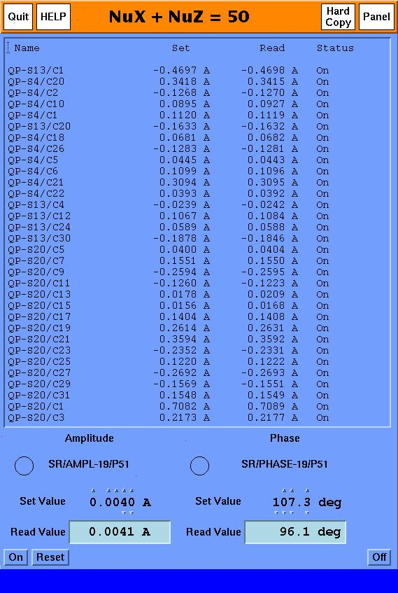

2010: Preserving vertical emittance during beam delivery
Coupling may be represented by two complex vectors (for the sum and difference resonances respectively) C±=|A±|e^{iφ±} .
In the ESRF storage ring, on top of the RDT static correction, C± may be dynamically varied in order to catch up coupling variations induced by ID gap movements.
A new software automatically minimizes C± by looking at the average vertical emittance
32 corrector skew quads

Slide 73
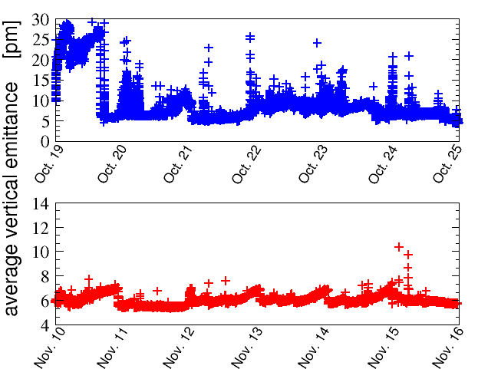
2010: Preserving vertical emittance during beam delivery
Coupling may be represented by two complex vectors (for the sum and difference resonances respectively) C±=|A±|e^{iφ±} .
In the ESRF storage ring, on top of the RDT static correction, C± may be dynamically varied in order to catch up coupling variations induced by ID gap movements.
A new software automatically minimizes C± by looking at the average vertical emittance
C± loop OFF, manual correction
32 corrector skew quads
C± loop ON, automatic hourly correction

Slide 74
Outlines
Vertical emittances in the presence of coupling
Coupling correction via Resonance Driving Terms
2010: Application in the ESRF storage ring
2010: Preserving small vertical emittance during beam delivery
2011: Towards ultra-small vertical emittance
PS: Indirect measurements of vertical emittance

Slide 75
2011: Towards ultra-small vertical emittance
2010, with 32 skew quad correctors

Slide 76
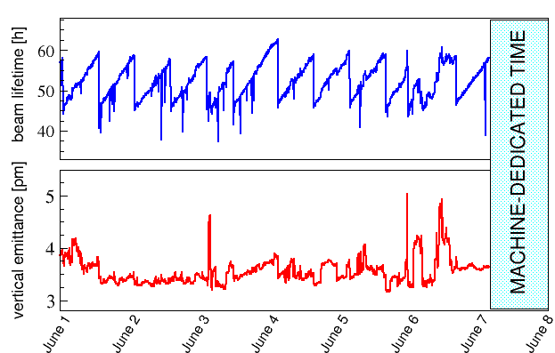
2011: Towards ultra-small vertical emittance
2011, with 64 skew quad correctors

Slide 77
Conclusion
The Resonance Driving Terms (RDT) formalism helps to clarify the various definitions of “vertical emittance” in the presence of coupling and allows a straightforward linear correction algorithm.

Slide 78
Conclusion
The Resonance Driving Terms (RDT) formalism helps to clarify the various definitions of “vertical emittance” in the presence of coupling and allows a straightforward linear correction algorithm.
Applications in the ESRF storage ring led to vertical emittance of ε_{y} = 2.6 ± 1.1 pm, a record low for this machine (ε_{x}=4.2 nm => ε_{y}/ε_{x}≈ 0.06%, a factor 10 lower than in the past).

Slide 79
Conclusion
The Resonance Driving Terms (RDT) formalism helps to clarify the various definitions of “vertical emittance” in the presence of coupling and allows a straightforward linear correction algorithm.
Applications in the ESRF storage ring led to vertical emittance of ε_{y} = 2.6 ± 1.1 pm, a record low for this machine (ε_{x}=4.2 nm => ε_{y}/ε_{x}≈ 0.06%, a factor 10 lower than in the past).
Two procedures to preserve small vertical emittance during beam delivery were successfully tested: as of spring 2011 stable ε_{y} = 3.2-4.5 pm delivered to users (lifetime of 45 hours after refilling @ 200 mA, 10 hours less than in the past only).

Slide 80
Conclusion
The Resonance Driving Terms (RDT) formalism helps to clarify the various definitions of “vertical emittance” in the presence of coupling and allows a straightforward linear correction algorithm.
Applications in the ESRF storage ring led to vertical emittance of ε_{y} = 2.6 ± 1.1 pm, a record low for this machine (ε_{x}=4.2 nm => ε_{y}/ε_{x}≈ 0.06%, a factor 10 lower than in the past).
Two procedures to preserve small vertical emittance during beam delivery were successfully tested: as of spring 2011 stable ε_{y} = 3.2-4.5 pm delivered to users (lifetime of 45 hours after refilling @ 200 mA, 10 hours less than in the past only).
Final goal: to deliver a beam of ε_{y} = 2 pm.

Slide 81
Outlines
Vertical emittances in the presence of coupling
Coupling correction via Resonance Driving Terms
2010: Application in the ESRF storage ring
2010: Preserving small vertical emittance during beam delivery
2011: Towards ultra-small vertical emittance
PS: Indirect measurements of vertical emittance

Slide 82
The coupling sum resonance
Lepton machine => low hor. emittance => hor. focusing stronger than vertical => Qx >> Qy (@ ESRF Qx=36.44 , Qy=13.39 , Qx-Qy=23.05 )
Low-emitt. Rings: |f₁₀₁₀| ~ |f₁₀₀₁| ( i.e. S₊ ~ S₋ )=> |C⁺|~|C⁻ |

Slide 83
The coupling sum resonance
Lepton machine => low hor. emittance => hor. focusing stronger than vertical => Qx >> Qy (@ ESRF Qx=36.44 , Qy=13.39 , Qx-Qy=23.05 )
Hadron machine => almost “round” beam (Ex~Ey) => similar hor. & ver. focusing => Qx ~ Qy (like the CERN SPS Qx=26.18 , Qy=26.22 , Qx-Qy=-0.04 )
Low-emitt. Rings: |f₁₀₁₀| ~ |f₁₀₀₁| ( i.e. S₊ ~ S₋ )=> |C⁺|~|C⁻ |
Hadron Rings: |f₁₀₁₀| << |f₁₀₀₁| ( i.e. S₊ << S₋ )=> |C⁺|<<|C⁻ |

Slide 84
The coupling sum resonance
Lepton machine => low hor. emittance => hor. focusing stronger than vertical => Qx >> Qy (@ ESRF Qx=36.44 , Qy=13.39 , Qx-Qy=23.05 )
Hadron machine => almost “round” beam (Ex~Ey) => similar hor. & ver. focusing => Qx ~ Qy (like the CERN SPS Qx=26.18 , Qy=26.22 , Qx-Qy=-0.04 )
WHY?
Low-emitt. Rings: |f₁₀₁₀| ~ |f₁₀₀₁| ( i.e. S₊ ~ S₋ )=> |C⁺|~|C⁻ |
Hadron Rings: |f₁₀₁₀| << |f₁₀₀₁| ( i.e. S₊ << S₋ )=> |C⁺|<<|C⁻ |

Slide 85
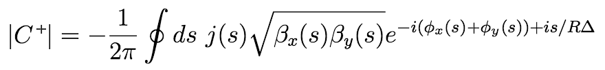

The coupling sum resonance

Slide 86
The coupling sum resonance

Slide 87
The coupling sum resonance

Slide 88
The coupling sum resonance
Σϕ
Δϕ

Slide 89
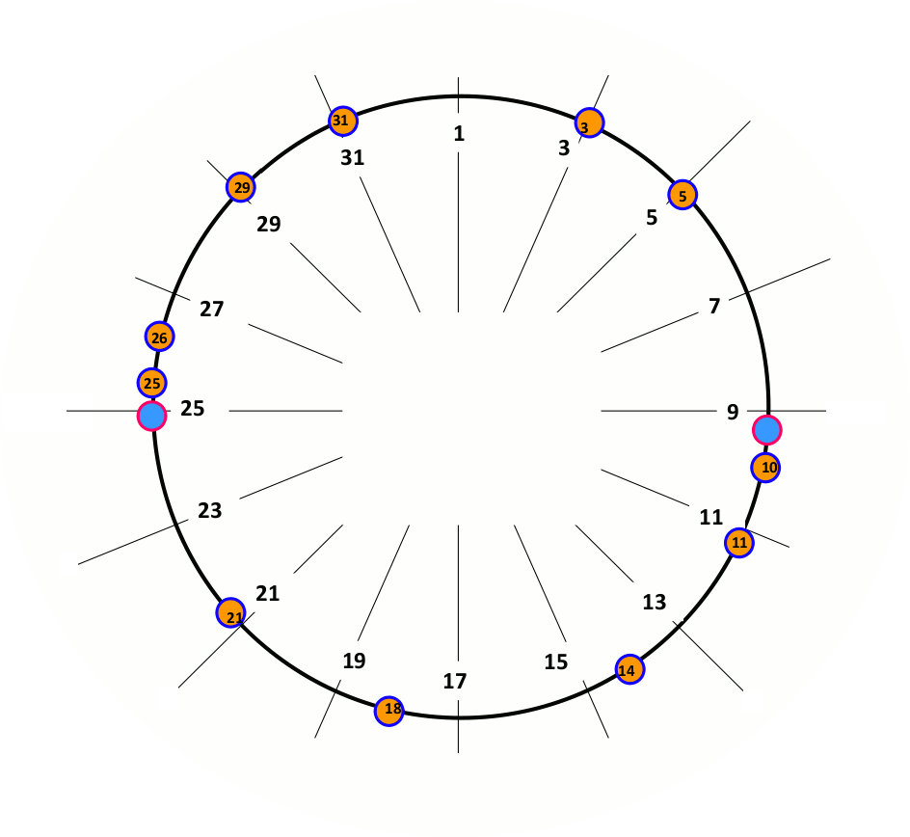
Low-emittance rings [Q_{x}>Q_{y}]
Q_{x}=20.44
ΣQ=30.76
ΔQ=10.12
Q_{y}=10.32
Σϕ=26.91
Δϕ= 8.85
ϕ_{x}=17.88
ϕ_{x}=2.55
Σϕ=3.84
Δϕ=1.26
ϕ_{y}=9.03
ϕ_{y}=1.29
Σϕ=23.07
Δϕ= 7.49
ϕ_{x}=15.33
ϕ_{x}=5.11
Σϕ=7.69
Δϕ=2.53
ϕ_{y}=7.74
ϕ_{y}=2.58
Σϕ=19.22
Δϕ= 6.32
ϕ_{x}=12.77
ϕ_{x}=7.66
Σϕ=11.53
Δϕ= 3.79
ϕ_{y}=6.45
ϕ_{y}=3.87
ϕ_{x}=10.22
Σϕ=15.38
Δϕ= 5.06
ϕ_{y}=5.16

Slide 90
Low-emittance rings [Q_{x}>Q_{y}]
Q_{x}=20.44
ΣQ=30.76
ΔQ=10.12
Q_{y}=10.32
Σϕ=26.91
Δϕ= 8.85
ϕ_{x}=17.88
ϕ_{x}=2.55
Σϕ=3.84
Δϕ=1.26
ϕ_{y}=9.03
ϕ_{y}=1.29
Σϕ=23.07
Δϕ= 7.49
ϕ_{x}=15.33
ϕ_{x}=5.11
Σϕ=7.69
Δϕ=2.53
ϕ_{y}=7.74
ϕ_{y}=2.58
Σϕ=19.22
Δϕ= 6.32
ϕ_{x}=12.77
ϕ_{x}=7.66
Σϕ=11.53
Δϕ= 3.79
ϕ_{y}=6.45
ϕ_{y}=3.87
ϕ_{x}=10.22
Σϕ=15.38
Δϕ= 5.06
ϕ_{y}=5.16

Slide 91
Low-emittance rings [Q_{x}>Q_{y}]
Q_{x}=20.44
ΣQ=30.76
ΔQ=10.12
Q_{y}=10.32
Σϕ
ϕ_{y}=7.74
ϕ_{y}=2.58
Δϕ

Slide 92
Low-emittance rings [Q_{x}>Q_{y}]
Q_{x}=20.44
ΣQ=30.76
ΔQ=10.12
Q_{y}=10.32
The same for both
Σϕ
ϕ_{y}=7.74
ϕ_{y}=2.58
Δϕ

Slide 93
Low-emittance rings [Q_{x}>Q_{y}]
Q_{x}=20.44
ΣQ=30.76
ΔQ=10.12
Q_{y}=10.32
The same for both
Σϕ
ϕ_{y}=7.74
ϕ_{y}=2.58
Δϕ
The sum Σ-term oscillates 3 times faster than difference Δ-term, only

Slide 94
Low-emittance rings [Q_{x}>Q_{y}]
Q_{x}=20.44
ΣQ=30.76
ΔQ=10.12
Q_{y}=10.32
The same for both
Σϕ
ϕ_{y}=7.74
ϕ_{y}=2.58
Δϕ
The sum Σ-term oscillates 3 times faster than difference Δ-term, only
|C⁺|~|C⁻|

Slide 95
Hadron rings [Q_{x}~Q_{y}]
Q_{x}=26.18
ΣQ=52.40
ΔQ=-0.04
Q_{y}=26.22
Σϕ=45.75
Δϕ=-0.03
ϕ_{x}=22.89
ϕ_{x}=3.27
Σϕ= 6.55
Δϕ=-0.01
ϕ_{y}=22.86
ϕ_{y}=3.28
Σϕ=39.20
Δϕ=-0.03
ϕ_{x}=19.62
ϕ_{x}=6.55
Σϕ=13.10
Δϕ=-0.01
ϕ_{y}=19.58
ϕ_{y}=6.56
Σϕ=32.75
Δϕ=-0.03
ϕ_{x}=16.36
ϕ_{x}=9.82
Σϕ=19.66
Δϕ=-0.02
ϕ_{y}=16.39
ϕ_{y}=9.84
ϕ_{x}=13.09
Σϕ=26.20
Δϕ=-0.02
ϕ_{y}=13.11

Slide 96
Hadron rings [Q_{x}~Q_{y}]
Q_{x}=26.18
ΣQ=52.40
ΔQ=-0.04
Q_{y}=26.22
Σϕ=45.75
Δϕ=-0.03
ϕ_{x}=22.89
ϕ_{x}=3.27
Σϕ= 6.55
Δϕ=-0.01
ϕ_{y}=22.86
ϕ_{y}=3.28
Σϕ=39.20
Δϕ=-0.03
ϕ_{x}=19.62
ϕ_{x}=6.55
Σϕ=13.10
Δϕ=-0.01
ϕ_{y}=19.58
ϕ_{y}=6.56
Σϕ=32.75
Δϕ=-0.03
ϕ_{x}=16.36
ϕ_{x}=9.82
Σϕ=19.66
Δϕ=-0.02
ϕ_{y}=16.39
ϕ_{y}=9.84
ϕ_{x}=13.09
Σϕ=26.20
Δϕ=-0.02
ϕ_{y}=13.11

Slide 97
Hadron rings [Q_{x}~Q_{y}]
Q_{x}=26.18
ΣQ=52.40
ΔQ=-0.04
Q_{y}=26.22
The same for both
Σϕ
ϕ_{y}=7.74
ϕ_{y}=2.58
Δϕ
=1
The sum Σ-term oscillates 52 times, while the difference Δ-term does not
|C⁺|<<|C⁻|

Slide 98
Caution with Guignard’s formula
At very low coupling ε_{y} may be smaller than monitor/camera resolution and hence non measurable.

Slide 99
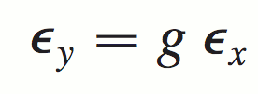
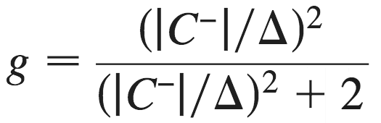
Caution with Guignard’s formula
At very low coupling ε_{y} may be smaller than monitor/camera resolution and hence non measurable.
One may be then tempted to use Guignard’s formula
The “large” ε_{x} easier to measure and “g” evaluated from tune measurements (closest tune approach). Δ = Qx-Qy (fractional part, |C⁻| is the difference resonance stop band.

Slide 100
Caution with Guignard’s formula
At very low coupling ε_{y} may be smaller than monitor/camera resolution and hence non measurable.
One may be then tempted to use Guignard’s formula
The “large” ε_{x} easier to measure and “g” evaluated from tune measurements (closest tune approach). Δ = Qx-Qy (fractional part, |C⁻| is the difference resonance stop band.
But the formula is only valid for:
  sum resonance negligible, i.e. |C⁻| >> |C⁺|
  Vert. dispersion Dy contribution to ε_{y} << betatron coupling contribution

Slide 101
Caution with Guignard’s formula
At very low coupling ε_{y} may be smaller than monitor/camera resolution and hence non measurable.
One may be then tempted to use Guignard’s formula
The “large” ε_{x} easier to measure and “g” evaluated from tune measurements (closest tune approach). Δ = Qx-Qy (fractional part, |C⁻| is the difference resonance stop band.
But the formula is only valid for:
  sum resonance negligible, i.e. |C⁻| << |C⁺|
  Vert. dispersion Dy contribution to ε_{y} > betatron coupling contribution
@ ESRF SR
9E-4
3E-3
0.94 pm
0.65 pm

Slide 102
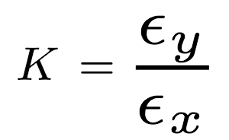
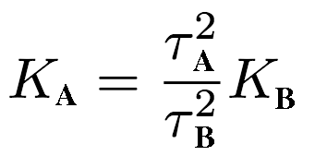
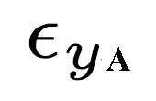
Caution with lifetime measurement (1)
At very low coupling ε_{y} may be smaller than monitor/camera resolution and hence non measurable.
One may use the reduction of the Touschek lifetime

Slide 103
Caution with lifetime measurement (1)
At very low coupling ε_{y} may be smaller than monitor/camera resolution and hence non measurable.
One may use the reduction of the Touschek lifetime
This approach is valid under the assumption that the lifetime reduction is exclusively induced by the Touschek effect.
However, the sum resonance ( |C⁺| ) is unstable and may account for lower-than-expected lifetime with larger ε_{y} , if inadvertently enhanced during coupling correction.

Slide 104
Caution with lifetime measurement (1)
At very low coupling ε_{y} may be smaller than monitor/camera resolution and hence non measurable.
One may use the reduction of the Touschek lifetime
This approach is valid under the assumption that the lifetime reduction is exclusively induced by the Touschek effect.
However, the sum resonance ( |C⁺| ) is unstable and may account for lower-than-expected lifetime with larger ε_{y} , if inadvertently enhanced during coupling correction.
At the ESRF, while trimming skews, it has been sometimes observed that:

Slide 105
Caution with lifetime measurement (1)
At very low coupling ε_{y} may be smaller than monitor/camera resolution and hence non measurable.
One may be then tempted to use Touschek-lifetime reduction
This approach is valid under the assumption that the lifetime reduction is exclusively induced by the Touschek effect.
However, the sum resonance ( |C⁺| ) is unstable and may account for lower-than-expected lifetime with larger ε_{y} , if inadvertently enhanced during coupling correction.
At the ESRF, while trimming skews, it has been sometimes observed that:
1. reducing |C⁻|, both Ey and lifetime decrease (stronger Touschek)

Slide 106
Caution with lifetime measurement (1)
At very low coupling ε_{y} may be smaller than monitor/camera resolution and hence non measurable.
One may be then tempted to use Touschek-lifetime reduction
This approach is valid under the assumption that the lifetime reduction is exclusively induced by the Touschek effect.
However, the sum resonance ( |C⁺| ) is unstable and may account for lower-than-expected lifetime with larger ε_{y} , if inadvertently enhanced during coupling correction.
At the ESRF, while trimming skews, it has been sometimes observed that:
1. reducing |C⁻|, both Ey and lifetime decrease (stronger Touschek)
2. increasing |C⁺|, Ey increases whereas lifetime decreases (sum resonance stronger than Touschek ?)

Slide 107
Caution with lifetime measurement (2)
At very low coupling ε_{y} may be smaller than monitor/camera resolution and hence non measurable.
One may infer the average ε_{y} via
Touschek-lifetime measurement.

Slide 108
Caution with lifetime measurement (2)
At very low coupling ε_{y} may be smaller than monitor/camera resolution and hence non measurable.
One may infer the average ε_{y} via
Touschek-lifetime measurement.
A depends on several RF-related parameters (bunch length, RF acceptance, dynamic aperture).

Slide 109
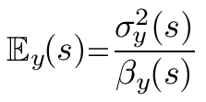
Caution with lifetime measurement (2)
At very low coupling ε_{y} may be smaller than monitor/camera resolution and hence non measurable.
One may infer the average ε_{y} via
Touschek-lifetime measurement.
A depends on several RF-related parameters (bunch length, RF acceptance, dynamic aperture).
The emittance in the formula shall be the apparent one, not the model eigen-emittance Ev

Slide 110
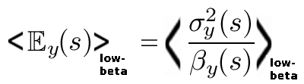
Caution with lifetime measurement (2)
At very low coupling ε_{y} may be smaller than monitor/camera resolution and hence non measurable.
One may infer the average ε_{y} via
Touschek-lifetime measurement.
A depends on several RF-related parameters (bunch length, RF acceptance, dynamic aperture) and β-functions
Actually, it shall be the apparent emittance averaged along the low-beta regions of the ring (those with the high scattering rate contributing the most the lifetime integral), not the model eigen-emittance Ev

Slide 111
Caution with lifetime measurement (2)
At very low coupling ε_{y} may be smaller than monitor/camera resolution and hence non measurable.
One may infer the average ε_{y} via
Touschek-lifetime measurement.
A depends on several RF-related parameters (bunch length, RF acceptance, dynamic aperture).
Actually it shall be the apparent emittance averaged along the low-beta regions of the ring (those with the high scattering rate contributing the most the lifetime integral) , not the model eigen-emittance Ev

Slide 112
Caution with lifetime measurement (2)
At very low coupling ε_{y} may be smaller than monitor/camera resolution and hence non measurable.
One may infer the average ε_{y} via
Touschek-lifetime measurement.
A depends on several RF-related parameters (bunch length, RF acceptance, dynamic aperture).
Actually, it shall be the apparent emittance averaged along the low-beta regions of the ring (those with the high scattering rate contributing the most the lifetime integral) , not the model eigen-emittance Ev
Eigen-emittance Ev= 9 pm [from the model]
Vs
Av. apparent emittance <E_{y}>=16 pm [measured]

Slide 113
Caution with lifetime measurement (2)
At very low coupling ε_{y} may be smaller than monitor/camera resolution and hence non measurable.
One may infer the average ε_{y} via
Touschek-lifetime measurement.
A depends on several RF-related parameters (bunch length, RF acceptance, dynamic aperture).
It actually shall be the apparent emittance averaged along the low-beta regions of the ring (those with the high scattering rate contributing the most the lifetime integral), not the model eigen-emittance Ev
Measured <Ey> not model eigen-emittance Ev !!

Slide 114
Caution with lifetime measurement (2)
At very low coupling ε_{y} may be smaller than monitor/camera resolution and hence non measurable.
One may infer the average ε_{y} via
Touschek-lifetime measurement.
A depends on several RF-related parameters (bunch length, RF acceptance, dynamic aperture).
It actually shall be the apparent emittance averaged along the low-beta regions of the ring (those with the high scattering rate contributing the most the lifetime integral), not the model eigen-emittance Ev
1/ Vacuum Lifetime

Slide 115
Caution with lifetime measurement (2)
At very low coupling ε_{y} may be smaller than monitor/camera resolution and hence non measurable.
One may infer the average ε_{y} via
Touschek-lifetime measurement.
A depends on several RF-related parameters (bunch length, RF acceptance, dynamic aperture).
It actually shall be the apparent emittance averaged along the low-beta regions of the ring (those with the high scattering rate contributing the most the lifetime integral), not the model eigen-emittance Ev
A inferred from lifetime
measurement at large
emittance (with white noise,
rather than with coupling) => no need of RF-related parameters

Slide 116
Caution with lifetime measurement (2)
At very low coupling ε_{y} may be smaller than monitor/camera resolution and hence non measurable.
Conditions | 200 mA m 7/8 no Single Bunch |  | 01-Feb-11
Measurements
 | Model eigen-emittance | [pm] | 2.4
 | Vert Emitt. <IAX> | [pm] | 4.2±1.2
 | Vert Emitt. ID25-b | [pm] | 3.64
 | Vert Emitt. ID25-XRL | [pm] | 3.75
 | Vert Emitt. D9-a | [pm] | 7.1
 | Total Lifetime | [h] | 51.5
Processing
 | Touschek Prolongated Vert Emitt | [pm] | 3.9
 | Vacuum Lifetime | [h] | 170
 | Touschek Lifetime | [h] | 74
Estimation
 | Total Lifetime @ 2pm | [h] | 40.4

Slide 117
Caution with lifetime measurement (2)
At very low coupling ε_{y} may be smaller than monitor/camera resolution and hence non measurable.
Conditions | 200 mA m 7/8 no Single Bunch |  | 01-Feb-11
Measurements
 | Model eigen-emittance | [pm] | 2.4
 | Vert Emitt. <IAX> | [pm] | 4.2±1.2
 | Vert Emitt. ID25-b | [pm] | 3.64
 | Vert Emitt. ID25-XRL | [pm] | 3.75
 | Vert Emitt. D9-a | [pm] | 7.1
 | Total Lifetime | [h] | 51.5
Processing
 | Touschek Prolongated Vert Emitt | [pm] | 3.9
 | Vacuum Lifetime | [h] | 170
 | Touschek Lifetime | [h] | 74
Estimation
 | Total Lifetime @ 2pm | [h] | 40.4
OK!

Slide 118
Caution with lifetime measurement (2)
At very low coupling ε_{y} may be smaller than monitor/camera resolution and hence non measurable.
Conditions | 200 mA m 7/8 no Single Bunch |  | 01-Feb-11
Measurements
 | Model eigen-emittance | [pm] | 2.4
 | Vert Emitt. <IAX> | [pm] | 4.2±1.2
 | Vert Emitt. ID25-b | [pm] | 3.64
 | Vert Emitt. ID25-XRL | [pm] | 3.75
 | Vert Emitt. D9-a | [pm] | 7.1
 | Total Lifetime | [h] | 51.5
Processing
 | Touschek Prolongated Vert Emitt | [pm] | 3.9
 | Vacuum Lifetime | [h] | 170
 | Touschek Lifetime | [h] | 74
Estimation
 | Total Lifetime @ 2pm | [h] | 40.4
NO!!

Slide 119
Caution with lifetime measurement (2)
At very low coupling ε_{y} may be smaller than monitor/camera resolution and hence non measurable.
Touschek lifetime measurement @ ESRF
Conditions | 200 mA m 7/8 no Single Bunch |  | 01-Feb-11
Measurements
 | Model eigen-emittance | [pm] | 2.4
 | Vert Emitt. <IAX> | [pm] | 4.2±1.2
 | Vert Emitt. ID25-b | [pm] | 3.64
 | Vert Emitt. ID25-XRL | [pm] | 3.75
 | Vert Emitt. D9-a | [pm] | 7.1
 | Total Lifetime | [h] | 51.5
Processing
 | Touschek Prolongated Vert Emitt | [pm] | 3.9
 | Vacuum Lifetime | [h] | 170
 | Touschek Lifetime | [h] | 74
Estimation
 | Total Lifetime @ 2pm | [h] | 40.4
large <Ey> with white noise
rather than with coupling to keep βx, βy & δEy constant
NO!!
Measured <Ey> not model eigen-emittance Ev !!

Slide 120
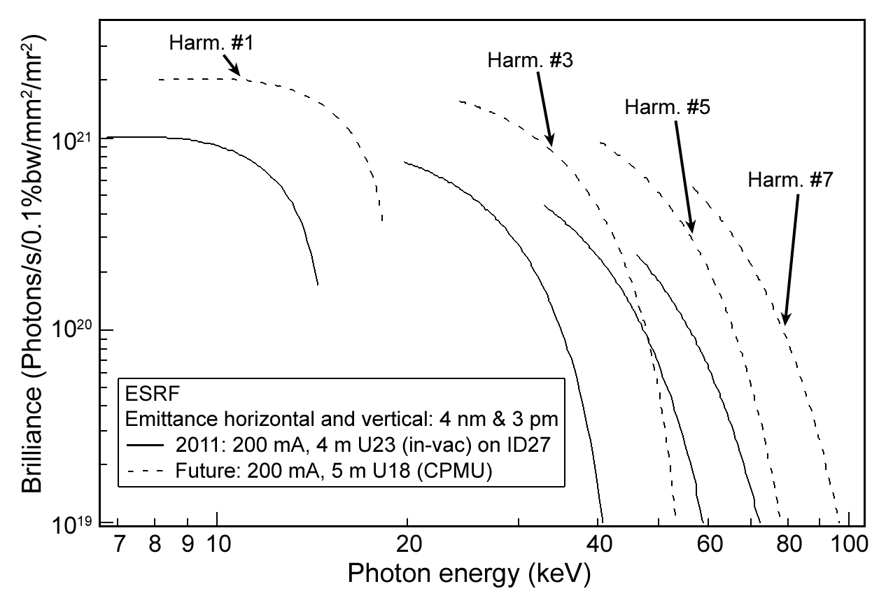
EXTRA: Brilliance @ ε_{y} = 3 pm @200 mA
Solid curve: Brilliance of the X-ray beam emitted from the two in-vacuum undulators installed on ID27 (High Pressure beamline). Each undulator segment has a period of 23 mm, a length of 2 m and is operated with a minimum gap of 6 mm.

