Slide 1
CERN’s Accelerator Complex
Connecting the dots…
Rende Steerenberg BE/OP

Slide 2
Topics
The CERN Accelerator Complex
Satisfying the Experiments
The Next Step

Slide 3
Topics
The CERN Accelerator Complex
Satisfying the Experiments
The Next Step

Slide 4
Our Accelerator Complex

Slide 5
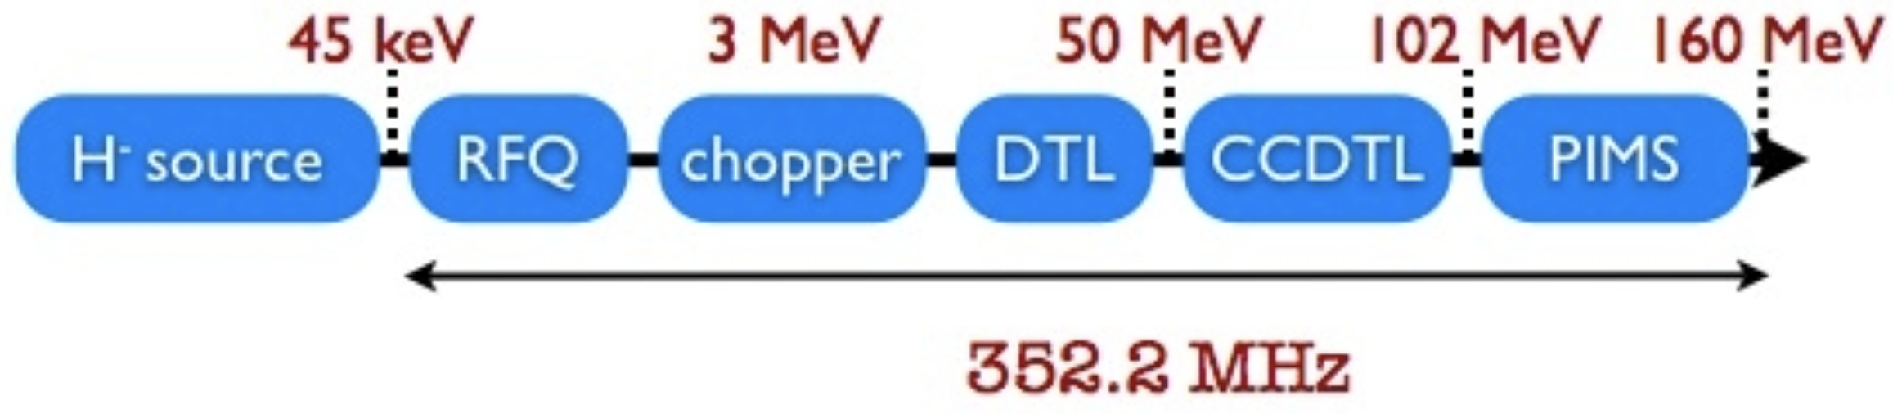
Linear Accelerator 4 (LINAC4)
The source is extracting H⁻ ions at an energy of 45 keV
Accelerates beam up to 160 MeV
Can provide a pulse of H⁻ ions every 1.2 s
e⁻
P⁺
e⁻

Slide 6
Our Accelerator Complex

Slide 7
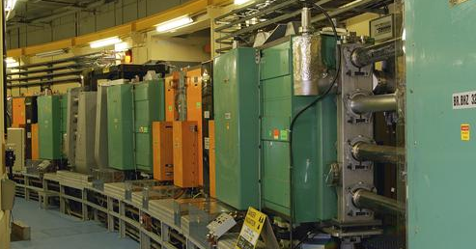
Proton Synchrotron Booster (PSB)
1st circular accelerator with 4 superposed rings
Circumference of 157 m
Accelerates protons from 160 MeV to 2 GeV
Each ring will inject over multiple turns, using charge exchange injection
  Converting H⁻ into protons
Can cycle every 1.2 s
Before stripping foil
The (PSB) cycle
Behind stripping foil
x’
x’
+
+
+
+
-
+
+
+
-
+
-
+
+
-
+
+
+
+
-
-
+
+
+
+
+
-
+
+
+
-
+
+
+
x
+
+
x
+
-
+
+
+
+
+
+
+
+
-
+
+
+
-
1.2 seconds

Slide 8
Our Accelerator Complex

Slide 9
Proton Synchrotron (PS)
The oldest operating accelerator at CERN
Circumference of 628m
Increases energy from 2 GeV to max. 26 GeV
Cycle length ranges from 1.2s to 3.6s
Many RF systems allow for complex beam manipulations
  Among others, the 25 ns bunch spacing for LHC
Various types of extractions:
  Fast extraction
  Multi-turn extraction (MTE)
  Slow extraction

Slide 10
Our Accelerator Complex

Slide 11
Super Proton Synchrotron (SPS)
The first accelerator in the chain at ~30m under ground
Circumference of 6.9 km
Increases proton beam energy up to 450 GeV
Provides:
  Slow extracted beam to the North Area
  Fast extracted beam to LHC, AWAKE and HiRadMat

Slide 12
Our Accelerator Complex
Counter
Clock-wise
Clock-wise

Slide 13
Large Hadron Collider (LHC)
1232 main dipole magnets that deviate the beams around the 27 km circumference
392 main quadrupole magnets that keep the beams focused
~6000 corrector magnets to preserve the beam quality
Main magnets use superconducting cables (Cu-clad Nb-Ti)
12’000 A provides a magnetic field of 8.33 Tesla
Operating in 150 tons of superfluid helium at 1.9K

Slide 14
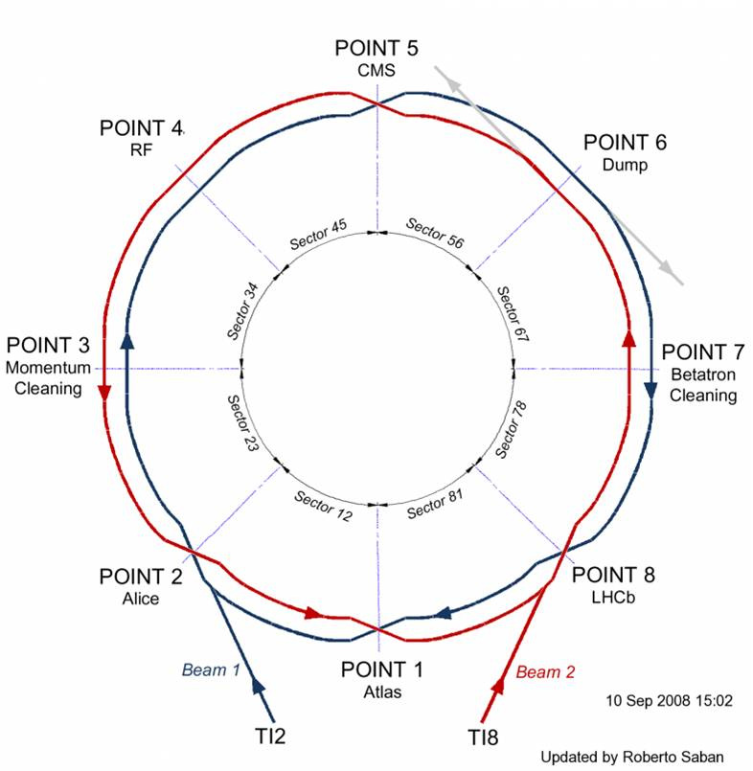
Large Hadron Collider (LHC)

Slide 15
Topics
The CERN Accelerator Complex
Satisfying the Experiments
The Next Step

Slide 16
The Injectors Preparing LHC Beams
To LHC clock-wise or counter clock-wise
SPS
East Area
nTOF
nTOF
PS
PSB
ISOLDE
ISOLDE
ISOLDE
ISOLDE
East Area
ISOLDE
nTOF
nTOF
Time

Slide 17
The LHC Cycle
Squeeze
&
Adjust
Injection
Ramp
Stable Beams
Ramp down
6.8 TeV
450 GeV

Slide 18
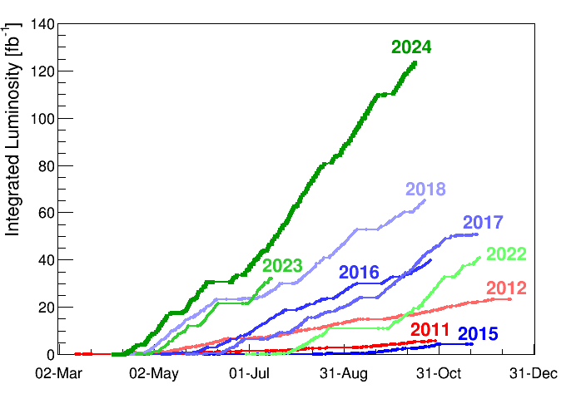
Integrated Luminosity

Slide 19
Topics
The CERN Accelerator Complex
Satisfying the Experiments
The Next Step

Slide 20
The High-Luminosity LHC upgrade is under way
The HL-LHC will use new technologies to provide 10 times more collisions than the LHC
The stored beam energy will increase from ~300 MJ to ~600 MJ
It will give access to rare phenomena, greater precision and larger discovery potential
It will start operating in 2030 and run until 2041

Slide 21
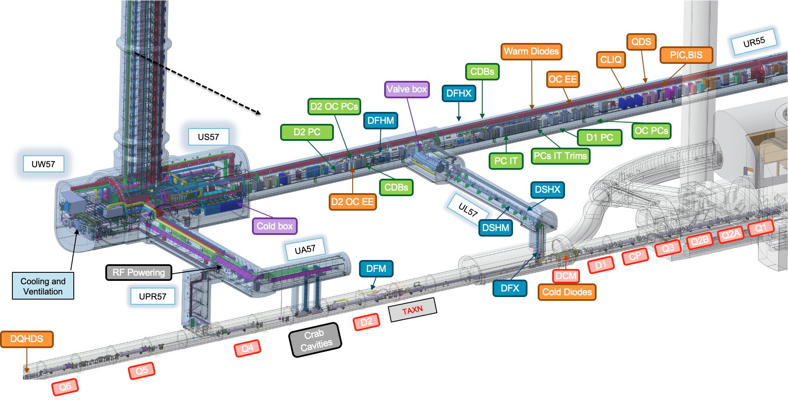
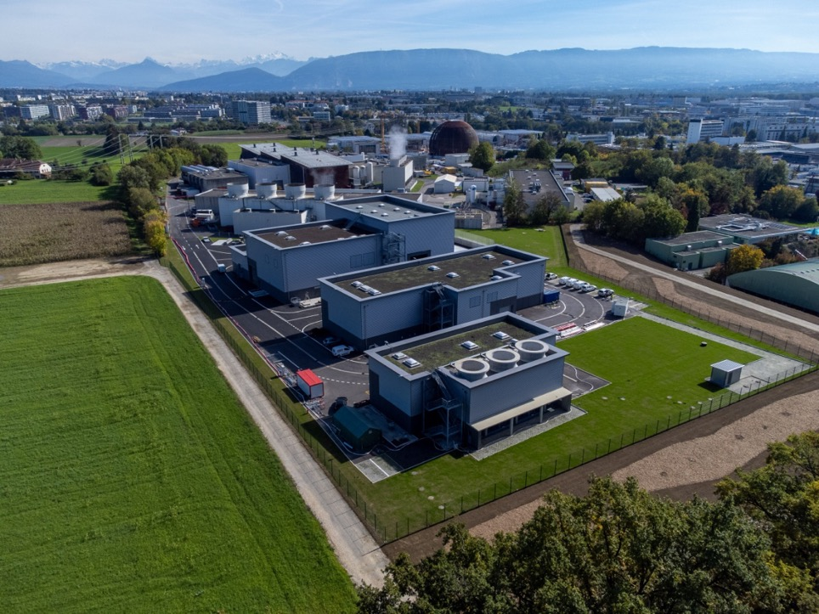
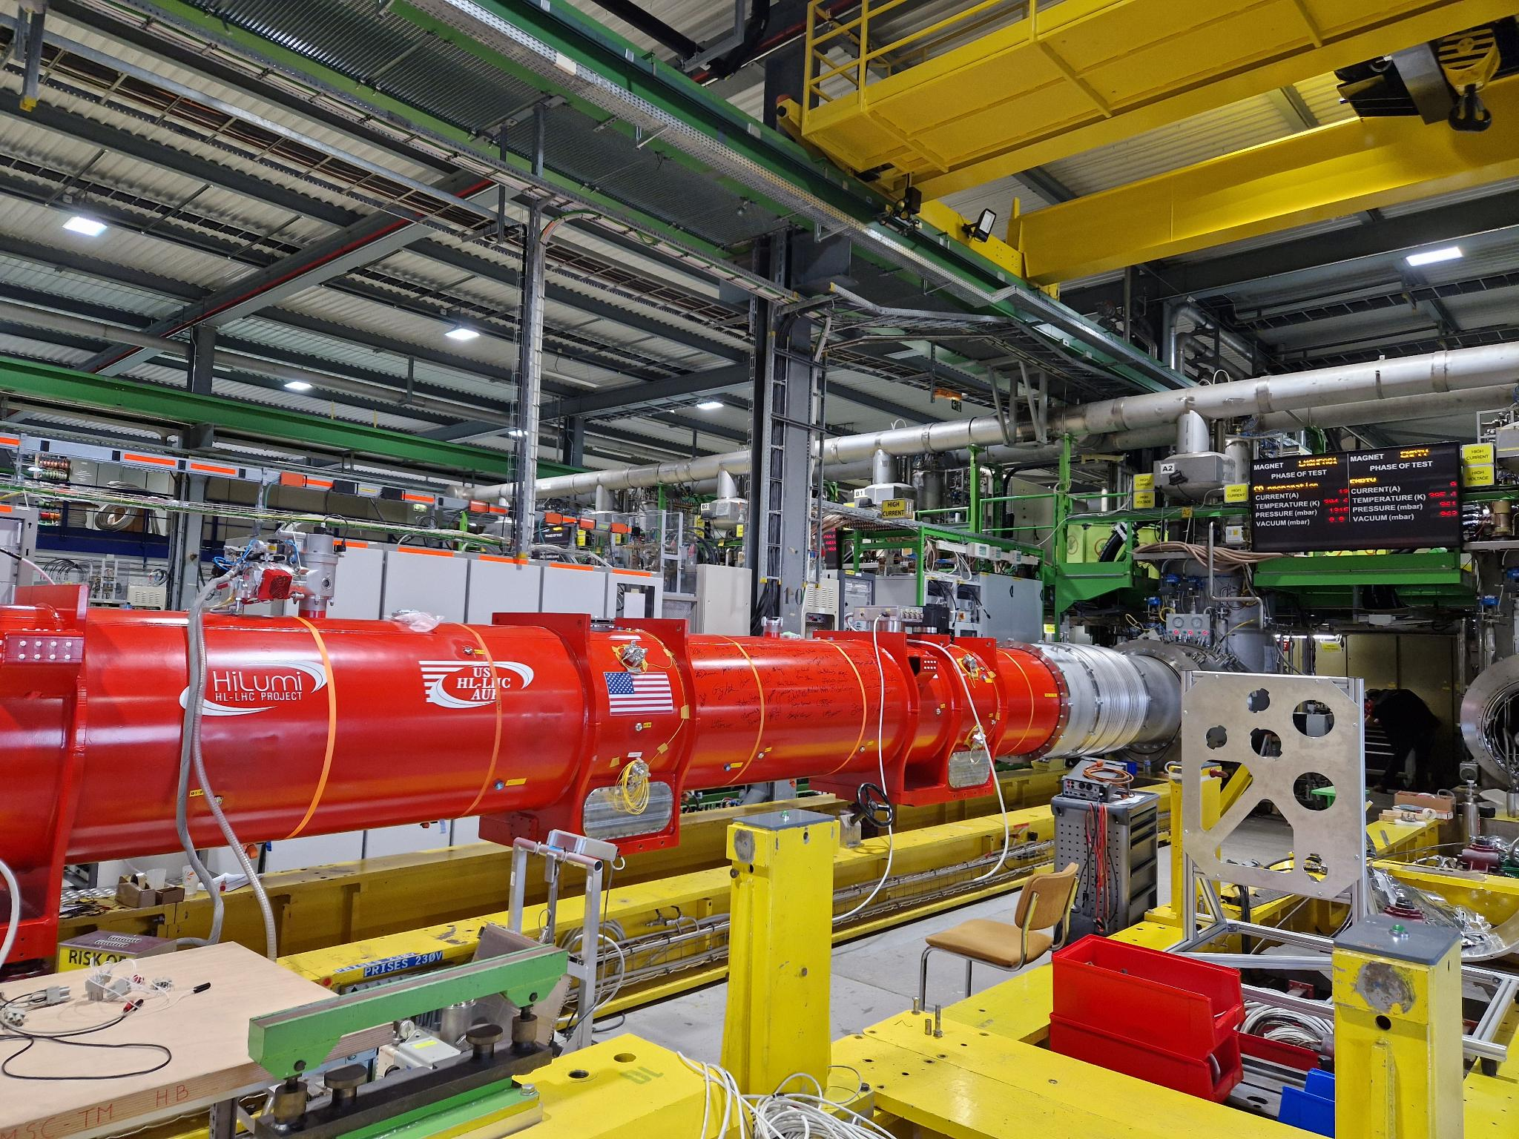
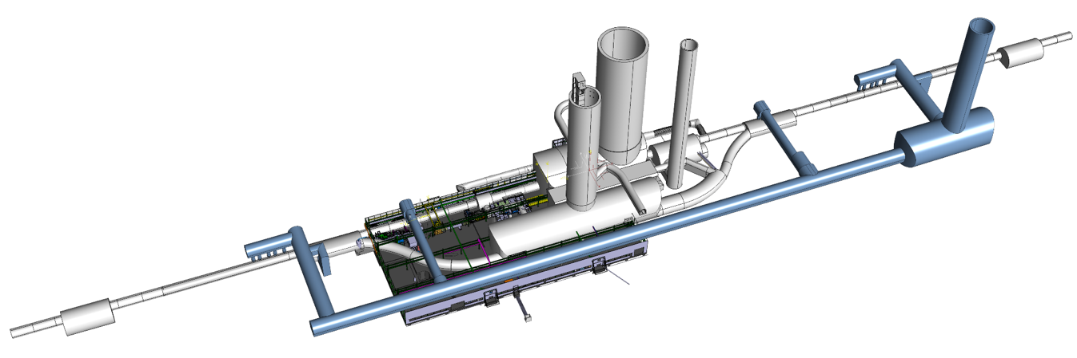
New Facilities and Equipment Being Added

Slide 22
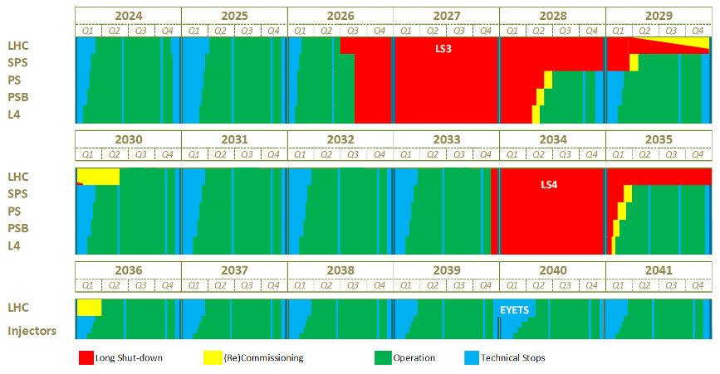
The CERN Long-Term Schedule
Run 3
Long shut-down 3
Run 4
Long shut-down 4

Slide 23
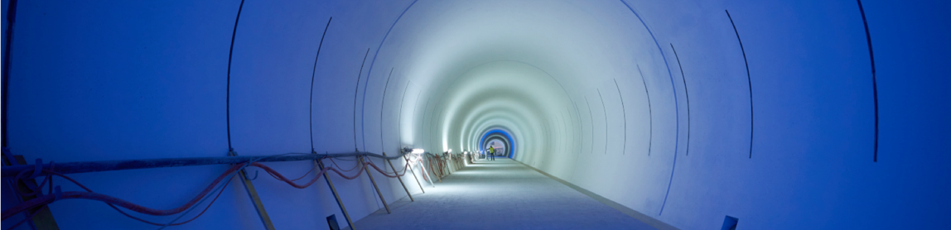
The future lies ahead, waiting to be shaped
Success with your career at CERN!

