Slide 1
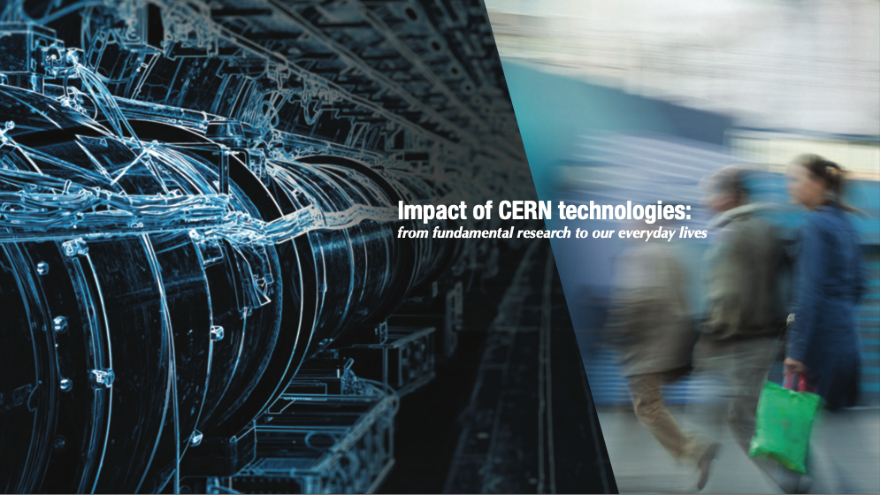
From CERN technologies to impactful innovations
Photo: CERN
Manuela Cirilli,
Medical Applications Adviser
CERN Knowledge Transfer group
Photo: CNAO treatment room

Slide 2
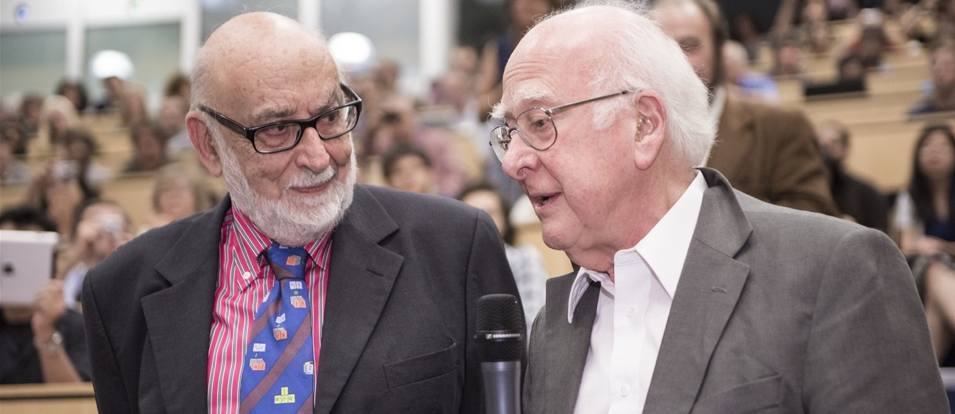
CERN: where the Higgs boson was discovered
François Englert and Peter Higgs. With Robert Brout, they proposed the mechanism in 1964.

Slide 3
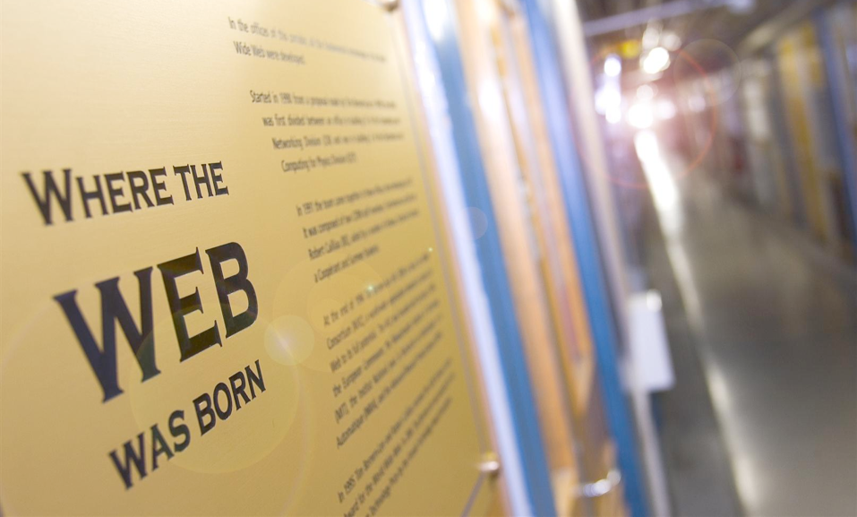

Slide 4
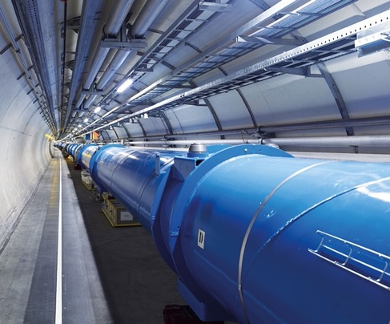
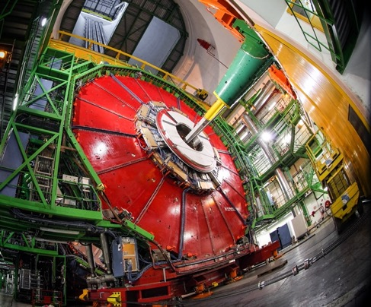
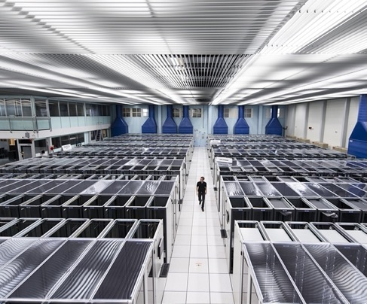
Particle physics technologies
ACCELERATORS
DETECTORS
COMPUTING

Slide 5
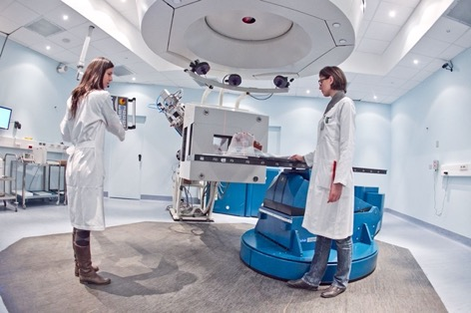
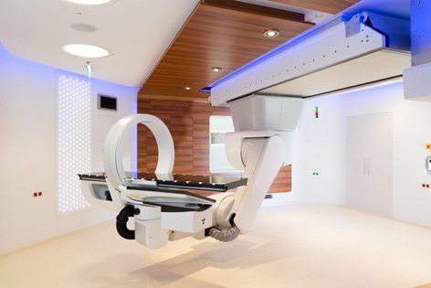


Hadron therapy: cancer radiotherapy with protons and other ions
Active since the 1990s:
- synchrotrons for C-ion therapy
- linear accelerators for innovative proton and Carbon ion therapy systems
Recent years: focus on innovative technologies for multi-ion therapy
5350 patients treated 2011-2024
2500 patients treated 2017-2024
Notes:
Hadrontherapy: a bit like drugs for rare diseases; they cost a fortune, but for a small number of people they might represent a life-death difference, or a chance to lead a normal life after treatment

Slide 6
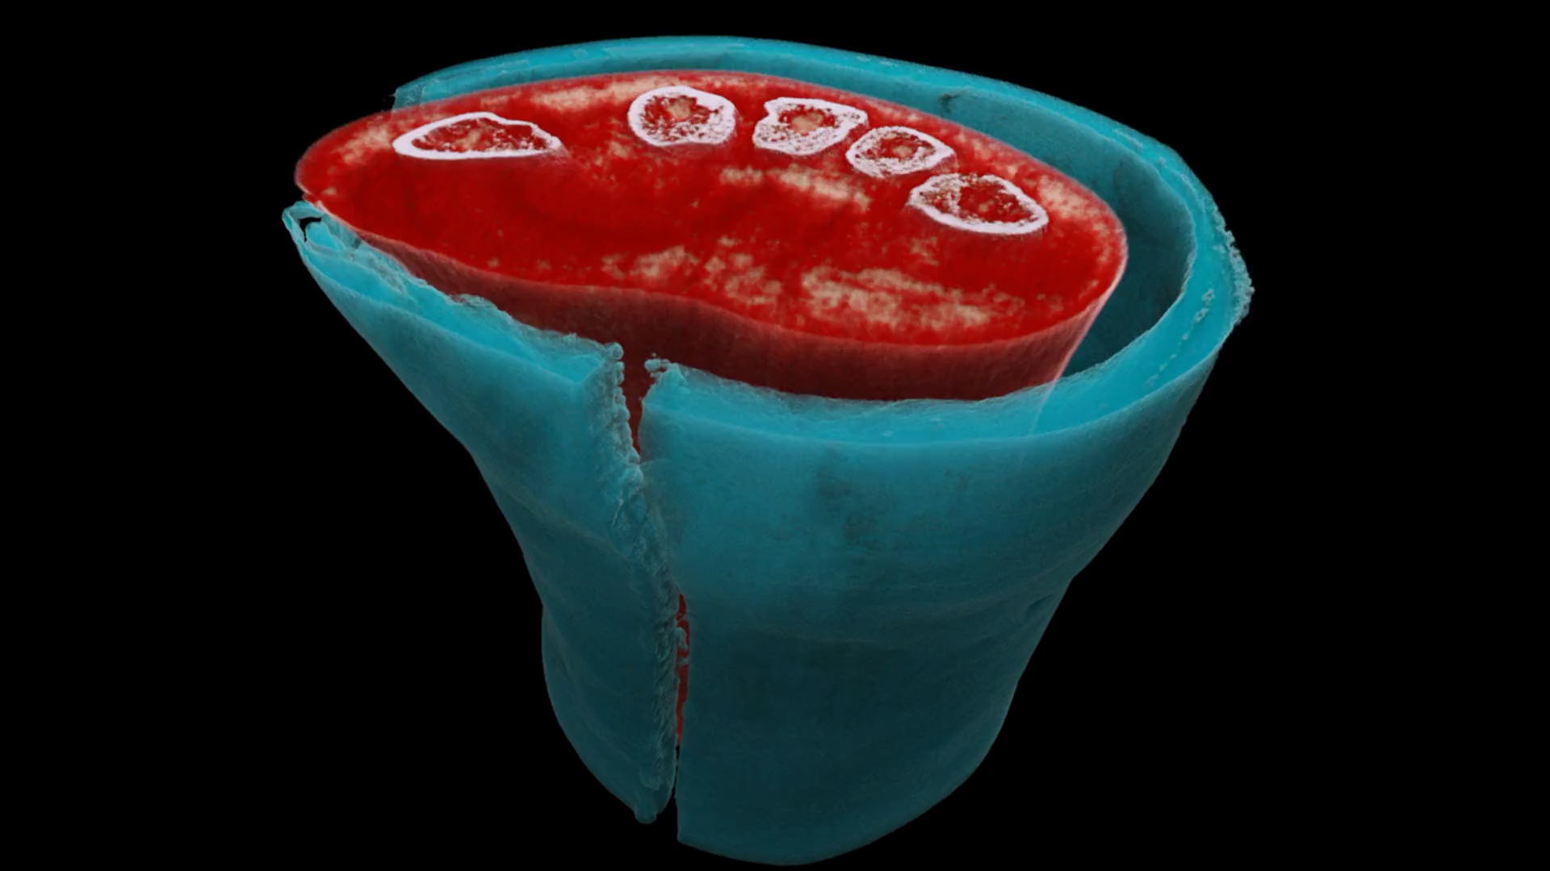



Slide 7

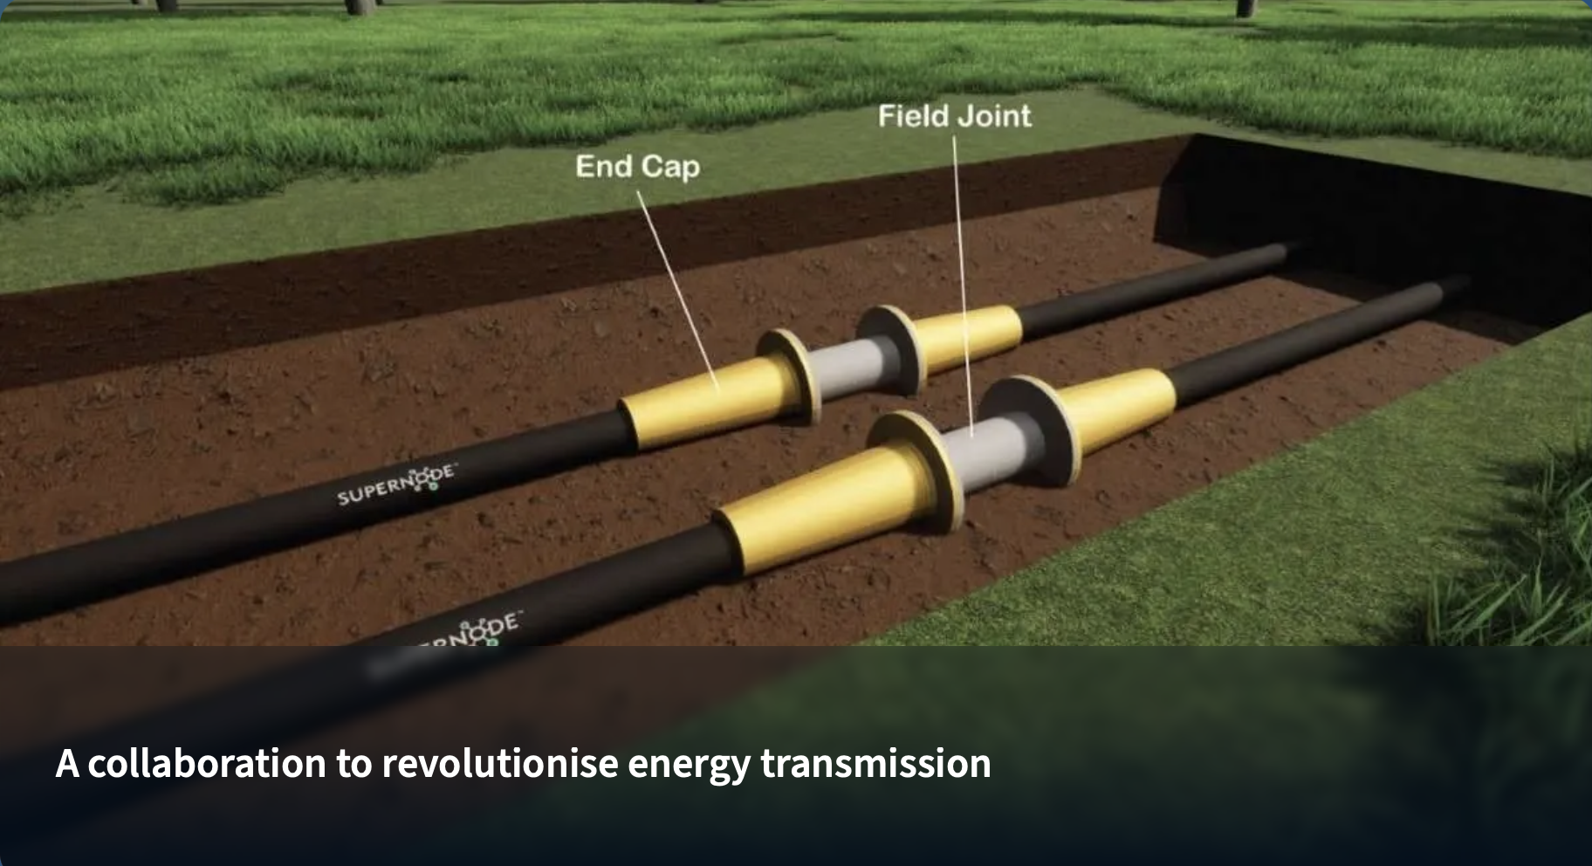
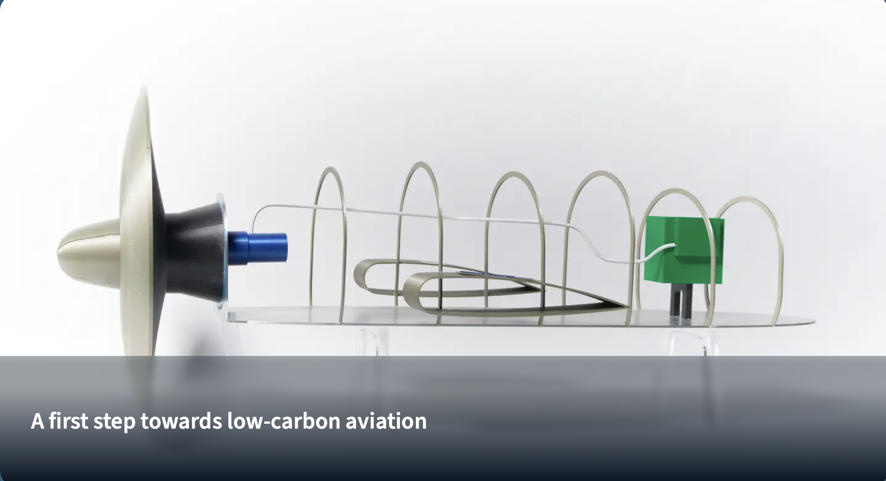
CERN and Airbus UpNext, a wholly owned subsidiary of Airbus, are exploring the potential use of superconducting technologies developed by CERN in the electrical distribution systems of future hydrogen-powered aircraft.
SuperNode and CERN initiated a collaboration to pioneer a novel type of insulation for superconducting cables. The primary goal is to enhance energy transmission capabilities, thus accelerating the transition to renewable energy.

Slide 8
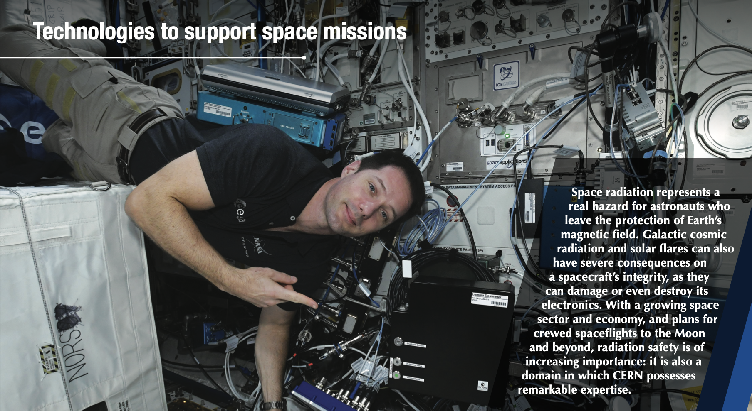

Slide 9
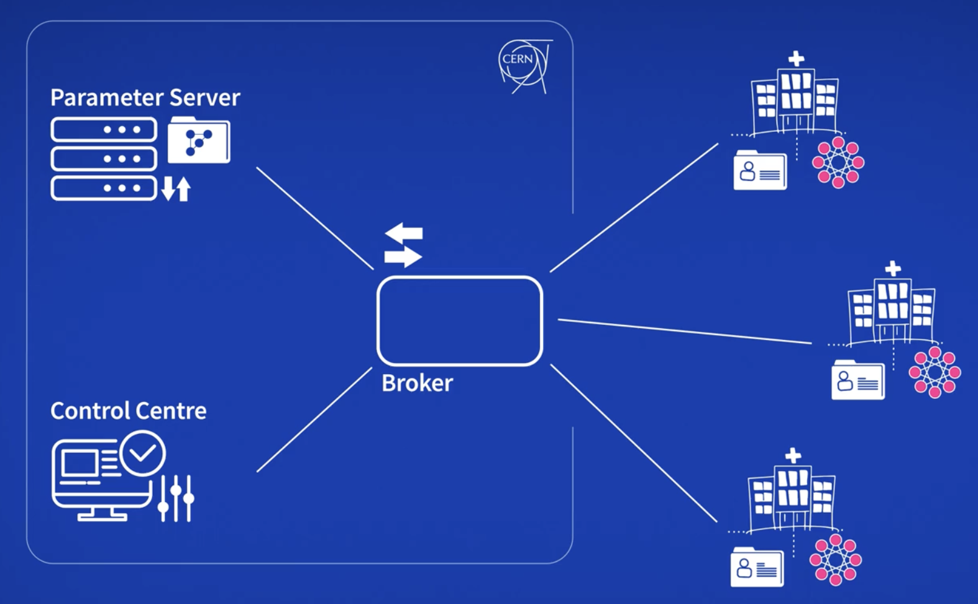


From AI…
Edge-SpAIce - Novel Edge-AI system for accurate and near real-time plastic detection and monitoring in marine environment
CAFEIN - CERN’s Federated Learning for Artificial Intelligence in healthcare
…to Quantum Tech
Notes:
Hadrontherapy: a bit like drugs for rare diseases; they cost a fortune, but for a small number of people they might represent a life-death difference, or a chance to lead a normal life after treatment

Slide 10
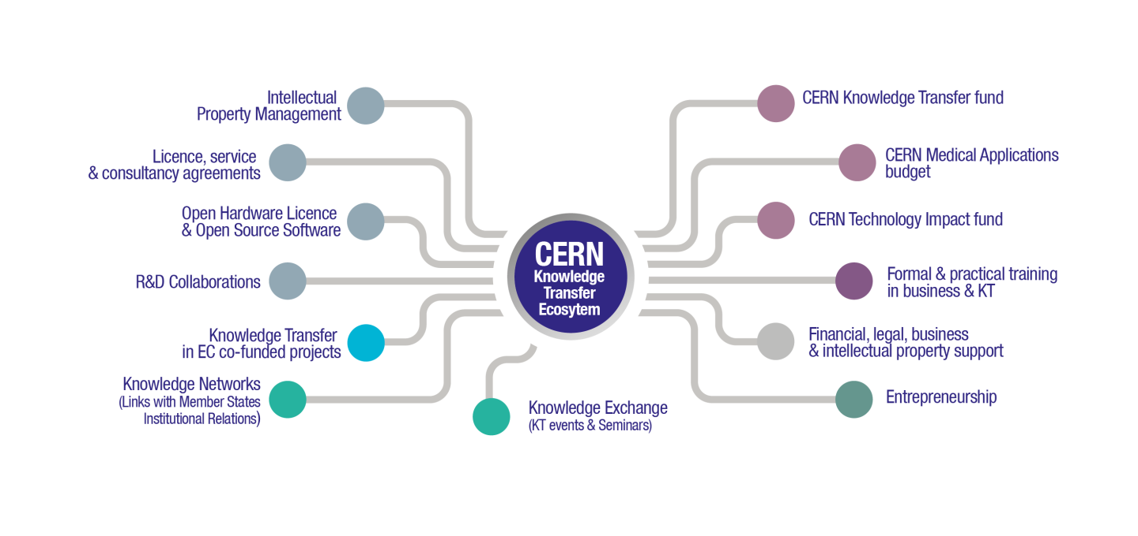

Slide 11
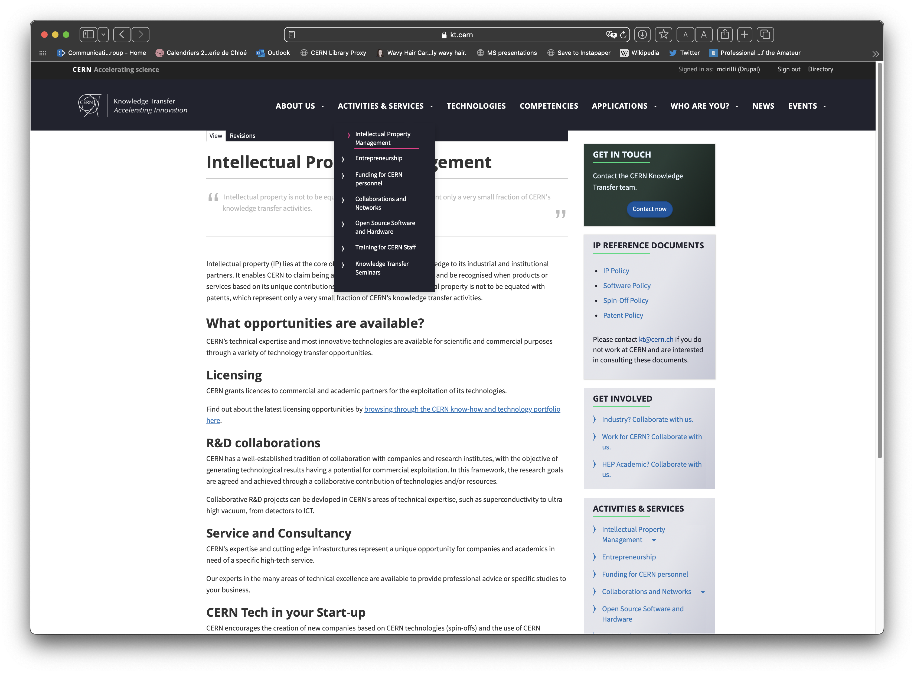
https://kt.cern/activities-services/intellectual-property-management

Slide 12
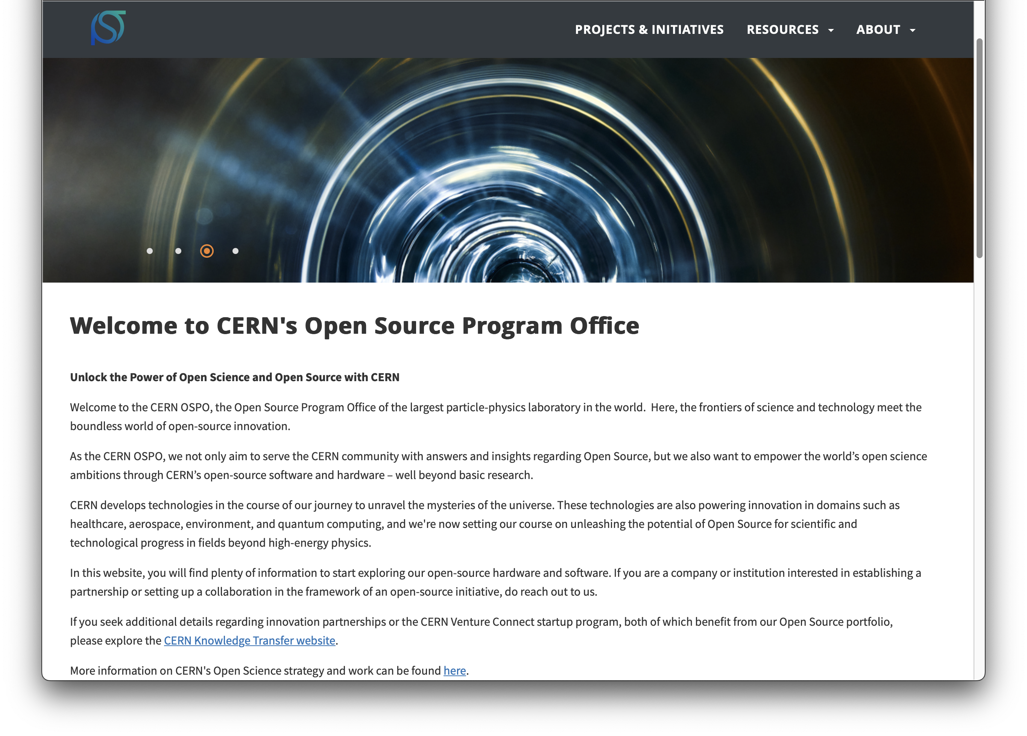

https://opensource.web.cern.ch

Slide 13

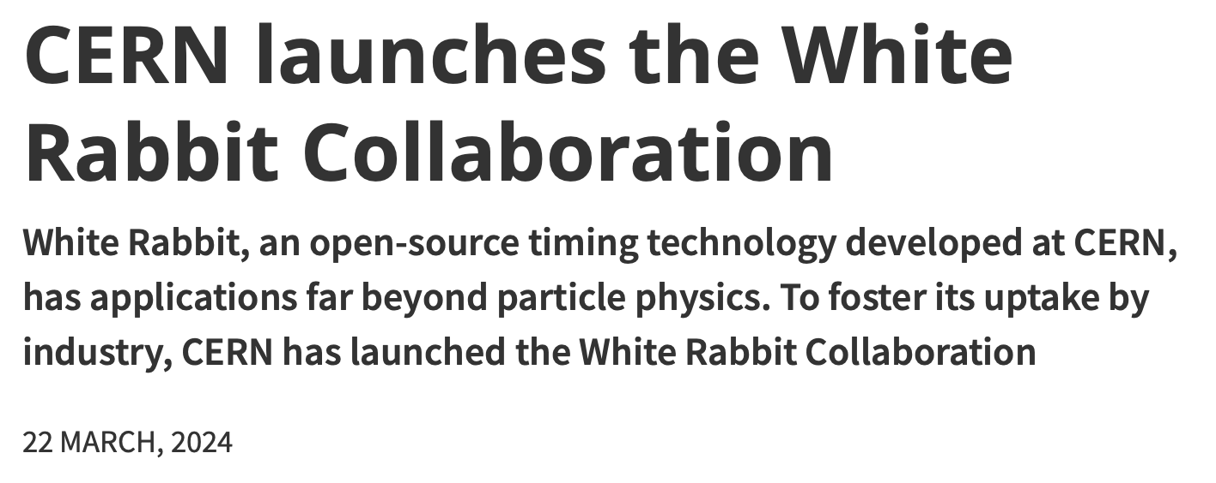
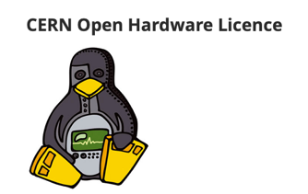
White Rabbit
A novel time- synchronisation system that offers sub-nanosecond accuracy and precision of a few picoseconds.
Fully open hardware and software
Since 2020, included in the worldwide IEEE industry standard called Precision Time Protocol (PTP)

Slide 14
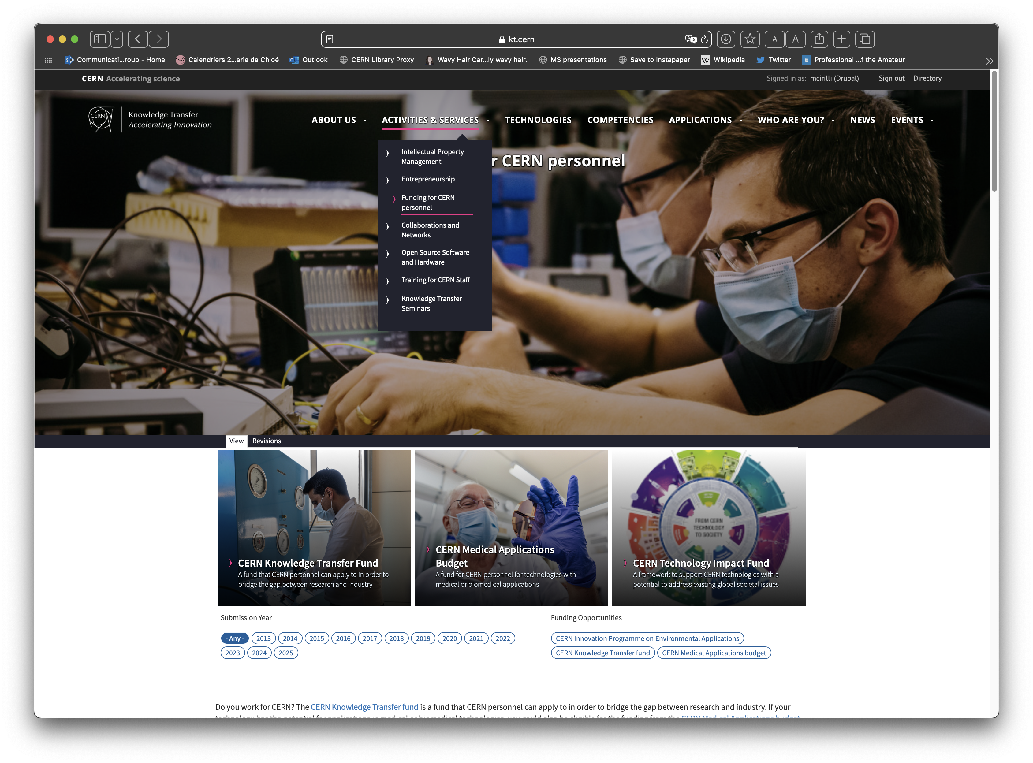
https://kt.cern/activities-services/funding-cern-personnel

Slide 15





CERN Venture Connect
Connect with investors
and venture startup economy
Access breakthrough
CERN technologies
Get 0% equity,
express agreements
2% royalty only
revenues higher than 1MCHF

Slide 16
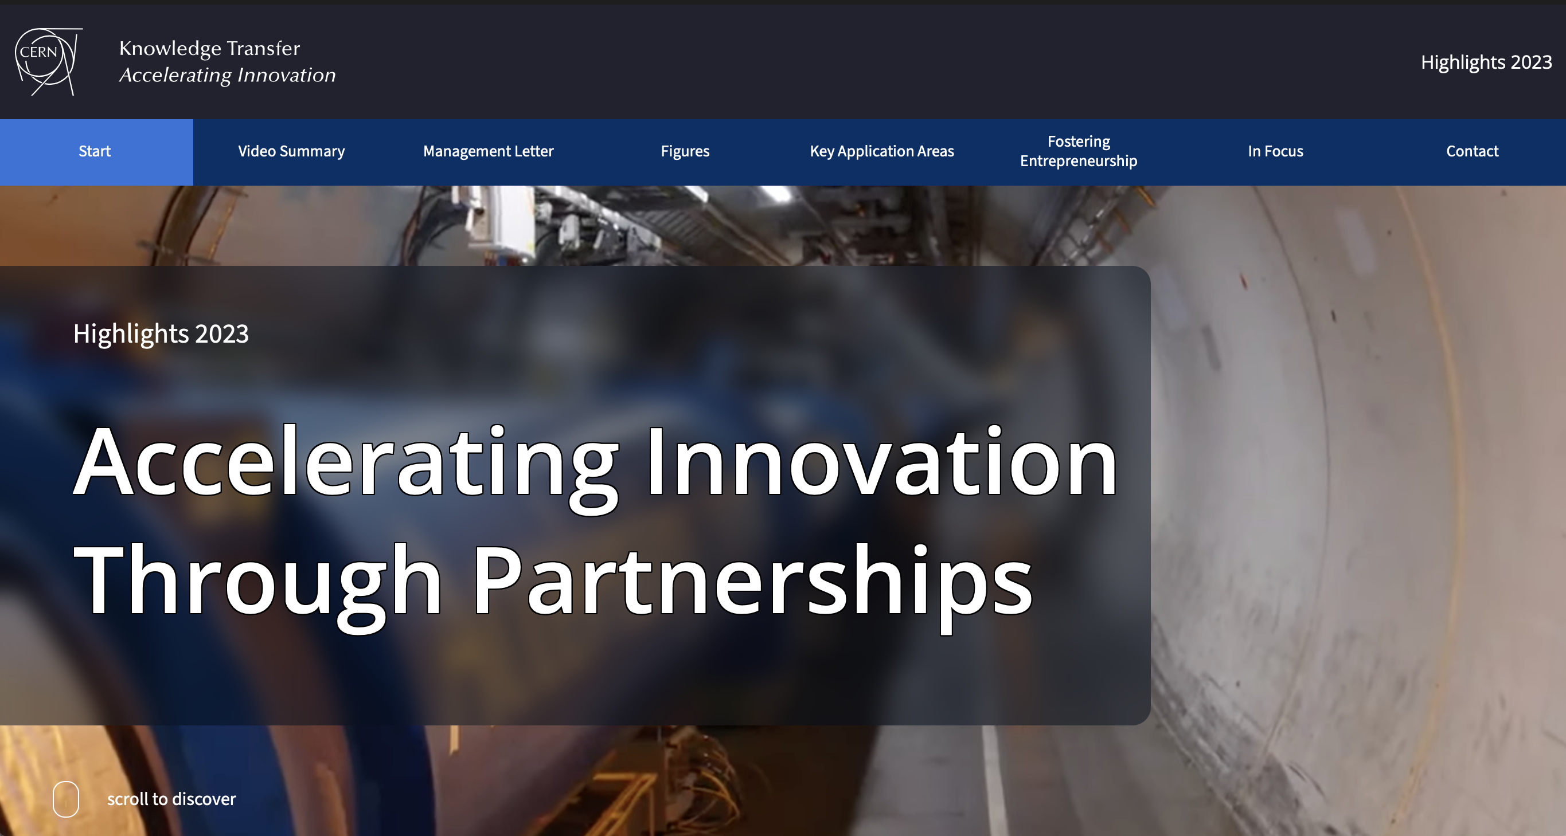
https://report2023-kt.web.cern.ch
Follow us on LinkedIn
https://www.linkedin.com/showcase/cern-innovation-partnerships/

