Slide 1
TE-MSC Activities for the LHC
LS3
Readiness Review
EDMS 3170211
Sandrine Le Naour
2024-12-10 – TE-MSC meeting

Slide 2
LS3 activities for MSC in the LHC

Slide 3
MSC activities and contribution during LS3
MSC activities in Arc and DS
Consolidation activities in the LHC
Change of cryomagnets (quench heater circuit issue) :
  MQ.11R8, MB.A18L1, MQ.14L3, MB.C28L6 (NCR 2570229​, NCR 2579551, NCR 2868367, NCR 3091387)
Diode blowholes issue (NCR 2707278)
  42 diodes to open in all sectors but S23, S56
Connection cryostat inspection
LEJL.5L6 & LEBL.11R4 (NCR 2571503, NCR 2550143)
Current leads maintenance
Known and unknown NC
HL-LHC activities for WP3 :
Change of cryo-magnets (cold mass with MS corrector magnet) :
Q10R1, Q10L1, Q10R5, Q10L5
BST activities see G. Rosaz presentation
Opening and closure of the interconnection
V line cutting and PIM flange cutting on magnet side if necessary

Slide 4
MSC activities and contribution during LS3
MSC activities in Arc and DS
MSC activities in LSS (MS & IT)
Consolidation activities in the LHC
Change of cryomagnets (quench heater circuit issue) :
  MQ.11R8, MB.A18L1, MQ.14L3, MB.C28L6 (NCR 2570229​, NCR 2579551, NCR 2868367, NCR 3091387)
Diode blowholes issue (NCR 2707278)
  42 diodes to open in all sectors but S23, S56
Connection cryostat inspection
LEJL.5L6 & LEBL.11R4 (NCR 2571503, NCR 2550143)
Current leads maintenance
Known and unknown NC
HL-LHC activities for WP3 :
Change of cryo-magnets (cold mass with MS corrector magnet) :
Q10R1, Q10L1, Q10R5, Q10L5
BST activities see G. Rosaz presentation
Opening and closure of the interconnection
V line cutting and PIM flange cutting on magnet side if necessary
Consolidation activities in the LHC
Seal maintenance on normal conductor magnets
Bellows consolidation in IT in point 2 & 8
  Exchange of wedge welded bellows by hydroformed bellows where it is possible
HL-LHC activities in IT 2 & 8 for WP12/ WP14
  Installation of D1 mask
  aC coating of beam line
    Opening / Closure of IT interconnection and PIM cutting
HL-LHC activities in Pt 1 & 5 for WP3/ WP9 / WP15
Disconnection of Inner Triplet (IT)
Disconnection and connection of magnets in MS : Q5,Q4 (-D2)
Connection of WP3 magnets and interlinks
Splicing work on the DSL, and QRL/QXL jumper plug cutting
HL-LHC activities in Pt 1 & 5 for WP6a : Cold Powering systems
HL-LHC activities in Pt 4
Replacement of BGI magnets (NC magnets)

Slide 5
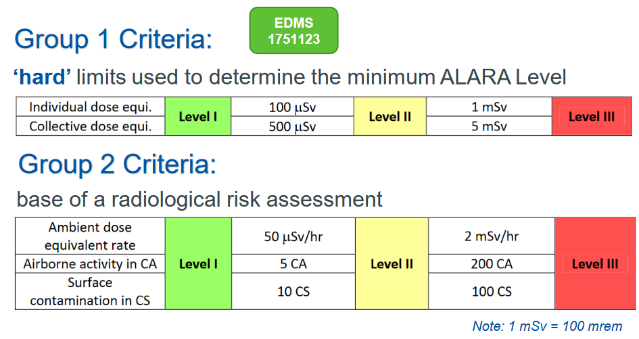
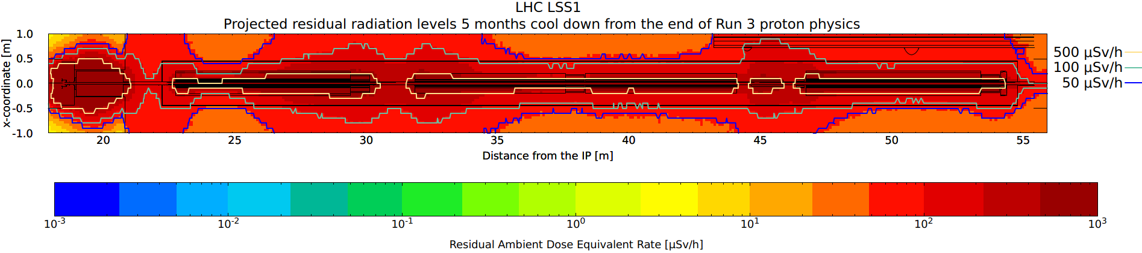
Inner Triplet disconnection in point 1&5
Three months after the beginning of LS3, the inner triplet magnets Q1, Q2, Q3 and D1 must be dismantled.
A DIMR has been defined, requiring intervention of several equipment owners from different groups. The collective dose will be collected by B. Di Girolamo by the end of the year.
For the disconnection of the IT magnets managed by TE-MSC, a first estimation of exposure time and dose received has been performed mixing fast and proper disconnection of cryogenics lines.
This activity reaches the ALARA 3 level : 20 mSv < Coll. Dose < 5 mSv. The tooling development /preparation and the sorting of the equipment (waste or spare) is the key to reduce the exposure time.
D1 disconnection is very fast : ~1h per side
For the SAM (Stand Alone Magnet), the residual ambient dose rate is two orders of magnitude lower with respect to IT interconnection.
Q1
Q2
Q3

Slide 6
Preliminary Schedule

Slide 7
TE-MSC schedule
All TE-MSC activities are in the master schedule and three main phases appears
Phase 1 : ~2 ½ months from the first cryo lockout | IT, D1 & MS disconnection Preparatory work for BST (10 IC) : IC opening and PIM cutting Removal of the two Q10 of point 1
Phase 2 : ~1 ½ year No LS3 extension included. In case of LS3 extension only phase 2 will benefit of the extension | Preparatory work for BST/aC coating (Arc - IT) PIM flanges cutting on mag side if needed (Criteria to be defined) Magnet exchange IT 2 & 8 - bellows consolidation IT R2 & L8 - D1 mask Diode blowholes QXL/QRL plug and DSL splices Replacement of 4 BGI magnets (NCM team) Non-Conformity revealed during phase 1 and 2 Q4,5,10 connection if possible
Phase 3 : Q4 2028 → Q2 2029 ~ 9 months | WP3 magnet connections Q4,5,10 connection if not done
Phase 1 : Q4 2026 ~2 ½ months long after the first cryo lockout: | IT, D1 & MS disconnection in point 1&5 Preparatory work for BST (12 IC) : IC opening and PIM cutting Removal of the two Q10 of point 1
Phase 1 : ~2 ½ months from the first cryo lockout | IT, D1 & MS disconnection Preparatory work for BST (10 IC) : IC opening and PIM cutting Removal of the two Q10 of point 1
Phase 2 : Q1 2027→ Q3 2028 ~1 3/4 year In case of LS3 extension only phase 2 will benefit of the extension | Preparatory work for BST/aC coating (Arc - IT) PIM flanges cutting on mag side if needed (Criteria to be defined) Removal of two Q10 of Point 5 Magnet exchange (QH issue) IT 2 & 8 - bellows consolidation IT R2 & L8 - D1 mask Diode blowholes QXL/QRL jumper plug and DSL splices Non-Conformity revealed during phase 1 and 2 Q4,5,10 connection if possible
Very dense period
Very varied period
Very dense period

Slide 8
Coordination

Slide 9
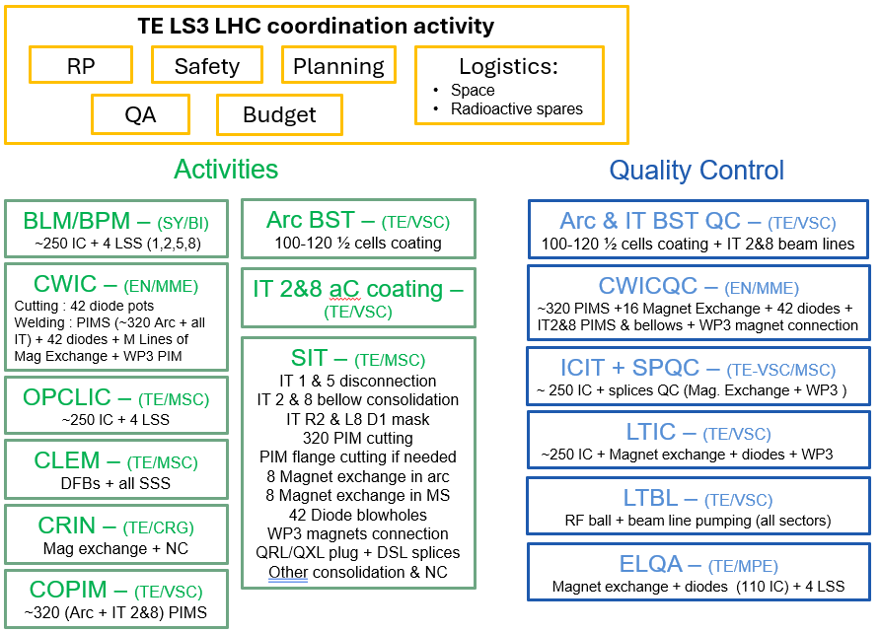
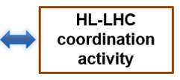
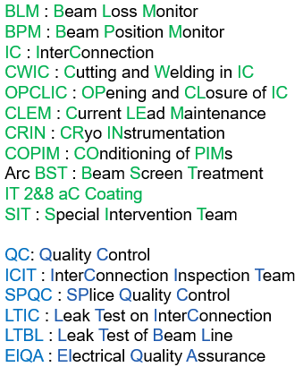
NCM activities :
D1 disconnection
BGI magnets

Slide 10
Resources

Slide 11
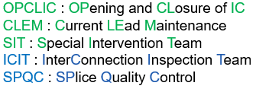
TE-MSC resources
For superconducting magnet activities, TE-MSC will be organised in four teams : SIT, OPCLIC, CLEM and ICIT/SPQC.
For each team, the size and the profile of interveners have been determined.
  For OPCLIC and ICIT, 15 % of the arc interconnections will be opened (~ 250 IC) + interconnections in 4 LSS (1,2,5,8)
  For CLEM and SIT, the team size will be equivalent of the ones of LS1/LS2.
As in the previous long shutdowns, SIT team will count ~75% of MSC resources (staff + FSU) and ~25% of newcomers (temp contract). The team will evolve along the different phases of activities.
At the opposite, for OPCLIC , only 15% of the team will come from MSC resources.
In 2026, a part of TE-MSC resources will be detached from magnet activities at surface to tunnel activities, although the cold mass production is not over. For the phase 3 (WP3 magnet connection), more resources will be available.
Depending on the planning and the progress of WP3 activities, 6 to 8 persons should come from outside of MSC personnel.
In case of a start of LS3 in 2026 (July/Oct), the WP3 cold mass production will be closer to the end.
For that aspect, a latest start of LS3 is an advantage (more time for preparation and training).

Slide 12
Summary
The list of TE-MSC activities (HL-HLC project and consolidation project) for LS3 has been presented and they are all approved and validated in PLAN tool.
Most of them were already performed in the previous long shutdown (procedures known). Only activities around the inner triplets are new and the study will start on Oct 2024.
Dismantling of the inner triplet of points 1 & 5 brings to an ALARA 3 level.
The TE-MSC activities and aC-coating activities (Arc and IT) will benefit of a close coordination plan to assure safety and quality assurance. A new tool of coordination based on e-MIP program will be adapted.
TE-MSC resources size and profile has been defined. Six to eight persons could not come from TE-MSC resources.
A delay or an extension of LS3 translates in a better availability on TE-MSC resources.

Slide 14
EDMS link

Slide 15
Cryo-magnets readiness
Exchange of cryo-magnets due to quench heater circuit issues : MQ.11R8, MB.A18L1, MQ.14L3, MB.C28L6
3 out of 4 cryo-magnets are ready.
The issue of the Q14L3 appeared in May 2024 . A SSS cold mass is available but needs to be prepared, cryostated and cold tested before LS3. TE-VSC will insert beam screens and BPMs. All these activities are planned in 2025.
If other need of magnet exchanged, please consider the time preparation of the spare magnet !
WP3 magnet readiness : see WP3 planning (link).
Exchange of Q10 in points 1 and 5 : New optics layout with a MS in Q10 (MQML+MCBC → MQML+MSCB )
MQML and MSCB magnets are being tested individually, before the cold masses assembly.
Vacuum vessels for Q10 are not available, the ones from Q10 in the LHC will be reused. Cryostating, cold testing and beam screens installation will be done during LS3.
Q4, Q5 modification for HL-LHC : LQY, LQM
Q4L1 and Q4R5 will be swapped, as well as Q4R1 and Q4L5. The new layout requires new service modules and modified beam screens (aC coated and, in some cases, rotated). For Q5, the service module remains the same.
All modifications will be done during LS3.

