Slide 1
LS3 activities and resources for WP6a installation
Y. Leclercq for WP6a
10.12.2024

Slide 2
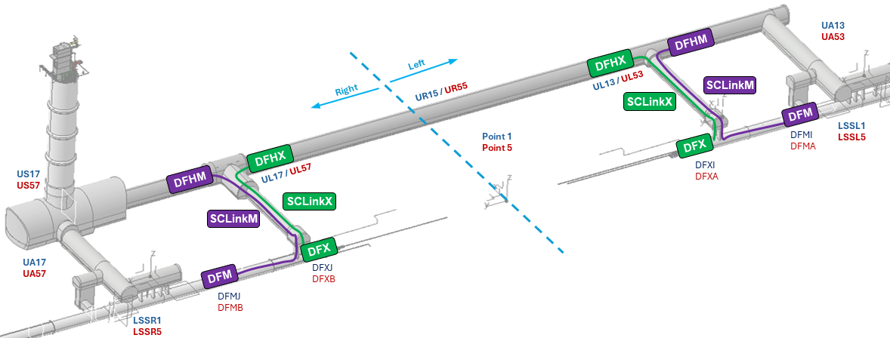
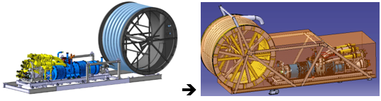
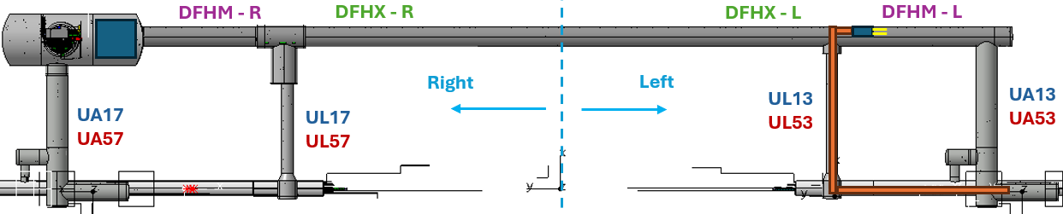
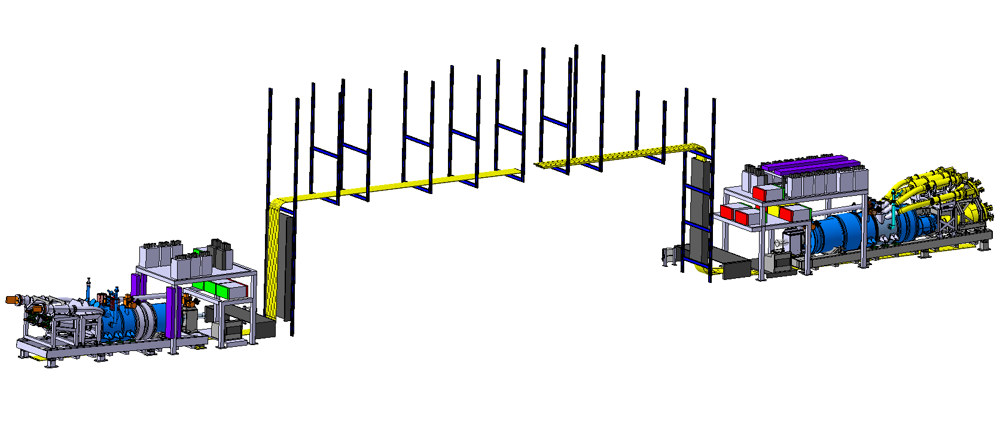
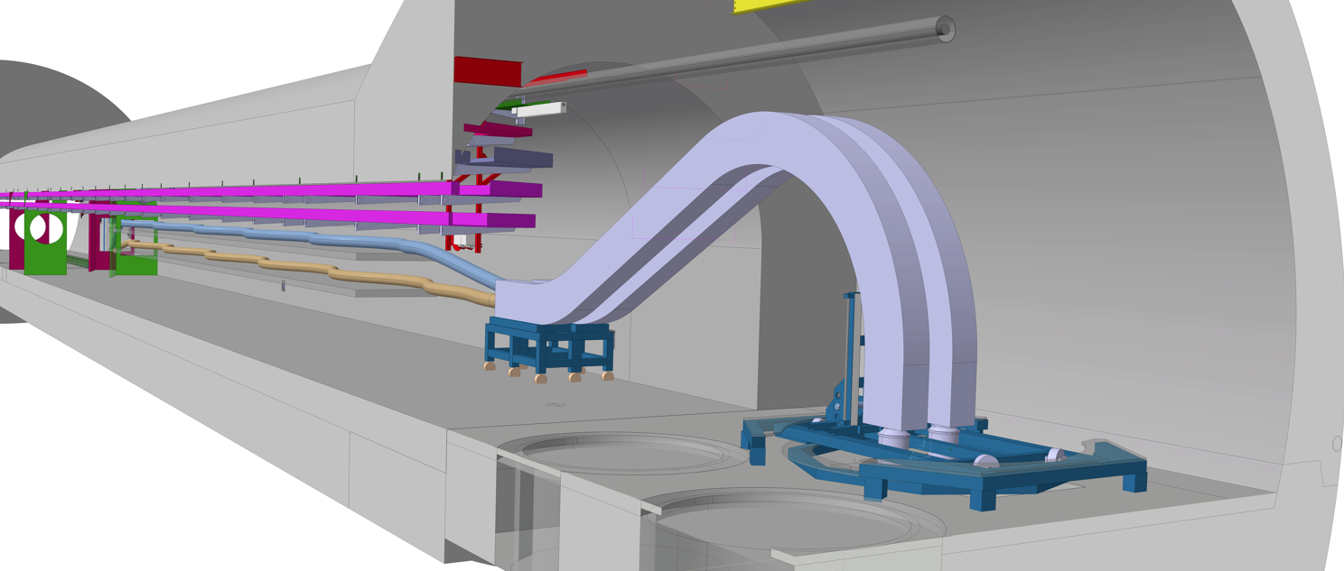
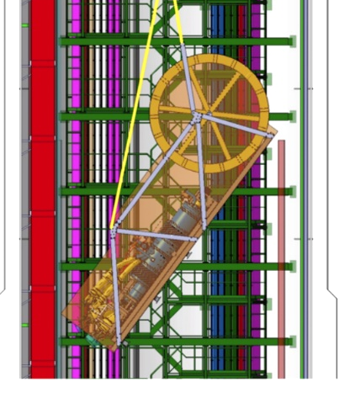
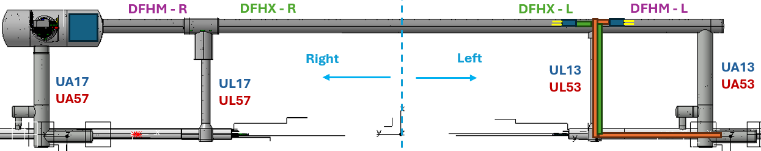
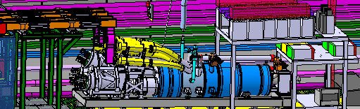
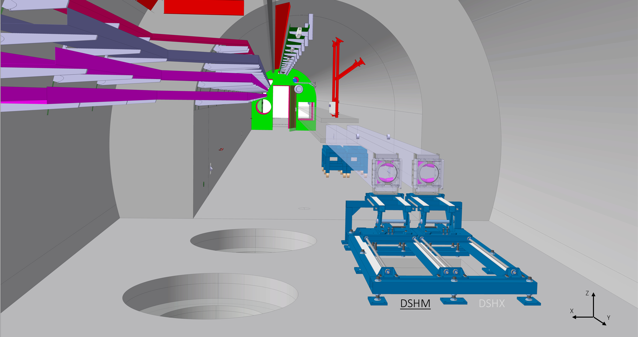
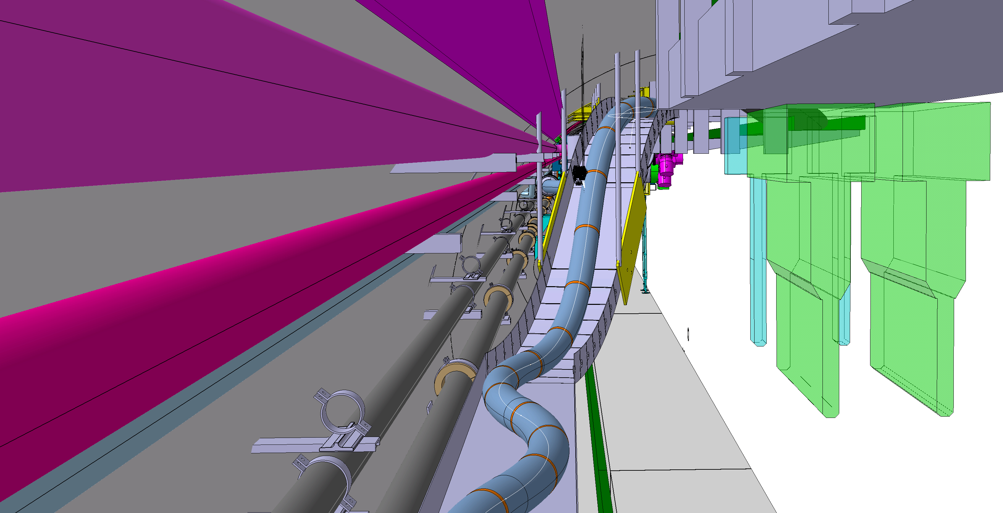
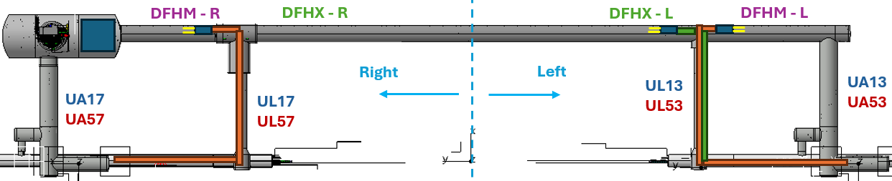
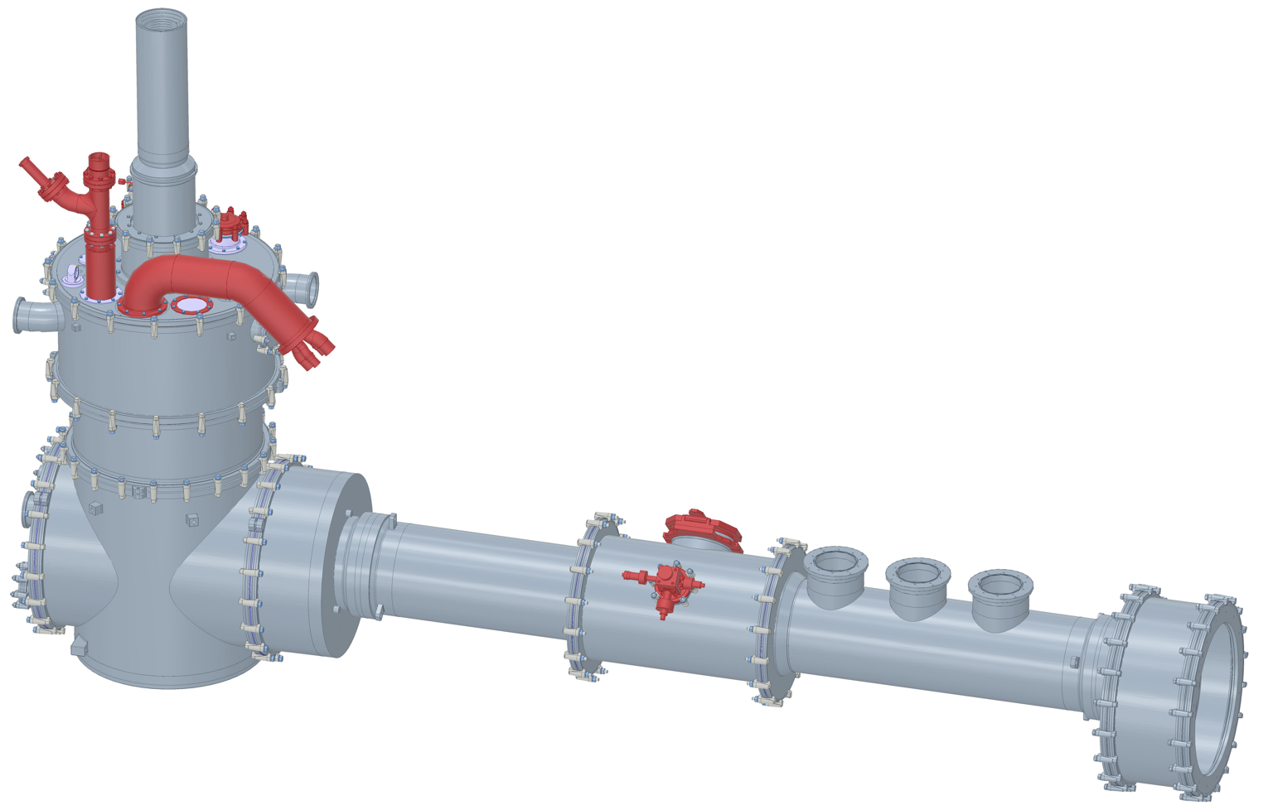
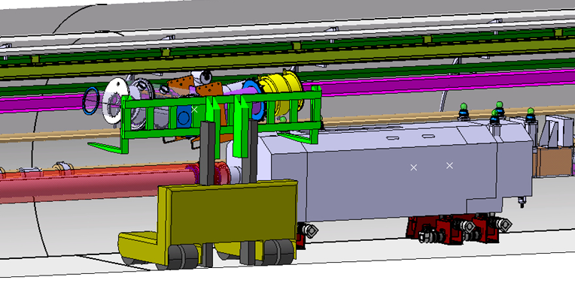
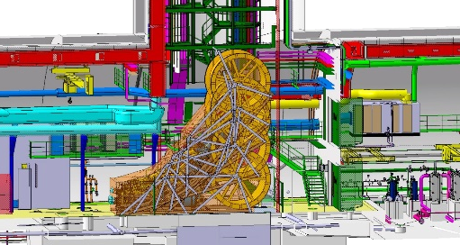
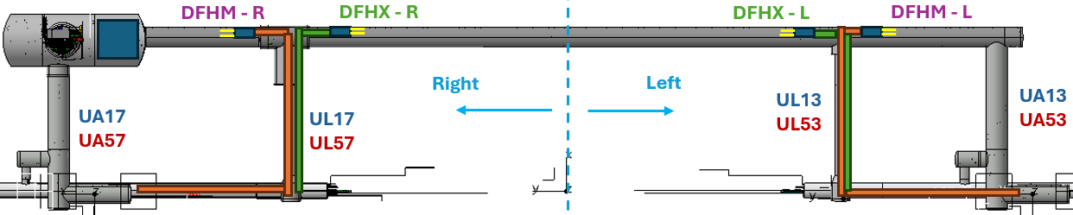
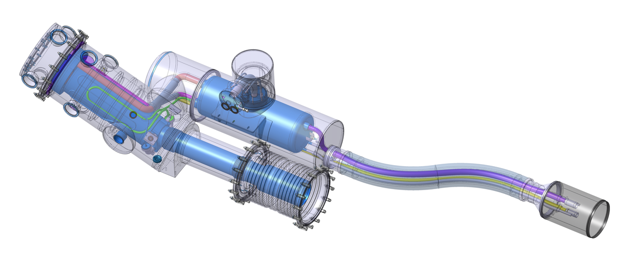
WP6a LS3 activities : Scope
4 cold powering systems per point : 2 types X&M
Installation from Q2-2028 to Q2-2029 (non-continuous)
Cold Powering System installation :
Transport activities
Mechanical activities : Welding, adjusting, forming, assembly
Electrical activities : Instrumentation, soldering, routing, testing
QC activities : HV, Instrumentation, Leak tests, dimensional
1. Supports & Tooling installation
2. Lowering SCLink+DFH
3. Unspooling
4. Core insertion
5. UR Interface activity
UR
Preparation
Left -M
M
Cryogenic interfaces
Left -X
Electrical interfaces
UL
Lowering
Right -M
6. LHC Interface activity
LHC
Landing
DFX assembly
X
Right -X
DFM assembly

Slide 3
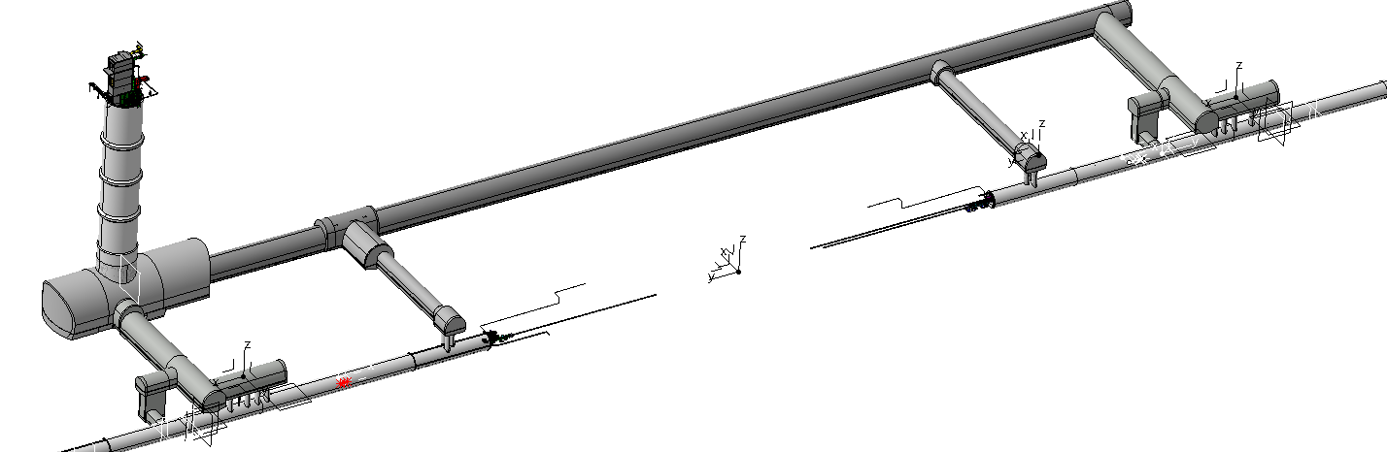
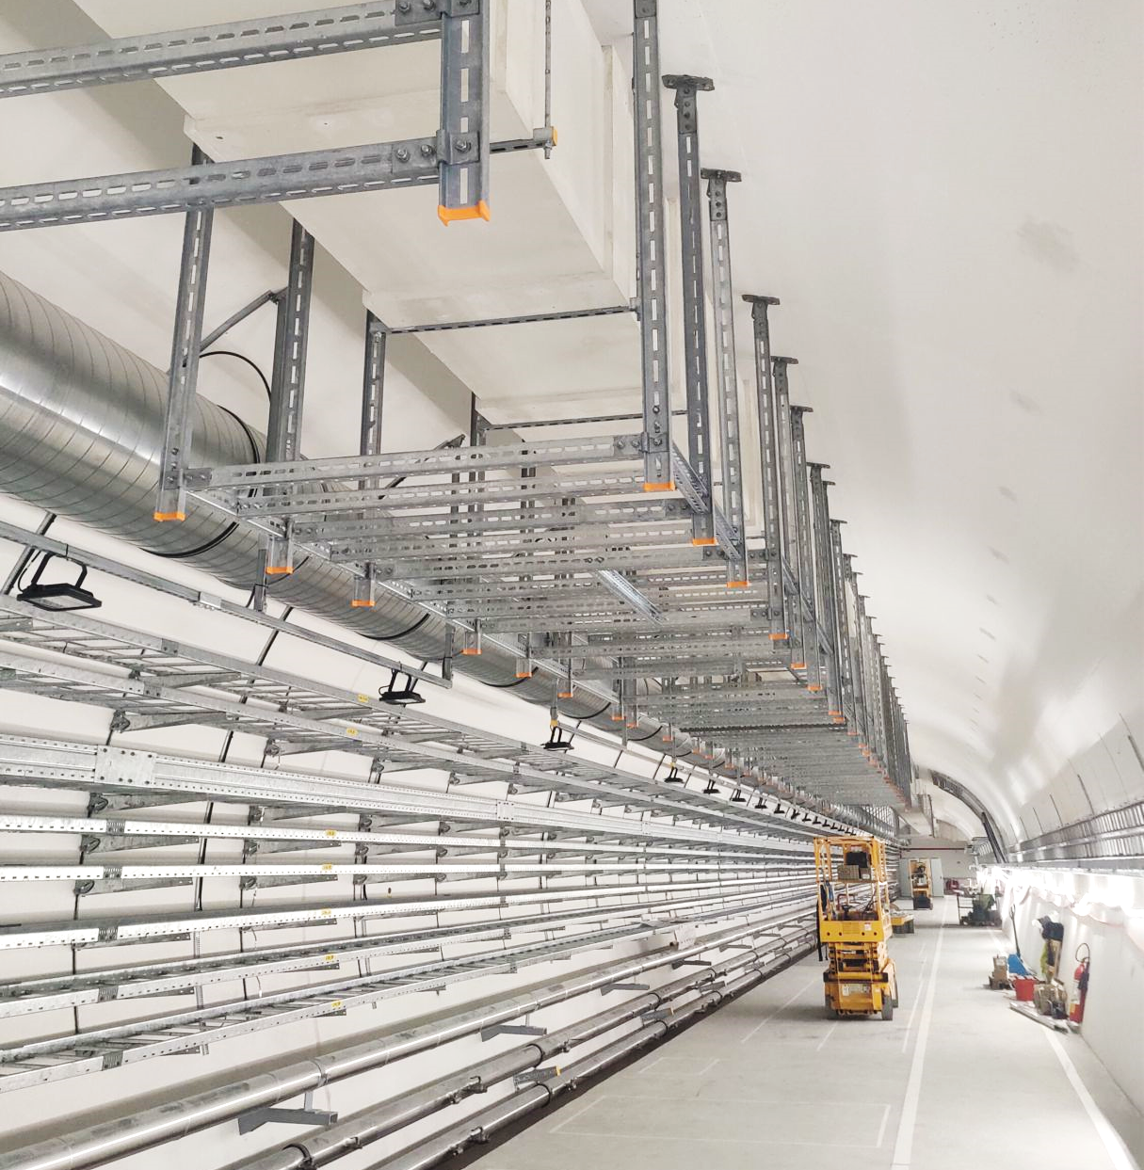
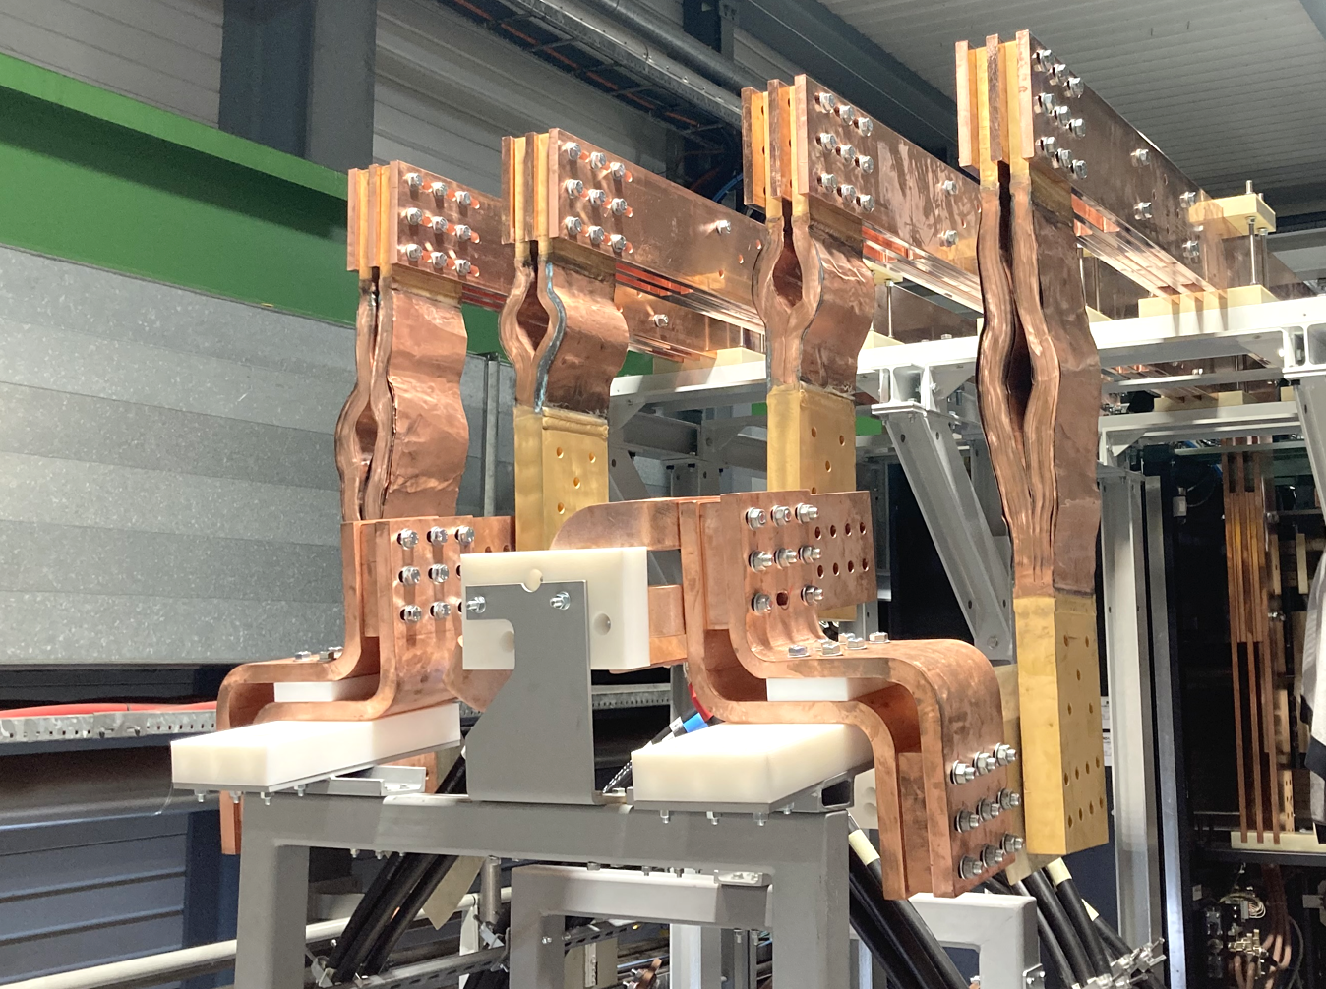
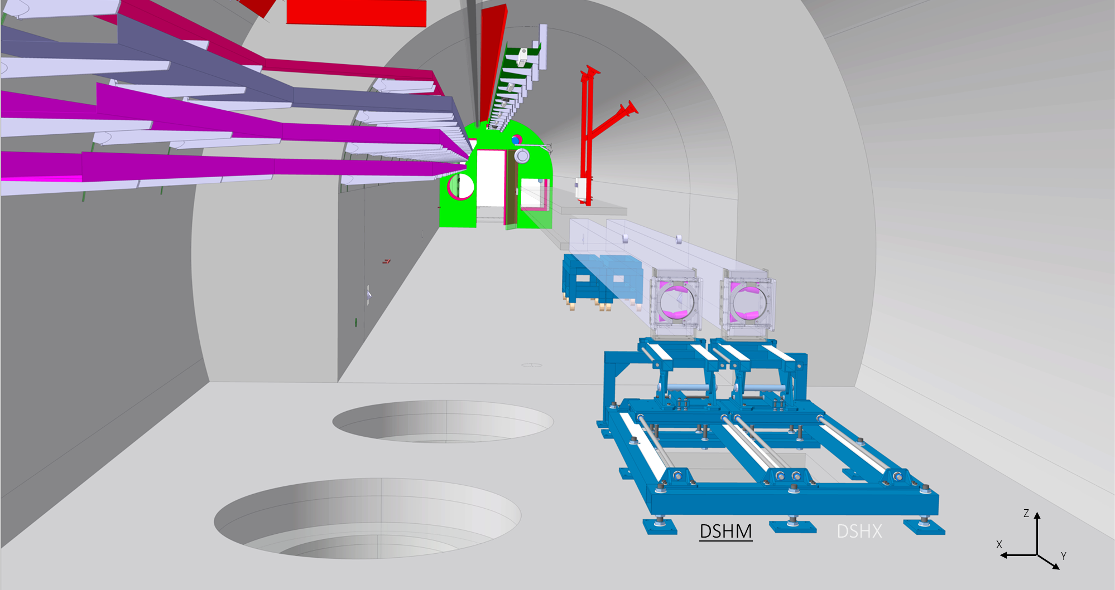
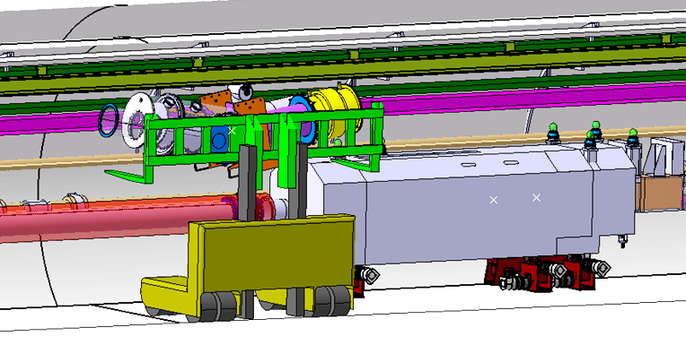
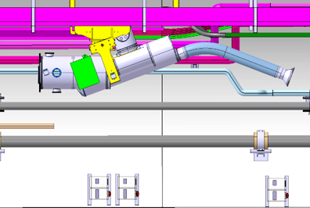
Supports & tooling installation
1
2
3
2
UR – service galleries
  Install cryogenic warm return lines supports
    Use of EN-EL sub-contractor
  Install flexible busbars
    EN-HE + MSC
UL – connecting galleries
  Install shelves
    EN-ACE-COS
  Install cable chains
    EN-HE + MSC
  Install supporting structures
    EN-ACE-COS
LHC tunnel
  Core location : DFX-DSHM tooling
    EN-ACE-COS + MSC
  Tunnel : tray over QXL
    EN-ACE-COS TBC
  D2 location
    DFM support install. & transport
    EN-ACE-COS + EN-HE + MSC
3

Slide 4
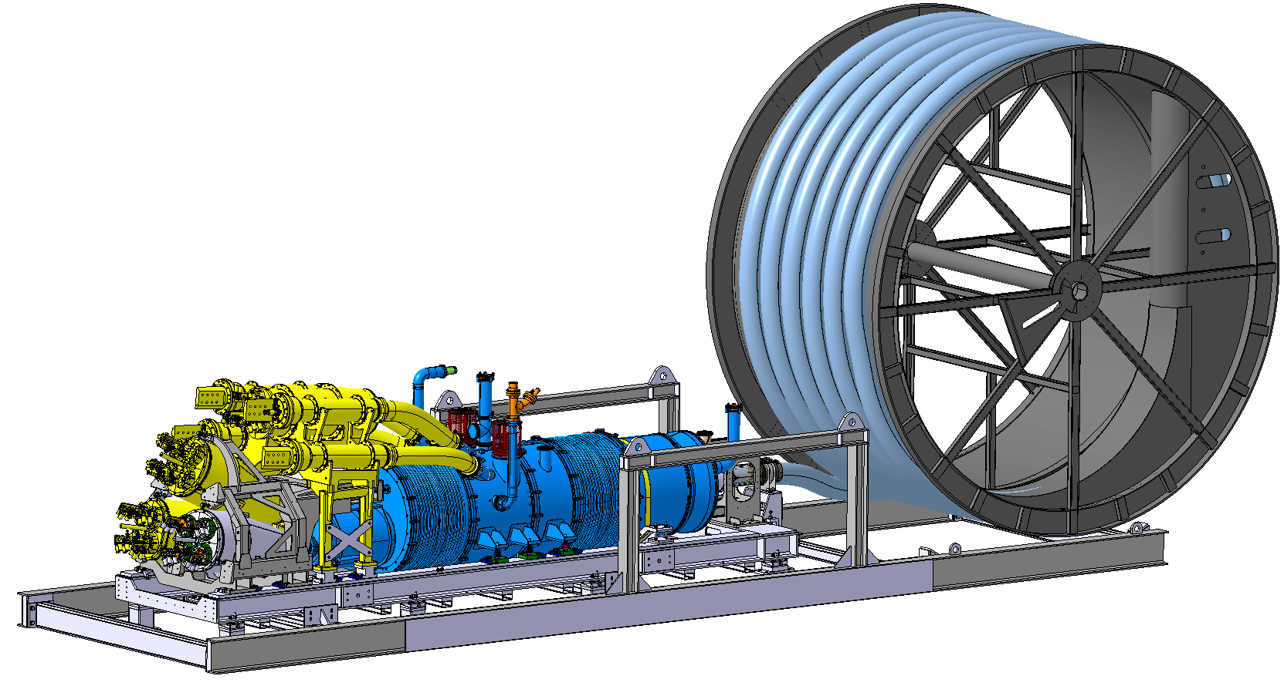
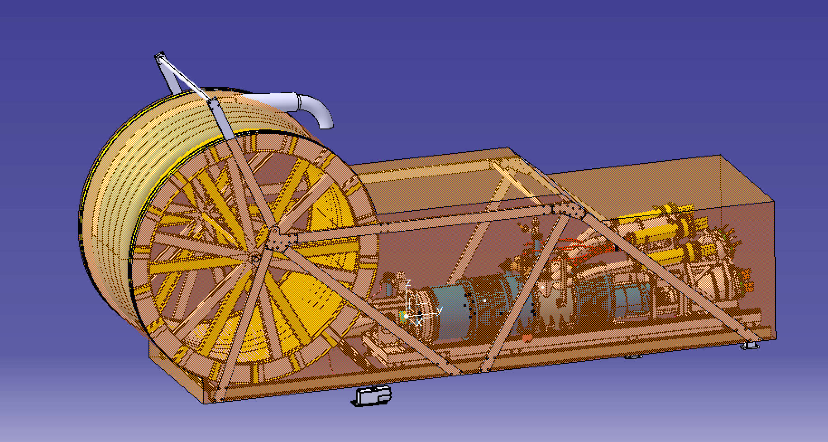
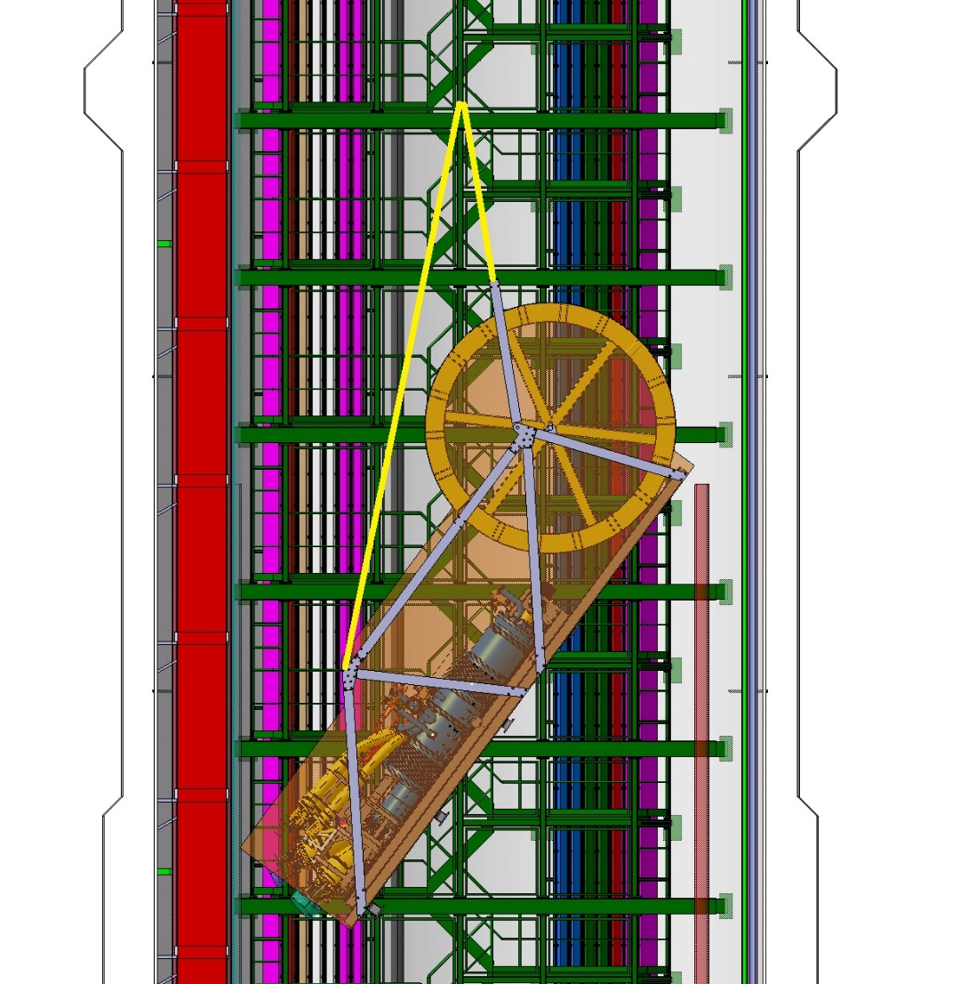
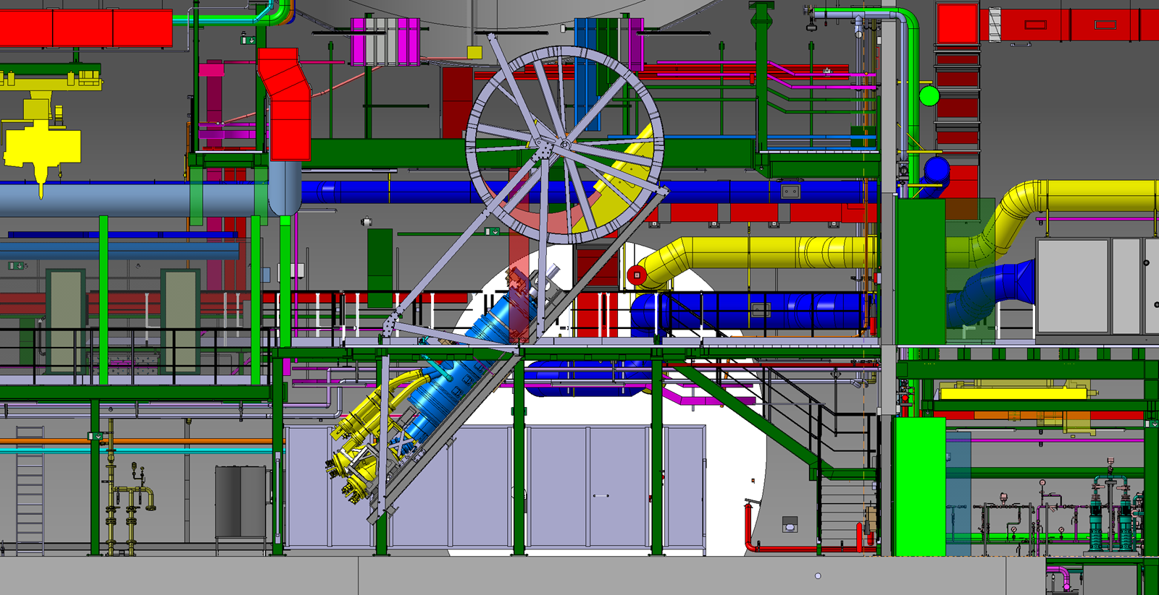

Lowering SCLink+DFH
1
2
3
From Flex to pit
  Transfer to point1/5
    EN-HE
  Install lifting tool
    EN-HE + MSC tbc
Lowering
  Install lifting tool
    EN-HE
  Lower against wall
    EN-HE
Landing
  Reception & load transfer to ground
    EN-HE
  Disconnect overhead crane
    EN-HE

Slide 5
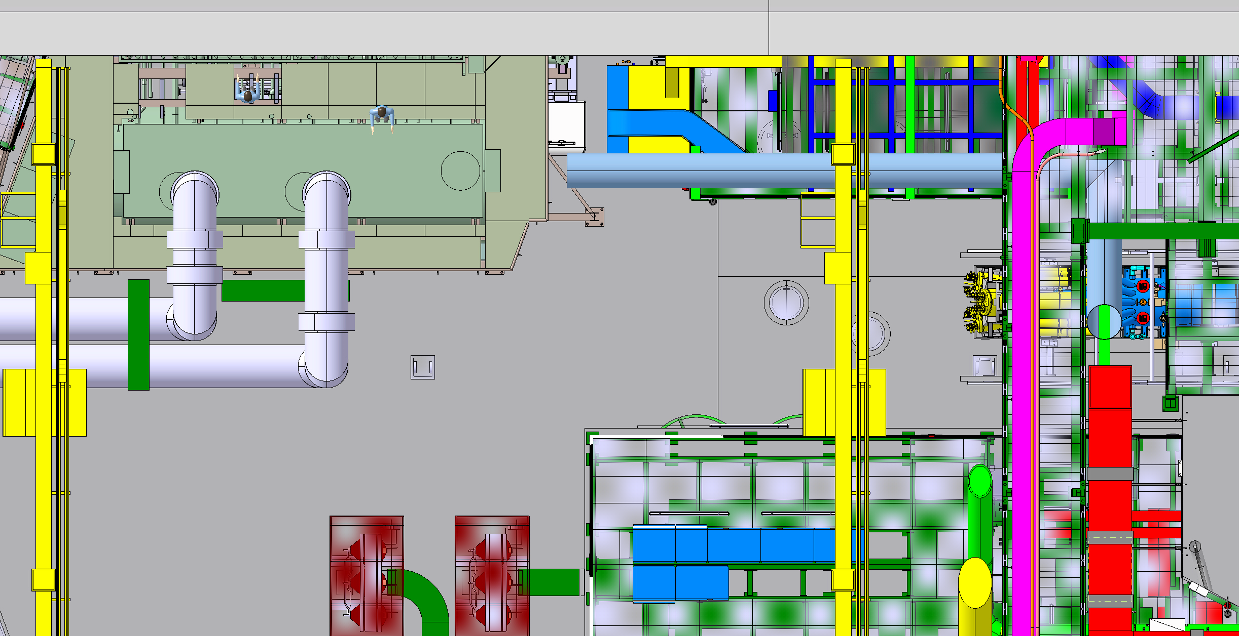
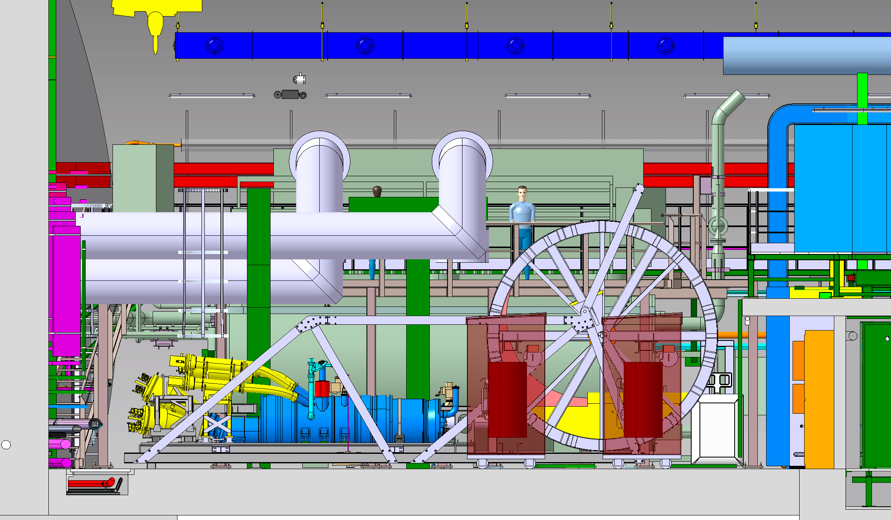
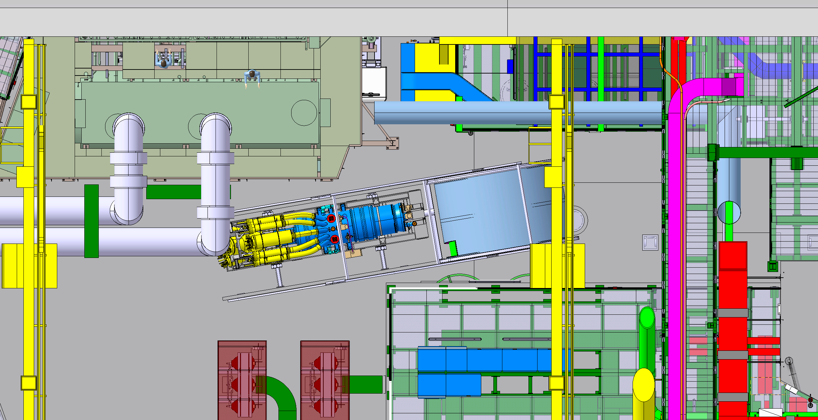
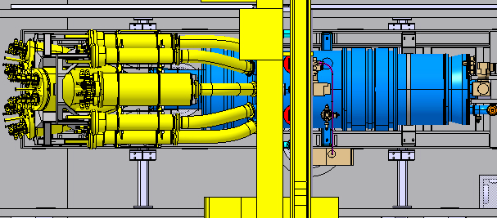
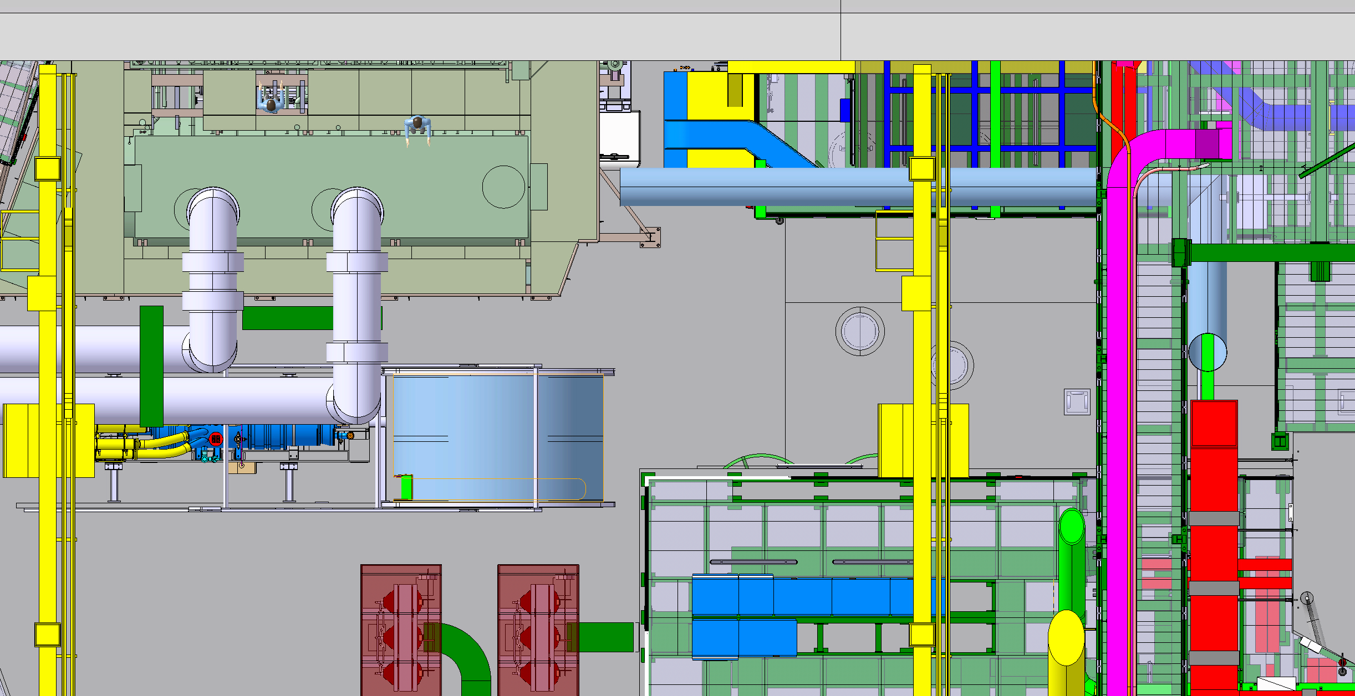
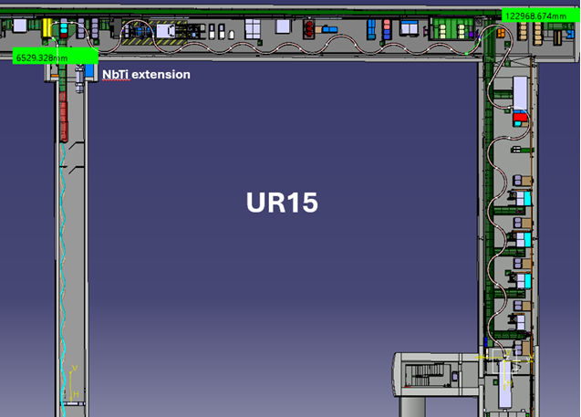
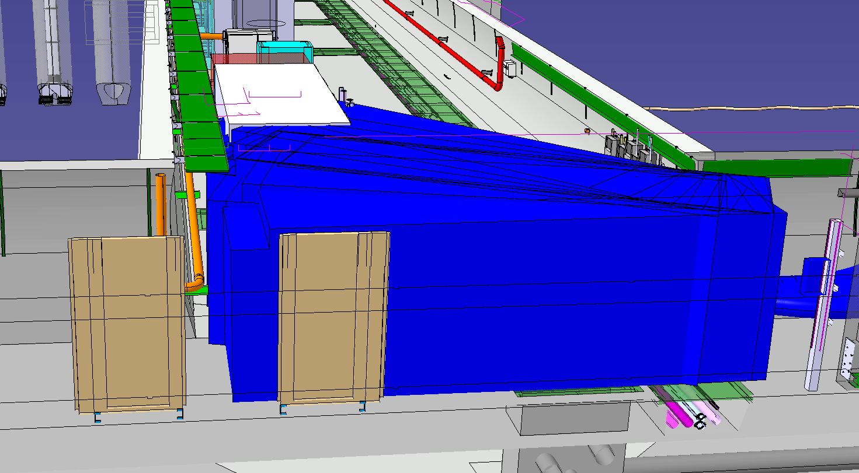
Unspooling
2
1
Position SCLink+DFH
  Transfer to unspooling location
    EN-HE
  Install spooler
    MSC
Unspooling in UR
  P1 then P5 : M-left/X-left/M-right/X-right
    EN-HE + MSC

Slide 6
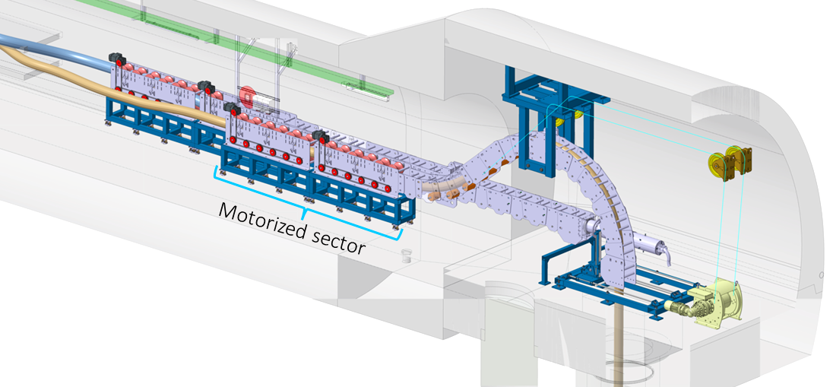
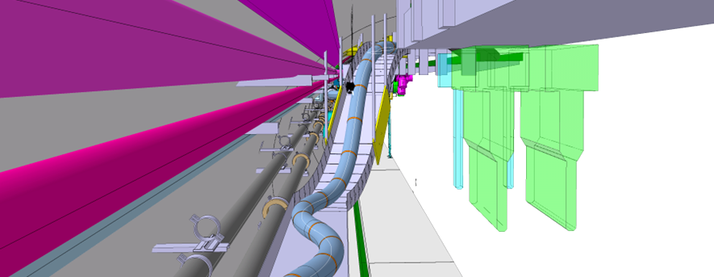
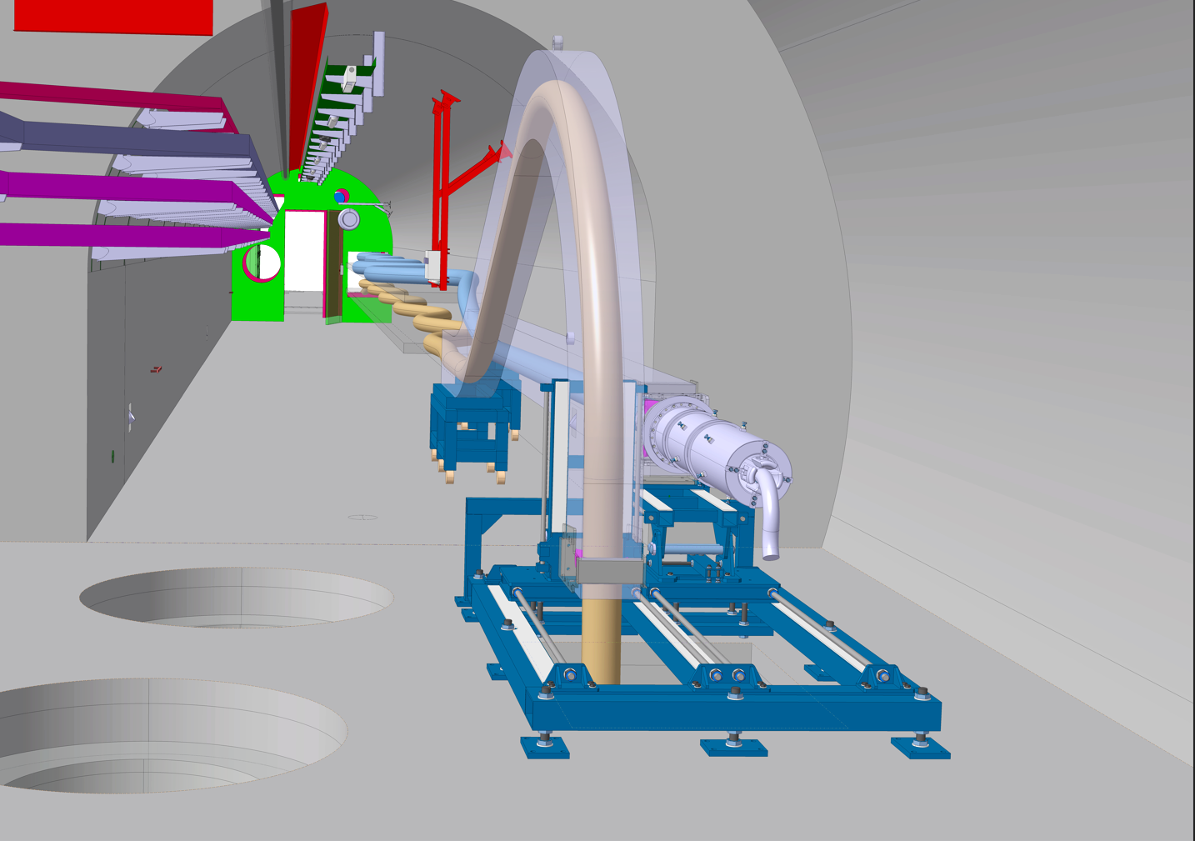
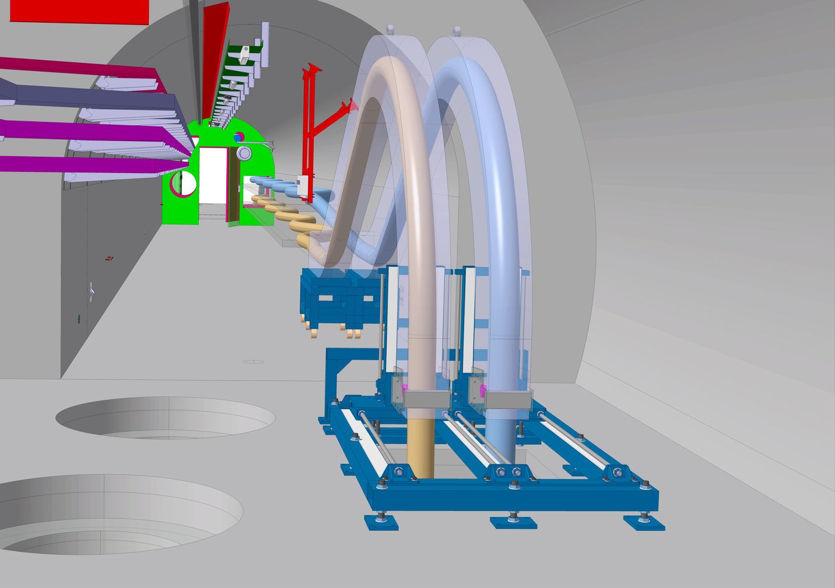
Core insertion
1
3
3
2
1
M-type insertion
  Install on shelves
  Install cable chain horizontally
  Form the SCLink
  Lower the SCLink head
    EN-HE + MSC
M-SCLink routing to DFM
  Transfer from core to QXL tray
  Route to DFM area above QXL
  Store on the wall
    EN-HE + MSC
  QC : Leak & HV test #1
    ElQA + TE-VSC + MSC
X-type insertion
  Install on shelves
  Install cable chain horizontally
  Form the Sclink
  Lower the Sclink head
    EN-HE + MSC
  QC : Leak & HV test #2
    ElQA + TE-VSC + MSC
2

Slide 7
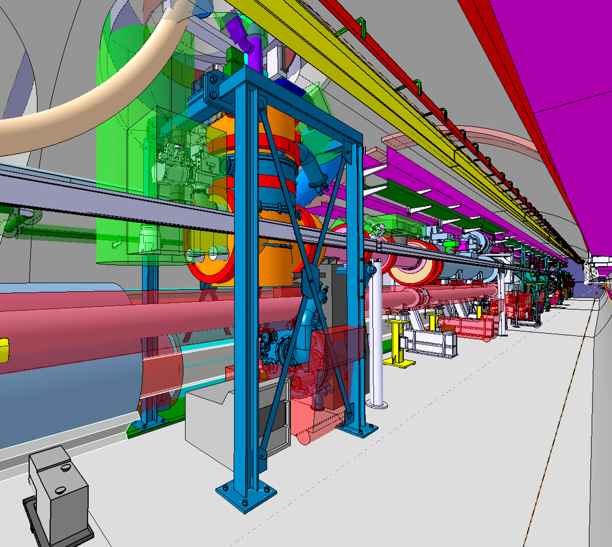
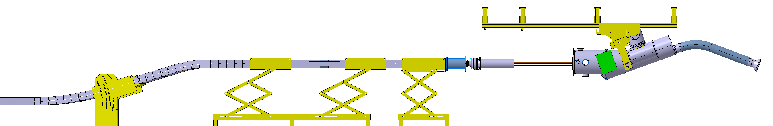
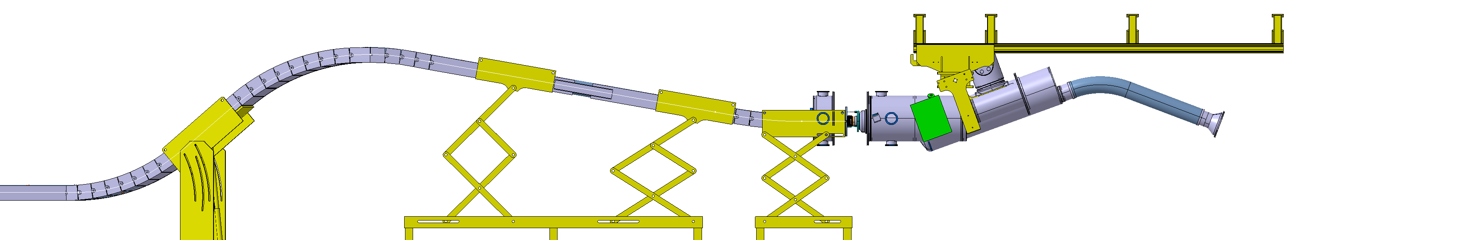
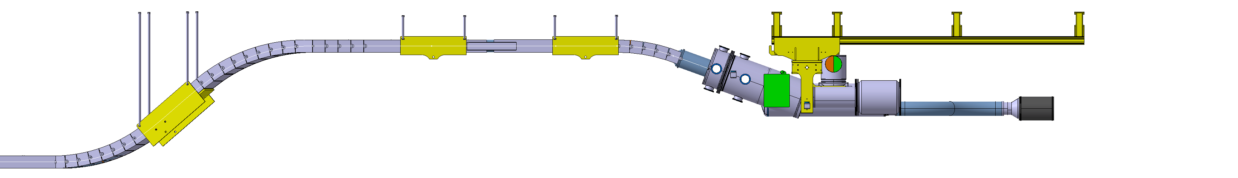
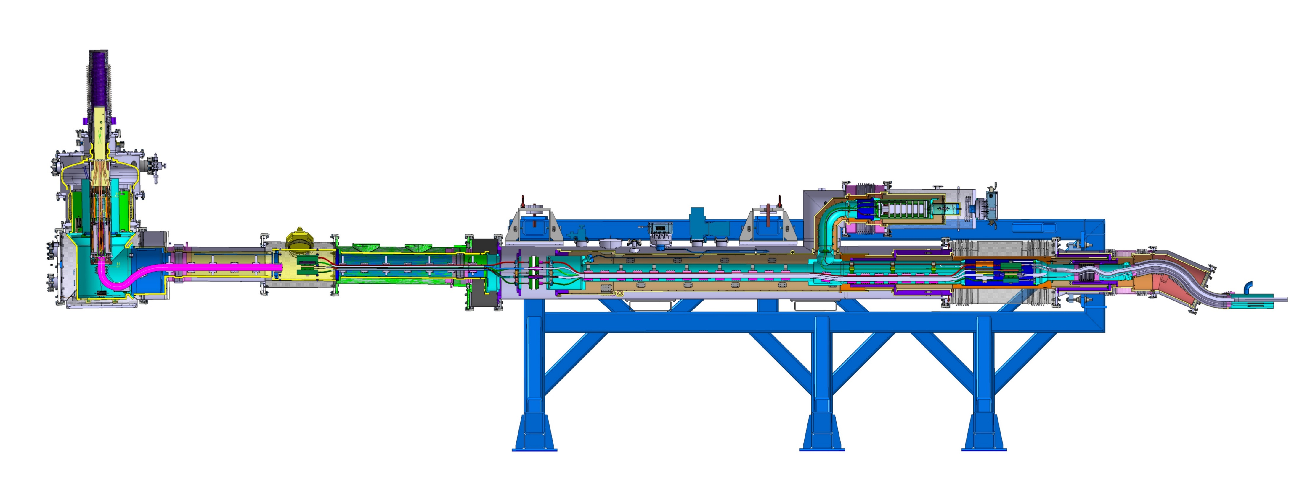
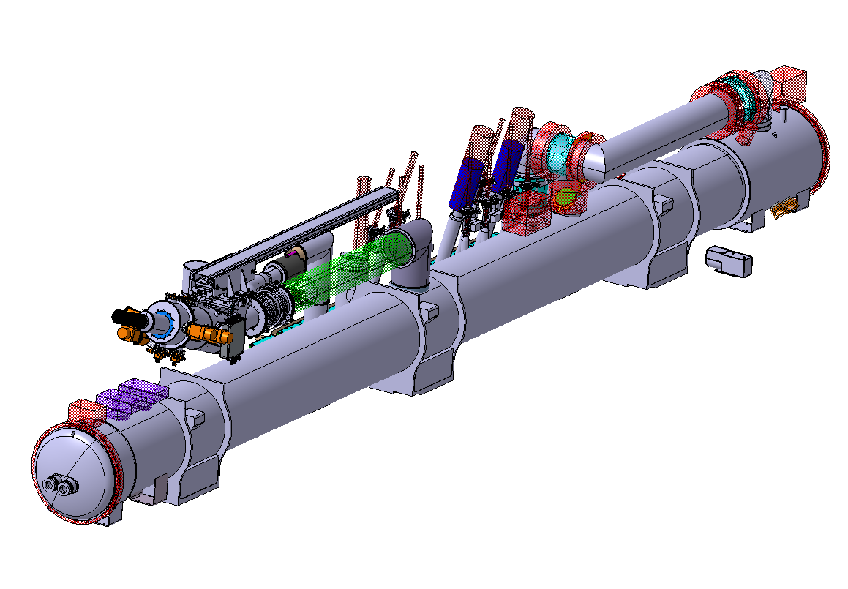
Interfaces
1
1
2
3
2
3
2
3
2
3
UR galleries
  Cryogenic interfaces
    Warm return lines to GMS / MSC
  Electrical interfaces
    Busbars, proximity equipment / MSC
  Quality controls
    ElQA + TE-VSC + MSC
LHC Tunnel
  DFX assembly
    EN-MME + EN-HE + MSC
  DFM assembly
    EN-MME + EN-HE + MSC
  Cryogenic transfer lines
    EN-MME + EN-HE + MSC
  Quality controls #2
    ElQA + EN-MME + TE-VSC + MSC
LHC tunnel – post magnet installation
  IT DFX-DCM interconnect closure
    Instrumentation continuity : MSC
    Vessels closure : EN-MME + MSC
  MS DFM-DQM interconnect closure
    Instrumentation continuity : MSC
    Vessels closure : EN-MME + MSC

Slide 8
Resources summary
SCLink system unspooling
  Continuous activity in series
  “Lowering” supervised by EN-HE
  “Unspooling & core insertion” supervised by WP6a
  MSC : 1 WP6a expert team
DFX & DFM assemblies
  Continuous activity
  DFX&DFM of same system, 50 meters away, in parallel
  MSC : 2 teams with 1 supervision
Interfaces
  Assembly electrical components
  Coordination cryogenic lines installation
  MSC : 2 teams with 1 supervision
Interconnect with Magnets
  Electrical activity (instrumentation) WP6a
  Cryostat closure
  MSC : 2 teams with 1 supervision
WP6a resources during LS3 :
  Latest “in work” planning foresees start of DFX/DFM assemblies after completion of unspooling activity
  1 team for Unspooling – 2 teams for DF assemblies
  Each team
    1 coordinator
    2 or 3 technical staffs
    2/3 industrial support
  Overall coordination
 | Comment | Support | MSC contribution
Preparation phase | In series : Mechanical activities | EN-ACE-COS, EN-HE | Inspection
Lowering, Unspooling | In series : Transport & delicate handling | EN-HE , TE-VSC/ElQA | Handling
DFX/M assemblies | In parallel : DFM & DFX of same system 50m away : Mechanical & Electrical QC | EN-HE, EN-MME TE-VSC, ElQA | Mech & elec.
Interfaces UR | Mechanical & electrical | EN-MME, EN-HE | Assembly : Mech. & Elec.
Interfaces LHC | Mechanical & electrical | EN-HE, EN-MME | Assembly : Mech. & Elec.
In work schedule – WP15
Linear LS3 v02.29
DFX & DFM assembly in parallel for each system
8 x CPS unspooled in series

