Slide 1

The deployment of IPv6 on WLCG – some history
David Kelsey
(Head of Particle Physics Computing Group)
STFC Rutherford Appleton Laboratory
- UK Research and Innovation
28 Jan 2025

Slide 2
Contents of talk
CERN Large Hadron Collider, WLCG & GridPP
HEP networking and data transfers
Why use IPv6?
Preparatory work during 2011-2016
The transition 2016-2020
Problems & lessons learned
Summary
Acknowledgements: All my many colleagues in the HEPiX IPv6 WG, the WLCG IPv6 task force and experts in the Experiments and Sites

Slide 3
Large Hadron Collider (LHC) at CERN, & WLCG

Slide 4
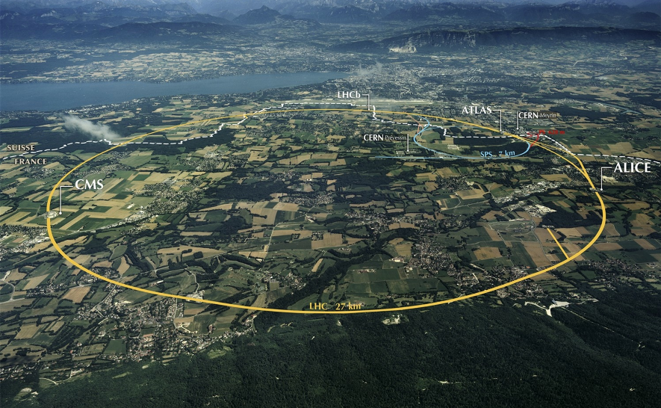
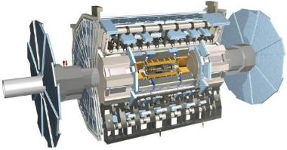
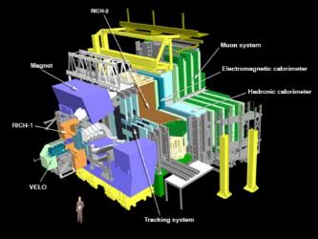
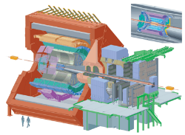
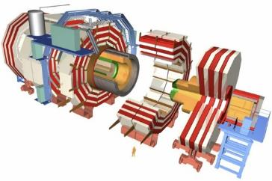
The Large Hadron Collider (LHC)
A new frontier in Energy (13 TeV) & Data volumes: LHC experiments generated 50-70 PB/year in Run 2 (2015-18)

Slide 5

Physics results (Run1) including…
In July 2012 >
Nobel Prize in Physics 2013:
F. Englert &
P. Higgs

Slide 6
Worldwide LHC Computing Grid (WLCG)
The WLCG is a global collaboration
more than 170 computing centres in 42 countries
Its mission is to store, distribute and analyse the data generated by the LHC experiments
Sites hierarchically arranged with three tiers:
  Tier-0 at CERN (and Wigner in Hungary)
  13 Tier-1s (mainly national laboratories)
  >150 Tier-2s (generally university physics laboratories)

Slide 7
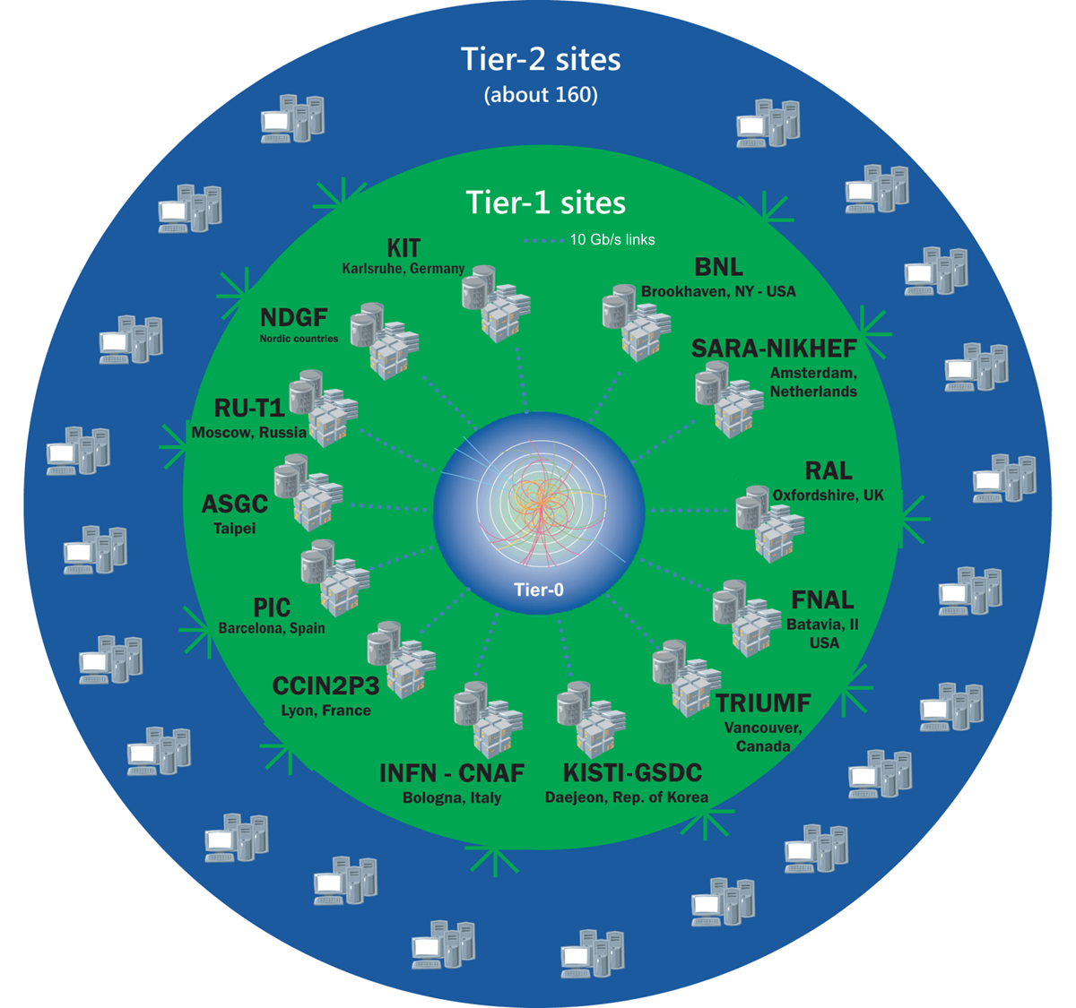
WLCG Tiers Hierarchy
Tier-0
(CERN and Hungary):
data recording, reconstruction and distribution
Tier-1: permanent storage, re-processing, analysis
Tier-2: Simulation,
end-user analysis
~750k CPU cores
~ 1 EB storage
> 2 million jobs/day
10-100 Gbps links
Image from 2014

Slide 8
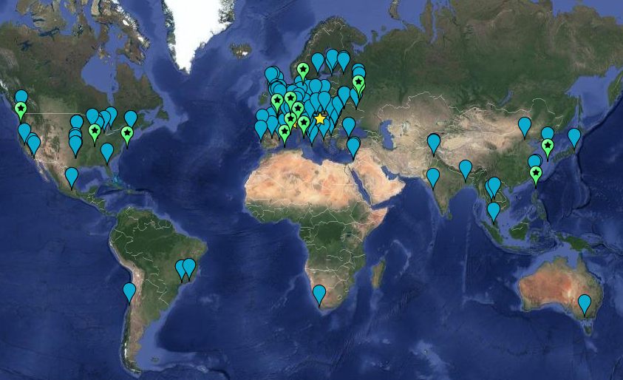

WLCG sites

Slide 9
High Energy Physics Networking

Slide 10
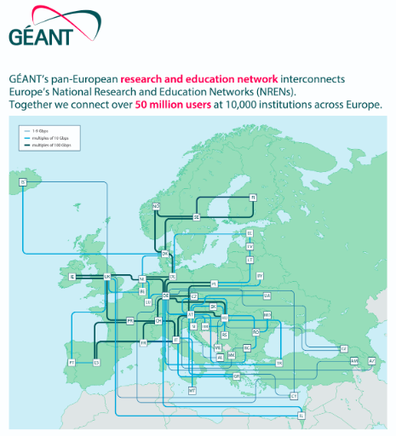

Slide 11


Slide 12
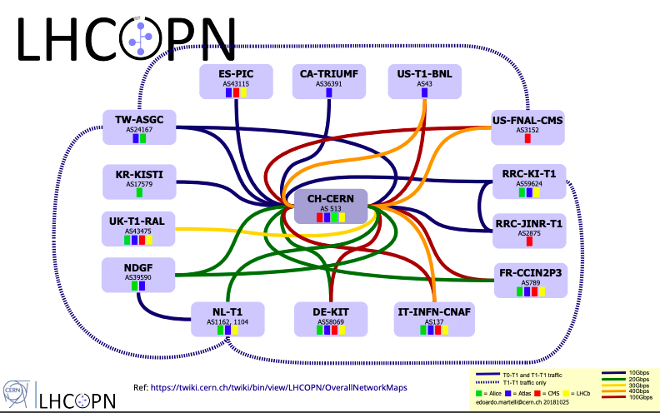
LHCOPN – optical private net
Connect Tier-0 and Tier-1s

Slide 13
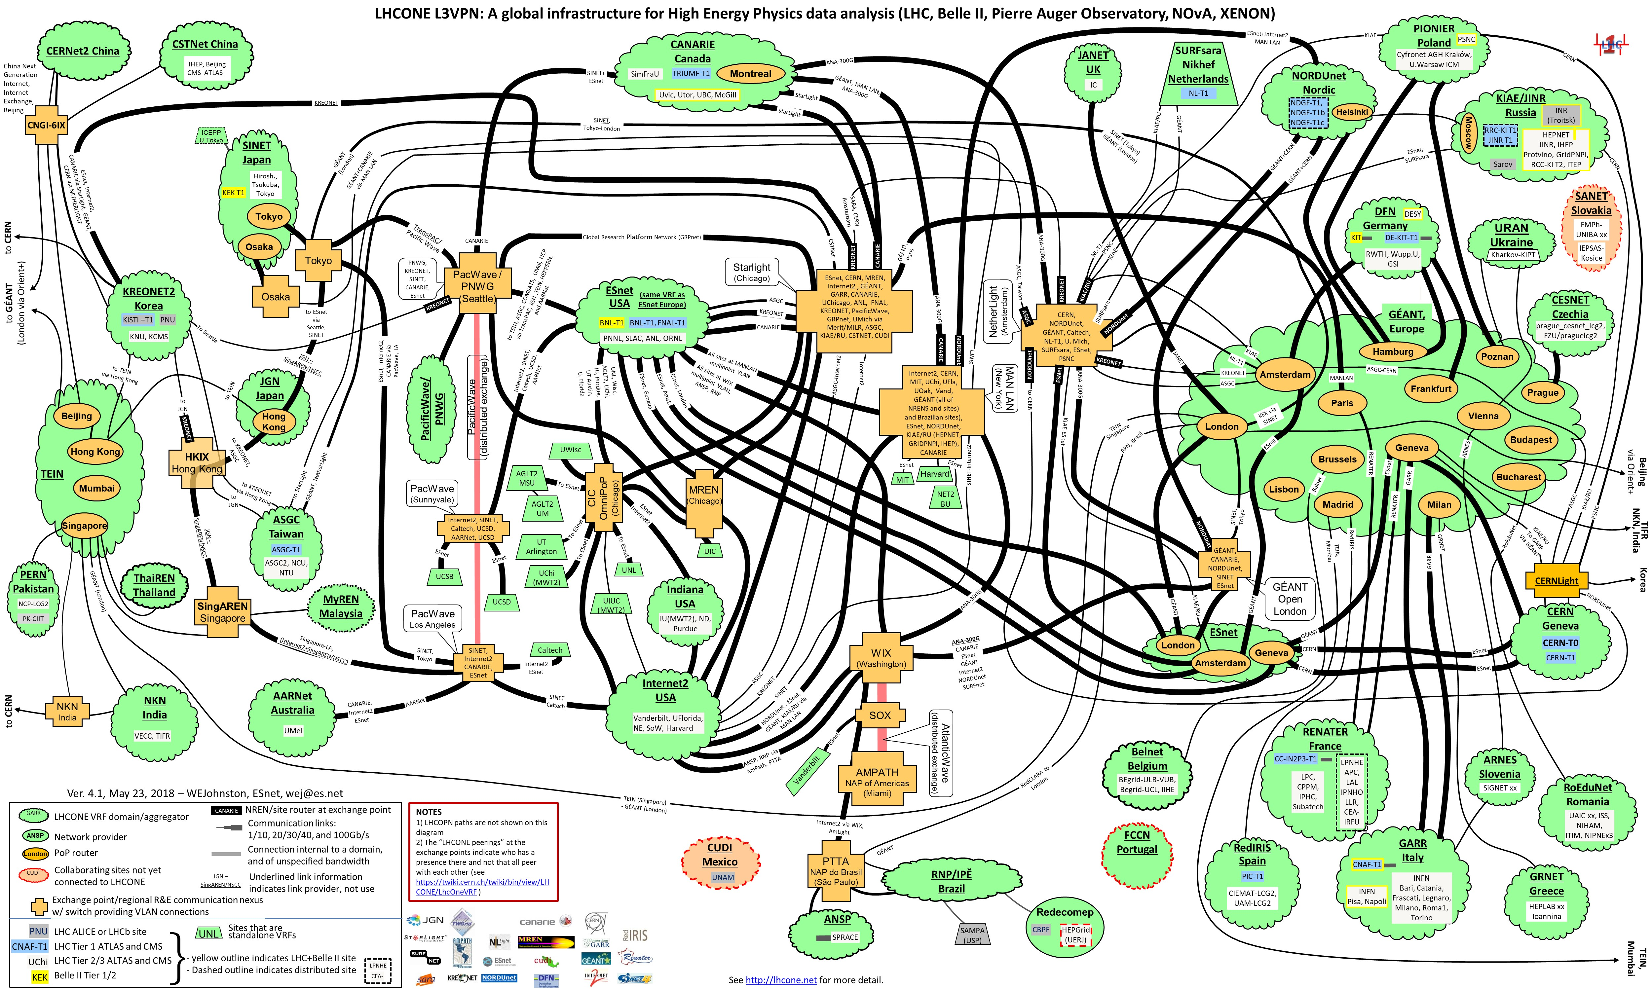
LHCONE – L3VPN

Slide 14
WLCG Data Transfers
(from 2019 – old)

Slide 15
Data transfers in WLCG
From Tier-0 to Tier-1s
From Tier-1s to Tier-2s
Requirements – Fast and reliable!
Multiple protocols and implementations, but the standard approach is:
FTS3 and GridFTP
Bulk data transferred between storage clusters with the File Transfer Service (FTS3) using GridFTP
Also data transfer from federated data storage using a HEP-specific protocol called XrootD
direct access to data by an analysis job at one site from storage at another

Slide 16

Globus GridFTP
High-performance, reliable, optimized for high-bandwidth WANs
Based on FTP protocol
  with extensions for high-performance operation and security
Standardized through Open Grid Forum (OGF)
Implementation provided by the Globus Alliance
Performance
- Parallel TCP streams, optimal TCP buffer
- Non TCP protocol such as UDT (reliable UDP)
Cluster-to-cluster data movement
Multicasting, Overlay routing
Multiple security options
  Anonymous, password, SSH, GSI
Support for reliable and re-startable transfers

Slide 17
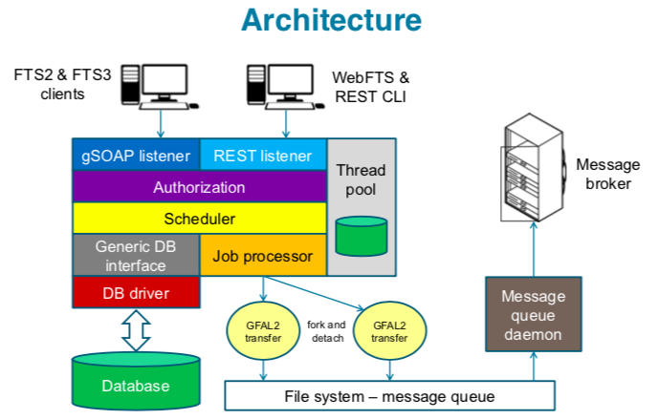
File Transfer Service (FTS3)
Powerful and reliable file transfer service
Supports multiple protocols, standard API
zero configuration
web monitoring
web interface
use of federated IDs
3rd-party transfers:
  source and destination can both be remote data centers

Slide 18
Why should WLCG use IPv6?

Slide 19
Why IPv6?
Survey of 18 major HEP sites (Sep 2010) – IPv6 readiness
  National NRENs ready, Universities and Labs not ready
  Some reported lack of IPv4 address space, including CERN
HEPiX meeting – Cornell, Ithaca NY – Nov 2010
  Projected IANA IPv4 address exhaustion
  Sep 2010 – memo from US Federal CIO to all Exec depts (incl DOE)
Offers of opportunistic CPU resources which could be IPv6-only
  Experiments want to be able to use them
Recognition that much of our middleware, software and technology was not yet IPv6 capable
HEPiX decided to create a working group (started April 2011)
  No specific funding – but motivated, competent volunteers!

Slide 20
Preparatory work during
2011-2016

Slide 21
HEPiX IPv6 Working Group
Phase 1 – full analysis of work to be done
  Applications, system and network tools, operational security
  Create and operate a distributed test-bed
    No interference with WLCG production data analysis!
  Propose timetable and plan for transition
2012
CERN announces shortages of routable IPv4 addresses
  explosion of virtualisation
Active HEPiX IPv6 test-bed with ~ 12 sites
  engagement of all 4 LHC experiments
Testing regular data transfers across the testbed
Testing dual-stack services (production) at Imperial College London
Concluded not able to support IPv6-only clients until at least 2014

Slide 22
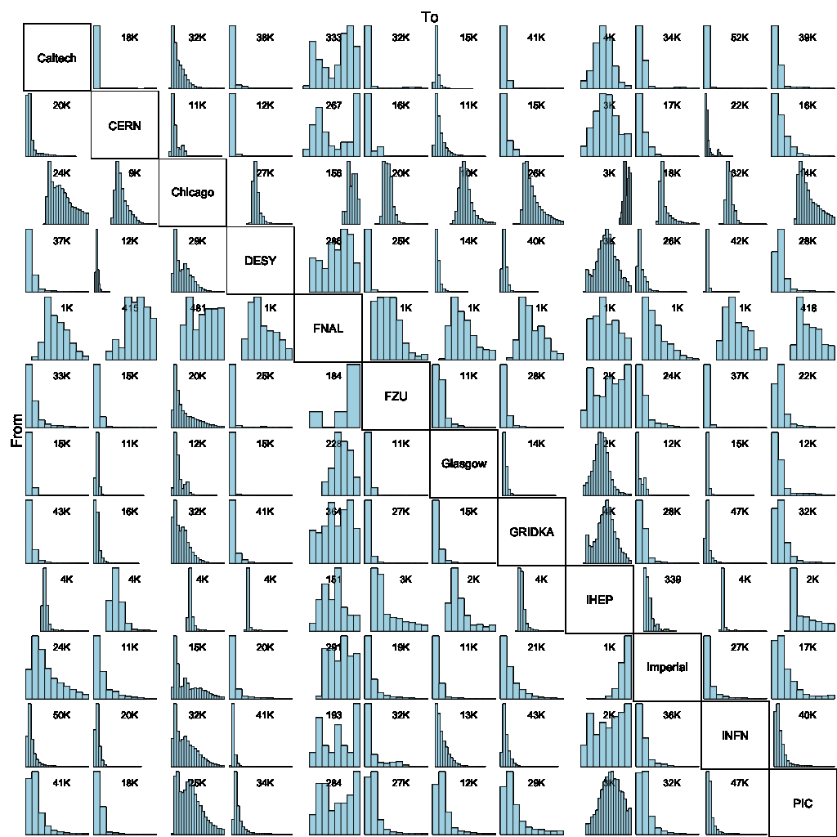
At CHEP2013 conference
> 2 PB data transferred over IPv6 in last 6 months
Success rate > 87%
Very High!
GridFTP IPv6 data transfer mesh

Slide 23
2013-14 Data Management
Testing the important data transfer protocols, technology and data storage/file systems
  For IPv6-readiness
GridFTP, DPM, dCache, xRootD, OpenAFS, FTS, CASTOR
  Found many problems needing work
    Worked closely with developer community
Concluded IPv6 support will be much later than 2014!

Slide 24
2015
At CHEP conference in April 2015
  75% of Tier-1 sites are IPv6-ready (but only 20% of Tier2)
  10% of sites now reporting lack of IPv4 addresses
Most important IPv6-only use case
  Sites, Clouds providing CPU (virtual machines)
  Opportunistic resources may be IPv6-only
  Need dual-stack federated storage services
  And dual-stack central WLCG and Experiment services

Slide 25
The transition 2016-2020

Slide 26
2016
Continue to push for
  deployment of production dual-stack data services
  LHCOPN (Tier0-Tier1 private network)
    IPv6 peering everywhere
perfSONAR – end to end network monitoring – dual-stack
Move central services and central monitoring to IPv6
Wrote guidance on IPv6 security for WLCG sites
Deployment timetable approved by WLCG Management Board (Sep 2016)

Slide 27
WLCG – IPv6 deployment
Plan approved by WLCG Management Board
April 2017 – support for IPv6-only CPU starts
  Tier-1s to provide dual-stack storage (in testbed)
April 2018
  Tier-1 dual-stack storage in production mode
By end of LHC Run 2 (end 2018)
  A large number of Tier-2s to migrate storage to IPv6
  All requested to do this

Slide 28
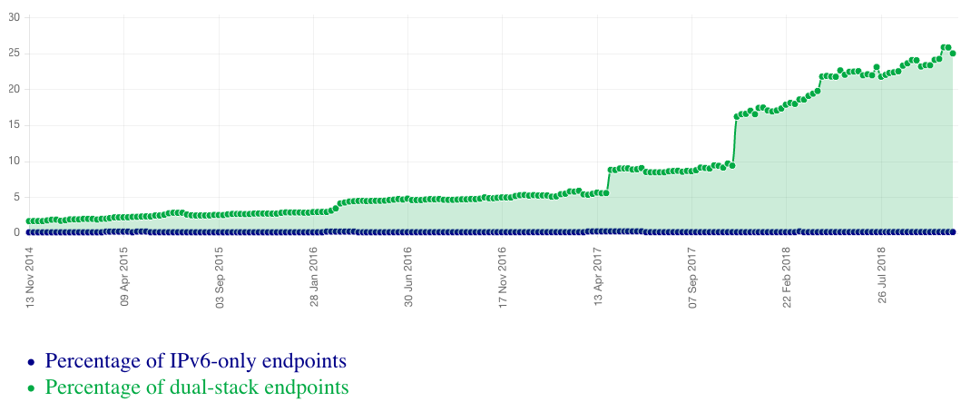
Growth of dual-stack hosts in the WLCG
~25%
All services, not just storage
Fraction of endpoints listed in the CERN central BDII (lcg-bdii.cern.ch) where the DNS returns a dual-stack IPv6-IPv4 (A+AAAA) resolution (green line) or an IPv6-only resolution (blue line). (http://orsone.mi.infn.it/~prelz/ipv6_bdii/).

Slide 29
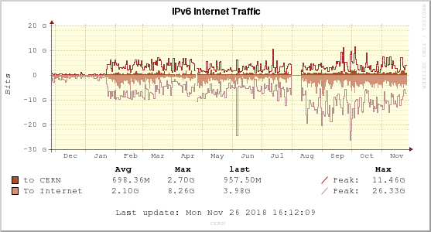
Turning on IPv6 on CERN Tier-0 disk storage (EOS) in Jan 2018
Non-LHCOPN/non-LHCONE traffic

Slide 30
Tier-1 and Tier-2 transition tracking
11 Tier-1s are now IPv6 capable
All have dual-stack storage except for 3
  To be fixed in 1Q2019
115 Tier-2 sites requested to deploy dual-stack perfSONAR and storage by end of Run 2 (end of 2018)
  USA taking care of their sites
Follow up with assistance, checking deployment etc
Largest blocker:
  Sites waiting for campus infrastructure to be IPv6-ready

Slide 31
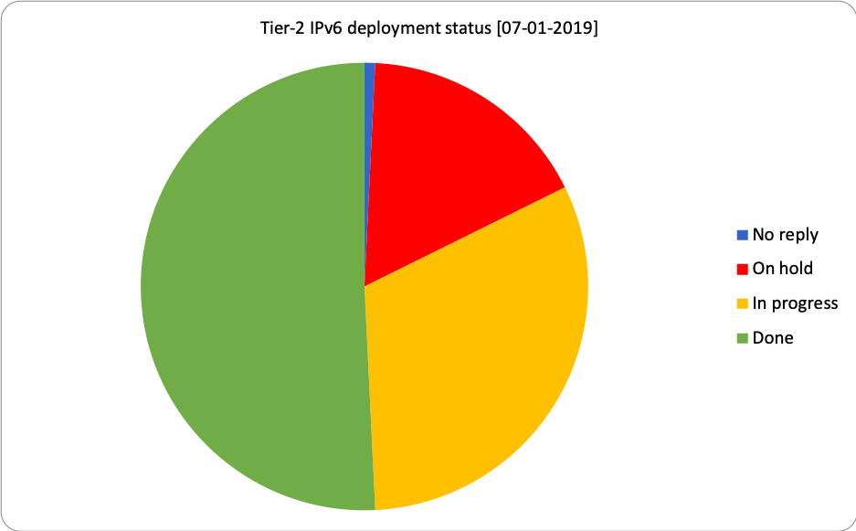
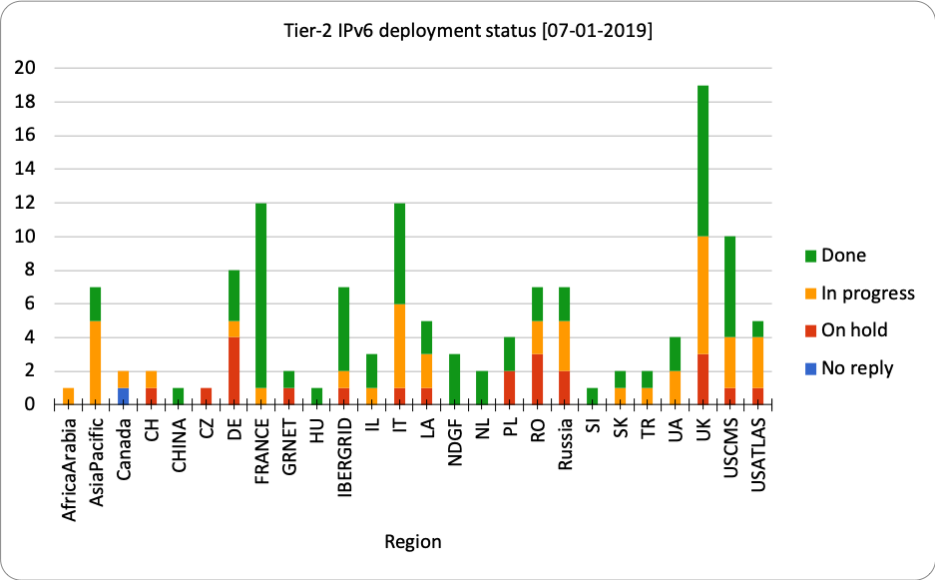
Tier-2s: Old status - 130 Tier-2 sites (Jan 2019)
>50% of Tier-2s now with dual-stack perfSONAR and storage
https://twiki.cern.ch/twiki/bin/view/LCG/WlcgIpv6#WLCG_Tier_2_IPv6_deployment_stat
31

Slide 32
Storage accessible 2018 over IPv6
Experiment | Fraction of Tier-2 storage accessible via IPv6
ALICE | 51%
ATLAS | 37%
CMS | 65%
LHCb | 33%
Overall | 49%
Country | Fraction of Tier-2 storage accessible via IPv6
UK | 53%

Slide 33
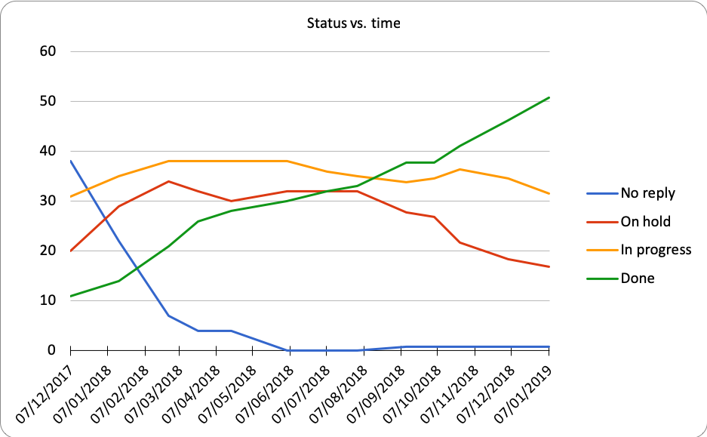
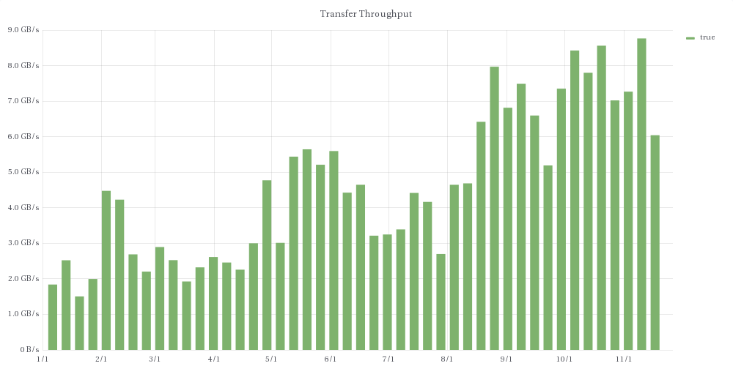
Tracking IPv6 during 2018
7 GB/s
Transfer Throughput over IPv6
2 GB/s

Slide 34
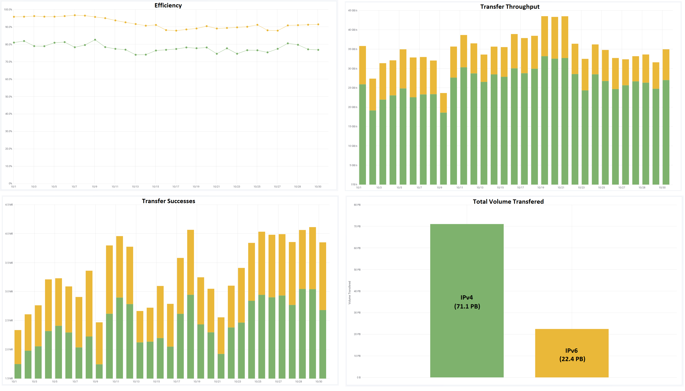
FTS3 file transfers (Oct 2018) ~24% IPv6
Efficiency
Throughput
Successes
Total 93.5 PB
IPv4 71.1 PB
IPv6 22.4 PB

Slide 35
End to end network monitoring

Slide 36
perfSONAR – network monitoring
Developed by ESnet, GEANT, Indiana University and Internet2
perfSONAR, a widely-deployed test and measurement infrastructure
used by science networks and facilities around the world
to aid in network diagnosis
allowing users to characterize and isolate problems
measurements of network performance metrics over time as well as “on-demand” tests’
perfSONAR is IPv6 compatible
http://www.perfsonar.net/about/what-is-perfsonar/
WLCG goals with perfSONAR
  Find and isolate “network” problems; alerting in time
  Characterize network use such as finding base-line performance
  In the future: provide a source of network metrics for higher level services

Slide 37
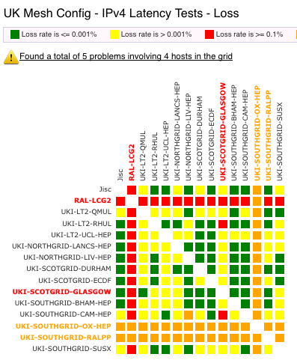
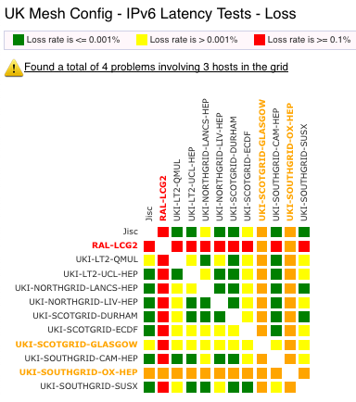
perfSONAR dashboards
WLCG has meshes for a variety of groupings e.g. the LHCOPN, CMS and ATLAS
UK also runs one: throughput, latency, loss, traceroute
Gives insight into network performance over IPv6 and IPv6 within UK
https://ps-dash.dev.ja.net/maddash-webui/index.cgi?dashboard=UK%20Mesh%20Config

Slide 38
Not everything went smoothly!

Slide 39
Problems & lessons learned
Many blocking issues outside of our own control
  Both software and site networking teams
Developers claim that software is fully IPv6-compliant!
Software/protocols fixed-size storage for IP addresses
Software/protocols assume single address (as in IPv4)
Performance differences between IPv4 & IPv6
  IPv6 must perform at least as well
Have to understand cases where fraction of IPv6 is smaller than expected
  Preference for IPv6 over IPv4 must be established
Can be lots of development effort and testing is not easy when no other positive change re functionality
Sys admins, operations staff, security team, developers
  All need TRAINING and experience

