Slide 1
Advanced Training School on Operation of Accelerators
CERN, 12-16 May 2025
Organizers: F. Asvesta, M. Borge, R. Corsini, I. Efthymiopoulos, D.Gamba, P. Korysko, M.Lozano, L.Ponce, T. Prebibaj, A. Rodrigues
I. Efthymiopoulos
ATSOA25 Meeting, 12.05.2025

Slide 2
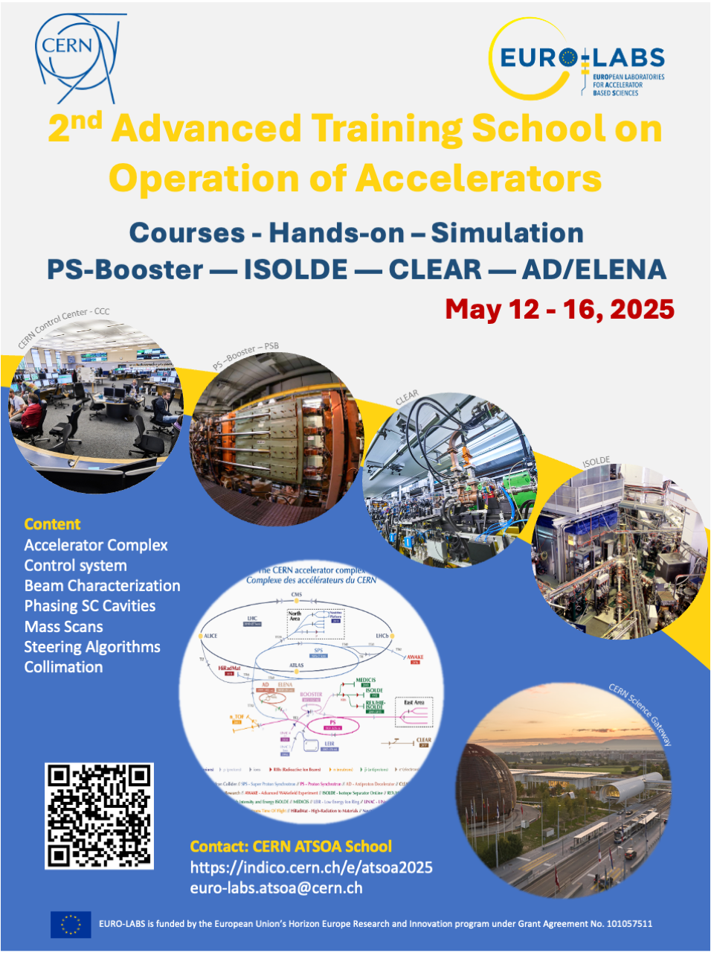
ATSOA 2025 @ CERN
Welcome!
Event web : https://indico.cern.ch/e/atsoa2025
Thank you for your interest to the school
We hope the school will be interesting for you, and what you will learn, as well as the overall experience, will be profitable for your future career

Slide 3
ATSOA 2025 @ CERN
Advanced
  no real prerequisite, basic knowledge of physics, electromagnetism, mathematics and programming – ready to learn and explore
Training
  content – subjects/topics - hands-on on – learn principles and apply to real systems
School
  students/trainees – lecturers/instructors - exercises
Operation of Accelerators
  Beam production/manipulation – systems in accelerators – practice with real beams
us
you

Slide 4

Accelerators
AD Complex
ELENA
D.Gamba
L. Ponce
ISOLDE
A. Rodriguez
CPS Complex
PSB + PS
F. Asvesta
T. Prebibaj
CLEAR
R. Corsini
P. Koryzko

Slide 5
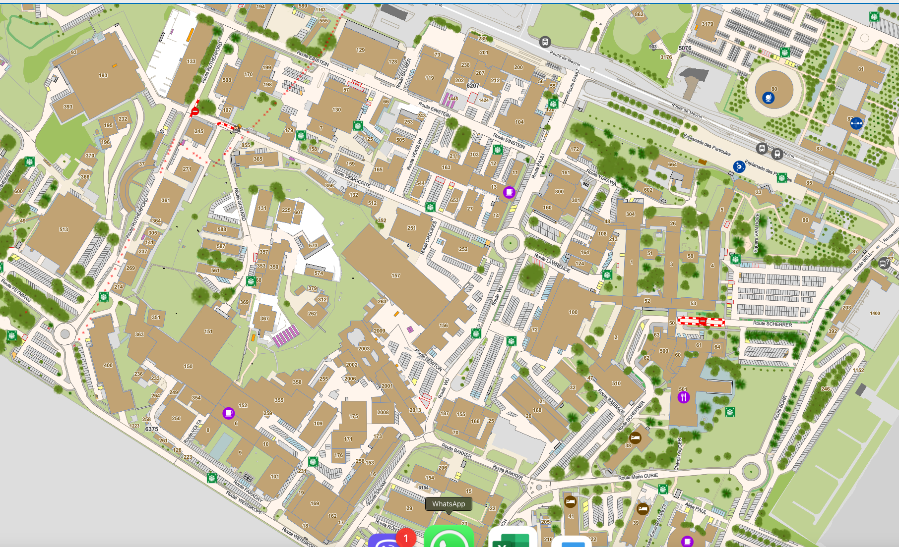
Map - locations
Tram to Geneva
AD/ELENA
(b 193)
ISOLDE
(b 508)
Main restaurant
Shuttle to CERN Prevesin - PSB
Building 6
Hostel
CLEAR
(b 2008)

Slide 6
ATSOA25 - The Program
 | Group A (6) | Group B (4) | Group C (5) | Group D (4)
Hans-on | ISOLDE - PSB | CLEAR - AD | PSB - ISOLDE | AD - CLEAR
Visit | CLEAR | ISOLDE | AD | PSB
 | Monday 03/06 | Tuesday 04/06 | Wednesday 05/06 | Thursday 06/06 | Friday 07/06
AM 09:00 – 12:00 | Introduction All | hands-on ISOLDE : Group A PSB: Group C CLEAR: Group B AD: Group D | visit ISOLDE: Group B PSB: Group D CLEAR: Group A AD: Group C | hands-on ISOLDE: Group C PSB: Group A CLEAR: Group D AD: Group B | Prep presentations All
Lunch 12:00 – 14:00
PM 14:00 – 17:30 | hands-on ISOLDE : Group A PSB: Group C CLEAR: Group B AD : Group D | hands-on ISOLDE : Group A PSB: Group C CLEAR: Group B AD : Group D | hands-on ISOLDE : Group C PSB: Group A CLEAR: Group D AD: Group B | hands-on ISOLDE : Group C PSB: Group A CLEAR: Group D AD: Group B | Closing All

Slide 7
ATSOA25 - Visits
 | Group A (6) | Group B (4) | Group C (5) | Group D (4)
Hans-on | ISOLDE - PSB | CLEAR - AD | PSB - ISOLDE | AD - CLEAR
Visit | AD-CLEAR | ISOLDE-PSB | AD-CLEAR | ISOLDE-PSB
Group A + Group C (11 students)
AD/ELENA | 09:00 – 10:30
CLEAR | 10:45 – 12:00
Group B + Group D (8 students)
CCC/PSB | Shuttle #5 bldg. 500 08:33 – CCC 08:51 CCC 09:51 – bldg. 13 10:01
ISOLDE | 10:15 – 12:00

Slide 8
ATSOA25 - The Program
Friday closing session
  Each group prepares a short presentation (oral and/or slides) on things they learned, what they will take home
  AND
  questions or issues they would like to further discuss

Slide 9
ATSOA25 - Practicalities
School Dinner on Wednesday
  Two alternatives – depending on the weather!!
    nearby Pizzeria
    Restaurant down-town Geneva
  I will inform you by e-mail and also confirm participation
Expenses – Reimbursement
  You pay for lunch/dinner and CERN hostel.
  Please provide, as instructed, the Invoice of the Hostel timely to initiate the reimbursement

Slide 10
ATSOA25 - Practicalities
School survey
  Feedback (form on indico) on the school organization courses, and overall experience
  I would appreciate it if you could fill it all of you!
Certificate of attendance
  I will provide an attendance certificate for the school by email a few days after the end of the School
I propose we create a WhatsApp or Viber group for fast communication
  Volunteers?

