Slide 1
2nd CERN Advanced Training School on Operation of Accelerators
@ ELENA
D. Gamba, L. Ponce, et al.
12/05/2025 – ATSOA2025

Slide 2
Outline
The Antimatter Complex at CERN: AD/ELENA
  What it is and how it works
  Chosen specificity: e-cooling
Expectations for the week
Where is the control room?!
For the groups coming to ELENA:
  Recall on tune and coupling
  How does an e-cooler look like?
  Tune and Cooling interplay: is this important?
  Your tools, and what you should be careful about

Slide 3







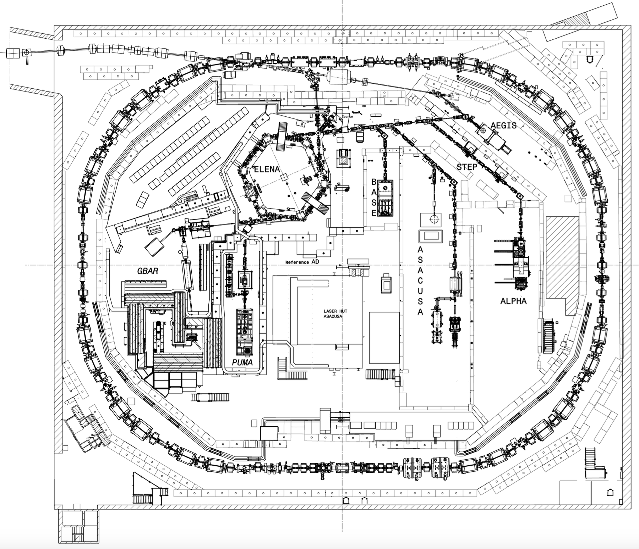
AD/ELENA: a Unique pbar Facility!
Six collaborations, pioneering work by Gabrielse, Oelert, Hayano, Hangst, Charlton et al.
The only place in the world with low energy pbars in a synchrotron!
Serving 60 Research Institutes/Universities – 350 Scientists – 6 Active Collaborations
ASACUSA
Antiprotonic helium spectroscopy
BASE, BASE-STEP
Fundamental properties
of the proton/antiproton, tests of clock WEP / tests of exotic physics / antimatter-dark matter interaction, etc...
PUMA
Antiproton/nuclei scattering to study neutron skins
AD ring length: 182 m
26 GeV protons
on iridium target
antiprotons
Momentum selection
(3.57 GeV/c) chicane
30 m
AD deceleration
(to 5.3 MeV)
- since 1999 -
ALPHA,
Spectroscopy of 1S-2S in antihydrogen
ASACUSA, ALPHA
Spectroscopy of GS-HFS in antihydrogen
ALPHA, AEgIS, GBAR
Test free fall weak equivalence principle with antihydrogen
ELENA decelerator
(to 100 keV)
- since 2018 -
antihydrogen
Electrostatic transfer line to experiments
- since 2021 -

Slide 4
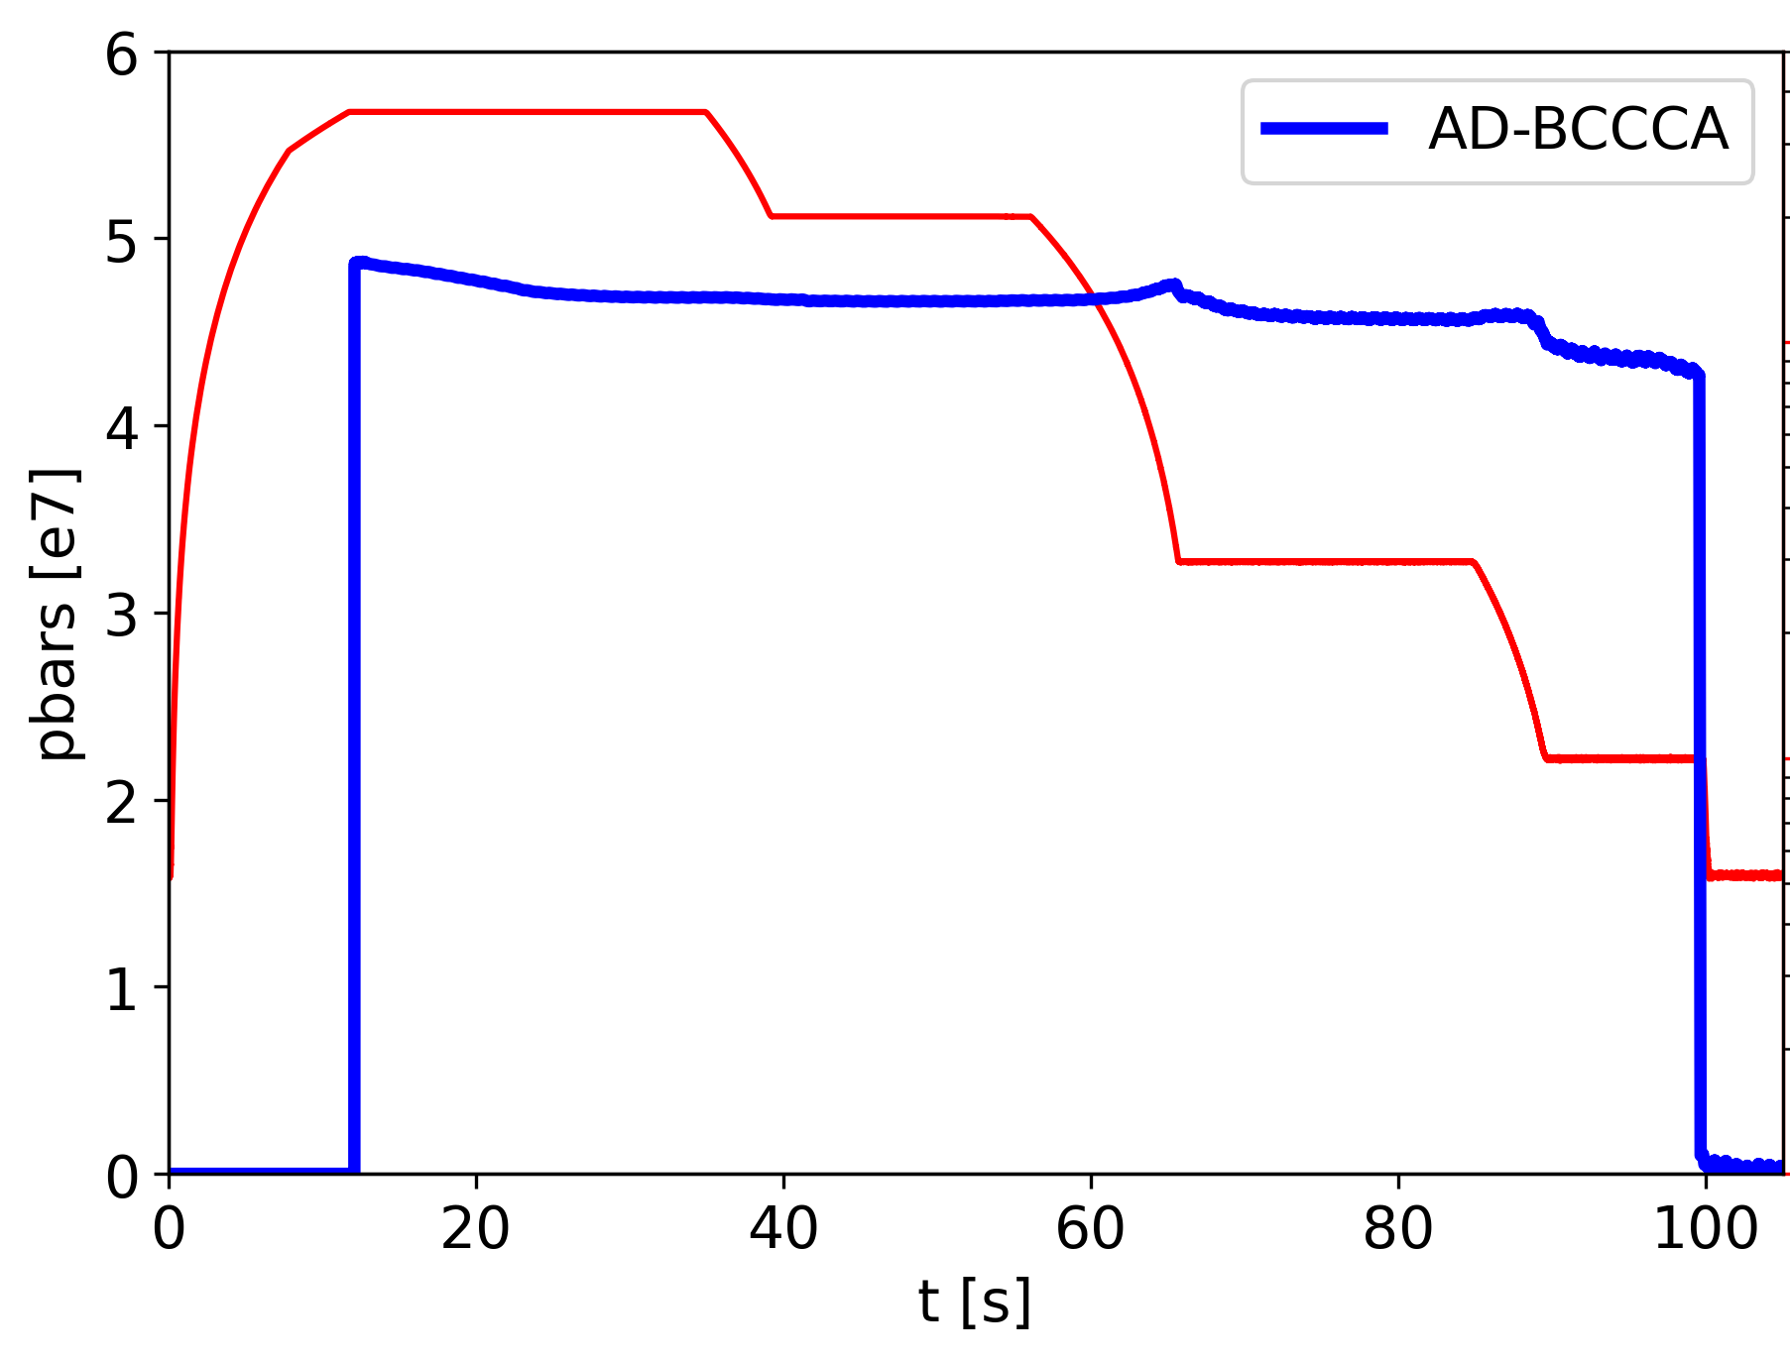
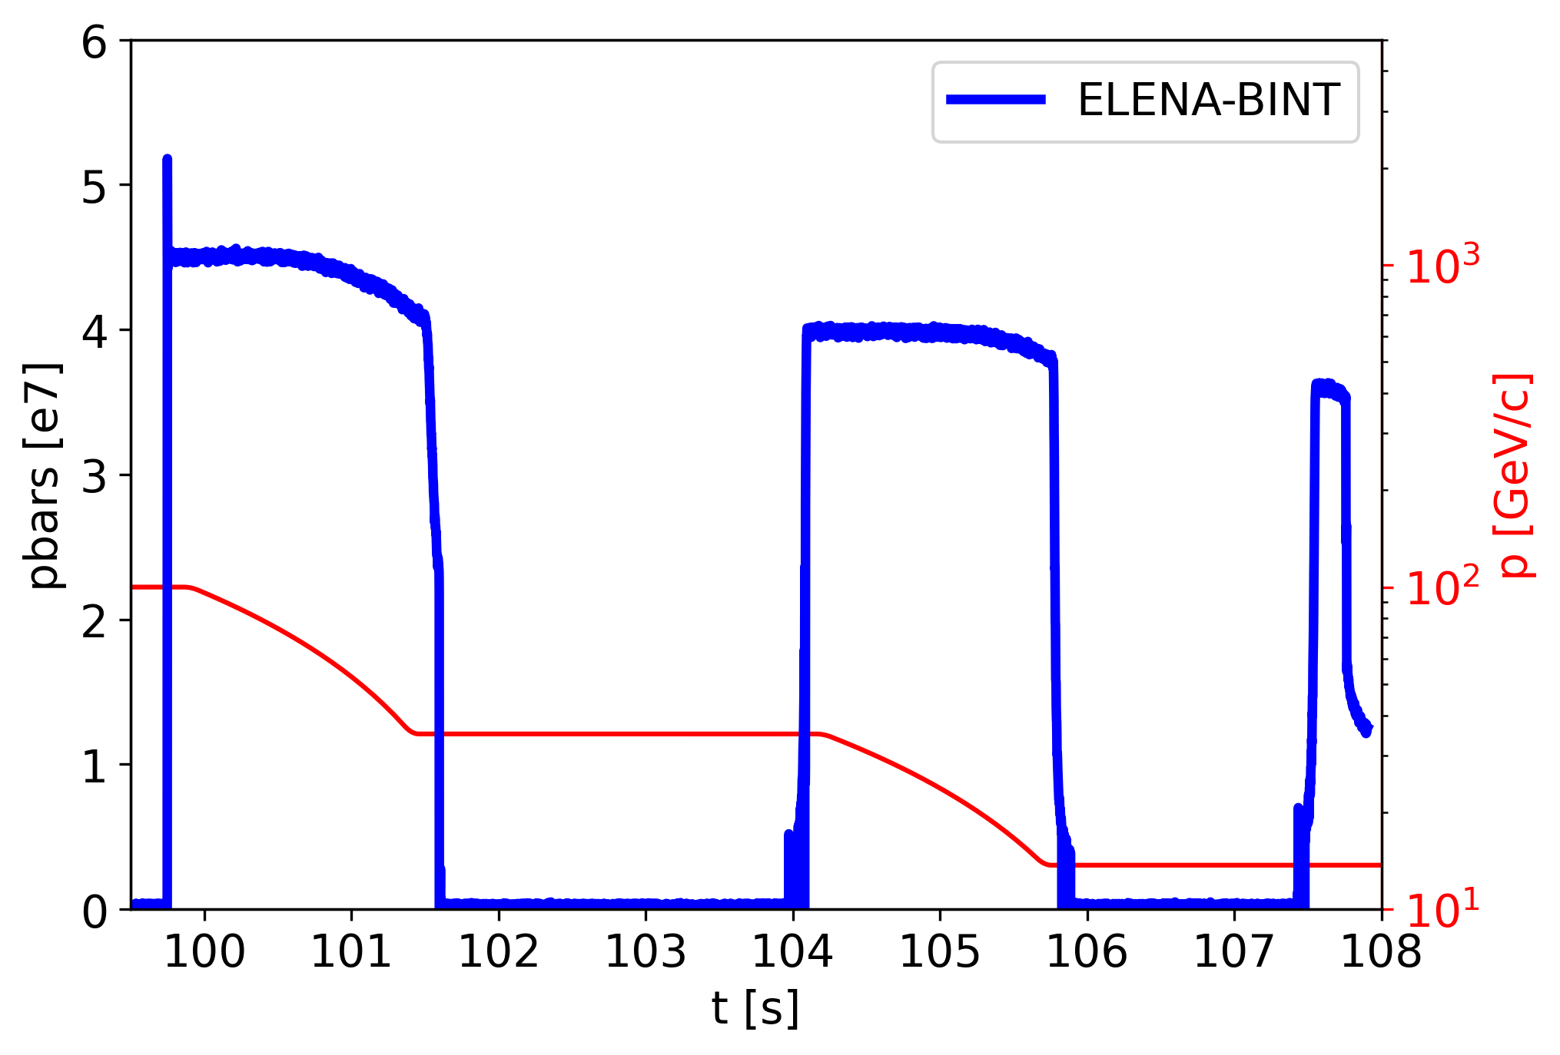
From 25 GeV p to 100 keV pbar: 4e7 pbars/2’
Generating pbars from 26 GeV/c protons (yield of the order of 3e-6 pbar/p)
Up to 80% deceleration efficiency from 2.75 GeV (3.57 GeV/c) to 100 keV (13.7 MeV/c)
  Requiring several stochastic and electron cooling steps
p from
PS
p-pbar
yield
AD Cooling and
Deceleration
Transfer to
ELENA
ELENA Cooling and
Deceleration
to users
p
2e13
1.8e13
AD s-cooling
ELENA e-cooling
AD e-cooling
PS eje
FTA9053
(AD target)

Slide 5
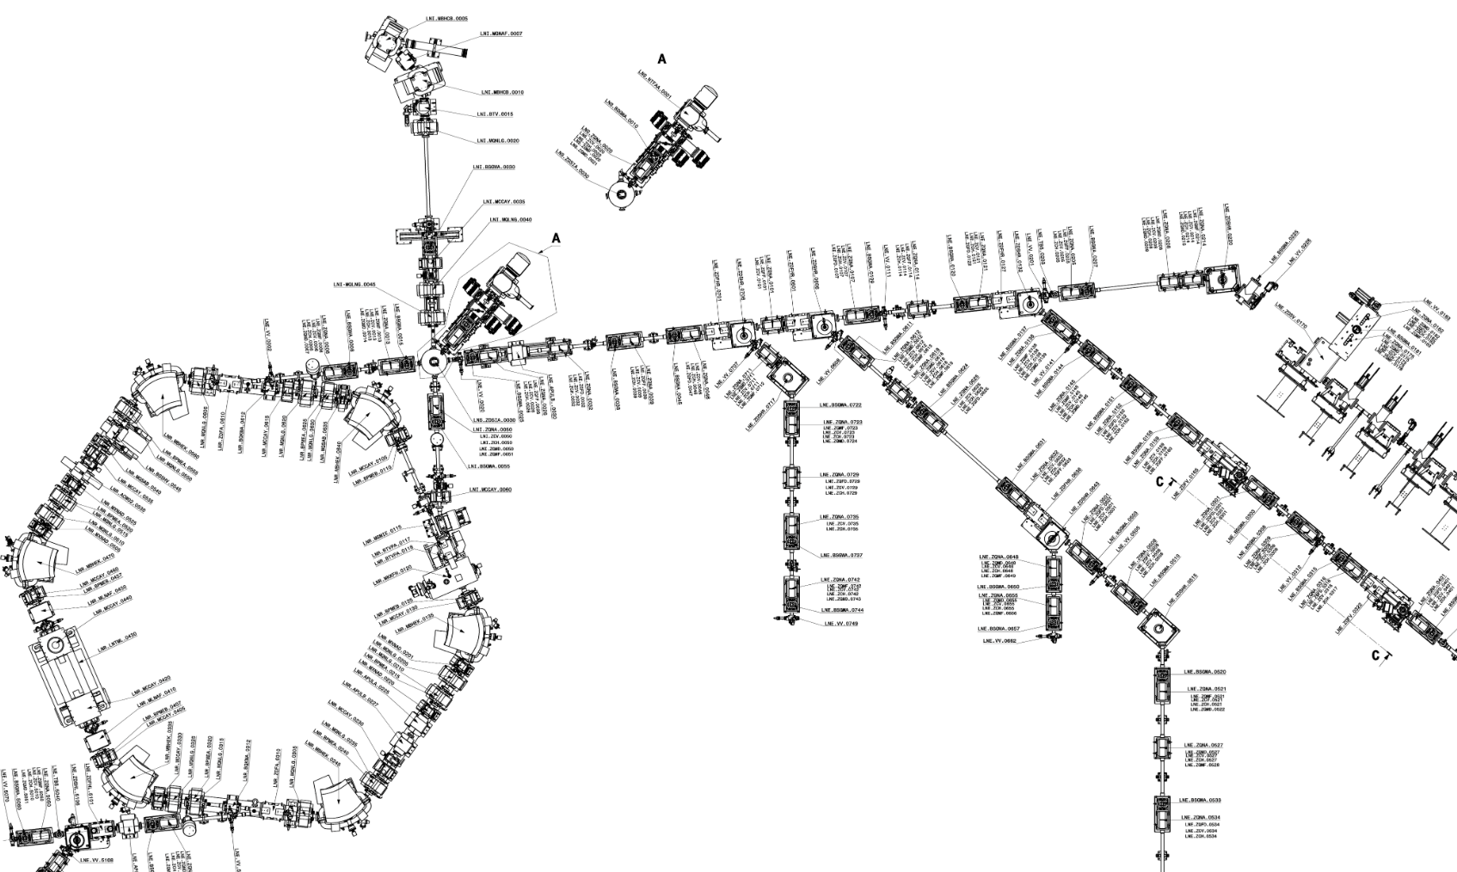
Serving 4 Users at a Time
Up to 4 experiments served at the same time with 1e7 pbars/bunch
  24/7 beam availability was the key game changer for AD users since ELENA is online (2021)
  Users are taking beam right now !
    We will need to be careful !
AD produces
1 bunch at 5.3 MeV
Pbars from AD
ELENA: 4 bunches
at 100 keV
  <150 ns FWHM
  <1e-3 RMS dp/p
  <3 um emit.
H⁻ from
local source
ELENA can use H⁻ from a local source:
  Instrumental for commissioning, but also used for physics
  It will be the source of beam during the school !

Slide 6
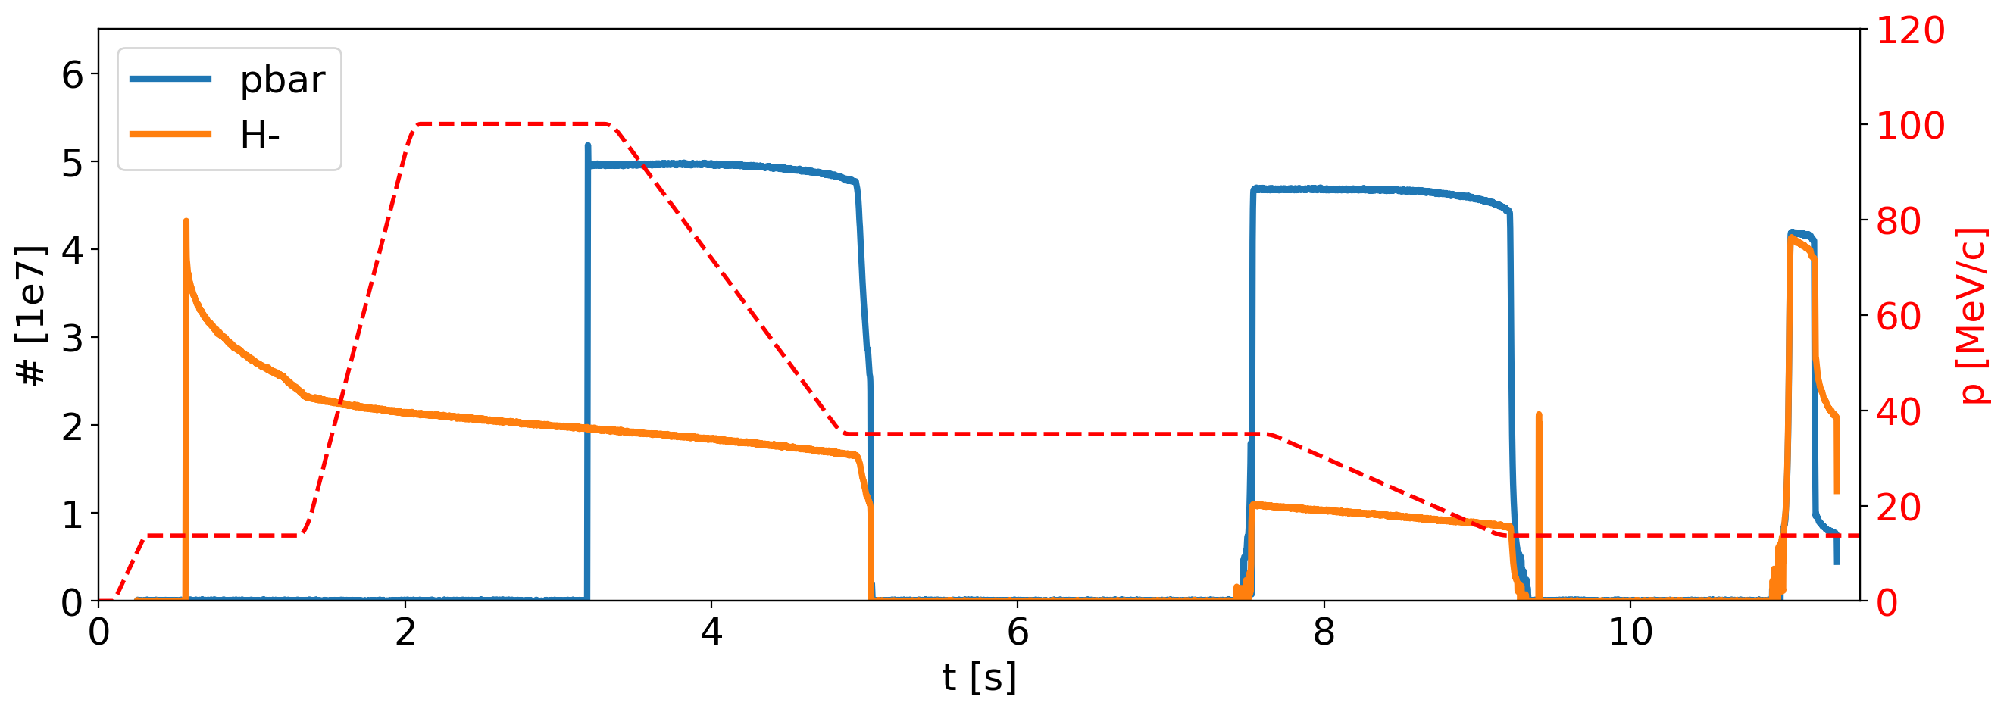
The ELENA cycle
Running with two (magnetically-equal) ~15-second-long pbar or H⁻ cycles:
Second H⁻ injection to increase beam intensity @100 keV before extraction
n bunches extracted on demand by users
h=1
h=4
h=4
h=1
E-cooling
E-cooling
E-cooling
Repetition rate is too slow, and all pbar cycles “taken” for physics
    You can use H⁻ cycles, still with a “poor” repetition rate: one cycle every about 2 minutes
    H⁻ lifetime strongly affected by vacuum levels in the ring (typically 10⁻¹¹ mbar)
    We will concentrate on the final 2-s long plateau, where you will play with cooling !

Slide 7
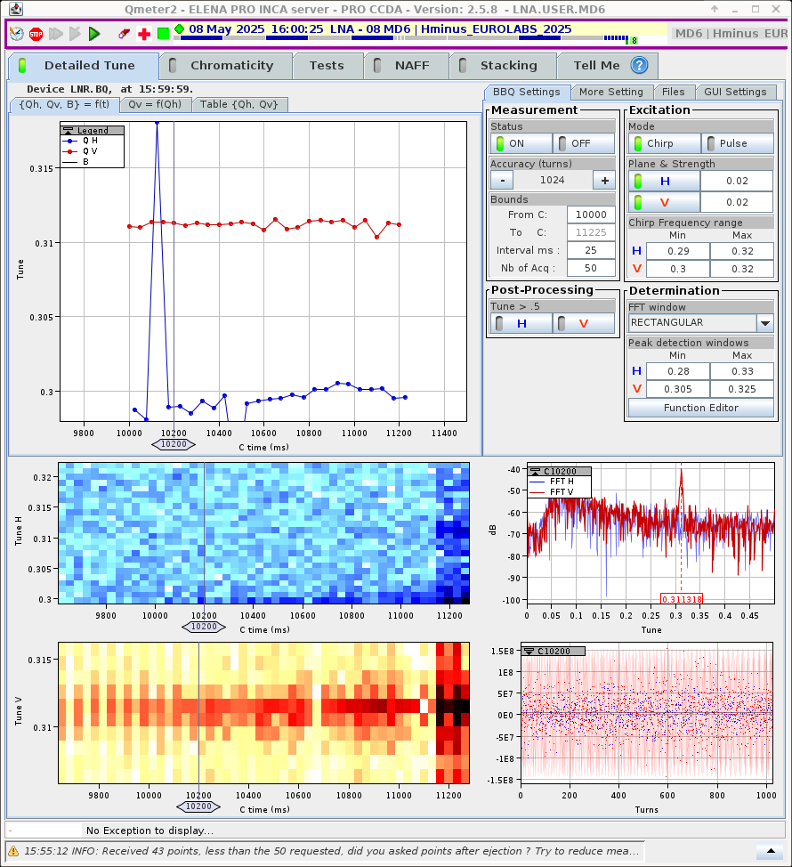
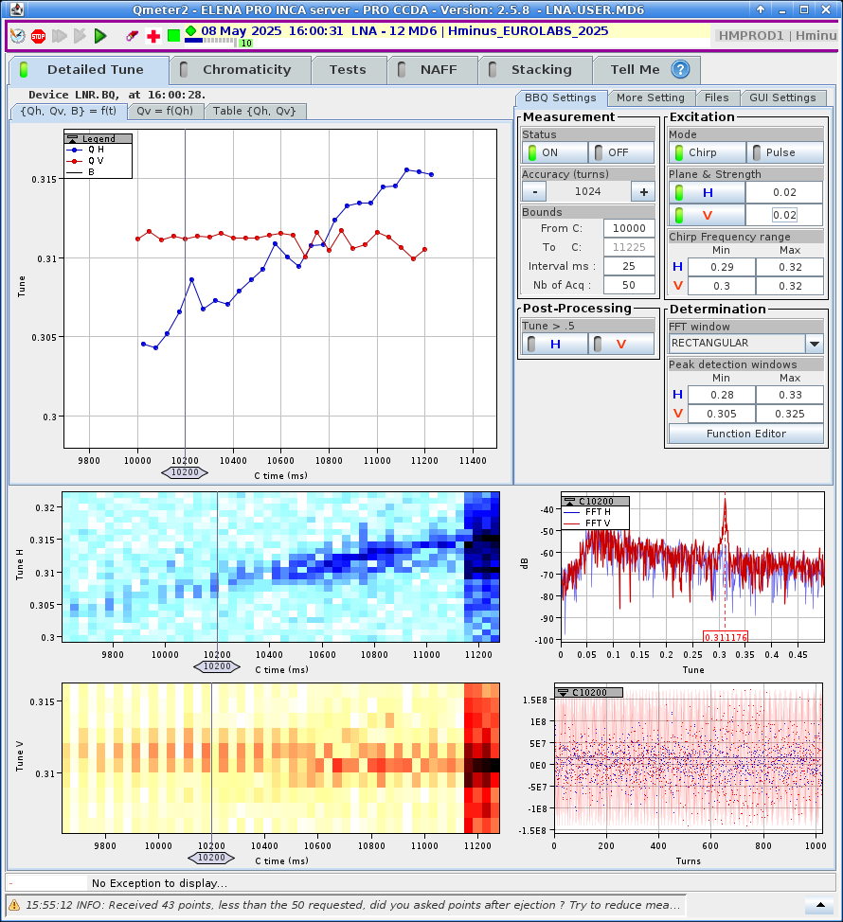
ELENA: A Toy Ring for Optics, e.g. Tune and Coupling
What you will be able to explore:
Measure and change basic beam properties, e.g. Tune:
Is there any coupling in the machine?
Can you try to correct it? How?

Slide 8
Cooling: Why?
Example: transverse phase-space
Beam size depends on β (depends on the machine optics) and 𝜖 (property of the beam)
Normalised emittance is constant with energy
  Good for colliders: the higher the energy the smaller the beam size, hence higher luminosity:
  Bad for decelerators: beam size increases, but the vacuum pipe remains the same ➔ losses!
A “cooling” mechanism to reduce beam emittances is the fundamental ingredient for AD/ELENA
Beam
Acceptance
  You will have a unique chance to play with such a technique in ELENA !

Slide 9
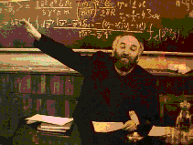
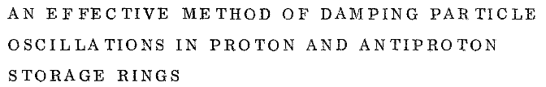
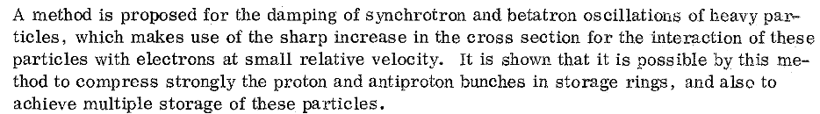
History: First Idea of Electron Cooling
Electron cooling was proposed by G.I.Budker in 1965 as a method for preparing of the beams for hadron colliders.
The electron beam moving with the same average velocity as proton beam absorbs the kinetic energy of heavy particles (protons or ions).
G.I. Budker is discussing electron cooling
Budker, G. I. (1967), Soviet Atomic Energy 22 (5): 438–440

Slide 10
E-Cooling: What?
Simple analogy (by I. Meshkov): a bullet (“ion”) shot at a heap of sand (“electrons”!) flying with average velocity v₀ :
V_{ion} ⇒ v₀ ≡ ⟨v_{e}⟩
V_{ion} ≠ v₀
ion
e⁻
v₀
To be efficient, it requires a good alignment (both in terms of longitudinal “speed”
and transverse position/angle) between e⁻ trajectory and ion beam closed orbit !
YOUR EXERCISE: check the impact of misalignments on cooling and optimise it !

Slide 11
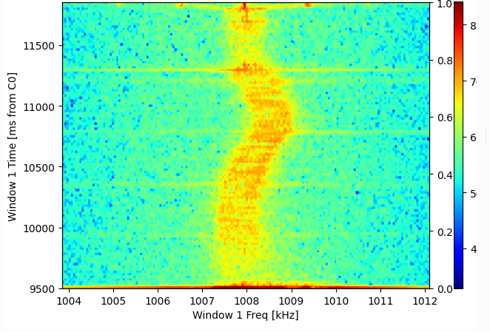
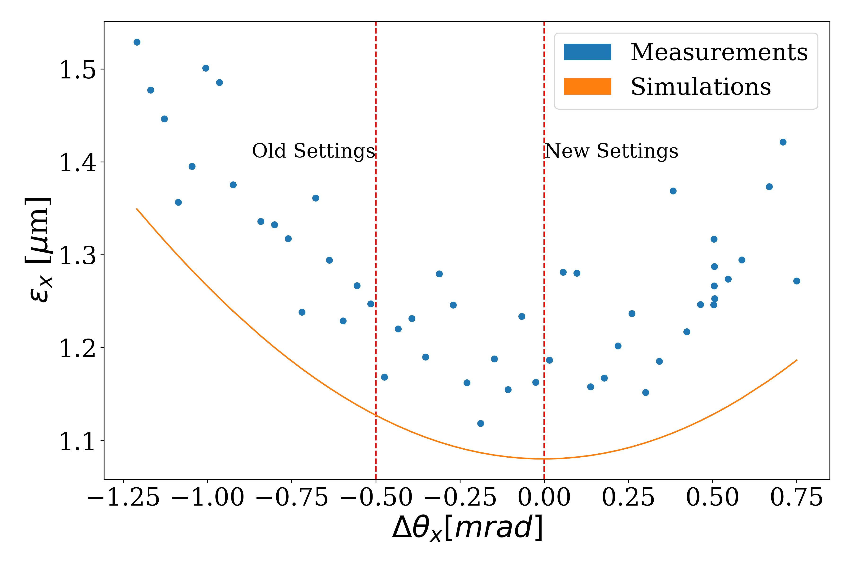
Understanding E-Cooling at ELENA
What you will be able to explore:
What is the impact of trajectory misalignments between ions and e⁻?
What is happening here?
A possible strategy to optimise cooling.
Find the best configuration to minimise final beam size (emittance)

Slide 12
Expectations from Your Stay in the ACR
First half a day:
  Visit of the facility with one operator in charge of the facility
  Walking through the machine settings, beam observables, and control system of AD and ELENA
  Questions and answer: profit of machine experts around you!
Second day:
  Split in two groups: one using ELENA user “MD4”, one using “MD6”, looking at final e-cooling plateau
  Measure and correct transverse coupling
  Characterise e-cooling
  Optimise e-cooling for faster cooling and smaller final emittances
  (Optional) More advanced optimisations?
    Can you find a better machine setup? (lower emittance? Faster cooling? Shorter bunches?)
  “Take home” some data for further analysis, … and questions …

Slide 13
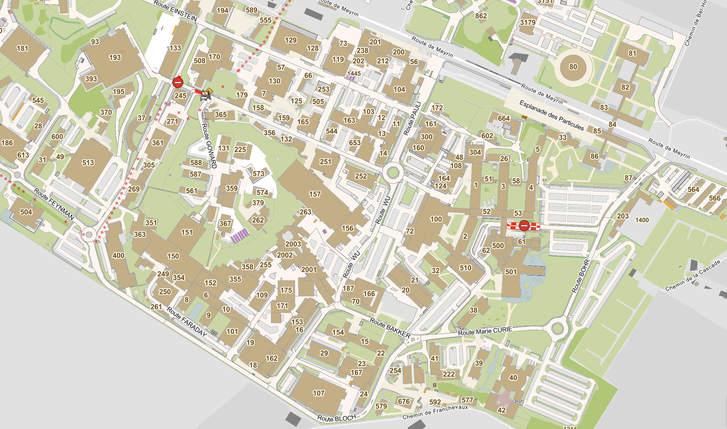
Where is the Antimatter Complex ?
CERN Globe
CERN Entrance B
ISOLDE
Control Room
AD
Control Room
CERN
Restaurant 1
CERN
Restaurant 2
Suggested path to reach the AD Control Room (ACR)
CLEAR
Control Room
Meeting Room(s)

Slide 14
For the Groups Coming to ELENA

Slide 15
Tune and Coupling Observation in Practice
  The simplest method to determine if there is coupling is to excite a beam oscillation in one plane (by kicking the beam), and then observe the oscillations or the frequency content
  If there is coupling, then for a horizontal kick there will be a vertical oscillation (and vice-versa).
Example from the LHC

Slide 16
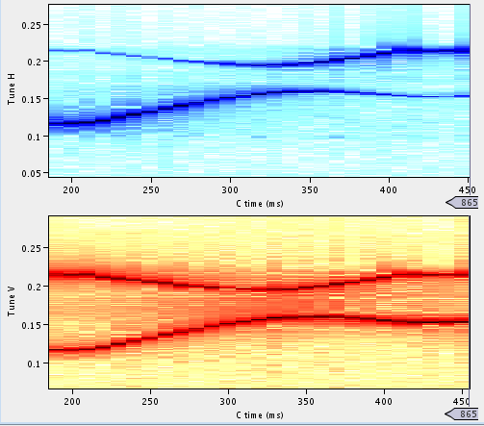
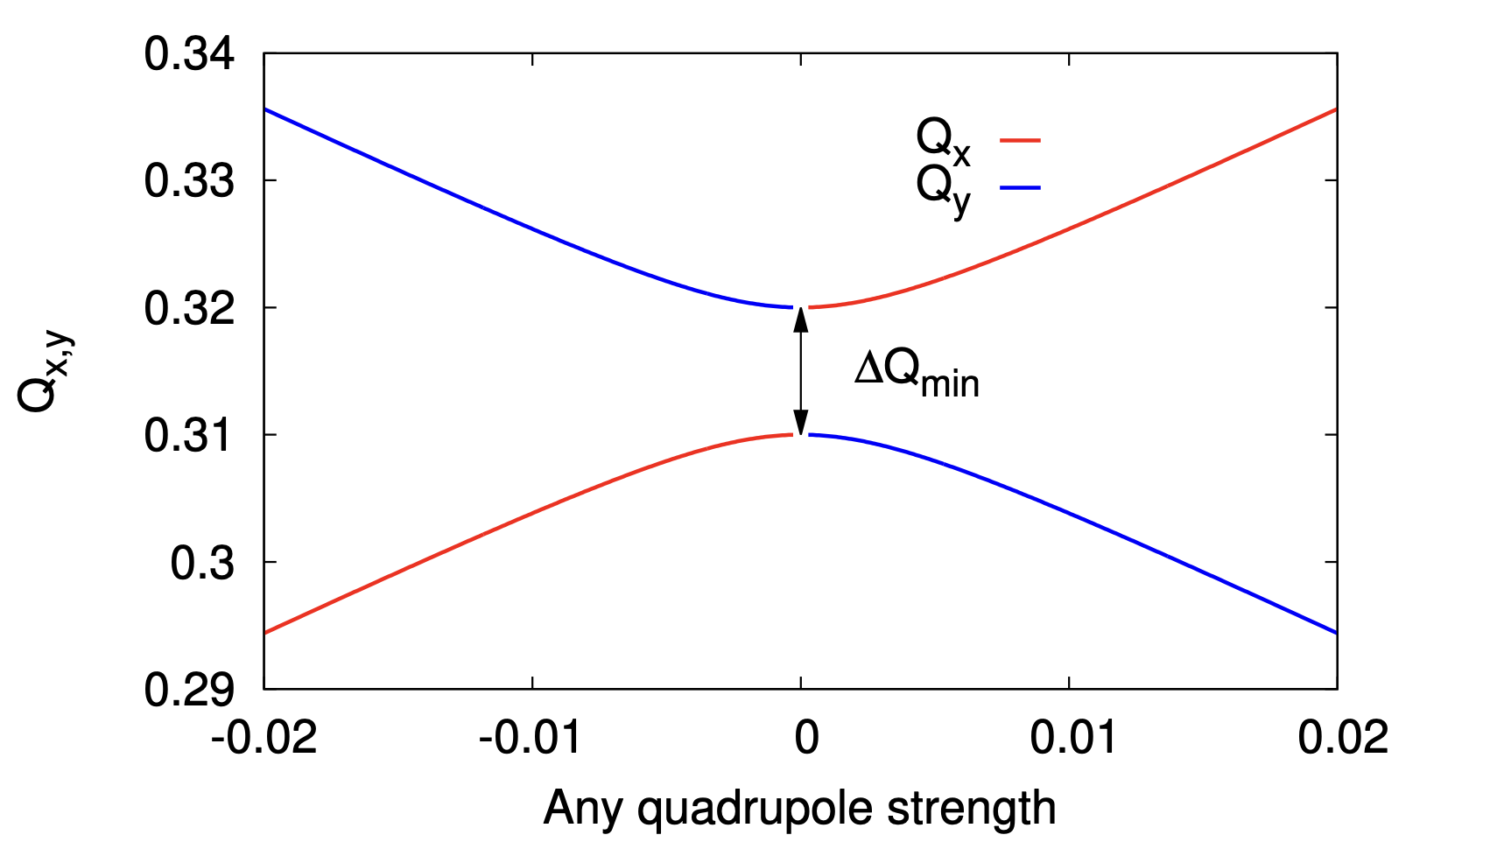
Quantifying Coupling with Closest Tune Approach
  Coupling makes it impossible to approach the measured tunes closer than ,
  where is referred to as the coupling coefficient
  can be measured by trying to approach the tunes and measure their minimum distance
programmed Q_{y}
minimum tune separation
measured
e.g. in the
CERN PS
programmed Q_{x}
programmed Q_{y}
minimum tune separation
programmed Q_{x}
(recall )

Slide 17
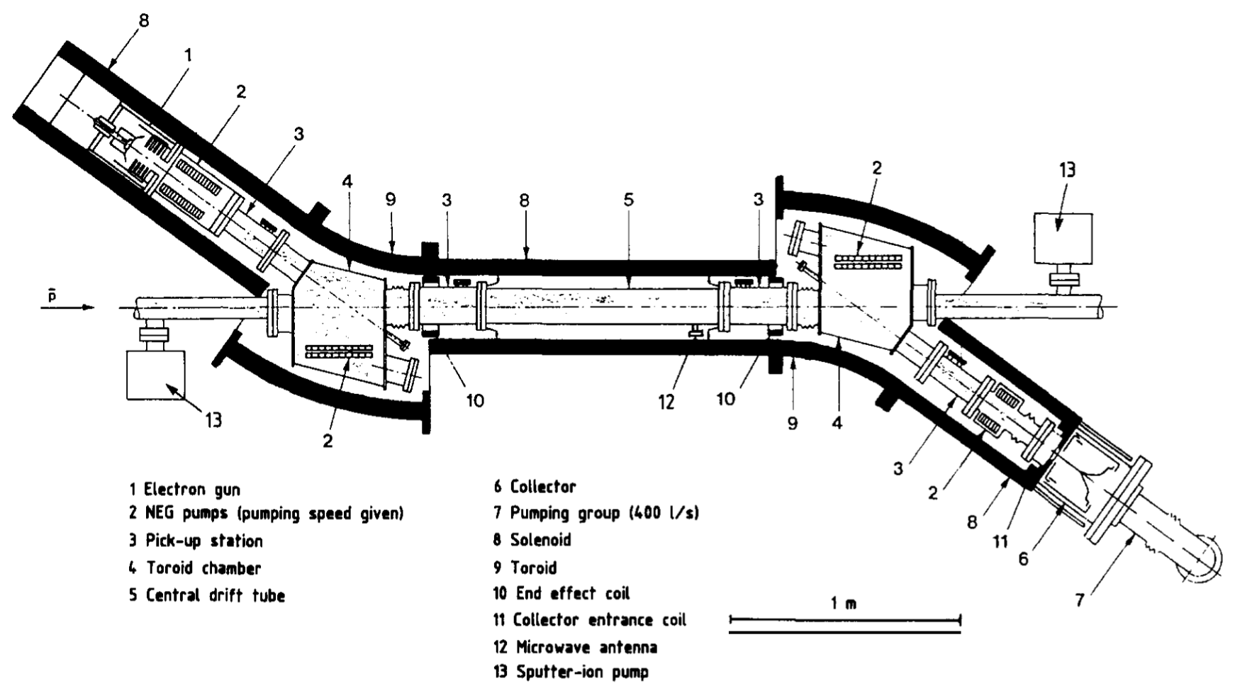
How to Realise Electron Cooling in Practice
A guiding magnetic field carries a DC electron beam from a cathode into the ion beam and then to a collector.
Source:
electron gun
E⁻ beam transport: solenoids, toroids, steering magnets
e⁻
ions
Beam dump:
collector
The LEAR (now ~AD) e-cooler, CERN-EP/90-04

Slide 18
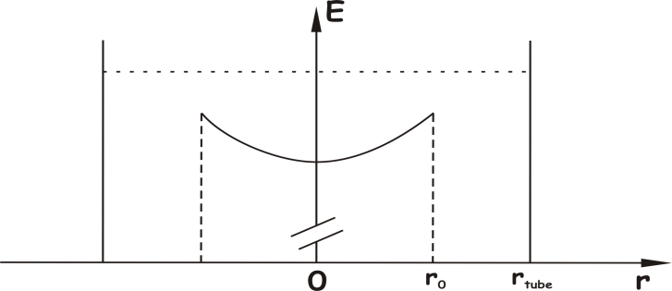
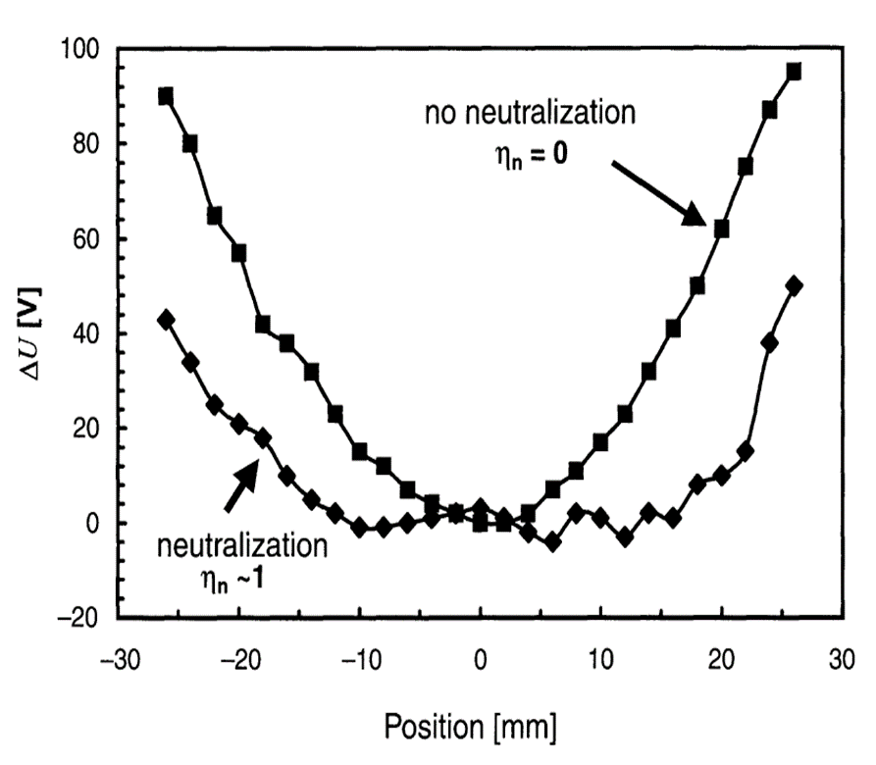
Other Properties of Generated Electron Beam:
Electron velocities
The longitudinal energy a of the electron beam is not constant along its radius (r), but it typically follows the relation:
where E₀ is the energy in the center of the beam and r₀ is the beam radius.
This effect can be partially cured by trapping positive ions in the electron beam along the interaction region!
It can be of a few %!
Details on CERN-EP/90-04
(details not discussed here. See CERN-EP/90-04 )

Slide 19
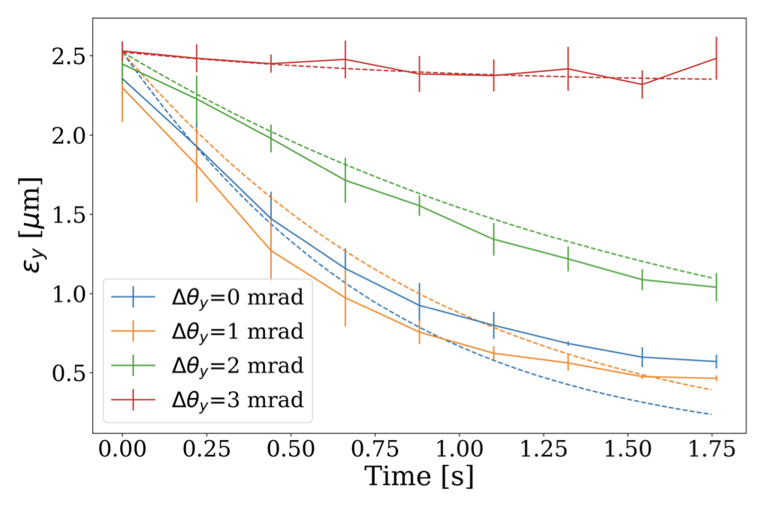
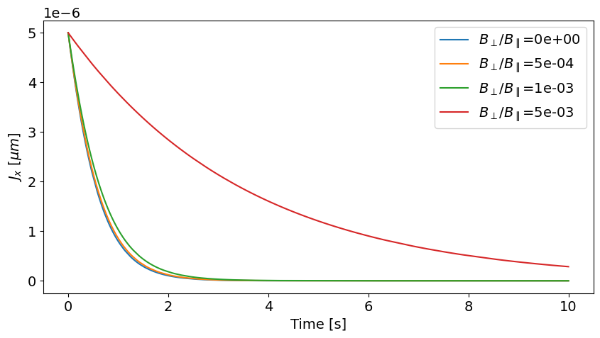
E-cooling studies in ELENA
Test bed for Xsuite e-cooling model benchmark (P. Kruyt)
  Generally, good agreement between measurements and simulations
  Still to test impact of field quality degradation (introduced with correction coils) on cooling efficiency
Measurements and simulations at 13.7 MeV/c
Simulations at 35 MeV/c
ELENA magnetic field quality somewhere in this range

Slide 20
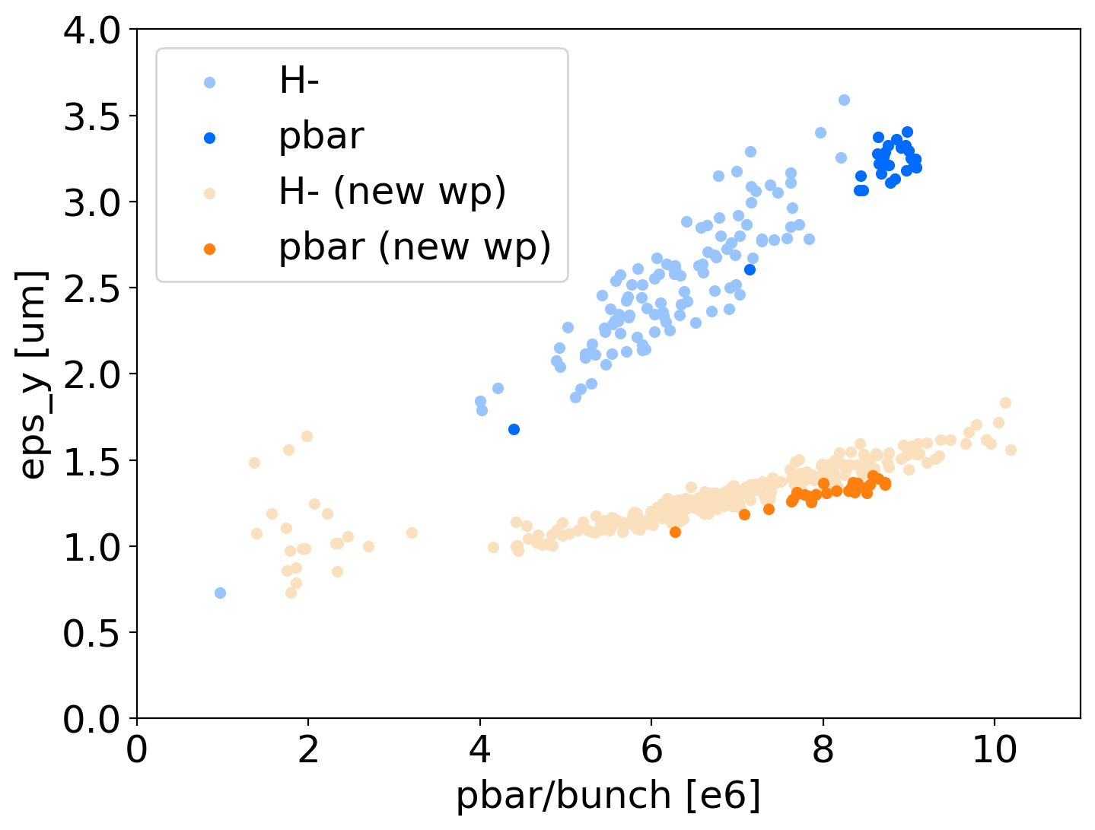
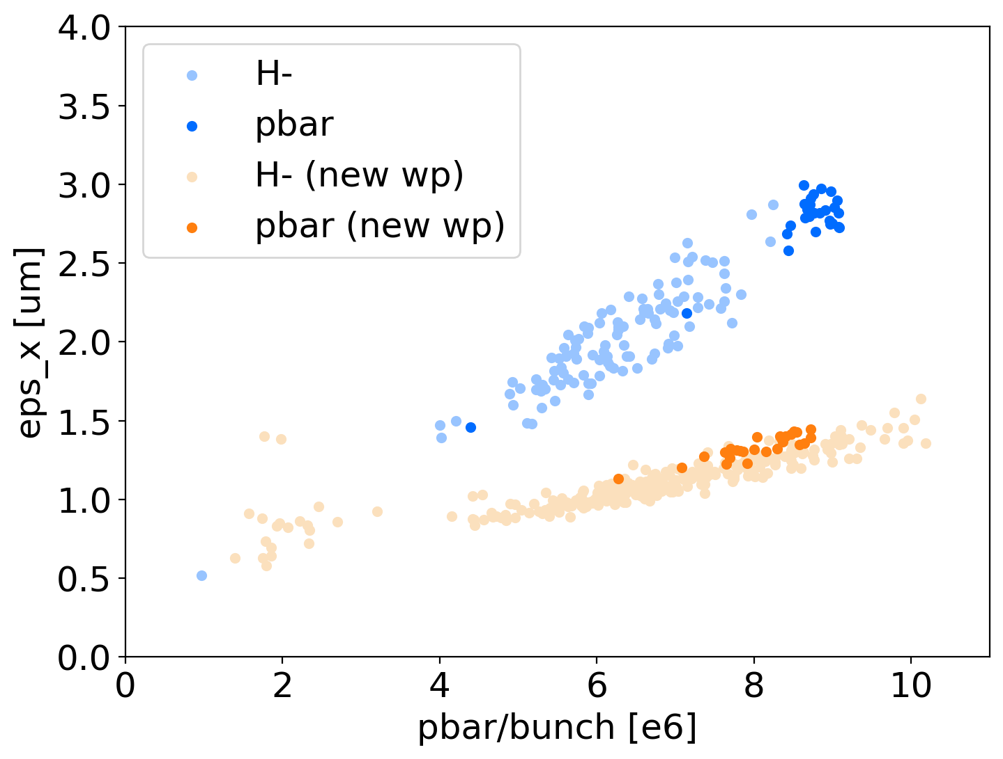
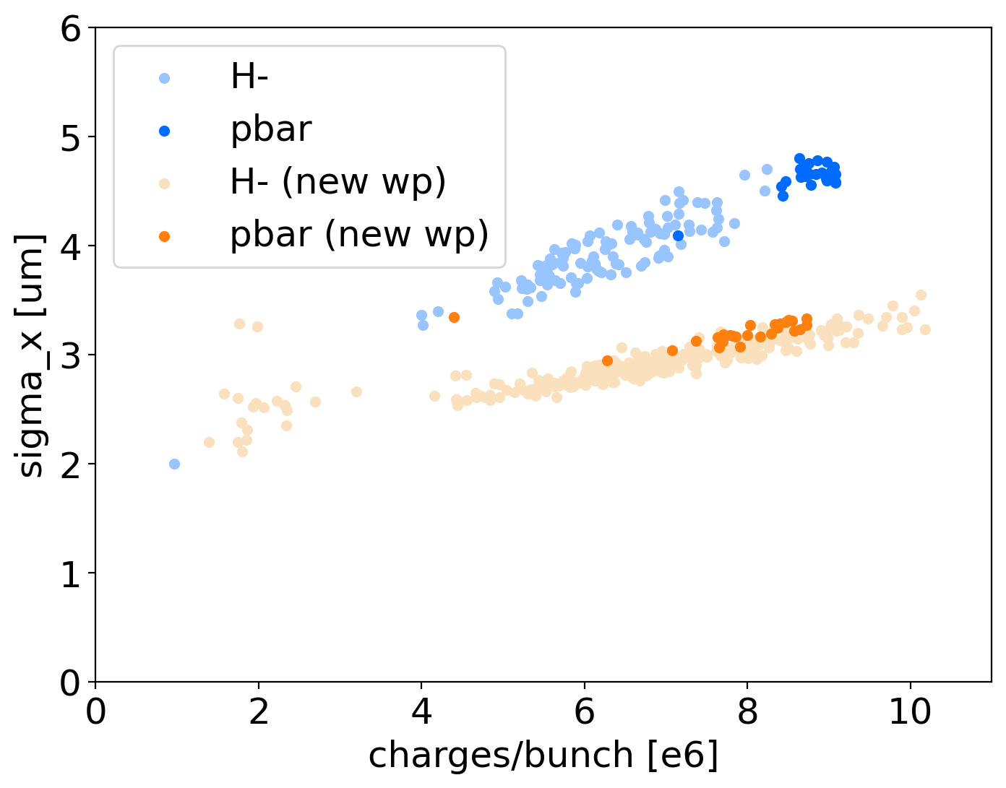
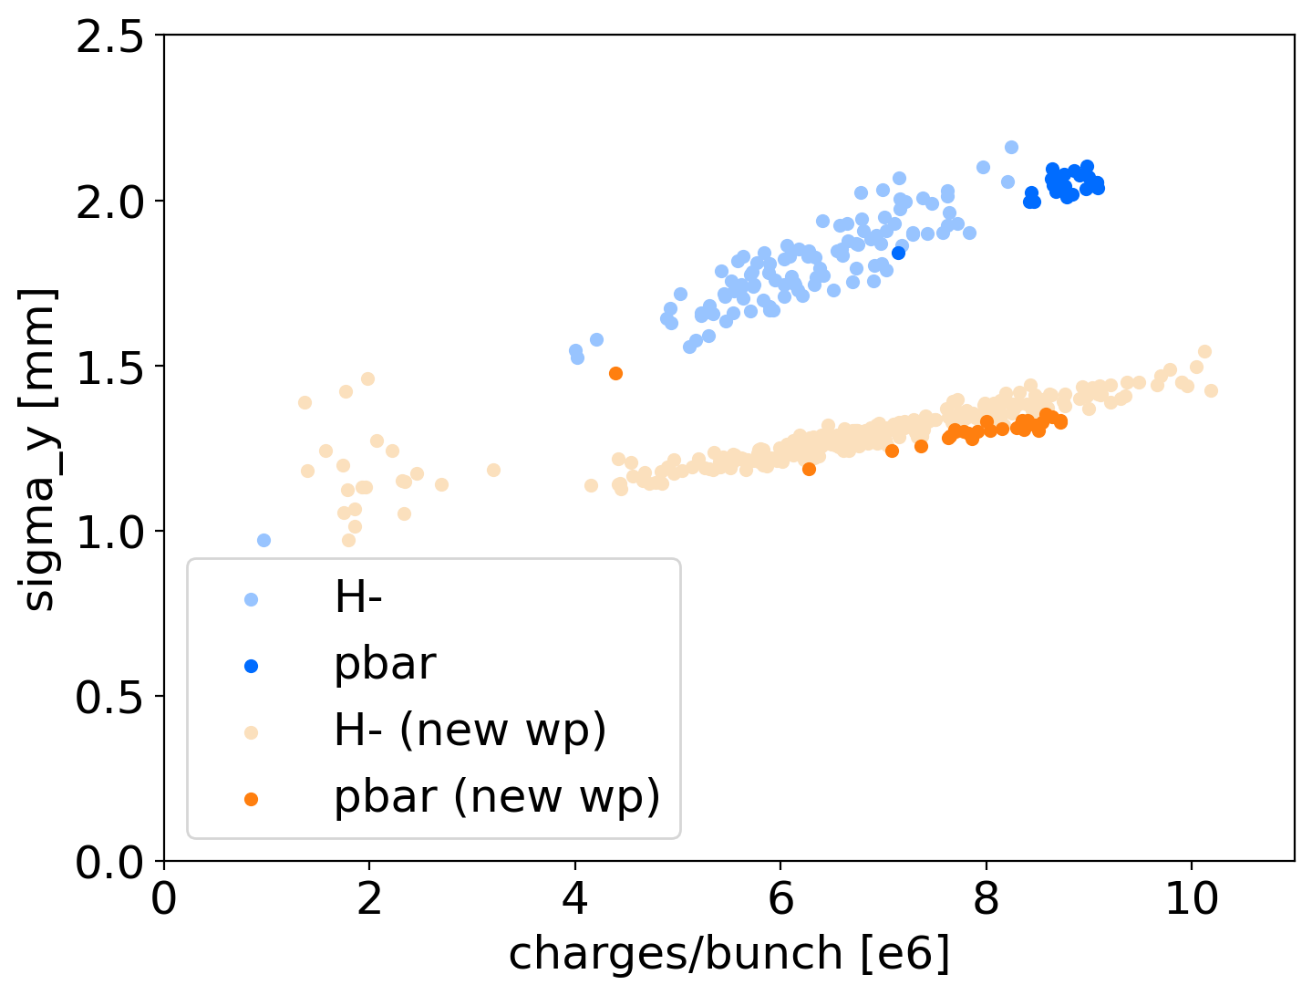
More complex example: ELENA emittance at ejection
Plots assuming beta_x = 7.7 m and betay = 1.3 m irrespectively from working point => big assumption! Optics is actually diffferent
Up to 4th order resonances
A typical challenge in low energy synchrotrons:
Possibly excited resonance limit the possible tunes that one can use in a machine, e.g. ELENA
Space-charge effect induces a tune spread experienced by the beam depending on particle particle density within the beam
  i.e. smaller beam size (or emittance) = higher tune spread
An optimisation example:
Observation: the beam emittance at ELENA extraction was above the design value
We simulated expected tune spread due to space charge, and measured excitation state of resonance by scanning the tune diagram
We identified a more robust working point
Factor 2 emittance reduction obtained in 2023
Used in operation since 2024
Initial working point
Third order
resonance found to be excited
x2 emittance reduction!
ELENA Design

Slide 21
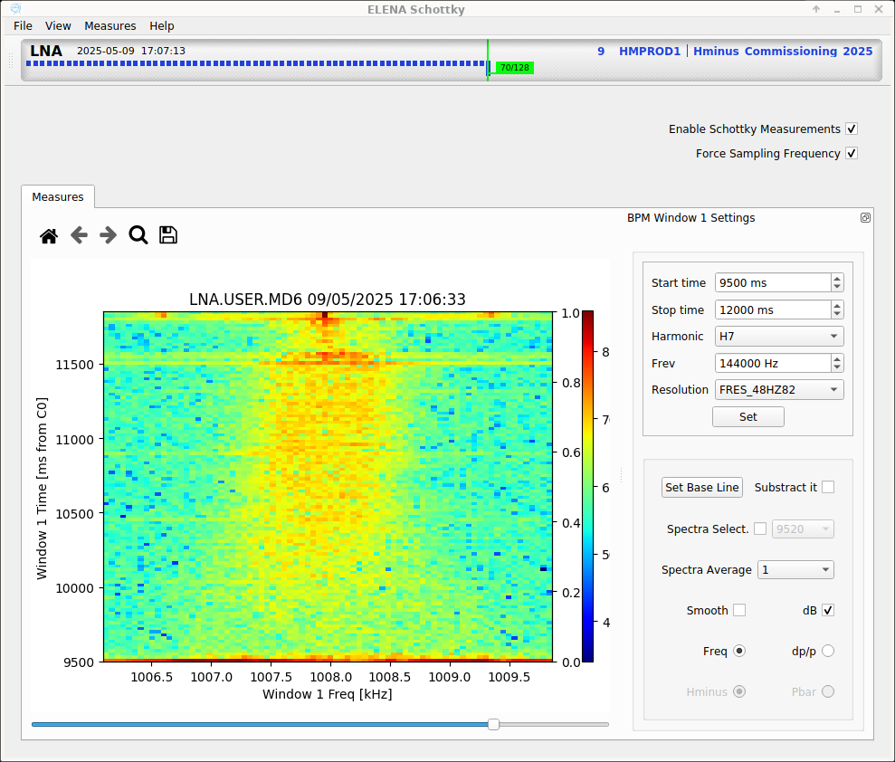
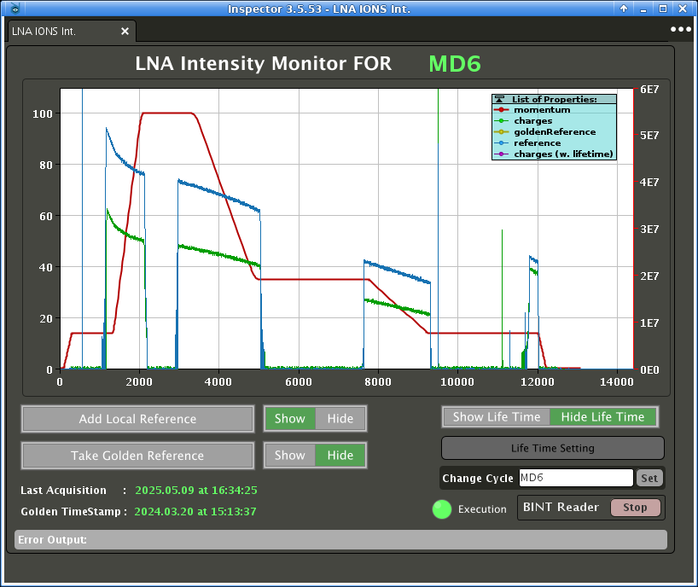
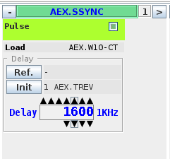
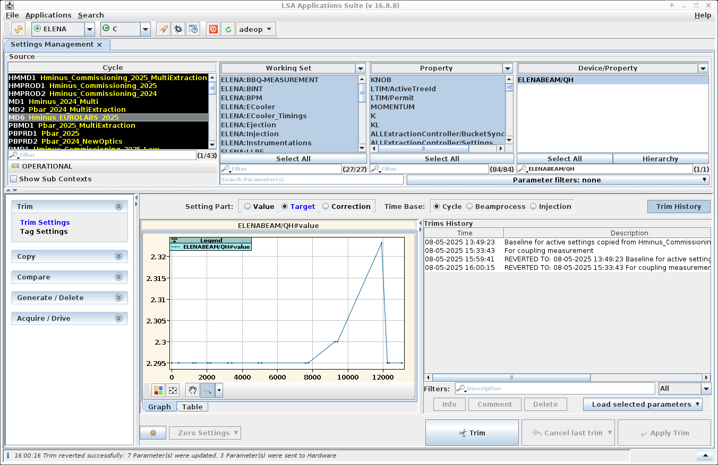
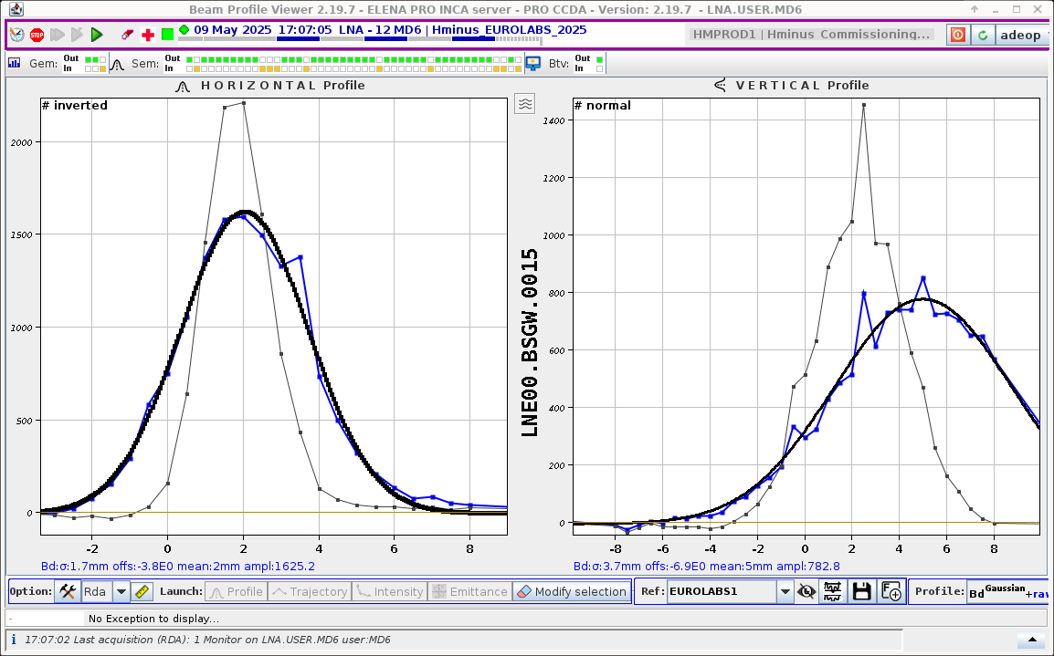
Your Main Tools…
Measuring beam properties
Energy(Frequency) Spread
Setting machine parameters
Beam intensity
“Knobs”:
mainly to control beam extraction
time for e-cooling studies
“All machine parameters” editor
(Please, be careful at what you touch!)
Beam Tunes
Beam size – after extraction

Slide 22
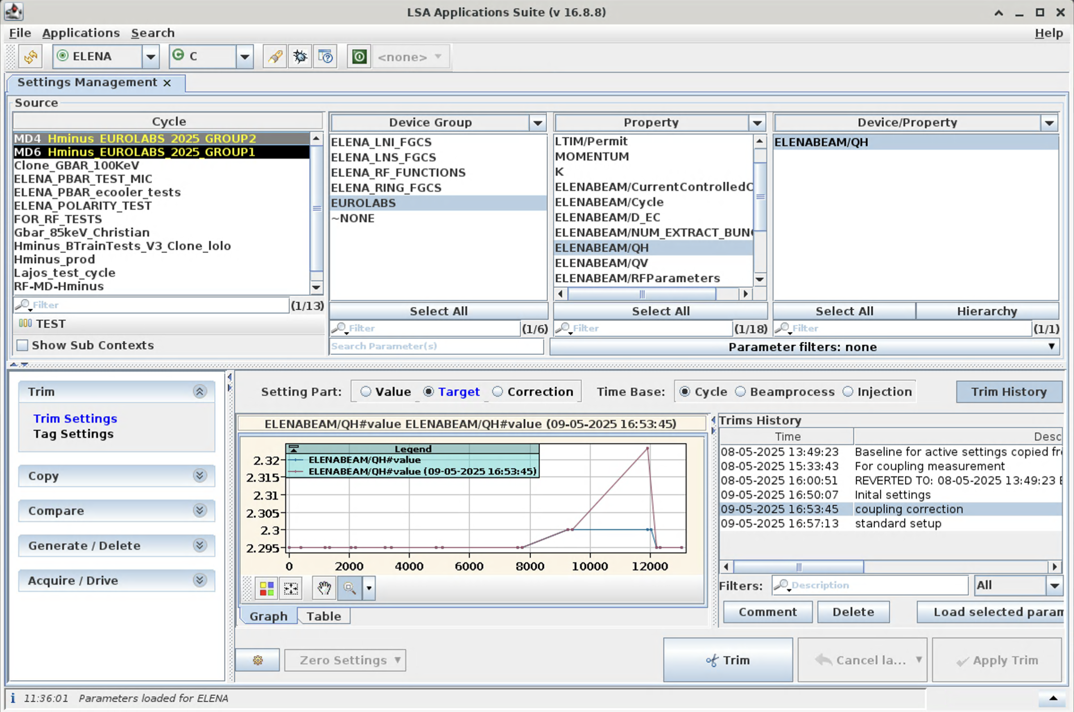
LSA Settings Management: some words
Parameters under “Device Group” “EUROLABS” are normally “safe”
to touch
Only act on MD4/MD6 cycles which you find under “TEST” !
You can see
(and can re-load) the “history” of a parameter settings under “Trim History”
Typically, you are meant to look at / modify (“trim”) “target” settings

Slide 23
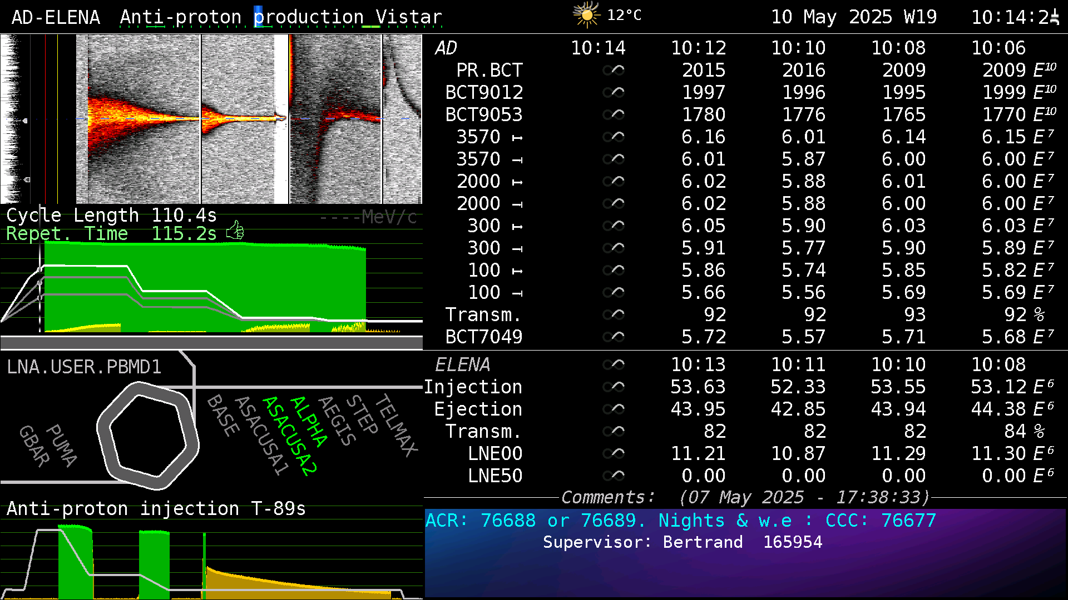
A Quick Eye on the Operational (Physics!) Pbar Cycles
Keep an eye on the AD Vistar: live – and short history – check that all is well.
Numbers that
should never
really change…
Last pbar cycle
in ELENA:
Users taking
beam can
change
Intensity “shape”
should remain
“constant”

Slide 24
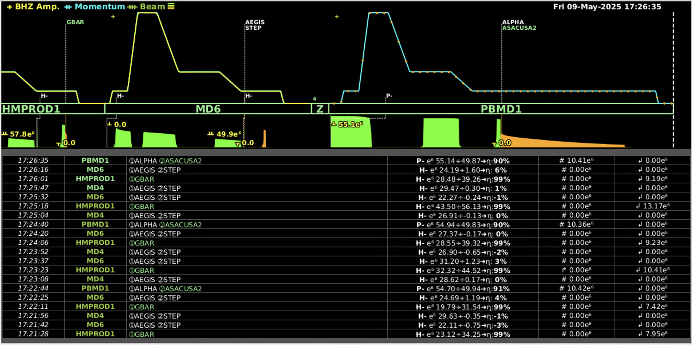
A Quick Eye on ELENA cycles (all!)
Keep an eye on the ELENA Vistar: live – and short history – check that all is well
  at least on the the “production” cycles: HMPROD1 and PBMD1 (or PBPRD1) …
LIVE VIEW
Showing which cycle is being played, and a
short history of performance
“Your” cycles: MD4/6
Physics H⁻: HMPROD1
Physics pbar: PBMD1

Slide 25
APPENDIX

Slide 26
Overview of AD and ELENA rings and instruments
Slow machines
  Featuring cooling:
  i.e. no emittance preservation
Mostly relying on destructive
transverse measurements: scrapers
  IPM in AD seems to work since this yets!
  Neutrals monitor in ELENA (H⁻ only): usable?
  SEMs in ELENA for ejected beam characterization
  BTVs partially used for optics matching
Intensity (and Schottky) monitoring essential!
  Several “BCT”s, and BCCCA in AD, (using BPMs in ELENA)
+BPMs +Tune Meters (AD/ELENA)
BTVs
AD ring length: 182 m
SEMs
BCT/LPU
Schottky
30 m
SCRAPERs
Neutral H monitor
IPM
BCCCA
ELENA e-cooling
AD s-cooling
AD e-cooling

Slide 27
CERN Coolers Main Parameters
Each cooler is designed with specific parameters to match the accelerator needs
 | LEIR | AD |  | ELENA
(Main) Ion particle | ²⁰⁸Pb⁵⁴⁺ | pbar | pbar | pbar | pbar
Ion momentum | ~88 MeV/c/u | 300 MeV/c | 100 MeV/c | 35 MeV/c | 13.7 MeV/c
Electron kinetic energy | 2.3 keV (<6.5 keV) | 25.5 keV (<35 keV) | 2.9 keV | 355 eV | 55 eV
Relativistic beta | 0.094 | 0.305 | 0.106 | 0.037 | 0.015
Electron current | 600 mA | 2.5 A | 100 mA | 5 mA | 1 mA
Cooling length | 2.5 m | 1.5 m |  | 1 m
Ring length | 78.54 m | 182.43 m |  | 30.41 m
Gun magnetic field | Up to 2.3 kG | 590 G |  | Up to 1 kG
Drift magnet field | 750 G | 590 G |  | 100 G
Electron beam radius (drift) | 14 - 25 mm | 25 mm |  | 8 to 25 mm
Notes:
For LEIR we typically speak about 4.2 MeV/u kinetic energy

