Slide 1


The CLEAR Facility and Program
for the ATSOA25
P. Korysko*, R. Corsini
ATSOA25
May 12, 2025
*pierre.korysko@cern.ch

Slide 2

CLEAR Beam Line:
History & Parameters

Slide 3
CLEAR Scientific and Strategic goals
Scientific and strategic goals:
Providing a test facility at CERN with high availability, easy access and high-quality e- beams.
Performing R&D on accelerator components, including beam instrumentation prototyping and high gradient RF technology.
Providing an irradiation facility with Very High Energy Electrons (VHEE), e.g., for testing electronic components in collaboration with ESA or for medical purposes.
Maintaining CERN and European expertise for electron linacs linked to future collider studies.
Using CLEAR as a training infrastructure for the next generation of accelerator scientists and engineers (including YOU!).
CLEAR is a versatile electron linac and an experimental beamline,
operated at CERN as a multi-purpose user facility.
P. Korysko - ATSOA25 - May 12, 2025
3

Slide 4
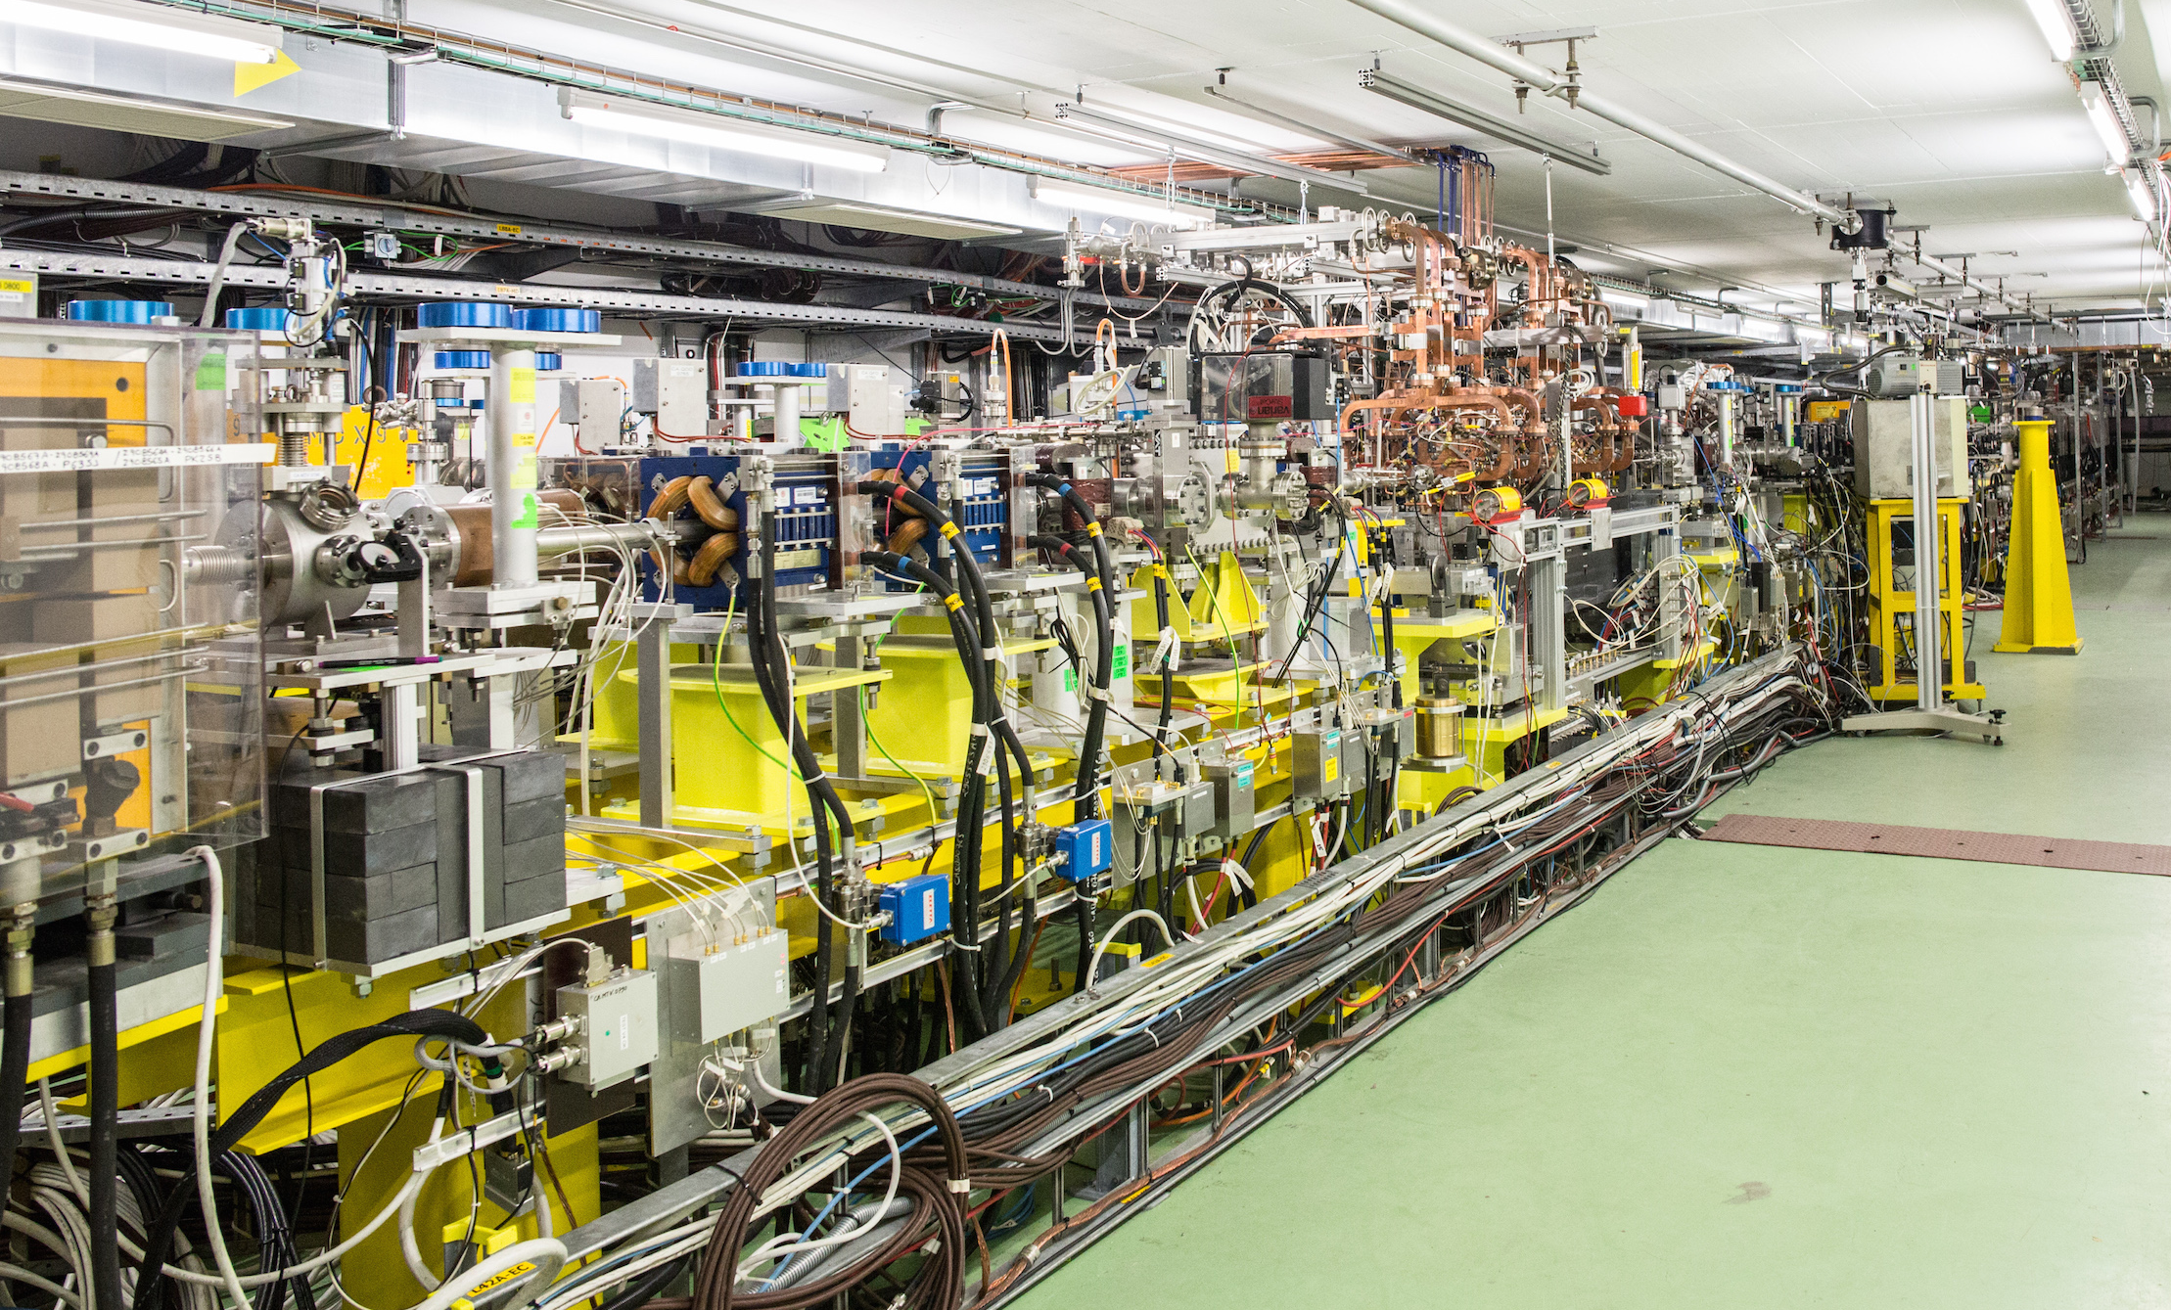
CLEAR Timeline
Approved December 2016.
Began operation in 2017.
Flexible beam program.
  8-12 hours a day, 5 days a week.
Independent of LHC runs and
long shutdowns.
2017 → 19 weeks of beam.
2018 → 36 weeks of beam.
2019 → 38 weeks of beam.
2020 → 34 weeks of beam (despite Covid-19).
2021 → 35 weeks of beam (despite Covid-19).
2022 → 37 weeks of beam and 27 experiments.
2023 → 38 weeks of beam and 30 experiment.
2024 → 39 weeks of beam and 32 experiment.
P. Korysko - ATSOA25 - May 12, 2025
4

Slide 5
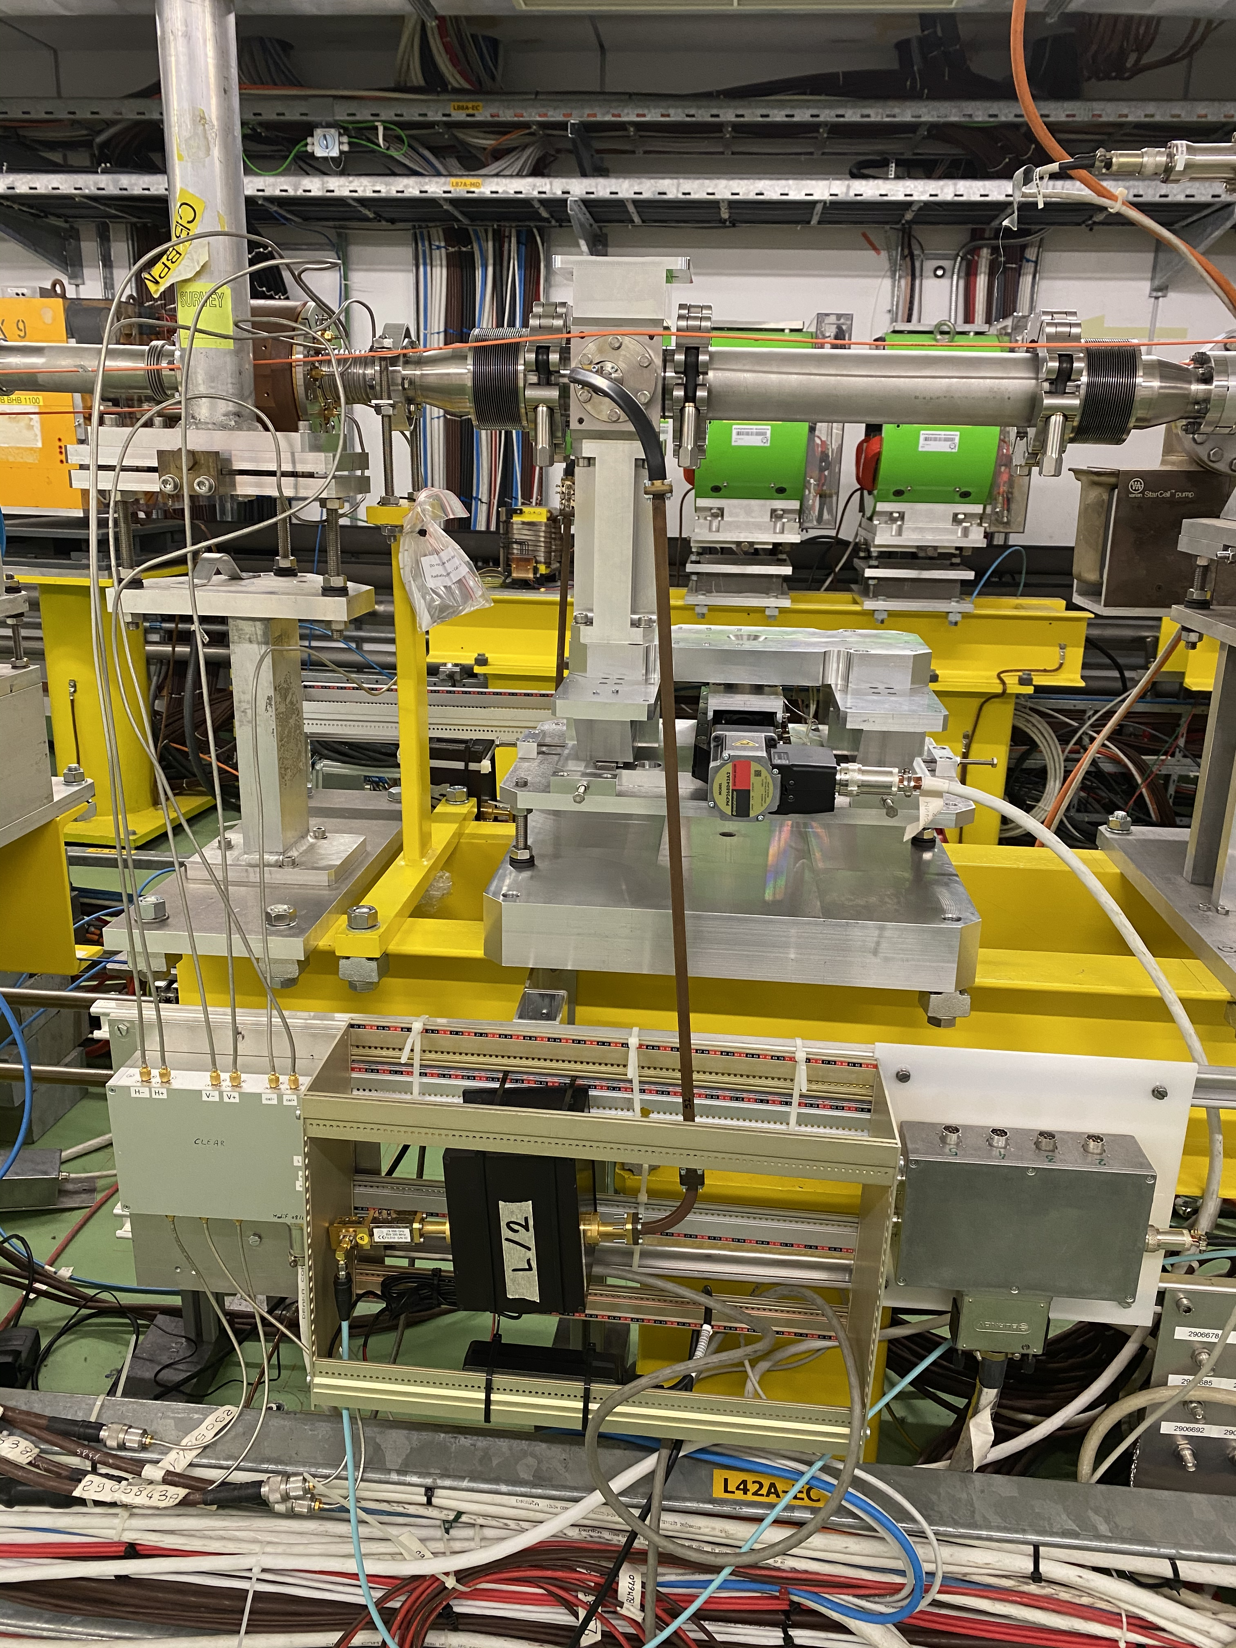

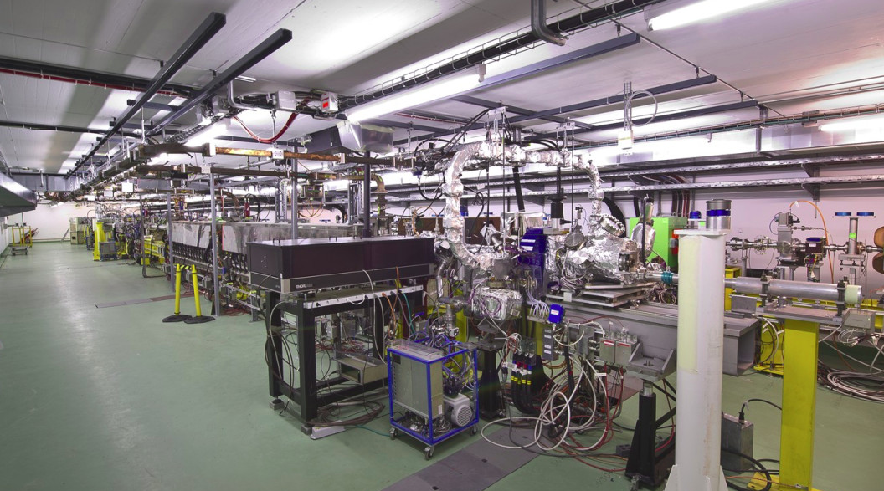
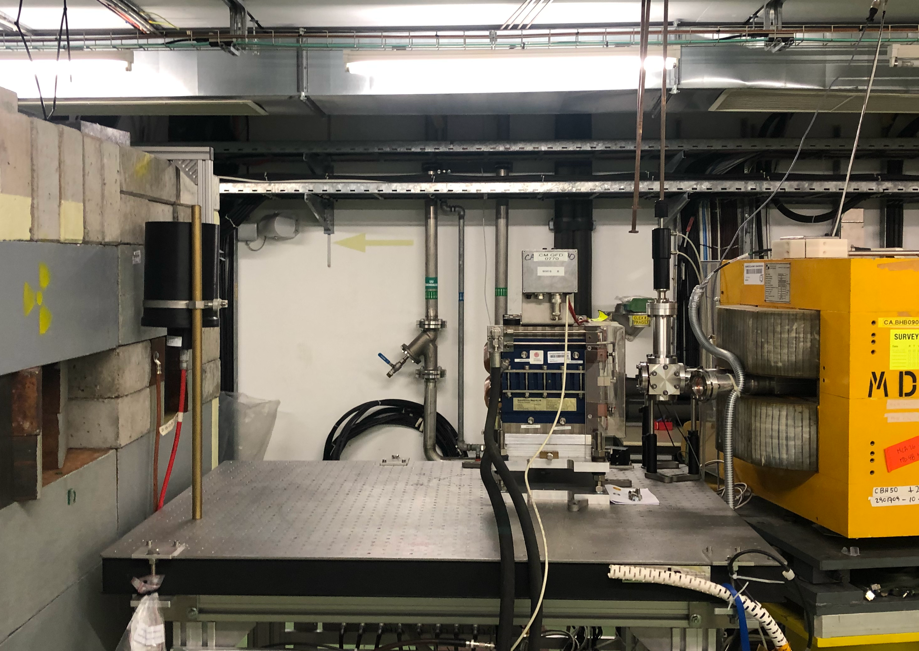
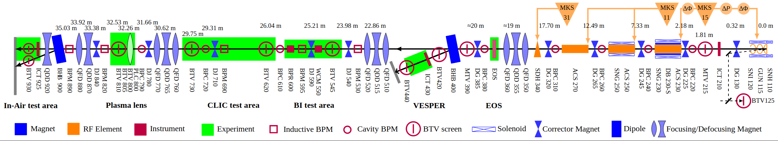
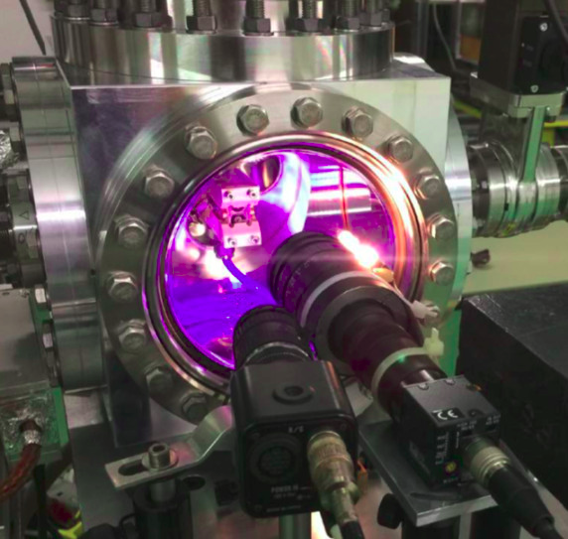
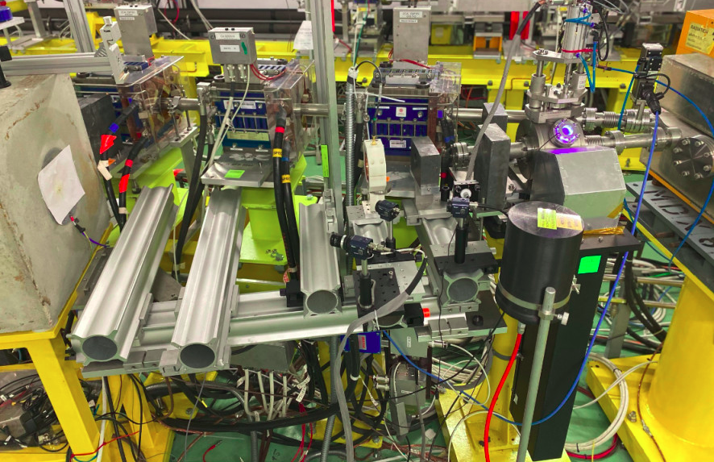


The CLEAR Beam Line in 2025
In-Air Test Stand
Diagnostics studies
Irradiation
  Electronics
  VHEE
BI Test Stand
CLEAR Injector
Flexible Linac
60 – 220 MeV
Plasma Lens
Novel plasma based focusing
Irradiation facility
- Space probes
- Electronics
- VHEE
P. Korysko - ATSOA25 - May 12, 2025
5

Slide 6
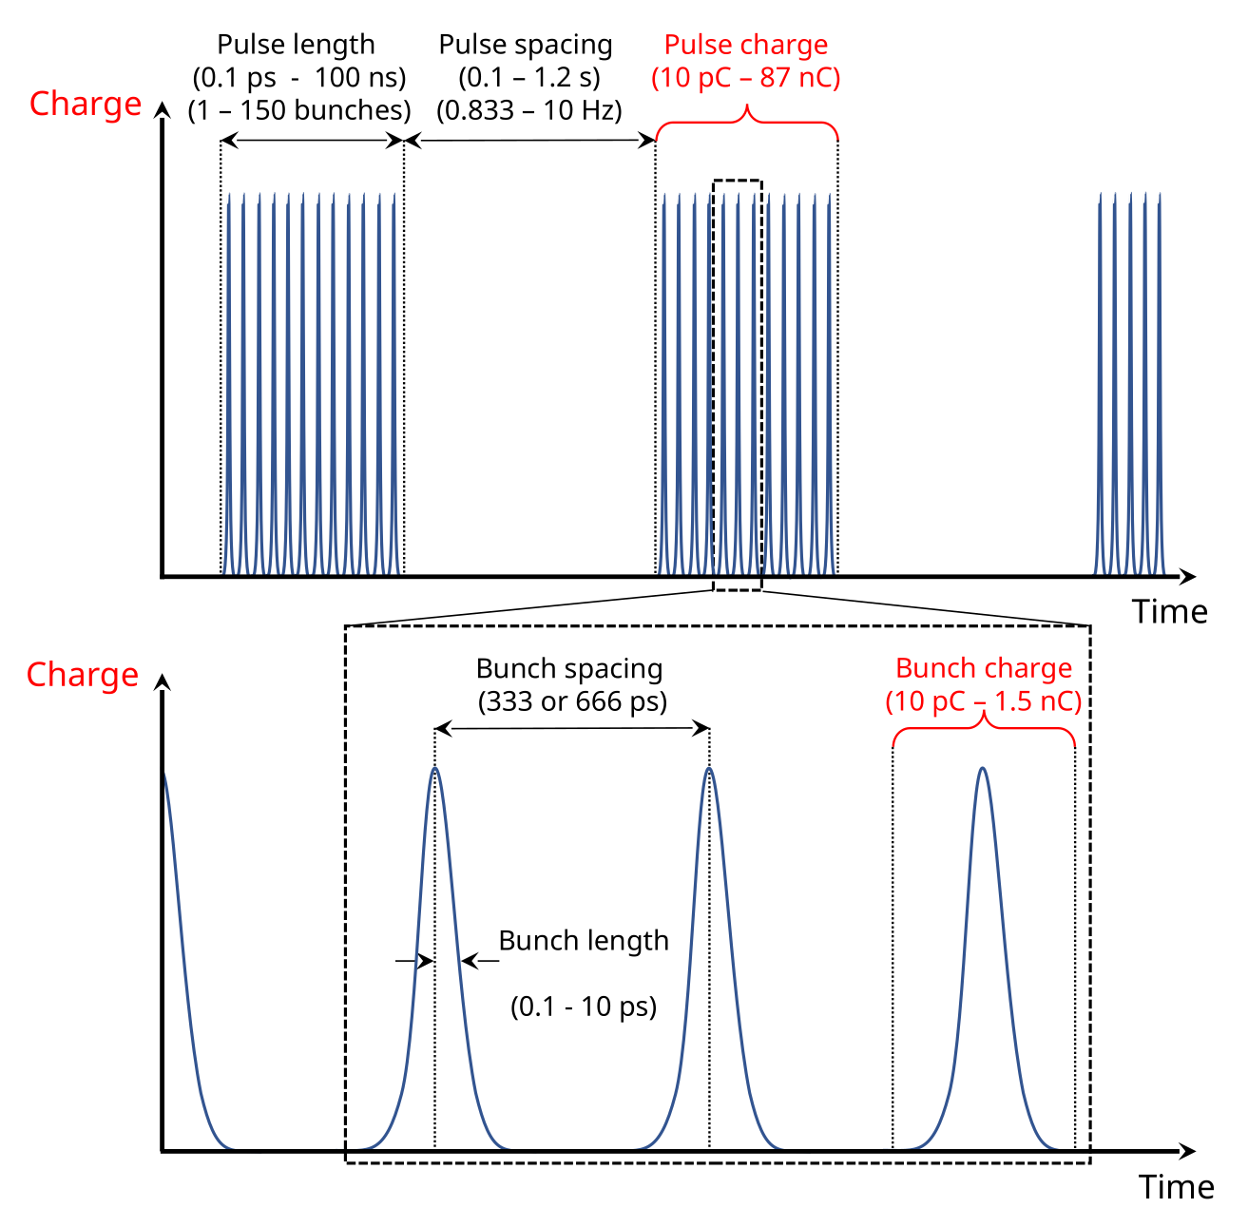
CLEAR Beam Parameters in 2025
Parameter | Value
Energy | 60 – 220 MeV
Energy spread | < 0.2 % rms (< 1 MeV FWHM)
Bunch length | 0.1 – 10 ps RMS
Bunch charge | 10 pC – 1.5 nC
Normalised emittance | 3 – 20 μm
Bunches per pulse | 1 – 200
Max. charge per pulse | 87 nC
Repetition rate | 0.833 – 10 Hz
Bunch spacing | 1.5 or 3.0 GHz
P. Korysko - ATSOA25 - May 12, 2025
6

Slide 7
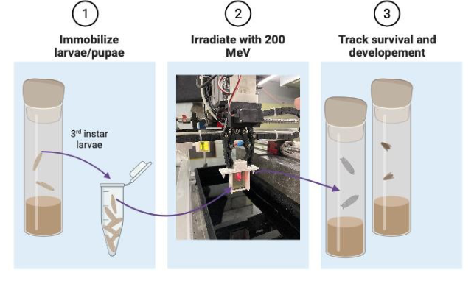
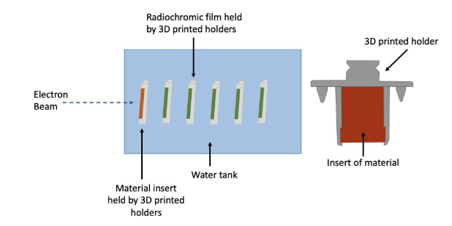
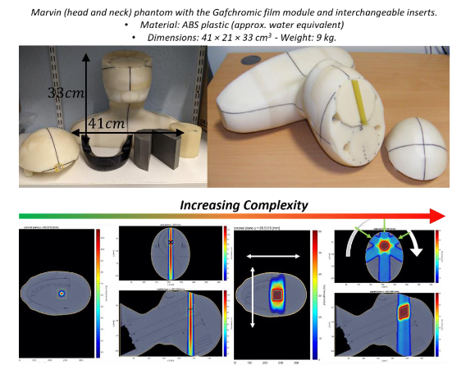
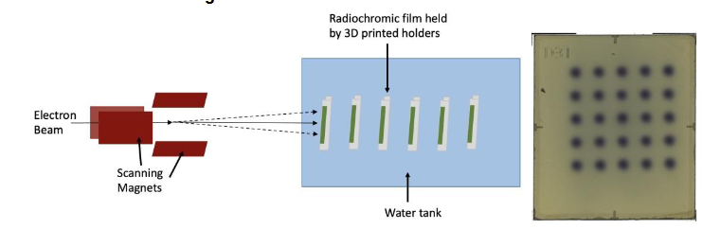
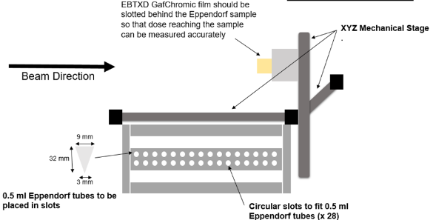
Medical Applications done in 2024
VHEE at UHDR Studies with Liposomes
VHEE at UHDR Studies with Biodosimeters
VHEE at UHDR Studies with Short Peptides & LCMS
VHEE at UHDR Studies with Cells
VHEE at UHDR Studies with Drosophilae
VHEE Material Irradiation Studies
Goal: explore dose and dose rate parameters for both healthy and cancerous cells.
Plan Delivery to an Anatomical Phantom
Radio-enhancement effect of
Nanoparticles in VHEE beams
& Gold Nanoparticles Plasmid Studies
P. Korysko - ATSOA25 - May 12, 2025
7

Slide 8
Practical Days

Slide 9
What will you do?
Start the CLEAR RF, optimise phases and send the laser to the photocathode.
Measure the beam energy thanks to the spectrometer line.
Transport and align the beam from the electron gun to the end of the machine using the steering magnets and the beam instrumentation devices along the line.
Measure the beam charge with the Integrating Current Transformers.
Measure the beam position and size with scintillating screens and cameras.
Perform quadrupole scans to measure the emittance and the Twiss parameters.
Measure the electron bunch length with a deflecting cavity.
Use a double foil scattering system with a collimator to obtain a uniform beam in air.
Use the CLEAR-Robot to measure the beam parameters in water and set up the beam to irradiate films.
Operate the accelerator from start to end.
P. Korysko - ATSOA25 - May 12, 2025
9

Slide 10
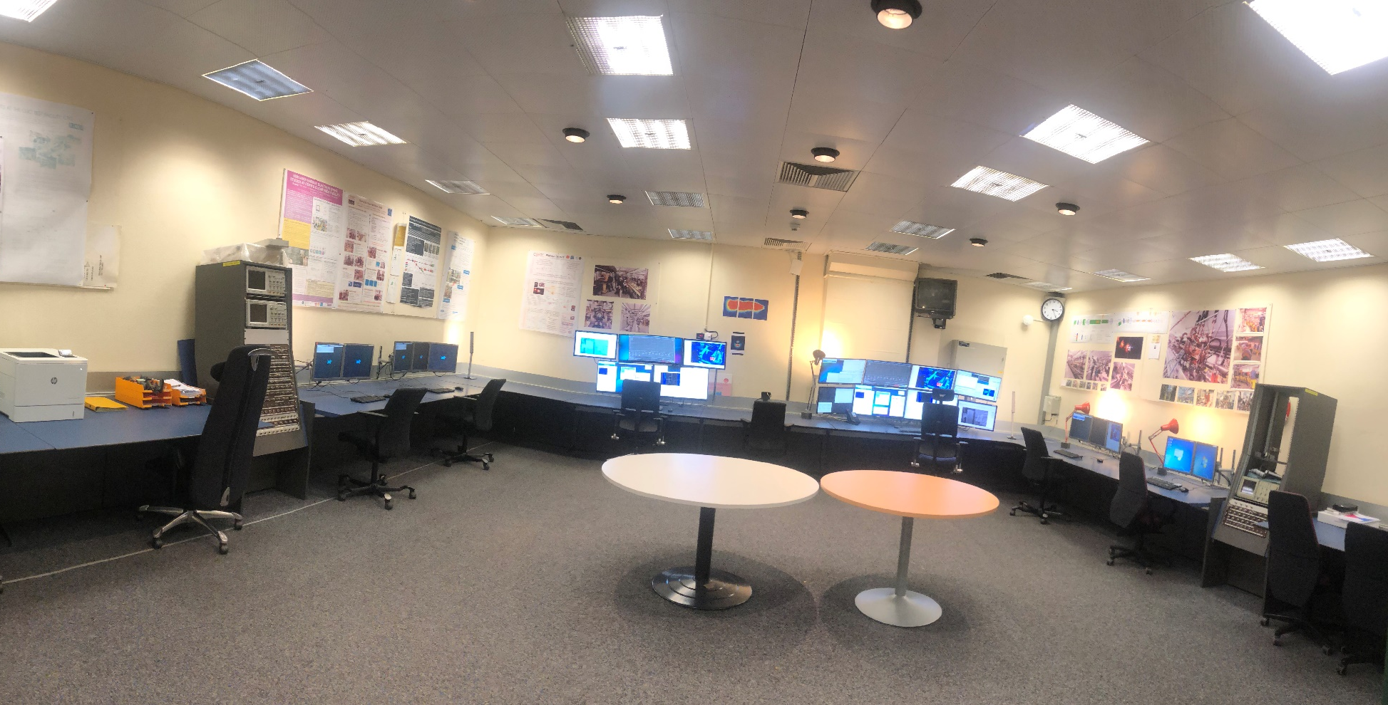
The CLEAR Control Room
P. Korysko - ATSOA25 - May 12, 2025
10

Slide 11
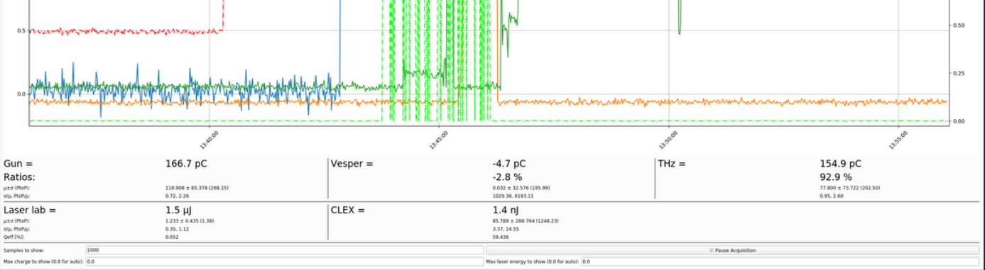
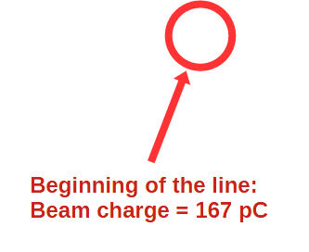
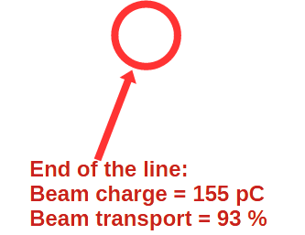
Beam charge measurement and transport
P. Korysko - ATSOA25 - May 12, 2025
11

Slide 12
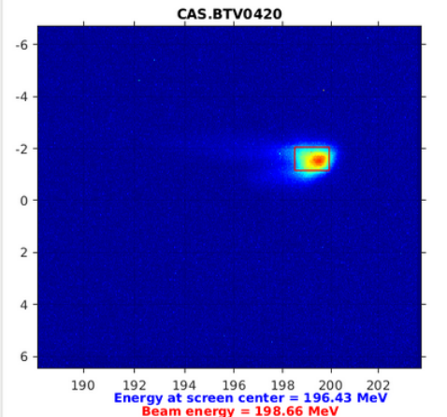
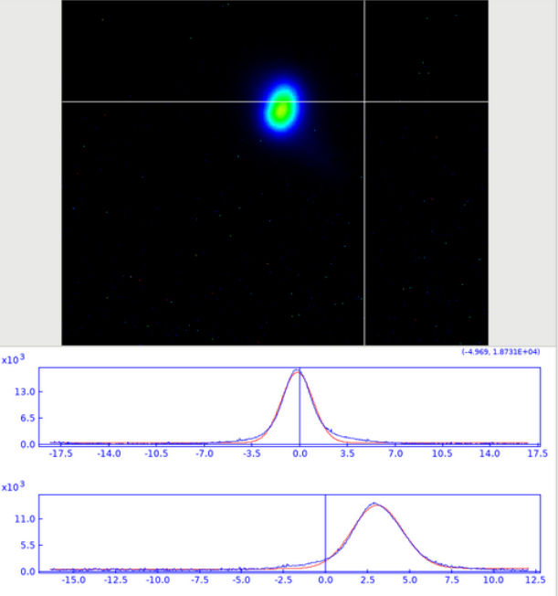
Beam Energy and Transverse Profile
Measurement of the beam energy with the spectrometer line (VESPER)
Measurement of the beam profile, position and size at the end of the line (THz)
P. Korysko - ATSOA25 - May 12, 2025
12

Slide 13
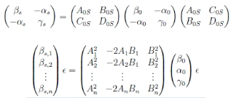
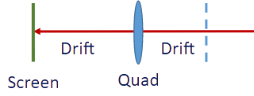
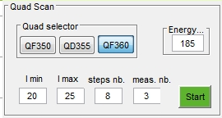
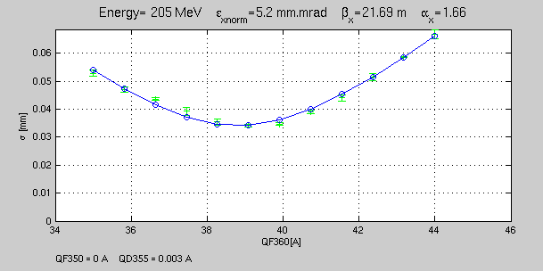
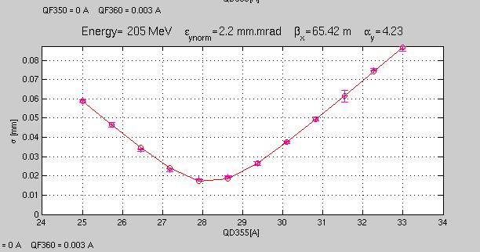
Quadrupole Scans
Horizontal beam size as a
function of the quadrupole current
Vertical beam size as a
function of the quadrupole current
P. Korysko - ATSOA25 - May 12, 2025
13

Slide 14
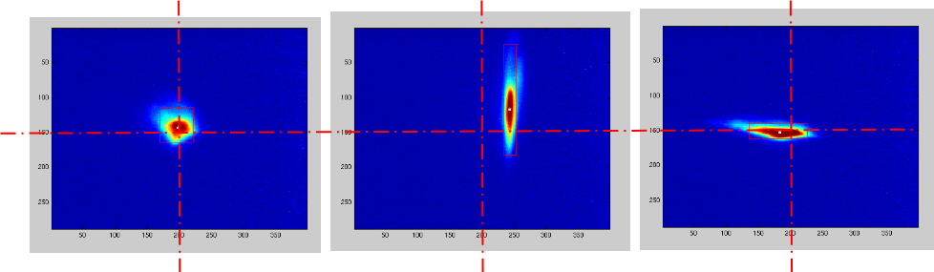
Alignment of the beam in the quadrupoles
Quads Off
Horizontal focusing quad with beam offset in both axis
Vertical focusing quad with
Horizontal beam offset
P. Korysko - ATSOA25 - May 12, 2025
14

Slide 15

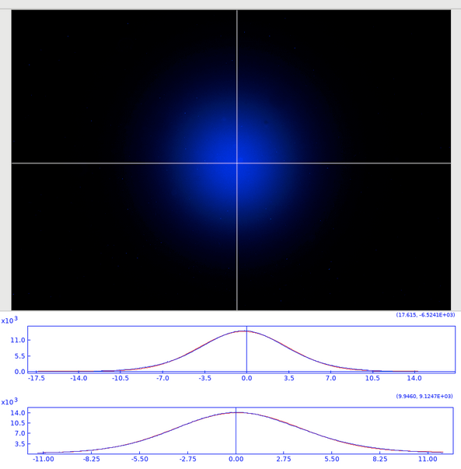
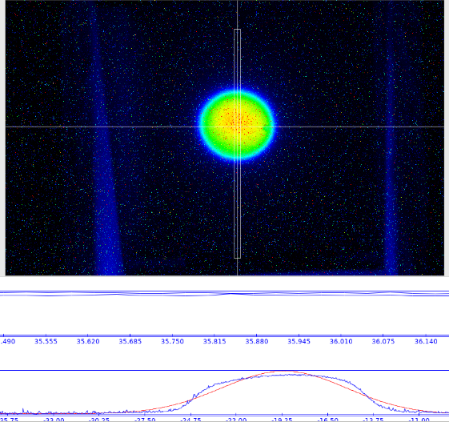
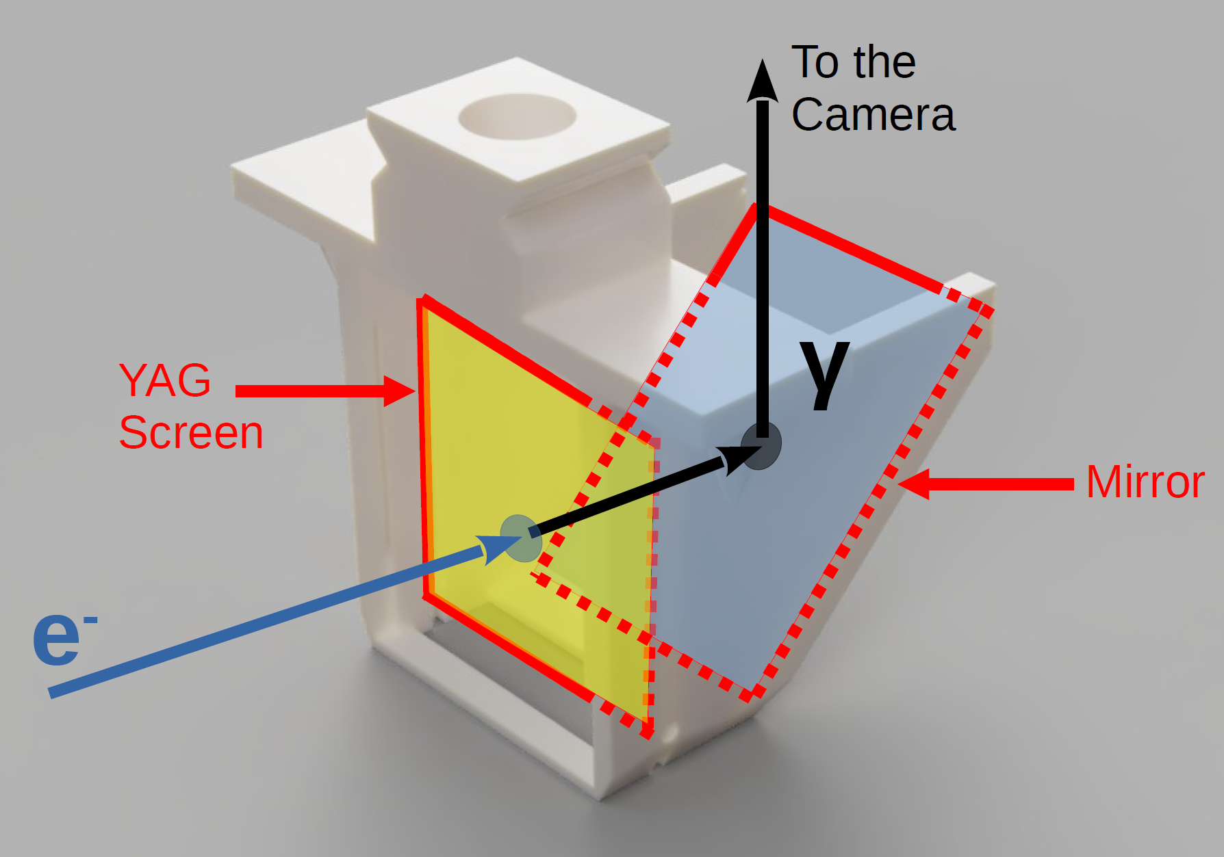
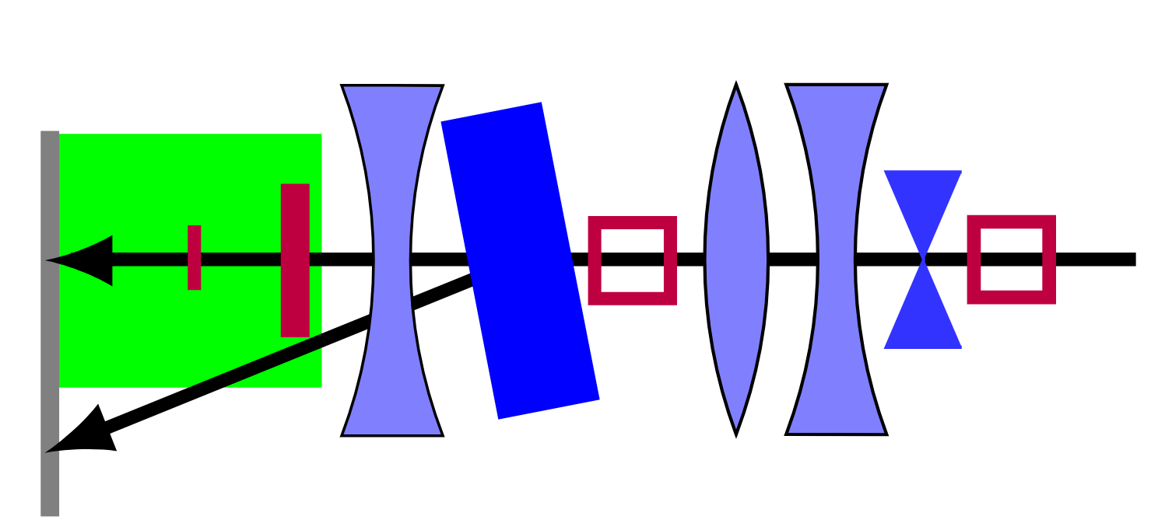
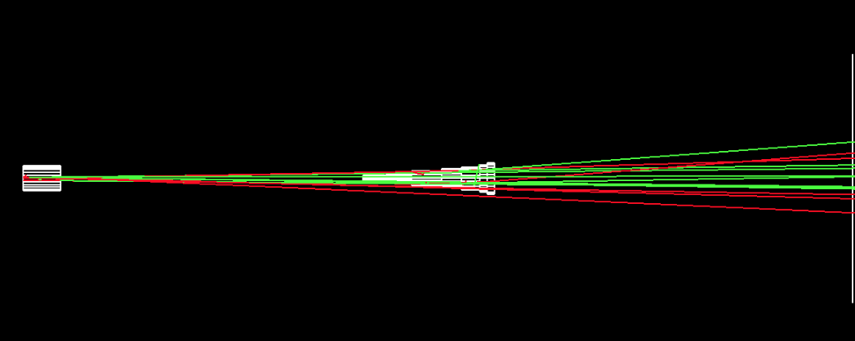
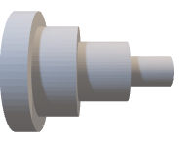
Obtain a Uniform Beam
Camera
e⁻ beam
Gaussian Beam
Uniform Beam
e⁻
e⁻
YAG
Screen
Scatterer 2
Scatterer 1
Screen
Collimator
P. Korysko - ATSOA25 - May 12, 2025
15

Slide 16
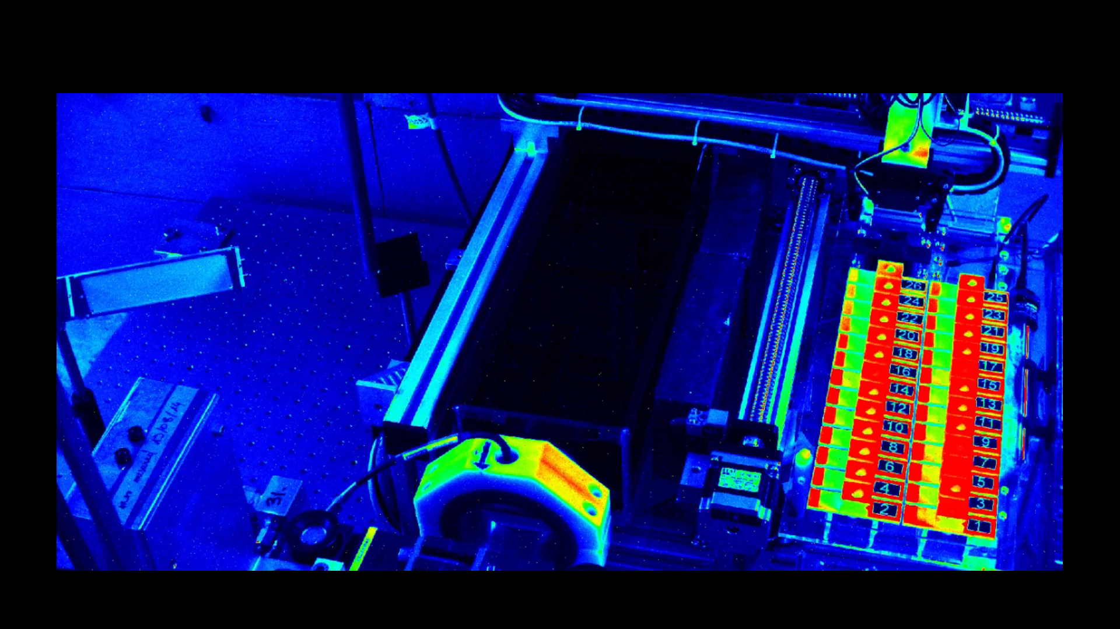
Irradiate Samples
Link to Video
P. Korysko - ATSOA25 - May 12, 2025
16

Slide 17
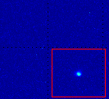
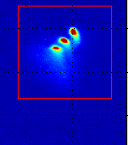
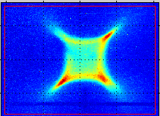
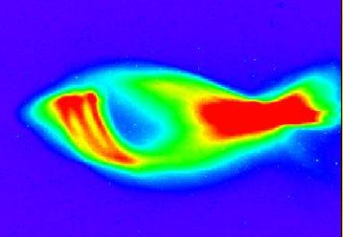

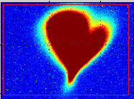
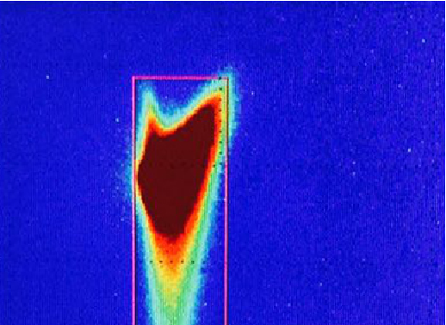
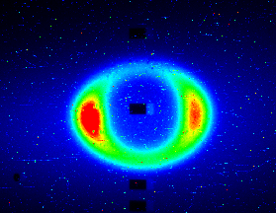
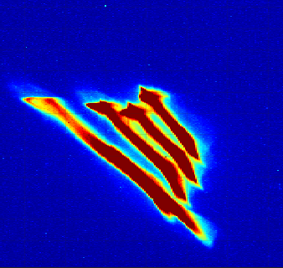
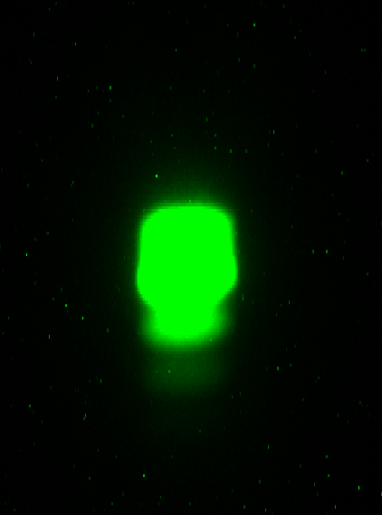
Beam Shape Contest:
Take part !
Smallest beam: 37 um x 33 um
3 bunches with transverse
space separation
Octupolar fields
Fishy Beam
Demon’s face
Valentine’s day beam
Cat head
Sauron
Monster claws
Lego Head
P. Korysko - ATSOA25 - May 12, 2025
17

Slide 18
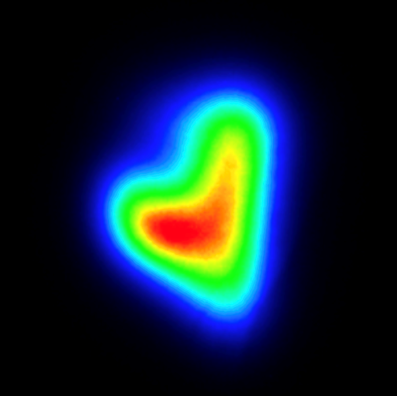
Thank you

