Slide 1
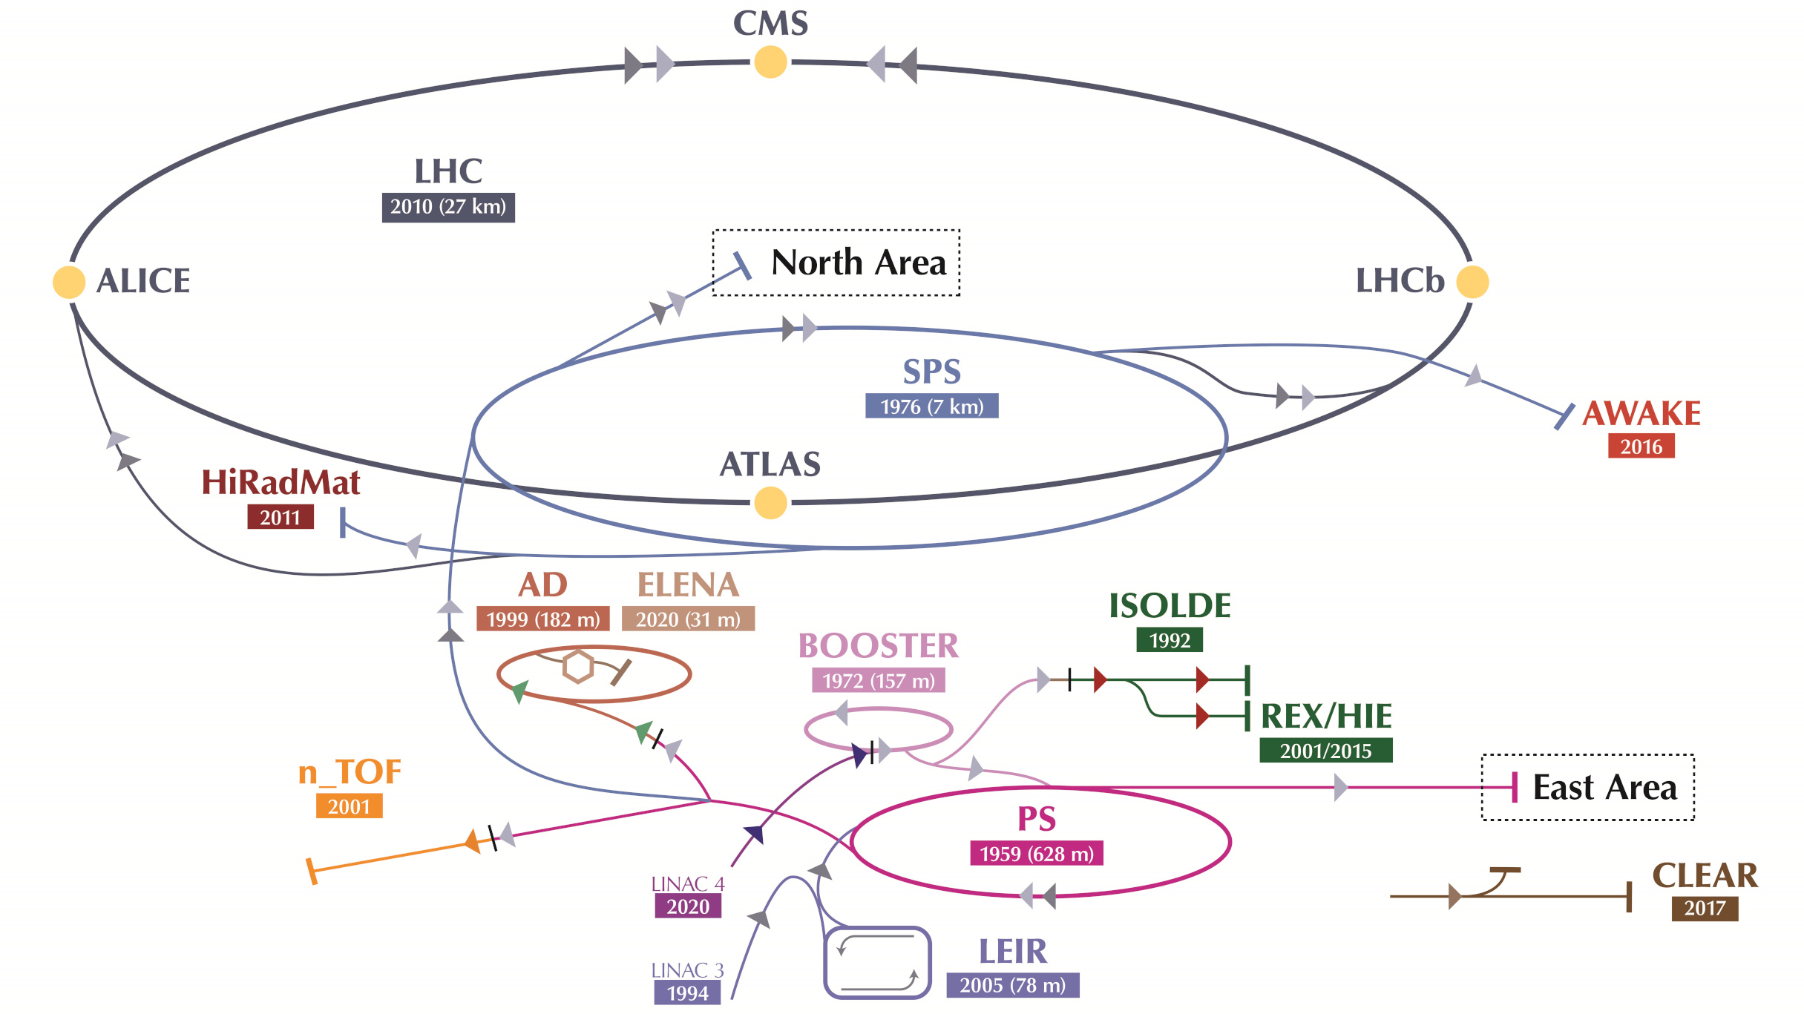


Group A Presentation
ATSOA 2025 EUROLABS
Lennert De Keukeleere
Carl Jolly
Javier Luis Correa Laorden
Daniel Movilla Quintero
Diego Garrido
Björn Dörschel
16.05.2025

Slide 2
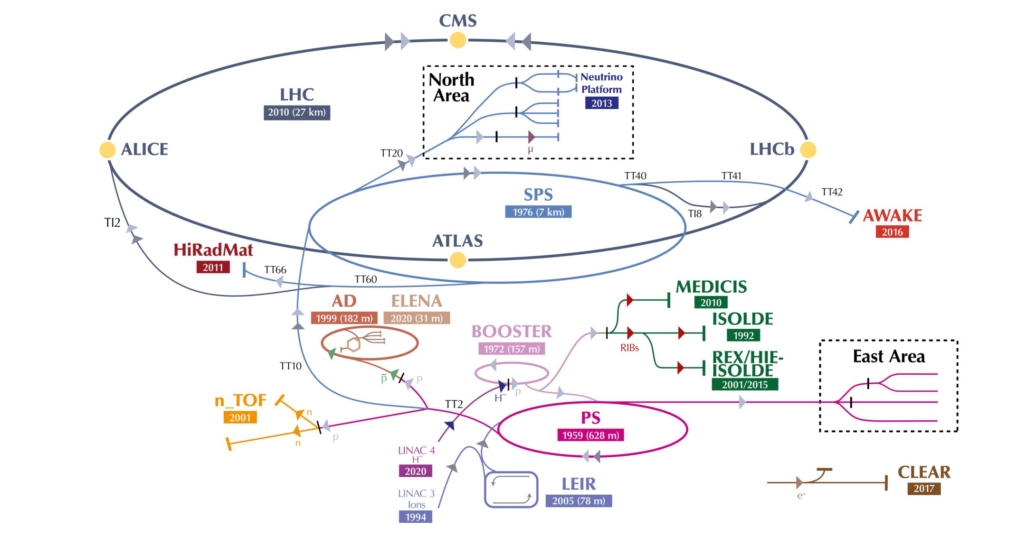
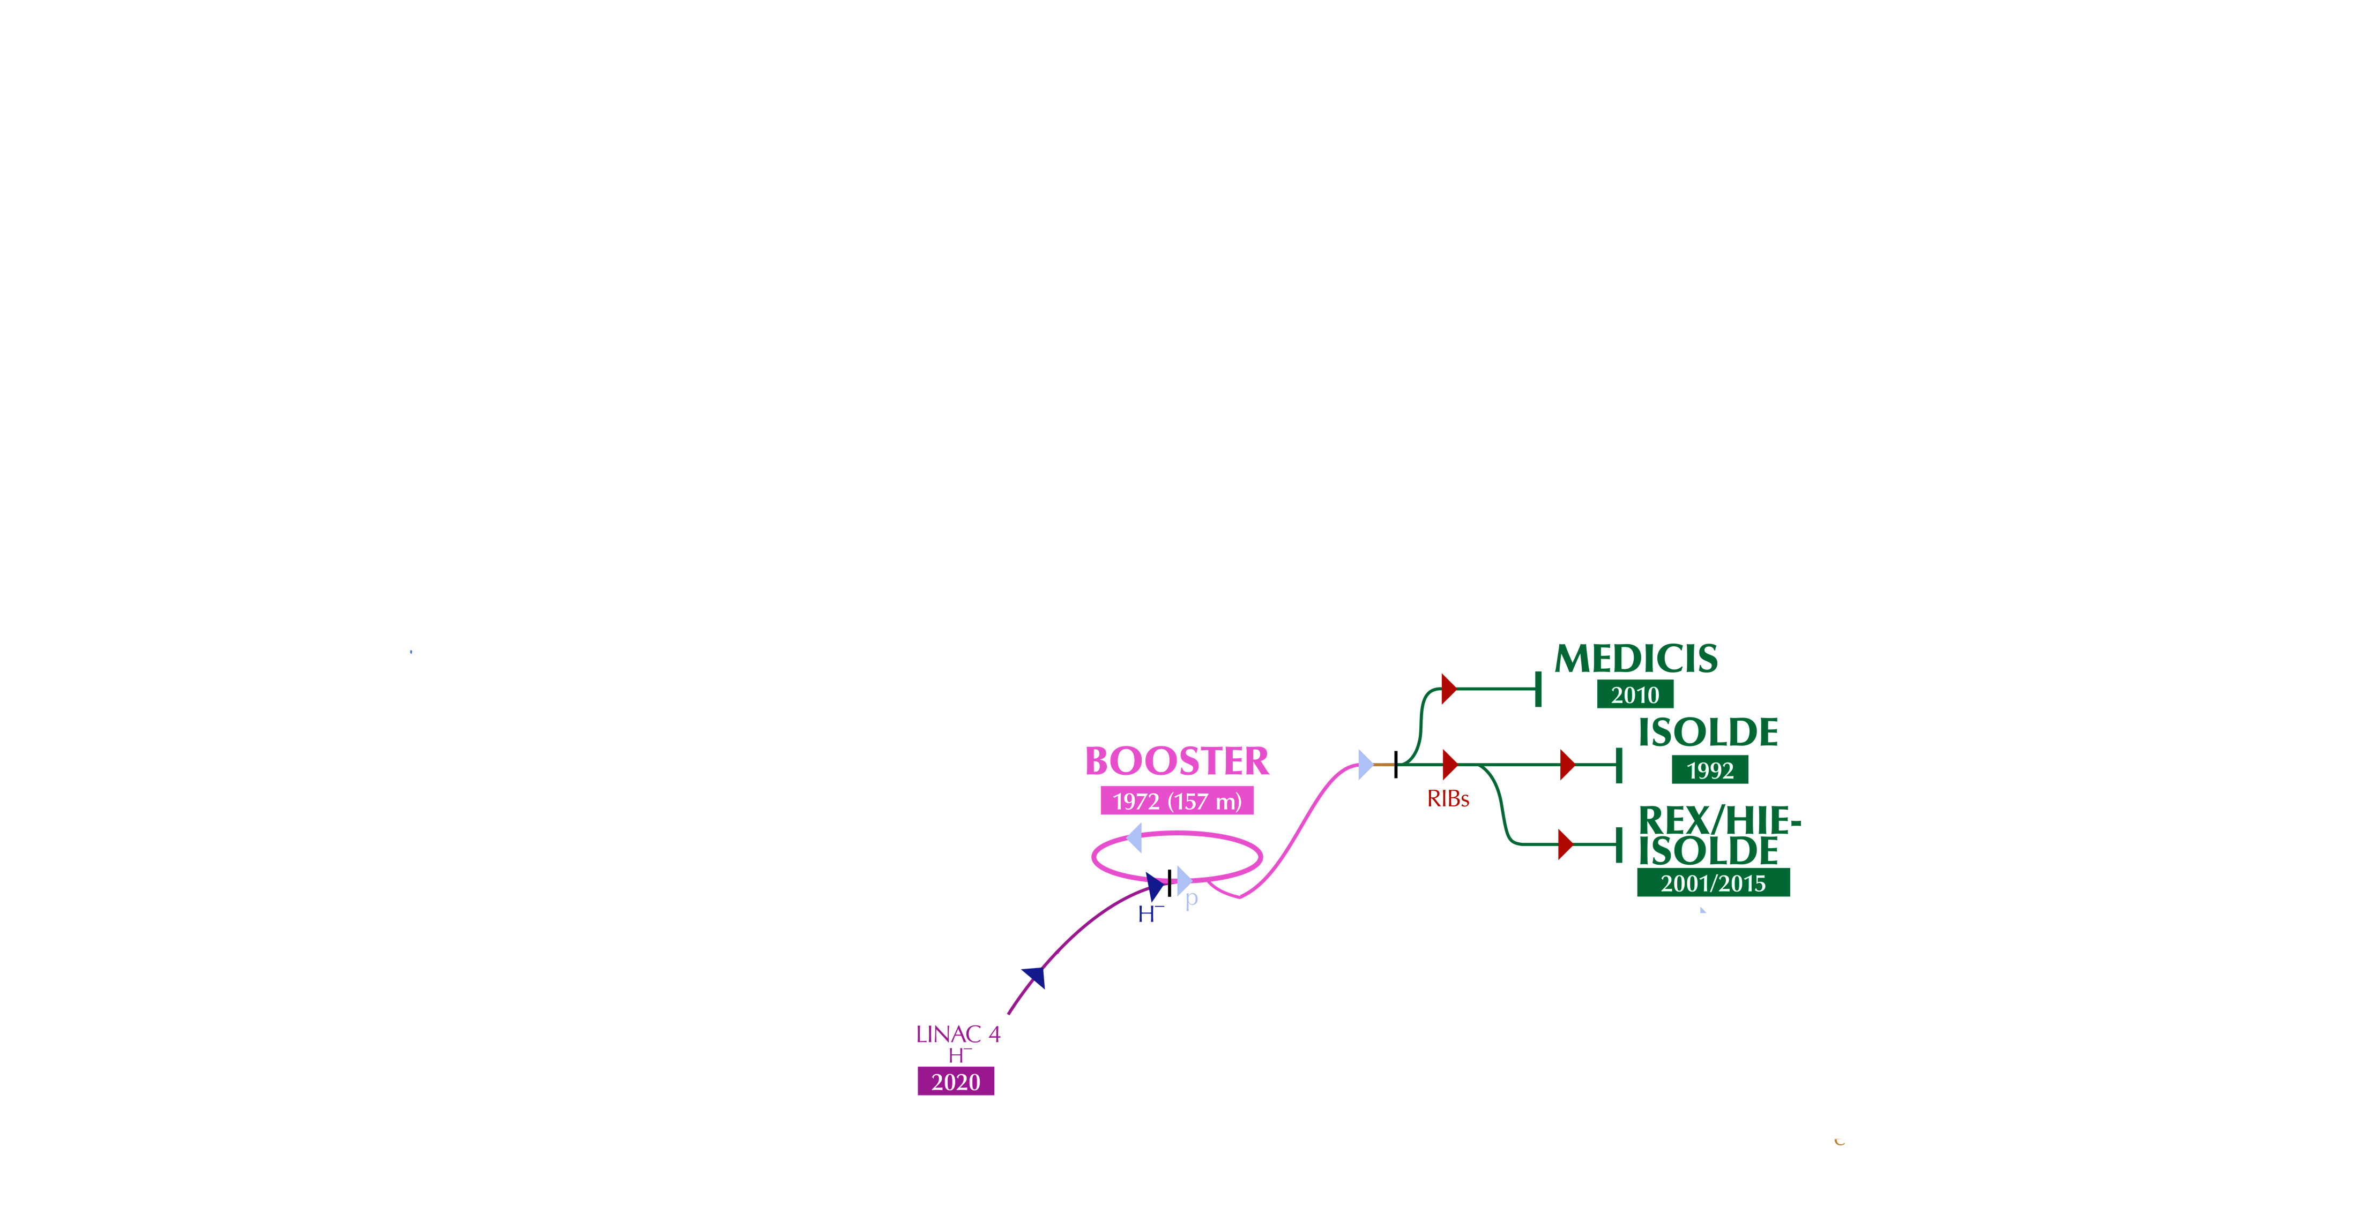
WHERE ARE WE

Slide 3
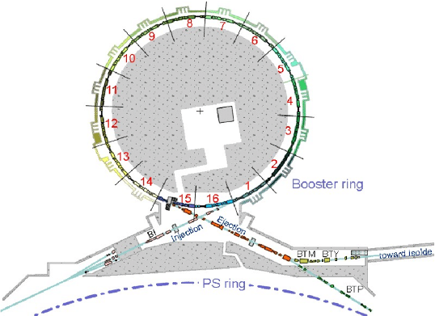
WHAT IS THE BOOSTER

Slide 4
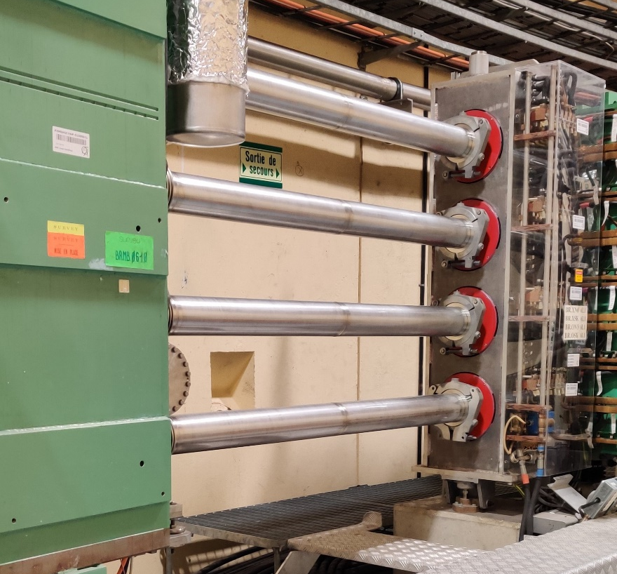
WHAT IS THE BOOSTER

Slide 5
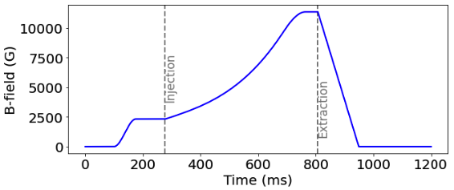
WHAT IS THE BOOSTER

Slide 6
WHAT IS THE BOOSTER
➔ From 160 MeV to 2 GeV

Slide 7

EMITTANCE $ϵ$
x
x
Particle beam
Particle beam
z
z
${\vec{v}}_{particle}=v_{x}{\hat{u}}_{x}+v_{y}{\hat{u}}_{y}$+$v_{z}{\hat{u}}_{z}$
${\vec{v}}_{particle}=v_{x}{\hat{u}}_{x}+v_{y}{\hat{u}}_{y}$+$v_{z}{\hat{u}}_{z}$

Slide 8
EMITTANCE $ϵ$
x
x
Particle beam
Particle beam
z
z
map beam in
phase space
map beam in
phase space
map beam in
phase space
map beam in
phase space
map beam in
phase space
x
x
x’
x’
${\vec{v}}_{particle}=v_{x}{\hat{u}}_{x}+v_{y}{\hat{u}}_{y}$+$v_{z}{\hat{u}}_{z}$
${\vec{v}}_{particle}=v_{x}{\hat{u}}_{x}+v_{y}{\hat{u}}_{y}$+$v_{z}{\hat{u}}_{z}$
z
z

Slide 9
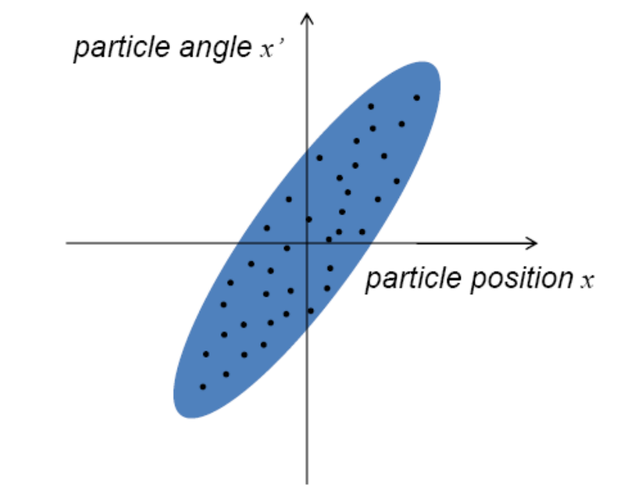
EMITTANCE $ϵ$
x
x
Particle beam
Particle beam
z
z
map beam in
phase space
map beam in
phase space
map beam in
phase space
map beam in
phase space
map beam in
phase space
map beam in
phase space
x
x
x’
x’
${\vec{v}}_{particle}=v_{x}{\hat{u}}_{x}+v_{y}{\hat{u}}_{y}$+$v_{z}{\hat{u}}_{z}$
${\vec{v}}_{particle}=v_{x}{\hat{u}}_{x}+v_{y}{\hat{u}}_{y}$+$v_{z}{\hat{u}}_{z}$
z
z

Slide 10
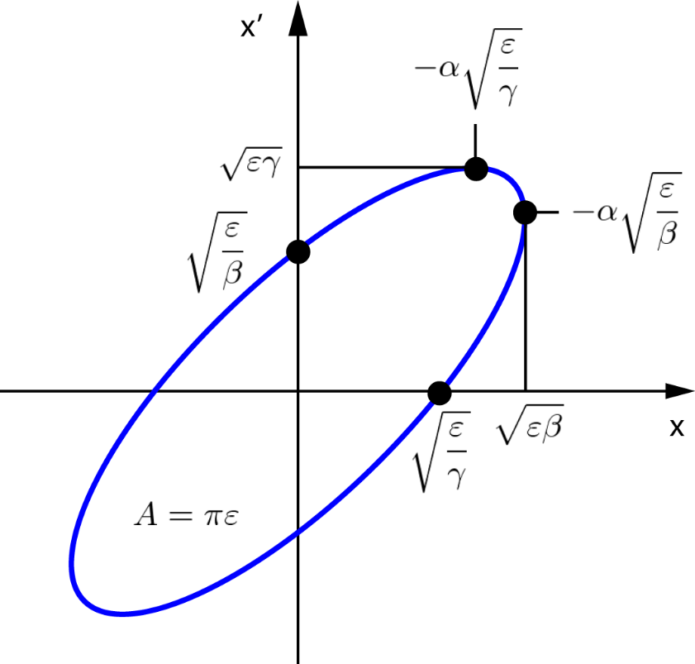
EMITTANCE $ϵ$
x
x
Particle beam
Particle beam
z
z
map beam in
phase space
map beam in
phase space
collective behaviour
map beam in
phase space
map beam in
phase space
map beam in
phase space
map beam in
phase space
x
x
x’
x’
${\vec{v}}_{particle}=v_{x}{\hat{u}}_{x}+v_{y}{\hat{u}}_{y}$+$v_{z}{\hat{u}}_{z}$
${\vec{v}}_{particle}=v_{x}{\hat{u}}_{x}+v_{y}{\hat{u}}_{y}$+$v_{z}{\hat{u}}_{z}$
z
z

Slide 11
EMITTANCE $ϵ$
x
x
Particle beam
Particle beam
z
z
map beam in
phase space
map beam in
phase space
collective behaviour
map beam in
phase space
map beam in
phase space
map beam in
phase space
map beam in
phase space
x
x
x’
x’
${\vec{v}}_{particle}=v_{x}{\hat{u}}_{x}+v_{y}{\hat{u}}_{y}$+$v_{z}{\hat{u}}_{z}$
${\vec{v}}_{particle}=v_{x}{\hat{u}}_{x}+v_{y}{\hat{u}}_{y}$+$v_{z}{\hat{u}}_{z}$
z
z

Slide 12
PROTON FORCES IN A BEAM BUNCH
+q
+q

Slide 13


PROTON FORCES IN A BEAM BUNCH
$$F_{E}$$
$$F_{E}$$
+q
+q

Slide 14
PROTON FORCES IN A BEAM BUNCH
v
v
$$F_{E}$$
$$F_{E}$$
+q
+q

Slide 15


PROTON FORCES IN A BEAM BUNCH
v
v
$$F_{B}$$
$$F_{B}$$
$$F_{E}$$
$$F_{E}$$
+q
+q

Slide 16
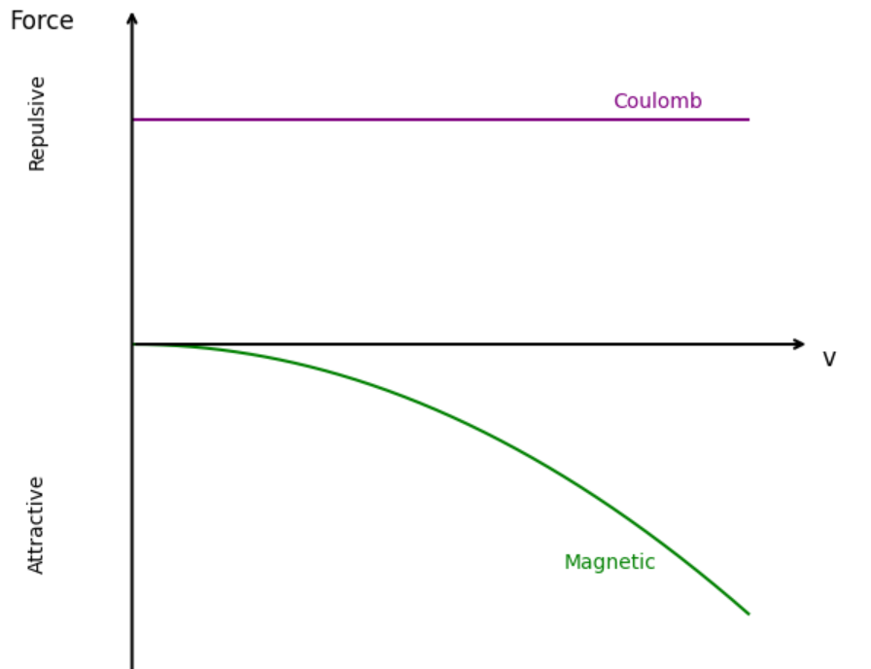
PROTON FORCES IN A BEAM BUNCH
v
v
$$F_{B}$$
$$F_{B}$$
$$F_{E}$$
$$F_{E}$$
+q
+q

Slide 17
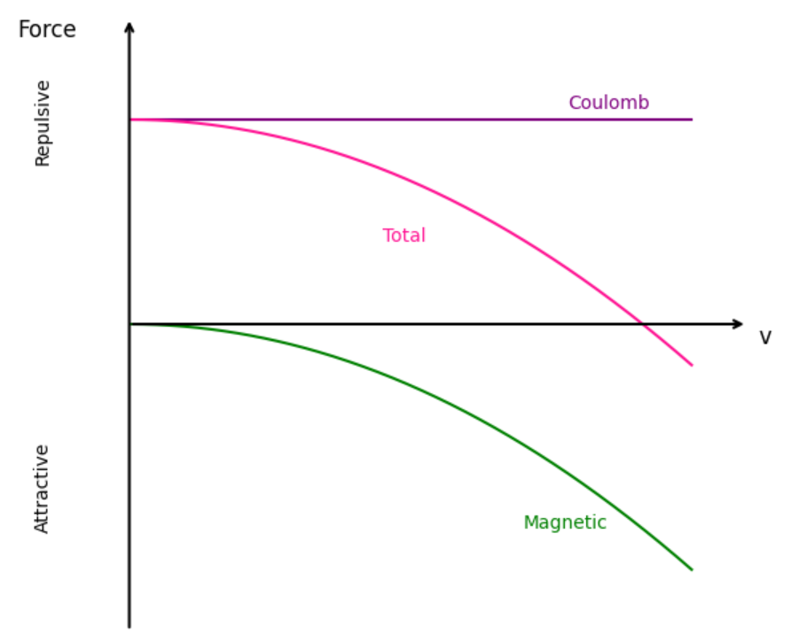
PROTON FORCES IN A BEAM BUNCH
v
v
$$F_{B}$$
$$F_{B}$$
$$F_{E}$$
$$F_{E}$$
+q
+q

Slide 18
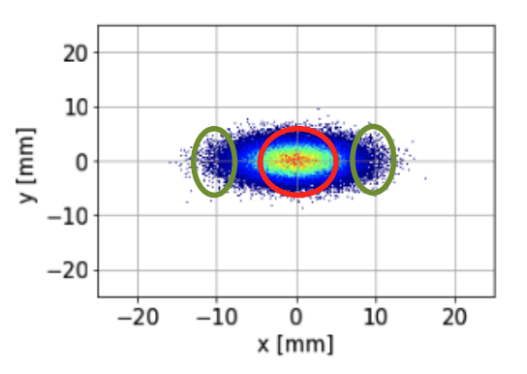
HOW TO UTILISE SPACE CHARGE

Slide 19
WHAT IS THE TUNE
The “tune” is like the number of times the particle wiggles a little side-to-side or up-and-down while going all the way around the circle once.
If the tune is just the wrong number — like a bad rhythm — then those wiggles can get bigger and bigger until the particle flies away and we lose it.
But if we set the tune just right, the particles stay safe and smooth all the way around.
Chat GPT

Slide 20
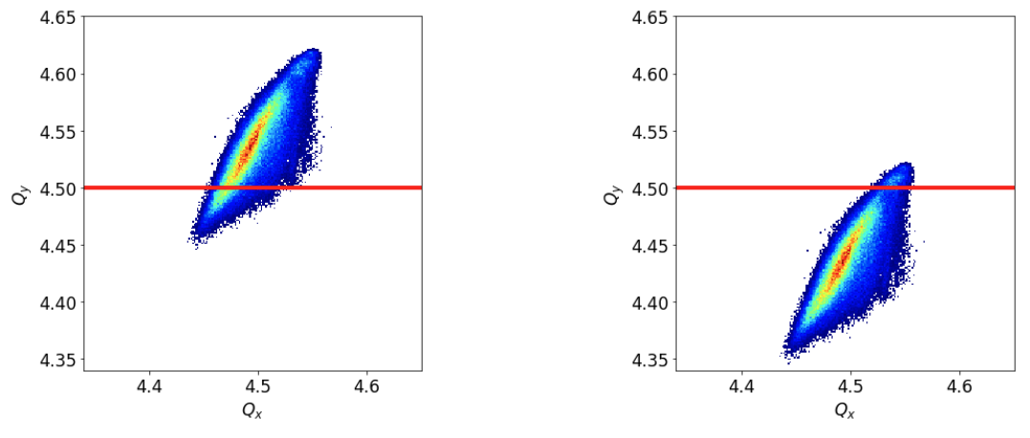
HOW TO UTILISE SPACE CHARGE
Emittance Blows up
Beam Losses

Slide 21
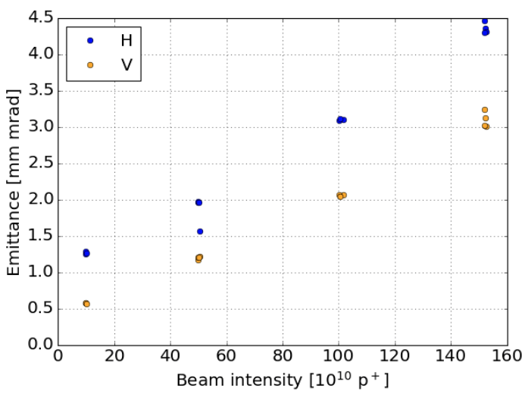
RELATION OF EMITTANCE AND INTENSITY
Operation settings
At 160 MeV
No acceleration
1 Ring
Question
What‘s the relation between Emittance and Intensity?
Answer
due to space charge, the emittance increases if you put more charge in the bunch

Slide 22
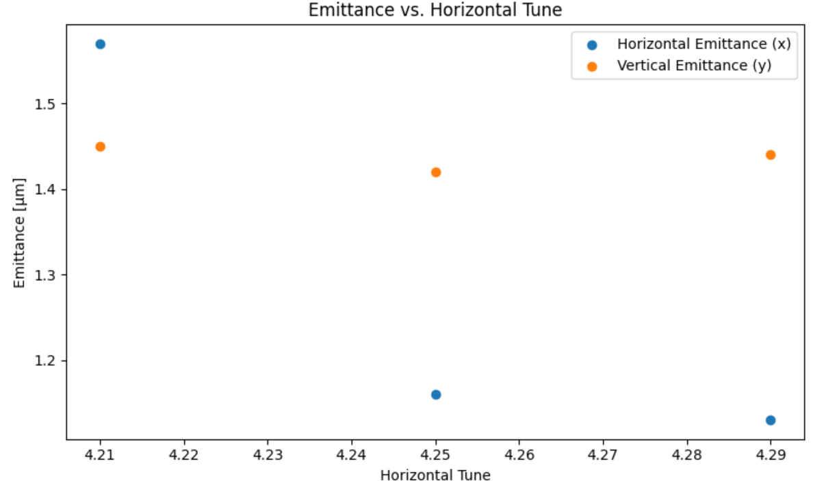


EMITTANCE AGAINST TUNE
Question
What happens to the emittance if you move away from a resonance
Answer
Emittance decreases
$$Q_{y}$$
$$Q_{x}$$

Slide 23
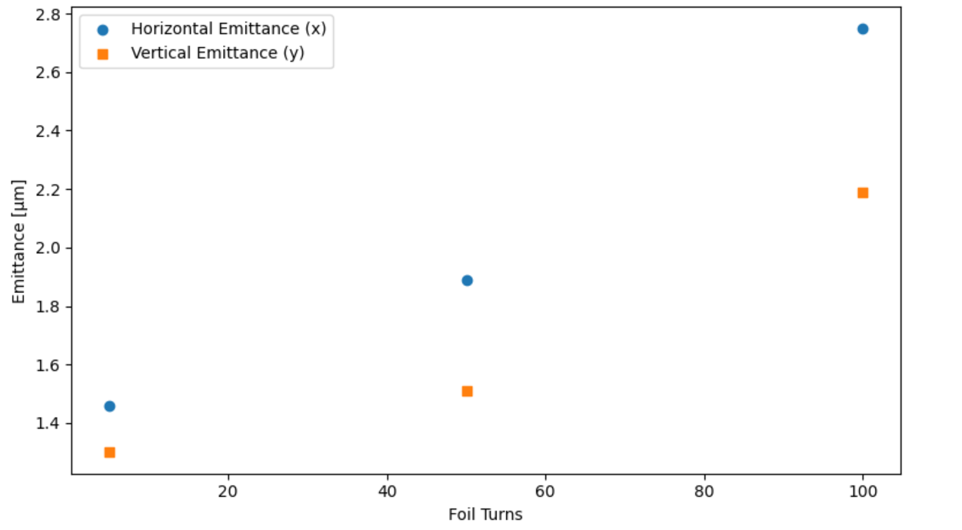
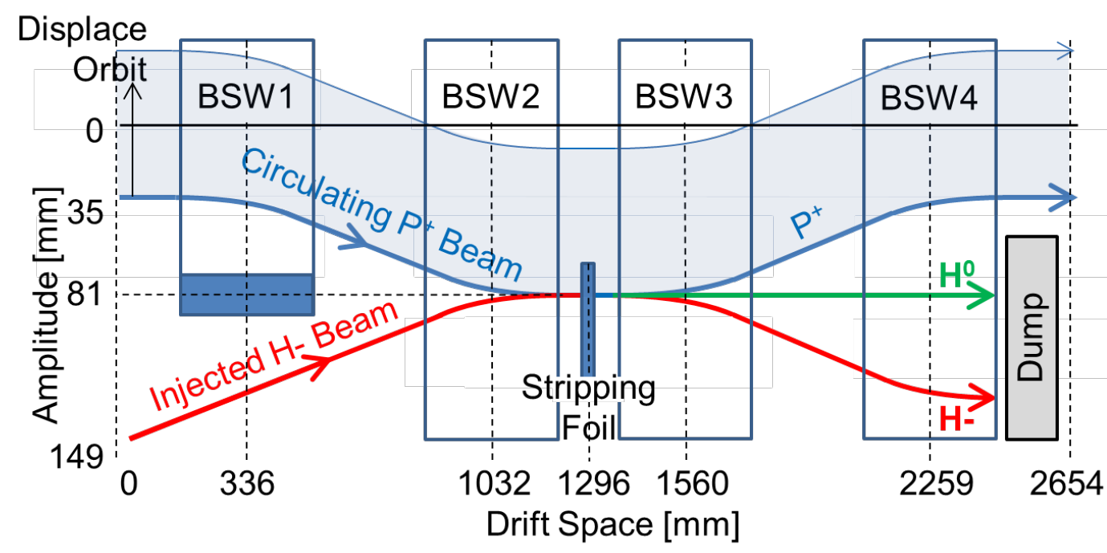
EMITTANCE AGAINST FOIL TURNS
Question
What happens to the emittance as you go through the stripping foil?
Answer
Emittance increases

Slide 24
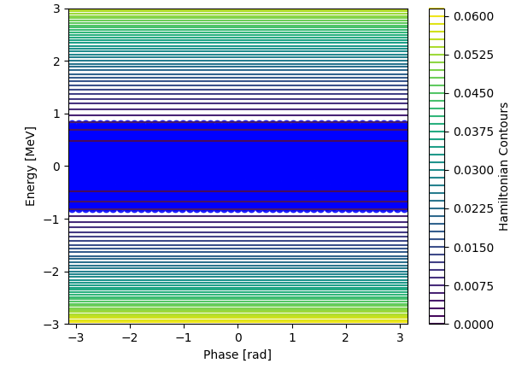
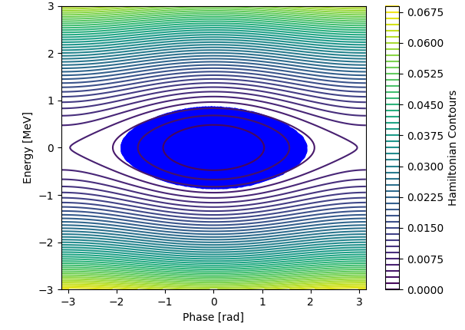
CAPTURING A COASTING BEAM
Inject a coasting beam.
Here the RF cavities are switched off.
Turn on the RF cavities and capture the beam to an RF bucket

Slide 25
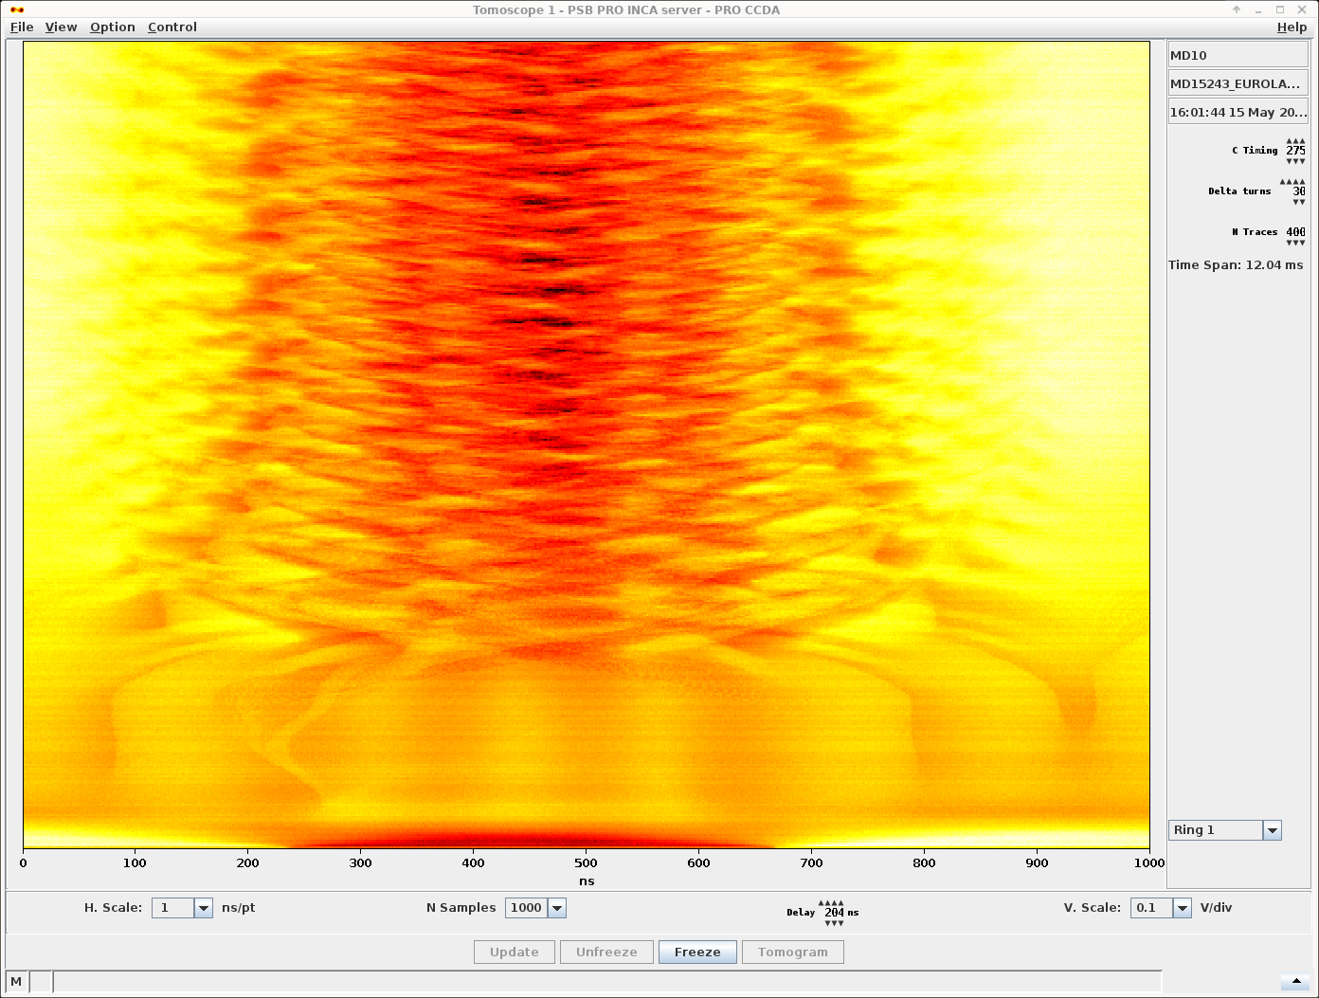
TRYING THIS ON THE PSB
“Waterfall” plot - each row is a beam profile
Beam captured into the RF bucket. (3)
Time
Beam becomes coasting (2)
Beam injected (1)

Slide 26
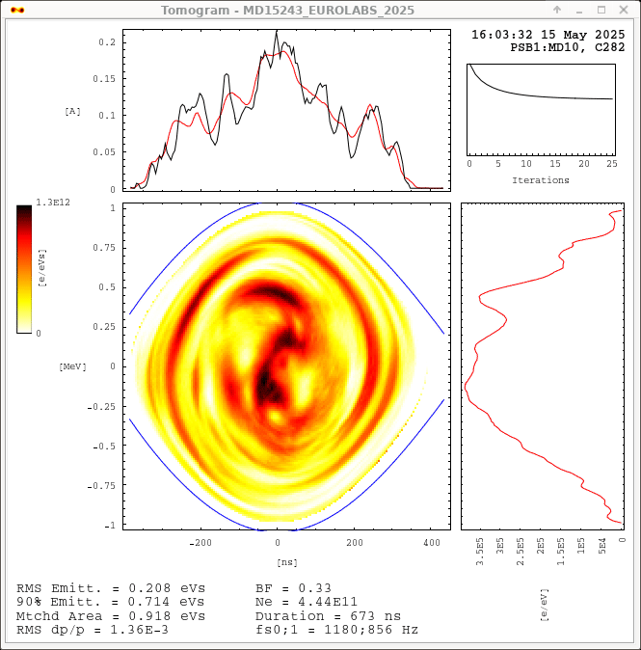
LONGITUDINAL PHASE SPACE TOMOGRAPHY
This technique allows you to reconstruct the longitudinal space from the waterfall plot on the previous slide.
The longitudinal phase space is reconstructed.
The tomography algorithm iterates to find the best fit to the data.
The fit here was not perfect…

Slide 27
WHERE ARE WE

Slide 28
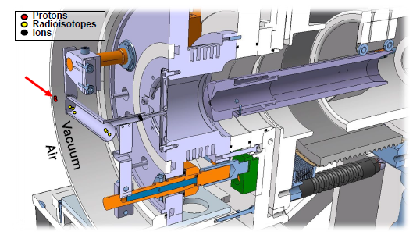
ISOLDE RADIOACTIVE ION BEAM GENERATION
PROTON BEAM 1.4 GeV
PULSE FRECUENCY 1.2s
TAGET HEATED UP TO 2000 °C.
SURFACE AND LASER IONIZATION
DIFFUSION OUT OF THE TARGET
TARGET UNIT AT 30-60 kV

Slide 29
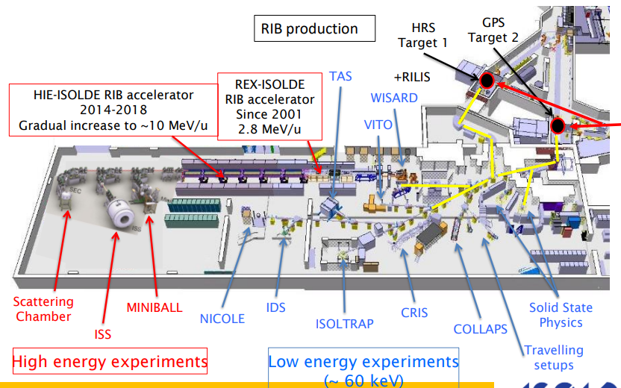
ISOLDE SCHEME
Image from
M.J.Borge slides

Slide 30
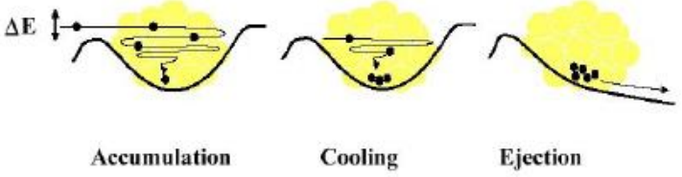
REX LOW ENERGY

Slide 31
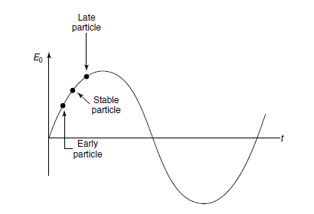
REX-HIE ISOLDE POST ACCELERATION
A/Q SEPARATOR
NORMAL CONDUCTING
ACCELERATION
SUPERCONDUCTING
ACCELERATION
RFQ

Slide 32
REX-HIE ISOLDE OPERATION
VACUUM
CRIOGENICS

Slide 33
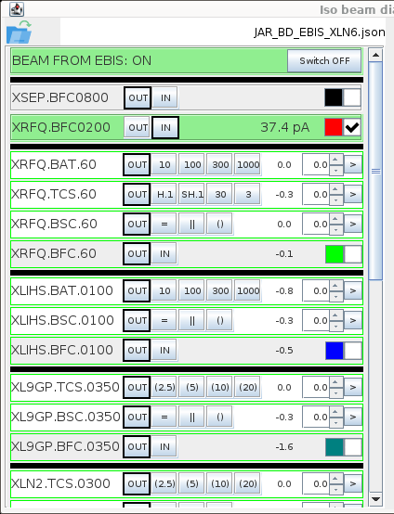
REX-HIE ISOLDE OPERATION

Slide 34
REX-HIE ISOLDE OPERATION
A/Q SCAN

Slide 35
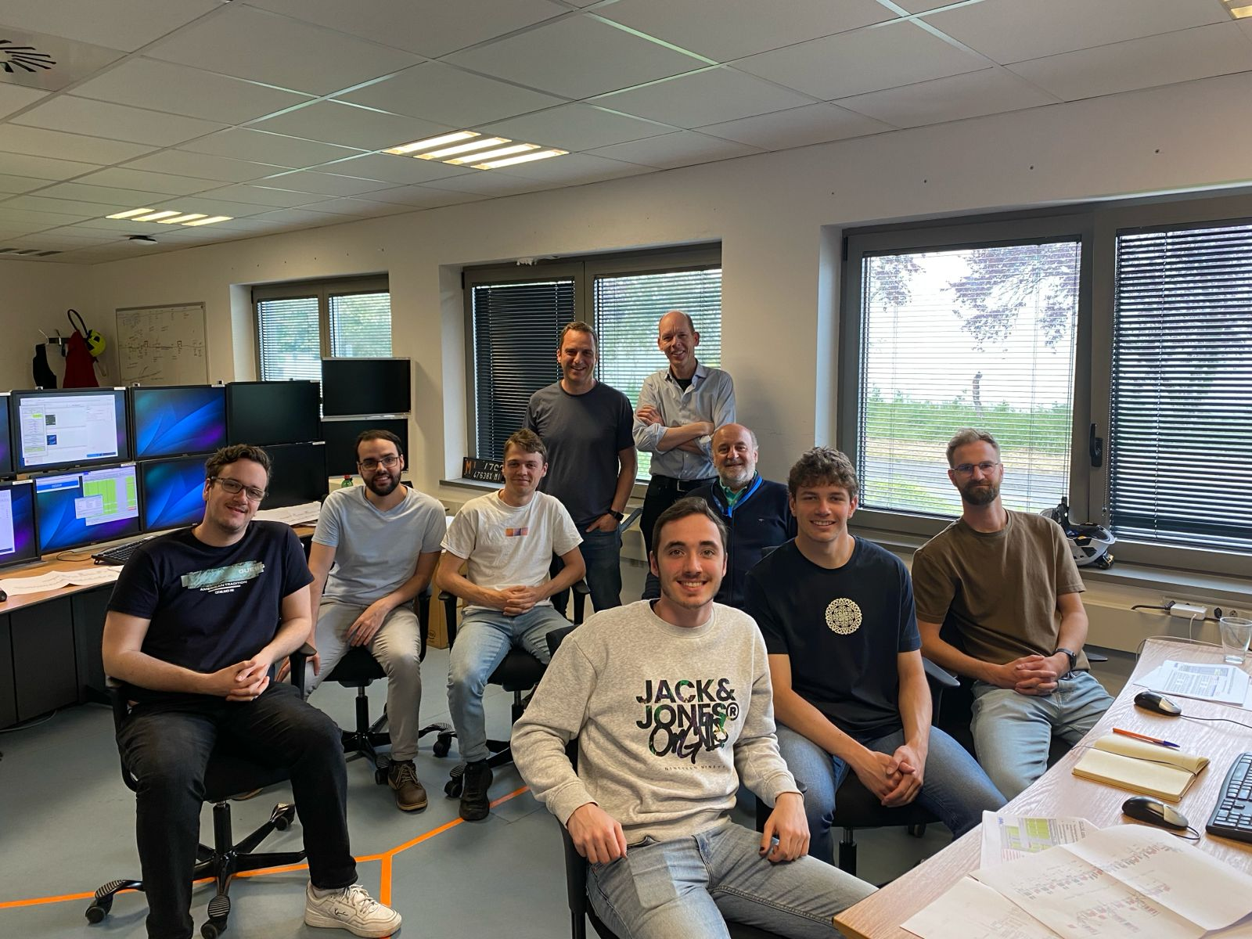
Thank you

