Slide 1





Advanced Training School on Operation of Accelerators
May 12 - 16, 2025
Joshua Appleby, Nikolay Azaryan, Sasha Horney, Tuuli Nissinen, Vincenzo Sansipersico

Slide 2

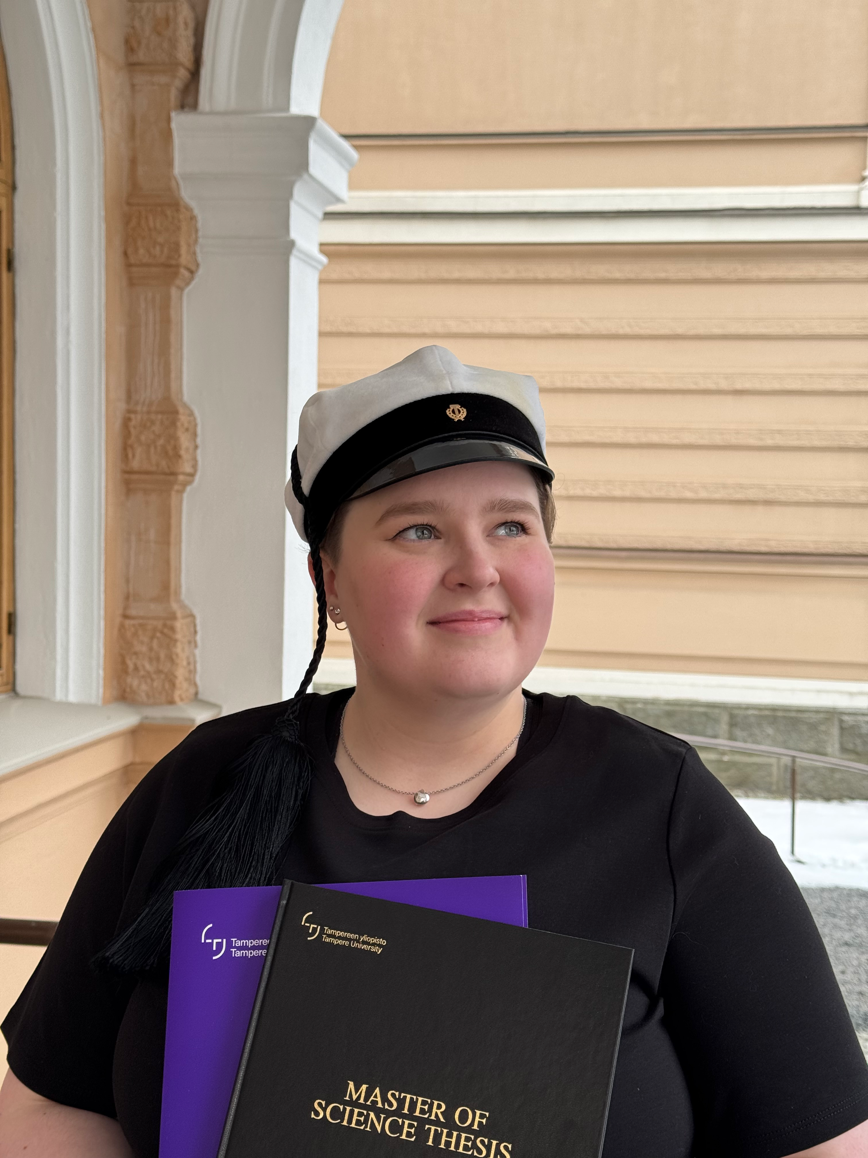
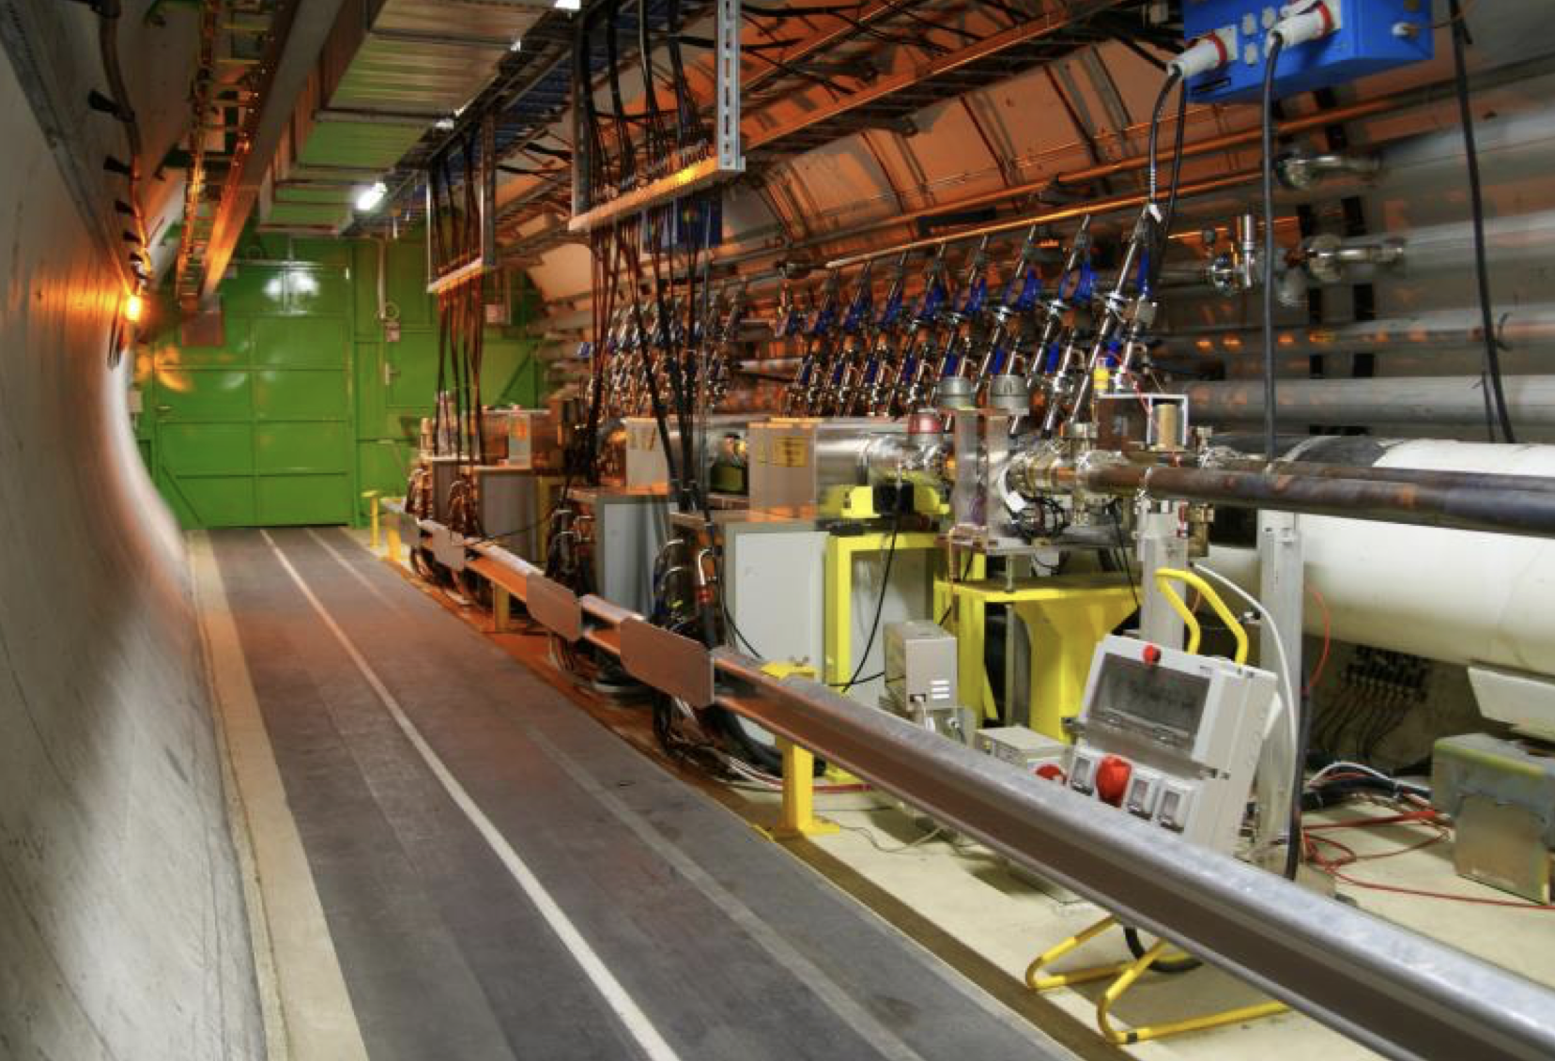
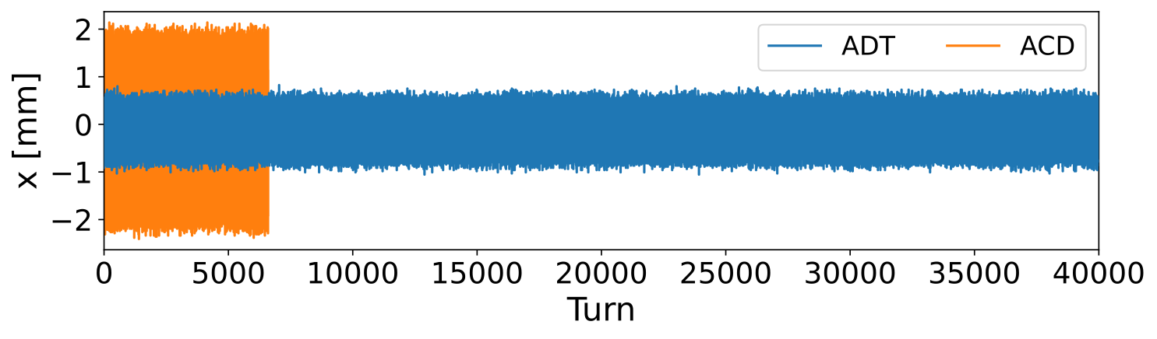
Tuuli Nissinen
MSc (Tech) in Physics, ex-CERN Technical Student
CERN work on optics for the LHC, BE-ABP-LNO
  validation of the LHC Transverse Damper (ADT) for optics measurements
  prior experience in operations, eager to learn more
currently applying for PhDs
in accelerator physics
→ excellent opportunity to
get a broader overview

Slide 3








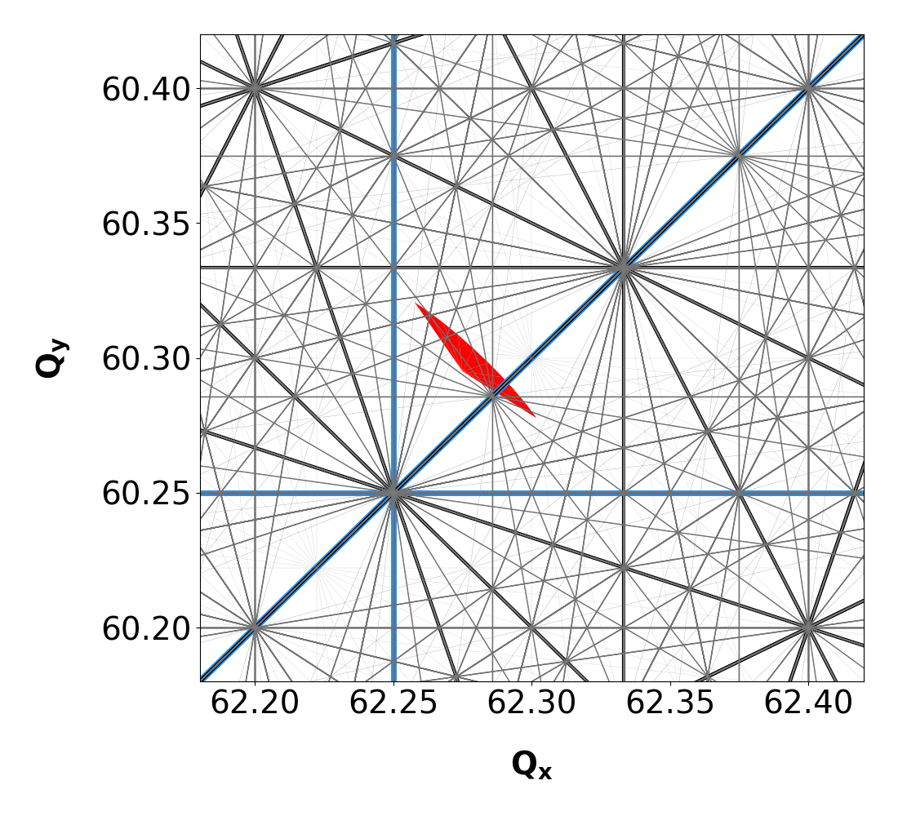
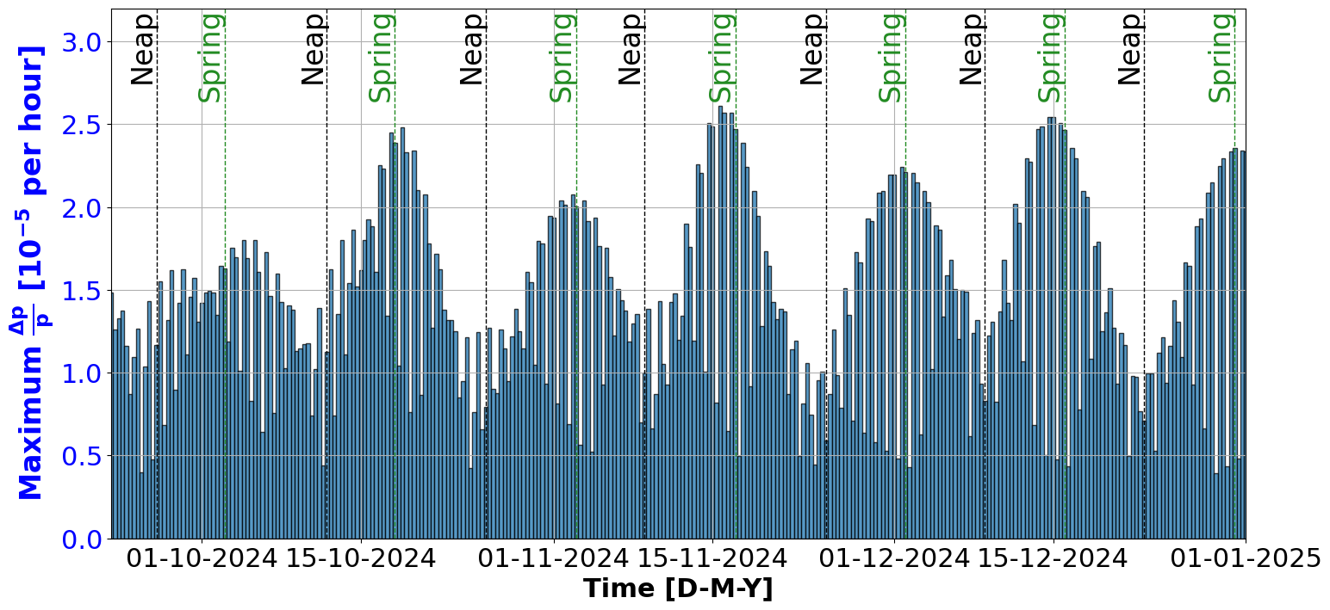
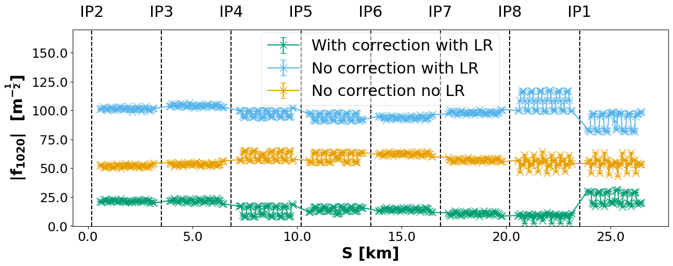
Sasha - an introduction
Did my MPhys @ University of Bristol
In my final year of DPhil @ University of Oxford and CERN Doctoral student
Focus on LHC and correcting resonances

Slide 4
Personal highlights
PSB - Sasha & Tuuli
operation much less streamlined than LHC
beam brightness, coupling, resonances, unbunched beams…
→ a lot of measurements in 1.5 days!

Slide 5
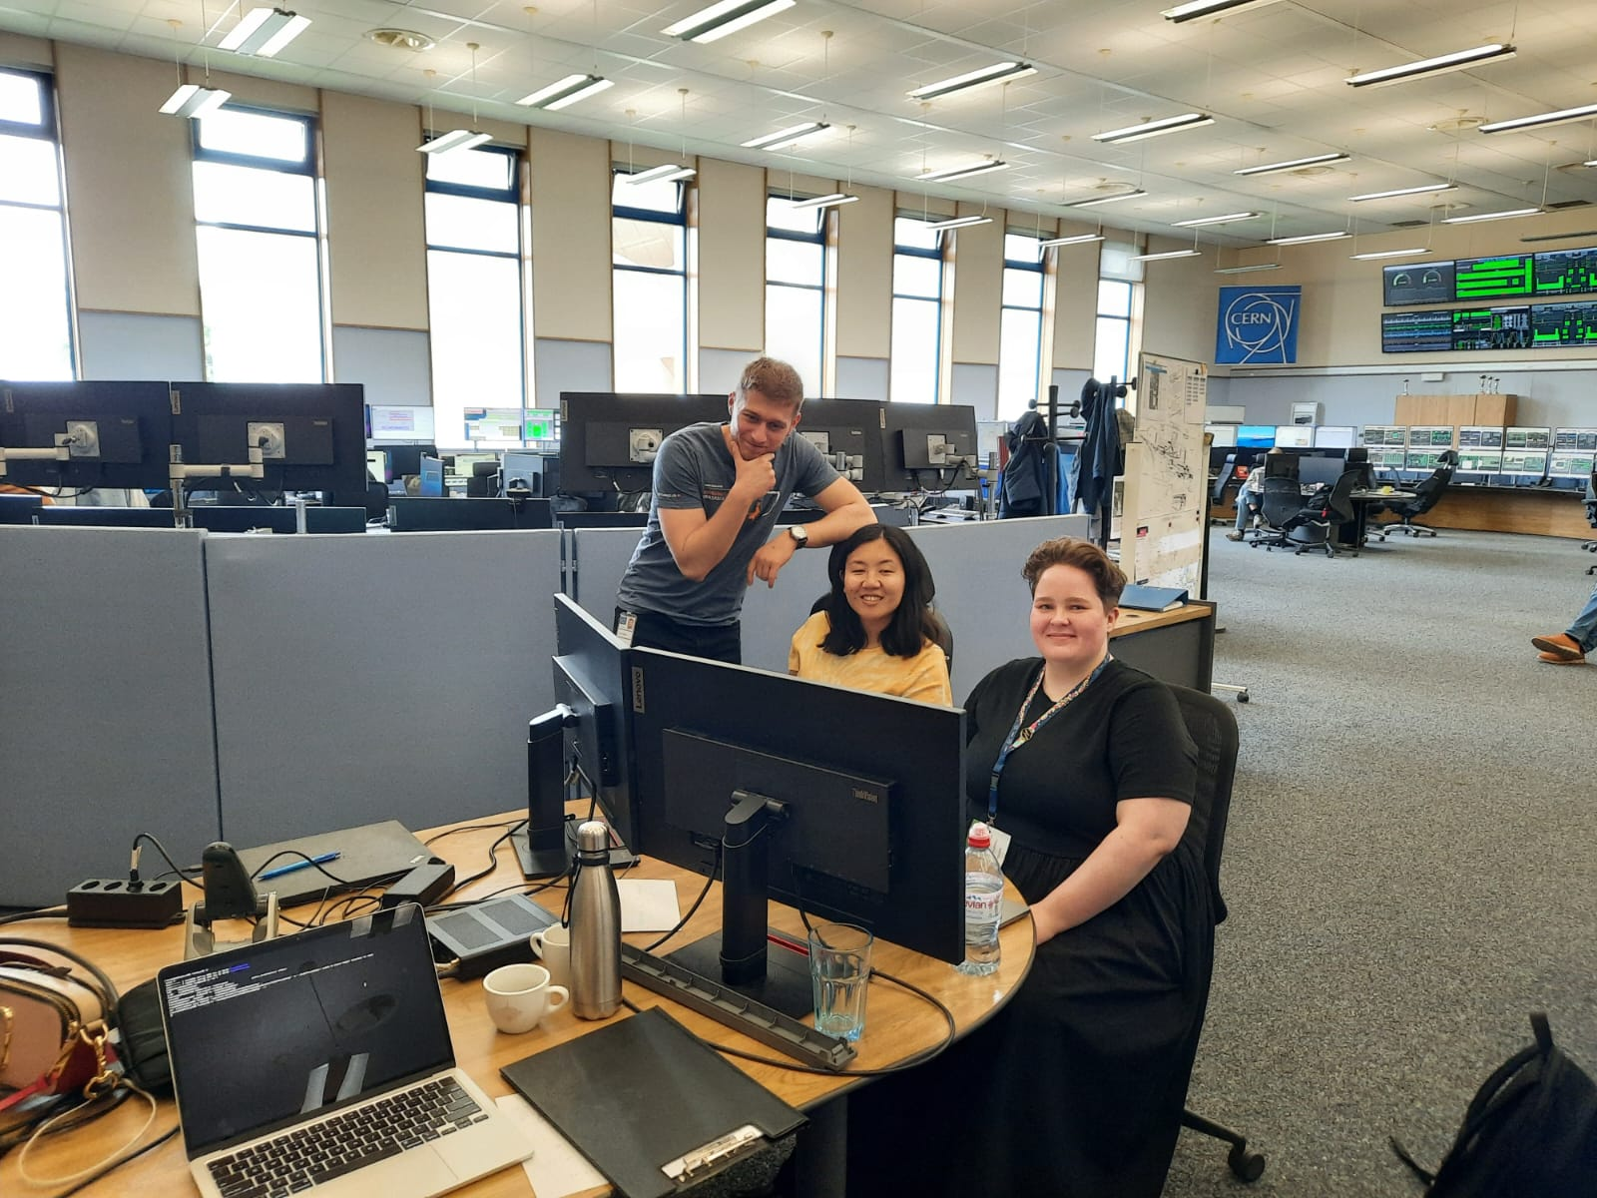
Personal highlights
PSB - Sasha & Tuuli
Very fun to be back at the CCC (during regular working hours!!)

Slide 6
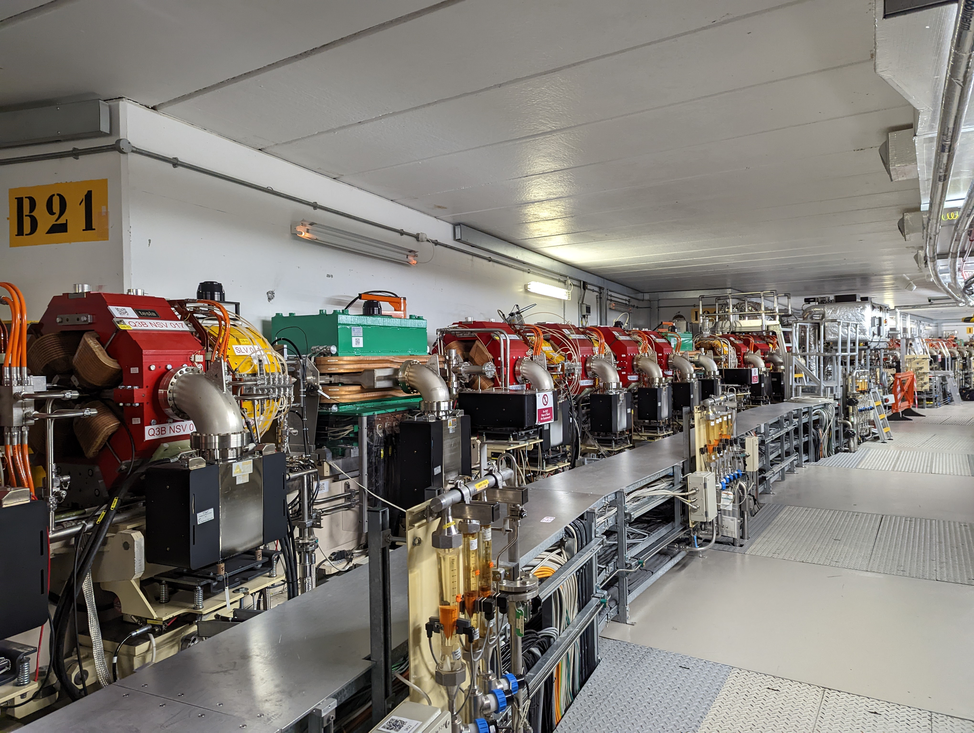

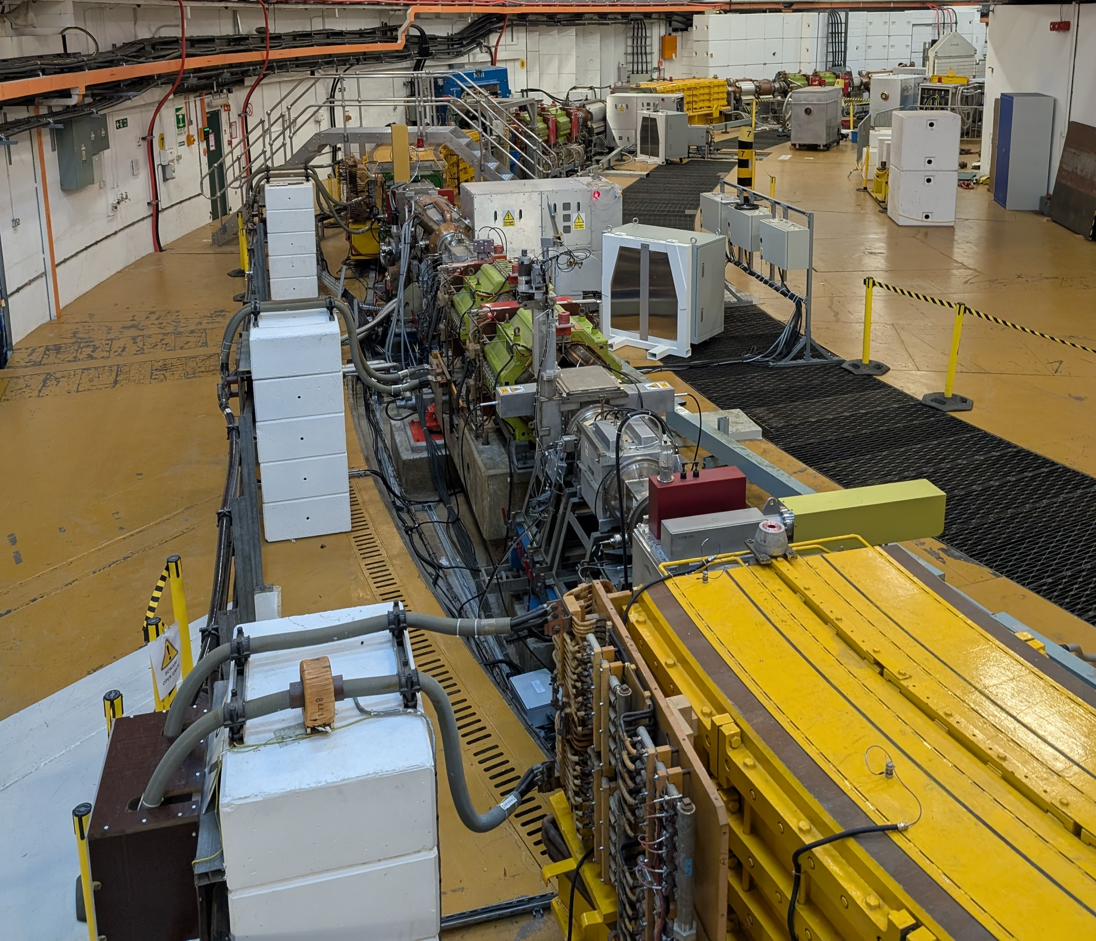



My Background – Josh Appleby
Previously worked at Diamond Light Source on Fast Beam Based Alignment
Now a PhD student at Oxford University, under the John Adams Institute, in collaboration with the ISIS Neutron and Muon Source
  Transverse optics for high intensity circular accelerators
  Optimisation of the working point while considering space charge and avoiding / mitigating resonances

Slide 7
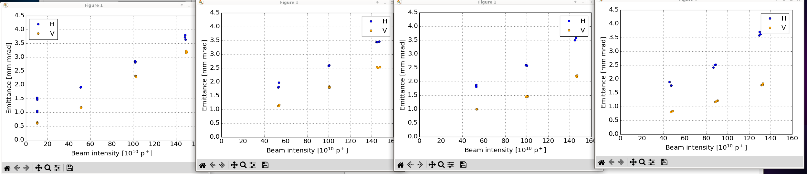
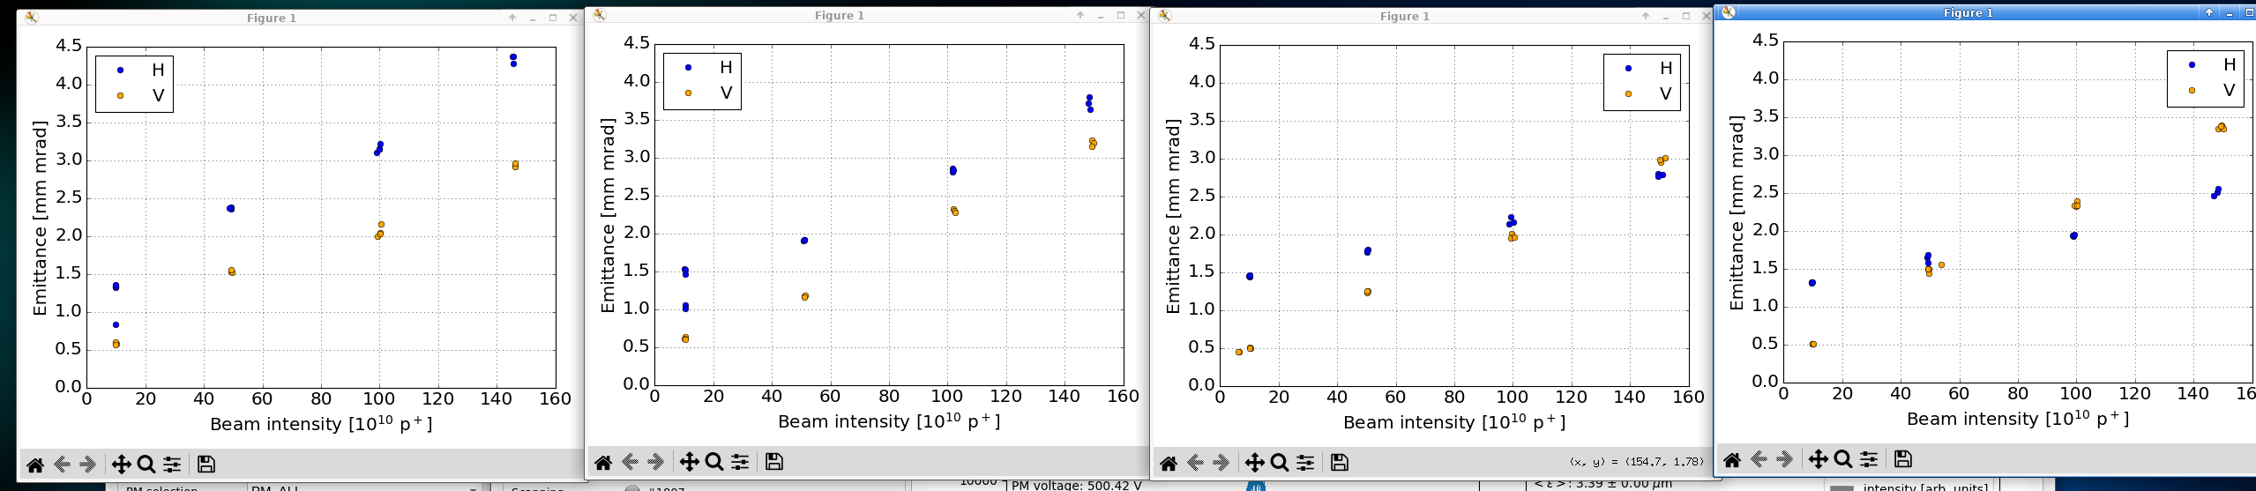
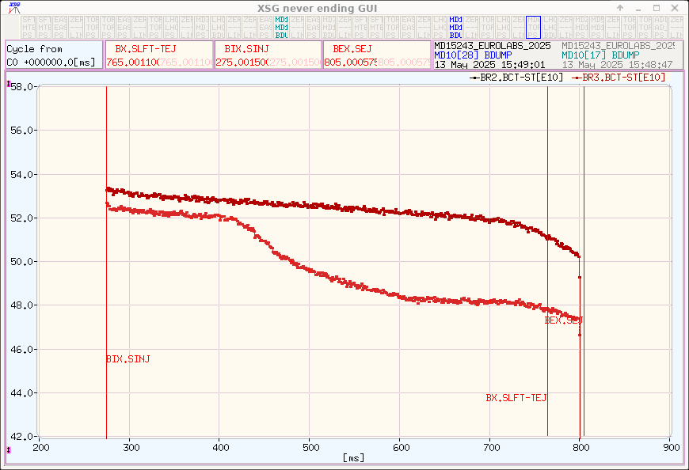
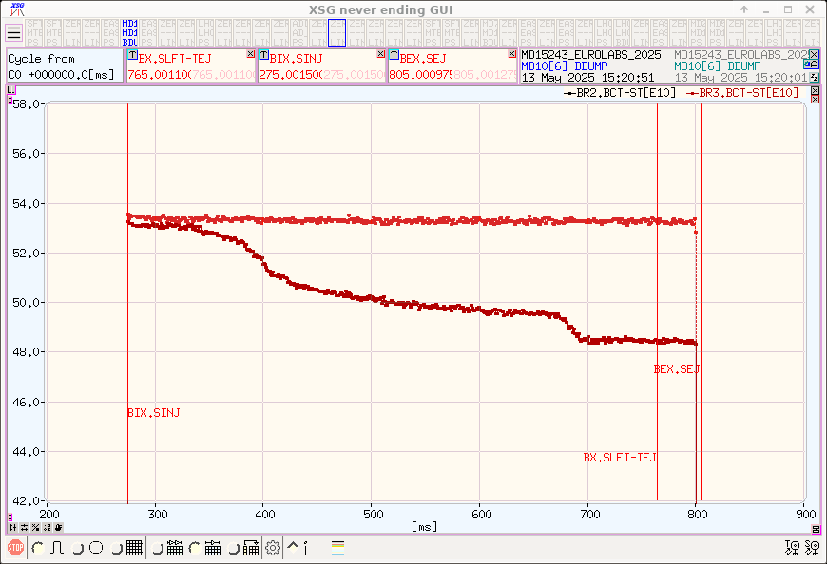
Takeaways
PSB is similar to ISIS Synchrotron, both are space charge dominated machines
Investigated emittance growth vs beam intensity as the tunes are changed:
How to investigate beam intensity with wire scanners
How to adjust the beam intensity by altering the number of turns and the bunch length during injection
(The importance of pressing “send tunes” when altering the tune) - oops
How to adjust the emittance of the beam by increasing the number of turns that intercept with the stripping foil
Investigated the effect of positive detuning with sextupoles or octupoles:
How to avoid or intercept resonances
Understanding space charge with bunched or coasting beam
Also enjoyed operating ISOLDE and visiting CLEAR and AD/ELENA

Slide 8
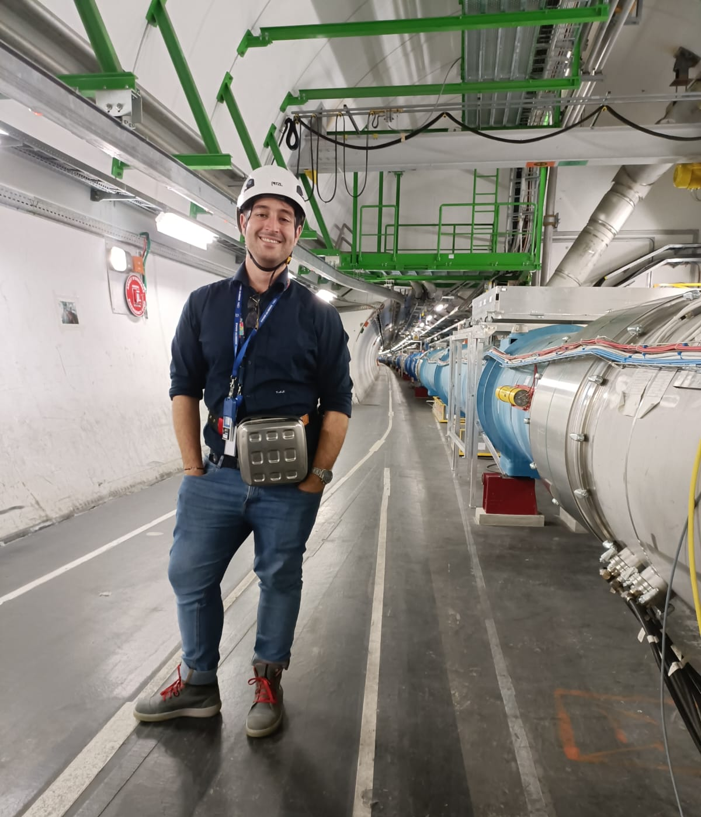
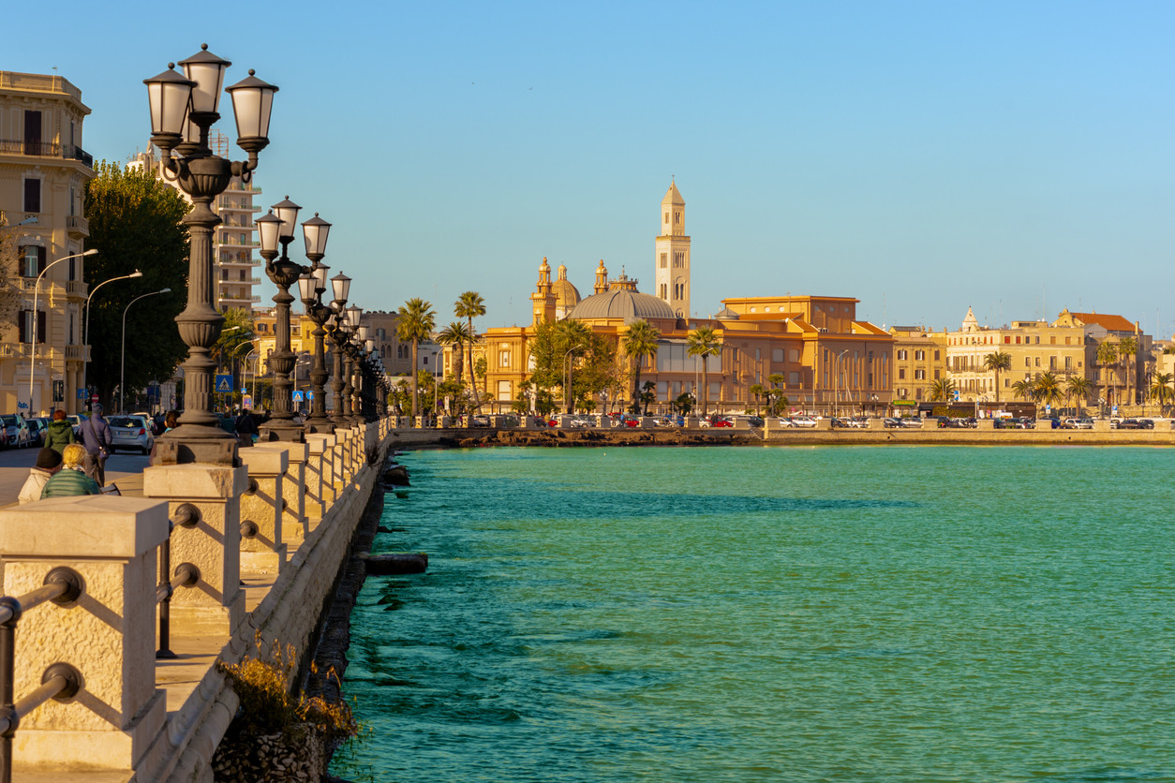
Vincenzo Alberto Sansipersico
CERN Doctoral Student – Accelerator & Technologies Sector
PhD at Riga Technical University
Next Ion Medical Machine Study (NIMMS)
Longitudinal Beam Dynamics
Slow Extraction
FLASH Therapy

Slide 9
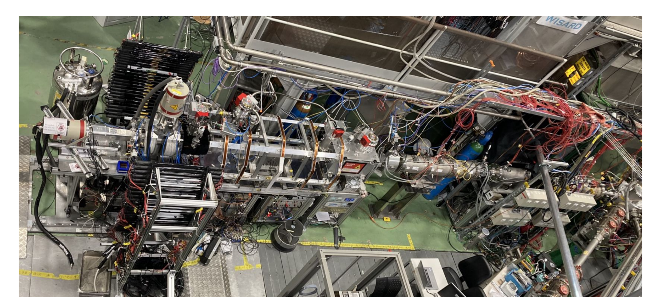
Nikolay AZARYAN
BACKGROUND
- Development and commissioning of various subsystems for cyclotrons (ion sources, vacuum, magnets, cavities, targets)
- Manufacturing technology of SRF cavities
- High precision alignment of large-scale accelerators (ILC/CLIC) and detectors (ATLAS)
- Currently developing commissioning and maintaining of VITO beamline in ISOLDE

Slide 10
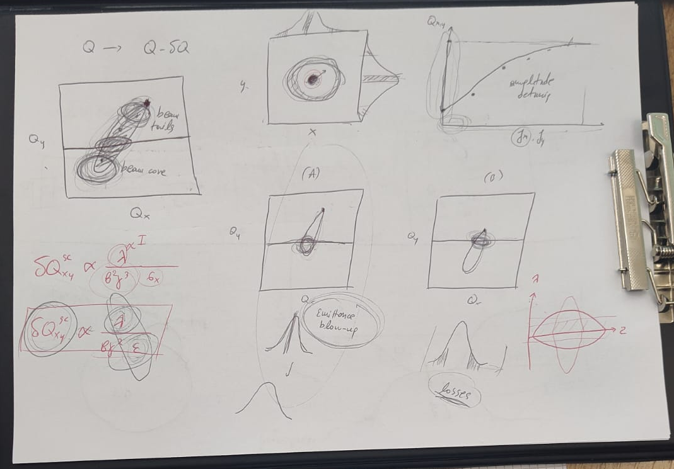
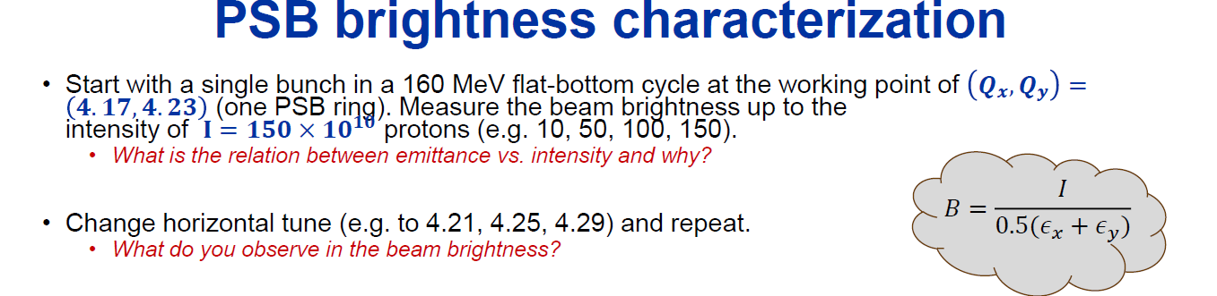

PSB Facility

Slide 11
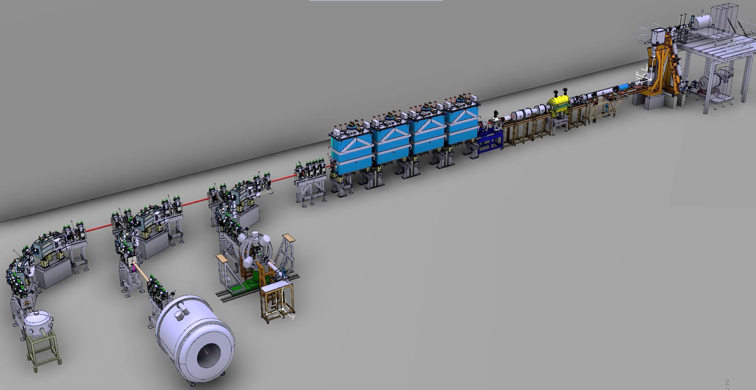
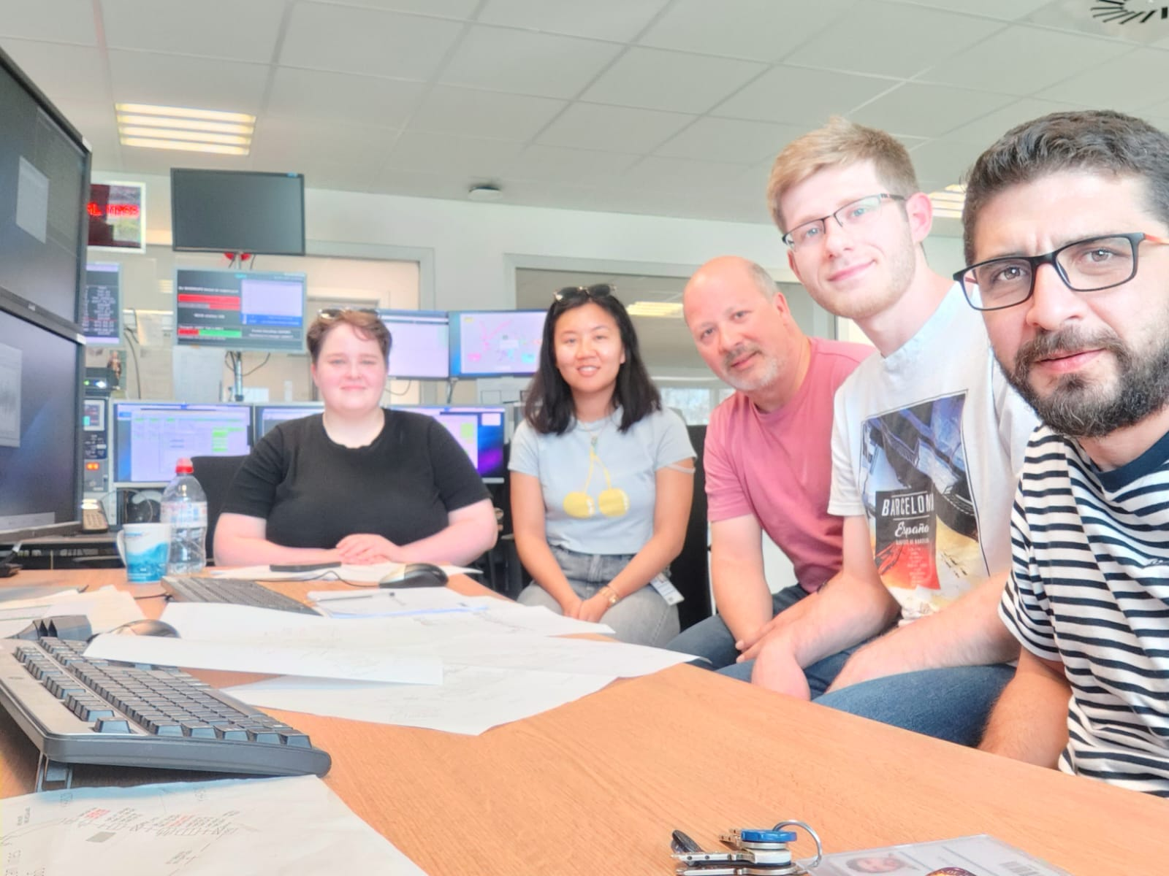
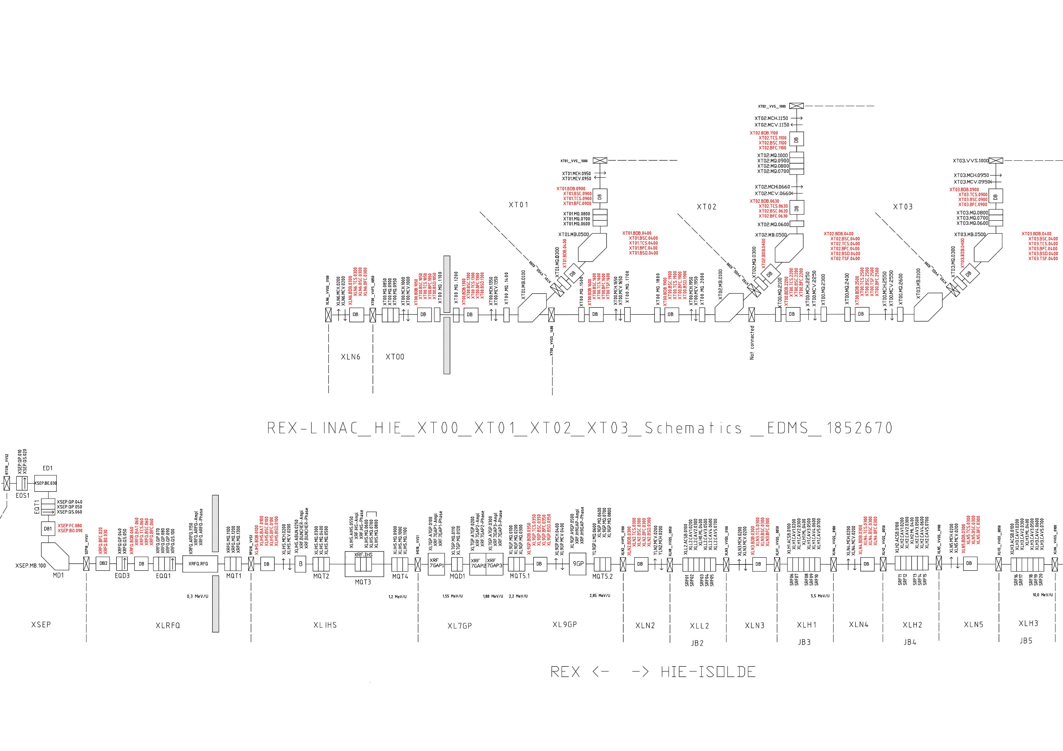
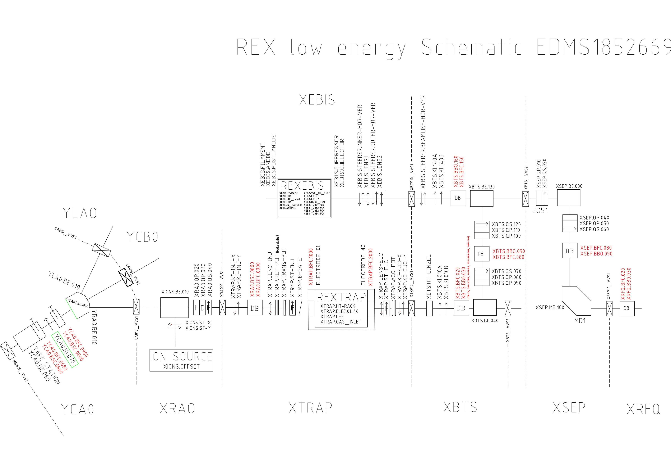

ISOLDE
What we did
Started the EBIS ion source and did a mass scan
Tuned the beam optics for A/q = 2.5 and get up to 3 pA at the end of beamline
Not succeeded with A/q = 4 -> went to 3
Scaled the beam optics for a new A/q ratio
Tried to improve the transmission – get about 50%
Reduced the gradient from 2.85 MeV/u to 2.5 MeV/u
What we learned
Always better make a notes what we did

Slide 12
Thank you for a great school!
Joshua Appleby, Nikolay Azaryan, Sasha Horney, Tuuli Nissinen, Vincenzo Sansipersico

