Slide 1




ATSOA2025
CLEAR and AD-ELENA hands-on
Group D – Sabrina Wang, Michael Roosa, Muhammed Zeki and Sarah Geffroy

Slide 2
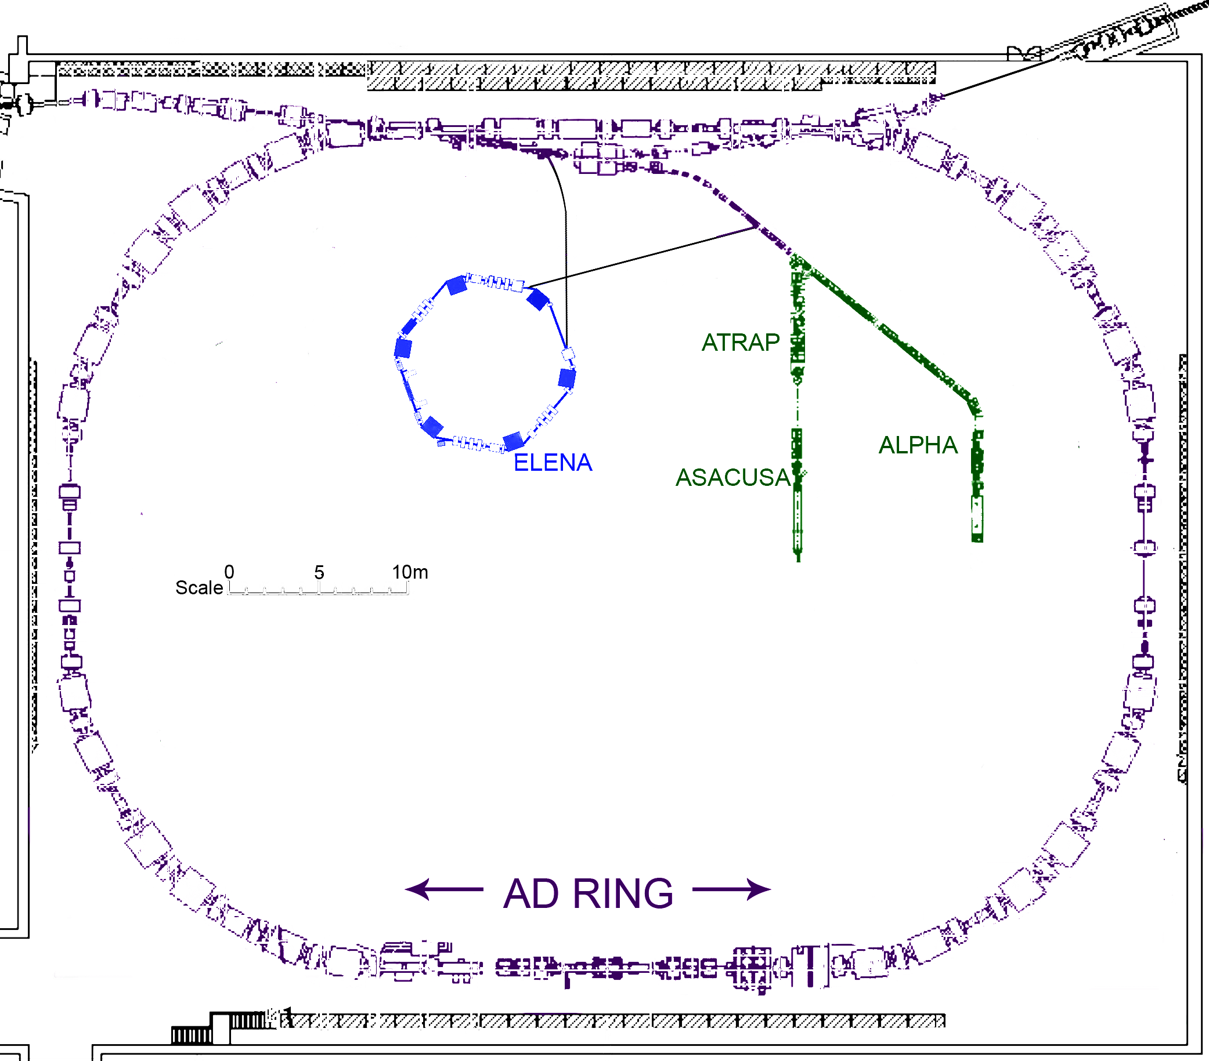
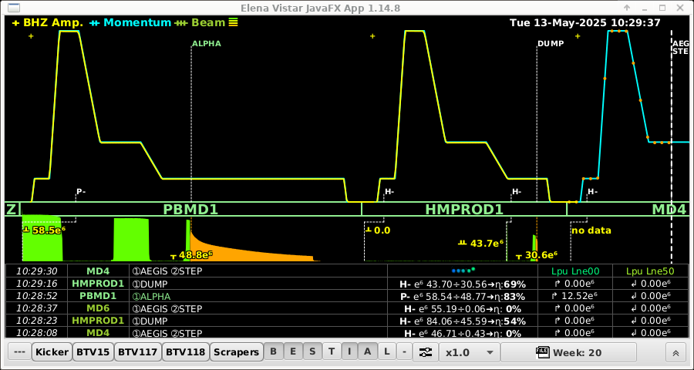
What is AD-ELENA ?
Two decelerating synchrotrons to provide a stable antiproton beam for different experiments.
25 GeV to 100 keV antiprotons by two techniques : electron-cooling and stochastic cooling .
Providing beam to experiments every 2 minutes for pbar and every 15s for H⁻
Now able to provide 12 millions pbar per shot!
2

Slide 3

ELECTRON COOLING
An electron beam is sent in the same direction and at the same velocity as the antiproton beam.
How does this works?
e⁻
$$\overline{p}$$
It takes about 2s to do the cooling. It allows to reduce the emittance if the beam is cooled properly.
Observable : beam size at one location.
3

Slide 4
ELECTRON COOLING
It takes about 2s to do the cooling. It allows to reduce the emittance.
Same optics – same location : if the emittance reduces the beam size reduces.
Observable : beam size at one location.
Two parameters : angle between electron and antiproton beams and duration of cooling
4

Slide 5
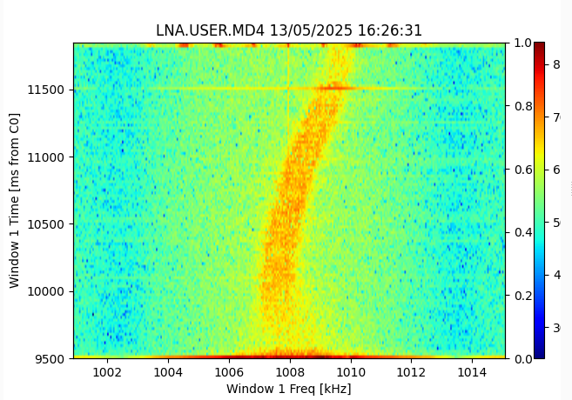
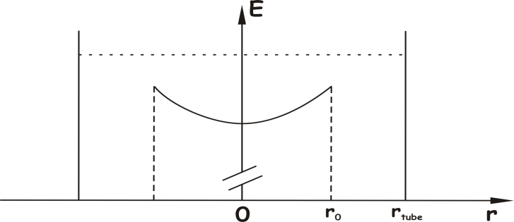
Offset « COOLING »
Difference of energy between central and peripherical electrons
5

Slide 6

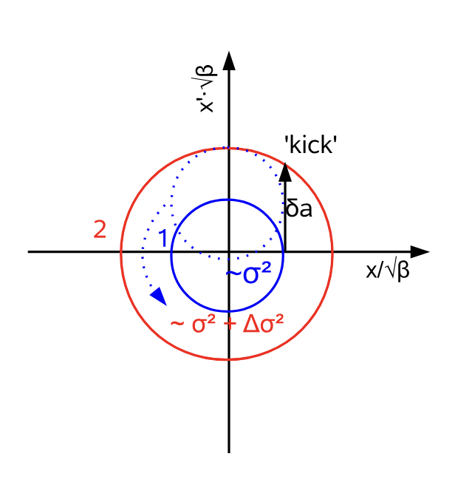
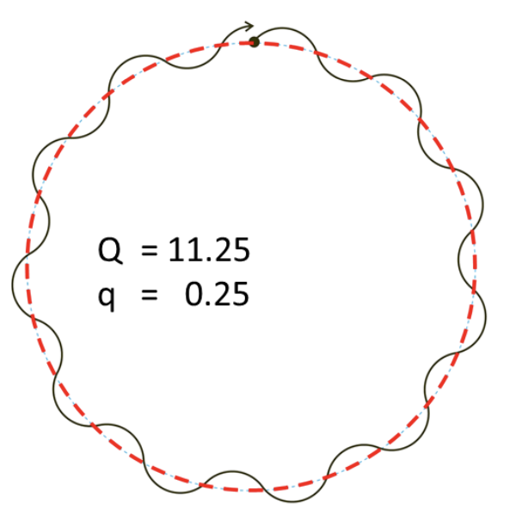
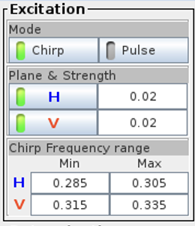
Tuning at
What is “Tune”?
How to measure?
The non-integer component of number of betatron oscillations per revolution
From R. Jones “Measuring Tune, Chromaticity and coupling”, arXiv:2005.02753
From R. J. Steigen, “Tune and chromaticity diagnostics”,
doi: 10.5170/CERN-2009-005.317
6

Slide 7
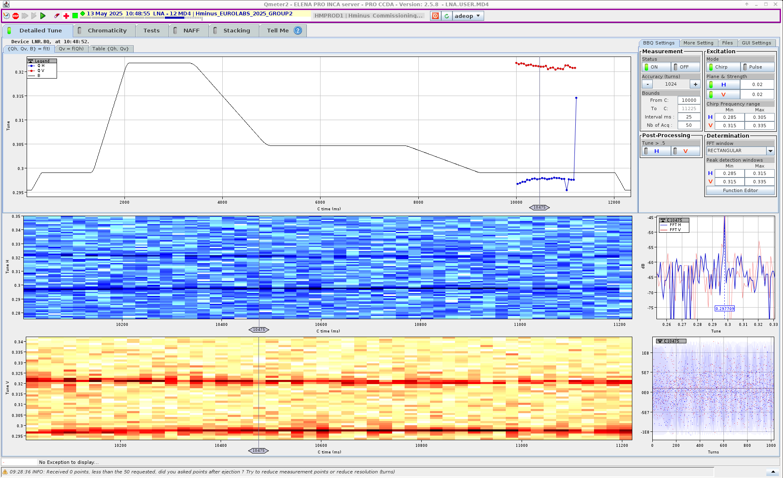
Tuning at
Where we started
Two resonsances:
Horizontal and Vertical tune
A problem:
7

Slide 8
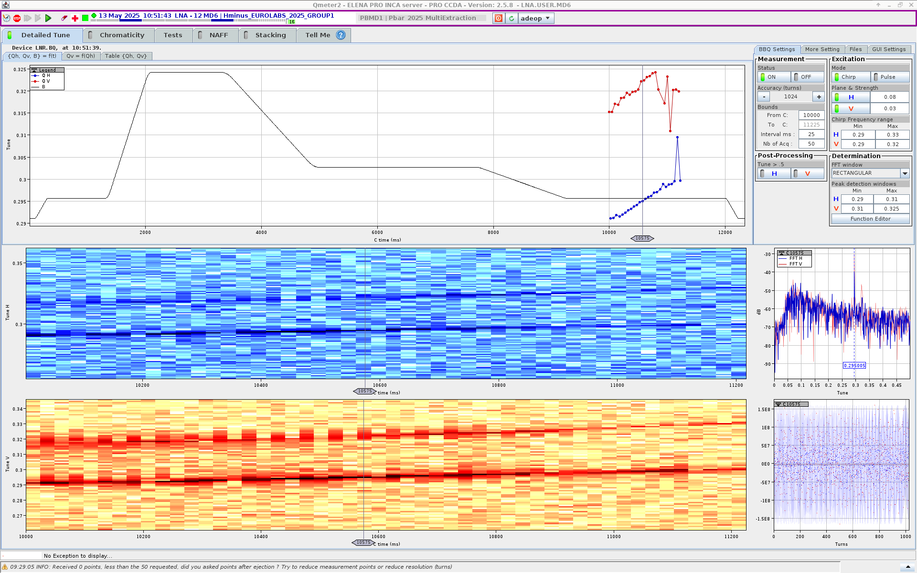
Tuning at
A demonstration :
Coupled tunes mean changes in Horizontal effect Vertical
We ramp the H quads and watch both tunes change
8

Slide 9
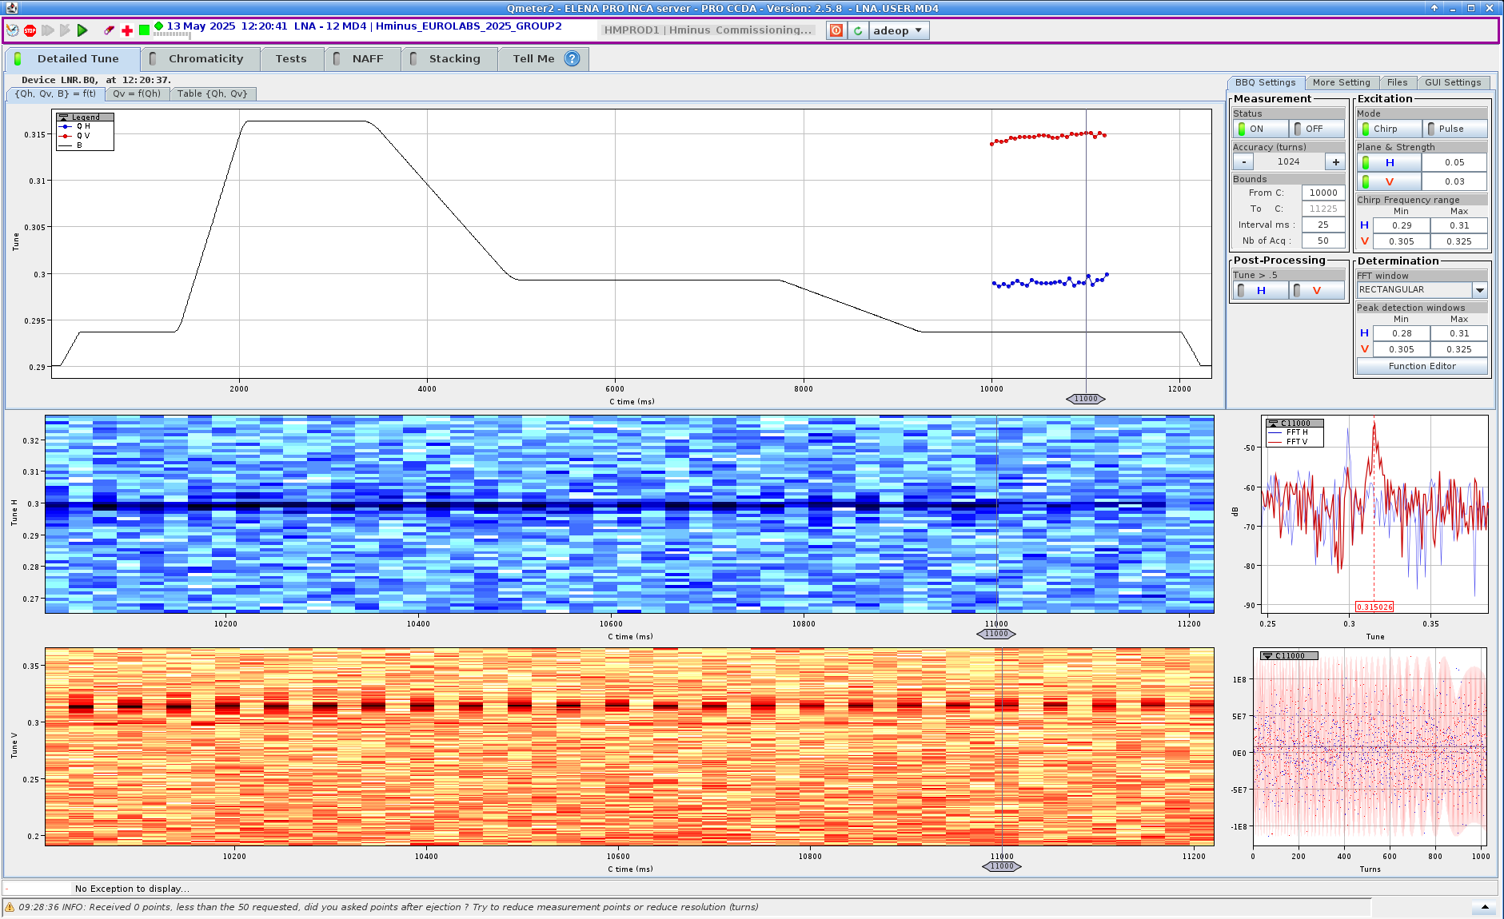
Tuning at
Coupling can be corrected by adjusting skew quadrupoles.
After some testing, we isolate the two tunes!
9

Slide 10
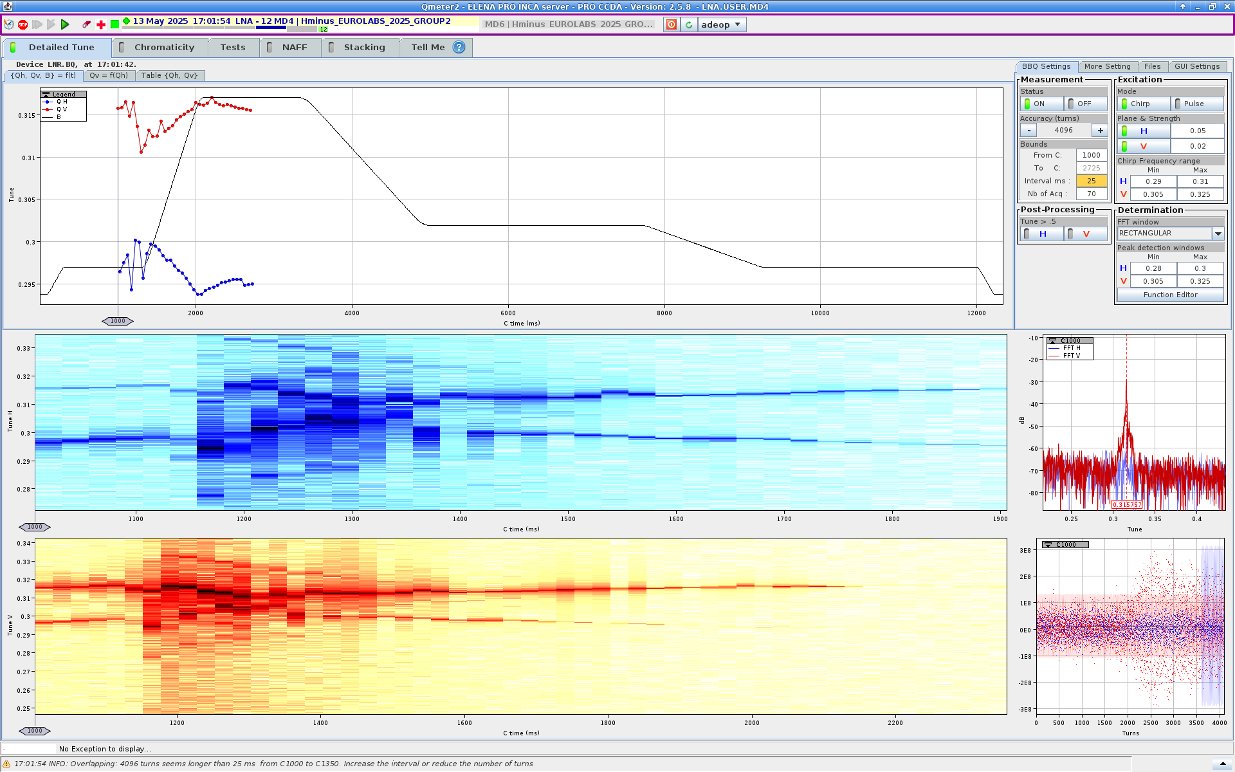
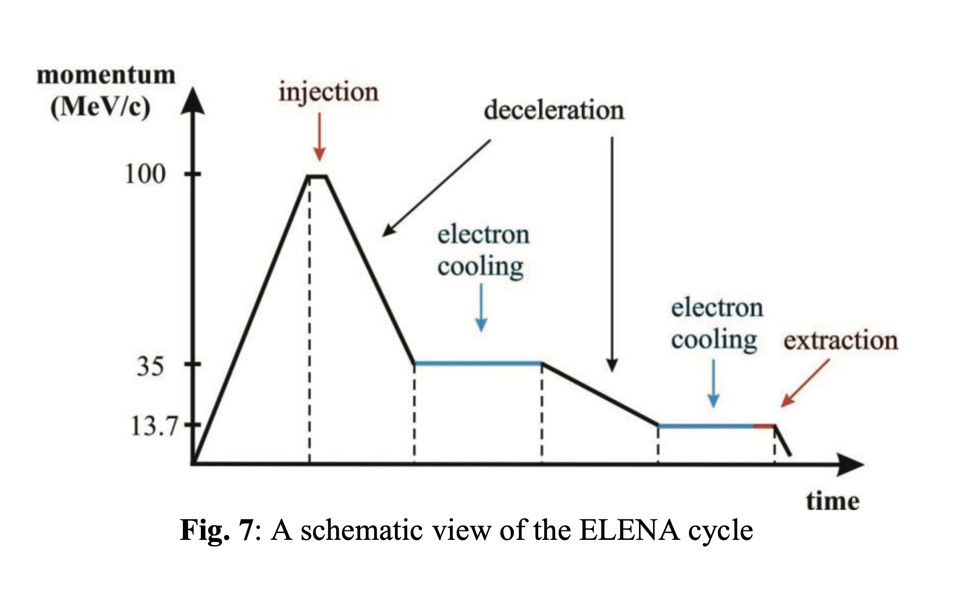
Tuning at
A challenge!
What about during a ramp?
H⁻ Injection ramp
We played with: Quads (H,V Skew),
and found…. it is hard
10
Only one power supply was tripped in exercise (Sorry GBAR)

Slide 11
CLEAR – CERN Linear Electron Accelerator for Research
11

Slide 12
What is CLEAR?
CLEAR is a test facility at CERN based on a linear electron accelerator.
Located in the CLIC Experimental Area (CLEX).
LHC upgrades (injector chain validation)
Advanced acceleration studies: X-band acceleration, Plasma lenses, THz radiation
Irradiation tests for electronics & materials
Medical beam applications
Student and researcher training
12

Slide 13
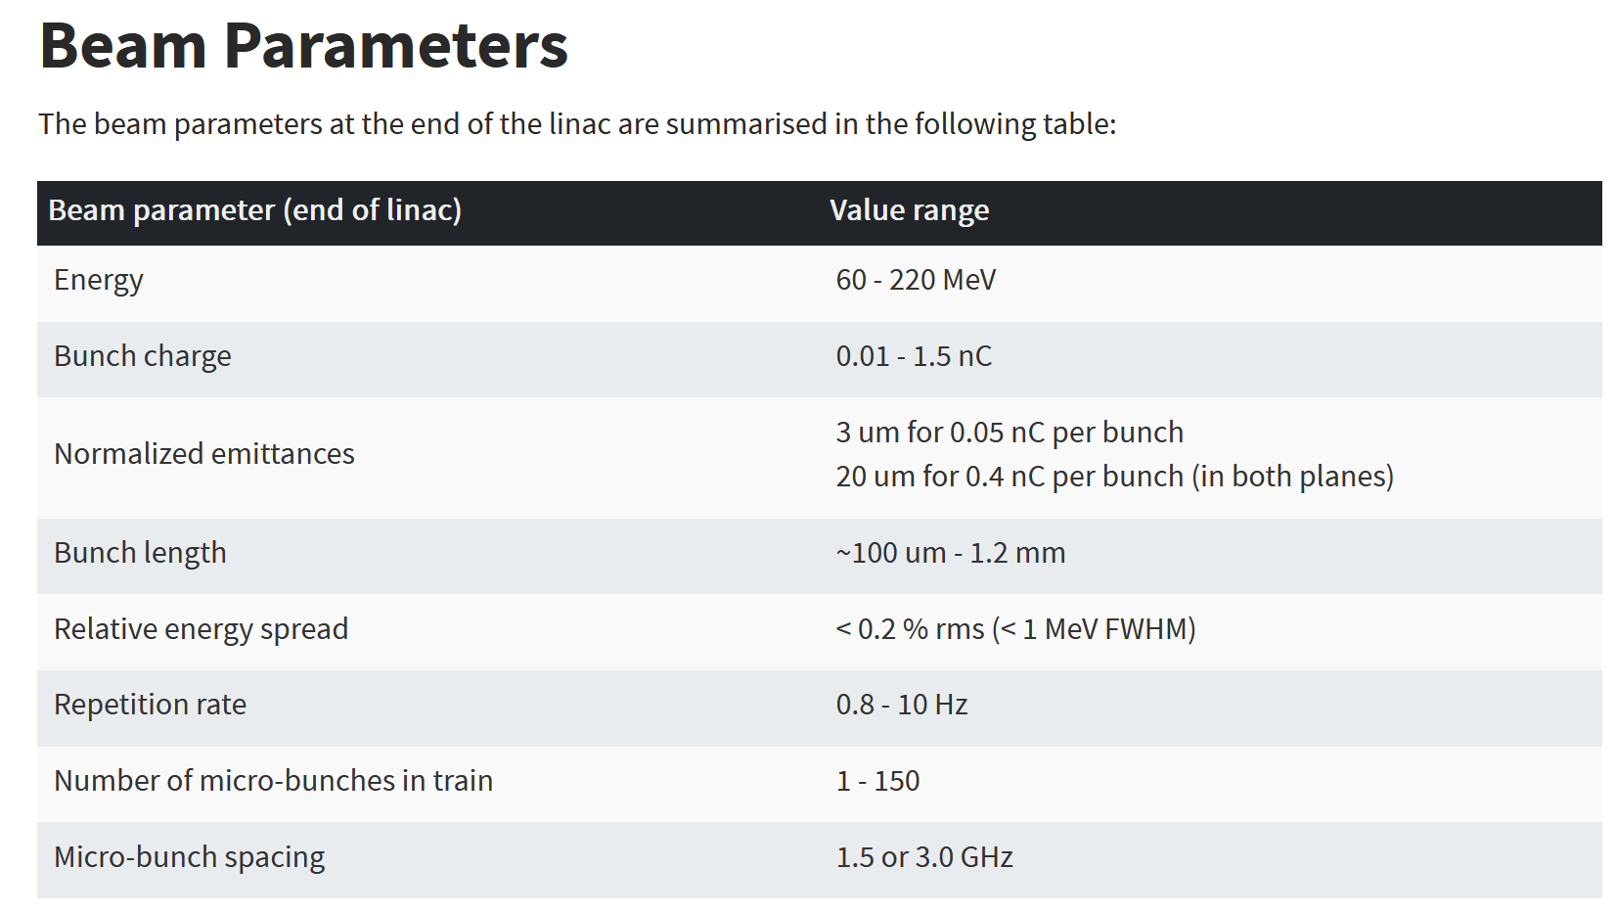
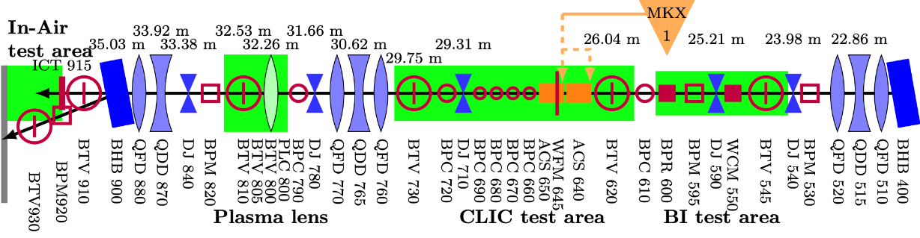
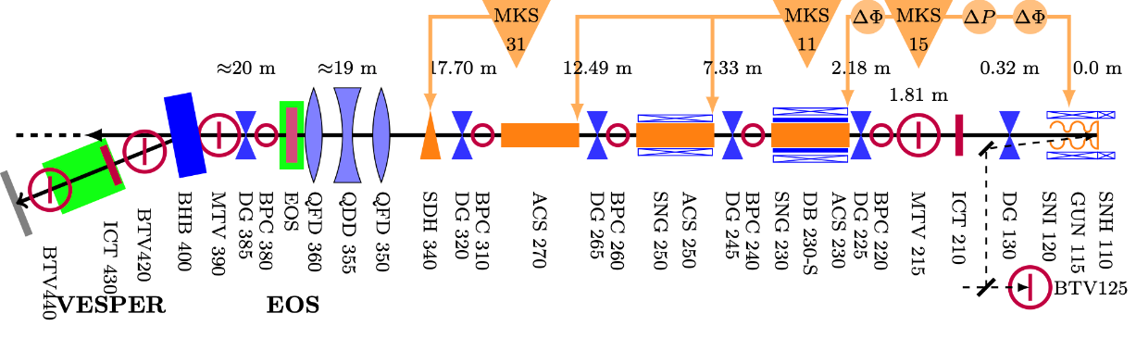
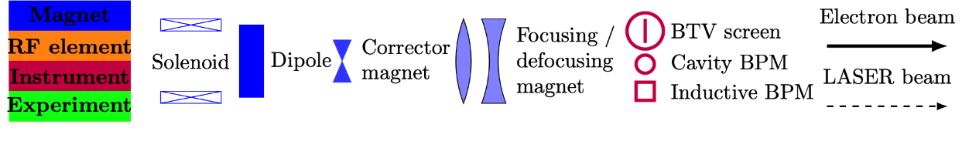
The CLEAR Beamline
Core components:
RF Photocathode electron gun(5 MeV)
Accelerating structures(3) and Deflector C.
BPMs and ICTs
2Dipoles, quadrupoles(3 triplets, 1 double)
and correctors(11), YAG screens(10).
13

Slide 14
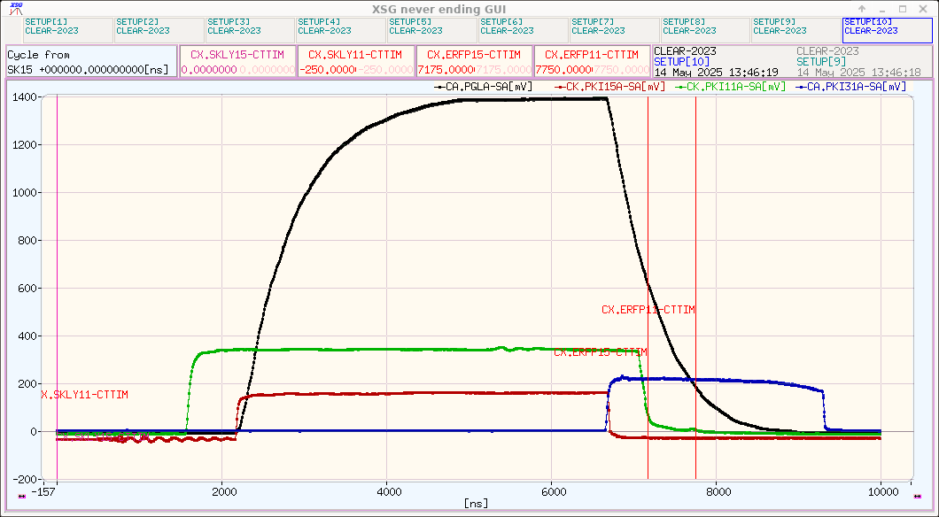
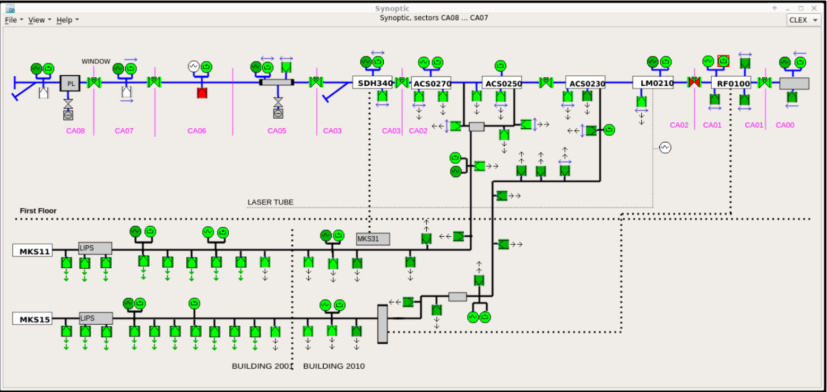
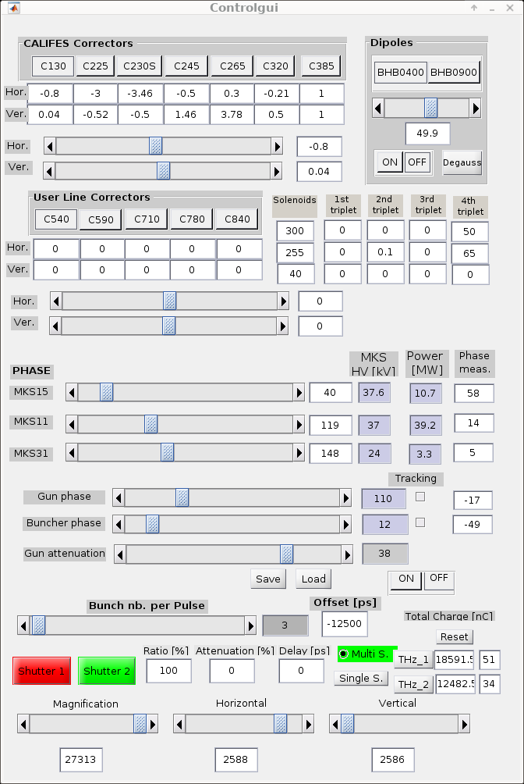
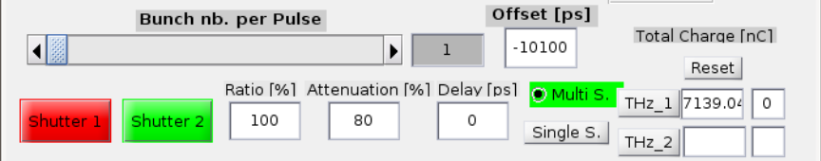
Operation: Starting the Beam
WorkingSet → CLEX → Longitudinal select the MKS11, MKS15, MKS30.
MATLAB control scripts: lectimad.m, Controlgui.m
Checklist:
1. Turn ON magnets & klystrons power
2. Verify vacuum
3. Activate laser system & Beam ON!!!
5. Logbook entries
Panel for monitoring the RF
CLEAR vacuum system
The laser parameters
Control panel for corrector and dipole settings
14

Slide 15
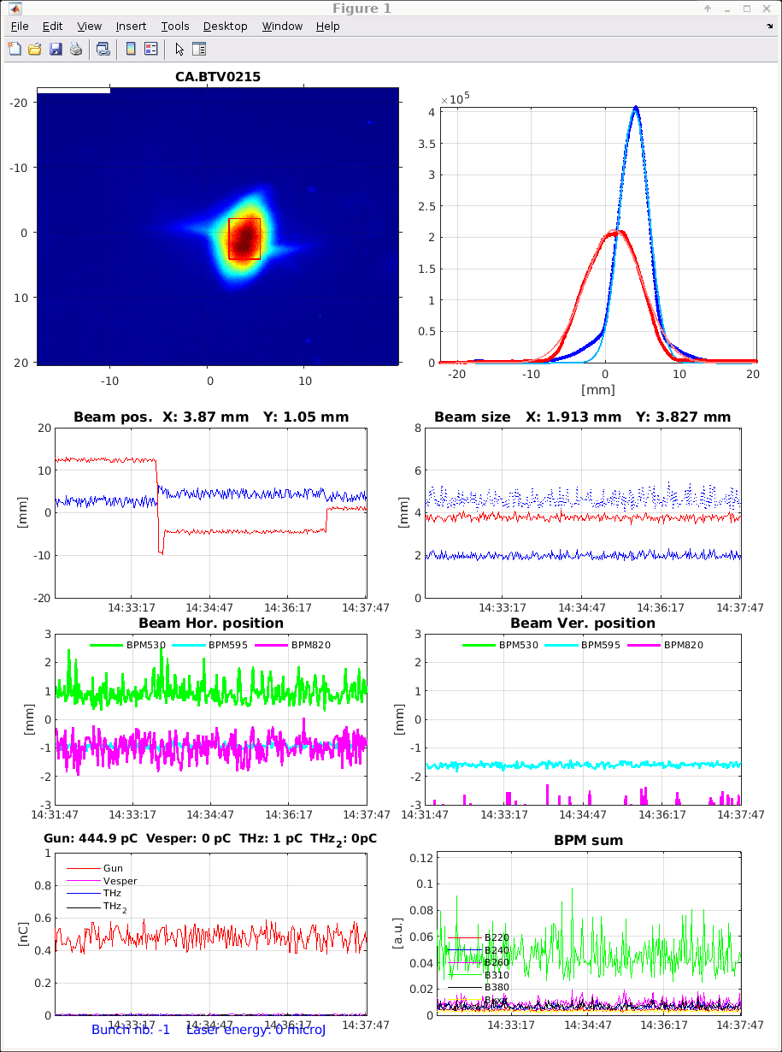
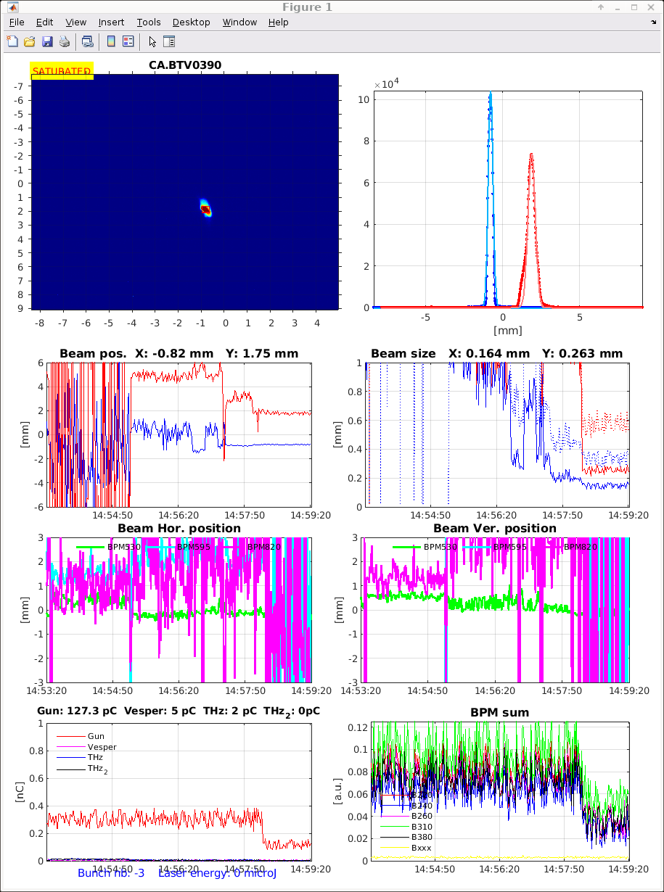
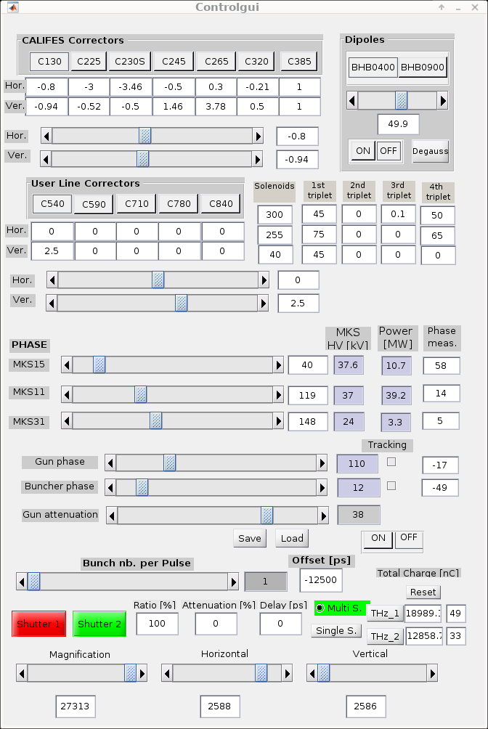
Centered and Focused Beam
We centered the beam at first on screen 215 using the corrector magnets[1] and then focused the beam on screen 390[2].
2
1
15

Slide 16
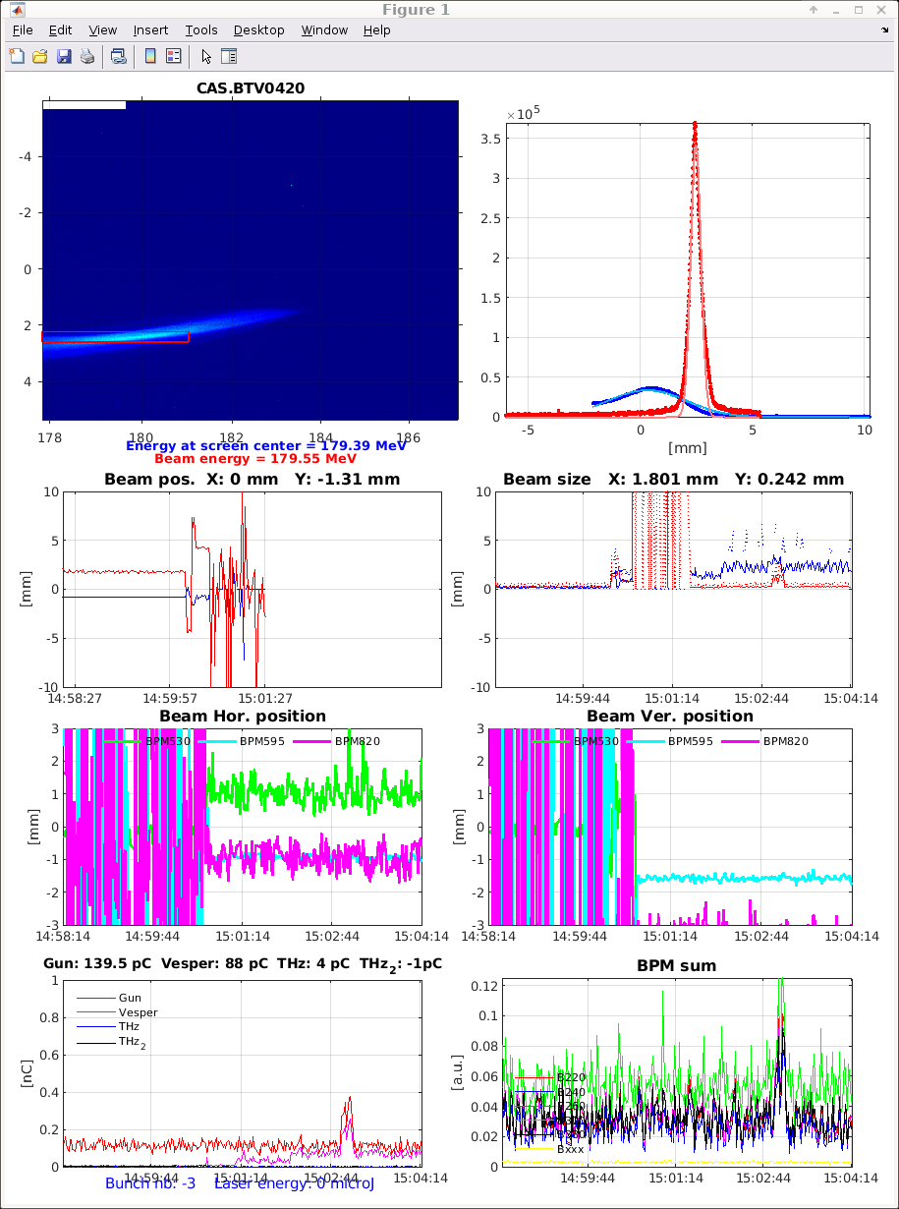

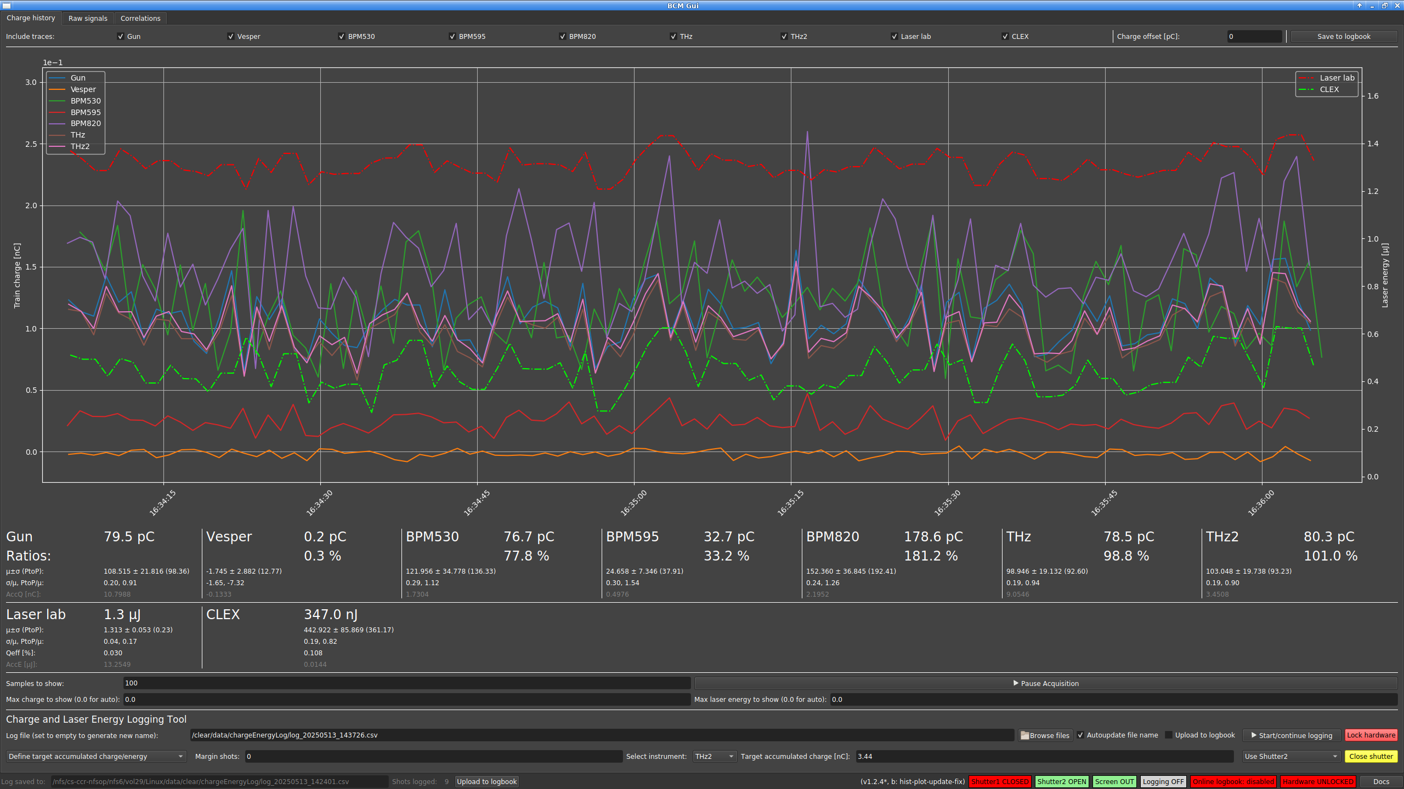
Measured the Beam Energy
[1]
[2]
Initial Energy = 175 MeV[1], but it isnt enough for us* of course we optimized the beam again and again and…… optimized energy increased the 197 MeV[2].
16
*We increased the power of the RF so Beam energy also increased.

Slide 17
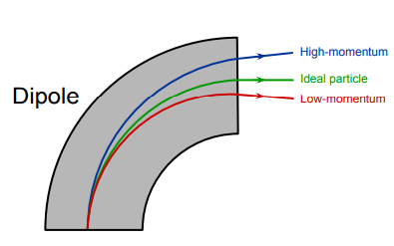
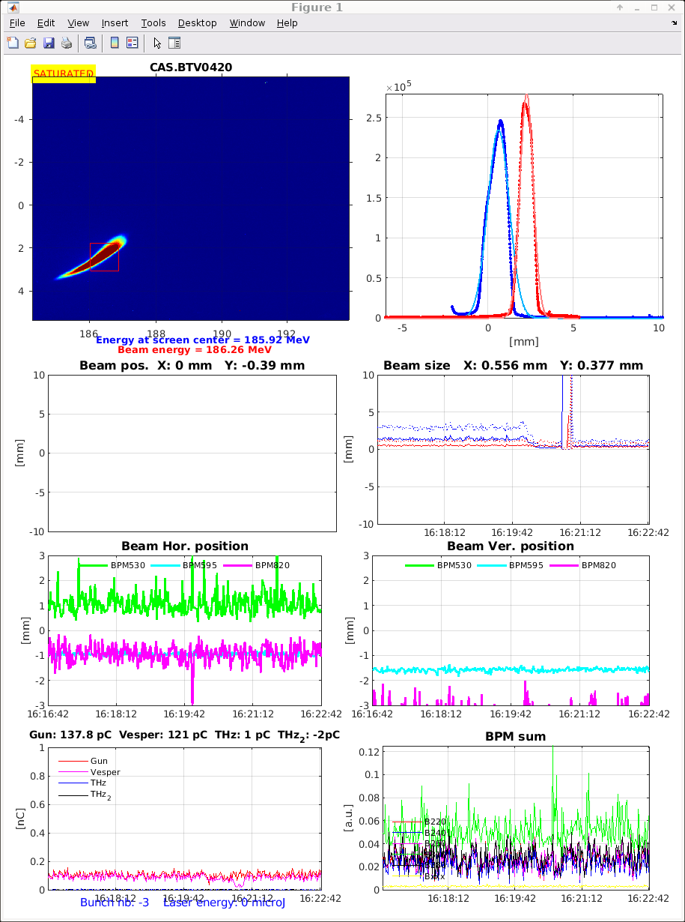
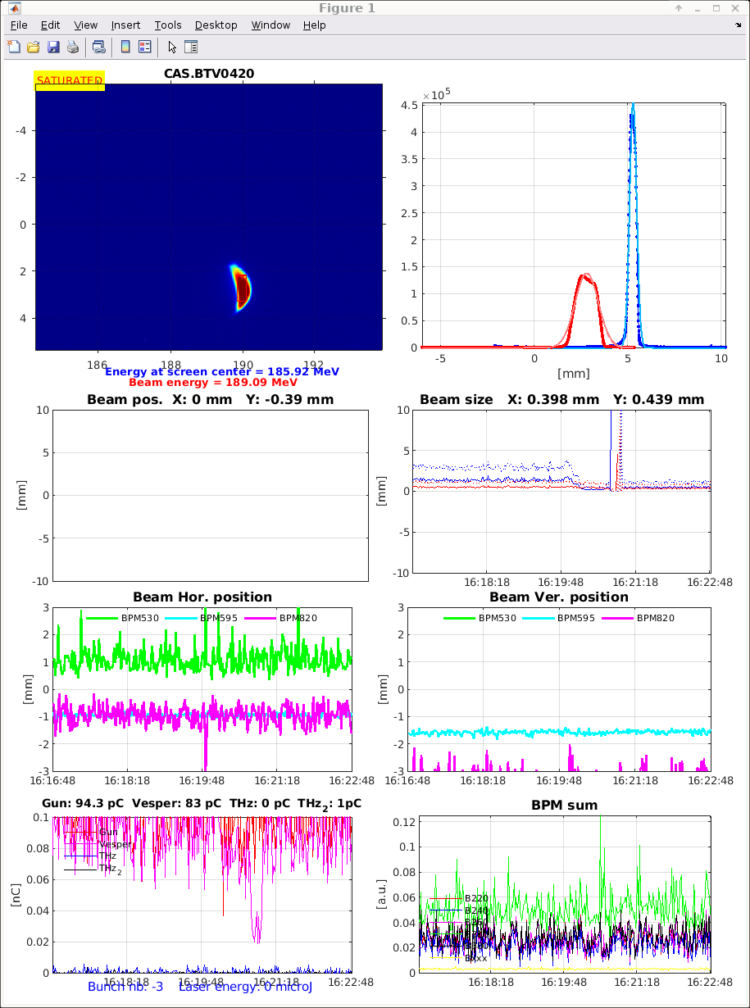
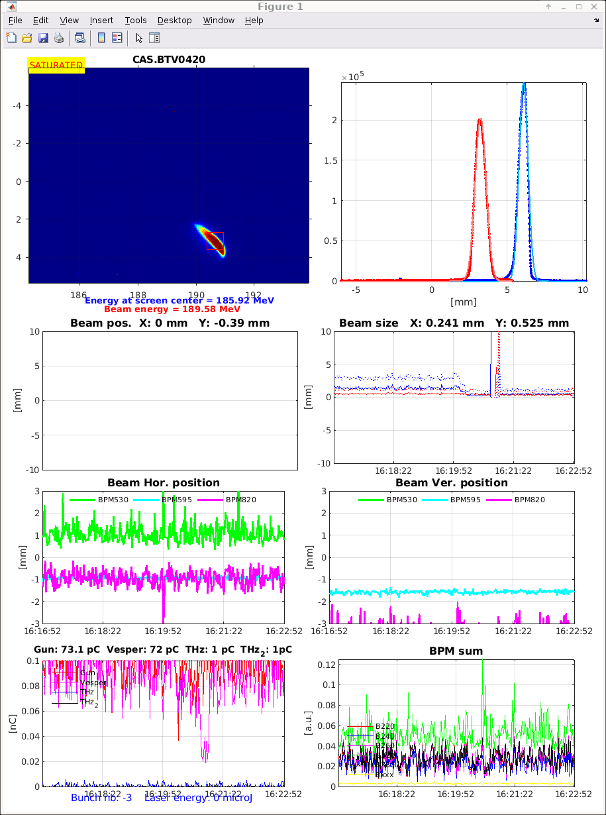
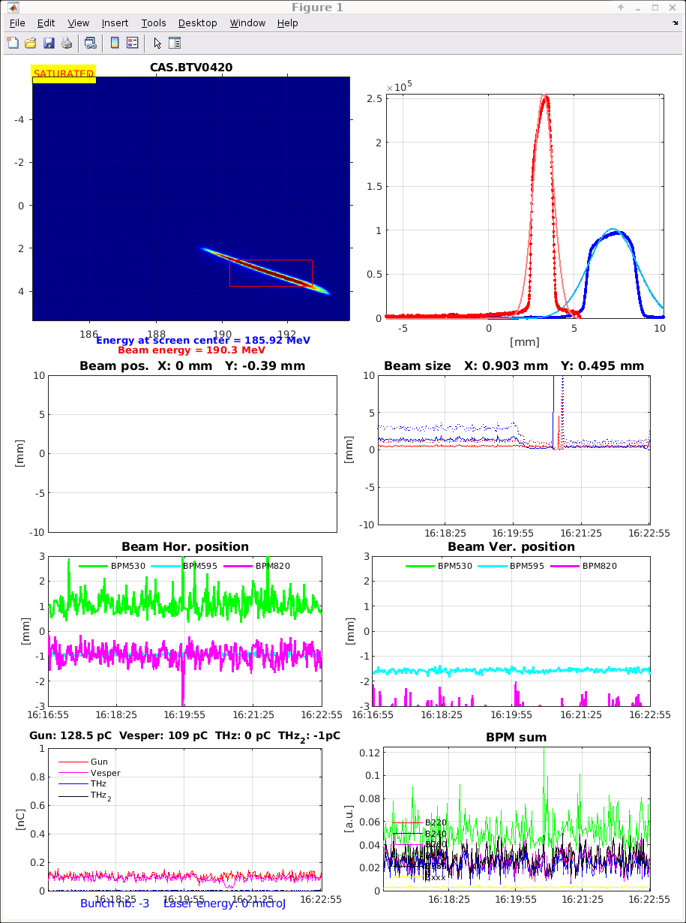

Measured the Beam Energy
*We increased the power of the RF so Beam energy also increased.
Electrons deflect in a dipole magnet due to Lorentz force.
The bending radius (ρ) is proportional to momentum (p): ρ = p / (qB).
For high-energy electrons: E ≈ qBρc
E$αB$
17

Slide 18
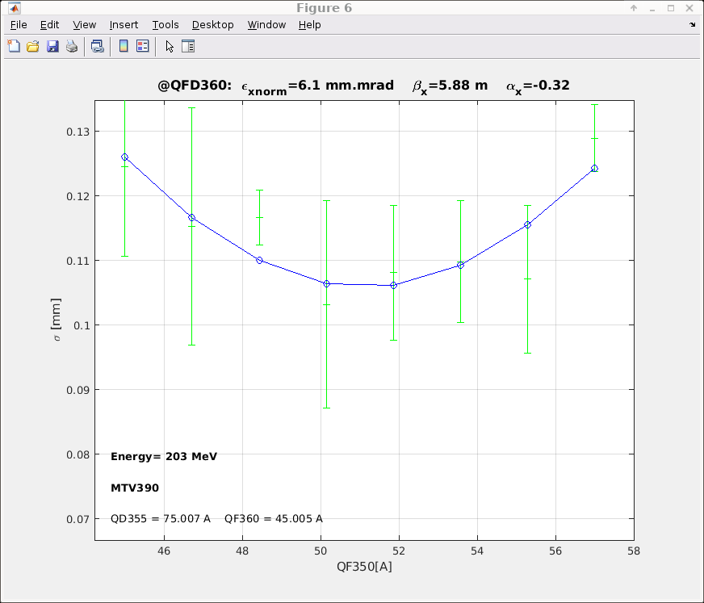
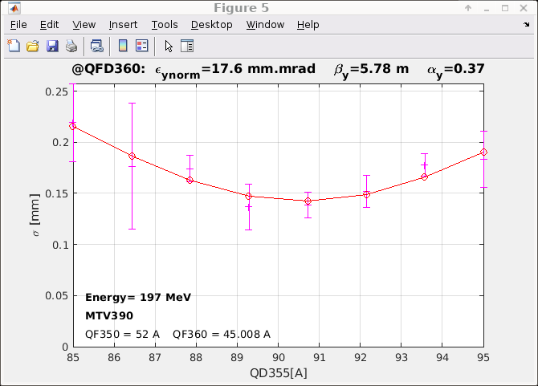
Emittance & Twiss Parameters
Quadrupole scan: Vary quadrupole magnet [1] current and record beam size (σ) on screen (MTV390)[2].
Fit σ² vs. quadrupole strength → extract Twiss parameters and normalized emittance.
Results:
• Horizontal (X): εₙₒᵣₘ = 6.1 mm·mrad, βₓ = 5.88 m, αₓ = –0.32, Energy = 203 MeV
• Vertical (Y): εₙₒᵣₘ = 17.6 mm·mrad, βᵧ = 5.78 m, αᵧ = 0.37, Energy = 197 MeV
σ² = ε · (βk² + 2αk + γ), where γ = (1 + α²)/β
Parabolic fit shows minimum beam size → determines beam focusing and emittance.
2
1
18
Horizontal (X)
Vertical (Y)

Slide 19
Bunch Length Measurement
Done using RF Deflector (RFD)
Deflector introduces time-to-position correlation
Beam spread measured on screen
Script: BunchLength.m in MATLAB
Time resolution: down to few femtoseconds
19

Slide 20
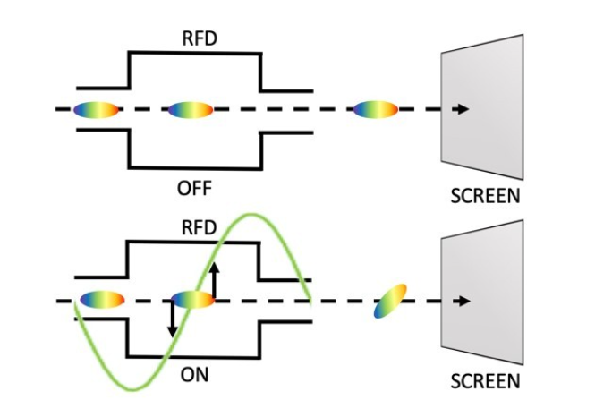
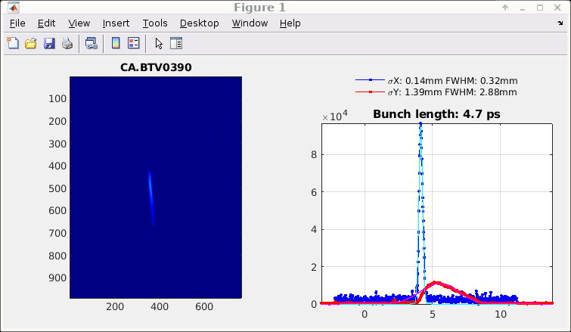
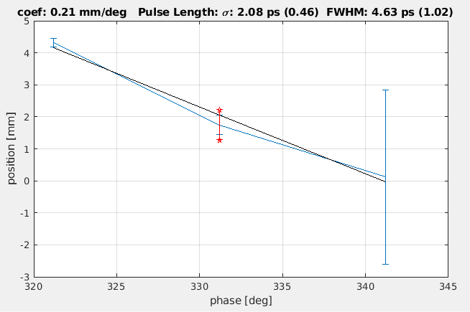
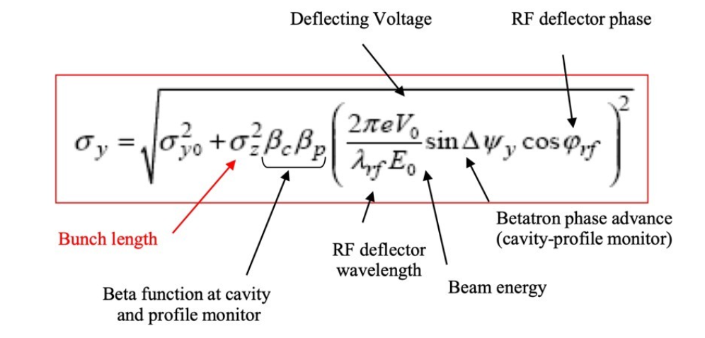
Bunch length calculation
Programme uses 3 points in RF to calculate bunch length
20

Slide 21
Sample Irradiation Setup
Use C-Robot GUI to place material sample into beam
YAG screen for profile measurement
Calculate dose: for example 1 nC on 5.5 mm x 5.5 mm beam → ~1 Gy
21

Slide 22
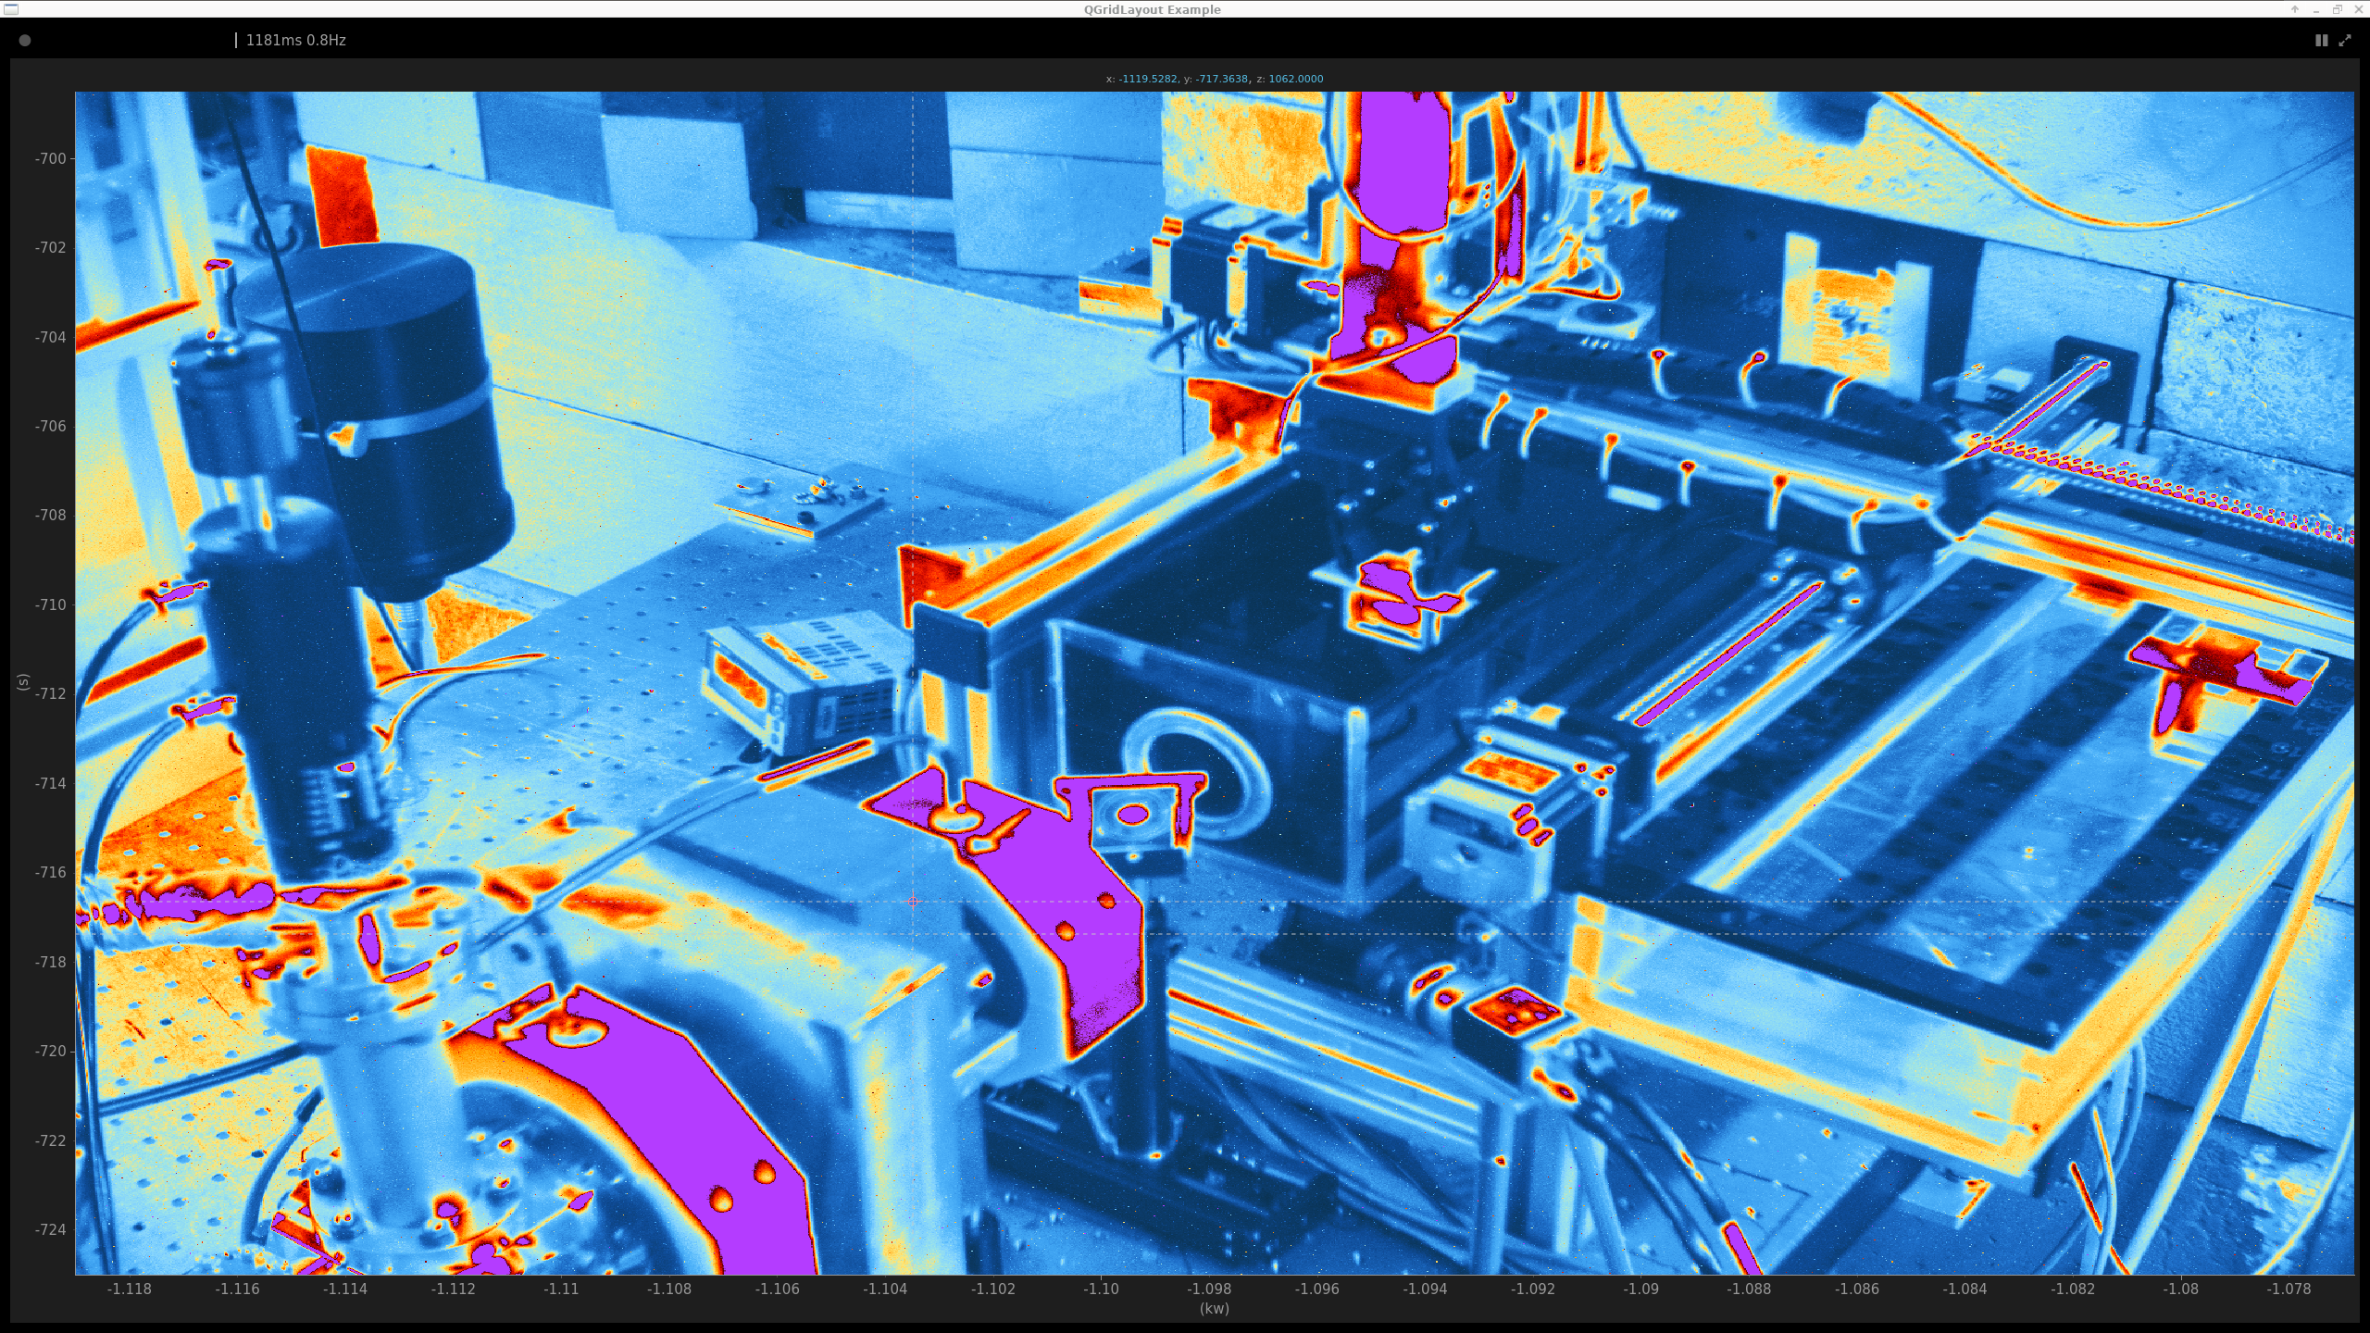
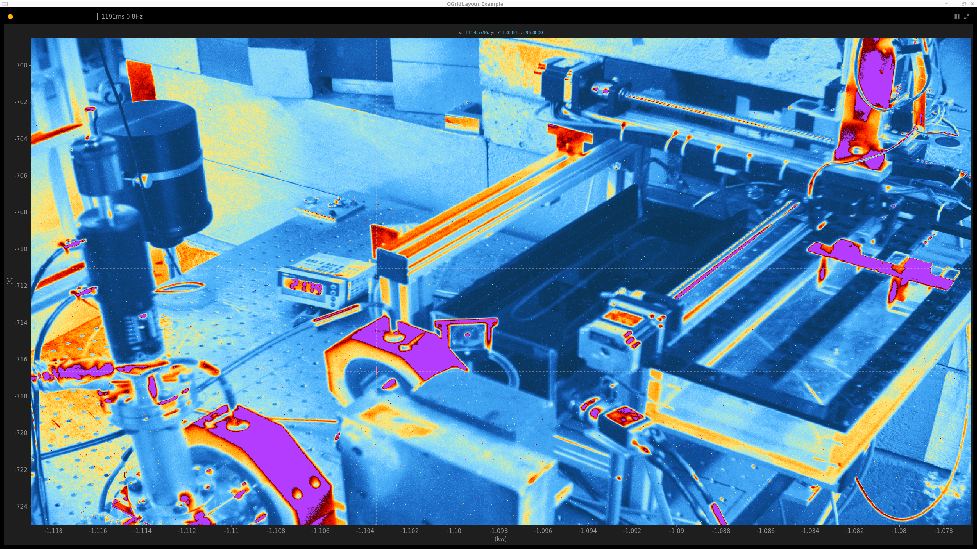
Robot arm, camera
Sample
Samples waiting to be irradiated
Collimator
Camera
YAG screen with laser dot to align
Water phantom
22

Slide 23
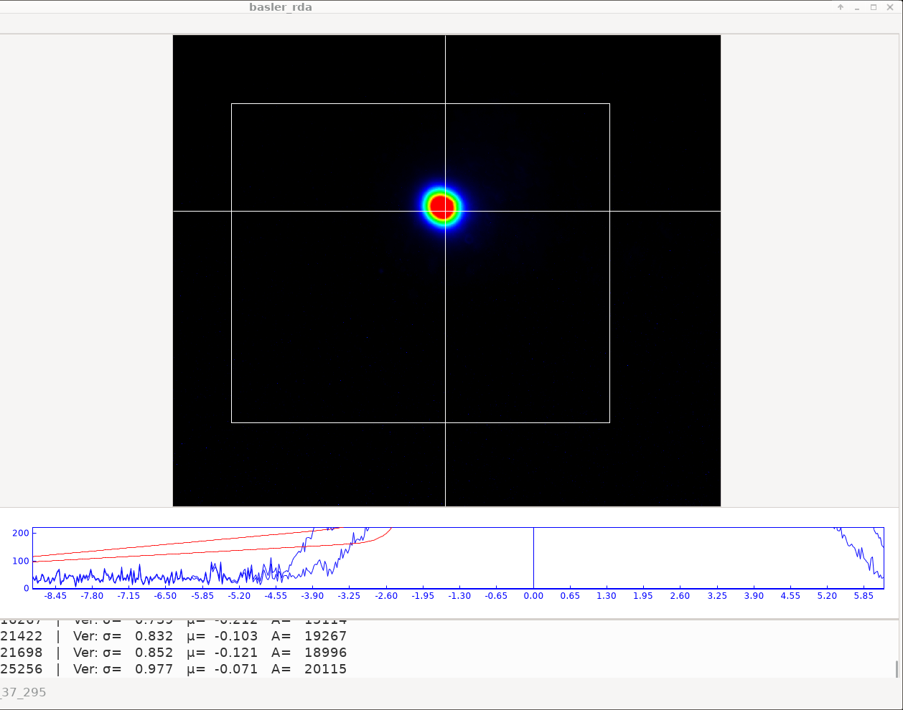
Beam centered on laser reference point
23

Slide 24
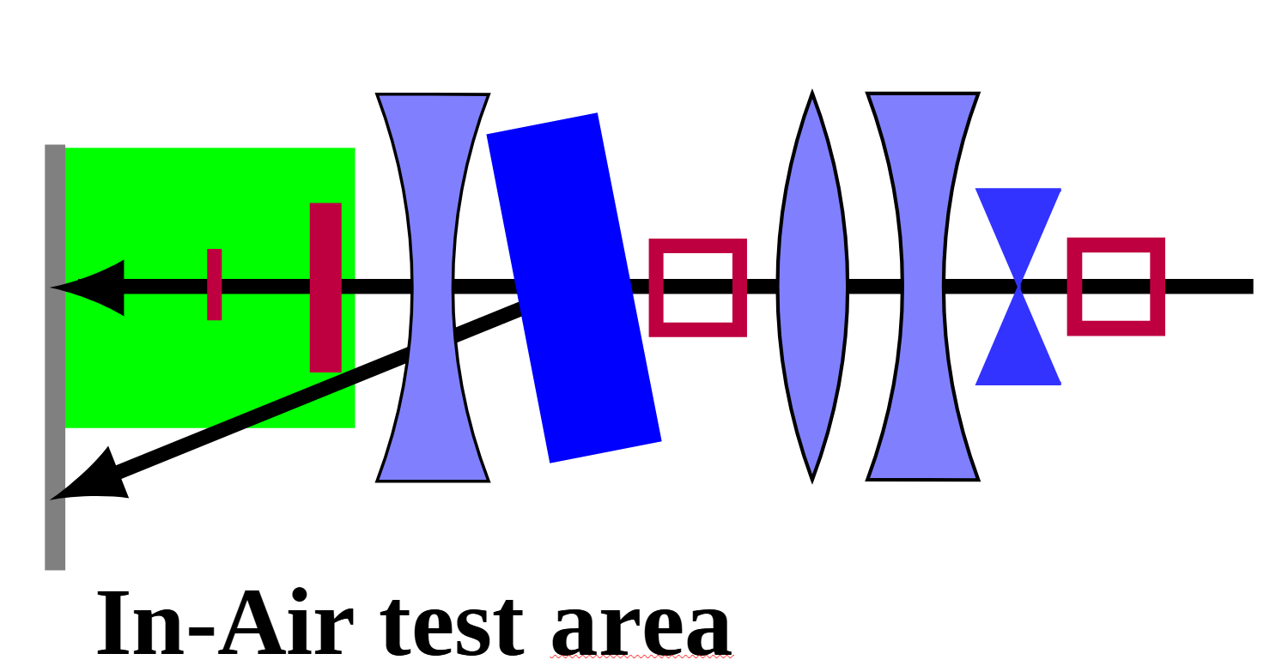
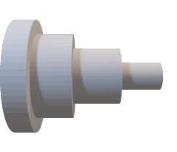
Creating a Uniform Beam
Dual-scattering system
S1- aluminum sheet for enlarging the beam
S2 – gaussian shaped for flattening beam
e⁻
YAG Screen
24

Slide 25
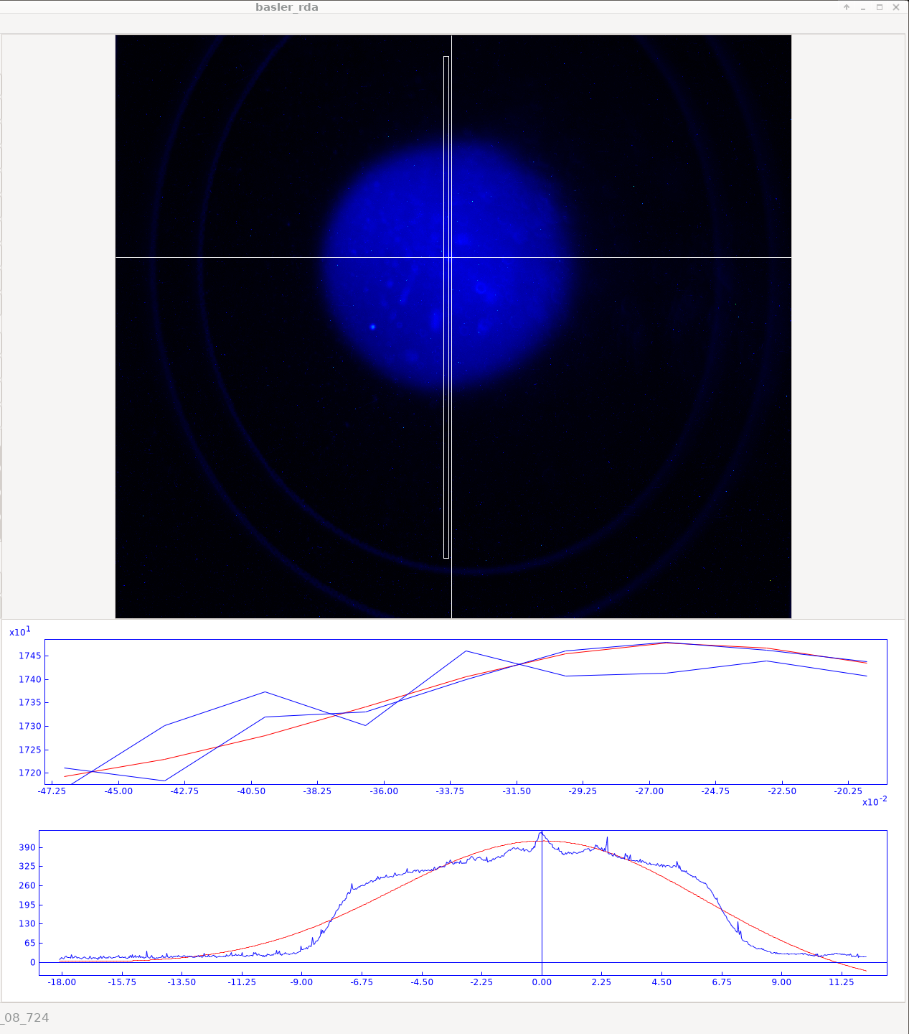
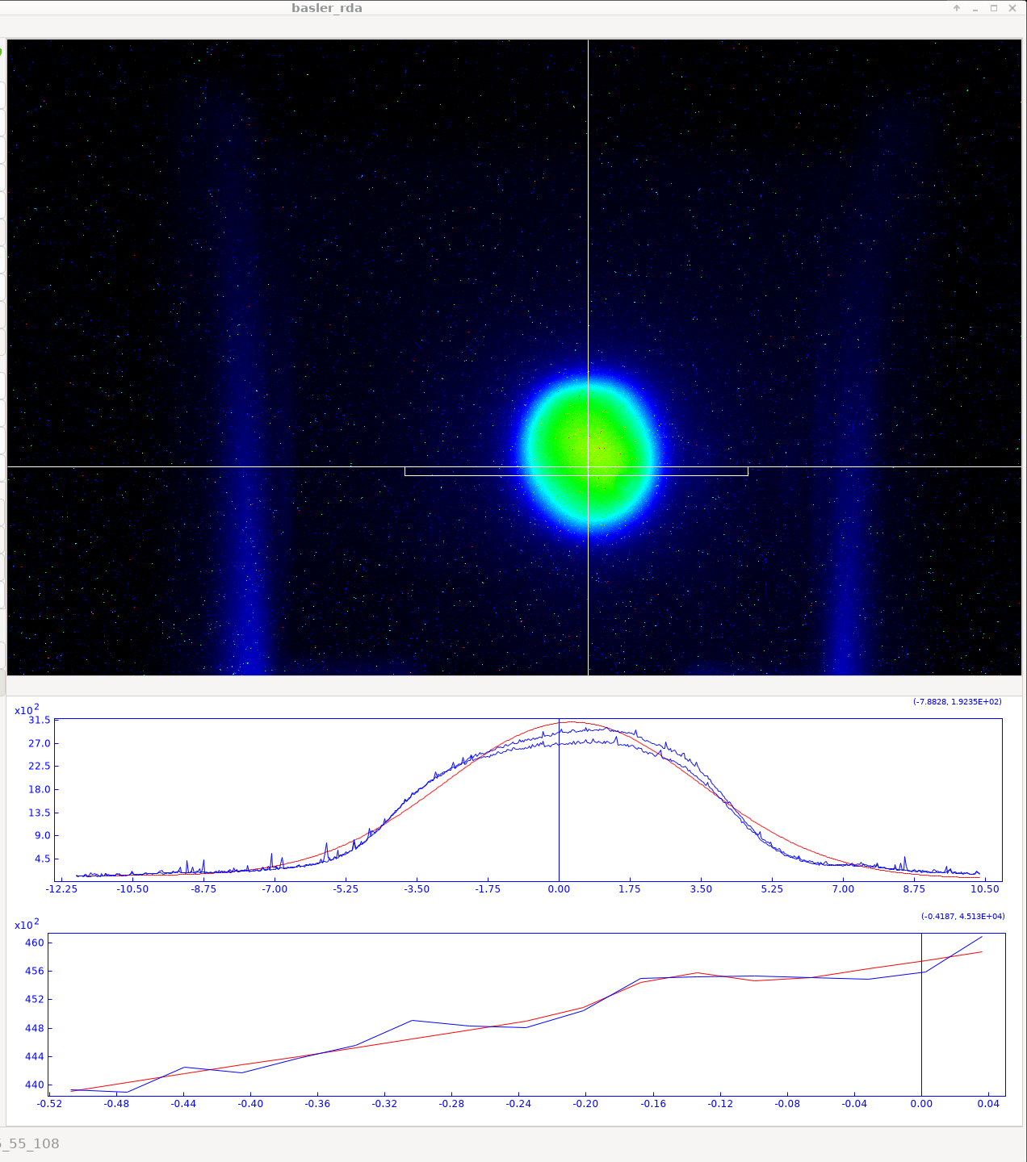
Flat beams obtained
In Air
In water
25

Slide 26
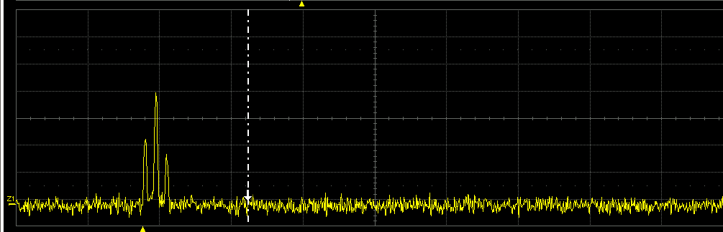
Varying Dose Rates
Changing dose
laser intensity- dose per bunch
Number of bunches
Changing time
Laser frequency
26

Slide 27
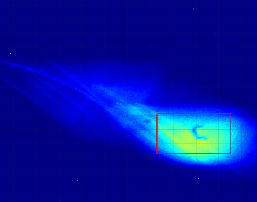
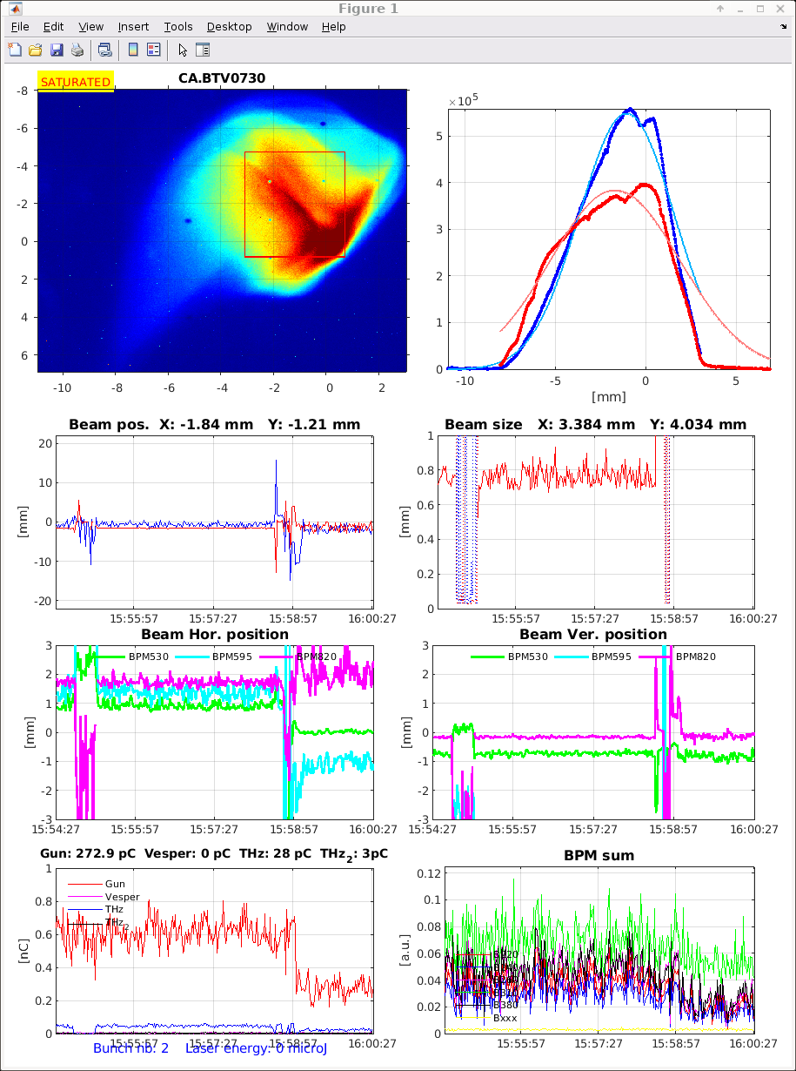
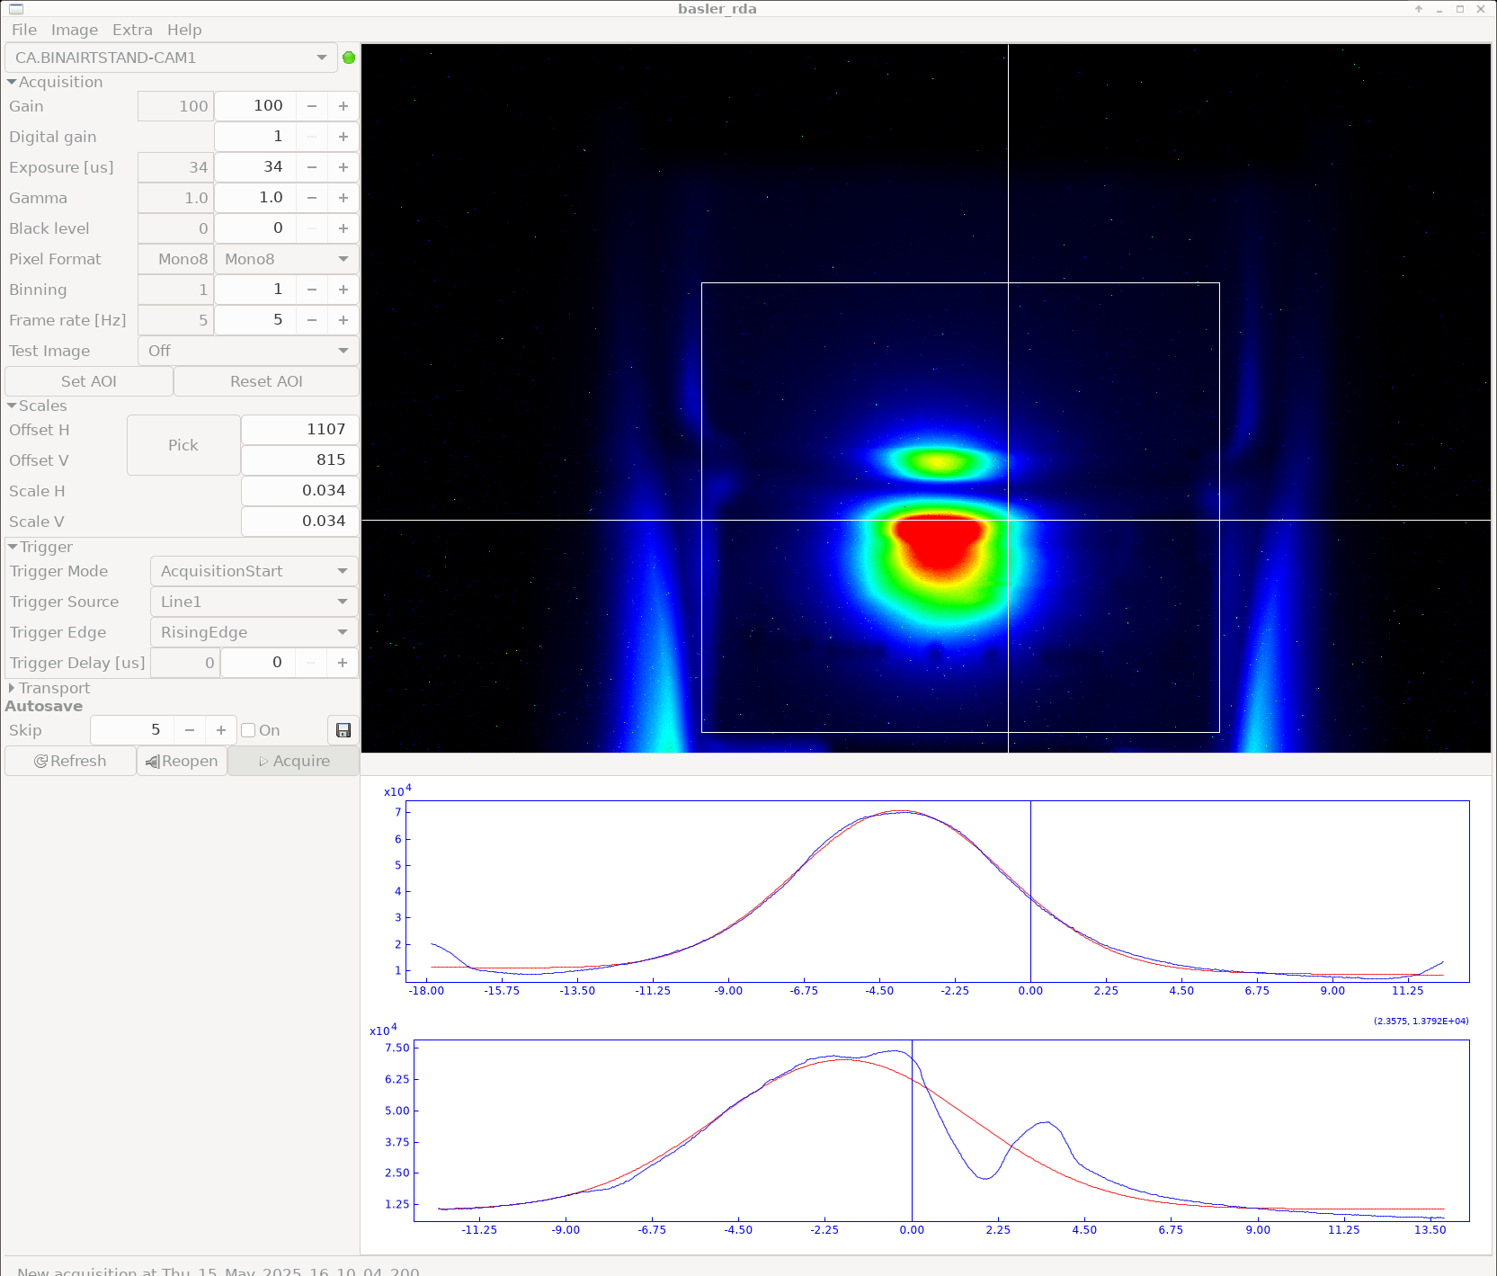
Funky Beams
27

Slide 28
Take home message
Sarah: This week allowed me to understand more what they do in AD-ELENA as a user myself. Being involved with two accelerators operating at very different energy scales allowed me to better understand the contrasting operational requirements, tuning procedures, and problem-solving approaches specific to each type of machine.
Zeki :
This week gave me valuable hands-on experience with real accelerator operations at CLEAR.
Working directly with beam diagnostics, emittance measurements, and energy calibration helped me connect theory with practice and better understand the complexity of beamline tuning
Michael :
I learned how operators address the needs of different users -- e.g. energy or irradiation uniformity -- using various beam-line elements.
Sabrina :
I have enjoyed learning about both ELENA and CLEAR and visiting the others. It was great to gain hands on experience on beam manipulation and using the techniques such as the dual-scattering system. It will be very useful for my PhD.
28

Slide 29
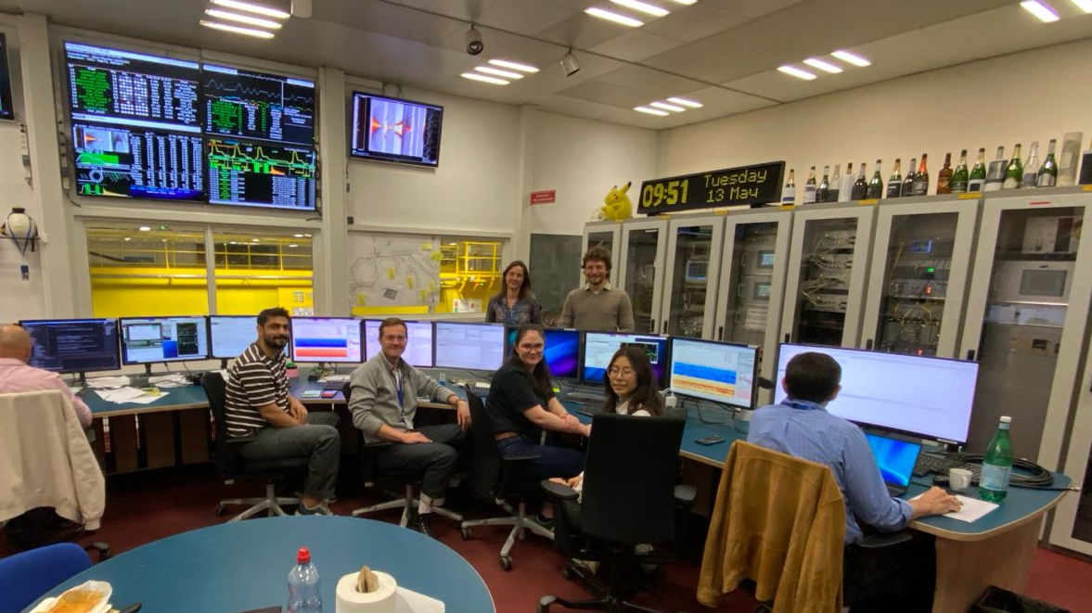
Thank you all for this week!
29

